Slide 1


U.S. HISTORY
Chapter 4 Rule Britannia! The English Empire, 1660–1763
PowerPoint Image Slideshow

Slide 2
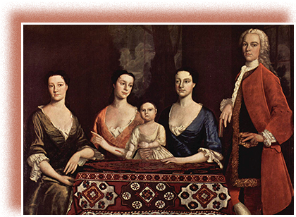
Figure 4.1
Isaac Royall and his family, seen here in a 1741 portrait by Robert Feke, moved to Medford, Massachusetts, from the West Indian island of Antigua, bringing their slaves with them. They were an affluent British colonial family, proud of their success and the success of the British Empire.

Slide 3
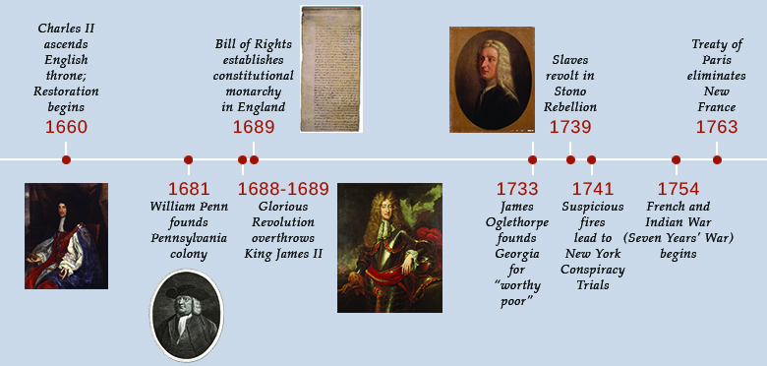
Figure 4.2

Slide 4
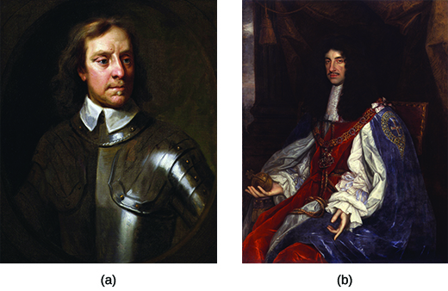
Figure 4.3
The monarchy and Parliament fought for control of England during the seventeenth century. Though Oliver Cromwell (a), shown here in a 1656 portrait by Samuel Cooper, appeared to offer England a better mode of government, he assumed broad powers for himself and disregarded cherished English liberties established under Magna Carta in 1215. As a result, the English people welcomed Charles II (b) back to the throne in 1660. This portrait by John Michael Wright was painted ca. 1660–1665, soon after the new king gained the throne.

Slide 5
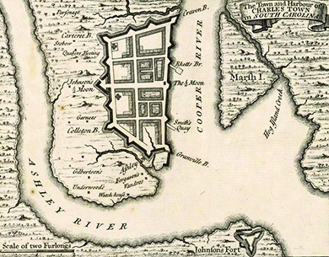
Figure 4.4
The port of colonial Charles Towne, depicted here on a 1733 map of North America, was the largest in the South and played a significant role in the Atlantic slave trade.

Slide 6
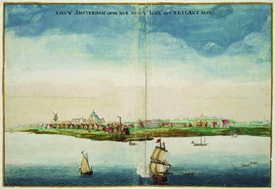
Figure 4.5
“View of New Amsterdam” (ca. 1665), a watercolor by Johannes Vingboons, was painted during the Anglo-Dutch wars of the 1660s and 1670s. New Amsterdam was officially reincorporated as New York City in 1664, but alternated under Dutch and English rule until 1674.

Slide 7
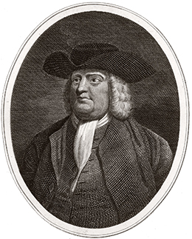
Figure 4.6
Charles II granted William Penn the land that eventually became the Commonwealth of Pennsylvania in order to settle a debt the English crown owed to Penn’s father.

Slide 8
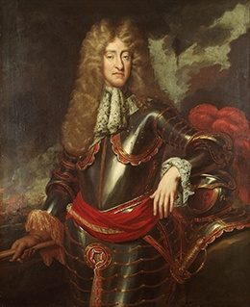
Figure 4.7
James II (shown here in a painting ca. 1690) worked to centralize the English government. The Catholic king of France, Louis XIV, provided a template for James’s policies.

Slide 9
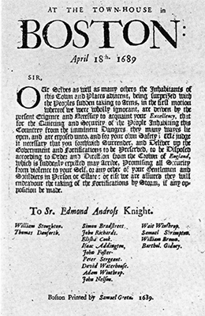
Figure 4.8
This broadside, signed by several citizens, demands the surrender of Sir Edmund (spelled here “Edmond”) Andros, James II’s hand-picked leader of the Dominion of New England.

Slide 10
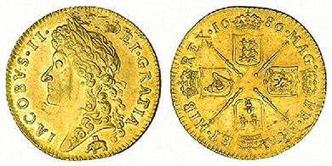
Figure 4.9
The 1686 English guinea shows the logo of the Royal African Company, an elephant and castle, beneath a bust of King James II. The coins were commonly called guineas because most British gold came from Guinea in West Africa.

Slide 11
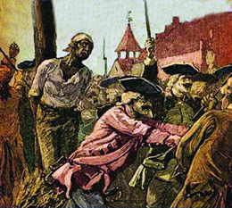
Figure 4.10
In the wake of a series of fires throughout New York City, rumors of a slave revolt led authorities to convict and execute thirty people, including thirteen black men who were publicly burned at the stake.

Slide 12
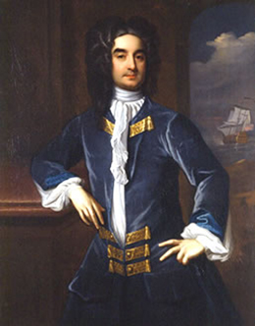
Figure 4.11
This painting by Hans Hysing, ca. 1724, depicts William Byrd II. Byrd was a wealthy gentleman planter in Virginia and a member of the colonial gentry.

Slide 13
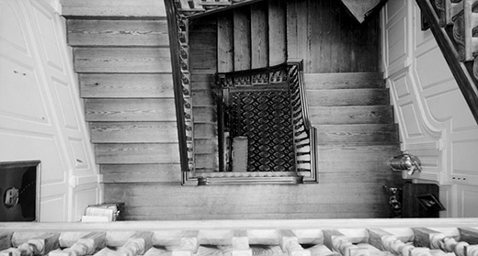
Figure 4.12
This photograph shows the view down the stairway from the third floor of Westover Plantation, home of William Byrd II. What does this image suggest about the lifestyle of the inhabitants—masters and servants—of this house?

Slide 14
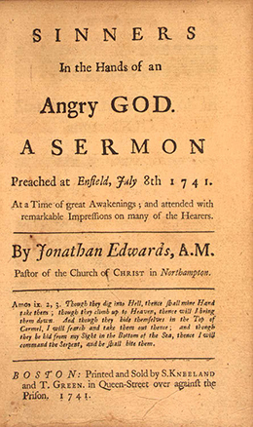
Figure 4.13
This image shows the frontispiece of Sinners in the Hands of an Angry God, A Sermon Preached at Enfield, July 8, 1741 by Jonathan Edwards. Edwards was an evangelical preacher who led a Protestant revival in New England. This was his most famous sermon, the text of which was reprinted often and distributed widely.

Slide 15
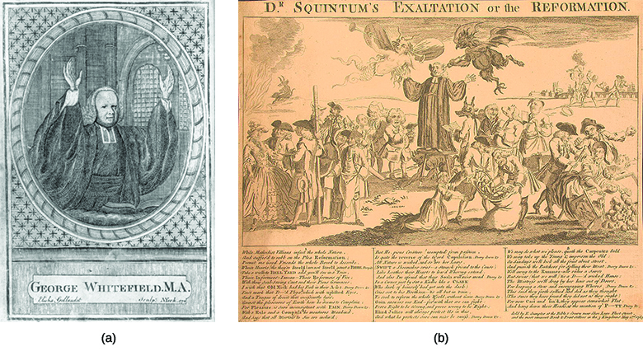
Figure 4.14
In the 1774 portrait of George Whitefield by engraver Elisha Gallaudet (a), Whitefield appears with a gentle expression on his face. Although his hands are raised in exultation or entreaty, he does not look particularly roused or rousing. In the 1763 British political cartoon to the right, “Dr. Squintum’s Exaltation or the Reformation” (b), Whitefield’s hands are raised in a similar position, but there the similarities end.

Slide 16
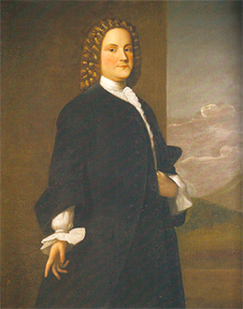
Figure 4.15
In this 1748 portrait by Robert Feke, a forty-year-old Franklin wears a stylish British wig, as befitted a proud and loyal member of the British Empire.

Slide 17
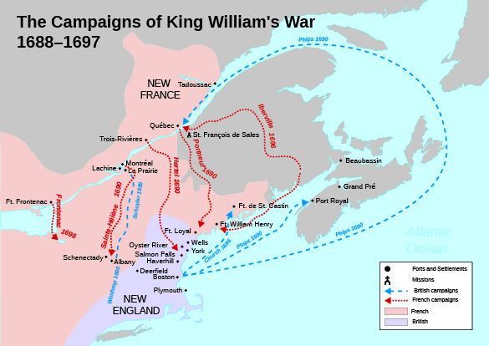
Figure 4.16
This map shows the French and British armies’ movements during King William’s War, in which there was no clear victor.

Slide 18
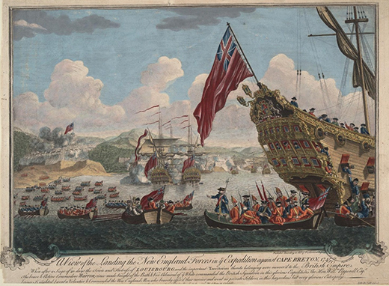
Figure 4.17
In this 1747 painting by J. Stevens, View of the landing of the New England forces in ye expedition against Cape Breton, British forces land on the island of Cape Breton to capture Fort Louisbourg.

Slide 19
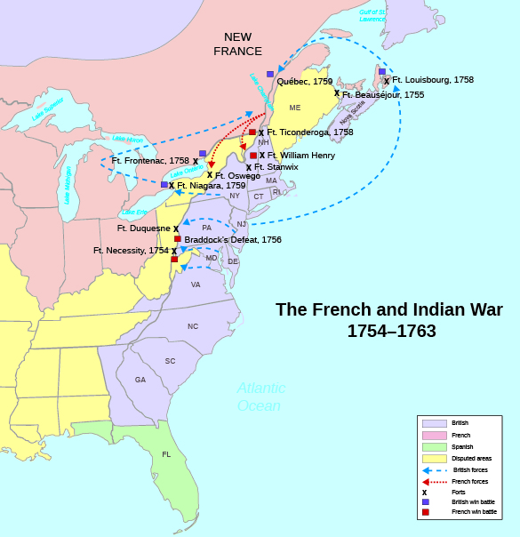
Figure 4.18
This schematic map depicts the events of the French and Indian War. Note the scarcity of British victories.

