Slide 1
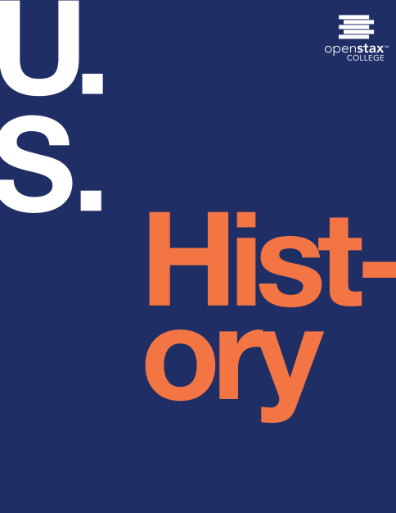

U.S. HISTORY
Chapter 5 Imperial Reforms and Colonial Protests, 1763-1774
PowerPoint Image Slideshow

Slide 2
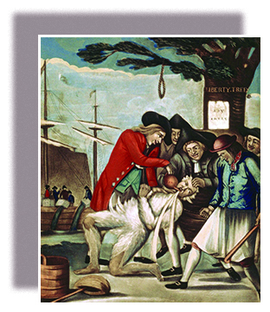
Figure 5.1
The Bostonians Paying the Excise-man, or Tarring and Feathering (1774), attributed to Philip Dawe, depicts the most publicized tarring and feathering incident of the American Revolution. The victim is John Malcolm, a customs official loyal to the British crown.

Slide 3
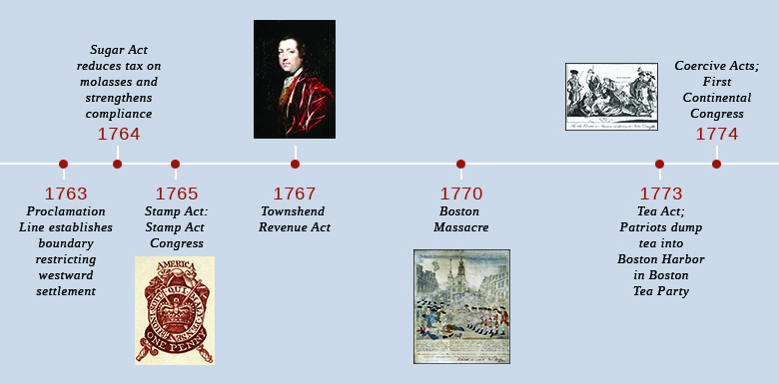
Figure 5.2
(credit “1765”: modification of work by the United Kingdom Government)

Slide 4
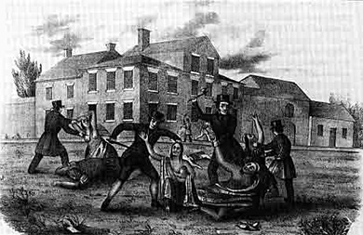
Figure 5.3
This nineteenth-century lithograph depicts the massacre of Conestoga in 1763 at Lancaster, Pennsylvania, where they had been placed in protective custody. None of the attackers, members of the Paxton Boys, were ever identified.

Slide 5
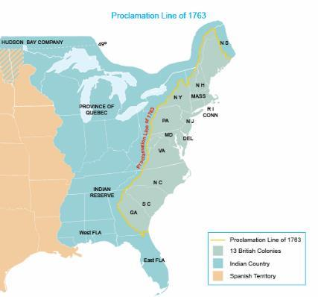
Figure 5.4
This map shows the status of the American colonies in 1763, after the end of the French and Indian War. Although Great Britain won control of the territory east of the Mississippi, the Proclamation Line of 1763 prohibited British colonists from settling west of the Appalachian Mountains. (credit: modification of work by the National Atlas of the United States)

Slide 6
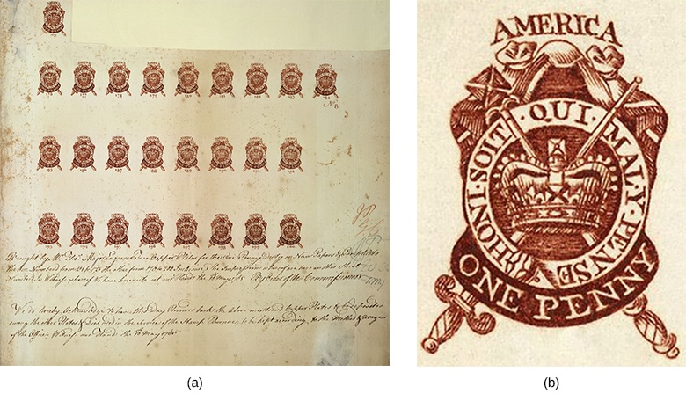
Figure 5.5
Under the Stamp Act, anyone who used or purchased anything printed on paper had to buy a revenue stamp for it. Image (a) shows a partial proof sheet of one-penny stamps. Image (b) provides a close-up of a one-penny stamp. (credit a: modification of work by the United Kingdom Government; credit b: modification of work by the United Kingdom Government)

Slide 7
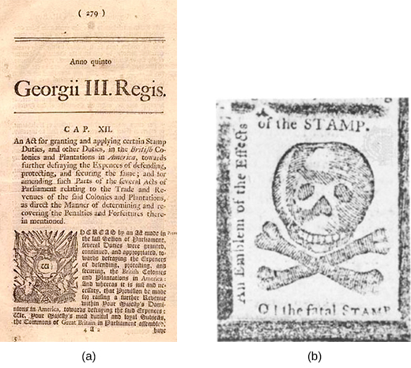
Figure 5.6
The announcement of the Stamp Act, seen in this newspaper publication (a), raised numerous concerns among colonists in America. Protests against British imperial policy took many forms, such as this mock stamp (b) whose text reads “An Emblem of the Effects of the STAMP. O! the Fatal STAMP.”

Slide 8
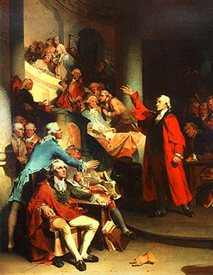
Figure 5.7
Patrick Henry Before the Virginia House of Burgesses (1851), painted by Peter F. Rothermel, offers a romanticized depiction of Henry’s speech denouncing the Stamp Act of 1765. Supporters and opponents alike debated the stark language of the speech, which quickly became legendary.

Slide 9
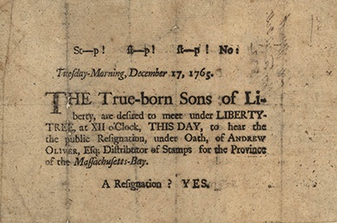
Figure 5.8
With this broadside of December 17, 1765, the Sons of Liberty call for the resignation of Andrew Oliver, the Massachusetts Distributor of Stamps.

Slide 10
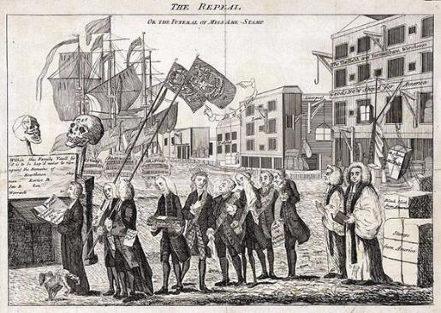
Figure 5.9
This 1766 illustration shows a funeral procession for the Stamp Act. Reverend William Scott leads the procession of politicians who had supported the act, while a dog urinates on his leg. George Grenville, pictured fourth in line, carries a small coffin. What point do you think this cartoon is trying to make?

Slide 11
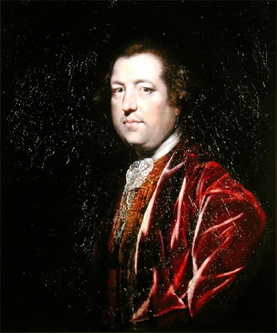
Figure 5.10
Charles Townshend, chancellor of the exchequer, shown here in a 1765 painting by Joshua Reynolds, instituted the Townshend Revenue Act of 1767 in order to raise money to support the British military presence in the colonies.

Slide 12
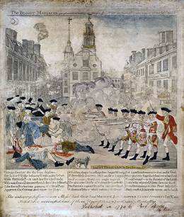
Figure 5.11
The Sons of Liberty circulated this sensationalized version of the events of March 5, 1770, in order to promote the rightness of their cause. The verses below the image begin as follows: “Unhappy Boston! see thy Sons deplore, Thy hallowed Walks besmeared with guiltless Gore.”

Slide 13
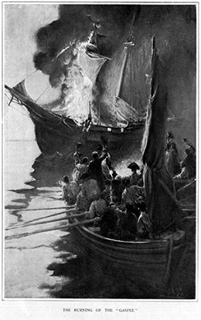
Figure 5.12
This 1883 engraving, which appeared in Harper’s New Monthly Magazine, depicts the burning of the Gaspée. This attack provoked the British government to convene a Royal Commission of Inquiry; some regarded the Commission as an example of excessive British power and control over the colonies.

Slide 14
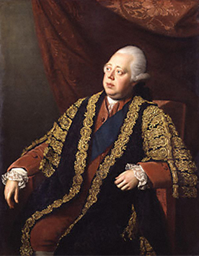
Figure 5.13
Lord North, seen here in Portrait of Frederick North, Lord North (1773–1774), painted by Nathaniel Dance, was prime minister at the time of the destruction of the tea and insisted that Massachusetts make good on the loss.

Slide 15
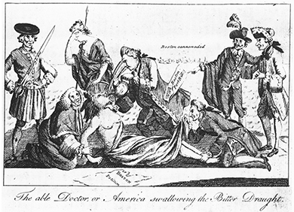
Figure 5.14
The artist of “The Able Doctor, or America Swallowing the Bitter Draught” (London Magazine, May 1, 1774) targets select members of Parliament as the perpetrators of a devilish scheme to overturn the constitution; this is why Mother Britannia weeps. Note that this cartoon came from a British publication; Great Britain was not united in support of Parliament’s policies toward the American colonies.

Slide 16
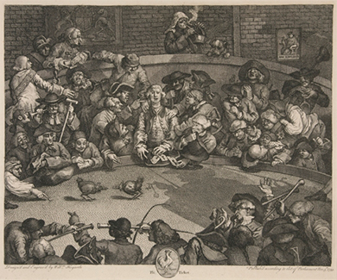
Figure 5.15
Cockfights, as depicted in The Cockpit (1759) by British artist and engraver William Hogarth, were among the entertainments the First Continental Congress sought to outlaw, considering them un-American.

