Slide 1


U.S. History
Chapter 7 Creating Republican Governments, 1776–1790
PowerPoint Image Slideshow

Slide 2
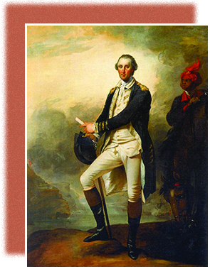
Figure 7.1
John Trumbull, Washington’s aide-de-camp, painted this wartime image of Washington on a promontory above the Hudson River. Just behind Washington, his slave William “Billy” Lee has his eyes firmly fixed on his master. In the far background, British warships fire on an American fort.

Slide 3
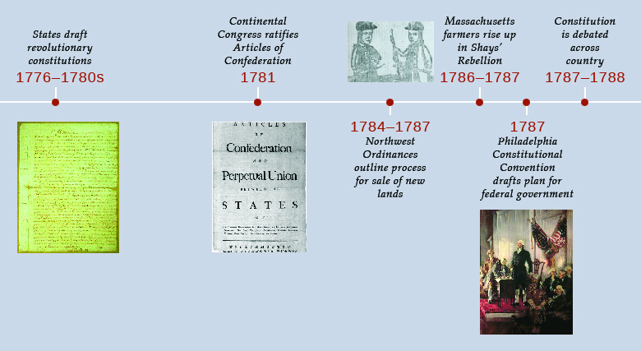
Figure 7.2

Slide 4
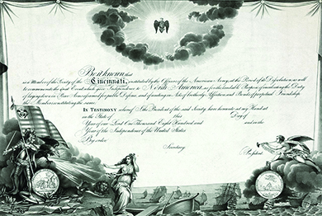
Figure 7.3
This membership certificate for the Society of the Cincinnati commemorates “the great Event which gave Independence to North America.”

Slide 5
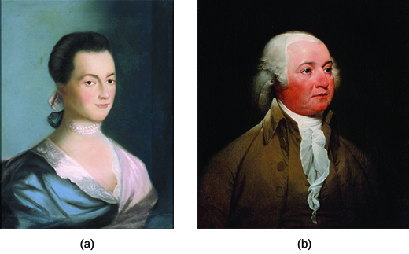
Figure 7.4
Abigail Adams (a), shown here in a 1766 portrait by Benjamin Blythe, is best remembered for her eloquent letters to her husband, John Adams (b), who would later become the second president of the United States.

Slide 6
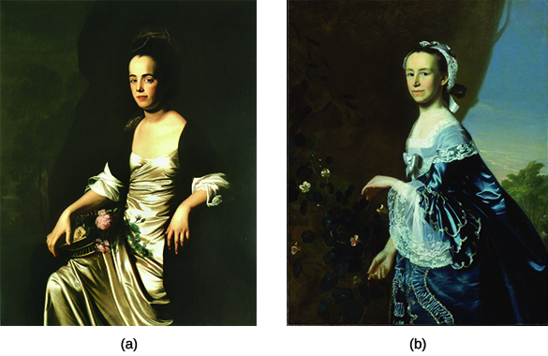
Figure 7.5
John Singleton Copley’s 1772 portrait of Judith Sargent Murray (a) and 1763 portrait of Mercy Otis Warren (b) show two of America’s earliest advocates for women’s rights. Notice how their fine silk dresses telegraph their privileged social status.

Slide 7
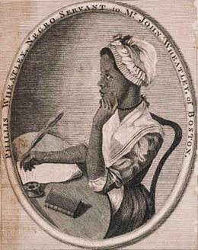
Figure 7.6
This portrait of Phillis Wheatley from the frontispiece of Poems on various subjects, religious and moral shows the writer at work. Despite her status as a slave, her poems won great renown in America and in Europe.

Slide 8
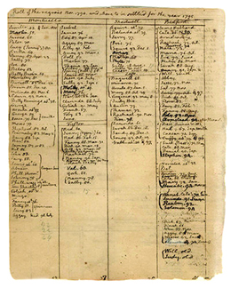
Figure 7.7
This page, taken from one of Thomas Jefferson’s record books from 1795, lists his slaves.

Slide 9
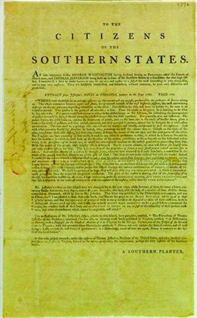
Figure 7.8
This 1796 broadside to “the Citizens of the Southern States” by “a Southern Planter” argued that Thomas Jefferson’s advocacy of the emancipation of slaves in his Notes on the State of Virginia posed a threat to the safety, the prosperity, and even the existence of the southern states.

Slide 10
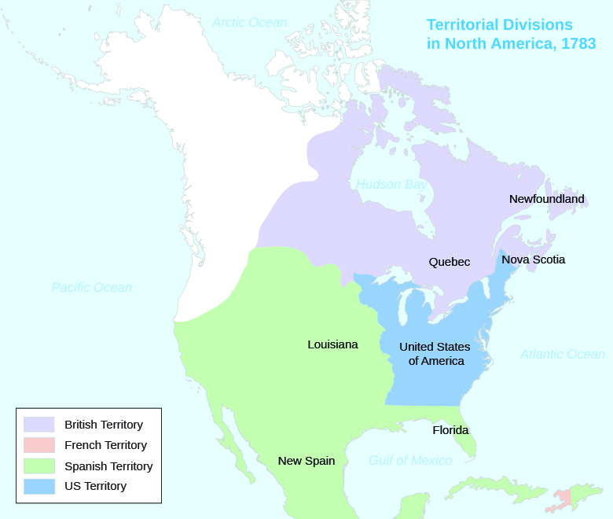
Figure 7.9
The 1783 Treaty of Paris divided North America into territories belonging to the United States and several European countries, but it failed to address Indian lands at all.

Slide 11
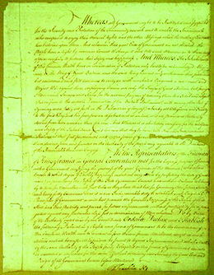
Figure 7.10
The 1776 Pennsylvania constitution, the first page of which is shown here, adhered to more democratic principles than some other states’ constitutions did initially.

Slide 12
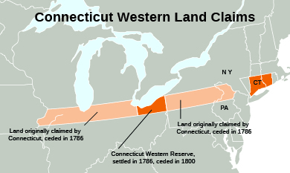
Figure 7.11
Connecticut, like many other states, used its state constitution to stake claims to uncharted western lands.

Slide 13
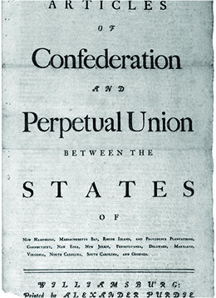
Figure 7.12
The first page of the 1777 Articles of Confederation, printed by Alexander Purdie, emphasized the “perpetual union” between the states.

Slide 14
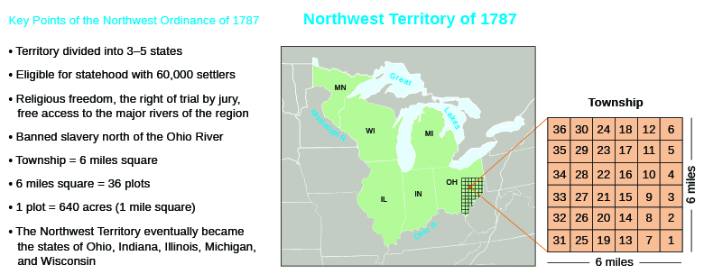
Figure 7.13
The Northwest Ordinance of 1787 created territories and an orderly method for the admission of new states.

Slide 15
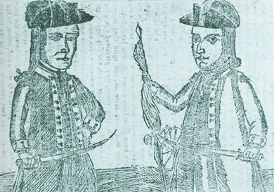
Figure 7.14
This woodcut, from Bickerstaff’s Boston Almanack of 1787, depicts Daniel Shays and Job Shattuck. Shays and Shattuck were two of the leaders of the rebels who rose up against the Massachusetts government in 1786 to 1787. As Revolutionary War veterans, both men wear the uniform of officers of the Continental Army.

Slide 16
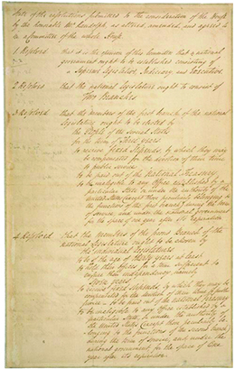
Figure 7.15
James Madison’s Virginia Plan, shown here, proposed a strong national government with proportional state representation.

Slide 17
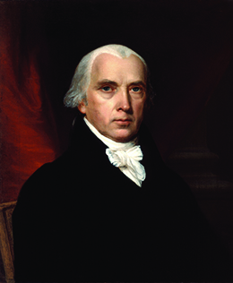
Figure 7.16
John Vanderlyn’s 1816 portrait depicts James Madison, one of the leading Federalists who supported the 1787 Constitution.

Slide 18
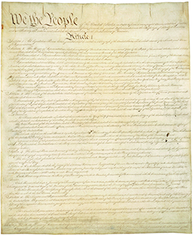
Figure 7.17
The first page of the 1787 United States Constitution, shown here, begins: “We the People of the United States, in Order to form a more perfect Union, establish Justice, insure domestic Tranquility, provide for the common defence, promote the general Welfare, and secure the Blessings of Liberty to ourselves and our Posterity, do ordain and establish this Constitution for the United States of America.”

