Slide 1


U.S. History
Chapter 8 Growing Pains: The New Republic, 1790–1820
PowerPoint Image Slideshow

Slide 2
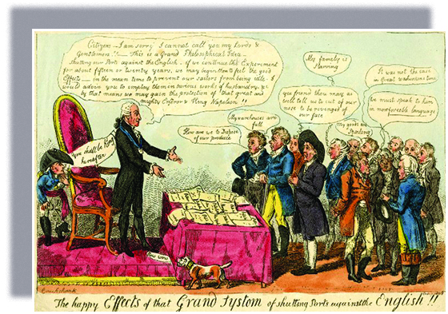
Figure 8.1
“The happy Effects of the Grand Systom [sic] of shutting Ports against the English!!” appeared in 1808. Less than a year earlier, Thomas Jefferson had recommended (and Congress had passed) the Embargo Act of 1807, which barred American ships from leaving their ports.

Slide 3
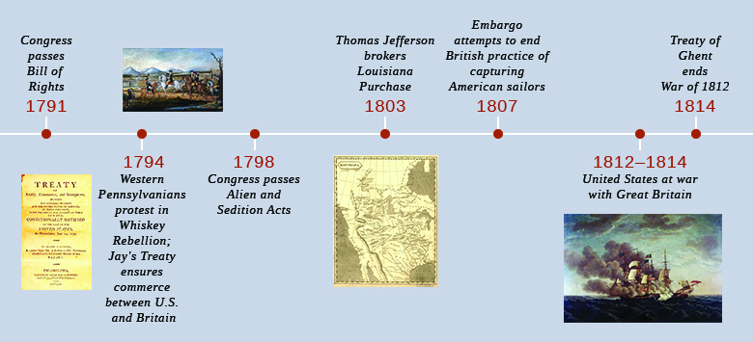
Figure 8.2

Slide 4
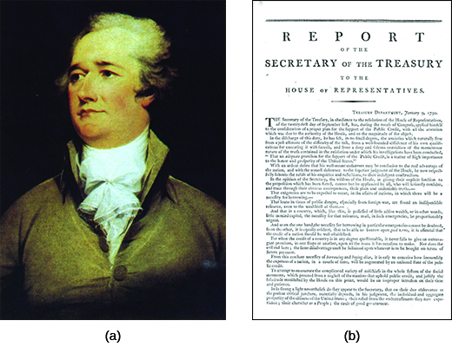
Figure 8.3
As the first secretary of the treasury, Alexander Hamilton (a), shown here in a 1792 portrait by John Trumbull, released the “Report on Public Credit” (b) in January 1790.

Slide 5
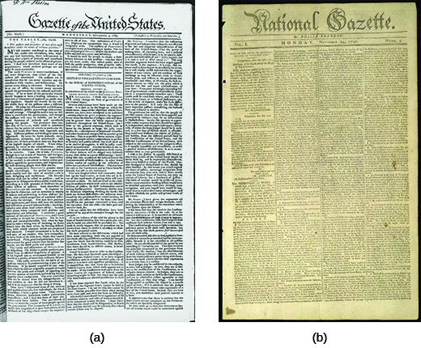
Figure 8.4
Here, the front page of the Federalist Gazette of the United States from September 9, 1789 (a), is shown beside that of the oppositional National Gazette from November 14, 1791 (b). The Gazette of the United States featured articles, sometimes written pseudonymously or anonymously, from leading Federalists like Alexander Hamilton and John Adams. The National Gazette was founded two years later to counter their political influence.

Slide 6
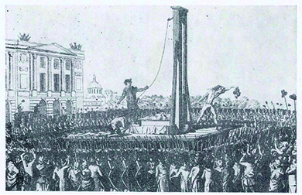
Figure 8.5
An image from a 1791 Hungarian journal depicts the beheading of Louis XVI during the French Revolution. The violence of the revolutionary French horrified many in the United States—especially Federalists, who saw it as an example of what could happen when the mob gained political control and instituted direct democracy.

Slide 7
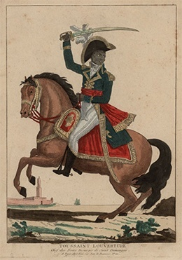
Figure 8.6
An 1802 portrait shows Toussaint L’Ouverture, “Chef des Noirs Insurgés de Saint Domingue” (“Leader of the Black Insurgents of Saint Domingue”), mounted and armed in an elaborate uniform.

Slide 8
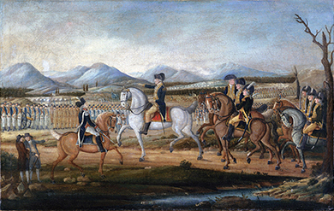
Figure 8.7
This painting, attributed to Frederick Kemmelmeyer ca. 1795, depicts the massive force George Washington led to put down the Whiskey Rebellion of the previous year. Federalists made clear they would not tolerate mob action.

Slide 9
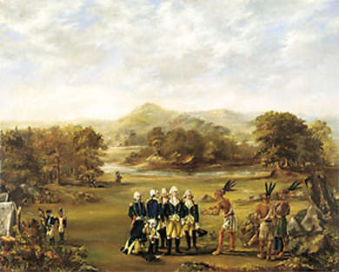
Figure 8.8
Notice the contrasts between the depictions of federal and native representatives in this painting of the signing of the Treaty of Greenville in 1795. What message or messages did the artist intend to convey?

Slide 10
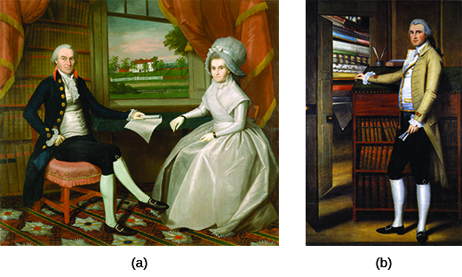
Figure 8.9
Ralph Earl’s portraits are known for placing their subjects in an orderly world, as seen here in the 1801 portrait of Oliver and Abigail Wolcott Ellsworth (a) and the 1789 portrait of Elijah Boardman (b). What similarities do you see in the two portraits by Ralph Earl? What do the details of each portrait reveal about the sitters? About the artist and the 1790s?

Slide 11
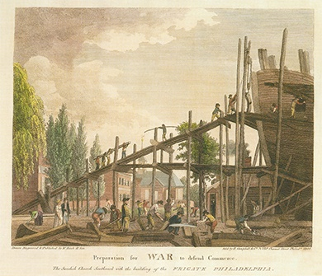
Figure 8.10
This 1799 print, entitled “Preparation for WAR to defend Commerce,” shows the construction of a naval ship, part of the effort to ensure the United States had access to free trade in the Atlantic world.

Slide 12
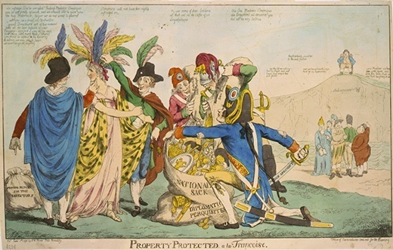
Figure 8.11
This anonymous 1798 cartoon, Property Protected à la Françoise, satirizes the XYZ affair. Five Frenchmen are shown plundering the treasures of a woman representing the United States. One man holds a sword labeled “French Argument” and a sack of gold and riches labeled “National Sack and Diplomatic Perquisites,” while the others collect her valuables. A group of other Europeans look on and commiserate that France treated them the same way.

Slide 13
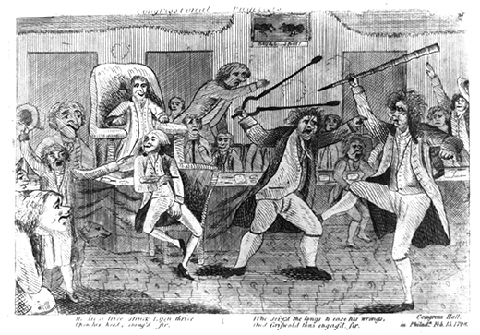
Figure 8.12
This 1798 cartoon, “Congressional Pugilists,” shows partisan chaos in the U.S. House of Representatives as Matthew Lyon, a Democratic-Republican from Vermont, holds forth against his opponent, Federalist Roger Griswold.

Slide 14
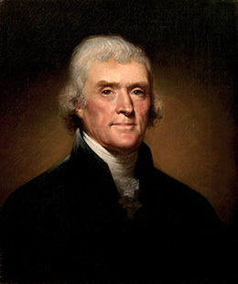
Figure 8.13
Thomas Jefferson’s victory in 1800 signaled the ascendency of the Democratic-Republicans and the decline of Federalist power.

Slide 15
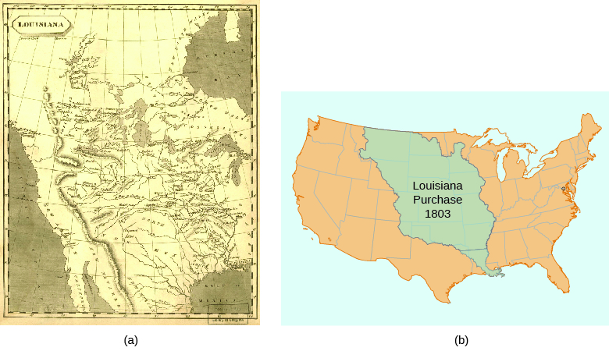
Figure 8.14
This 1804 map (a) shows the territory added to the United States in the Louisiana Purchase of 1803. Compare this depiction to the contemporary map (b). How does the 1804 version differ from what you know of the geography of the United States?

Slide 16
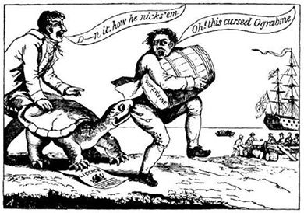
Figure 8.15
In this political cartoon from 1807, a snapping turtle (holding a shipping license) grabs a smuggler in the act of sneaking a barrel of sugar to a British ship. The smuggler cries, “Oh, this cursed Ograbme!” (“Ograbme” is “embargo” spelled backwards.)

Slide 17
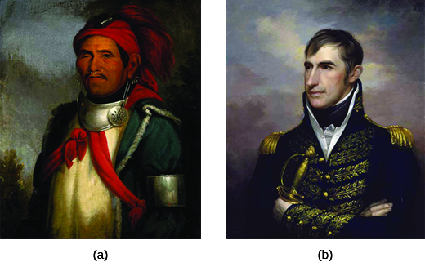
Figure 8.16
Portrait (a), painted by Charles Bird King in 1820, is a depiction of Shawnee prophet Tenskwatawa. Portrait (b) is Rembrandt Peele’s 1813 depiction of William Henry Harrison. What are the significant similarities and differences between the portraits? What was each artist trying to convey?

Slide 18
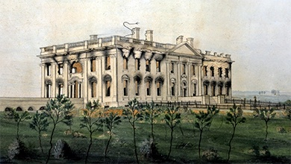
Figure 8.17
George Munger painted The President’s House shortly after the War of 1812, ca. 1814–1815. The painting shows the result of the British burning of Washington, DC.

