Slide 1


U.S. History
Chapter 9 Industrial Transformation in the North, 1800–1850
PowerPoint Image Slideshow

Slide 2
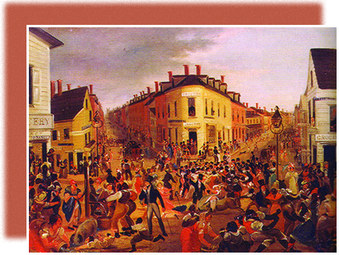
Figure 9.1
Five Points (1827), by George Catlin, depicts the infamous Five Points neighborhood of New York City, so called because it was centered at the intersection of five streets. Five Points was home to a polyglot mix of recent immigrants, freed slaves, and other members of the working class.

Slide 3
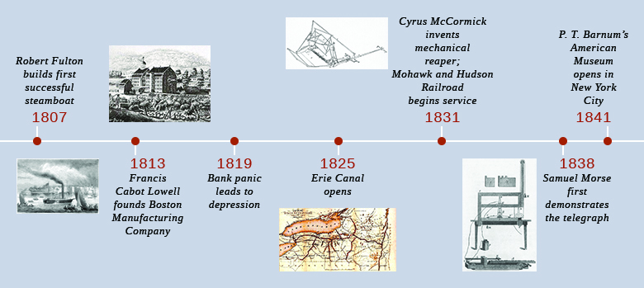
Figure 9.2
(credit “1807 photo”: Project Gutenberg Archives)

Slide 4
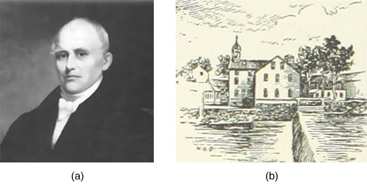
Figure 9.3
Samuel Slater (a) was a British migrant who brought plans for English textile mills to the United States and built the nation’s first successful water-powered mill in Pawtucket, Massachusetts (b).

Slide 5
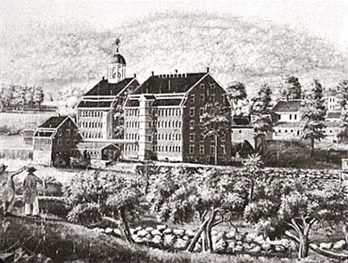
Figure 9.4
openstax college logo
The Boston Manufacturing Company, shown in this engraving made in 1813–1816, was headquartered in Waltham, Massachusetts. The company started the northeastern textile industry by building water-powered textile mills along suitable rivers and developing mill towns around them.

Slide 6
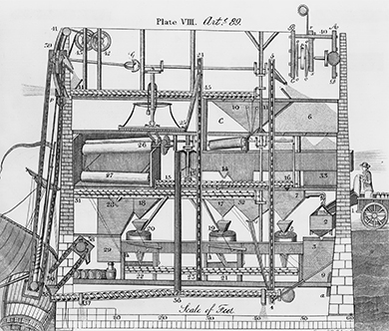
Figure 9.5
Oliver Evans was an American engineer and inventor, best known for developing ways to automate the flour milling process, which is illustrated here in a drawing from a 1785 instructional book called The Young Mill- right & Miller’s Guide.

Slide 7
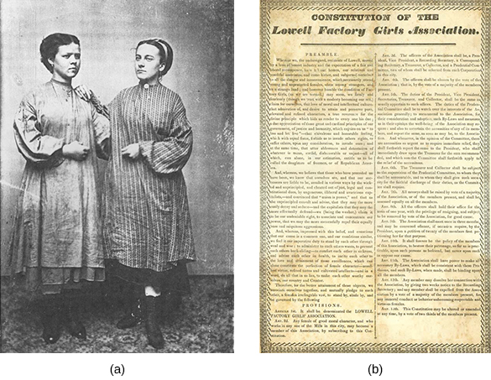
Figure 9.6
New England mill workers were often young women, as seen in this early tintype made ca. 1870 (a). When management proposed rent increases for those living in company boarding houses, female textile workers in Lowell responded by forming the Lowell Factory Girls Association—its constitution is shown in image (b)—in 1836 and organizing a “turn-out” or strike.

Slide 8
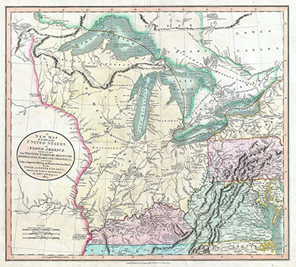
Figure 9.7
Cartographer John Cary drew this map “exhibiting The Western Territory, Kentucky, Pennsylvania, Maryland, Virginia &c” for his 1808 atlas; it depicted the huge western territory that fascinated settlers in the early nineteenth century.

Slide 9
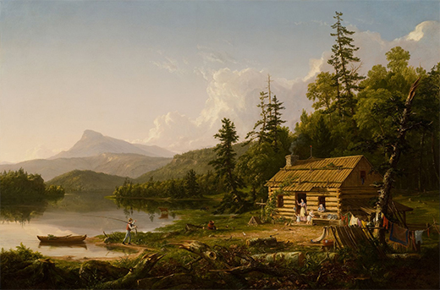
Figure 9.8
Thomas Cole, who painted Home in the Woods in 1847, was an American artist. Cole founded the Hudson River School, a style renowned for portrayals of landscapes and wilderness influenced by the emotional aesthetic known as romanticism. In what ways is this image realistic, and how is it idealized or romanticized?

Slide 10
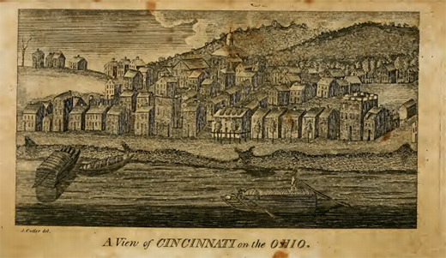
Figure 9.9
This engraving from A Topographical Description of the State of Ohio, Indiana Territory, and Louisiana (1812), by Jervis Cutler, presents a view of Cincinnati as it may have looked to Gershom Flagg.

Slide 11
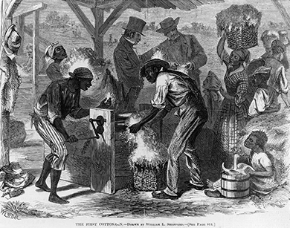
Figure 9.10
The First Cotton-Gin, an 1869 drawing by William L. Sheppard, shows the first use of a cotton gin “at the close of the last century.” African American slaves handle the gin while white men conduct business in the background. What do you think the artist was trying to convey with this image? (credit: Library of Congress)

Slide 12
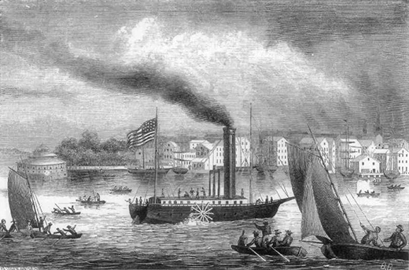
Figure 9.11
Fulton’s steamboat the Clermont transformed the speed, cost, and dependability of water transportation in the United States. (credit: Project Gutenberg Archives)

Slide 13
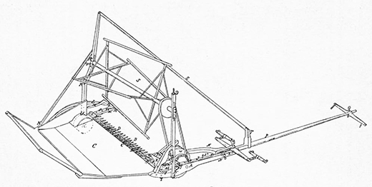
Figure 9.12
This sketch is from the 1845 patent for an improved grain reaper invented by Cyrus Hall McCormick. The reaper mechanized the labor-intensive use of scythes to harvest wheat.

Slide 14
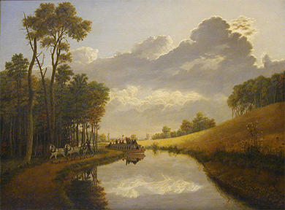
Figure 9.13
Although the Erie Canal was primarily used for commerce and trade, in Pittsford on the Erie Canal (1837), George Harvey portrays it in a pastoral, natural setting. Why do you think the painter chose to portray the canal this way?

Slide 15
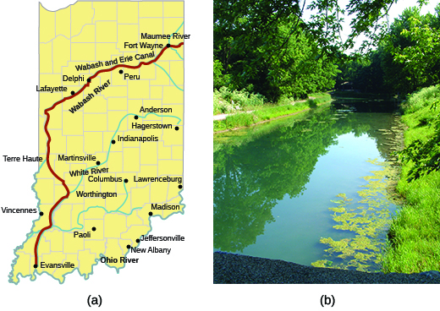
Figure 9.14
This map (a) shows the route taken by the Wabash and Erie Canal through the state of Indiana. The canal began operation in 1843 and boats operated on it until the 1870s. Sections have since been restored, as shown in this 2007 photo (b) from Delphi, Indiana.

Slide 16
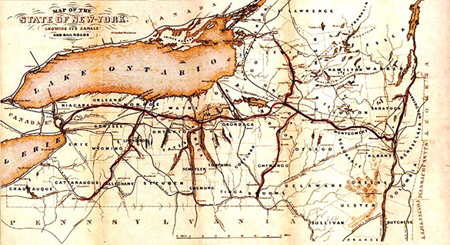
Figure 9.15
This 1853 map of the “Empire State” shows the extent of New York’s canal and railroad networks. The entire country’s transportation infrastructure grew dramatically during the first half of the nineteenth century.

Slide 17
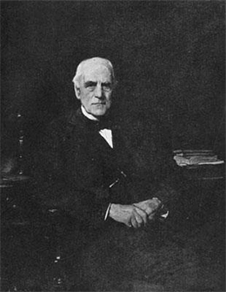
Figure 9.16
Junius Spencer Morgan of Boston was one of the fathers of the American private banking system. (credit: Project Gutenberg Archives)

Slide 18
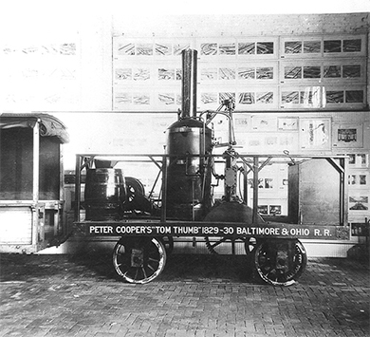
Figure 9.17
Peter Cooper, who would go on to found the Cooper Union for the Advancement of Science and Art in New York City, designed and built the Tom Thumb, the first American-built steam locomotive, a replica of which is shown here.

Slide 19
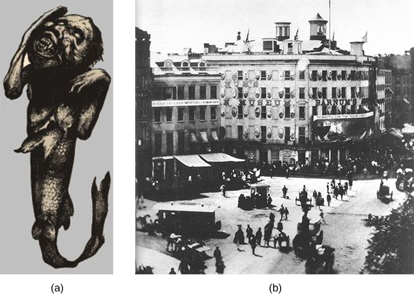
Figure 9.18
Spurious though they were, attractions such as the Feejee mermaid (a) from P. T. Barnum’s American Museum in New York City (b) drew throngs of working-class wage earners in the middle of the nineteenth century.

