Slide 1


U.S. History
Chapter 12 Cotton is King: The Antebellum South, 1800–1860
PowerPoint Image Slideshow

Slide 2
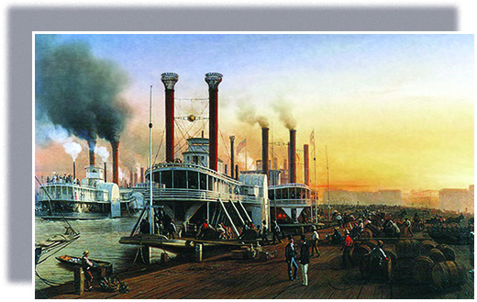
Figure 12.1
Bateaux à Vapeur Géant, la Nouvelle-Orléans 1853 (Giant Steamboats at New Orleans, 1853), by Hippolyte Sebron, shows how New Orleans, at the mouth of the Mississippi River, was the primary trading hub for the cotton that fueled the growth of the southern economy.

Slide 3
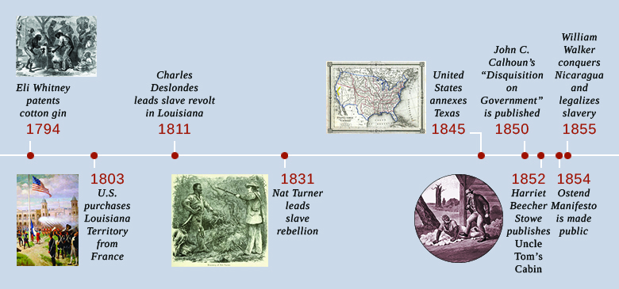
Figure 12.2

Slide 4
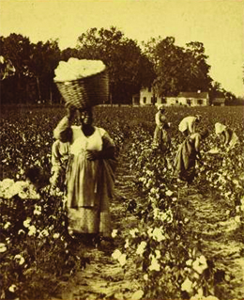
Figure 12.3
In the late nineteenth century, J. N. Wilson captured this image of harvest time at a southern plantation. While the workers in this photograph are not slave laborers, the process of cotton harvesting shown here had changed little from antebellum times.

Slide 5
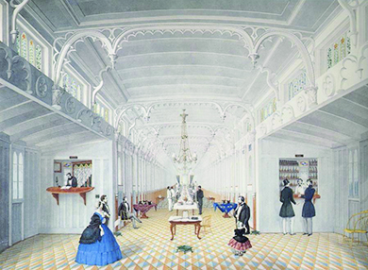
Figure 12.4
As in this depiction of the saloon of the Mississippi River steamboat Princess, elegant and luxurious rooms often occupied the interiors of antebellum steamships, whose decks were filled with cargo.

Slide 6
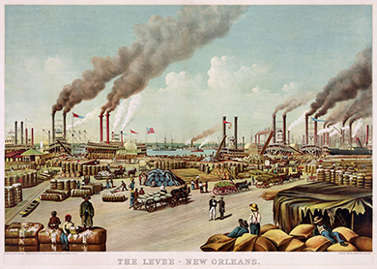
Figure 12.5
This print of The Levee - New Orleans (1884) shows the bustling port of New Orleans with bales of cotton waiting to be shipped. The sheer volume of cotton indicates its economic importance throughout the century.

Slide 7
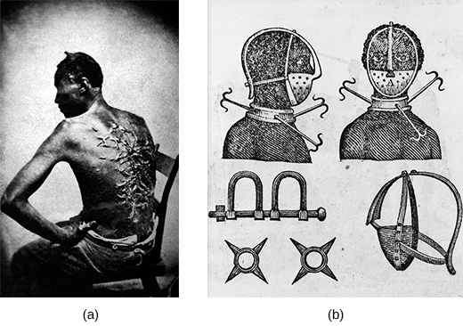
Figure 12.6
The original caption of this photograph of a slave’s scarred back (a), taken in Baton Rouge, Louisiana, in 1863, reads as follows: “Overseer Artayou Carrier whipped me. I was two months in bed sore from the whipping. My master come after I was whipped; he discharged the overseer. The very words of poor Peter, taken as he sat for his picture.” Images like this one helped bolster the northern abolitionist message of the inhumanity of slavery. The drawing of an iron mask, collar, leg shackles, and spurs (b) demonstrates the various cruel and painful instruments used to restrain slaves.

Slide 8
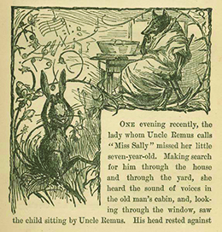
Figure 12.7
Brer Rabbit, depicted here in an illustration from Uncle Remus, His Songs and His Sayings: The Folk-Lore of the Old Plantation (1881) by Joel Chandler Harris, was a trickster who outwitted his opponents.

Slide 9
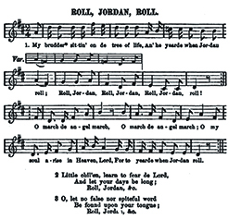
Figure 12.8
This version of “Roll, Jordan, Roll” was included in Slave Songs of the United States, the first published collection of African American music, which appeared in 1867.

Slide 10
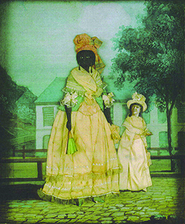
Figure 12.9
In this late eighteenth-century painting, a free woman of color stands with her quadroon daughter in New Orleans. Families with members that had widely varying ethnic characteristics were not uncommon at the time, especially in the larger cities.

Slide 11
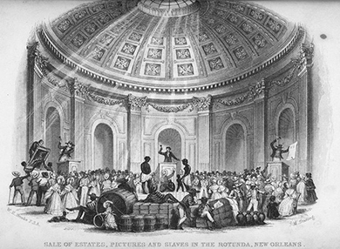
Figure 12.10
In Sale of Estates, Pictures and Slaves in the Rotunda, New Orleans (1853) by J. M. Starling, it is clear that slaves are considered property to be auctioned off, just like pictures or other items.

Slide 12
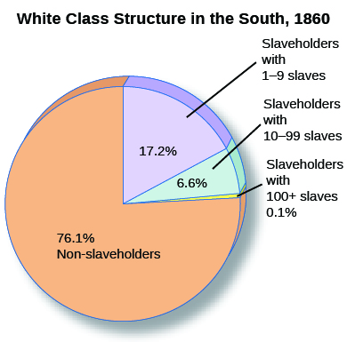
Figure 12.11
As the wealth of the antebellum South increased, it also became more unequally distributed, and an ever-smaller percentage of slaveholders held a substantial number of slaves.

Slide 13
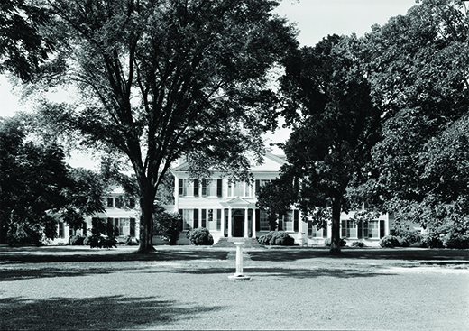
Figure 12.12
The grand house of Edward Lloyd V advertised the status and wealth of its owner. In its heyday, the Lloyd family’s plantation boasted holdings of forty-two thousand acres and one thousand slaves.

Slide 14
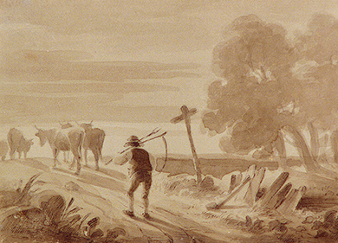
Figure 12.13
In this painting by Felix Octavius Carr Darley, a yeoman farmer carrying a scythe follows his livestock down the road.

Slide 15
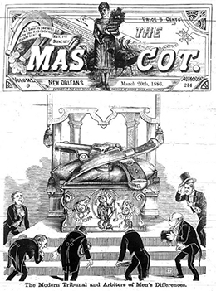
Figure 12.14
“The Modern Tribunal and Arbiter of Men’s Differences,” an illustration that appeared on the cover of The Mascot, a newspaper published in nineteenth-century New Orleans, reveals the importance of dueling in southern culture; it shows men bowing before an altar on which are laid a pistol and knife.

Slide 16
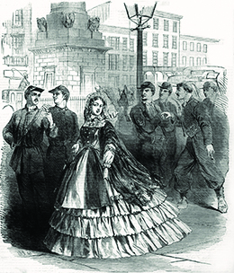
Figure 12.15
This cover illustration from Harper’s Weekly in 1861 shows the ideal of southern womanhood.

Slide 17
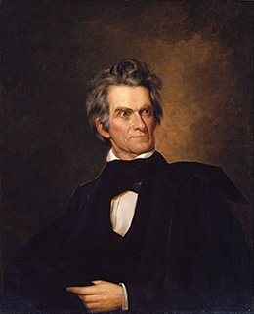
Figure 12.16
John C. Calhoun, shown here in a ca. 1845 portrait by George Alexander Healy, defended states’ rights, especially the right of the southern states to protect slavery from a hostile northern majority.

Slide 18
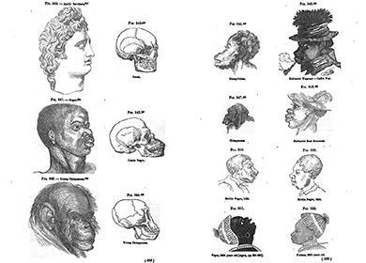
Figure 12.17
This 1857 illustration by an advocate of polygenism indicates that the “Negro” occupies a place between the Greeks and chimpanzees. What does this image reveal about the methods of those who advocated polygenism?

Slide 19
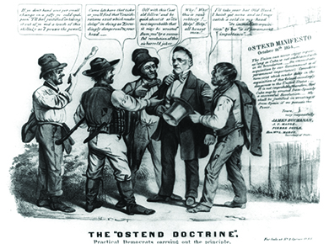
Figure 12.18
The “Ostend Doctrine” (1856), by artist Louis Maurer and lithographer Nathaniel Currier, mocks James Buchanan by depicting him being robbed, just as many northerners believed slaveholders were attempting to rob Spain. The thugs robbing Buchanan use specific phrases from the Ostend Manifesto as they relieve him of his belongings.

Slide 20
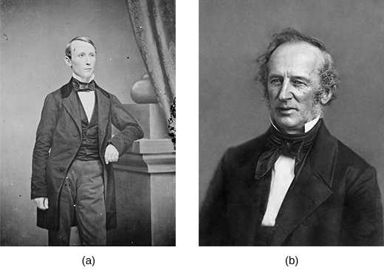
Figure 12.19
Famed Civil War photographer Mathew Brady took this photograph (a) of “General” William Walker circa 1855–1860. Walker led a filibuster expedition and briefly conquered Nicaragua, fulfilling a dream of many proexpansionist southern slaveholders. Cornelius Vanderbilt (b), the shipping tycoon who controlled much of the traffic across Nicaragua between the Atlantic and the Pacific, clashed with Walker and ultimately supported Costa Rica in its war against him.

