Slide 1


BIOLOGY 2e
Chapter 18 RESPIRATORY SYSTEM
PowerPoint Image Slideshow
This work is licensed under a Creative Commons Attribution-NonCommercial-ShareAlike 4.0 International License.

Slide 2
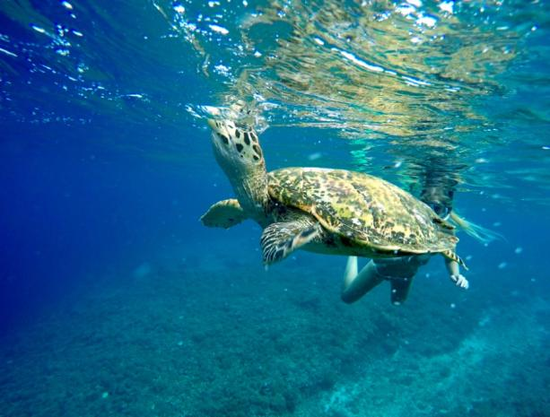
Gas Exchange
All cells require oxygen for use in the efficient production of energy through cellular respiration
One of the major physiological challenges facing all multicellular animals is obtaining sufficient oxygen and disposing of excess carbon dioxide
Caption: Sea Turtle Breath Underwater © dronepicr, License

Slide 3
Gas Exchange between Alveoli and Blood
In vertebrates, the gases diffuse into the aqueous layer covering the epithelial cells that line the respiratory organs
Diffusion is passive, driven only by the difference in O₂ and CO₂ concentrations on the two sides of the membranes and their relative solubility's in the plasma membrane
  High O₂ in Alveoli into Blood
  High CO₂ in Blood into Alveoli
Opposite Occurs in the Tissue

Slide 4
Gas Exchange
Rate of diffusion between two regions is governed by Fick’s Law of Diffusion
R = Rate of diffusion
D = Diffusion constant
A = Area over which diffusion takes place
Δp = Pressure difference between two sides
d = Distance over which diffusion occurs
DA Δp
R =
d

Slide 5
Gas Exchange
Evolutionary changes have occurred to optimize the rate of diffusion R. This can be done in several ways:
  Increase surface area A
  Decrease distance d
  Increase concentration difference Δp

Slide 6
Gas Exchange
Gases diffuse directly into unicellular organisms
Small organisms can rely on direct diffusion of gases
However, most multicellular animals require system adaptations to enhance gas exchange
  Amphibians respire across their skin as well as lungs
  Insects have an extensive tracheal system
  Fish use gills
  Mammals have a large network of alveoli in lung tissue

Slide 7
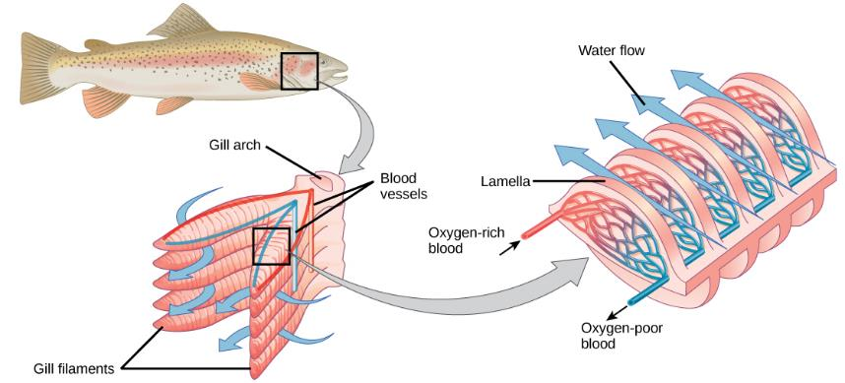
Gills
Increase surface area for diffusion
Move water into the mouth, through the gills, and out of the fish through the open operculum or gill cover

Slide 8
Lungs
Gills were replaced in terrestrial animals by lungs
The lung minimizes evaporation by moving air through a branched tubular passage
  Covered in mucus to prevent direct contact of lung tissue with air

Slide 9
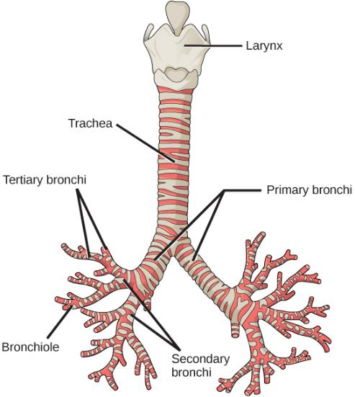
Lungs

Slide 10
Air Pressure
Air exerts a pressure downward, due to gravity
A pressure of 760 mm Hg is defined as one atmosphere (1.0 atm) of pressure
Partial pressure is the pressure contributed by a gas to the total atmospheric pressure

Slide 11
Air Pressure
Partial pressures are based on the % of the gas in dry air
At sea level or 1.0 atm or 760 mmHg
  PN₂ nitrogen = 760 × 79.02% = 600.6 mmHg
  PO₂ oxygen = 760 × 20.95% = 159.2 mmHg
  PCO₂ carbon dioxide = 760 × 0.03% = 0.2 mmHg
At 5364 m (17,598 ft.) the atmospheric pressure is 401 mmHg, this is the pressure at base camp 1 on Mount Everest.
  PO₂ = 401 × 20.95% = 84 mmHg
    Notice that the % of oxygen is the same at this altitude as it is at sea level but the partial pressure of oxygen is lower
    This is why most climbers on Mount Everest use supplemental oxygen!

Slide 12
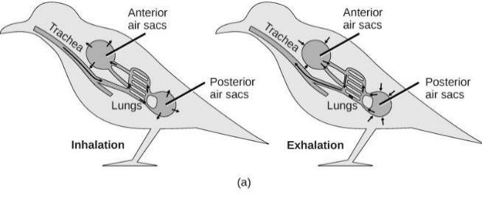
Lungs
Lungs of birds have unidirectional flow
Watch this video:
https://www.youtube.com/watch?v=kWMmyVu1ueY
Download for free at http://cnx.org/contents/185cbf87-c72e-48f5-b51e-f14f21b5eabd@10.61

Slide 13
Lungs
Lungs of mammals are packed with millions of alveoli (sites of gas exchange)
Inhaled air passes through the larynx, glottis, and trachea
Bifurcates into the right and left bronchi, which enter each lung and further subdivide into bronchioles
Alveoli are surrounded by an extensive capillary network

Slide 14
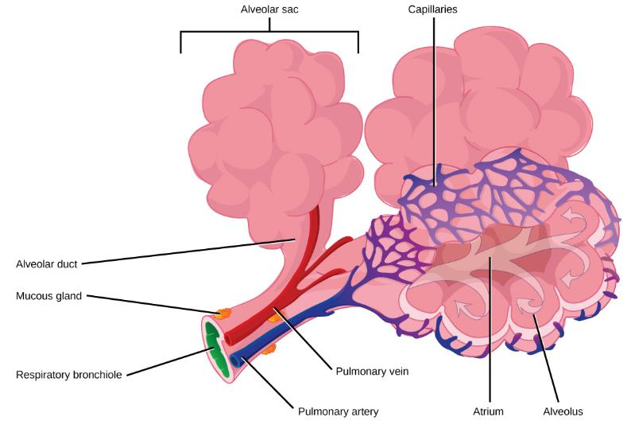
Lungs

Slide 15
Lung Structure and Function
During inhalation, thoracic volume increases through contraction of two muscle sets
  Contraction of the external intercostal muscles expands the rib cage
  Contraction of the diaphragm expands the volume of thorax and lungs
Produces negative pressure which draws air into the lungs
Caption: Diagram showing lining of the lungs (c) Cancer Research UK, Public Domain

Slide 16
Lung Structure and Function
Tidal volume
  Volume of air moving in and out of lungs in a person at rest
Vital capacity
  Maximum amount of air that can be expired after a forceful inspiration

Slide 17
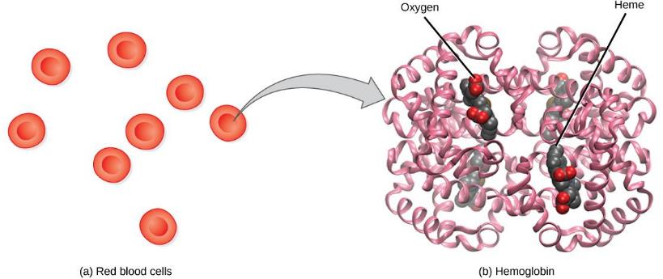
Hemoglobin
Consists of four polypeptide chains: two α and two β
  Each chain is associated with a heme group
  Each heme group has a central iron atom that can bind a molecule of O₂
Hemoglobin loads up with oxygen in the lungs, forming oxyhemoglobin
Download for free at http://cnx.org/contents/185cbf87-c72e-48f5-b51e-f14f21b5eabd@10.61

Slide 18
Hemoglobin
Hemoglobin’s affinity for O₂ is affected by pH and temperature
The pH effect is known as the Bohr shift
  Increased CO₂ in blood increases H+
    Lower pH reduces hemoglobin’s affinity for O₂
  Facilitates oxygen unloading in the tissue
    If there is high levels of CO₂, that means that oxygen is needed – the hemoglobin lets go of the oxygen
Increasing temperature has a similar effect

Slide 19
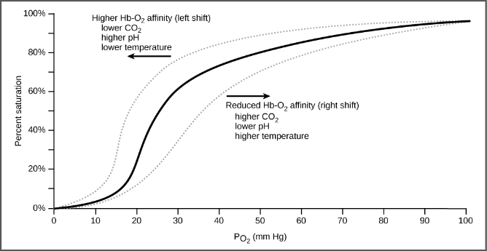
Hemoglobin
The oxygen dissociation curve demonstrates that, as the partial pressure of oxygen increases, more oxygen binds hemoglobin. However, the affinity of hemoglobin for oxygen may shift to the left or the right depending on environmental conditions.
Download for free at http://cnx.org/contents/185cbf87-c72e-48f5-b51e-f14f21b5eabd@10.61

Slide 20
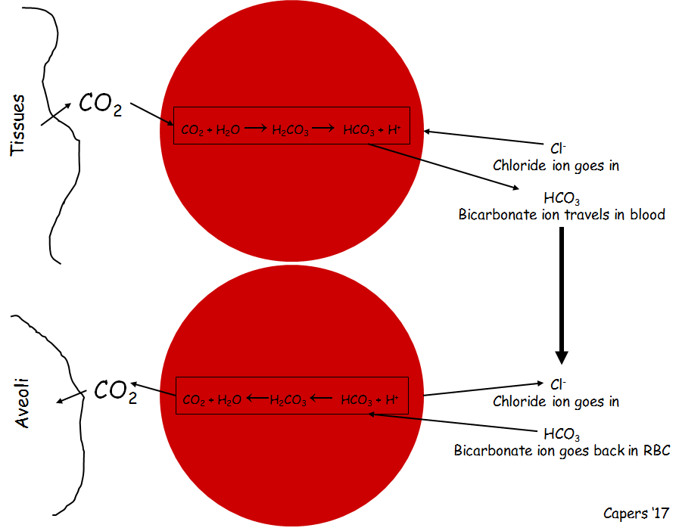
Transportation of Carbon Dioxide
Not the same as oxygen
About 8% of the CO₂ in blood is dissolved in plasma
20% of the CO₂ in blood is bound to hemoglobin
Remaining 72% diffuses into red blood cells and becomes bicarbonate

Slide 21
Lung Function
Hypoventilation
  Insufficient breathing
  Blood has abnormally high PCO₂
Hyperventilation
  Excessive breathing
  Blood has abnormally low PCO₂
Brain isn’t signaled to initiate breath, person feels like they can’t breathe, start trying to take many shallow breaths (like they can’t catch their breath), breathing paper bag adds CO₂ to system triggering brain to initiate deep breath
Neurons are sensitive to blood PCO₂ changes
  A rise in PCO₂ causes increased production of carbonic acid (H₂CO₃), lowering the blood pH
  Stimulates chemosensitive neurons in the aortic and carotid bodies
  Send impulses to respiratory control center to increase rate of breathing
  Brain also contains central chemoreceptors that are sensitive to changes in the pH of cerebrospinal fluid (CSF)

Slide 22
Respiratory Diseases
Chronic obstructive pulmonary disease (COPD)
  Refers to any disorder that obstructs airflow on a long-term basis
  Asthma
    Allergen triggers the release of histamine, causing intense constriction of the bronchi and sometimes suffocation
  Emphysema
    Alveolar walls break down and the lung exhibits larger but fewer alveoli
    Lungs become less elastic
    Eighty to 90% of emphysema deaths are caused by cigarette smoking

Slide 23
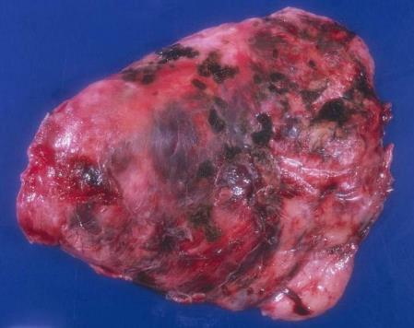
Respiratory Diseases
Lung cancer accounts for more deaths than any other form of cancer
Caused mainly by cigarette smoking
Follows or accompanies COPD
Lung cancer metastasizes (spreads) so rapidly that it has usually invaded other organs by the time it is diagnosed
Chance of recovery from metastasized lung cancer is poor, with only 3% of patients surviving for 5 years after diagnosis
Caption: Solitary fibrous tumor of pleura © Yale Rosen, License

