Slide 1


BIOLOGY 2e
Chapter 19 CIRCULATORY SYSTEM
PowerPoint Image Slideshow
This work is licensed under a Creative Commons Attribution-NonCommercial-ShareAlike 4.0 International License.

Slide 2
Invertebrate Circulatory Systems
Sponges, cnidarians, and nematodes lack a separate circulatory system
Sponges circulate water using many incurrent pores and one excurrent pore
Hydra circulate water through a gastrovascular cavity (also for digestion)
Nematodes are thin enough that the digestive tract can also be used as a circulatory system

Slide 3
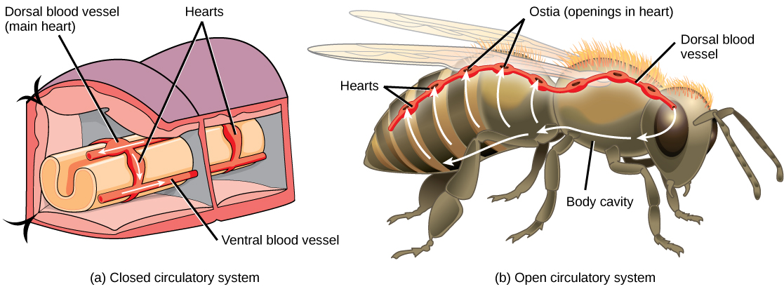
Invertebrate Circulatory Systems
Larger animals require a separate circulatory system for nutrient and waste transport
Open circulatory system
  No distinction between circulating and extracellular fluid
  Fluid called hemolymph
Closed circulatory system
  Distinct circulatory fluid enclosed in blood vessels and transported away from and back to the heart

Slide 4
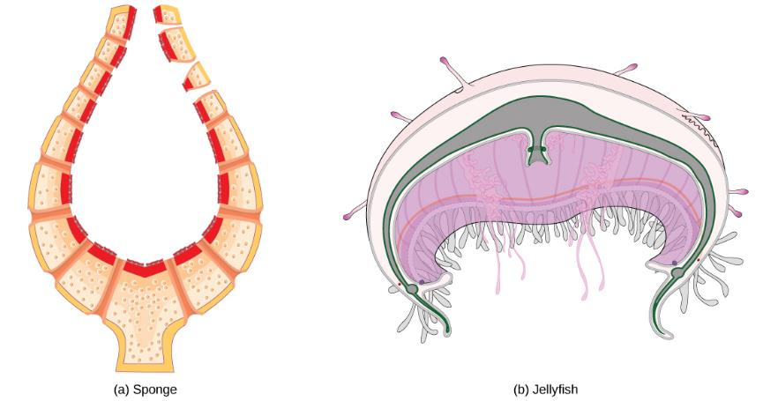
Invertebrate Circulatory Systems

Slide 5
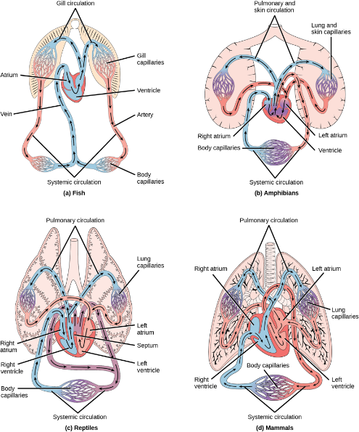
vertebrate Circulatory Systems

Slide 6
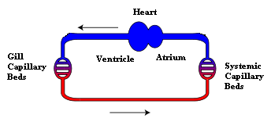
vertebrate Circulatory Systems
Fishes
  Evolved a true chamber-pump heart
  Have a 2 chambered heart
Blood is pumped through the gills, and then to the rest of the body
Caption:Fish Circulation (c) Lennart B, Public domain

Slide 7
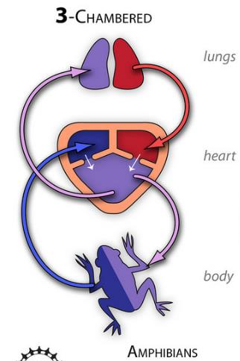

vertebrate Circulatory Systems
Amphibians
  Advent of lungs required a second pumping circuit, or double circulation
  Pulmonary circulation moves blood between the heart and lungs
  Systemic circulation moves blood between the heart and the rest of the body
  3 chambered heart

Slide 8

vertebrate Circulatory Systems
Reptile heart
  3-chambered heart
    2 atria and 2 ventricles
      But there is incomplete separation of the ventricles

Slide 9
vertebrate Circulatory Systems
Mammals, birds, and crocodilians
  4-chambered heart
  2 separate atria and 2 separate ventricles
  Right atrium receives deoxygenated blood from the body and delivers it to the right ventricle, which pumps it to the lungs
  Left atrium receives oxygenated blood from the lungs and delivers it to the left ventricle, which pumps it to rest of the body

Slide 10
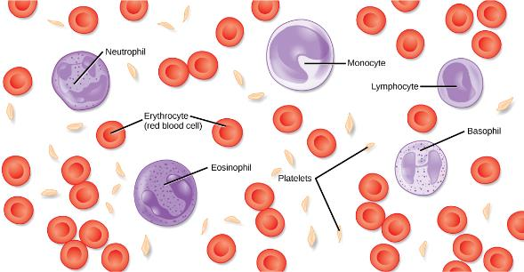
Blood
Connective Tissue
  Extracellular matrix – plasma
  Cells – RBCs, WBCs, platelets
Functions of circulating blood
  Transportation
  Regulation
  Protection
Download for free at http://cnx.org/contents/185cbf87-c72e-48f5-b51e-f14f21b5eabd@10.61

Slide 11
Blood plasma
92% water
Contains the following solutes
  Nutrients, wastes, and hormones
  Ions
    Na⁺, Cl–, HCO₃, and trace Ca²⁺, Mg²⁺, Cu²⁺, K⁺, Zn²⁺
  Proteins
    Albumin, alpha (α) and beta (β) globulins
    Fibrinogen
      If removed, plasma is called SERUM

Slide 12
Red blood cells (erythrocytes)
About 5 million per microliter of blood
Hematocrit is the fraction of the total blood volume occupied by red blood cells
Mature mammalian erythrocytes lack nuclei
Live for 120 days
RBCs of vertebrates contain hemoglobin
  Pigment that binds and transports oxygen

Slide 13
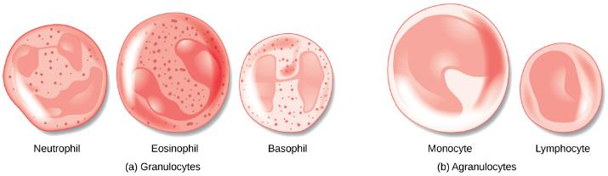
White blood cells (leukocytes)
Less than 1% of blood cells
Larger than erythrocytes and have nuclei
Can migrate out of capillaries into tissue fluid
Types
  Granular leukocytes
    Neutrophils, eosinophils, and basophils
  Agranular leukocytes
    Monocytes and lymphocytes
Download for free at http://cnx.org/contents/185cbf87-c72e-48f5-b51e-f14f21b5eabd@10.61

Slide 14
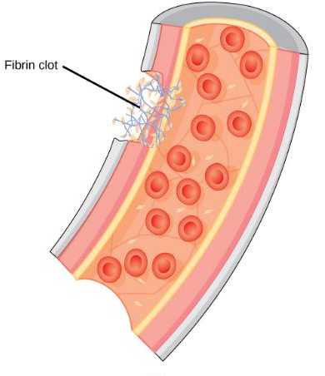
Platelets
Cell fragments that pinch off from larger cells in the bone marrow
Function in the formation of blood clots

Slide 15
Characteristics of Blood Vessels
Blood leaves heart through the arteries
Arterioles are the finest, microscopic branches of the arterial tree
Blood from arterioles enters capillaries
Blood is collected into venules, which lead to larger vessels, veins
Veins carry blood back to heart

Slide 16
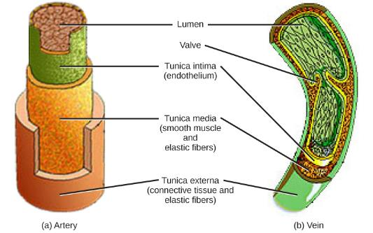
Characteristics of Blood Vessels
Arteries and veins are composed of four tissue layers
  Endothelium, elastic fibers, smooth muscle, and connective tissue
  Walls too thick for exchange of materials across the wall
Capillaries are composed of only a single layer of endothelial cells
  Allow rapid exchange of gases and metabolites between blood and body cells

Slide 17
The Lymphatic System
Significant amount of water and solutes in the blood plasma filter through the walls of the capillaries to form the interstitial (tissue) fluid
Fluid that does not return to capillaries is returned to circulation by the lymphatic system
  Lymph returns to circulation in the subclavian vein

Slide 18
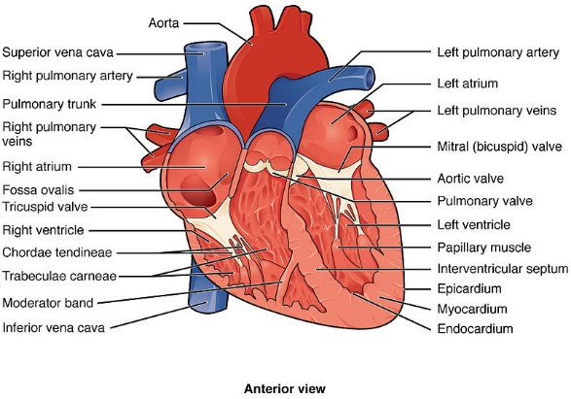
Mammalian Heart

Slide 19
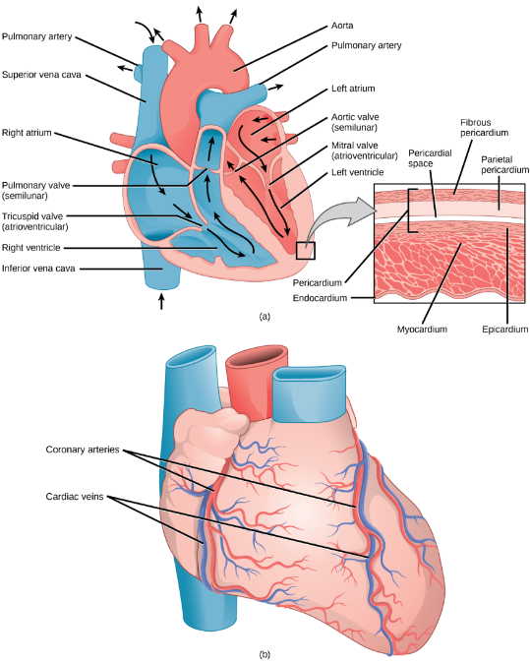
Mammalian
Heart

Slide 20
Mammalian Heart
Heart has two pairs of valves
  Atrioventricular (AV) valves
    Maintain unidirectional blood flow between atria and ventricles
    Tricuspid valve = On the right
    Bicuspid, or mitral, valve = On the left
  Semilunar valves
    Ensure one-way flow out of the ventricles to the vessels
    Pulmonary valve located at the exit of the right ventricle
    Aortic valve located at the exit of the left ventricle

Slide 21
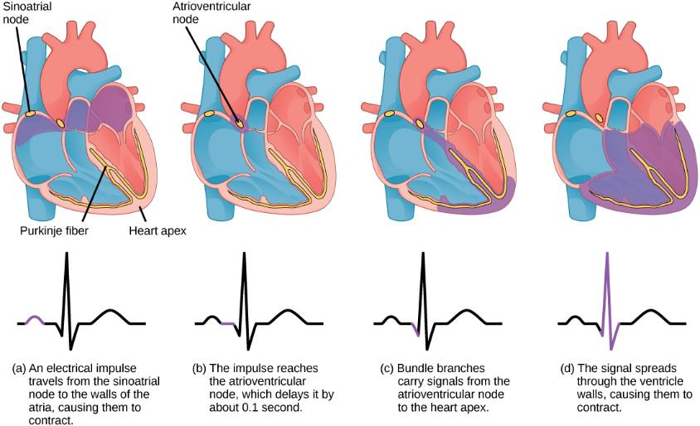
Mammalian Heart

Slide 22
The Cardiac Cycle
Valves open and close as the heart goes through the cardiac cycle
Ventricles relaxed and filling (diastole)
Ventricles contracted and pumping (systole)
“Lub-dub” sounds heard with stethoscope
  Lub – AV valves closing
  Dub – closing of semilunar valves

Slide 23

The Cardiac Cycle
Heart contains “self-excitable” autorhythmic fibers
Most important is the sinoatrial (SA) node
  Located in wall of right atrium
  Acts as pacemaker
  Autonomic nervous system can modulate rate

Slide 24
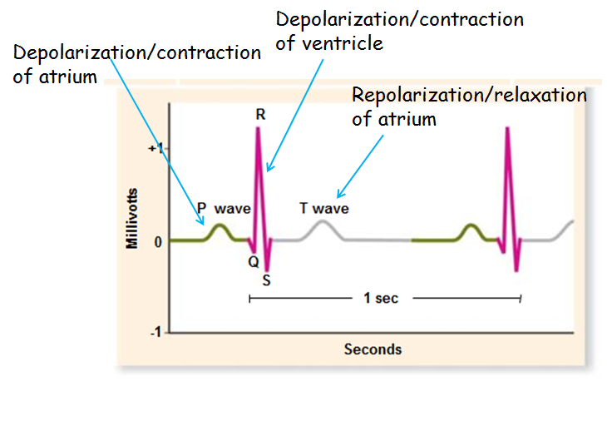
The Cardiac Cycle
Electrical activity can be recorded on an electrocardiogram (ECG or EKG)

Slide 25
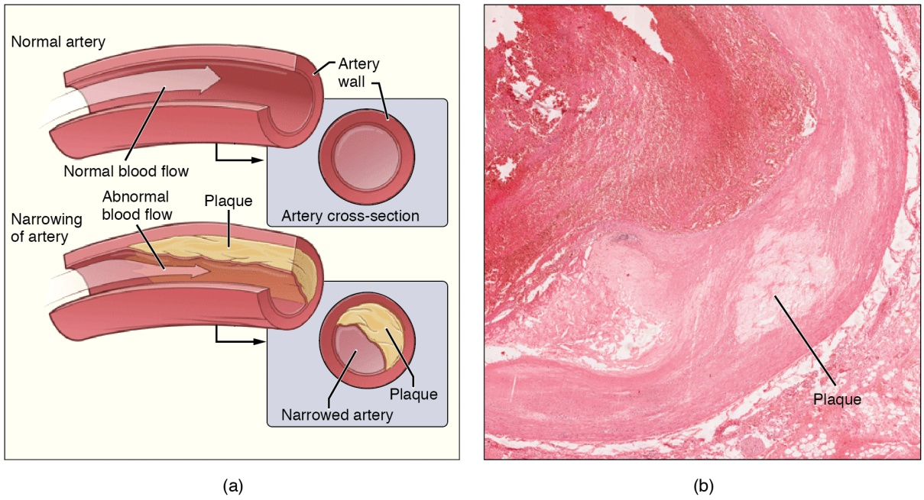
Cardiovascular Diseases
Leading cause of death in the United States
Atherosclerosis
  Accumulation of fatty material within arteries
  Impedes blood flow
Arteriosclerosis
  Arterial hardening due to calcium deposition
(Download for free at https://cnx.org/contents/FPtK1zmh@8.103:zMTtFGyH@4/Introduction

Slide 26
Blood Flow and Blood Pressure
Blood Pressure measured as systole/diastole
  Systole – ventricle contraction
  Diastole – ventricle relaxation
Increases with blood volume
Blood volume is regulated by four hormones
Antidiuretic hormone (ADH)
Aldosterone – encourages kidney to excrete postassium and retain sodium
Atrial natriuretic hormone – increases sodium excretion and decreases blood pressure
Nitric oxide (NO) – vasodialator

