Slide 1


BIOLOGY 2e
Chapter 21 THE IMMUNE SYSTEM
PowerPoint Image Slideshow
This work is licensed under a Creative Commons Attribution-NonCommercial-ShareAlike 4.0 International License.

Slide 2
Introduction
As long lived multicellular organisms, we need protection against pathogenic organisms.
  Only a small percentage of microbes are pathogenic.
  However, those that are pathogenic are very good at invading our tissues when getting past certain barriers.
  Our immune system has the ability to fight:
    Viruses
    Bacteria
    Protozoans (i.e. malaria, amoebas)
    Fungi
    Parasitic animals (i.e. tapeworms, flukes)

Slide 3
Two Immune Systems:
Innate Immune System
  Innate immune components found throughout all of the animal kingdom and even in the plant kingdom
  Nonspecific
  No memory
Adaptive Immune System
  Found only in vertebrate animals
  Highly specific
  Has memory (gives us the ability to recover from an infection and then have protection when exposed to same pathogen)

Slide 4
Innate Immune System
Physical and Chemical Barriers
  Skin
  Normal flora found on skin
  Mucous and cilia in respiratory tract
  Low pH of stomach
  Antimicrobial peptides
Simplified illustration of the stages of phagocytosis (c) Graham Colm, Public Domain

Slide 5
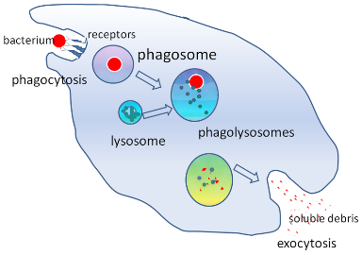
Innate Immune System
Pathogen Recognition
  Microbes have different cell surface markers than our cells
  Anything that is foreign is called an antigen
  Cells will recognize these pathogen associated molecular patterns (PAMPs) and phagocytize
  These markers are not specific – they are found on wide range of microbes
  We will see later that cells of the adaptive immune response can recognize one bacterial species from another

Slide 6
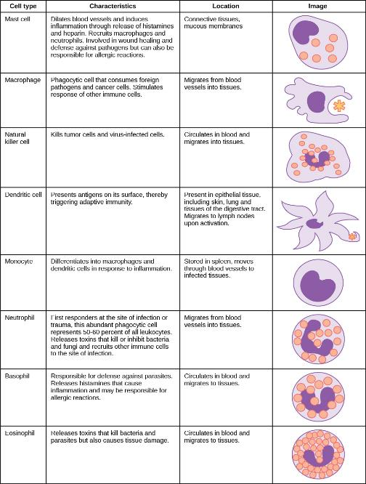
Innate Immune
System
Cells involved in the Innate Immune System –
Cells of the immune system are white blood cells (WBCs),
leukocytes

Slide 7
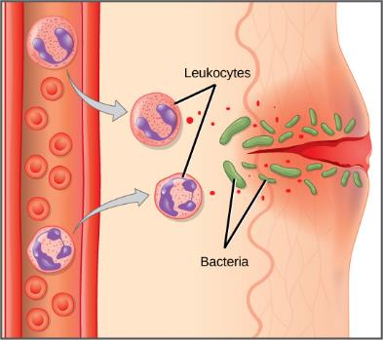
Innate Immune System
Inflammatory Response
  Pain
  Heat – body raises temp in attempt to slow growth of pathogenic bacteria
  Redness
  Swelling (edema)
    Redness and swelling are due to increased vascular permeability to allow WBCs to leave capillaries and enter tissues
Download for free at https://cnx.org/contents/GFy_h8cu@10.96:XaEKhjEp@6/Innate-Immune-Response

Slide 8
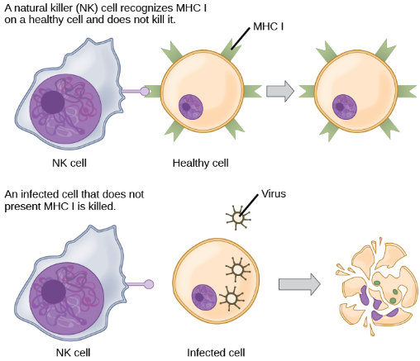
Innate Immune System
Natural Killer Cells
  Kill virus infected or altered self cells (tumor cells)
Download for free at https://cnx.org/contents/GFy_h8cu@10.96:etZobsU-@6/Adaptive-Immune-Response

Slide 9
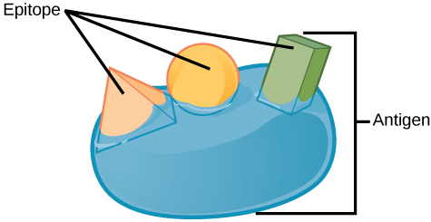
Adaptive Immune Response
Characteristics:
    Cells: B cells and T cells (lymphocytes)
    Can take days or even weeks to become upregulated
        We’ll talk about primary and secondary response later
        Remember the innate immune system is immediate
Download for free at https://cnx.org/contents/GFy_h8cu@10.96:etZobsU-@6/Adaptive-Immune-Response

Slide 10
Adaptive Immune Response
Characteristics:
    Highly specific Antibodies (Abs) made by B cells and T-cell Receptors (TCRs) made by T cells
        Innate immune system recognizes PAMPs found on wide variety of microbes, B cells and T cells can distinguish between different motifs (epitopes) found on an individual microbe
    Has memory

Slide 11
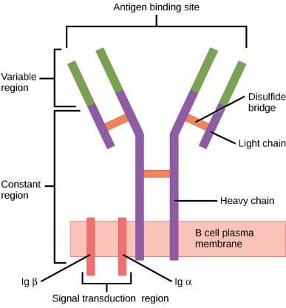
Adaptive Immune System –
Humoral Response
B Cells
  Mature in the bone marrow
  Make antibodies (Abs)
  Antibodies are proteins – encoded for in our DNA
  Each B cell produces antibodies with a specific variable region that recognizes a specific epitope
  Can be secreted or membrane-bound on the
  B cell
Download for free at https://cnx.org/contents/GFy_h8cu@10.96:etZobsU-@6/Adaptive-Immune-Response

Slide 12
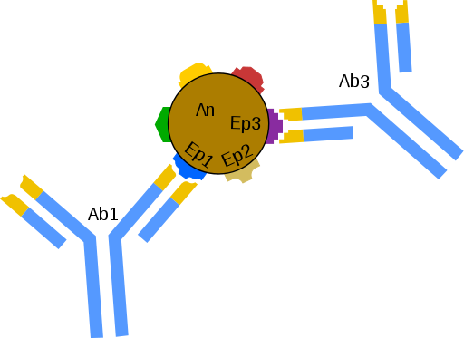
Adaptive Immune System –
Humoral Response
Each B cell secretes antibodies with a specific variable region that recognizes a specific epitope
Title: Schemat łączenia się przeciwciał (Ab) z epitopami (Ep) znajdującymi się na powierzchni antygenu., (c) Schorschski, Public Domain

Slide 13
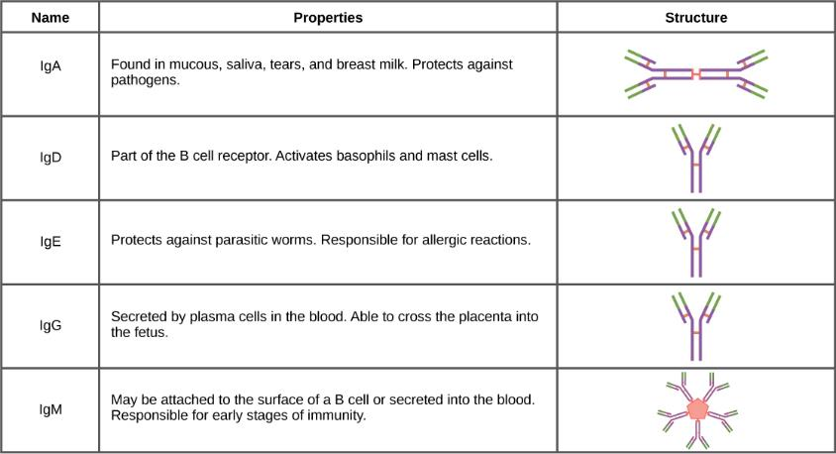
Adaptive Immune System –
Humoral Response
Download for free at https://cnx.org/contents/GFy_h8cu@10.96:Ab5hWIaf@6/Antibodies

Slide 14
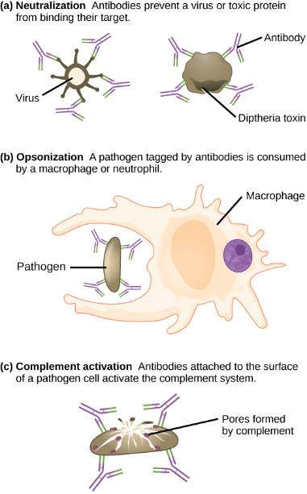
Adaptive Immune System –
Humoral Response
Antibody Function

Slide 15
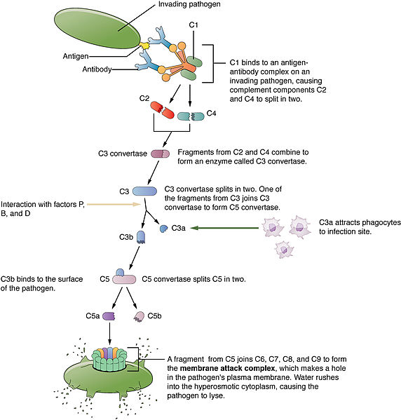
Adaptive Immune System –
Humoral Response
Complement process can make a hole in the pathogen’s membrane
Download for free at https://cnx.org/contents/FPtK1zmh@6.27:zMTtFGyH@4/Introduction

Slide 16
Adaptive Immune System
Major Histocompatibility Complex (MHC)
  Antigen presenting molecules
  MHC Class I
    Found on all of our nucleated cells
  MHC Class II
    Found on Antigen Presenting Cells (APCs)
      B cells
      Dendritic cells
      macrophages

Slide 17
Adaptive Immune System –
Cell-Mediated Response
T cells
  Mature in the thymus
  Produce the T cell receptor (TCR) that is membrane bound
    Also encoded in our DNA
    Recognized specific antigens presented in MHC molecules
  3 populations of T cells
    TH – helper T cells – CD4 markers
    Tc – cytotoxic T cell – CD8 markers
    T regulatory cells

Slide 18
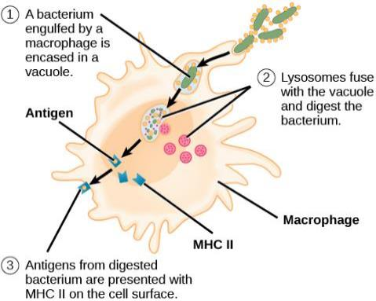
Adaptive Immune System –
Cell-Mediated Response
How an antigen presenting cell (APC) processes antigen to be presented on the MHC to a T cell
Download for free at https://cnx.org/contents/GFy_h8cu@10.96:etZobsU-@6/Adaptive-Immune-Response

Slide 19

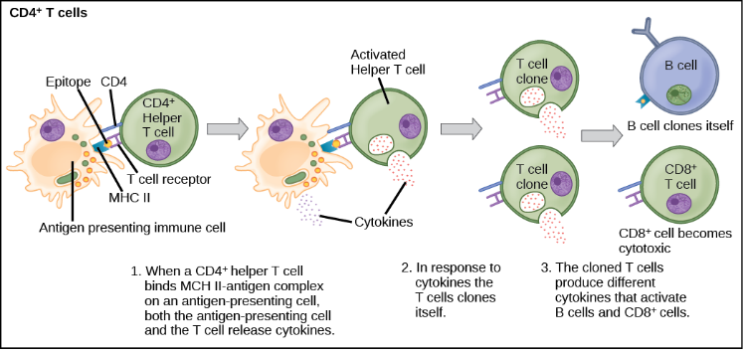
Adaptive Immune System –
Cell-Mediated Response
Helper T cells will then release cytokines to upregulate B cells, other immune cells, will go through mitosis to make clones of itself
Download for free at https://cnx.org/contents/GFy_h8cu@10.96:etZobsU-@6/Adaptive-Immune-Response

Slide 20

Adaptive Immune System –
Cell-Mediated Response
Cytotoxic T cells will kill infected self cells or altered (tumor) self cells
For instance, if a cell is infected with a virus, it will present some of that virus on it’s MHC Class I, the Tc cell will then force that self cell to go through apoptosis
Download for free at https://cnx.org/contents/GFy_h8cu@10.96:etZobsU-@6/Adaptive-Immune-Response

Slide 21
Adaptive Immune Response
How does the variable region of an antibody secreted by one B cell differ from another B cell?
How does the variable region of the T cell receptor (TCR) of one T cell differ from another T cell?
  Process called gene rearrangement
  During B and T cell development, the region of the DNA that codes for the variable region “rearranges” – this results in each B and T cell having unique variable region
    Results in high diversity
    Process is complicated and will be explained further in a class such as Immunology

Slide 22
Lymphatic System
Most of the cells in the blood vessels are erythrocytes.
The leukocytes have the ability of migrating into the tissues along with other fluid, nutrients, etc.
Lymph is that watery fluid that then travels through our lymph vessels to be dumped back into circulation.
Along the way, the lymph will travel through lymph nodes.
  There are a congregation of B, T and other white blood cells there.
  If there is something foreign that made it past the skin or mucosal membranes into the tissues, hopefully it will be detected in the lymph nodes, clones of T and B cells specific for the antigen will be released into circulation to find more of that same antigen

Slide 23
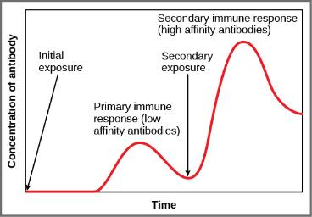
Adaptive Immune Response
Primary Response
  Initial exposure to antigen/pathogen
  Takes days to weeks for B and
  T cells to upregulate and mount a full response
  After recovery, memory B and
  T cells that are specific to that antigen/pathogen will remain and circulate (up to decades)
Secondary Response
  Second exposure to same antigen/pathogen
  Memory cells will respond faster
  Results in an individual either not getting sick or being able to recover faster
Download for free at https://cnx.org/contents/GFy_h8cu@10.96:etZobsU-@6/Adaptive-Immune-Response

Slide 24
Adaptive Immune Response
Vaccination initiates that Primary Immune Response
  The body is given time to mount a primary response against a pathogen and make memory B and T cells against that pathogen
  When person is exposed to pathogen later, a secondary response will hopefully prevent sickness

Slide 25
Antibodies

Slide 26
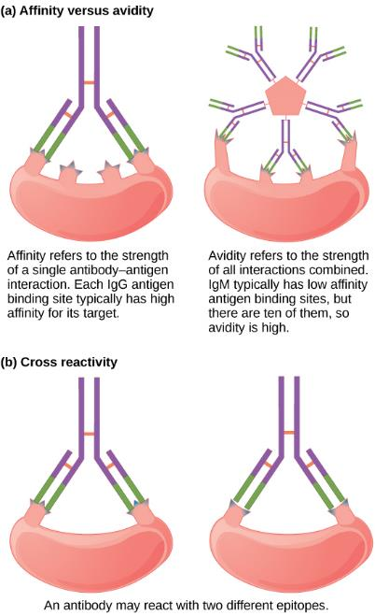
Antibodies

Slide 27
Things that can go wrong:
Chronic Inflammation
  Can cause damage to tissues
Allergies
  Immune system’s over-reaction to antigen
Autoimmunity
  The immune system can sometimes recognize self antigen as being foreign – results in tissue/organ damage
    Lupus
    Multiple sclerosis
    Grave’s disease
    Rheumatoid arthritis

Slide 28
Things that can go wrong:
Immunodeficiency
  Primary – genetic/developmental defect results in individual lacking in some component of the immune system
    SCID
    Inability to make certain antibody class
    Lack of thymus
  Acquired – later in life (i.e. AIDS as a result of HIV infection)

Slide 29
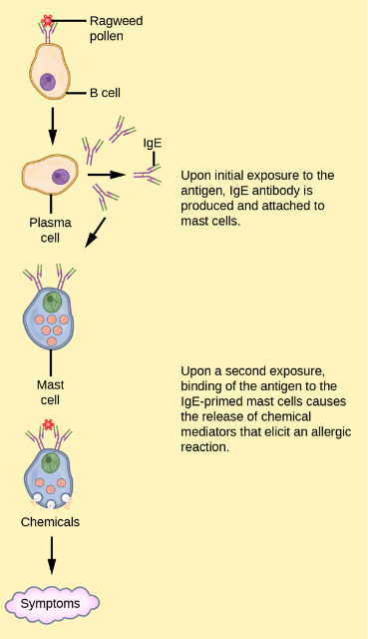
Allergies

