Slide 1

The Endocrine System
General Biology II
Notes:
All text in these slides is taken from https://courses.lumenlearning.com/wm-biology1/ where it is published under one or more open licenses.
All images in these slides are attributed in the notes of the slide on which they appear and licensed as indicated.
Cover Image: "Peacock Feathers." Authored by: Andre Mouton. Provided by: Unsplash. Located at: https://unsplash.com/photos/_d3sppFprWI. Content Type: CC Licensed Content, Shared Previously. License: CC0: No Rights Reserved.

Slide 2
Classifying Hormones
The hormones in the human body, they can be divided into three classes based on their chemical structure:
lipid-derived hormones can diffuse across plasma membranes
amino acid-derived
peptide (peptide and proteins)

Slide 3
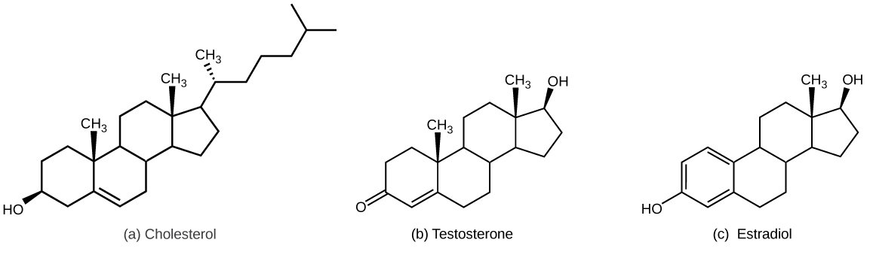
Lipid-derived Hormones
Notes:
Biology. Provided by: OpenStax CNX. Located at: http://cnx.org/contents/185cbf87-c72e-48f5-b51e-f14f21b5eabd@10.8. License: CC BY: Attribution. License Terms: Download for free at http://cnx.org/contents/185cbf87-c72e-48f5-b51e-f14f21b5eabd@10.8

Slide 4
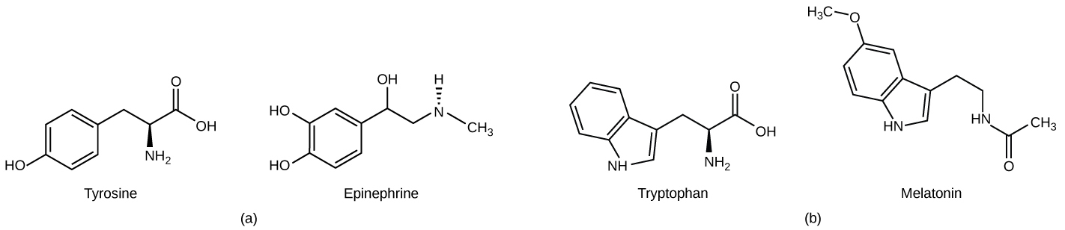
Amino Acid-Derived Hormones
Notes:
Biology. Provided by: OpenStax CNX. Located at: http://cnx.org/contents/185cbf87-c72e-48f5-b51e-f14f21b5eabd@10.8. License: CC BY: Attribution. License Terms: Download for free at http://cnx.org/contents/185cbf87-c72e-48f5-b51e-f14f21b5eabd@10.8

Slide 5
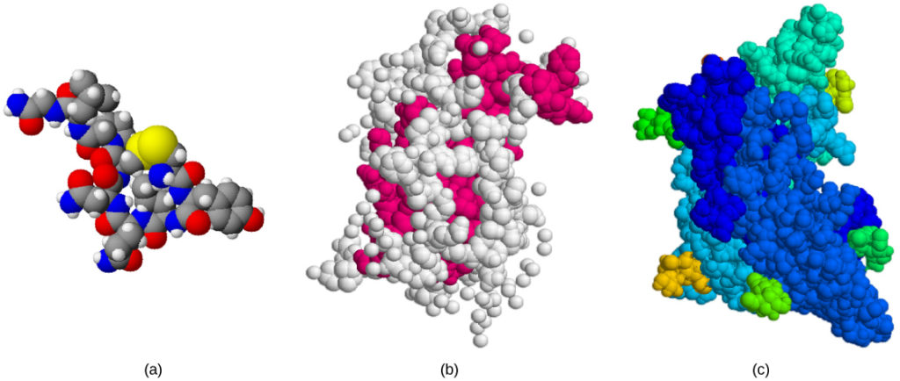
Peptide Hormones
The structures of peptide hormones (a) oxytocin, (b) growth hormone, and (c) follicle-stimulating hormone.
Notes:
Biology. Provided by: OpenStax CNX. Located at: http://cnx.org/contents/185cbf87-c72e-48f5-b51e-f14f21b5eabd@10.8. License: CC BY: Attribution. License Terms: Download for free at http://cnx.org/contents/185cbf87-c72e-48f5-b51e-f14f21b5eabd@10.8

Slide 6
Hormone Regulation
Hormone levels are primarily controlled through negative feedback, in which rising levels of a hormone inhibit its further release
The three mechanisms of hormonal release are in response to:
Humoral stimuli: changes in extracellular fluid levels or ion levels
Hormonal stimuli: hormones released by other endocrine glands
Neural stimuli: neural stimulation

Slide 7
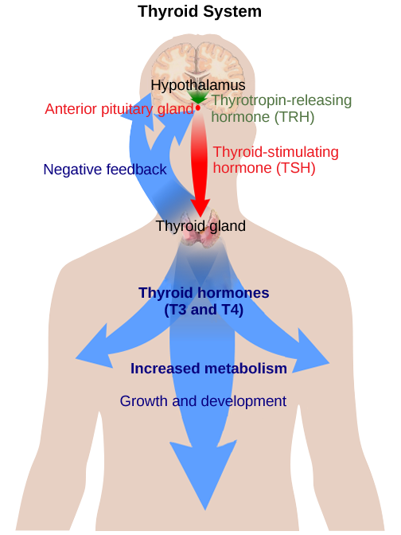
Negative Feedback
The anterior pituitary stimulates the thyroid gland to release thyroid hormones T3 and T4. Increasing levels of these hormones in the blood results in feedback to the hypothalamus and anterior pituitary to inhibit further signaling to the thyroid gland.
Notes:
(credit: modification of work by Mikael Häggström) Biology. Provided by: OpenStax CNX. Located at: http://cnx.org/contents/185cbf87-c72e-48f5-b51e-f14f21b5eabd@10.8. License: CC BY: Attribution. License Terms: Download for free at http://cnx.org/contents/185cbf87-c72e-48f5-b51e-f14f21b5eabd@10.8

Slide 8
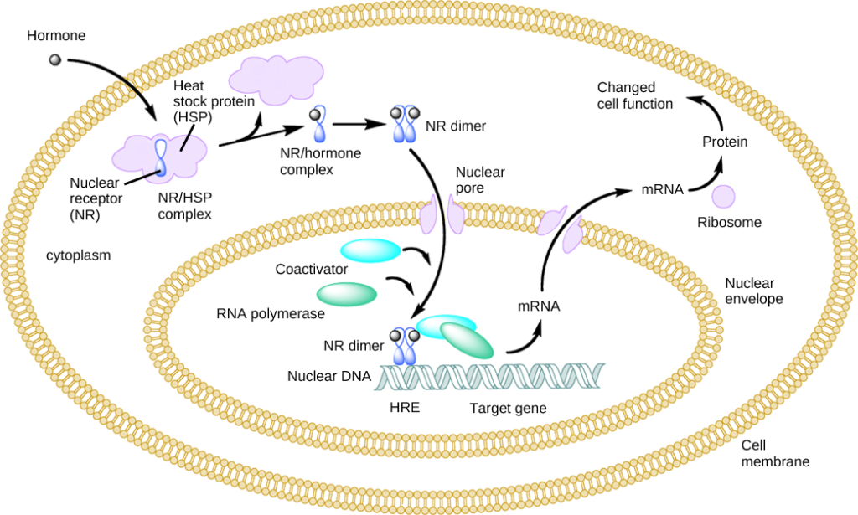
Intracellular Nuclear Receptor
Notes:
Biology. Provided by: OpenStax CNX. Located at: http://cnx.org/contents/185cbf87-c72e-48f5-b51e-f14f21b5eabd@10.8. License: CC BY: Attribution. License Terms: Download for free at http://cnx.org/contents/185cbf87-c72e-48f5-b51e-f14f21b5eabd@10.8

Slide 9
Practice Question
What type of hormone can use the intracellular nuclear receptor on the last slide?
Notes:
Lipid-derived hormones since they are the only ones that can diffuse through the cell membrane

Slide 10
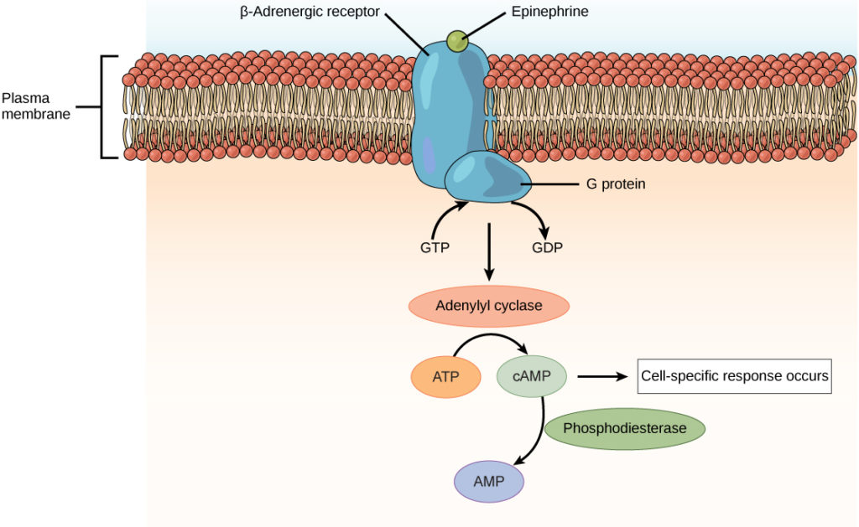
Plasma Membrane Hormone Receptors
Notes:
Biology. Provided by: OpenStax CNX. Located at: http://cnx.org/contents/185cbf87-c72e-48f5-b51e-f14f21b5eabd@10.8. License: CC BY: Attribution. License Terms: Download for free at http://cnx.org/contents/185cbf87-c72e-48f5-b51e-f14f21b5eabd@10.8

Slide 11
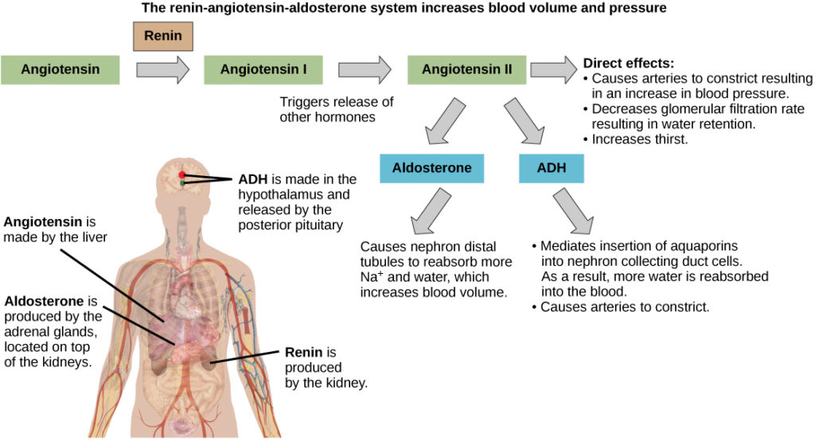
Hormonal Regulation of the Excretory System to Maintain Water Levels
Notes:
(credit: modification of work by Mikael Häggström) in Biology. Provided by: OpenStax CNX. Located at: http://cnx.org/contents/185cbf87-c72e-48f5-b51e-f14f21b5eabd@10.8. License: CC BY: Attribution. License Terms: Download for free at http://cnx.org/contents/185cbf87-c72e-48f5-b51e-f14f21b5eabd@10.8

Slide 12
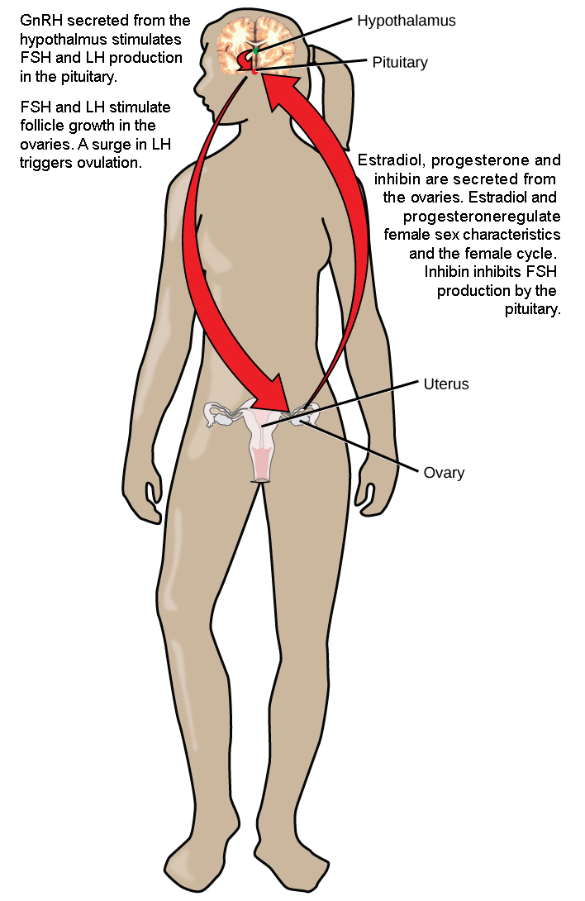
Hormone Regulation of the Female Reproductive System
Notes:
Biology. Provided by: OpenStax CNX. Located at: http://cnx.org/contents/185cbf87-c72e-48f5-b51e-f14f21b5eabd@10.8. License: CC BY: Attribution. License Terms: Download for free at http://cnx.org/contents/185cbf87-c72e-48f5-b51e-f14f21b5eabd@10.8

Slide 13
Hormones Regulate the Male Reproductive System
The reproductive system is controlled by the gonadotropins follicle-stimulating hormone (FSH) and luteinizing hormone (LH), which are produced by the pituitary gland. Gonadotropin release is controlled by the hypothalamic hormone gonadotropin-releasing hormone (GnRH). FSH stimulates the maturation of sperm cells in males and is inhibited by the hormone inhibin, while LH stimulates the production of the androgen testosterone

Slide 14
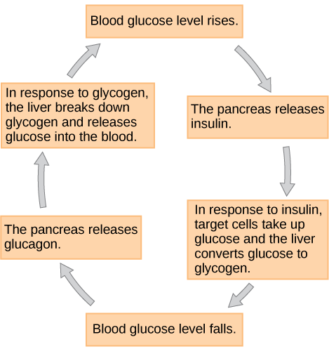
Insulin and Glucagon Regulate Blood Glucose Levels
Notes:
Biology. Provided by: OpenStax CNX. Located at: http://cnx.org/contents/185cbf87-c72e-48f5-b51e-f14f21b5eabd@10.8. License: CC BY: Attribution. License Terms: Download for free at http://cnx.org/contents/185cbf87-c72e-48f5-b51e-f14f21b5eabd@10.8

Slide 15
Hormonal Regulation of Metabolism
Insulin is produced by the pancreas in response to rising blood glucose levels and allows cells to utilize blood glucose and store excess glucose for later use. Diabetes mellitus is caused by reduced insulin activity and causes high blood glucose levels, or hyperglycemia. Glucagon is released by the pancreas in response to low blood glucose levels and stimulates the breakdown of glycogen into glucose, which can be used by the body. The body’s basal metabolic rate is controlled by the thyroid hormones thyroxine (T₄) and triiodothyronine (T₃). The anterior pituitary produces thyroid stimulating hormone (TSH), which controls the release of T₃ and T₄ from the thyroid gland. Iodine is necessary in the production of thyroid hormone, and the lack of iodine can lead to a condition called goiter.

Slide 16
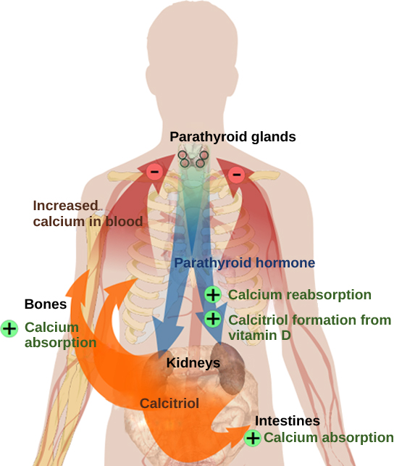
Blood Calcium Levels and Growth
Parathyroid hormone (PTH) is released in response to low blood calcium levels. It increases blood calcium levels by targeting the skeleton, the kidneys, and the intestine.
Notes:
(credit: modification of work by Mikael Häggström) in Biology. Provided by: OpenStax CNX. Located at: http://cnx.org/contents/185cbf87-c72e-48f5-b51e-f14f21b5eabd@10.8. License: CC BY: Attribution. License Terms: Download for free at http://cnx.org/contents/185cbf87-c72e-48f5-b51e-f14f21b5eabd@10.8

Slide 17
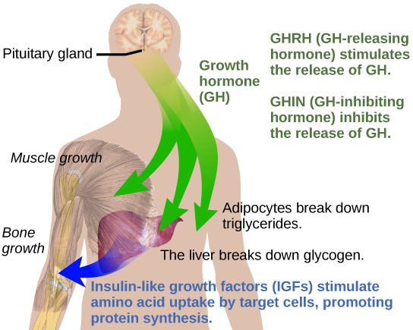
Growth Hormones
Growth hormone directly accelerates the rate of protein synthesis in skeletal muscle and bones. Insulin-like growth factor 1 (IGF-1) is activated by growth hormone and also allows formation of new proteins in muscle cells and bone
Notes:
(credit: modification of work by Mikael Häggström) in Biology. Provided by: OpenStax CNX. Located at: http://cnx.org/contents/185cbf87-c72e-48f5-b51e-f14f21b5eabd@10.8. License: CC BY: Attribution. License Terms: Download for free at http://cnx.org/contents/185cbf87-c72e-48f5-b51e-f14f21b5eabd@10.8

Slide 18
Stress Hormones
The sympathetic nervous system regulates the stress response via the hypothalamus.
When presented with a stressful situation, the body responds by calling for the release of hormones that provide a burst of energy.
Long-term stress response differs from short-term stress response.
Notes:
(credit: modification of work by Mikael Häggström) in Biology. Provided by: OpenStax CNX. Located at: http://cnx.org/contents/185cbf87-c72e-48f5-b51e-f14f21b5eabd@10.8. License: CC BY: Attribution. License Terms: Download for free at http://cnx.org/contents/185cbf87-c72e-48f5-b51e-f14f21b5eabd@10.8

Slide 19
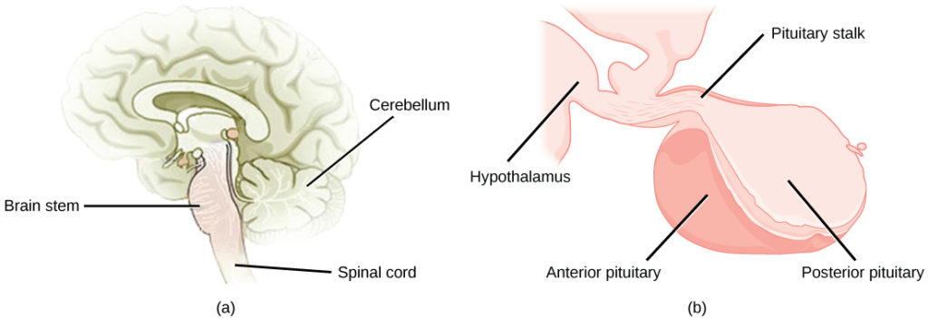
Hypothalamic-Pituitary Axis
Notes:
(credit a: modification of work by NCI; credit b: modification of work by Gray’s Anatomy) in Biology. Provided by: OpenStax CNX. Located at: http://cnx.org/contents/185cbf87-c72e-48f5-b51e-f14f21b5eabd@10.8. License: CC BY: Attribution. License Terms: Download for free at http://cnx.org/contents/185cbf87-c72e-48f5-b51e-f14f21b5eabd@10.8

Slide 20
Hypothalamic and Pituitary Hormones
Endocrine Gland | Hormone Released | Chemical Class | Target Tissue/Organ | Major Function of Hormone
Hypothalamus | Hypothalamic releasing and inhibiting hormones | Peptide | Anterior pituitary | Regulate anterior pituitary hormone
Posterior Pituitary | Antidiuretic (ADH) | Peptide | Kidneys | Stimulates water reabsorption by kidneys
Posterior Pituitary | Oxytocin | Peptide | Uterus, mammary glands | Stimulates uterine muscle contractions and release of milk by mammary glands
Anterior Pituitary | Thyroid stimulating (TSH) | Glycoprotein | Thyroid | Stimulates thyroid
Anterior Pituitary | Adrenocorticotropic (ACTH) | Peptide | Adrenal cortex | Stimulates adrenal cortex
Anterior Pituitary | Gonadotropic (FSH, LH) | Glycoprotein | Gonads | Egg and sperm production, sex hormone production
Anterior Pituitary | Prolactin (PRL) | Protein | Mammary glands | Milk production
Anterior Pituitary | Growth (GH) | Protein | Soft tissue, bones | Cell division, protein synthesis and bone growth
Notes:
Human Physiology. Provided by: Wikibooks. Located at: https://en.wikibooks.org/wiki/Human_Physiology. License: CC BY-SA: Attribution-ShareAlike

Slide 21
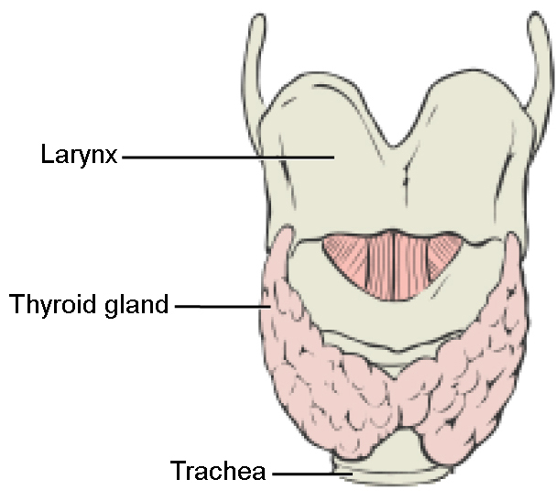
Thyroid Gland
The thyroid gland makes hormones T3 and T4 and Calcitonin that increase metabolic rate and regulate growth and development
Notes:
Biology. Provided by: OpenStax CNX. Located at: http://cnx.org/contents/185cbf87-c72e-48f5-b51e-f14f21b5eabd@10.8. License: CC BY: Attribution. License Terms: Download for free at http://cnx.org/contents/185cbf87-c72e-48f5-b51e-f14f21b5eabd@10.8

Slide 22
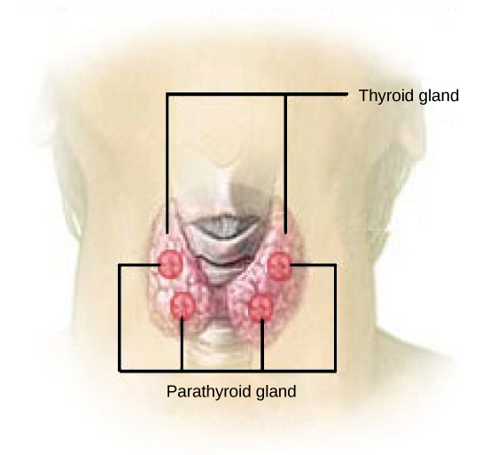
Parathyroid
The parathyroid glands produce parathyroid hormone (PTH). PTH increases blood calcium concentrations when calcium ion levels fall below normal. These hormones encourage bone growth, muscle mass, and blood cell formation
Notes:
(credit: modification of work by NCI) in Biology. Provided by: OpenStax CNX. Located at: http://cnx.org/contents/185cbf87-c72e-48f5-b51e-f14f21b5eabd@10.8. License: CC BY: Attribution. License Terms: Download for free at http://cnx.org/contents/185cbf87-c72e-48f5-b51e-f14f21b5eabd@10.8

Slide 23
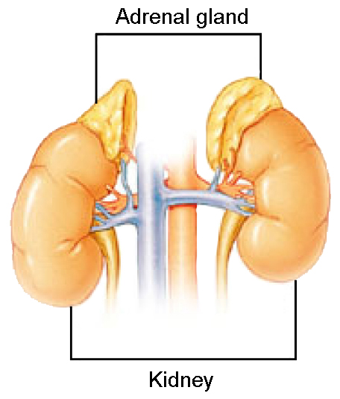
Adrenal Gland
Notes:
Biology. Provided by: OpenStax CNX. Located at: http://cnx.org/contents/185cbf87-c72e-48f5-b51e-f14f21b5eabd@10.8. License: CC BY: Attribution. License Terms: Download for free at http://cnx.org/contents/185cbf87-c72e-48f5-b51e-f14f21b5eabd@10.8

Slide 24
Adrenal Function
Endocrine Gland | Hormone Released | Chemical Class | Target Tissue/Organ | Major Function of Hormone
Adrenal Cortex | Glucocorticoids (cortisol) | Steroid | All tissue | Raise blood glucose level, stimulates breakdown of protein
Adrenal Cortex | Mineralocorticoids (aldosterone) | Steroid | Kidneys | Reabsorb sodium and excrete potassium
Adrenal Cortex | Sex Hormones | Steroid | Gonads, skin, muscles and bones | Stimulates reproductive organs and brings on sex characteristics
Adrenal Medulla | Epinephrine and norepinephrine | Modified amino acid | Cardiac and other muscles | Released in emergency situations, raises blood glucose level, “fight or flight” response
Notes:
Human Physiology. Provided by: Wikibooks. Located at: https://en.wikibooks.org/wiki/Human_Physiology. License: CC BY-SA: Attribution-ShareAlike

Slide 25
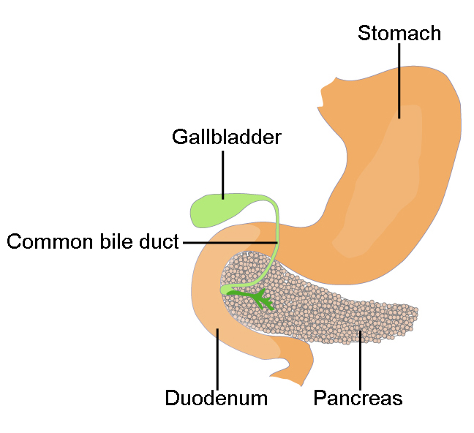
Pancreas
Notes:
Biology. Provided by: OpenStax CNX. Located at: http://cnx.org/contents/185cbf87-c72e-48f5-b51e-f14f21b5eabd@10.8. License: CC BY: Attribution. License Terms: Download for free at http://cnx.org/contents/185cbf87-c72e-48f5-b51e-f14f21b5eabd@10.8

Slide 26
Endocrine Gland Functions
Endocrine Gland | Associated Hormones | Effect
Pancreas | insulin | reduces blood glucose levels
Pancreas | glucagon | increases blood glucose levels
Pineal gland | melatonin | regulates some biological rhythms and protects CNS from free radicals
Testes | androgens | regulate, promote, increase or maintain sperm production; male secondary sexual characteristics
Ovaries | estrogen | promotes uterine lining growth; female secondary sexual characteristics
Ovaries | progestins | promote and maintain uterine lining growth
Notes:
Biology. Provided by: OpenStax CNX. Located at: http://cnx.org/contents/185cbf87-c72e-48f5-b51e-f14f21b5eabd@10.8. License: CC BY: Attribution. License Terms: Download for free at http://cnx.org/contents/185cbf87-c72e-48f5-b51e-f14f21b5eabd@10.8

Slide 27
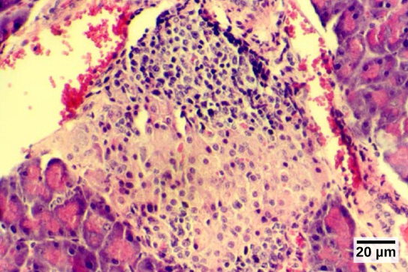
The Islets of Langerhans
Notes:
(credit: modification of work by Muhammad T. Tabiin, Christopher P. White, Grant Morahan, and Bernard E. Tuch; scale-bar data from Matt Russell) in Biology. Provided by: OpenStax CNX. Located at: http://cnx.org/contents/185cbf87-c72e-48f5-b51e-f14f21b5eabd@10.8. License: CC BY: Attribution. License Terms: Download for free at http://cnx.org/contents/185cbf87-c72e-48f5-b51e-f14f21b5eabd@10.8

Slide 28
Secondary Function
Some organs possess endocrine activity as a secondary function but have another primary function. The heart produces the hormone atrial natriuretic peptide, which functions to reduce blood volume, pressure, and Na⁺ concentration. The gastrointestinal tract produces various hormones that aid in digestion. The kidneys produce renin, calcitriol, and erythropoietin. Adipose tissue produces leptin, which promotes satiety signals in the brain.

Slide 29
Quick Review
What are the different types of hormones? How is hormone production regulated?
What are the two types of hormone receptors?
How do hormones regulate body processes?
What is the role of different glands in the endocrine system?

