Slide 1
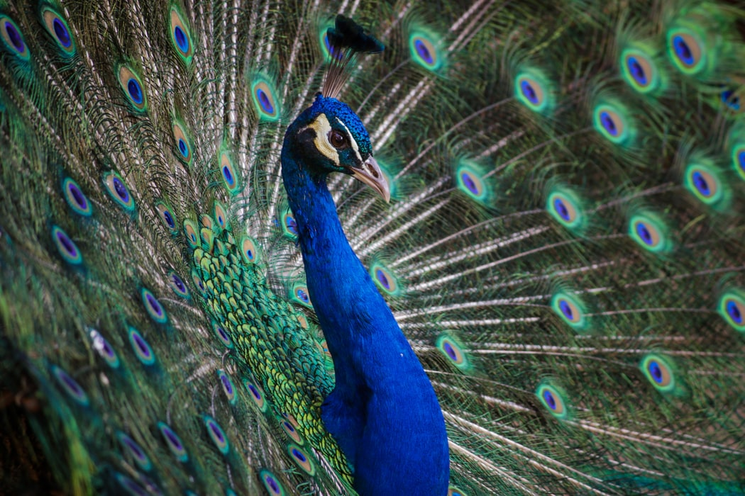
Reproductive System
General Biology II
Notes:
All text in these slides is taken from https://courses.lumenlearning.com/wm-biology1/ where it is published under one or more open licenses.
All images in these slides are attributed in the notes of the slide on which they appear and licensed as indicated.
Cover Image: Microscope: amyloplasts and leucoplastos. Authored by: emanuel1901. Located at: https://pixabay.com/en/microscope-amyloplasts-leucoplastos-1221391/. License: CC0: Public Domain.

Slide 2
Sexual vs. Asexual Reproduction
Sexual Reproduction
Produces offspring with novel combinations of genes
Can be an adaptive advantage in unstable or unpredictable environments
Asexual Reproduction
Produces offspring with the same genes as the parent
The parent organism survived to reproduce so those were good genes if the environment remained stable

Slide 3
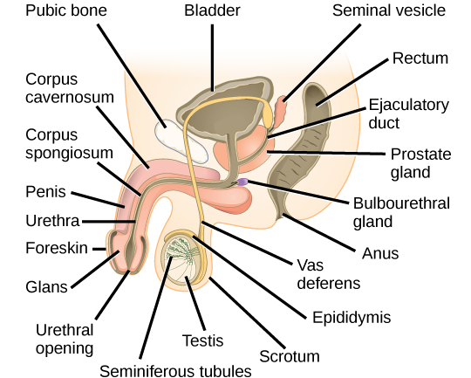
Male Reproductive Anatomy
Notes:
Biology. Provided by: OpenStax CNX. Located at: http://cnx.org/contents/185cbf87-c72e-48f5-b51e-f14f21b5eabd@10.8. License: CC BY: Attribution. License Terms: Download for free at http://cnx.org/contents/185cbf87-c72e-48f5-b51e-f14f21b5eabd@10.8

Slide 4
Function of Organs in the Male Reproductive System
Organ | Location | Function
Scrotum | External | Carry and support testes
Penis | External | Deliver urine, copulating organ
Testes | Internal | Produce sperm and male hormones
Seminal Vesicles | Internal | Contribute to semen production
Prostate Gland | Internal | Contribute to semen production
Bulbourethral Glands | Internal | Clean urethra at ejaculation
Notes:
Biology. Provided by: OpenStax CNX. Located at: http://cnx.org/contents/185cbf87-c72e-48f5-b51e-f14f21b5eabd@10.8. License: CC BY: Attribution. License Terms: Download for free at http://cnx.org/contents/185cbf87-c72e-48f5-b51e-f14f21b5eabd@10.8

Slide 5
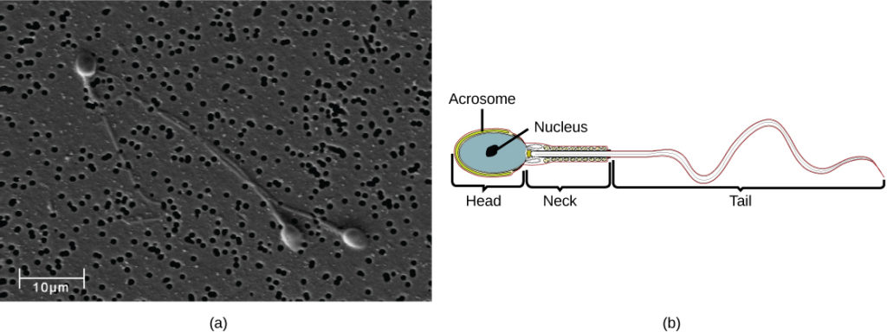
Sperm
Human sperm, visualized using scanning electron microscopy, have a flagellum, neck, and head
Notes:
(credit b: modification of work by Mariana Ruiz Villareal; scale-bar data from Matt Russell) in Biology. Provided by: OpenStax CNX. Located at: http://cnx.org/contents/185cbf87-c72e-48f5-b51e-f14f21b5eabd@10.8. License: CC BY: Attribution. License Terms: Download for free at http://cnx.org/contents/185cbf87-c72e-48f5-b51e-f14f21b5eabd@10.8

Slide 6
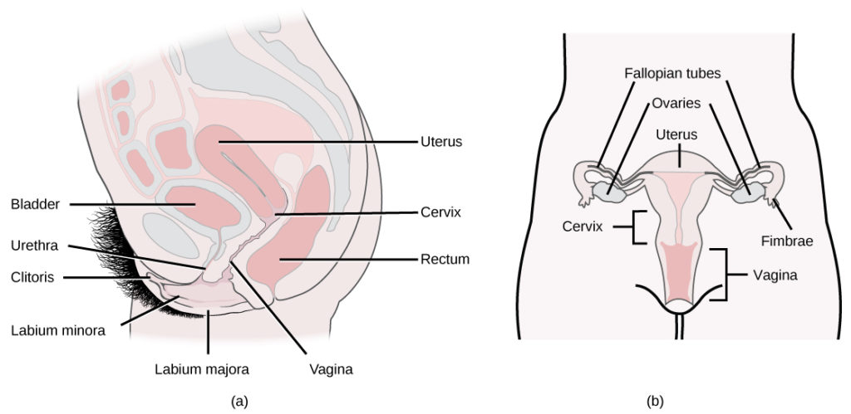
Female Reproductive Anatomy
Notes:
(credit a: modification of work by Gray’s Anatomy; credit b: modification of work by CDC) in Biology. Provided by: OpenStax CNX. Located at: http://cnx.org/contents/185cbf87-c72e-48f5-b51e-f14f21b5eabd@10.8. License: CC BY: Attribution. License Terms: Download for free at http://cnx.org/contents/185cbf87-c72e-48f5-b51e-f14f21b5eabd@10.8

Slide 7
Female Reproductive Organs
Organ | Location | Function
Clitoris | External | Sensory organ
Mons pubis | External | Fatty area overlying pubic bone
Labia majora | External | Covers labia minora
Labia minora | External | Covers vestibule
Greater vestibular glands | External | Secrete mucus; lubricate vagina
Breast | External | Produce and deliver milk
Ovaries | Internal | Carry and develop eggs
Oviducts (Fallopian tubes) | Internal | Transport egg to uterus
Uterus | Internal | Support developing embryo
Vagina | Internal | Common tube for intercourse, birth canal, passing menstrual flow
Notes:
Biology. Provided by: OpenStax CNX. Located at: http://cnx.org/contents/185cbf87-c72e-48f5-b51e-f14f21b5eabd@10.8. License: CC BY: Attribution. License Terms: Download for free at http://cnx.org/contents/185cbf87-c72e-48f5-b51e-f14f21b5eabd@10.8

Slide 8
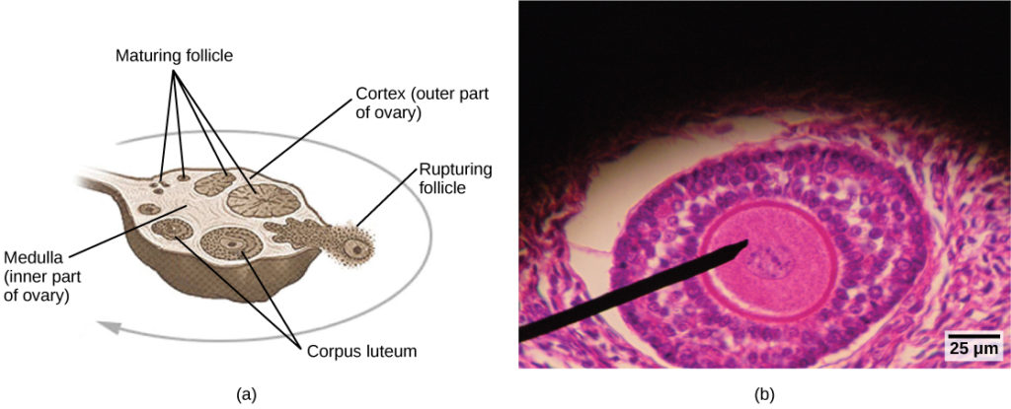
Follicles in the Ovary
Oocytes develop in (a) follicles, located in the ovary. At the beginning of the menstrual cycle, the follicle matures. At ovulation, the follicle ruptures, releasing the egg. The follicle becomes a corpus luteum, which eventually degenerates. The (b) follicle in this light micrograph has an oocyte at its center.
Notes:
(credit a: modification of work by NIH; scale-bar data from Matt Russell) in Biology. Provided by: OpenStax CNX. Located at: http://cnx.org/contents/185cbf87-c72e-48f5-b51e-f14f21b5eabd@10.8. License: CC BY: Attribution. License Terms: Download for free at http://cnx.org/contents/185cbf87-c72e-48f5-b51e-f14f21b5eabd@10.8

Slide 9
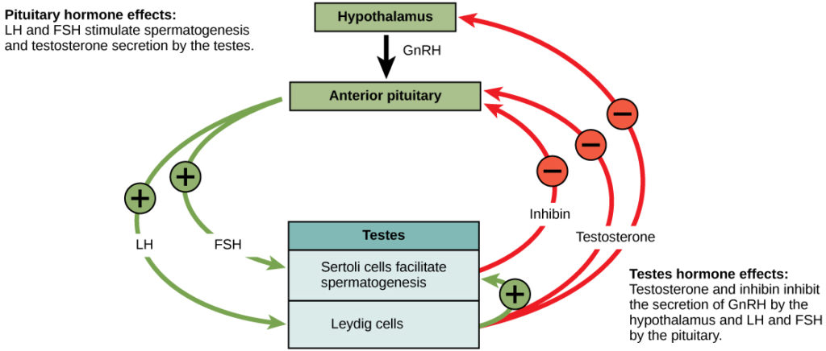
Male Hormone Activity
Notes:
Biology. Provided by: OpenStax CNX. Located at: http://cnx.org/contents/185cbf87-c72e-48f5-b51e-f14f21b5eabd@10.8. License: CC BY: Attribution. License Terms: Download for free at http://cnx.org/contents/185cbf87-c72e-48f5-b51e-f14f21b5eabd@10.8

Slide 10
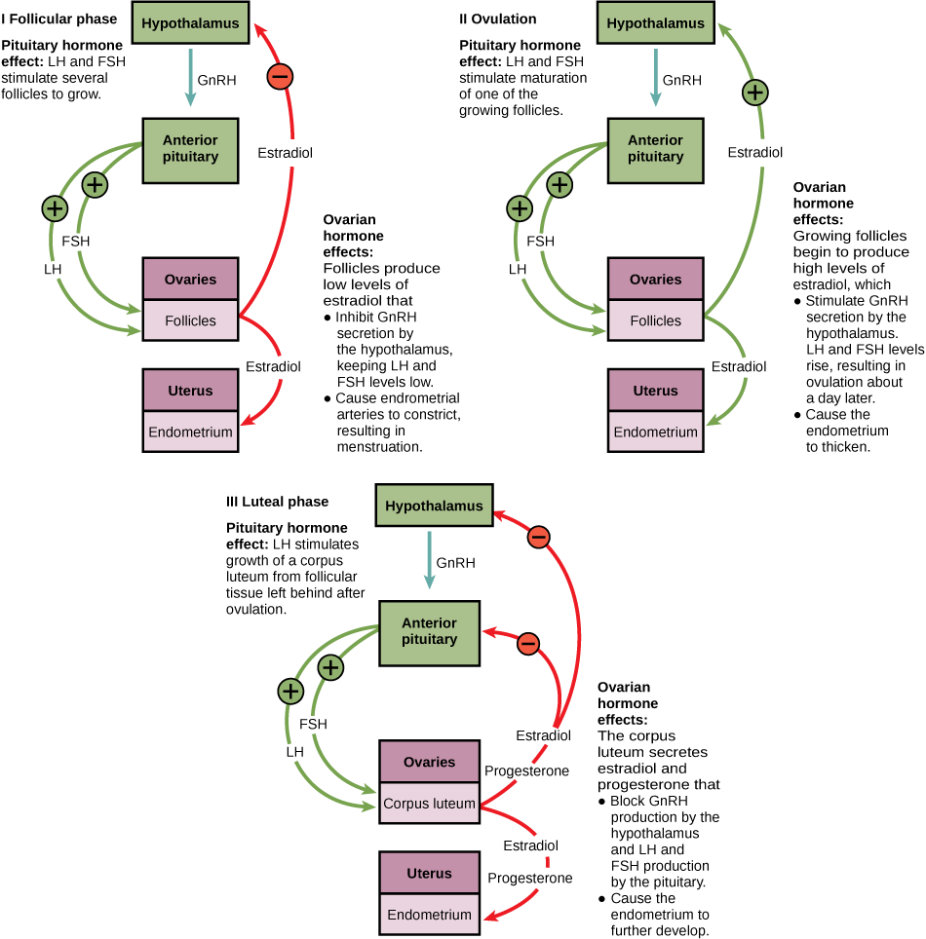
Female Hormone Activity
Notes:
Biology. Provided by: OpenStax CNX. Located at: http://cnx.org/contents/185cbf87-c72e-48f5-b51e-f14f21b5eabd@10.8. License: CC BY: Attribution. License Terms: Download for free at http://cnx.org/contents/185cbf87-c72e-48f5-b51e-f14f21b5eabd@10.8

Slide 11
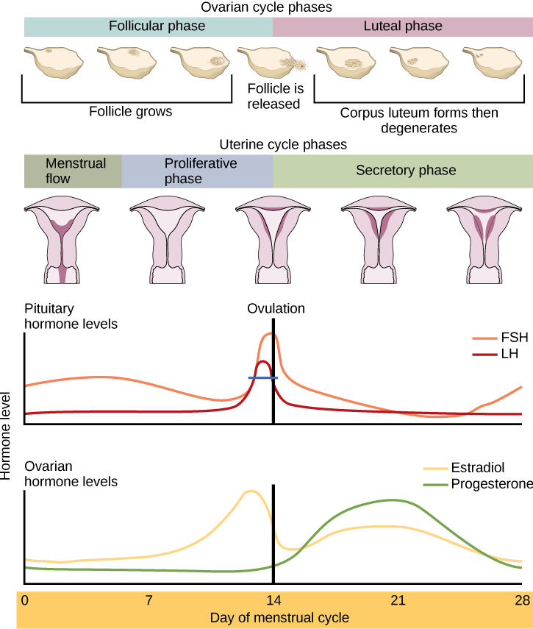
Hormones and the Ovarian Cycle
Notes:
Biology. Provided by: OpenStax CNX. Located at: http://cnx.org/contents/185cbf87-c72e-48f5-b51e-f14f21b5eabd@10.8. License: CC BY: Attribution. License Terms: Download for free at http://cnx.org/contents/185cbf87-c72e-48f5-b51e-f14f21b5eabd@10.8

Slide 12
Internal Fertilization
Internal fertilization has the advantage of protecting the fertilized egg from dehydration on land
The embryo is isolated within the female, which limits predation on the young
Internal fertilization enhances the fertilization of eggs by a specific male
Fewer offspring are produced through this method, but their survival rate is higher than that for external fertilization

Slide 13
External Fertilization
Broadcast spawning can result in a greater mixture of the genes within a group, leading to higher genetic diversity and a greater chance of species survival in a hostile environment
For sessile aquatic organisms like sponges, broadcast spawning is the only mechanism for fertilization and colonization of new environments
The presence of the fertilized eggs and developing young in the water provides opportunities for predation resulting in a loss of offspring
The offspring produced must mature rapidly
The survival rate of eggs is low

Slide 14
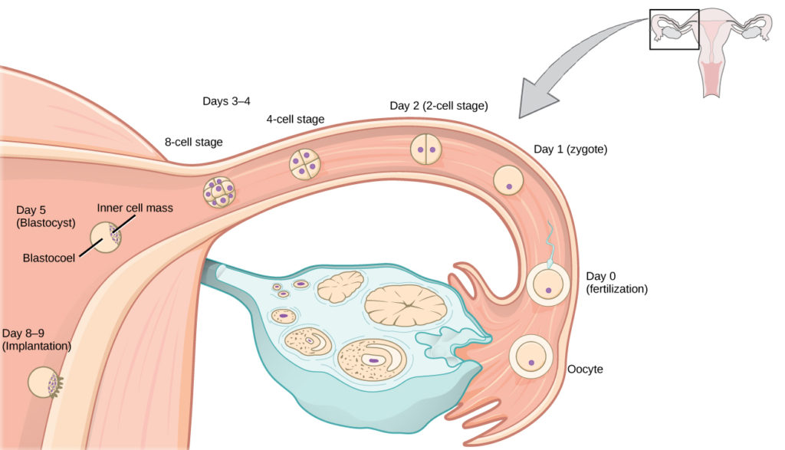
Human Fertilization and Implantation
Notes:
(credit: Ed Uthman) in Biology. Provided by: OpenStax CNX. Located at: http://cnx.org/contents/185cbf87-c72e-48f5-b51e-f14f21b5eabd@10.8. License: CC BY: Attribution. License Terms: Download for free at http://cnx.org/contents/185cbf87-c72e-48f5-b51e-f14f21b5eabd@10.8

Slide 15
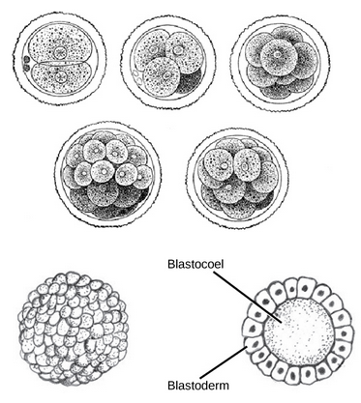
From Zygote to Blastula
During cleavage, the zygote rapidly divides into multiple cells without increasing in size. (b) The cells rearrange themselves to form a hollow ball with a fluid-filled or yolk-filled cavity called the blastula
Notes:
(credit a: modification of work by Gray’s Anatomy; credit b: modification of work by Pearson Scott Foresman, donated to the Wikimedia Foundation) in Biology. Provided by: OpenStax CNX. Located at: http://cnx.org/contents/185cbf87-c72e-48f5-b51e-f14f21b5eabd@10.8. License: CC BY: Attribution. License Terms: Download for free at http://cnx.org/contents/185cbf87-c72e-48f5-b51e-f14f21b5eabd@10.8

Slide 16
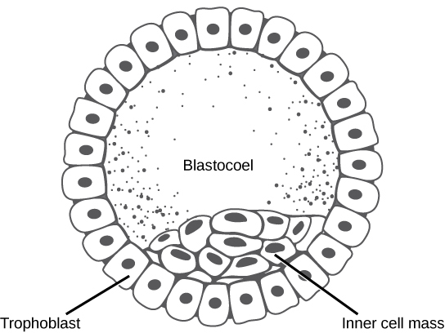
From Blastula to Blastocyst
The rearrangement of the cells in the mammalian blastula to two layers—the inner cell mass and the trophoblast—results in the formation of the blastocyst
Notes:
Biology. Provided by: OpenStax CNX. Located at: http://cnx.org/contents/185cbf87-c72e-48f5-b51e-f14f21b5eabd@10.8. License: CC BY: Attribution. License Terms: Download for free at http://cnx.org/contents/185cbf87-c72e-48f5-b51e-f14f21b5eabd@10.8

Slide 17
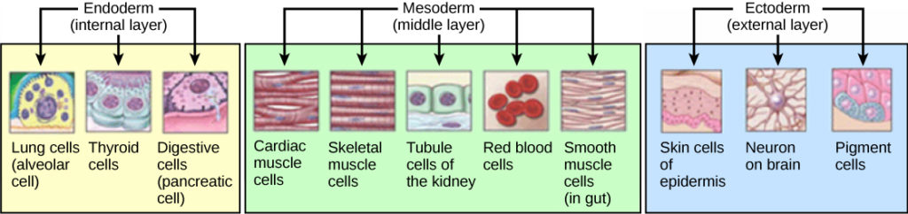
Gastrulation
During gastrulation, the blastula folds upon itself to form the three layers of cells. Each of these layers is called a germ layer and each germ layer differentiates into different organ systems.
Notes:
(credit: modification of work by NIH, NCBI) in Biology. Provided by: OpenStax CNX. Located at: http://cnx.org/contents/185cbf87-c72e-48f5-b51e-f14f21b5eabd@10.8. License: CC BY: Attribution. License Terms: Download for free at http://cnx.org/contents/185cbf87-c72e-48f5-b51e-f14f21b5eabd@10.8

Slide 18
Organogenesis
Organs form from the germ layers through the process of differentiation. During differentiation, the embryonic stem cells express specific sets of genes which will determine their ultimate cell type

Slide 19
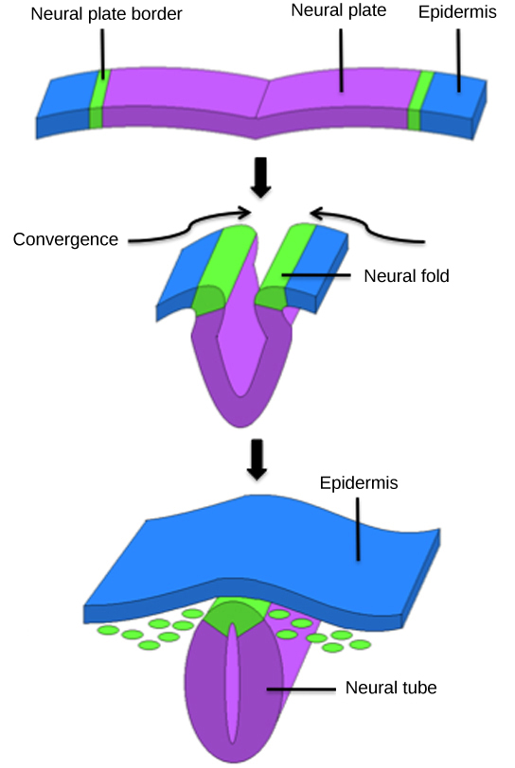
Forming the Neural Tube
In vertebrates the central region of the ectoderm forms the neural tube, which gives rise to the brain and the spinal cord
Notes:
Biology. Provided by: OpenStax CNX. Located at: http://cnx.org/contents/185cbf87-c72e-48f5-b51e-f14f21b5eabd@10.8. License: CC BY: Attribution. License Terms: Download for free at http://cnx.org/contents/185cbf87-c72e-48f5-b51e-f14f21b5eabd@10.8

Slide 20
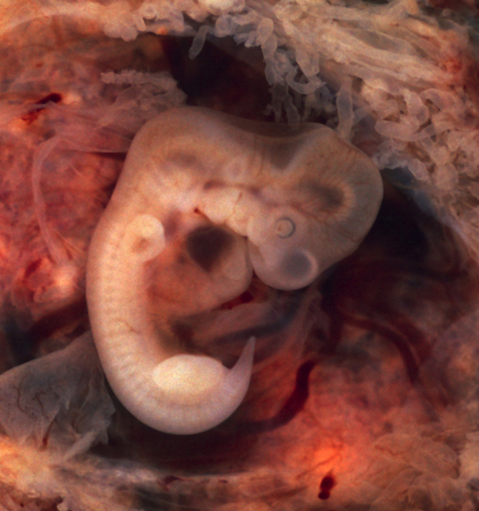
The Embryo
In this five-week old human embryo, somites are segments along the length of the body that will ultimately form ribs, lungs, and spine muscle
Notes:
(credit: modification of work by Ed Uthman) in Biology. Provided by: OpenStax CNX. Located at: http://cnx.org/contents/185cbf87-c72e-48f5-b51e-f14f21b5eabd@10.8. License: CC BY: Attribution. License Terms: Download for free at http://cnx.org/contents/185cbf87-c72e-48f5-b51e-f14f21b5eabd@10.8

Slide 21
The First Trimester: The Placenta
During the first two to four weeks of the first trimester, nutrition and waste are handled by the endometrial lining through diffusion
As the trimester progresses, the outer layer of the embryo begins to merge with the endometrium, and the placenta forms
This organ takes over the nutrient and waste requirements of the embryo and fetus, with the mother’s blood passing nutrients to the placenta and removing waste from it

Slide 22
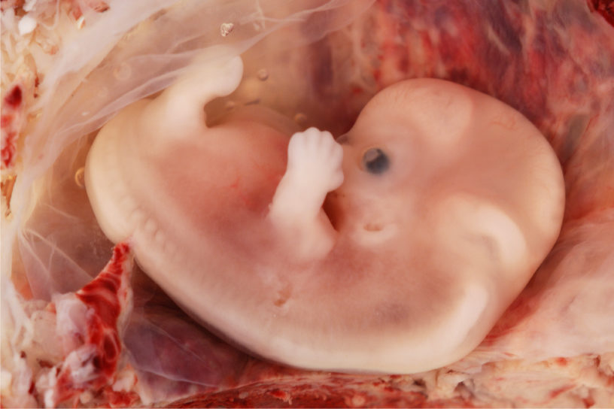
Development in the First Trimester
Internal organs and body structures begin to develop during the first trimester
By five weeks, limb buds, eyes, the heart, and liver have been basically formed though many of the organs, such as the lungs and liver, are not yet functioning
By eight weeks, the term fetus applies, and the body is essentially formed
At this stage the fetus is about 5 cm long
Notes:
(credit: Ed Uthman) in Biology. Provided by: OpenStax CNX. Located at: http://cnx.org/contents/185cbf87-c72e-48f5-b51e-f14f21b5eabd@10.8. License: CC BY: Attribution. License Terms: Download for free at http://cnx.org/contents/185cbf87-c72e-48f5-b51e-f14f21b5eabd@10.8

Slide 23
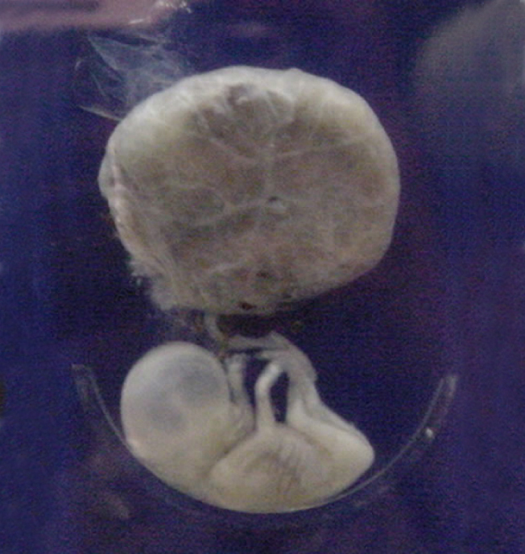
Second Trimester Fetal Development
The fetus grows to about 30 cm
It becomes active and the mother usually feels the first movements
All organs and structures continue to develop
The placenta has taken over the functions of nutrition and waste and the production of estrogen and progesterone
Notes:
(credit: National Museum of Health and Medicine) in Biology. Provided by: OpenStax CNX. Located at: http://cnx.org/contents/185cbf87-c72e-48f5-b51e-f14f21b5eabd@10.8. License: CC BY: Attribution. License Terms: Download for free at http://cnx.org/contents/185cbf87-c72e-48f5-b51e-f14f21b5eabd@10.8

Slide 24
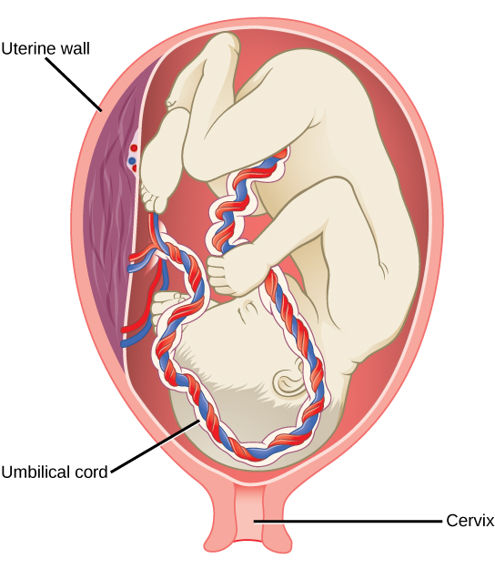
Third Trimester Fetal Development
During the third trimester, the fetus grows to 3 to 4 kg and about 50 cm long
This is the period of the most rapid growth during the pregnancy
Organ development continues to birth (and some systems, such as the nervous system and liver, continue to develop after birth)
Notes:
(credit: modification of work by Gray’s Anatomy) in Biology. Provided by: OpenStax CNX. Located at: http://cnx.org/contents/185cbf87-c72e-48f5-b51e-f14f21b5eabd@10.8. License: CC BY: Attribution. License Terms: Download for free at http://cnx.org/contents/185cbf87-c72e-48f5-b51e-f14f21b5eabd@10.8

Slide 25
Practice Question
Why is exposure to toxins especially dangerous during the first trimester?
Notes:
All of the organ systems are in their initial developmental stages. Neural tube formation is very important.

Slide 26
Quick Review
What are the advantages and disadvantages of asexual and sexual reproduction?
What is the anatomy of the human male and female reproductive system?
What are the roles of male and female reproductive hormones?
What are internal and external methods of fertilization?
How does the embryo form from the zygote?
What is the process of organogenesis and vertebrate formation?
What fetal development occurs during the three trimesters of gestation?

