Slide 1


BIOLOGY 2e
Chapter 2 THE CHEMICAL FOUNDATION OF LIFE
PowerPoint Image Slideshow
This work is licensed under a Creative Commons Attribution-NonCommercial-ShareAlike 4.0 International License.

Slide 2
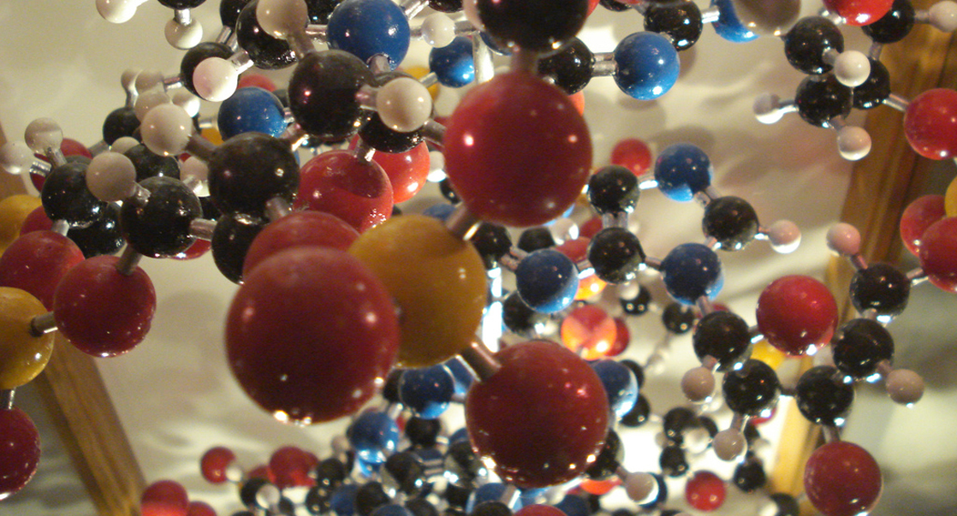
Atoms are the Building blocks of Molecules
Life is composed of matter
Matter:
  occupies space
  has mass
Elements are unique forms of matter
  Specific chemical properties
  Specific physical properties

Slide 3
Elements and the Living World
Elements cannot be broken down into smaller substances
Each element is designated by a chemical symbol (one or two letters)
  Sulfur = S
  Calcium = Ca
Four most common elements of living organisms
Carbon C
Oxygen = O
Hydrogen = H
Nitrogen = N

Slide 4
Elements and the Living World
Comparing the elements of living
organisms to the non-living world
Element | Life (Humans) | Atmosphere | Earth’s Crust
Oxygen (O) | 65% | 21% | 46%
Carbon (C) | 18% | trace | trace
Hydrogen (H) | 10% | trace | 0.1%
Nitrogen (N) | 3% | 78% | trace

Slide 5
Atoms are the Building blocks of Elements
Atom – smallest unit of matter that retains all chemical properties of an element
Atoms contains two regions
Nucleus – center of the atom and contains protons and neutrons
Outermost region – holds electrons in orbit around the nucleus
Protons, neutrons, and electrons are referred to as sub-atomic particles

Slide 6
Key properties of sub-atomic particles
 | Charge | Mass (amu) | Location
Proton | +1 | 1 | nucleus
Neutron | 0 | 1 | nucleus
Electron | -1 | 0 | orbitals

Slide 7
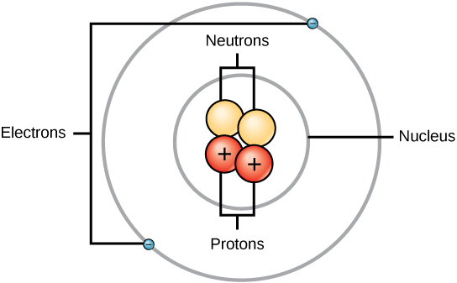
The arrangement of sub-atomic particles in an atom
Example of an atom from the element Helium (He)
Simplified depiction of how sub-atomic particles are arranged within an atom.

Slide 8
What’s the difference between
Atomic number and Atomic mass?
Atoms of each element have a standard number of protons and electrons
Atomic Number is the number of protons
  Each element has a distinct atomic number
Atomic Mass is the mass of the atom, roughly equal to number of protons and neutrons
  The number of neutrons can vary in an element
  Elements with different number of neutrons are isotopes
  Electrons don’t need to be included in calculation of atomic mass
  Atomic mass is expressed in atomic mass units (amu)
We can calculate the number of neutrons in an element by subtracting the atomic number from the atomic mass

Slide 9
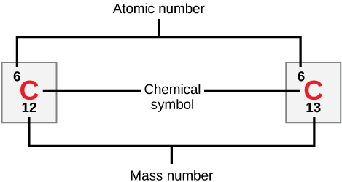
Figure 2.3 Atomic mass vs. atomic number
Carbon has an atomic number of six, and two stable isotopes with mass numbers of twelve and thirteen, respectively. Carbon-12’s atomic mass is approx. 12.11.

Slide 10
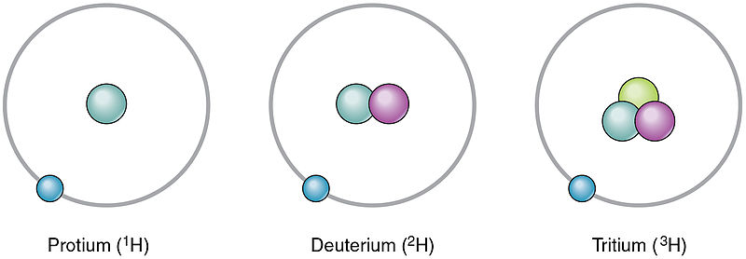
Isotopes
Forms of an element with different numbers of neutrons, and thus different mass numbers
Example:
¹H has 0 neutrons
²H has 1 neutron
³H has 2 neutrons

Slide 11
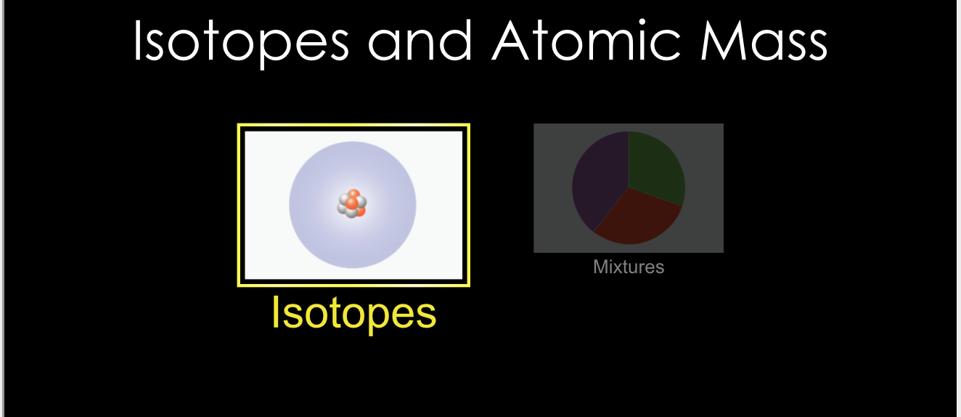
Isotope Simulation
https://phet.colorado.edu/sims/html/isotopes-and-atomic-mass/latest/isotopes-and-atomic-mass_en.html

Slide 12
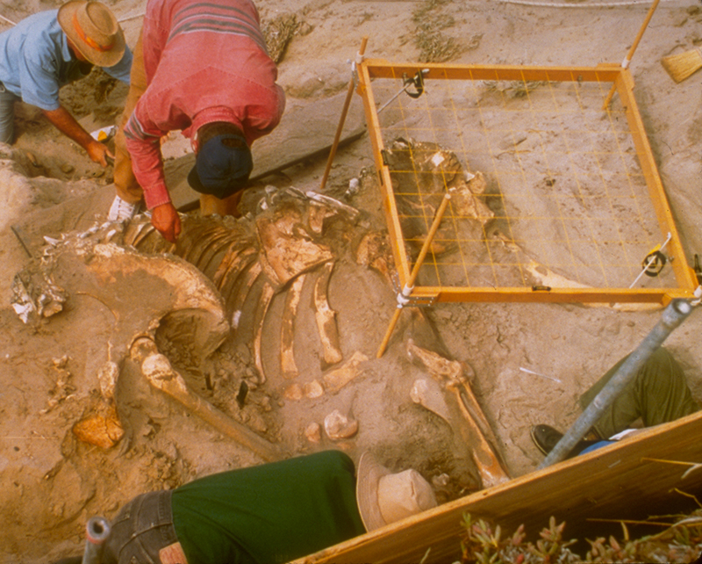
Isotopes can be used as a research tool
Radioisotopes – isotopes that emit neutrons, protons, and electrons
Radiometric dating takes advantage of this natural phenomenon
Example: Over time Carbon-14 decays to Nitrogen-14. Researchers can compare Carbon-14 in atmosphere to carbon-14 in fossils remains and estimate fossil age
The age of carbon-containing remains less than about 50,000 years old, such as this pygmy mammoth, can be determined using carbon dating.
For older objects, scientists analyze the presence of isotopes of uranium (which decays to lead), potassium, or rubidium.

Slide 13
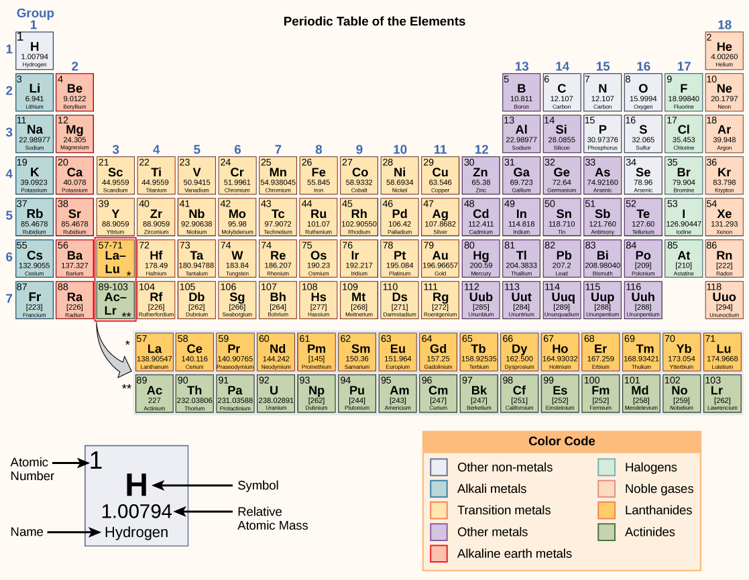
Periodic Table
The periodic table shows the atomic mass and atomic number of each element. The atomic number appears above the symbol for the element and the approximate atomic mass appears below it.

Slide 14
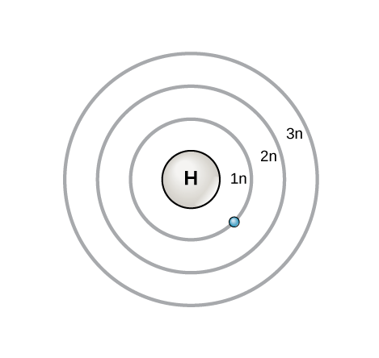
Electron Shells and the Bohr Model
Atoms with neutral charge
  Number of protons = number of electrons
  Number of electrons = atomic number
Bohr model – early model with protons in nucleus and
electrons in circular orbits at specific distance from nucleus
Orbits: electron shells or energy levels
An electron normally exists in the lowest available energy shell (closest to the nucleus)
Electrons fill orbitals closest to nucleus first, then those further away in order (i.e. 1n fills first, then 2n, then 3n, etc

Slide 15
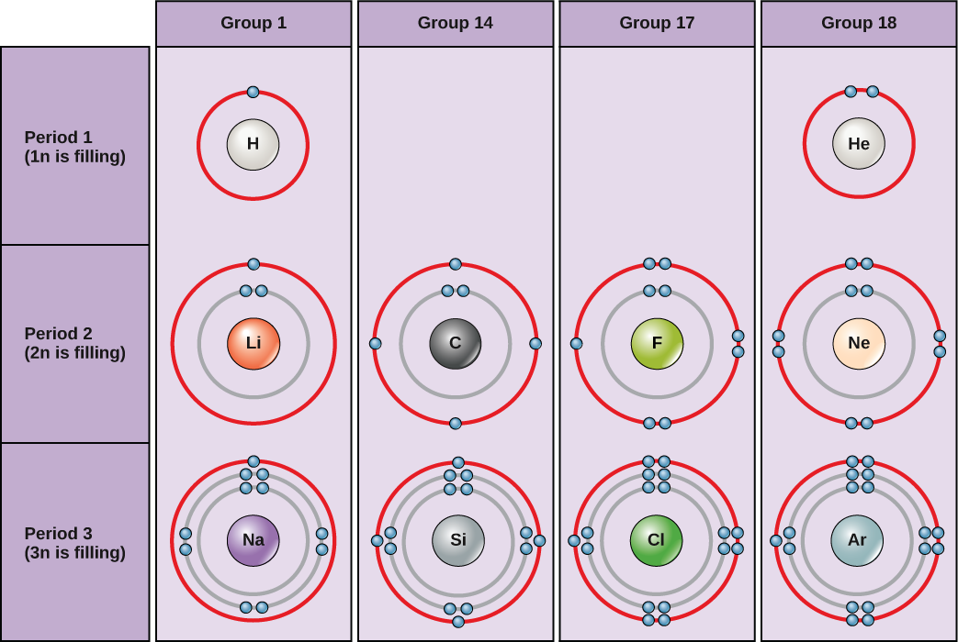
Figure 2.7 – electrons filling their shells
Outer shell: Valence shell
The most stable configuration occurs when the valence shell is filled
The elements in group 18 of this diagram have full valence shells

Slide 16
Figure 2.7 – electrons filling their shells
When the first two outer shells are filled each will have eight electrons (octet rule)
Group 1 elements (H, Li, NA) could achieve stability by losing an outer electron
Group 17 elements could achieve stability by gaining one additional electron

Slide 17
What about electron orbitals?
Bohr models are incomplete
Electrons are not in planet-like orbits
Electron orbitals – complex shapes that describe how electrons are spatially distributed around the nucleus
Quantum mechanics allows us to predict where an electron might be at any given time
This predicted area is known as the orbital

Slide 18
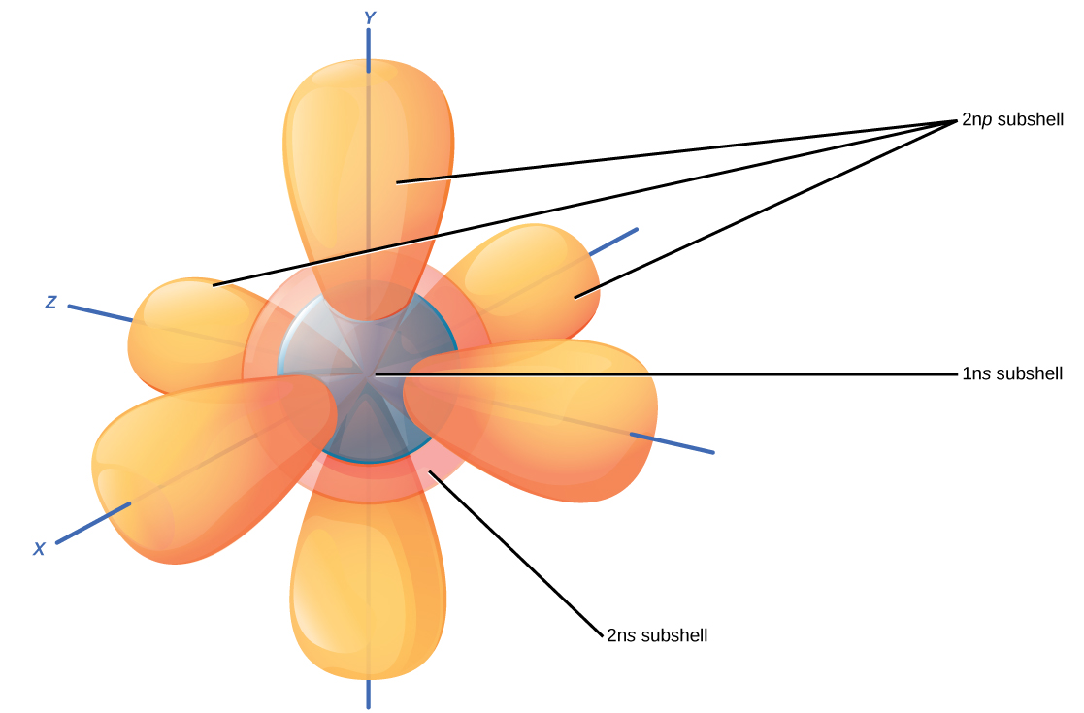
Figure 2.8 Subshells have unique shapes
Within each Bohr model shell are subshells
Each subshell (s,p,d,f) has a specified number of orbitals containing electrons
The s subshell is spherical and has one orbital
The p subshell is dumbbell shaped and has three orbitals
Notes:
The s subshells are shaped like spheres. Both the 1n and 2n principal shells have an s orbital, but the size of the sphere is larger in the 2n orbital. Each sphere is a single orbital. p subshells are made up of three dumbbell-shaped orbitals. Principal shell 2n has a p subshell, but shell 1 does not.

Slide 19
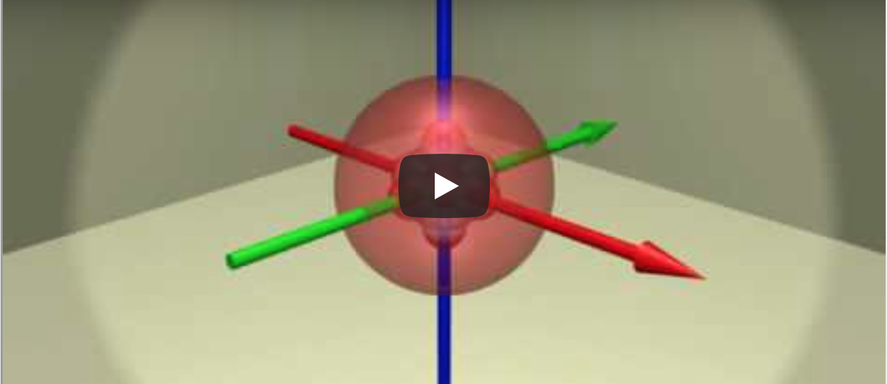
Orbitals: Electron Configuration of Scandium
https://youtu.be/sMt5Dcex0kg

Slide 20
Electrons determine how atoms interact
Chemical reactions are changes in distribution of electrons between atoms

Slide 21
Chemical Reactions
Reactants – substances used at beginning of reaction
Products – substances formed at the end of the reaction
2H₂O₂ 2H₂O + O₂
Reactants Products

Slide 22
Chemical Reaction can be reversible or Irreversible
2H₂O₂ 2H₂O + O₂
Irreversible reaction: proceeds in one direction until all the reactants are used up
HCO₃⁻ + H⁺ H₂CO₃
Reversible reaction: Reactants are converted to products but some product can be converted back to reactant

Slide 23
How Do Atoms Bond to Form Molecules?
Chemical bond: the attractive force that links atoms together to form molecules

Slide 24
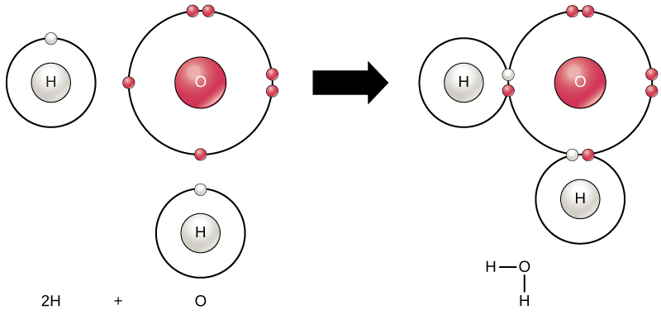
2.9 Covalent Bonds – Electrons are shared
Two or more atoms may bond with each other to form a molecule.
When two hydrogens and an oxygen share electrons via covalent bonds, a water molecule is formed.

Slide 25
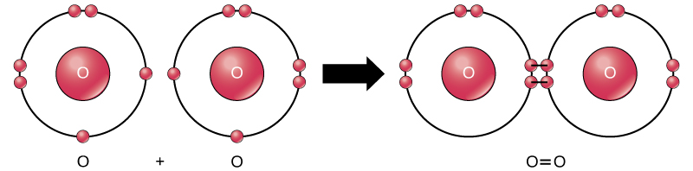
More than one set of electrons can be shared
The oxygen atoms in an O₂ molecule are joined by a double bond.

Slide 26
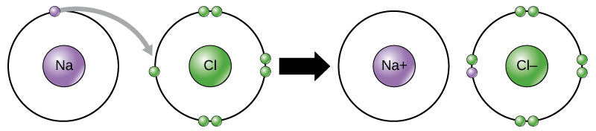
Ionic Bonds – Atoms give up or gain electrons
In the formation of an ionic compound, metals lose electrons and nonmetals gain electrons to achieve an octet.

Slide 27
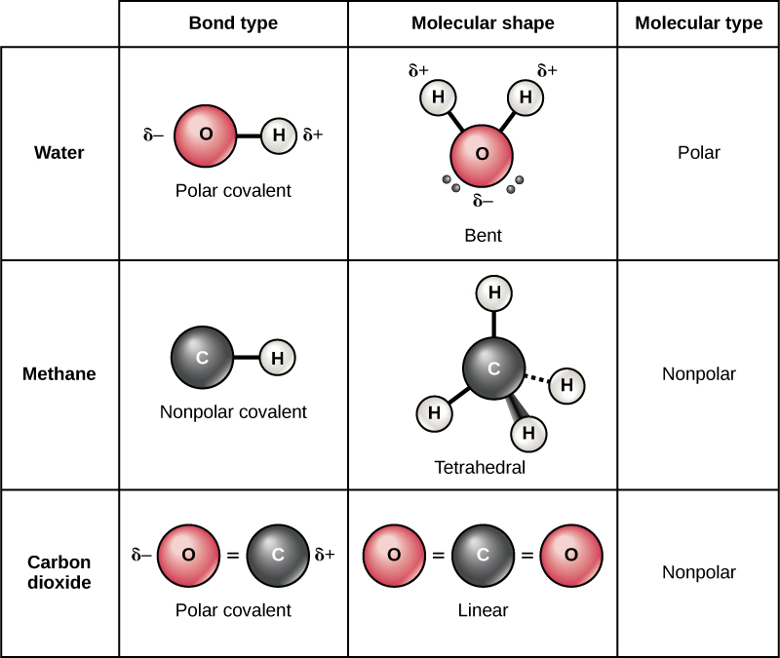
Polar Bonds–Covalent bonds in which there is unequal sharing of the electrons
Polar Covalent Bonds
Electrons are unequally shared by the atoms and attracted more to one nucleus than the other
Water is a great example
Oxygen has higher electronegativity than hydrogen
This means it wants the electrons more than than hydrogen does

Slide 28
Non-Polar Bonds–Covalent bonds in which there is equal sharing of the electrons
Non-Polar Covalent Bonds
Electrons are equally shared by the atoms
Methane (CH₄) is a great example
Carbon shares electrons with four hydrogens equally
Both bond type and molecular shape determine whether a molecule is polar or nonpolar
Why is carbon dioxide a nonpolar molecule even though the oxygen-carbon bond is a polar covalent bond?

Slide 29
An example of mixing a polar compound with a nonpolar compound
The polarity of water. The polarity of water is due to the differing electronegativities of hydrogen and oxygen. As a consequence, hydrogen bonds are formed when the slightly negative oxygen on one water molecule is attracted to the slightly positive hydrogen of another water molecule. Credit: Rao, A., Fletcher, S., Ryan, K., Tag, A. and Hawkins, A. Department of Biology, Texas A&M University

Slide 30
Hydrogen bonds and vander waals interactions
Ionic and Covalent bonds – require energy to break
Weaker bonds
Hydrogen bonds – interaction between the δ⁺ of hydrogen and the δ⁻ of a more electronegative atom on another molecule – often occurs between water molecules
Van der Waals interactions – weak attractions or interactions between two or more molecules (in close proximity) due to changes in electron density

Slide 31

Water – essential to life
Water makes up 60-70% of human body
Most critical molecule for life on earth
Why?
  It is a polar molecule
  It can form hydrogen bonds
From: http://www.freefoto.com/preview/15-24-1/Stream-of-running-water

Slide 32
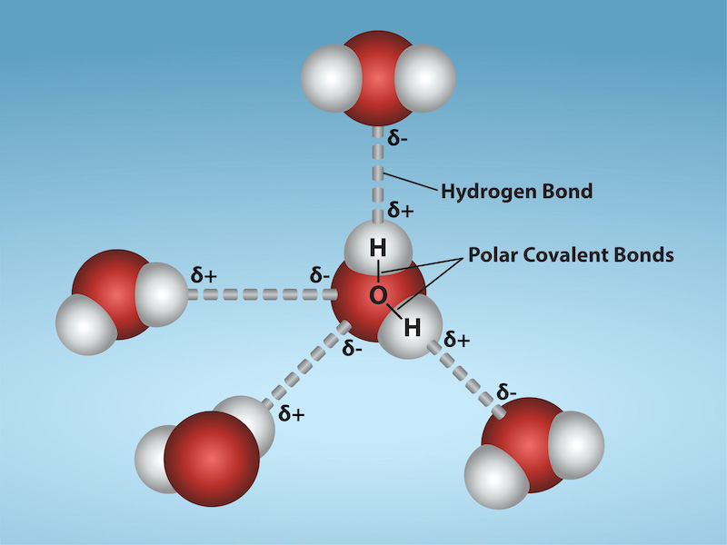
Hydrogen Bonds – the key to water
H has a δ⁺ and O has δ⁻
The chemical bonds between hydrogen and oxygen in water are polar colvalent bonds
Oxygen pulls the shared electron closer—slightly negative charge
Hydrogen has slightly positive charge
Hydrogen of one water molecule forms a weak hydrogen bond with the oxygen of an adjacent water molecule
from: http://cnx.org/content/col11496/1.6

Slide 33
Hydrogen bonds are key to three states of water
Three states of water
Liquid water – hydrogen bonds are constantly made, broken and remade
Gas - water is heated the increased kinetic energy of water causes hydrogen bonds to break and water molecules escape into air as gas
Solid water – temperature is lowered and a crystalline structure is maintained

Slide 34
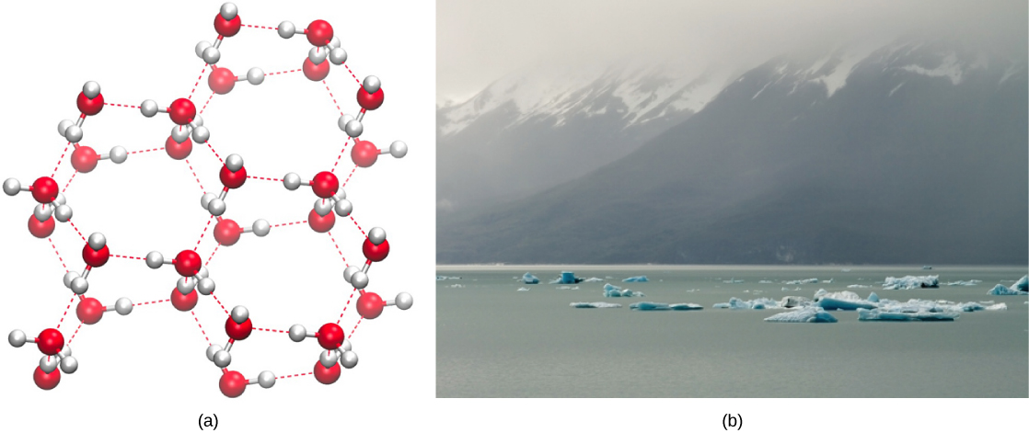
The power of Hydrogen Bonds
Hydrogen bonding makes ice less dense than liquid water. The (a) lattice structure of ice makes it less dense than the freely flowing molecules of liquid water, enabling it to (b) float on water. (credit a: modification of work by Jane Whitney, image created using Visual Molecular Dynamics (VMD) software ^{[1]}; credit b: modification of work by Carlos Ponte)
See video of Ice Lattice: http://www.janewhitney.com/ice_movie_resources.html

Slide 35
Additional important properties of water
Heat capacity – Specific heat capacity refers to the amount of heat one gram of a substance must absorb in order to raise its temperature one degree Celsius
So what does this mean?
It takes a long time for water to heat up and a long time for it to cool down!

Slide 36
Additional important properties of water
Heat of Vaporization – The amount of energy required to change one gram of a liquid substance to gas
Water has a high heat of vaporization

Slide 37
Waters solvent properties
Ions and polar molecules can dissolve in water
Water is the solvent
The compounds dissolved or mixed in with the water are the solute

Slide 38
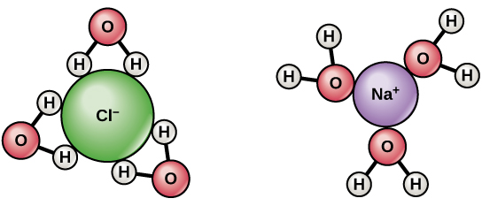
Water can form hydrogen bonds with other polar molecules and ions
Dissociation of NaCl in water
Atoms break off from molecules and form ions
When table salt (NaCl) is mixed in water, spheres of hydration are formed around the ions.

Slide 39
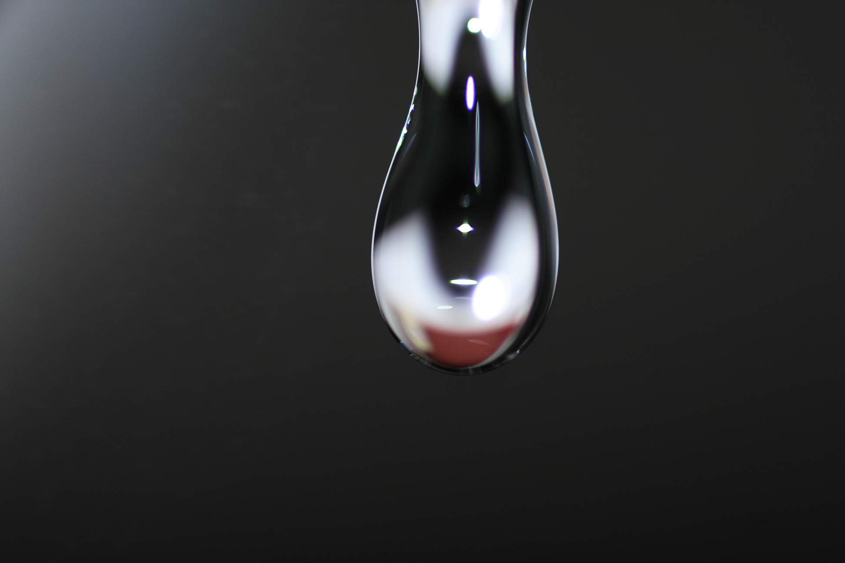
Cohesion in water
Cohesion
Water molecules at the liquid-gas interface stick together due to hydrogen bonding
https://bealbio.wikispaces.com/Period+2+Chem+ch+3

Slide 40
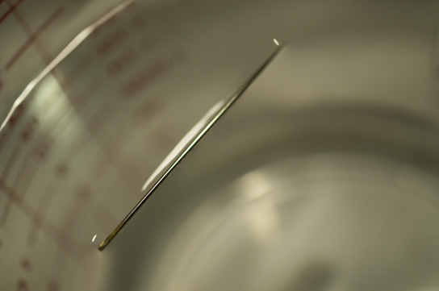
Cohesion allows for development of surface tension
Surface Tension: capacity of a substance to withstand being ruptured when placed under tension or stress
The weight of the needle is pulling the surface downward; at the same time, the surface tension is pulling it up, suspending it on the surface of the water and keeping it from sinking. Notice the indentation in the water around the needle. (credit: Cory Zanker)

Slide 41
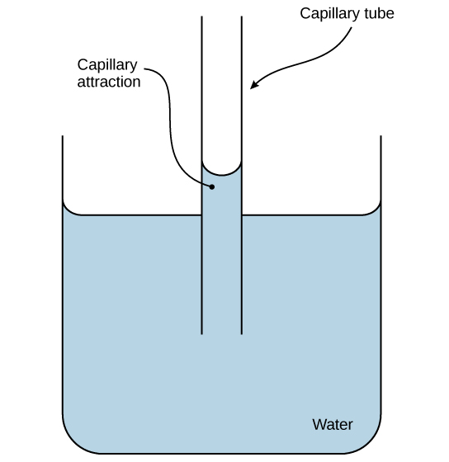
Water exhibits unique properties
Capillary action in a glass tube is caused by the adhesive forces exerted by the internal surface of the glass exceeding the cohesive forces between the water molecules themselves. (credit: modification of work by Pearson-Scott Foresman, donated to the Wikimedia Foundation)
Adhesion – An attraction between water molecules and other molecules
Water moves up tube because the molecules of water are attracted to the charged surface of the glass tube

Slide 42
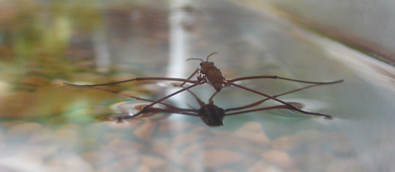
The Cohesive property of water can be observed in the natural world
Water’s cohesive and adhesive properties allow this water strider (Gerris sp.) to stay afloat. (credit: Tim Vickers)

Slide 43
pH, Buffers, Acids and bases
The pH of a solution indicates acidity or alkalinity
Small percentage of water molecules dissociate (ionize) into equal number of hydrogen ions (H⁺) and hydroxide ions (OH⁻)
H2O(I) H⁺ (aq) + OH⁻ (aq)
Concentration of H⁺ ions in pure water = 1 X 10⁻⁷ moles/liter
Concentration of OH⁻ ions in pure water = 1 X 10⁻⁷ moles/liter
Solutions with high H⁺ concentration are acidic
Solutions with high OH⁻ concentration are alkaline (basic)

Slide 44

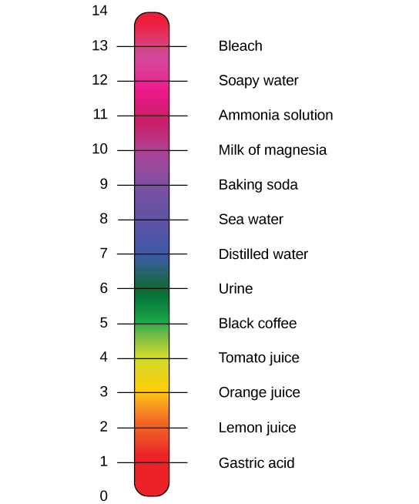
The pH of a solution indicates its acidity or alkalinity
H2O(I)↔H+(aq)+OH−(aq)
pH is related to concentration of H⁺ ions in the solution
pH is the negative of the base 10 logarithm of the [H+]
The log10 of 1 X 10-7 is -7, and the negative of that number is 7
Neutral solution has a pH of 7
Acidic solutions have pH<7
Basic solutions have pH > 7

Slide 45

Figure 2.20
Buffers play a key role in maintaining the internal solutions of an organism at near neutral pH
This diagram shows the body’s buffering of blood pH levels. The blue arrows show the process of raising pH as more CO₂ is made. The purple arrows indicate the reverse process: the lowering of pH as more bicarbonate is created.

Slide 46
Carbon
By the end of this section, you will be able to:
Explain why carbon is important for life
Describe the role of functional groups in biological molecules

Slide 47
Carbon is an essential atom of life
Carbon – key component of macromolecules (proteins, carbohydrate, lipids and nucleic acids)
Carbon is unique
  It can form covalent bonds with up to four different atoms
  This allows it to serve as the “backbone” for the macromolecules
  Each carbon has four electrons in the outer shell
  It forms four covalent bonds to “fill” the outer shell
  This allows it to achieve the “octet rule”

Slide 48
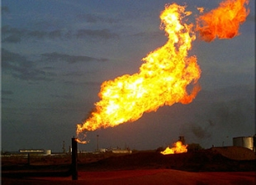
Hydrocarbons
Hydrocarbons = carbon + hydrogen (e.g. methane)
Covent bonds between atoms in hydrocarbons store energy
This energy is released when these molecules are burned
The energy released from these
hydrocarbons heats our homes
and powers our cars

Slide 49
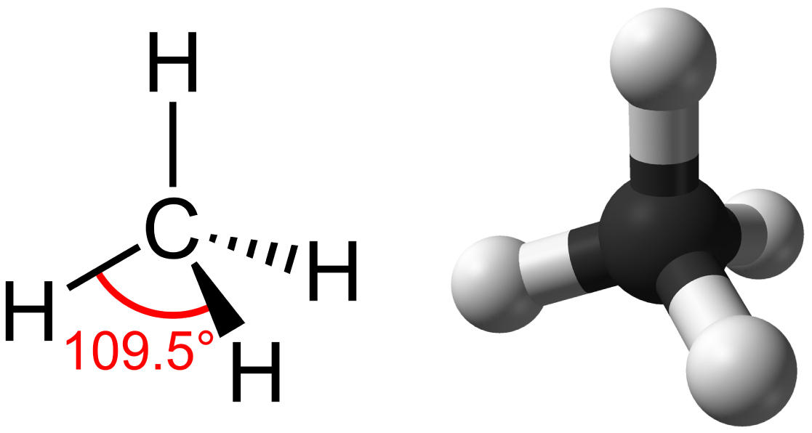
Methane – binds to four hydrogens to satisfy the octet rule
Methane has a tetrahedral geometry, with each of the four hydrogen atoms spaced 109.5° apart.

Slide 50
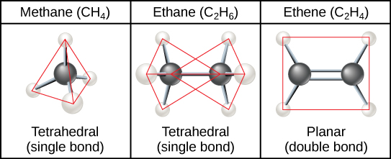
hydrocarbon chains
AKA Aliphatic hydrocarbons
carbon forms single bonds with other atoms - shape is tetrahedral.
two carbon atoms form a double bond - shape is planar, or flat.
Single bonds, like those found in ethane, are able to rotate.
Double bonds, like those found in ethene cannot rotate, so the atoms on either side are locked in place.

Slide 51
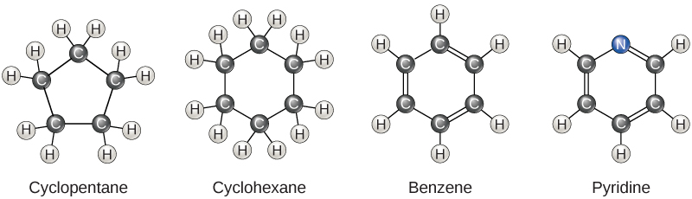
Hydrocarbon Rings
AKA aromatic hydrocarbons
Figure 2.23
Carbon can form five-and six membered rings (closed chain)
Single or double bonds may connect the carbons in the ring
Nitrogen may be substituted for carbon
Benzene is a particularly important hydrocarbon ring – used in some amino acids, cholesterol and its derivatives.

Slide 52
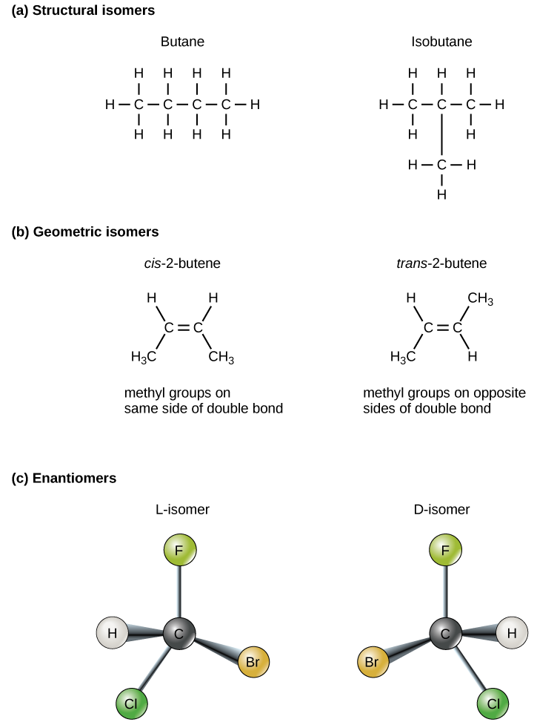
Isomers
Isomers - molecules that have the same chemical formula but differ in placement/arrangement of atoms or types of bonds between atoms
Structural isomers - have a different covalent arrangement of atoms.
Geometric isomers - have a different arrangement of atoms around a double bond
Enantiomers - molecules that share chemical formula and bonds but differ in 3D placement of atoms; mirror images

Slide 53
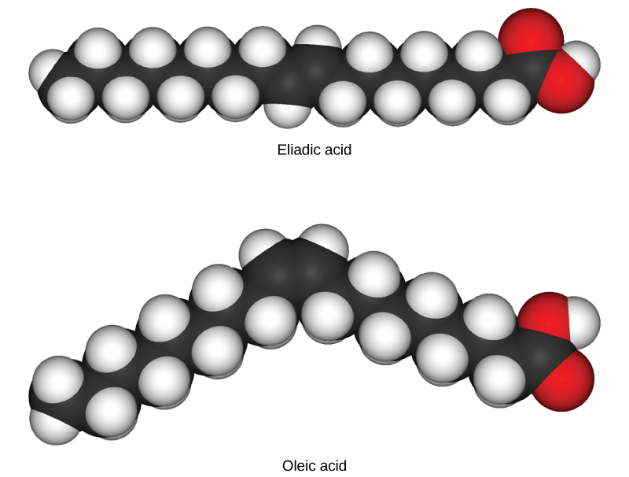
Trans vs. Cis molecules
Trans configuration
Carbons are on opposite sides of double bond
Some long chain hydrocarbons can have one or more double bonds
Fatty acids with double bond are
unsaturated
Fatty acids with no
double bonds are saturated
Cis configuration
Carbons on same side of double bond
These space-filling models show a cis (oleic acid) and a trans (eliadic acid) fatty acid. Notice the bend in the molecule cause by the cis configuration.

Slide 54
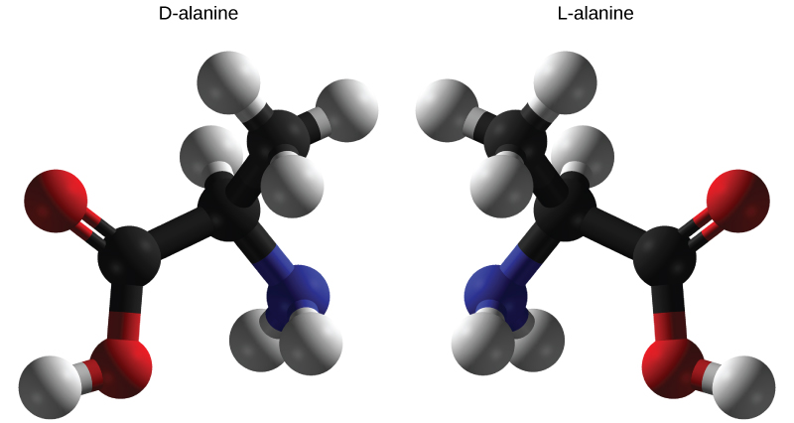
A closer look at enantiomers
D-alanine and L-alanine are examples of enantiomers or mirror images
You cannot superimpose these two structures on each other
Only the L-forms of amino acids are used to make proteins

Slide 55
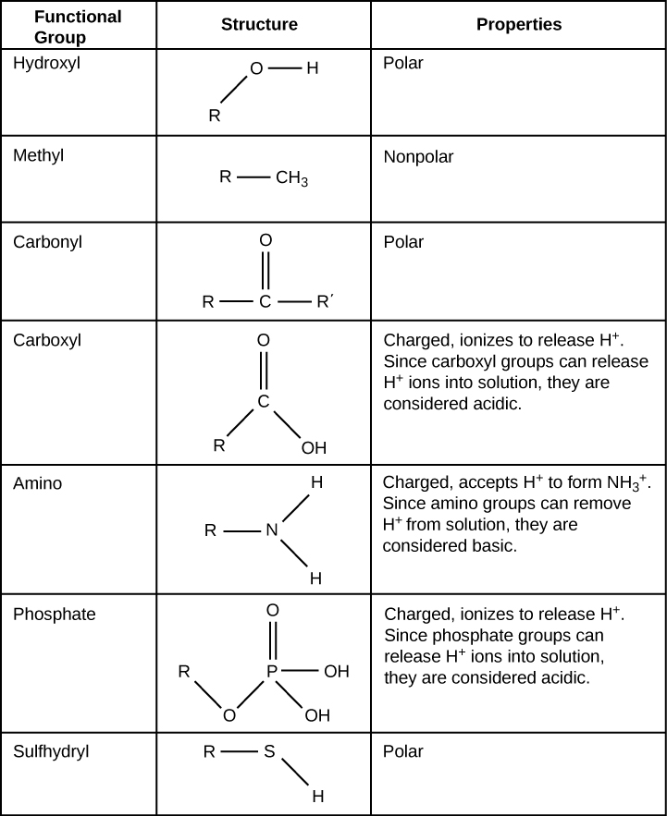
Functional Groups
Functional Groups – groups of atoms within a molecule that confer consistent specific properties to these molecules
Each of the four types of macromolecules has its own set of characteristic functional groups
Functional groups often interact with other functional groups via hydrogen bonds
Study this table to become familiar with some of the more important functional groups

Slide 56
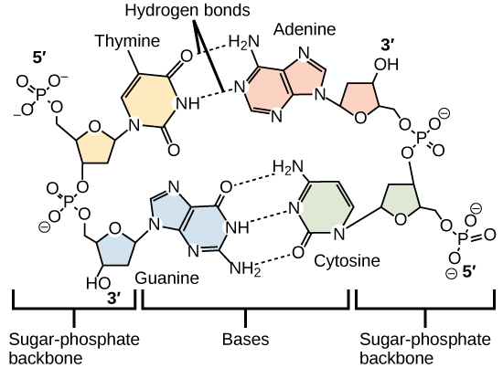
Hydrogen bonds between functional groups helps stabilize biological molecules and allows them to perform their biological function
Hydrogen bonds - connect two strands of DNA together to create the double-helix structure
DNA structure is vital for DNA function!

