Slide 1
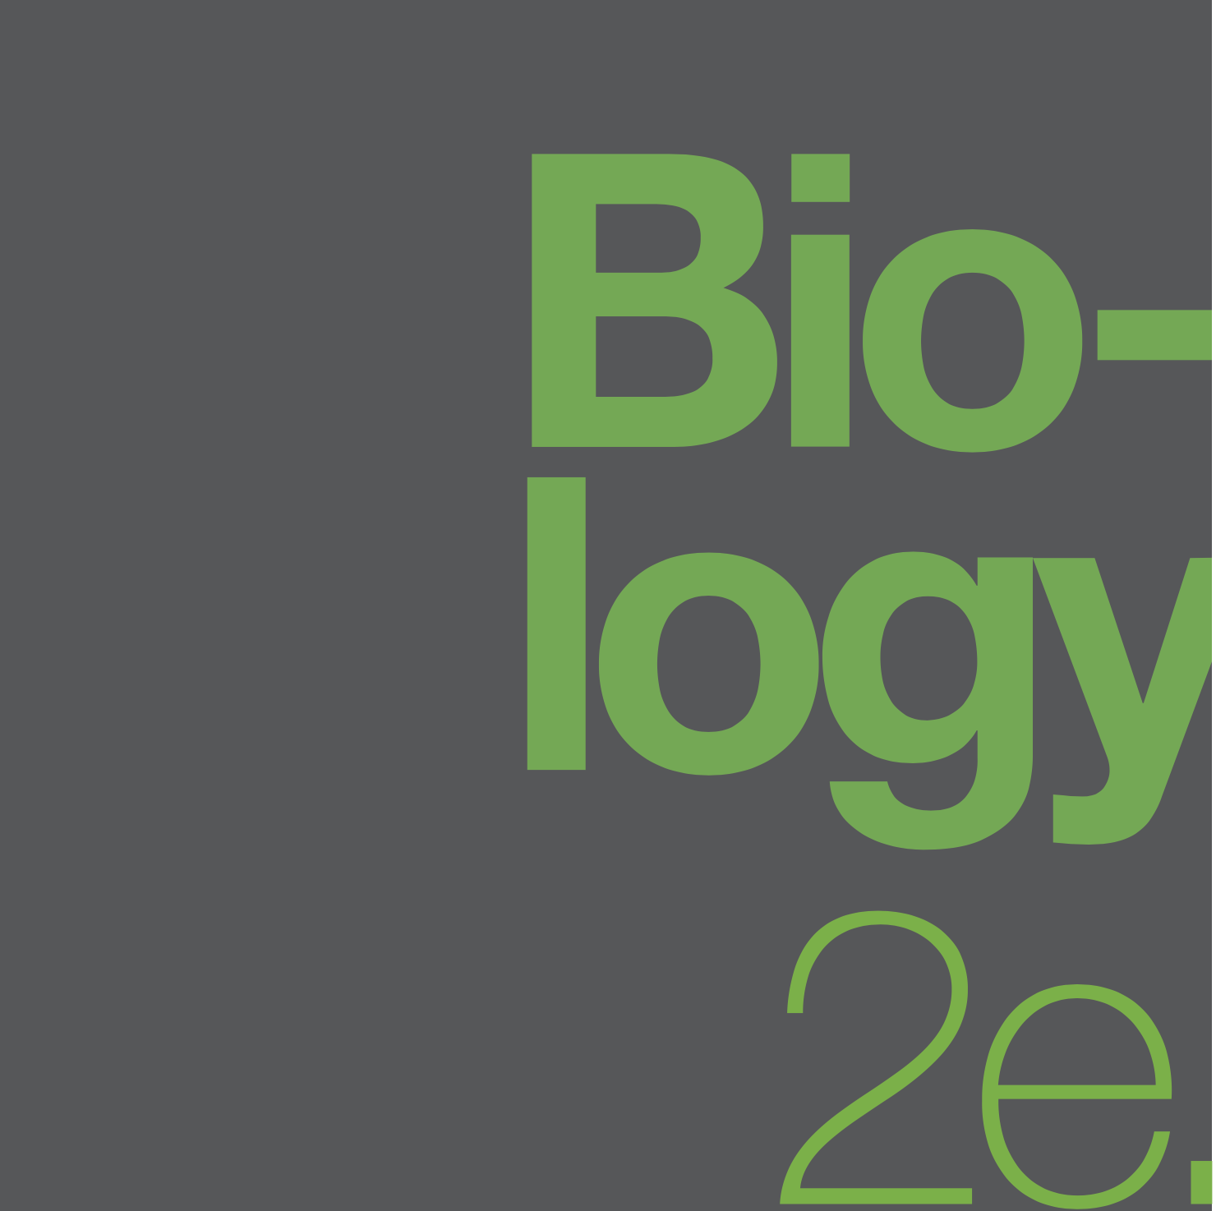

BIOLOGY 2e
Chapter 8 PHOTOSYNTHESIS
PowerPoint Image Slideshow
This work is licensed under a Creative Commons Attribution-NonCommercial-ShareAlike 4.0 International License.

Slide 2
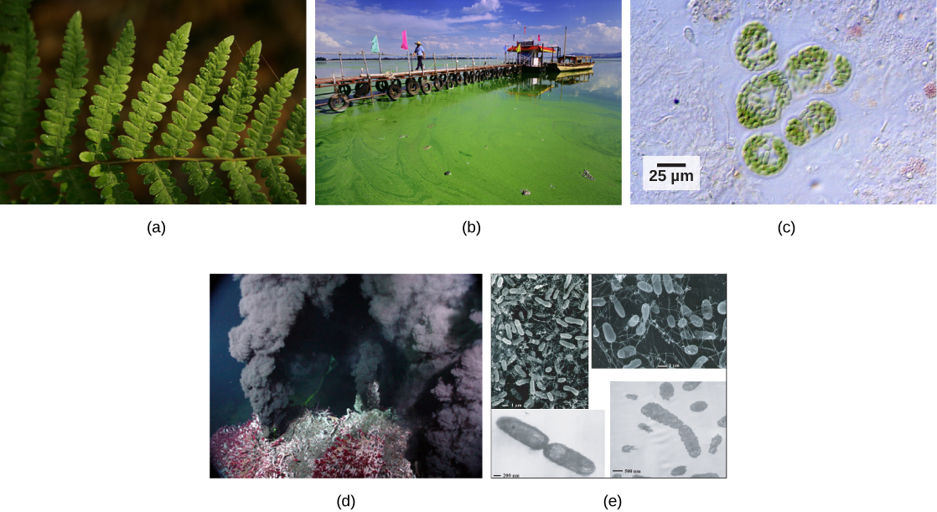
AUTOTROPHS and HETEROTROPHS
There are two types of autotrophs:
Photoautotrophs use sunlight to make food. They include plants (a), algae (b), and cyanobacteria (c). Chemiautotrophs, such as thermophilic bacteria (e), capture energy from inorganic compounds to make food.

Slide 3
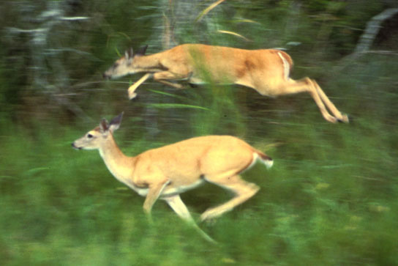
AUTOTROPHS and HETEROTROPHS
Heterotrophs, including animals, fungi, and most bacteria, rely on the sugars produced by autotrophs for their energy needs.
The predator that eats the deer receives a portion of the energy that originated in the photosynthetic vegetation that the deer consumed.

Slide 4
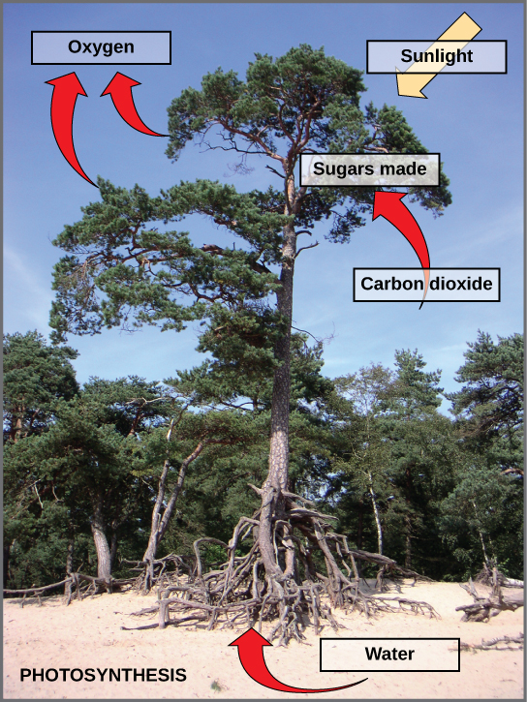
8.1 Overview of photosynthesis
Photosynthesis uses solar energy to produce sugar from carbon dioxide and water. Oxygen is a waste product.

Slide 5
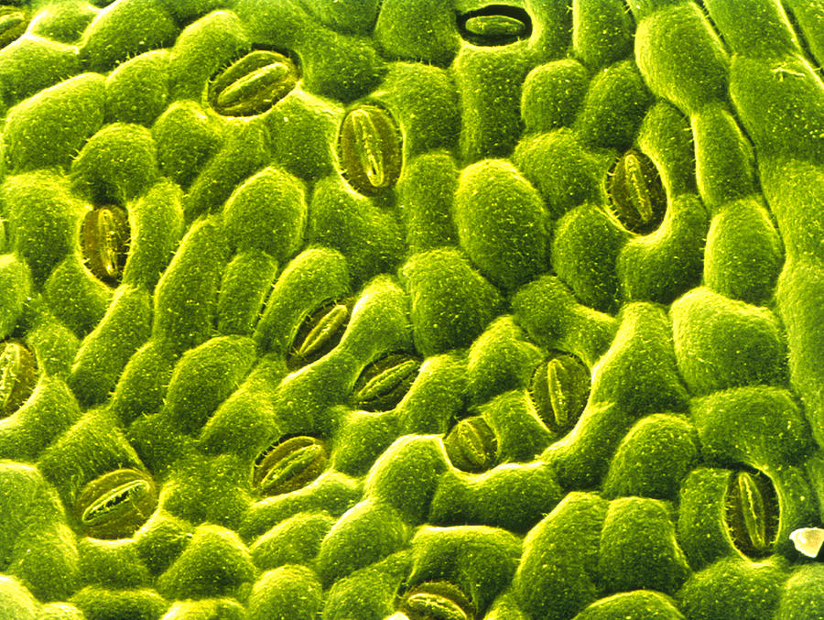
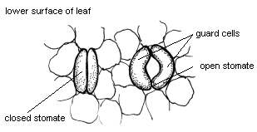
PHOTOSYNTHETIC REACTANTS
Before exploring the chemical nature of photosynthesis, let’s establish the sources of its components:
H2O is absorbed by the roots from the soil.
CO2 is acquired from the air as a result of gas exchange through the stomata (small pores on the leaf underside).
Likewise, the O2 waste product exits through the stomata.
Sunlight.
Stoma (singular)
Guard cells

Slide 6
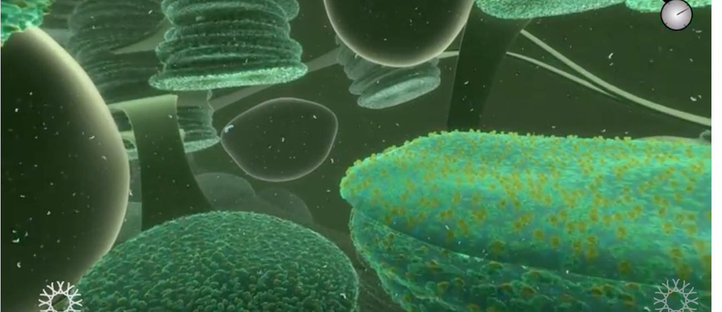
LEAF STRUCTURE
https://www.youtube.com/watch?v=Bf-RFPaZeAM
Animation from California Academy of Sciences

Slide 7
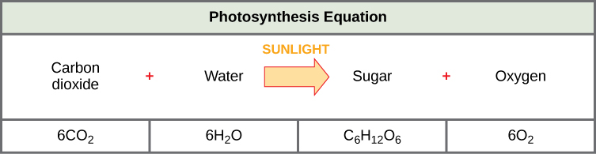
PHOTOSYNTHESIS EQUATION
Just like cellular respiration, photosynthesis involves complex metabolic pathways.
The two metabolic pathways of photosynthesis are:
  The Light reaction
  The Calvin cycle

Slide 8
REACTION OUTCOMES AND LOCATIONS
The light reaction converts light energy to chemical energy, making ATP and NADPH (an e⁻ carrier).
  It occurs in the thylakoid membranes of chloroplasts.
The Calvin cycle uses the ATP and NADPH to make sugar (food)
  It occurs in the stroma of chloroplasts.

Slide 9
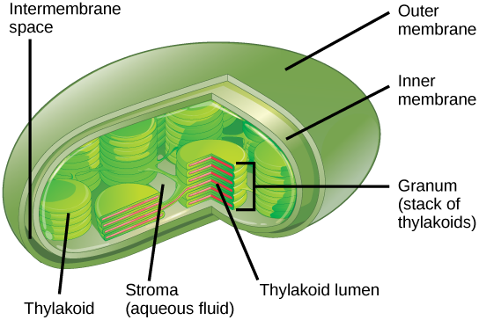
CHLOROPLAST STRUCTURE
Double membrane (outer & inner)
Stroma (not to be confused with stoma)
Grana (stacks of thylakoids)
Lumen is inside the thylakoid
  Notes:
  Only plant cells that conduct photosynthesis have chloroplasts.
  High densities of chloroplasts occur in mesophyll (middle leaf) cells of leaves.

Slide 10
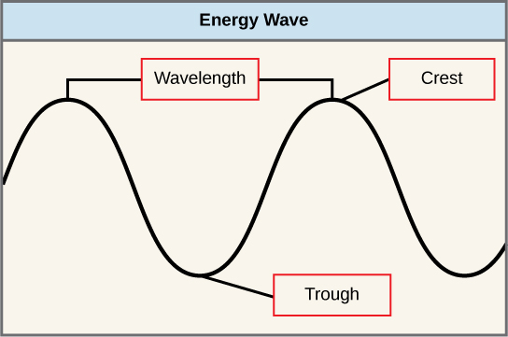
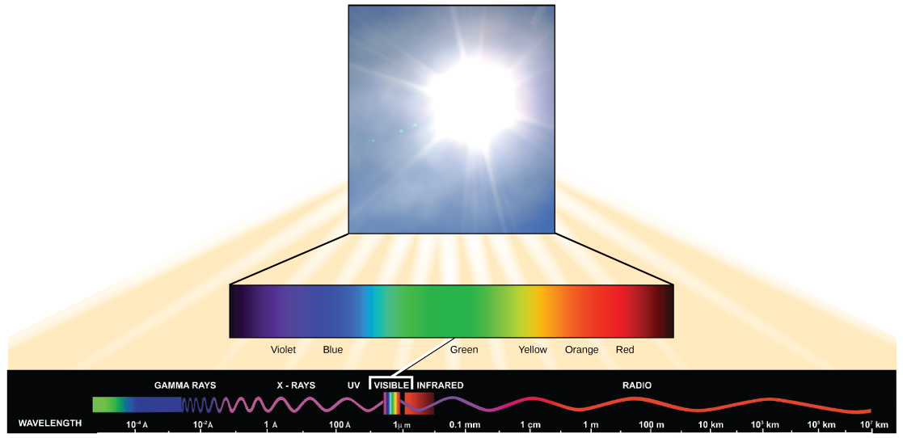
What is light energy?
Light energy is electromagnetic energy, composed of photon particles that travel as waves.
Longer wavelengths (crests farther apart) carry less energy than shorter wavelengths
We can see only a fraction of this energy (visible range)
  Plants use wavelengths in this range too

Slide 11
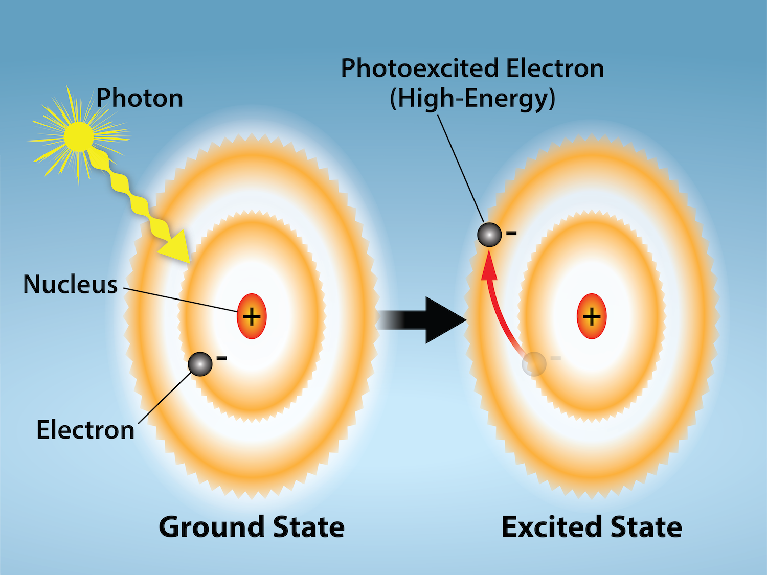
Absorption of Light

Slide 12
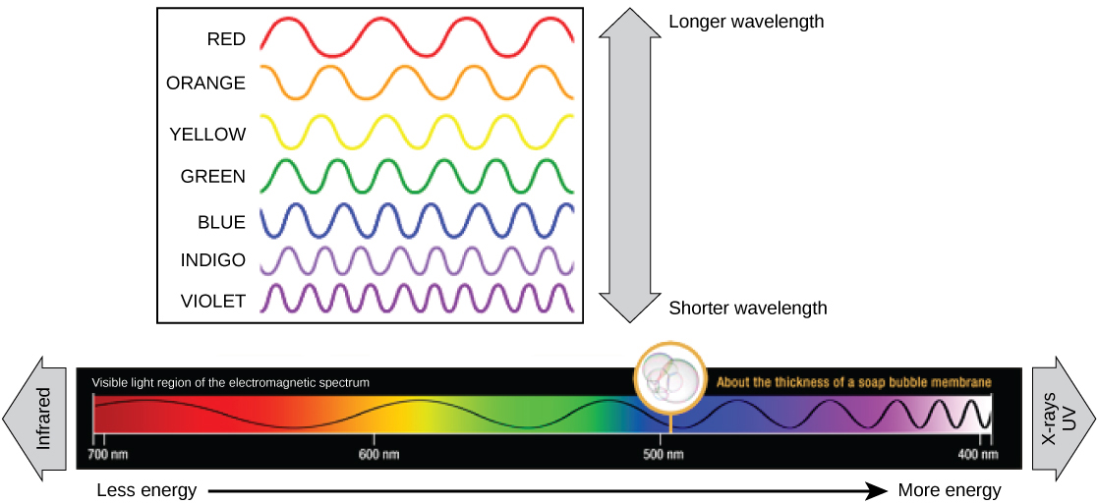
What is light energy?
Wavelengths are measured in nm.
In the visible range (700-400nm), the violets have the shortest wavelengths (and most energy) and the reds have the longest.

Slide 13
absorption of light
Pigments absorb specific wavelengths of light;
  each has a unique absorbance spectrum.
The main pigments of thylakoid membranes are:
  chlorophyll a (a)
  chlorophyll b (b)
  β-carotene (c), a type of carotinoid.
Chlorophyll a and b capture light for photosynthesis; reason leaves are green (green wavelengths are reflected).
β-carotene helps to protect photosystems by dissipating excess energy; also found in cells of carrots & oranges
Other carotenoids include lycopene (red color of tomato) and zeaxanthin (yellow of corn seeds)

Slide 14
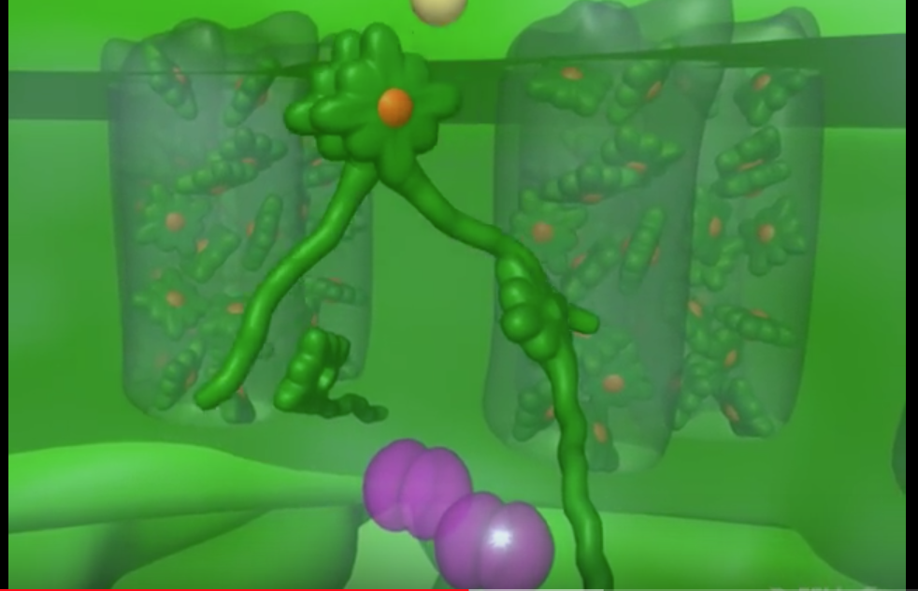
The light reaction
https://www.youtube.com/watch?v=hj_WKgnL6MI&t=72s

Slide 15
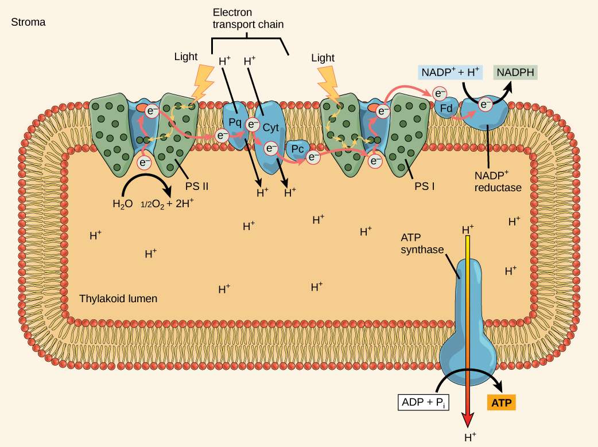
components of thylakoid membranes
Components of the thylakoid membranes include:
Photosystems II and I; sites of light absorption
Molecules that make up an Electron Transport Chain (ETC)
Two enzyme complexes, NADP reductase and ATP synthase

Slide 16
components of thylakoid membranes

Slide 17
8.2 The photosystems
Photosystem II and I consists of a light-harvesting complex and a reaction center.
Pigments in the light-harvesting complex pass light energy to two special chlorophyll a molecules in the reaction center.
In the reaction center, the light excites an e⁻ from the chlorophyll a pair, passing it to the first electron acceptor of the ETC.
  This is a light driven redox reaction
The lost electron is then replaced.
  In photosystem II (a), the e⁻ comes from the splitting of water, which releases oxygen as a waste product
  In photosystem I (b), the e⁻ comes from the ETC

Slide 18
The Electron transport chains
(Figure 8.16)
There are two parts of the ETC in the light reaction:
The first, transports e- from PSII to PSI via
  Plastoquinone Qb
  Cytochrome b₆f
  Plastocyanin
The second transports e- from PSI to NADP reductase via
  Ferredoxin
The final e- acceptor of the light reaction is NADP+ → yielding NADPH

Slide 19
The Electron transport chains
(
Just like the ETC of cellular respiration:
a H+ gradient is created as e- fall down the chain
  pumped into the lumen space
ATP synthase uses the gradient to generate ATP (chemiosmosis)

Slide 20
MOVING to the CALVIN CYCLE
The ATP and NADPH from the Light-Dependent Reaction are made in the stroma for use in the Calvin Cycle.

Slide 21
The LIGHT-INDEPENDENT REACTIONS
Three stages to the Calvin Cycle:
  Fixation: CO2 added to RuBP by enzyme Rubisco to generate 2 3-PGA molecules
  Reduction: ATP and NADPH used to add e⁻ and make sugar (GA3P)
    Note 2 GA3P → glucose
  Regeneration: of RuBP from GA3P
Three cycles are required to make one GA3P.

Slide 22
The CALVIN CYCLE

Slide 23
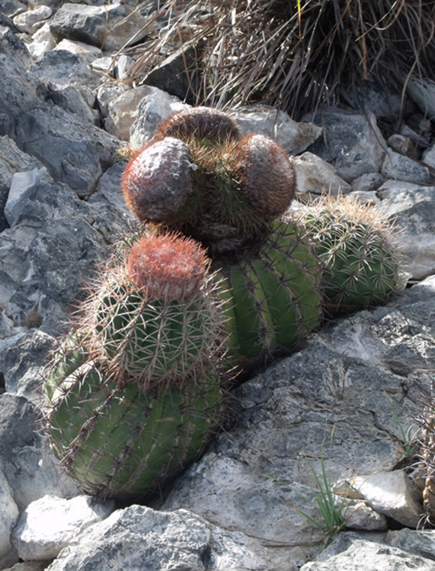
THE CALVIN CYCLE
RuBisCO: ribulose bisphosphate carboxylase oxygenase.
RuBisCO can function as a carboxylase (Calvin cycle) or an oxygenase (photorespiration – which does not result in sugar production).
  Some plants, like this cactus, have evolved mechanisms to reduce the chances of photorespiration.

Slide 24
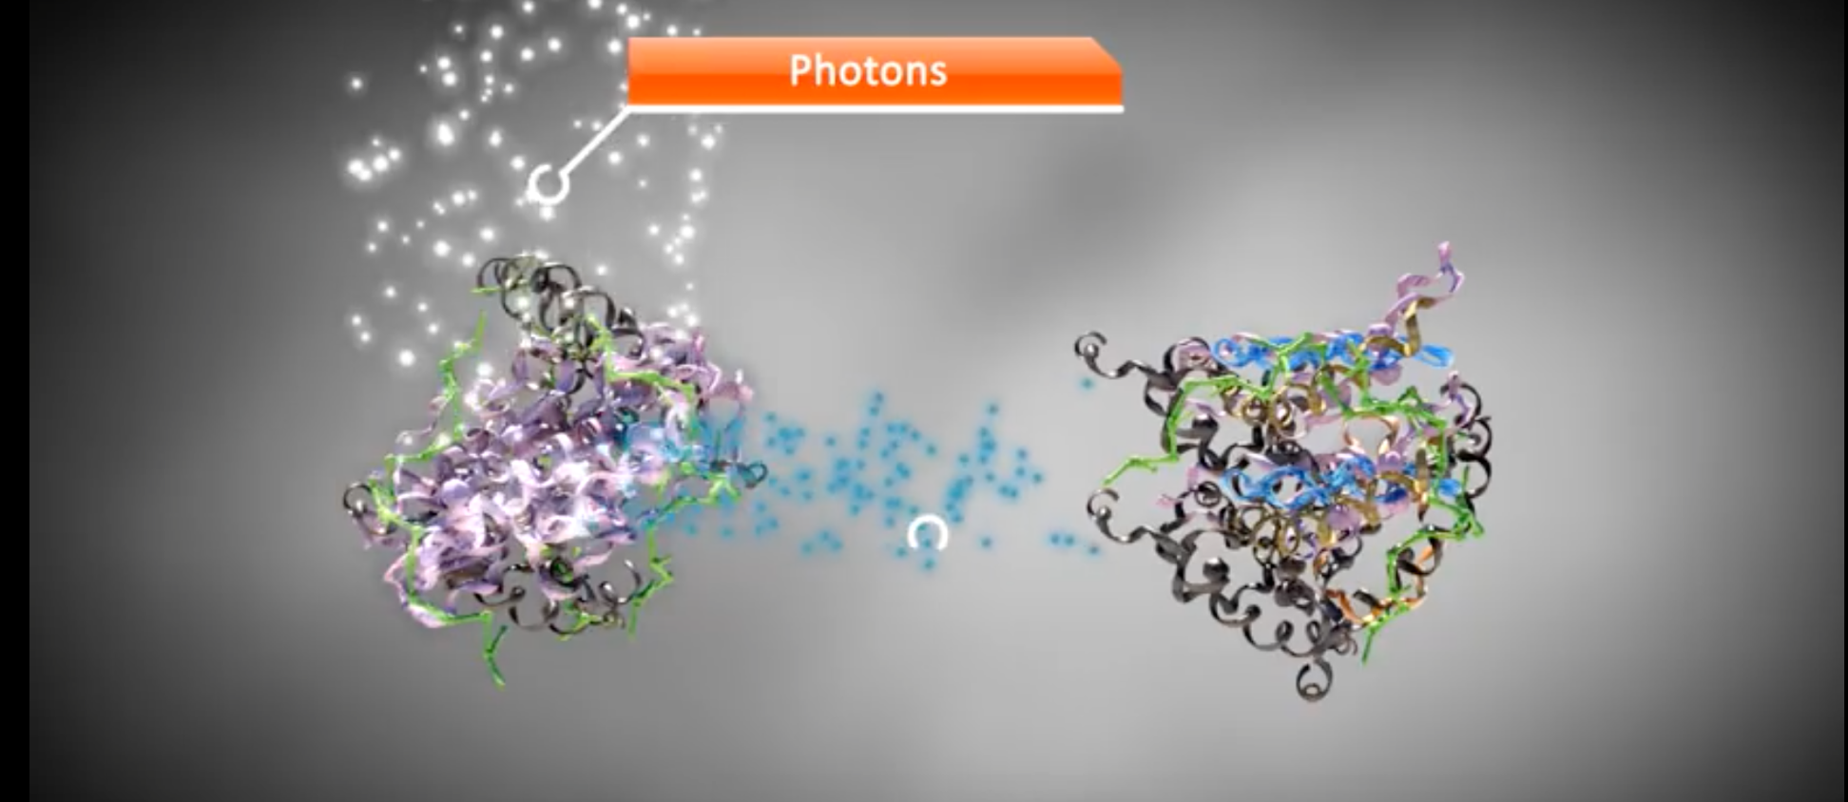
ANIMATION OF WHOLE PROCESS
https://www.youtube.com/watch?v=gz5L1GUaaXA

Slide 25
This PowerPoint file is copyright Rice University.
Modified and improved by E.G Cantonwine, Valdosta State University.
Revised for OpenStax Biology 2e by OpenStax.

