Slide 1
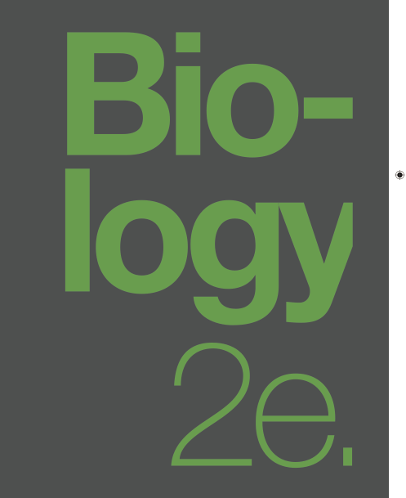

BIOLOGY 2e
Chapter 15 GENES AND PROTEINS
PowerPoint Image Slideshow
This work is licensed under a Creative Commons Attribution-NonCommercial-ShareAlike 4.0 International License.

Slide 2
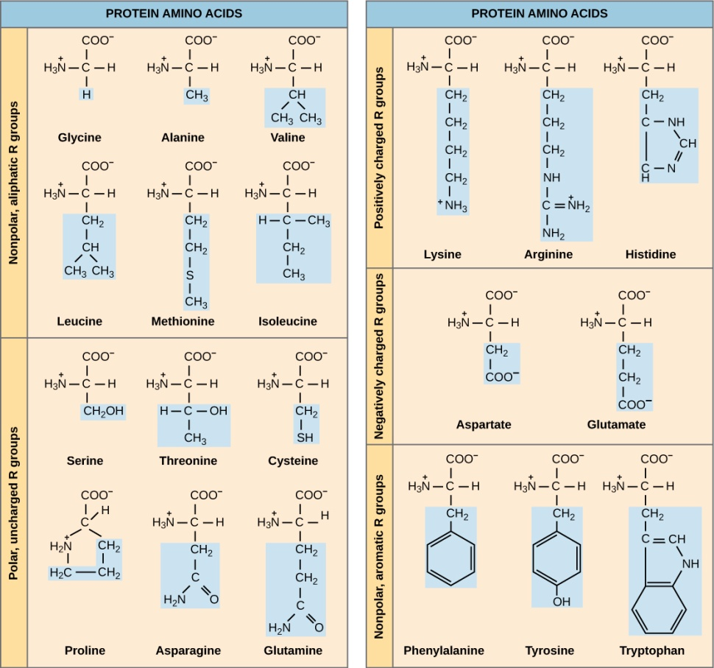
Protein Structure

Slide 3
Flow of genetic information
The Central Dogma:
DNA is first transcribed into mRNA
mRNA strands are then translated into proteins

Slide 4
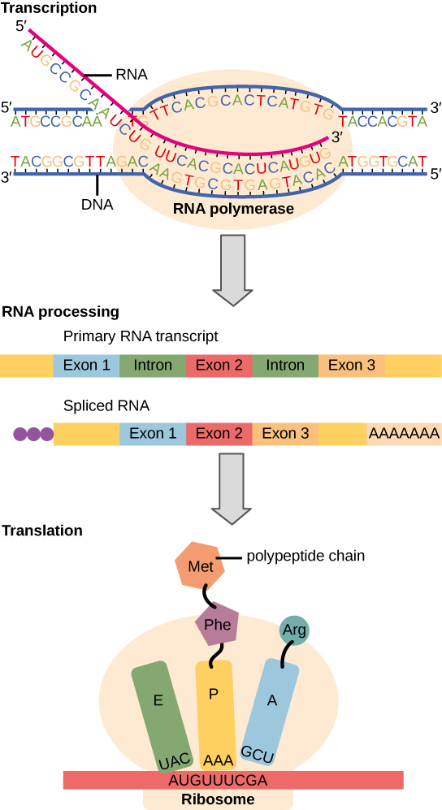
Flow of genetic information
Instructions on DNA are transcribed onto messenger RNA.
Ribosomes are able to read the genetic information inscribed on a strand of messenger RNA.
They use this information to string amino acids together into a protein.

Slide 5
Degeneracy of the genetic code
Nucleotides in an mRNA sequence code for amino acids in 3 nucleotide portions known as codons.
The reading frame refers to which nucleotide starts the first codon; for each segment of DNA, there a 6 possible reading frames.
There are 64 possible codons that code for the 20 amino acids and 3 stop codons meaning that multiple codons can specify one amino acid.

Slide 6
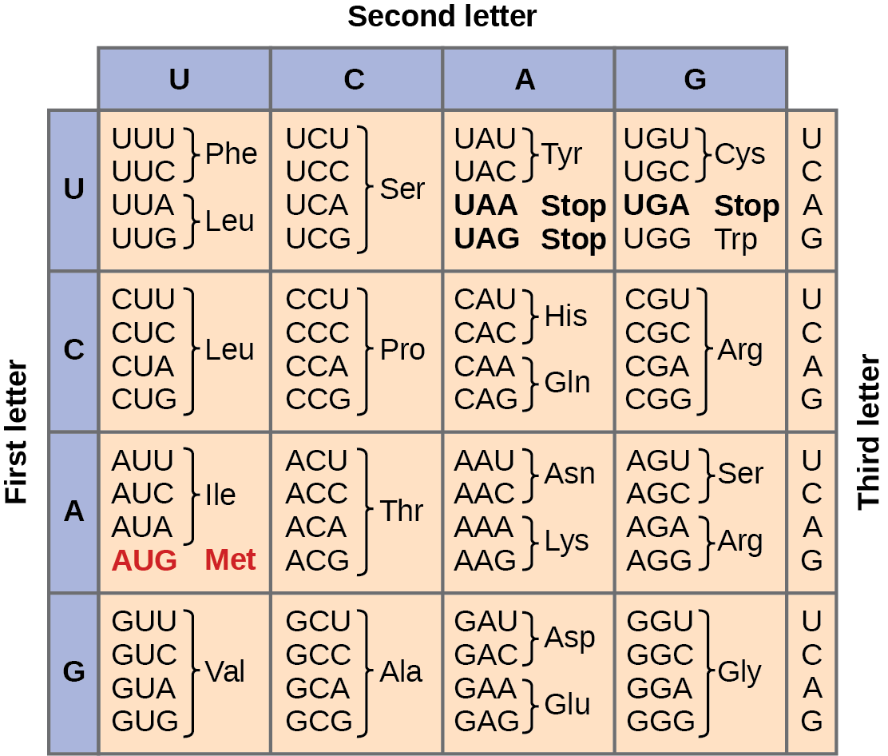
The genetic code
This figure shows the genetic code for translating each nucleotide triplet in mRNA into an amino acid or a termination signal in a nascent protein. (credit: modification of work by NIH)

Slide 7
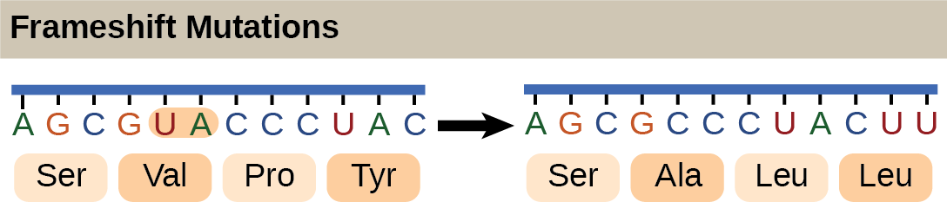
Frameshift mutations
The deletion of two nucleotides shifts the reading frame of an mRNA and changes the entire protein message, creating a nonfunctional protein or terminating protein synthesis altogether.

Slide 8
Steps of transcription
Initiation
  Promoter is a piece of DNA upstream that indicates where the RNA polymerase should bind and start
Elongation
  RNA polymerase adds complimentary nucleotides (A, U, C, G) to make the mRNA
Termination
Note: Since there is no nuclear membrane in prokaryotes, there is no separation of the transcription and translation process.
A ribosome will “grab onto” the growing mRNA to start translation

Slide 9
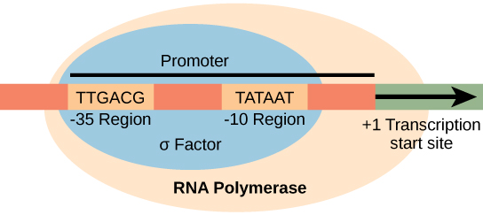
Initiation
The σ subunit of prokaryotic RNA polymerase recognizes consensus sequences found in the promoter region upstream of the transcription start sight. The σ subunit dissociates from the polymerase after transcription has been initiated.

Slide 10
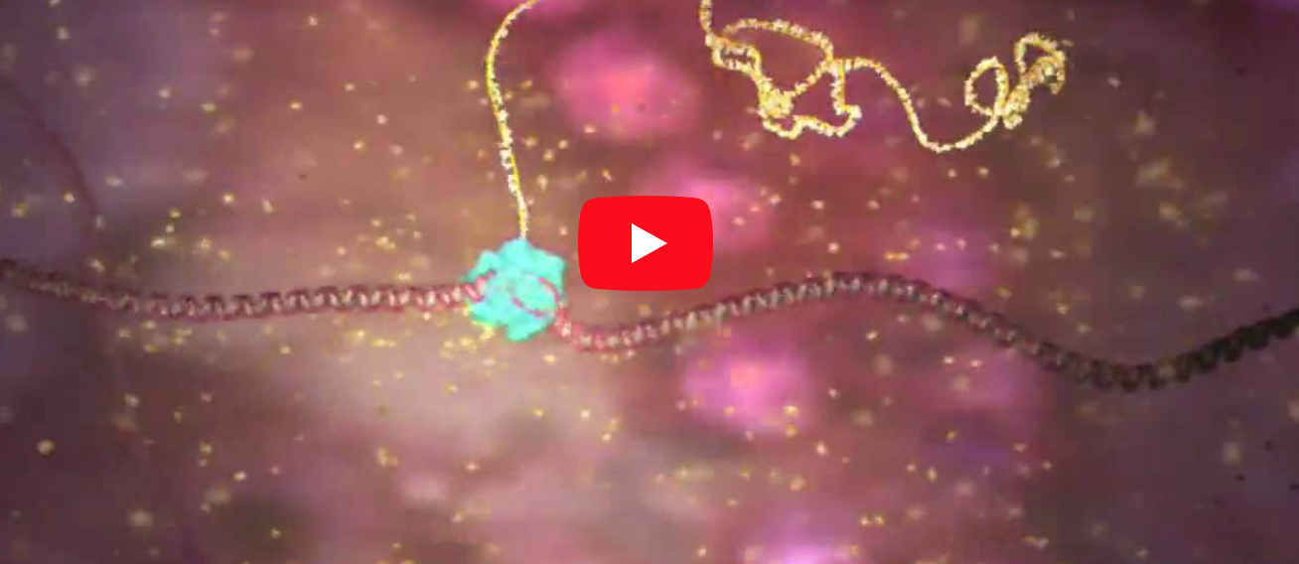
The first part of Transcription
https://www.wehi.edu.au/wehi-tv/dna-central-dogma-part-1-transcription

Slide 11
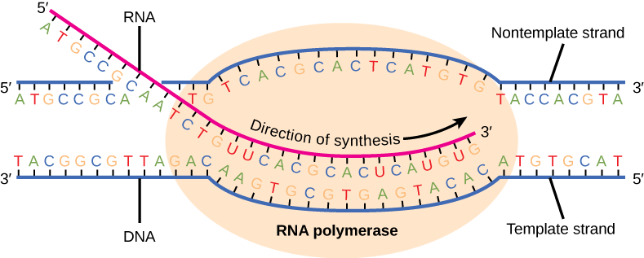
Elongation
During elongation, the prokaryotic RNA polymerase tracks along the DNA template.
Then it synthesizes mRNA in the 5' to 3' direction, and unwinds and rewinds the DNA as it is read.
Elongation occurs at a rate of 40 nucleotides per second.

Slide 12
termination
Liberates the mRNA strand
Occurs by:
  Rho protein interaction
  Formation of an mRNA hairpin
Two types of termination signals:
  Rho-dependent (controlled by the Rho protein)
  Rho-independent (controlled by sequences in the DNA strand)

Slide 13
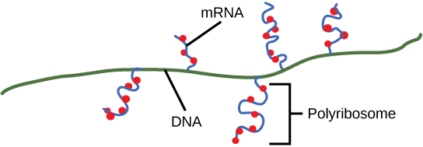
Multiple polymerases can transcribe a single bacterial gene while numerous ribosomes concurrently translate the mRNA transcripts into polypeptides. In this way, a specific protein can rapidly reach a high concentration in the bacterial cell.

Slide 14
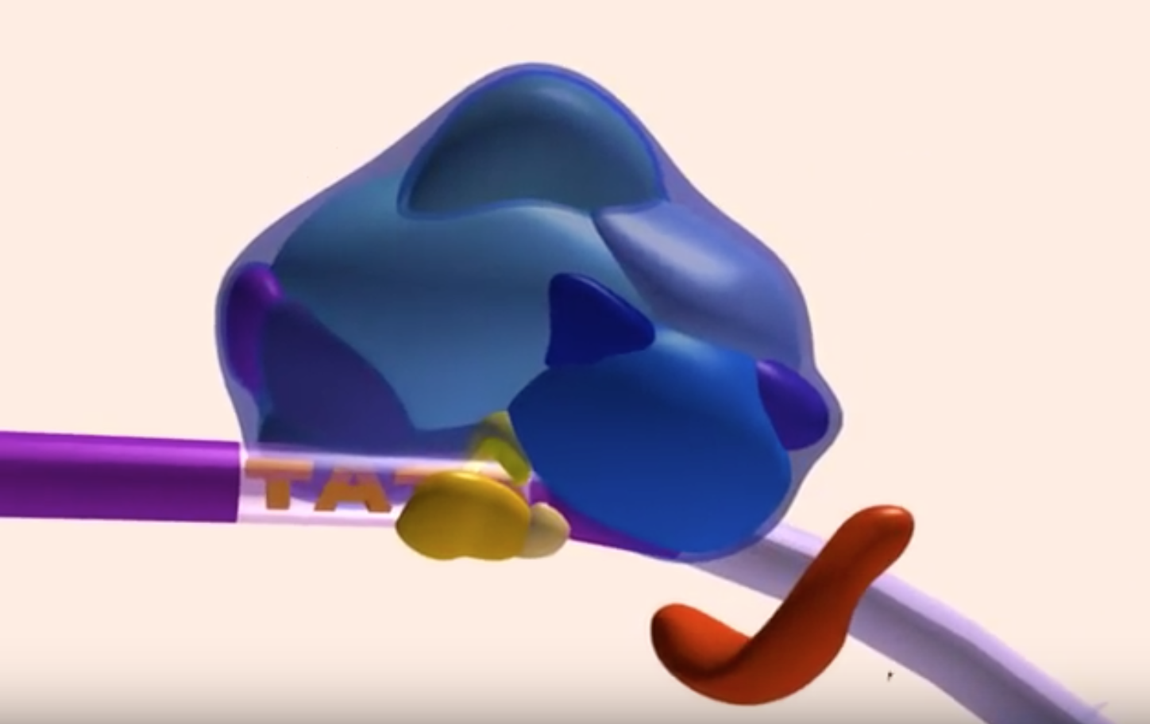
Transcription
https://www.youtube.com/watch?v=WsofH466lqk

Slide 15
Types of eukaryotic polymerases
RNA polymerase I
  Transcribes rRNA genes
RNA polymerase II
  Transcribes protein-coding genes
RNA polymerase III
  Transcribes rRNA, tRNA, and small nuclear RNA genes

Slide 16
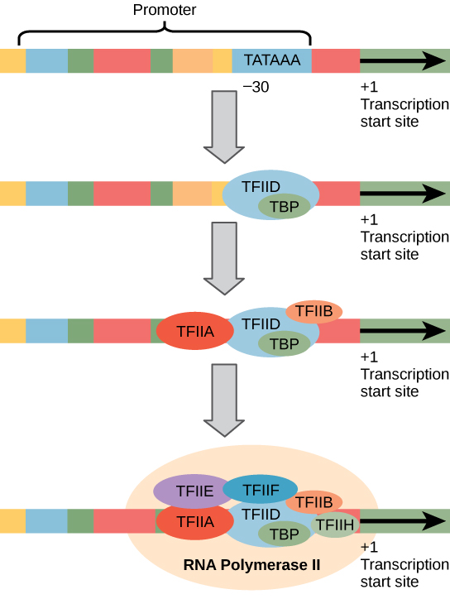
Initiation
Transcription factors recognize the promoter.
RNA polymerase II then binds and forms the transcription initiation complex.

Slide 17
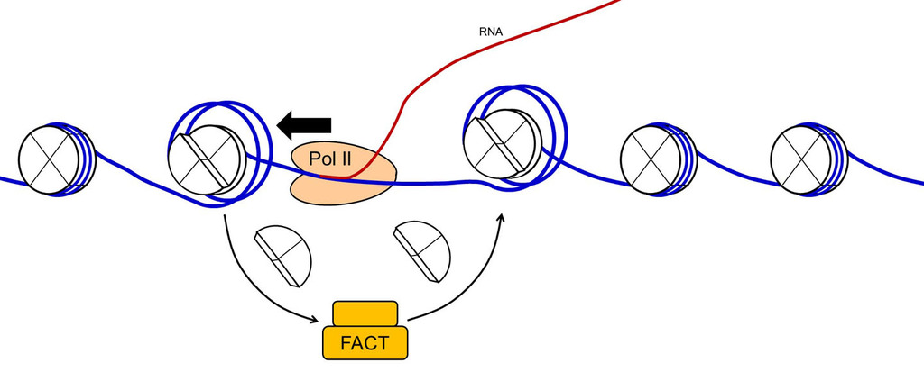
elongation
mRNA is synthesized 5’ to 3’
The FACT complex reassembles the nucleosomes as polymerase synthesizes the mRNA

Slide 18
Termination
RNA polymerase I requires a termination protein that recognizes a specific 18 nucleotide sequence.
RNA polymerase III terminates transcription via hairpin formation.
RNA polymerase II transcribes 1,000 – 2,000 nucleotides excess of the gene template which are removed during mRNA processing.

Slide 19
mRNA processing
Addition of a 5' methylguanosine cap and a 3’ poly-A tail
Intron splicing – removal of the non-coding introns.

Slide 20
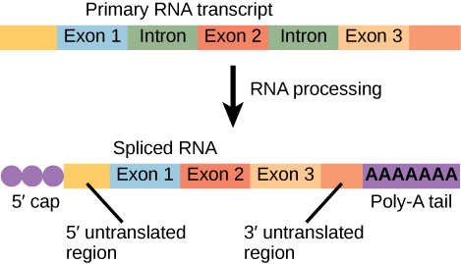
mRNA Processing
Eukaryotic mRNA contains introns that must be spliced out. A 5' cap and 3' poly-A tail are also added.

Slide 21
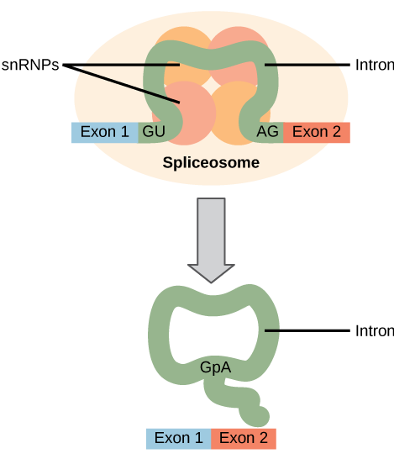
Pre-mRNA Splicing
Pre-mRNA splicing involves the precise removal of introns from the primary RNA transcript.
The splicing process is catalyzed by protein complexes called spliceosomes that are composed of proteins and RNA molecules called snRNAs.
Spliceosomes recognize sequences at the 5' and 3' end of the intron.

Slide 22
Rrna and Trna processing
Intramolecular cleavage
Splicing
Methylation
Chemical conversion of nucleotides

Slide 23
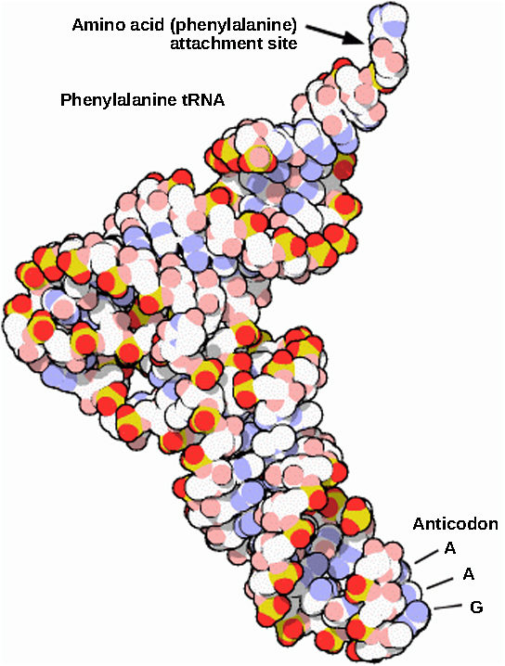
Rrna and Trna processing
This is a space-filling model of a tRNA molecule that adds the amino acid phenylalanine to a growing polypeptide chain. The anticodon AAG binds the Codon UUC on the mRNA. The amino acid phenylalanine is attached to the other end of the tRNA.

Slide 24
protein synthesis
Decodes mRNA to produce a polypeptide
Polypeptides are formed when the amino group of one amino acid forms an amide (i.e., peptide) bond with the carboxyl group of another amino acid.
The reaction is catalyzed by ribosomes.

Slide 25
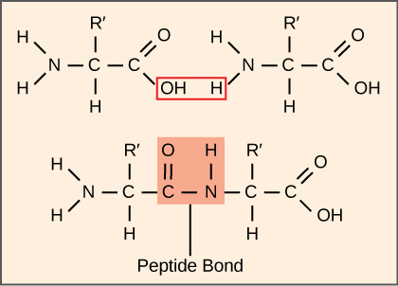
Figure 15.15
A peptide bond links the carboxyl end of one amino acid with the amino end of another, expelling one water molecule. For simplicity in this image, only the functional groups involved in the peptide bond are shown. The R and R' designations refer to the rest of each amino acid structure.

Slide 26
Translation Process
Initiation
    mRNA attaches to the smaller subunit of the ribosome
    AUG is the start codon – a tRNA with the appropriate anticodon attaches
    The larger subunit of the ribosome then comes in
Elongation
    tRNAs move in with the appropriate amino acid, the amino acid chain grows using peptidyl transferase
Termination
    Stop codon is reached
    The amino acid chain then is processed
        In eukaryotes, the amino acid chain moves into the endoplasmic reticulum to be further processed

Slide 27
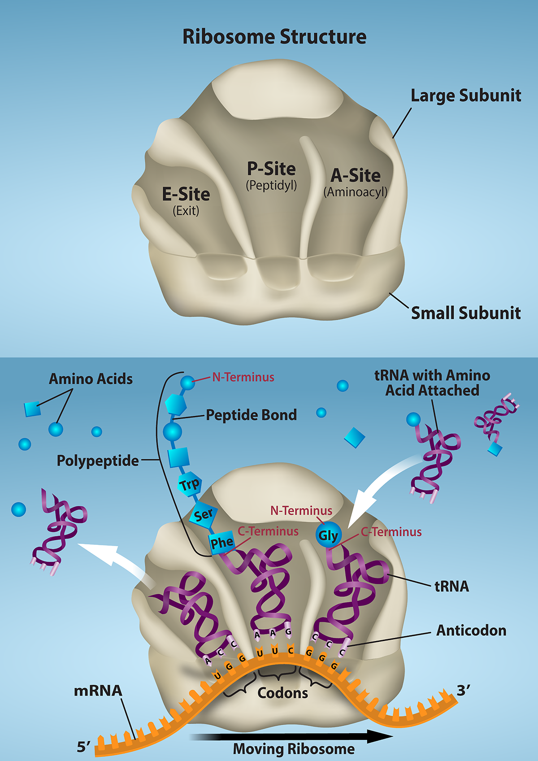
Figure 15.16
The ribosome is responsible for translating the mRNA into protein. A. The ribosome consists of a large and small ribosomal subunit. Assembly of the subunits on the mRNA forms three tRNA binding sites. B. During translation, charged tRNAs enter the Acceptor site, and the anticodon on the tRNA base pairs with the codon in the mRNA.

Slide 28
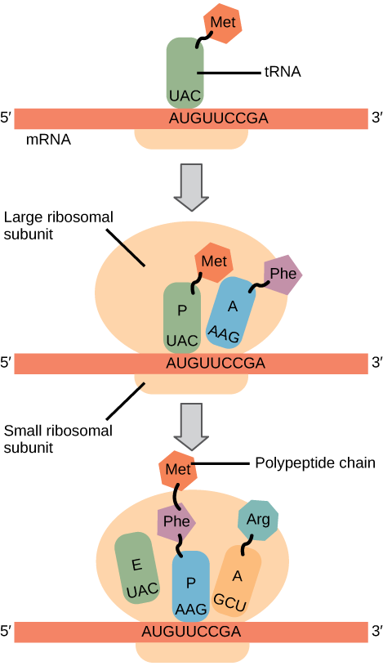
Translation Process

