Slide 1
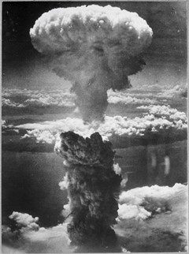
Ethics & Societal Responsibility
Image credit: “atomic-bomb” by vaXzine is marked with CC BY-NC-ND 2.0.

Slide 2
Student Learning Outcomes
Recall or identify cases in the sciences of physics, medicine, genetics, or forensics that raised ethical questions
Discuss how science can contribute to innovation in society in general, or to the diagnosis or treatment of diseases given specific examples cases
Debate the role of responsibility of science for society given the specific examples and guiding questions in this chapter
Debate the responsibility society has in science given the specific examples and guiding questions in this chapter

Slide 3
Student Learning Outcomes
Recall or identify cases in the sciences of physics, medicine, genetics, or forensics that raised ethical questions
Discuss how science can contribute to innovation in society in general, or to the diagnosis or treatment of diseases given specific examples cases
Debate the role of responsibility of science for society given the specific examples and guiding questions in this chapter
Debate the responsibility society has in science given the specific examples and guiding questions in this chapter

Slide 4
Definition of Ethics and Societal Responsibility
Ethics is the study of the standards of right and wrong that inform us as to how we ought to behave.
Common ethics: ethics that the majority of people agree on
Professional ethics: rules or expectation imposed on a trainee, student, employee in a company, an institution or as member of a profession
Research ethics: how research is conducted and how findings from that research are used and by whom
Personal ethics: personal values and moral qualities and are chosen by an individual
        Utilitarian Ethics (outcome based),
        Deontological Ethics (duty based),
        Virtue Ethics (virtue based), and
        Communitarian Ethics (community based)

Slide 5
Doing Science the Ethical Way
Human beings as research subjects:
  is exceptional because technically humans cannot be used in anyway similar to animals in research.
  See also historical events such as Helsinki declaration, Tuskegee syphilis study, the case of Henrietta Lacks, and gene therapy death
full disclose about the research procedures and findings
full disclose about the study’s strengths and weaknesses
openness about a study’s sponsors (and conflicts of interest)
standard of replicability

Slide 6
Responsible Research and Innovation
Example is the Rome Declaration on Responsible Research and Innovation in Europe (2014) :
  on-going process of aligning research and innovation to the values, needs and expectations of society.
  must consider the principles ..(of) … the respect of human dignity, freedom, democracy, equality, the rule of law and the respect of human rights, including the rights of persons belonging to minorities.
International Organization for Standardization and Societal Responsibility
  industry standards for social responsibility
  developed a standard for societal responsibility called ISO 26000

Slide 7
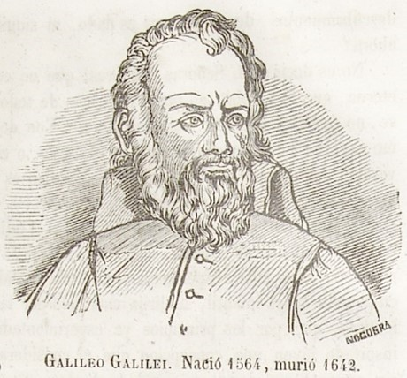
History of Ethics in STEM
Galileo Galilei (1564–1642) and Heliocentrism
  Italian scientist
  model of the sun at its center and planets of the solar system circling around it.
  clashed with existing models proposing the planet Earth at the center and everything else moving around Earth.
  clashed also with religious authorities.
  was jailed, condemned and forced to deny his own research findings.
Image credit: ‘Galileo Galilei’ by Biblioteca Rector Machado y Nuñez is marked with CC PDM 1.0. Available at https://www.flickr.com/photos/37667416@N04/3968863200

Slide 8
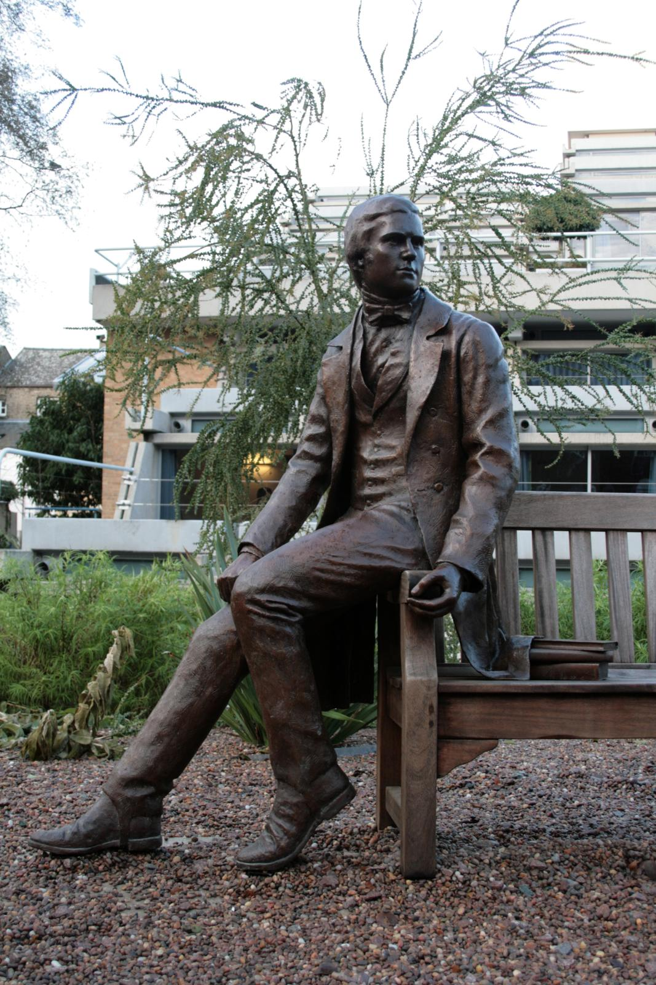
History of Ethics in STEM
Charles Darwin (1809-1882) and the origin of species:
  animal species evolved and were not created
  concerns with prevailing religious views of the origins of animals arising from a creator
  second book entitled “The Descent of Man, and Selection in Relation to Sex” wherein he proposes that morality and ethics in humans developed or evolved for biological reasons.
  biologicalization of ethics is receiving wide criticism even into contemporary times.
Image credit: “Charles Darwin Bicentenary Statue, Cambridge 17-01-2010” by Karen Roe is licensed under CC BY 2.0.

Slide 9
History of Ethics in STEM
Charles Darwin (1809-1882) and “The Descent of Man, and Selection in Relation to Sex” :
Are there dangers, if the concept of the survival of a “tribe” or “race” is used as a measuring stick to defend ethical standards in a society?
Is war culture of a nation justified for ethical reasons if it allows this nation to survive better against other competing nations?
Is it ethical to justify cannibalism if a society evolved where cannibalism is practiced?
Image credit: “Charles Darwin Bicentenary Statue, Cambridge 17-01-2010” by Karen Roe is licensed under CC BY 2.0.

Slide 10
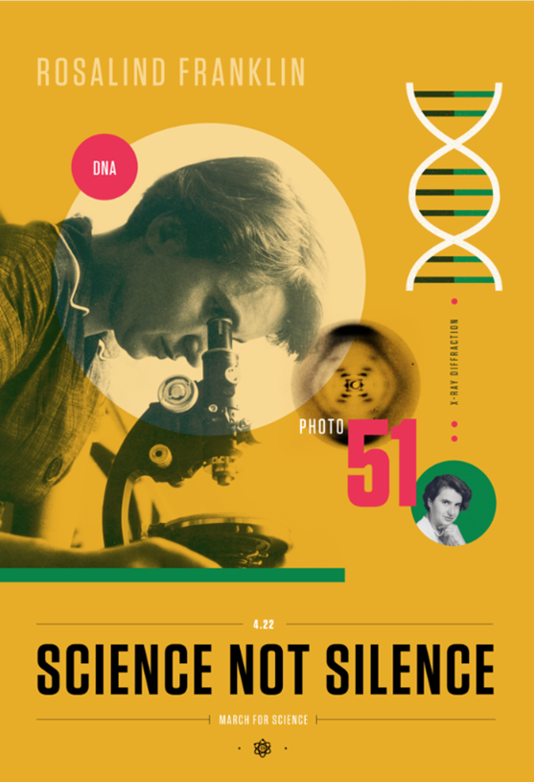
History of Ethics in STEM
Rosalind Franklin (1920-1958) and the DNA structure (1809-1882)
brand new analysis of the structure of the DNA
Her findings were taken without her consent and knowledge and used by Watson and Crick which received the credit and also the Nobel prize
Is it ethical to justify cannibalism if a society evolved where cannibalism is practiced?
Image credit: “File:Rosalind Franklin – Beyond Curie – March for Science Poster.png” by Amanda Phingbodhipakkiya is marked with CC BY-SA 4.0.

Slide 11
History of Ethics in STEM
Rosalind Franklin (1920-1958) and the DNA structure (1809-1882)
Is it ethical to take someone else’s research findings without their consent?
Is it ethical to take someone else’s research findings to improve your own research without acknowledging the contribution of that work?
Is it ethical to treat someone with less respect or give them less credit because they are a female?
Image credit: “File:Rosalind Franklin – Beyond Curie – March for Science Poster.png” by Amanda Phingbodhipakkiya is marked with CC BY-SA 4.0.

Slide 12
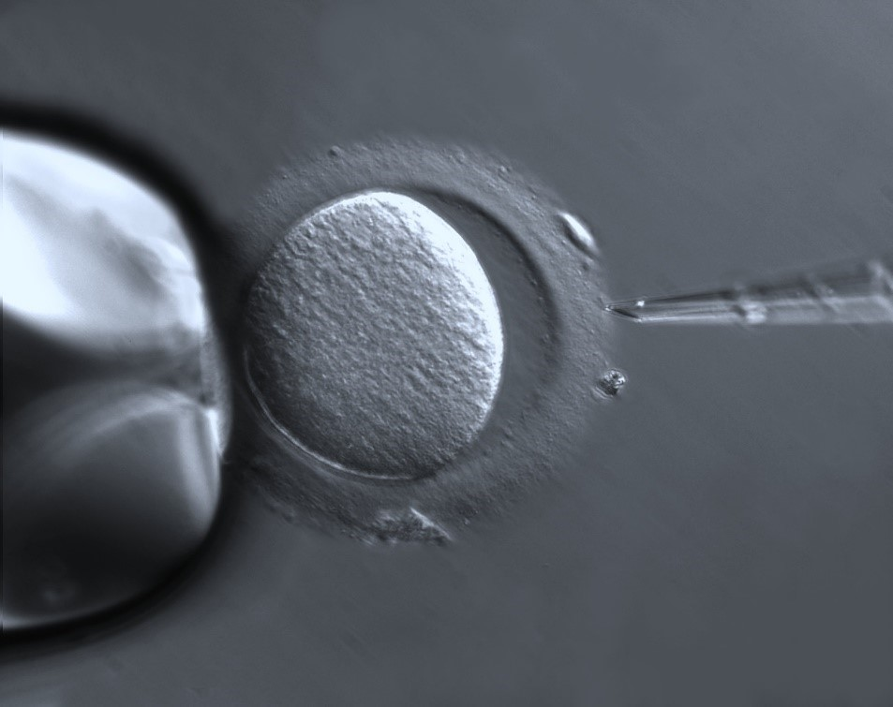
History of Ethics in STEM
in vitro fertilization of human egg (1978 – “test tube baby”)
In vitro fertilization (IVF): to fertilize a human egg in a test tube
ethical concerns arose
  Is it ethical for woman to share some of her stored eggs with a female friend?
  Is it ethical for a person to offer eggs to others for profit reasons?
Image credit: “Oocyte with Zona pellucida” by ZEISS Microscopy is marked with CC BY-SA 2.0.

Slide 13
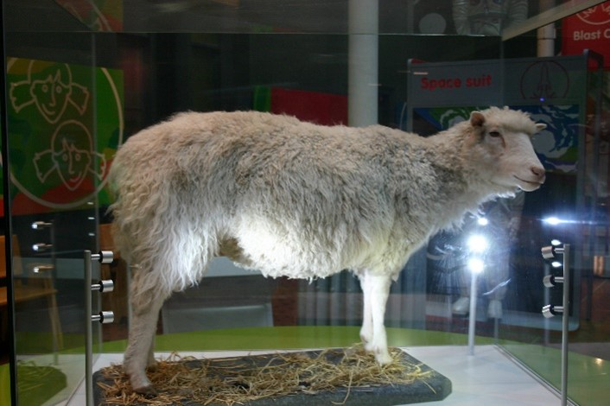
History of Ethics in STEM
Cloning of Dolly the sheep (1996)
cloning from an adult sheep using its somatic cells instead of its gametes (egg or sperm cells)
Is it ethical to do cloning if at that time the success rate was at best 12% and 88% was the lowest failure rate at that time (rates from A. Fiester. 2005)?
Is it ethical to expose the female animal to the treatments and surgery to retrieve a useful egg for animal cloning?
Is it ethical to expose the surrogate mother animal to the treatments to bring the cloned egg to birth?
Is cloning of animals opening the door for attempts to clone humans?
Image credit: The photo of “Dolly the Sheep” by Neil T is marked with CC BY-SA 2.0

Slide 14
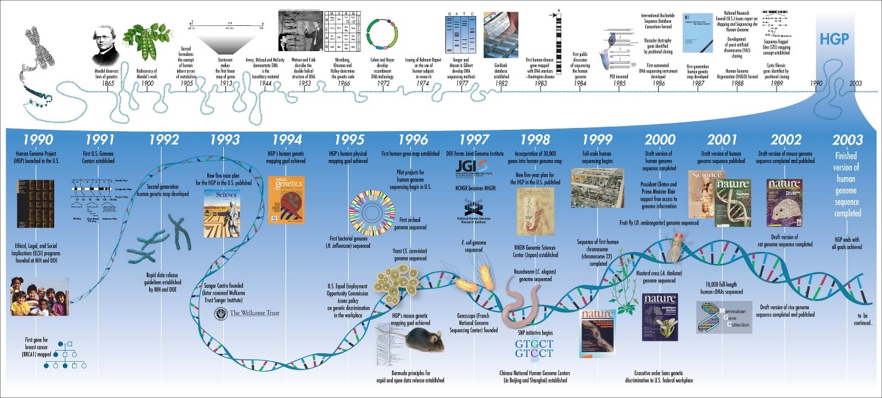
History of Ethics in STEM
Human Genome Project (1990-2003)
goal to sequence all 3 billion base pairs that make up the entire human genome
study the ethical, legal and societal issues (ELSI)
Who should have access to personal genetic information, and how will it be used?
Who owns and controls genetic information?
How does personal genetic information affect an individual and society’s perceptions of that individual? How does genomic information affect members of minority communities?
Image credit: Figure ”human genome” by vaXzine is marked with CC BY-NC-ND 2.0.

Slide 15
History of Ethics in STEM
Human Genome Project (1990-2003)
goal to sequence all 3 billion base pairs that make up the entire human genome
study the ethical, legal and societal issues (ELSI)
Who should have access to personal genetic information, and how will it be used?
Who owns and controls genetic information?
How does personal genetic information affect an individual and society’s perceptions of that individual? How does genomic information affect members of minority communities?
Image credit: Figure ”human genome” by vaXzine is marked with CC BY-NC-ND 2.0.

Slide 16
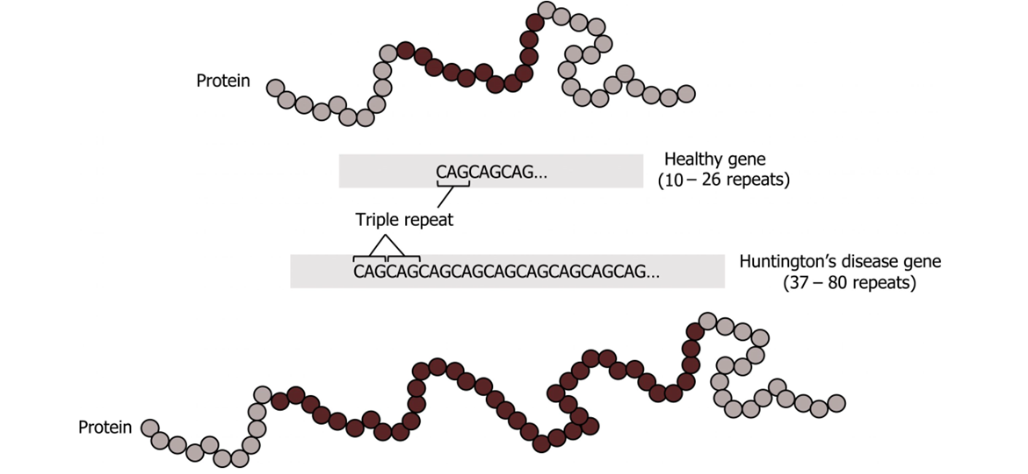
History of Ethics in STEM
Huntington’s Disease
inherited & often signs or symptoms show at the adult age of 30 to 40 years old.
The damage to the nerve cells can impact movement, speech, thinking, and psyche. Unfortunately, the disease is progressing and there is no cure
Should testing be performed when no treatment is available?
Should parents have the right to have their minor children tested for adult-onset diseases?
Should the 18 year old child tell the parent about a positive test result to a parent who doesn’t want to get tested and doesn’t want to know about their chances of having inherited that disease?
Image credit: Licensed with a Creative Commons Attribution NonCommercial-ShareAlike 4.0 License. Retrieved from LeClair, Renée (2021). Cell Biology, Genetics, and Biochemistry for Pre-Clinical Students. Roanoke: Virginia Tech Carilion School of Medicine. https://doi.org/10.21061/cellbio. Licensed with CC BY-NC-SA 4.0 https://creativecommons.org/licenses/by-nc-sa/4.0.

Slide 17
History of Ethics in STEM
Huntington’s Disease
inherited & often signs or symptoms show at the adult age of 30 to 40 years old.
The damage to the nerve cells can impact movement, speech, thinking, and psyche. Unfortunately, the disease is progressing and there is no cure
Should testing be performed when no treatment is available?
Should parents have the right to have their minor children tested for adult-onset diseases?
Should the 18 year old child tell the parent about a positive test result to a parent who doesn’t want to get tested and doesn’t want to know about their chances of having inherited that disease?
Image credit: Licensed with a Creative Commons Attribution NonCommercial-ShareAlike 4.0 License. Retrieved from LeClair, Renée (2021). Cell Biology, Genetics, and Biochemistry for Pre-Clinical Students. Roanoke: Virginia Tech Carilion School of Medicine. https://doi.org/10.21061/cellbio. Licensed with CC BY-NC-SA 4.0 https://creativecommons.org/licenses/by-nc-sa/4.0.

Slide 18
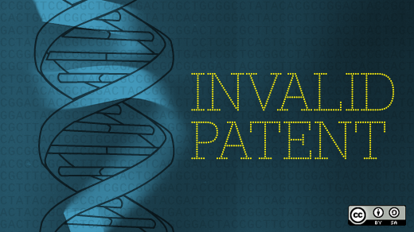
History of Ethics in STEM
Ownership of a gene (1990-2013)
questions about ownership of genes and patent rights for genes
commercial entities were endeavoring to patent genes or genetic information
In 2013, the Supreme Court of the USA ruled that human genes itself can’t be patented, but complementary DNA (cDNA) can.
If a research university is prevented to research additional and deeper functions of a gene because research on the gene is prohibited by a gene patent, is that good, bad, neutral, and for whom?
If patients can’t afford to be tested for a genetic disease, because a gene patent requires expensive license fees for that test – is that good, bad, neutral, and for whom?
Image credit: “Gene patenting and free software: a breakthrough” by opensourceway is marked with CC BY-SA 2.0..

Slide 19

Atomic Fission, Albert Einstein, and the Atomic Bomb
Albert Einstein was a well known physicist concerned about research into splitting of the atom (nuclear fission) and the threat of the atomic bomb by Nazi Germany
In 1939, the physicists warned the US President and encouraged to promote nuclear research in the US.
“Manhattan project”: US government effort to research how to build an atomic bomb and to actually build it
Einstein was not allowed to work on the Manhattan project and was distraught after the first atomic bomb destroyed the city of Hiroshima, Japan. He also regretted encouraging the US government into research about nuclear weapons based on hindsight.
Should scientists get involved into politics?
Should scientists encourage research that can be misused?
Do scientists have individual ethical responsibility?
Do scientists have a societal ethical responsibility?
Image credit: Kelly Michals took a photograph on November 14, 2018 of Jack Aeby’s photograph of the Trinity nuclear test that occurred July 16th 1945. “Jack Aeby’s Color Photo of the Trinity Nuclear Test” by rocbolt is licensed under CC BY-NC 2.0.

Slide 20
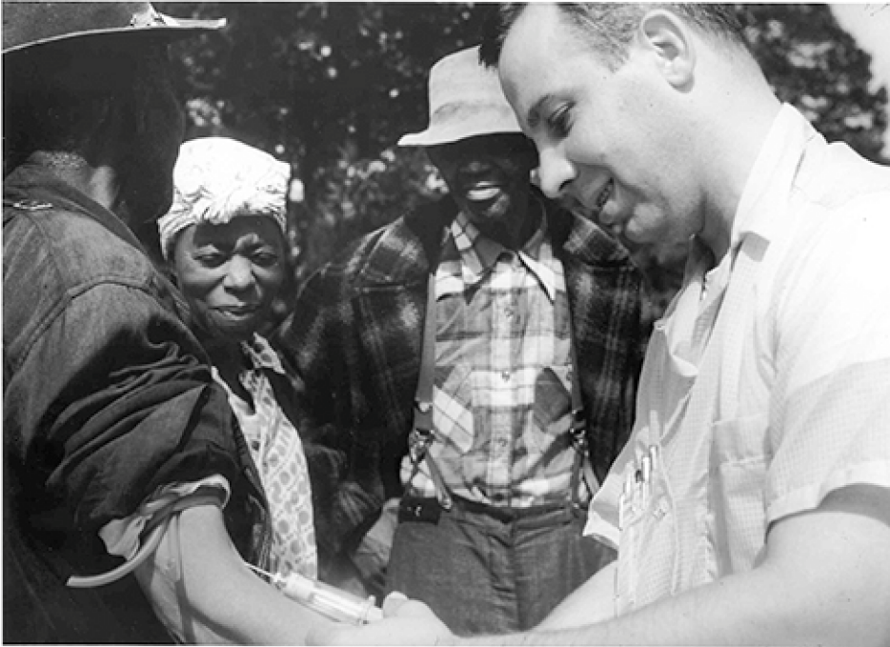
Tuskegee Syphilis Experiment
In 1932, poor, rural, black, male sharecroppers from Tuskegee, Alabama, were recruited to participate in an experiment conducted by the U.S. Public Health Service, with the aim of studying syphilis in black men
About two thirds (399) tested positive for syphilis, and they served as the experimental group (given that the researchers could not randomly assign participants to groups, this represents a quasi-experiment). The remaining syphilis-free individuals (201) served as the control group. However, those individuals that tested positive for syphilis were never informed that they had the disease. While there was no treatment for syphilis when the study began, by 1947 penicillin was recognized as an effective treatment for the disease. Despite this, no penicillin was administered to the participants in this study, and the participants were not allowed to seek treatment at any other facilities if they continued in the study. Over the course of 40 years, many of the participants unknowingly spread syphilis to their wives (and subsequently their children born from their wives) and eventually died because they never received treatment for the disease. This study was discontinued in 1972 when the experiment was discovered by the national press (https://apnews.com/article/business-science-health-race-and-ethnicity-syphilis-e9dd07eaa4e74052878a68132cd3803a ). The resulting outrage over the experiment led directly to the National Research Act of 1974 and the strict ethical guidelines for research on humans described in this chapter.
Image credit: The original image is entitled “Figure 2.21 A participant in the Tuskegee Syphilis Study receives an injection.” It is from the book Psychology 2e. https://openstax.org/details/books/psychology-2e?Book%20details. Published: 4/22/2020. Digital ISBN-13: 978-1-951693-23-7; retrieved 3/15/2022. License: CC BY by OpenStax is licensed under Creative Commons Attribution License v4.0

Slide 21
Tuskegee Syphilis Experiment
Throughout history, race has been divisive and, in some cases, a discouraging factor in scientific inquiry.
Why is this study unethical?
How were the men who participated and their families harmed as a function of this research?
As a consequence, Tuskegee University created the nation’s first bioethics center to study moral and ethical question in research and medical treatment of African Americans and other underserved people.
The National Center for Bioethics in Research and Health Care received seed funding 2 years after the public apology of the President of the United States about the terrible , “deeply, profoundly, morally wrong” study, a study that was “clearly racist” ( words in quotes are from the public apology May 16 of 1997 made by the US President).
Image credit: The original image is entitled “Figure 2.21 A participant in the Tuskegee Syphilis Study receives an injection.” It is from the book Psychology 2e. https://openstax.org/details/books/psychology-2e?Book%20details. Published: 4/22/2020. Digital ISBN-13: 978-1-951693-23-7; retrieved 3/15/2022. License: CC BY by OpenStax is licensed under Creative Commons Attribution License v4.0

Slide 22
Helsinki Protocol for Human Research
is a statement of ethical principles to provide guidance to physicians and other participants in medical research involving human subjects, identifiable human material or identifiable data
the well-being of the human subject should take precedence over the interests of science and society
ethical standards for all human beings , research populations that are vulnerable and need special protection
needs of the economically and medically disadvantaged must be recognized
Special attention for those who cannot give or refuse consent for themselves, for those who may be subject to giving consent under duress
Did the Tuskegee experiment violate concerns or basic principles outlined in the Helsinki declaration?
Which sections of the Helsinki declaration are maybe addressing problems and concerns with the Tuskegee experiment ?
What additional improvements could you suggest for the Helsinki declaration ?
Image credit:

Slide 23
Henrietta Lacks and HeLa cells
Henrietta Lacks, an African American mother of five children, went to Johns Hopkins hospital and diagnosed with cervical cancer
received treatment and died less than a year after cancer diagnosis
During the treatment cancer cells were removed and used for further biomedical research without her informed consent
Some of her cells were immortal, proved very valuable for research, and named “HeLa” cells resembling the first two letters of her first and last name.
Money was made from the HeLa cells without informing the surviving family members of Henrietta Lacks. (Reference “ Henrietta Lacks: science must right a historical wrong “https://www.nature.com/articles/d41586-020-02494-z ).
Henrietta Lacks genome derived from the HeLa cells was published without informing the family members.
Image credit:

Slide 24
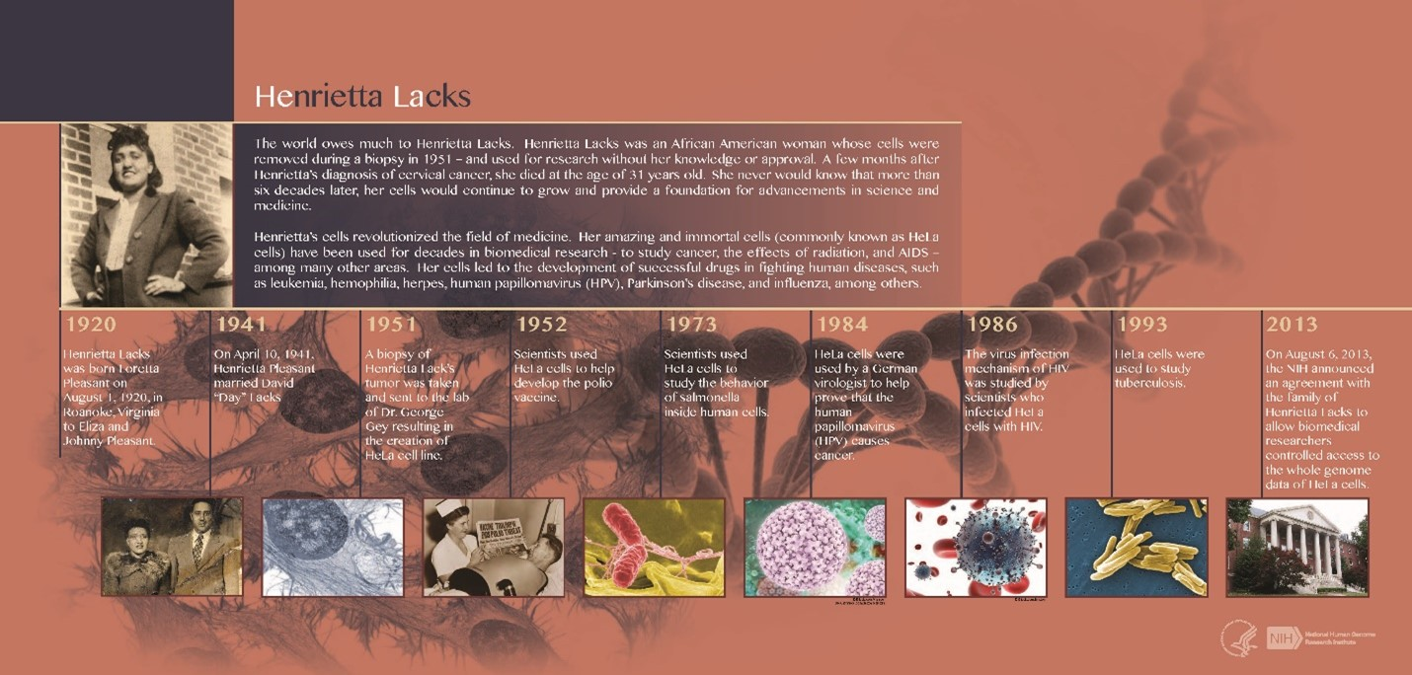
Henrietta Lacks and HeLa cells
Is it ethical to take someone’s cells, tissue, organs, fluids without their informed consent?
Is it ethical for a scientist to use someone’s cells, tissue, organs, fluids for another type of research than the type of research that was approved by the patient?
Is it ethical to use research data years later after the patient gave approval do to do some additional follow up research or is a second approval needed?
Is it ethical to make monetary gains from someone’s cells, tissue, organs, fluids without the approval of the donor?
Image credit: “Henrietta Lacks (HeLa) Timeline” by National Institutes of Health (NIH) is marked with CC BY-NC 2.0.

Slide 25
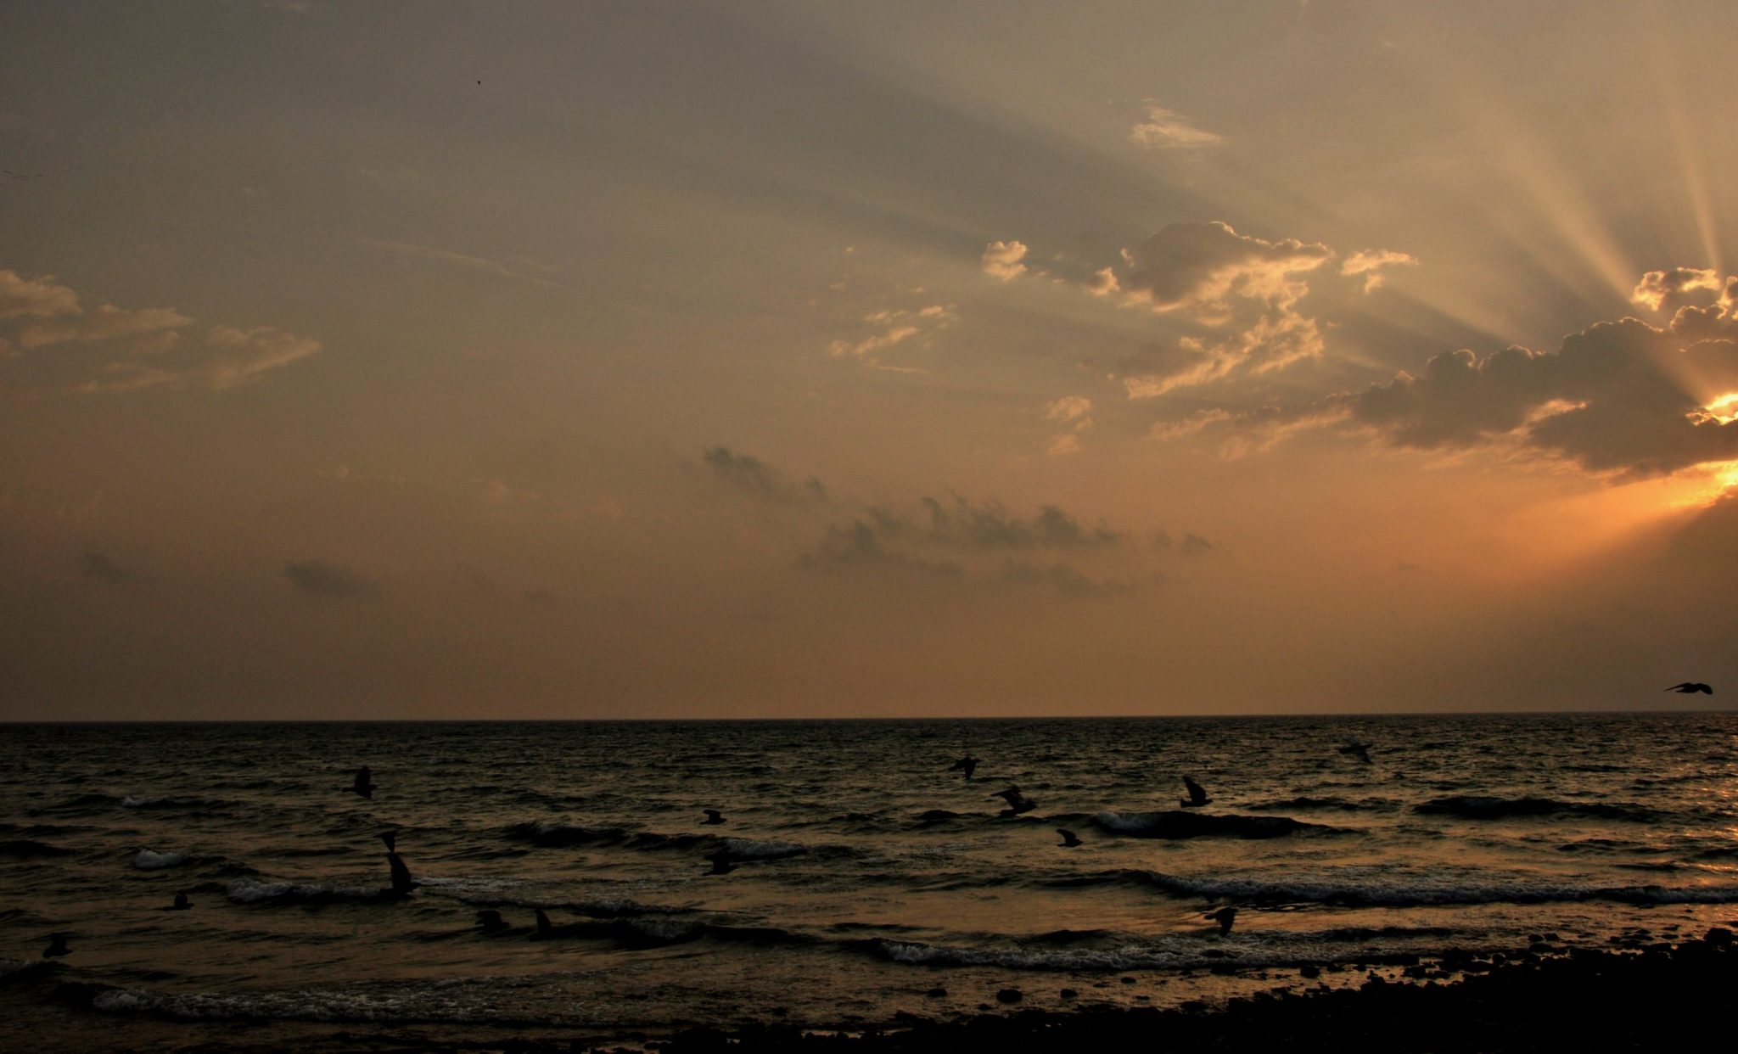
Gene Therapy and Death in 2000
Some diseases are caused by inherited mutations to multiple genes or a single gene (like sickle cell disease).
Scientists developed the technology called gene therapy to treat these type of diseases for ailing animals. Gene therapy aims to replace the defective mutated gene with an unmutated version of the gene.
success in animals and with individual human cells in the labs
hope to help humans
In 1999, an approved clinical trial was done to test the safety of gene therapy for disorder of nitrogen metabolism.
18 year old Jesse Gelsinger suffered from a mild version of the disease and received the gene therapy. Four days after he received the gene therapy, he passed away.
This tragic loss led to a lawsuit, a stop to gene therapy trials, and investigations ?
If adults have a mild form of disease that can be survived by sticking to a harsh diet without harm to their lives, but participation in a clinical trial phase 1 has a chance of causing life ending harm, should this be done?
Is it ethical to Involve babies in a clinical trial phase 1 that would die from severe case of the disease without treatment in a year. Babies can’t understand the risk of the treatment. If the treatment has a possibility to causes death but if lack of treatment causes also death within 12 months?
Image credit: Figure: “Life of The clouds….A Tear And A Smile…” by -Reji is licensed under CC BY-NC-SA 2.0.

Slide 26
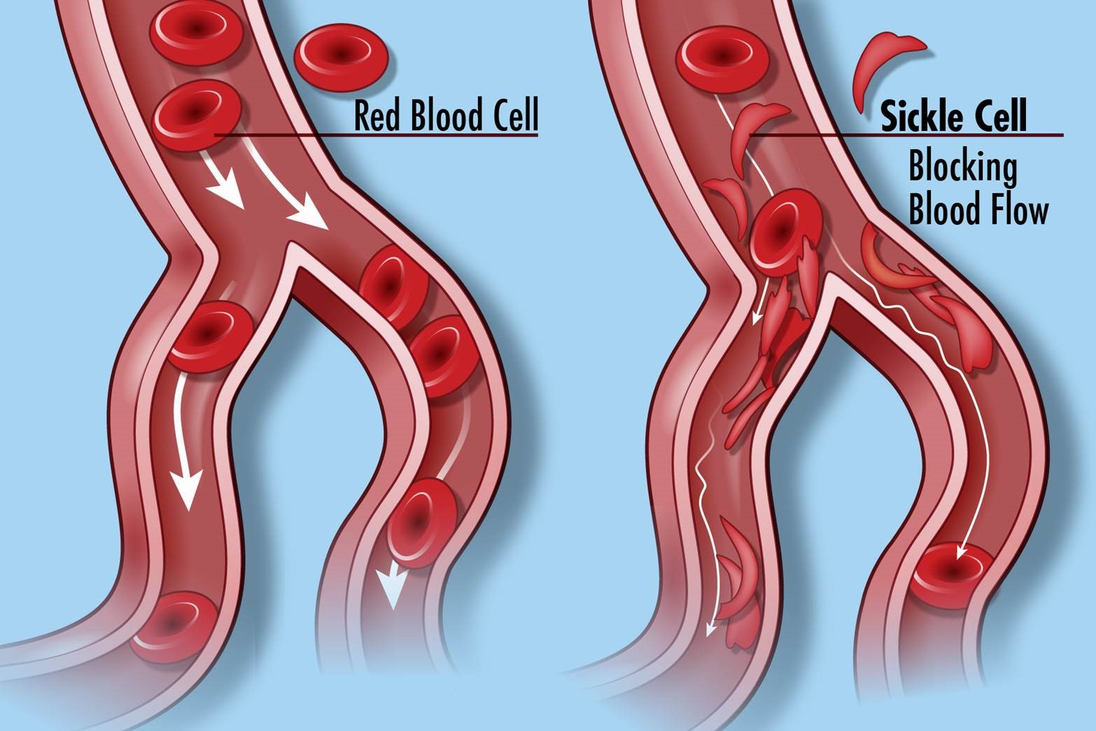
Gene Therapy for Sickle Cell Disease 2018
a change of one amino acid in hemoglobin molecules distort the red blood cells and causes them to assume a crescent or “sickle” shape, which clogs blood vessels.
A change in nucleotide sequence of the gene’s coding region for the hemoglobin βchain is causing the disease.
myriad serious health problems such as breathlessness, dizziness, headaches, and abdominal pain for those affected.
In 2019, Ms. Gray was offered participation in an gene therapy experiment using a new technique called CRISPR.
Treatment is lengthy and did also involve very unpleasant chemotherapy.
Treatment showed improvement of quality of life for Mrs. Gray, an African American mother, after some months.
unclear if the improvements will last and how long.
New technique with chances for unforeseen dangerous complications
Should a scientist or a doctor offer participation of a new experimental treatment that hasn’t been tried on any human being before?
Should a scientist or doctor include additional ethical considerations if an experimental treatment is offered to a demographic group that is exposed to disproportionally high health disparities?
Should a scientist or doctor offer participation of a new experimental treatment to a person that is parenting dependent children?
Image credit: “Sickle Cell Disease” by National Institutes of Health (NIH) is licensed under CC BY-NC 2.0.

Slide 27
Ethics of Genetic Testing & Medical Disease Diagnostics
Genetic counseling: “the process of helping people understand and adapt to the medical, psychological and familial implications of genetic contributions to disease” (National Society of Genetic Counselors (NSGC)).
autonomy of the individual, the right to full information about the genetic disease and available options (world health organization (WHO)).
genetic counseling: should be education, voluntary and non-prescriptive(WHO)
genetic counseling: sensitive to societal, cultural, and religious views of the individual (WHO).
genetic testing: Besides the “right to know” the question about “the right not to know” (refusal to be tested-WHO)
If parents find out that their children have a risk of getting a genetic disease, should they decide against biological children?
The actress Angelina Jolie wrote an open opinion letter to the New York times entitled “My Medical Choice”. The actress decided to test for an allele of the BRCA1 gene that can increase the breast cancer risk. The actress found out that she had the allele that causes increased risk for breast cancer. The actress then had her breast tissue removed (mastectomy) in order to reduce the risk for breast cancer. What do you think about her choice to take the test? What do you think about her choice to proactively have surgery? BRCA1 mutations can also increase risk for ovarian cancer. What do you think about proactively removing the ovaries?
Image credit:

Slide 28
Ethics of DNA Testing in Forensic Science and Criminal Justice
to determine the biological parent (father, mother).
to identify a deceased victim.
For sexual violence, it can also be used to identify the assaulting criminal.
A Louisiana physician was convicted of attempted second degree murder by injecting his former girl friend with HIV from one of his patients based on DNA analysis of HIV mutations.
the State of Louisiana versus Franklin, that ruled a cheek swab for DNA testing is allowed even if a person is not convicted of a crime, but only arrested (State v. Franklin, 76 So. 3d 423 (La. 2011)
federal case of U.S. v. Mitchell, 652 F.3d 387 (3d Cir. 2011) states “… DNA collection from arrestees …. is reasonable and does not violate the Fourth Amendment.”
familial DNA searching was used to point to an innocent New Orleans film maker as a murder suspect . The film maker experienced stressful times until he was cleared.
How long should the genetic information be used ? Only for the specific incident, arrest, law suit, civil case, criminal case or for 1 year, 10 years, a life time?
Should the collected DNA also be used for other purposes than originally intended?.
Image credit:

Slide 29
Use of Animals & Environment and Ethics
Animal Welfare Act of 1966 (https://www.nal.usda.gov/animal-health-and-welfare/animal-welfare-act )
  regulates the treatment of animals in research, teaching, testing, exhibition, transport, and by dealers
Rene Descartes: animals have no souls and have much more in common with inanimate machines.
British Utilitarian philosopher Jeremy Bentham claimed that animals deserve moral consideration to the extent that they can feel pain
Utilitarian arguments alone cannot possibly be the basis for objecting to all uses of animals by humans that are currently the norm
Philosopher Kant: equality based on the rational recognition that another counts just as much as I do
Biology suggests that we are much more closely related to other living things than we previously suspected
Image credit:

Slide 30
Use of Animals & Environment and Ethics
Ethics and the Environment
A thing is right when it tends to preserve the integrity, stability, and beauty of the biotic community. It is wrong when it tends otherwise (Aldo Leopold).
Potentially negative impacts of economic activity, impacts such as pollution and resource depletion that seem to accompany many manufacturing processes as well as other human activities like transportation.
The loss of biodiversity, or put more simply the currently unfolding mass extinction of species.
Our welfare depends on the stability of the climate, on the existence of biodiversity and the availability of energy resources.
The interconnections between organisms each of which depend on other organisms for their own survival. The “biotic community” is the network of interdependent organisms that make up a given ecosystem and that we ignore at our peril.
Image credit:

