Slide 1
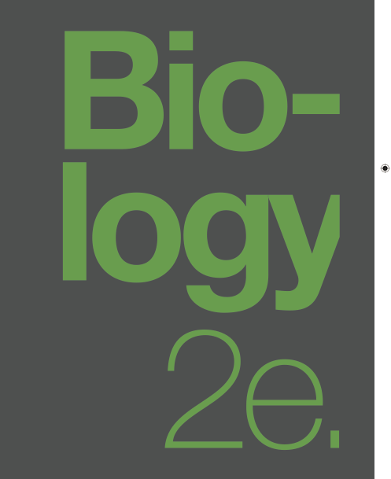
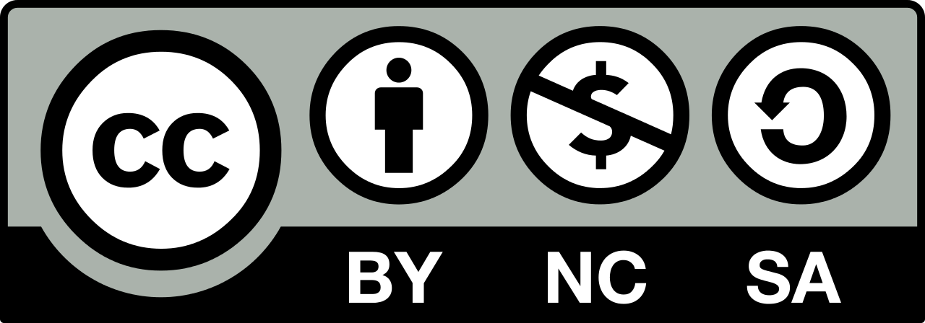
BIOLOGY 2e
Chapter 7 CELLULAR RESPIRATION
PowerPoint Image Slideshow
This work is licensed under a Creative Commons Attribution-NonCommercial-ShareAlike 4.0 International License.

Slide 2
Respiration Overview
Cells extract energy from food to generate ATP in a process called glucose catabolism or cellular respiration.
As we work through the metabolic pathways involved, notice the close link between the transfer of energy and the movement of electrons (electrons have high energy levels).
This incremental transfer of electrons allows the cell to transfer food energy in small packages that can be captured in the phosphate bonds of ATP.

Slide 3
Redox reactions
Redox reactions are chemical reactions where electrons are transferred from one molecule to another.
Molecules that can donate electron(s) in a redox reaction are reducing agents, and those that can accept electrons are oxidizing agents.
Molecules that gain electron(s) after the reaction are reduced, and those that lose electron(s) are oxidized.
AH
(Reducing Agent)
X⁺
(Oxidizing agent)
A⁺
(oxidized)
XH
(reduced)
+ → +

Slide 4
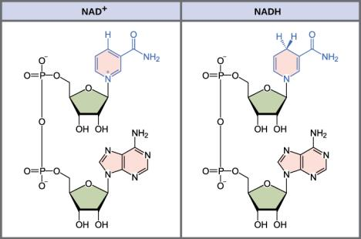
Redox reactions
Molecules like nicotineamide adenine dinucleotide (NAD) can occur in an oxidized state (NAD+) or a reduced state (NADH).
  NADH carries 2e- and 1H+ more than NAD
NAD is called an electron carrier because NAD+ accepts electrons from redox reactions while NADH donates them.
Electron carriers are very important molecules in cellular respiration and photosynthesis.
They shuttle electrons to electron transport chains where ATP is produced.
Other electron carriers include:
FAD⁺, FADH₂
NADP⁺, NADPH

Slide 5
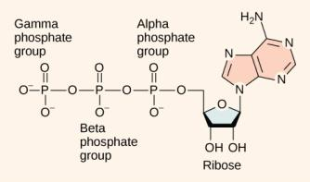
ATP in living systems
The hydrolysis of ATP → ADP + Pi is exergonic and can provide energy for a coupled endergonic reaction.
The loss of a phosphate group from a molecule is called dephosphorylation.
Phosphorylation is the process of adding a phosphate group is to a molecule.
Phosphorylated molecules tend to be less stable and more likely to react.

Slide 6
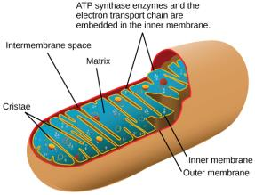
ATP in living systems
ATP is generated by an endergonic reaction where ADP undergoes phosphorylation, ADP + Pi → ATP.
The energy required for this reaction can come from:
  a coupled exergonic reaction (substrate-level phosphorylation) or
  a process called chemiosmosis, which requires the enzyme ATP synthase.
  90% of ATP is produced by chemiosmosis.
  Occurs in mitochondria, chloroplasts, and plasma membrane of aerobic prokaryotes.

Slide 7
Cellular respiration
C₆H₁₂O₆ + 6 O₂ → 6 CO₂ + 6 H₂O + ~36 ATP
The metabolic pathways involved are:
Glycolysis
Oxidation of Pyruvate and Citric Acid Cycle
Oxidative Phosphorylation

Slide 8
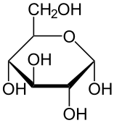
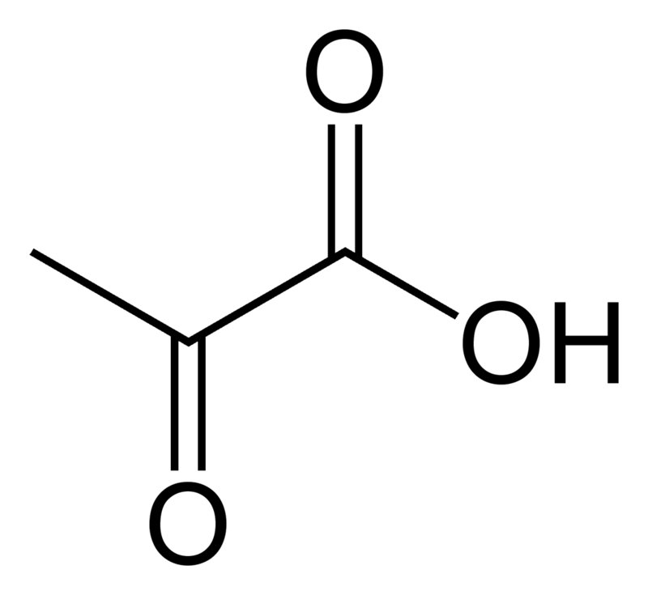
Glycolysis
Glycolysis is the first metabolic pathway of glucose metabolism; includes 10 enzymatic reactions.
Nearly all organisms perform glycolysis
  occurs in the cytoplasm
  O₂ is not required
Inputs are 1 Glucose, 2 NAD⁺, 2 ATP, 4 ADP
Outputs are 2 Pyruvate, 2 NADH, 4 ATP, 2 ADP
→ → → → → → → → → →
-
+
-

Slide 9
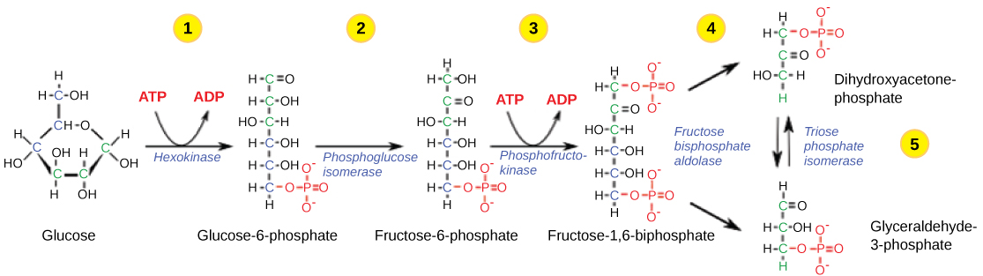
Glycolysis
The first half of glycolysis involves 5 enzymes and uses two ATP molecules.
Glucose is phosphorylated twice and then split into two three-carbon molecules, called glyceraldehyde-3-phosphate (G3P).

Slide 10
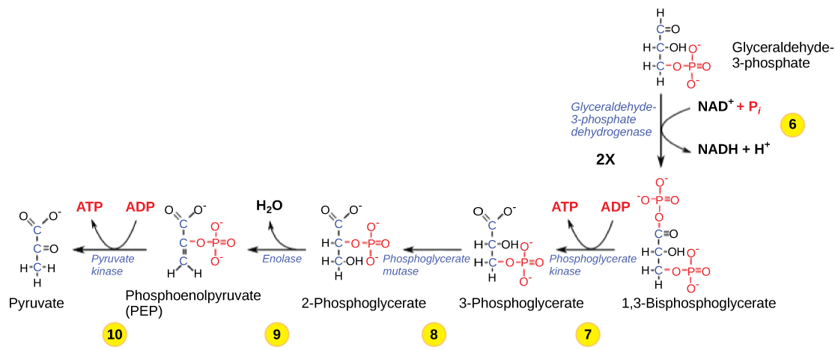
Glycolysis
The second half of glycolysis involves phosphorylation without ATP investment (step 6) and produces two NADH and four ATP molecules to generate 2 pyruvate molecules.
Net ATP production of glycolysis is 2 ATP.
These are the only ATP produced in glucose
catabolism by anaerobic cells.

Slide 11
Glycolysis

Slide 12
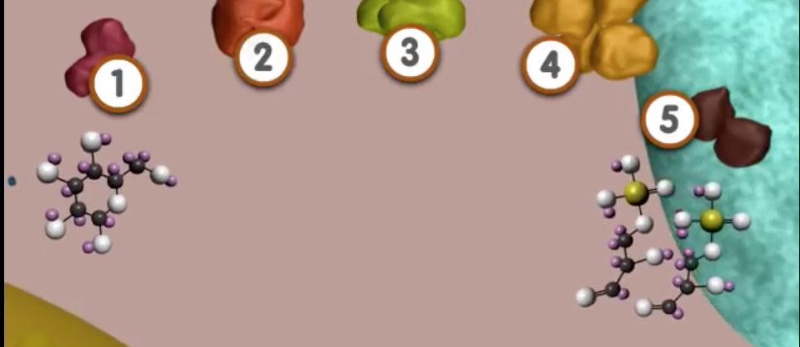
Glycolysis
https://www.youtube.com/watch?v=8Kn6BVGqKd8

Slide 13
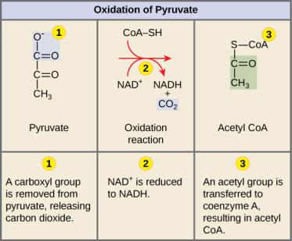
Oxidation of pyruvate
In eukaryotic cells, if oxygen is present, the 2 pyruvate molecules enter mitochondria where each is converted to Acetyl CoA before entering the CAC:
  a CO2 is released
  It is oxidized, transferring e- to NADH
  coenzyme A is attached
Inputs:
2 pyruvate, 2 NAD+
2 coenzyme A
Outputs:
2 CO2, 2 NADH, 2 acetyl CoA

Slide 14
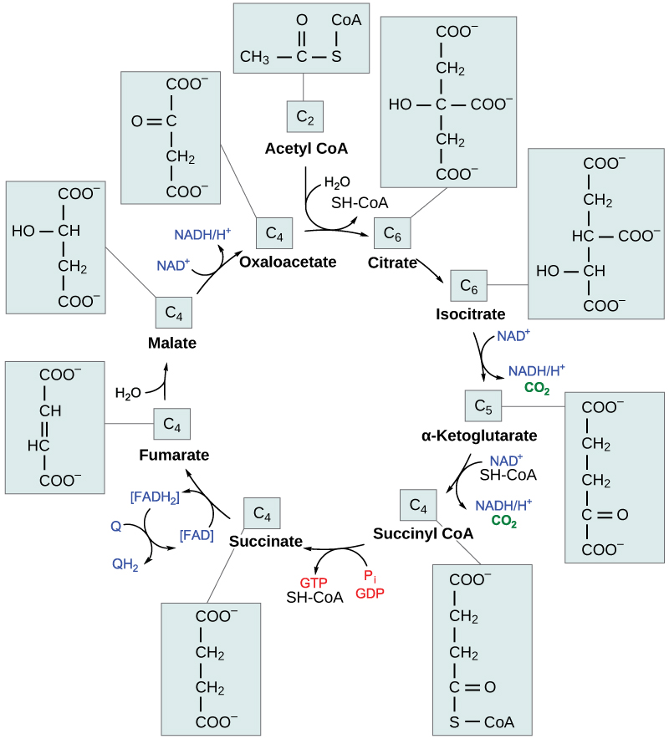
citric acid cycle occurs in the mitochondrial matrix
Step 1 - the acetyl group from acetyl CoA is transferred to oxaloacetate to form citrate.
Through a series of reactions
  citrate is oxidized (3 NADH & 1 FADH₂ made)
  2 CO₂ released
  1 GTP or ATP produced
The final product of the citric acid cycle is oxaloacetate.
The cycle runs continuously in the presence of sufficient reactants.

Slide 16
Outputs per glucose to this point
4 ATP (2 from glycolysis, 2 from CAC)
6 CO2 (2 from oxidation of pyruvate, 4 from CAC)
10 NADH (2 from glycolysis, 2 from oxidation of pyruvate, 6 from CAC)
2 FADH₂ (from CAC)
Glucose is completely oxidized at the end of CAC.
  All possible electrons have been removed.
Question: Is most of the energy from glucose stored in the ATP, the CO₂, or the electron carrier molecules?

Slide 17

Oxidative Phosphorylation
Most of the ATP produced during cellular respiration occurs in the last pathway, oxidative phosphorylation.
This is the only pathway where O₂ is an input.
The pathway consists of an electron transport chain and chemiosmosis, which generates ATP.
A H⁺ concentration gradient created by the ETC, provides the energy to power chemiosmosis.

Slide 18
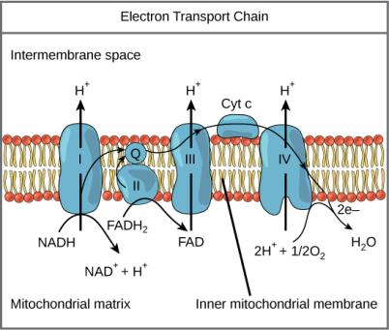
Oxidative phosphorylation - ETC
https://www.youtube.com/watch?v=xbJ0nbzt5Kw
The ETC is a series of electron transporters embedded in the inner mitochondrial membrane.
They shuttle electrons from NADH and FADH₂ to O₂.
In the process, protons (H⁺) are pumped from the mitochondrial matrix to the intermembrane space, and O₂ is reduced to form H₂O.

Slide 19
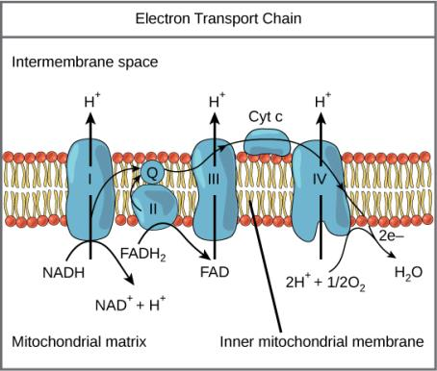
Each component of the ETC is more electronegative than the previous.
e- from NADH are transferred to complex I of ETC
  Includes NADH dehydrogenase, a B-vitamin derived molecule, & an Fe-S containing protein
e- from FADH₂ enter the ETC at complex II.
Ubiquinone (Q) carries e- from complexes I and II to complex III
Complex III is called cytochrome oxidoreductase.
  Includes transmembrane cytochrome B and peripheral protein cytochrome C
Cytochrome C carries each e- to complex IV
  Oxygen is reduced at complex IV (the final e- acceptor)

Slide 20
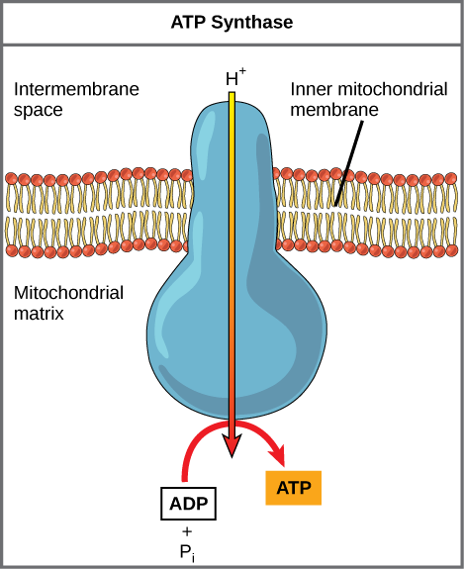
Oxidative phosphorylation – chemiosmosis
Chemiosmosis uses kinetic energy from protons falling down its gradient to form ATP from ADP + Pi. The complex, integral protein ATP synthase mediates this reaction.
www.youtube.com/watch?v=3y1dO4nNaKY
(Credit: modification of work by Klaus Hoffmeier)

Slide 21
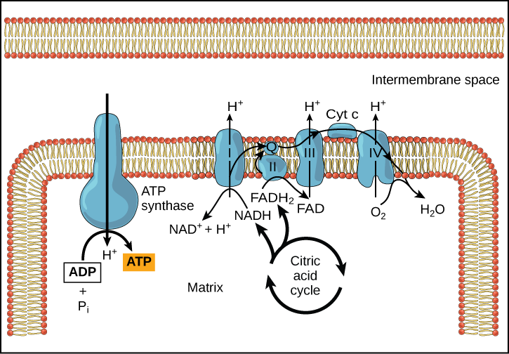
ETC & Chemiosmosis

Slide 22
ATP yield
The number of ATP generated by cellular respiration is 30-36 per glucose
  Varies by species and how efficiently NADH from glycolysis enters mitochondria
Cellular respiration in total stores ~ 34% of the energy from glucose in ATP

Slide 23
Metabolism without oxygen
Glycolysis occurs in aerobic and anaerobic environments.
NAD⁺ is an input of glycolysis; regenerated during oxidative phosphorylation when O₂ is present.
When O₂ is lacking, fermentation regenerates NAD⁺; otherwise, glycolysis would halt.
There are two common types of fermentation
  Lactic acid fermentation
  Alcohol fermentation

Slide 24
Lactic acid fermentation
  Occurs in muscle cells when O₂ is limited, mammalian red blood cells, & some bacteria, ex. those in yogurt
Lactate dehydrogenase catalyzes this reaction.
Pyruvate + NADH ←→ lactate + NAD⁺

Slide 25
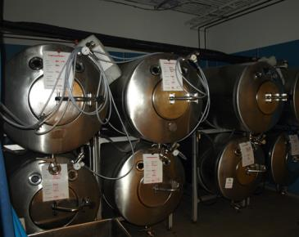
Alcohol fermentation
  anaerobic yeast species
Involves two reactions
  First, catalyzed by pyruvate decarboxylase
  Second, by alcohol dehydrogenase
Fermentation tanks have valves so that the pressure inside the tanks created by the CO² produced can be released.
Pyruvate → CO₂ + acetylaldehide
acetylaldehide + NADH→ ethanol + NAD⁺

Slide 26
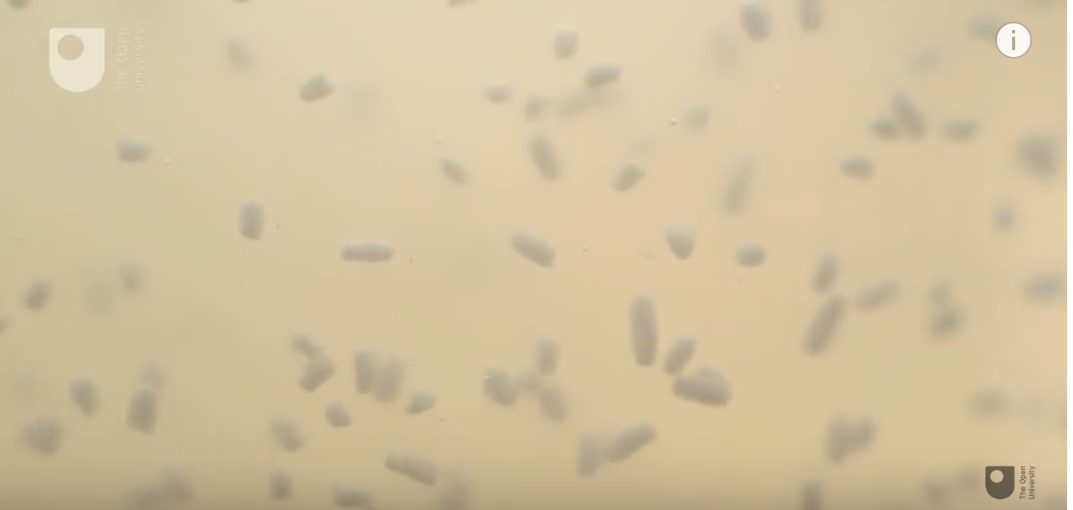
Measuring respiration in yeast
https://www.youtube.com/watch?v=Cngt2HmJuSo

Slide 27
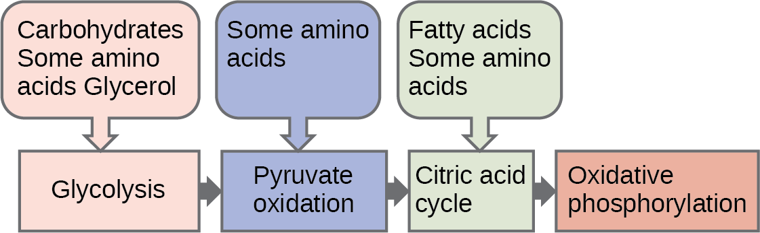
Connections of Lipid and Glucose Metabolisms
Catabolic pathways for carbohydrates, lipids, and proteins eventually connect to glycolysis or the CAC pathways.

Slide 28
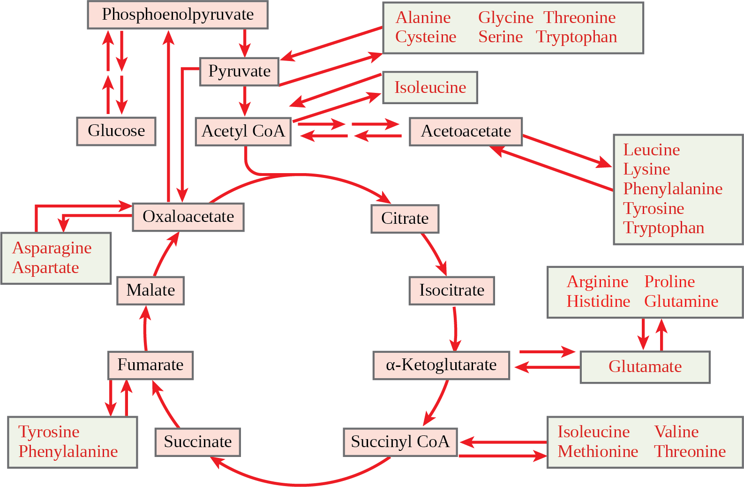
Citric Acid Cycle
Amino Acids that enter the Citric Acid Cycle do so at different locations, depending on the AA.

Slide 29
Regulation of Cellular respiration
Cellular respiration is regulated by many mechanisms, including
Hormonal control of glucose entry into the cell
Enzyme reversibility (functioning to substrate product equilibrium) or irreversibility (able to exceed equilibrium)
Enzyme sensitivity to pH changes due to lactic acid build-up
Feedback controls

Slide 30
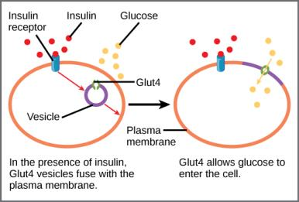
Regulatory mechanisms

Slide 31
Summary of Feedback Controls in Cellular Respiration
Pathway | Enzyme affected | Elevated levels of effector | Effect on pathway activity
glycolysis | Hexokinase | Glucose-6-phosphate | decrease
 | Phosphofructokinase | Fructose-6-phosphate | increase
 |  | Citrate, acidic pH | decrease
Pyruvate to acetyl coA | Pyruvate dehydrogenase | ADP, pyruvate | increase
 |  | Acetyl coA, ATP, NADH | decrease
CAC | Isocitrate dehydrogenase | ADP | increase
 |  | ATP, NADH | decrease
 | Ketoglutarate dehydrogenase | Calcium ions, ADP | increase
 |  | ATP, NADH, succinyl coA | decrease
ETC |  | ADP | Increase
 |  | ATP | decrease

