Slide 1
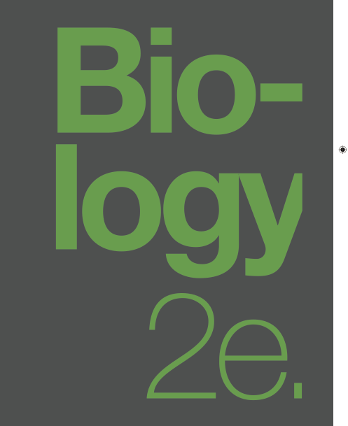

BIOLOGY 2e
Chapter 14 DNA STRUCTURE AND FUNCTION
PowerPoint Image Slideshow
This work is licensed under a Creative Commons Attribution-NonCommercial-ShareAlike 4.0 International License.

Slide 2
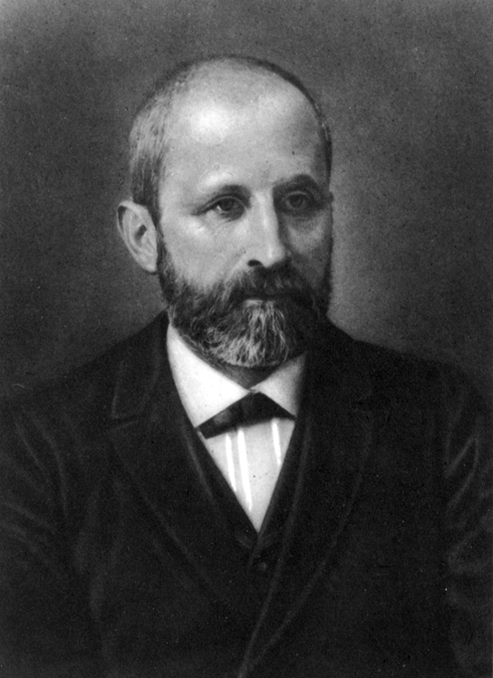
Historical Background
In 1869 Friedrich Miescher isolated phosphate rich acidic compounds from the nuclei of leucocytes in pus from hospital bandages.
He termed this material nuclein since he was able to isolate it from prepared cell nuclei.
Eventually this material became known as DNA or Deoxyribonucleic Acid.

Slide 3
Frederick Griffith and the “Transforming Principle”
Griffith used two strains of Streptococcus pneumoniae.
The R strain had rough colonies and was non-pathogenic.
The S strain had smooth colonies and was pathogenic causing death.
When Griffith injected a mouse with the heat-killed S strain and a live R strain, the mouse died.
Live S strain bacteria were recovered from the dead mouse.
Griffith concluded that something had passed from the heat-killed S strain to the R strain, transforming the R strain into S strain in the process.

Slide 4
Oswald Avery, Colin Macleod, and Maclyn McCarty (1944): Showed the transforming principle was most likely to be nucleic acids.
DNA is the informational component transferred during transformation
Recovered cell extracts of the S strain from dead mice.
Systematically used enzymes to specifically degrade macromolecules.
Sequentially mixed these extracts with R strain and injected the mice.

Slide 5
Hershey and Chase's Blender Experiment
Hershey and Chase reasoned that bacteriophages were injecting their genes into bacteria host to reproduce.
Sought to isolate the injected material.
Bacteria were infected with phage radiolabeled with either ³⁵S, which labels protein, or ³²P, which labels DNA.
Given just enough time to infect the hosts, the phage coats were then knocked off host with a blender.
Bacteria were centrifuged and examined to see what had entered the cell.
Only ³²P entered the bacterial cells, indicating that DNA is the genetic material.

Slide 6
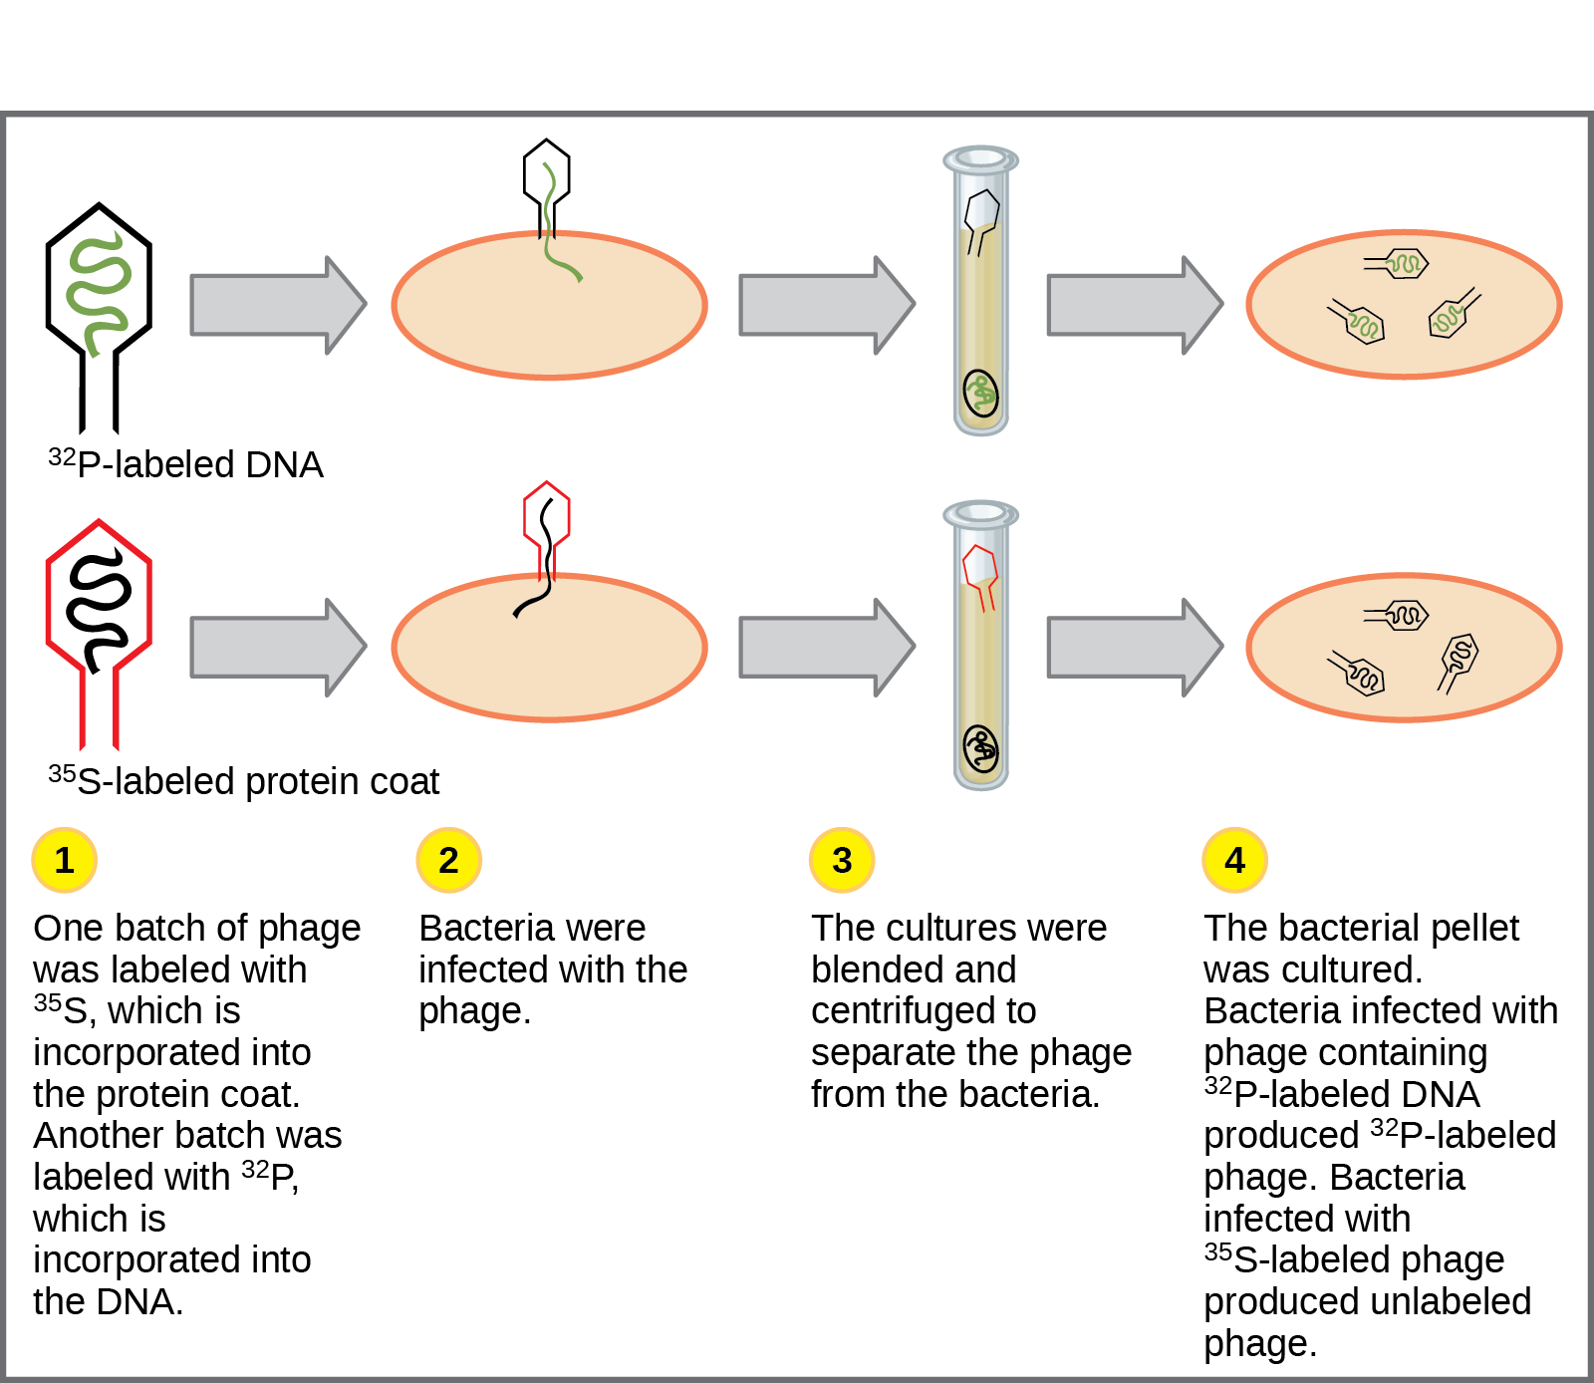
Hershey and Chase's Blender Experiment

Slide 7
Erwin Chargaff broke nucleic acids into their components.
Showed DNA was composed of 4 nucleotide building blocks, adenine, thymine, cytosine and guanine.
In 1950, he discovered that the amounts of adenine and thymine in DNA were roughly the same, as were the amounts of cytosine and guanine.
This later became known as Chargaff's rules:
% adenine = % thymine
and
% cytosine = % guanine

Slide 8
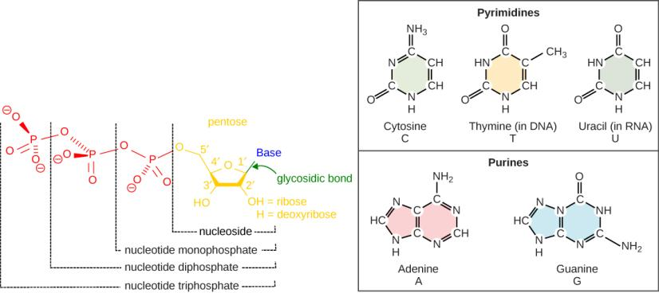
Structure of Nucleotides
Each nucleotide is made up of
A sugar (deoxyribose in DNA and ribose in RNA)
A nitrogenous base (either adenine, thymine, cytosine and guanine or uracil in RNA)
A phosphate group

Slide 9
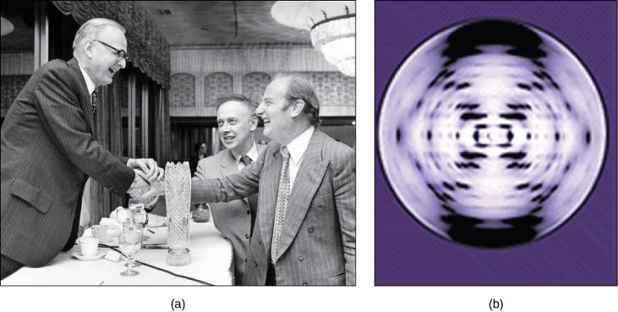
Chargaff’s rules and Rosalind Franklin’s findings helped James Watson and Francis Crick determine the structure of the DNA molecule in 1953
The work of pioneering scientists (a) James Watson, Francis Crick, and Maclyn McCarty led to our present day understanding of DNA. Scientist Rosalind Franklin discovered (b) the X-ray diffraction pattern of DNA, which helped to elucidate its double helix structure. (credit a: modification of work by Marjorie McCarty, Public Library of Science)

Slide 10
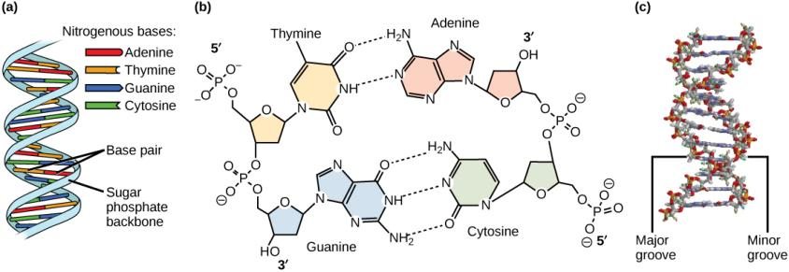
DNA Structure
DNA is a double helix polymer made up of repeating nucleotides bound covalently linked by phosphodiester bonds (a&b).
The two polymer strands run in opposite directions They are directional and antiparallel (b).
The Two polymer strands are held together by specific complementary hydrogen bonds between opposing nitrogenous bases(b).
This forms a regular double helix with major and minor grooves for access by DNA binding proteins during processes such as transcription (the copying of RNA from DNA) and replication (c).

Slide 11
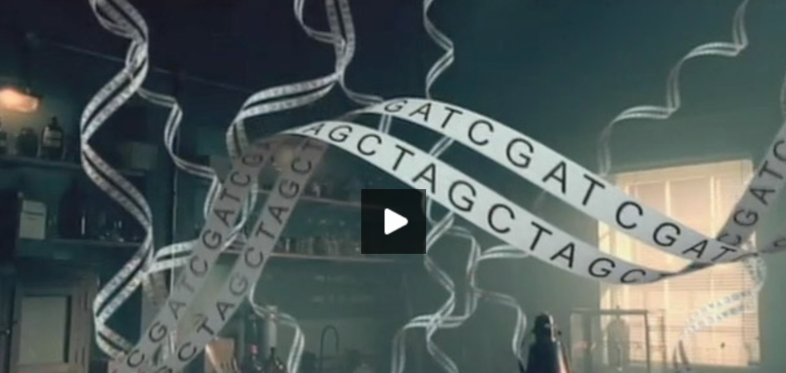
Sanger method of dna sequencing
https://www.dnalc.org/view/15479-Sanger-method-of-DNA-sequencing-3D-animation-with-narration.html

Slide 12
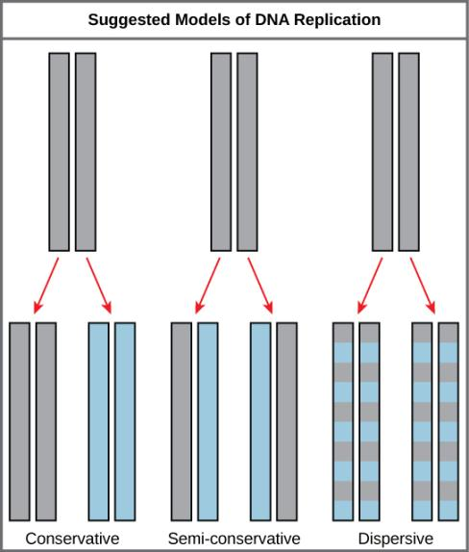
DNA replication
The three suggested possible models by which DNA replication might occur.
Conservative replication – original parent double strands remain intact and two completely new double helix strands are synthesized
Semi-conservative replication– the two strands come apart – each acts as a template for synthesis of a new complementary strand.
Dispersive replication– both original parent strands are broken up into small pieces and incorporated into newly synthesized strands
Gray indicates the original DNA strands, and blue indicates newly synthesized DNA.

Slide 13
Meselson and Stahl’s experiment demonstrated that replication was semi-conservative
Meselson and Stahl experimented with E. coli grown first in heavy nitrogen (¹⁵N) then in ¹⁴N.
DNA grown in ¹⁵N (red band) is heavier than DNA grown in ¹⁴N (orange band), and sediments to a lower level in cesium chloride solution in an ultracentrifuge.
When DNA grown in ¹⁵N is switched to media containing ¹⁴N, after one round of cell division the DNA sediments halfway between the ¹⁵N and ¹⁴N levels, indicating that it now contains fifty percent ¹⁴N.
In subsequent cell divisions, an increasing amount of DNA contains ¹⁴N only. This data supports the semi-conservative replication model.

Slide 14
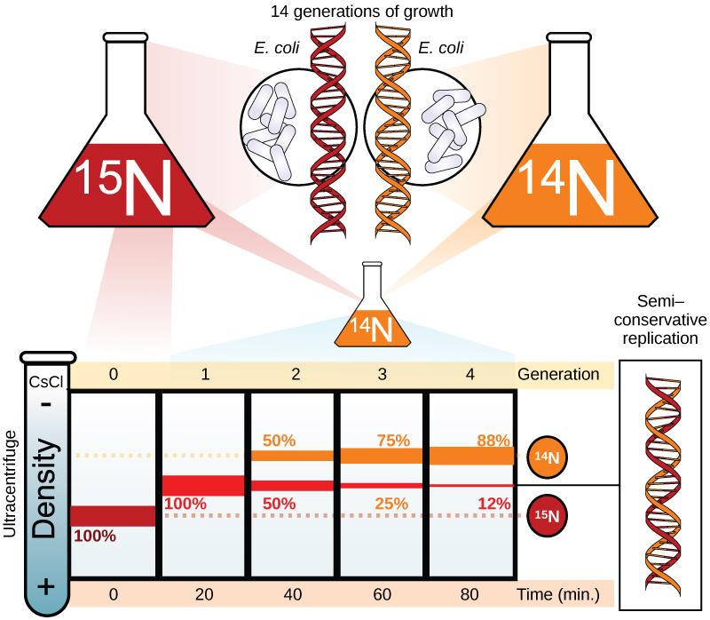
Meselson and Stahl’s experiment demonstrated that replication was semi-conservative

Slide 15
Model of DNA replication in prokaryotes

Slide 16
Model of DNA Replication in Prokaryotes
A replication fork is formed when helicase separates the DNA strands at the origin of replication.
Topoisomerase prevents the over-winding of the DNA double helix ahead of the replication fork as the DNA is opening up.
Single-strand binding proteins(ssb) bind to the single-stranded DNA to prevent the helix from re-forming.
Primase synthesizes an RNA primer. DNA polymerase III uses this primer to synthesize the daughter DNA strand.
DNA polymerase I replaces the RNA primer with DNA.
DNA ligase seals the gaps between the Okazaki fragments, joining the fragments into a single DNA molecule.

Slide 17
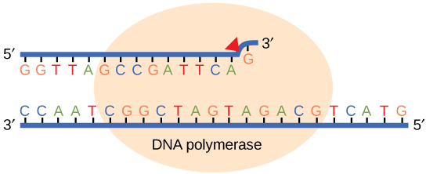
Mistakes during replication are detected and repaired by DNA polymerase proofreading activity
Proofreading by DNA polymerase corrects errors during replication.

Slide 18
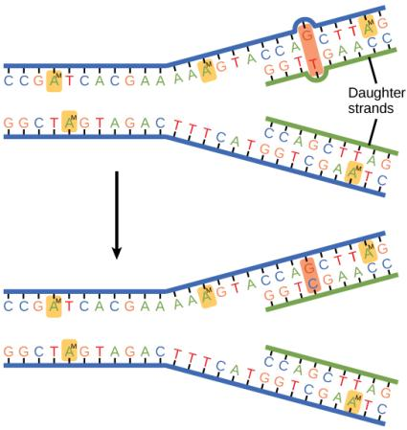
Mismatch Repair
In mismatch repair, the incorrectly added base is detected after replication.
The mismatch repair proteins detect this base and remove it from the newly synthesized strand by nuclease action.
The gap is now filled with the correctly paired base.

Slide 19
Nucleotide excision
Nucleotide excision repairs thymine dimers.
When exposed to UV, thymines lying adjacent to each other can form covalently linked thymine dimers.
In normal cells, these mutations are excised and replaced.

Slide 20
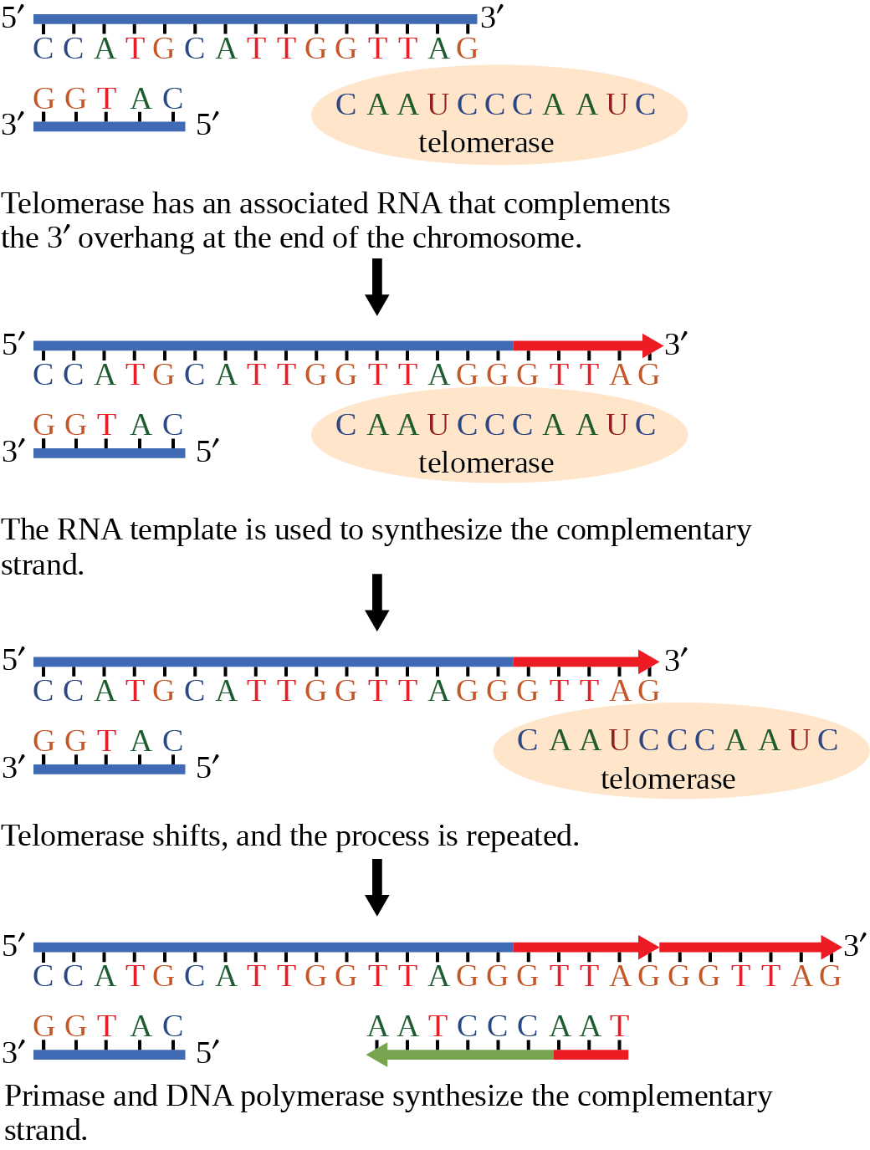
Replication potentially shortens the ends of eukaryotic chromosomes
The ends of linear chromosomes are maintained by the action of the telomerase enzyme.

Slide 21
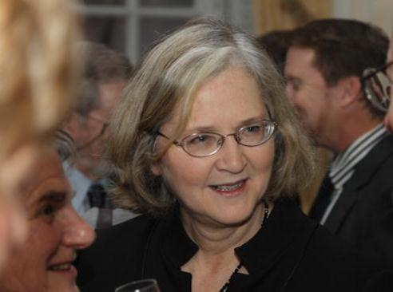
Elizabeth Blackburn, 2009 Nobel Laureate
Elizabeth Blackburn, 2009 Nobel Laureate, is the scientist who discovered how telomerase works.

Slide 22
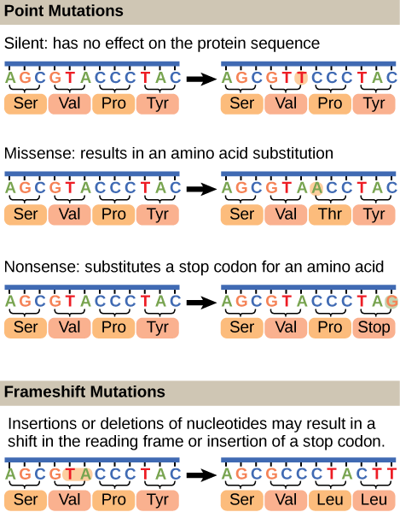
Uncorrected replication errors result in mutations
Replication is not a perfect process. Errors occur and if uncorrected produce mutations.
Mutations are changes in the nucleotide sequence of the DNA strands.
Mutations can lead to changes in the protein sequence encoded by the DNA.

Slide 23
Uncorrected replication errors result in mutations
There are several types of mutation:
Point mutations
Silent
Missense
Nonsense
Frameshift mutations
insertions
deletions
Chromosome mutations
insertions, deletions, translocations, inversions,
fusions, duplications

Slide 24
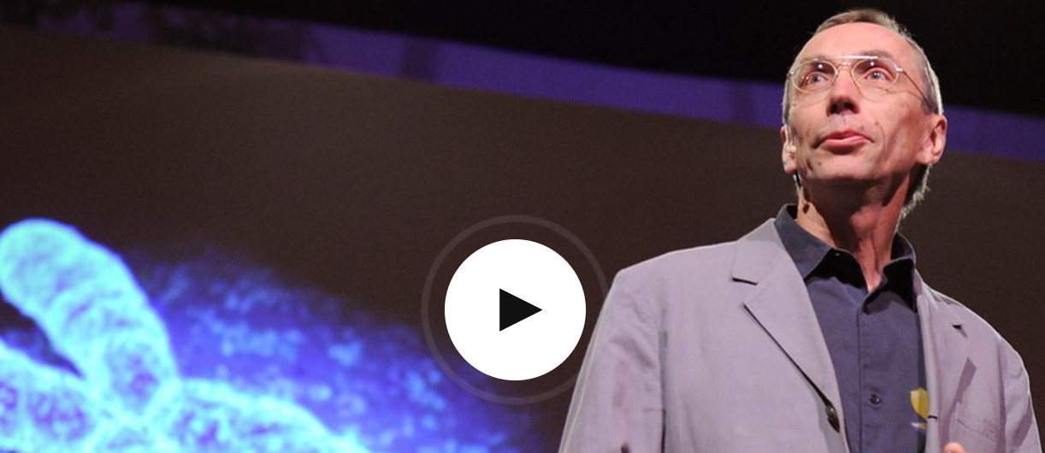
Svante Pääbo’s talk explaining the Neanderthal genome research
https://www.ted.com/talks/svante_paeaebo_dna_clues_to_our_inner_neanderthal

Slide 25
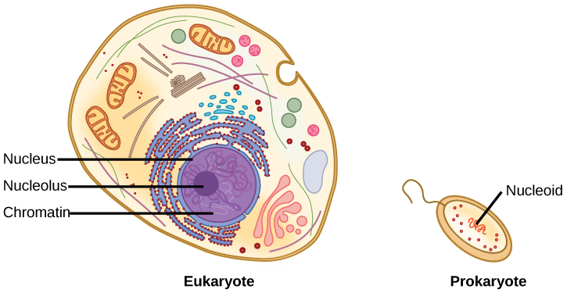
Eukaryote Vs Prokaryote
A eukaryote contains a well-defined nucleus, whereas in prokaryotes, the chromosome lies in the cytoplasm in an area called the nucleoid.

Slide 26
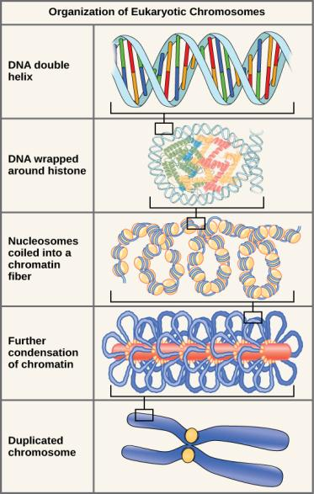
Compaction of the Eukaryotic Chromosome.
DNA double helix
The DNA helix is wrapped around an octet of histone proteins to form nucleosomes.
Nucleosomes are coiled up to forn a solenoid shape.
The solenoid is further looped back and forth and attached to scaffolding proteins
Fully compacted DNA and packaging proteins form a condensed eukaryotic chromosome.

Slide 27
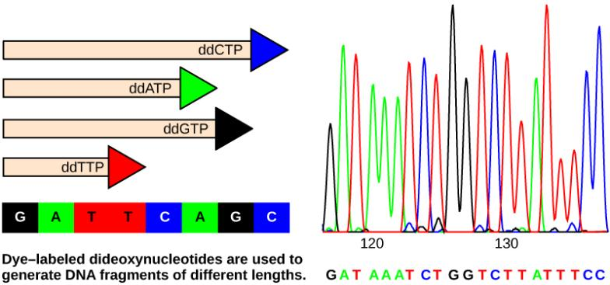
Reading the DNA code – Sanger dideoxynucleotide sequencing
In Frederick Sanger's dideoxy chain termination method, dye-labeled dideoxynucleotides are used to generate DNA fragments that terminate at different points.
The DNA is separated by capillary electrophoresis on the basis of size, and from the order of fragments formed, the DNA sequence can be read. The DNA sequence readout is shown on anelectropherogram that is generated by a laser scanner.

Slide 28
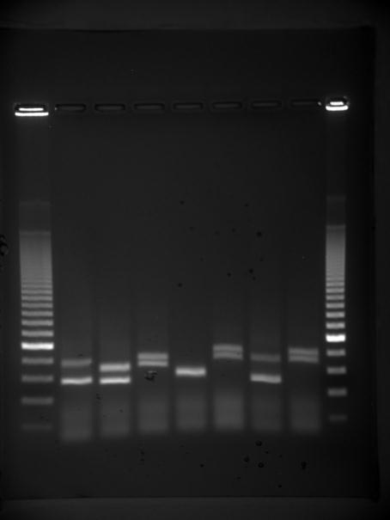
Gel Electrophoresis
DNA has a negative charge and will move towards a positive pole in an electrical field.
DNA fragments are loaded into a gel that is electrified.
The gel acts as a sieve sorting fragments by size.
Small fragments move more easily through the pores of the gel than do large ones.
The result is that smaller fragments move faster than larger fragments sorting by size.

