Slide 1
MEDIEVAL PERIOD
(DARK AGES)
Dr. Doris -Spooner Hall
Exploring The Arts

Slide 2
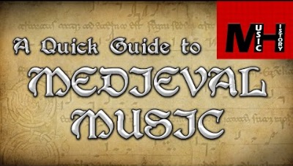
Overview of the Medieval Period

Slide 3
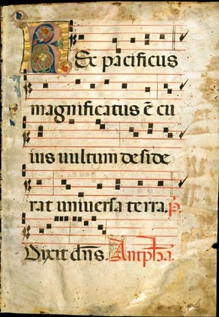
Medieval Period
        Music of the Medieval Period
        consisted of neumes,
        3 spaces and a 4 line staff.

Slide 4
Medieval Period
The Middle ages span from the 5th Century to the 15th Century
Music held a central place in the cultures of ancient Greece, Rome and the Judiac world.
The culture was shaped by Monasteries.
Center of power was the church and state in terms of music.

Slide 5
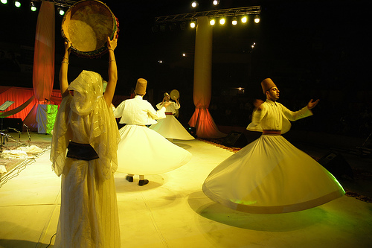

Slide 6
During the Middle Ages, as during other periods of Western history, sacred and secular worlds were both separate and integrated. However, during this time, the Catholic Church was the most widespread and influential institution and leader in all things sacred. The Catholic Church’s head, the Pope, maintained political and spiritual power and influence among the noble classes and their geographic territories; the life of a high church official was not completely different from that of a noble counterpart, and many younger sons and daughters of the aristocracy found vocations in the church. Towns large and small had churches, spaces open to all: commoners, clergy, and nobles.
The Catholic Church also developed a system of monasteries, where monks studied and prayed, often in solitude, even while making cultural and scientific discoveries that would eventually shape human life more broadly. In civic and secular life, kings, dukes, and lords wielded power over their lands and the commoners living therein. Kings and dukes had courts, gatherings of fellow nobles, where they forged political alliances, threw lavish parties, and celebrated both love and war in song and dance. Many of the important historical developments of the Middle Ages arose from either in the church or the court. One such important development stemming from the Catholic Church would be the developments of architecture.

Slide 7
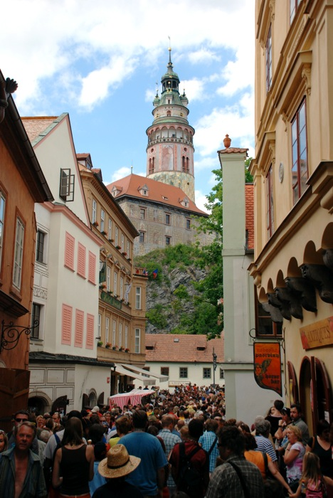

Slide 8
During this period, architects built increasingly tall and imposing cathedrals for worship through the technological innovations of pointed arches, flying buttresses, and large cut glass windows. This new architectural style was referred to as “gothic,” which vastly contrast the Romanesque style, with its rounded arches and smaller windows. Another important development stemming from the courts occurred in the arts. Poets and musicians, attached to the courts, wrote poetry, literature, and music, less and less in Latin—still the common language of the church—and increasingly in their own vernacular languages (the predecessors of today’s French, Italian, Spanish, German, and English).
However, one major development of the Middle Ages spanned sacred and secular worlds: universities shot up in locales from Bologna, Italy, and Paris, France, to Oxford, England (the University of Bologna begin the first). At university, a young man could pursue a degree in theology, law, or medicine. Music of a sort was studied as one of the seven liberal arts and sciences, specifically as the science of proportions.

Slide 9
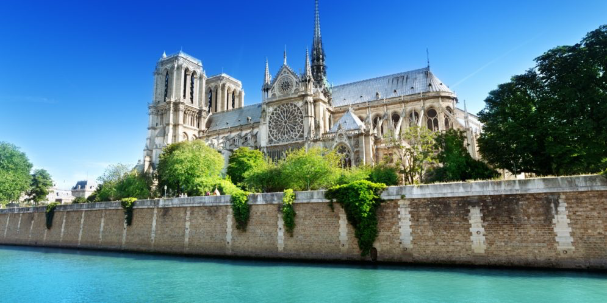
Notre Dame de Paris/
Author: “Zuffe”
The ambulatory of Notre Dame
Source: Wikimedia Commons

Slide 10
Not surprisingly, given their importance during the Middle Ages, both the Catholic Church and the network of aristocratic courts left a significant mark on music of the time. Much of the music from that era that was written down in notation and still exists comes from Christian worship or court entertainment. Churches and courts employed scribes and artists to write down their music in beautifully illuminated manuscripts such as this one that features Guillaume Machaut’s “Dame, avous sans retollir,” discussed later. Churchmen such as the monk Guido of Arezzo devised musical systems such as “solfège” still used today.
As we study a few compositions from the Middle Ages, we will see the following musical developments at play: (1) the development of musical texture from monophony to polyphony, and (2) the shift from music whose rhythm is hinted at by its words, to music that has what we refer to today as meter. Although we know that instrumental music existed in the Middle Ages, most of the music that has survived is vocal.

Slide 11
Medieval Period
Women as well as men played a role in preserving knowledge and cultivating music for the church.
Great Cathedrals were built which was the beginning of the structure of the church.
Our word “music” derives from the Greek Mousike which refers to the art of the Muses of Greek mythology.

Slide 12
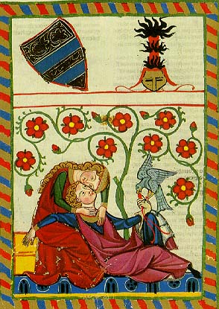

Slide 13
Sacred Music in the Medieval Period
What was the age of knighthood? ___________
Monophonic in texture
Gregorian Chant: 5 parts
Kyrie
Gloria
Credo
Sanctus-Benedictus
Agnus Dei
The Gregorian Chant received its name from Pope Gregory I.

Slide 14
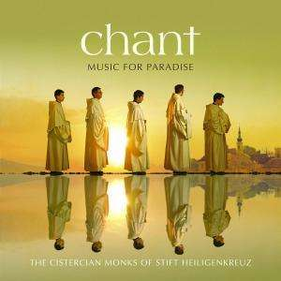

Slide 15
The earliest music of Catholic Christianity was chant, that is, monophonic a cappella music, most often sung in worship. As you learned in the first chapter of this book, monophony refers to music with one melodic line that may be performed by one or many individuals at the same time. Largely due to the belief of some Catholics that instruments were too closely associated with secular music, instruments were rarely used in medieval worship; therefore, most chant was sung a cappella, or without instruments. As musical notation for rhythm had not yet developed, the exact development of rhythm in chant is uncertain. However, based on church traditions (some of which still exist), we believe that the rhythms of medieval chants were guided by the natural rhythms provided by the words.
Medieval Catholic worship included services throughout the day. The most important of these services was the Mass, at which the Eucharist, also known as communion, was celebrated (this celebration includes the consumption of bread and wine representing the flesh and blood of Jesus Christ). Five chants of the mass (the Kyrie, Gloria, Credo, Sanctus, and Agnus Dei) were typically included in every mass, no matter what date in the church calendar. The chants were called the Gregorian Chants.
Catholics, as well as some Protestants, still use this Liturgy in worship today. In the evening, one might attend a Vespers service, at which chants called hymns were sung. Hymns, like most of the rest of the Catholic liturgy, were sung in Latin. Hymns most often featured four-line strophes in which the lines were generally the same length and often rhymed. Each strophe of a given hymn was sung to the same music, and for that reason, we say that hymns are in strophic form.

Slide 16
Sacred Music of the Medieval Period
What is Syllabic, Neumatic, and Melismatic?
What is the Organum and its significance?
The Notre Dame School and the Notre Dame Cathedral… Leonin and Perotin
The Notre Dame Cathedral is in Paris, France.
The beginning of polyphonic music.
What is iso-rhythm or same rhythm

Slide 17
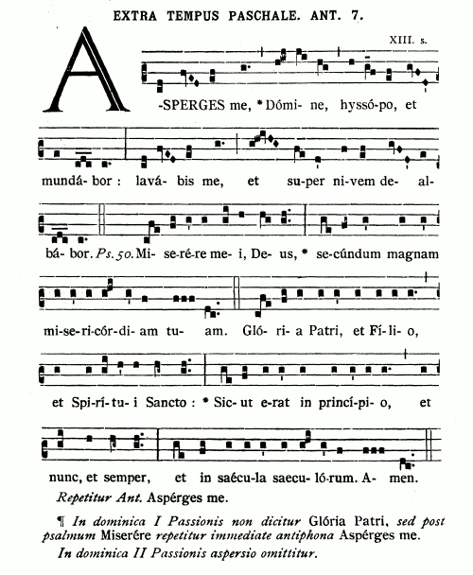

Slide 18
Characteristics of the Gregorian Chant
Music of the Greek and Hebrews
Monophonic texture
Lacking in harmony and counterpoint
Free flowing vocal lines.
Avoids wide leaps, mostly steps
Syllabic, Neumatic, and Melismatic
Elaborate improvisation sometimes.

Slide 19
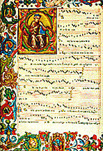

Slide 20
Gregorian Chant
Neumes representing notes
Modes – Bases of the modern scales
Used in the Mass consisting of the Proper and the Ordinary.
What are the Offices, Proper, and Ordinary of the Mass.

Slide 21
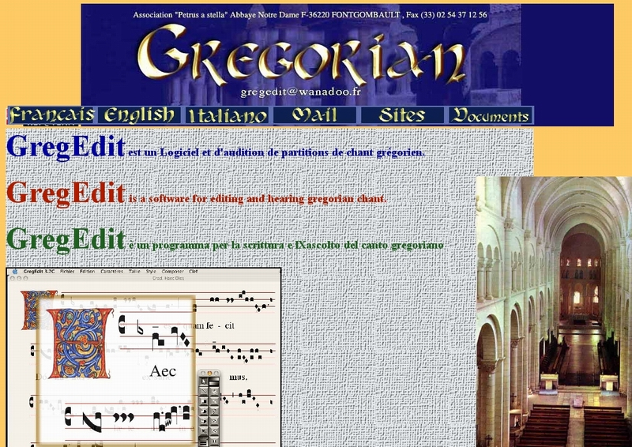

Slide 22
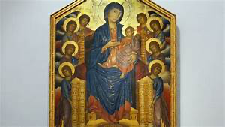
Catholics, as well as some Protestants, still use this Liturgy in worship today. In the evening, one might attend a Vespers service, at which chants called hymns were sung. Hymns, like most of the rest of the Catholic liturgy, were sung in Latin. Hymns most often featured four-line strophes in which the lines were generally the same length and often rhymed. Each strophe of a given hymn was sung to the same music, and for that reason, we say that hymns are in strophic form.
Hymns like most chants generally had a range of about an octave, which made them easy to sing. Throughout the Middle Ages, Mary the mother of Jesus, referred to as the Virgin Mary, was a central figure in Catholic devotion and worship. Under Catholic belief, she is upheld as the perfect woman, having been chosen by God to miraculously give birth to the Christ while still a virgin. She was given the role of intercessor, a mediator for the Christian believer with a petition for God, and as such appeared in many medieval chants.
The Virgin Mary featured in a panel from an altarpiece painted by Cimabue around 1280
Author: Cimabue
Source: Wikimedia Commons

Slide 23
“Ave Generosa” by Hildegard of Bingen (Twelfth Century)
Many composers of the Middle Ages will forever remain anonymous. Hildegard of Bingen (1098-1179) from the German Rhineland is a notable exception. At the age of fourteen, Hildegard’s family gave her to the Catholic Church where she studied Latin and theology at the local monastery. Known for her religious visions, Hildegard eventually became an influential religious leader, artist, poet, scientist, and musician. She would go on to found three convents and become an abbess, the chief administrator of an abbey.
Writing poetry and music for her fellow nuns to use in worship was one of many of Hildegard’s activities, and the hymn “Ave Generosa” is just one of her many compositions. This hymn is a 12th century composition, and a type of chant. It is strophic in form. This hymn has multiple strophes in Latin that praise Mary and her role as the bearer of the Son of God. The manuscript contains one melodic line that is sung for each of the strophes, making it a strophic monophonic chant. Although some leaps occur, the melody is conjunct. The range of the melody line, although still approachable for the amateur singer, is a bit wider than other church chant of the Middle Ages. The melody also contains melismatic at several places. A melismatic style is the singing of multiple pitches on one syllable of text. Overall, the rhythm of the chant follows the rhythm of the syllables of the text.

Slide 24
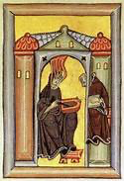
YouTube: https://www.youtube.com/watch?v=RJzeD4HHnxs&feature=youtu.be

Slide 25
Explanation from You
What is a Motet and an Organum?
What do we mean by polyphonic?
Explain “Chant as Music for Worship” in your own words – p. 86-87 Cultural Perspective 4

Slide 26
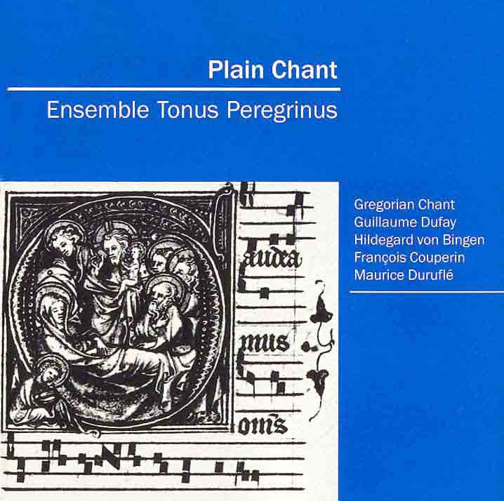

Slide 27
Secular Music of the Medieval Period
Secular music arose in courts. Performed by aristocratic Trouveres ( Northern France, Troubadors came from (Southern Region of France, Jongleurs and Minnesingers (Germany)
Secular songs were sung Monophonically.
Instrumental music was improvised
There music derived from simple ballads to love songs, political and moral duties, war songs, laments, and dance songs.

Slide 28
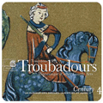

Slide 29
Guillaume de Machaut and the French Ars Nova
Ars Nova meaning – New Music, New Style, New Technique
French composer, poet, musician, composer, and a priest who took the Holy Orders.
Developed in to rhythm, meter , harmony, and counterpoint that transformed the art of music.
Explain the Instrumental Music of the Medieval Period from reading in your textbook.

Slide 30
Guillaume de Machaut
End of the Times for the Medieval Period moving to the Renaissance 16th Century

Slide 31
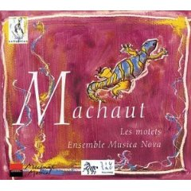

Slide 32
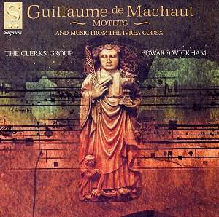

Slide 33
Medieval Summary
In the Medieval period, we have studied music that dates back almost 1500 years from today. In some ways, it differs greatly from our music today, though some continuous threads exist. Individuals in the Middle Ages used music for worship and entertainment, just as occurs today. They wrote sacred music for worship and used sacred ideas in entertainment music. Music for entertainment included songs about love, religion, and current events as well as music that might be danced to. Though the style and form of their music is quite different from ours in many ways, some aspects of musical style have not changed. Conjunct music with a relatively narrow range is still a typical choice in folk and pop music, because it is easy for even the amateur to sing. Songs in strophic form and songs with a refrain and contrasting verses also still appear in today’s pop music. As we continue to study music of the Renaissance, keep in mind these categories of music that remain to the present day.

Slide 34
Medieval Glossary/Vocabulary
A cappella – vocal music without instrumental accompaniment
Cadence – the ending of a musical phrase providing a sense of closure, often using one chord that resolves to another
Chant – text set to a melody written in monophonic texture with un-notated rhythms typically used in religious worship
Courtly Love – love for a beloved, without any concern for whether the love will be returned, called “courtly” because it was praised by those participating in medieval courts
Drone – a sustained pitch or pitches often found in music of the Middle Ages or earlier and in folk music
Hymn – religious song most generally having multiple strophes of the same number and length of lines and using strophic form
Mass – Catholic celebration of the Eucharist consisting of liturgical texts set to music by composers starting in the Middle Ages

Slide 35
Melisma – multiple pitches sung to one syllable of text Polyphony – musical texture that simultaneously features two or more relatively independent and important melodic lines
Refrain – a repeating musical section, generally also with repeated text; sometimes called a “chorus”
Rhythm According to the Text – rhythm that follows the rhythm of the text and is not notated
Song – a composition sung by voice(s)
Strophe – section of a poem or lyric text generally of a set number of lines and line length; a text may have multiple strophes
Strophic – musical form in which all verses or strophes of a song are sung to the same music
Syllabic – music in which each syllable of a text is set to one musical note
Verse and Refrain Form – a musical form (sometimes referred to as verse and chorus) in which one section of music is sung to all the verses and a different section of music is sung to the repeating refrain or chorus

Slide 36
RENAISSANCE PERIOD
MUSIC
OF THE
16TH CENTURY
The End
Of the
Medieval Period
5th Century to the 15th Century

