Slide 1
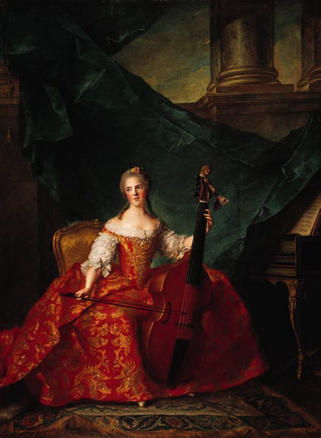
Eighteenth-Century Classicism
“Music is the favorite passion of my soul.”
—Thomas Jefferson
Notes:
“Music [is] the favorite passion of my soul.” —Thomas Jefferson
Artwork: Anne Henriette de France by Jean-Marc Nattier (1685–1766).

Slide 2


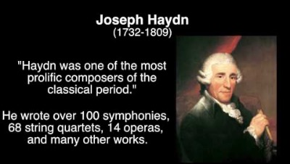
OVERVIEW OF THE CLASSICAL PERIOD IN MUSIC

Slide 3
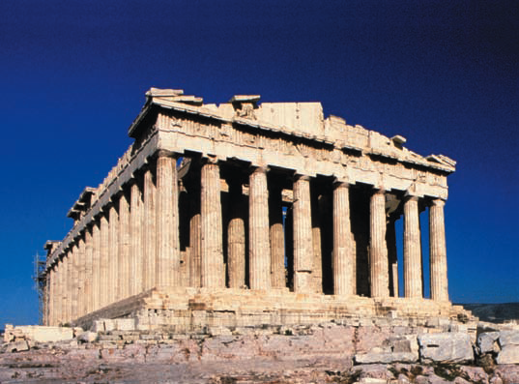
Classicism in the Arts
Order, objectivity, and proportion
Greece and Rome
European aristocratic sovereigns
American Revolution (1775–83)
French Revolution (1789–99)
Advances in science and ideas
Industrial Revolution
Age of Reason
The Parthenon, Athens (447–438 B.C.E.)
Notes:
In the Classical era, order, reason, and serenity were used to express emotions in the different art forms. The Classicists sought to emulate the qualities of order, stability, and harmonious proportion, which were found in the art and literature of ancient Greek and Rome.
Aristocratic sovereigns continued to rule, enjoying power through inherited right. However, the social upheaval of the French revolution from
1789–99 shifted the power from the aristocracy to the middle class.
The American Revolution (1775–83) broke out before the French Revolution. The trigger was injustices imposed on them by the English king, George II, however, the main issue was that of human equality and freedom. The Industrial Revolution contributed to the wealth of the middle class. Inventions included the improved steam engine, spinning jenny, and cotton gin. Advances in science improved the human condition as well. Benjamin Franklin harnessed electricit,; Joseph Priestly discovered oxygen, and Edward Jenner perfected vaccination.
This era has been called the Age of Reason due to the popularity of the social and political ideas of Voltaire and Rousseau. These philosophers were also advocates of the middle class because equality of man was a main tenet of their philosophy: “Man is born free, and everywhere he is in chains.” —Rousseau
Pictured: The Parthenon, Athens (447–438 B.C.E.). The architecture of ancient Greece embodied the ideals of order and harmonious proportions.

Slide 4
Of all the musical periods, the Classical period is the shortest, spanning less than a century. Its music is dominated by three composers whose works are still some of the bests known of all Western art music: Joseph Haydn (1732-1809), Wolfgang Amadeus Mozart (1756-1791), and Ludwig van Beethoven (1770-1827). Although born in different European regions, all three spent a substantial amount of time in Vienna, Austria, which might be considered the European musical capital of the time.
Music scholars have referred to this time as the Classical period in music for several reasons. For one, the music of Haydn, Mozart, and Beethoven has served as the model for most composers after their time and is still played today; in this way, the music is “classic” in that it has provided an exemplar and has stood the test of time. As we will also see, this music has often been perceived as emulating the balance and portion of ancient Greek and Roman art, the time to which the word “classical” is affixed within literature and art history, as well as the wider field of history.
Our use of the Classical period to refer to music of roughly 1750 to 1815, however, should not be confused with our broader use of the term “classical music” to refer to art music (music that does not otherwise fall within the spheres of popular music or folk music). Beginning towards the end of the 16th century, citizens in Europe became skeptical of traditional politics, governance, wealth distribution, and the aristocracy. Philosophers and theorists across Europe began to question these norms and issues and began suggesting instead that humanity could benefit from change. Publications and scientific discoveries of these thinkers proving and understanding many of nature’s laws spurred the paradigm shift of logic referred to as the Age of Reason, or the Enlightenment.

Slide 5
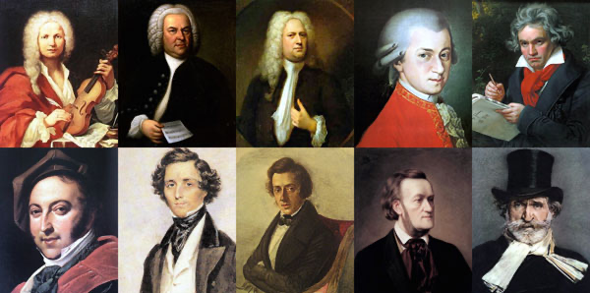
Classicism in the Arts
Viennese School
The rising middle class, on the contrary, viewed and interpreted neoclassical arts as representations of Roman and Greek city-states. This view assisted their resolve to rebel against the tyrants and abolish despotism. Here musical terminology diverges from that used by art historians (Neoclassicism in music would have to wait for the 20th century). As we have few musical exemplars from classical antiquity and as the music of Haydn, Mozart, and Beethoven would become the model for nineteenth century music, music historians have referred to this period as a time of Musical Classicism.
Haydn
Mozart
Beethoven
Schubert
Notes:
The Viennese school is a name given to a group of Classical era composers: Haydn, Mozart, and Beethoven. Their music characterizes the Classical Period in music (c. 1750–1825) with lyrical and appealing treatment of melodic and harmonic elements, as well as the development of highly structured instrumental forms.
“Classicism” does not imply that these outstanding composers strictly adhered to the forms that were set into place during this era. They would often depart from them as they desired. With regard to harmonic material, they would often experiment with the possibilities of the major-minor system to the fullest.
One example of such a departure is found in Mozart’s String Quartet No. 19 in C major, K. 465, which was nicknamed “Dissonance” because of its unusually slow introduction.
The ideas of the Viennese school were continued in the work of Franz Schubert.

Slide 6

Classicism in the Arts
Elements of Classical Style
Singable, lyrical melody
Diatonic harmony
Regular rhythms and meters
Homophonic texture
(melody with accompanying harmony)
Frequent use of folk elements
The Rotunda of the University of Virginia
Mozart: Piano Concerto No. 21, II
Haydn: Trumpet Concerto in E flat, III
Haydn: Symphony No. 94, III (folk elements)
Notes:
Elegant, lyrical melodies characterize the Classical style. Even the instrumental melodies of this era are easy to sing.
Classical melodies are often structured in symmetrical four-bar phrases with clear cadences (or resting points) and tend to move stepwise or by small leaps within a narrow range.
The harmonies are diatonic—built from the seven tones of the major or minor scale. The melody is often set gracefully in a homophonic texture (a melody with an accompanying harmony).
Although designed to cater to aristocratic elegance, the songs, symphonies, concerti, string quartets, and sonatas of the Classical era exhibit the influence of the folk and popular elements present in the surrounding culture.
Musical Examples: Mozart Piano Concerto No. 21, II
Haydn Trumpet Concerto in E flat, III
Haydn Symphony No. 94, III. [link to excerpts]
Pictured: Thomas Jefferson’s design for the Rotunda of the University of Virginia at Charlottesville, completed in 1826, reflects his admiration for classical architecture.

Slide 7
The seeds for the Enlightenment can be found in England in approximately the 1680s. In that decade, Newton published Principia Mathematica and John Locke published his “Essay Concerning Human Understanding.” These two works provided the philosophical, mathematical, and scientific foundation for the Enlightenment’s great developments. Locke stressed that knowledge is gained through accumulated life experience rather than by acquired outside truth. Newton’s mathematics and optical theory showed that humans can observe, study, define, and test the world around them and can also mathematically measure and prove natural occurrences. Besides Locke and Newton, Enlightenment thinkers included Voltaire, Montesquieu, Jean-Jacque Rousseau, Benjamin Franklin, and Immanuel Kant. Their works especially stressed improving humanity’s condition using reason and common sense to provide liberty and justice for all. Many Enlightenment thinkers challenged blind and unconditional following of the authority of religious traditions and institutions and emphasized what they saw as “universal human goods and rights.” They believed that if humankind would simply act with common sense—found in ideas such as “the golden rule”—then societies might advance with greater universal justice and liberty.
Being able to solve and understand many of the mysteries of the universe in a quantifiable manner using math and reason, was empowering. Much of the educated middle class applied these learned principles to improve society. Enlightenment ideals lead to political revolutions throughout the Western world. Governmental changes such as Britain’s embrace of constitutional democratic form of government and later the United States of America’s establishment of democratic republic completely changed the outlook of the function of a nation/state. The overall well-being and prosperity of all in society became the mission of governance. Up until the mid-1700s art, including music, was under the direct control or patronage of the monarchy/aristocracy, the class whose unquestioned rule was founded on divine hereditary right.

Slide 8
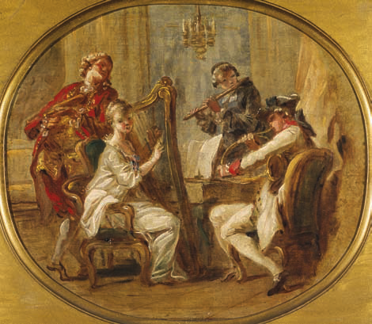
Classicism in the Arts
The Patronage System
Music was considered to be an adornment of life
Social events
Musicians little better than servants
Women under the system of patronage
Public concert venue (site) inspires productivity in composers
Notes:
The culture of the eighteenth century received its sustenance from the patronage (or sponsorship) of the aristocracy—who viewed the arts as a necessary adornment of life.
Social events created a steady demand for new works from composers. Musicians ranked little better than servants, but most found it to be a workable system that provided economic security and an environment in which they were able to function as artists.
Middle-class women found a place as musicians under the patronage system. They were prominent figures in operas and court ballets. Some were court instrumentalists and music teachers- offering private lessons to members of the nobility. There was a rise in the number of women pianists and violinists who made careers as solo performers.
Eventually musical performances were able to be held in public concert venues. The audiences of this era were eager to hear the latest works rather than music of the past, which inspired productivity in composers.

Slide 9

The Development of Classical Forms
“I alter some things, eliminate and try again until I am satisfied. Then begins the mental working out of this material in its breadth, its narrowness, its height and depth.”
—Ludwig van Beethoven
Evoë 3 (2003), Bridget Riley
Notes:
“I alter some things, eliminate and try again until I am satisfied. Then begins the mental working out of this material in its breadth, its narrowness, its height and depth.” —Ludwig van Beethoven
Artwork: British optical artist Bridget Riley (b. 1931) explores the large-scale development of a motive through subtle variations in size, shape, and position. Evoë 3 (2003).

Slide 10
Sonata Form
The most important innovation in form during the Classical period is what we call Sonata Form. This form got its name from being used as the first movement of most piano sonatas of the Classical period. Consisting of three sections—exposition, development, and recapitulation—it was also used for the first movements (and sometimes final movements) of almost all Classical symphonies and string quartets. The exposition of a sonata form presents the primary themes and keys of the movement. After the first theme is presented in the home or tonic key, the music modulates to a different key during a sub-section that is called a “transition.” Once the new key is established, subsequent themes appear. The exposition generally ends with a rousing confirmation of the new key in a sub-section called the “closing.” The exposition then often repeats.
As its name implies, the development “develops” the primary themes of the movement. The motives that comprise the musical themes are often broken apart and given to different parts of the orchestra. These motives are often repeated in sequences and these sequences often lead to frequent modulations from one musical key to another that contribute to an overall sense of instability. Near the end of the development, there is sometimes a sub-section called the “retransition” during which the harmonies, textures, and dynamics of the music prepare the listener for the final section of the form, the recapitulation.

Slide 11
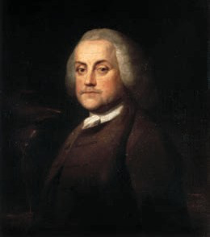
The seeds for the Enlightenment can be found in England in approximately the 1680s. In that decade, Newton published Principia Mathematica and John Locke published his “Essay Concerning Human Understanding.” These two works provided the philosophical, mathematical, and scientific foundation for the Enlightenment’s great developments. Locke stressed that knowledge is gained through accumulated life experience rather than by acquired outside truth. Newton’s mathematics and optical theory showed that humans can observe, study, define, and test the world around them and can also mathematically measure and prove natural occurrences. Besides Locke and Newton, Enlightenment thinkers included Voltaire, Montesquieu, Jean-Jacque Rousseau, Benjamin Franklin, and Immanuel Kant. Their works especially stressed improving humanity’s condition using reason and common sense to provide liberty and justice for all. Many Enlightenment thinkers challenged blind and unconditional following of the authority of religious traditions and institutions and emphasized what they saw as “universal human goods and rights.” They believed that if humankind would simply act with common sense—found in ideas such as “the golden rule”—then societies might advance with greater universal justice and liberty.
Benjamin Franklin 1959
Author: Benjamin Wilson
Source: Wikimedia Commons
License: Public Domain

Slide 12
Also true to its name, the recapitulation brings back the primary themes and home key of the movement. A simultaneous return of the first theme and home key generally marks its beginning. In the recapitulation, the listener hears the same musical themes as in the first presented in the exposition. The main difference between the exposition and the recapitulation is that the recapitulation stays in the home key. After all, the movement is about to end and ending in the home key provides the listener a sense of closure. Recapitulations often end with sub-sections called codas. The coda, or “tail,” of the movement is a sub-section that re-emphasizes the home key and that generally provides a dramatic conclusion. Starting in the late eighteenth century there were reports of listeners recognizing the basic sections of sonata form, and contemporary music theorists outlined them in music composition treatises. Their descriptions are generalizations based on the multitudinous sonata form movements composed by Haydn, Mozart, and Beethoven. Although the sonata form movements of Haydn, Mozart, and Beethoven share many of the characteristics outlined above, each sonata form is slightly different. Perhaps that is what makes their music so interesting: it takes what is expected and does something different. In fact, composers continued to write sonata forms through the nineteenth and twentieth centuries. By the end of the nineteenth century, some of these sonata forms were massive, almost-hour-long movements. You will have the opportunity to hear sonata form in several of our focus compositions from the Classical period.

Slide 13
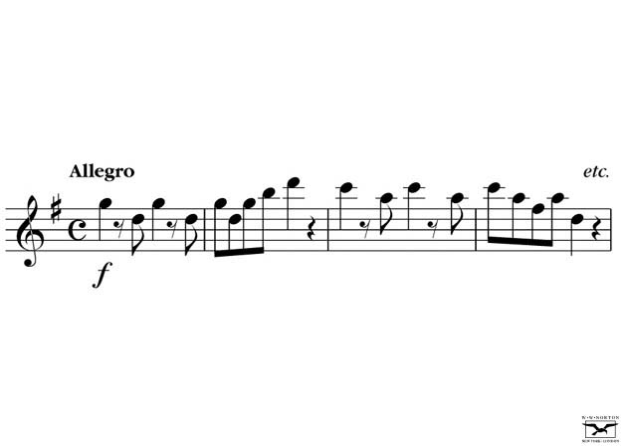
The Development of Classical Forms
Expanding Musical Ideas
Themes
Mozart, Eine kleine Nachtmusic, K. 525, I
Mozart: Symphony No. 40, I
Notes:
Musical ideas maybe be considered in terms of thought. Each thought flows logically to the next in a steady progression until it reaches a conclusion.
Themes are the musical thoughts or ideas used as building blocks in the construction of a composition.
Here is notation of the first part of the melody from Mozart’s Eine Kleine Nachtmusik, first movement.
Listen also to the opening of Mozart’s Symphony No. 40, I. [link to excerpt]

Slide 14
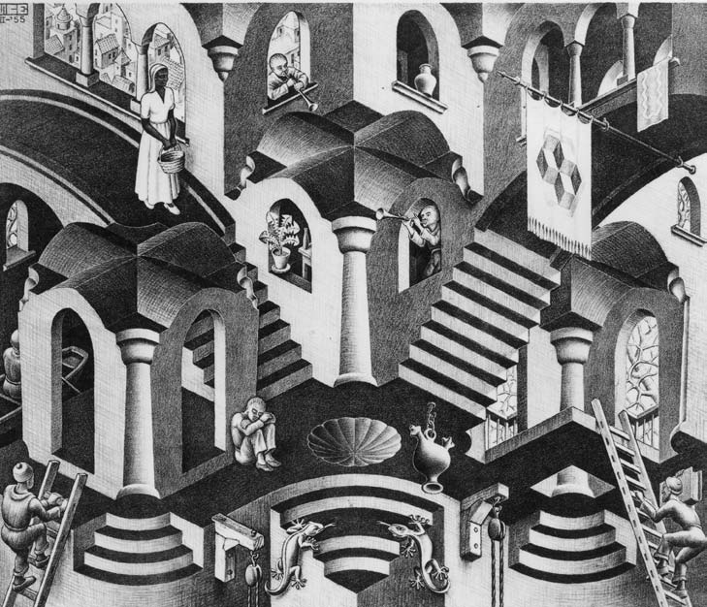
The Development of Classical Forms
Expanding Musical Ideas
Thematic development
Purcell: Rondeau from Abdelazar
Berlioz: Symphonie fantastique, I (idée fixe)
Berlioz: Symphonie fantastique, II (idée fixe)
Berlioz: Symphonie fantastique, III (idée fixe)
Berlioz: Symphonie fantastique, IV (idée fixe)
Berlioz: Symphonie fantastique, V (idée fixe)
Notes:
Thematic development is the expansion of a theme achieved by varying different elements, such as its melodic outline, rhythm, or harmony.
Thematic development requires the most imagination and skill on the part of the composer and is one of the most important techniques in the creation of a piece of music.
Here are some examples of thematic development as found in Purcell’s Rondeau from Abdelazar and the idée fixe from Berlioz’s Symphonie fantastique.
[link to excerpt]

Slide 15
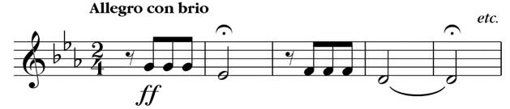
The Development of Classical Forms
Expanding Musical Ideas
Motives
Beethoven: Symphony No. 5
Mendelssohn: Italian Symphony, I
Notes:
A theme can be divided into motives, which are its smallest melodic or rhythmic units. Or conversely, motives can be connected in order to create themes that may be quite expansive.
Motives are often treated in sequence. That is: they are repeated at a higher or lower level.
Here is the musical notation the motive that comprises the first theme of Beethoven’s Symphony No. 5. Here it is treated in sequence.
Motives may also be discerned from this excerpt from Mendelssohn’s Italian Symphony, I. [ link to excerpt]

Slide 16
The Development of Classical Forms
Expanding Musical Ideas
Ostinato
o
o
t
t
s
n
o
s
n
o
i
t
i
t
a
a
o
o
t
t
s
n
o
s
n
o
i
t
i
t
a
a
An Italian word that means “obstinate” or “stubborn”
A figure that repeats over and over, usually in the bass
Notes:
An ostinato is a short repeated musical pattern. The term is derived from an Italian word that means “obstinate” or “stubborn.”
An ostinato is often an organizing feature of a work. One example of its use is in Pachelbel’s Canon in D, which features beautiful melodic lines in an imitative polyphonic setting over a constantly repeated series of notes in the bass. [no link to excerpt on this page]

Slide 17
The Development of Classical Forms
Classical Forms
Absolute music
Mozart: Sinfonia Concertante
Multimovement cycles
Symphony & String Quartet
I – Fast
II – Slow
III – Triple-meter dance
IV – Fast
Sonata & Concerto
I – Fast
II – Slow
III – Fast
Beethoven: Piano Sonata No. 8
Mozart: Symphony No. 40, I
Mozart: Piano Concerto No. 21
Beethoven: String Quartet in C Op. 59, IV
Notes:
Every musical work has a form. Absolute music is music with no pictorial or literary association.
In absolute music, form is essential because there is no prescribed story or text to hold the music together.
A mulitimovement cycle is a three- or four-movement structure found in various genres, such as the symphony, sonata, string quartet, or concerto. Each movement of a cycle is in a prescribed form, with the tempi often determined by the relative position of the movement.
Symphonies and string quartets are usually four-movement works with the relationship of the movements as noted. A sonata or concerto is usually a three-movement work, with the movements being in the order of fast-slow-fast. In addition, each movement has an internal form that binds its elements into a unique artistic unit.
Available for listening: Mozart: Symphony No. 40, I
Beethoven String Quartet in C Op. 59, IV
Beethoven Piano Sonata, No. 8
Mozart Piano Concerto, No. 21
[link to excerpt]

Slide 18
The Development of Classical Forms
The First Movement (I)
Sonata-allegro form /sonata form
A
B
A’
Exposition (repeated)
Development
Recapitulation
Theme II
Closing
Theme
Bridge
Theme I
Theme I
Bridge
Theme II
Closing
Theme
Coda
Notes:
Sonata-allegro form (also known as sonata form) is one of the most highly organized movements in a multimovement cycle.
There are three main sections in sonata-allegro form/sonata form: exposition, development, and recapitulation.
In the exposition, two themes are presented in contrasting keys. The first theme establishes the home key or tonic; a transitional passage or bridge leads to a second theme in a contrasting key. A closing section with a new theme (sometimes called the closing theme) still in the contrasting key closes out the exposition. In many eighteenth-century cycles, the exposition is repeated.
In the development, one or more of the themes undergo thematic development. Modulation, exchanges of motives, expansion, and contrasting of themes occur in this section.
In the recapitulation, which occurs after the development section, all themes return to the tonic key. The movement will often end with a coda, which is an extension of the final closing theme that leads to the final cadence or resting point in the home key.

Slide 19
Exposition (First Movement)
A
B
A’
Exposition (repeated)
Development
Recapitulation
Theme II
Closing
Theme
Bridge
Theme I
Theme I
Bridge
Theme II
Closing
Theme
Coda
Tonic
Key
Transitional
Passage
Contrasting
Key
Notes:
Here is a diagram of sonata-allegro or sonata form with a breakdown of the exposition. The exposition is often repeated in eighteenth-century works.

Slide 20
Development (First Movement)
A
B
A’
Exposition (repeated)
Development
Recapitulation
Theme II
Closing
Theme
Bridge
Theme I
Theme I
Bridge
Theme II
Closing
Theme
Coda
Musical conflict and action
Frequent modulations
Tension
Thematic development, motives
Notes:
Here is a diagram of sonata-allegro or sonata form with a breakdown of the development section, which is characterized by musical conflict and action, frequent modulations, tension, as well thematic and motivic development.

Slide 21
Recapitulation (First Movement)
A
B
A’
Exposition (repeated)
Development
Recapitulation
Theme II
Closing
Theme
Bridge
Theme I
Theme I
Bridge
Theme II
Closing Theme
Coda
Tonic
Key
Tonic
Key!
Closes the entire
movement
Notes:
Here is a diagram of sonata-allegro or sonata form with a breakdown of the recapitulation. The reestablishment of the tonic key is a welcome relief after the modulation and intensity of the development section.
The recapitulation follows the general form of the exposition.
A Coda (which means ‘tail’ in Italian) closes the entire movement

Slide 22
The Development of Classical Forms
The Second Movement (II)
Typically an Andante or Adagio tempo
Ternary (A-B-A) form
Shortened sonata form
Theme and variations (next slide)
Slow rondo
Mozart: Piano Concerto No. 21, II
Beethoven: Symphony No. 7, II
Notes:
The Second Movement (II) of a multimovement cycle is usually the slow movement—typically an Andante or Adagio in ternary (or A-B-A) form.
Sometimes the second movement would be in a shortened sonata form, or a theme and variations form.
Theme and variations form will be discussed on a later slide.
Here are some examples of second movements from Mozart’s Piano Concerto No. 21 and Beethoven’s Symphony No. 7. [link to excerpt]

Slide 23
Theme and Variations
Theme
Variation I
Variation II
Variation III
||: a :||: b :||: a' :||: b' :||: a'' :||: b'' :||: a''' :||: b''' :||: etc.
Change of key
Melodic variation
Harmonic variation
Rhythmic variation
Meter, texture, dynamics, and timbre
“Greensleeves”
Notes:
In theme and variations form, the theme is stated, followed by a series of structured variations.
Each variation sets forth the idea of the theme in a new way—through melodic, harmonic, or rhythmic variation.
Variations on the theme may also be accomplished by changing meter, texture, dynamics, and timbre.
Here is a link to variations on the tune “Greensleeves” [link to excerpt]

Slide 24
The Development of Classical Forms
The Third Movement (III)
Minuet/Trio
A
B
A
Minuet
Trio
Minuet
||: a :||: b :||: c :||: d :|| a | b |
Dance I
(no repeats)
Dance I
Dance II
(3 instruments)
or
(Rounded Binary)
||: a :||: b -a :||
Notes:
In a Classical symphony or string quartet, the third movement is almost always a minuet and trio
A minuet was a stately Baroque court dance in triple meter. The trio was a different minuet played by fewer instruments (usually three)- thus quieter in nature than the 1st minuet.
With regard to form, the overall structure is Minuet (A) Trio (B) Minuet (A)
The Minuet and Trio sections are each in a binary (two part) or rounded binary form.

Slide 25
Scherzo
Scherzo-trio-scherzo
Faster pace and rhythmic drive
Notes:
In the nineteenth century the minuet is replaced by a scherzo.
Scherzo is from the Italian word for “joke.” It is in triple meter and three-part form (scherzo-trio-scherzo) that resembles the form of a minuet with a faster pace and more rhythmic drive.

Slide 26
The Development of Classical Forms
The Fourth Movement (IV)
Rondo
Form:
A-B-A-B-A, or
A-B-A-C-A, or
A-B-A-C-A-B-A, etc.
Notes:
Multimovement cycles in the Classical era often ended with another sonata-allegro form (as previously discussed) or a rondo.
A rondo is based on the recurrence of a catchy musical refrain or idea known as the rondo theme, which is labeled as A in this diagram of possible rondo structure.

Slide 27
The Development of Classical Forms
The Multimovement Cycle as a Whole
The Classical style of music embodies balance, structure, and flexibility of expression, arguably related to the noble simplicity and calm grandeur that the eighteenth-century art historian Johann Joachim Winckelmann saw in ancient Greek art. In the music of Haydn, Mozart, and the early Beethoven, we find tuneful melodies using question/answer or antecedent/consequent phrasing; flexible deployment of rhythm and rests; and slower harmonic rhythm (harmonic rhythm is the rate at which the chords or harmonies change). Composers included more expressive marks in their music, such as the crescendo and decrescendo. The homophony of the Classical period featured predominant melody lines accompanied by relatively interesting and independent lines. In the case of a symphony or operatic ensemble, the texture might be described as homophony with multiple accompanying lines or polyphony with a predominant melodic line.
Notes:
The multimovement cycle of the Classical era was the form employed for many of the most important musical works, including symphonies, sonatas, string quartets, concertos, and other types of chamber music.
This outline sums up the most common practices with regard to form in the cycle.
(Paste general scheme as text for slide p. 161 shorter as graphic)

Slide 28
Classical Chamber Music
You listen to four sensible persons conversing,
you profit from their discourse, and you get to
know their several instruments.
—Johann Wolfgang von Goethe, writing about quartets
Notes:
You listen to four sensible persons conversing, you profit from their discourse, and you get to know their several instruments.
– Johann Wolfgang von Goethe, writing about quartets
Chamber music is music for a small ensemble of 2 to about 10 players, usually with one on a part, though each player functioning as a member of a team rather than as a soloist. The Classical era was considered to be the golden age of chamber music.
The true chamber music style could be compared to a friendly conversation among equals.

Slide 29
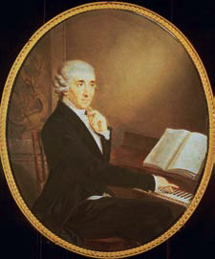
Classical Chamber Music
The String Quartet
“Can you see the notes behave like waves? Up and down they go! Look, you can also see the mountains. You have to amuse yourself sometimes after being serious so long.” —Joseph Haydn
iMusic Example: Haydn’s Symphony No. 100 II
Joseph Haydn 1732–1809
Classical Era 1725–1825
1720 1730 1740 1750 1760 1770 1780 1790 1800 1810
Notes:
Franz Joseph Haydn wrote over one hundred symphonies in the four-movement structure, thus he earned the nickname “Father of the Symphony.”
His most famous symphonies were a set of twelve works commissioned for a concert series in London after his service in Esterhazy had come to a close.

Slide 30
. Classical Chamber Music
The String Quartet
Joseph Haydn (1732–1809)
Austrian composer
Folk song and dance
St. Stephen’s Cathedral in Vienna
Esterházy patronage
  Eszterháza
Two successful trips to England
Died in 1809
Notes:
Joseph Haydn (1732–1809) was one of the most prolific composers of the Classical era. He was influenced musically at an early age by the folk songs and dances of his hometown of Rohrau, a small village in Austria.
He had a beautiful voice as a child and became a singer for St. Stephen’s Cathedral in Vienna until his voice changed at the age of sixteen. He settled in Vienna and earned a living teaching and accompanying.
He eventually attracted the attention of the Viennese aristocracy and, at the age of 29, entered the service of the Esterhazy family—a very wealthy family of Hungarian princes known for their patronage of the arts. He remained in their service for 30 years and had under his direction an orchestra, an opera company, a marionette theater, and a chapel.
Upon the Esterházy prince’s death, he made two visits to London where he was very well received. He died in 1809 and was acknowledged throughout Europe as the premier musician of his time.

Slide 31
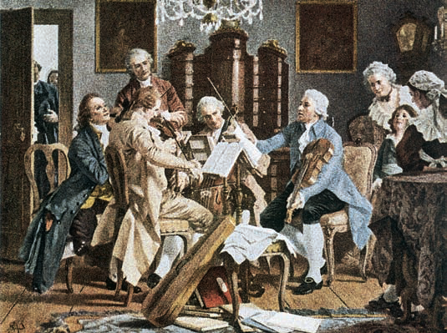
Classical Chamber Music
The String Quartet
Beethoven: String Quartet in C
Beethoven: Serenade in D
Dvořák: Piano Quintet in A
Chamber music
String quartets
Trios
Quintets
Serenades
Divertimentos
Notes:
The most prominent ensemble in chamber music was the string quartet, consisting of two violins, a viola, and a cello.
Other combinations would be the duo sonata—violin or cello and piano; the piano trio—violin, cello, and piano; and the quintet—a combination of string or wind instruments or a string quartet along with a solo instrument such as the clarinet or piano.
Composers would also write chamber music for larger groups, such as sextets, septets, and octets; or in other popular genres intended for entertainment, such as a serenade or divertimento.
A serenade is a Classical instrumental genre that combines elements of chamber music and symphony, often performed in the evening or at social functions.
A divertimento is a Classical instrumental genre for chamber ensemble or soloist, often performed as light entertainment.
The following are examples of chamber music: Beethoven String Quartet in C; Beethoven Serenade in D and Dvořák Piano Quintet in A. [link to excerpt]

Slide 32
Classical Chamber Music
The String Quartet
The String Quartet
Most important chamber music genre of era
Instrumentation: two violins, viola, cello
Beethoven: String Quartet in F
Notes:
The string quartet became the most important chamber music genre of the Classical era. Instrumentation consists of two violins, a viola, and a cello.
Here is an example of string quartet music: Beethoven String Quartet in E [link to excerpt]

Slide 33
Common String Quartet Structure
Tempo
Form
1st movement | Fast | Sonata-allegro
2nd movement | Slow | A-B-A or Theme & variations
3rd movement | Moderate dance | Minuet & trio
4th movement | Fast | Sonata-allegro or rondo
Notes:
The structure of a string quartet is as follows:
The first movement is usually fast in sonata-allegro form. The second movement is a slow movement in A-B-A or theme and variations form.
The third movement is often a dance-related movement, such as a minuet and trio at a moderate tempo; and the work would conclude with the fourth movement at a fast tempo in sonata-allegro or rondo form.
Follow the listening guide for Haydn’s String Quartet in G major; Op. 76, No. 3. Haydn wrote 68 string quartets in all. They are among his most frequently performed works today.

Slide 34
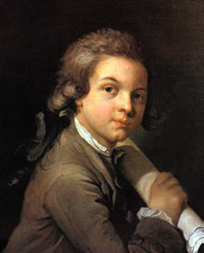
Classical Chamber Music
Mozart and Chamber Music
“People make a mistake who think that my art has come easily to me. Nobody has devoted so much time and thought to composition as I. There is not a famous master whose music I have not studied over and over.”
- W. A. Mozart
Wolfgang Amadeus Mozart 1756–1791
1720 1730 1740 1750 1760 1770 1780 1790 1800 1810
Notes:
“People make a mistake who think that my art has come easily to me. Nobody has devoted so much time and thought ot composition asI. There is not a famous master whose music I have not studied over and over.” —W. A. Mozart
Mozart lived from 1756–1791. He was knighted by the pope at age 14 when, after one hearing, he wrote out a famous choir work performed in the Sistine Chapel.

Slide 35
Classical Chamber Music
Mozart and Chamber Music
Wolfgang Amadeus Mozart
(1756–1791)
Austrian composer, pianist, violinist
Father was a musician
Child prodigy
Patronage system
Archbishop of Salzburg
Freelance musician at age 25
Notes:
Wolfgang Amadeus Mozart (1756–1791) was an Austrian composer, pianist, violinist. His father was a composer and violinist.
Mozart was a child prodigy who began writing music before the age of five.
He rebelled against the social restrictions of the patronage system, which resulted in his dismissal by his patron, the Archbishop of Salzburg.
Mozart then began a career as a freelance musician at age 25.

Slide 36
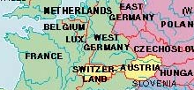
Classical Chamber Music
Mozart and Chamber Music
Salzburg, Austria
Wolfgang Amadeus Mozart 1756–1791
Classical Era 1725–1825
1720 1730 1740 1750 1760 1770 1780 1790 1800 1810
Notes:
Salzburg, where Mozart was born, is in the northwest corner of Austria. Vienna (where he worked in his later life) is on the Eastern side of Austria.

Slide 37
Classical Chamber Music
Mozart and Chamber Music
Leopold Mozart
Composer-violinist to the archbishop of Salzburg
Organized concert tours for children Wolfgang and sister, Nannerl
Notes:
Wolfgang Mozart’s father, Leopold, was father to six children. The only two that survived infancy were Wolfgang and Marie Anne (known as “Nannerl” to differentiate her from her mother).
Leopold was an excellent violinist and a good composer, employed by the archbishop of Salzburg. He wrote a method book called “The Violin School” that was one of the best violin method books of the day.
He was a very domineering man who strove to insure his children’s success. He organized concert tours for Wolfgang Mozart and his sister Nannerl.

Slide 38
Classical Chamber Music
Mozart and Chamber Music
Moves to Vienna at age 25
Establishes freelance career
Struggles financially
Marries Constanza Weber
Contributes to all genres
Librettist Lorenzo da Ponte
Requiem Mass, left unfinished
Died at 35
Rheumatic fever, heart disease, trichinosis
Notes:
Wolfgang Mozart moved to Vienna at the age of 25, after his dismissal by the archbishop of Salzburg. He struggled financially, because he did not have a steady income provided by a patron.
In 1782, he married his landlord’s daughter, Constanza Weber against his father’s wishes.
He reached the peak of his career in the late 1780s with his three comic operas, which were a result of collaboration with librettist Lorenzo da Ponte.
His health declined, though he continued to produce masterpieces such as his Clarinet Concerto and final opera, The Magic Flute, in 1791. He began the composition of a Requiem Mass that was commissioned by a count. He had a notion that he would not live to finish the requiem mass.
He died on December 4, 1791 at the age of 35. Possible causes of death include rheumatic fever, heart disease, and trichinosis.

Slide 39
Wolfgang Amadeus Mozart
Opera
Opera buffa
  The Marriage of Figaro
  Don Giovanni
Opera seria
  Idomeneo
Singspiel
  The Magic Flute
Don Giovanni, K. 527, Act I,
“Ah! del padre in periglio”
Notes:
Produces his most successful operas with Lorenzo da Ponte who was the librettist for The Marriage of Figaro and Don Giovanni
Vienna loved The Marriage of Figaro. The city of Prague loved Don Giovanni (it was written for the Prague Opera), but it was not as well received in Vienna.
Mozart wrote more than 20 operas in different genres: opera buffa (Italian comic opera) ; opera seria (Italian serious opera) and Singspiel (a lighter form of German opera that included spoken dialogue.)
Here is an aria from Mozart’s opera, Don Giovanni [link to excerpt]

Slide 40
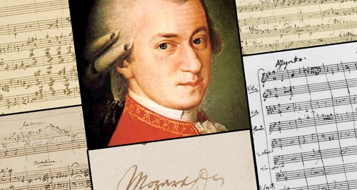
Wolfgang Amadeus Mozart (b. 1756-91) was born in Salzburg, Austria. His father, Leopold Mozart, was an accomplished violinist of the Archbishop of Salzburg’s court. Additionally, Leopold had written a respected book on the playing of the violin. At a very young age, Wolfgang began his career as a composer and performer. A prodigy, his talent far exceeded any in music, past his contemporaries. He began writing music prior to the age of five. At the age of six, Wolfgang performed in the court of Empress Maria Theresa.
Mozart’s father was quite proud of his children, both being child prodigies. At age seven, Wolfgang, his father, and his sister Maria Anna (nicknamed “Nannerl”) embarked on a tour featuring Wolfgang in London, Munich, and Paris. As was customary at the time, Wolfgang, the son, was promoted and pushed ahead with his musical career by his father. While his sister, the female, grew up traditionally, married, and eventually took care of her father Leopold in his later years. However, while the two siblings were still performing, these tours occurred from when Wolfgang was between the ages of six and seventeen. The tours, though, were quite demeaning for the young musical genius in that he was often looked upon as just a superficial genre of entertainment rather than being respected as a musical prodigy. He would often be asked to identify the tonality of a piece while listening to it or asked to sight read and perform with a cloth over his hands while at the piano. Still, the tours allowed young Mozart to accumulate knowledge about musical styles across Europe.

Slide 41
Classical Chamber Music
Mozart and Chamber Music
Ludwig Köchel’s Catalog
Catalog
Number
Title
Movement
Eine kleine Nachtmusik, K. 525, I
Notes:
Mozart’s music was catalogued chronologically by Ludwig Köchel. Works are listed with a K followed by a number
The chronology of Mozart’s music is being revised continuously.

Slide 42
Classical Chamber Music
Mozart and Chamber Music
Social Music: Divertimentos and serenades
Chamber music
Piano works
Symphonies
Piano Concerto No. 21 in C, K. 467, II
Symphony No. 40 in G, K. 550, I
Notes:
Mozart is known for his simple, elegant, and tuneful melodies. His instrumental music conveyed a range of moods from dramatic to lively and playful.
Like Haydn, Mozart favored the string quartet. Mozart was also one of the most outstanding pianists of his time. He wrote many works for the piano and more than 40 symphonies.
Here is Mozart’s Piano Concerto No. 21 in C, K. 467, Second Movment; and Mozart’s Symphony No. 40 in G minor, K. 550, First Movement [link to excerpt]
Mozart’s social music included divertimentos and serenades. One such piece is Eine kleine Nachtmusik (1787), a serenade for strings. A listening guide for the first and third movements of this work is to follow.

Slide 43
Mozart: Eine kleine Nachtmusik, K. 525
“A Little Night Music”
One of the most famous chamber music works of the era
Title literally means “A Little Night Music”
Serenade for strings (written for a string quartet with an added double bass)
Written for outdoor public performance
Four movements (originally five)
Notes:
Mozart: Eine kleine Nachtmusik, K. 525 is one of the most famous chamber music works of the era.
The title literally means: “A Little Night Music.” It is a serenade for strings (written for a string quartet with an added double bass).
It was a piece written for outdoor public performance. There are four movements (originally five).

Slide 44
Mozart: Eine kleine Nachtmusik, K. 525 (Theme I)
Key
Signature
Tempo
Rocket Theme
Meter
Symmetrical Phrases
Dynamic marking
Notes:
Eine Kleine Nachtmusik is a piece in four movements (originally five.)
The first movement is in G major, in sonata-allegro form. Listen for a march-like disjunct melody, and an ascending (rocket) theme, and a graceful descending tune of the second theme—a quick tempo in duple meter. The harmony is consonant with a homophonic texture.
(Need to load correct listening guide.. P. 168 – 169)

Slide 45
Mozart: Eine kleine Nachtmusik, K. 525
II: Romanza, Andante (walking pace), in C major
Rondo-like structure
III: Allegretto, in G major
Minuet and trio form
IV: Allegro in G major
Sonata-rondo form (hybrid form)
Notes:
The second movement of Eine kleine is in a rondo-like structure. The tempo is andante (walking pace) and in the key of C major.
The third movement (see Listening Guide to follow) is Allegro, in G major, and is in minuet and trio form.
The fourth movement is Allegro in G major as well, and the form is a sonata-rondo form, which is a hybrid between sonata form and rondo form.
.

Slide 46
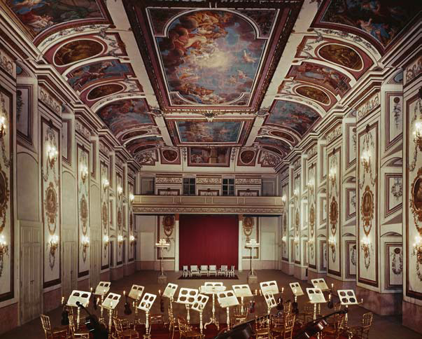
The Classical Symphony
“I frequently compare a symphony with a novel in which the themes are characters. After we have made their acquaintance, we follow their evolution, the unfolding of their psychology.”
— Arthur Honegger
Notes:
“I frequently compare a symphony with a novel in which the themes are characters. After we have made their acquaintance, we follow their evolution, the unfolding of their psychology.” —Arthur Honegger
Pictured: The hall in the Eszteráza Palace where Haydn presented his symphonies.

Slide 47
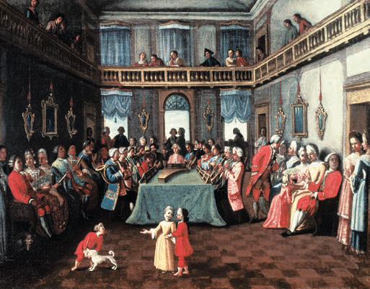
The Classical Symphony
Historical Background
Historical background
Origins in Italian opera overture
  Three-part form
Standard ideas, including “Mannheim” traits
  Rocket themes
  Steamroller effects
Mozart: Symphony No. 40, IV
Beethoven: Wellington’s Victory
Notes:
The symphony was a principal instrumental form of the Classical era. It had its roots in the Italian opera overture that was an orchestral piece in three-part form—fast-slow-fast. Eventually these parts became separate movements to which different effects were added.
Rocket themes, which are characterized by a quick rise from the low to high register, and steamroller effects, which are long, drawn out crescendos became standard in the classical symphony.
These effects are attributed mostly to composers who were active in Mannheim—a German city along the Rhine River. This group of composers, known as the Mannheim school, also added a minuet and trio movement, making it a four-movement form that paralleled the form of the string quartet.
Here are examples of symphonic works: Mozart’s Symphony No. 40, Fourth Movement; and Beethoven’s Wellington’s Victory [link to excerpt]

Slide 48
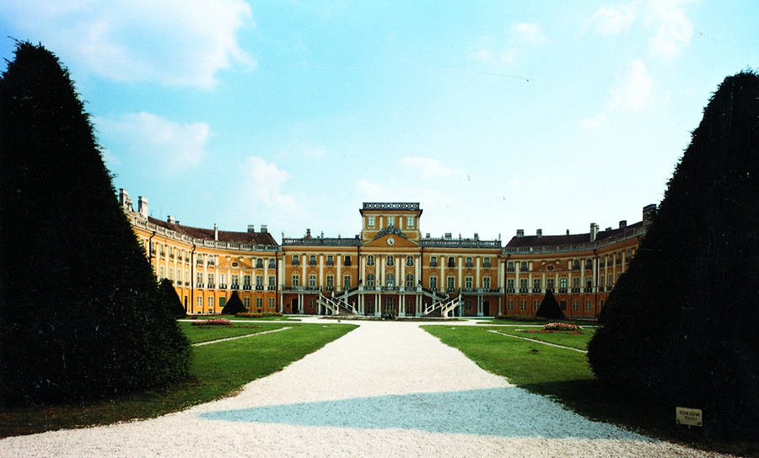
The Classical Symphony
The Classical Orchestra
30–40 players
Centered around string section
Interchange among instrument groups like lively conversation
Mozart:
. 40, I
Eszterháza Palace in Fertöd, Hungary
Mozart: Symphony No. 40, I
Notes:
The Classical orchestra generally consisted of 30 to 40 players. It was centered around the string section. The early Classical orchestra generally had woodwinds and brass in in pairs to provide color, body, and sound mass as well as to assist the strings.
The interchange and imitation of themes among the various instrumental groups may be compared to a lively conversation.
Musical Example:
Mozart’s Symphony No. 40, First Movement for the different instrumental timbres which are present . . . and the conversation which ensues. [link to excerpt]
Pictured: A modern-day photograph of the Eszterháza Palace in Fertöd, Hungary, where Haydn was employed.

Slide 49
The Classical Symphony
The Movements of the Symphony
I: fast
II: slow
III: moderate
IV: fast
Mozart: Symphony No. 40, I
Beethoven: Symphony No. 7, II
Haydn: Symphony No. 94 (Surprise), III
Mozart: Symphony No. 40, IV
Notes:
Here are examples of the different movements of the symphony: first movement of Mozart’s Symphony No. 40, second movement of Beethoven’s Symphony No. 7, third movement of Haydn’s Symphony 94, and the fourth movement of Mozart’s Symphony No. 40. [link to excerpt]
The first movement is often a fast tempo; the second a slow; the third a moderate tempo—usually a dance-related movement, such as a minuet and trio; and the fourth movement is often a fast movement.

Slide 50
The Classical Symphony
Haydn and the Symphony
String quartet
100-plus symphonies
  London symphonies
Masses, oratorios
Notes:
Haydn’s output included 68 string quartets, over 100 symphonies—including the 12 London symphonies, and sacred vocal music, such as masses, and two very successful oratorios—The Creation and The Seasons.

Slide 51
The Classical Symphony
Haydn and the Symphony
Haydn Symphony No. 100 in G major (Military)
Large orchestra
London symphonies
III: Allegro molto, minuet form G major
Notes:
Haydn’s Symphony No. 100 (the Military) was part of his last set of 12 works known as the London symphonies, which were commissioned for a concert series in London.
This particular symphony was premiered in London in 1794 during his second London visit and was received enthusiastically by the audience.
The nickname “Military” comes from the composer’s use of percussion instruments associated with Turkish military music, such as the triangle, cymbals, bass drum, and bell tree. The work also contains a solo trumpet fanfare, which is also a military effect
Haydn’s Military symphony follows the multimovement pattern. A listening guide to the second movement follows. [link to excerpt is not applicable]

Slide 52
The Classical Symphony
Haydn and the Symphony
Haydn: Symphony No. 100 (Military),
Second Movement
Second movement
Graceful theme
Large orchestra
  French horns, percussion
Notes:
The second movement of Haydn’s Military symphony is an Allegretto movement in the contrasting key of C major.
Listen for a simple graceful theme in regular phrases with a march-like rhythm in regular duple meter. There is a shift in the harmony from C major to C minor, then back to C major. The texture is homophonic. It is in a three-part form (ternary A-B-A’) with the return of A in variation. The A section is in a rounded binary form.
With regard to expression, listen for sudden dynamic contrasts.
This piece was written for a large orchestra, including woodwinds, trumpets, French horns, and many percussion instruments not typically found in orchestras of this era.

Slide 53
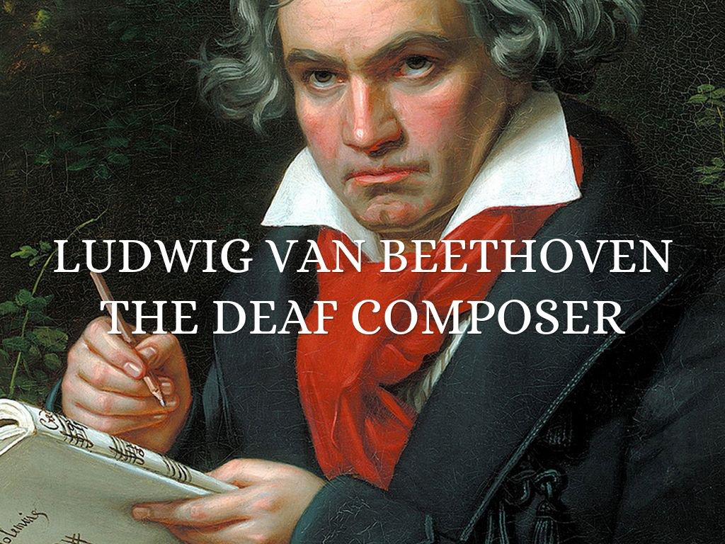
Beethoven was born in Bonn in December of 1770. As you can see from the map at the beginning of this chapter, Bonn sat at the Western edge of the Germanic lands, on the Rhine River. Those in Bonn were well-acquainted with traditions of the Netherlands and of the French; they would be some of the first to hear of the revolutionary ideas coming out of France in the 1780s. The area was ruled by the Elector of Cologne. As the Kapellmeister for the Elector, Beethoven’s grandfather held the most important musical position in Bonn; he died when Beethoven was three years old. Beethoven’s father, Johann Beethoven, sang in the Electoral Chapel his entire life. While he may have provided his son with music lessons at an early stage of Ludwig’s life, it appears that Johann had given into alcoholism and depression, especially after the death of Maria Magdalena Keverich (Johann’s wife and Ludwig’s mother) in 1787.

Slide 54

In 1792, he returned to Vienna for good. Perhaps the most universally known fact of Beethoven’s life is that he went deaf. You can read entire books on the topic; for our present purposes, the timing of his hearing loss is most important. It was at the end of the 1790s that Beethoven first recognized that he was losing his hearing. By 1801, he was writing about it to his most trusted friends. The loss of his hearing was an existential crisis for Beethoven. During the fall of 1802, he composed a letter to his brothers that included his last will and testament, a document that we’ve come to know as the small town of Heiligenstadt, north of the Viennese city center, where he was staying.
The three most important composers of the Classical period were Joseph Haydn, Wolfgang Amadeus Mozart, and Ludwig van Beethoven. Although they were born in different places, all three composers spent the last years of their lives in Vienna, Austria, a city which might be considered the musical capitol of the Classical period (see map below).
England: Mozart and Haydn traveled here. Bonn, Germany: Beethoven born here. Vienna, Austria: Haydn, Mozart, and Beethoven spent their last years here. Salzburg, Austria: Mozart born here. France: Home of the French Revolution
Map of Europe
Author: User: “Ssolberggj”
Source: Wikimedia Commons
License: CC BY-SA 3.0

Slide 55
The Classical Period Summary
The Classical Period 18th century music lasted 75 years spading the musical compositions of Haydn, Mozart, and Beethoven were rife with innovations in musical genre, style, and form. In many ways, they shaped music for the next 200 years. Composers continued to write symphonies and string quartets, using forms such as the sonata, theme, and variations.
A large portion of late eighteenth and early nineteenth-century society continued playing music in the home and going to theaters for opera and to concerts at which orchestral compositions such as concertos and symphonies were performed.
Although that live performance culture may not be as prevalent at the beginning of the twenty-first century, we might ask why it was so important for Western music culture for so long. We also might ask if any of its elements inform our music of today.

