Slide 1
Gospel Music

Slide 2
GOSPEL
Gospel…
“Good News”
Christ died for our sins, He was buried, He rose again on the third day

Slide 3
Gospel Origins
Religious music in general
First came out of the African-American church in the first quarter of the 20th century
Has spread throughout the world including Australia, Norway, and Quebec

Slide 4
Origins
1920’s-1940’s

Slide 5
Gospel Music
Had its roots in the Sanctified and Holiness churches
“Holy Rollers”
“The Holy Ghost”, “Getting Happy”
Melded traditional religious themes with blues and boogie-woogie techniques
Brought Jazz instruments into the church.

Slide 6
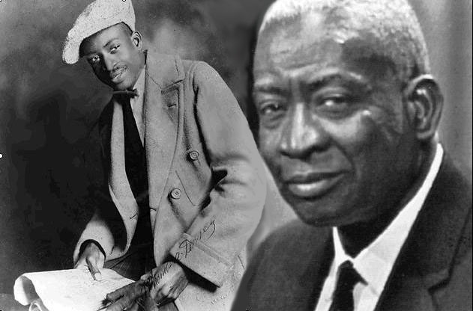
Thomas Andrew Dorsey
Thomas Andrew Dorsey (1899-1993)
Father of Gospel Music
Father was a minister and mother was a piano teacher

Slide 7
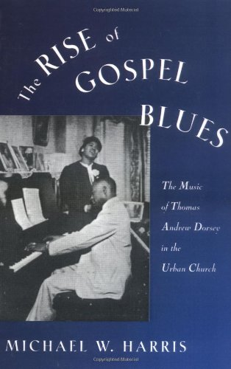
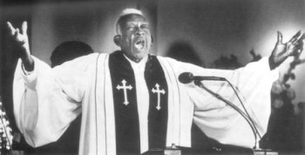
Thomas Andrew Dorsey
Started playing blues piano as a young man
Became an agent for Paramount records
Credited with more than 400 blues and jazz songs

Slide 8
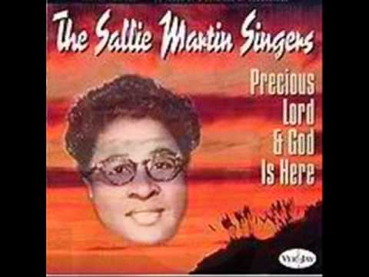
Sallie Martin
1895-1988
Mother of Gospel Music
Raised as a Baptist (Pittfield, GA)
Joined the Pentecostal church
Moved to Chicago in 1927

Slide 9
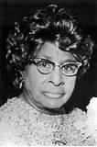
Sallie Martin
Helped Dorsey introduced his music as well as manage his finances
Formed the Sallie Martin Singers in 1940
Started her own publishing house
“Martin and Morris Music, Inc.” (Kenneth Morris)

Slide 10
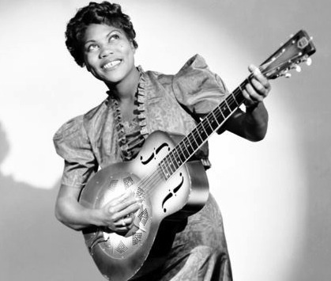
Sister Rosetta Tharpe
1915(AR)-1973(NY)
COGIC
Mother was a COGIC Evangelist
Singer, songwriter, recording artist
First real “star” of Gospel Music
Mixed spiritual lyrics with early rock accompaniment
First great recording star of Gospel music
“This Train” (1938)

Slide 11
The Golden Age
1940s to 1950s

Slide 12
GOSPEL QUARTETS
Dixie Hummingbirds,
Pilgrim Travelers,
Soul Stirrers,
Five Blind Boys of Mississippi
Introduced jubilee styles with intricate harmonies and ad libs

Slide 13
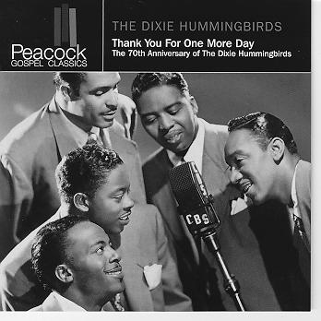
Dixie Hummingbirds

Slide 14
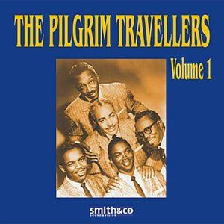
Pilgrim Travelers

Slide 15
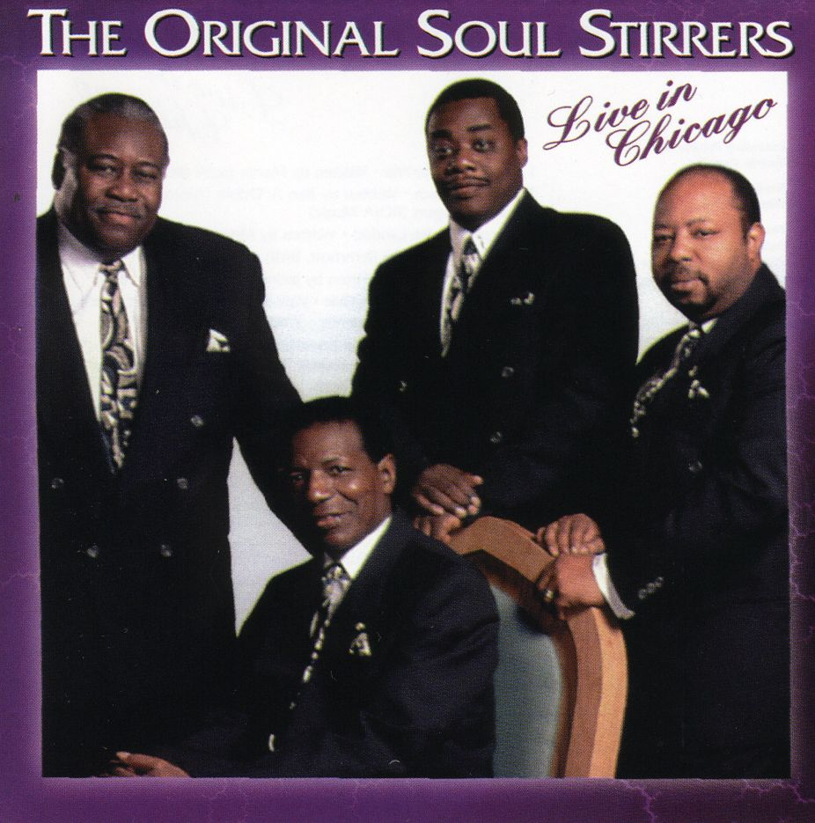
Soul Stirrers

Slide 16
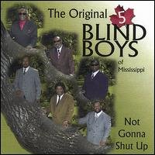
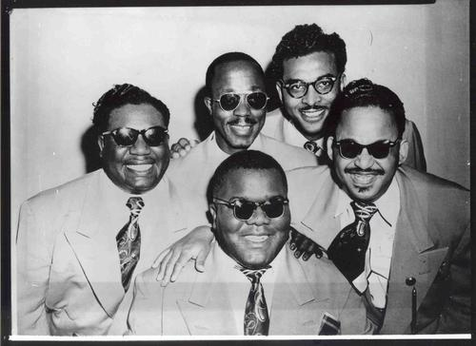
Five Blind Boys of Mississippi

Slide 17
Women Singers
Clara Ward,
The Caravans,
The Davis Sisters,
Dorothy Love Coates
Relied on overpowering technique and dramatic personal witness moreso than the theatrics of their male counterparts

Slide 18
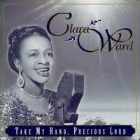
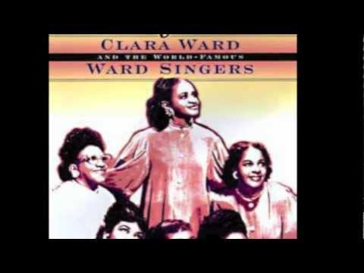
Clara Ward

Slide 19
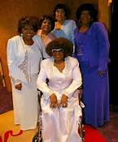
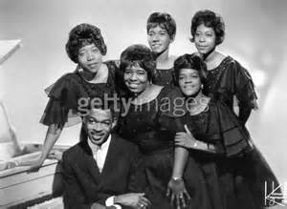
The Caravans

Slide 20
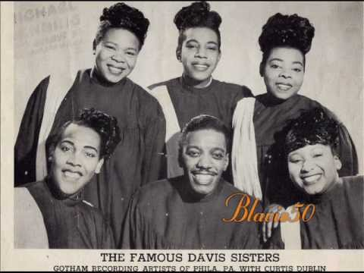
The Davis Sisters

Slide 21
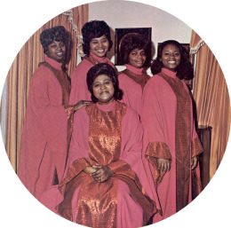
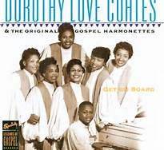
Dorothy Love Coates

Slide 22
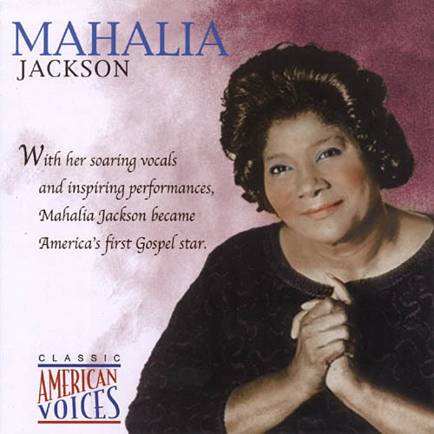
Mahalia Jackson
1912-1972
Grew up in New Orleans, LA
Baptist
Moved to Chicago in 1927
Began her solo recording career in 1937
“Move On Up a Little Higher” (1948)

Slide 23
INNOVATIONS
1960s-1970s

Slide 24
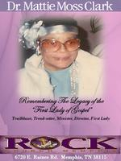
Dr. Mattie Moss Clark
1925-1994
Born in Selma,AL
Began playing piano at the age of 6
Attended Selma University
Relocated to Detroit in 1947

Slide 25
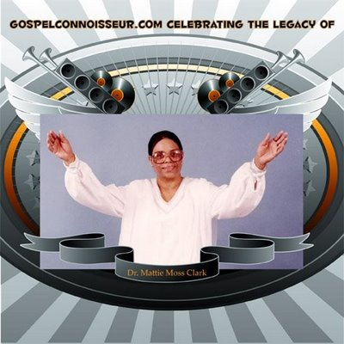
Dr. Mattie Moss Clark
Arranged and Wrote hundreds of songs
Recorded over 50 albums
Died of complications of diabetes
Mother of the Clark Sisters

Slide 26
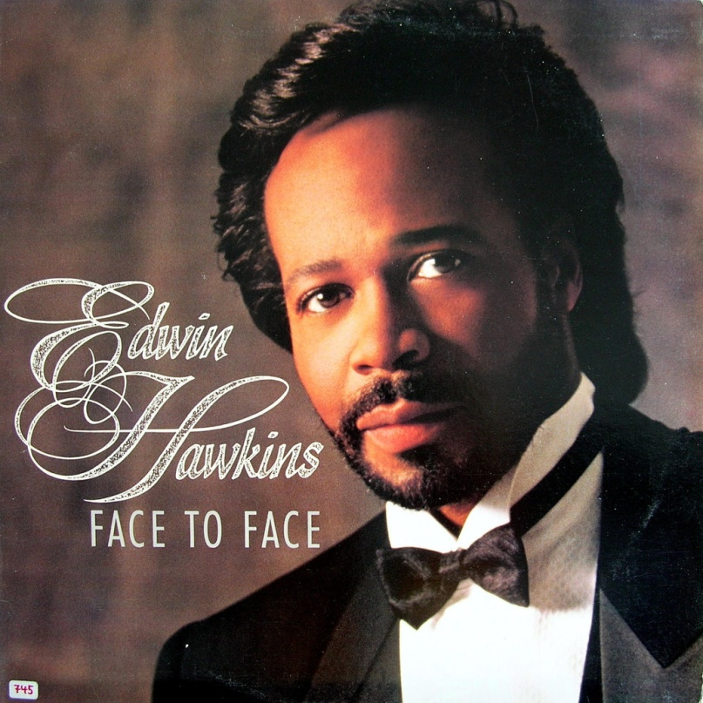
Edwin Hawkins
1943-present
Born in Oakland, CA
“Oh Happy Day” (1968)
Syncopated, R&B feel
Sold more than 7 million copies
Won a grammy for the song

Slide 27
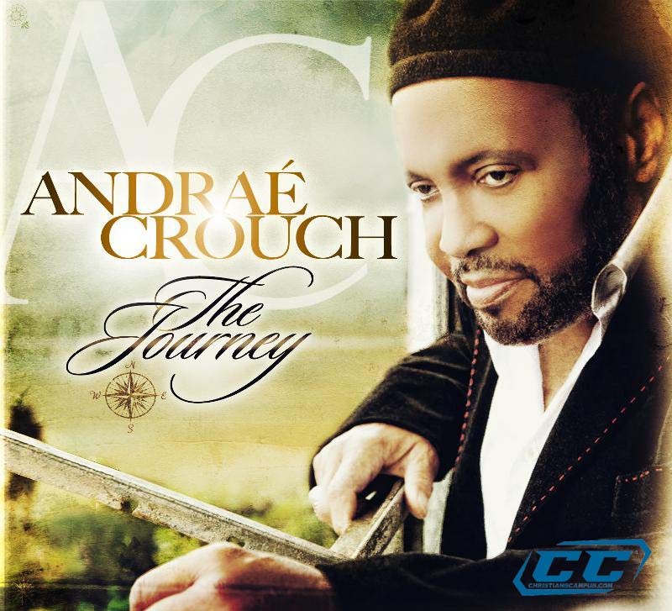
Andrae Crouch
1942-present
Southern California
Jesus Movement
“The Blood”, “My Tribute”
More than 30 albums
Grammys, Dove Awards, ASCAP, Billboard, NAACP Awards

Slide 28
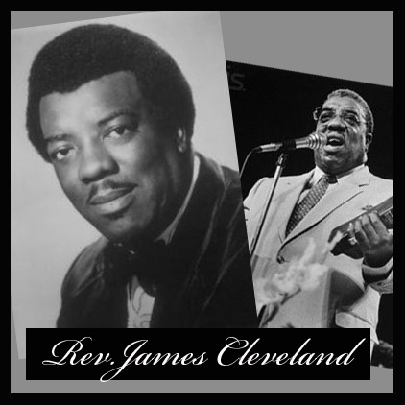
James Cleveland
1931-1991
Born in Chicago
Driving force behind the modern gospel sound and mass choirs
Southern California Community Choir
Gospel Music Workshop of America
30,000 members - 150 chapters
Died in 1991 (AIDS related)

Slide 29
1980s To Present

Slide 30
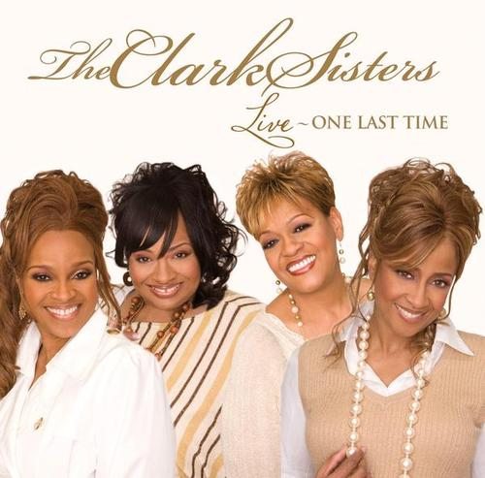
The Clark Sisters
Jacky, Deniece, Elbernita (Twinkie), Dorinda, Karen
Daughters of Dr. Mattie Moss Clark
You Brought the Sunshine
Runs, riffs, melismas, jazzy sound, scats

Slide 31
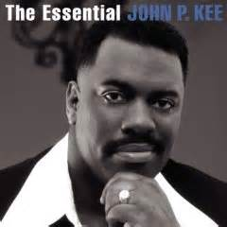
John P. Kee
John Prince Kee
1962-present
15th of 16 children
Durham, NC
Ushered in “hip-hop” styled gospel music
New Life Community Choir
“Wash Me, Lord”, “We Walk By Faith”, “Lily in the Valley

Slide 32

Yolando Adams
1961-present
Born in Houston, TX
Commercial success
Worked as a schoolteacher and part-time model
“The Battle Is the Lord’s”, “Open My Heart”

Slide 33
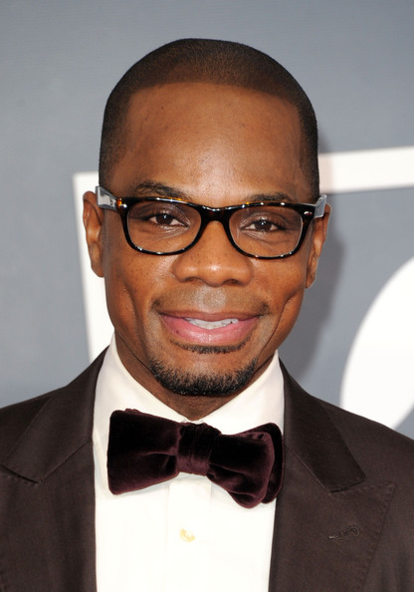
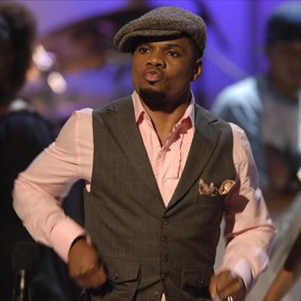
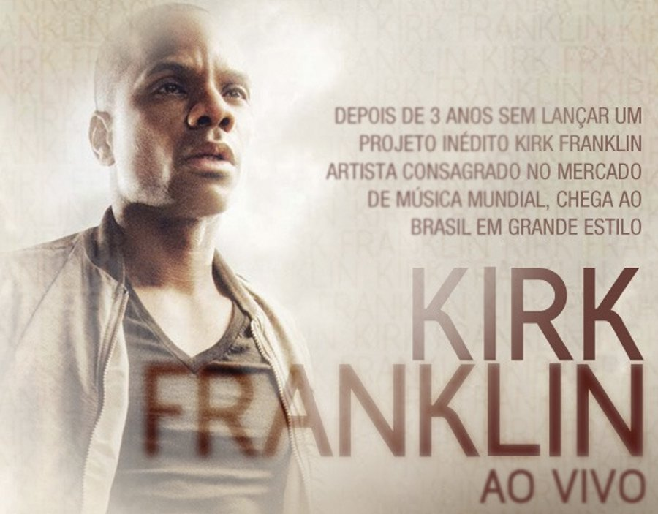
Kirk Franklin
1970-present
Platinum-selling artist
Born in Fort Worth, TX
Introduced Kirk Franklin and the Family in 1993 as well as 1NC and God’s Property
“Why We Sing”, “Lean on Me”, “Looking for You”

Slide 34
More
Gospel Stars For You
Artists
  Shirley Caesar
  Richard Smallwood
  Tonex
  Kim Burrell
  Donnie McClurkin
  Mary Mary
  Darryl Coley
  Vanessa Bell Armstrong
  Ricky Dillard
  Tye Tribbett
Movies
  Say Amen Somebody
  Gospel
  Gospel Music

Slide 35
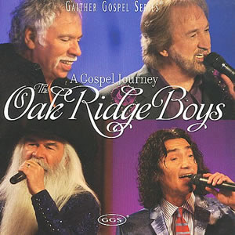
Oak Ridge Boys

Slide 36
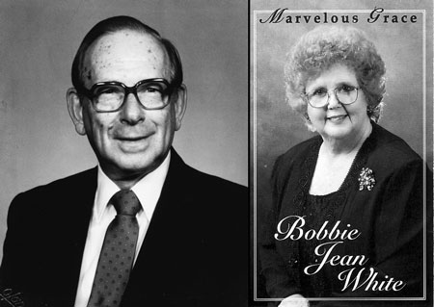
Bobbie Jean White

Slide 37
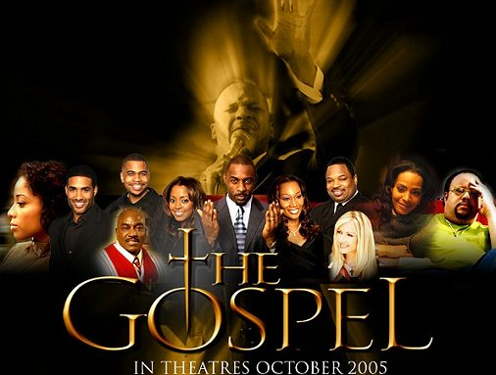
Gospel Music In The Theaters

Slide 38
The End
Dr. Doris S. Hall

