Slide 1
What is Ballet?
BALLET

Slide 2

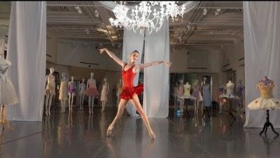

Slide 3
Ballet is an art form created by the movement of the human body.
It is theatrical – performed on a stage to an audience utilizing costumes, scenic design and lighting. It can tell a story or express a thought, concept or emotion. Ballet dance can be magical, exciting, provoking or disturbing.

Slide 4
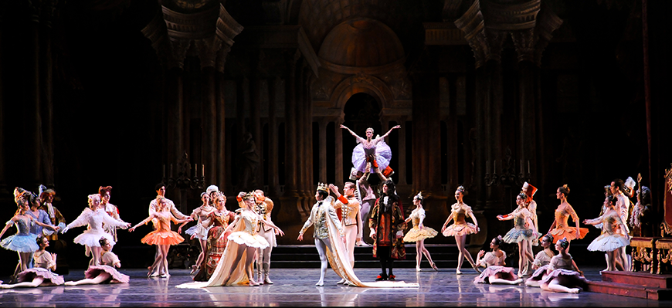
TYPES OF BALLET
William Forsythe’s In the Middle, Somewhat Elevated.
Photo by Rich Sofranko
Story ballets (not surprisingly!) tell a story. They contain narrative action, characters, a beginning and an end. The Nutcracker and The Sleeping Beauty are famous story ballets from the 19th century; classic stories and novels such as The Great Gatsby and The Three Musketeers also have been transformed into ballets.

Slide 5
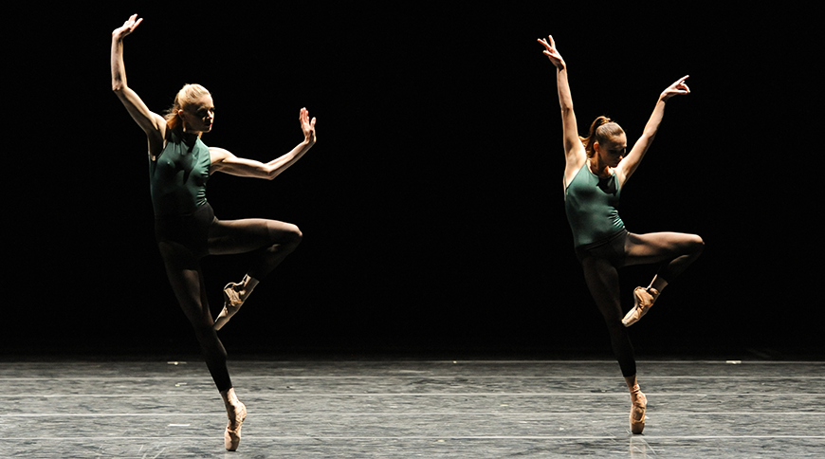
Plotless ballets have no storyline. Instead they use the movement of the body and theatrical elements to interpret music, create an image or express or provoke emotion. Choreographer George Balanchine was a prolific creator of plotless ballets.

Slide 6
STYLES OF BALLET
Classical ballet
is what people generally think of first when it comes to “ballet.” Classical ballet reached its height in 19th- century Russia through the work of choreographers like Marius Petipa and Lev Ivanov. The following elements characterize this style:
graceful, flowing movements
classical form: turn-out of the legs and pointe work
balance and symmetry
ethereal quality
emphasis on story ballets and narrative
elaborate sets and costumes

Slide 7
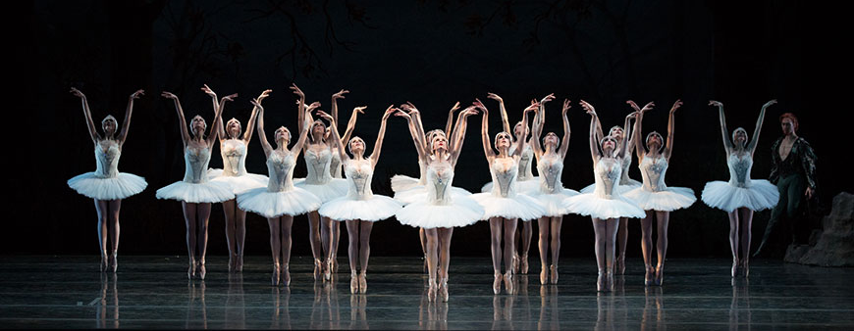
CLASSICAL BALLET
PBT in George Balanchine’s Agon. Photo by Rich Sofranko

Slide 8
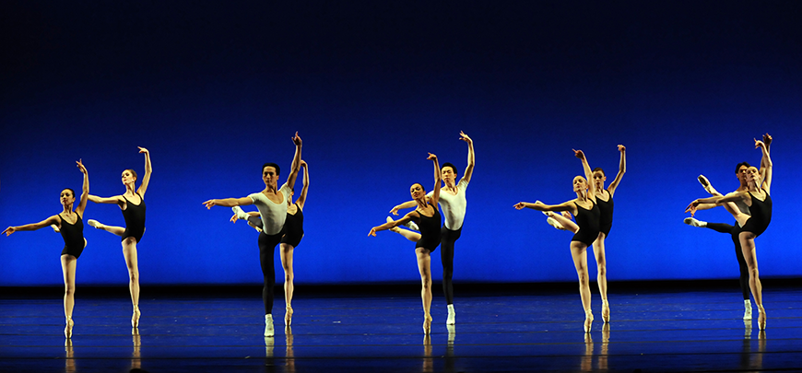
Neo-Classical Ballet
Neo-classical ballet
was introduced in the 20th century by choreographers like George Balanchine. It generally includes:
increased speed, energy and attack
manipulation of the classical form
asymmetry, an off-balance feel
non-narrative, often one-act ballets
pared-down aesthetic with simple sets and costumes

Slide 9
Contemporary Ballet
Contemporary ballet
is influenced by modern dance. Renowned contemporary ballet choreographers include Twyla Tharp, Jiří Kylián, Paul Taylor, William Forsythe and Dwight Rhoden. In contemporary ballet, you may see:
floor work
turn-in of the legs
greater range of movement and body line
pointe shoes but also bare feet

Slide 10
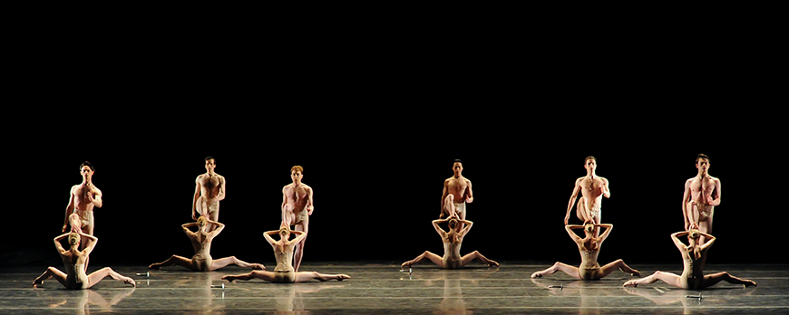
PBT in Jiří Kylián’s Petite Mort. Photo by Rich Sofranko

