Slide 1

DANCE
ELEMENTS/DANCERS/CHOREOGRAPHERS/
DANCE COMPANIES

Slide 2
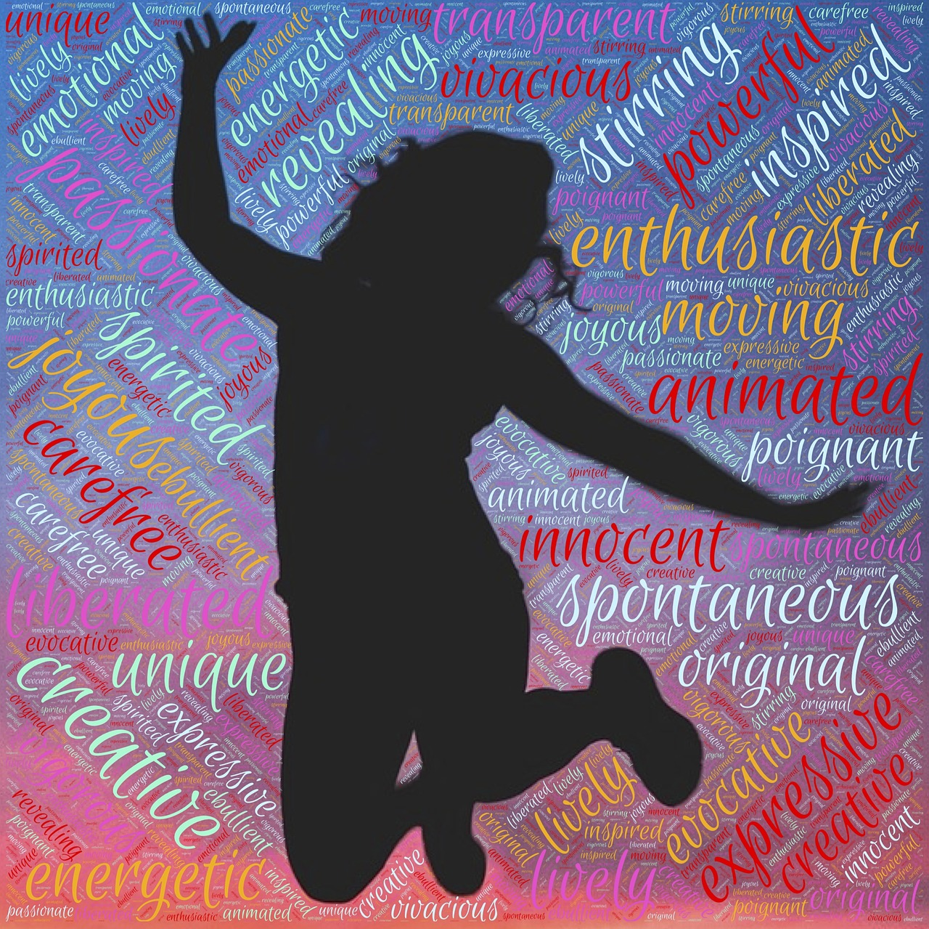
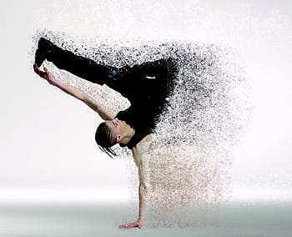
ELEMENTS OF DANCE
BODY is the dancer’s instrument of expression. Exploring body shapes and moves increases our awareness of movement possibilities:
Body Parts: Each part (head, shoulder, elbow, knee, etc.) can move alone or in combination.
Body Shapes:
Shapes can be curved, straight, angular, twisted, wide, narrow, symmetrical, asymmetrical, etc.
Body Moves:
Locomotor: (traveling) walk, run, jump, hop, skip, leap, gallop, crawl, etc.
Non-locomotor: (in place) melt, stretch, bend, twist, swing, turn, shake
ENERGY An exploration of “how” a movement is done rather than “what” it is, gives us a richer sense of dance as an expressive art:
Use of Force: Either powerful (strong, forceful) or gentle (light, delicate)
Use of Time: Either quick (hurried, fighting against time) or unhurried (slow, sustained, having lots of time)
Use of Space: Either to the target (direct, single focused) or wandering (indirect, multi focused)
Use of Flow: Either going (free, letting energy flow out) or stopping (careful, holding in the flow of energy)
Attack of Movement: Either percussive and sharp or smooth and sustained

Slide 3


ELEMENTS OF DANCE
SPACE: An exploration of space increases our awareness of the visual design aspects of movement:
Personal Space: The space around the dancer’s body.
General Space: The defined space in which the dancer can move.
Levels: High, middle, low
Directions: Forward, back, right, left, up, down, diagonals.
Pathways: Where the dancer goes through space (in a circle, figure eight, spiral, zig zag, straight lines, and combinations of lines.)
Size: Movements or shapes can be large or small.
Range: Movements or shapes can be near reach or far reach
Personal Space: The space around the dancer’s body.
General Space: The defined space in which the dancer can move.
Levels: High, middle, low
Directions: Forward, back, right, left, up, down, diagonals.
Pathways: Where the dancer goes through space (in a circle, figure eight, spiral, zig zag, straight lines, and combinations of lines.)
Size: Movements or shapes can be large or small.
Range: Movements or shapes can be near reach or far reach
TIME: Dance is a time art; movement develops and reveals itself in time. Adding a rhythmic sense to movement is what helps transform it into dance:
Pulse: The basic pulse or underlying beat
Speed (tempo): Fast, moderate, slow
Rhythm Pattern: A grouping of long or short beats, accents or silences
Natural Rhythm: Timing which comes from the rhythms of the breath, the
heartbeat, or natural sources like the wind or the ocean.

Slide 4
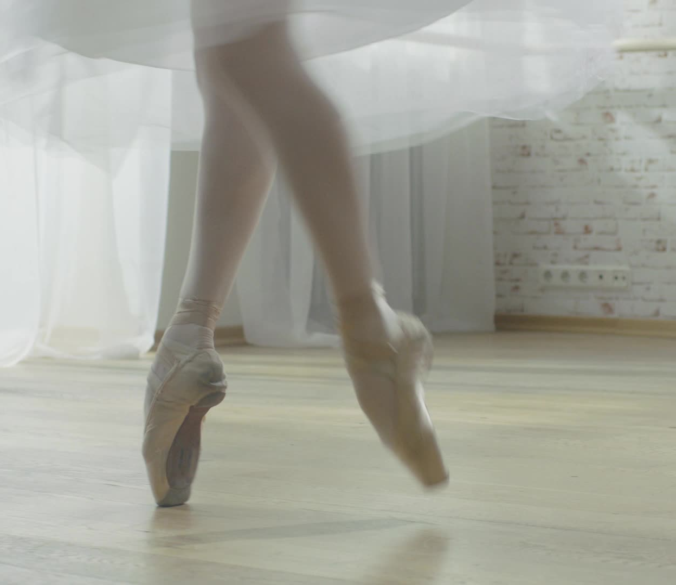
Please Review and View the Dancers and Choreographers below thoroughly and carefully. VIDEOS have been provided for most of the dancers and choreographers.
ASSIGNMENT: WRITE THRE STATEMENTS FROM YOUR RESEARCH ABOUT EACH DANCER AND CHOREOGRAPHER. PLEASE USE GOOGLE SEARCH, AND OTHER RESEARCH DEVICES FOR YOUR ANSWERS. YOU WILL TURN THIS ASSIGNMENT IN MICROSOFT WORD IN YOUR CLASS.

Slide 5
Great Dancers
&
Choreographers
of the
20th & 21st Centuries

Slide 6

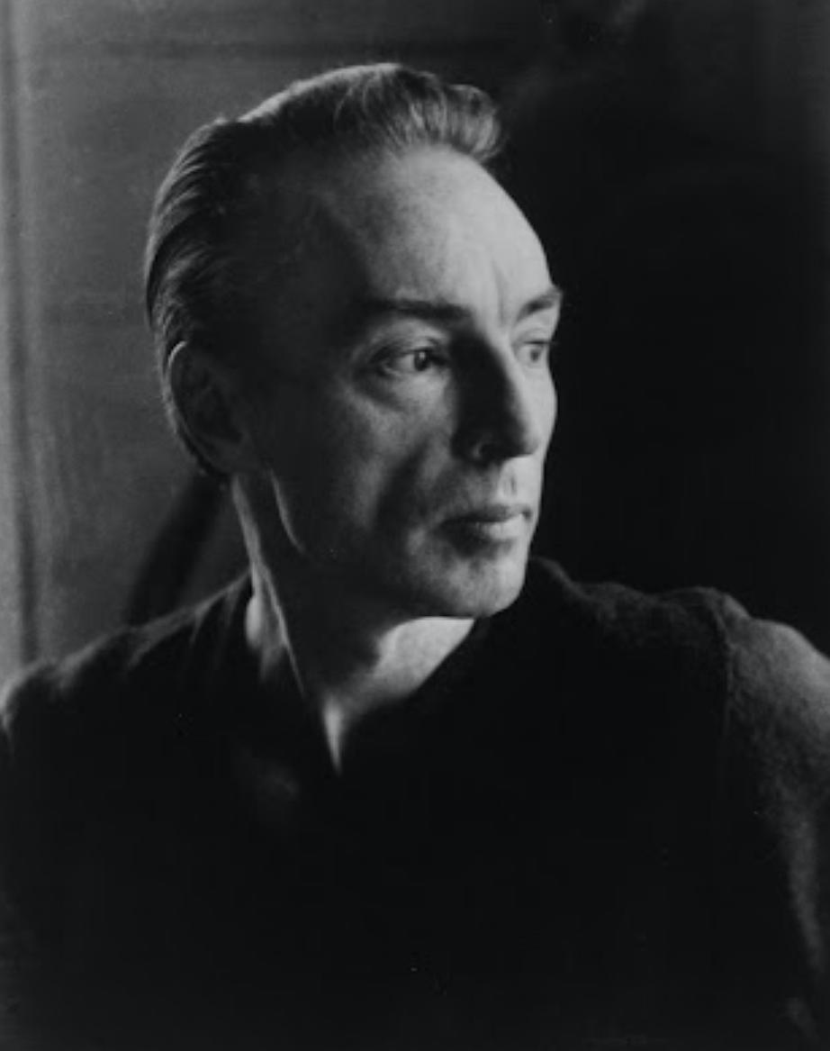
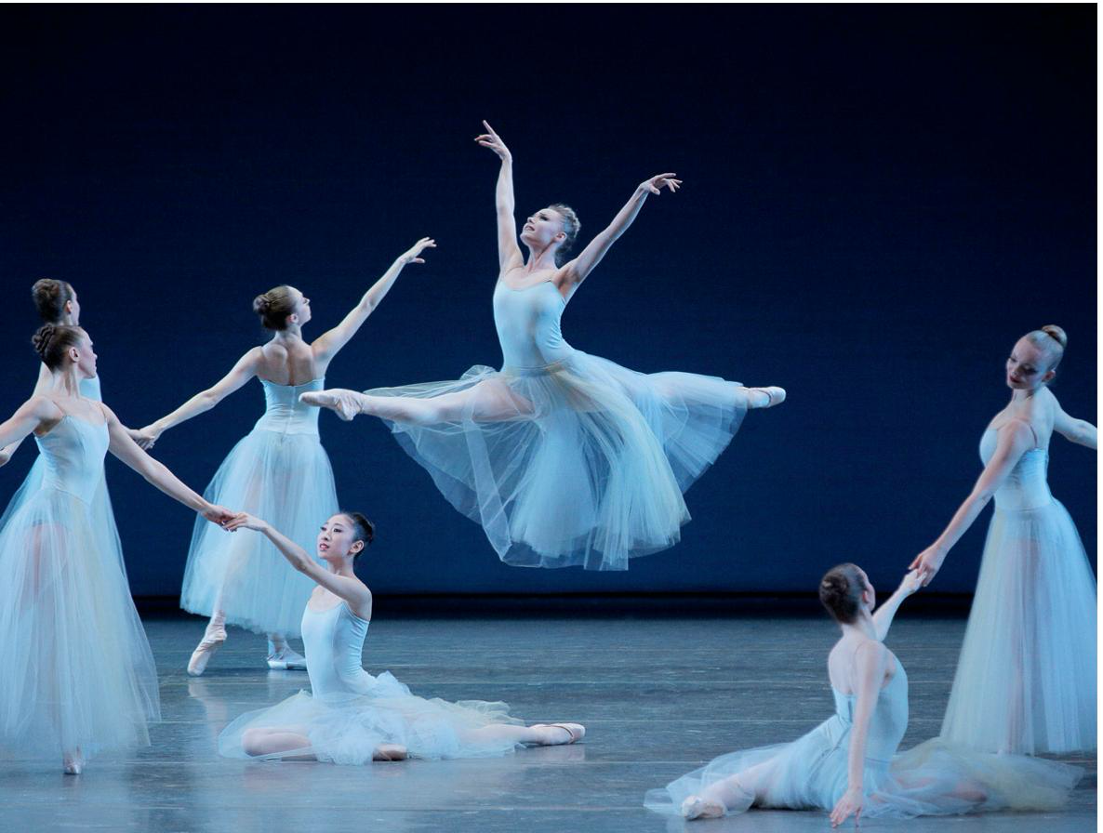
GEORGE BALANCHINE

Slide 7

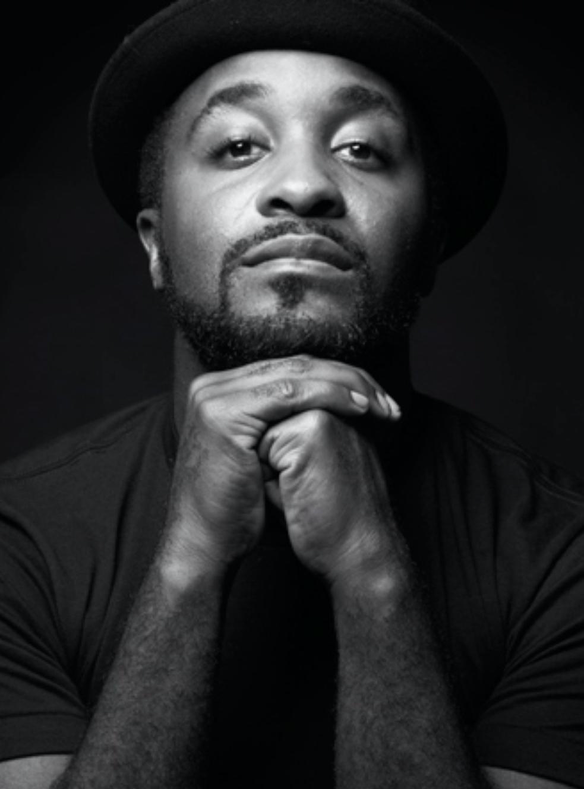
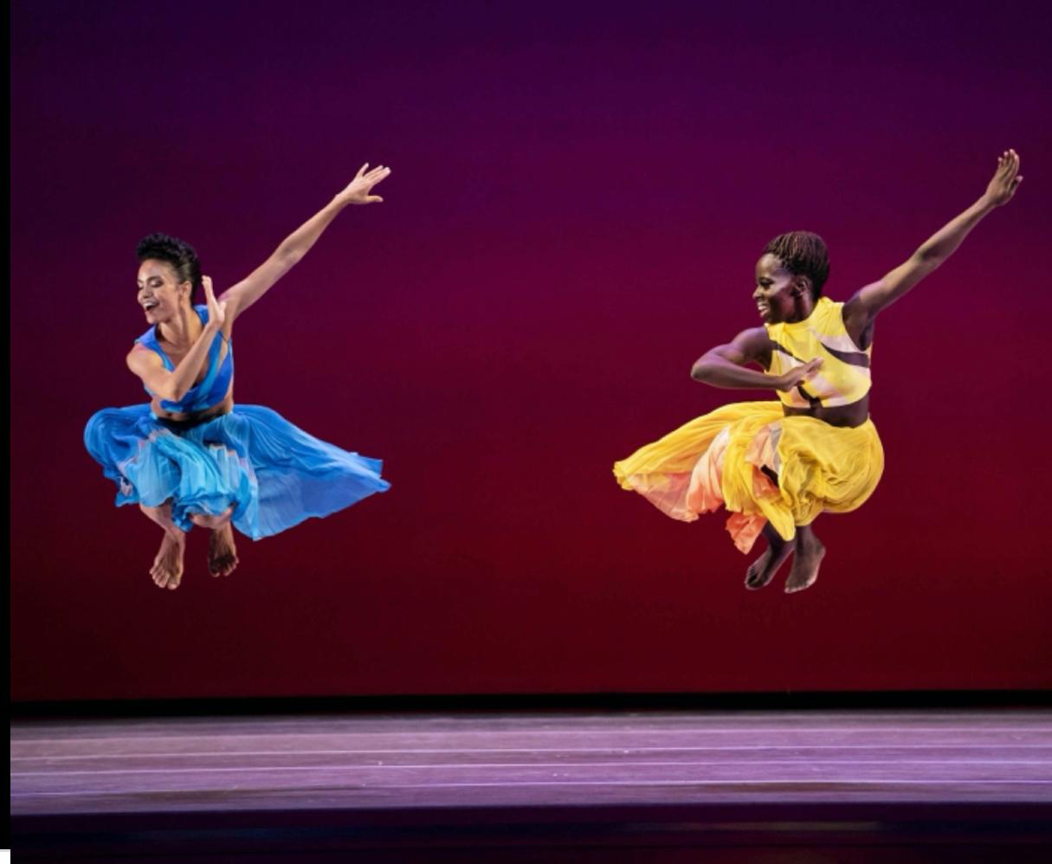
DARRELL GRAND MOULTRIE

Slide 8
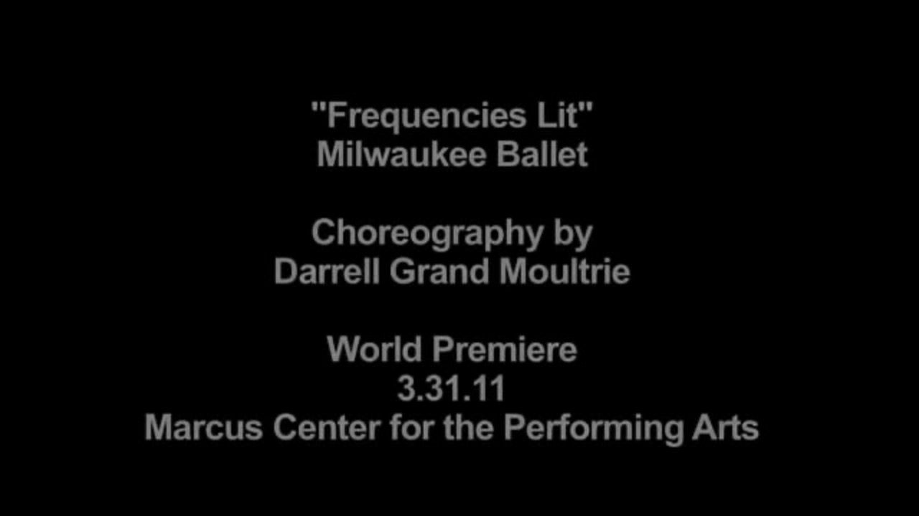

Slide 9

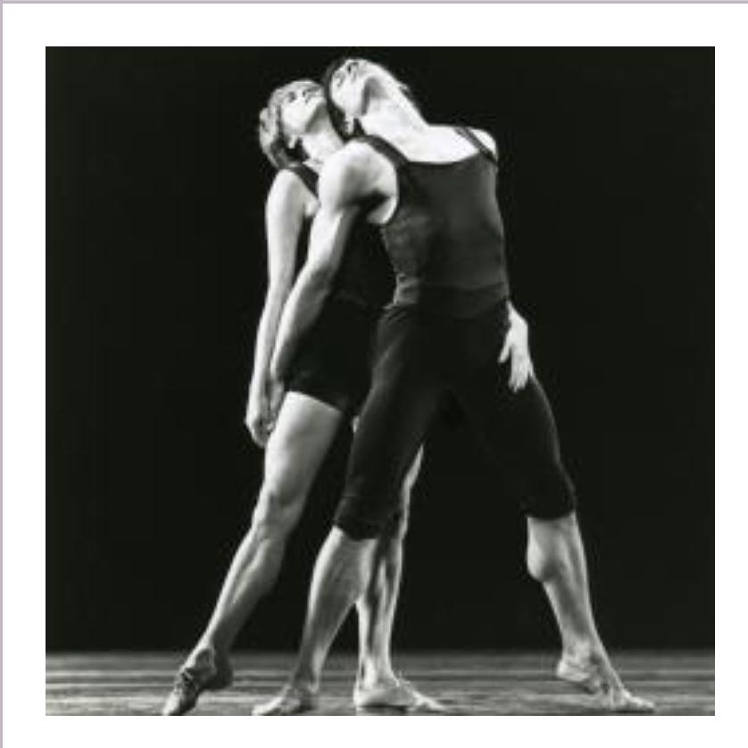
TWYLA THARP

Slide 10

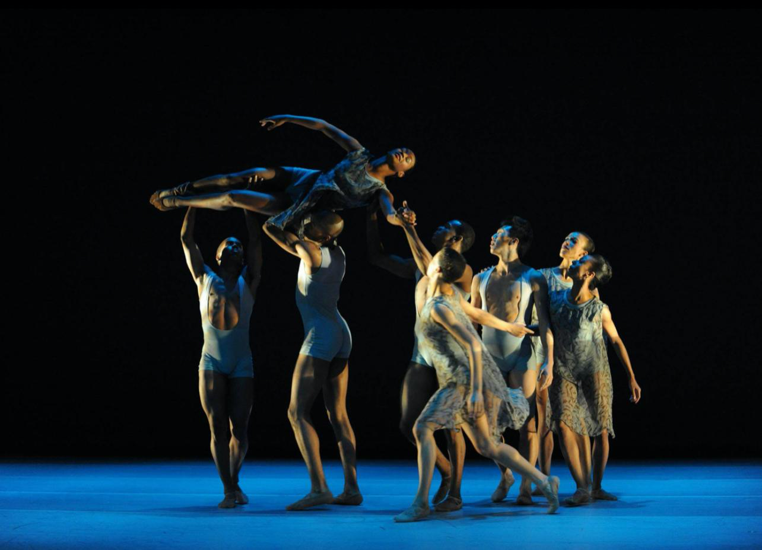
THANG DAO

Slide 11
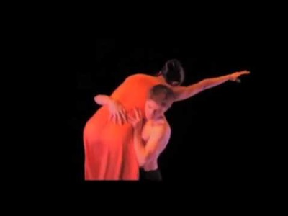

Slide 12

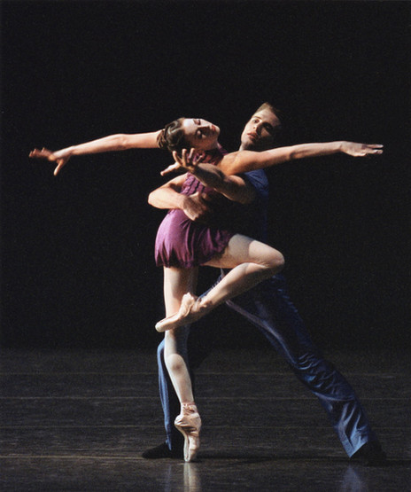
MIRIAM MAHDAVIANI

Slide 13
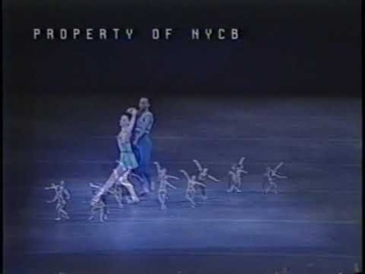

Slide 14
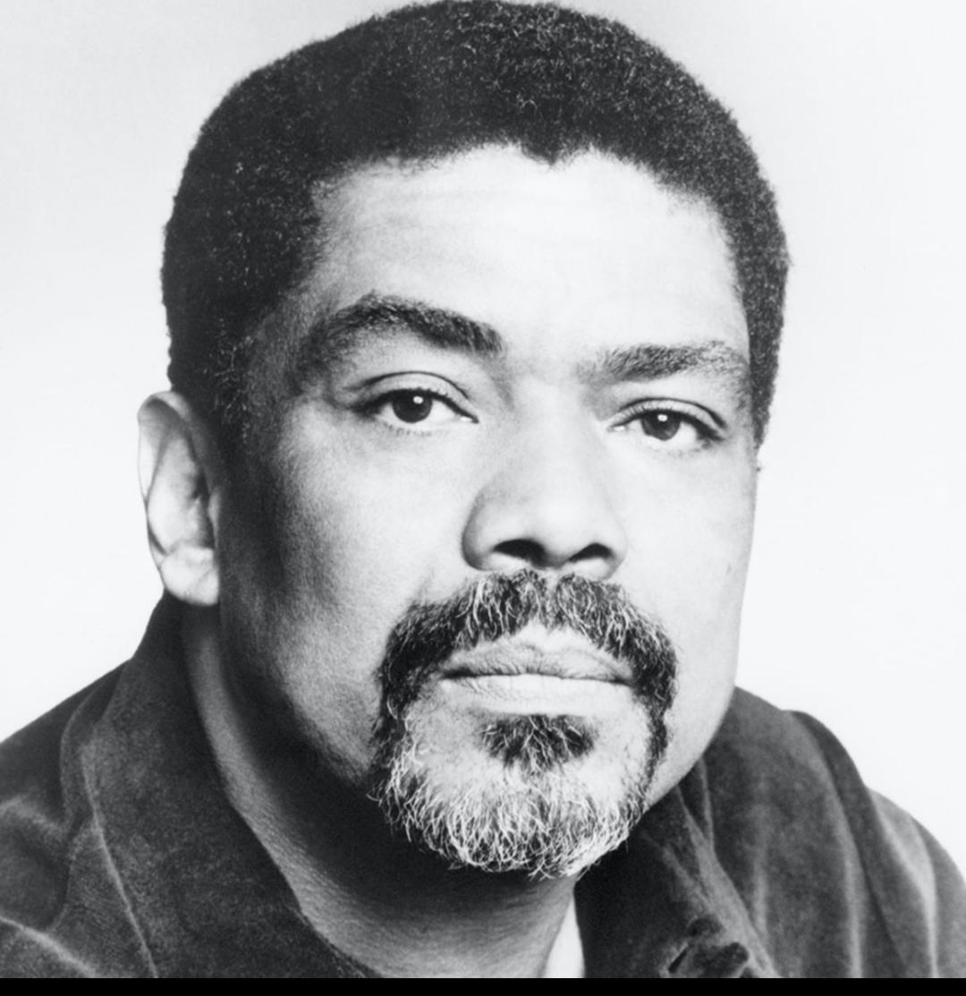
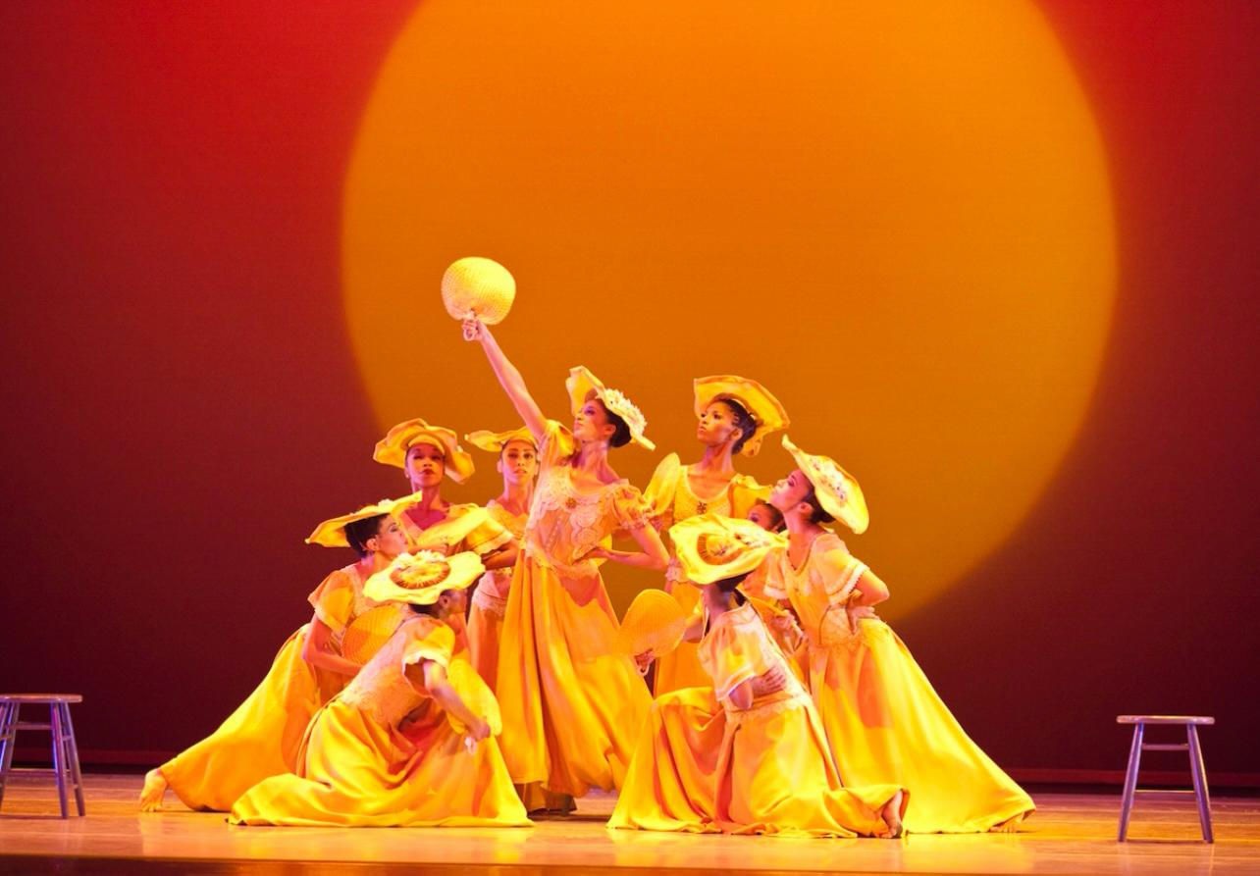
ALVIN AILEY

Slide 15
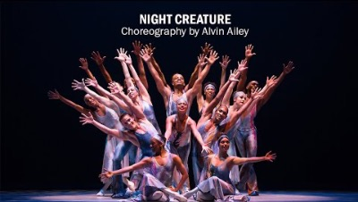

Slide 16
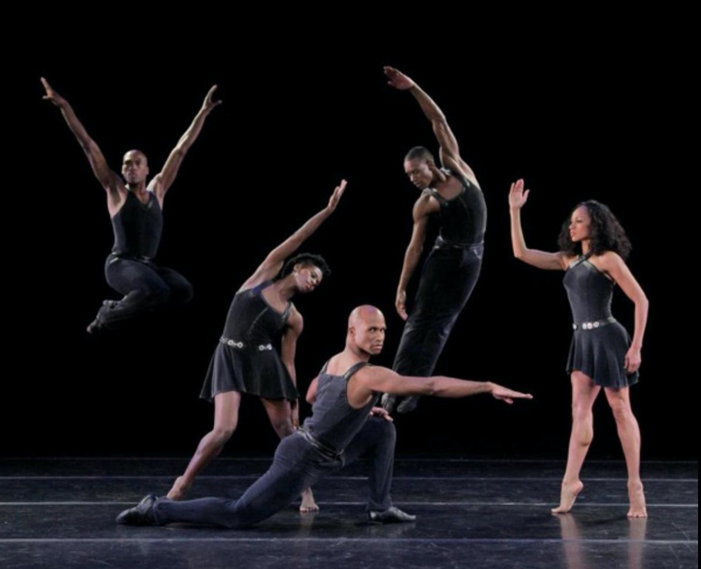
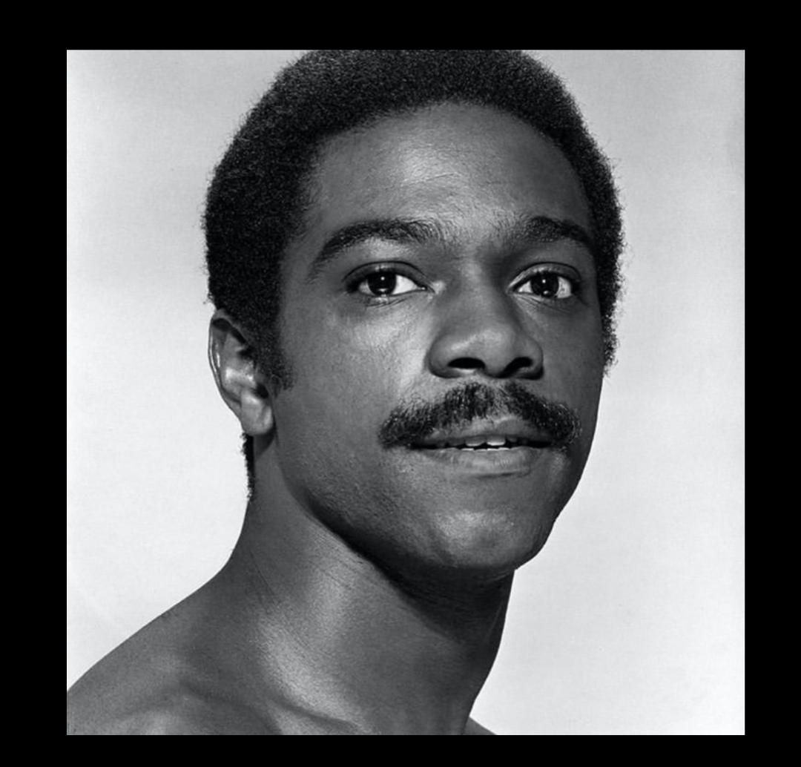
ULYSSES DOVE

Slide 17
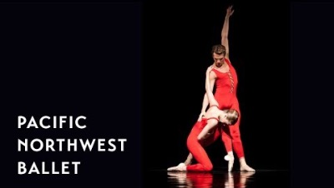

Slide 18

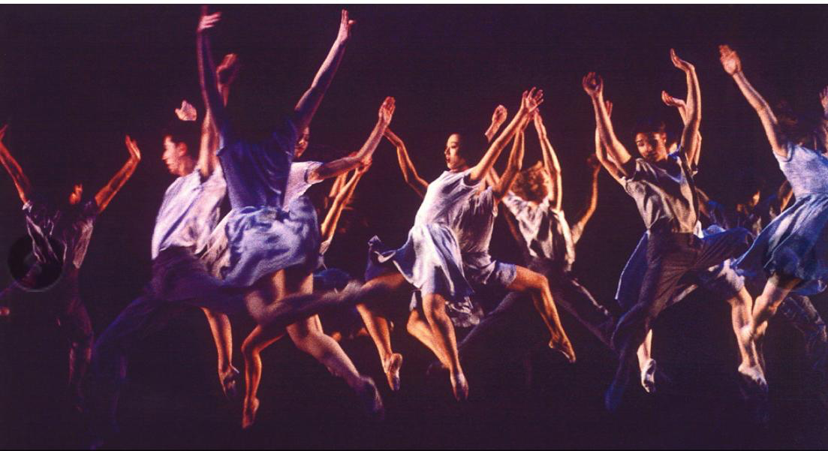
LILA YORK

Slide 19
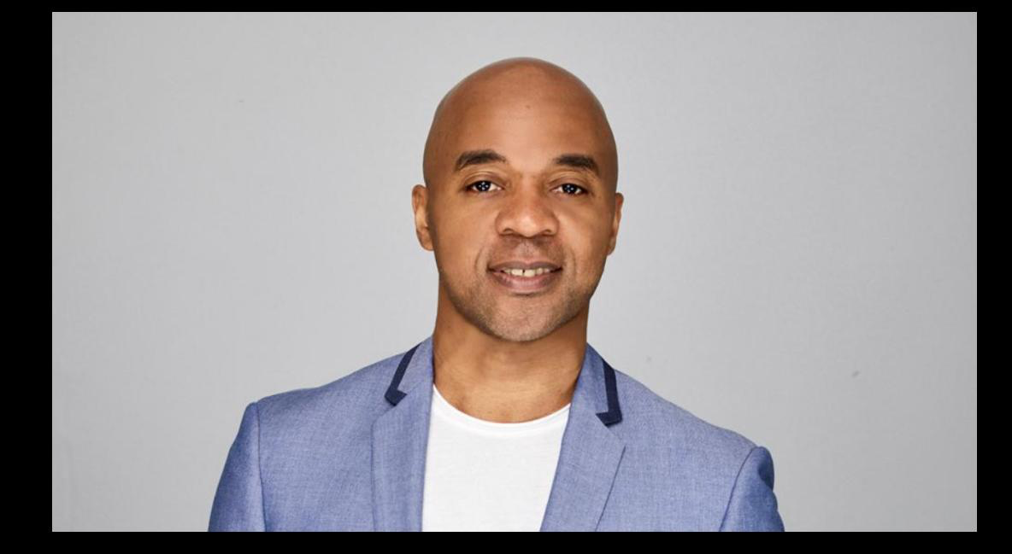
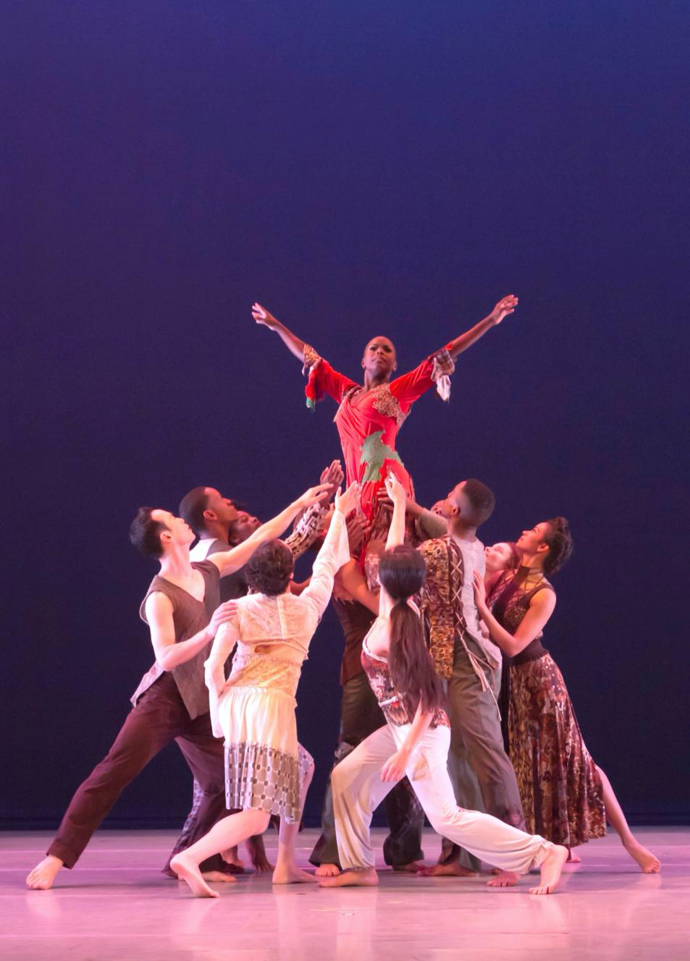
MATTHEW RUSHING

Slide 20
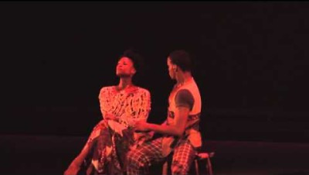

Slide 21

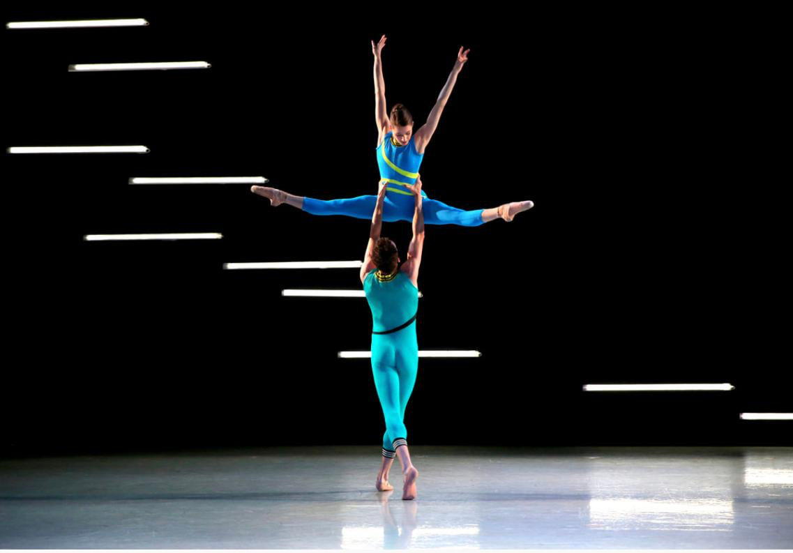
KATARZYNA SKARPETOWSKA

Slide 22


Slide 23
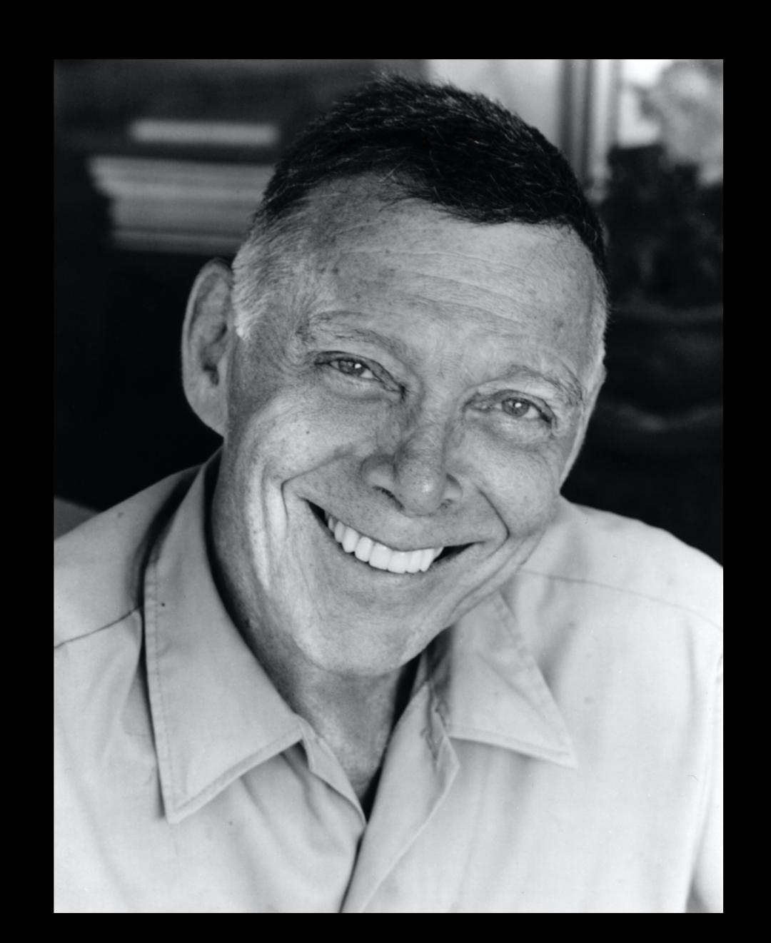
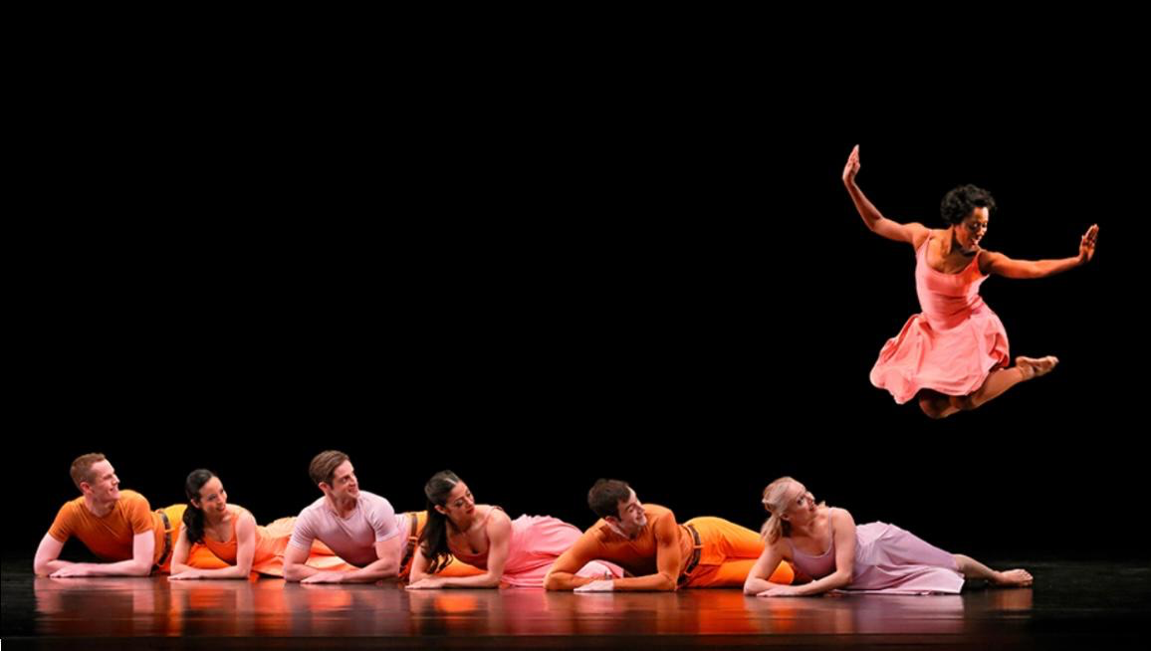
PAUL TAYLOR

Slide 24
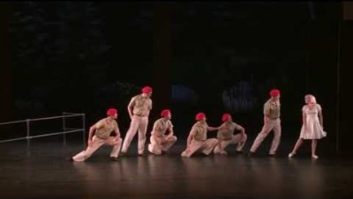

Slide 25
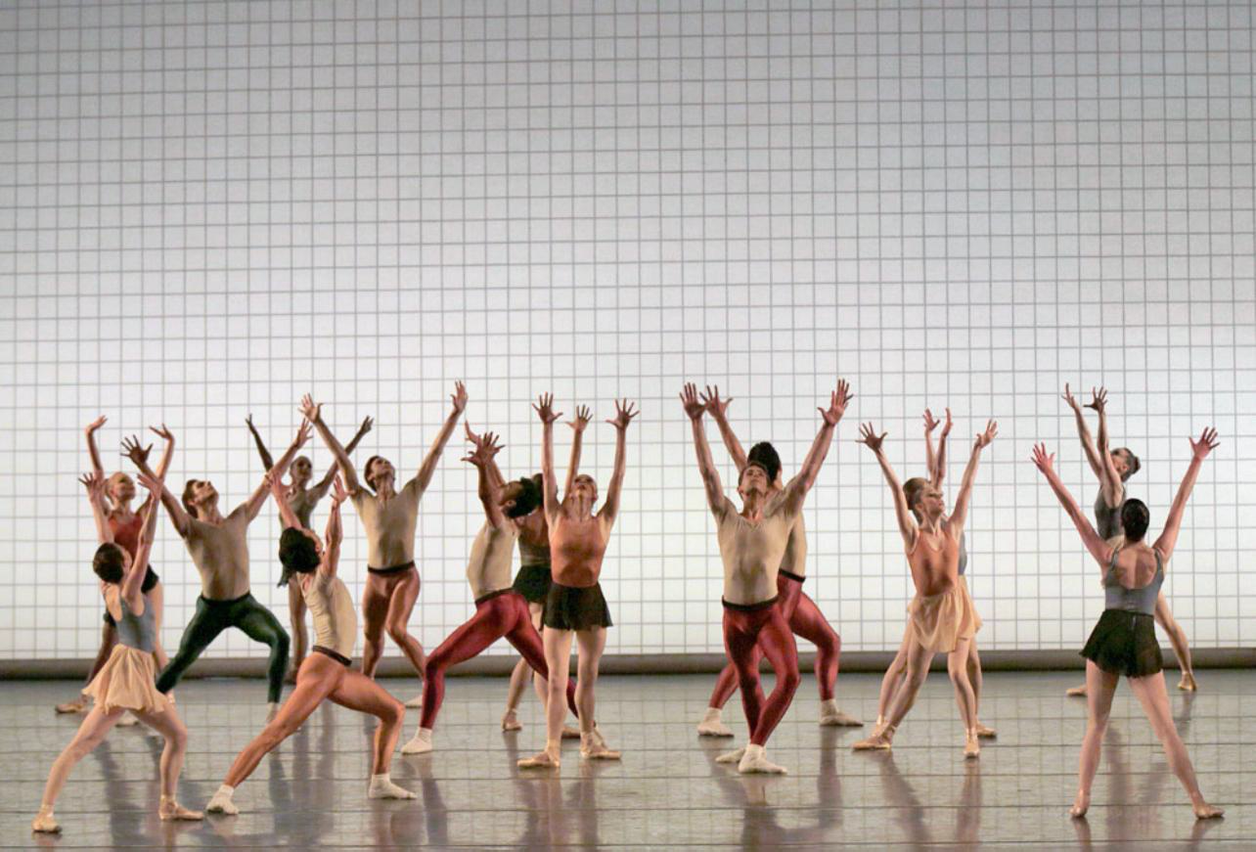
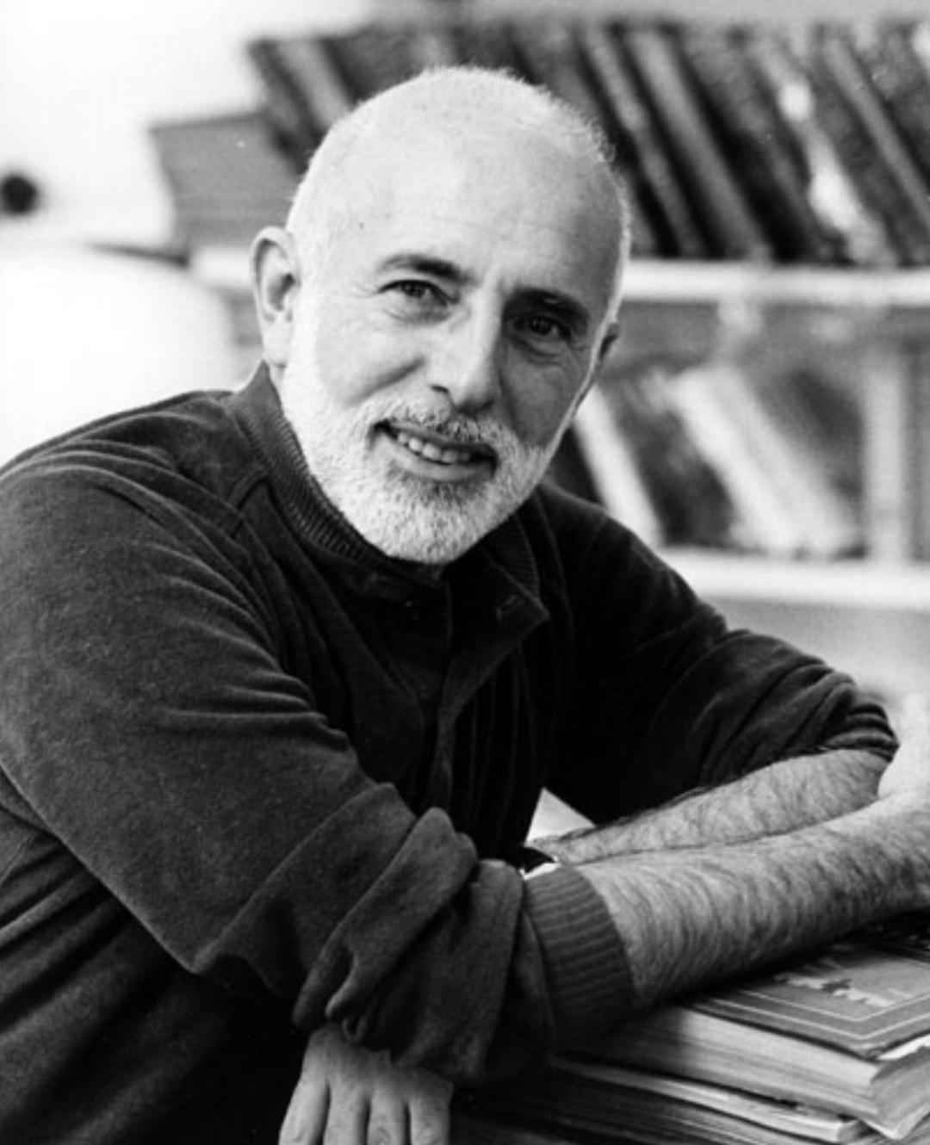
JEROME ROBBINS

Slide 26
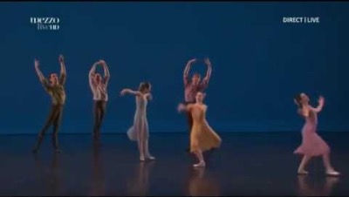

Slide 27
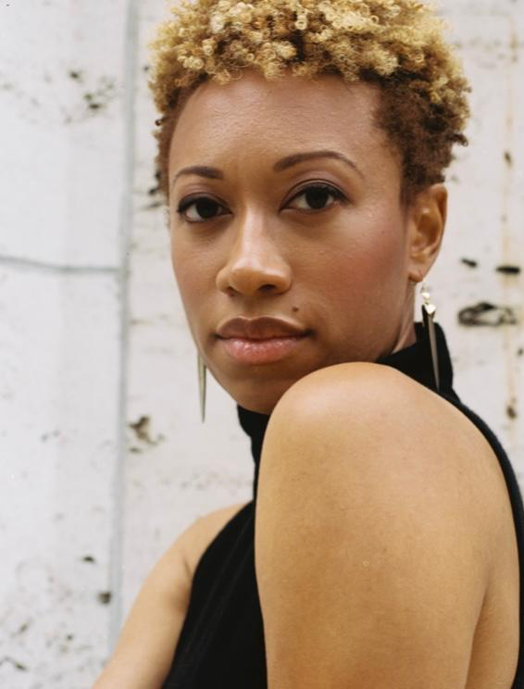
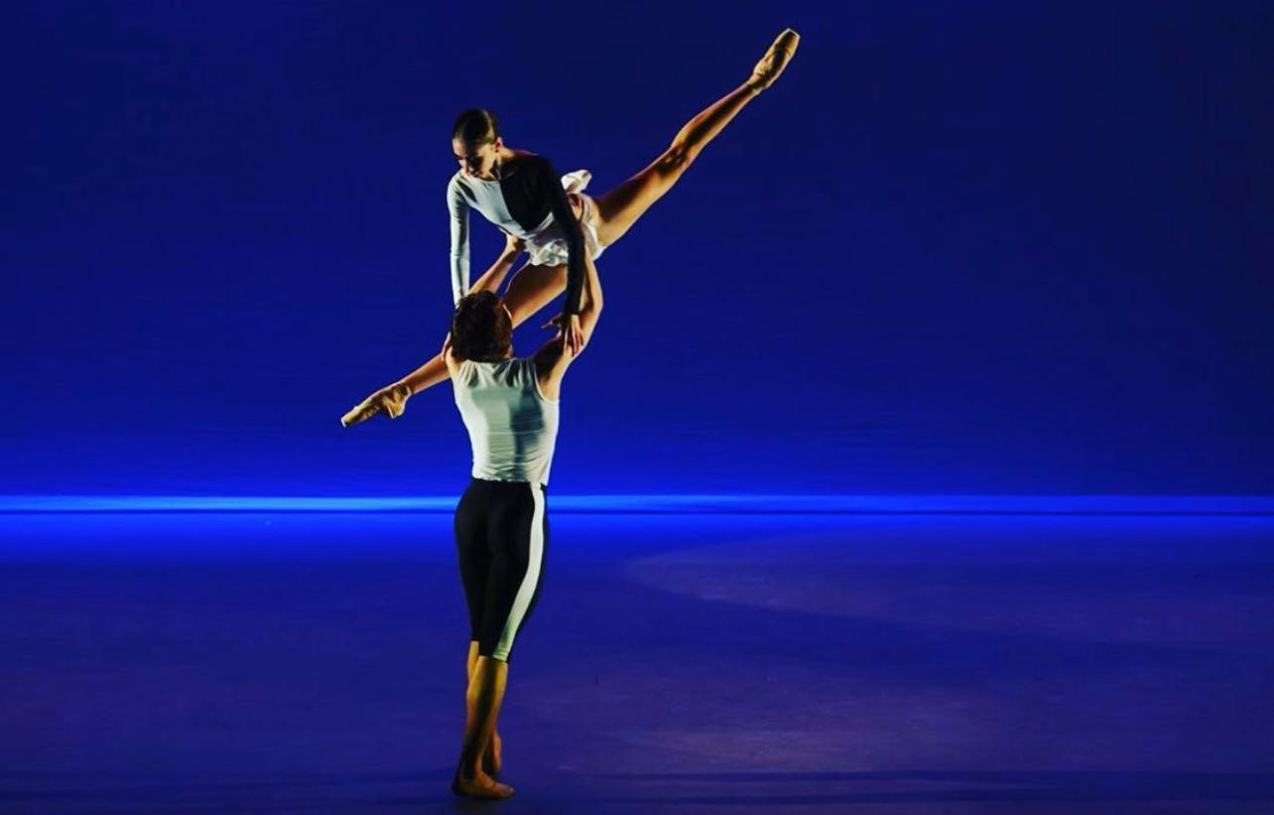
AMY HALL GARNER

Slide 28
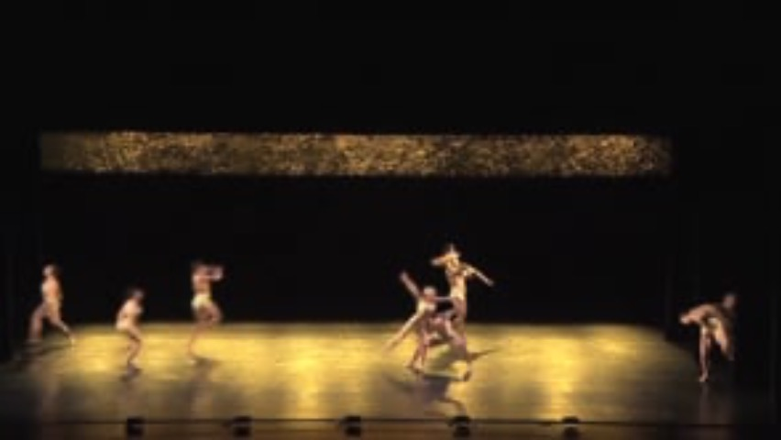

Slide 29
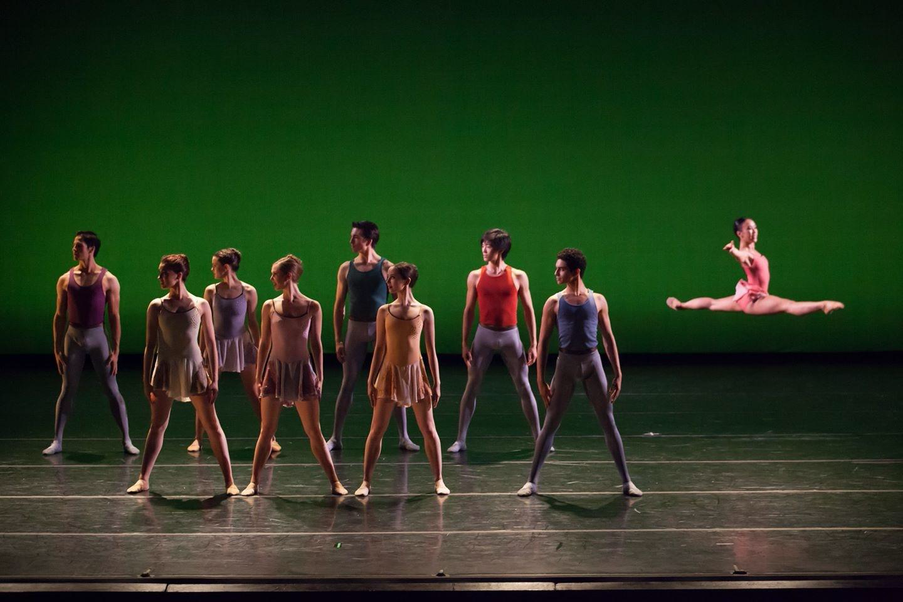

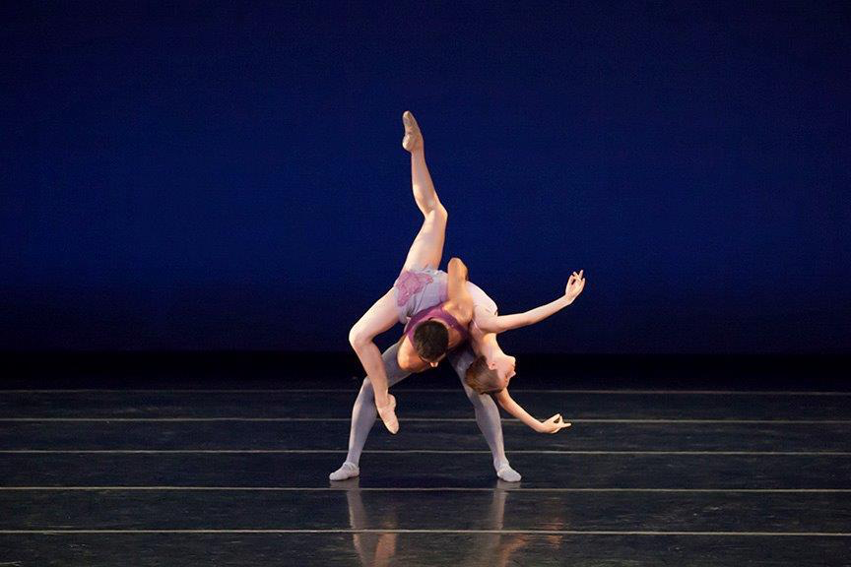
NATREA BLAKE

Slide 30

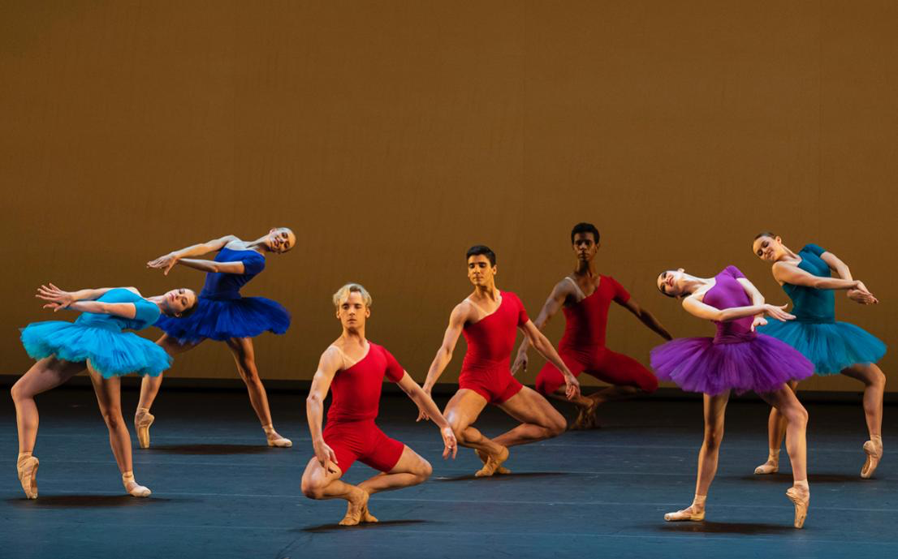
LAUREN LOVETTE

Slide 31
