Slide 1

Environmental Science
Chapter 1 Learning Objectives
After completing this chapter, you will be able to:
Discuss a brief history of environmental science.
Explain the basic characteristics of life forms.
Identify renewable and non-renewable energy resources, and their hazards and impacts.
Differentiate among various environmental stressors and their impact on biodiversity.
Explain the role of human beings on the environment and its ecosystems.

Slide 2
The History of Environmental Science
The history of environmental science can be traced back to ancient civilizations where people had to develop techniques for adapting to their environment to survive.
During the 1970s, there was a growing recognition of the need for environmental regulation, and many countries passed laws to protect their air, water, and land resources.
In 1970, the United States passed the Clean Air Act (Summary of the Clean Air Act | US EPA) and the Clean Water Act of 1972 (Summary of the Clean Water Act | US EPA), which set standards for air and water quality and established regulatory agencies to enforce these standards.

Slide 3
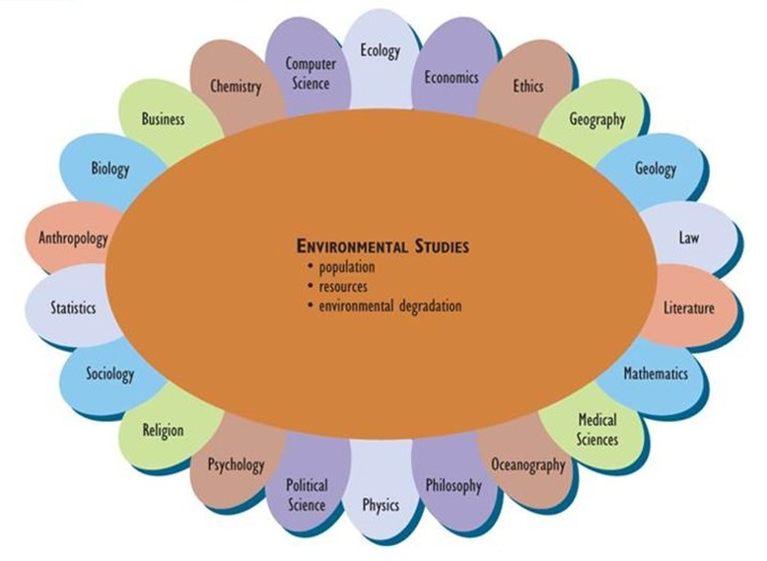
Today, environmental science is a multidisciplinary field focused on understanding the interactions between humans and the natural environment and developing solutions to environmental problems.
Interdisciplinary Nature of Environmental Science
Figure 1.4. Environmental studies center around multiple factors such as population, resources, and environmental degradation with contributions from different disciplines.

Slide 4
Biosphere: Lithosphere, Hydrosphere, and Atmosphere
Lithosphere is the outer crust of the Earth, which is composed of four layers (core, mantle, lithosphere, and crust) arranged in concentric layers like an onion.
The massive core has a diameter of about 3,500 km and is composed of hot, molten metals, particularly iron, and nickel. The internal heat of Earth is thought to be generated by the slow, radioactive decay of unstable isotopes of certain elements, such as uranium.
The mantle is a less dense region that encloses the core. It is about 2,800 kilometers thick and composed of minerals in a plastic, semi-liquid state known as magma. The mantle contains relatively light elements, notably silicon, oxygen, and magnesium, occurring as various mineral compounds.
The lithosphere is only about 80 kilometers thick. It is composed of rigid, relatively light rocks, especially basaltic, granitic, and sedimentary ones.

Slide 5
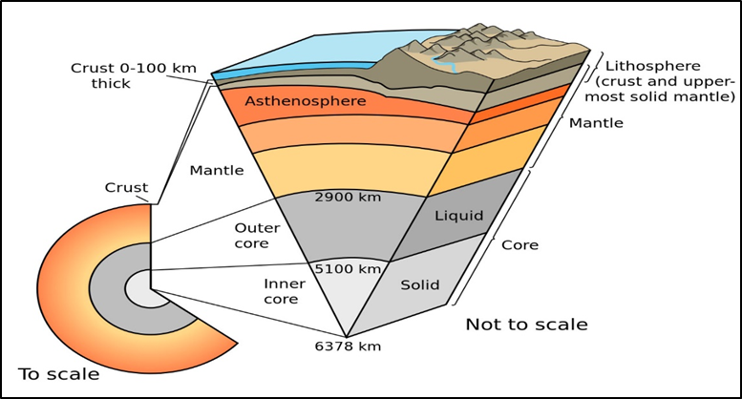
The outermost layer is known as the crust. The oceanic crust is relatively thin, averaging 10–15 kilometers, while the continental crust is 20–60 kilometers thick.
Figure 1.5. Illustration of different layers of earth, from the inner core to the lithosphere, which is composed of the crust and the uppermost solid mantle. Source:

Slide 6
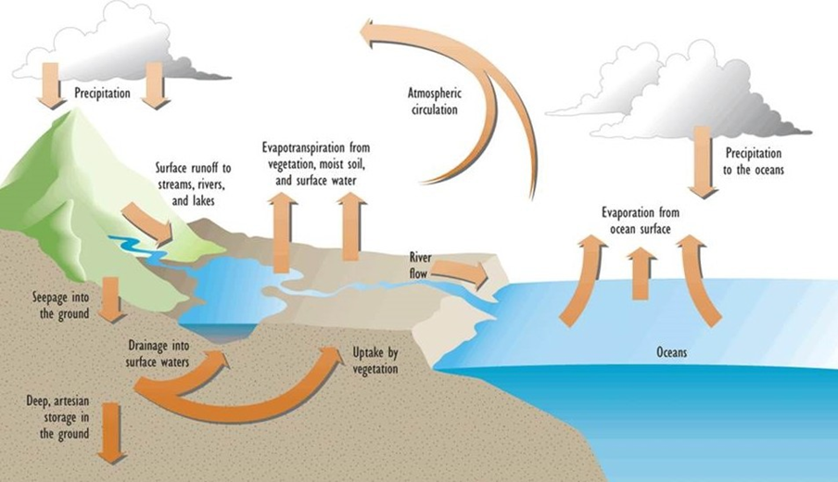
The hydrosphere is the portion of Earth that contains water (H₂O), including in the oceans, atmosphere, land surface, and underground. The hydrologic cycle (or water cycle) refers to the rates of movement (fluxes) of water among these various reservoirs (compartments).
Figure 1.6. Major Elements of the Hydrologic Cycle. The hydrologic cycle includes the influences of oceans and other kinds of surface water (such as lakes and rivers), as well as groundwater and atmospheric moisture (clouds and humidity). Water evaporates, precipitates as rain and snow, and flows in various kinds of channels, both along the surface as well as underground. Source:

Slide 7
The atmosphere is an envelope of gasses that surrounds the Earth and is held in place by the attractive forces of gravity.
The troposphere (or lower atmosphere) contains 85-90% of the atmospheric mass and extends from the surface to an altitude of 8-20 kilometers. It is thinner at high latitudes, and thicker at equatorial latitudes, but also varies seasonally, at any place being thicker during the summer than in the winter.
The stratosphere extends from the troposphere to as high as about 50 kilometers above the earth, depending on the season and latitude. Air temperature varies little with altitude within the stratosphere, and there are few convective air currents.
The mesosphere extends beyond the stratosphere to about 75 kilometers.
The thermosphere extends to 450 kilometers or more.

Slide 8
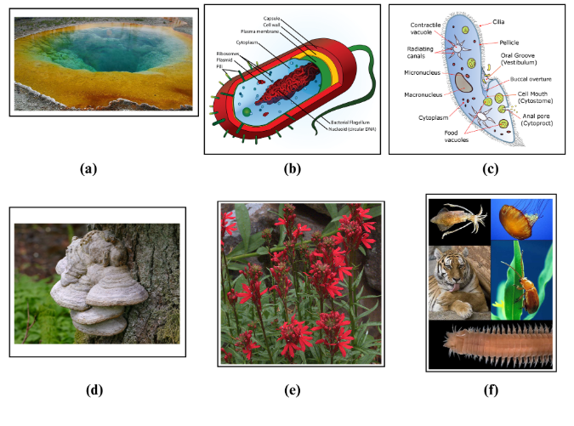
Preserving Biodiversity and the Six Kingdoms of Life
Figure 1.7 shows examples of organisms in the six kingdoms of life. (a) This image shows a hot spring at Yellowstone National Park. Hot springs are extreme environments where some archaea can thrive due to the high aquatic temperatures. (CC-BY OpenStax Microbiology) (b) This diagram depicts the structure of an average prokaryotic cell. (CC0) (c) Paramecia are common examples of protists. (CC-BY-SA) (d) A tinder fungus is pictured on a dead pine tree in Lysekil, Sweden. (CC0) (e) Plants exist in many forms. This cardinal flower was photographed at the Regional Parks Botanic Garden near Berkeley, California. (CC BY John Rusk) (f) Kingdom Animalia includes approximately 36 phyla with wide-ranging characteristics. This image shows examples within this grouping as follows (from left to right, top to bottom): European squid, Atlantic Sea Nettle, tiger, flea beetle, and bristle worm. (CC BY-SA)

Slide 9
The six kingdoms of life are separated into two groups: prokaryotic and eukaryotic organisms. Prokaryotic organisms lack a true nucleus and other membrane-bound organelles and include Domains Archaea and Bacteria.
Archaea is a group of single-celled microorganisms that are distinct from both bacteria and eukaryotes.
Kingdom Bacteria is also known as Eubacteria, which means “true bacteria.” This kingdom includes a diverse group of prokaryotic organisms that are found in virtually every habitat on Earth.
Eukaryotic organisms have a true nucleus and other membrane-bound organelles and include Domain Eukarya. Domain Eukarya includes four kingdoms: Protista, Fungi, Plants, and Animals. Protista is a biological kingdom that includes a diverse group of eukaryotic microorganisms.
Fungi are a diverse group of organisms that includes yeasts, molds, and mushrooms. Fungi play important roles in nutrient cycling and the decomposition of organic matter.

Slide 10
Environmental Hazards
Biological hazards are caused by a variety of organisms belonging to the six kingdoms of life. The effect of biological hazards such as physiological changes, responses to stimuli, reproductive behavior, and diseases, could cause short (acute) and or long-term (chronic) damage to life forms.
Chemical hazards are mainly two kinds – inorganic such as toxic metals. The chemical hazards are toxic which affects the living organisms and their habitats including the water, air, and soil quality.
Physical hazards ranging from a wet floor in buildings, foul odor in the air, depth in water bodies, and extreme temperatures cause thermal pollution.
Natural disasters such as hurricanes, tornadoes, earthquakes, and volcano eruptions, cause loss of life and biodiversity, disrupt the harmony in ecosystems, reduce the productivity of food chains and food webs, and damage the environmental quality.

Slide 11
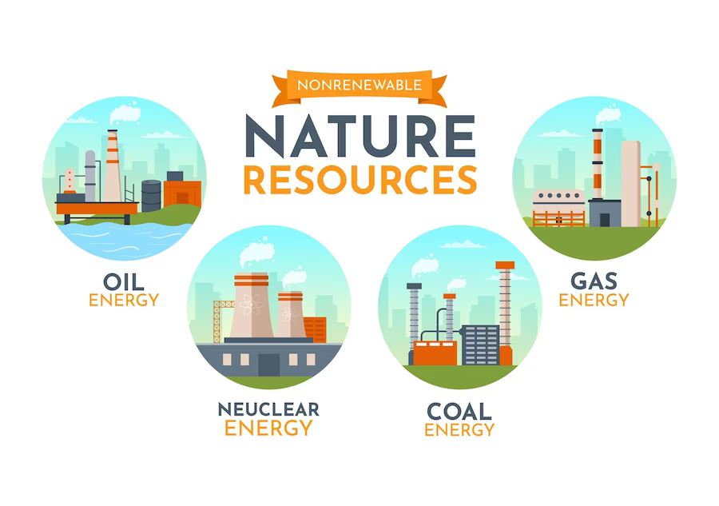
Anthropogenic toxins and their distribution in the environment and among the biota are due to human activities which eventually damage the natural resources and human health.
Non-Renewable and Renewable Energy Sources
Figure 1.10

Slide 12
Non-renewable energy sources are those that cannot be easily replenished in a short time, making them finite and unsustainable in the long run.
Fossil fuels are generally the remains of plants and animals that died millions of years ago and are found deep underground. These fuels may include coal, oil, and natural gas. Tar sands and shale gas are also considered non-renewable energy resources.
Nuclear energy produced by splitting atoms of uranium or plutonium is a process called nuclear fission. From such an exothermic process, the liberated heat is used to generate electricity.

Slide 13
Renewable Energy Sources
Renewable energy sources are those that can be refilled naturally and in a relatively short time or at continuous bases (solar, wind). These energy resources are sustainable and reusable, environmentally friendly, and carbon footprint-reducing agents.
Solar energy is generated by capturing solar radiation from the sun using solar panels. This can be used to generate electricity, water heating, or provide energy for a range of other applications.
Wind turbines generate electricity by harnessing the power of the wind. Hydroelectric power is generated by capturing the energy of falling water to turn turbines and generate electricity.
Geothermal energy is generated by capturing the heat of the Earth’s interior to generate electricity or heat buildings. Biomass energy is generated by burning organic materials such as wood, agricultural waste, and other plant-based substances.

Slide 14
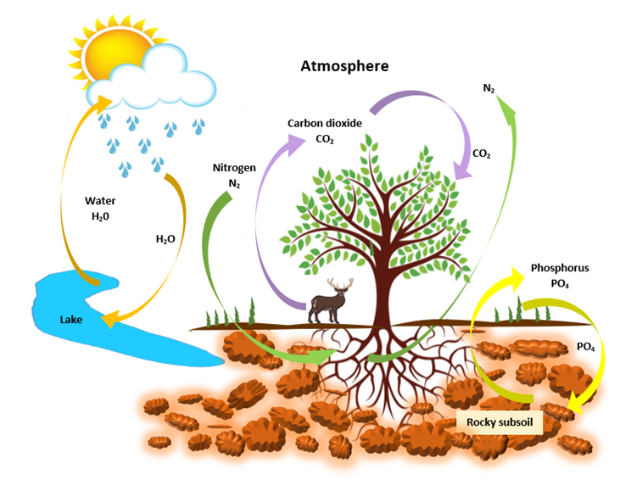
Nutrient Cycles
The movement of nutrients through the environment is known as nutrient cycles or biogeochemical cycles.
Carbon is recycled and moves through the environment when animals release CO₂ into the atmosphere to be absorbed by plant leaves.
The atmosphere contains 78% of gaseous nitrogen (N₂). However, nitrogen changes various forms when it enters the soil from the atmosphere.
The majority of the phosphorus in the environment is bonded to subterranean rocks and is only released during weathering processes.
Figure 1.14. The Nutrient Cycle. While carbon and nitrogen are mostly found in the atmosphere, phosphorus is mainly recycled in rocks, sediment, and soil. Water molecules can circulate from lakes, oceans, rivers, and streams to the atmosphere and back to the Earth thanks to the hydrologic cycle. (Source: Courtesy of Waneene C. Dorsey, Grambling State University)

Slide 15
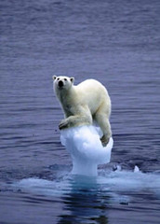
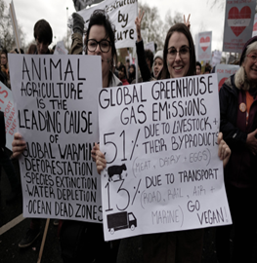
The recycling of water involves four major processes: evaporation, condensation, precipitation, and infiltration. Evaporation occurs when water is heated by the ambient temperature (temperature in the environment) and turns into a gaseous vapor.
Global Warming
(a) (b)
Figure 1.16 Global warming. (a) Degradation of the polar bear habitat. Glacier melting is a major cause of flooding and a global concern for environmentalists. (b) Animal agriculture is a significant contributor to global warming. Source: Courtesy of openverse.org, CC by 2.0 attribution.

Slide 16
An increase in the Earth’s surface temperature is referred to as global warming, also known as climate change.
Natural occurrences on the Earth and anthropogenic activities are responsible for increased surface temperatures. Rising sea levels, sporadic flooding, melting glaciers, wildfires, storms, and the loss of wildlife habitats are just a few of the damaging effects of heightened warming trends.
Greenhouse gases are a product of man-made activities such as agricultural activities, combustion of fossil fuels, deforestation, and industrial manufacturing of products. Major greenhouse gases include carbon dioxide, chlorofluorocarbons, methane, ozone, nitrous oxide, and water vapor.
The greenhouse effect occurs when a layer of greenhouse gasses from man-made activities hovers in the Earth’s atmosphere. Because of this, solar radiation strikes the surface of the Earth and bounces back into the atmosphere. The rays from the sunlight are blocked by the layer of greenhouse gasses. The surface temperature of the Earth increases as a result of this activity.

Slide 17
Environmental Quality and Agriculture
Agriculture can be defined as the science, and art, of cultivating the soil, producing crops, and raising livestock.
Today, the world supports an enormous population (more than 7.3 billion in 2015 and 7.9 billion in 2023), and almost all depend on the agricultural production of food (fishing and hunting also provide some food).
The development of agricultural practices and technologies, and their improvements over time, are among the most crucial of the “revolutions” that have marked the socio-cultural evolution of Homo sapiens.
Modern agriculture involves several distinct management practices that impact crop plants, production of crops, cultivation practices, and livestock, to name a few.

Slide 18
Environmental impacts on agriculture include declining site capability, nutrient loss, organic matter, soil erosion, compaction, salinization, and desertification.
Agricultural site capability (or site quality) refers to the ability of an ecosystem to sustain the productivity of crops. Soil organic matter is a crucial factor that affects fertility and site capability since the organic matter has a strong influence on the capacity of soil to hold water and nutrients and on its aeration, drainage, and tilth.
Soil is eroded by wind and by the runoff of rain and melted snow. Although erosion is a natural process, its rate can be greatly increased by agricultural practices, and this may be a serious environmental problem.
Compaction occurs when the air spaces in the soil are compressed resulting in waterlogging, oxygen-poor conditions, impaired nutrient cycling, poor root growth, and decreased crop productivity.
Salinization is a buildup of soluble minerals in the surface soil that can be a major problem in drier regions. Desertification, the increasing aridity of drylands, is a complex problem, caused by both climate change and other anthropogenic influences.

Slide 19
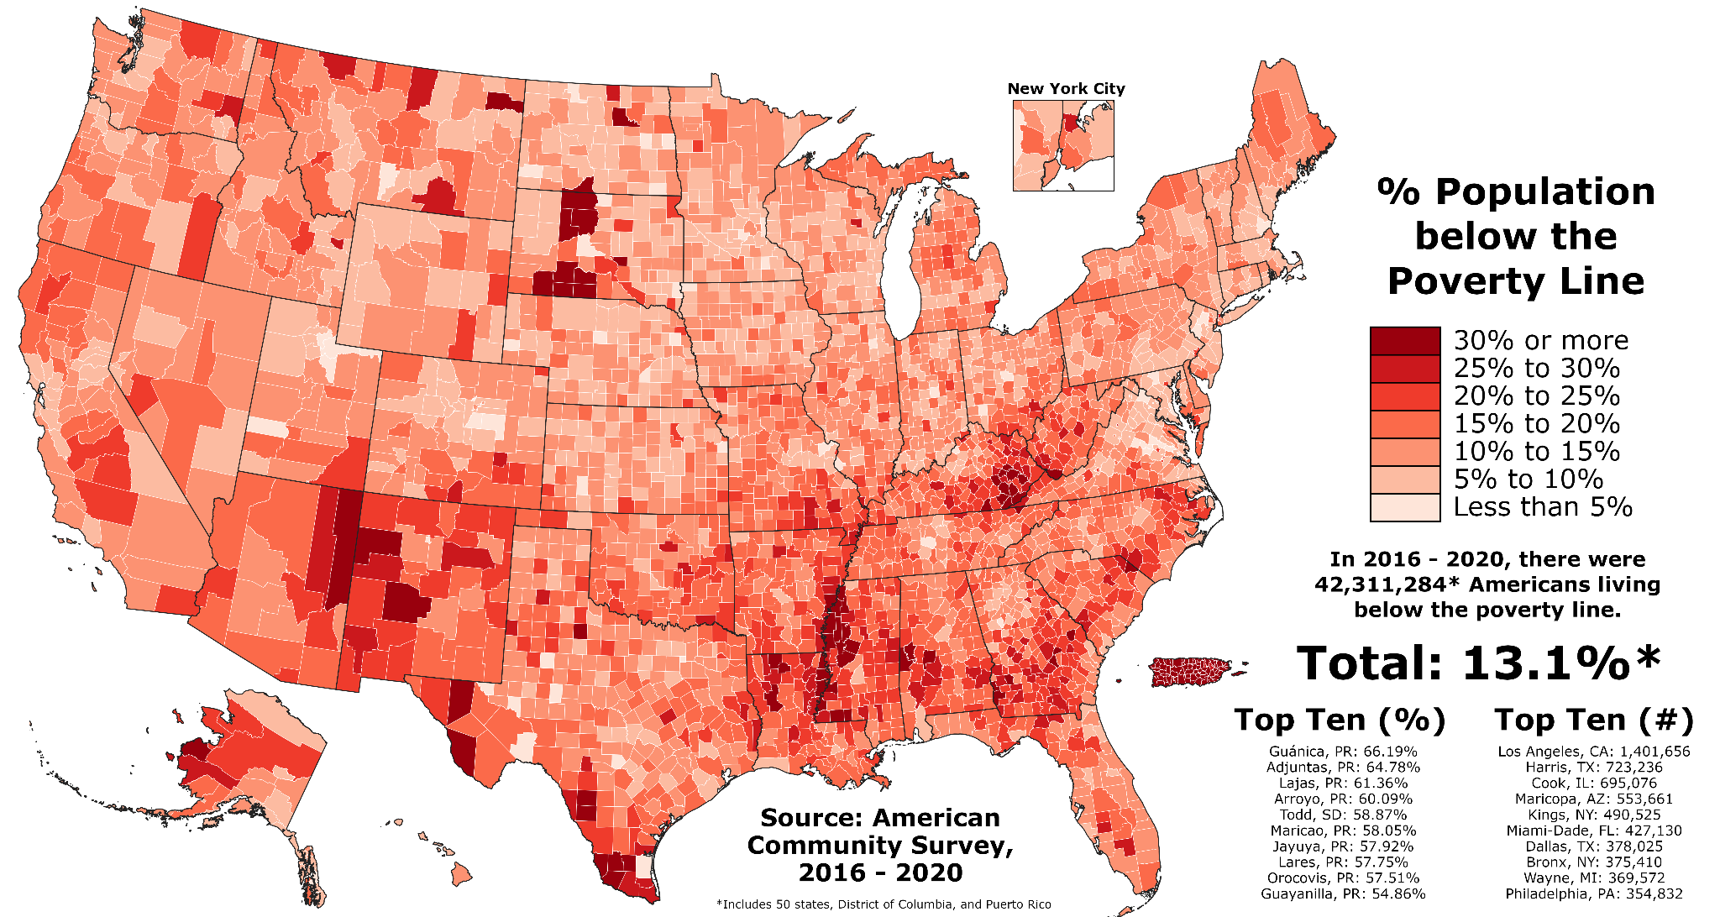
Environmental Impact on Food Supply, Nutrition, Malnutrition, and Starvation
Environmental impacts on human behaviors include food supply, nutrition, malnutrition, and starvation. In 2014, more than 7.3 billion people were alive, and almost all were reliant on crops as their prime source of food.
Figure 1.19. Poverty in the United States is depicted by county. The American Community Survey collected data from 2016–2020 to display the proportion of Americans living below the poverty line in each county of the fifty states. Attribution: CC BY-SA 4.0 via Wikimedia Commons.

Slide 20
Environmental Ethics
Environmental ethics center around the responsibility of our society to make ethical and moral decisions in response to the world around us. Ethics provides guidance about which alternative actions should be favored or even allowed to occur.
Perceptions of value (of merit or importance) also profoundly influence how the consequences of human actions are interpreted. Environmental values can be divided into two broad classes: utilitarian and intrinsic.
Utilitarian value (also known as instrumental value) is based on the known importance of something to the welfare of people (see also the discussion of the anthropocentric world view, below).
Intrinsic value is based on the belief that components of the natural environment (such as species and natural ecosystems) have inherent value and a right to exist, regardless of any positive, negative, or neutral relationships with humans.

Slide 21
Environmental Quality
Environmental quality deals with anthropogenic pollution and disturbances and their effects on people, their economies, other species, and natural ecosystems. Pollution may be caused by gases emitted by power plants and vehicles, pesticides, or heated water discharged into lakes.
In a general sense, the cumulative impact of humans on the biosphere is a function of two major factors: (1) the size of the population and (2) the per-capita (per-person) environmental impact.
Sustainable economic development requires meeting and sustaining the needs of the current generation without inhibiting future generations from meeting and sustaining their needs.

Slide 22
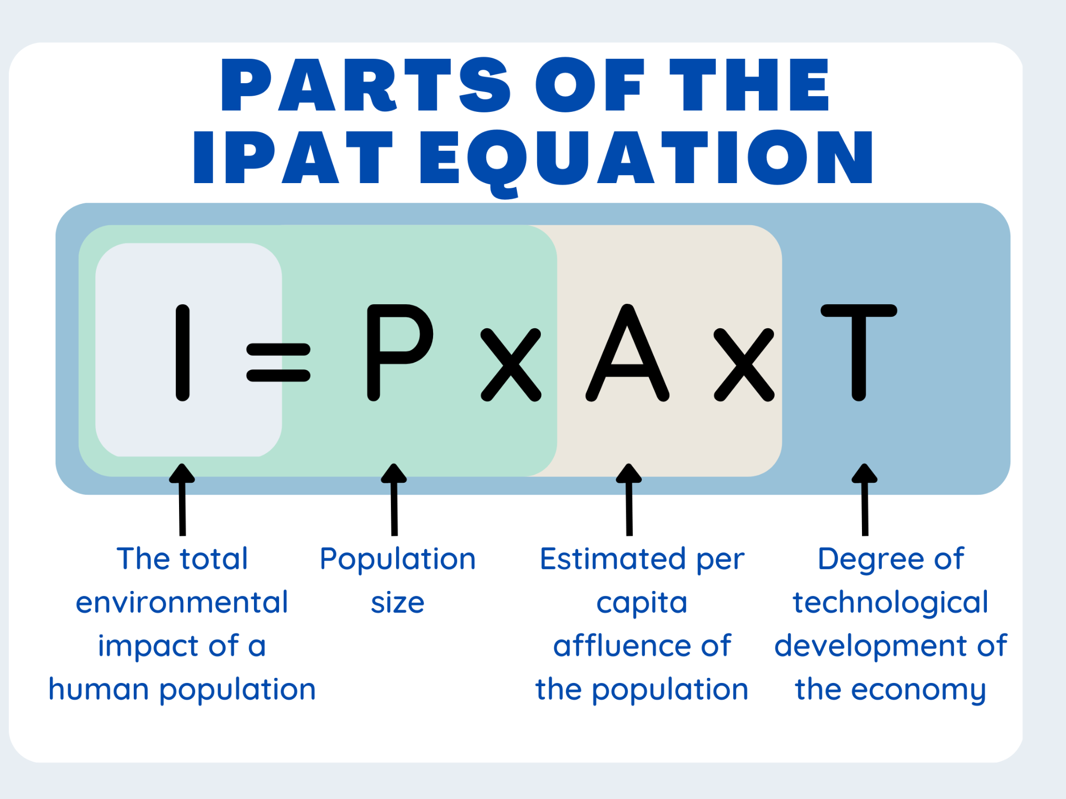
Meeting goals for environmental quality, specifically sustainable economic development can be measured by applying the IPAT Equation.
The Tragedy of the Commons is an economic principle that focuses on individuals intentionally or unintentionally using resources in excess. This principle applies to situations of overgrazing, overusing resources, depleting food sources, polluting water, air, and land, and contributing to global climate change.
Figure 1.20. The IPAT equation shows the contributing factors to the environmental impact of a location.

Slide 23
Environmental Justice
Environmental justice is the fair treatment and inclusion of all individuals independent of their demographic characteristics (race, ethnicity, national origin, and socioeconomic status) in the “development, implementation, and enforcement of environmental laws, regulations, and policies.”
Unequal access to resources and societal systemic problems are the root causes of environmental injustice.

