Slide 1

Water, Soil, and Air Quality
Chapter 2: Learning Objectives
After completing this chapter, you will be able to:
Explain the water cycle and its importance for living organisms.
Explain how soil erosion, cleaning vegetation and soil pollution are affecting our environment.
Identify different types of water bodies and their availability for human consumption.
Describe how water can become polluted.
Explain the importance of soil fertility.
Describe how soil erosion, cleaning vegetation, and soil pollution are affecting our environment.
Explain how burning fossil fuel contribute to the amount of pollutants in the environment.
Describe how air quality management is important for a clean and healthy atmosphere.

Slide 2
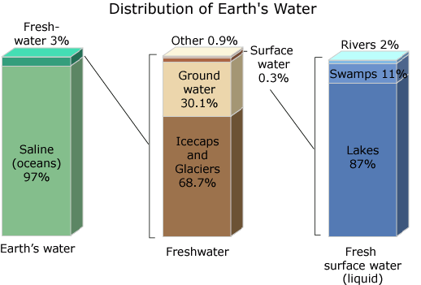
Water
Water is an essential commodity for human life and survival. We need to consume it to stay alive and use it to clean our food, utensils, clothes, bodies, and surroundings to prevent diseases.
About 71% of the Earth’s surface is covered by water, most of which is in oceans and unavailable for human consumption due to its high salinity.
Approximately 97% of all water is saline and 2% is fresh water held in ice caps and glaciers.
At least 99% of all water is generally unsuitable for human use because of salinity (ocean water) and location (ice caps and glaciers), leaving less than 1% of total water as fresh water that is available for consumption. Of this available fresh water, approximately 97% is groundwater stored deep below the surface of the Earth and only 1.4% is surface water in rivers and lakes.
Figure 2.1 Distribution of Earth’s water.

Slide 3
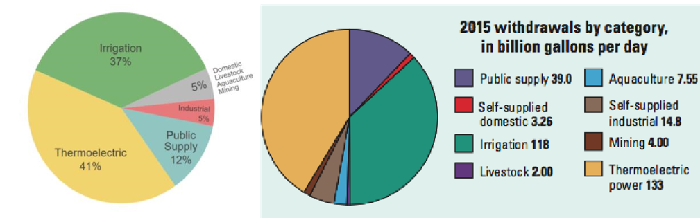
There are three main sectors that use water – industrial, agricultural, and domestic. When water is removed from its source such as river or lake and returned to this source after use, this is referred to as non-consumptive use.
Consumptive use is when water is taken out from a source and consumed by plants and animals or used in industrial processes.
Figure 2.2: Estimated 2015 water withdrawals in the US. Irrigation and thermoelectric power usages account for most water withdrawals

Slide 4

Water Scarcity and Shortage
Water scarcity is caused by the demand for water or a certain quality being greater than the supply. Scarcity can be defined as either physical scarcity or economic scarcity.
Physical water scarcity is a situation where there is an actual shortage of water, regardless of quality or infrastructure. It is estimated that about 1.2 million people around the world are experiencing physical water scarcity.
Economic scarcity is a condition where countries lack the financial resources and/or infrastructure to supply their citizens with reliable safe drinking water. About 1.6 billion people are experiencing economic water shortage; most of them live in less industrialized countries.

Slide 5
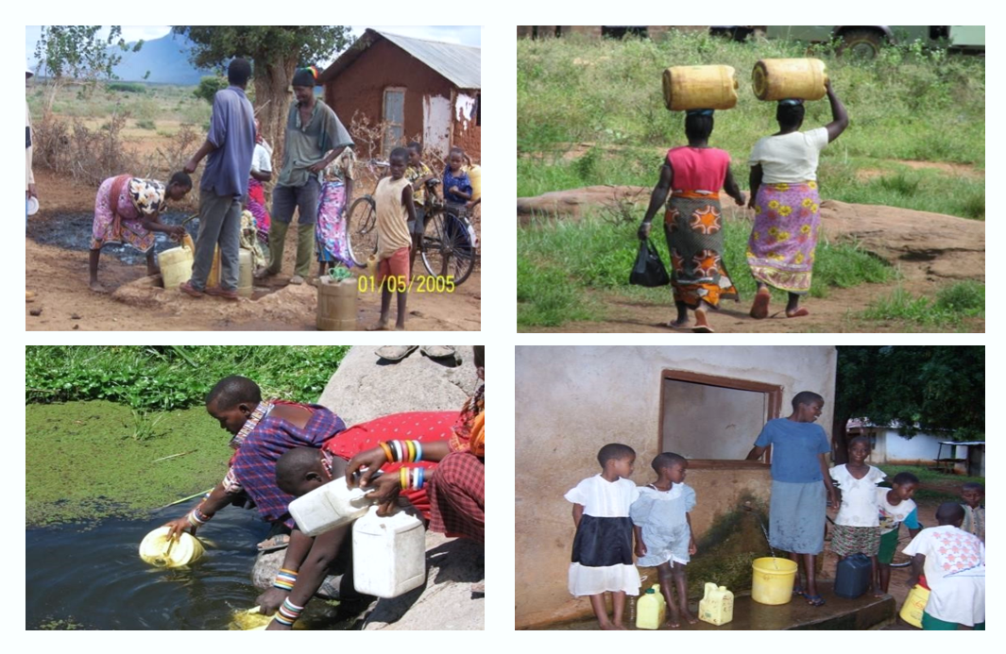
Water pollution is a major problem facing many of our surface and groundwater sources. Human sources of contamination can be categorized as either point source or nonpoint source.
Point-source pollution is water pollution coming from a single point, such as a sewage-outflow pipe.
Non-point source (NPS) pollution is pollution discharged over a wide land area such as agricultural runoff and urban stormwater runoff, not from one specific location.
Non-point source pollution contamination occurs when rainwater, snowmelt, or irrigation washes off plowed fields, city streets, or suburban backyards and carries pollutants into the water sources. As this runoff moves across the land surface, it picks up soil particles and pollutants, such as nutrients, metals, and pesticides.
Figure 2.5: Communities in southeast Kenya without easy access to safe drinking water. (Top left) Groundwater in the area is too salty for consumption. (Top right) Maasai women in Amboseli National Park collect water from a wetland. (Bottom left) Women in Magwede village in SE Kenya walking long distances to get water from a Kiosk. (Bottom right) Children collect water in Bungule Village from a water kiosk that is only open for about an hour every day. Photo credit: Jonathan Levy, Sam Mutiti, and Christine Mutiti.

Slide 6
Contamination of Water Sources
Chemical pollution includes things such as toxic metals, organic compounds, acidic waters from mining activities and industry, pharmaceuticals, and many other chemical compounds from industries and wastewater treatment plants.
Physical pollution includes sediment pollution, trash thrown in the water bodies, thermal (temperature), and another suspended load. High temperatures typically affect the metabolism of aquatic fauna in a negative way and can encourage eutrophication.
Biological pollution usually refers to pathogenic bacteria, viruses, and parasitic protozoa. Common pathogenic microbes introduced into natural water bodies are pathogens from untreated sewage or surface runoff from intensive livestock grazing.

Slide 7
Physical Surface Water Pollution
The most significant physical pollutant is excess sediment in runoff from agricultural plots, clear-cut forests, improperly graded slopes, urban streets, and other poorly managed lands (especially when steep slopes or lands near streams are involved).
Other physical pollutants include a variety of plastic refuse products such as packaging materials; the most pernicious of these items are ring-shaped objects that can trap or strangle fish and other aquatic fauna in our rivers, lakes, and oceans.
Power plants and other industrial facilities that use natural water bodies for cooling can cause thermal pollution in surface water. Thermal pollution can change the ecology of the water bodies and harm living things.
Table 2.1. Chemical Compounds and Their Common Sources
Contaminants | Common Sources
Heavy Metals (lead, chromium, zinc, arsenic, cadmium, mercury, selenium etc.) | Mines, industries, rocks, power plants
Cations (carbonates, nitrates, phosphates, fluorides, sulfates) | Sewage, wastewater treatment plants, agriculture, fertilizer use)
Other Metals (sodium, calcium) | Industry
Pharmaceuticals (medicines, hormones) | Industrial activities, hormones and hospitals
Pesticides (atrazine, chlordane, DDT) | Agriculture, golf courses, lawns
Organic compounds (benzene, xylene, phenols, trichloroethylene, dioxin, etc.) | Industry, powerplants, transformers, gas stations
Radioactive isotopes | Nuclear powerplants, Hospitals
Pathogens (bacteria, viruses, protozoan) | Animal farms, sewage, runoff

Slide 8

Biological Pollution
Common biological pollutants include pathogenic microbes such as bacteria, viruses, protozoa, and helminths. The most frequently encountered bacteria are E.coli, Shigella, Vibrio cholerae, Campylobacter, and species of the genus Salmonella (which variously cause typhoid fever and food-borne illnesses).
Common viral pollutants include the Norwalk virus, Enteroviruses, Adenovirus, and Hepatitis A/E, while protozoans are dominated by G. lamblia and species in the genus Cryptosporidium. All these are fecal-oral route parasites often transmitted as water pollutants and are associated with inadequate sanitation.
They originate from various sources that include sewage treatment facilities, animal fecal waste, leaky septic tanks, and recreational areas such as swimming pools. In addition, we also have parasitic worms (helminth) and amoeba (protist E. histolytica) that live inside faunal digestive systems for part of their life cycle and are partially spread as water pollutants, with an estimated three billion people currently affected globally.

Slide 9
Groundwater Pollution
Surface water is not the only water source that can get contaminated by the pollutants discussed under surface water. Groundwater can also become contaminated by both natural and anthropogenic sources of pollution.
Naturally occurring contaminants are present in the rocks and sediments. As groundwater flows through sediments, metals such as iron and manganese are dissolved and may later be found in high concentrations in the water. Industrial discharges, urban activities, agriculture, groundwater withdrawal, and disposal of waste all can affect groundwater quality.
Contaminants from leaking fuel tanks or fuel or toxic chemical spills may enter the groundwater and contaminate the aquifer. Pesticides and fertilizers applied to lawns and crops can accumulate and migrate to the water table.

Slide 10
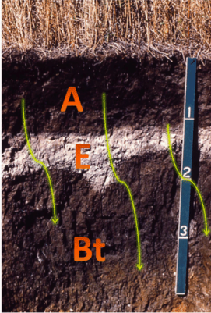
Soil
Soil consists predominantly of mineral matter, but also contains organic matter (humus) and living organisms. The pore spaces between mineral grains are filled with varying proportions of water and air.
In common usage, the term soil is sometimes restricted to only the dark topsoil in which we plant our seeds or vegetables. In a more broad definition, civil engineers use the term soil for any unconsolidated (soft when wet) material that is not considered bedrock.
Soil can be as much as several hundred feet thick! Ancient soils, sometimes buried and preserved in the subsurface, are referred to as paleosols and reflect past climatic and environmental conditions.
Figure 2.7: Soil Profile. The photograph shows a soil profile from South Dakota with A, E, and Bt horizons. The yellow arrows symbolize the translocation of fine clays to the Bt horizon. The scale is in feet. Source: University of Idaho and modified by D. Grimley.

Slide 11
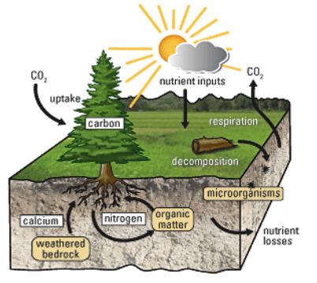
The accumulation of a higher number of toxic substances, acids, alkaline components, salts, radioactive heavy metals, and the generation/increasing number of pathogenic organisms in soil are the leading causes of soil pollution.
Soil pollutants are grouped into two categories – the organic pollutants (Ops) and the inorganic (Ips) pollutants. Soil pollution is considered as pollution due to human activities and is undertaken as land degradation due to the addition of chemical compounds from various industrial and anthropogenic sources.
A number of new emerging concerns are increasing amounts of synthetic chemicals are constantly being added and that can change the natural microbial especially pathogenic bacterial population penetration in their system and can cause acquired systemic resistance to commonly used antibiotics to treat pathogenic bacteria.
Another concerning pollutant is nanoplastics (submicron-size plastics) are everywhere in the environment. The main accumulation is runoff water and depositing in soil.
Figure 2.8: Soil and plant Nutrient Cycle. Figure illustrates the uptake of nutrients by plants by plants in the forest soil ecosystem. Source: US Geological Survey.

Slide 12
Air and atmosphere
Earth’s atmosphere is divided into four distinct layers based on thermal characteristics (temperature changes), chemical composition, movement, and density. The troposphere is the lowest layer extending from the surface up to roughly 18 km above the surface depending on location (varies from as low as 6 km to as high as 20 km).
The stratosphere is the layer that extends from the tropopause up to about 50 km to 53 km above the Earth’s surface depending on location. The proportions of most gases in this layer are similar to that of the troposphere with two main exceptions: 1) there is almost no water vapor in the stratosphere, and 2) the stratosphere has nearly 1,000 times more ozone (O₃) than the troposphere.
Above the stratosphere is the mesosphere which extends to about 85 km above the Earth's surface. The mesosphere has no ozone molecules and the other gases such as oxygen and nitrogen continue to become less dense with height. As a result, not much ultraviolet and x-ray radiation from the sun is absorbed by molecules in this layer so temperature decreases with altitude.
Both the stratosphere and the mesosphere are considered the middle atmosphere. Between about 85 km and 600 km lies the thermosphere. This layer is known as the upper atmosphere. Unlike the mesosphere, the gases in this layer readily absorb incoming high-energy ultraviolet and x-ray radiation from the sun.

Slide 13
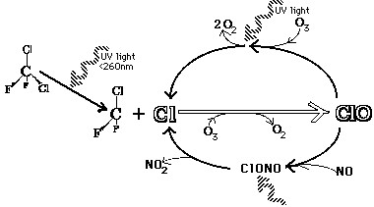
Ozone Depletion
Global ozone concentrations change periodically with regular natural cycles such as changing seasons, winds, and long-timescale sun variations. Concentrations of ozone in the atmosphere are measured in parts per billion (ppb).
Chlorofluorocarbons (CFCs) are man-made compounds made up of chlorine, fluorine, and carbon. These compounds were commonly used as propellants in everyday products such as shaving cream, hair spray, deodorants, paints, and insecticides and as coolants in refrigerators and air conditioners.
CFCs are extremely stable molecules and do not react with other chemicals in the lower atmosphere, part of the reason why they were considered a safe choice.
Figure 2.9: Ozone destruction. UV radiation frees a chlorine (Cl) atom from a CFC molecule, this atom reacts with ozone and produces an oxygen gas molecule and chlorine monoxide (ClO). ClO reacts with another oxygen atom, it frees up the Cl atom which then proceeds to destroy another ozone molecule. Source: Wikimedia commons.

Slide 14

Air Pollution
Air pollution occurs in many forms but can generally be thought of as gaseous and particulate contaminants that are present in the earth’s atmosphere. Chemicals discharged into the air that have a direct impact on the environment are called primary pollutants. These primary pollutants sometimes react with other chemicals in the air to produce secondary pollutants.
Outdoor air pollution involves exposures that take place outside of the built environment. Examples include fine particles produced by the burning of coal, noxious gases such as sulfur dioxide, nitrogen oxides, and carbon monoxide; ground-level ozone, and tobacco smoke.
Indoor air pollution involves exposure to particulates, carbon oxides, and other pollutants carried by indoor air or dust. Examples include household products and chemicals, out-gassing of building materials, allergens (cockroach and mouse dropping, mold, pollen), and tobacco smoke.

Slide 15
Sources of Air Pollution
A stationary source of air pollution refers to an emission source that does not move, also known as a point source. Stationary sources include factories, power plants, and dry cleaners. The term area source is used to describe many small sources of air pollution located together whose individual emissions may be below thresholds of concern, but whose collective emissions can be significant.
A mobile source of air pollution refers to a source that is capable of moving under its own power. In general, mobile sources imply “on-road” transportation, which includes vehicles such as cars, sport utility vehicles, and buses. In addition, there is also a “non-road” or “off-road” category that includes gas-powered lawn tools and mowers, farm and construction equipment, recreational vehicles, boats, planes, and trains.
Agricultural sources arise from operations that raise animals and grow crops, which can generate emissions of gases and particulate matter. For example, animals confined to a barn or restricted area produce large amounts of manure. Manure emits various gases, particularly ammonia into the air. This ammonia can be emitted from the animal houses, manure storage areas, or from the land after the manure is applied.

Slide 16
Six Common Air Pollutants
Ground-level ozone is not emitted directly into the air but is created by chemical reactions between oxides of nitrogen (NOx) and volatile organic compounds (VOC) in the presence of sunlight. Emissions from industrial facilities and electric utilities, motor vehicle exhaust, gasoline vapors, and chemical solvents are some of the major sources of NOx and VOC.
Particulate matter, also known as particle pollution, is a complex mixture of extremely small particles and liquid droplets. Particle pollution is made up of a number of components, including acids (such as nitrates and sulfates), organic chemicals, metals, and soil or dust particles. The size of particles is directly linked to their potential for causing health problems.
Carbon monoxide (CO) is a colorless, odorless gas emitted from combustion processes. Nationally and, particularly in urban areas, the majority of CO emissions to ambient air come from mobile sources. CO can cause harmful health effects by reducing oxygen delivery to the body’s organs (like the heart and brain) and tissues. At extremely high levels, CO can cause death.

Slide 17
Nitrogen dioxide (NO₂) is one of a group of highly reactive gasses known as “oxides of nitrogen,” or nitrogen oxides (NOx). Other nitrogen oxides include nitrous acid and nitric acid. EPA’s National Ambient Air Quality Standard uses NO₂ as the indicator for the larger group of nitrogen oxides. NO₂ forms quickly from emissions from cars, trucks and buses, power plants, and off-road equipment.
Sulfur dioxide (SO₂) is one of a group of highly reactive gasses known as “oxides of sulfur.” The largest sources of SO₂ emissions are from fossil fuel combustion at power plants (73%) and other industrial facilities (20%). Smaller sources of SO₂ emissions include industrial processes such as extracting metal from ore, and the burning of high sulfur-containing fuels by locomotives, large ships, and non-road equipment. SO₂ is linked with a number of adverse effects on the respiratory system.
Lead is a metal found naturally in the environment as well as in manufactured products. The major sources of lead emissions have historically been from fuels in on-road motor vehicles (such as cars and trucks) and industrial sources. As a result of regulatory efforts in the U.S. to remove lead from on-road motor vehicle gasoline, emissions of lead from the transportation sector dramatically declined by 95 percent between 1980 and 1999, and levels of lead in the air decreased by 94 percent between 1980 and 1999.

Slide 18
Indoor Pollution
Sick building syndrome is a term used to describe situations in which building occupants have health symptoms that are associated only with spending time in that building. Causes of sick building syndrome are believed to include inadequate ventilation, indoor air pollution, and biological contaminants.
Secondhand smoke is the combination of smoke that comes from a cigarette and smoke breathed out by a smoker. When a non-smoker is around someone smoking, they breathe in secondhand smoke. Secondhand smoke is dangerous to anyone who breathes it in. There is no safe amount of secondhand smoke. It contains over 7,000 harmful chemicals, at least 250 of which are known to damage human health.
Acid Rain
When higher-than-normal amounts of nitric and sulfuric acid occur in the atmosphere, the result is precipitation with a pH below 5.6 which is referred to as acid rain. Acid rain includes both wet deposition (rainfall, snow, fog) and dry deposition (particulates).

Slide 19
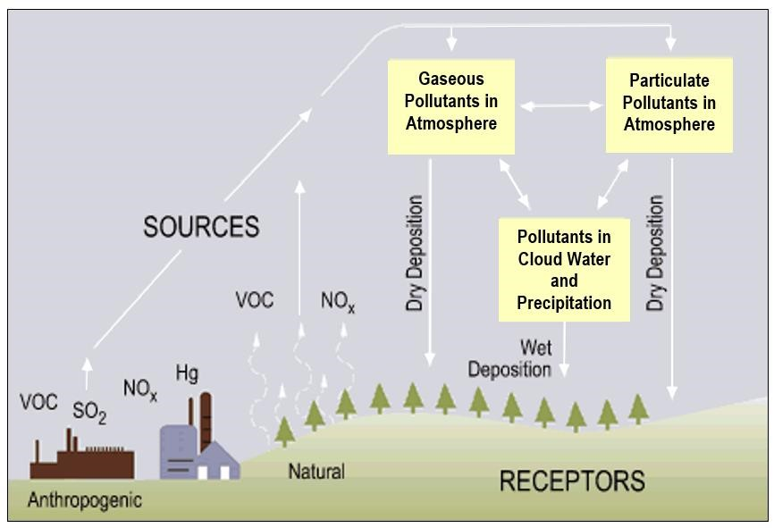
Acid rain occurs when these gases react in the atmosphere with water, oxygen, and other chemicals to form various acidic compounds.
International policy efforts to restrict production of ozone-depleting CFCs culminated in the 1987 treaty known as the Montreal Protocol in which signing nations agreed to cut CFC production in half by 1998.
As part of the United States' commitment to implementing the Montreal Protocol, the U.S. Congress amended the Clean Air Act (section 5.7), adding provisions for the protection of the ozone layer.
The Clean Air Act amendments passed by Congress require the Environmental Protection Agency (EPA) to develop and implement regulations for the responsible management of ozone-depleting substances in the United States.
Figure 2.11: Formation of acid rain from both natural and anthropogenic pollutants. Source: US EPA, public domain.

