Slide 1

Global Climate and Greenhouse Gases
Chapter 8 Learning Objectives
After completing this chapter, you will be able to:
Outline the physical basis of Earth’s greenhouse effect, and describe how human influences may be causing it to intensify.
Explain the term greenhouse gas (GHG).
Describe how the various GHGs vary in their effectiveness and influence on the greenhouse effect.
Identify which GHGs have been increasing in concentration in the atmosphere, and give the reasons for those changes.
Discuss strategies for reducing the intensity of the human influence on the greenhouse effect.

Slide 2

The Greenhouse Effect
Earth’s greenhouse effect is a well-understood physical phenomenon, and it is critical in maintaining the average surface temperature of the planet at about 15°C. Without this influence, the surface temperature would average about -18°C, or 33° cooler than it actually is.
This would be frostier than organisms could tolerate over the long term because at -18°C water is in a solid state. Liquid water is crucial to the proper functioning of organisms and ecosystems. At Earth’s actual average temperature of 15°C, water is unfrozen for much or all of the year (depending on location).
Solar electromagnetic radiation is the major input of energy to Earth. On average, this energy arrives at a rate of about 8.4 J/cm²•min. Much of the incoming solar radiation penetrates the atmosphere and is absorbed by the surface of the planet.
Figure 8.1. The combustion of fossil fuels for transportation and commercial energy is the leading anthropogenic source of emissions of carbon dioxide to the atmosphere. Source: B. Freedman.

Slide 3
The surface temperature does not increase excessively because Earth dissipates the absorbed solar energy by emitting long-wave infrared radiation. The surface temperature is determined by the equilibrium rates at which (1) solar energy is absorbed by the surface, and (2) the absorbed energy is re-radiated in a longer-wavelength form.
If the atmosphere were transparent to the long-wave infrared radiated by the surface, then that energy would travel unobstructed to outer space. However, this is not the case because so-called greenhouse gases (GHGs; also known as radiatively active gases or RAGs) are present in the atmosphere.
GHGs efficiently absorb infrared radiation and become heated as a consequence. They then dissipate some of this thermal energy through yet another re-radiation. (This re-radiated energy has a longer wavelength than the electromagnetic energy that was originally absorbed.

Slide 4

The re-radiated energy of the GHGs is emitted in all directions, including back toward the surface. The net effect of the various energy transformations and re-radiations involving atmospheric GHGs is a reduction in the rate of cooling of the Earth’s surface.
The process just described is known as the greenhouse effect because its physical mechanism is similar to the warming of a glass-encased space by solar radiation. The encasing glass of a literal greenhouse is transparent to incoming solar radiation. The solar energy is absorbed by, and therefore heats, internal surfaces of the greenhouse, such as plants, soil, and other materials.
Radiatively Active Gases
Water vapor (H₂O) is the most important of the radiatively active constituents of Earth’s atmosphere, accounting for about 36% of the overall greenhouse effect, followed by carbon dioxide (CO₂; about 20%). Lesser roles are played by trace concentrations of methane (CH₄), nitrous oxide (N₂O), ozone (O₃), carbon tetrachloride (CCl₄), and chlorofluorocarbons (CFCs).

Slide 5

Prior to 1750, the atmospheric concentration of CO₂ was about 280 ppm, whereas in 2014 it had reached 399 ppm, which is a 43% increase. Other GHGs have also increased during this period. The increases have been especially rapid since the middle of the twentieth century, coinciding with enormous increases in population, industrialization, and deforestation.
Table 8.1. Increases and Characteristics of Greenhouse Gases. Source: Data from Blasing, 2014.
Gas | Concentration |  | Global Warming Potential | Lifetime | % Radiative Forcing
CO₂ (ppm) | 1750 | 2014 | 1 | 100-300 Y | 57
 | 200 | 396
CH₄ (ppm) | 0.72 | 1.83 | 28 | 12 Y | 15
N₂O (ppm) | 0.27 | 0.33 | 265 | 121 Y | 5
O₃ (ppm) | 0.24 | 0.34 | 17 | days | 12
CCL₄ (ppt) | 0 | 84 | 1730 | days | <1
CFCs (ppt) | 0 | 836 | 5k-10k | 45-100 d | 8
HCFCs (ppt) | 0 | 266 | 0.8k-2.0k | 9-17 d | 2

Slide 6
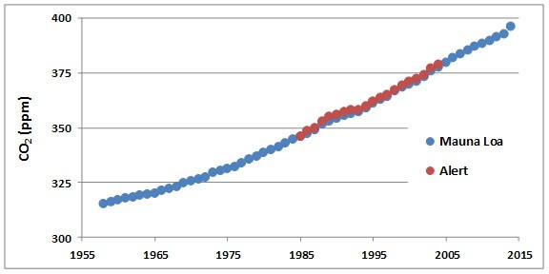
Concentrations of CO₂ in the atmosphere have been increasing steadily for at least the past century. The data record supporting this change is excellent and demonstrates one of the most convincing examples of long-term changes in any aspect of environmental chemistry.
For example, atmospheric CO₂ has been monitored continuously since 1958 at a remote observatory located on Mauna Loa, a mountain on the island of Hawaii (Figure 8.1).
Data are also shown for Alert, a high-Arctic station located at the northern tip of Ellesmere Island, Nunavut. The data from both places clearly show steadily increasing concentrations of CO₂ in the atmosphere during the past five decades.
Figure 8.1. Increases in Atmospheric CO₂. These data are from measurements made on an equatorial station on Mauna Loa, Hawaii, and in the High Arctic in northern Ellesmere Island, Nunavut. Each datum represents an annual average. Note that prior to 1750, the concentration of CO₂ in the atmosphere was about 280 ppm (see text). Source: Data from Keeling et al. (2014).

Slide 7
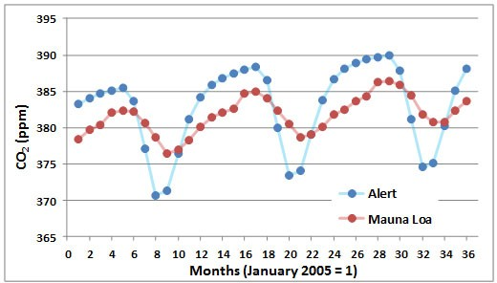
A seasonal cycle of CO₂ concentration is illustrated in Figure 8.2, again using data from Mauna Loa and Alert. The annual periodicity is caused by high rates of CO₂ uptake by vegetation of the Northern Hemisphere during the growing season.
This seasonal CO₂ fixation occurs at rates that are high enough to depress its overall concentration in the global atmosphere. The effects are larger in the Arctic than at the Equator, although both regions have the same annual average concentration of CO₂.
The two most important sources of anthropogenic emissions are:
1. The combustion of fossil fuels, during which the carbon content of the fuel is oxidized to CO₂, which is emitted to the atmosphere
2. Deforestation is an ecological conversion in which mature forests that store large amounts of organic carbon are converted into ecosystems that contain much less, with the difference being made up by releasing CO₂ into the atmosphere.
Figure 8.2. Seasonal Changes in Atmospheric CO₂. These data are based on measurements made at Mauna Loa, Hawaii, and Alert, Ellesmere Island. Source: Data from Keeling et al. (2008, 2014).

Slide 8
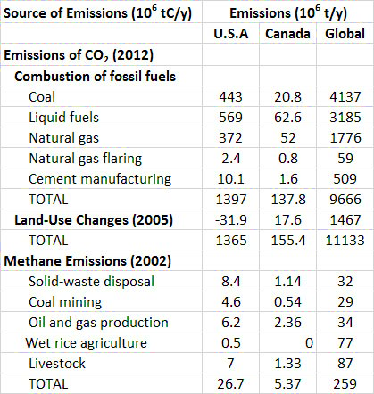
Table 8.2. Global and North American
Emissions of Carbon Dioxide and Methane.
Source: CDIAC (2015).
CO₂ from Fossil Fuels
Fossil fuels are the most important source of energy in industrialized countries, followed by hydroelectricity, nuclear power, and relatively minor sources such as wood, solar, and wind energies.
The rates of utilization of coal, petroleum, natural gas, and oil sand have increased enormously during the past century, mostly to satisfy surging energy demands for industry, transportation, and space heating.
The manufacturing of cement also results in large emissions of CO₂ into the atmosphere.

Slide 9

Between 1860 and 1869, during the middle part of the Industrial Revolution, the combustion of fossil fuels, mainly coal, resulted in the global emission of about 422 million tons of CO₂ per year (Boden et al., 2013).
By 2012, global emissions from fossil-fuel combustion had increased by 80, to 35.4 billion tons per year. About 95% of the commercial emission of CO₂ in 2012 was due to the combustion of fossil fuels, of which 43% was from liquid hydrocarbons, 33% from coal, and 18% from natural gas. The remaining 5% is associated with cement manufacturing and gas flaring.
The global commercial emissions are equivalent to about 1.3 tCO₂/person•year. Of course, per-capita use of fossil fuels differs greatly among countries, depending on their kind and degree of industrialization, types of energy sources, climate, and other factors. The largest per-capita emissions are in several countries that flare large amounts of fossil fuels at wellheads and refiners, such as Qatar and Trinidad and Tobago.
Other than those cases, the greatest emissions are in wealthy, energy-intensive countries, such as Canada, Australia, the United States, Japan, and most of Western Europe. The smallest emissions are in the poorest, least-developed countries, where there is relatively little use of fossil fuels because of the expense of purchasing them.

Slide 10
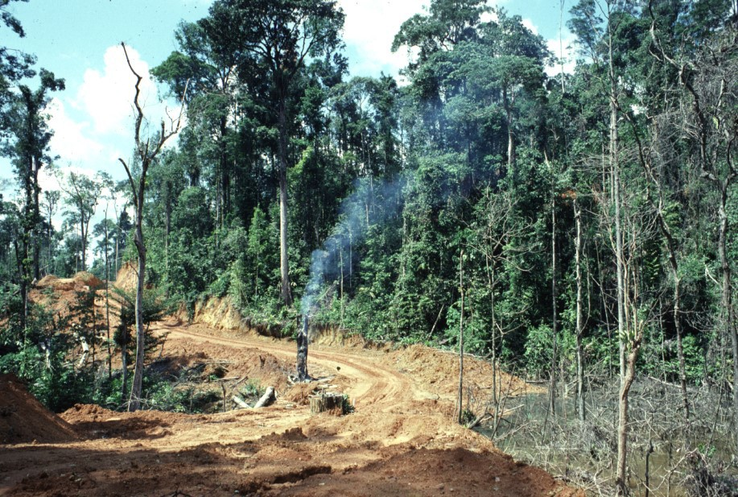
CO₂ from Clearing Forest
Mature forest stores large amounts of organic carbon in vegetation and the dead organic matter of soil. All other kinds of ecosystems, including younger forests that are regenerating from a disturbance, store much less organic carbon than occurs in older forests.
Whenever an area of mature forest is disturbed by timber harvesting or is cleared to provide land for agricultural or urbanized use, much less organic carbon will be stored on the land.
If a harvested stand is allowed to regenerate into another mature forest, then the depletion of stored carbon will be a medium-term phenomenon. However, if the forest is converted into anthropogenic land-use, such as for agriculture or urbanization, there is a permanent loss of carbon stored on the land.
Figure 8.5. The conversion of carbon-dense ecosystems, such as forests, into agricultural and urban ecosystems that store much less carbon is an important source of CO₂ emissions. This site on Sumatra has had its tree cover felled and the woody debris burned. The land will be planted with a variety of crops. Deforestation is proceeding rapidly in this region of Indonesia, and in most tropical countries. Source: B. Freedman.

Slide 11
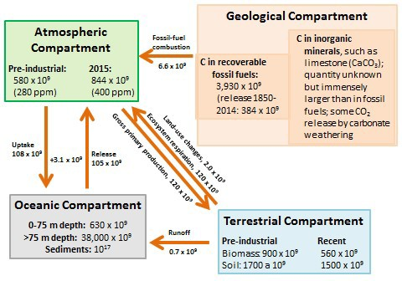
Key anthropogenic influences on the global carbon budget are summarized in Figure 8. 6 which shows the major compartments in which carbon is stored as well as transfers between them.
Anthropogenic emissions have caused a 43% increase in the amount of CO₂ stored in the atmosphere, from about 580 x 10⁹ t of CO₂-C in pre-industrial times to 844 x 10⁹ t in 2015.
The atmospheric concentration of CO₂ has accordingly increased during the same period, from about 280 ppm to 400 ppm.
Figure 8.6. Key Compartments and Fluxes of the Global Carbon Cycle. Amounts stored in the compartments are in units of tons of carbon, while transfers are in tons of carbon per year. Sources: Data from Blasing (1985), Solomon et al. (1985), Schlesinger (1995), and Global Carbon Budget (2014).

Slide 12

The oceans have a net absorption of about 3.1 x 10⁹ t/y of CO₂-C from the atmosphere. However, this is much less than the anthropogenic emissions of 8.6 × 10⁹ t/y of CO₂-C, and so the amount of CO₂ stored in the atmosphere is increasing.
The oceans have an enormous capacity for absorbing atmospheric CO₂, which is ultimately deposited as a mineral that accumulates in sediment (mostly as the shells of calcium carbonate (CaCO₃), mollusks, foraminifera, and other invertebrates).
However, the rate of formation of CaCO₃ is affected by various factors, including the concentration of inorganic carbon in seawater as well as acidity.

Slide 13

Climate Change
Earth has a naturally occurring greenhouse effect, the physical mechanism of which is relatively simple and understood by scientists. Moreover, the greenhouse effect helps to maintain the surface temperature within a range that is comfortable for organisms – averaging about 15°C, or 33° warmer than it would be with a non-greenhouse atmosphere.
Climate change refers to long-term variations of the weather that are experienced in a region. One of the most important indicators of climate change is the temperature of the surface atmosphere.
Air temperature is measured routinely in many places throughout the world. These data can be used to calculate estimates of the average surface temperature of Earth and to detect changes over time.

Slide 14

The Intergovernmental Panel on Climate Change (IPCC)
IPCC is mandated by the United Nations to review the accumulating body of scientific evidence related to climate change. The IPCC also helps to formulate policies to reduce emissions of greenhouse gases and to deal with the economic and ecological consequences of climate change.
The 2014 IPCC report made strong statements about the reality of global warming, its potential consequences, and the anthropogenic role in its causation.
Highlights from the 2014 IPCC Report
“Human interference with the climate system is occurring, and climate change poses risks for human and natural systems. In recent decades, changes in climate have caused impacts on natural and human systems on all continents and across the oceans. The evidence of impacts is strongest for natural systems, but effects on human systems have also been attributed.”
Figure 8.10. In October 2018, scientists cheered on the adoption of the special report on the recommended global warming limit of 1.5ºC over pre-industrial levels. (Creative Commons Attribution, 4.0).

Slide 15
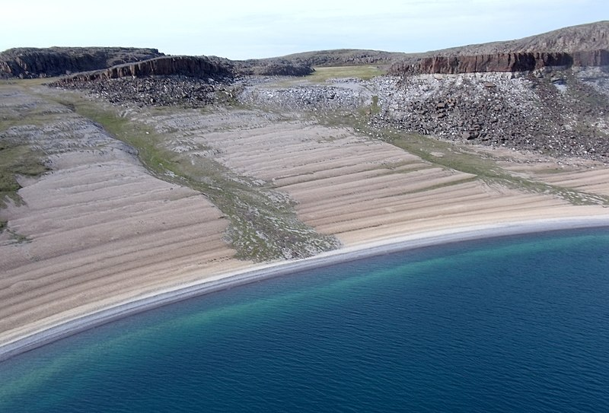
Ecological Effects
Deglaciation takes place when the surface temperatures of the Earth increase and cause glaciers to melt. When the buried Earth’s crust rises because of melting ice sheets, this process is known as glacial rebound, isostatic rebound, or crustal rebound.
This type of event can cause the formation of a post-glacial rebound beach as seen in Figure 8.11. The melting of ice is a contributing factor in causing sea levels to rise.
However, sea levels in the U.S. East Coast areas rise significantly faster than other regions. This sea level rise can have a significant impact on coastal communities and be observed from the coast of Maine down to Florida.
Figure 8.11. Post-glacial rebounding beach. After, the last Ice Age, a layered beach was formed by post-glacial rebound activity at the Bathurst Inlet, Nunavut(Source: Mike Beauregard from Nunavut, Canada, CC BY 2.0, Wikimedia).

Slide 16
Climate change in tropical countries, which support a larger number of species, has great ecological consequences. For example, most of northern and central South America is now characterized by a warm and humid, tropical climate. However, this region is thought to have been considerably drier during the past glacial period, which ended 10-14 thousand years ago.
The restructuring of tropical ecosystems during the Pleistocene Ice Age, which was driven by climate changes of the time, must have had enormous impacts on the multitudes of rare species of the rainforest. It is likely that many of those species became extinct as a result of the habitat changes.
In marine ecosystems, increases in water temperature would adversely affect some biota. Prolonged warming may cause corals to lose their symbiotic algae (known as zooxanthellae), sometimes resulting in death of the coral. This syndrome of damage, known as coral bleaching, can be induced by unusually high or low temperature, changes in salinity, and other stresses.

Slide 17
Changes in climate would influence the ability of landscapes to support agricultural production. In the state of Louisiana, this climate change is likely to cause episodic flooding, which reduces agricultural production and harms the seafood industries. The U.S. EPA has predicted that in the next 10 years, droughts will become more apparent along with an increase in flooding events. Heavy precipitation will also cause sea levels to rise.
An additional predicted effect of global warming is an increase in sea level. This change would be caused mostly by a thermal expansion of seawater because as water warms, its volume increases. There would also be an influence on sea level from the melting of massive glaciers, particularly those in Antarctica and Greenland, which would release some of their enormous mass into the oceans.
It is also predicted that global warming might increase the frequency, and perhaps the severity of events of severe weather. This means that hurricanes, tornadoes, and even El Niño events could become more frequent, and perhaps also more intense. These extremes of weather have well-known, devastating effects on economic and ecological systems.

Slide 18
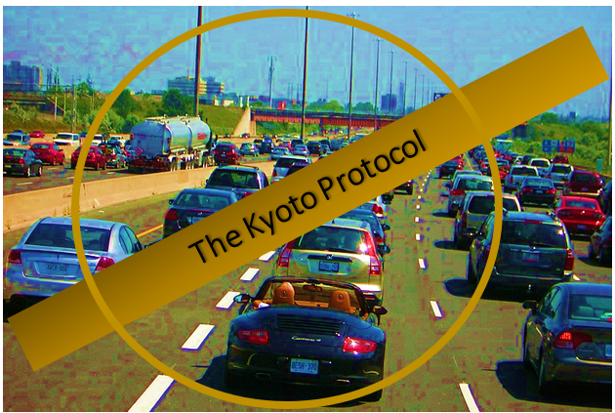
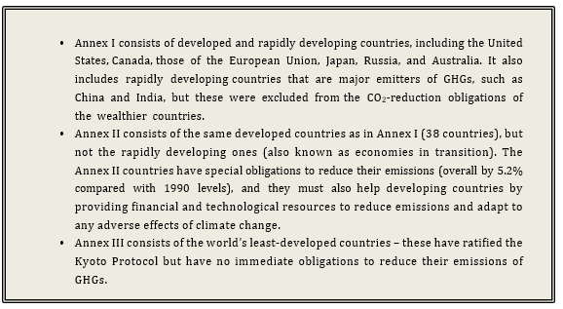
According to the terms of the Kyoto Protocol, the world’s nations are divided into three groups:
Key aspects of the Kyoto Protocol are the binding targets that it sets for the reduction of GHG emissions by developed countries. It is important to understand, however, that the Protocol is only a first step toward reducing global emissions of GHGs – the intent is to negotiate additional protocols that will include reductions by rapidly developing countries such as China and India and further efforts by developed ones.
Figure 8.12. The Kyoto Protocol commits stakeholder countries to reduce greenhouse gas emissions because of global warming caused by anthropogenic activities that release C02 emissions. (Source: Waneene C. Dorsey, Grambling State University. Modified from Wikipedia, Robert Jack, CC-By-2.0.)

