Slide 1

Impact of Environmental Health on Public Health
Chapter 9 Learning Objectives
After completing this chapter, you will be able to:
Explain the difference between environmental health and public health.
Describe how environmental factors interact in soil, water, air, and living beings.
Explain how environmental pollution impacts public health.
Explain how environmental and public health relate to the economy.
Explain the role of government in environmental and public health.

Slide 2

Public health is a very broad field that covers several fields of science, technology, mathematics, engineering, nutrition, health, transportation, education, medicine, politics, environmental health, hazards, infectious diseases, pandemics, the quality of air, soil, and water.
According to the American Public Health Association (APHA), environmental health is the branch of public health that: focuses on the relationships between people and their environment; promotes human health and well-being; and fosters healthy and safe communities.
APHA defines public health as a science-based, evidence-backed field that strives to give everyone a safe place to live, learn, work, and play.
Figure 1. This figure shows the human population growth from 1950 to 2050 (with a projected number) (Source: World Population Growth Chart 2050 - Google Search).

Slide 3
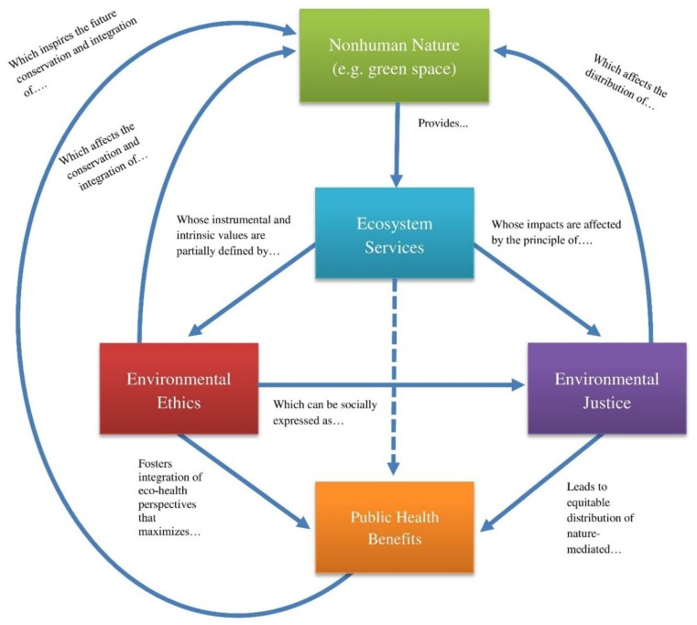
Many people willingly choose to expose themselves to toxicologically significant doses of certain chemicals. These choices include taking up hazardous occupations, smoking cigarettes, and ingesting medicines and recreational drugs.
The consequences of these sorts of “voluntary” exposures are interpreted using criteria that are different from those applied to “involuntary” ones.
Figure 2. This figure explains how Public Health and Non-human Nature interact via Ecosystem Services, Environmental Ethics, and Environmental Justice. (Source: Conceptual-map-illustrating-the-connections-among-nonhuman-nature-ecosystem-services-environmental-ethics-environmental.jpg (761×683) (wikimedia.org).

Slide 4

Air Quality
About 78% of the mass of the atmosphere is composed of nitrogen gas (N₂), while 21% is oxygen (O₂), 0.9% argon (Ar), and 0.04% carbon dioxide (CO₂). The rest is various trace gases, including potentially toxic ones such as ozone (O₃) and sulfur dioxide (SO₂).
The atmosphere also contains highly variable concentrations of water vapor, which can range from only 0.01% in frigid winter air in the Arctic to 5% in warm, humid tropical air.
Pollution is not only caused by human activities – in some cases, it is a purely natural phenomenon. “Natural” sources of pollution include emissions of particulates and gases such as sulfur dioxide from volcanoes, seeps of petroleum on the ocean floor, high concentrations of metals in certain soils and rocks, and the heat of geothermal springs.

Slide 5
How to improve air quality:
Air quality could be improved by the reduction of deforestation, soil erosion, burning of fossil fuels, and wild forest fires. Freedman suggested the following procedures to improve the air quality:
Switching from coal, which is a relatively “dirty” fossil fuel, to “cleaner” ones such as natural gas or oil, or to alternative energy technologies such as nuclear power and hydroelectricity
Constructing tall smokestacks to spread emissions over a much wider area so that ground-level exposures become less common and less intense – this tactic is the “dilution solution to pollution”
Centralizing energy production in large power plants to replace much of the relatively dirty and inefficient burning of coal in home fireplaces and furnaces, thereby permitting better control of emissions.
Treating waste gases to remove some of their pollutant content, thereby reducing emissions to the Atmosphere

Slide 6
Impact
Auto exhaust fumes, smoking, secondhand smoke, laboratory solvents, and particulate matter released into the air from the mining industry will cause health severe and chronic problems such as asthma, bronchitis, emphysema, lung cancer, etc., to humans depending on the length and exposure levels.
Yet gaseous NO and N₂O are air pollutants if they occur in high concentrations, especially in sunny environments where they are involved in the photochemical production of toxic ozone. Furthermore, large amounts of NO^{3–} and NH⁴⁺ in rain and snow may contribute to acid rain.
Carbon dioxide is one of the most important plant nutrients because carbon comprises about half of plant biomass. But this critical nutrient occurs in a relatively small atmospheric concentration – only about 0.04%. However, the concentration of CO2 in the atmosphere has increased by about 45% during the past two centuries and it continues to increase. This well-documented change is contributing to global warming, an important environmental problem.

Slide 7

Water Quality
Water is needed by natural ecosystems for the metabolic needs of organisms, for cooling, and as a ubiquitous solvent that allows water-soluble nutrients to be absorbed by organisms.
Water is also required by people for use in agriculture, industry, and recreation. Unfortunately, in many regions water and its biological resources (such as algae, fish, etc.) have been used excessively, and water quality has been degraded through point and non-point sources of pollution.
According to the World Health Organization, 10% of the world’s population does not have improved water quality resources
(Source: Drinking-water (who.int); Lake Reeds Sunset - Free photo on Pixabay - Pixabay) .

Slide 8
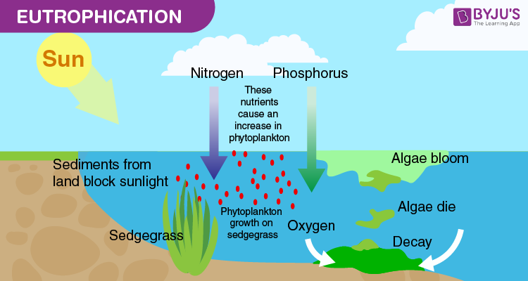
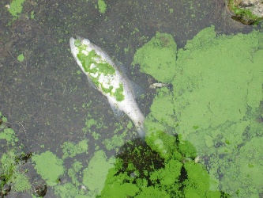

Figure 3 (L-R). (L) Explains the process of eutrophication in a natural aquatic ecosystem and (R) explains the formation of algal blooms and fish death due to reduced levels of oxygen in water.
Eutrophication, or excessive productivity of waterbodies due to thick mats of algal blooms, is another environmental problem related to an excessive supply of nutrients – phosphorus and nitrogen.
It is most often caused by an excess of PO₄^{3–}, usually because of sewage dumping or runoff from fertilized agricultural land. Highly eutrophic lakes are degraded ecologically and may no longer be useful as a source of drinking water or for recreation. Excessive eutrophication results in the death of organisms such as fish and causes skin rashes, dermatitis, conjunctivitis, and in humans.

Slide 9
Certain species of amoebae (Kingdom Protista) are parasites of animals, including amoebic dysentery in humans. The ciliate Giardia causes a water-borne disease known as hiker’s diarrhea (or beaver fever), the risk of which is a reason why even the cleanest looking natural water should be boiled or otherwise disinfected before drinking.
In a detailed review of several research articles on water quality and human health, Lin et al. (2022) concluded that most of the sewage generated by human activities into natural water bodies without treatment resulted in more than 50 diseases. Among these 80% of diseases and 50% of child deaths worldwide are related to poor water quality.
An additional case of natural pollution involves certain species of marine phytoplankton that occasionally become abundant and cause ecological damage by forming algal blooms. In events called toxic blooms, these algae release biochemical compounds that are poisonous to a broad range of animals that are exposed through the food chains and food webs, in some instance they may reach humans through biomagnification and cause illnesses such as paralytic shellfish poisoning (PSP).

Slide 10
Soil Quality
Soil is a complex and variable mixture of fragmented rock, organic matter, moisture, gases, and living organisms that covers almost all terrestrial landscapes.
Soil provides mechanical support for growing, even for trees as tall as 100 m. Soil also stores water and nutrients for use by plants and provides habitat for the many organisms that are active in the decomposition of dead biomass and recycling of its nutrient content.
Soil is a component of all terrestrial ecosystems, but it is also in itself a dynamic ecosystem with a variety of physicochemical factors such as depth, temperature, moisture, pH, dissolved gases, and biota such as insects, earthworms, nematodes or roundworms.
Figure 4. This figure explains the “Textural Classification of Soils”. The percentage composition of clay-, silt-, and sand-sized particles is used to classify soils into the 12 major types that are shown. Source: Modified from Foth (1990). (Source: Chapter 5; B. Freedman)

Slide 11
Terrestrial plants obtain their water and much of the nutrients they need from the soil, absorbing them through their roots. Soil also provides a habitat for a great diversity of animals and microorganisms that play a crucial role in litter decomposition and nutrient cycling.
Healthy soil plays a critical role in human and ecosystem health. Healthy soil is needed to grow crops, plants, and animals in general, pollinators, provide quality healthy, and nutritious food, and sustain populations.
The poor health quality of soil and its impact on human health in the figure below which explains the impact of specific chemicals in soil on various organs and organ systems of the human body. Soil pollution due to a variety of inorganic and organic chemicals is a great and growing threat to human health. It results in food crop contamination and disease.

Slide 12
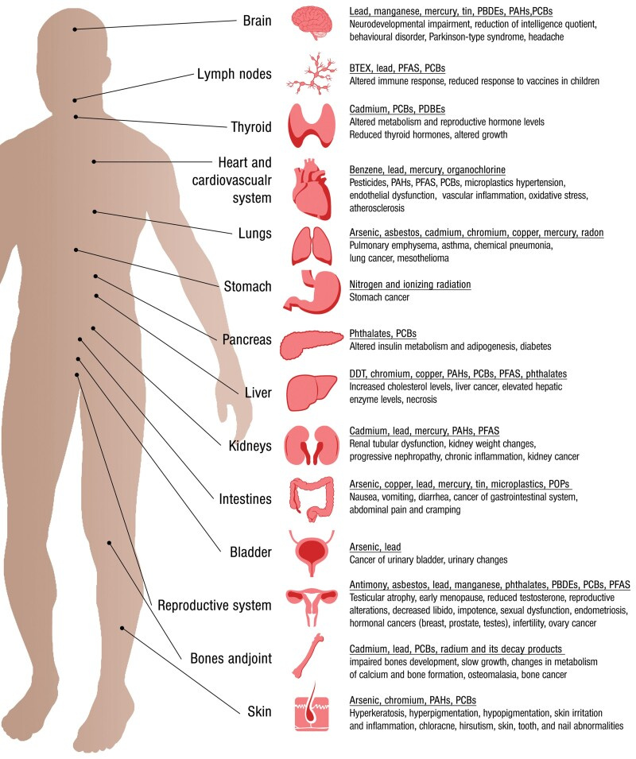
Figure 5. This figure explains the main effects of soil contaminants on human health, indicating the organs or systems affected and the contaminants causing them. PCBs, polychlorinated biphenyls; PBDEs, polybrominated diphenyl ethers; PFAS, per- and polyfluoroalkyl substances; POPs, persistent organic pollutants; BTEX, refers to the chemicals benzene, toluene, ethylbenzene, and xylene. Adapted from the report of the Food and Agriculture Organization of the United Nations (created from data in the Agency for Toxic Substances and Disease Registry, and Campanale et al. 2020), https://www.fao.org/3/cb4894en/online/src/html/chapter-04-3.html. (Source: Munzel, et al. 2023 - Soil and water pollution and human health: what should cardiologists worry about? - PMC (nih.gov).

Slide 13

Environmental Hazards and Toxins
Impact
Environmental hazards are broadly divided into biological, physical, and chemical hazards caused by natural and or anthropogenic (man-made) means. A prolonged intensification of stress in the environment by a variety of biological, chemical, physical, natural, and anthropogenic hazards will cause both short and long-term damage to public health. Consider, for example, the release of toxic fumes gases, or metals into the atmosphere, soil, or water will result in toxic effects on the environment and public health.
For instance, a case in which a new metal smelter is constructed in a forested landscape. If the smelter emits toxic sulfur dioxide gas, the toxic stress will damage the tree-sized plants of the forest and eventually cause them to give way to shrub-sized and herbaceous vegetation. If the long-term stress is extremely severe, the landscape could entirely lose its vegetation. This kind of ecological damage involves changes in the composition and dominance of species in communities, in the spatial distribution of biomass, and in functions such as productivity, litter decomposition, and nutrient cycling.
The hazardous substances and conditions in the environment impact the public health by causing human illness, diseases, death due to excessive release of toxic gasses such as CO₂, CO, SO₂, etc. They will also negatively affect the loss of habitats, life forms, and biodiversity. Additionally, they cause chronic respiratory and heart diseases.

Slide 14

Lead
Lead and lead compounds are listed as “reasonably anticipated to be a human carcinogen.” It can affect almost every organ and system in your body. It can be equally harmful if breathed or swallowed.
The part of the body most sensitive to lead exposure is the central nervous system, especially in children, who are more vulnerable to lead poisoning than adults. A child who swallows large amounts of lead can develop brain damage that can cause convulsions and death; the child can also develop blood anemia, kidney damage, colic, and muscle weakness.
Repeated low levels of exposure to lead can alter a child’s normal mental and physical growth and result in learning or behavioral problems. Exposure to high levels of lead in pregnant women can cause miscarriage, premature births, and smaller babies. Repeated or chronic exposure can cause lead to accumulate in your body, leading to lead poisoning.
Source: B. Freedman; Health Effects of Lead Exposure | Lead | CDC

Slide 15
Acute toxicity is defined as occurring when a short-term exposure to a chemical in a high concentration results in biochemical or anatomical damages or even death (a common acute endpoint). Chronic toxicity involves a longer-term exposure to low to moderate concentrations of a chemical. Over time, chronic exposures may cause biochemical or anatomical damage, or perhaps a lethal condition such as cancer (Source: B. Freedman).
Indoor Environmental Quality
The indoor environment of residential and office buildings is often contaminated by gases and fumes. For example, space heaters, furnaces, and fireplaces burning wood, kerosene, or fuel oil may emit carbon monoxide into the indoor environment. All high-temperature combustions emit nitric oxide, and many synthetic materials and fabrics vent formaldehyde and other organic vapors. These chemicals can accumulate if indoor air is not exchanged frequently with cleaner, outdoor air.
Impact
Indoor pollution and toxins released from space heaters, furnaces, fireplaces burning wood, kerosene, nitric oxide, organic vapors, etc., cause health problems and loss of man hours, productivity, and even death.

Slide 16
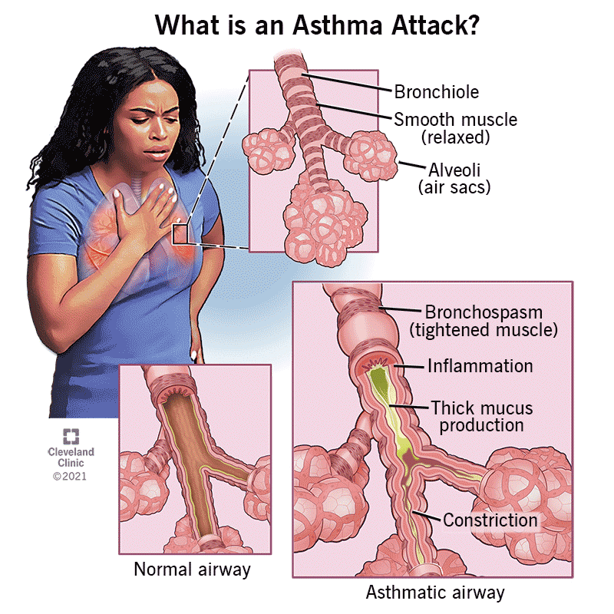
Outdoor Environmental Quality
For instance, smoking tobacco is a leading source of easily avoidable air pollution. People inhale a great variety of toxic gases and fumes when they smoke tobacco (and also marijuana). In addition, non-smokers are indirectly exposed to lower concentrations of those chemicals because of the lingering residues of “second-hand smoke” that may occur in indoor atmospheres.
Impact
Smoking is also the most important cause of preventable diseases, especially lung cancer and heart disease. Smog causes a significant number of problems and toxicity to vegetation, erodes building surfaces and metal sculptures due to acid rain, heart, and lung problems such as asthma, bronchitis, emphysema, etc., in vulnerable populations. Poor outdoor air quality due to excessive exhausts from automobiles, wildfires, industries, etc., aggravates asthma, wheezing, cough, etc. (source: Asthma and Outdoor Air Pollution, EPA-452-F-04-002 (airnow.gov); Asthma | CDC; Protect Yourself from Wildfire Smoke | Air | CDC).
Figure 6. This figure explains anatomy of human respiratory system and asthma (Asthma: Types, Causes, Symptoms, Diagnosis & Treatment (clevelandclinic.org)).

Slide 17
Impact on Economy
A prolonged drought can have a serious economic impact on a community. Increased demand for water and electricity may result in shortages of resources. Moreover, food shortages may occur if agricultural production is damaged or destroyed by a loss of crops or livestock.
Soil is economically important because it critically influences the kinds of agricultural crops that can be grown. Some of the most productive agricultural soils are alluvial deposits found along rivers and their deltas, where periodic flooding and silt deposition bring in abundant supplies of nutrients Overflooding due to hurricanes and forest fires damages soil nutrients by erosion.
Fungi are ecologically important because they are excellent decomposers, allowing nutrients to be recycled and reducing the accumulation of dead biomass. Various kinds of fungi are economically important because they spoil stored grain and other foods, are parasites of agricultural or forestry plants, or cause diseases in humans and other animals. Ringworm is a disease of the skin, usually the scalp, which is caused by various fungi. The chestnut blight fungus (Endothia parasitica) was accidentally introduced to North America and wiped out the native chestnut (Castanea dentata), which used to be a prominent and valuable tree in eastern forests. The Dutch elm disease fungus (Ceratocystis ulmi) is another introduced pathogen that is killing elm trees (especially white elm, Ulmus americana).

Slide 18

Sustainable economic development and technology involves the following actions for environmental and public health:
Increasing the efficiency of use of non-renewable resources – for example, by recycling and re-using metals and other materials;
Increasing the use of renewable materials in the economy, such as products manufactured from trees or agricultural biomass;
Rapidly increasing the use of renewable sources of energy, such as electricity generated using hydro, solar, wind, or biomass technologies;
Improving social equity, ultimately to such a degree that all citizens have access to the necessities and amenities of life such as clean air, water, housing, and energy, education, and healthcare facilities, accessibility for vaccinations for infectious diseases and pandemics COVID-19;
Reduction of pollution and improvement of ecological and human health effects; and
Reduction or elimination of disturbances that cause damage to natural ecosystems.

Slide 19

Role of Government Regulation and Policies for Environmental and Public Health
The U.S. Department of Agriculture, the federal agency responsible for regulating pesticides before the formation of the U.S. Environmental Protection Agency (EPA) in 1970, began regulatory actions in the late 1950s and 1960s to prohibit many of Dichloro-diphenyl-trichloro-ethane’s (DDT) uses because of mounting evidence of the pesticide's declining benefits and environmental and toxicological effects. The publication in 1962 of Rachel Carson's Silent Spring stimulated widespread public concern over the dangers of improper pesticide use and the need for better pesticide controls.
In 1972, the EPA issued a cancellation order for DDT based on its adverse environmental effects, such as those on wildlife (such as Bald Eagle), as well as its potential human health risks. Since then, studies have continued, and a relationship between DDT exposure and reproductive effects in humans is suspected, based on studies in animals. Exposure to high doses, human symptoms can include vomiting, tremors or shakiness, and seizures. In addition, some animals exposed to DDT in studies developed liver tumors. As a result, today, DDT is classified as a probable human carcinogen by U.S. and international authorities.

