Slide 1

Global Nutrition, Starvation, and Malnutrition
Chapter 10 Learning Objectives
After completing this chapter, you will be able to:
Define domestication and relate it to humans, crops, and livestock.
List the most important plants and animals in agriculture; provide an overview of the management systems used in their cultivation.
Explain how organic agriculture uses a more ecological approach to the cultivation of crops.
Explain the difference between macronutrients and micronutrients.
Explain the four pillars of food security.
Provide an overview of the factors leading to global starvation and malnutrition.
Describe global, national, and state strategies to address nutrition challenges.
Identify nutritional connections between human health and environmental factors.

Slide 2
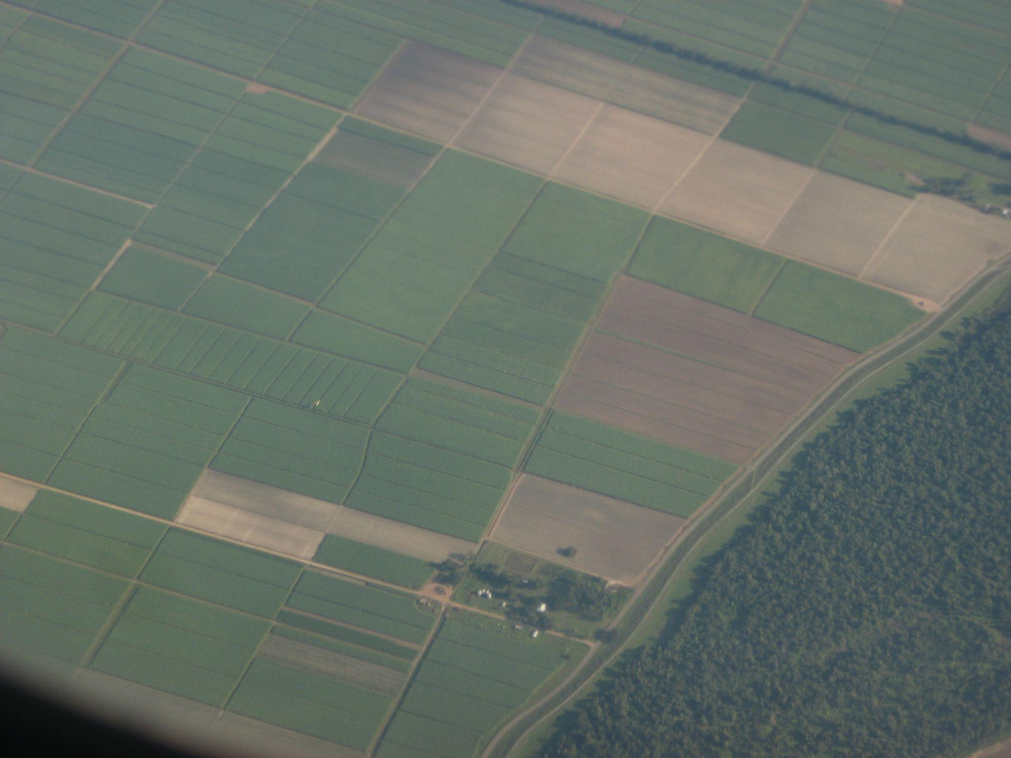
Agriculture and Environmental Factors
Agriculture was probably first practiced in the Fertile Crescent, a region of southwestern Asia that includes parts of what are now Iran, Iraq, Israel, Jordan, Lebanon, Syria, and Turkey. Similar developments likely occurred at about the same time in China, although the archaeological evidence is less clear.
Other cultures discovered the benefits of agriculture later through the domestication of local species of plants and animals (for instance, in parts of Central America, western South America, and New Guinea).
However, in other regions, domesticated species were mostly imported from elsewhere, as occurred in Australia, Europe, and North America.
Figure 10.1. Aerial view of agriculture in Ascension Parish, Louisiana near the Mississippi River. Attribution: Ken Lund, CC BY-SA 2.0 via Flickr, September 9, 2009.

Slide 3

Domesticated Plants
Domestication refers to the progressive modification of crops through the selective breeding of cultivated races (or cultivars), which are now genetically, anatomically, and physiologically different from their wild ancestors.
Crop plants have been selectively bred to increase their yield and response to management practices and to enhance their taste.
Most crop plants are grown as food, while others are fiber sources, fuel, or medicine. Important domesticated food plants include the following: small grains, legumes, sweet fruits, vegetable fruits, roots and tubers, vegetables, edible oils, sugar crops, herbs and spices, beverages, and recreational drugs.
Domesticated plants—cotton, flax, and hemp—cultivated as sources of fiber can manufacture thread, woven textiles, rope, and paper.

Slide 4
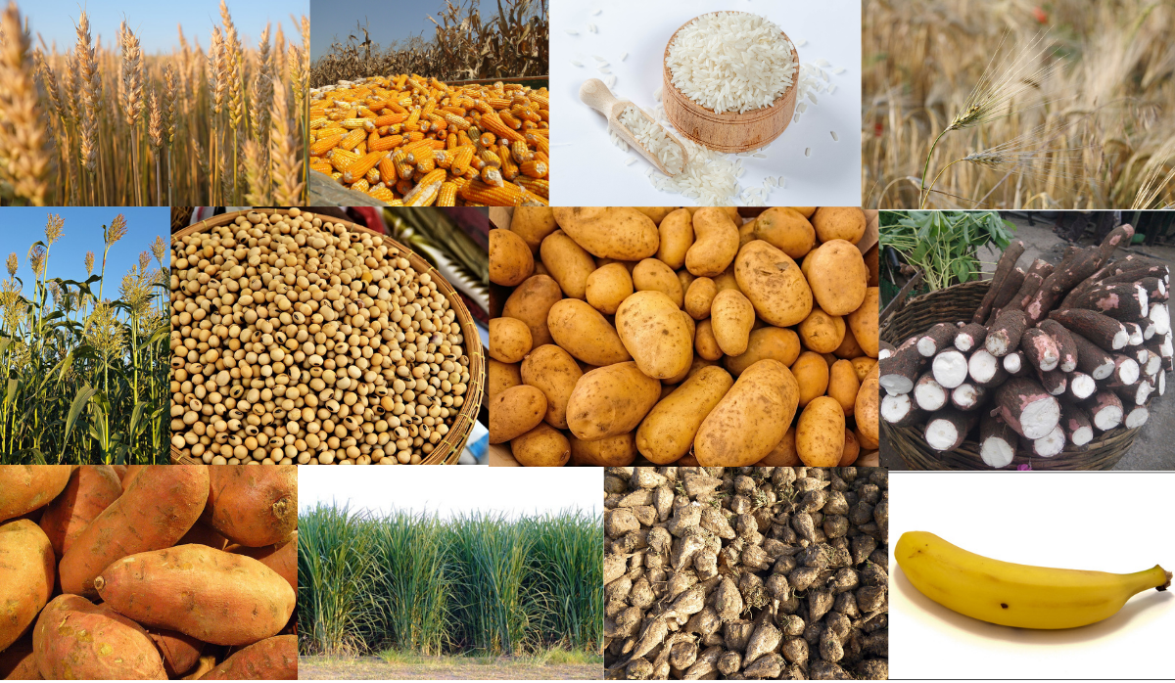
There is a rich diversity of crop species. However, the inventory of cultivated plants is only a tiny fraction of the species potentially useful as foods or for other purposes that have not yet been investigated for their usefulness.
Only a tiny fraction of the 250,000 species of vascular plants have been investigated for their usefulness.
Overall, people eat several thousand species of plants, of which about 200 have been domesticated. Of these, only 12 species account for about 80% of global food production (Diamond, 1999).
Figure 10.2 shows the 12 species (left top to bottom, left to right) as wheat, maize, rice, barley, sorghum, soybean, potato, cassava, sweet potato, sugar cane, sugar beet, and banana. Source: See endnotes for each image source.

Slide 5


Domesticated Animals
Domesticated animals raised in agricultural settings primarily as sources of food are livestock. According to the United States Department of Agriculture (USDA), the United States has the largest fed-cattle industry and is the largest beef producer in the world.
The United States is the third-largest global producer and consumer of pork after China and the European Union. The USDA provides statistical data on vital livestock in the United States: cattle, hogs, chicken, sheep, lamb, and mutton. In addition to livestock, commodities are also significant to the economy.
According to the Louisiana Department of Agriculture and Forestry, the top 10 commodities in Louisiana are soybeans, beef cattle, aquaculture, feed grains, horses, sugarcane, forestry, poultry, rice, and marine fisheries. As mentioned in Chapter 1, several distinct management practices in agriculture benefit the commodities.

Slide 6

Management Systems
Various management practices and systems apply to cultivating any crop plant (or livestock). The most intensive systems may involve cultivating a monoculture (only one crop species) using a series of such practices as tilling the soil, planting, applying fertilizer and pesticide, and harvesting ripe crops.
Intensive agricultural systems are typically used on relatively large farms that rely on specialized, fossil-fueled machinery (known as mechanization). Intensive systems may also be used on smaller farms to achieve higher production on a limited area of land.
Using intensive agricultural systems is common in relatively developed countries, such as Canada and the United States.
It also occurs in plantation-style agriculture in less-developed countries, where commodities are primarily grown for an export market. In contrast, subsistence farming, as commonly practiced by impoverished communities in less-developed countries, involves little or no use of fertilizer or pesticide and no mechanization.

Slide 7

Environmental Impacts of Agriculture
Agricultural chemicals
The most notable agricultural pollutant of groundwater is nitrate, which originates from manure applications to farmland and fertilizer. This problem occurs because the nitrate ion (NO₃–) drains readily with water that percolates through the soil to groundwater.
Nitrate is highly soluble in water and not retained by ion-exchange reactions in soil. Nitrate pollution is a hazard for people who use groundwater as a source of drinking water. Although nitrate is not very toxic, nitrate-to-nitrite conversion occurs in the human gut by microbial organisms, including bacteria.
When nitrite is absorbed into the blood, it strongly binds with hemoglobin (forming a compound known as methemoglobin), thereby reducing the capacity to carry oxygen. Children are especially vulnerable to this effect; the so-called “blue-baby syndrome” refers to oxygen-starved infants poisoned by nitrate in their drinking water or food.
Nitrate pollution of groundwater is a widespread problem since groundwater and surface water contamination stems from using agricultural pesticides.

Slide 8
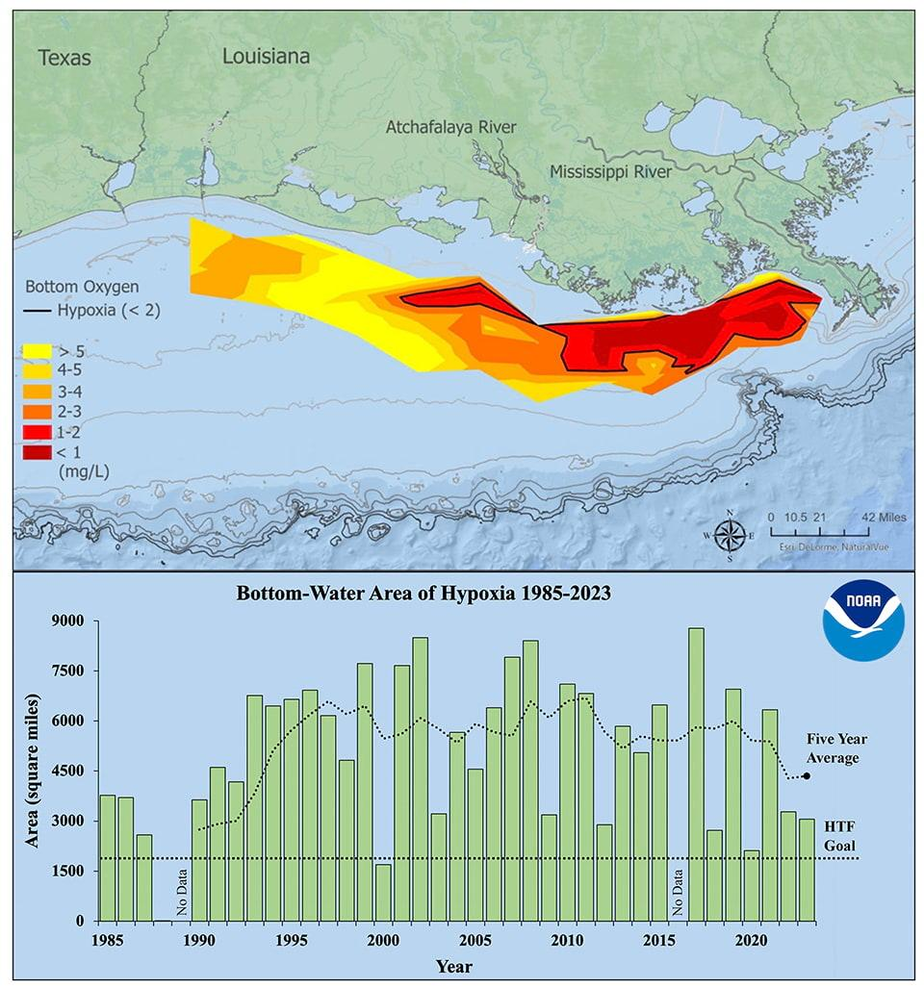
Figure 10.4 shows two images depicting the dead zones and levels of hypoxia. The top image shows the dead zone in the Gulf of Mexico. Data collection occurred from July 23 to July 28, 2023. At 3,058 square miles, the 2023 hypoxic zone in the Gulf of Mexico is the 7th smallest ever measured in the 37-year record. The bright red area denotes 2 milligrams per liter of oxygen or lower, the level that is considered hypoxic (low oxygen availability), at the bottom of the seafloor. The bottom image shows the bottom-water area of hypoxia over 38 years. Long-term measured the size of the hypoxic zone (green bars) measured during the ship surveys since 1985, including the target goal established by the Mississippi River/Gulf of Mexico Watershed Nutrient Task Force and the five-year average size (black dashed lines). Source: National Oceanic and Atmospheric Administration, 2023.

Slide 9

Impact of Agriculture on Aquatic Ecosystems
Too much decaying organic matter in water is a pollutant because it removes oxygen from water, which can kill fish, shellfish, and aquatic insects. The amount of oxygen used by aerobic (in the presence of oxygen) bacterial decomposition of organic matter is called biochemical oxygen demand (BOD).
The primary source of dead organic matter in many natural waters is sewage, whereas grass and leaves are minor sources of dead organic matter. Excessive plant nutrients, particularly nitrogen (N) and phosphorus (P) are pollutants closely related to oxygen-demanding waste.
Nitrogen and phosphorus are limiting nutrients, however, because they are usually present in water at low concentrations, restricting the total amount of plant growth. Their limiting ability explains why N and P are prominent ingredients in most fertilizers.

Slide 10
Exponential growths of these algae are called harmful algal blooms. When the prolific algal layer dies, it becomes oxygen-demanding waste, resulting in extremely low O₂ concentrations in the water (< 2 ppm O₂), a condition called hypoxia. This results in a dead zone because it causes death from asphyxiation to organisms unable to leave that environment.
In North America, Europe, and Asia, an estimated 50% of lakes are negatively impacted by cultural eutrophication. In addition, the size and number of marine hypoxic zones have grown dramatically over the past 50 years, such as an enormous dead zone located offshore Louisiana in the Gulf of Mexico.
Cultural eutrophication and hypoxia are difficult to combat because they are caused primarily by nonpoint source pollution. Nonpoint source pollution is difficult to regulate and remove from wastewater.

Slide 11
Organic Agriculture and Soil Fertility
In organic agriculture, crops are grown using relatively “natural” methods of maintaining soil fertility without chemical fertilizers, and pest-control methods do not involve synthetic pesticides. A central focus of organic agriculture is the maintenance of soil fertility by enhancing natural pathways of nutrient cycling and soil tilth.
In natural ecosystems, microorganisms continuously recycle inorganic nutrients (such as nitrate, ammonium, and phosphate) from dead organic matter, most of which is plant litter. The microbes metabolize the complex organic forms of nutrients, converting them to simple inorganic molecules.
The fixation of atmospheric N₂ by microorganisms is also a critical source of nitrogen input in organic agriculture. Overall, the release of inorganic nutrients is typically slow enough that they can be effectively taken up by crop plants, so relatively little is lost to groundwater or surface water.

Slide 12
Organic farmers enhance the organic content and cultivated soil fertility in three ways.
1. They add livestock manure and composted urine to the soil because these materials contain beneficial organic matter and nutrients.
  2. They add green manure, which is living plant biomass incorporated into the
  soil by plowing.
3. They add compost, or partially decomposed and humified organic material, to the soil.
Growing plants take up the same inorganic nutrient forms (such as nitrate, ammonium, and phosphate) from the soil, regardless of whether they are supplied by organic practices or with manufactured fertilizer.
The primary difference is in the role of ecological processes versus manufacturing – organic methods rely on renewable energy sources and materials rather than non-renewable ones. Overall, the longer-term effects on soil fertility and tilth using organic practices are much less damaging than those associated with conventional agriculture.

Slide 13
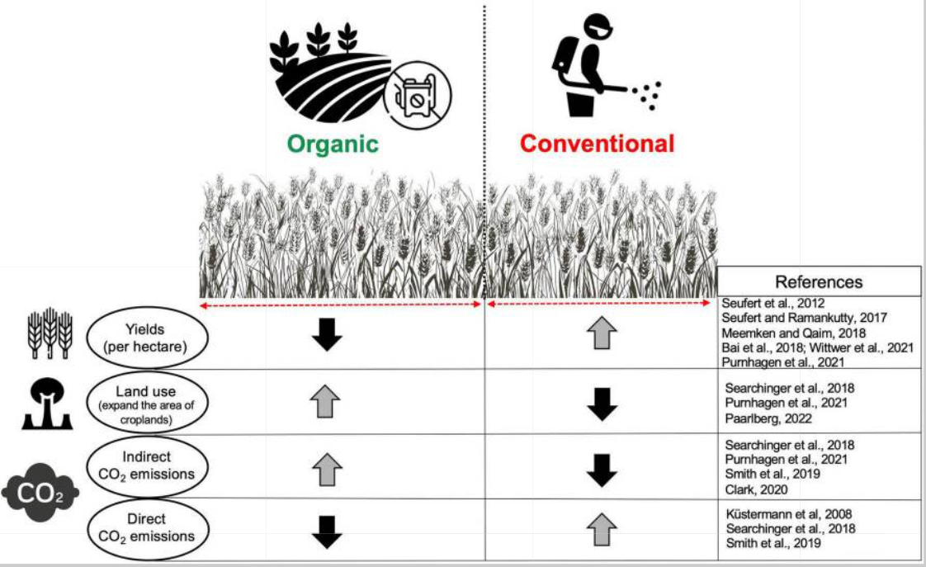
Pest Management
All agricultural ecosystems have problems with pests. In conventional agriculture, these problems are usually managed using pesticides. Although pesticides can reduce the effects of pests on crop yield, their use may cause environmental damage.
Instead of synthetic pesticides, organic farmers rely on other methods of pest management, such as using crop varieties that are resistant to pests and diseases, using biological pest management by introducing or enhancing populations of natural predators, parasites, or diseases, changing habitat conditions to make them less suitable for pests, using control tactics only when necessary by undertaking careful monitoring of pest abundance and using pesticides based on natural products.
Figure 10.5. This table compares organic and conventional agriculture production yield, land usage, and carbon dioxide emissions. An upward arrow indicates an increase in the observed factors in the table. A downward arrow indicates a decrease in the observed factors (Azarbad, 2022).

Slide 14

Antibiotics, Growth-Relating Compounds, and Transgenic Crops
Animals housed in unsanitary conditions are vulnerable to infection, which may retard their growth or kill them. In conventional agriculture, this problem is managed partly through antibiotic use, which may be given to sick animals or as a prophylactic treatment by adding them continuously to the feed of an entire herd.
Ultimately, humans are exposed to small antibiotic residues when they eat the products of these animals. Although this low-level exposure has not been conclusively demonstrated to pose an unacceptable human health risk, the issue is controversial. One potential problem lies in the emergence of antibiotic-resistant pathogens, resulting in antibiotics becoming less effective for medical purposes.
Organic farmers might use antibiotics to treat an infection in a particular sick animal, but farmers do not continuously add antibiotics to livestock feed. In addition, many raise their animals under more open and sanitary conditions than practices used in conventional agriculture.
Animals that are relatively free of the stresses of crowding and constant exposure to manure are more resistant to diseases and have less need for antibiotic treatment.

Slide 15
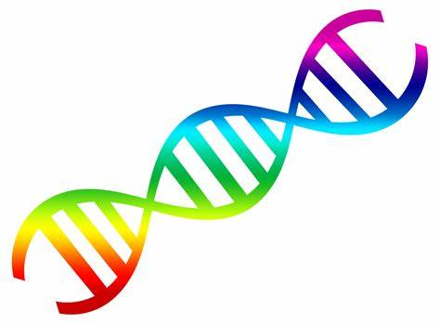
Transgenic crops are genetically modified by introducing genetic material (DNA or RNA) from another species.
This genetic modification is a type of bioengineering that intends to confer some advantage to the crop that was not developed through selective breeding. Selective breeding relies only on the intrinsic genetic information (the genome) that is naturally present in the species.
Varieties of several critical crops are transgenic and have been patented by the private companies that developed and marketed them. Transgenic crops are increasingly being grown in conventional agriculture in the United States, but the crops are generally not used in organic agriculture.

Slide 16
Organic vs. Conventional
Many people believe that organically grown food is safer or more nutritious than food grown by conventional agriculture because non-organic foods may have trace contamination with antibiotics, growth hormones, and pesticides, and the potential human health risks.
The most important benefits of organic agriculture are the reduced use of non-renewable sources of energy and materials, improved agroecosystem health, and enhanced sustainability of food production.
Nutrients and Nutrition
Nutrition refers to a balanced consumption of essential nutrients. Nutrients are substances required by the body to perform its basic functions. Nutrients must be obtained from our diet since the human body does not synthesize or produce them.

Slide 17
Nutrients have one or more of three functions: they provide energy, contribute to body structure, and/or regulate chemical processes in the body.
These functions allow humans to detect and respond to environmental surroundings, move, excrete wastes, respire (breathe), grow, and reproduce. Nutrients are needed in large amounts (macronutrients) while other essential nutrients are required in the body in lesser amounts (micronutrients) for the body to function and maintain overall health.
There are three classes of macronutrients: carbohydrates, proteins, and lipids. These three cell components are biological macromolecules, which are large molecules necessary for life built from smaller organic molecules.
Monomers serve as building blocks by combining covalent bonds to form larger molecules known as polymers. Carbohydrates and proteins consist of monomer subunits that can be metabolically processed into cellular energy. Lipids lack monomers but still undergo metabolic processing into cellular energy.

Slide 18
Minerals | Major Functions
Trace Minerals
Chromium | Assists insulin in glucose metabolism
Copper | Coenzyme, iron metabolism
Fluoride | Bone and teeth health maintenance, tooth decay prevention
Iodine | Thyroid hormone production, growth, metabolism
Iron | Carries oxygen, assists in energy production
Manganese | Coenzyme
Molybdenum | Coenzyme
Selenium | Antioxidant
Zinc | Protein and DNA production, wound healing, growth, immune system function
Macrominerals
Calcium | Bone and teeth health maintenance, nerve transmission, muscle contraction, blood clotting
Chloride | Fluid balance, stomach acid production
Magnesium | Protein production, nerve transmission, muscle contraction
Phosphorus | Bone and teeth health maintenance, acid-base balance
Potassium | Fluid balance, nerve transmission, muscle contraction
Sodium | Fluid balance, nerve transmission, muscle contraction
Sulfur | Protein production
Micronutrients
Micronutrients are nutrients required in lesser amounts but are still essential for performing bodily functions. Micronutrients include all the essential minerals and vitamins. There are sixteen essential minerals and thirteen vitamins.
Table 10.1 lists the sixteen essential minerals and their functions. Many minerals are critical for enzyme function. Other minerals maintain fluid balance, build bone tissue, synthesize hormones, transmit nerve impulses, contract and relax muscles, and protect against harmful free radicals in the body that can cause health problems such as cancer.
Table 10.1 Essential Minerals and Their Major Functions. This table was modified from OpenStax’s Anatomy and Physiology 2e.

Slide 19
Vitamin deficiencies can cause severe health problems and even death. For example, folate makes red blood cells. Folate is essential during prenatal development, but the body does not naturally produce folate. Folate must be consumed through food, such as dark green leafy vegetables, liver, cereals, enriched bread, beans, or supplements. In early pregnancy diagnosis, prenatal vitamins containing calcium, folic acid, and iron are prescribed. Folate deficiencies can lead to wide-ranging issues, such as poor growth, gingivitis, appetite loss, shortness of breath, gastrointestinal problems, and mental deficits.
Another example is Vitamin C or ascorbic acid. Vitamin C is easily absorbable due to its water-soluble nature. It is necessary to produce collagen for connective tissue formation and teeth and wound healing. Vitamin C deficiencies can lead to various dental issues (gingivitis, bleeding gums), damage to the integumentary system (dry hair, dry and scaly skin, slow wound healing, easy bruising), and even compromised immunity.
Vitamins | Major Functions
Water-soluble
Biotin (Vitamin B7) | Coenzyme, amino acid, and fatty acid metabolism
C (ascorbic acid) | Collagen synthesis; antioxidant
Cobalamin (Vitamin B12) | Coenzyme, red blood cell synthesis
Folate (Vitamin B9) | Coenzyme, essential for growth, especially in prenatal development
Niacin (Vitamin 3) | Coenzyme, energy metabolism assistance
Pantothenic acid (Vitamin B5) | Coenzyme, energy metabolism assistance
Pyridoxine (Vitamin B6) | Coenzyme, amino acid synthesis assistance
Riboflavin (Vitamin B2) | Coenzyme, energy metabolism assistance
Thiamin (Vitamin B1) | Coenzyme, energy metabolism assistance
Fat-soluble
A | Vision, reproduction, immune system function
D | Bone and teeth health maintenance, immune system function
E | Antioxidant, cell membrane protection
K | Bone and teeth health maintenance, blood clotting
Table 10.2 Essential Vitamins and Their Major Functions. This table was modified from OpenStax’s Anatomy and Physiology 2e.

Slide 20

Food Security, Malnutrition, Starvation
Food security refers to having adequate access to food and consuming enough nutrients to achieve a healthy lifestyle. Food insecurity is defined as not having adequate access to food that meets nutritional needs.
Food access can vary based on individual characteristics, such as socioeconomic status and residence near grocery stores. Unfortunately, employment status or access to money can impact food access.
An individual must have continuous access to sufficient food of the right dietary mix to be food secure. Individuals who never have enough quality food are chronically food insecure.
One measurement of food quality is the amount of nutrients it contains relative to the amount of energy it provides. High-quality foods are nutrient-dense, meaning they have significant amounts of one or more essential nutrients respective to the number of calories they provide.
Empty-calorie foods, such as carbonated sugary soft drinks, provide many calories and very little if any, other nutrients.
Figure 10.6 shows the four pillars of food security. Without access, availability, or utilization, an individual or household may become food unstable.

Slide 21


At a global level, the dominant pillar is food availability. Does global agricultural activity produce sufficient food to feed all the world’s inhabitants? The answer today is yes, but it may not be factual in the future given the impact of additional factors, such as a growing world population, emerging plant, and animal pests and diseases, declining soil productivity and environmental quality, increasing use of land for fuel rather than food, and lack of attention to agricultural research and development.
Food utilization translates the food available to a household into nutritional security for its members. One aspect of utilization is analyzed in terms of distribution according to need, which has specific nutritional standards for varying age groups. Hidden hunger commonly results from poor food utilization.
The last pillar of food security, food stability, is when a population, household, or individual has access to food at all times and does not risk losing food access as a consequence of cyclical events or sudden shocks. For instance, job loss can lead to food instability for individuals. Crippling health conditions or health diagnoses causing an individual to lack ungainful employment can lead to food instability.

Slide 22
Malnutrition
When someone lacks food stability or lives in a food-insecure household, they may suffer from malnutrition, which results from a failure to meet nutrient requirements. Malnutrition can occur by consuming too little food or not enough vital nutrients.
There are two basic types of malnutrition. The first is macronutrient deficiency or inadequate protein consumption required for cell growth, maintenance, and repair. The second type of malnutrition is micronutrient deficiency, or inadequate vitamin and mineral intake.
There is also undernutrition and overnutrition. Undernutrition is characterized by a lack of nutrients and insufficient energy supply. Undernutrition is intricately linked with suppression of the immune system at multiple levels. Undernourished children commonly die from severe diarrhea and/or pneumonia resulting from a bacterial or viral infection developed from immune system suppression.

Slide 23
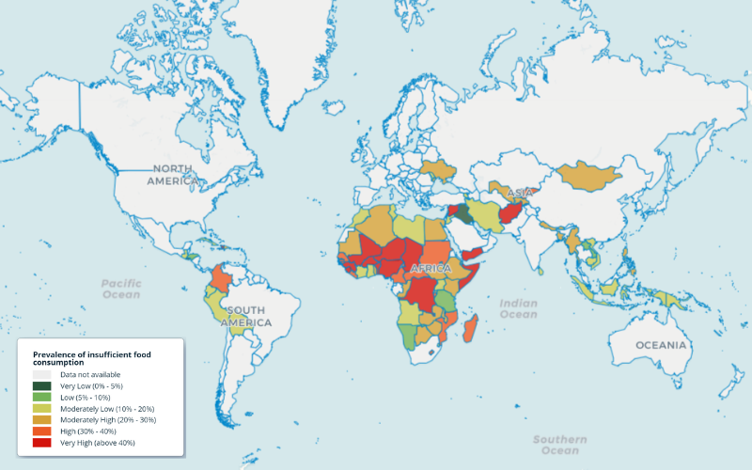
Overnutrition can result in obesity or a metabolic disorder that leads to an overaccumulation of fat tissue. Obesity is a known risk factor for many diseases, such as Type 2 diabetes, cardiovascular disease, cancer, and inflammatory disorders such as rheumatoid arthritis. Undernutrition is common in the elderly, individuals with certain diseases, and the poverty-stricken.
Starvation
Figure 10.7 shows the data visualized for insufficient food consumption across the globe. Fourteen countries have 40% of their population experiencing insufficient food consumption: Afghanistan (87.63%), Benin (42.82%), Burkina Faso (57.37%), Chad (57.92%), the Democratic Republic of Congo (40.44%), Guinea (54.36%), Haiti (60.57%), Mali (70.24%), Niger (82.20%), Nigeria (40.44%), Sierra Leone (56.86%), Somalia (93.26%), the Syrian Arab Republic (68.42%), and Yemen (52.70%). All but one of the fourteen countries have updated information for August 2023. Benin’s data was last collected on January 10, 2022. Most countries’ data were collected via surveys but Afghanistan's data was based on predictive modeling. Source: World Food Programme, 2023b.

Slide 24
Starvation, the most extreme form of malnutrition, refers to severe scarcity in caloric energy intake that is insufficient to meet an individual’s energy and nutritional needs. Starvation is a crisis typically occurring in developing countries. Women and children are the most vulnerable populations.
The World Food Programme (WFP) is a humanitarian organization in over 120 countries and territories dedicated to food assistance and nutritional education. According to the WFP, 783 million people experience food insecurity.
Different factors contribute to global starvation: familial socioeconomic factors that limit financial resources, the country’s economic status (high-income, newly emerging, and low-income), conflict within regions that lead to a severe disruption of the economy and the functioning and infrastructure of civilization in affected regions, access to nutritional foods and beverages, medical conditions that affect the body’s ability to absorb nutrients such as irritable bowel syndrome (IBS), climate change impacts on crop yield, and mental health conditions.

Slide 25



Complications from starvation include:
1. Immune system failures increase susceptibility to illness,
2. Cardiovascular system issues (low heart rate, inability to
maintain body temperature and low blood pressure), 3. Digestion system deterioration, and
4. Vision issues.

