Slide 1
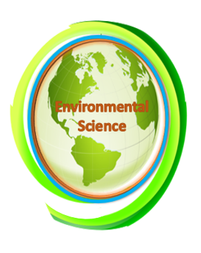
Environmental Justice
Chapter 11 Learning Objectives
After completing this chapter, you will be able to:
Explain the significance of environmental justice in the context of environmental science.
Define environmental ethics and how communities are affected in decision-making.
Differentiate between the environmental worldviews.
Explain significant incidents of environmental injustice (i.e., environmental racism).
Explain the interconnectedness of social, economic, and environmental factors relating to environmental justice.

Slide 2


Environmental Ethics
Foundations of Environmental Ethics
Developments and advances in technology and medicine can potentially create otherwise unforeseen or unexpected ethical dilemmas. In most cases, it is very difficult, if not impossible, to predict potential ethical issues about an innovation until it is already in use and the world.
Ethical dilemmas created by innovations emerge with use. These dilemmas lead to confrontation and debate only after they become apparent. This is why it can sometimes seem like ethical debates are always playing catch-up, that we are motivated to debate the ethical implications of something only after issues become apparent.
Metaethics, normative ethics, and applied ethics are the three main areas of ethics that are each distinguished by a different level of inquiry and analysis. Applied ethics focuses on the application of moral norms and principles to controversial issues to determine the rightness of specific actions.

Slide 3
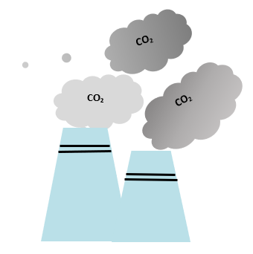
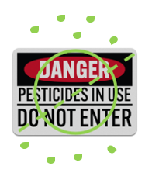
Aldo Leopold’s A Sand County Almanac, published in 1949, called upon humanity to expand our idea of community to include the entire natural world, grounding this approach in the belief that all of nature is connected and interdependent in important ways.
Rachel Carson’s Silent Spring (1962) drew attention to the dangers of what were then commonly used commercial pesticides. Carson’s essays drew attention to the far-reaching impacts of human activity and its potential to cause significant harm to the environment and humanity.
Our reliance on fossil fuels to meet our energy needs, for example, releases a key greenhouse gas, carbon dioxide (CO₂), into the air. Greenhouse gases trap heat in Earth’s atmosphere, resulting in changes in the planet’s climate.

Slide 4

The two countries that produce the most CO₂ are the United States and China. The United States is the biggest gasoline consumer in the world, using approximately 370 million gallons of gasoline per day in 2022. China is the biggest coal consumer, burning approximately three billion tons of coal in 2022—more than half of the worldwide total coal consumption.
Human activities have and continue to significantly impact the natural world. Anthropogenic climate change refers to changes in Earth’s climate caused or influenced by human activity. Severe weather and natural disasters are increasing in frequency and intensity because of the changing climate.
Environmental ethics is an area of applied ethics that attempts to identify the right conduct in our relationship with the nonhuman world. For decades, scientists have expressed concern about the short- and long-term effects of human activities on the climate and Earth’s ecosystems.

Slide 5

Environmental ethics exists in three groups that address the agency and value (or non-value) of nonhuman elements: frontier, sustainable, and land ethic.
Frontier Ethic
Ethical attitudes and behaviors determine human interaction with the land and its natural resources. Early European settlers in North America rapidly consumed the land’s natural resources. After they depleted one area, they moved westward to new frontiers. Their attitude towards the land was that of a frontier ethic.
A frontier ethic assumes that the earth has an unlimited supply of resources. If resources run out in one area, more can be found elsewhere or human ingenuity will find substitutes. This attitude sees humans as masters who manage the planet. The frontier ethic is completely anthropocentric (human-centered).
Sustainable Ethic
A sustainable ethic is an environmental ethic by which people treat the earth as if its resources are limited. This ethic assumes that the earth’s resources are not unlimited and that humans must use and conserve resources to allow their continued use in the future. A sustainable ethic also assumes that humans are a part of the natural environment and that we suffer when the health of a natural ecosystem is impaired.

Slide 6


A sustainable ethic includes the following tenets:
  The Earth has a limited supply of resources.
  Humans must conserve resources.
  Humans share the earth’s resources with other living things.
  Growth is not sustainable.
  Humans are a part of nature.
  Humans are affected by natural laws.
  Humans succeed best when they maintain the integrity of natural processes and cooperate with nature.
A sustainable ethic can be either anthropocentric or biocentric (life-centered). An advocate for conserving oil resources may consider all oil resources as the property of humans. Using oil resources wisely so that future generations have access to them is an attitude consistent with an anthropocentric ethic. Using resources wisely to prevent ecological damage is in accord with a biocentric ethic.

Slide 7
Land Ethic
Aldo Leopold, an American wildlife natural historian and philosopher, advocated a biocentric ethic in his book, A Sand County Almanac. He suggested that humans had always considered land as property, just as ancient Greeks considered slaves as property. He believed that mistreatment of land (or of slaves) makes little economic or moral sense, much as today, the concept of slavery is considered immoral.
All humans are merely one component of an ethical framework. Leopold suggested that land be included in an ethical framework, calling this the land ethic.
“The land ethic simply enlarges the boundary of the community to include soils, waters, plants, and animals; or collectively, the land. In short, a land ethic changes the role of Homo sapiens from conqueror of the land community to plain member and citizen of it. It implies respect for his fellow members, and also respect for the community as such” (Aldo Leopold, 1949).

Slide 8
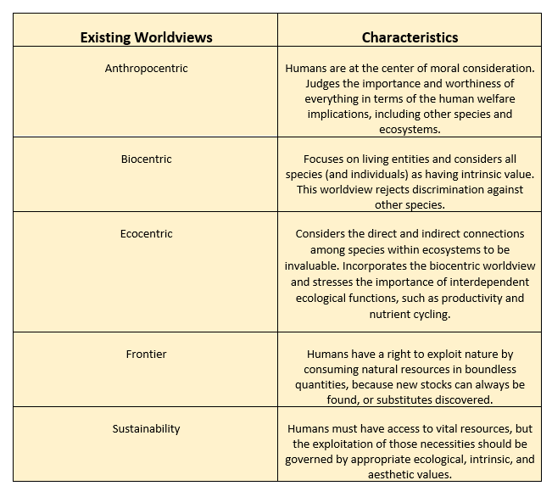
Table 11.1. Existing Worldviews in Environmental Science.
Worldviews in Environmental Science
The attitudes of people and their societies toward other species, natural ecosystems, and resources have enormous implications for environmental quality.
Extraordinary damages have been legitimized by attitudes based on a belief in the inalienable right of humans to harvest whatever they desire from nature without consideration of pollution, threats to species, or the availability of resources for future generations.
One of the keys to resolving the environmental crisis is to achieve widespread adoption of ecocentric and ecological sustainability worldviews.

Slide 9
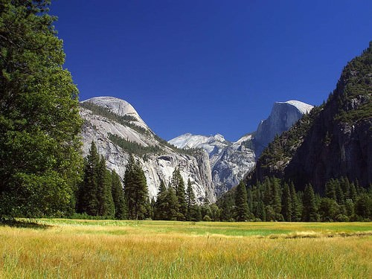
Case Study: Hetch Hetchy Valley
In 1913, the Hetch Hetchy Valley – located in Yosemite National Park in California – was the site of a conflict between two factions, one with an anthropocentric ethic and the other with a biocentric ethic. As the last American frontiers were settled, the rate of forest destruction started to concern the public.
The conservation movement gained momentum but quickly broke into two factions. One faction, led by Gifford Pinchot, Chief Forester under Teddy Roosevelt, advocated utilitarian conservation (i.e., conservation of resources for the public good).
The other faction, led by John Muir, advocated the preservation of forests and other wilderness for their inherent value. Both groups rejected the first tenet of frontier ethics, the assumption that resources are limitless. However, the conservationists agreed with the rest of the tenets of frontier ethics while the preservationists agreed with the tenets of the sustainable ethic.
Figure 11.1. Yosemite Valley, California, USA.

Slide 10

John Muir, the founder of the Sierra Club and a great lover of wilderness, led the fight against the dam. He saw wilderness as having an intrinsic value, separate from its utilitarian value to people. He advocated the preservation of wild places for their inherent beauty and for the sake of the creatures that live there.
The issue aroused the American public, who were becoming increasingly alarmed at the growth of cities and the destruction of the landscape for commercial enterprises. Key senators received thousands of letters of protest.
Despite public protest, Congress voted to dam the valley. The preservationists lost the fight for the Hetch Hetchy Valley. Their questioning of traditional American values had some lasting effects.
In 1916, Congress passed the “National Park System Organic Act,” which declared that parks were to be maintained in a manner that left them unimpaired for future generations. As we use our public lands, we continue debating whether we should be guided by preservationism or conservationism.

Slide 11
Case Study: Tragedy of the Commons
The Tragedy of the Commons was introduced in chapter one. It applies to what is arguably the most consequential environmental problem: global climate change. The atmosphere is a commons into which countries are dumping carbon dioxide from the burning of fossil fuels.
As a country, the immediate benefit from the continued use of fossil fuels is seen as a positive component (because of economic growth). All countries, however, will share the negative long-term effects.
The SARS-CoV-2 disease leading to the COVID-19 pandemic revealed notions of the Tragedy of the Commons. Maaravi et al. (2021) explored the impact of COVID-19 (number of cases and deaths) based on culture in 69 countries.
The study revealed countries with a score leaning towards individualism (versus collectivism) had higher COVID-19 cases and mortality rates. Therefore, the study highlighted the tragedy of individualistic countries during the pandemic and the social implications of considering the greater good in moving towards a more collectivistic society.

Slide 12


The Tragedy of the Commons is a frequent economic and social framework for discussions about a range of common resources, even extending into digital resources such as open media repositories and online libraries.
Prominent economist Elinor Ostrom, the first woman to receive the Nobel Prize in Economics, proposed an alternate version, sometimes referred to as the "non-tragedy of the commons."
After extensive fieldwork in areas as diverse as Indonesia, Kenya, Maine, the United States, and Nepal, she challenged the notion that people would only avoid depletion of common resources if required by regulatory laws and property rights. She noted that farmers working on shared land could communicate and cooperate to maximize and preserve the fields over time.
She argued that when those who benefit most from a resource are near it (like a farm field that directly serves a town), the resource is managed better without external influence.

Slide 13
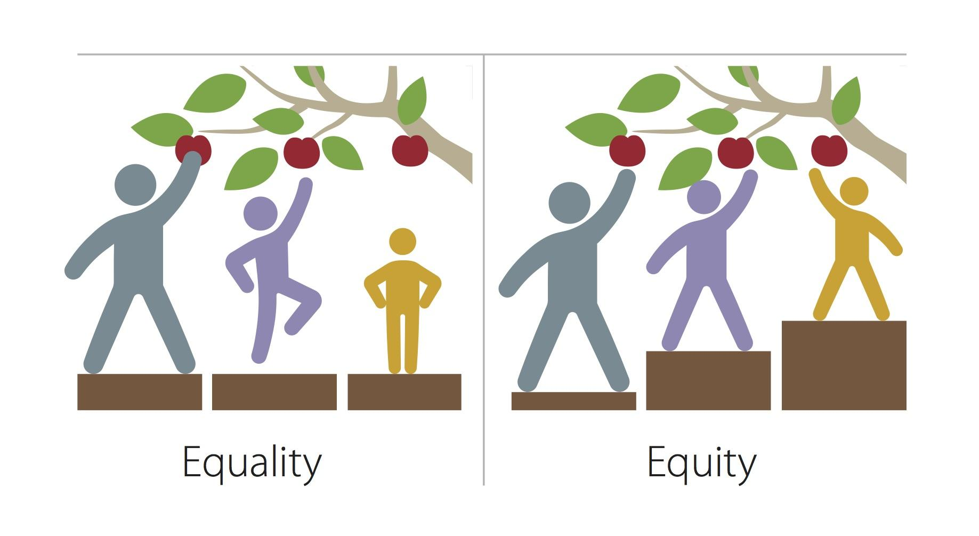
Environmental Equity
Equity addresses the need to provide people with the necessary tools to obtain their wants or needs. Figure 11.2 explains the difference between equality and equity in meeting similar outcomes for all people. Therefore, environmental equity acknowledges the need for the fair treatment, safety, and protection of individuals from environmental hazards and disasters irrespective of their income and access to resources.
While much progress is being made to improve resource efficiency, far less progress has been made to improve resource distribution. Currently, just one-fifth of the global population is consuming three-quarters of the earth’s resources (Figure 11.3).
Environmental Equity and Justice
Figure 11.2 shows a diagram depicting equality and equity. Equality is providing every person with the same resources to meet the same outcomes. Equity acknowledges the uniqueness of each individual and their need for different resources to meet the same outcomes (Source: MPCA Photos, 2016. CC BY-NC 2.0)

Slide 14
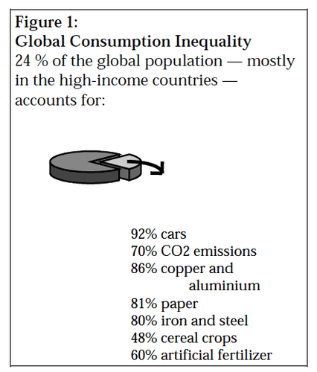
Countries such as China, Brazil, India, and Malaysia are catching up fast. In such a situation, global consumption of resources and energy needs to be drastically reduced to a point where it can be repeated by future generations. But who will do the reduction? Poorer nations want to produce and consume more.
Yet so do richer countries: their economies demand ever greater consumption-based expansion. Such stalemates have prevented any meaningful progress towards equitable and sustainable resource distribution at the international level. These issues of fairness and distributional justice remain unresolved.
Figure 11.3 shows the global consumption of the earth’s resources. The graphic reveals 24% of the global population consists mostly of high-income countries and accounts for 92% of car sales, 70% of carbon dioxide emissions, 80% of copper and aluminum usage, 81% of paper usage, 80% of iron and steel usage, 45% of cereal crops consumption, and 60% of artificial fertilizer (Source: Fisher, 2017).

Slide 15

Environmental justice is the fair treatment and meaningful involvement of all people regardless of race, color, national origin, or income concerning the development, implementation, and enforcement of environmental laws, regulations, and policies. It will be achieved when everyone enjoys the same degree of protection from environmental and health hazards and equal access to the decision-making process to have a healthy environment to live, learn, and work.
During the 1980s, minority groups protested that hazardous waste sites were preferentially located in minority neighborhoods. In 1987, Benjamin Chavis of the United Church of Christ Commission for Racism and Justice coined the term environmental racism to describe such a practice.
The charges generally failed to consider whether the facility or the demography of the area came first. Most hazardous waste sites are located on property that was used as disposal sites long before modern facilities and disposal methods were available.

Slide 16

Decisions in citing hazardous waste facilities are generally made based on economics, geological suitability, and the political climate. For example, a site must have a soil type and geological profile that prevents hazardous materials from moving into local aquifers. The cost of land is also an important consideration. The high cost of buying land would make it economically unfeasible to build a hazardous waste site in Beverly Hills.
An ideal world would have no hazardous waste facilities. Unfortunately, we live in a world plagued by rampant pollution and dumping of hazardous waste. Our industrialized society has necessarily produced waste during the manufacturing of products for our basic needs. Until technology can find a way to manage (or eliminate) hazardous waste, disposal facilities will be necessary to protect both humans and the environment.
In 1992, the United States Office of Environmental Equity was established. It became the Office of Environmental Justice under the Environmental Protection Agency (EPA). This office oversees programs, partnerships, and tools that address disparities affecting indigenous, low-income, minority, and tribal citizens.

Slide 17
Environmental Inequities in Vulnerable Communities
Vulnerable communities experience environmental injustice and inequities for several reasons. Vulnerable communities are typically minority communities or low-income households. These individuals are often denied input in policy-making decisions or legislation. Therefore, these groups are impacted by environmental practices that may lack oversight and protection.
Loyola University, located in New Orleans, Louisiana, established the Loyola Jesuit Social Research Institute (JSRI). One task of this institute is measuring and comparing social justice across the United States.
JSRI created the JustSouth Index in 2016 to examine three dimensions of social justice: poverty, disparity, and immigrant exclusion. For two consecutive years (2016-2018), Louisiana ranked 51 out of 51. In 2019, Louisiana moved above Mississippi to rank 50 out of 51. These numbers are concerning and highlight the need for improvements in Louisiana and other states experiencing slow to no advancement toward social justice.

Slide 18
Indigenous People
The United Nations officially classifies indigenous people as “having a historical continuity with pre-invasion and pre-colonial societies,” and “consider themselves distinct from other sectors of the societies now prevailing in those territories or parts of them”.
Indigenous people are “determined to preserve, develop and transmit to future generations, their ancestral territories, and their ethnic identity, as the basis of their continued existence as peoples, in accordance with their own cultural patterns, social institutions, and legal systems” (United Nations, 2004).
A few of the many groups of indigenous people around the world are the many tribes of Native Americans (i.e., Navajo, Cherokee, Mexican American Indian, Chippewa, Sioux) in the contiguous 48 states, the Inuit of the arctic region from Siberia to Canada, the rainforest tribes in Brazil, the Aboriginal and Torres Strait Islander people of Australia, the Sami of northern Europe, the Ainu of northern Japan, and the Maori of New Zealand.

Slide 19
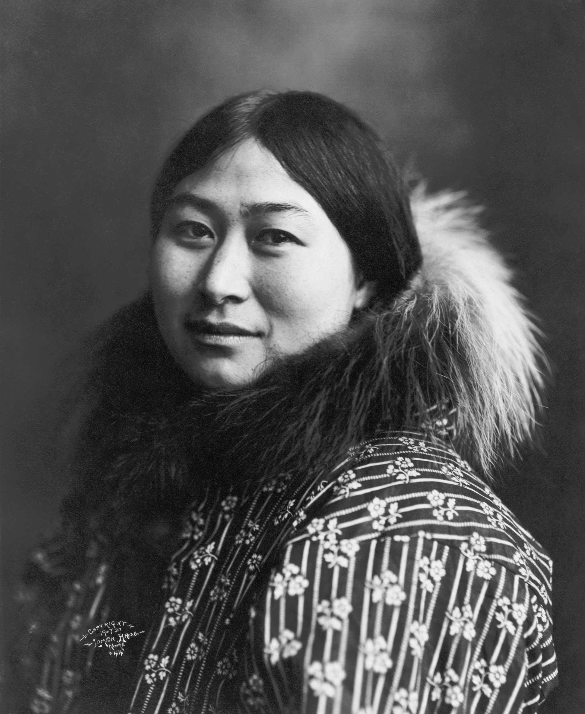
Many problems face indigenous people, such as the lack of human rights, exploitation of their traditional lands and themselves, and degradation of their culture. In response to the problems faced by these people, the United Nations proclaimed an “International Decade of the World’s Indigenous People” beginning in 1994.
This proclamation’s main objective, according to the United Nations, is “the strengthening of international cooperation for the solution of problems faced by indigenous people in such areas as human rights, the environment, development, health, culture and education.”
Its goal is to protect the rights of indigenous people. Such protection would enable them to retain their cultural identities, such as their language and social customs while participating in the political, economic, and social activities of the region in which they reside.
Figure 11.4 An Inupiaq woman, Nome, Alaska, c. 1907. Credit: This work is in the Public Domain, CC0

Slide 20
In the United States, many of those in the federal government are pushing to exploit oil resources in the Arctic National Wildlife Refuge on the northern coast of Alaska. The “Gwich’in,” an indigenous people who rely culturally and spiritually on the herds of caribou that live in the region, claims that drilling in the region would devastate their way of life.
A few months’ oil supply would destroy thousands of years of culture. Drilling efforts have been stymied in the past, but mostly out of concern for environmental factors and not necessarily the needs of the indigenous people.
Curiously, another group of indigenous people, the “Inupiat Eskimo,” favor oil drilling in the Arctic National Wildlife Refuge. Because they own considerable amounts of land adjacent to the refuge, they would potentially reap economic benefits from the development of the region.

Slide 21
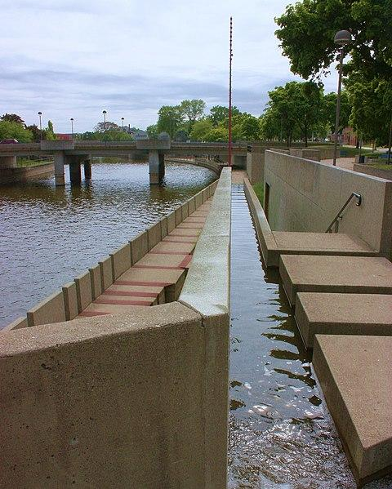
Flint Michigan
Detroit is the most populous city in Michigan—population of 632,464 residents as of 2021. According to the 2021 census, approximately 80% of the residents identify as racial minorities.
The median household income is approximately $35,000. Approximately 30% of residents live in poverty. Detroit has been known as the birth of the automobile industry (early 1900s) and Motown Records (founded in 1959). These significant industries brought economic prosperity to Detroit in manufacturing jobs and entertainment revenue from the 1940s through the 1960s.
Detroit declined greatly in the 1970s due to decreased economic opportunities, people migrating from the city to nearby suburban communities, housing issues, racial discrimination, and increased violence.
Figure 11.5 shows the Flint River in Flint, Michigan. This picture was taken in 2009 (Source: CC BY-SA 2.0, Edward Kobayashi; This work is in Wikipedia Commons.).

Slide 22
Flint, Michigan is approximately 70 miles north of Detroit, Michigan. According to the 2013 United States Census Bureau, the Flint population was 99,487. As of 2022, the population is 79,854 and over 50% identify as a racial minority.
In April 2014, the City of Flint, Michigan began looking for cheaper water due to its growing population, which prompted a switch from the Detroit water supply to the Flint River. Water supply for public consumption undergo quality control testing measures, such as pH, bacterial growth, temperature, and trace elements, such as fluorine.
The Detroit River has been the water source for 46 years and has undergone water quality testing. The Flint River's quality was not tested until 2015 when researchers discovered lead in the drinking water. Residents of Flint, Michigan were exposed to the contaminated water for one and a half years before the city switched the water back to the Detroit River in October 2015. The city declared a public health emergency due to lead exposure and other health concerns.

Slide 23
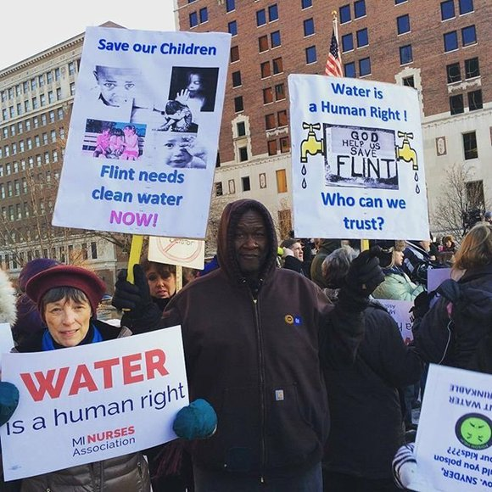


The health effects from the contaminated water were drastically present: lead exposure and Legionnaires’ disease. The number of children under 5 with elevated lead levels in their blood increased from 2.1% in 2013 to 4.0% in 2015. Lead exposure is known to cause lifelong issues for survivors. The children are at risk for developing kidney damage, nervous system damage, and anemia.
Adults who experience prolonged exposure are at an increased risk for high blood pressure, heart disease, and kidney. Lead exposure even affects fertility and causes poor birth outcomes. Legionnaires’ disease is caused by the bacterium Legionella pneumophila.
The Flint River contained this bacterium. There were 91 confirmed cases of Legionnaires’ disease and 12 deaths.
Figure 11.6 shows Flint, Michigan residents protesting at the Michigan State Capital in January 2016, three years after the initial switch from the Detroit water supply to the contaminated Flint River (Source: CC BY-SA, 4.0, Shannon Nobles, This work is in Wikimedia Commons.).

Slide 24
Unfortunately, residents complained about the unsafe and unsanitary water conditions for a while but were dismissed by city officials. Multiple agencies were criticized for delayed or ineffective responses. The county-level agency was the Genesee County Health Department. The state-level agencies were the Michigan Department of Environmental Quality and the Michigan Department of Health and Human Services.
The Flint Water Advisory Task was established to identify the issues and provide recommendations for a resolution. Once the agency’s roles were identified, action was taken to address these agencies for immediate resolutions through lawsuits and criminal charges.
Resulting actions included replacing pipe infrastructure contaminated with lead and water testing and treatment. Follow this link to a PBS documentary on the Flint Water Crisis: https://youtu.be/6oVEBCtJgeA?si=aqqqzmSvdfxXanWp.

Slide 25
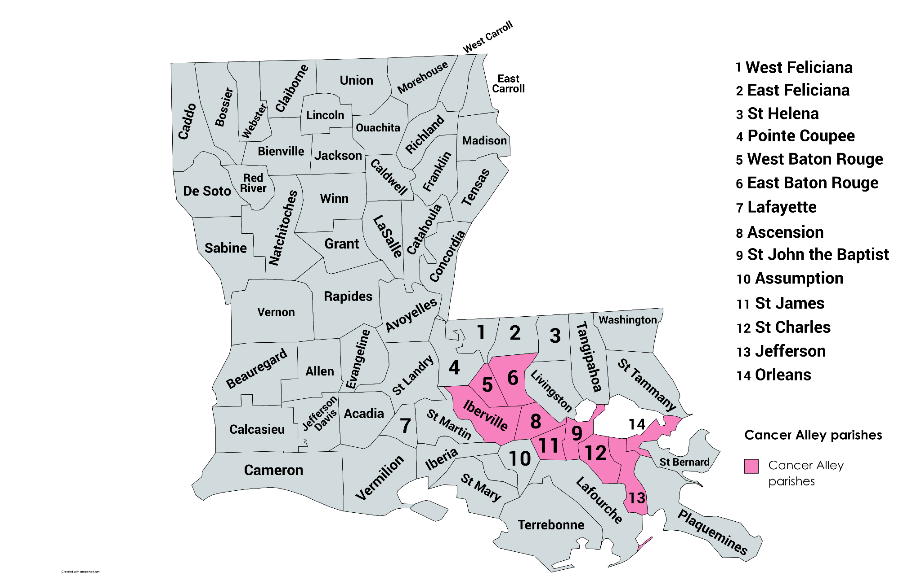
Cancer Alley
The Port of South Louisiana is located along the Mississippi River in Louisiana between Baton Rouge and New Orleans, Louisiana. This area is the River Parishes, which consists of St. James, St. John the Baptist, and St. Charles Parishes from east to west. The port ranks first in total domestic trade in the United States.
Trade imports include over 50% of all the nation’s grain exports, million short tons of maize, soybean, animal feed, and wheat, and 67% of petroleum imports. These facts are some of the economic and international benefits. However, any damages or negative impacts at this port could impact the nation’s economy.
Along Cancer Alley, there are approximately 200 industrial facilities, such as petrochemical plants and refineries. The population residing in these parishes is predominantly African-American and economically disadvantaged.
Figure 11.7 shows a map of the 64 Louisiana parishes. The Cancer Alley Parishes are highlighted in pink. It includes the stretch of I-10 from Baton Rouge to New Orleans, including the River Parishes (St. James, St. John the Baptist, and St. Charles Parishes), West Baton Rouge, East Baton Rouge, Iberville, Ascension, Assumption, Jefferson, and Orleans (Source: CC BY-SA 4.0, Patapsco913; Cancer Alley, 2023

Slide 26
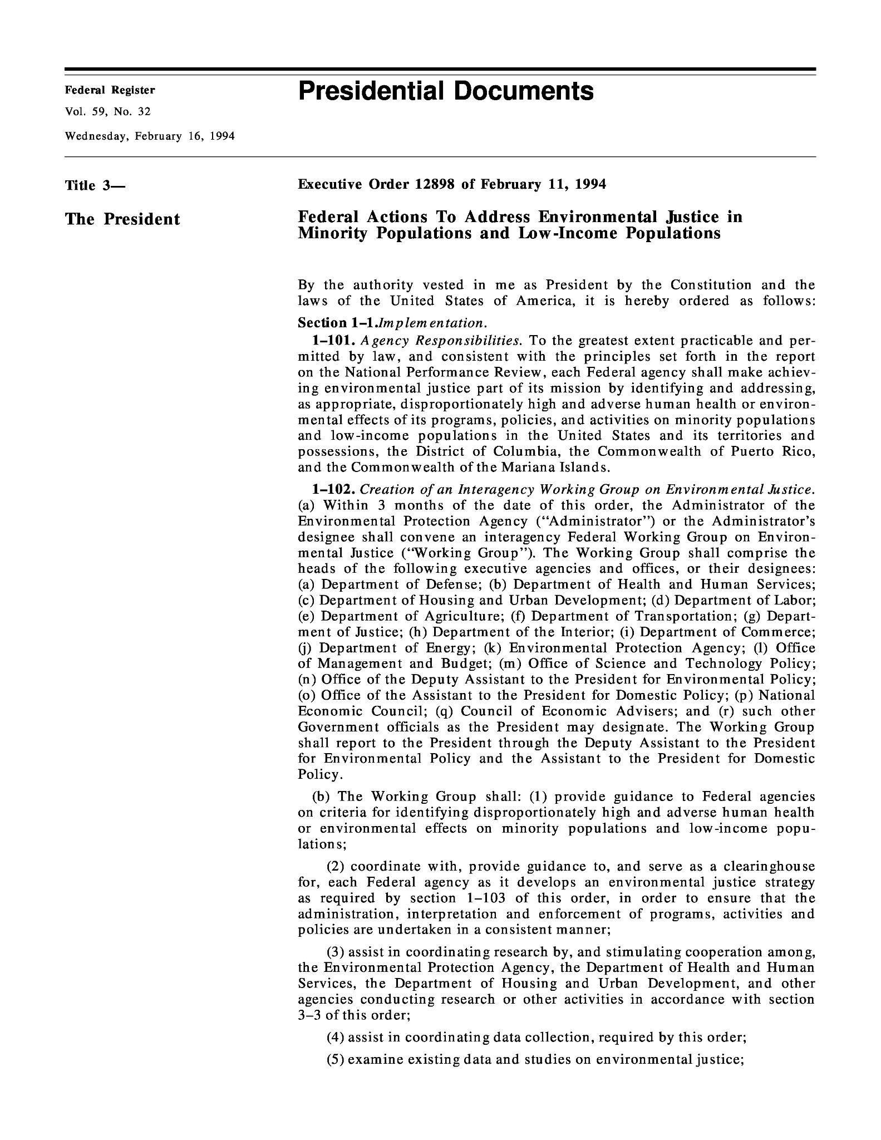
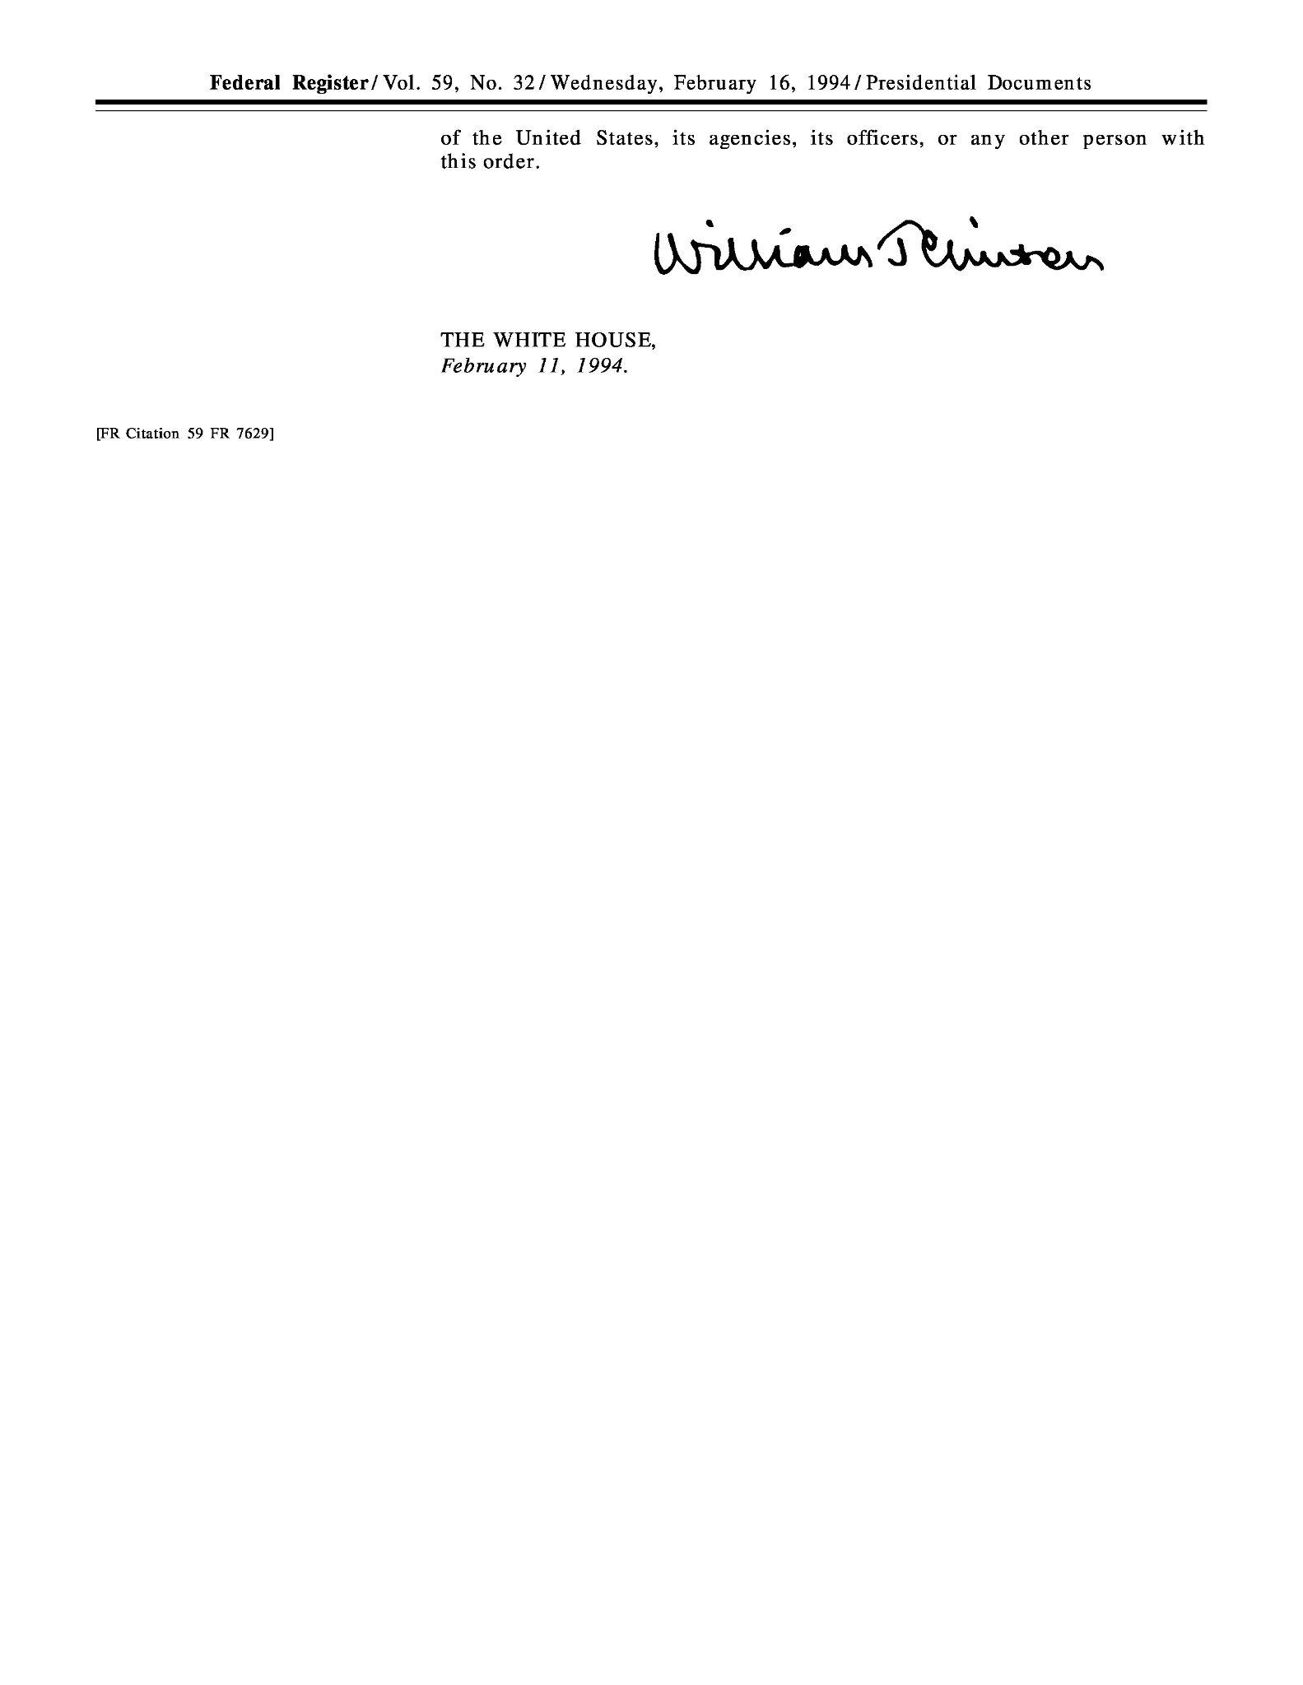
A research study conducted in 2012 explored the disparities in cancer risks from air pollution in Cancer Alley. The study acknowledged the low socioeconomic status (SES) of the Cancer Alley residents tabulated by the high poverty and low literacy levels.
The “racial makeup of Cancer Alley is 55% white and 40% black compared to state averages of 64% and 32%, national averages of 75% and 12%, respectively” (James et al., 2012). The study highlighted the contributing quantities of different chemical sources to the environment. The study revealed SES played a role in exacerbating the disparities.
Addressing Environmental Injustices
Figure 11.8 shows the start and end of Executive Order 12898. The right image shows the date and order information in the federal register. The left image shows the presidential signature. Follow this link for the detailed executive order: https://www.archives.gov/files/federal-register/executive-orders/pdf/12898.pdf.

Slide 27
It is critical to support community engagement and empowerment for environmental issues. It is also important to give residents a voice in policy and decision-making as a means to work with and not for them. Amplifying marginalized voices and promoting inclusive environmental planning would create a collaborative network between residents and political leaders.
In 1994, President William “Bill” Clinton signed Executive Order 12898, Federal Actions to Address Environmental Justice in Minority Populations and Low-Income Populations. This order required governmental agencies to focus on their decision-making impacts as they worked towards “the goal of achieving environmental protection for all communities” (United States Environmental Protection Agency, 2023 January).
As an additional measure to support the need for environmental justice, the EPA created the Environmental Justice Screening Tool (EJScreen) that combines environmental and demographic indicators across the United States in maps and reports. The EJScreen tool provides data supporting the need for outreach and informing the public on public health concerns. Visit this website to find the EJScreen software: https://www.epa.gov/ejscreen.

