Slide 1

PRINCIPLES OF
MICROECONOMICS 2e
Chapter 4 Labor and Financial Markets
PowerPoint Image Slideshow

Slide 2
CH.4 OUTLINE
4.1: Demand and Supply at Work in Labor
Markets
4.2: Demand and Supply in Financial Markets
4.3: The Market System as an Efficient
Mechanism for Information

Slide 3

Other Types of Markets
People often think of demand and supply in relation to goods, but labor markets, such as the nursing profession, can also apply to this analysis. (Credit: modification of work by "Fotos GOVBA"/Flickr Creative Commons)

Slide 4
4.1 Demand and Supply at Work in Labor Markets
Labor market - the supply and demand for labor.
Law of demand in labor markets:
  Higher salary or wage (price) in the labor market → decrease in the quantity of labor demanded by employers.
  Lower salary or wage (price) → increase in the quantity of labor demanded.
Law of supply labor markets:
  Higher price for labor → higher quantity of labor supplied.
  Lower price for labor → lower quantity supplied.
Equilibrium - the quantity supplied and the quantity demanded are equal.
  At the equilibrium wage, employers can find workers, and workers can find jobs.

Slide 5
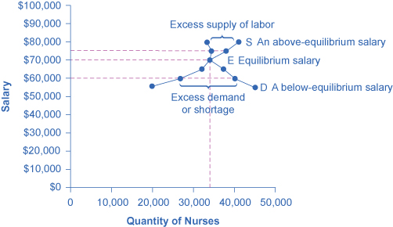
Labor Market Example: Demand and
Supply for Nurses
The demand curve (D) employers who want to hire nurses intersects with the supply curve (S) of those who are qualified and willing to work as nurses at the equilibrium point (E).
At an above-equilibrium salary of $75,000, quantity supplied increases to 38,000, but the quantity of nurses demanded at the higher pay declines to 33,000. At this above-equilibrium salary, an excess supply or surplus of nurses would exist.
At a below-equilibrium salary of $60,000, quantity supplied declines to 27,000, while the quantity demanded at the lower wage increases to 40,000 nurses. At this below-equilibrium salary, excess demand or a shortage exists.

Slide 6
Shifts in Labor Demand
Factors that can shift the demand curve for labor:
  Demand for Output
  Education and Training
  Technology
  Number of Companies
  Government Regulations
  Price and Availability of Other Inputs

Slide 7
Shifts in Labor Supply
Factors that can shift the supply curve of labor:
  Number of Workers
  Required Education
  Government Policies

Slide 8
Technology and Wage Inequality
Discussion Question: How will new technologies affect the wages of high-skill and low-skill workers?
Hint - use the four-step process of analyzing how shifts in supply or demand affect a market.

Slide 9
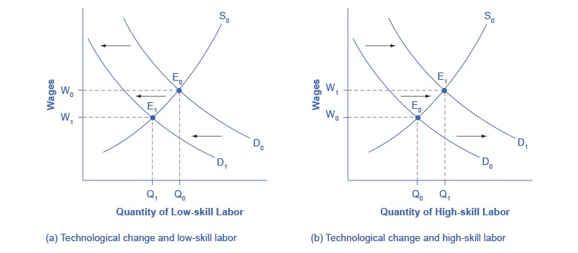
Technology and Wages: Applying Demand and Supply
The demand for low-skill labor shifts to the left when technology can do the job previously done by these workers.
New technologies can also increase the demand for high-skill labor in fields such as information technology and network administration.

Slide 10
Price Floors in the Labor Market
Salary or wage - money paid for work or a service.
Minimum wage - a price floor that makes it illegal for an
employer to pay employees less than a certain hourly rate.
Living wage - the amount a full-time worker would need to make to afford the essentials of life: food, clothing, shelter, and healthcare.

Slide 11
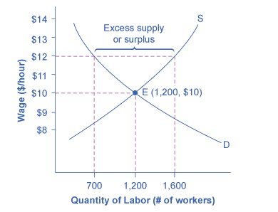
A Living Wage: Example of a Price Floor
The original equilibrium in this labor market is a wage of $10/hour and a quantity of 1,200 workers, shown at point E.
Imposing a wage floor at $12/hour leads to an excess supply of labor.
At that wage, the quantity of labor supplied is 1,600 and the quantity of labor demanded is only 700.

Slide 12
4.2 Demand and Supply in Financial
Markets
Savings = supply of financial capital
Borrowing = demand for financial capital
Financial capital - economic resources measured in terms of money.
Interest rate - the “price” of borrowing in the financial market; a rate of return on an investment.
Usury laws - laws that impose an upper limit on the interest rate that lenders can charge.

Slide 13
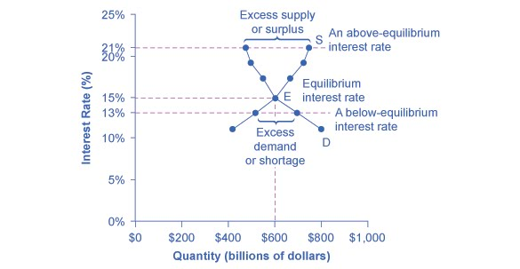
Demand and Supply for Borrowing Money
with Credit Cards
In this market for credit card borrowing, the demand curve (D) for borrowing financial capital intersects the supply curve (S) for lending financial capital at equilibrium (E).
At the equilibrium, the interest rate (the “price” in this market) is 15% and the quantity of financial capital being loaned and borrowed is $600 billion.
At an above-equilibrium interest rate like 21%, the quantity of financial capital supplied would increase to $750 billion, but the quantity demanded would decrease to $480 billion.
At a below-equilibrium interest rate like 13%, the quantity of financial capital demanded would increase to $700 billion, but the quantity of financial capital supplied would decrease to $510 billion.

Slide 14
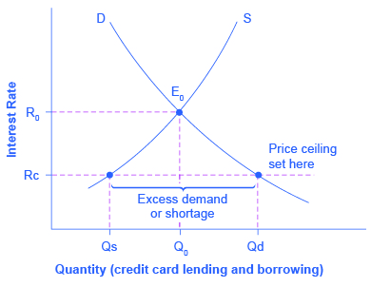
Credit Card Interest Rates: Another Price
Ceiling Example
The original intersection of demand D and supply S occurs at equilibrium E₀.
However, a price ceiling is set at the interest rate R_{c}, below the equilibrium interest rate R₀, and so the interest rate cannot adjust upward to the equilibrium.
At the price ceiling, the quantity demanded, Q_{d}, exceeds the quantity supplied, Q_{s}. There is excess demand, also called a shortage.

Slide 15
Financial Decisions Across Time
Intertemporal decision making - deciding when to consume goods: now or in the future.
Discussion question: What are examples of intertemporal decision making?

Slide 16
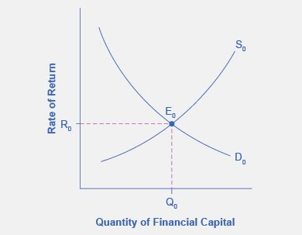
The Effect of Growing U.S. Debt
The graph shows the demand for financial capital from and supply of financial capital into the U.S. financial markets by the foreign sector before the increase in uncertainty regarding U.S. public debt.
The original equilibrium (E₀) occurs at an equilibrium rate of return (R₀) and the equilibrium quantity is at Q₀.

Slide 17
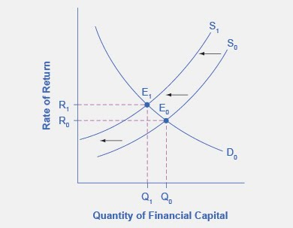
The Effect of Growing U.S. Debt
When the enthusiasm of foreign investors for investing their money in the U.S. economy diminishes, the supply of financial capital shifts to the left (S₁).
This leads to a new equilibrium, E₁, which occurs at the higher interest rate, R₁, and the lower quantity of financial investment, Q₁.

Slide 18
4.3 The Market System as an Efficient Mechanism for Information
Demand and supply models -
  Second fundamental diagram for this course (the first was the budget constraint/opportunity set model).
  Demand and supply curves explain existing levels of, and how economic events will cause changes in, prices and quantities.
The horizontal axis shows the different measures of quantity of :
  a good or service
  labor for a given job
  financial capital
The vertical axis shows a measure of the price of:
  a good or service
  the wage in the labor market
  the rate of return (like the interest rate) in the financial market.

Slide 19
Effects of price controls on the equilibrium of prices and quantities
Changes in demand and supply reveal themselves through consumers’ and producers’ behavior.
Price controls may deprive everyone in the economy of this critical information.
Without this information, it becomes difficult for buyers and sellers to react as changes occur throughout the economy.

Slide 20
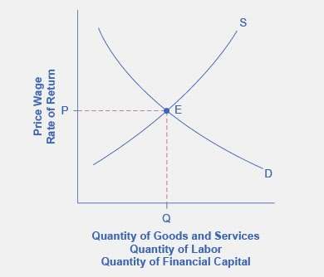
A Generic Demand and Supply Curve
The horizontal axis shows the different measures of quantity.
The vertical axis shows a measure of price.
The demand and supply curves can be used to explain how economic events will cause changes in prices, wages, and rates of return.

Slide 21
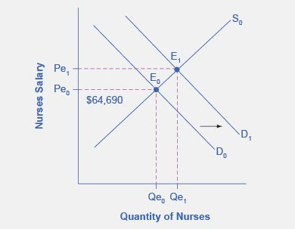
Demand for Nurses as Baby Boomers
Come of Age
In 2010, the median salary for nurses was $64,690.
As demand for services increases, the demand curve shifts to the right (from D₀ to D₁) and the equilibrium quantity of nurses increases from Qe₀ to Qe₁.
The equilibrium salary increases from Pe₀ to Pe₁.

Slide 22
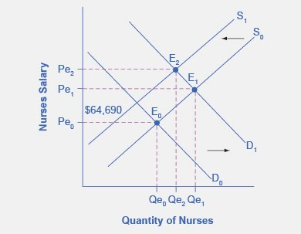
Impact of Decreasing Supply of Nurses Between
2014 and 2024
Suppose that as the demand for nurses increases, the supply shrinks due to an increasing number of nurses entering retirement and increases in the tuition of nursing degrees.
This causes a leftward shift of the supply curve resulting in even higher salaries for nurses, at Pe₂.
While we do not know if the number of nurses will increase or decrease relative to their initial employment, we know they will have higher salaries.

Slide 23
This OpenStax ancillary resource is © Rice University under a CC-BY 4.0 International license; it may be reproduced or modified but must be attributed to OpenStax, Rice University and any changes must be noted.

