Slide 1

PRINCIPLES OF
MICROECONOMICS 2e
Chapter 12 Positive Externalities and Public Goods
PowerPoint Image Slideshow

Slide 2
CH.12 OUTLINE
12.1: Why the Private Sector Underinvests in
Innovation
12.2: How Governments Can Encourage
Innovation
12.3: Public Goods

Slide 3

View from Voyager
Launched by NASA in 1977, Voyager 1’s primary mission was to provide detailed images of Jupiter, Saturn, and their moons.
In August of 2012, Voyager I entered interstellar space—the first human-made object to do so—and it is expected to send data and images back to earth until 2025.
Such a technological feat has a lot to do with economic principles.
(Credit: modification of work by NASA/JPL)

Slide 4
12.1 Why the Private Sector
Underinvests in Innovation
Market competition can provide an incentive for discovering new technology, because a firm can earn higher profits:
  by finding a way to produce products more cheaply
  by creating products with characteristics consumers want.
In some cases competition can discourage new technology, especially when other firms can quickly copy a new idea.
Studies by economists have found that the original inventor receives 1/3 to 1/2 of the total economic benefits from innovations, while other businesses and new product users receive the rest.

Slide 5
The Positive Externalities of
New Technology
Private benefits - the benefits a person who consumes a good or service receives, or a new product's benefits or process that a company invents that the company captures.
Social benefits - the value of all the positive externalities of the new idea or product (whether enjoyed by other companies or society as a whole), as well as the private benefits the firm that developed the new technology receives.
= private benefits + external benefits
Positive externalities or benefits - beneficial spillovers to a third party or parties.

Slide 6
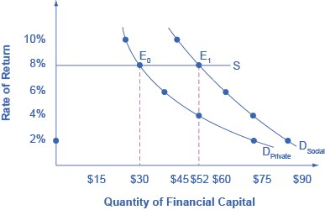
Positive Externalities and Technology
Big Drug faces a cost of borrowing of 8%.
If the firm receives only the private benefits of investing in R&D, then we show its demand curve for financial capital by D_{Private}, and the equilibrium will occur at $30 million.
Because there are spillover benefits, society would find it optimal to have $52 million of investment.

Slide 7
Positive Externalities and
Technology, Continued
If the firm could keep the social benefits of its investment for itself, its demand curve for financial capital would be D_{Social} and it would be willing to borrow $52 million. (The firm’s private demand curve would be the same as society’s demand curve.)
But, unless there is a way for the company to fully enjoy the total benefits, then it will borrow less than the socially optimal level of $52 million.

Slide 8
Why Invest in Human Capital?
The investment in education, or human capital, requires a certain upfront cost with an uncertain future benefit.
The idea is that higher levels of educational attainment will eventually serve to increase the person’s future productivity and subsequent ability to earn.
Economists have found though several studies that the rate of return of a college education to that person, in the United States, is approximately 10-15%.
Private rates of return - the estimated rates of return go primarily to an individual; for example, earning interest on a savings account.

Slide 9
Society Gains When People Learn
Society also gains from investing in the education of another student.
The social rate of return on schooling is also positive:
  better health outcomes for the population
  lower levels of crime
  a cleaner environment
  a more stable, democratic government
Social rate of return - when the estimated rates of return go primarily to society.

Slide 10
Positive Externalities Response
The appropriate public policy response to a positive externality, like a new technology, is to help the party creating the positive externality receive a greater share of the social benefits.

Slide 11
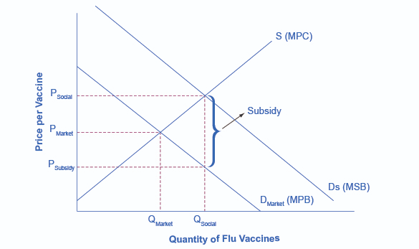
The Market for Flu Shots with Spillover Benefits (A Positive Externality)
The equilibrium quantity of flu shots produced in the market, where MPB = MPC, is Q_{Market} and the price of flu shots is P_{Market}.
The market demand curve does not reflect the positive externality of flu vaccinations, so only Q_{Market} will be exchanged.
This outcome is inefficient because the marginal social benefit exceeds the marginal social cost.

Slide 12
The Market for Flu Shots with Spillover Benefits (A Positive Externality), Cont.
If the government provides a subsidy to consumers of flu shots, equal to the MSB - MPB, the level of vaccinations can increase to the socially optimal quantity of Q_{Social}.

Slide 13
12.2 How Governments Can Encourage Innovation
Different government policies can increase the incentives to innovate:
  guaranteeing intellectual property rights
  government assistance with the costs of research and development (R&D)
  cooperative research ventures between universities and companies.
Intellectual property rights: the body of law including patents, trademarks, copyrights, and trade secret law that protect the right of inventors to produce and sell their inventions.
  Patents - give the inventor the exclusive legal right to make, use, or sell the invention for a limited time.
  Copyright laws - give the author an exclusive legal right over works of literature, music, film/video, and pictures.

Slide 14
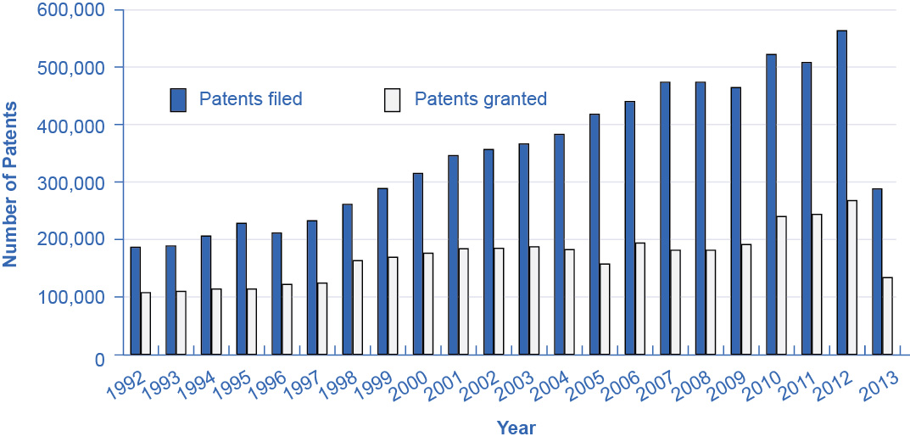
Patents Filed and Granted, 1981–2012
The number of applications filed for patents increased substantially from the mid-1990s into the first years of the 2000s, due in part to the invention of the Internet, which has led to many other inventions and to the 1998 Copyright Term Extension Act.
(Source: http://www.uspto.gov/web/offices/ac/ido/oeip/taf/us_stat.htm)

Slide 15
Government Spending on Research and Development
If the private sector does not have sufficient incentive to carry out R&D, one possibility is for the government to fund such work directly.
Government spending can provide direct financial support for R&D conducted at:
  colleges and universities
  nonprofit research entities
  sometimes by private firms
  government-run laboratories

Slide 16
Tax Breaks for Research and
Development
A complementary approach is to give firms a reduction in taxes depending on how much R&D they do.
The federal government refers to this policy as the research and experimentation (R&E) tax credit.
Studies find that each dollar of foregone tax revenue through the R&E Tax Credit causes firms to invest at least a dollar or more in R&D.

Slide 17

Cooperative Research
State and federal governments support research in a variety of ways, such as through partnerships and grants for innovative projects.
  Examples: National Institutes of Health, National Academy of Scientists, and the Agriculture and Food Research Initiative.
Cooperation between government-funded universities, academies, and the private sector can spur product innovation and create whole new industries.

Slide 18
13.3 Public Goods
Public good - good that is nonexcludable and non-rival, and is difficult for market producers to sell to individual consumers.
  Nonexludable - it is costly or impossible to exclude someone from using the good, and thus hard to charge for it.
  Non-rival - even when one person uses the public good, another can also use it.
Examples: fire and police service and national defense

Slide 19
The Free Rider Problem of Public Goods
Free rider - those who want others to pay for the public good and then plan to use the good themselves.
  If many people act as free riders, the public good may never be provided.
The free rider problem can be expressed in similar terms as the prisoner’s dilemma game.

Slide 20
The Role of Government in Paying for
Public Goods
The key to paying for public goods is to assure that everyone will make a contribution and to prevent free riders.
  This is done through government spending and taxes.
In some cases, markets can produce public goods.
  Creates an indirect way of “charging” for it.
  Example: radio is a public good, but revenue is made by selling advertising, and “charging” listeners by taking up some of their time.
Social pressures and personal appeals can also reduce the number of free riders and to collect resources for the public good.

Slide 21
Positive Externalities in Public Health Programs
Advances in public health have all been closely linked to positive externalities and public goods.
Rise in life expectancy seems to stem from three primary factors related to public health programs/goods:
  Public sanitation systems - providing clean water and disposing of human waste help to prevent the transmission of many diseases.
  Medical discoveries from government or university-funded research, such as:
    Immunizations
    Antibiotics
    High blood pressure reducers
  Changes in public behavior through government health campaigns. Examples:
    Hand washing
    Food storage and protection
    Reducing tobacco smokers
    Precautions against sexually transmitted diseases

Slide 22
This OpenStax ancillary resource is © Rice University under a CC-BY 4.0 International license; it may be reproduced or modified but must be attributed to OpenStax, Rice University and any changes must be noted.
This chapter 12 corresponds with the original text’s chapter 13.

