Slide 1
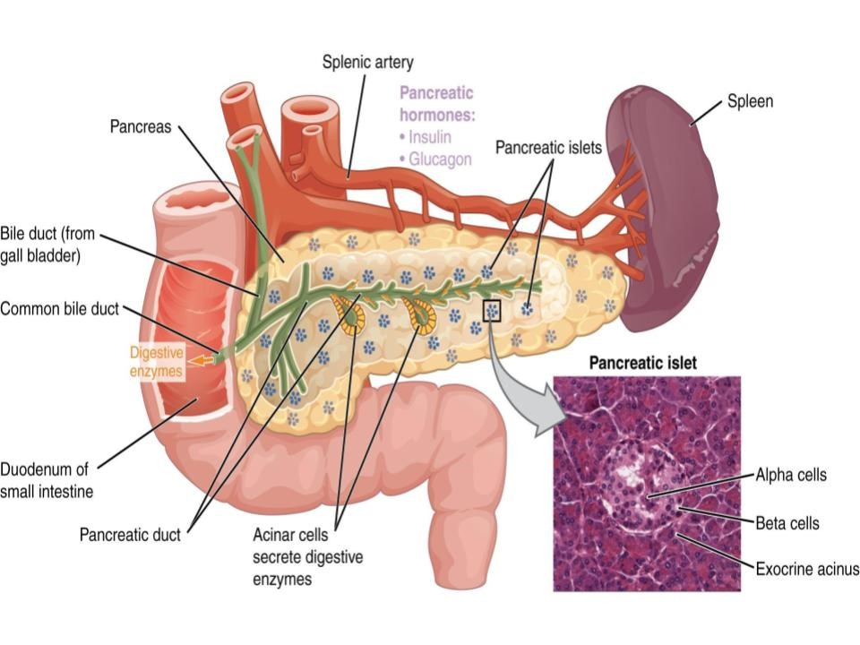
Chapter 1: Endocrine System
Anatomy and Physiology II

Slide 2
Chapter 1: Endocrine System
The Learning Objectives for this unit include:
Identify the major endocrine organs, their anatomical locations, and the hormones they produce
Classify hormones by chemical structure and explain how they act through various receptor types and signaling pathways
Describe mechanisms of hormonal regulation, including feedback loops and responses to humoral, hormonal, and neural stimuli
Summarize the roles of key glands, such as the pituitary, thyroid, adrenal, pancreas, and reproductive organs, in maintaining homeostasis
Explain the physiological effects of endocrine hormones on metabolism, growth, reproduction, and calcium and glucose balance
Describe the embryological origins of the endocrine system and how endocrine function changes across the lifespan

Slide 3
Chemistry of Hormones
1. Local hormones act on target cells close to the site of release
2. Four classes of chemical messengers:
a. paracrine act on neighboring cells; histamine – secreted by one cell type into the extracellular fluid and affect surrounding cells
b. autocrine act on the cell which secretes them; Interleukin 2 – white blood cells during an infection
c. Neurotransmitters – chemical messengers secreted by neurons that activate an adjacent cell, whether it is another neuron, a muscle cell, or a glandular cell.
d. Endocrine chemical messengers - secreted into the blood stream by certain glands and cells

Slide 4
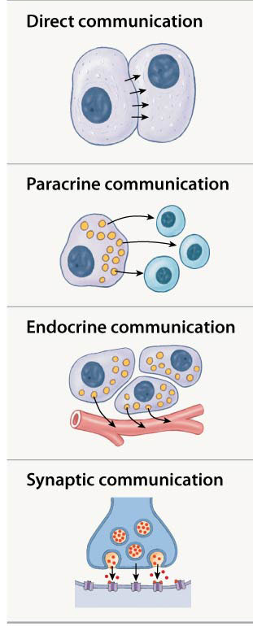
Mechanisms of intercellular communication
Mechanism | Transition | Chemical mediators | Distribution of effects
Direct | Through gap junctions | Ions, small solutes, lipid-soluble materials | Usually limited to adjacent cells of the same type interconnected with connexons
Paracrine | Through extracellular fluid | Paracrine factors | Limited to the local area where paracrine factor is high, target cell must have appropriate receptor
Endocrine | Through the blood stream | Hormones | Target cells mainly in other distant tissues and organs and must have appropriate receptor
Synaptic | Across synapse | Neurotransmittors (ex: E, NE, Ach, DA) | Limited to very specific area, target cell must have appropriate receptor

Slide 5
Nervous system vs endocrine system
Similarities:
  Both use chemicals that bind to specific receptors on their target cells
  They share many chemical messengers (neurotransmitters in nervous system, hormones in the endocrine system)
  Both regulated primarily by negative feedback mechanisms
  Common goal of both is to preserve homeostasis by coordinating and regulating other cells, tissues, organs, and systems
Nervous | Endocrine
Electrical impulses | Chemical messengers (hormones)
Rapid (milliseconds) | Slower (seconds to days)
Short-lived | Long-lasting
Highly specific (neurons/synapses) | Broad effects on multiple organs/tissues
Voluntary and involuntary | Involuntary only
Brain, spinal cord, peripheral nerves | Endocrine glands (e.g., pituitary, thyroid)

Slide 6
Characteristics of the Endocrine System
Composed of endocrine glands and specialized endocrine cells located throughout the body
Target cells (2,000-1,000,000)
Receptor proteins compound on cell membrane or in cytoplasm
Binding of hormones to receptor causes a change in the rate of cellular metabolism
Hormones are not changed and are always present but only secreted when needed
Hormones produced by nerve cells are called neuroendocrine cells
Because of the phenomenon of enzyme amplification, a single hormone molecule can ultimately cause a target cell to produce millions of molecules of a metabolic product

Slide 7
Hormones
Both neurotransmitters and hormones can affect their targets through receptors linked to G proteins
The hormones secreted by most endocrine glands can be described as amplitude-modulated signals, which consist mainly of fluctuations in the concentration of hormones in the bloodstream, over a period of time ranging from minutes to hours.
The all-or-none action potentials carried along axons can be described as frequency- modulated signals, which vary in frequency but not amplitude

Slide 8
General Characteristics of Hormones
Stability – they must remain active in the circulation long enough to arrive at their target cells.
Communication – they must be able to interact with their target tissue in a specific manner in order to activate a coordinated set of events.
Distribution – they are transported by the blood to many locations.

Slide 9
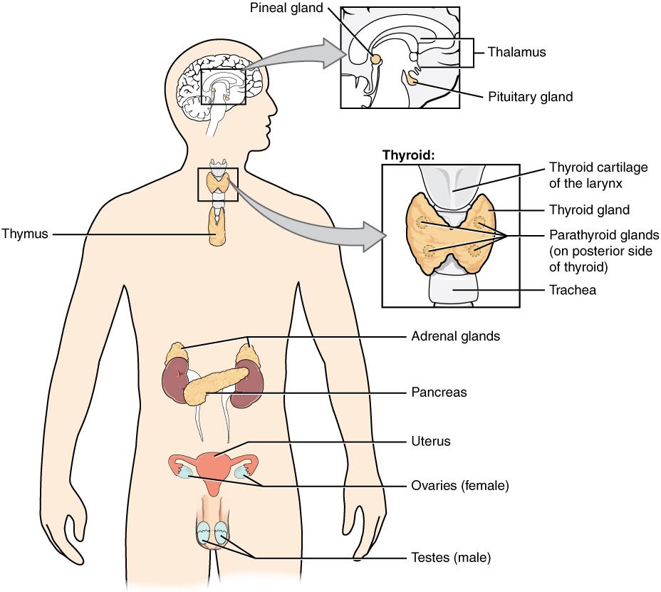

Endocrine system
  Hypothalamus
    Secretes hormones involved in fluid balance, smooth muscle contraction, control of hormone secretion by anterior pituitary gland
  Pituitary gland
    Secretes hormone stimulating melanin production as well as multiple hormones regulating endocrine activity of the adrenal cortex, thyroid gland, and reproductive organs
  Pineal gland
    Secretes melatonin, which affects reproductive function and circadian (day/night) rhythms
  Thyroid gland
    Secretes hormones affecting metabolic rate and calcium ion levels in body fluids
  Parathyroid glands
    Secrete hormone important to regulation of calcium ion levels in body fluids
  Adrenal glands
    Cells of the cortex secrete hormones involved with mineral balance, metabolic control, and resistance to stress
    Medullae release epinephrine and norepinephrine during sympathetic activation
  Pancreas (pancreatic islets)
    Secretes hormones regulating rate of glucose uptake by body tissues

Slide 10
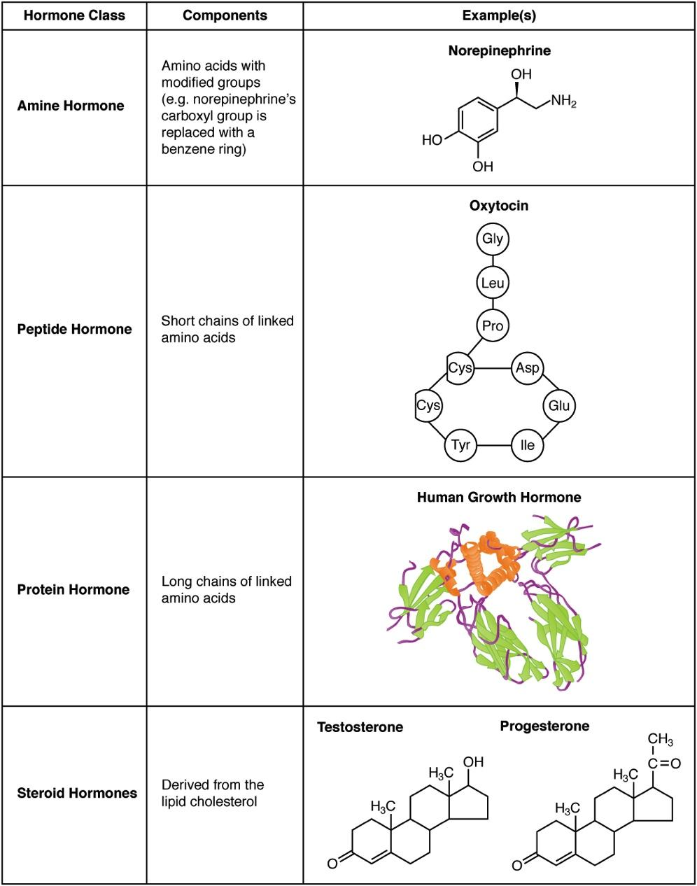
Amine, peptide, protein, and steroid hormone structure
Amino acid derivatives
Thyroid hormones (T³ and T⁴)
Catecholamines: Includes epinephrine, norepinephrine, and dopamine and melatonin.
Peptide hormones
Includes most hormones of body
Range from short polypeptide chains of amino acids (ADH, OXY) to small proteins (Insulin, GH, PRL)
Glycoproteins may also function as hormones. Examples: TSH, LH, FSH
Lipid derivatives
Consist of carbon rings and side chains built from either fatty acids (eicosanoids) or cholesterol (steroid molecules)
Eicosanoids
Important paracrine factors that coordinate cellular activities and enzymatic processes in extracellular fluids
Leukotrienes (secondary roles as hormones)
Prostaglandins (involved primarily in coordinating local cellular activities)
Steroid hormones
Released by:
Reproductive organs (androgens by testes; estrogen and progesterone by ovaries)
Adrenal cortex (corticosteroids)
Kidneys (calcitriol)
Bound to specific transport proteins in blood
Remain in circulation longer than peptide hormones

Slide 11
Hormone binding: lipid soluble
Receptor in cytoplasm or nucleus
    Steroid hormones
      Lipid-soluble hormones, so diffuse through plasma membrane
      Alter activity of specific genes
      Affect DNA transcription rate, changing pattern of protein synthesis
      Change synthesis of enzyme and structural proteins affecting cell’s metabolic activity and structure
        Example: testosterone causes increased structural proteins in muscle fibers, increasing muscle size
    Thyroid hormones
      Transported across cell membrane
      Bind to receptors on mitochondria
        Increase rate of ATP production
      Bind to receptors in nucleus
        Activate specific genes or change rate of transcription
        Affects cell’s metabolic activity and structure

Slide 12
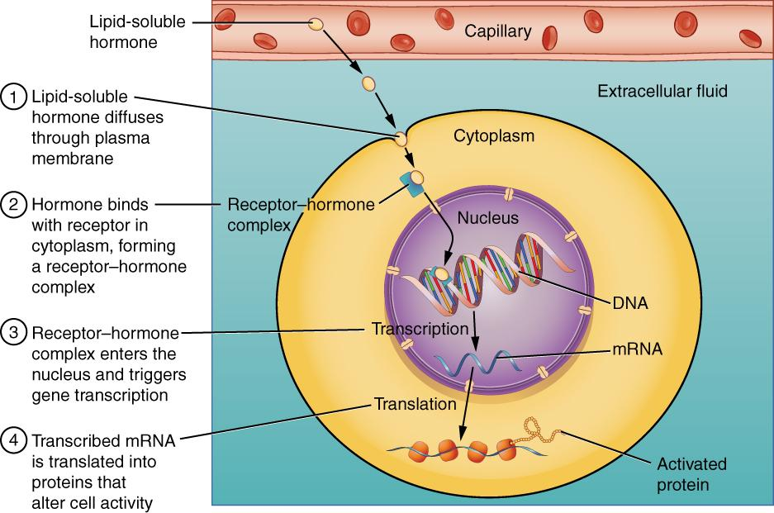
Lipid soluble hormones
Binding of Lipid-Soluble Hormones
A steroid hormone directly initiates the production of proteins within a target cell. Steroid hormones easily diffuse through the cell membrane. The hormone binds to its receptor in the cytosol, forming a receptor–hormone complex. The receptor–hormone complex then enters the nucleus and binds to the target gene on the DNA. Transcription of the gene creates a messenger RNA that is translated into the desired protein within the cytoplasm.

Slide 13
Hormone binding: water soluble
Two possible receptor locations on target cells
  Receptor in plasma membrane
    Water-soluble hormones cannot cross plasma membrane
    Act as first messenger, relaying message to an intracellular intermediary (second messenger)
    Second messenger then affects enzyme activity and changes cellular metabolic reactions
    Generally involves a G protein (enzyme complex coupled to receptor)
    Examples:
      Cyclic-AMP (cAMP)
        Increased levels may activate enzymes or open ion channels, accelerating cell metabolic activity
        Decreased levels has inhibitory effect on cell
      Calcium ions (Ca++)
        Generally function in combination with intracellular protein called calmodulin to activate enzymes

Slide 14
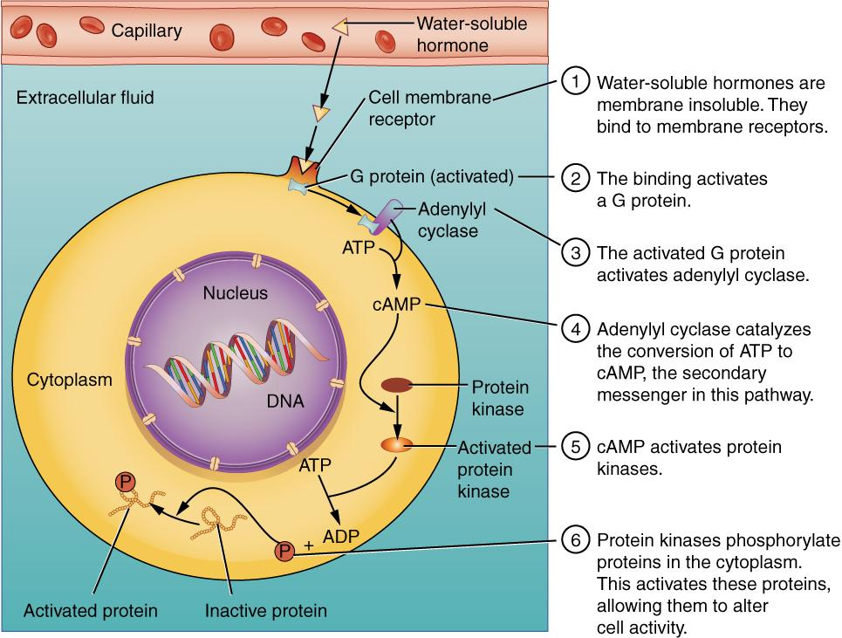
Water soluble hormones
Epinephrine video
Binding of Water-Soluble Hormones
Water-soluble hormones cannot diffuse through the cell membrane. These hormones must bind to a surface cell-membrane receptor. The receptor then initiates a cell-signaling pathway within the cell involving G proteins, adenylyl cyclase, the secondary messenger cyclic AMP (cAMP), and protein kinases. In the final step, these protein kinases phosphorylate proteins in the cytoplasm. This activates proteins in the cell that carry out the changes specified by the hormone.

Slide 15
Transport
Transport proteins have 3 functions:
Make lipid-soluble hormones temporarily water-soluble thus increasing their solubility in the blood
They retard the passage of small hormone molecules through the filtering mechanism in the kidney, thus slowing the rate of hormone loss in the urine
They provide a ready reserve of hormone in the bloodstream

Slide 16
Interactions between hormones
Antagonistic effect: insulin vs glucagon
Synergistic effect: FSH and Estrogen
Permissive effect: renin converts Angiotensin I to Angiotensin II

Slide 17
Control of Hormonal Secretion
Stimulation of Hormone Release 1. Hormonal stimulation – exhibited by hormones that are sensitive to circulating blood levels of certain molecules, such as glucose or calcium
Neural stimuli cause hormone secretion in direct response to action potentials in neurons, as occurs during stress or exercise.
Hormonal stimulation of other hormone secretion is common in the endocrine system.
Inhibition of Hormone Release
a. Humoral substances can inhibit the secretion of hormones
b. Neural stimuli can prevent hormone secretion
c. Inhibiting hormones prevent the hormone release
Regulation of Hormone levels in the blood
a. Negative feedback
b. Positive feedback

Slide 18
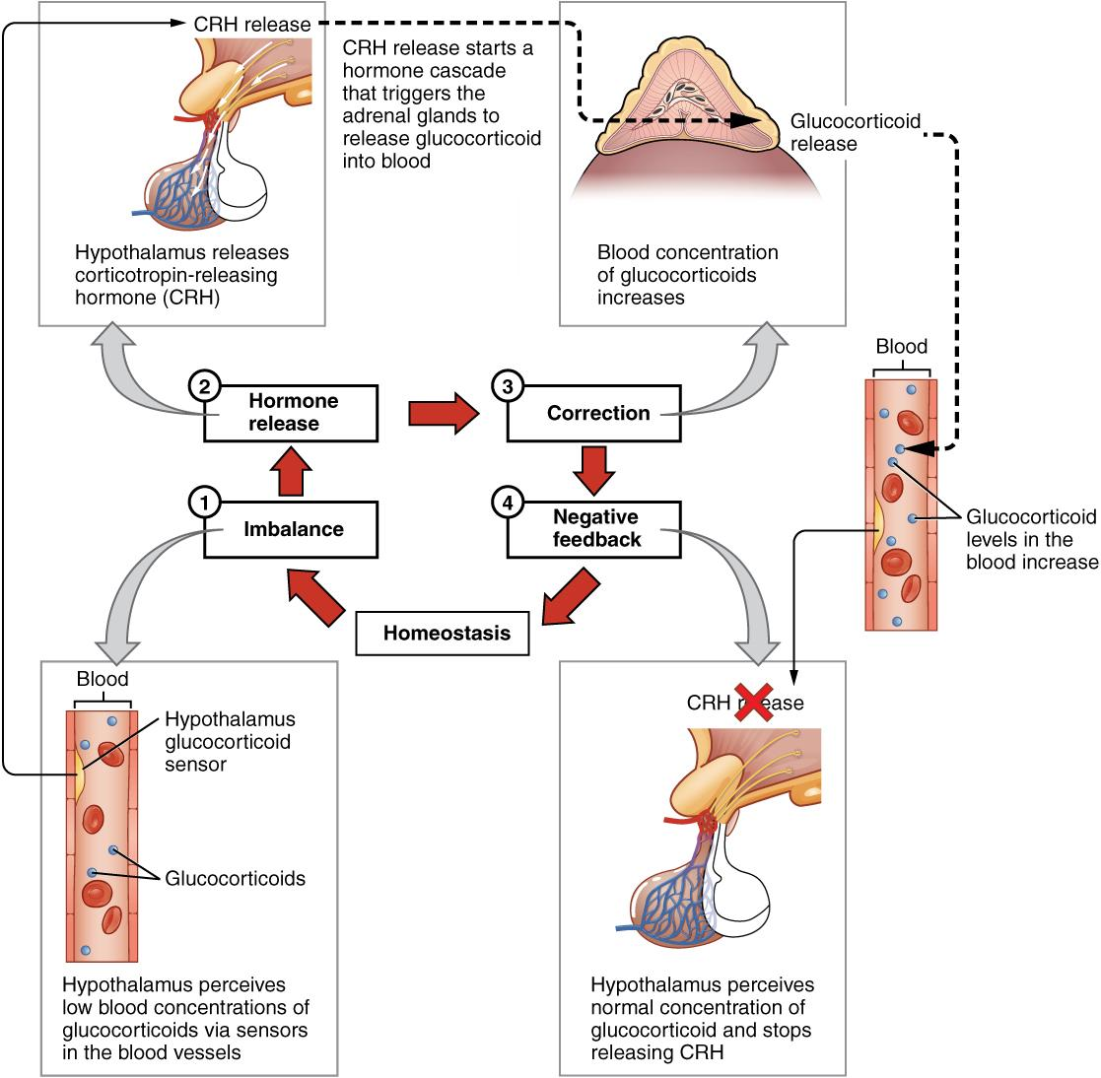
Negative feedback
Negative Feedback Loop
The release of adrenal glucocorticoids is stimulated by the release of hormones from the hypothalamus and pituitary gland. This signaling is inhibited when glucocorticoid levels become elevated by causing negative signals to the pituitary gland and hypothalamus.

Slide 19
Patterns of Hormone Secretion
1. Chronic hormone secretion –is exemplified by thyroid hormones, which vary in the blood within a small range of concentrations and remain relatively constant over long periods of time
2. Acute hormone secretion – represented by epinephrine which is released in large amounts in response to stress or physical exercise
3. Episodic hormone secretion – observed in steroid reproductive hormones, which fluctuate over a month in cyclic fashion

Slide 20
Hormones Effects
1. Control of food intake and digestion
2. Help regulate metabolism and energy balance
3. Tissue development
4. Ion regulation (pH, Na+, K+, Ca2+)
5. Water balance
6. Heart rate and blood pressure regulation
7. Control of blood glucose and other nutrients
8. Control of reproductive functions
9. Uterine contractions and milk release
10. Immune system regulation

Slide 21
Hypothalamus
  Provides highest level of endocrine function by integrating nervous and endocrine systems
  Three mechanisms of integration:
    Hypothalamic neurons synthesize two hormones that are transported to and released by the posterior pituitary
      Antidiuretic hormone (ADH)
        Synthesized by the supraoptic nuclei
      Oxytocin (OXT)
        Synthesized by the paraventricular nuclei
  Secretes regulatory hormones that control anterior pituitary gland endocrine cells
  Contains autonomic centers that directly stimulate the endocrine cells in the adrenal medullae
    Stimulated in response to sympathetic division activation
    In response, adrenal medulla releases epinephrine and norepinephrine into bloodstream

Slide 22
Hypothalamus
Major integrating link between nervous system and endocrine system. It receives input from limbic system, cerebral cortex, thalamus, and reticulating activating system as well as from internal organs and from the retina.
Regulates body temperature, thirst, hunger, sexual behavior and defensive reactions
Releasing and inhibiting hormones produced by the hypothalamus gets into the pituitary by way of a blood vessel called hypophyseal portal system.
Thyrotropin releasing hormone parvocellular neurosecretory neurons release thyroid stimulating hormone stimulate prolactin release peptide target tissue anterior pituitary cells
Gonadotropin releasing hormone neuroendocrine cells of the Preoptic area release of FSH and LH peptide target tissue is the anterior pituitary cells that secrete LH and FSH
Growth hormone releasing hormone neuroendocrine cells of the Arcuate nucleus release of GH peptide target tissue is the anterior pituitary cells
Corticotropin releasing hormone parvocellular neurosecretory neurons release ACTH peptide anterior pituitary
Growth hormone inhibiting hormone Somatostatin neuroendocrine cells of the Periventricular nucleus inhibit the release of GH and TSH peptide target tissue is the anterior pituitary cells
Prolactin inhibiting hormone Dopamine dopamine nucleus of the arcuate nucleus inhibit release of prolactin and TSH peptide target tissue is the anterior pituitary cells
Prolactin releasing hormone release prolactin unknown structure target tissue is the anterior pituitary

Slide 23
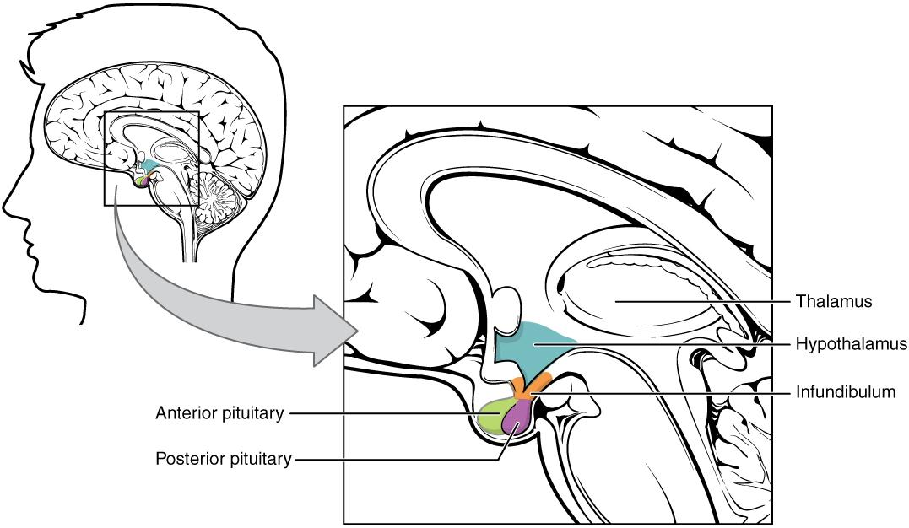
Hypothalamus - pituitary
Pituitary video
Hypothalamus–Pituitary Complex
The hypothalamus region lies inferior and anterior to the thalamus. It connects to the pituitary gland by the stalk-like infundibulum. The pituitary gland consists of an anterior and posterior lobe, with each lobe secreting different hormones in response to signals from the hypothalamus.

Slide 24
Pituitary
Pituitary Known as the “master gland” but under the control of the hypothalamus Pea shaped Attached to the hypothalamus by the infundibulum

Slide 25
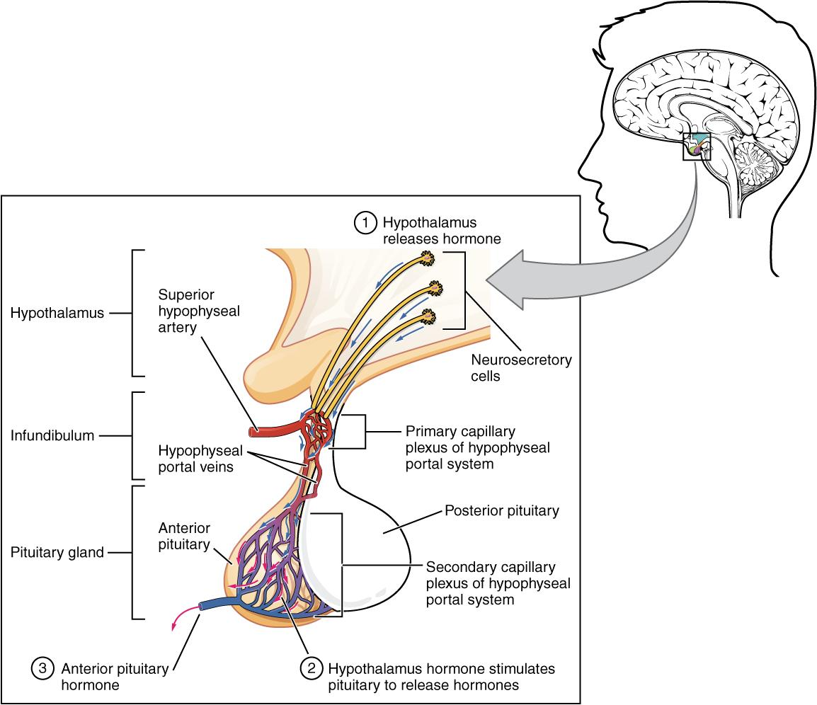
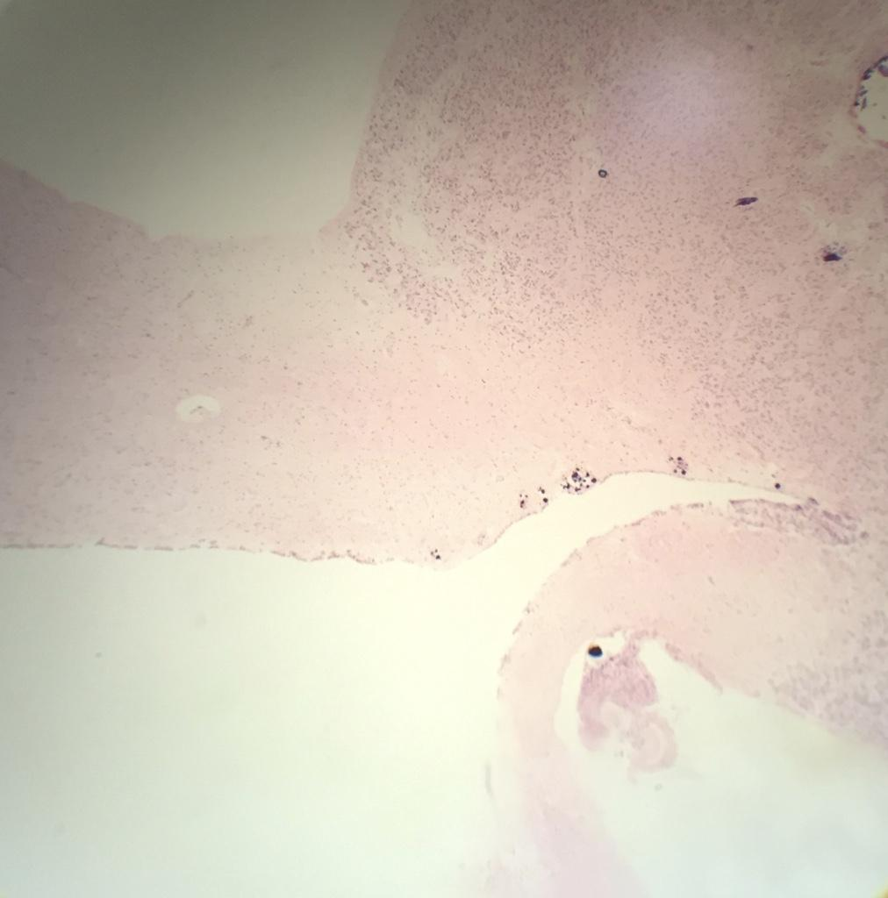
Anterior pituitary
anterior
posterior
Anterior Pituitary
The anterior pituitary manufactures seven hormones. The hypothalamus produces separate hormones that stimulate or inhibit hormone production in the anterior pituitary. Hormones from the hypothalamus reach the anterior pituitary via the hypophyseal portal system.

Slide 26
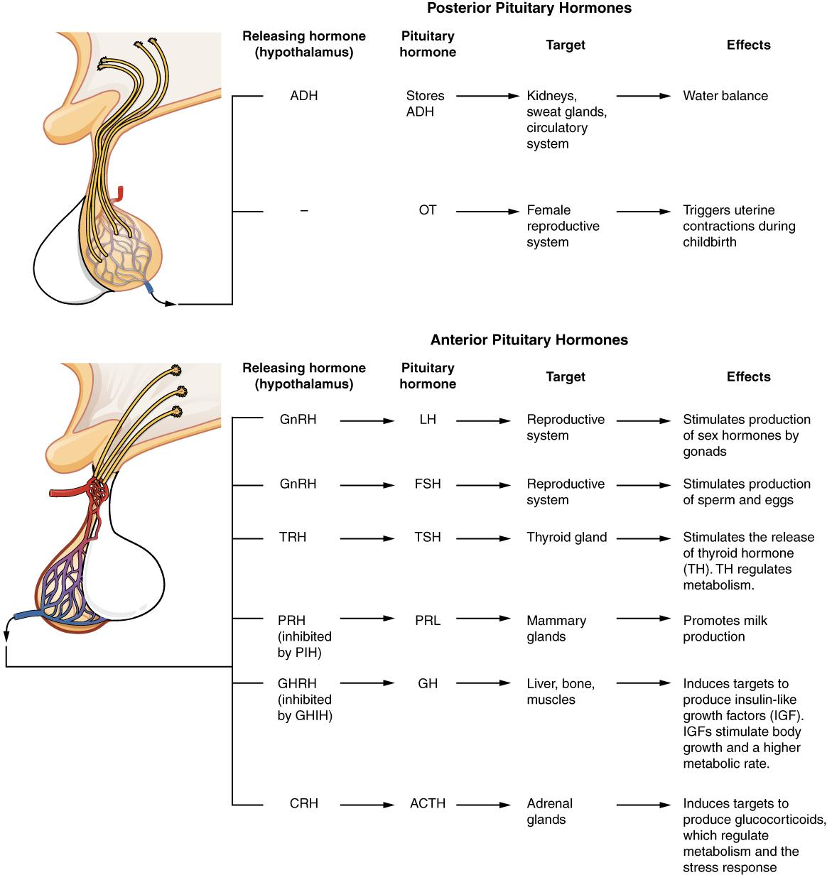
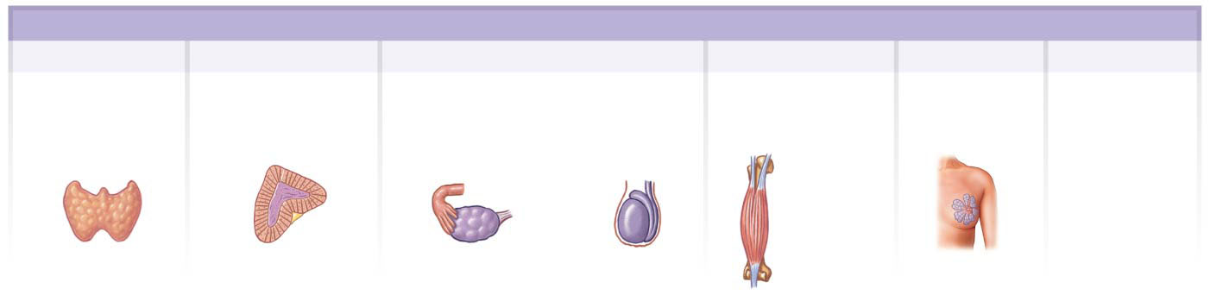
Major pituitary hormones
Hormones of the Anterior Lobe
TSH
ACTH
Gonadotropins (FSH and LH)
GH
PRL
MSH
Thyroid-
stimulating
hormone
Adreno-
corticotropic
hormone
Follicle-
stimulating
hormone
Luteinizing
hormone
Growth
hormone
Prolactin
Melanocyte-
stimulating
hormone
Musculo-
skeletal
system
Thyroid gland
Adrenal gland
Ovary
Testis
Mammary
gland

Slide 27
Anterior Pituitary
Several of the anterior pituitary hormones are tropic hormone or tropin (hormones that influence another endocrine gland)
Control
1) neurosecretory cells in the hypothalamus secrete releasing hormones and inhibiting hormone
2) negative feedback
Cell types
1) somatotrophs
2) lactotrophs
3) corticotrophs
4) thyrotrophs
5) gonadotrophs
Human Growth Hormone
Stimulates liver, muscle, cartilage, bone and other tissues to secrete insulin-like growth factors(IGFs) IGFs promote growth of body cells, protein synthesis, tissue repair, lipolysis, and elevation of blood glucose concentration
Stimulates somatomedins – promote bone and cartilage growth
Somatostatin inhibit growth hormone secretions
Hypersecretion in childhood causes giantism and in adults causes acromegaly. Most plentiful
Excessive - hyperglycemia Protein Secreted by Somatrophs Target – most tissues

Slide 28
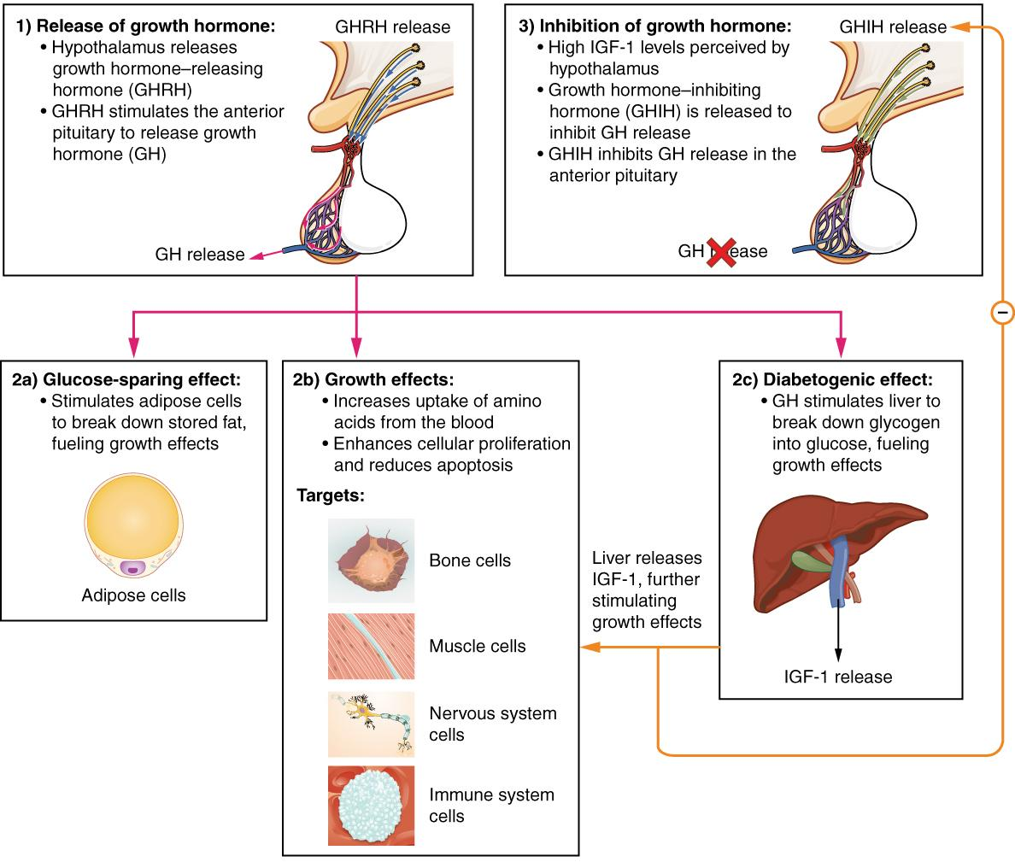
Growth hormone
Hormonal Regulation of Growth
Growth hormone (GH) directly accelerates the rate of protein synthesis in skeletal muscle and bones. Insulin-like growth factor 1 (IGF-1) is activated by growth hormone and indirectly supports the formation of new proteins in muscle cells and bone.

Slide 29
Anterior Pituitary
Thyroid Stimulating Hormone
Secreted by thyrothrophs Regulates thyroid hormones Controlled by thyrotropin releasing hormone Glycoprotein Target tissue is the thyroid gland
Follicle Stimulating Hormone
Secreted by gonadotrophs In females, initiates follicle development and secretion of estrogen in the ovaries In males, stimulates the production of sperm Glycoprotein Target tissue is females, follicles in ovaries; in males, seminiferous tubules
Prolactin
Secreted by lactotrophs Milk secretion Protein Sexual gratification after sexual acts Target tissue are the ovaries and mammary glands
Adrenocorticotrophic hormones
Secreted by corticotrophs Controls secretion of glucocorticoids Peptide Target tissue is the adrenal cortex
Melanocyte stimulating hormone
intermediate pituitary Secreted by melanotrophs Skin pigmentation Peptide Target tissue is melanocytes in the skin May regulate appetite and sexual behavior
Luteinizing Hormone
Secreted by gonadotrophs In females, stimulates the secretion of estrogen by the ovaries to result in ovulation and stimulated the corpus luteum to secrete progesterone In males, stimulate interstitial cells to secrete testosterone Glycoprotein Target tissue – ovaries in females; testes in males

Slide 30
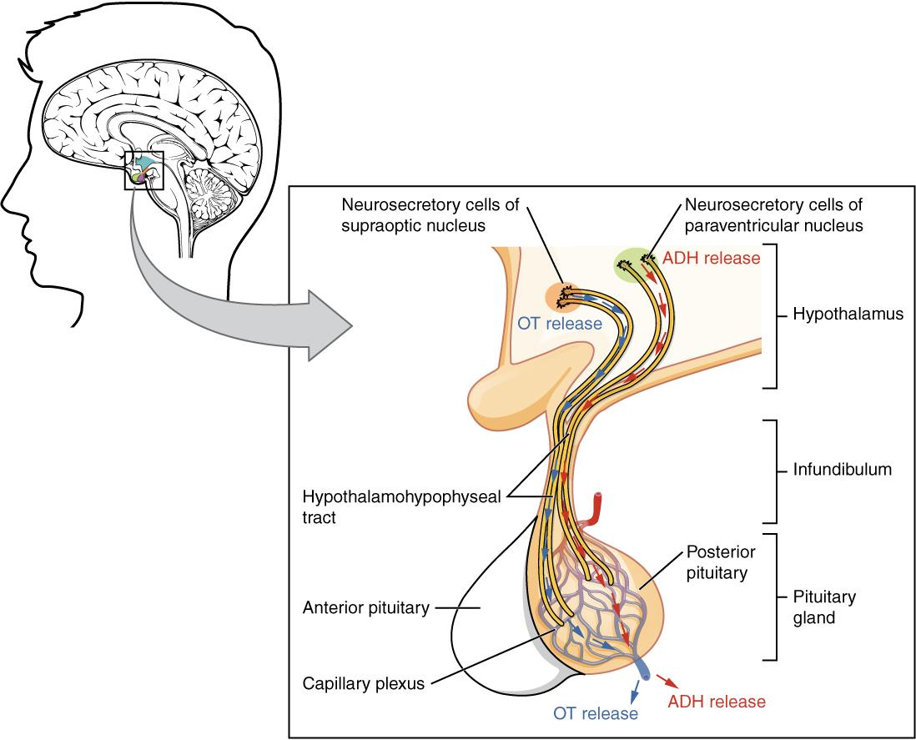
Posterior pituitary
anterior
posterior
Posterior Pituitary
Neurosecretory cells in the hypothalamus release oxytocin (OT) or ADH into the posterior lobe of the pituitary gland. These hormones are stored or released into the blood via the capillary plexus.

Slide 31
Posterior Pituitary (neurohypophysis)
Stores and releases two hormones
Oxytocin
Stimulates uterine contractions and milk-let-down involved in orgasm circadian homeostasis ( body temperature, activity level, wakefulness) magnocellular neurosecretory cells peptide target tissue is the uterus and mammary glands
Antidiuretic hormone
Stimulates water reabsorption by the kidneys and arteriolar constriction Effect is to decrease urine volume and conserve body water Controlled by osmotic pressure of the blood magnocellular neurosecretory cells in posterior pituitary parvocellular neurosecretory neurons in hypothalamus peptide target tissue is the kidneys

Slide 32
Pituitary hormones
Major Pituitary Hormones
Major pituitary hormones and their target organs.

Slide 33
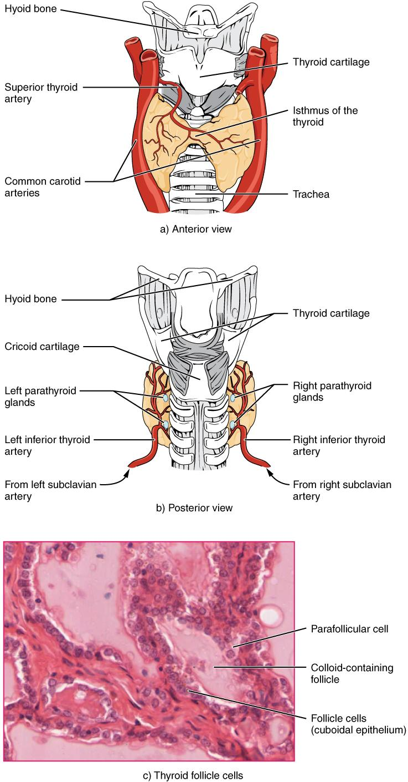
Thyroid gland
The thyroid gland is located in the neck where it wraps around the trachea.
  Contains large numbers of thyroid follicles
    Hollow spheres lined by simple cuboidal epithelium
    Follicle cavity holds viscous colloid (fluid packed with dissolved proteins)
    Into that colloid, follicle cells secrete a globular protein called thyroglobulin
      Molecule containing the amino acid tyrosine (building block of thyroid hormones)
    Network of capillaries surrounds each follicle, transporting nutrients, wastes, and secretory products
  C (clear) cells
    Between basement membrane of follicle cells
    Secrete hormone calcitonin (CT)
      Regulates Ca ion concentrations in body fluids

Slide 34
Effect of thyroid hormone on tissues
Increased rates of O₂ consumption and energy consumption, in children may cause rise in body temperature
Increased heart rate and force of contraction; generally results in a rise in blood pressure
Increased sensitivity to sympathetic stimulation
Maintenance of normal sensitivity of respiration centers to changes in O₂ ad CO₂ concentrations
Stimulation of RBC formation and thus enhanced O₂ delivery
Stimulation of activity in other endocrine tissues
Accelerated turnover of minerals in bone

Slide 35
Thyroid Gland
Located just below the larynx
Follicular cells – thyroxine and triiodothyronine
Parafollicular – calcitonin
Synthesized from iodine and tyrosine within thyroglobulin Thyroxin-binding globulin transports it The formation, storage, and release steps include iodide trapping, synthesis of thyroglobulin, oxidation of iodide, iodination of tyrosine, coupling of T1 and T2, pinocytosis and digestion of colloid, secretion of thyroid hormones, and transport in blood

Slide 36
Thyroid
Thyroid hormones
regulate oxygen use and basal metabolic rate, cellular metabolism and growth and development
Controlled by the levels of iodine
thyroxin and triiodothryonine thyroid epithelial cells thyroid follicles
follicular cells amine- tyrosine target tissue is most cells of the body T3 and T4 are transported in combination with plasma proteins in the circulatory system. 75% are bound to thyroxine-binding globulin, which is synthesized by the liver, and 20-30% are bound to other plasma proteins, including albumin.
Calcitonin
Lowers the blood calcium
Controlled by levels of calcium parafollicular cells or C cells polypeptide target tissue is bone decreased rate of breakdown of bone by osteoclasts

Slide 37
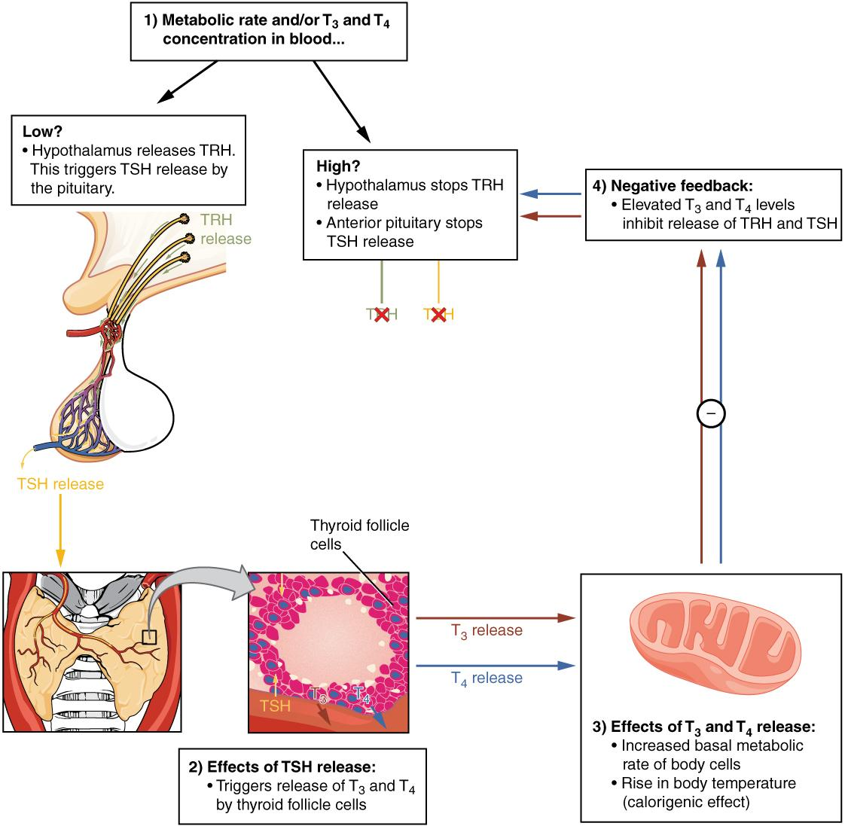
Negative feedback
Classic Negative Feedback Loop
A classic negative feedback loop controls the regulation of thyroid hormone levels.

Slide 38
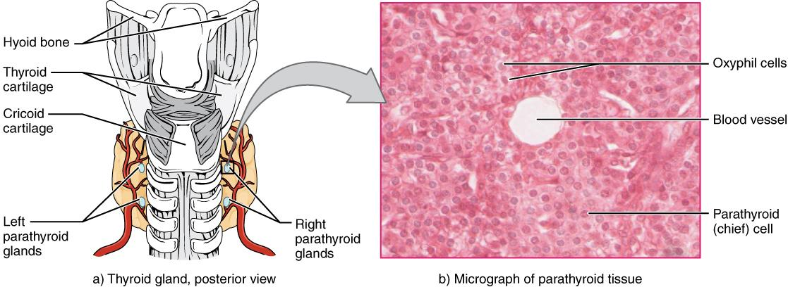
Parathyroid glands
Parathyroid Glands
The small parathyroid glands are embedded in the posterior surface of the thyroid gland. LM × 760. (Micrograph provided by the Regents of University of Michigan Medical School © 2012)

Slide 39
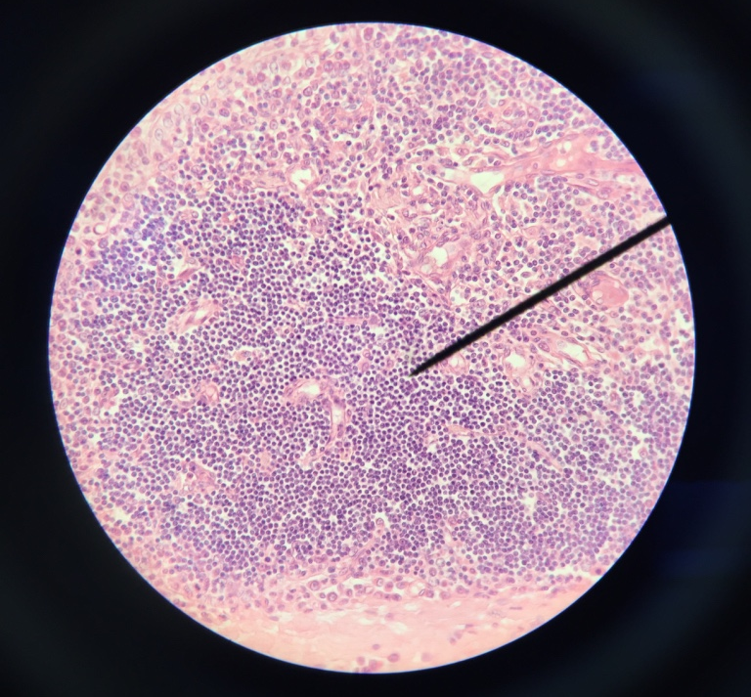
Parathyroid
Chief cells
Oxyphil cells
Thyroid gland

Slide 40
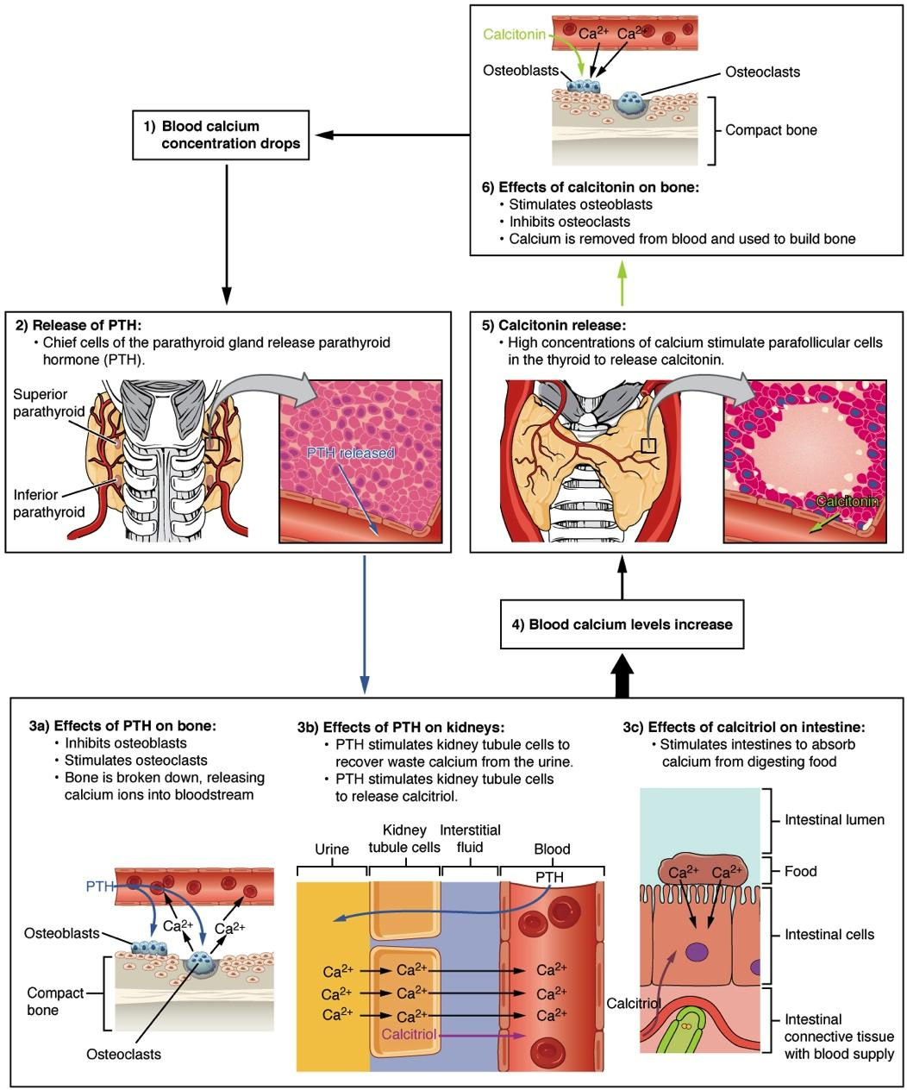
PTH and blood calcium
Parathyroid Hormone in Maintaining Blood Calcium Homeostasis
Parathyroid hormone increases blood calcium levels when they drop too low. Conversely, calcitonin, which is released from the thyroid gland, decreases blood calcium levels when they become too high. These two mechanisms constantly maintain blood calcium concentration at homeostasis.

Slide 41
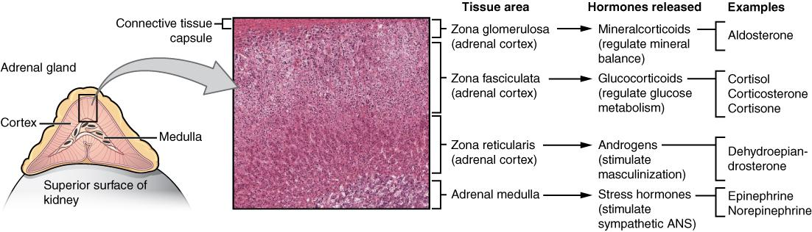
Adrenal glands
Adrenal Glands
Both adrenal glands sit atop the kidneys and are composed of an outer cortex and an inner medulla, all surrounded by a connective tissue capsule. The cortex can be subdivided into additional zones, all of which produce different types of hormones. LM × 204. (Micrograph provided by the Regents of University of Michigan Medical School © 2012)

Slide 42
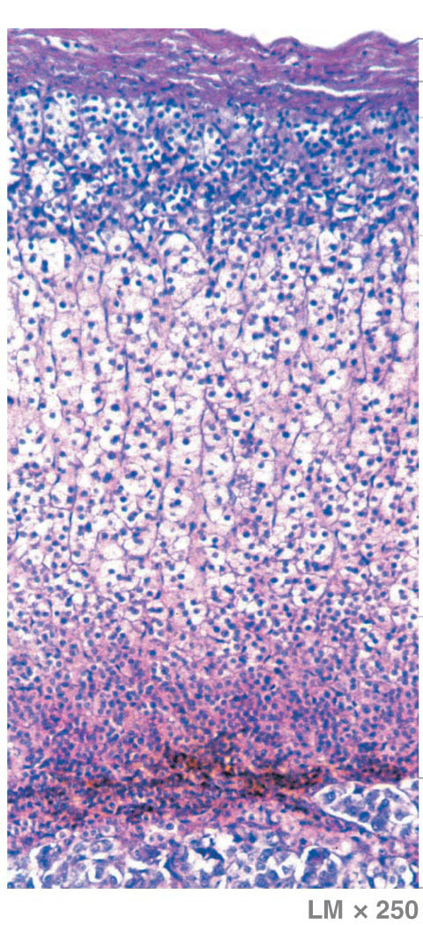
Micrograph of adrenal gland zones
Region/zone | Hormone | Primary Targets | Hormonal effects | Regulatory control
Adrenal Capsule
Adrenal Cortex
Zona glomerulosa (outer region of cortex) | Mineralocorticoids primarily aldosterone | kidneys | Aldosterone increases renal reabsorption of Na+ and water, especially in the presence of ADH. It also accelerates urinary loss of K+ | Mineralocorticoid secretion is stimulated by activating the renin-angiotensin-aldosterone system and inhibited by hormones opposing that system.
Zona fasciculata (large central portion of cortex) | Glucocorticoids are steroid hormones that affect glucose metabolism. The primary hormones are cortisol (hydrocortisone) and smaller amounts of corticosterone. The liver converts some cortisol to cortisone, another metabolically active glucocorticoid. | Most cells | Glucocorticoids increase rates of glucose and glycogen formation by the liver. They also stimulate release of amino acids from skeletal muscles, and lipids from adipose tissues, and they promote lipid catabolism within peripheral cells. These actions supplement the glucose-sparing effect of growth hormone. Cortisol also reduces inflammation. | Glucocorticoid secretion is stimulated by ACTH from the anterior lobe of the pituitary.
Zona reticularis (narrow band bordering each adrenal medulla) | Small quantities of androgens that may be converted to estrogens in the blood stream. | Skin, bones, and other tissues but min. effects in normal adults | Adrenal androgens stimulate the development of pubic hair in boys and girls before puberty. | Androgen secretion is stimulated by ACTH
Adrenal medulla | Epinephrine (E), norepinephrine (NE) | Most cells | Epinephrine and norepinephrine increase cardiac activity, blood pressure, glycogen breakdown, and blood glucose levels. | Epinephrine and norepinephrine secretion is stimulated by sympathetic preganglionic fibers during sympathetic activation.
Adrenal gland
3

Slide 43
What are the effects of Adrenaline?
        Signals the liver and skeletal muscle cells to convert glycogen into glucose, resulting in increased blood glucose levels.
        These hormones increase the heart rate, pulse, and blood pressure to prepare the body to fight the perceived threat or flee from it.
        Dilates the airways, raising blood oxygen levels.
        Prompts vasodilation, further increasing the oxygenation of important organs such as the lungs, brain, heart, and skeletal muscle.
        Triggers vasoconstriction to blood vessels serving less essential organs such as the gastrointestinal tract, kidneys, and skin, and downregulates some components of the immune system.
        Other effects include a dry mouth, loss of appetite, pupil dilation, and a loss of peripheral vision.
Adrenaline video

Slide 44
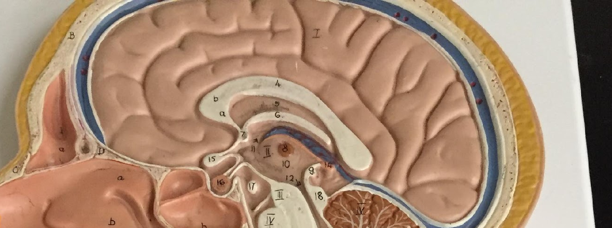
The Pineal Gland
  Part of epithalamus
  Lies in posterior portion of third ventricle roof
  Contains neurons, neuroglia, and secretory cells called pinealocytes
    Pinealocytes produce melatonin from molecules of serotonin (a neurotransmitter)
    Collaterals from the visual pathway enter the pineal gland and affect rate of melatonin production
      Rate lowest during daylight and highest at night
Pineal gland

Slide 45
The Pineal Gland
Functions of melatonin
  Inhibiting reproductive functions
    May play role in timing of human sexual maturation
      Melatonin levels decline at puberty
      Pineal tumors stopping melatonin production cause premature puberty in young children
  Protecting against damage by free radicals
    Very effective antioxidant
    May protect CNS from free radicals such as nitric oxide (NO) or hydrogen peroxide (H₂O₂) formed in active neural tissue
  Setting circadian rhythms
    Pineal activity is cyclical
    Daily changes in physiological processes follow a regular day/night pattern
    Melatonin secretion increases in darkness
      Suggested as primary cause of seasonal affective disorder (SAD)
        Condition can develop during the winter in people living at higher latitudes (shorter days, less sunlight)
        Characterized by changes in mood, eating habits, and sleeping patterns
Melatonin video

Slide 46
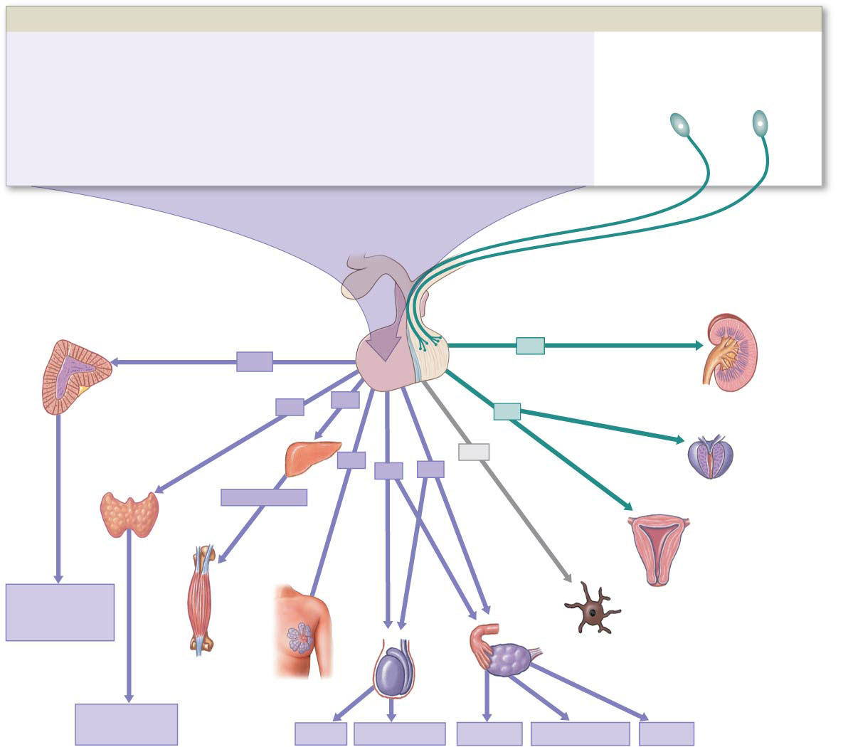
Gonadal and placental glands
Ovaries produce:
Estrogen – regulates secondary sex characteristics
Progesterone – stimulates uterus to thicken and vascularize in preparation for implantation of embryo
Testes produce:
Testosterone – regulates secondary sex characteristics, normal sex behaviors and production of sperm
Inhibin – inhibits release of FSH and GnRH when sperm counts are high
Placenta produces:
hCG (human chorionic gonadotrophic) – aids in maintaining pregnancy and keeping corpus luteum intact

Slide 47
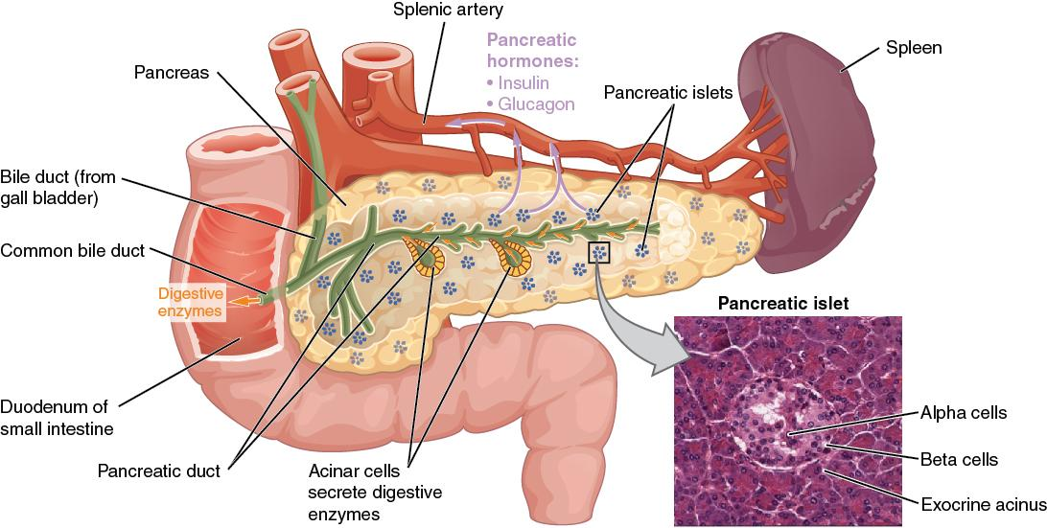
Pancreas
Pancreatic acini (exocrine cells)
Sodium bicarbonate
Proteases
Pancreatic amylase
Pancreatic lipase
Pancreatic nuclease
Pancreas
The pancreatic exocrine function involves the acinar cells secreting digestive enzymes that are transported into the small intestine by the pancreatic duct. Its endocrine function involves the secretion of insulin (produced by beta cells) and glucagon (produced by alpha cells) within the pancreatic islets. These two hormones regulate the rate of glucose metabolism in the body. The micrograph reveals pancreatic islets. LM × 760. (Micrograph provided by the Regents of University of Michigan Medical School © 2012)

Slide 48
Pancreatic islets – endocrine cells
  Alpha cells
    Secrete glucagon
      Raises blood glucose
        Increases rate of glycogen breakdown and glucose release by liver
  Beta cells
    Secrete insulin
      Lowers blood glucose
        Increases glucose uptake and utilization by cells
        Increases glycogen production in liver and skeletal muscles
  Delta cells
    Produce peptide hormone identical to growth hormone–inhibiting hormone (GH–IH)
      Suppresses release of glucagon and insulin
      Slows rates of food absorption and enzyme secretion in intestinal tract
  PP cells
    Produce pancreatic polypeptide (PP)
      Inhibits gallbladder contraction
      Regulates production of some pancreatic enzymes
      May help control rate of nutrient absorption

Slide 49
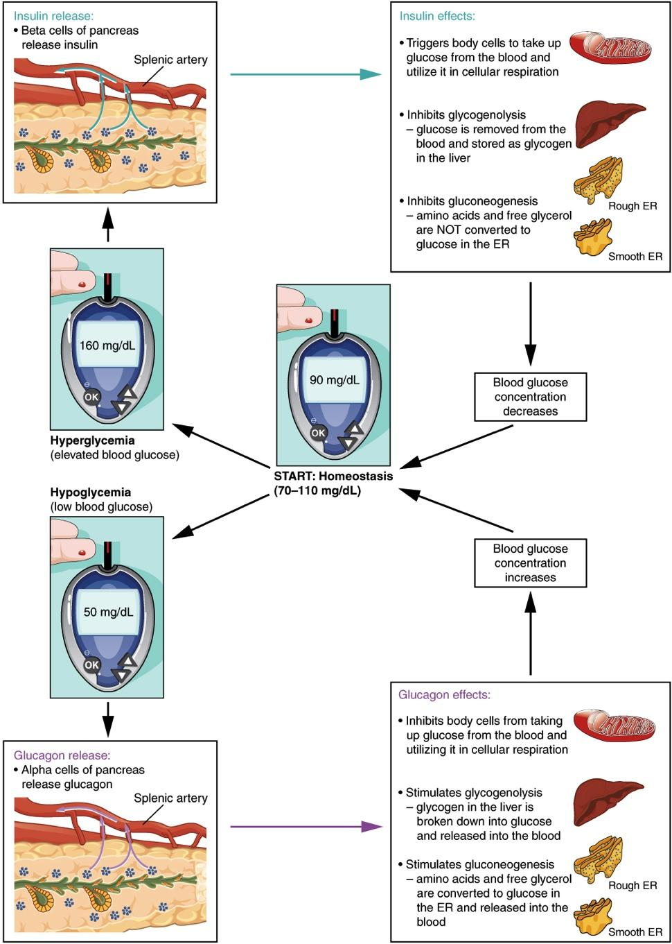
Regulating blood glucose levels
Homeostatic Regulation of Blood Glucose Levels
Blood glucose concentration is tightly maintained between 70 mg/dL and 110 mg/dL. If blood glucose concentration rises above this range, insulin is released, which stimulates body cells to remove glucose from the blood. If blood glucose concentration drops below this range, glucagon is released, which stimulates body cells to release glucose into the blood.
Pancreas video
insulin

Slide 50
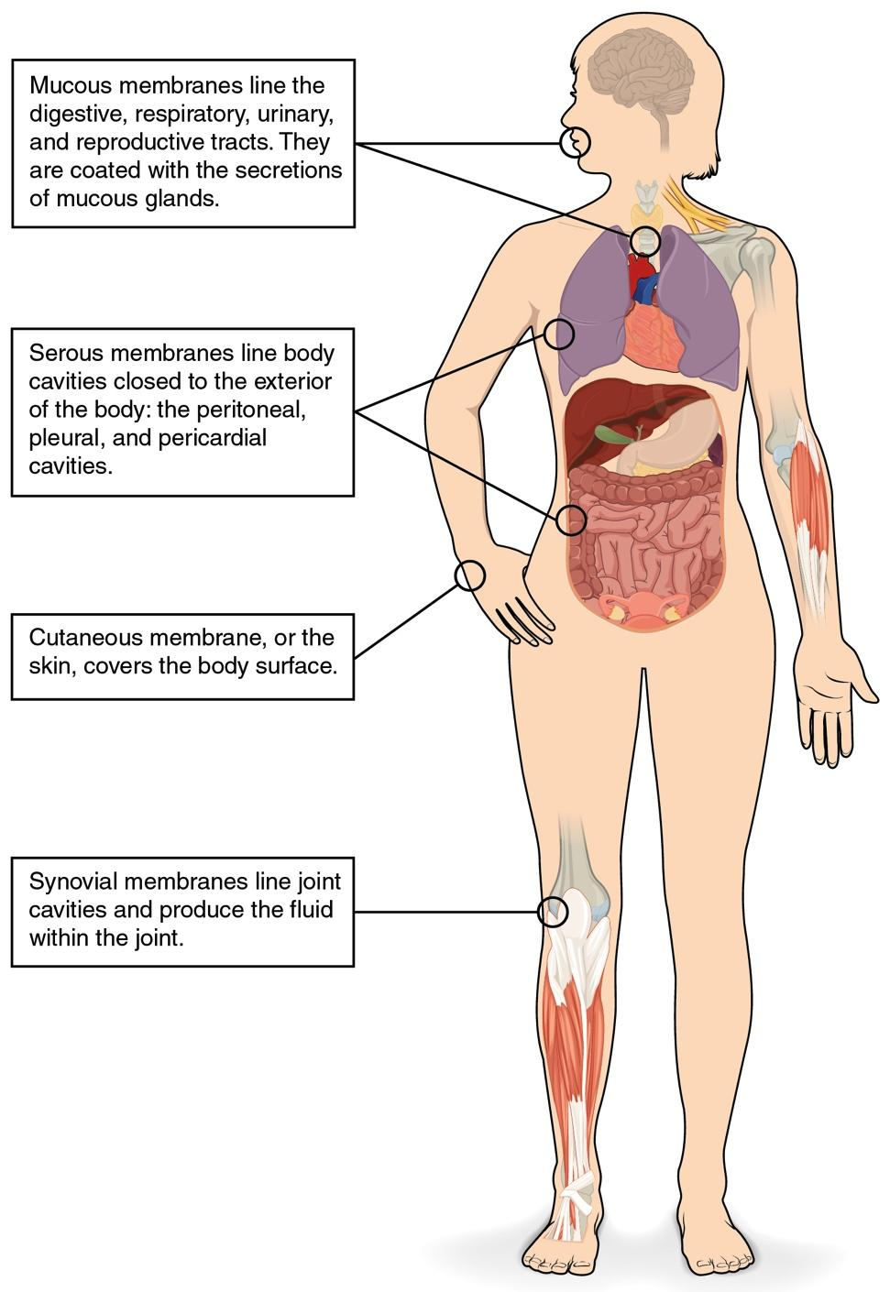
Organs with secondary endocrine function
GI
Heart – secretes ANP inhibiting aldosterone
Gastrointestinal tract – produces secretin, gastrin, CCK, GIP, VIP, ghrelin, galanin and neuropeptide Y….
Kidney – secretes EPO and renin
Skeleton – produces FGF23 and osteocalcin
Adipose tissue – releases leptin
Skin – produces cholecalciferol inactive vitamin D
Thymus – thymosin essential of development of T lymphocytes
Liver – secretes ILGF, Angiotensinogen, Thrombopoetin, Hepcinogin
Thymus
Heart
Liver
Kidney
Skin
Adipose
Skeleton

Slide 51
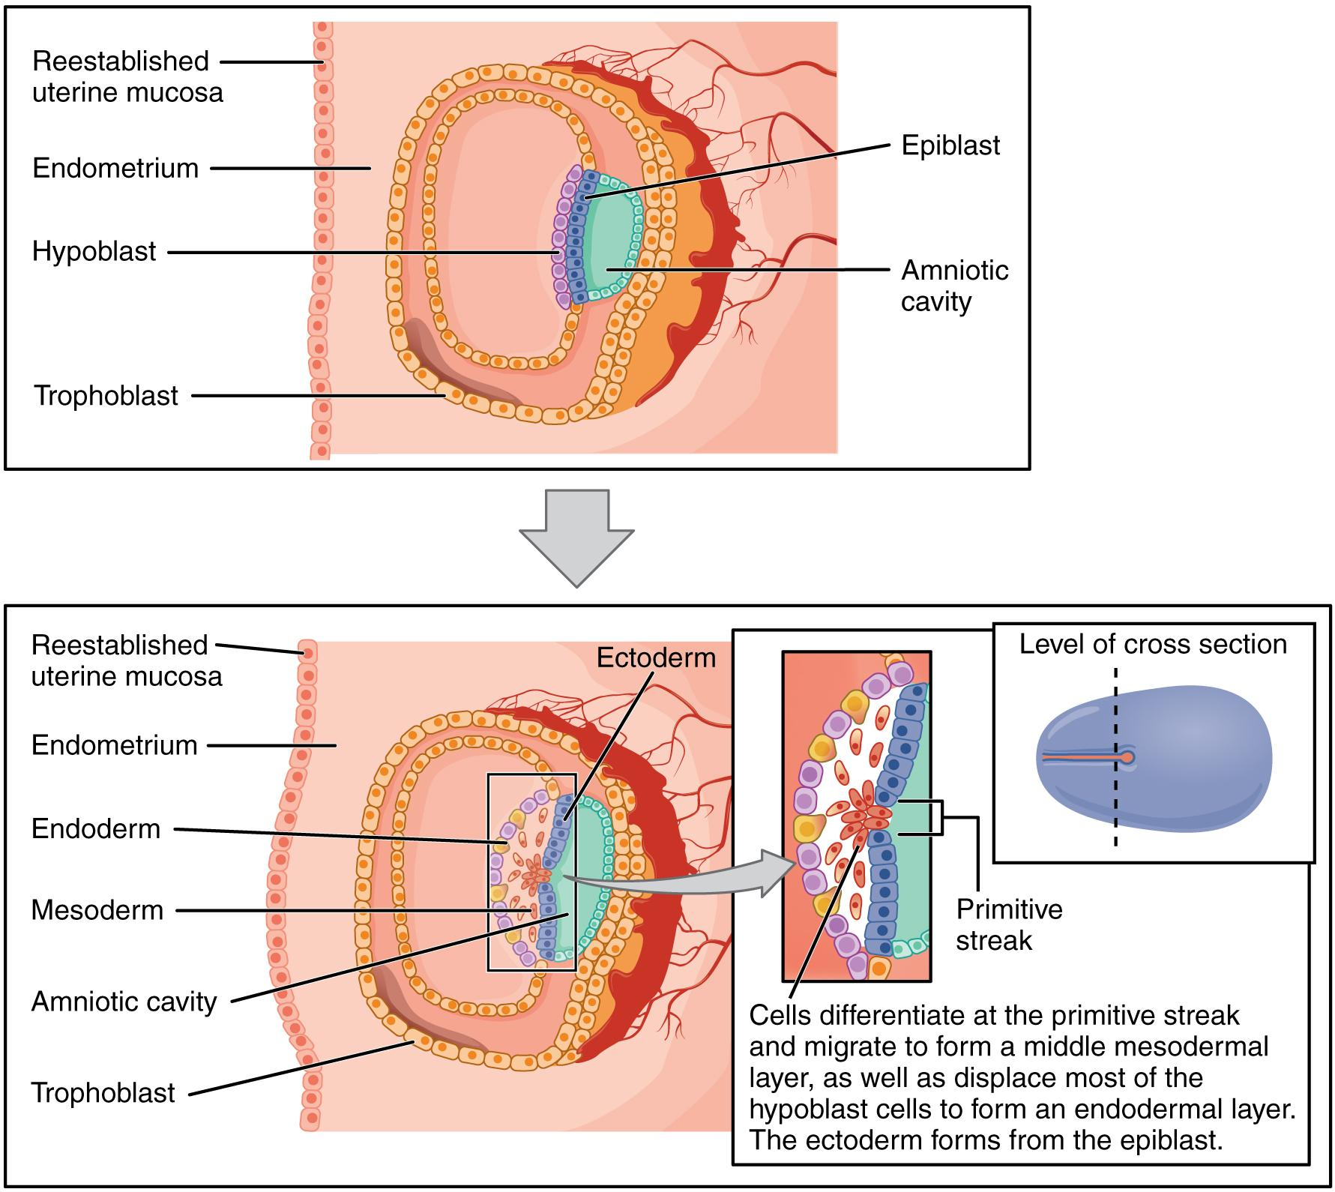
Development and aging
Endoderm – thyroid, parathyroid, pancreas and thymus
Mesoderm – gonads and adrenal cortex
Ectoderm – pituitary gland, pineal gland, adrenal medulla
Germ Layers
Formation of the three primary germ layers occurs during the first 2 weeks of development. The embryo at this stage is only a few millimeters in length.

Slide 52
Hormone | Underproduction or tissue insensitivity | Principle signs and symptoms | Overproduction or tissue hypersensitivity | Principle signs and symptoms
Growth hormone (GH) | Pituitary growth failure | Delayed growth, abnormal fat distribution, low blood glucose hours after meal | Gigantism, acromegally | Excessive growth
Antidiuretic hormone (ADH) | Diabetes insipidus | Polyuria, dehydration, thirst | Syndrome of Inappropriate ADH secretion (SIADH) | Increased body weight and water content
Thyroxin (T₃) and Triiodothyronine (T₄) | Hypothyroidism | Low metabolic rate, low body temp., impaired physical and mental development | Hyperthyroidism, Graves disease | High metabolic rate and body temp.
Parathyroid hormone (PTH) | Hypoparathyroidism | Muscle weakness, neurological problems, dense bones, tetany | Hyperparathyroidism | Neurological, mental, and muscular problems due to high blood Ca concentration, weak and brittle bones
Insulin | Diabetes melllitus Type I | High blood glucose, impaired glucose utilization, dependence on lipids for energy, glycosuria | Excess insulin production (also caused by administering too much insulin) | Low blood glucose levels, possibly causing coma
Mineralcorticoids Ex: Aldosterone | Hypoaldosteronism | Polyuria, low blood volume, high blood K⁺ and low blood Na⁺ conc. | Aldosteronism | Increased body weight due to Na⁺ and H₂O retention, low K⁺
Glucocorticoids Ex: Cortisol | Addison’s disease | Inability to tolerate stress, mobilize energy reserves or maintain normal blood glucose concentrations | Cushing’s disease | Excessive breakdown of tissue proteins and lipid reserves, impaired glucose metabolism
Epinephrine (E) and Norepinephrin (NE) | None | None | Pheochromocytoma | High met. rate, body temp, and heart rate, increased glucose
Estrogens | Hypogonadism | Sterility, lack of secondary sex char. | Andrenogenital syndrome /precocious puberty | Overproduction of androgens by zona reticularis, leads to masculinization/ premature sexual maturation and behavior
Androgens | Hypogonadism | Sterility, lack of secondary sex char. | Andrenogenital syndrome (gynocomastia)/precocious puberty | Overproduction of estrogens sometimes due leads to adrenal or interstitial tumor, breast enlargement/ premature sexual maturation and behavior

Slide 53
Stress
Stages
1. Alarm Reaction a. nerve impulses from the hypothalamus to the sympathetic division b. fight or flight response
2. Resistance reaction
a. regulating hormones
b. corticotropin releasing hormone, growth hormone releasing hormone and thyrotropin releasing hormone
c. increase secretion of adrenocorticotrophic hormones
d. long-term and accelerate catabolism to provide energy to counteract stress
e. glucocorticoids increase during stress
3. Exhaustion
a. results from dramatic changes during alarm and resistance reaction
b. caused mainly by loss of potassium, depletion of adrenal glucocorticoids, and weakened organs
Productive stress – eustress
Harmful stress – distress
Stressors
Environmental
Surgical
Poisons
Emotional
Infections
Fevers

Slide 54
Stress and Disease
1. Acromegaly – excess growth hormone, adults in early 20s
2. Addison’s – insufficient amounts of steroid hormones
3. Cushing’s syndrome – high levels of cortisol
4. Diabetes insipidus – deficiency of ADH
5. Diabetes mellitus – high blood sugar or low insulin
6. Endemic goiter – iodine deficiency
7. Giantism – increased growth hormone in children
8. Hypoglycemia – increase in insulin
9. Myxedema – prolonged hypothyroidism
10. Grave’s disease – overactive thyroid

Slide 55
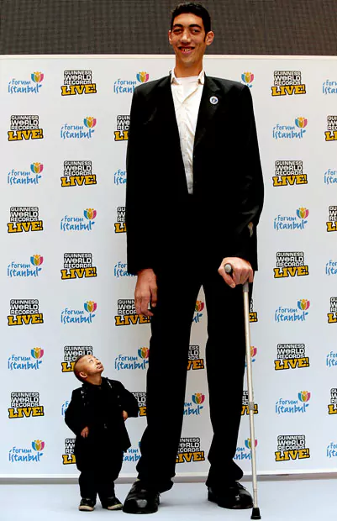
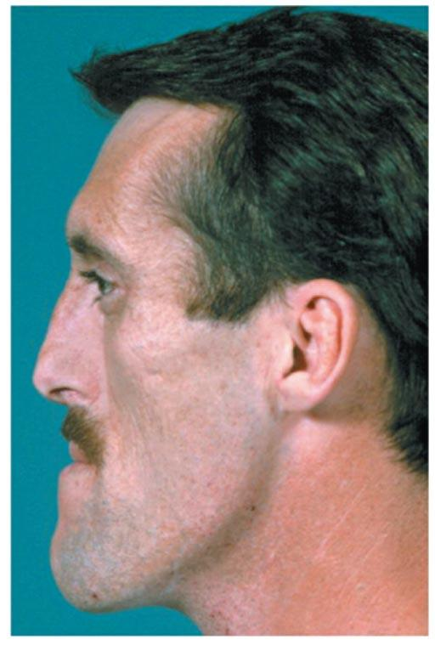
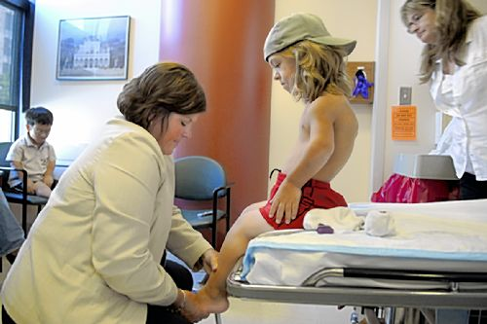
Dwarfism vs Gigantism
Pituitary Dwarfism
Acromegally
Pituitary Gigantism
Guinness Book of World Records: World’s Shortest Man (He PingPing) and Tallest Man (Sultan Kosen)

Slide 56
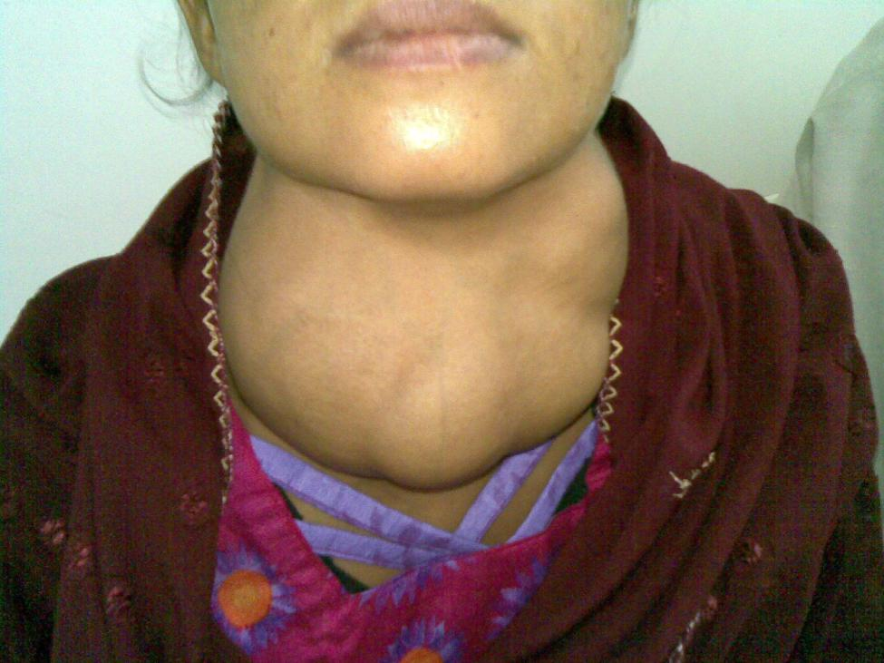
Goiter
Goiter
(credit: “Almazi”/Wikimedia Commons)

Slide 57
Preparation and Work Due
  Reading Assignment:
  Textbook: Read CH 1 in the course textbook
  Complete the Module 1 Quiz and Module 1 Case Study
See Module 1 for more information & assignments
Presented in accordance with the National Association of Biology Teachers and the National Research Council (Cheesman et al., 2007).
Figures (unless otherwise cited) originated from: OpenStax College, Rice University. 2022. Anatomy and Physiology 2e.

