Slide 1

Introduction & Lab Safety
Anatomy and Physiology II Lab
Notes:
‹#›
Welcome to Human Anatomy II Lab. My name is [Your Name], and this session covers the course intro and essential safety guidelines. We’ll explore what you can expect this semester and how to stay safe in our lab environment.

Slide 2
Introduction & Lab Safety
  Instructor Can Edit As Needed:
Include information here about the instructor
Contact Information
Prefered method for students to contact instructor
Office location/office hours
Classroom location
Other general course guidelines
Notes:
‹#›

Slide 3
Course Learning Objectives
  Structure and function of the:
Endocrine system
Circulatory system- heart, blood, and blood vessels
Lymphatic system
Respiratory system
Digestive system
Urinary system
Female and Male Reproductive systems
Pregnancy and Embryology

Slide 4
Resources and Information
Textbook:
Anspaugh, K.; Davis, J.O.; Dorsey, W.; Menard-Harvey, S.; Messerli, T.; Simms, D.; and T. Johnson. 2025. Human Anatomy and Physiology II. Pressbooks Publishing
Lab Manual:
Anspaugh, K.; Davis, J.O.; Dorsey, W.; Menard-Harvey, S.; Messerli, T.; Simms, D.; and T. Johnson. 2025. Human Anatomy and Physiology II Lab Manual. Pressbooks Publishing
Course Materials on Moodle:
- News Forum, Syllabus, Course Calendar
PowerPoint slides
Exams, Quizzes, and Assignments

Slide 5
Introduction & Lab Safety
The Learning Objectives for this unit include:
Identify the characteristics & appropriate uses of a Biosafety Level 1 (BSL-1) laboratory, including the types of agents handled & safety precautions required
Demonstrate proper use and location of essential laboratory safety equipment, including fire extinguishers, fire blankets, safety showers, and eye wash stations
Describe appropriate personal protective equipment (PPE) and dress code requirements necessary for safe conduct in a BSL-1 lab environment
Apply proper procedures for handling laboratory equipment, reporting incidents, and maintaining a clean and safe workspace
Differentiate between waste disposal methods for biohazard, sharps, and regular trash based on the material type and associated risk

Slide 6

Lab Safety
The Anatomy & Physiology II Lab is a BSL-1 Lab:
Lowest level of biosafety, low-risk agent
No unauthorized experiments
Instructor supervision is mandatory
Work with non-pathogenic microorganisms
Educational and preliminary research use
Notes:
We operate at Biosafety Level 1. BSL‑1 is about baseline safety, meaning only agents that don’t cause disease in healthy adults. Everything you do must be under guidance—no side experiments.

Slide 7
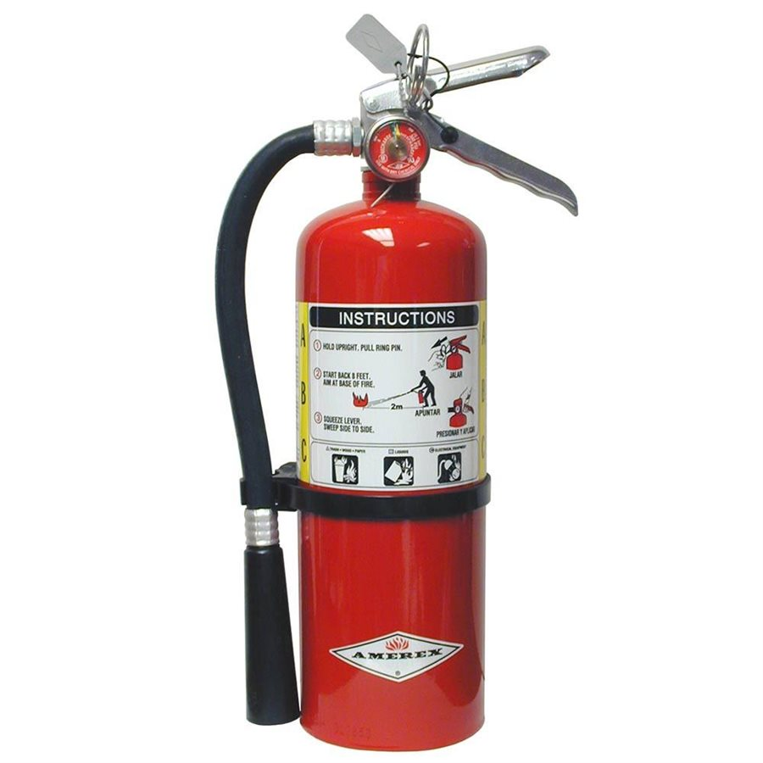
Lab Safety
Know the Location/Use of:
Fire extinguisher
Fire blanket
Safety shower
Eye wash
First aid kit
R.A.C.E. (large fire): Rescue, Alarm, Contain, Extinguish/Evacuate
P.A.S.S. (extinguisher): Pull, Aim, Squeeze, Sweep
www.unitedfire.net
Notes:
Before you start, you need to know where all safety gear is and how it works. We’ll have a tour of the lab equipment shortly. We use R.A.C.E. for full-blown emergencies and P.A.S.S. for extinguisher use. Know these acronyms—they’re critical in case of fire.

Slide 8
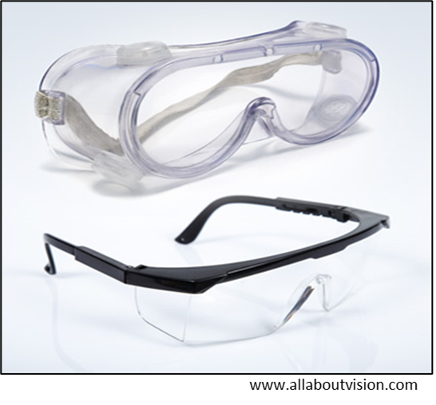
Lab Safety
Personal Protective Equipment (PPE):
Pants, closed-toe shoes, lab coat
Hair tied back, minimal jewelry
Safety glasses with side shields
Gloves required; report allergies
Notes:
Your attire and PPE protect you and maintain lab integrity. Notify me if you have allergies to gloves so we can adjust accordingly.

Slide 9
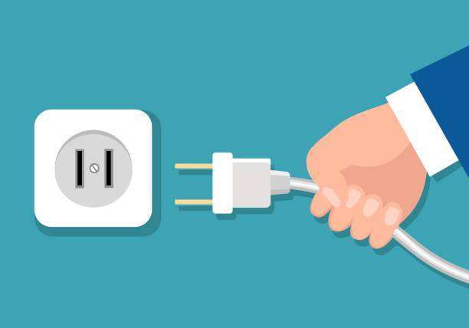
Lab Safety
Equipment Handling:
Use equipment only when directed
Clean and return properly
Turn off and unplug
Report malfunctions and re-supply needs
www.istockphoto.com
Notes:
Respect the lab equipment. Always clean up, disconnect, and flag any issues or shortage so we can maintain everything properly.

Slide 10
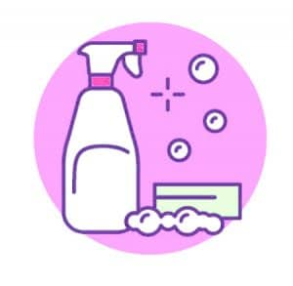
Lab Safety
Housekeeping:
Keep benches and aisles clear
Disinfect before/after use
No food, drinks, gum, cosmetics
Store personal items securely
www.laboratoryinfo.com
Notes:
A clean workspace is a safe workspace. Keep your area clutter-free and hygienic—and no eating or drinking in the lab.

Slide 11
Lab Safety
Biohazard Bins:
Blood/tissue paperware
Cultures, gloves, contaminated plastic
Sharps:
Needles, lancets, scalpel blades
Glass pipettes, slides, razor blades
Regular Trash:
Non-contaminated paper, wrappers, packaging
Clear/white liner bags
Notes:
Anything contaminated with biological material goes in the biohazard container—we’ll cover labeling and handling procedures in detail.
If it can puncture, it belongs in the sharps bin—not the trash. This protects everyone from accidental cuts or exposure.
Only clean, non-lab items go into regular trash. Everything else gets proper disposal to maintain safety.

Slide 12
Lab Safety
Health & Safety:
Immunocompromised students consult physician
Report allergies to instructor
Acknowledge safety rules before use
Any questions or concerns?
Notes:
Your health is a priority—if you're immunocompromised or allergic, discuss it with me. You’ll acknowledge these rules before lab work begins.
Open the floor for any questions or concerns

Slide 13
Preparation and Work Due
Reading Assignment:
Syllabus
Lab Manual: Introduction & Lab Safety
See the Introduction & Lab Safety Moodle module for more information and mandatory Introduction & Lab Safety Quiz
Presented in accordance with the National Association of Biology Teachers and the National Research Council (Cheesman et al., 2007).
Figures (unless otherwise noted) originated from: Anspaugh, K.; Davis, J.O.; Dorsey, W.; Menard-Harvey, S.; Messerli, T.; Simms, D.; and T. Johnson. 2025. Human Anatomy and Physiology II Lab Manual. Pressbooks Publishing

