Slide 1
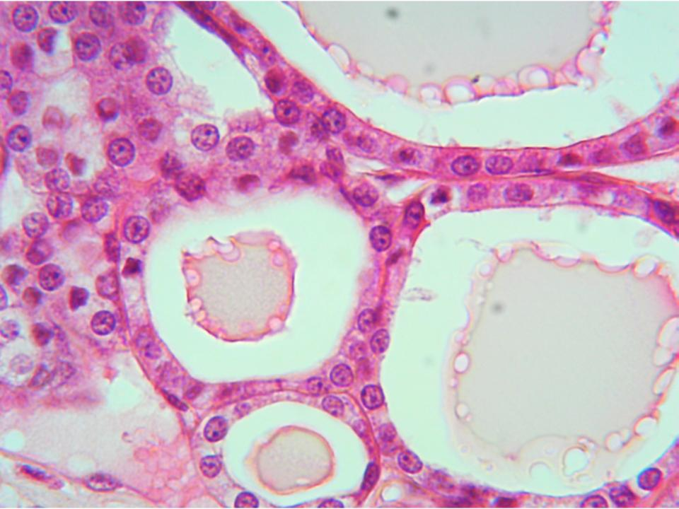
Lab 1: The Endocrine System
Anatomy and Physiology II Lab
Notes:
‹#›

Slide 2
Lab 1: The Endocrine System
The Learning Objectives for this unit include:
Describe the overall function of the endocrine system
Describe functions of endocrine organs
Identify endocrine structures in models and specimens
Identify histological features under the microscope
List major hormones and their sources

Slide 3
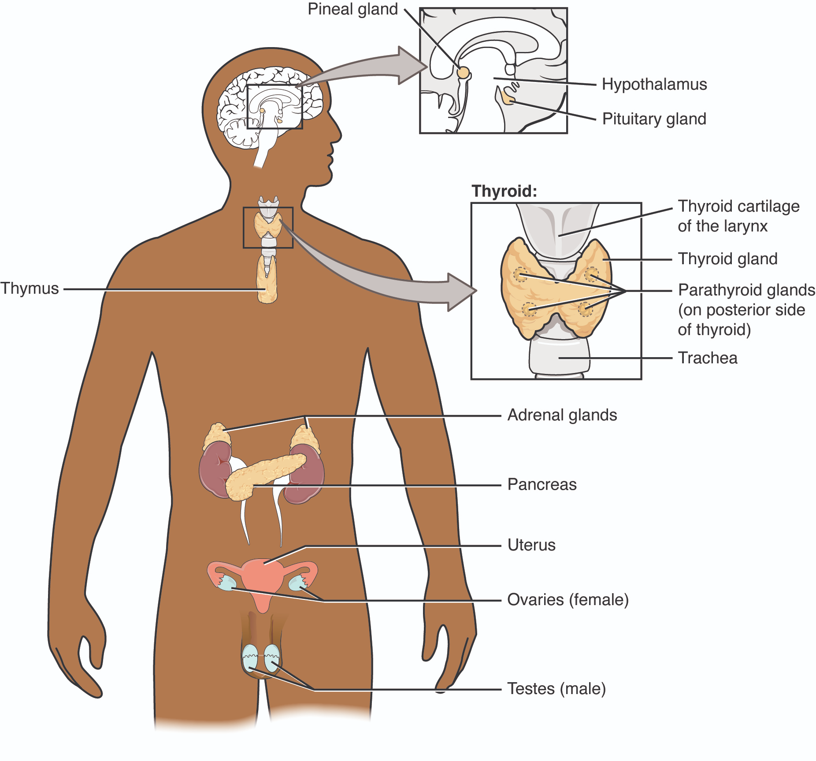
Endocrine System Organ Functions
Secretes hormones into the bloodstream
Includes glands like the pituitary, thyroid, adrenals, pancreas
Also includes other organs with endocrine cells (e.g., kidneys, heart, gonads)
Notes:
The endocrine system is a hormone-secreting network that helps maintain homeostasis. Some organs are purely endocrine, while others have mixed roles.

Slide 4
Hormones and Their Classification
Amino acid-based: amines, peptides, proteins (e.g, TRH, CRH, GHRH, GH, ACTH, TSH, ADH, T3, T4, PTH, ANP)
Steroid-based: cholesterol-derived (e.g., cortisol, androgens, estrogen, testosterone, progesterone, calcitriol)
Lipid-soluble: steroid, thyroid, calcitriol
Water-soluble: insulin, glucagon, GH, ADH, oxytocin, PTH, epinephrine, norepinephrine, melatonin
Notes:
Hormones vary by structure and solubility. These differences determine how they act on cells—either via membrane-bound or intracellular receptors.

Slide 5
Hormones and Their Classification
Endocrine Gland | Hormone | Function of Hormone
Hypothalamus | Releasing and inhibiting hormones | Controls pituitary gland
Pituitary Gland
Anterior lobe | GH (Growth hormone) | Cell division and tissue growth
 | FSH (Follicle stimulating hormone) | Female: ovarian follicle growth Male: Sperm production
 | ACTH (adrenocorticotropic hormone) | Stimulate secretion of adrenal gland cortex hormones
 | TSH (Thyroid stimulating hormone) | Stimulate synthesis and secretion of thyroid hormones
 | LH (luteinizing hormone) | Female: triggers ovulation Male: testosterone production
 | Prolactin | Milk production
Posterior lobe | Oxytocin | Milk let-down, uterine contraction
 | ADH (anti-diuretic hormone) | Increase water reabsorption by kidney
Pineal gland | Melatonin | Circadian rhythms (sleep/wake cycles)

Slide 6
Hormones and Their Classification
Endocrine Gland | Hormone | Function of hormone
Ovaries (follicular cells) | Estrogen | Female sex characteristic development; development of endometrium
 | Progesterone | Development of endometrium; support of pregnancy (corpus luteum)
Testes | Testosterone | Male sex characteristic development; sperm production
Thyroid Gland | T3 and T4 | Increase metabolism and body temperature
 | Calcitonin | Decrease blood calcium
Parathyroid Glands | PTH (parathyroid hormone) | Increase blood calcium
Pancreas: Alpha cells | Glucagon | Increase blood glucose
Beta cells | Insulin | Decrease blood glucose
Adrenal Gland: Cortex | Mineralocorticoids (aldosterone) | Increase Na+ (and, therefore,water) reabsorption by kidney
 | Glucocorticoids (cortisol) | Long term response to stress / decrease immune response; regulates glucose metabolism
 | Androgens (sm. amts) | estrogen/testosterone secretion

Slide 7
Pre-Lab Activities
Read the Chapter 1: Endocrine System in the textbook
Review the Introduction and Background sections of the lab manual Chapter 1
Complete the Pre-Lab Exercises (1.1-1.3) and use your answers to complete the Module 1 Quiz on Moodle
Notes:
Use anatomical models to identify major endocrine structures. Label carefully and refer to figures if needed. Confirm with your instructor once completed.

Slide 8
Lab Exercise 1.1: Exploring Endocrine Structures in Models
Materials: Brain, torso, reproductive system models
In the brain model (or Figure 1.2 in the lab manual), identify & label: thalamus, hypothalamus, pituitary gland, pineal gland, and infundibulum
In the torso and reproductive system models (or Figures 1.3-1.5 in the lab manual), identify & label: thyroid, adrenals, pancreas, and gonads (ovaries/testes)
Complete table and get instructor verification
Notes:
Use anatomical models to identify major endocrine structures. Label carefully and refer to figures if needed. Confirm with your instructor once completed.

Slide 9
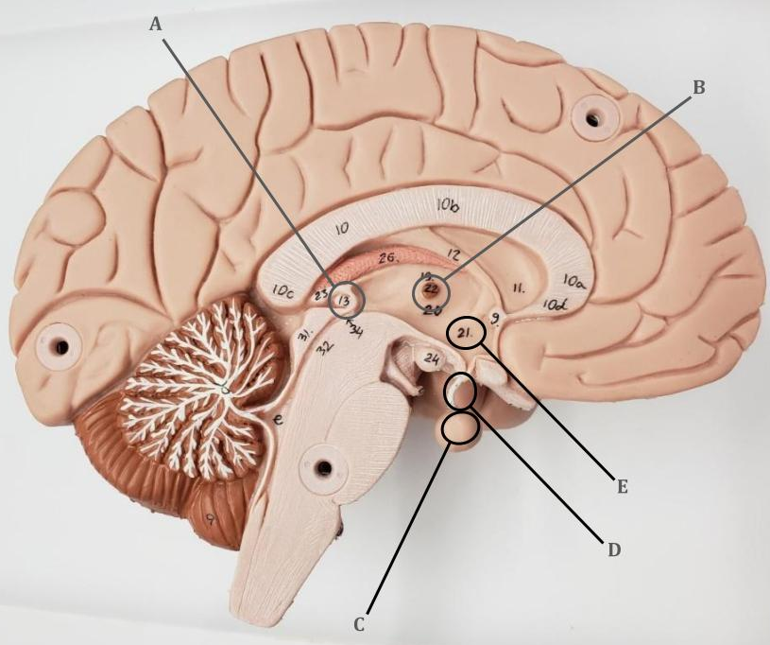
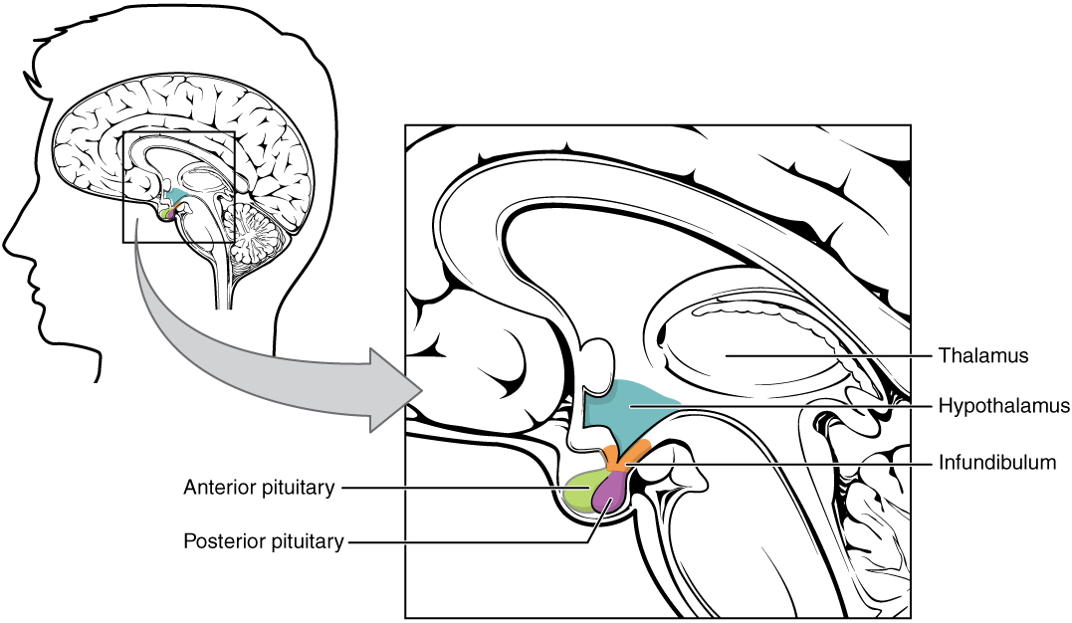
Endocrine Structures of the Brain

Slide 10
Thalamus and Hypothalamus
Thalamus: Sensory relay center that processes and transmits information to the cerebral cortex
Coordinates with the hypothalamus in autonomic and emotional regulation
Hypothalamus: Link between nervous and endocrine systems
Regulates homeostasis (e.g., body temperature, hunger, stress response)
Produces hormones that control the anterior pituitary gland, e.g., TRH → TSH → T3/T4 pathway influencing thyroid function
Works with pituitary as master regulator of endocrine system
Notes:
This axis controls many hormonal pathways. The anterior pituitary acts as the master gland, responding to releasing/inhibiting hormones from the hypothalamus.

Slide 11
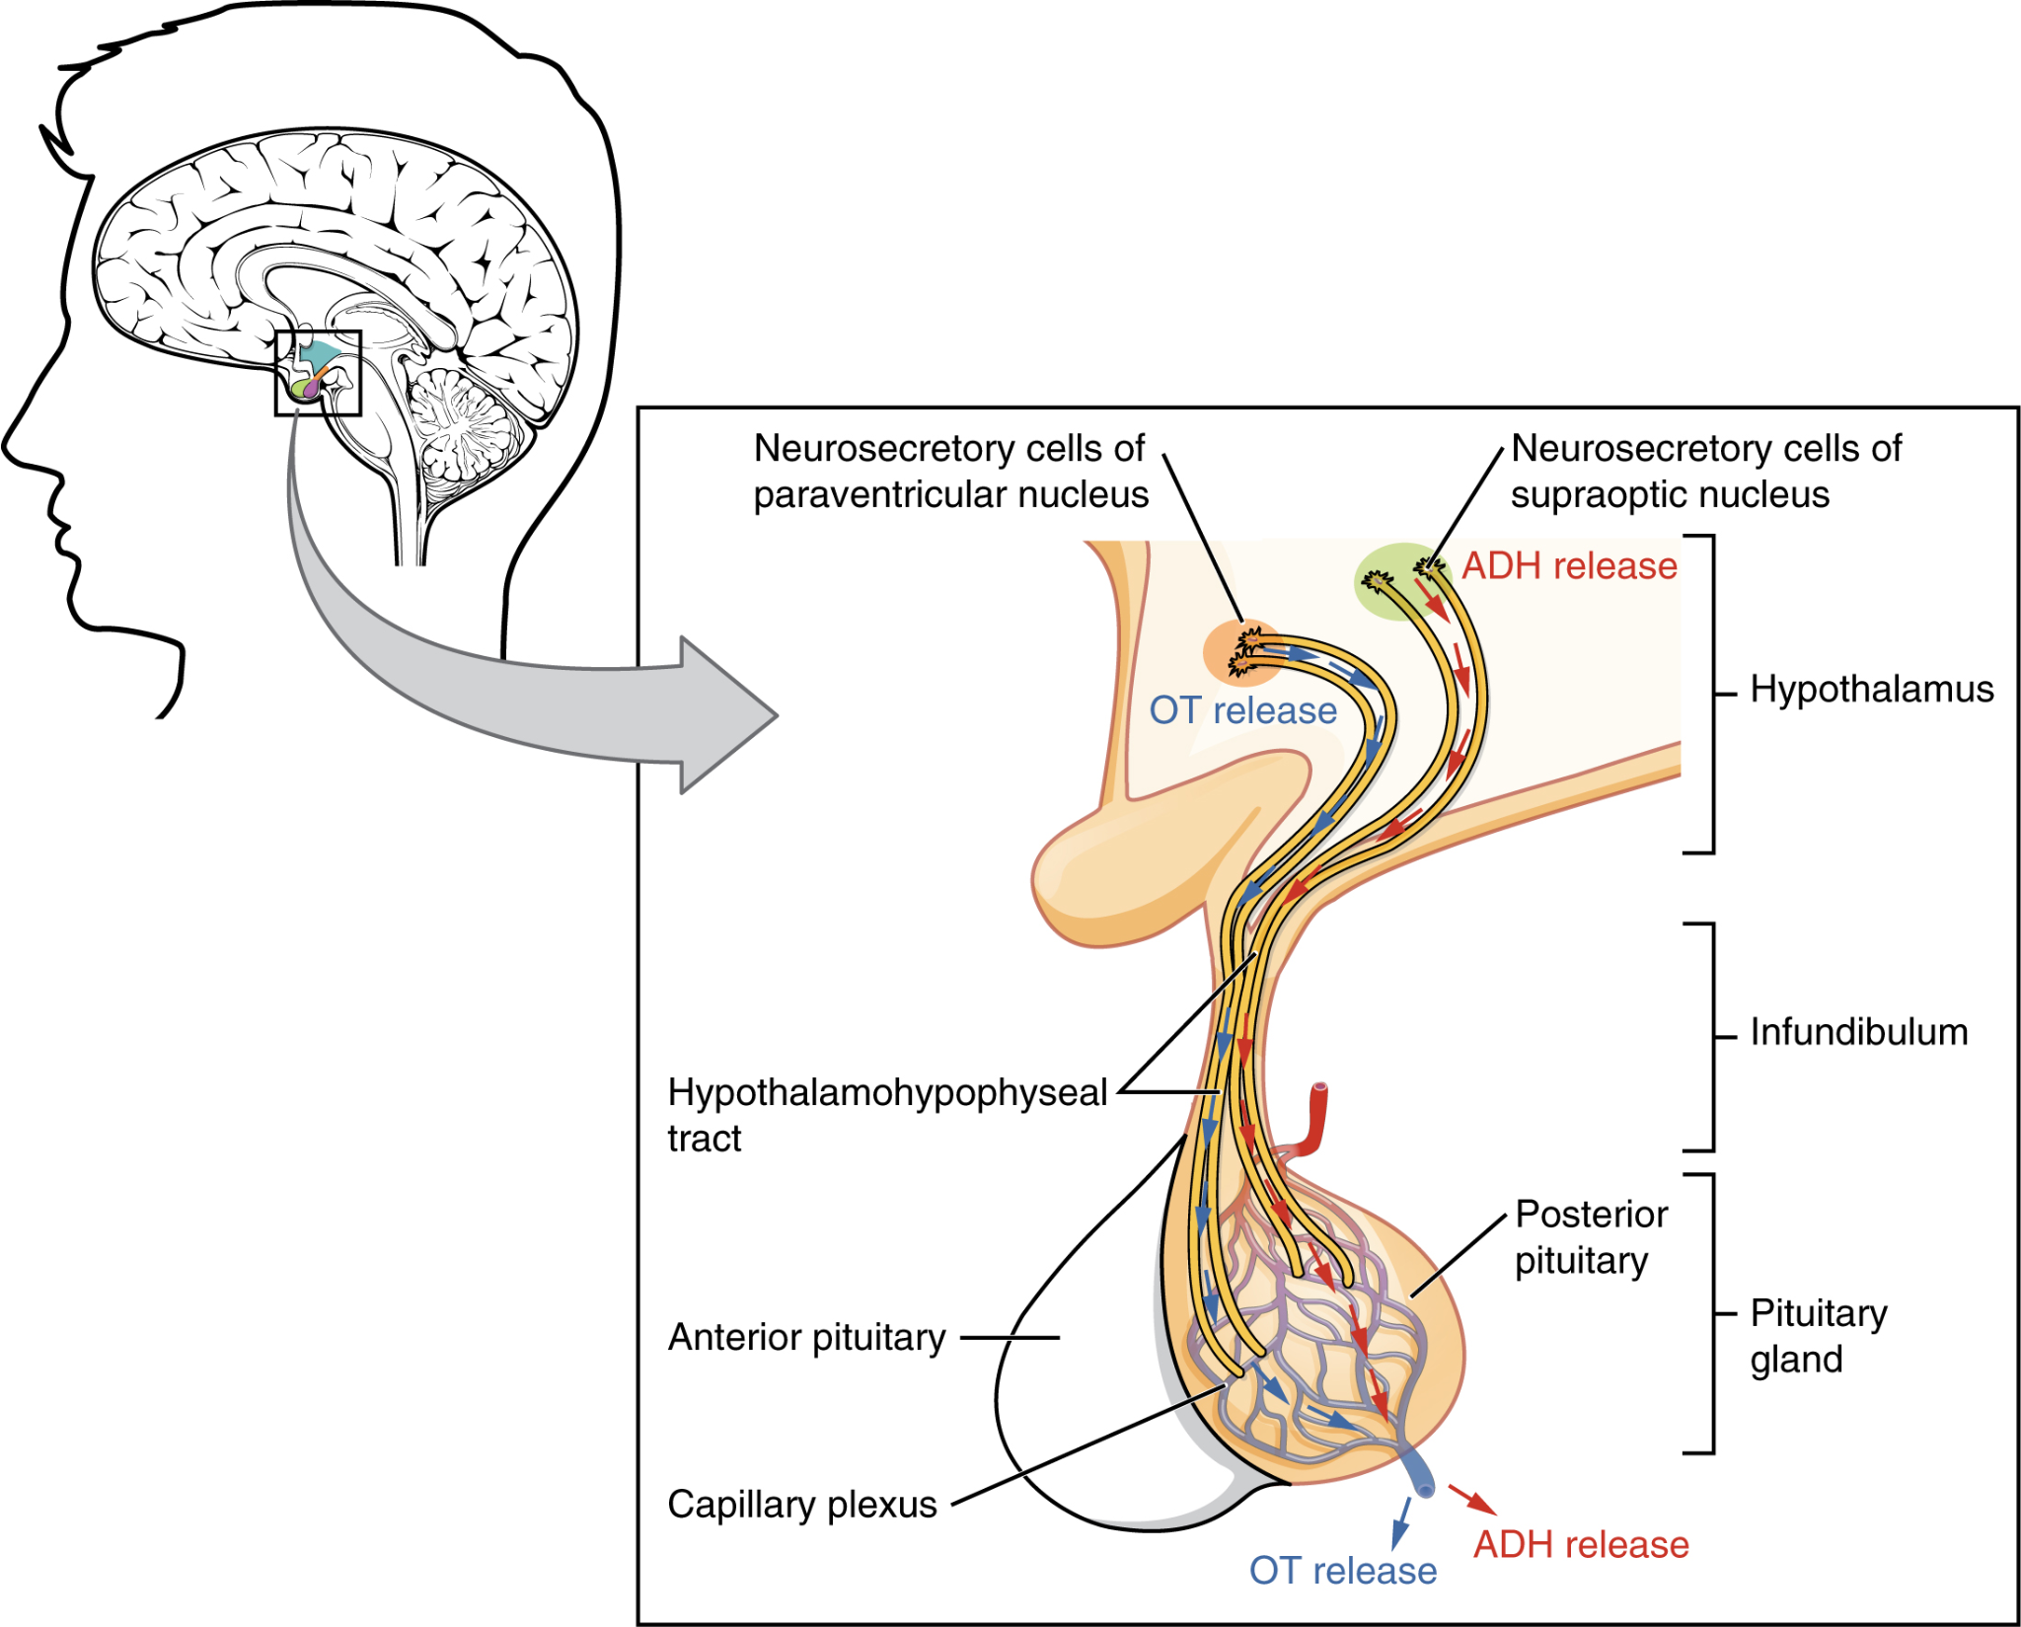
Pituitary Gland
Location:
Inferior to hypothalamus
Sits within the sella turcica of the sphenoid bone of skull
Two lobes:
Anterior pituitary (Adenohypophysis): ADH, oxytocin
Posterior pituitary (Neurohypophysis): GH, TSH, ACTH, FSH, LH, PRL

Slide 12
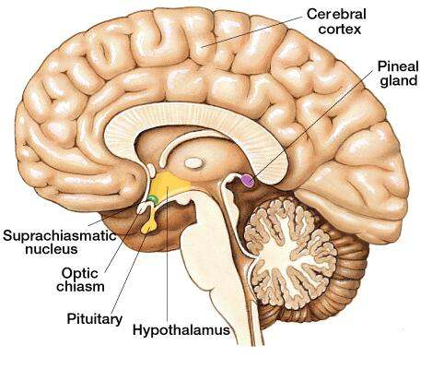
Pineal Gland
Location:
Posterior to thalamus and superior to cerebellum​
Function:
Regulation of sleep/wake cycles
Produces melatonin
Marieb and Smith, 2018

Slide 13
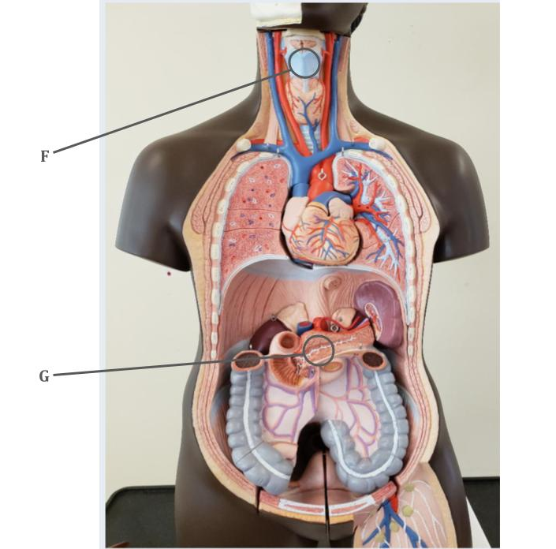
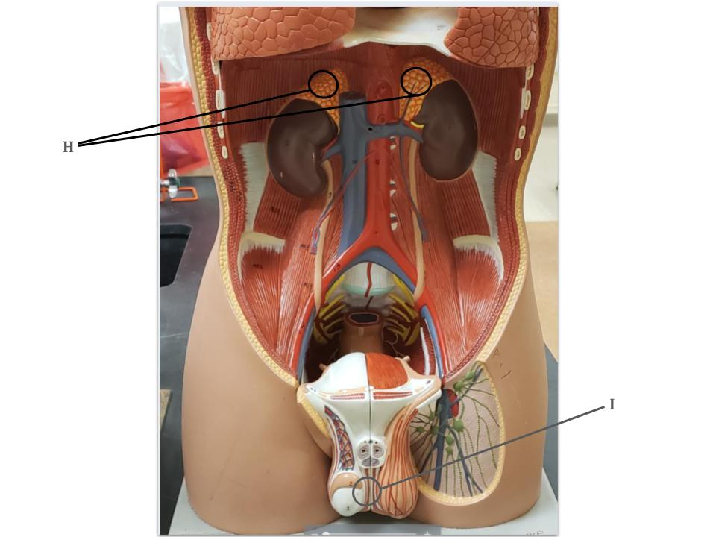
Endocrine Structures of the Body

Slide 14
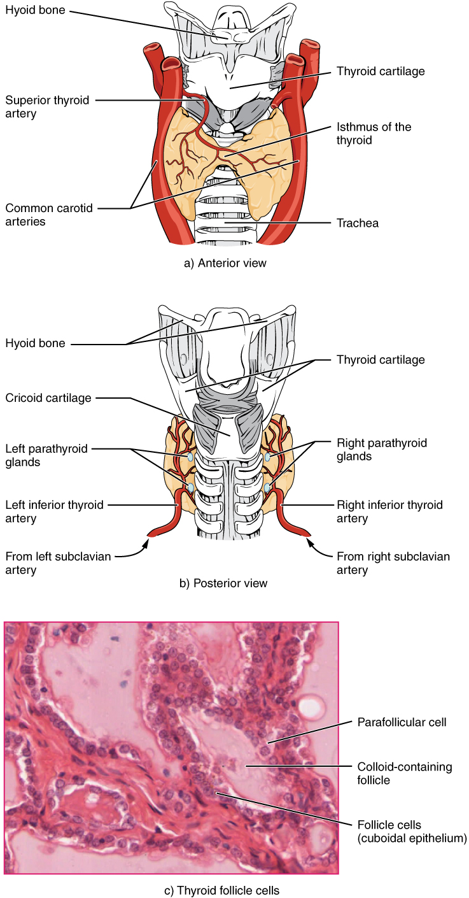
Thyroid Gland
Location:
Anterior neck, inferior to larynx
2 lobes joined by central mass (isthmus)
Function:
Regulate metabolism & blood calcium levels
Produces thyroxine (T4), triiodothyronine (T3), and calcitonin

Slide 15
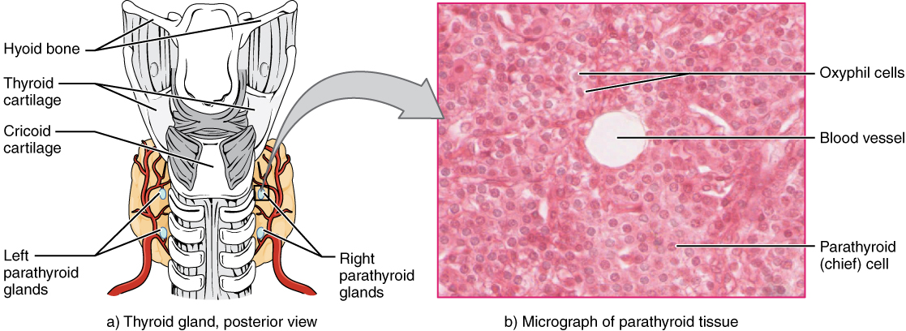
Parathyroid Gland
Location:
Embedded on posterior surface of the thyroid gland
Usually 4, but can vary
Function:
Increase blood calcium levels
Produces parathyroid hormone(PTH)

Slide 16
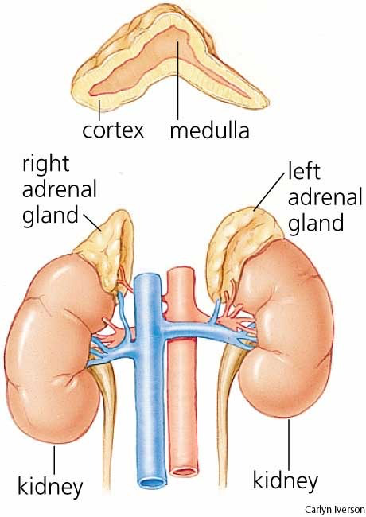
Adrenal Glands
Location:
One at superior pole of each kidney
Two regions: cortex & medulla
Cortex:
  Produces aldosterone (Na⁺ balance), cortisol (stress/metabolism), and androgens (sex hormones)
Medulla:
  Produces epinephrine & norepinephrine (fight-or-flight)
Notes:
Adrenal hormones help the body respond to stress. The cortex handles long-term regulation, and the medulla manages rapid responses.

Slide 17
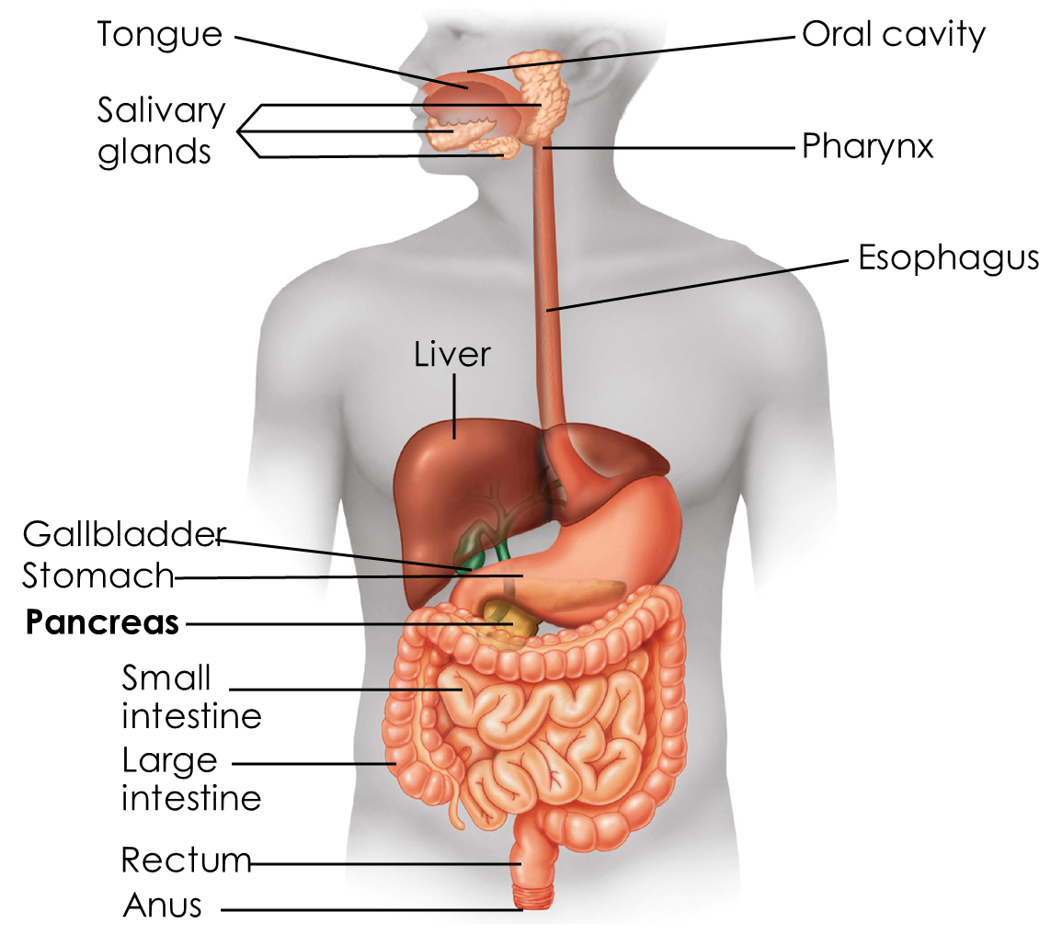
Pancreas
Location:
Posterior to stomach and along the first segment of the small intestine (duodenum)
Function:
  Regulation of blood glucose levels
  Produces glucagon (alpha cells), insulin (beta cells), and other hormones (e.g., somatostatin, pancreatic peptide)
Marieb and Smith, 2018
Notes:
The pancreas is crucial in regulating blood sugar. When insulin is deficient or ineffective, it results in diabetes mellitus.

Slide 18
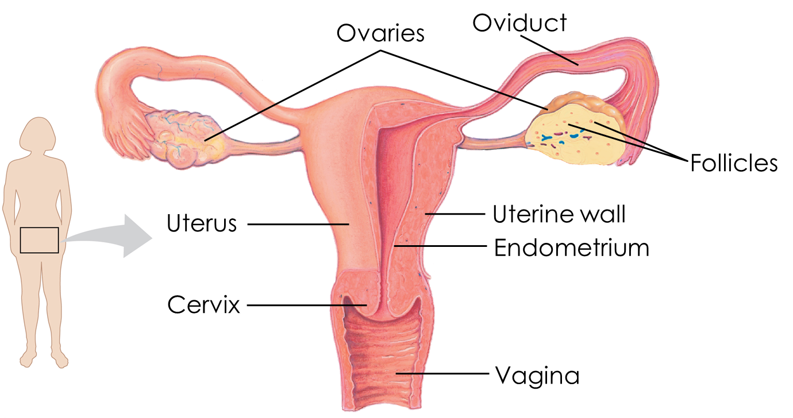
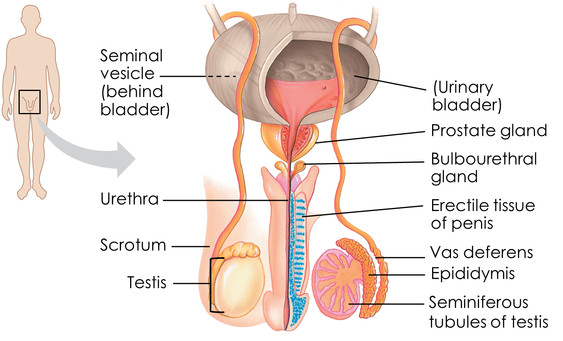
Gonads
OVARIES
TESTES
Location: paired almond-sized organs inside pelvic cavity
Function: produce steroids (estrogen, progesterone) and develop oocytes
Location: suspended in pouch-like sac outside pelvic cavity
Function: produce testosterone and sperm
Marieb and Smith, 2018

Slide 19
Lab Exercise 1.2: Examining Endocrine Histology
Materials: pituitary, parathyroid, thyroid, pancreas, adrenal slides (or Figures 1.6–1.9 in the lab manual)
View slides under 4x, 10x, 40x objectives
Identify: parafollicular cells, follicle cells, oxyfil cells, zones of adrenal glands, alpha cells, beta cells, etc.
Label table and confirm accuracy with instructor
Notes:
Focus on distinguishing tissue types and zones under the microscope. Use increasing magnification to identify fine structural details.

Slide 20
Example Histology Slides
THYROID
PARATHYROID

Slide 21
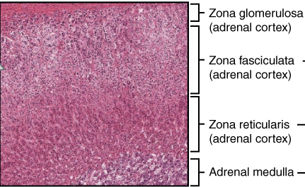
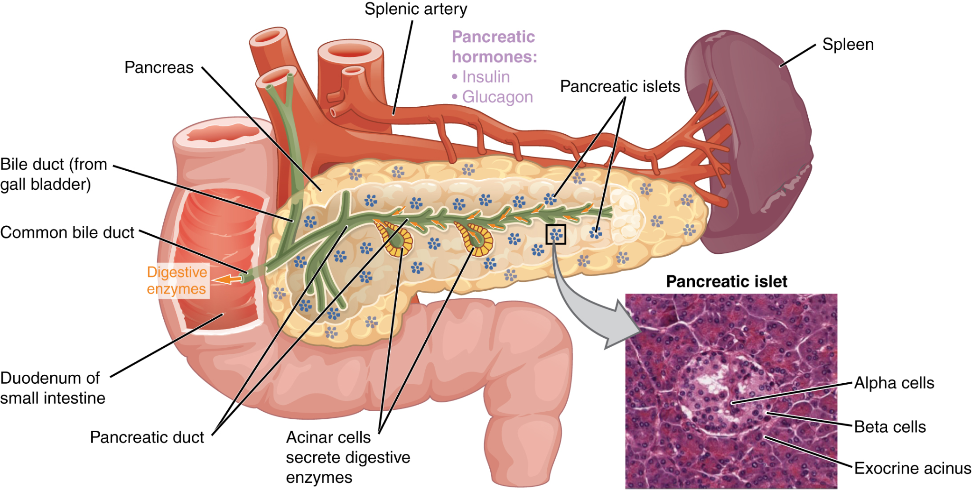
Example Histology Slides
ADRENAL
PANCREAS

Slide 22
Lab Exercise 1.3: Endocrine Physiology Simulation
Materials: Internet-connected computer
Go to https://pphys.edugen.wiley.com/index.html
Select 'Blood Glucose Regulation' simulation
Complete pre-lab quiz and reporting sections
Predict when glucose, insulin, glucagon, ketones peak
Notes:
This simulation helps you understand hormonal regulation of blood glucose. Make predictions before running the simulation, then record your findings.

Slide 23
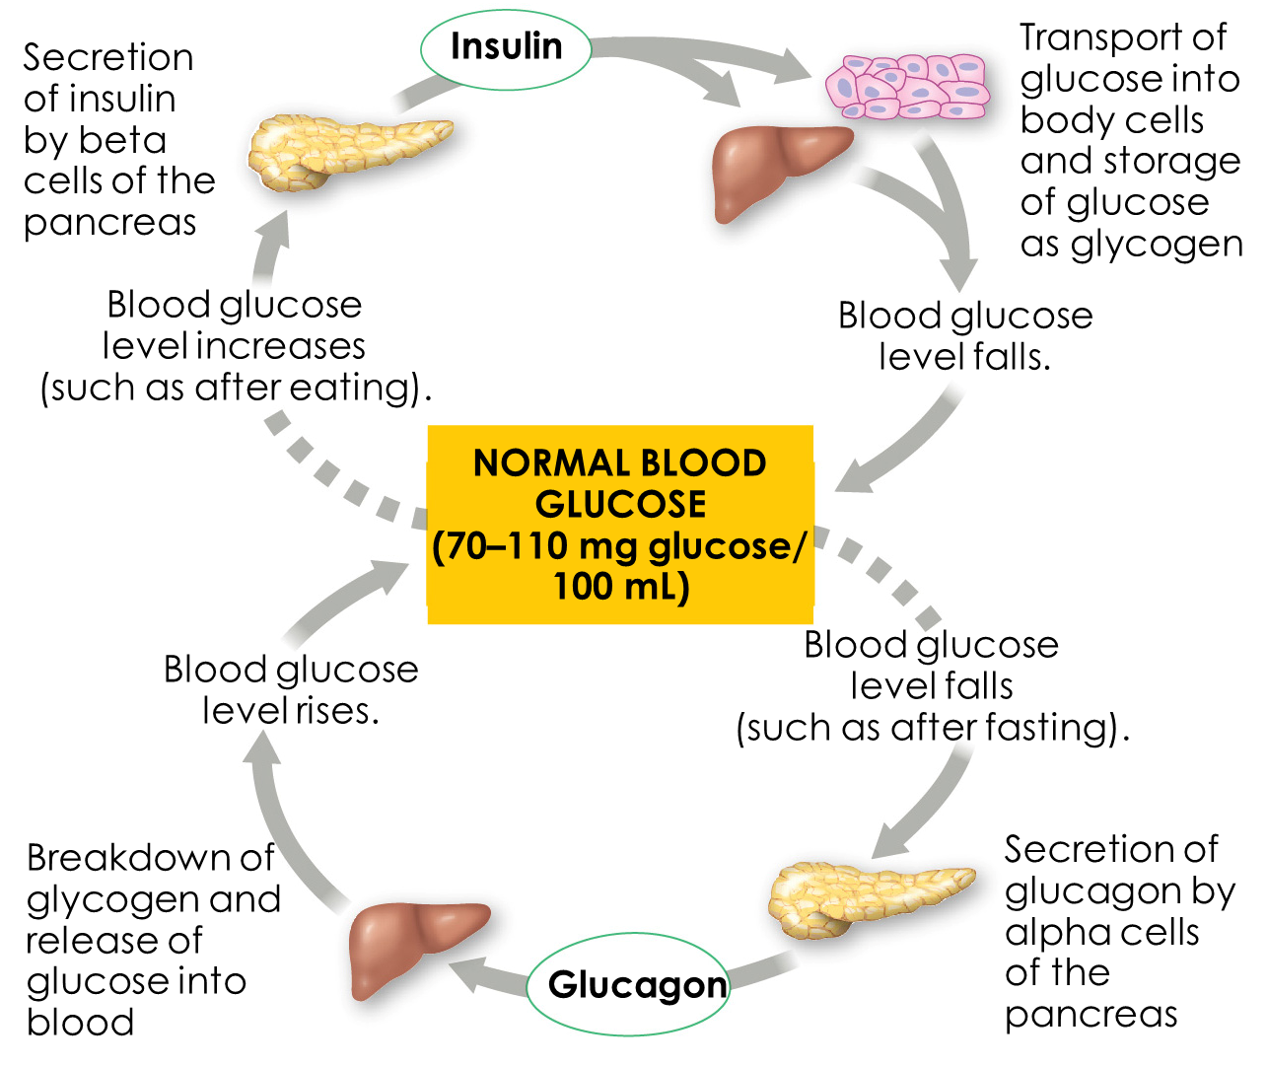
Blood Glucose Regulation
Watch this video: https://pphys.edugen.wiley.com/video/section05.html

Slide 24
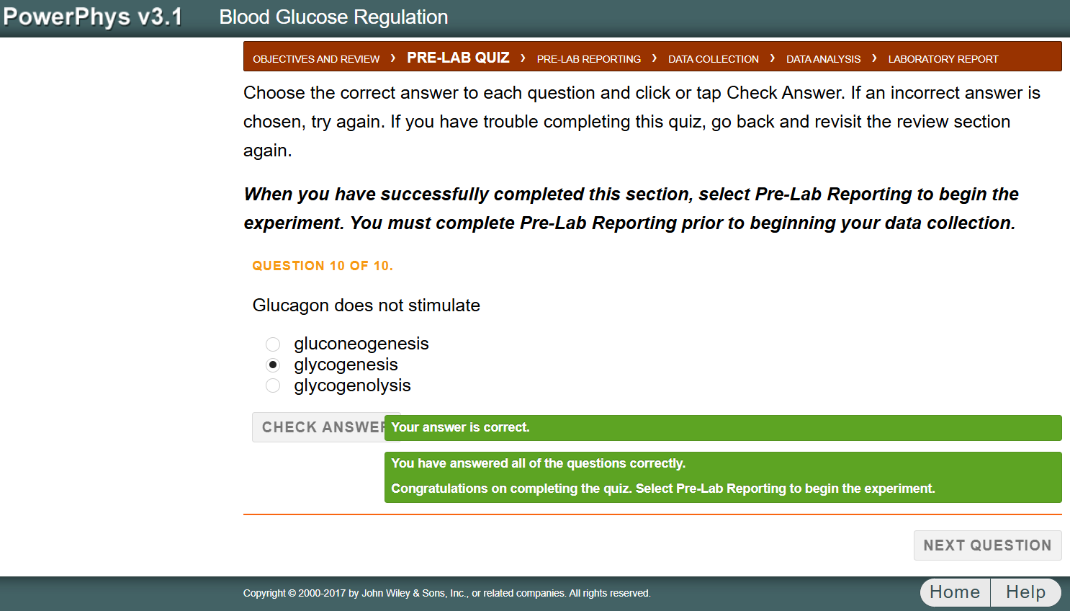
Blood Glucose Regulation

Slide 25
Lab Exercise 1.4: Fetal Pig Dissection – Endocrine Identification
Materials: preserved pig, tools, PPE, diagrams
BSL-1 safety protocols: PPE, sharps, disinfection, etc.
External observation and initial incision
Identify: thyroid, thymus, pancreas, adrenals, ovaries/testes
For online students (or if no specimen are available), use the following figures to identify each structure
Notes:
This dissection reveals real endocrine anatomy. Follow safety protocols and use your anatomical diagram to locate and identify each gland.

Slide 26
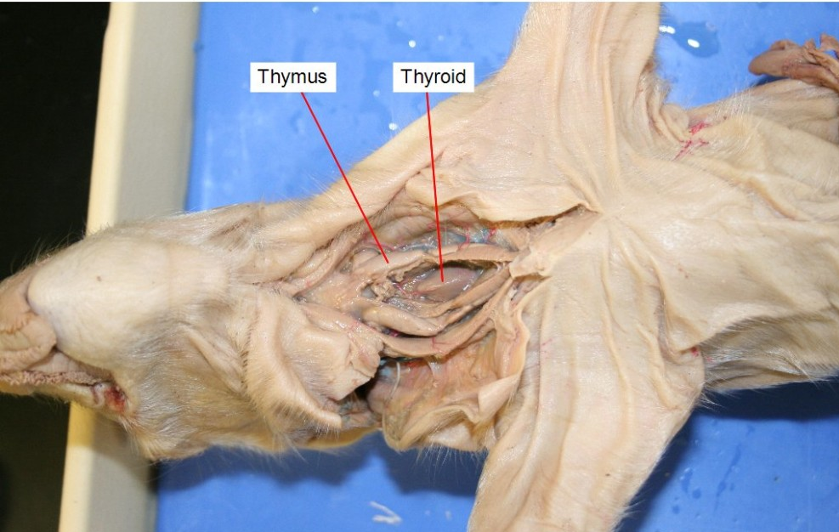
Thyroid and Thymus
https://courses.lumenlearning.com/bio2labs/

Slide 27
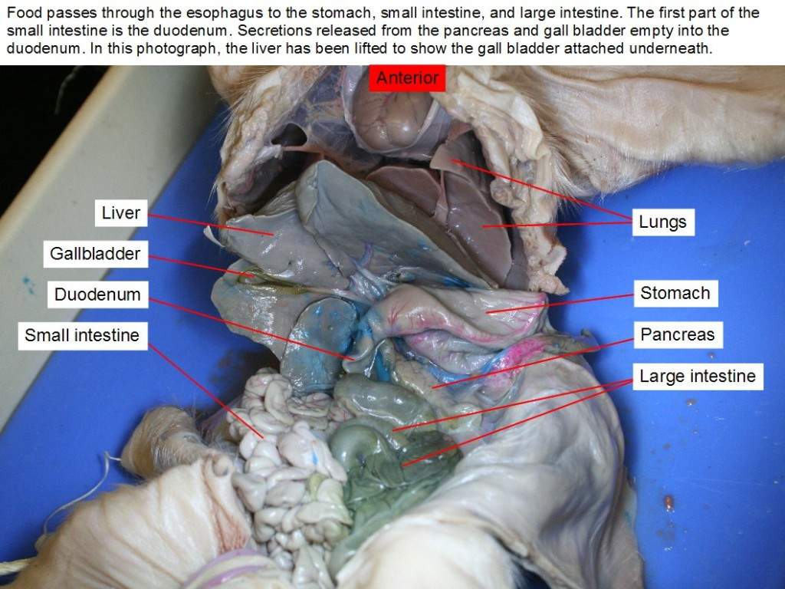
Pancreas
https://courses.lumenlearning.com/bio2labs/

Slide 28
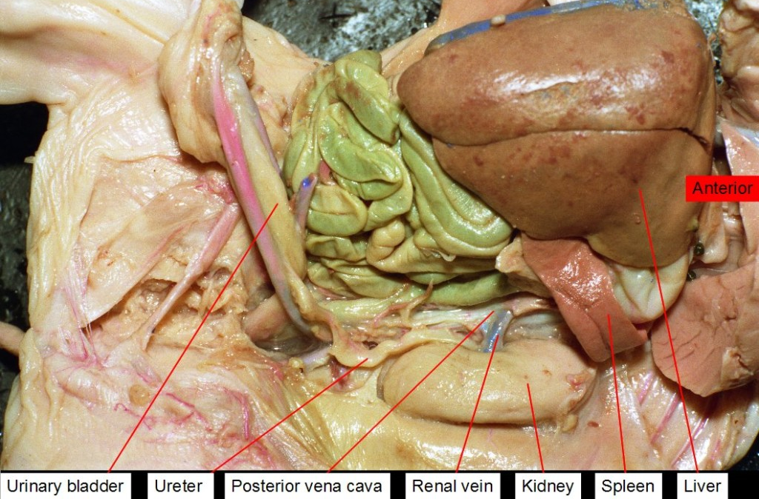
Adrenal Glands
https://courses.lumenlearning.com/bio2labs/

Slide 29
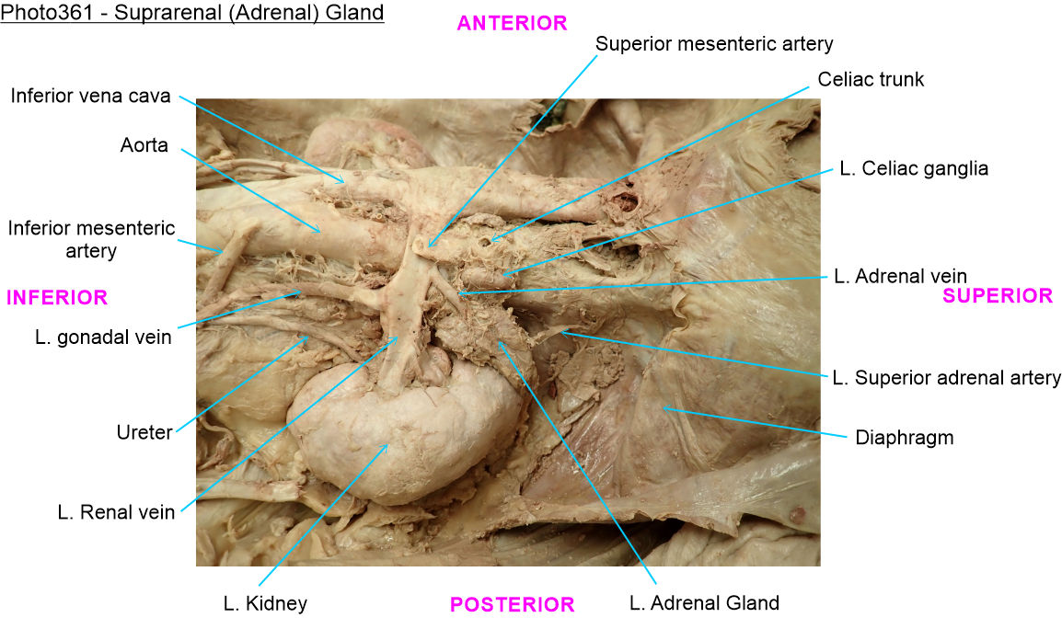
Adrenal Glands
https://medscope.umaryland.edu/

Slide 30
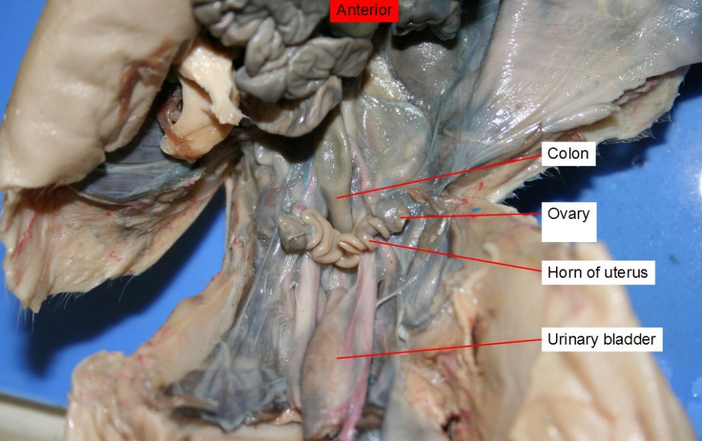
Ovaries
https://courses.lumenlearning.com/bio2labs/

Slide 31
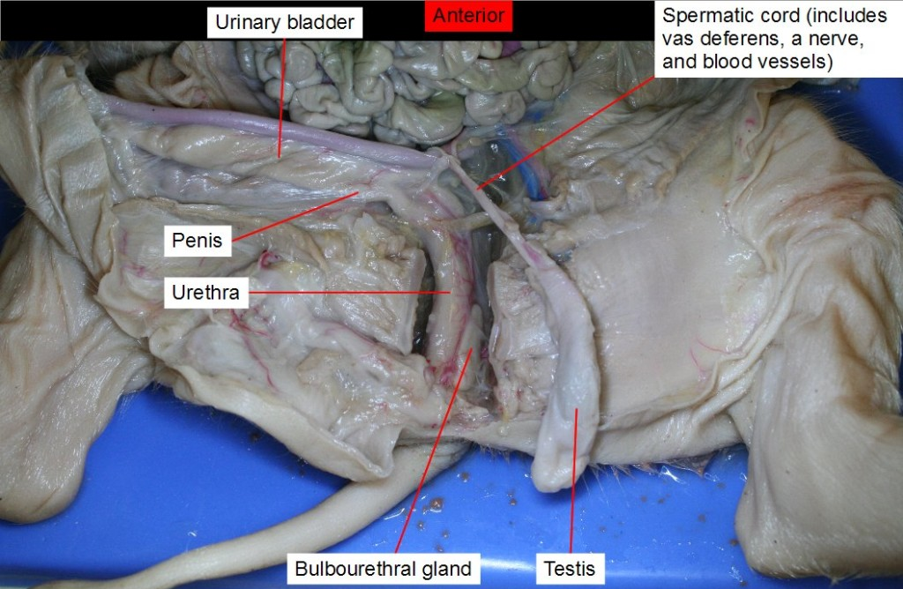
Testes
https://courses.lumenlearning.com/bio2labs/

Slide 32
Preparation and Work Due
  Reading Assignment:
  Textbook: Chapter 1
  Lab Manual: Chapter 1
See Module 1 for more information & assignments
Presented in accordance with the National Association of Biology Teachers and the National Research Council (Cheesman et al., 2007).
Figures (unless otherwise cited) originated from: OpenStax College, Rice University. 2022. Anatomy and Physiology 2e.

