Slide 1
Anatomy and Physiology II
Chapter 9: Nutrition and Metabolism
Images in these slides are from the course textbook unless otherwise noted.

Slide 2
Chapter 9 Objectives
Describe the processes involved in anabolic and catabolic reactions
Describe the steps necessary for carbohydrate, lipid, and protein metabolism
Explain the processes that regulate glucose levels during the absorptive and postabsorptive state
Explain how metabolism is essential to maintaining body temperature (thermoregulation)
Summarize the importance of vitamins and minerals in the diet

Slide 3

Metabolism
The sum of all energy-requiring and energy-consuming processes of the body
Many factors contribute to overall metabolism, including lean muscle mass, the amount and quality of food consumed, and the physical demands placed on the human body by age, sex, and activity level

Slide 4
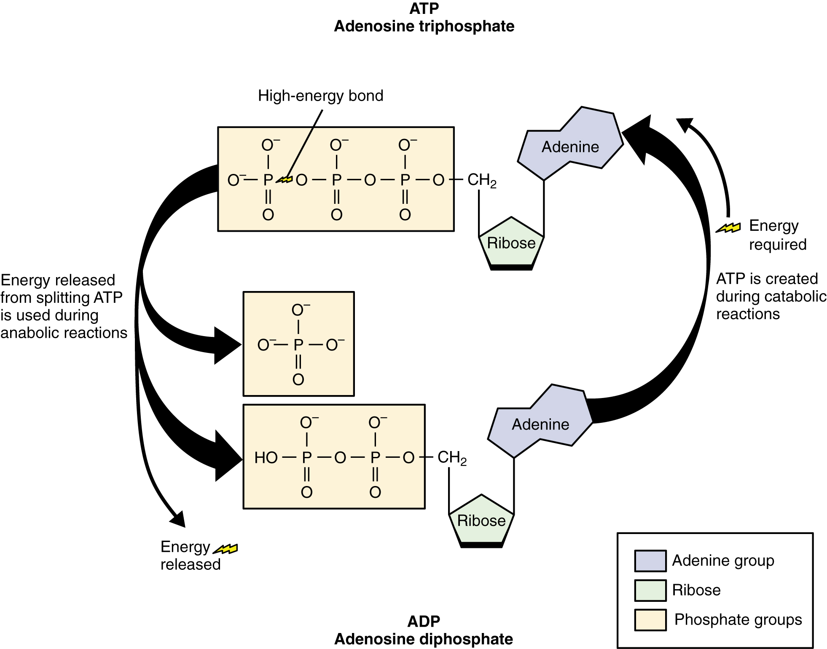
Adenosine Triphosphate
ATP is the energy molecule of the cell
During catabolic reactions, ATP is created and energy is stored until needed during anabolic reactions.

Slide 5
Metabolic Reactions
Catabolic
Breaking polymers into monomers
Energy released with breaking ATP bonds
  Coupled to ATP synthesis (40%)
  Most lost as heat (60%)
i.e. digesting nutrients
Anabolic
Synthesizing polymers from monomers
  Proteins from amino acids
  Lipids from fatty acids
  Polysaccharides from monosaccharides
ATP used to form bonds
i.e storing nutrients and biosynthesis rxns

Slide 6
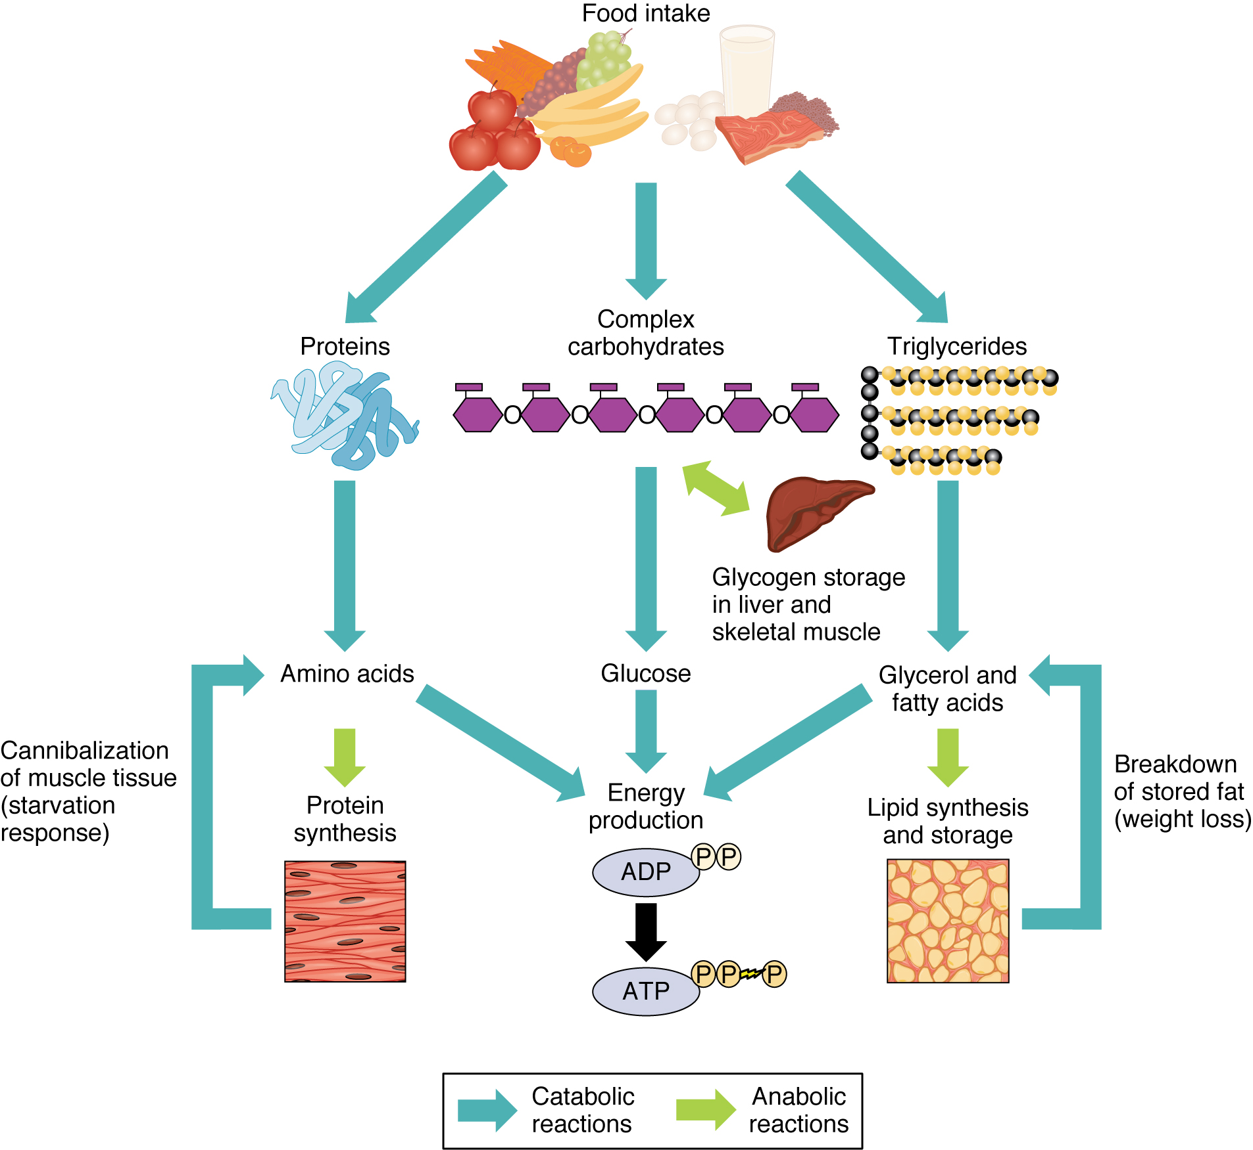
Sources of ATP
Carbohydrates for energy
Lipids for energy or storage
Proteins for reuse or energy with starvation
Nucleic acids for DNA replication and protein synthesis

Slide 7
Catabolic Hormones
Hormone | Function
Cortisol | Released from the adrenal gland in response to stress; its main role is to increase blood glucose levels by gluconeogenesis (breaking down fats and proteins)
Glucagon | Released from alpha cells in the pancreas either when starving or when the body needs to generate additional energy; it stimulates the breakdown of glycogen in the liver to increase blood glucose levels; its effect is the opposite of insulin; glucagon and insulin are a part of a negative-feedback system that stabilizes blood glucose levels
Adrenaline/ epinephrine | Released in response to the activation of the sympathetic nervous system; increases heart rate and heart contractility, constricts blood vessels, is a bronchodilator that opens (dilates) the bronchi of the lungs to increase air volume in the lungs, and stimulates gluconeogenesis

Slide 8
Anabolic Hormones
Hormone | Function
Growth Hormone (GH) | Synthesized and released from the pituitary gland; stimulates the growth of cells, tissues, and bones
Insulin-like Growth Factor (IGF) | Stimulates the growth of muscle and bone while also inhibiting cell death (apoptosis)
Insulin | Produced by the beta cells of the pancreas; plays an essential role in carbohydrate and fat metabolism, controls blood glucose levels, and promotes the uptake of glucose into body cells; causes cells in muscle, adipose tissue, and liver to take up glucose from the blood and store it in the liver and muscle as glucagon; its effect is the opposite of glucagon; glucagon and insulin are a part of a negative-feedback system that stabilizes blood glucose levels
Testosterone | Produced by the testes in males and the ovaries in females; stimulates an increase in muscle mass and strength as well as the growth and strengthening of bone
Estrogen | Produced primarily by the ovaries, it is also produced by the liver and adrenal glands; its anabolic functions include increasing metabolism and fat deposition

Slide 9
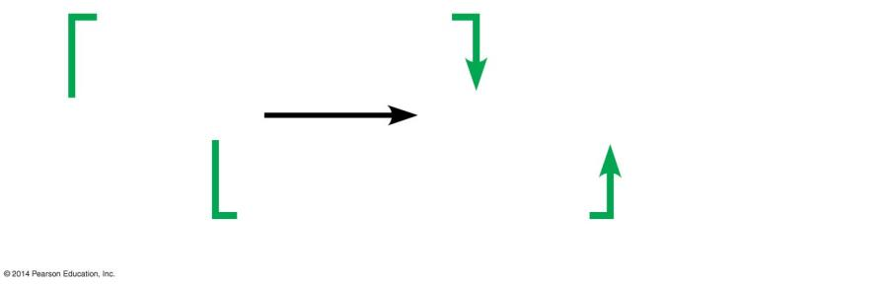
Redox Reactions Harness Energy
Movement of electrons between molecules, often seen with hydrogen ions (H+)
  Loss of electrons is oxidation (LEO or OIL)
  Gain of electrons is reduction (GER or RIG)
Coenzymes capture and transfer electrons
  NAD⁺ reduces to NADH, NADH oxidizes to NAD⁺
  FAD⁺ reduces to FADH₂, FADH₂ oxidizes to FAD⁺
Loss of hydrogen atoms
(becomes oxidized)
C₆H₁₂O₆ + 6 O₂
6 CO₂ + 6 H₂O + ATP + Heat
(Glucose)
Gain of hydrogen atoms
(becomes reduced)

Slide 10
Why is Glucose Preferred as a Primary Energy Source?
Glucose is a small, soluble molecule that is easily distributed through body fluids.
Glucose can provide ATP anaerobically through glycolysis. Although only a small amount of ATP is produced, glycolysis is important during peak levels of physical activity, in red blood cells, or when a tissue is temporarily deprived of oxygen.
Glucose can be stored as glycogen which forms compact, insoluble granules.
Glucose can be easily mobilized because the breakdown of glycogen (glycogenolysis) occurs very quickly and involves only a single enzymatic step. Mobilization of other intracellular reserves involves much more complex pathways and take considerably more time.

Slide 11
Carbohydrate Metabolism
During digestion, polysaccharides and disaccharides are converted to monosaccharides (primarily glucose), which are absorbed through capillaries in villi and transported to the liver via the hepatic portal vein
Liver cells convert much of the remaining fructose and practically all of the galactose to glucose, so carbohydrate metabolism is primarily concerned with glucose metabolism.
Fate of Carbohydrates
  Since glucose is the body’s preferred source for synthesizing ATP, the fate of absorbed glucose depends on the energy needs of body cells.
  If the cells require immediate energy, glucose is oxidized by the cells to produce ATP.
  Glucose can be used to form amino acids, which then can be incorporated into proteins.
  Excess glucose can be stored by the liver and skeletal muscles as glycogen, a process called glycogenesis.
  If glycogen storage areas are filled up, liver cells and fat cells can convert glucose to glycerol and fatty acids that can be used for synthesis of triglycerides (neutral fats) in the process of lipogenesis.

Slide 12
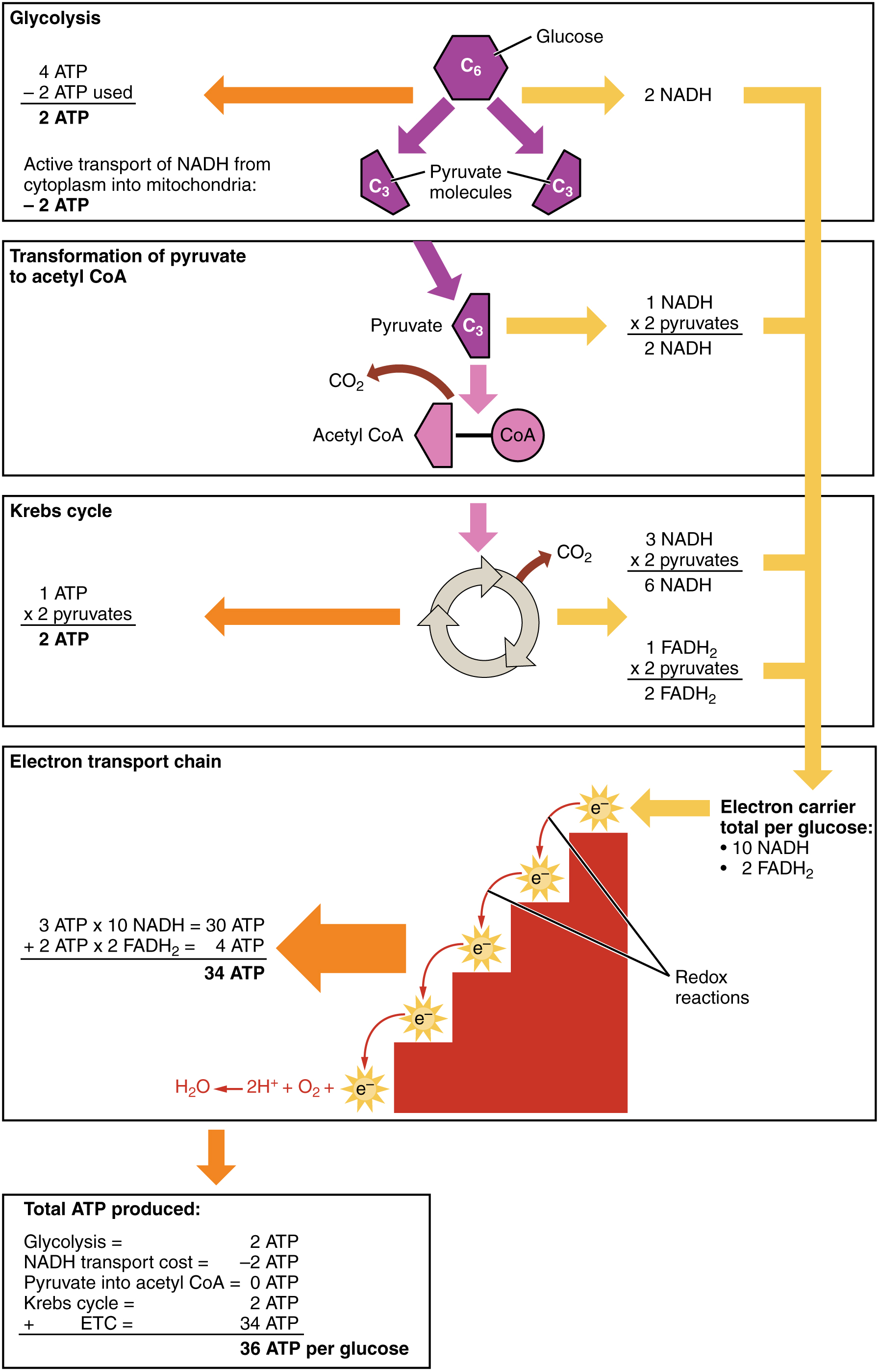
Carbohydrate Metabolism
Glucose oxidation is also called cellular respiration.
It occurs in every cell of the body (except red blood cells, which lack mitochondria) and provides the cell’s chief source of energy.
The complete oxidation of glucose to CO₂ and H₂0 produces large amounts of energy and occurs in four successive stages:
  Glycolysis
  Formation of acetyl coenzyme A
  Krebs cycle
  Electron transport chain .
Regulated by insulin and glucagon
Chemical equation:
C₆H₁₂O₆ + 6O₂ → 6CO₂ + 6H₂0 + 36 ATP + heat

Slide 13
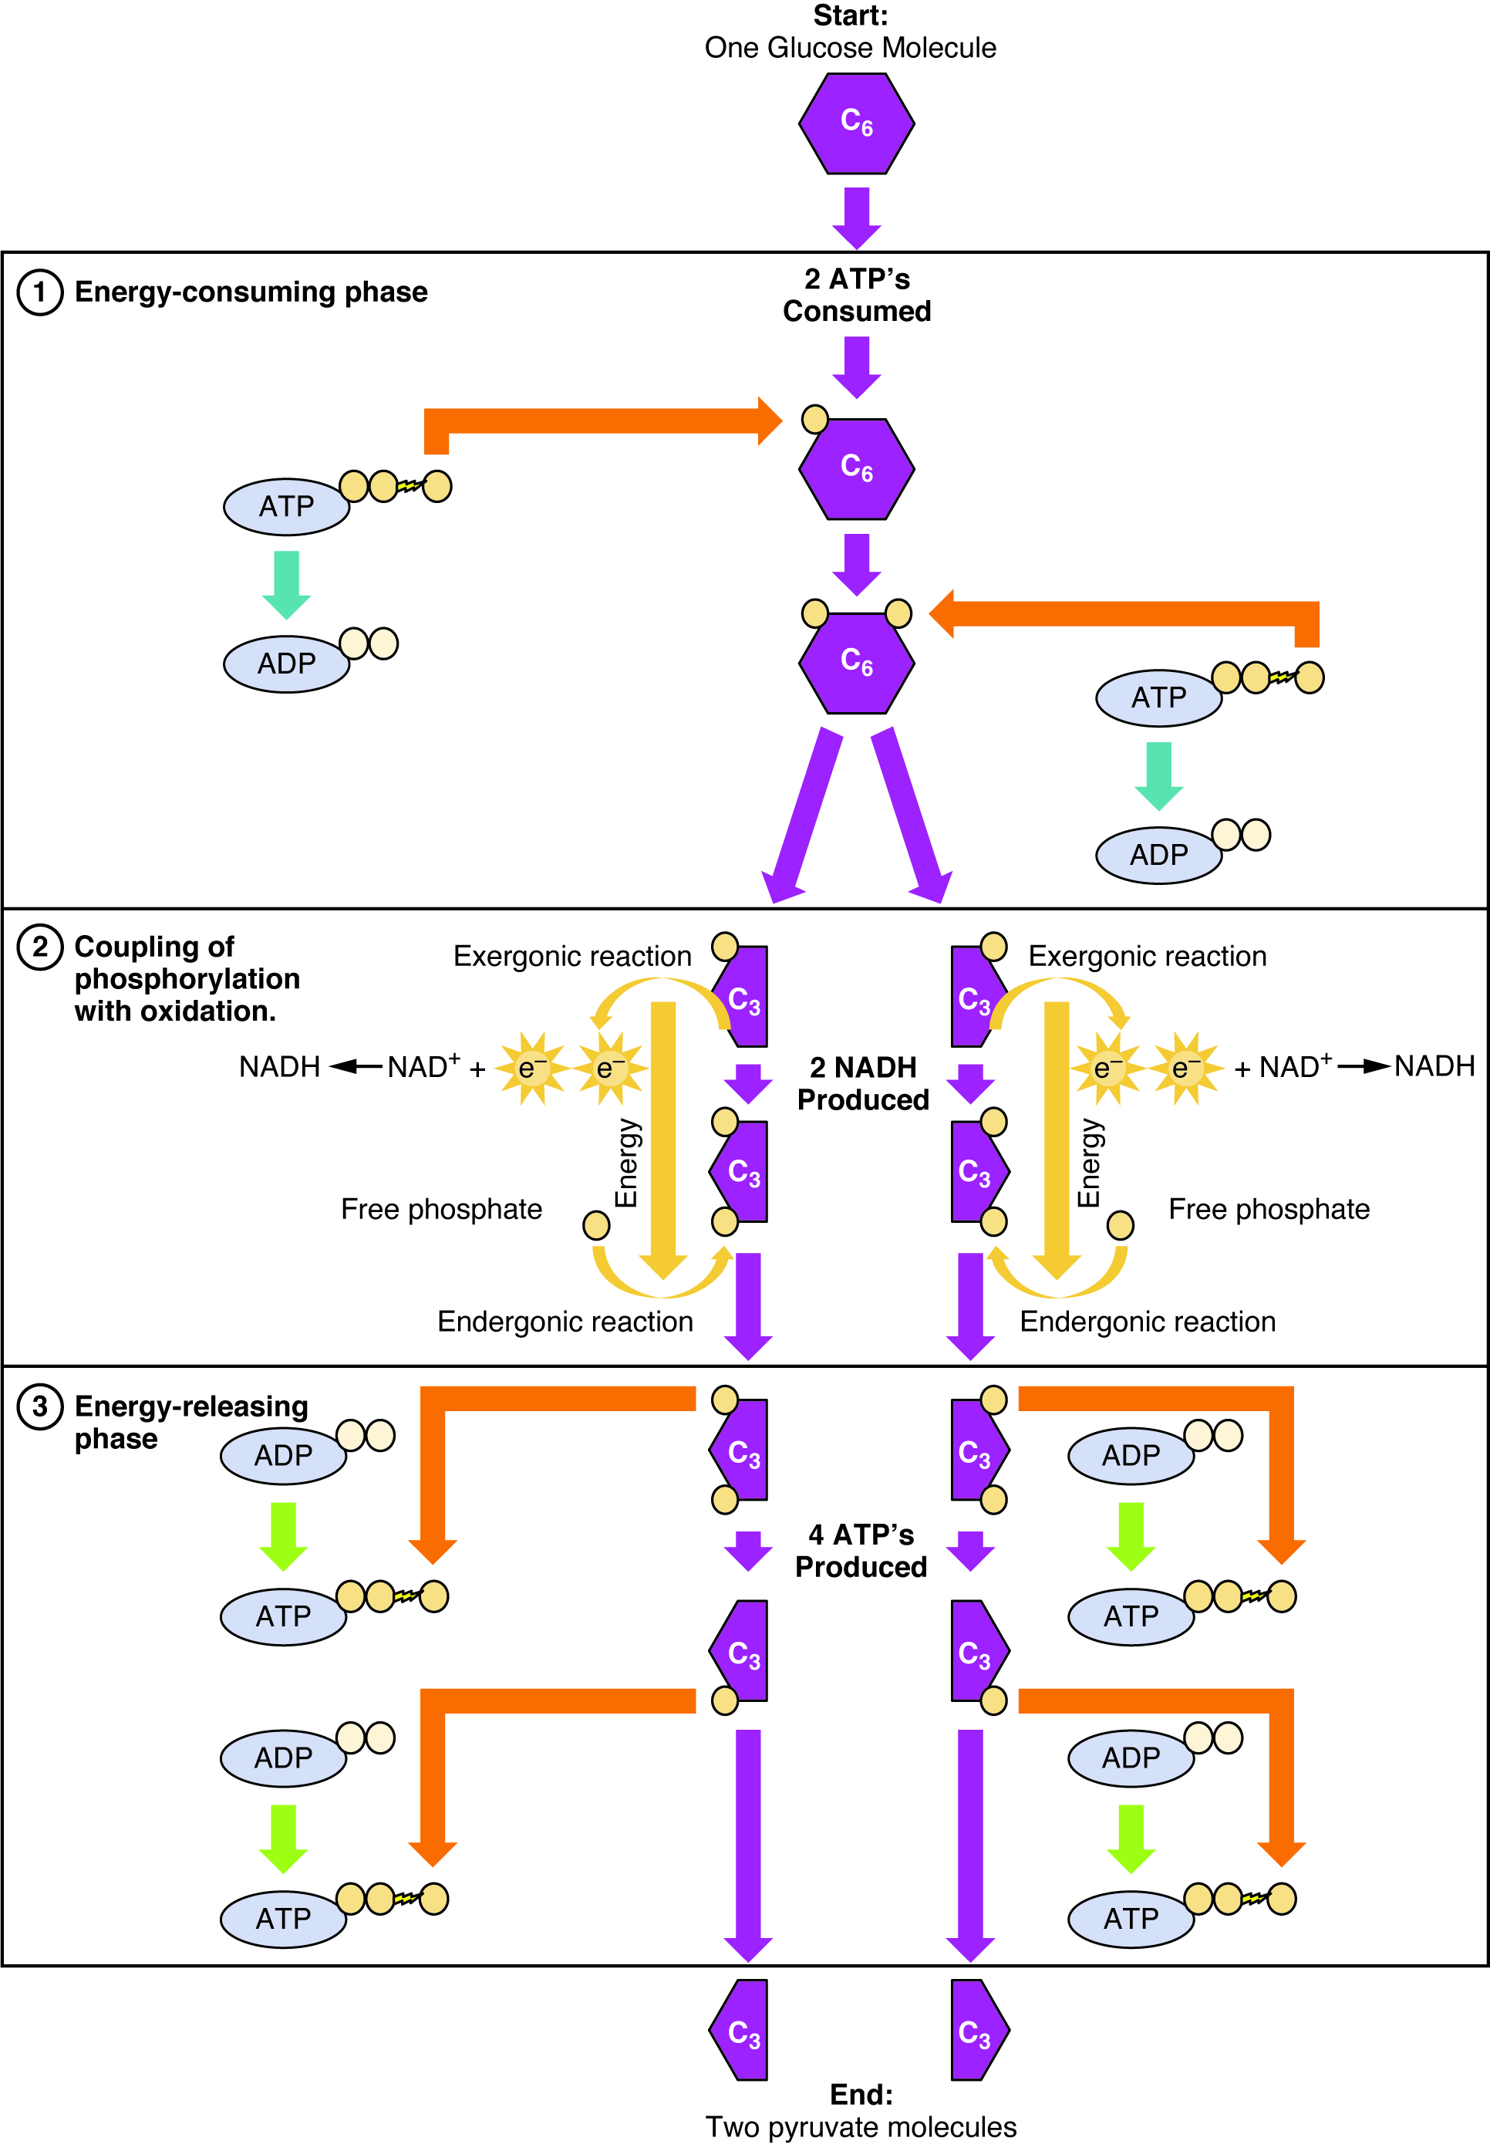
Glycolysis
Glycolysis refers to the breakdown of the six-carbon molecule, glucose, into two three-carbon molecules of pyruvic acid, each containing a phosphate.
The reactions of glycolysis use two ATP molecules, but produce four, a net gain of two.
  Two ATPs are consumed in the energy-consuming phase of glycolysis, to transfer two phosphates to the glucose molecule
  Further oxidation of the three-carbon compounds add an additional phosphate to each
  Both phosphates are removed from the two three-carbon compounds in the energy-releasing phase to produce four ATPs

Slide 14
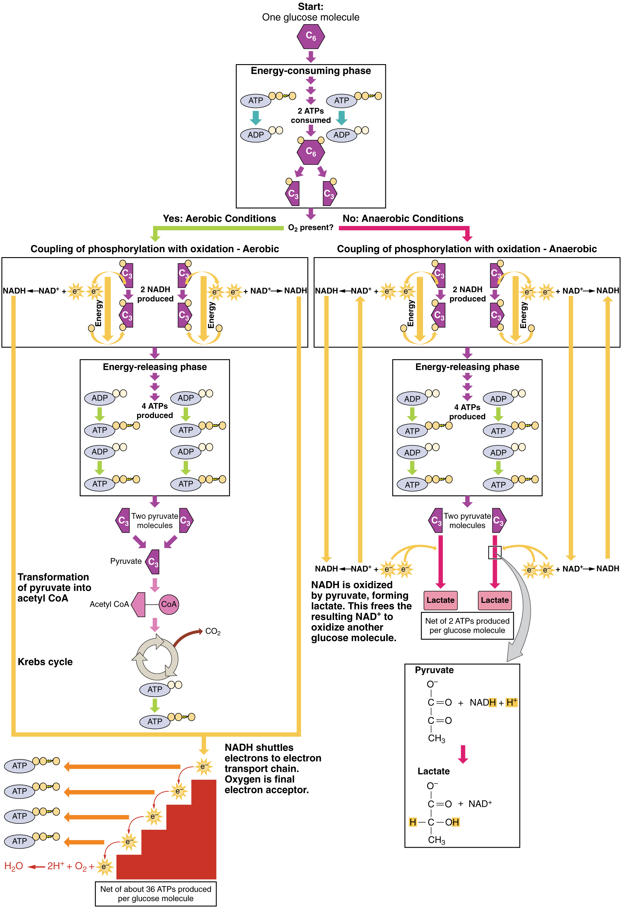
Anaerobic vs Aerobic Respiration
Depends on presence or absence of oxygen
Anaerobic respiration:
  When oxygen is in short supply, pyruvic acid is reduced to lactic acid.
Aerobic respiration:
  Under aerobic conditions, pyruvic acid is converted to acetyl coenzyme A and enters the Krebs cycle.
Thus the fate of pyruvic acid depends on the availability of O₂.
Erythrocytes that lack mitochondria utilize anaerobic as well

Slide 15
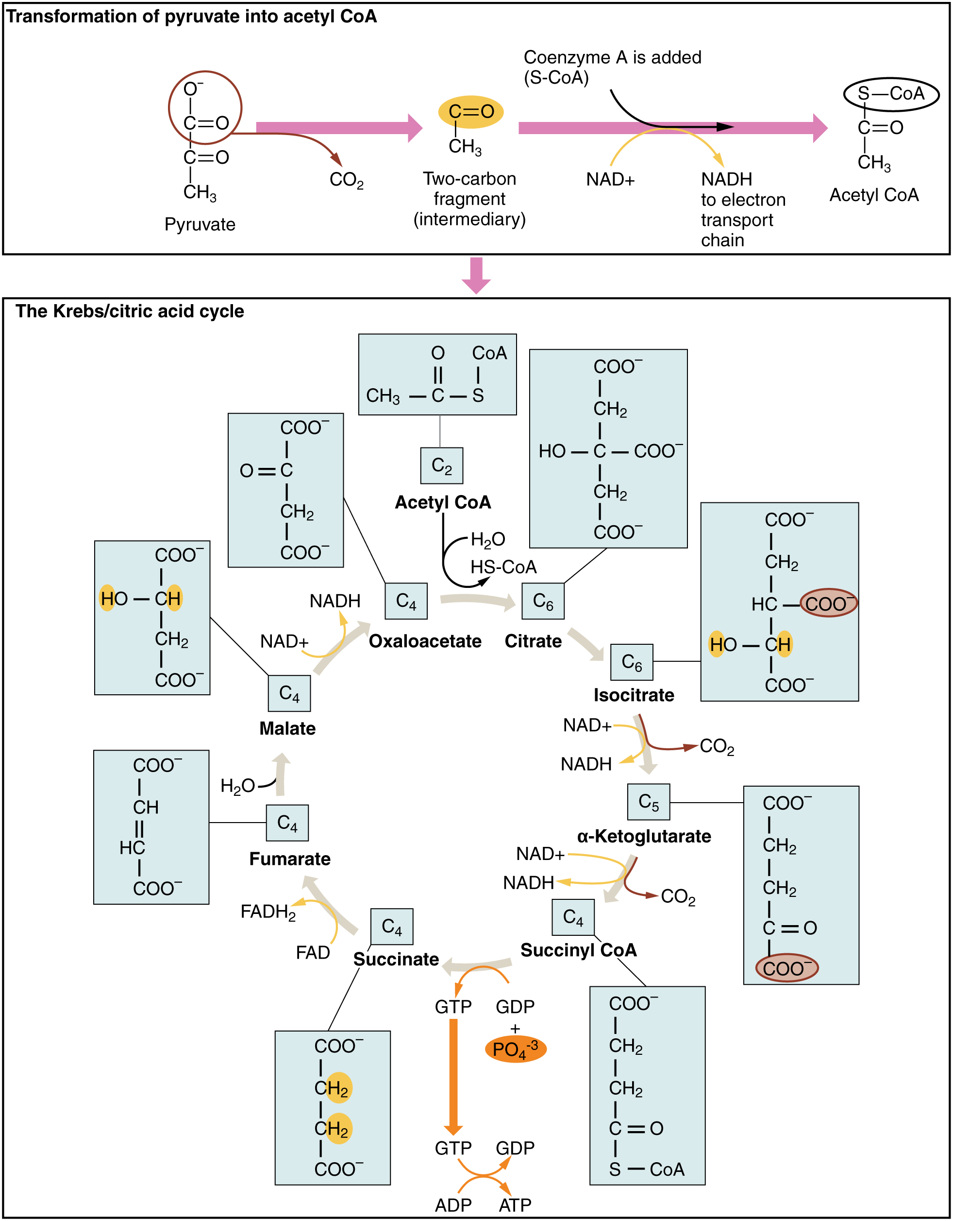
Kreb’s (Citric Acid) Cycle
The Krebs cycle involves decarboxylations and oxidations and reductions of various organic acids.
Each pyruvate is oxidized into a two-carbon acetyl-CoA molecule
Each acetyl-CoA is processed through the cycle and produces several high energy molecules
  3 NADH
  1 FADH₂
  2 ATP
Since the cycle starts with two pyruvates, this process occurs twice per single glucose molecule
The energy originally in glucose and then pyruvic acid is primarily in the reduced coenzymes NADH, H⁺ and FADH₂.

Slide 16
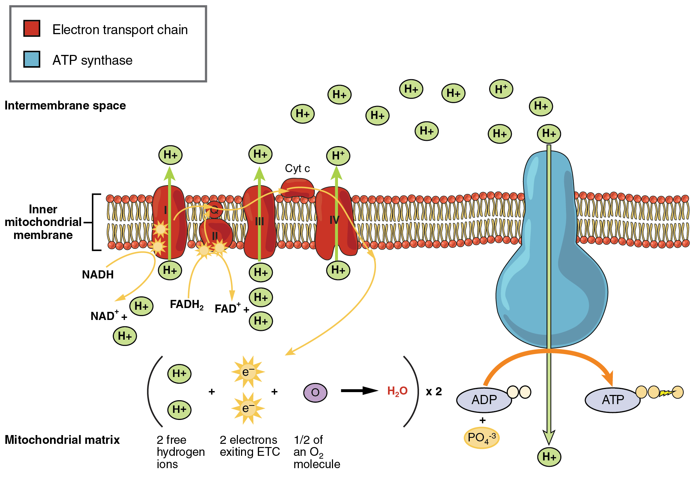
Oxidative Phosphorylation
Includes two different processes: the electron transport chain and chemiosmosis.
Directly uses oxygen
Overview
  NADH + H⁺ and FADH₂ (from glycolysis and Krebs cycle) deliver hydrogen atoms
  Hydrogen atoms combined with O₂ → water
  Released energy harnessed → ATP by oxidative phosphorylation

Slide 17
Oxidative Phosphorylation
Electron transport chain- a series of electron carriers and ion pumps that are used to pump H⁺ ions out of the inner mitochondrial matrix as electrons are delivered by electron carriers
  Process involves a series of oxidation-reduction reactions in which the energy in NADH, H⁺ and FADH₂ is liberated and transferred to ATP for storage.
  As electrons are passed through the chain, there is a stepwise release of energy from the electrons for the generation of ATP.
  In aerobic cellular respiration, the last electron receptor of the chain is molecular oxygen (O₂)
    Oxygen is a common final electron acceptor
    This final oxidation is irreversible.

Slide 18
Oxidative Phosphorylation
Chemiosmotic process
ATP synthase: enzyme that uses the H⁺ concentration gradient to fuel synthesis of ATP
  This mechanism of ATP generation links chemical reactions (electrons passing along the electron chain) with pumping of hydrogen ion.
  Called chemiosmosis.
    Energy used to pump H⁺ across inner mitochondrial membrane →
    As flows back through ATP synthase membrane channel → energy used to phosphorylate ADP

Slide 19
Carbohydrate Metabolism Summary
Involves glycolysis, the Kreb’s cycle, and the electron transport system
Total ATP produces can vary with efficiency of system
From one glucose molecule you get, 40% ATP production and 60% Heat production.

Slide 20
Glucose Anabolism
The conversion of glucose to glycogen for storage in the liver and skeletal muscle is called glycogenesis. The process occurs in the liver and is stimulated by insulin.
The conversion of glycogen back to glucose is called glycogenolysis. This process occurs between meals and is stimulated by glucagon and epinephrine.

Slide 21
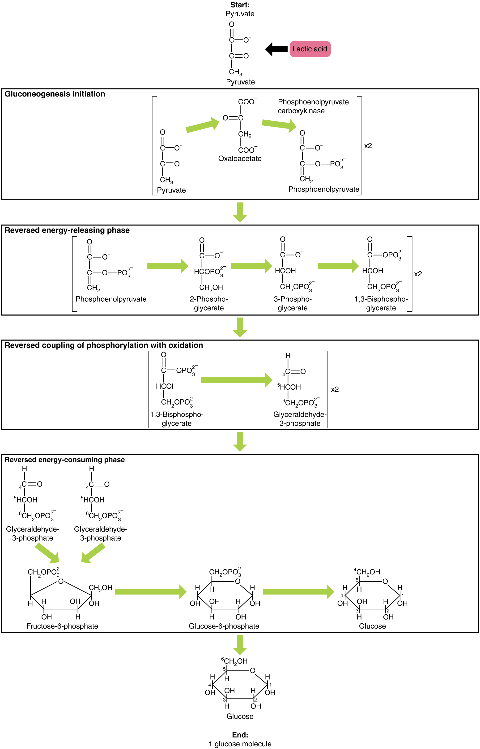
Gluconeogenesis
Gluconeogenesis: forms glucose from non-carbohydrate precursors
  Conversion of protein or fat molecules into glucose
  Glycerol (from fats) may be converted to glyceraldehyde-3-phosphate and some amino acids may be converted to pyruvic acid.
  Both of these compounds may enter the Krebs cycle to provide energy.
Gluconeogenesis is stimulated by cortisol, thyroid hormone, epinephrine, glucagon, and human growth hormone.
Gluconeogenesis is the synthesis of glucose from pyruvate, lactate, glycerol, alanine, or glutamate.

Slide 22
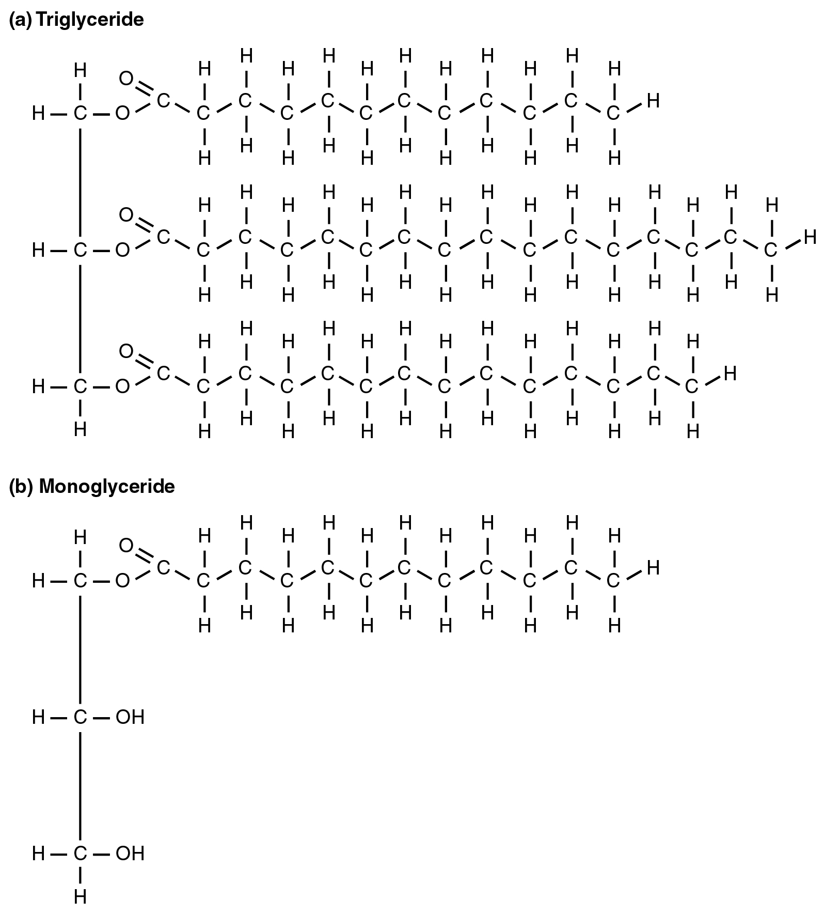
Lipid Metabolism
Lipid metabolism entails the oxidation of fatty acids to either generate energy or synthesize new lipids from smaller constituent molecules
Begins in the small intestine where emulsification by bile salts and pancreatic lipases, lipid digesting enzymes, can breakdown triglycerides into monoglycerides and shorter fatty acid chains.
Free fatty acids are reassembled into triglycerides in the intestinal mucosa cells for transport

Slide 23
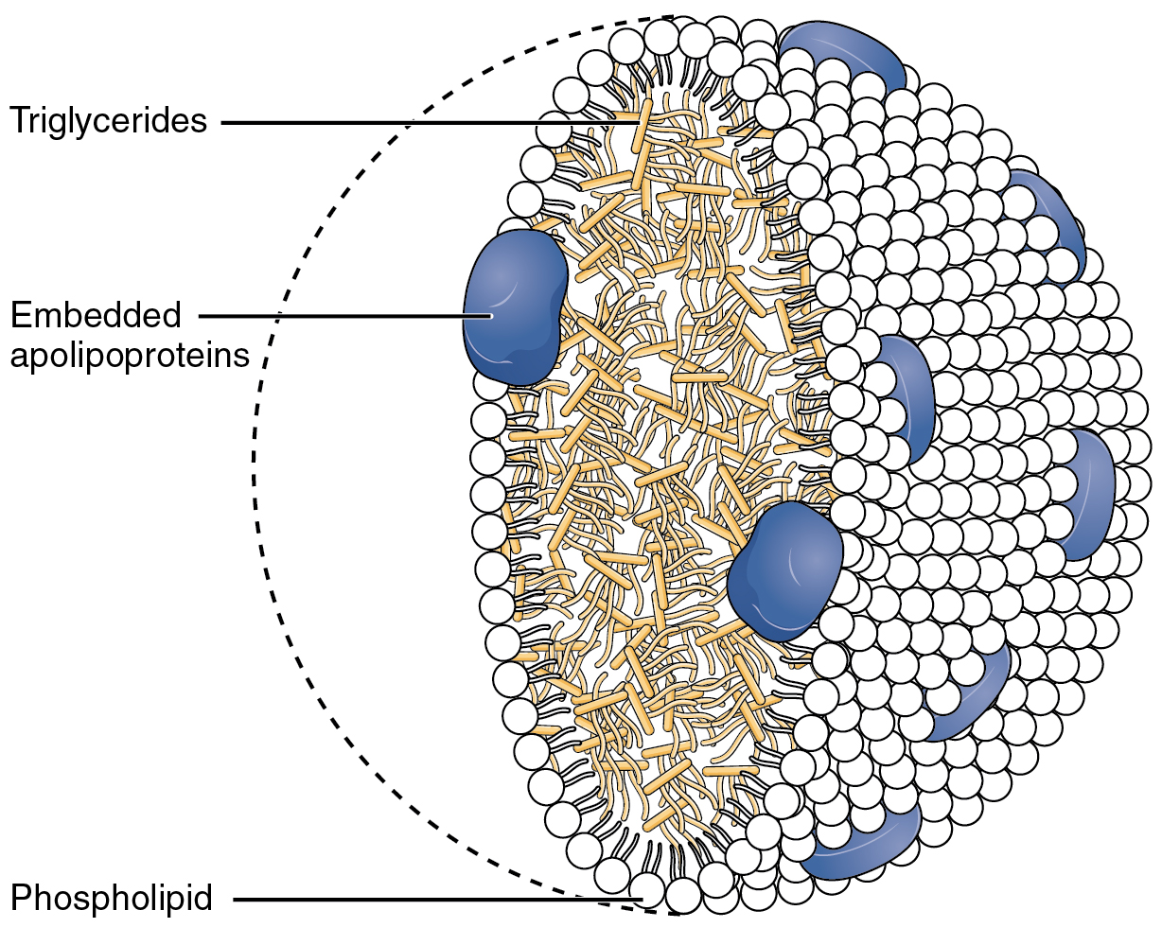
Lipid Transport
Most lipids are transported in the blood in combination with proteins as lipoproteins.
Four classes of lipoproteins are chylomicrons, very low-density lipoproteins (VLDLs), low-density lipoproteins (LDLs), and high-density lipoproteins (HDLs).
  Chylomicrons form in small intestinal mucosal cells and contain exogenous (dietary) lipids. They enter villi lacteals, are carried into the systemic circulation into adipose tissue where their triglyceride fatty acids are released and stored in the adipocytes and used by muscle cells for ATP production.
  VLDLs contain endogenous triglycerides. They are transport vehicles that carry triglycerides synthesized in hepatocytes to adipocytes for storage. VLDLs are converted to LDLs.
  LDLs carry about 75% of total blood cholesterol and deliver it to cells throughout the body. When present in excessive numbers, LDLs deposit cholesterol in and around smooth muscle fibers in arteries.
  HDLs remove excess cholesterol from body cells and transport it to the liver for elimination.

Slide 24
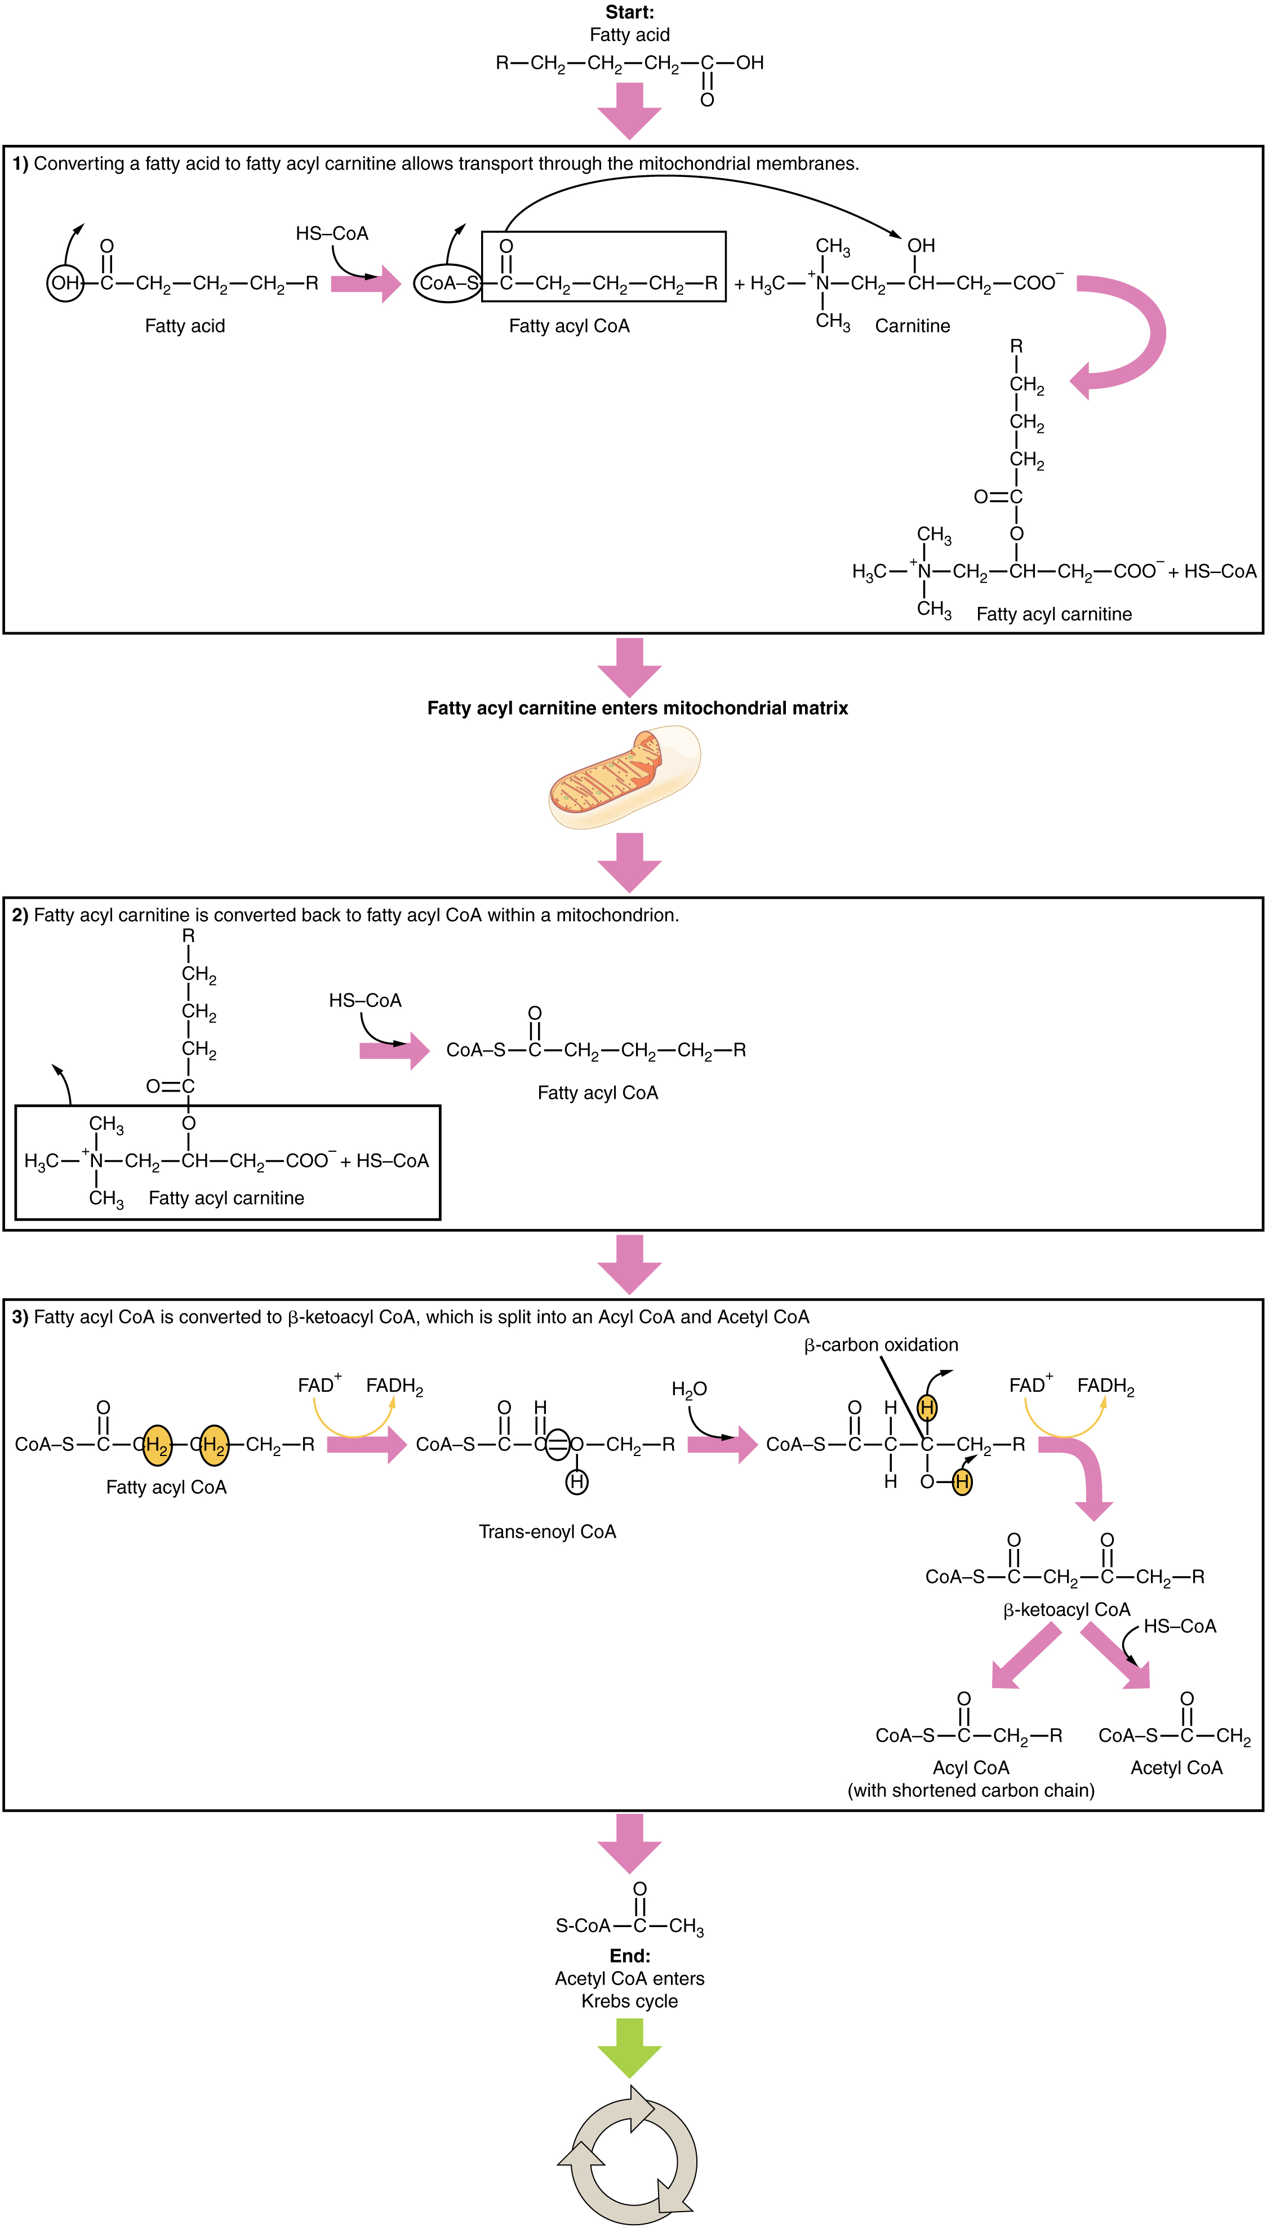
Lipolysis
Lipolysis: breakdown of triglycerides into free fatty acids and glycerol.
  Glycerol can be converted into pyruvate and enter glycolysis.
  Fatty acids undergo fatty acid oxidation, also known as beta (β)-oxidation where they are converted into acetyl-CoA for use in the Krebs cycle.
Energy source when glucose levels are low

Slide 25
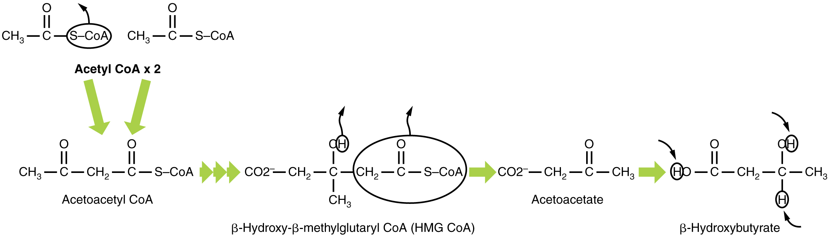
Ketogenesis
Ketogenesis – occurs when excess acetyl CoA from lipolysis is converted into ketone bodies
  Happens when glucose levels are low and the Krebs cycle can’t keep up with the levels of acetyl-CoA that beta (β)- oxidation is producing.
    Common in starvation modes and unmanaged diabetes
  Occurs in liver mitochondria

Slide 26
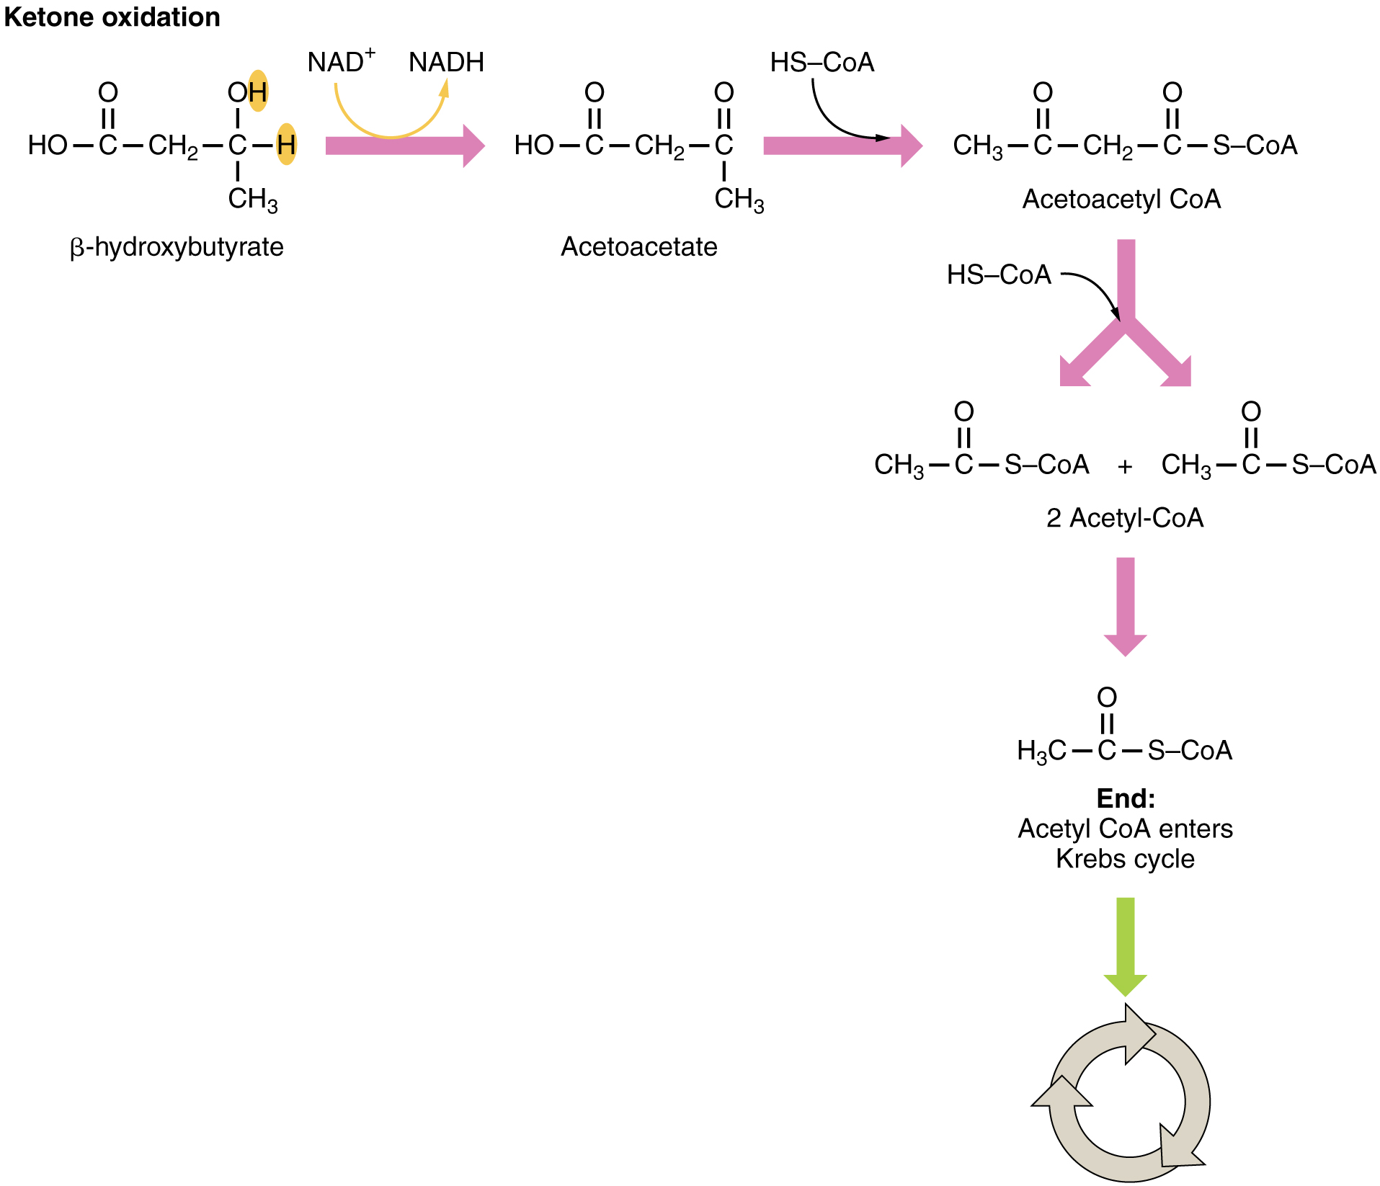
Ketone Oxidation
Ketones are oxidized to acetyl-CoA
Provides an alternate energy source for organs such as the brain when glucose levels are low
Excess ketone oxidation results in excess CO₂ and acetone
  Excess CO₂ acidifies the blood so can lead to ketoacidosis- a drop in blood pH as the CO₂ from the excess ketones accumulates in the blood.
  Excess acetone results in the sickly-sweet breath associated with unmanaged diabetes.

Slide 27
Lipogenesis
Lipogenesis: conversion of glucose or amino acids into lipids
  The process is stimulated by insulin.
  The intermediary links in lipogenesis are glyceraldehyde-3-phosphate and acetyl coenzyme A.
  Creates lipids when excess acetyl CoA is present, either because of the ingestion of excess carbohydrates or triglycerides.
    Subsequent addition of acetyl CoA’s together can make a variety of fatty acid chain lengths.
    Requires ATP, but triglyceride are more compact and stores more energy than carbohydrates, making them more efficient for long term energy supply.

Slide 28
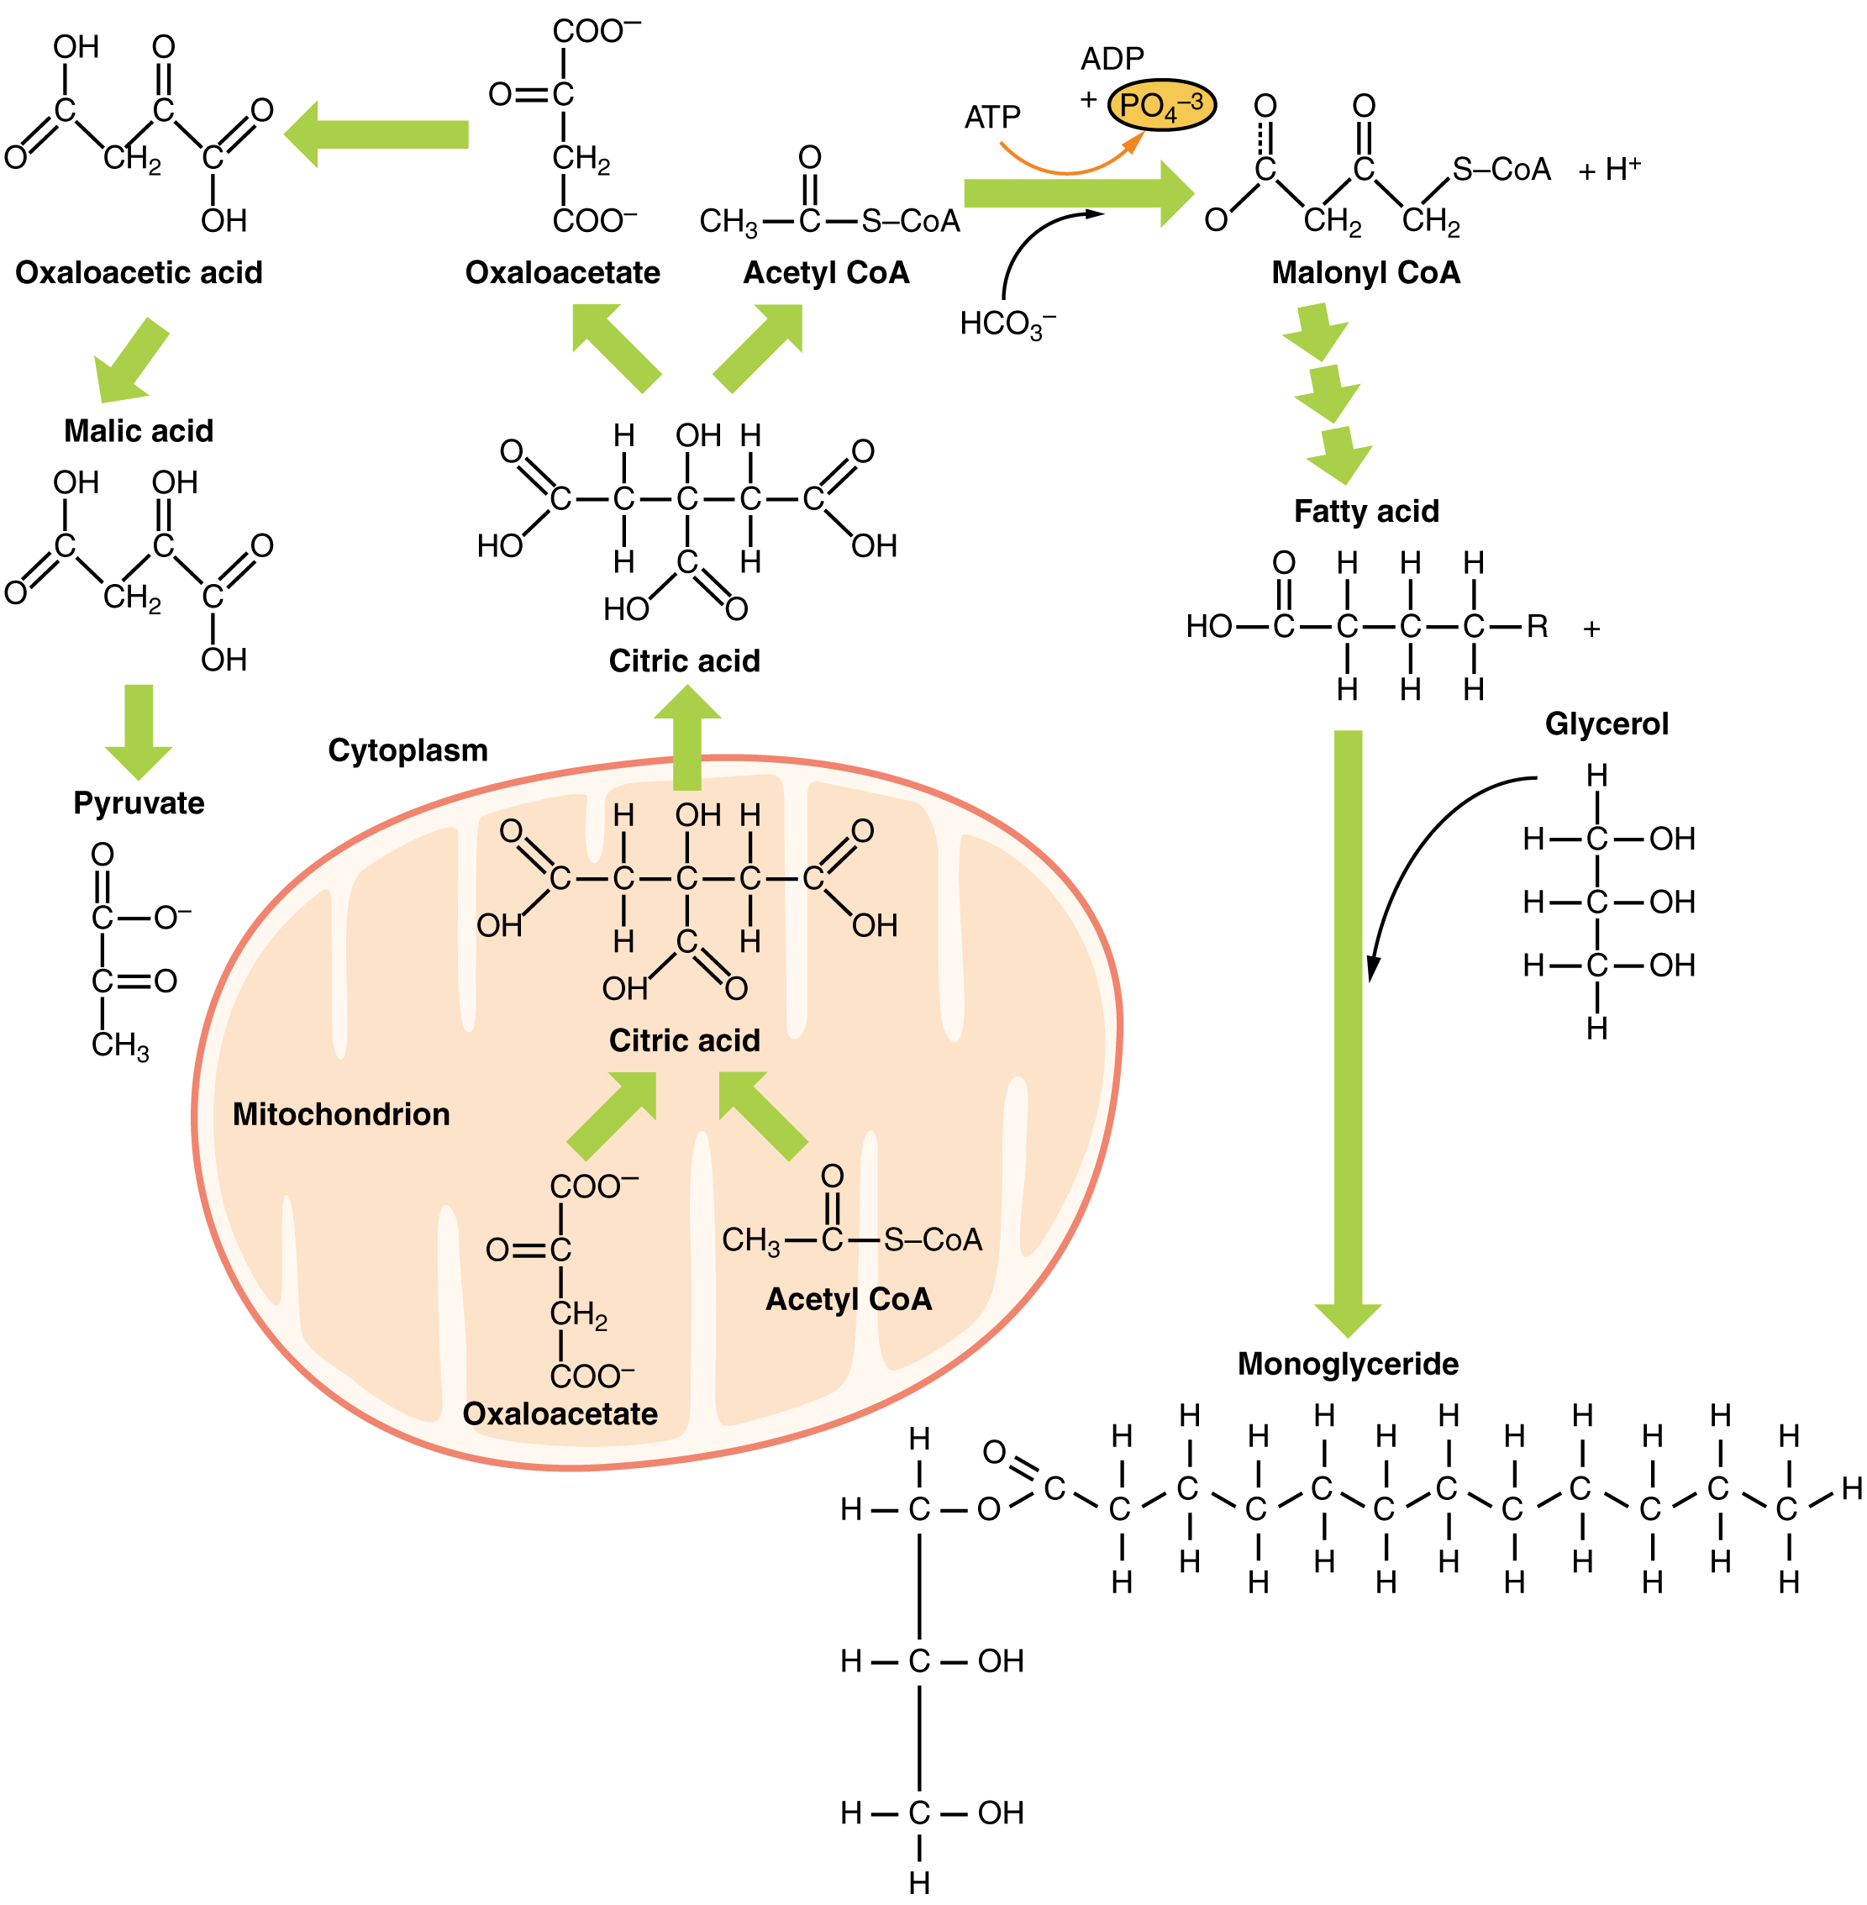
Lipid Metabolism
Lipids may follow one of several pathways during metabolism
Glycerol and fatty acids follow different pathways.

Slide 29
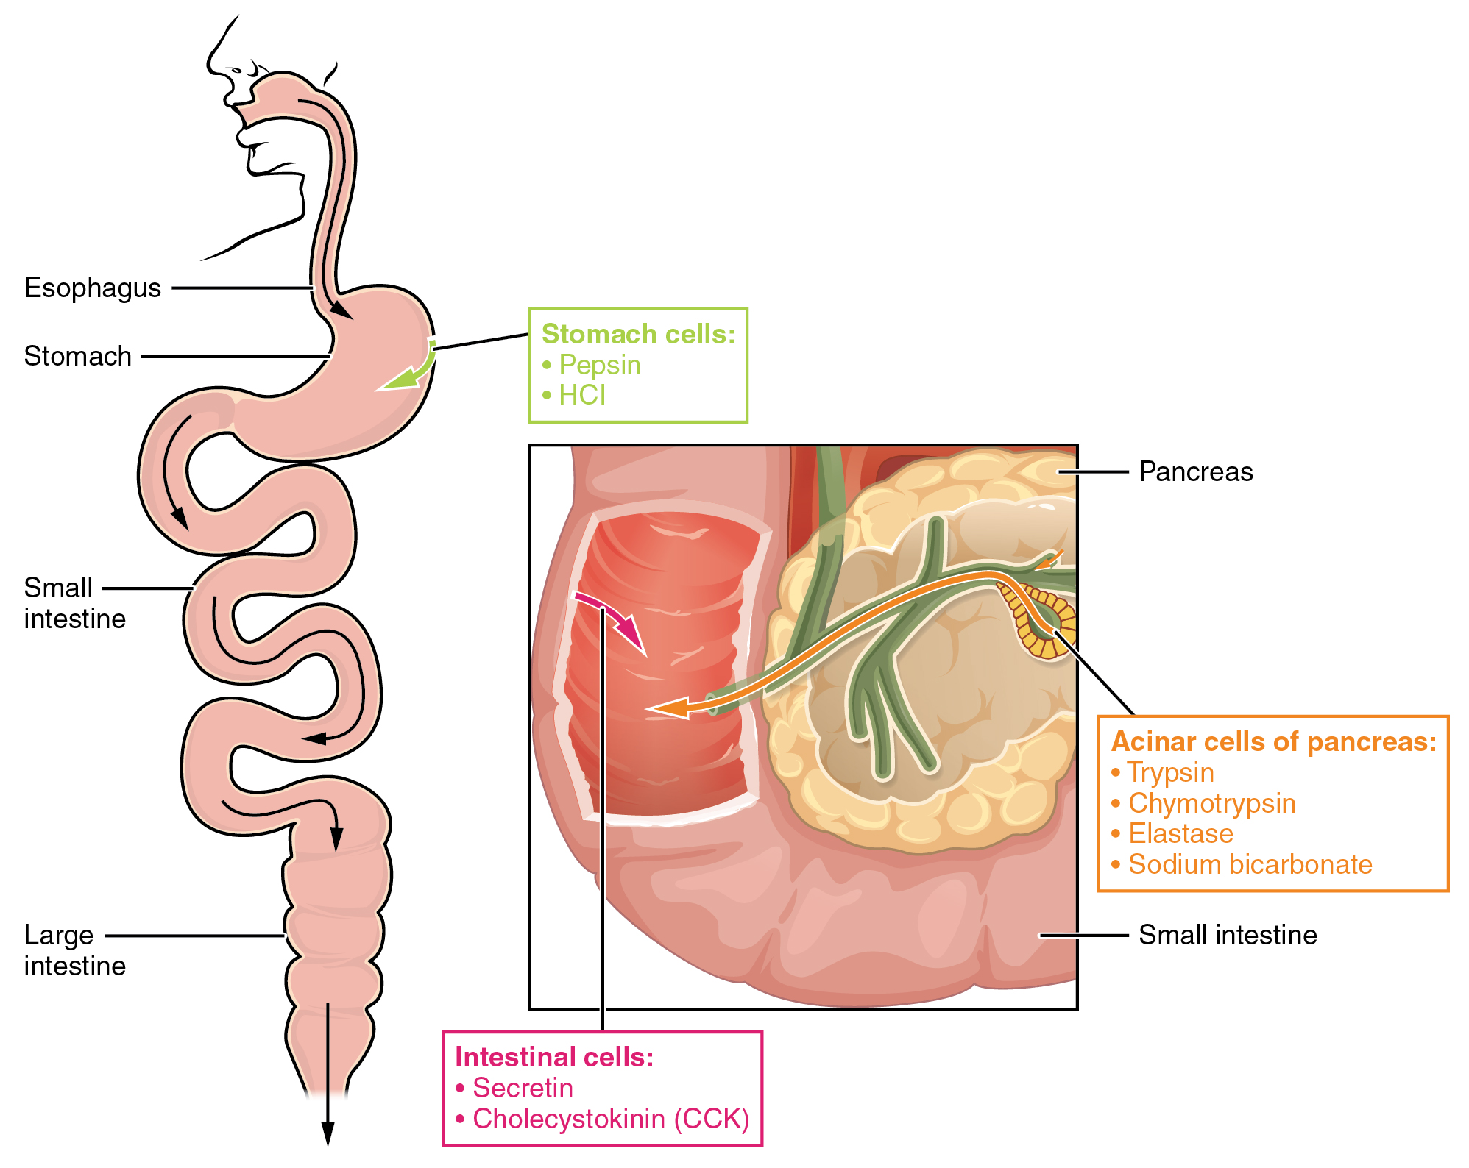
Protein Digesting Enzymes
Proteolysis – the breakdown of proteins into amino acids
Initiated in the stomach by pepsin and aided by the acidic environment created by hydrochloric acid (HCl), proteins are broken down into small polypeptides and amino acids.
As the chyme enters the duodenum, the distension signals the release of secretin and cholecystokinin (CCK).
  Digestive enzymes, in their inactive proenzyme form, are released from the pancreas, along with sodium bicarbonate (NaHCO₃), to continue the breakdown of proteins as well as buffer the small intestine against the acidic nature of chyme.
    Trypsin – converted from trypsinogen in the small intestine by enterokinase in the intestinal mucosa
    Chymotrypsin – converted from chymotrypsinogen by trypsin
    Elastase – a pancreatic protein digesting enzyme
  The resulting amino acids are transported into the intestinal mucosal cells by sodium to be absorbed into the blood for delivery to the liver and body cells for protein synthesis or as fuel for the Krebs Cycle.

Slide 30
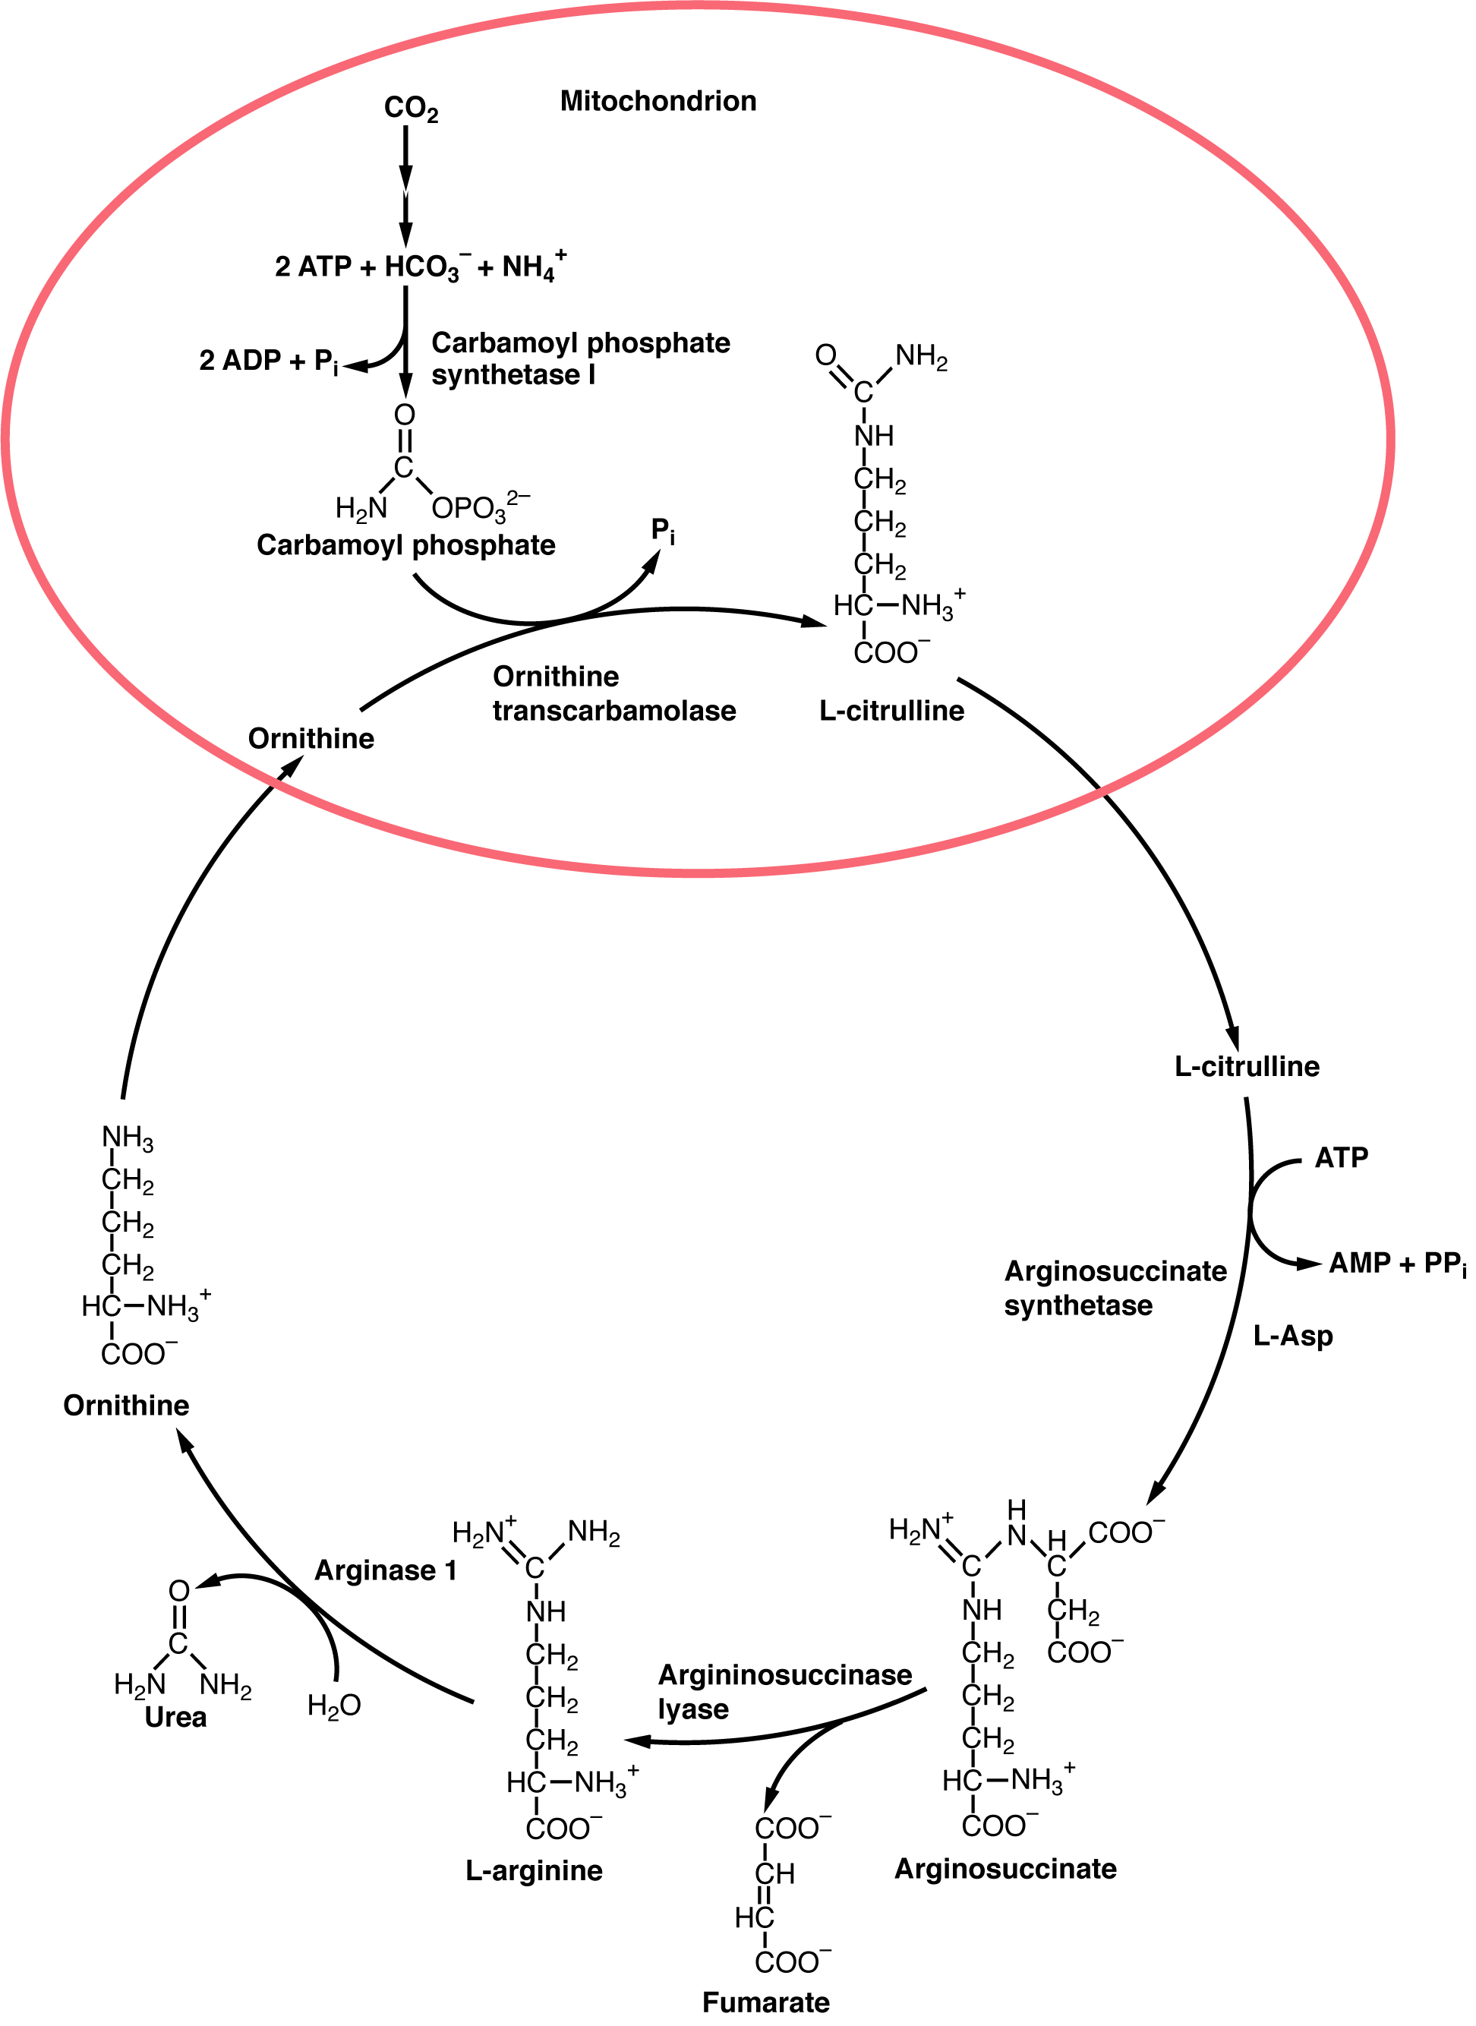
Urea Cycle
A metabolic series of reactions to convert nitrogenous waste from protein metabolism to urea.
Occurs in the liver to clear toxic ammonium ions due to proteolysis
Transamination of existing amino acids synthesizes new amino acids and ammonia
  Forms non-essential amino acids
  Forms intermediates for Krebs cycle (next slide)
This use of amino acids by the body creates ammonium ions that can combine with CO₂ and be converted into for safe excretion in the urine.

Slide 31
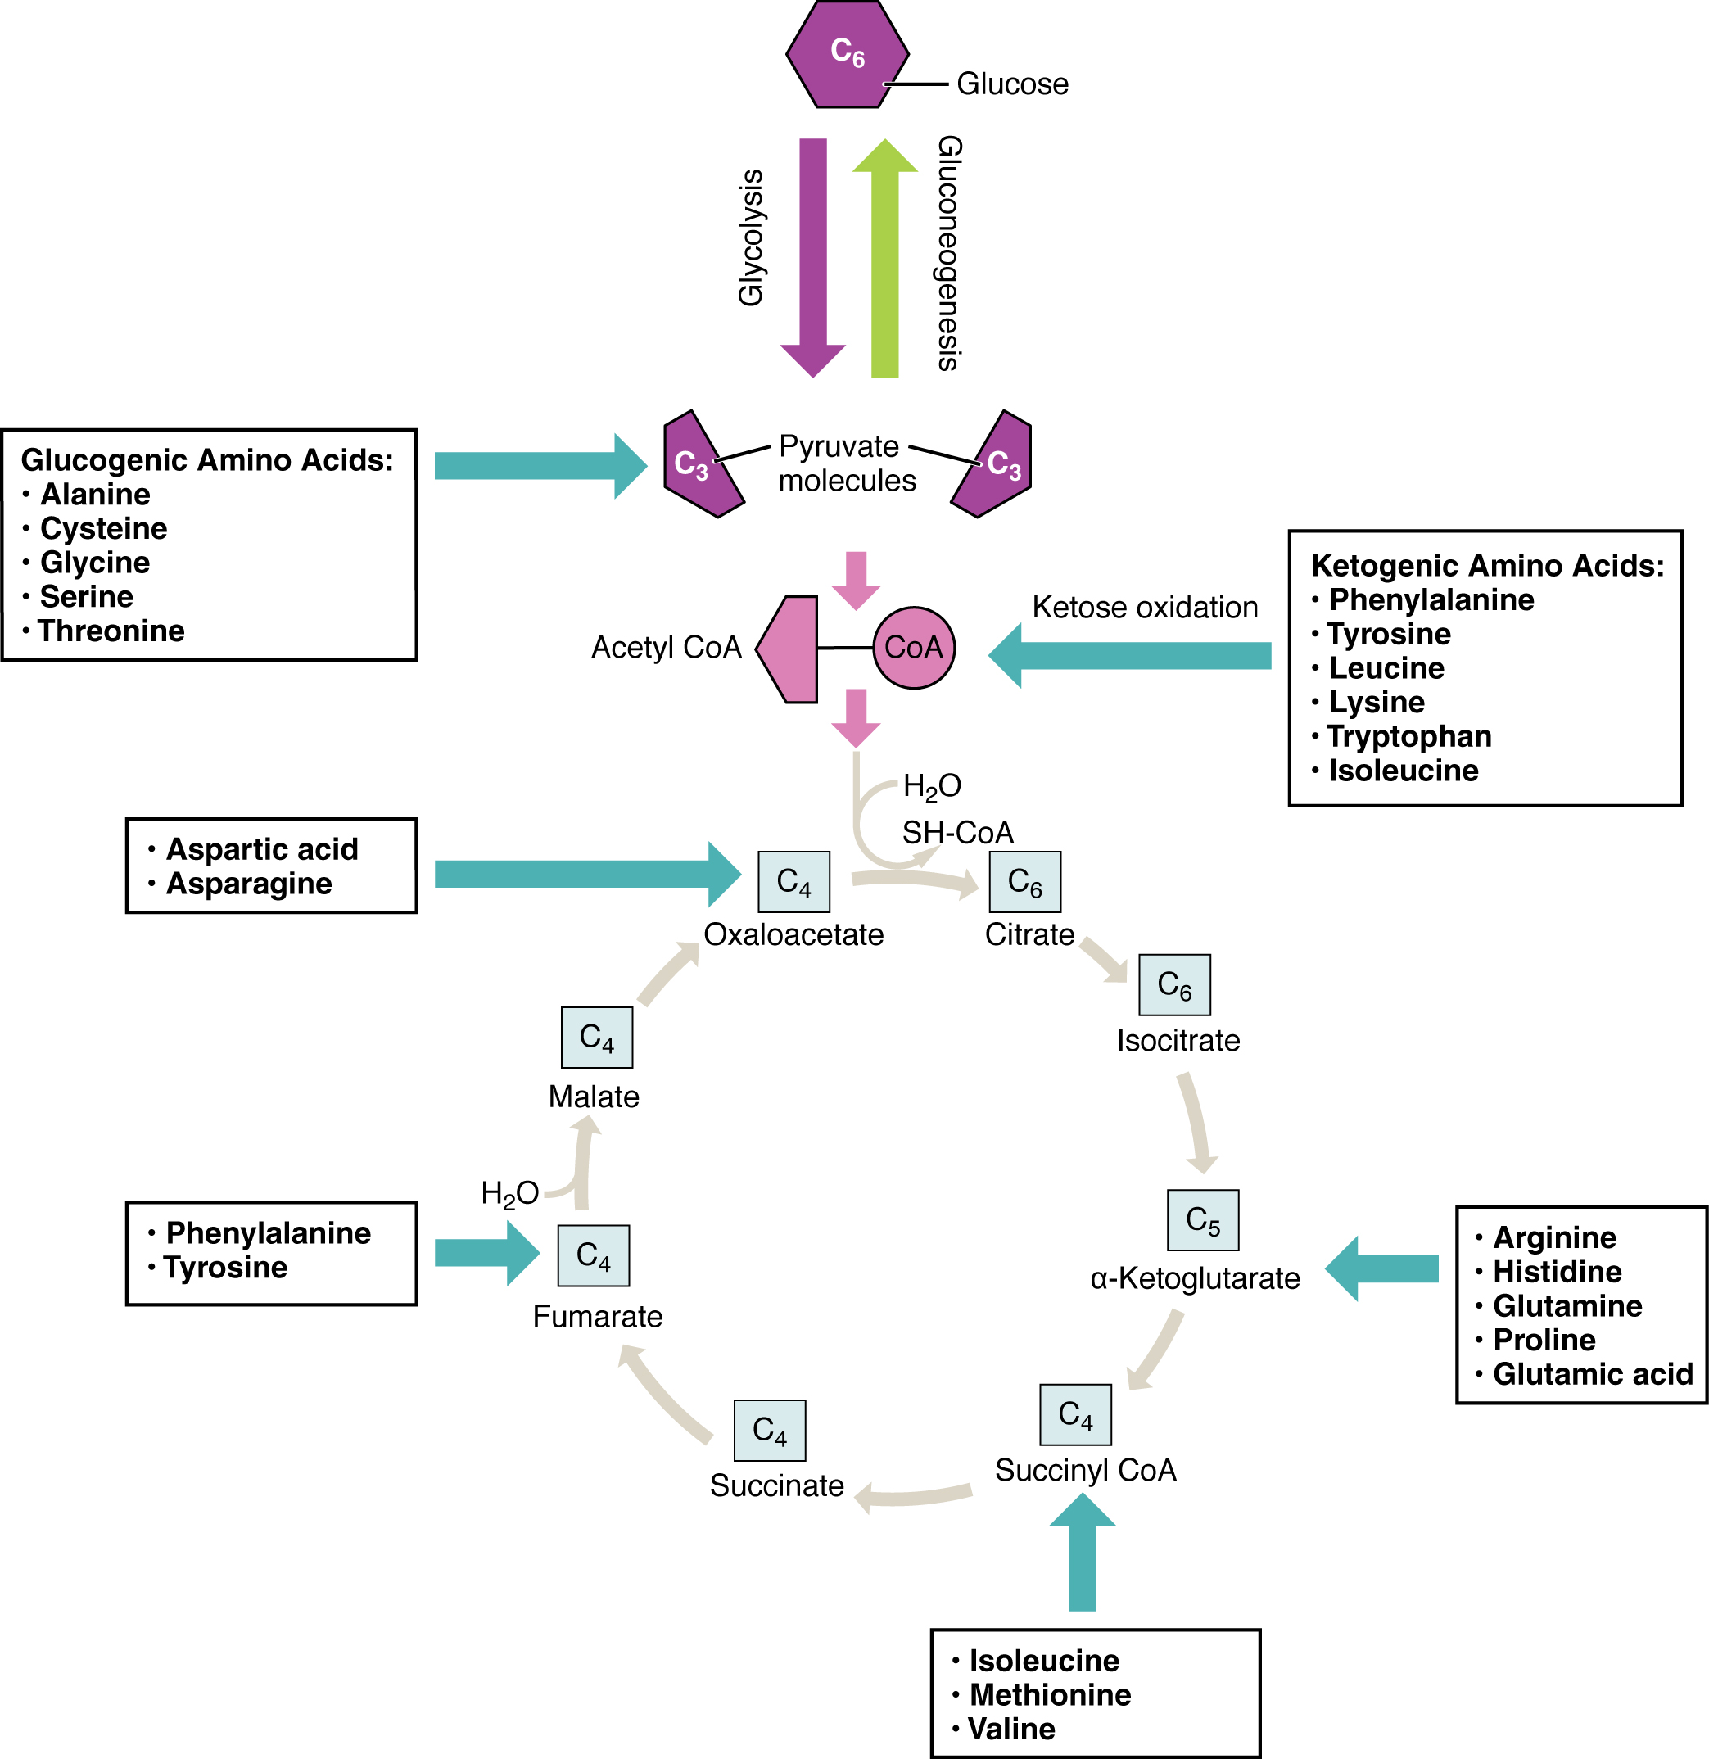
Accessing Energy from Amino Acids
Excess proteins and amino acids can’t be stored
Can be broken down into precursors for glycolysis or the Krebs cycle
The amino acids (bold at right) can enter through more than one pathway

Slide 32
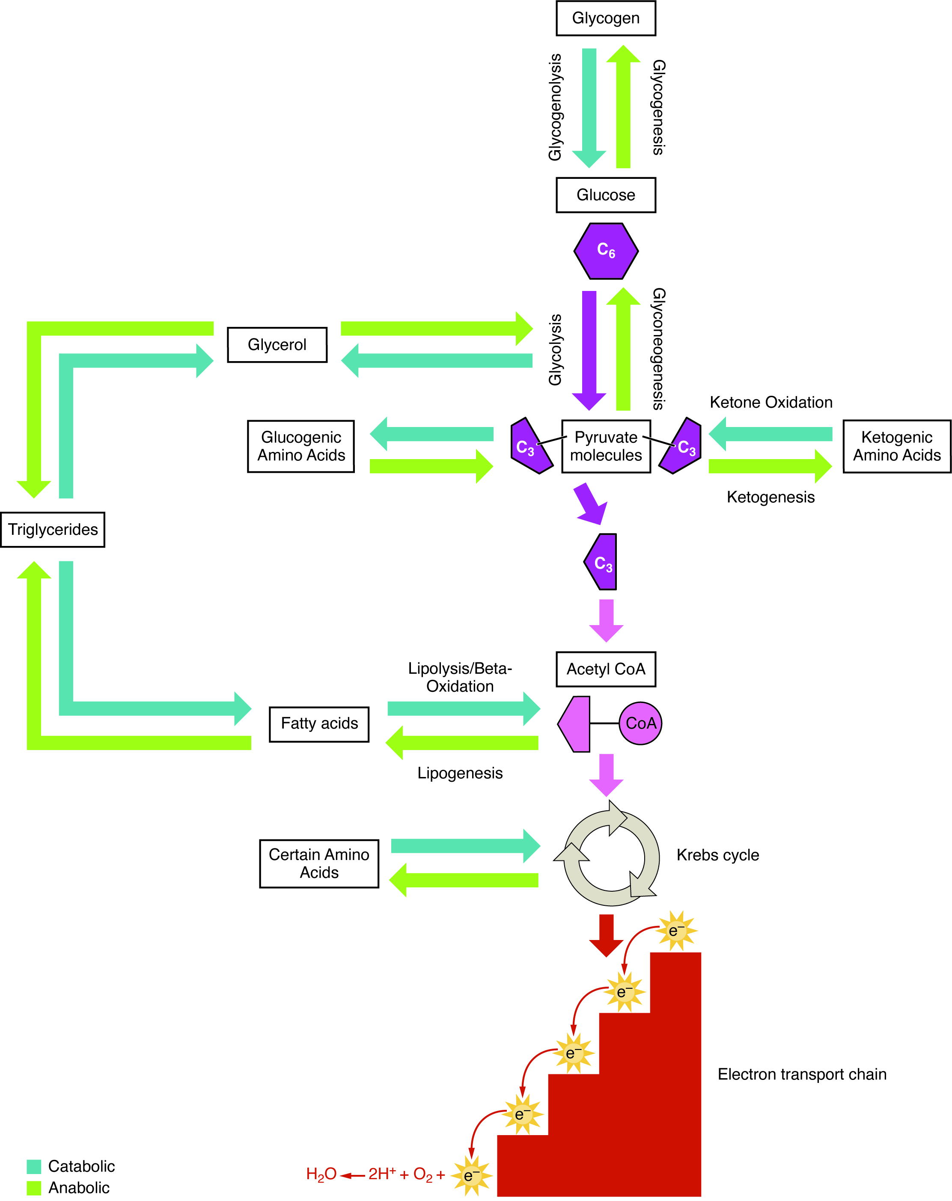
Metabolism Summary
Nutrients follow a complex pathway from ingestion through anabolism and catabolism to energy production

Slide 33
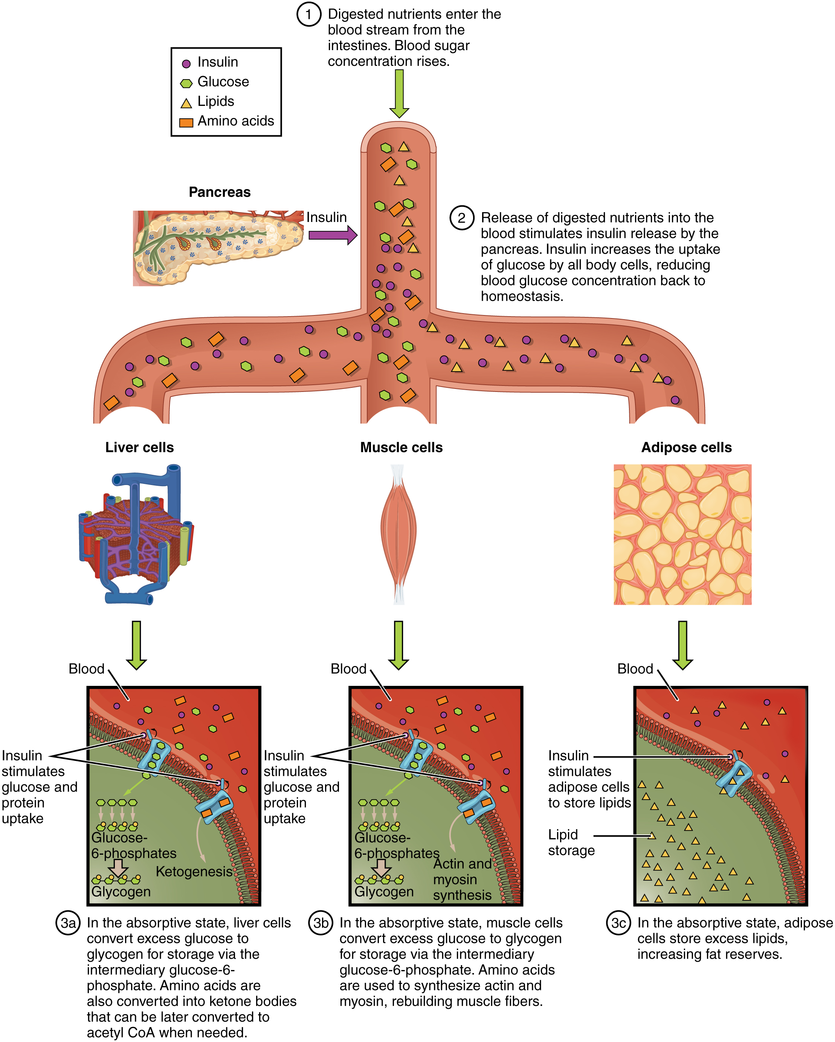
Absorptive State
The energy consumed by the foods we eat are either utilized for immediate use or stored for later to prevent the need to continuously eat while ensuring the body has a continuous source of glucose.
Absorptive State – also known as the fed state, occurs during and immediately after a meal as the GI tract digests and absorbs the food.
  Increase in blood glucose stimulates insulin release for glucose absorption
  When intake is greater than need
    Glucose not immediately needed by the cells can be converted into:
      Glycogen for storage in liver and muscles
      Fat (triglyceride) formation in adipose
    Stimulates most cells to increase amino acid uptake
      Causes accelerated protein synthesis

Slide 34
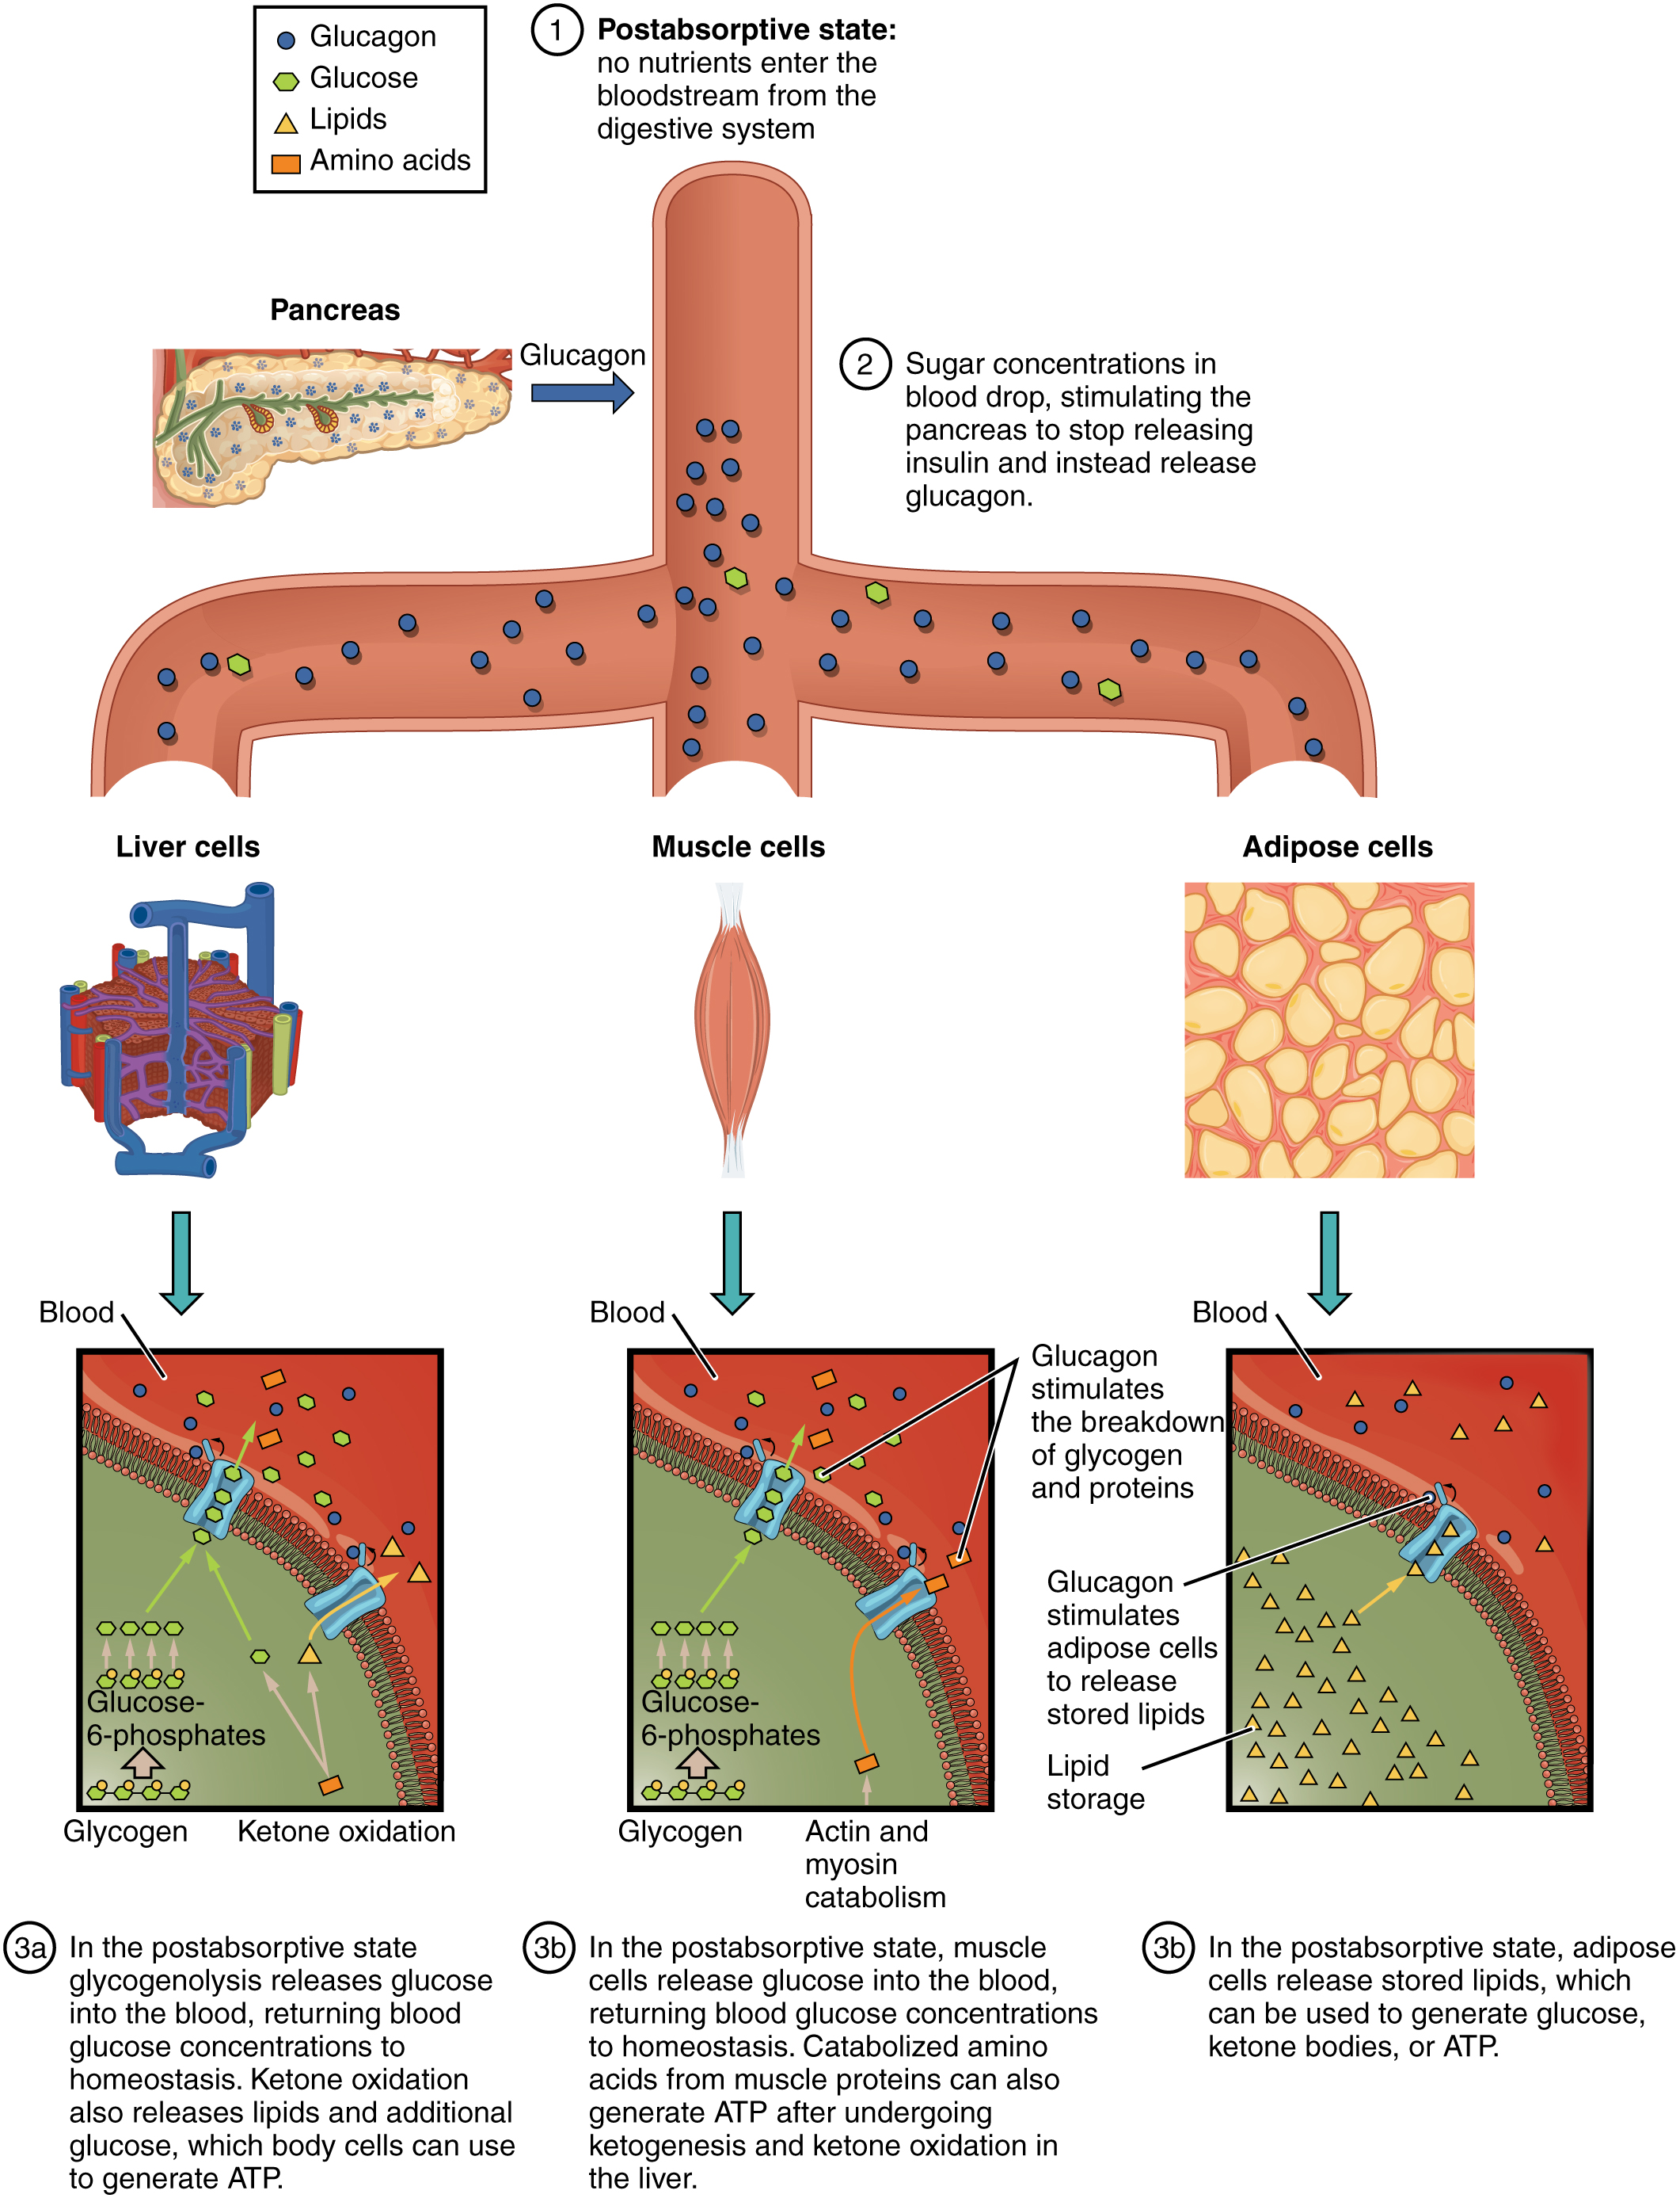
Postabsorptive State
Postabsorptive State – also known as the fasting state, occurs after a meal has been digested, absorbed, and stored.
  Decrease in blood glucose stimulates glucagon release
    Inhibits glycogen synthesis
    Stimulates the liver to start breaking down glycogen stores (glycogenolysis)
    Gluconeogenesis will also be initiated to replace lost liver glycogen stores.

Slide 35
Starvation
Liver and muscle glycogen reserves exhausted
Triaged system for brain glucose and amino acid preservation
‘Glucose sparing’ relies of fatty acids for fuel
  Ketone production for brain
  Beta-oxidation for acetyl-CoA to Krebs
  Gluconeogenesis for additional glucose
Survival dependent on reserves
  Ketone production from fatty acids spares proteins
  Exhaustion of lipid reserves triggers muscle protein use

Slide 36
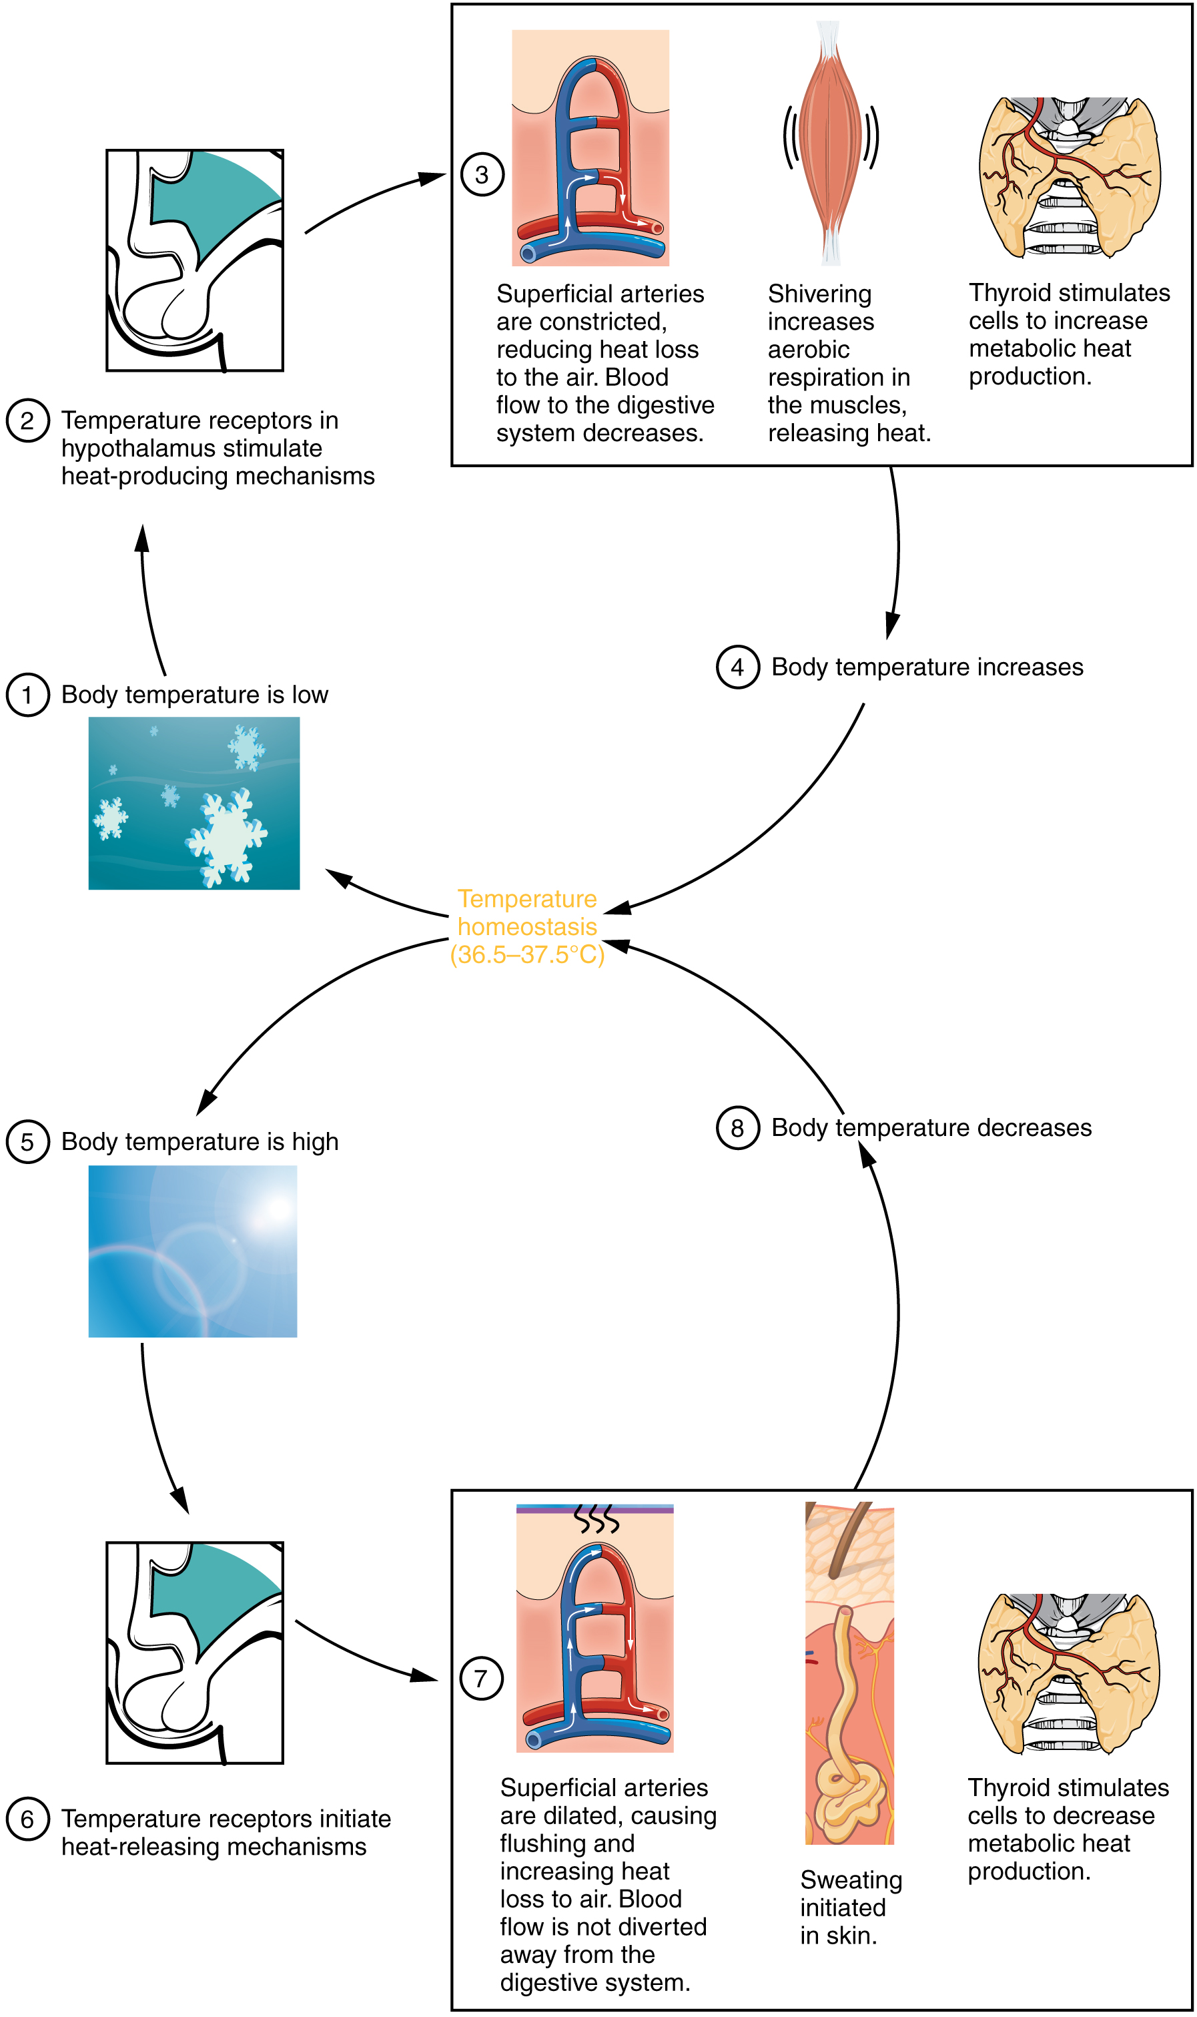
Thermoregulation
Thermoregulation – the body’s maintenance of a specific temperature, generally 36.5 – 37.5°C (97.7 – 99.5°F), despite the current and changing external environment.
  The energy required comes from ATP synthesis, roughly 60% of what is produced.
  The negative feedback system is overseen by the hypothalamus, but also supported by thyroid hormones (e.g. sweating to cool and shivering to warm).

Slide 37
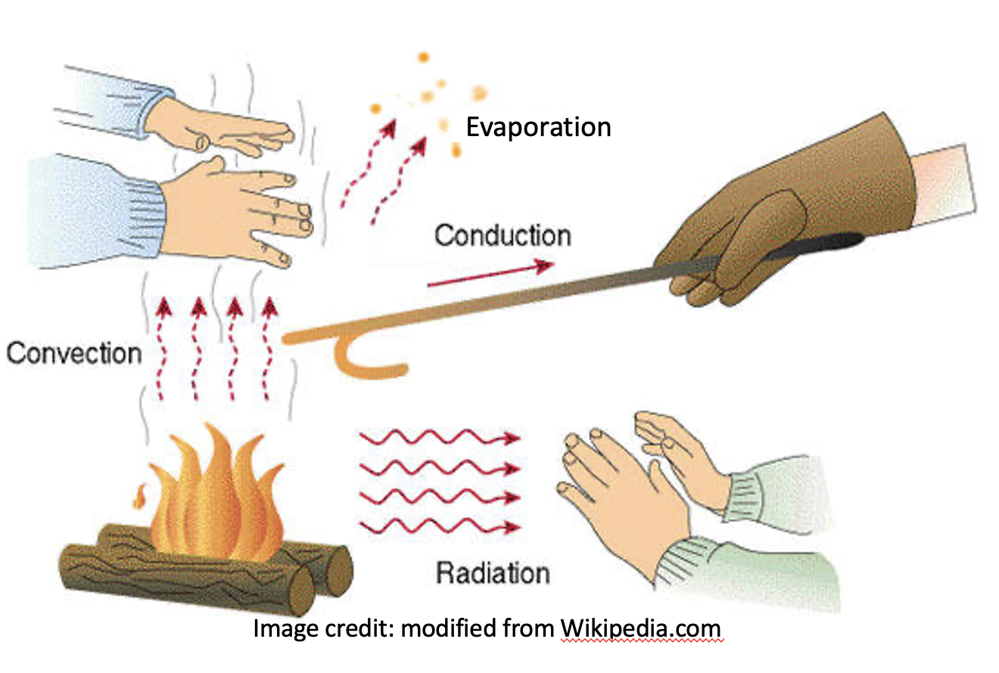
Heat Exchange Mechanisms
The body may employ one of four different mechanisms of heat exchange, which capitalize on the physical properties of heat to move from high concentration to low, to maintain homeostasis when the environment is not thermoneutral.
  Conduction – transfer of heat between two objects in direct contact with each other.
  Convection – transfer of heat to the air surrounding the heated source.
  Radiation – loss of heat in the form of infrared rays.
  Evaporation – transfer of heat by water molecules as the leave a surface.

Slide 38
Basal Metabolic Rate (BMR)
Basal metabolic rate (BMR) – daily amount of energy used by the body at rest, in a temperature neutral environment, in the postabsorptive state.
Distribution of energy use
  70% basic daily activity
  20% physical activity
  10% thermoregulation
Higher with higher activity level or more lean mass
Decreases with age due to loss of lean mass

Slide 39
Energy in our Food
Calories (C) – in the context of these course materials is the nutritional value used to refer to the amount of energy provide by a food item.
  Equivalent to the energy needed to raise 1kg (1000g) of water 1°C and on average we need 1500 to 2000 a day.
  Multiple factors contribute to individual need such as height, activity level, and age.
  Weight gain or loss is tied to the ratio of calories consumed vs calories burned.
  Calories are not created equal as proteins require more energy to metabolize than proteins.
    Varies between macronutrients

Slide 40
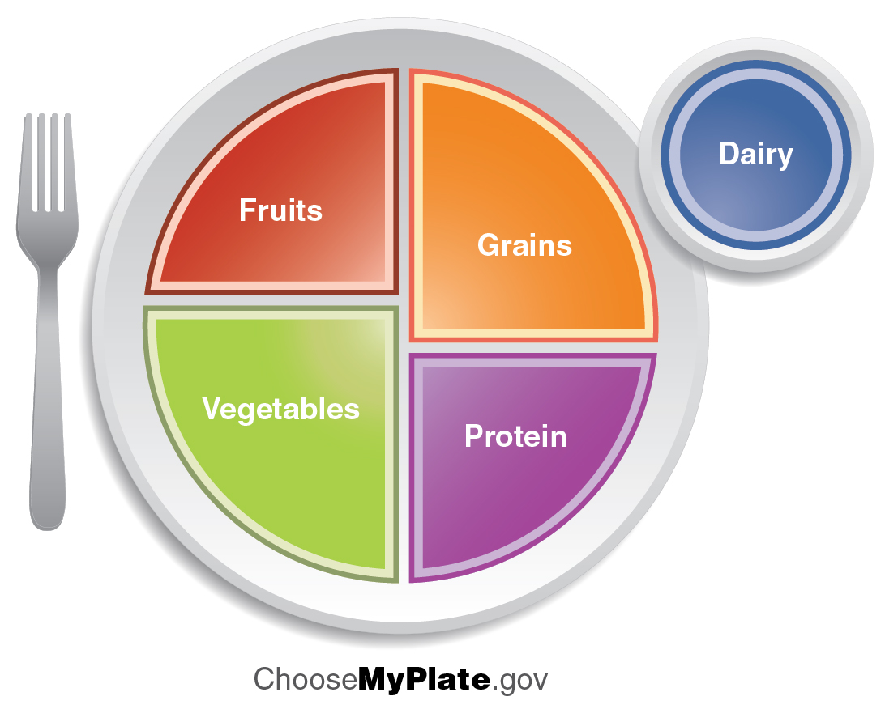
Energy in our Food
MyPlate visually represents the USDA’s current nutritional guidelines in the context of a healthy meal. as portions of a dinner plate.
  Six standard food categories (fruits, vegetables, grains, proteins, dairy, and oils) all represent as a proportion of a dinner plate.
  ChooseMyPlate.gov is the website where examples of each category as well as quantity are detailed.

Slide 41
Vitamins
Vitamins- organic compounds required in small amounts to facilitate the body’s metabolic pathways.
Most are obtained by our diet, but a few are capable of being synthesized in the body.
Classified by their physical properties in water.
  Fat-soluble vitamins
    Include vitamins A, D, E, and K
    Absorbed with lipids in the GI tract, they are transported in the lymphatic fluid and blood as chylomicrons with excess amounts being stored in adipose tissue.
  Water-soluble vitamins
    Absorbed with water in the GI tract, they are transported in the blood with excess amounts being excreted in urine.
    Include the eight B vitamins as well as vitamin C.

Slide 42
Minerals
Minerals – inorganic compounds required in small amounts to facilitate the body’s normal physiology.
  They are only able to be obtained by our diet.
  Classified by the necessary amount needing to be consumed
    Major minerals include calcium, phosphorous, sulfur, sodium, chloride, and magnesium.
    Trace minerals include iron, fluorine, manganese, copper, iodine, selenium, zinc, cobalt, and chromium.

Slide 43
Water Soluble Vitamins
Vitamin | Function | Deficiencies Can Lead To | Sources
Vitamin B₁ (Thiamine) | Needed by the body to process lipids, proteins, and carbohydrates Coenzyme removes CO₂ from organic compounds | Muscle weakness, Beriberi: reduced heart function, CNS problems | Milk, meat, dried beans, whole grains
Vitamin B₂ (Riboflavin) | Takes an active role in metabolism, aiding in the conversion of food to energy (FAD and FMN) | Cracks or sores on the outer surface of the lips (cheliosis); inflammation and redness of the tongue; moist, scaly skin inflammation (seborrheic dermatitis) | Meat, eggs, enriched grains, vegetables
Vitamin B₃ (Niacin) | Used by the body to release energy from carbohydrates and to process alcohol; required for the synthesis of sex hormones; component of coenzyme NAD⁺ and NADP⁺ | Pellagra, which can result in dermatitis, diarrhea, dementia, and death | Meat, eggs, grains, nuts, potatoes
Vitamin B₅ (Pantothenic acid) | Assists in producing energy from foods (lipids, in particular); component of coenzyme A | Fatigue, poor coordination, retarded growth, numbness, tingling of hands and feet | Meat, whole grains, milk, fruits, vegetables
Vitamin B₆ (Pyridoxine) | The principal vitamin for processing amino acids and lipids; also helps convert nutrients into energy | Irritability, depression, confusion, mouth sores or ulcers, anemia, muscular twitching | Meat, dairy products, whole grains, orange juice
Vitamin B₇ (Biotin) | Used in energy and amino acid metabolism, fat synthesis, and fat breakdown; helps the body use blood sugar | Hair loss, dermatitis, depression, numbness and tingling in the extremities; neuromuscular disorders | Meat, eggs, legumes and other vegetables
Vitamin B₉ (Folic acid) | Assists the normal development of cells, especially during fetal development; helps metabolize nucleic and amino acids | Deficiency during pregnancy is associated with birth defects, such as neural tube defects and anemia | Leafy green vegetables, whole wheat, fruits, nuts, legumes
Vitamin B₁₂ (Cobalamin) | Maintains healthy nervous system and assists with blood cell formation; coenzyme in nucleic acid metabolism | Anemia, neurological disorders, numbness, loss of balance | Meat, eggs, animal products
Vitamin C (Ascorbic acid) | Helps maintain connective tissue: bone, cartilage, and dentin; boosts the immune system | Scurvy, which results in bleeding, hair and tooth loss; joint pain and swelling; delayed wound healing | Citrus fruits, broccoli, tomatoes, red sweet bell peppers

Slide 44
Fat Soluble Vitamins
Vitamin | Function | Deficiencies Can Lead To | Sources
Vitamin A (Retinol) | Critical to the development of bones, teeth, and skin; helps maintain eyesight, enhances the immune system, fetal development, gene expression | Night-blindness, skin disorders, impaired immunity | Dark green leafy vegetables, yellow-orange vegetables fruits, milk, butter
Vitamin D | Critical for calcium absorption for bone development and strength; maintains a stable nervous system; maintains a normal and strong heartbeat; helps in blood clotting | Rickets, osteomalacia, immunity | Cod liver oil, milk, egg yolk
Vitamin E (Tocopherol) | Lessens oxidative damage of cells,and prevents lung damage from pollutants; vital to the immune system | Deficiency is rare; anemia, nervous system degeneration | Wheat germ oil, unrefined vegetable oils, nuts, seeds, grains
Vitamin K (Phylloquinone) | Essential to blood clotting | Bleeding and easy bruising | Leafy green vegetables, tea

Slide 45
Minerals
Mineral | Function | Deficiencies Can Lead To | Excess Can Lead To | Sources
*Calcium | Needed for muscle and neuron function; heart health; builds bone and supports synthesis and function of blood cells; nerve function | Osteoporosis, rickets, muscle spasms, impaired growth | Depressed neural function, lethargy and confusion, muscle pain and weakness, calcium salt deposits in soft tissues, kidney stones | Milk, yogurt, fish, green leafy vegetables, legumes
*Chlorine | Needed for production of hydrochloric acid (HCl) in the stomach and nerve function; osmotic balance | Muscle cramps, mood disturbances, reduced appetite | Vomiting | Table salt
Copper (trace amounts) | Required component of many redox enzymes, including cytochrome c oxidase; cofactor for hemoglobin synthesis | Copper deficiency is rare | Rare, abnormal storage in Wilson’s disease | Liver, oysters, cocoa, chocolate, sesame, nuts
Iodine | Required for the synthesis of thyroid hormones | Goiter | Depressed synthesis of thyroid hormones | Seafood, iodized salt, dairy products
Iron | Required for many proteins and enzymes, notably hemoglobin, to prevent anemia | Anemia, which causes poor concentration, fatigue, and poor immune function | Hemochromatosis, damage to liver (cirrhosis and liver cancer), heart, and pancreas (causes diabetes) | Red meat, leafy green vegetables, fish (tuna, salmon), eggs, dried fruits, beans, whole grains
*Magnesium | Required co-factor for ATP formation; bone formation; normal membrane functions; muscle function | Mood disturbances, muscle spasms | Diarrhea | Whole grains, leafy green vegetables
Manganese (trace amounts) | A cofactor in enzyme functions; trace amounts are required | Manganese deficiency is rare | Appears to contribute to obsessive behavior, hallucinations, and violent behavior | Common in most foods
*Greater than 200mg/day required

Slide 46
Minerals (continued)
Mineral | Function | Deficiencies Can Lead To | Excess Can Lead To | Sources
Molybdenum (trace amounts) | Acts as a cofactor for three essential enzymes in humans: sulfite oxidase, xanthine oxidase, and aldehyde oxidase | Molybdenum deficiency is rare
*Phosphorus | A component of bones and teeth; helps regulate acid-base balance; nucleotide synthesis | Weakness, bone abnormalities, calcium loss | Not known, but excess may depress absorption of iron and manganese | Milk, hard cheese, whole grains, meats
*Potassium | Vital for muscles, heart, and nerve function | Cardiac rhythm disturbance, muscle weakness | Usually a complication of renal failure or severe dehydration, but may result from severe alcoholism, paresthesias, muscular weakness, cardiac | Legumes, potato skin, tomatoes, bananas
Selenium (trace amounts) | A cofactor essential to activity of antioxidant enzymes like glutathione peroxidase; trace amounts are required | Selenium deficiency is rare but can cause oxidative damage | Nausea, vomiting, irritability, fatigue, weight loss, loss of hair | Common in most foods
*Sodium | Systemic electrolyte required for many functions; acid-base balance; water balance; nerve function | Muscle cramps, fatigue, reduced appetite | Hypertension and edema | Table salt
Sulfur | Essential constituent of many proteins (insulin), some vitamins (thiamin and biotin), found in mucopolysaccharides present in cartilage tendons and bones | Not known | Not known | Meat, milk, eggs, legumes,
Zinc (trace amounts) | Required for several enzymes such as carboxypeptidase, liver alcohol dehydrogenase, and carbonic anhydrase | Anemia, poor wound healing, can lead to short stature | Difficulty in walking, slurred speech, tremors, interferes with body’s ability to absorb copper, which can lead to weakened immunity | Common in most foods
*Greater than 200mg/day required

Slide 47
Metabolic Disorders
Physiological disruptions
  Cushing Syndrome
  Addison’s disease
Genetic disorders
  Pyruvate Dehydrogenase Complex Deficiency – genetic disorder that results from the lack of the enzyme needed to convert pyruvate to acetyl-CoA which slows progress of the Krebs cycle that effects ATP synthesis and can lead to degenerative diseases effecting the nervous system.
  Phenylketonuria (PKU) – genetic disorder that results from the lack of the enzyme needed to convert phenylalanine (PHE) to tyrosine (TYR) which can lead to toxic levels of accumulation that effect central nervous system development and functioning
Obesity- having a body mass index (BMI) or weight-to-height ratio of 30kg/m² or higher

