Slide 1
Chapter 3: Bacteria and Archaea

Slide 2
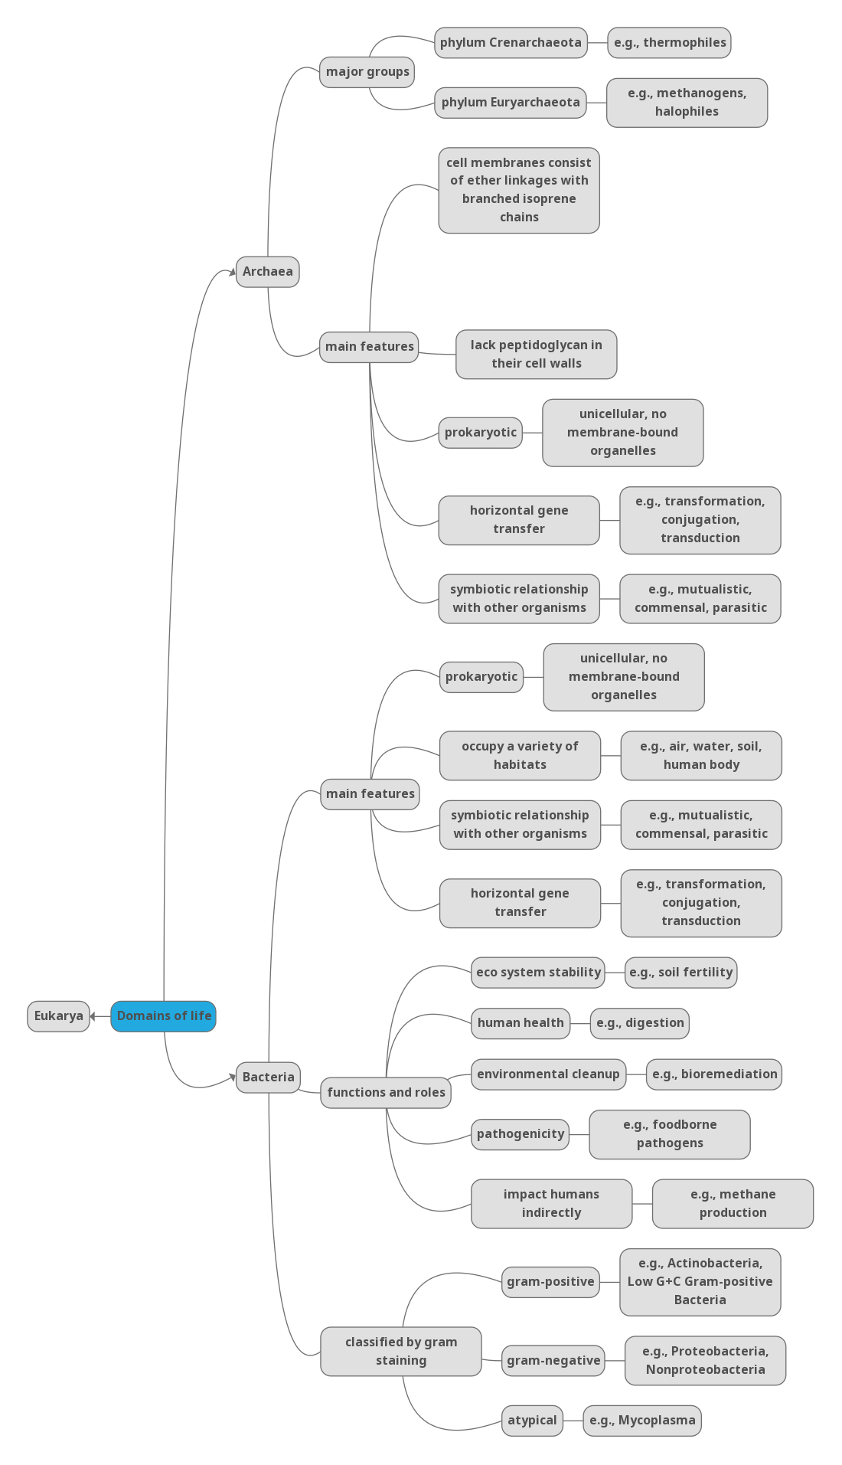
Concept map

Slide 3
Outline
Prokaryote Habitats and Functions
Symbiotic Relationships
Classification by Staining Patterns
Gram-negative bacteria
Gram-positive bacteria
Archaea
Prokaryotic genetics

Slide 4
Prokaryote Habitats and Functions
Describe the major habitats of prokaryotes and how environmental factors shape their distribution.
Explain the diverse functions of prokaryotes, their vast abundance, and their ecological significance across various environments.

Slide 5
Characteristics of Prokaryotes
• Unicellular
• No membrane-bound organelles
• Smaller than eukaryotic cells

Slide 6
Habitats of Prokaryotes
Prokaryotes are incredibly widespread and can thrive in a vast array of environments.
Extreme Environments: They are found in some of the most extreme conditions on Earth, including:
Antarctic ice shield (cold)
High-temperature hot springs (heat)
Deep-sea hydrothermal vents (high pressure, over 1,000 times surface pressure)
Some species, like Paracoccus denitrificans, can even withstand extreme gravitational forces (e.g., ~2.4 g, similar to Jupiter).

Slide 7
Habitats of Prokaryotes (cont.)
Human-Associated Environments: Prokaryotes are also abundant in areas connected to human activities, specifically on and within the human body:
Bacterial cells are roughly equal in number to human cells (though historically thought to outnumber them).
They thrive in the mouth, nasal cavity, throat, ears, gastrointestinal tract, and vagina.
Large colonies are found on healthy human skin, especially in moist areas (armpits, navel, behind ears), but also in drier regions.
Archaea are present in the human gastrointestinal tract, aiding digestion and metabolism.

Slide 8
Prokaryotes in the Air & Their Abundance
Abundant in the Air:
  Found high in the atmosphere.
  Up to 2,000 different kinds of bacteria in the air, similar to soil diversity.
Remarkable Numbers Across Habitats:
  Oceans: Approximately 1×1029 prokaryotic cells globally.
    Surface seawater: About 103 bacteria per microliter.
  Soil: A few grams can contain around a billion (109) bacterial cells.
  Human Body: Hundreds of billions of cells, slightly outnumbering human eukaryotic cells.
These staggering numbers highlight their prolific and diverse presence across Earth's ecosystems.

Slide 9
Why Prokaryotes Thrive: Resilience & Adaptability
Key to Success: Metabolic Flexibility:
  Ability to switch between different energy sources and metabolic pathways based on availability.
Examples of Metabolic Adaptation:
  Cyanobacteria: Can shift from conventional lipid metabolism (fatty aldehydes) to biofuel-generating metabolism (fatty acids, wax esters).
  Groundwater Bacteria: Store complex carbohydrates in pure water, metabolize them when phosphates are abundant.
  Sulfate-Reducing Bacteria: Can switch from reducing sulfates to alternative pathways, producing acids and free hydrogen ions.
This adaptability allows prokaryotes to occupy a wide range of ecological niches, contributing to their ubiquity.

Slide 10
Functions & Impact: Ecosystem Stability (Part 1)
Crucial for Ecosystem Health:
  Soil Formation & Stabilization: Essential for breaking down organic matter and developing biofilms.
  One gram of soil can contain up to 10 billion microorganisms (mostly prokaryotes, ~1,000 species).
  Bacteria utilize plant root substances (acids, carbohydrates) as nutrients.
  They metabolize these substances, returning byproducts to the soil, forming humus and enhancing fertility.
  Extreme Environments: Halobacteria in the Dead Sea decompose dead brine shrimp, providing nourishment for other organisms.

Slide 11
Functions & Impact: Element Cycling & Human Body (Part 2)
Vital for Capturing & Recycling Elements:
  Carbon Fixation: Convert inorganic carbon dioxide into organic products, which animals require for growth.
  Nitrogen Fixation: Convert atmospheric nitrogen into ammonia, essential for plant biomolecules.
    Example: Rhizobium bacteria in root nodules of legumes (clover, alfalfa, peas) produce ammonia for plant nucleic acids.
Essential Roles in the Human Body:
  Digestion: Assist in breaking down complex carbohydrates in the gastrointestinal tract.
  Nutrient Synthesis: Synthesize vital nutrients, such as certain vitamins.
  Immune System Development: Help train the immune system to function correctly.

Slide 12
Functions & Impact: Environmental Cleanup & Risks
Positive Contributions:
  Environmental Cleanup (Bioremediation): Degrade toxic chemicals polluting water and soil.
Potential Risks to Human Health:
  Pathogens: Less than 1% are human pathogens, but they cause many diseases upon entering the body.
  Food Contamination: Can spoil food or cause foodborne illnesses.
Indirect Impacts:
  Climate Change: As permafrost thaws, prokaryotes metabolize released carbon, producing large amounts of carbon dioxide and methane (greenhouse gases), contributing to global warming.

Slide 13
What is in Louisiana
Meanwhile, studies of prokaryotes and their functions in Louisiana have revealed some intriguing findings. One study discovered that Clostridium species were responsible for soft rot in sweet potato storage roots following flooding events in Louisiana. The research highlighted that these bacterial pathogens thrive in waterlogged conditions, exacerbating the decay of agricultural crops.
Another study demonstrated that oil contamination in Louisiana’s coastal salt marshes significantly altered the microbial community structure. This disruption resulted in changes to nutrient cycling, particularly in nitrogen and sulfur biogeochemistry, underscoring the profound environmental impact of oil spills on microbial ecosystems.

Slide 14
Symbiotic Relationships
Identify and differentiate the types of symbiotic relationships involving microbes, including mutualism, commensalism, and parasitism.
Explain the ecological and biological significance of microbial symbioses in natural environments and host organisms.

Slide 15
Prokaryotic Interactions
Ubiquity and Abundance: Prokaryotes engage in numerous interactions due to their widespread presence and large populations.
Interactions with Eukaryotes:
  Plants: Bacteria on roots/leaves derive nutrients and protect plants from pathogens.
  Conversely: Some bacteria are pathogenic to plants, similar to animal/human pathogens.
Prokaryotic Communities:
  Groups of interacting populations (same species in a geographic area).
  Can be cooperative (both benefit) or competitive (one competes for resources).
  Microbial Ecology: The study of these interactions and their impact on microbial communities.

Slide 16
Types of Symbiotic Relationships
Types of Symbiotic Relationships
Symbiosis: Interactions between different species within a community.
Range from mutually beneficial to harmful, or no significant effect.
Type | Population A | Population B
Mutualism | Benefitted | Benefitted
Amensalism | Harmed | Unaffected
Commensalism | Benefitted | Unaffected
Neutralism | Unaffected | Unaffected
Parasitism | Benefitted | Harmed

Slide 17
Mutualism (Syntropy/Crossfeeding)
Definition: Both species benefit from the interaction.
Examples in Humans:
  Bacteroides thetaiotaomicron (intestinal tract):
    Digests complex plant polysaccharides that human enzymes cannot break down.
    Converts them into monosaccharides absorbable by human cells.
  Certain strains of Escherichia coli (gut):
    E. coli uses intestinal contents for nutrients.
    Humans derive vital vitamins (e.g., Vitamin K for blood clotting) from E. coli.
    Note: Not all E. coli strains are mutualistic; some are pathogenic.

Slide 18
Amensalism & Commensalism
Amensalism:
  Definition: One population harms another but remains unaffected itself.
  Bacterial Example: Some species produce bactericidal substances that kill other bacteria.
  Skin Microbiota: Staphylococcus epidermidis and Cutibacterium acnes produce antibacterial bacteriocins that kill potential pathogens, while remaining unaffected.
Commensalism:
  Definition: One organism benefits, while the other is unaffected.
  Example: Staphylococcus epidermidis on human skin.
    Uses dead skin cells as nutrients.
    Humans are typically unaffected (especially with a healthy immune system).
    Note: This relationship can sometimes be considered mutualistic, as S. epidermidis's bacteriocin production can defend against pathogens.

Slide 19
Neutralism & Parasitism
Neutralism:
  Definition: Neither symbiotic organism is affected in any way.
  Example: Coexistence of metabolically active (vegetating) bacteria and dormant endospores.
  Bacillus anthracis: Endospores in soil can germinate when conditions are favorable, coexisting with ungerminated endospores.
Parasitism:
  Definition: One organism benefits while harming the other.
  Example: Relationship between humans and many pathogenic prokaryotes.
  These organisms invade the body, producing toxic substances or causing infectious diseases (e.g., tetanus, diphtheria, tuberculosis, leprosy).

Slide 20
The Human Microbiome
Microbiome: All prokaryotic and eukaryotic microorganisms and their genetic material associated with a specific organism or environment.
Human Microbiome Components:
  Resident Microbiota: Microorganisms that constantly live in or on our bodies.
  Transient Microbiota: Microorganisms temporarily found in the human body, potentially including pathogens.
Influencing Factors: Hygiene and diet can alter both resident and transient microbiota.

Slide 21
Diversity of the Human Microbiota
Amazing Diversity: Not only in species variety but also in preference for different body areas.
Oral Microbiota Example:
  Thousands of commensal or mutualistic bacterial species.
  Preferences for tongue surface, inner cheek, front/back teeth, or gums.
  Oxygen Exposure: Inner cheek has less diverse microbiota due to oxygen exposure.
  Tongue crypts and spaces between teeth have more diverse, anaerobic microbiota (Bacteroides, Fusobacterium).
Individual Differences: Significant variations in prevalence of bacteria like Streptococcus, Haemophilus, Neisseria between individuals.

Slide 22
Microbiota Variation by Body Site & Over Time
Differences by Body Site:
  Cheek: Predominance of Streptococcus.
  Throat, Palatine Tonsil, Saliva: Fewer Streptococcus, more Fusobacterium.
  Gums (Plaque): Predominantly Fusobacterium.
  Intestine: Streptococcus and Fusobacterium disappear; Bacteroides becomes predominant.
Changes Over Time (Within an Individual):
  Initial Colonization: First acquired during natural birth and shortly after.
    Lactobacillus spp. in the vagina increase before natural birth, serving as first colonization.
    Additional microbes acquired from caregivers and environment post-birth.
  Evolution Throughout Life: Microbiome continues to evolve.
  Rapid Shifts: Small intestine microbiota can change significantly (e.g., half different within 9 hours).
  Birth Mode Impact: Vaginal birth leads to Lactobacillus colonization; C-section often leads to skin microbiota microbes (including hospital pathogens), linked to higher disease incidence.

Slide 23
Importance of Resident Microbiota
Niche Occupation: Resident microbiota are crucial for human health by occupying niches that might otherwise be taken by pathogenic microorganisms.
Example: Vaginal Microbiota:
  Lactobacillus spp. are dominant.
  Produce lactic acid, contributing to vaginal acidity.
  Inhibits the growth of pathogenic yeasts (e.g., Candida albicans).
Disruption by Antibiotics:
  Decreases resident microbiota population.
  Increases vaginal pH, favoring yeast growth.
  Can disrupt intestinal and respiratory tract microbiota, increasing risk for secondary infections and long-term pathogen carriage.

Slide 24
Classification by Staining Patterns
Gram-negative bacteria
Describe the diversity within Gram-negative bacteria, highlighting key characteristics of Proteobacteria.
Explain the ecological roles and significance of different Proteobacteria groups.
Identify major Nonproteobacteria groups and summarize their unique features and functions.

Slide 25
Proteobacteria Overview
Diverse Group: Includes many bacteria that are part of the normal human microbiota, as well as numerous pathogens.
Five Classes: Proteobacteria are further divided into:
  Alphaproteobacteria
  Betaproteobacteria
  Gammaproteobacteria
  Deltaproteobacteria
  Epsilonproteobacteria
Alphaproteobacteria
Intracellular Nature: Many are obligate or facultative intracellular bacteria (live inside host cells).
Oligotrophs: Some species are oligotrophs, meaning they can thrive in low-nutrient environments such as:
  Deep oceanic sediments
  Glacial ice
  Deep undersurface soil

Slide 26
Alphaproteobacteria: Rickettsia
Obligate Intracellular Pathogens: Rickettsia are a notable group within Alphaproteobacteria.
  They require part of their life cycle to occur inside other cells (host cells).
  Outside a host cell, Rickettsia are metabolically inactive.
  Energy Dependency: They cannot synthesize their own ATP (adenosine triphosphate) and must rely on host cells for energy.
Serious Human Pathogens: Rickettsia species cause several severe human diseases.
  Example: Rickettsia rickettsii
    Causes Rocky Mountain spotted fever, a life-threatening form of meningoencephalitis (inflammation of brain membranes).
    Infects ticks and can be transmitted to humans through the bite of an infected tick.

Slide 27
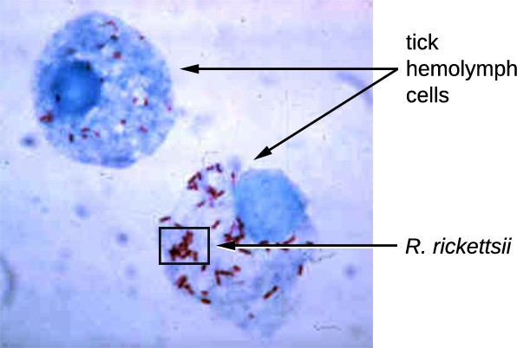
Figure 3.1. Rickettsias require special staining methods to see them under a microscope.

Slide 28
Rickettsia and Typhus
Rickettsia prowazekii
Spread by lice
Causes epidemic typhus, a severe disease common in warfare and mass migrations
Infects endothelial cells → inflammation of blood vessels
Symptoms: High fever, abdominal pain, delirium
Rickettsia typhi
Causes murine (endemic) typhus
Spread by fleas, less severe than epidemic typhus
Still observed in the southwestern U.S. during warm seasons

Slide 29
Alphaproteobacteria Highlights
Genus | Morphology | Unique Traits
Rickettsia | Gram-negative, pleomorphic | Obligate intracellular; causes typhus, spread by ticks/lice
Bartonella | Pleomorphic, flagellated coccobacillus | Transmitted by lice/fleas; causes trench fever, cat scratch
Brucella | Small flagellated coccobacillus | Transmitted via contaminated milk; causes brucellosis
Rhizobium | Rectangular bacilli, cluster-forming | Nitrogen-fixing; symbiotic with legumes
Caulobacter | Bacillus with stalk | Model for cell cycle research

Slide 30
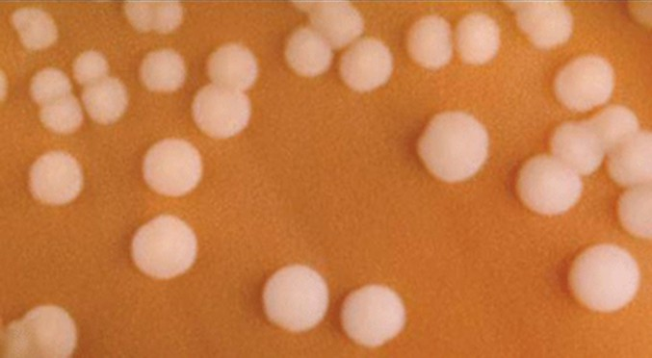
Figure 3.2. Neisseria meningitidis growing in colonies on a chocolate agar plate.

Slide 31
Betaproteobacteria and Pertussis
Bordetella pertussis
Pathogen responsible for whooping cough (pertussis)
Belongs to order Burkholderiales in Betaproteobacteria
Produces toxins that:
  Paralyze cilia in the respiratory tract
  Damage respiratory cells
  Cause severe coughing fits

Slide 32
Key Genera in Betaproteobacteria
Genus | Morphology | Notable Features
Bordetella | Small, gram-negative coccobacillus | Aerobic, fastidious; causes pertussis
Burkholderia | Gram-negative bacillus | Aquatic; infects CF patients; causes nosocomial infections
Neisseria | Coffee-bean shaped diplococcus | Causes gonorrhea and meningitis; requires chocolate agar
Leptothrix | Sheathed, filamentous bacillus | Oxidizes iron/manganese; clogs water pipes
Thiobacillus | Gram-negative bacillus | Thermophilic and acidophilic; oxidizes iron/sulfur

Slide 33
Gammaproteobacteria – Diverse and Pathogenic
Pseudomonas aeruginosa
Highly motile, strictly aerobic, and biofilm-forming
Causes:
  Wound and burn infections
  UTIs
  Respiratory infections in CF and ventilated patients
Resistant to many antibiotics
Other Notables
Pasteurella: animal-to-human infections, e.g., P. multocida via bites
Haemophilus influenzae: causes respiratory infections, once a major cause of meningitis
Vibrio cholerae: causes cholera (profuse diarrhea, dehydration)
Aliivibrio fischeri: symbiotic bioluminescence in squid

Slide 34
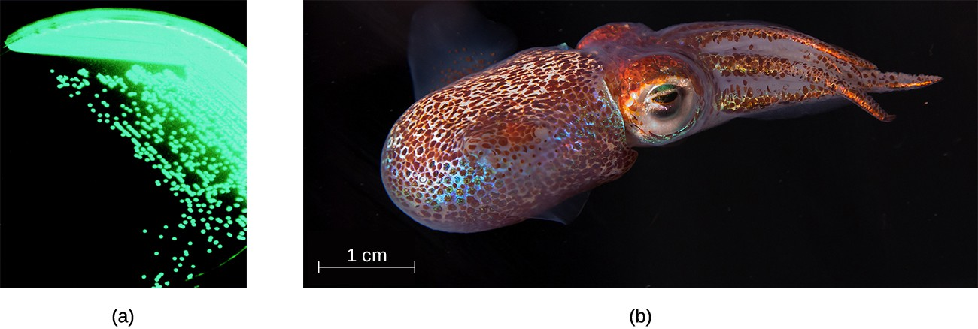
Figure 3.3. (a) Aliivibrio fischeri is a bioluminescent bacterium. (b) A. fischeri colonizes and lives in a mutualistic relationship with the Hawaiian bobtail squid (Euprymna scolopes).

Slide 35
Gammaproteobacteria – Key Pathogens
Legionella pneumophila
Causes Legionnaires disease
Found in warm aquatic environments (e.g., A/C units)
Spreads via aerosols → building-wide outbreaks
First identified in 1976, Philadelphia (American Legion convention)
Enterobacteriaceae Family
Enteric, facultative anaerobes, ferment carbohydrates
Two groups:
  Coliforms (e.g., E. coli): ferment lactose completely (acid + gas)
  Noncoliforms (e.g., Salmonella, Shigella, Yersinia): incomplete/no lactose fermentation

Slide 36
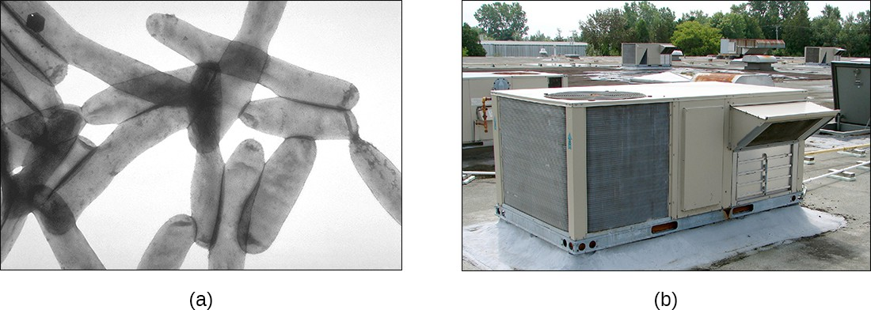
Figure 3.4. Legionella pneumophila, the causative agent of Legionnaires disease, thrives in warm water. (b) Outbreaks of Legionnaires disease often originate in the air conditioning units of large buildings when water in or near the system becomes contaminated with L. pneumophila.

Slide 37
Enteric Pathogens – Focus on E. coli & Salmonella
Escherichia coli
Usually mutualistic; produces vitamin K
Pathogenic strains (e.g., E. coli O157:H7) produce Shiga toxin
  Inhibits protein synthesis → cell death, hemorrhagic colitis
  Can lead to hemolytic uremic syndrome
Salmonella spp.
Includes many serotypes (not species)
Causes salmonellosis (vomiting, diarrhea, intestinal inflammation)
S. enterica serovar Typhi → Typhoid fever
  Symptoms: fever, abdominal pain, skin rash

Slide 38
Additional Gammaproteobacteria Highlights
Genus | Disease/Role
Klebsiella | Pneumonia in alcoholics; encapsulated, nonmotile
Proteus | UTIs, sepsis; urease-producing, motile
Pseudomonas | Hospital-acquired & CF infections; biofilm-forming
Shigella | Dysentery; produces Shiga toxin
Vibrio | Cholera, wound infections; marine, toxin-producing
Yersinia | Plague (Y. pestis); diarrhea (Y. enterocolitica)

Slide 39
Deltaproteobacteria – Unique Behaviors
Sulfate-Reducing Bacteria (SRBs)
Use sulfate as electron acceptor
Desulfovibrio orale linked to gum disease
Bdellovibrio
Parasite of gram-negative bacteria
Invades periplasmic space, feeds on host
Kills host from within
Myxobacteria
Social, soil-dwelling bacteria
Form fruiting bodies and myxospores
Still being studied for complex multicellular behavior

Slide 40
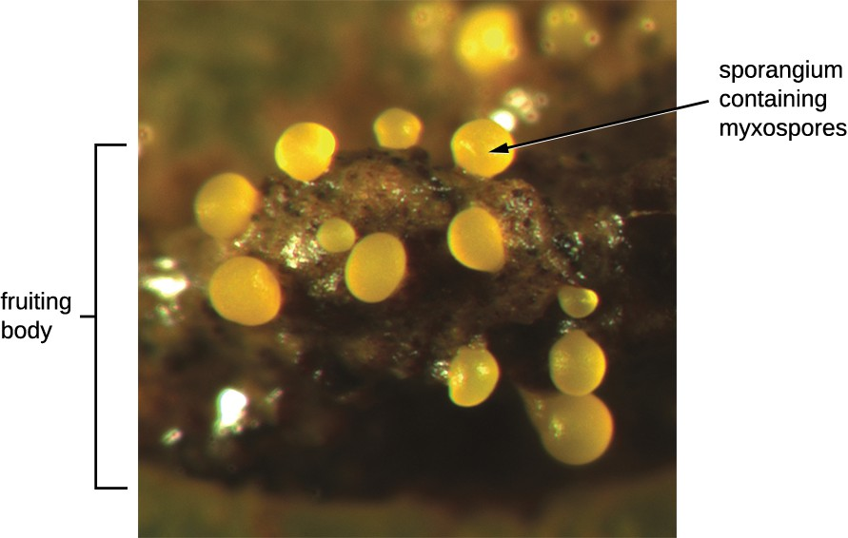
FIGURE 3.5 Myxobacteria form fruiting bodies.

Slide 41
Deltaproteobacteria – Unique Bacteria with Specialized Roles
Genus | Morphology | Unique Characteristics
Bdellovibrio | Gram-negative, comma-shaped rod | Obligate aerobes; motile; parasitize other bacteria
Desulfovibrio | Gram-negative, comma-shaped rod | Reduce sulfur; used in toxic/radioactive waste cleanup
Myxobacterium | Gram-negative, coccoid (colonies) | Gliding motility; model for cell communication studies

Slide 42
Epsilonproteobacteria – Microaerophilic Pathogens
Genus | Morphology | Unique Characteristics
Campylobacter | Gram-negative, spiral-shaped rod | Microaerophilic; C. jejuni causes foodborne enteritis (often from poultry)
Helicobacter | Gram-negative, spiral-shaped rod | H. pylori linked to gastritis, ulcers, and stomach cancer; urease-producing

Slide 43
Chlamydia – Intracellular Specialists
Chlamydia spp. are gram-negative, coccoid/ovoid, and obligate intracellular pathogens
Spread via elementary bodies (inactive, infectious form)
Inside host cells, they become active and replicate
C. trachomatis causes:
  Trachoma (eye infection → blindness)
  Lymphogranuloma venereum (LGV) – a common, highly contagious STD

Slide 44
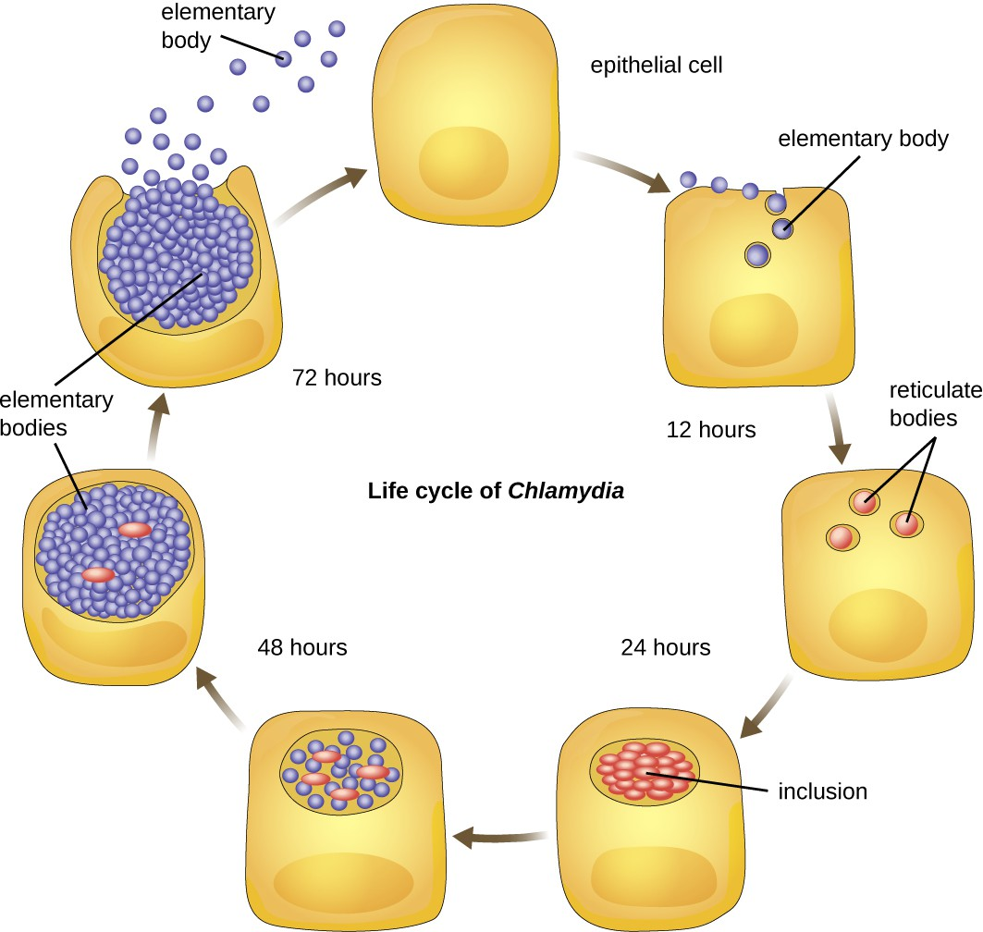
Figure 3.6.Chlamydia begins infection of a host when the metabolically inactive elementary bodies enter an epithelial cell.

Slide 45
Spirochetes – Motile, Spiral Bacteria
Genus | Unique Traits
Treponema | T. pallidum pallidum causes syphilis (3rd most common U.S. STD)
Borrelia | B. burgdorferi causes Lyme disease; B. recurrens causes relapsing fever
Leptospira | Found in water; zoonotic (via urine); can cause severe systemic disease
Darkfield microscopy required due to extreme thinness
Motility from axial filaments (internal flagella)

Slide 46
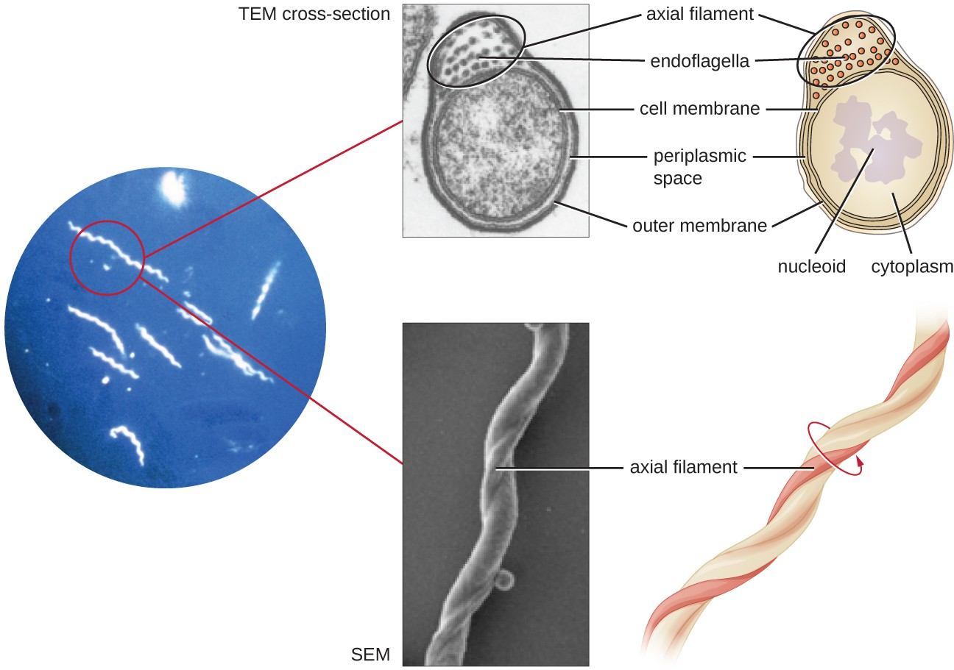
Figure 3.7. Spirochetes are typically observed using darkfield microscopy (left). However, electron microscopy (top center, bottom center) provides a more detailed view of their cellular morphology. The flagella found between the inner and outer membranes of spirochetes wrap around the bacterium, causing a twisting motion used for locomotion.

Slide 47
CFB Group – Anaerobic Fermenters of the Gut & Environment
Genus | Environment | Functions/Pathogenicity
Cytophaga | Aquatic/soil | Motile by gliding; decomposes cellulose; may infect fish
Fusobacterium | Oral cavity | Anaerobic; forms biofilms; may cause ulcers or periodontitis
Bacteroides | Large intestine | Mutualists (30% of gut microbiota); prevent pathogen colonization

Slide 48
Planctomycetes – Aquatic Budding Bacteria
Habitat: Freshwater, saltwater, brackish environments
Reproduction: Budding (asexual) rather than binary fission
Lifecycle:
  Swarmer cells: Motile, free-living
  Sessile cells: Use a holdfast to attach to surfaces and reproduce
Still being studied for their evolutionary uniqueness

Slide 49
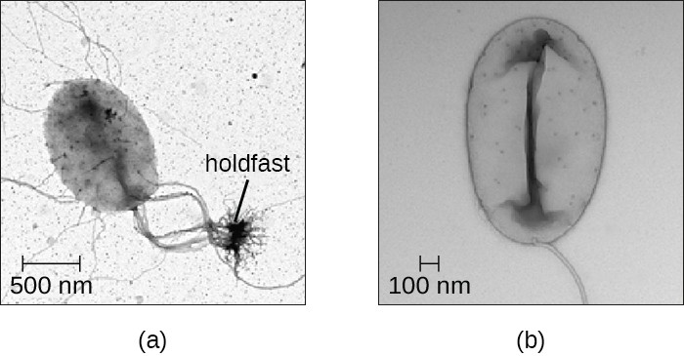
Figure 3.8. (a) Sessile Planctomycetes have a holdfast that allows them to adhere to surfaces in aquatic environments. (b) Swarmers are motile and lack a holdfast.

Slide 50
Classification of Bacteria by Staining Patterns
Gram-positive bacteria
Differentiate between high G+C and low G+C Gram-positive bacteria based on their genetic and phenotypic characteristics.
Describe the ecological roles and industrial or medical significance of Actinobacteria and other Gram-positive bacteria.

Slide 51
Classifying Gram-Positive Prokaryotes & Actinobacteria
Classification by G+C Ratio:
  Advances in nucleic acid biochemistry allow classification of Gram-positive prokaryotes based on the guanine to cytosine (G+C) ratios in their DNA.
  Two distinct groups are recognized: High G+C and Low G+C.
Actinobacteria: High G+C Gram-Positive Bacteria
Diverse Group:
  Name means "rays" and "small rod," but highly diverse in appearance (thin filamentous branching rods to coccobacilli).
  Range from very large and complex to among the smallest independently living organisms.
  Mostly live in soil, some aquatic; vast majority are aerobic.
  Distinctive Feature: Presence of several different peptidoglycans in the cell wall.
Genus Actinomyces:
  Important role in soil ecology.
  Some species are human pathogens:
    Opportunistic pathogens in the human mouth, causing periodontitis (gum inflammation) and oral abscesses.
    A. israelii: An anaerobe causing endocarditis (inflammation of the inner lining of the heart).

Slide 52
Actinobacteria: Mycobacterium
Microscopic Appearance: Bacilli covered with a mycolic acid coat.
Unique Characteristics:
  Waxy coat protects from some antibiotics, prevents drying, and blocks Gram stain penetration.
  Requires a special acid-fast staining procedure for visualization.
Important Pathogens:
  Mycobacterium tuberculosis:
    Causative agent of tuberculosis (TB), primarily affecting the lungs but can infect other body parts.
    Estimated one-third of the world's population infected; millions of new infections annually.
    Treatment Challenge: Requires combination drug therapy for extended periods; complicated by multidrug-resistant strains.
  Mycobacterium leprae:
    Causes Hansen's disease (leprosy).
    Chronic disease impacting peripheral nerves, skin integrity, and respiratory tract mucosal surfaces.
    Leads to loss of pain sensation and skin lesions, increasing susceptibility to secondary injuries and infections.

Slide 53
Other Actinobacteria: Corynebacterium, Bifidobacterium, Gardnerella
Genus Corynebacterium:
  Cell Wall: Contains diaminopimelic acid.
  Microscopic Appearance: Often form palisades (pairs of rod-shaped cells resembling a 'V').
  May contain metachromatic granules (intracellular inorganic phosphate storage, useful for identification).
  Pathogenic Species:
    Vast majority are nonpathogenic.
    C. diphtheriae: Causative agent of diphtheria, a potentially fatal disease (especially in children).
    Produces a toxin that forms a pseudomembrane in the throat, causing swelling and difficulty breathing.
Genus Bifidobacterium:
  Filamentous anaerobes.
  Commonly found in the human gastrointestinal tract, vagina, and mouth.
  Substantial part of the human gut microbiota; frequently used as probiotics and in yogurt production.
Genus Gardnerella:
  Only one species: G. vaginalis.
  Gram-Variable: Small coccobacilli do not show consistent Gram stain results.
  Classified as high G+C Gram-positive based on genome.
  Can cause bacterial vaginosis (mild or undetectable symptoms, but can lead to pregnancy complications).

Slide 54
Low G+C Gram-Positive Bacteria: Overview & Clostridium
Low G+C Gram-Positive Bacteria:
  One large and diverse class is Clostridia.
Genus Clostridium:
  Microscopic Morphology: Rod-shaped bacteria.
  Unique Characteristics:
    Generally obligate anaerobes.
    Produce endospores that can survive for many years.
    Found in anaerobic habitats like soil and aquatic sediments rich in organic nutrients.
  Highly Pathogenic: Produce more kinds of protein toxins than any other bacterial genus.
    C. perfringens: Third most common cause of food poisoning; causative agent of gas gangrene (endospores enter wound, germinate, produce tissue-killing toxin).
    C. tetani: Causes tetanus; produces a neurotoxin that blocks nerve impulse inhibition, leading to life-threatening spastic paralysis.
    C. botulinum: Produces botulinum neurotoxin (most lethal biological toxin known); causes botulism (blocks acetylcholine release, causing flaccid paralysis). Used cosmetically (Botox).
    Clostridioides difficile: Common source of hospital-acquired infections; can cause severe colitis, especially in immunosuppressed or antibiotic-treated patients.

Slide 55
Other Low G+C Gram-Positive Bacteria
Order Lactobacillales:
  Includes bacilli and cocci: Lactobacillus, Leuconostoc, Enterococcus, Streptococcus.
  Streptococcus (Streptococci):
    Spherical/ovoid, often form chains ("twisted chain").
    Classified by Lancefield groups and hemolysis on blood agar.
    S. pyogenes (Group A, β-hemolytic): "Pyogenic" (pus-producing); causes strep throat, impetigo, necrotizing fasciitis.
    Nonpyogenic streptococci: Inhabit the human mouth (not a taxon/Lancefield group); mostly commensals, but S. mutans causes dental caries.
    S. pneumoniae (Pneumococcus): Diplococci (pairs); causes pneumonia, meningitis, septicemia, etc., especially in vulnerable populations.
Class Bacilli:
  Morphologically diverse (bacillus and coccus shapes).
  Genus Bacillus:
    Bacillus-shaped, can produce endospores; aerobes/facultative anaerobes.
    Used in industry (antibiotics, enzymes, detergents).
    B. anthracis: Causes anthrax (severe disease in animals/humans, lethal if untreated).
    B. cereus: Causes food poisoning.
    B. thuringiensis: Produces insecticides.
  Genus Staphylococcus:
    Coccus-shaped, forms clusters ("bunches of grapes"); facultative anaerobic, halophilic, nonmotile.
    S. epidermidis: Main habitat is human skin; generally nonpathogenic but can cause infections in immunocompromised patients (wounds, prostheses, catheters).
    S. aureus: Causes wide variety of infections (boils, carbuncles, cellulitis, impetigo, staph food poisoning, toxic shock syndrome).
    Antibiotic Resistance: Many strains are resistant, including MRSA (methicillin-resistant S. aureus) and VRSA (vancomycin-resistant S. aureus) – highly difficult to treat, contagious, serious threat in healthcare settings.
Genus Mycoplasma:
  Unique Characteristics:
    Do not possess a cell wall (not Gram-stained, but genetically low G+C Gram-positive).
    Very small cells (~0.2 μm), pleomorphic (variable shapes, resemble animal cells).
    Difficult to identify due to lack of characteristic shape.
    M. pneumoniae: Causes "walking pneumonia" (milder than other forms).

Slide 56
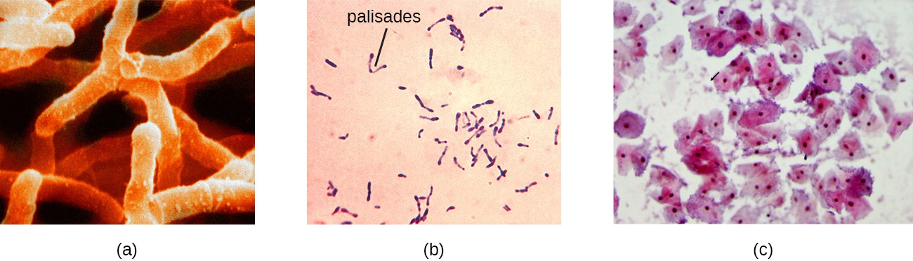
Figure 3.9. (a) Actinomyces israelii (false-color scanning electron micrograph [SEM]) has a branched structure. (b) Corynebacterium diphtheria causes the deadly disease diphtheria. Note the distinctive palisades. (c) The gram-variable bacterium Gardnerella vaginalis causes bacterial vaginosis.

Slide 57
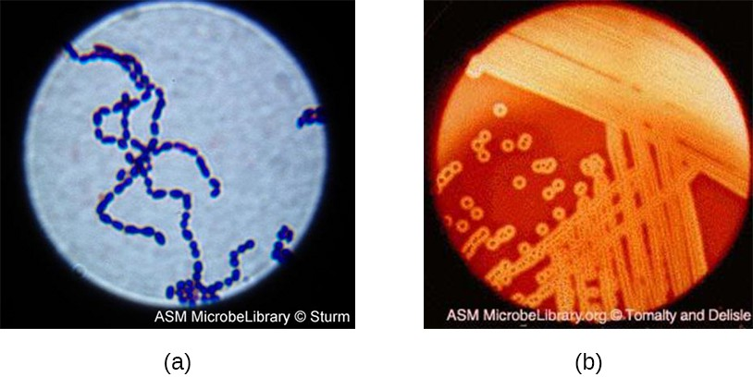
Figure 3.10. (a) A gram-stained specimen of Streptococcus pyogenes shows the chains of cocci characteristic of this organism’s morphology. (b) S. pyogenes on blood agar shows characteristic lysis of red blood cells, indicated by the halo of clearing around colonies.

Slide 58
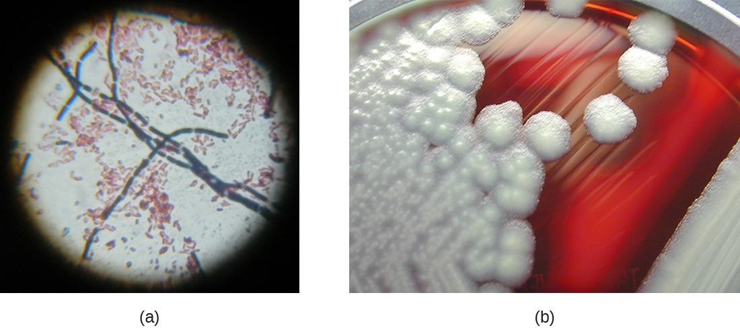
Figure 3.11. (a) In this gram-stained specimen, the violet rod-shaped cells forming chains are the gram-positive bacteria Bacillus cereus. The small, pink cells are the gram-negative bacteria Escherichia coli. (b) In this culture, white colonies of B. cereus have been grown on sheep blood agar.

Slide 59
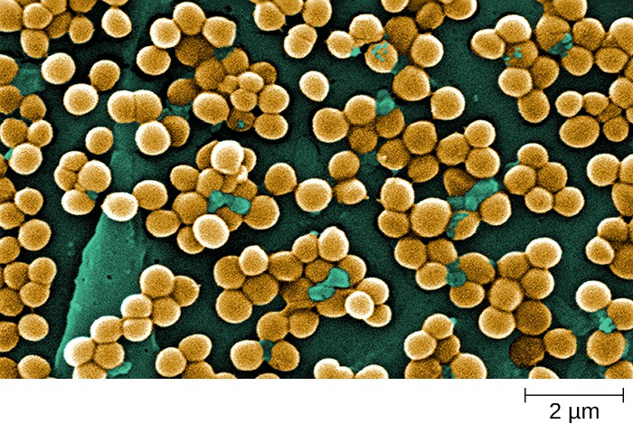
Figure 3.12. This SEM of Staphylococcus aureus illustrates the typical “grape-like” clustering of cells.

Slide 60
Archaea
Compare the structural and genetic characteristics that distinguish Archaea from bacteria, including differences in cell membrane composition, cell wall structure, and genome complexity.
Describe the diversity of Archaea, highlighting major phyla such as Crenarchaeota and Euryarchaeota, and explain their adaptations to extreme environments and unique metabolic processes like methanogenesis and sulfur oxidation.

Slide 61
Archaea: Distinctive Features and Diversity
Unicellular, but Structurally Unique from Bacteria:
  Cell Membranes: Ether linkages with branched isoprene chains (Bacteria have ester linkages with unbranched fatty acids).
  Cell Walls: Lack peptidoglycan (some have pseudopeptidoglycan).
  Genomes: Larger and more complex than bacterial genomes.
Diverse Habitats and Metabolism:
  Includes mesophiles (moderate conditions) and extremophiles (thrive in extreme environments like high temperatures or salinity).
  Perform unique metabolic processes like methanogenesis (producing methane), which bacteria and eukaryotes cannot.
Five Major Phyla: Crenarchaeota, Euryarchaeota, Korarchaeota, Nanoarchaeota, and Thaumarchaeota (many more likely unclassified).

Slide 62
Key Phyla Examples:
Crenarchaeota:
  Extremely diverse aquatic organisms, thought to be most abundant in oceans.
  Most are hyperthermophiles (e.g., Pyrolobus can grow up to 113∘C).
  Sulfolobus: Thermoacidophiles (prefer 70−80∘C and pH 2-3); oxidize sulfur to sulfuric acid in anaerobic conditions; used for producing thermostable, acid-resistant proteins (affitins).
  Thermoproteus: Strictly anaerobic, optimal growth at 85∘C; motile with flagella; unique monolayer cell membrane; autotrophic metabolism (reduces sulfur/hydrogen, uses CO2​/CO); considered a deep-branching, ancient life form.
Euryarchaeota:
  Includes Methanogens (Classes Methanobacteria, Methanococci, Methanomicrobia):
    Unique ability to reduce carbon dioxide with hydrogen to produce methane.
    Live in extreme environments (below freezing to boiling); found in hot springs and deep under ice.
    Produce gases in ruminants and humans; hypothesized to inhabit Mars.
  Halobacteria (Class Halobacteria):
    Halophilic ("salt-loving") archaea; require very high NaCl concentrations (e.g., Dead Sea, 36% saturation).
    Perform photosynthesis using bacteriorhodopsin, giving them and their water bodies a purple color.
    Halobacterium salinarum: Potentially oldest living organism (DNA from 250-million-year-old fossils).
    Haloferax volcanii: Sophisticated ion exchange system for salt balance at high temperatures.

Slide 63
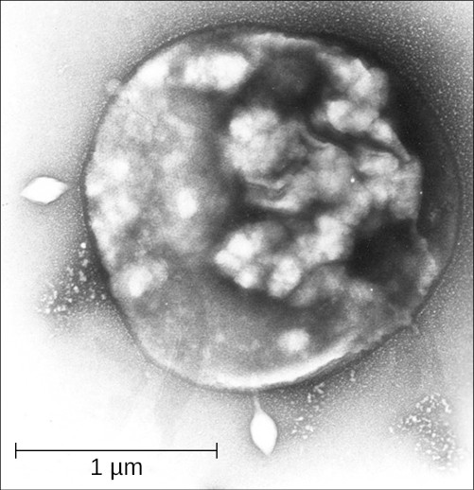
Figure 3.13. Sulfolobus, an archaeon of the class Crenarchaeota, oxidizes sulfur and stores sulfuric acid in its granules.

Slide 64
Prokaryotic genetics
Explain how genetic material determines the genotype and how this translates into phenotype in prokaryotes through the processes of DNA replication, transcription, and translation.
Describe the mechanisms of horizontal gene transfer in prokaryotes—transformation, transduction, and conjugation—and discuss their significance in genetic diversity and evolution.

Slide 65
Functions of Genetic Materials (DNA)
DNA's Dual Essential Functions:
  Inheritance: DNA is the genetic material passed from parent to offspring for all life on Earth, ensuring the continuity of genetic information.
    To preserve integrity, DNA must be replicated with high accuracy.
    Genome: Full complement of DNA in a cell, organized into genes on chromosomes and plasmids.
  Directing Protein Construction: DNA directs and regulates the synthesis of proteins essential for cell growth and reproduction.
    Gene Expression: The process of synthesizing a specific protein encoded by a gene.
      Transcription: DNA is "read" to produce an RNA molecule (e.g., messenger RNA (mRNA)).
      Translation: mRNA provides information for the ribosome to catalyze protein synthesis.
Central Dogma: Describes the flow of genetic information: DNA → RNA → Protein.
Cellular Characteristics:
  Genotype: The full collection of genes a cell contains (constant).
  Phenotype: Observable characteristics resulting from gene expression and environmental interactions (product of proteins produced).
Gene Regulation: Cells carefully regulate gene expression, producing proteins only when needed.

Slide 66
Figure 3.15 The central dogma states that DNA encodes messenger RNA, which, in turn, encodes protein.

Slide 67
Horizontal Gene Transfer (HGT) in Prokaryotes
Genetic Diversity in Asexual Organisms:
  For prokaryotes (dominant asexual reproduction), Horizontal Gene Transfer (HGT) is crucial for introducing genetic diversity.
  HGT: Introduction of genetic material from one organism to another within the same generation.
Impact and Prevalence:
  Allows even distantly related species to share genes, influencing their phenotypes.
  Thought to be more prevalent in prokaryotes, though typically only a small fraction of the genome is transferred at once.
  Believed to be a significant source of genetic variation (raw material for natural selection) alongside mutation.
Primary Mechanisms of HGT in Prokaryotes:
  Transformation: Uptake of naked DNA from the environment.
  Transduction: Gene transfer between cells via a virus (bacteriophage).
  Conjugation: Direct transfer of genes between cells using a hollow tube called a conjugation pilus.

Slide 68
HGT Mechanisms: Transformation and Transduction
Transformation:
  Discovery: First demonstrated by Frederick Griffith (1928) with Streptococcus pneumoniae ("transforming principle").
  Identified as DNA by Avery, MacLeod, and McCarty (1944).
  Process: Prokaryote takes up "naked DNA" (released from lysed cells) from the environment.
    Many bacteria are naturally competent (actively bind, transport, and make environmental DNA single-stranded).
    Single-stranded DNA can recombine into the bacterial genome, forming recombinant DNA.
    Can confer new phenotypic properties (e.g., nonpathogenic bacterium gaining a toxin gene).
  Significance: Important mechanism for acquiring virulence factors and antibiotic resistance genes in nature and exploited in genetic engineering.
Transduction:
  Mechanism: Viruses that infect bacteria (bacteriophages) transfer short pieces of chromosomal DNA.
  Generalized Transduction: Accidental packaging of any piece of chromosomal DNA into a phage head during assembly.
  Specialized Transduction: Imprecise excision of a lysogenic prophage carries adjacent bacterial chromosomal DNA to a new host cell.
    Results in lysogenic conversion, where the host acquires new properties (e.g., pathogenicity if a virulence gene is transferred).
  Medical Relevance: Explains virulence in pathogens like Corynebacterium diphtheriae and Clostridium botulinum due to toxin-encoding genes from bacteriophages. Archaea also have viruses for gene translocation.

Slide 69
HGT Mechanisms: Conjugation and Transposition
Conjugation:
  Mechanism: Direct DNA transfer from one prokaryote to another via a conjugation pilus (brings cells into contact).
  F Plasmid (Fertility Factor): In E. coli, genes for conjugation are on this plasmid. The pilus is the F pilus.
  Process (F Plasmid Transfer):
    F+ cells (donors, contain F plasmid) contact F- cells (recipients, lack F plasmid).
    A single-stranded copy of the F plasmid is transferred via rolling circle replication through a cytoplasmic bridge.
    F- cell synthesizes complementary strand, becoming an F+ cell.
  Chromosomal DNA Transfer:
    Hfr cells: F plasmid integrates into the bacterial chromosome, leading to high frequency of recombination.
    F' plasmid: Imprecise excision of integrated F plasmid can carry adjacent chromosomal DNA.
    Hfr cells can attempt to transfer the entire bacterial chromosome, but contact is transient, so genes closer to the F plasmid integration site are more likely to be transferred.
    Historically, used to map prokaryotic genes (distances measured in minutes).
Transposition:
  Transposons ("Jumping Genes"): DNA molecules with inverted repeat sequences at ends and a gene for transposase.
  Process: Transposase allows the entire sequence to independently excise from one location and integrate elsewhere (transposition).
  Discovery: Barbara McClintock (maize, 1940s); found in all organisms (prokaryotes and eukaryotes) – not prokaryote-specific.
  Types: Most are nonreplicative ("cut-and-paste"); some are replicative ("copy-and-paste").
  Impact: Introduces genetic diversity by moving within/between DNA molecules or cells. Can alter phenotype by inactivating/activating genes.
  Medical Significance: Bacterial transposons can relocate antibiotic resistance genes from chromosomes to plasmids (e.g., R plasmid in Shigella), which can then be easily transferred via conjugation.

Slide 70
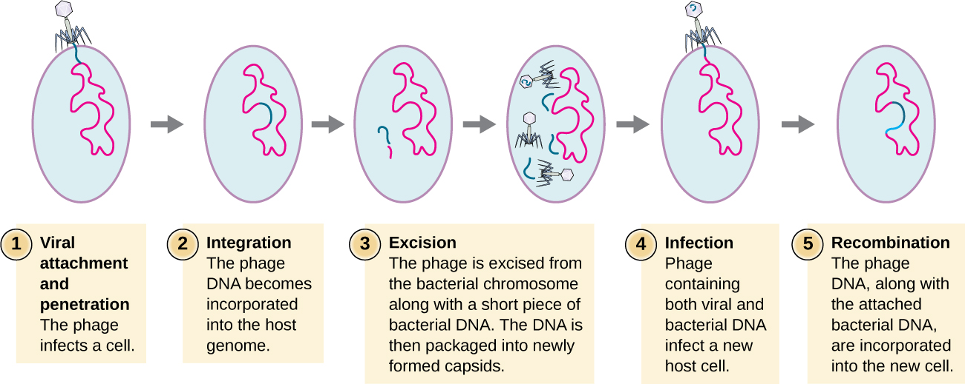
Figure 3.17. This flowchart illustrates the mechanism of specialized transduction. An integrated phage excises, bringing with it a piece of the DNA adjacent to its insertion point. On reinfection of a new bacterium, the phage DNA integrates along with the genetic material acquired from the previous host.

Slide 71
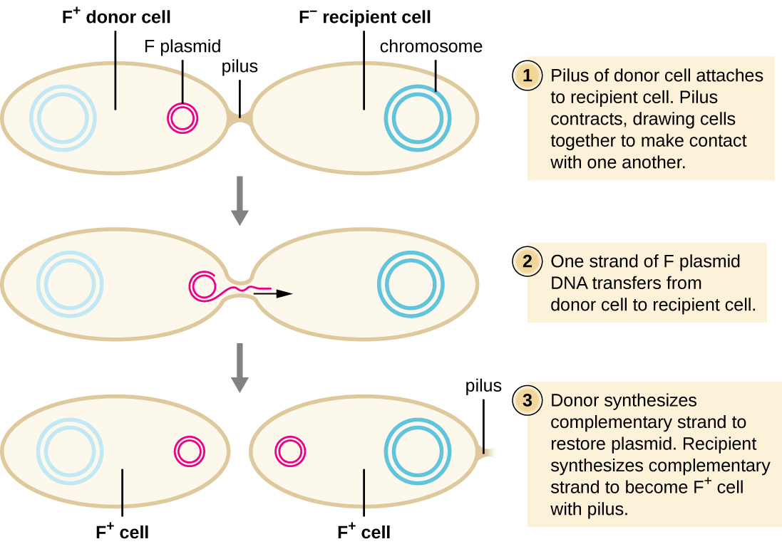
Figure 3.18 Typical conjugation of the F plasmid from an F+ cell to an F− cell is brought about by the conjugation pilus bringing the two cells into contact. A single strand of the F plasmid is transferred to the F− cell, which is then made double stranded.

Slide 72
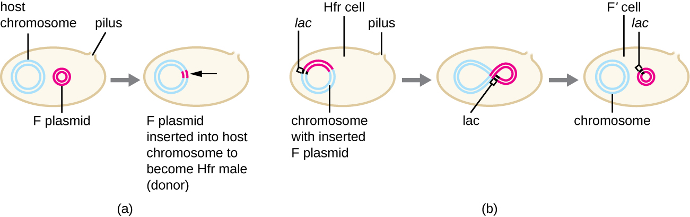
Figure 3.19. (a) The F plasmid can occasionally integrate into the bacterial chromosome, producing an Hfr cell. (b) Imprecise excision of the F plasmid from the chromosome of an Hfr cell may lead to the production of an F’ plasmid that carries chromosomal DNA adjacent to the integration site. This F’ plasmid can be transferred to an F− cell by conjugation.

Slide 73
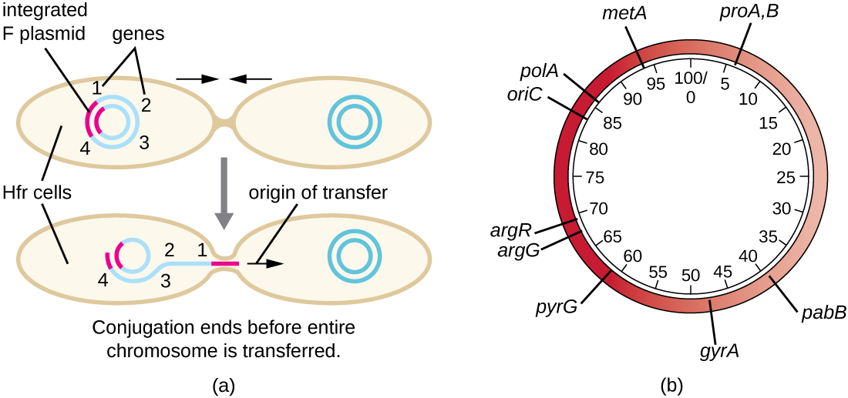
Figure 3.20 (a) An Hfr cell may attempt to transfer the entire bacterial chromosome to an F− cell, treating the chromosome like an extremely large F plasmid. However, contact between cells during conjugation is temporary. Chromosomal genes closest to the integration site (gene 1) that are first displaced during rolling circle replication will be transferred more quickly than genes far away from the integration site (gene 4). Hence, they are more likely to be recombined into the recipient F− cell’s chromosome. (b) The time it takes for a gene to be transferred, as detected by recombination into the F− cell’s chromosome, can be used to generate a map of the bacterial genome, such as this genomic map of E. coli. Note that it takes approximately 100 minutes for the entire genome (4.6 Mbp) of an Hfr strain of E. coli to be transferred by conjugation.

Slide 74
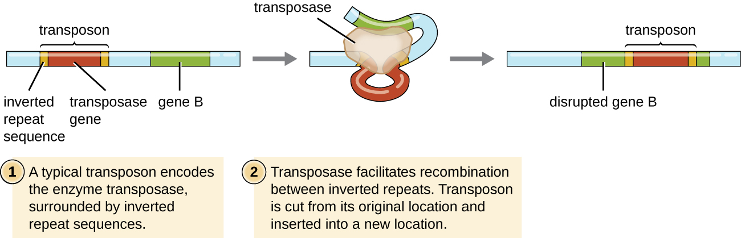
Figure 3.21 Transposons are segments of DNA that have the ability to move from one location to another because they code for the enzyme transposase. In this example, a [pb_glossary id="2055"]nonreplicative[/pb_glossary] transposon has disrupted gene B. The consequence of that the transcription of gene B may now have been interrupted.

Slide 75
Chapter Summary
Prokaryotic Diversity: Bacteria and Archaea
Prokaryotic Structure:
  Unicellular organisms lacking membrane-bound organelles.
  Simple cell structures.
  Found in diverse habitats (air, water, soil, human body).
Archaea:
  Lack peptidoglycan in cell walls.
  Unique membrane lipids (ether linkages, branched isoprene chains).
  Extremophiles: Thrive in extreme environments (thermophiles, methanogens, halophiles).
  Major groups: Crenarchaeota and Euryarchaeota.
Bacteria:
  Gram Staining: Classified as Gram-positive, Gram-negative, or Atypical.
  Essential Functions:
    Ecosystem roles (nutrient cycling, soil fertility).
    Human health (digestion).
    Environmental cleanup (bioremediation).
    Pathogenicity (foodborne illnesses).
  Symbiotic Relationships: Can be mutualistic, commensal, or parasitic.
  Genetic Variation: Enhanced by horizontal gene transfer (transformation, conjugation, transduction).
Genetic Classification: Modern phylogenetic trees (e.g., Carl Woese's three-domain system) distinguish Bacteria, Archaea, and Eukarya based on rRNA analysis.

