Slide 1
Chapter 6: Microbial Mechanisms of Pathogenicity

Slide 2
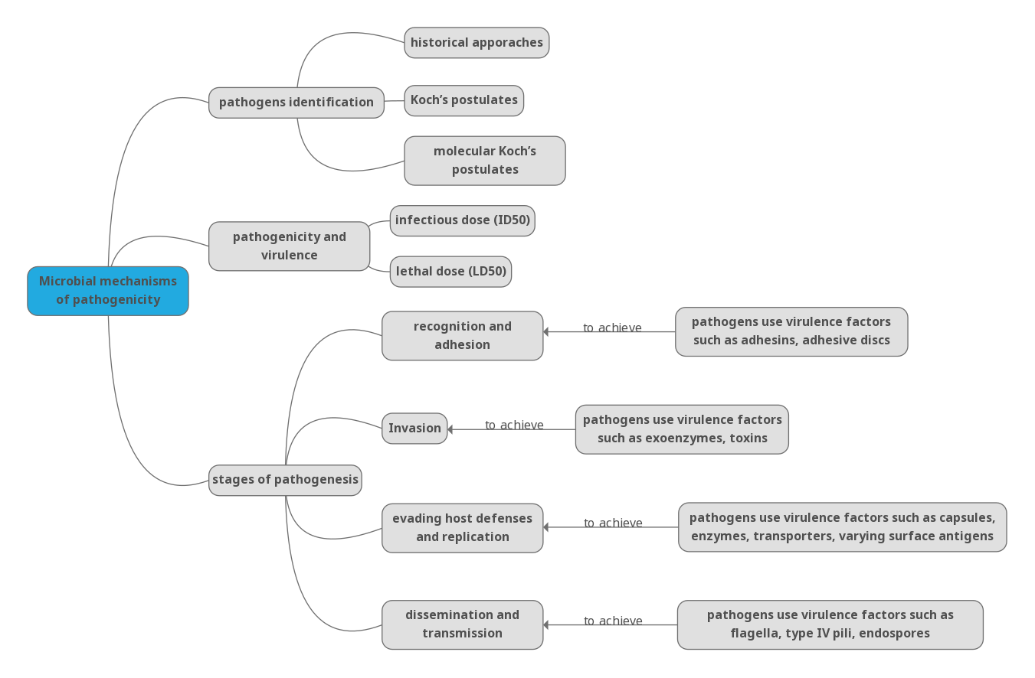
Concept map

Slide 3
Outline
How Pathogens Cause Disease
Pathogenicity and Virulence
Pathogens and Stages of Pathogenesis
Virulence Factors of Bacterial, Viral, and Eukaryotic Pathogens

Slide 4
How Pathogens Cause Disease
Explain the principles of Robert Koch’s postulates and molecular Koch’s postulates, and describe how each is used to identify and confirm the causative agents of infectious disease.
Compare and contrast classical Koch’s postulates with molecular Koch’s postulates, and evaluate their applicability and limitations in the identification of pathogens, especially in the context of modern microbiology.

Slide 5
Early Concepts of Disease Causality
Traditional Chinese Medicine (TCM):
  Emphasis on balancing "qi" (vital energy) and "yin-yang".
  Disease as an imbalance in these fundamental forces.
Ayurvedic Medicine:
  Focus on balancing bodily humors (doshas).
  Diagnosis through methods like pulse and urine analysis.
Islamic Golden Age:
  Scholars like Ibn Sina and Al-Razi advanced understanding of contagion and pathogen transmission.
  Laid groundwork for recognizing links between agents and disease.
Indigenous Cultures Worldwide:
  Developed extensive herbal knowledge and treatments.
  Many remedies, like Echinacea, scientifically validated for antimicrobial properties.
Key Takeaway: While lacking a full "pathogen" concept, these traditions laid crucial foundations for understanding infections and their spread.

Slide 6
Robert Koch and the Scientific Revolution in Pathogen Identification
Emergence (1884): Koch's postulates arose during a period of increasing scientific formalization.
Shift in Approach: Marked a move towards systematic, evidence-based pathogen identification.
Contrast to Traditional Methods: Moved beyond holistic and observational approaches to establish reproducible criteria.
Pivotal Advancement: Laid the foundation for modern infectious disease research by linking specific pathogens to specific diseases.

Slide 7
Koch's Postulates: Criteria for Linking Pathogens to Disease
(Proposed in 1884)
Presence in Disease: The suspected pathogen must be found in every case of the disease and not in healthy individuals.
Pure Culture Isolation: The suspected pathogen can be isolated and grown in pure culture.
Disease Induction: A healthy test subject infected with the suspected pathogen must develop the same signs and symptoms of disease as seen in postulate 1.
Re-isolation and Identification: The pathogen must be re-isolated from the new host and must be identical to the pathogen from postulate 2.
Tests typically performed on laboratory animals with comparisons between cultures from healthy and diseased specimens.

Slide 8
Challenges to Koch's Original Postulates
Limitation 1: Pathogen Presence in Healthy Individuals:
  H. pylori can be part of normal microbiota in healthy people without causing disease.
  Asymptomatic carriers (e.g., Brucella).
Limitation 2: Variable Susceptibility & Symptoms:
  Not all healthy subjects are equally susceptible (e.g., variations in microbiota and immune strength).
  Same disease may present with different signs/symptoms.
Limitation 3: Culturability & Animal Models:
  Some pathogens cannot be cultured in pure form (e.g., obligate intracellular bacteria, viruses like HIV).
  Lack of suitable animal models for all diseases.
Conclusion: These limitations highlight the complexity of infection and disease causation beyond Koch's original criteria.

Slide 9
Molecular Koch's Postulates: A Modern Revision
Proposed by Stanley Falkow (1988): Focuses on identifying genes responsible for pathogenicity, rather than the pathogen itself.
Key Principles:
  Phenotype Association: The disease sign/symptom should be associated only with pathogenic strains.
  Loss of Pathogenicity upon Gene Inactivation: Inactivation of suspected pathogenicity gene(s) should result in a measurable loss of pathogenicity.
  Restoration of Phenotype upon Gene Reversion: Reversion of the inactive gene should restore the disease phenotype.
Advantages: Explains infections by intracellular pathogens and pathogenic strains of typically non-pathogenic organisms (e.g., E. coli strains like ETEC, EHEC).

Slide 10
Challenges in Applying Molecular Koch's Postulates
Genetic Manipulation Difficulties: Not all pathogens can be easily genetically manipulated.
Lack of Suitable Animal Models: Still a limitation for some diseases, hindering the testing of pathogenicity.
Overall: While a significant advancement, molecular Koch's postulates also face practical limitations in certain contexts.

Slide 11
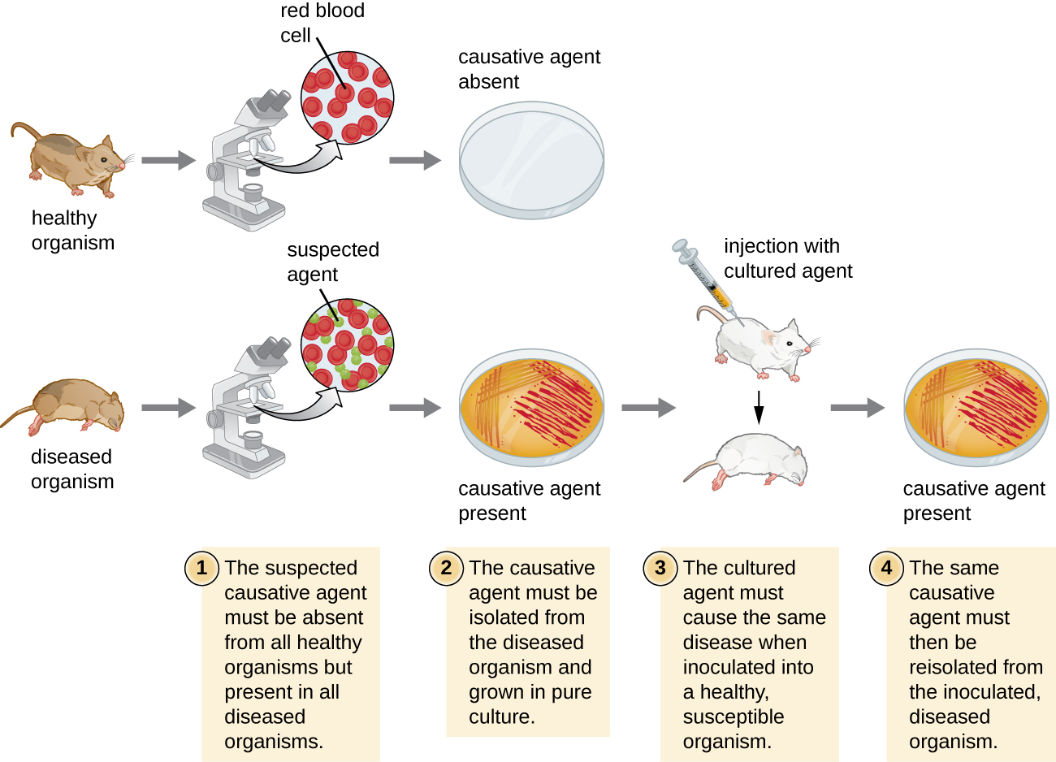
Figure 6.1. The steps for confirming that a pathogen is the cause of a particular disease using Koch’s postulates.

Slide 12
Pathogenicity and Virulence
Define and differentiate the concepts of pathogenicity and virulence, and explain how they relate to disease severity using examples such as Bacillus anthracis.
Interpret experimental data on ID₅₀ and LD₅₀ to evaluate the virulence of pathogens, and analyze how host and pathogen factors influence infection outcomes.

Slide 13
Pathogenicity vs. Virulence
Pathogenicity:
  A microbial agent's ability to cause disease.
Virulence:
  The degree of pathogenicity.
  Ranges from:
    Avirulent: Non-harmful
    Highly Virulent: Can cause severe illness or multi-organ failure (e.g., Bacillus anthracis).
    Less Virulent: May cause mild symptoms or remain asymptomatic.

Slide 14
Virulence in Action: Bacillus anthracis
Cause of Anthrax: A highly virulent pathogen.
Forms of Disease: Can produce various forms, with inhalation anthrax being the most severe.
Mechanism in Inhalation Anthrax:
  Spores germinate upon inhalation.
  Release potent toxins.
  Leads to:
    Edema (swelling)
    Hypoxia (lack of oxygen)
    Necrosis (tissue death)
Symptoms: High fever, difficulty breathing, multi-organ failure.
Genetic Basis: Virulence can be reduced if genes involved in pathogenesis are inactivated, aligning with Falkow's molecular Koch's postulates.

Slide 15
Quantifying Virulence: Experimental Measures
Controlled Experiments: Virulence is quantified using laboratory animals.
Two Key Indicators:
  Median Infectious Dose (ID50):
    Number of pathogen cells or virions required to cause active infection in 50% of inoculated animals.
  Median Lethal Dose (LD50):
    Number of pathogenic cells, virions, or amount of toxin required to kill 50% of infected animals.
Method: Animals are inoculated with a range of known pathogen concentrations; infection/death rates are plotted against concentration.

Slide 16
Interpreting Virulence Data
Graphical Representation (Figure 6.2 - Hypothetical LD50):
  Plots percentage of animals infected/killed against pathogen concentration.
  The point where 50% of animals are affected represents the ID50 or LD50.
  Example: If 50% of animals die at a concentration of 104 pathogen cells/virions, then the LD50 is 104.
Important Considerations:
  These are median values.
  Actual infective dose for an individual can vary widely.
  Factors influencing individual susceptibility:
    Route of entry
    Age, health, immune status of the host
    Environmental and pathogen-specific factors (e.g., susceptibility to stomach pH).

Slide 17
ID50 and Disease Severity: Not Always Correlated
Infective Dose ≠ Disease Severity: A low ID50 does not necessarily mean severe disease.
Example 1: Salmonella enterica serotype Typhimurium
  ID50: As low as a single cell.
  Disease: Salmonella gastroenteritis (salmonellosis) – nausea, vomiting, diarrhea.
  Mortality: Less than 1% in healthy adults.
Example 2: Salmonella enterica serotype Typhi
  ID50: Much higher, typically ~1,000 cells.
  Disease: Typhoid fever – a systemic and more severe disease.
  Mortality: Up to 10% in untreated individuals.
Conclusion: The number of pathogens needed to cause infection is distinct from the severity of the illness they cause.

Slide 18
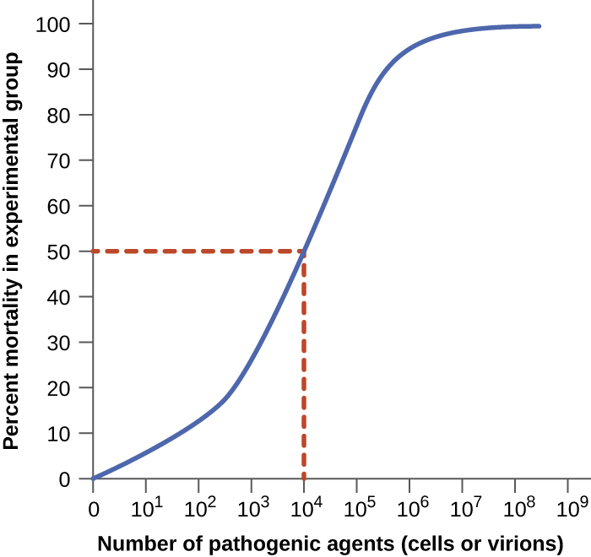
Figure 6.2. A graph like this is used to determine LD50 by plotting pathogen concentration against the percent of infected test animals that have died. In this example, the LD50 = 104 pathogenic particles.

Slide 19
Pathogens and Stages of Pathogenesis
Explain the different types of pathogens and their roles in infectious diseases.
Describe the stages of pathogenesis and how pathogens interact with the host during infection.

Slide 20
Classifying Pathogens: Primary vs. Opportunistic
Primary Pathogens:
  Cause disease in a host regardless of their immune system or microbiota.
  Example: Enterohemorrhagic E. coli (EHEC) – produces Shiga toxin, causing bloody diarrhea and renal failure even in healthy individuals.
Opportunistic Pathogens:
  Require a compromised host to cause infection.
  Host factors: Weakened immune system, elderly, post-surgery patients.
  Example: Staphylococcus epidermidis – often causes infections in hospital settings, especially with implanted devices.
  Normal microbiota members (E. coli, Candida) can become opportunistic if:
    They enter abnormal body locations.
    They overgrow due to environmental shifts (e.g., antibiotic use, leading to Candida oral thrush or vaginal yeast infections).

Slide 21
The Journey of Infection: Stages of Pathogenesis
To cause disease, a pathogen typically follows a series of key steps:
Recognition and Adhesion: Attaching to host cells.
Invasion: Spreading into host tissues.
Evading Host Defenses: Avoiding the immune system and Replication: Multiplying within the host.
Dissemination and Transmission: Spreading to new hosts.
These stages highlight the complex, multifactorial nature of microbial pathogenesis.

Slide 22
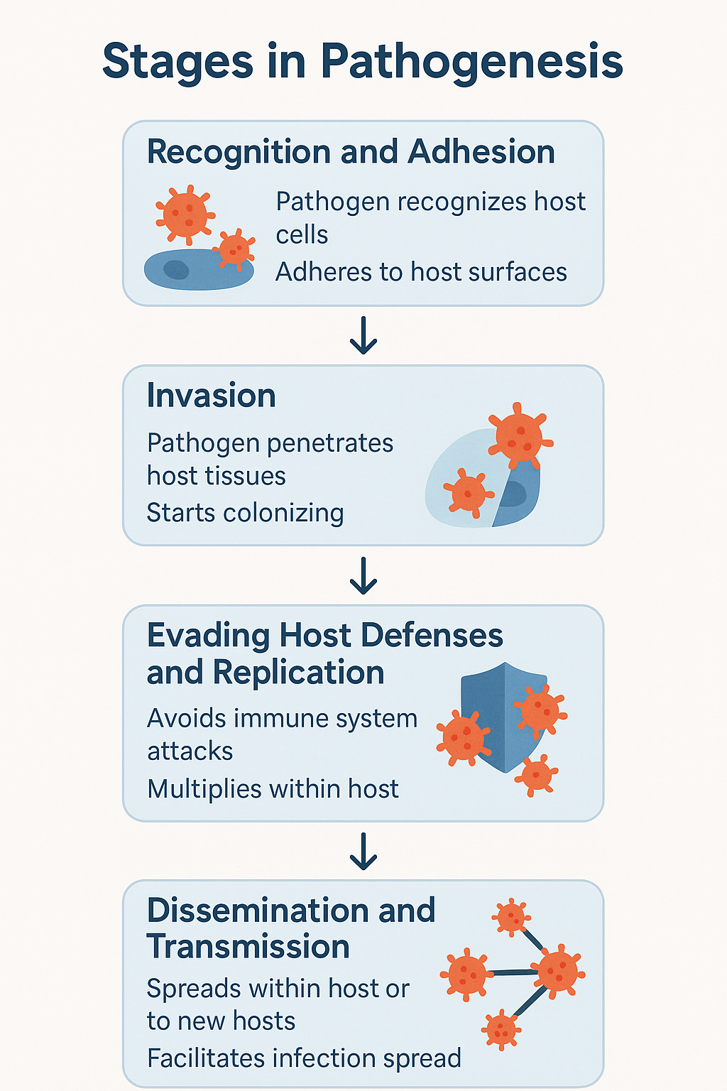
Diagram 6.1. Four key stages in the pathogenesis of infectious disease.

Slide 23
Step 1: Recognition and Adhesion
Initial Contact: Pathogens must recognize and bind to host cells.
Adhesins: Surface molecules on pathogens facilitating binding:
  Proteins or carbohydrates.
  Bind specifically to host cell receptors (e.g., glycoproteins).
  Found on bacterial fimbriae, flagella, protozoan cilia, viral capsids/membranes (spike proteins).
  Protozoa may use hooks and barbs.
Glycocalyces: Slime layers or capsules (rich in sugars/proteins) aid attachment.
Biofilms:
  Communities of bacteria encased in an extracellular matrix (exopolysaccharide - EPS).
  Enhance adhesion (e.g., Pseudomonas aeruginosa).
  Protect bacteria from immune system and antibiotics (EPS barrier, stationary phase cells).

Slide 24
Step 2: Invasion
Entry and Spread: Pathogen spreads from initial entry site to deeper tissues.
Virulence Factors: Facilitated by pathogen-produced exoenzymes and toxins.
  Help penetrate tissues, damage cells, and establish a foothold.
  Example: Helicobacter pylori produces urease to neutralize stomach acid, enabling penetration of stomach lining.
Intracellular Pathogens: Enter and reproduce inside host cells.
  Obligate: Only reproduce inside cells.
  Facultative: Reproduce inside or outside cells.
  Benefits: Evade immune system, exploit host nutrients.
Mechanisms of Entry (Endocytosis):
  Effector proteins: Secreted by pathogen, trigger membrane ruffling (e.g., Salmonella, Shigella).
  Surface proteins: Bind to host cell receptors (e.g., Yersinia pseudotuberculosis invasin binding to beta-1 integrins).

Slide 25
Steps 3: Evading Host Defenses and Replication
Immune Evasion: Pathogens employ strategies to survive within the host.
  Intracellular Pathogens: Reside within host cells, shielded from immune defenses (e.g., phagocytes).
    Prevent phagosome-lysosome fusion or lyse phagosome.
  Access to Nutrients: Utilize host cell machinery and nutrients for replication.
Replication & Damage: As pathogens multiply, they often:
  Secrete exoenzymes or toxins.
  Damage host tissues.
  Interfere with cellular functions.
  Contribute to symptoms (fever, pain, swelling) and may lead to systemic infection.

Slide 26
Step 4: Dissemination and Transmission
Dissemination: Pathogen spread within the host.
  Local: Affecting nearby tissues.
  Systemic: Spreading throughout the body to various organs.
Portals of Exit: Essential for transmission to new hosts.
  Common examples: Skin, respiratory tract, urogenital tract, gastrointestinal tract.
  Respiratory: Coughing/sneezing (e.g., influenza).
  Gastrointestinal: Feces (e.g., cholera).
  Urogenital: Urine, semen, vaginal secretions (e.g., STIs).
  Other: Tears, sweat, shed skin cells.
  Bloodborne: Insect vectors (e.g., malaria) or needles.
Crucial for Survival: Strategic exit ensures perpetuation of the infection cycle.

Slide 27
Virulence Factors of Bacterial, Viral, and Eukaryotic Pathogens
Identify and describe key virulence factors produced by bacterial, viral, and eukaryotic pathogens that contribute to their ability to cause disease.
Explain how different virulence factors facilitate pathogen survival, host invasion, and immune system evasion.

Slide 28
Defining Virulence Factors
Definition: Unique microbial characteristics (genes, proteins, structures) that enable a pathogen to cause disease.
Impact: Determine the extent and severity of the disease.
Genetic Basis: Encoded by genes, which can be identified using molecular Koch's postulates.
Role in Pathogenesis: Contribute to each step of the infection process.

Slide 29
Step 1: Recognition and Adhesion
Crucial First Step: Pathogens must first bind to host cells.
Adhesins: Proteins or glycoproteins on the pathogen's surface that bind to specific host cell receptors.
  Found in bacteria, viruses, fungi, and protozoa.
  Examples:
    Bacteria: Fimbriae (e.g., ETEC adhering to intestinal cells), N-methylphenylalanine pili (Vibrio cholerae).
    Fungi: Surface glycoproteins (e.g., Candida albicans binding to epithelial cells).
    Viruses: Spike proteins (e.g., Influenza hemagglutinin, HIV gp120).
    Protozoa: Adhesive discs (e.g., Giardia lamblia).
Other Adhesion Factors:
  Glycocalyces: Slime layers or capsules (e.g., Streptococcus mutans on teeth).
  Biofilms: Communities of bacteria in an extracellular matrix, enhancing adherence and protection (e.g., Pseudomonas aeruginosa).

Slide 30
Bacterial and Viral Adhesin Examples
Pathogen | Disease | Adhesin | Attachment Site
Streptococcus pyogenes | Strep throat | Protein F | Respiratory epithelial cells
Neisseria gonorrhoeae | Gonorrhea | Type IV pili | Urethral epithelial cells
Influenzavirus | Influenza | Hemagglutinin | Sialic acid on respiratory/intestinal cells
Herpes simplex virus | Oral/Genital Herpes | Glycoproteins gB, gC, gD | Heparan sulfate on mucosal surfaces
Human immunodeficiency virus | HIV/AIDS | Glycoprotein gp120 | CD4 and CCR5/CXCR4 of immune cells

Slide 31
Step 2: Invasion
Beyond Adhesion: After attaching, pathogens spread to deeper tissues or other body areas.
Mechanisms: Involve the production of exoenzymes and toxins.
Entering the Bloodstream: A common and effective means of dissemination.
  Bacteremia: Bacteria in blood.
  Pyemia: Pus-forming bacteria in blood.
  Viremia: Viruses in blood.
  Toxemia: Toxins in blood.
  Septicemia: Bacteria multiplying in blood, leading to septic shock (life-threatening drop in blood pressure, multi-organ failure).

Slide 32
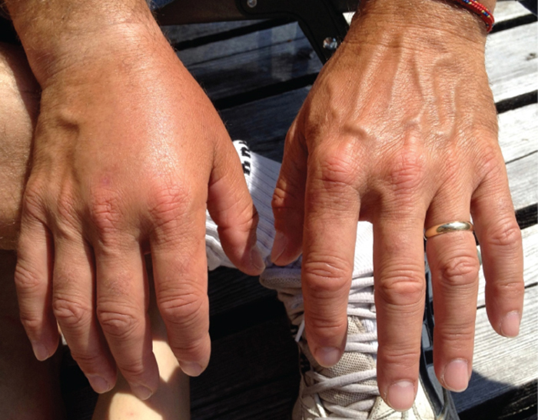
Figure 6.3. This patient has edema in the tissue of the right hand.

Slide 33
Invasion: The Role of Exoenzymes
Extracellular Enzymes: Produced by pathogens to facilitate invasion of host cells and deeper tissues.
Examples and Functions:
  Hyaluronidase S: (e.g., Staphylococcus aureus, Streptococcus pyogenes) Degrades hyaluronic acid (intercellular cement), promoting tissue spread.
  Nucleases (DNAse): (e.g., S. aureus) Breaks down extracellular DNA, which can trap bacteria, allowing them to spread.
  Phospholipases: (e.g., Bacillus anthracis, Listeria monocytogenes) Degrade phospholipid membranes, enabling escape from phagosomes or general cell lysis.
  Proteases (Collagenase): (e.g., Clostridium perfringens) Breaks down collagen in connective tissue, aiding in spread and leading to severe tissue damage (e.g., gas gangrene). Candida also produces proteases to degrade keratin.

Slide 34
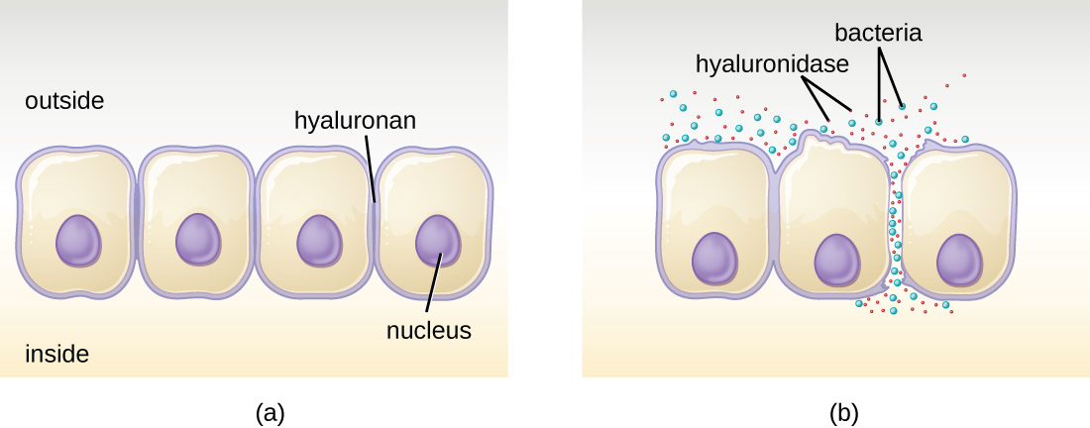
Figure 6.4. (a) Hyaluronan is a polymer found in the layers of epidermis that connect adjacent cells. (b) Hyaluronidase produced by bacteria degrades this adhesive polymer in the extracellular matrix, allowing passage between cells that would otherwise be blocked.

Slide 35
Invasion: Bacterial Toxins - Endotoxins
Toxins: Biological poisons that cause tissue damage and aid invasion (toxigenicity).
Endotoxins:
  Source: Found in the outer membrane of Gram-negative bacteria.
  Release: Released when bacteria die or multiply.
  Toxic Component: Lipid A.
  Effect: Triggers a general inflammatory response.
    Low levels: Beneficial, aid immune response.
    High levels: Excessive inflammation, dangerously low blood pressure, multi-organ failure, death.
  Detection: Limulus amebocyte lysate (LAL) test, ELISA.

Slide 36
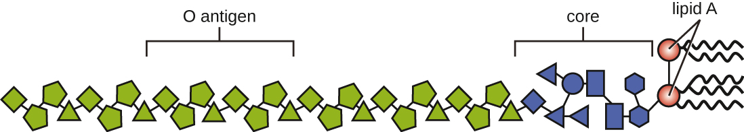
igure 6.5. Lipopolysaccharide is composed of lipid A, a core glycolipid, and an O-specific polysaccharide side chain. Lipid A is the toxic component that promotes inflammation and fever.

Slide 37
Invasion: Bacterial Toxins - Exotoxins
Source: Proteins actively secreted by bacteria (more common in Gram-positive, but also in Gram-negative).
Potency: Extremely potent (e.g., botulinum toxin is highly lethal).
Specificity: Target specific cells and disrupt their function.
Types of Exotoxins:
  Intracellular-Targeting Toxins (A-B Toxins):
    B subunit: Binds to host cell.
    A subunit: Enters cell, disrupts function.
    Examples: Diphtheria toxin (blocks protein synthesis), Cholera toxin (disrupts intestinal cells), Botulinum toxin (blocks nerve signals), Tetanus toxin (causes muscle spasms).

Slide 38
Exotoxins (Continued)
Membrane-Disrupting Toxins:
  Damage host cell membranes by creating pores or breaking down phospholipids.
  Examples:
    Hemolysins: (e.g., Streptolysins from Streptococcus pyogenes) Destroy red and white blood cells.
    Leukocidins: (e.g., Panton-Valentine leukocidin from Staphylococcus aureus) Target white blood cells.
Superantigens:
  Overstimulate the immune system.
  Lead to high fever, low blood pressure, organ failure, shock.
  Example: Toxic Shock Syndrome Toxin (TSST-1) from Staphylococcus aureus.

Slide 39
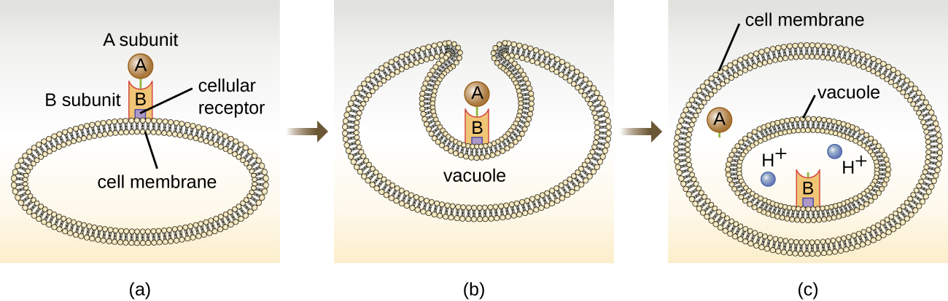
igure 6.6. (a) In A-B toxins, the B component binds to the host cell through its interaction with specific cell surface receptors. (b) The toxin is brought in through endocytosis. (c) Once inside the vacuole, the A component (active component) separates from the B component and the A component gains access to the cytoplasm.

Slide 40
Fungal Toxins (Mycotoxins)
Definition: Exotoxins produced by fungi, contributing to virulence.
Examples:
  Ergot Toxin (Claviceps purpurea): Grows on rye. Causes ergotism:
    Gangrenous ergotism: Vasoconstriction, tissue damage, gangrene.
    Convulsive ergotism: Affects CNS, causing hallucinations, mania.
  Aflatoxin (Aspergillus): From contaminated food/inhalation.
    Mutagen and carcinogen (linked to liver cancer).
    Can cross the placenta.
  Gliotoxin (Aspergillus): Suppresses immune response by inhibiting phagocytic cells and triggering cell death.

Slide 41
Step 3: Evading Host Defenses and Replication
Immune Evasion Strategies:
  Capsules: Help adhere, prevent phagocytosis by immune cells (e.g., Streptococcus pneumoniae, Cryptococcus).
  Proteases: Break down host antibodies, preventing immune marking for destruction.
  Surface Modification: Altering surface structures to avoid detection (e.g., Streptococcus M protein, Mycobacterium tuberculosis mycolic acid protecting from phagocytes).
  Coagulase & Kinases: (Staphylococcus aureus)
    Coagulase: Forms blood clots to shield bacteria.
    Kinases: Break down clots to allow trapped bacteria to spread.
  Evading Nutritional Immunity: Scavenging essential metals like iron and zinc from host (e.g., Neisseria meningitidis, Pseudomonas aeruginosa).

Slide 42
Immune Evasion: Antigenic Variation
Definition: Pathogens continuously change their surface proteins to evade host antibodies.
Bacterial Examples:
  Borrelia burgdorferi (Lyme disease): Alters VlsE protein, causing chronic infections.
  Neisseria gonorrhoeae: Frequently alters type IV pili.
Viral Examples (Influenzavirus):
  Antigenic Drift: Slight changes in spike proteins (H and N) due to point mutations.
  Antigenic Shift: Major change in spike proteins due to gene reassortment (e.g., two viruses infecting same host).
  Impact: Requires annual flu vaccines due to new strains.
Protozoan Examples:
  Plasmodium falciparum (Malaria): Alters PfEMP1 protein on infected red blood cells, leading to chronic infection.
  Trypanosoma brucei (African Sleeping Sickness): Alters glycoprotein coat.

Slide 43
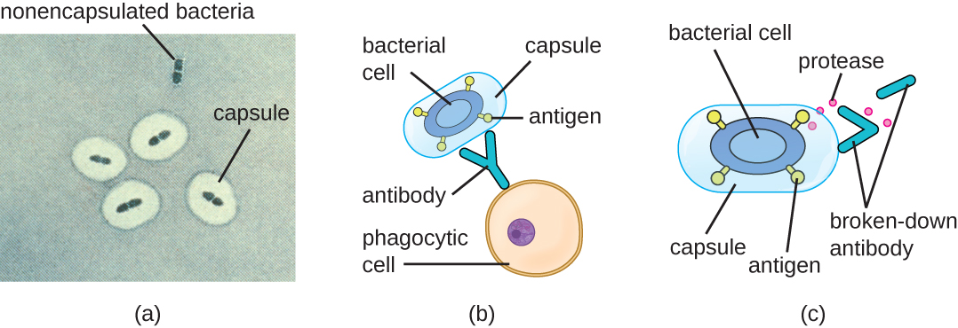
Figure 6.7. (a) A micrograph of capsules around bacterial cells. (b) Antibodies normally function by binding to antigens, molecules on the surface of pathogenic bacteria. Phagocytes then bind to the antibody, initiating phagocytosis. (c) Some bacteria also produce proteases, virulence factors that break down host antibodies to evade phagocytosis.

Slide 44
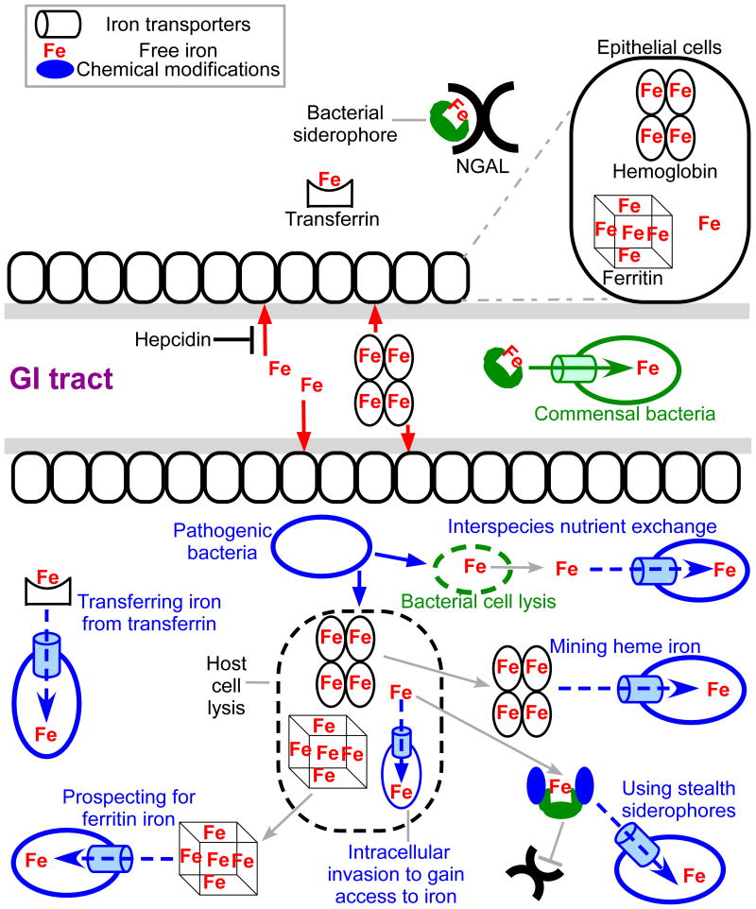
Figure 6.8. Under normal conditions, commensal bacteria of the GI tract use siderophore-based iron uptake systems to obtain iron. Upon infection, the host uses nutritional immunity to restrict bacterial access to essential nutrients including iron (top panel). Host iron limitation includes hepcidin- mediated reduction of circulatory iron and/or the production of NGAL to prevent siderophores from chelating free iron. Additionally, iron is kept unavailable for bacteria by being bound to heme or proteins such as transferrin or ferritin. Bacterial pathogens employ diverse strategies to counter nutritional immunity (bottom panel), including the utilization of transferrin/lactoferrin, heme/heme-containing proteins, iron storage proteins such as ferritin, blocking the host from recognizing their siderophores, utilizing other species siderophores, and even invading into the cytoplasm of host cells.

Slide 45
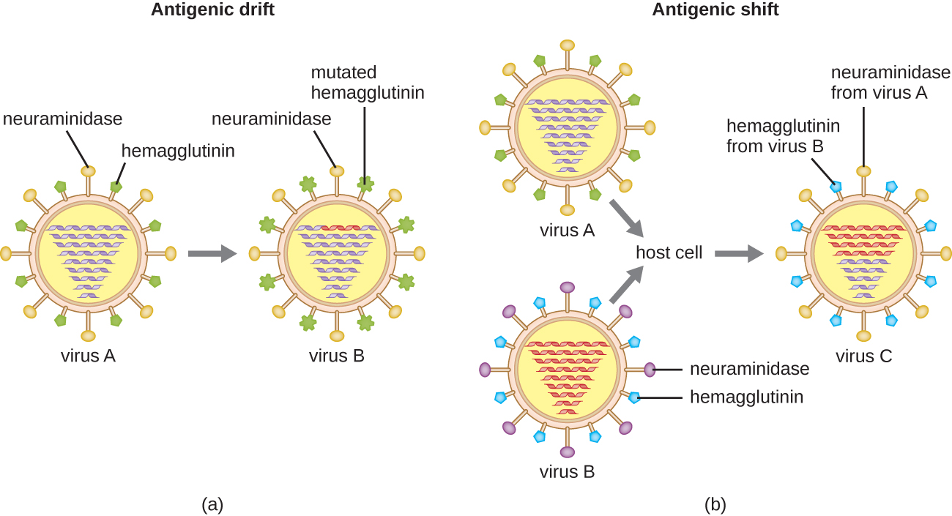
Figure 6.9. Antigenic drift and antigenic shift in influenza viruses. (a) In antigenic drift, mutations in the genes for the surface proteins neuraminidase and/or hemagglutinin result in small antigenic changes over time. (b) In antigenic shift, simultaneous infection of a cell with two different influenza viruses results in mixing of the genes. The resultant virus possesses a mixture of the proteins of the original viruses. Influenza pandemics can often be traced to antigenic shifts.

Slide 46
Step 4: Dissemination and Transmission
Spreading the Infection: Pathogens must spread within the host and exit to infect new hosts.
Key Factors:
  Motility (Flagella): Allows active movement through host tissues for invasion and spread (e.g., Salmonella).
  Pili (Type IV): Facilitate attachment and colonization, especially on mucosal surfaces, aiding local spread and transmission through contact (e.g., Neisseria gonorrhoeae).
  Biofilm Formation: Protective communities enhance persistence within tissues and protect bacteria for transmission (e.g., Pseudomonas aeruginosa in cystic fibrosis lungs).
  Vector-Mediated Transmission: Reliance on vectors like mosquitoes or ticks to move between hosts (e.g., Plasmodium for malaria, Borrelia for Lyme disease, Dengue virus).
  Environmental Persistence: Ability to survive harsh conditions outside the host (e.g., Clostridium difficile spores).

Slide 47
Nursing Relevance: Applying Virulence Factor Knowledge
Infection Control: Understanding adhesins and dissemination helps guide hygiene and isolation measures.
Diagnosis & Treatment: Recognizing symptoms of toxin-related infections and encapsulated pathogens aids early intervention.
Antimicrobial Stewardship: Knowledge of how pathogens evade antibiotics (e.g., biofilms) informs treatment choices.
Vaccination & Prevention: Understanding viral antigenic variation and bacterial capsules highlights the importance of vaccination programs.
Patient Education: Nurses educate on hygiene, safe practices, and the role of immune defenses.
By understanding these intricate mechanisms, healthcare professionals can better combat infectious diseases and protect public health.

Slide 48
What is in Louisiana
​Dr. Gerald Domingue, a native of Lafayette, Louisiana, made significant contributions to the understanding of microbial pathogenicity during his tenure as a professor at Tulane University School of Medicine. His research centered on cell wall-deficient bacteria, or L-form bacteria, revealing their ability to persist within host tissues, evade the immune system, and potentially contribute to chronic and recurrent infections. A notable 1974 study published in Infection and Immunity demonstrated the capacity of L-form bacteria to persist within human embryonic kidney cells and revert to their walled forms, elucidating a reproductive cycle crucial to their persistence and pathogenicity. Subsequent research explored the role of these bacteria in chronic urinary tract infections (UTIs), demonstrating their ability to survive antibiotic treatment by entering a dormant state within host cells. This work significantly advanced our understanding of antibiotic resistance and bacterial latency, influencing clinical approaches to managing recurrent UTIs. While Dr. Domingue’s work did explore the role of L-forms in persistent infections, the direct link to autoimmune diseases like rheumatoid arthritis and lupus, while investigated, remains an area of ongoing research with more complex connections than directly triggering such diseases. His research did highlight the challenge of detecting L-form bacteria using conventional culture techniques, emphasizing the need for alternative diagnostic methods. His findings, published in journals such as The Journal of Urology and Clinical Microbiology Reviews, continue to influence infectious disease research and challenge traditional models of bacterial pathogenesis, particularly concerning persistent and antibiotic resistant infections.

Slide 49
Chapter Summary: Core Concepts
How Pathogens Cause Disease:
  Pathogens must enter, evade host defenses, and damage tissues to establish infection.
Pathogenicity & Virulence:
  Pathogenicity: The ability of a microbe to cause disease.
  Virulence: The degree of disease severity.
Measuring Virulence:
  Infectious Dose (ID₅₀): Number of microbes to infect 50% of a population.
  Lethal Dose (LD₅₀): Number of microbes to kill 50% of a population.
Pathogen Identification:
  Early Methods: Relied on historical observations (e.g., Traditional Medicine).
  Koch's Postulates: Established scientific links between microbes and diseases.
  Molecular Koch's Postulates: Refined identification using genetic and molecular tools.

Slide 50
Chapter Summary: Stages & Virulence Factors
Stages of Pathogenesis:
  Recognition and Adhesion: Pathogens attach to host cells (e.g., using adhesins, adhesive discs).
  Invasion: Entry into host tissues (facilitated by exoenzymes, toxins).
  Evasion of Host Defenses and Replication: Avoiding immune detection and multiplying (e.g., capsules, enzymes, antigenic variation).
  Dissemination and Transmission: Spreading within the host and to new hosts (e.g., flagella, pili, endospores).
Virulence Factors:
  Specific molecules or structures produced by pathogens (bacterial, viral, eukaryotic).
  Enhance the pathogen's ability to cause disease.
  Include: Adhesins, toxins, capsules, enzymes, and mobile structures.

