Slide 1

Safely Purchasing and Receiving Food
MODULE 6

Slide 2

Student Learning Outcomes
  Define the responsibilities of the purchasing and receiving department as it relates to food handling
  Identify the proper steps and necessary equipment needed during the receiving process.
  List receiving temperatures and quality measures of TCS foods.

Slide 3
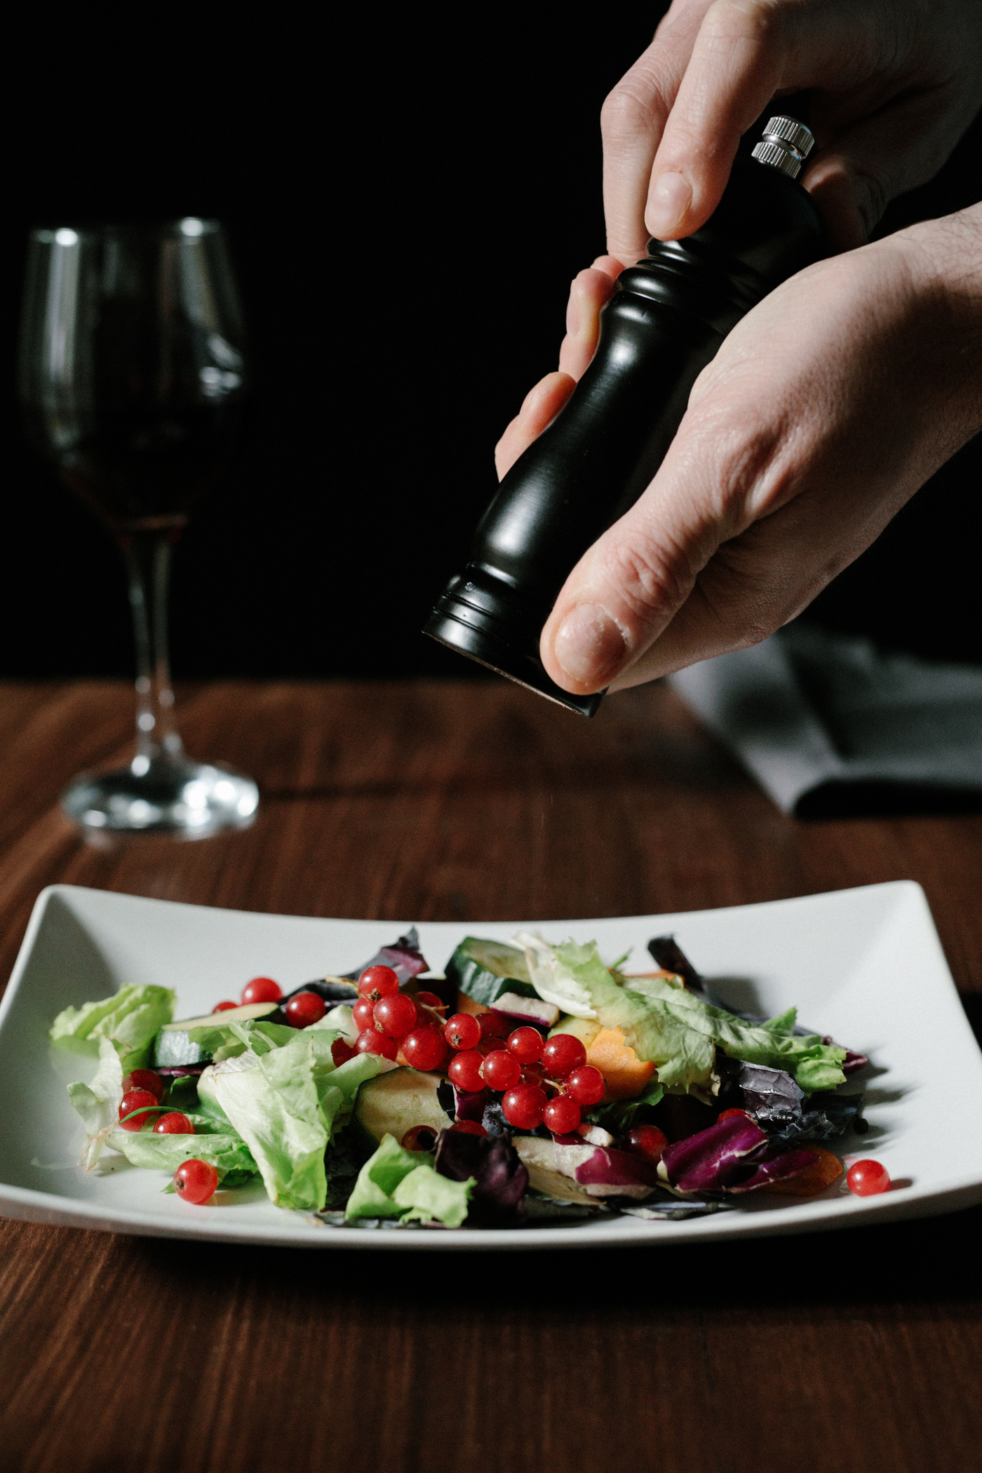
Introduction
The first step in the flow of food is purchasing.
Purchasing agents should ensure that vendors are:
  approved by the appropriate agencies
  reputable, and
  follow all laws and regulations

Slide 4
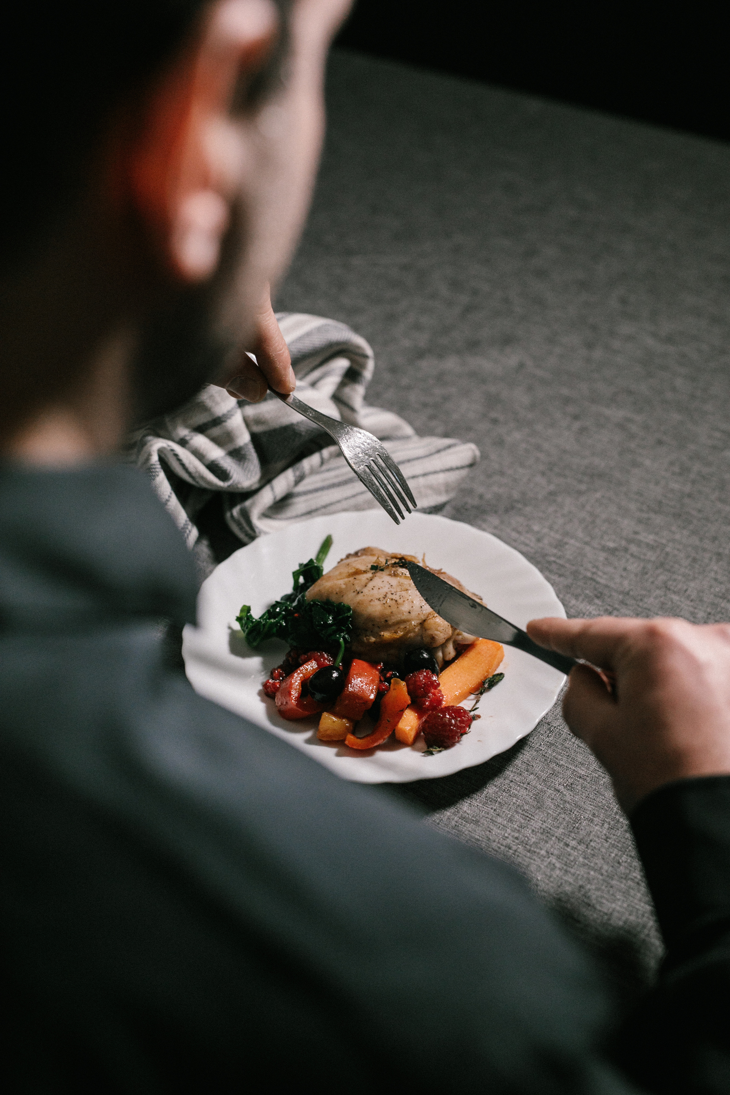
The two main agencies regarding purchasing foods are the
    FDA
    USDA

Slide 5
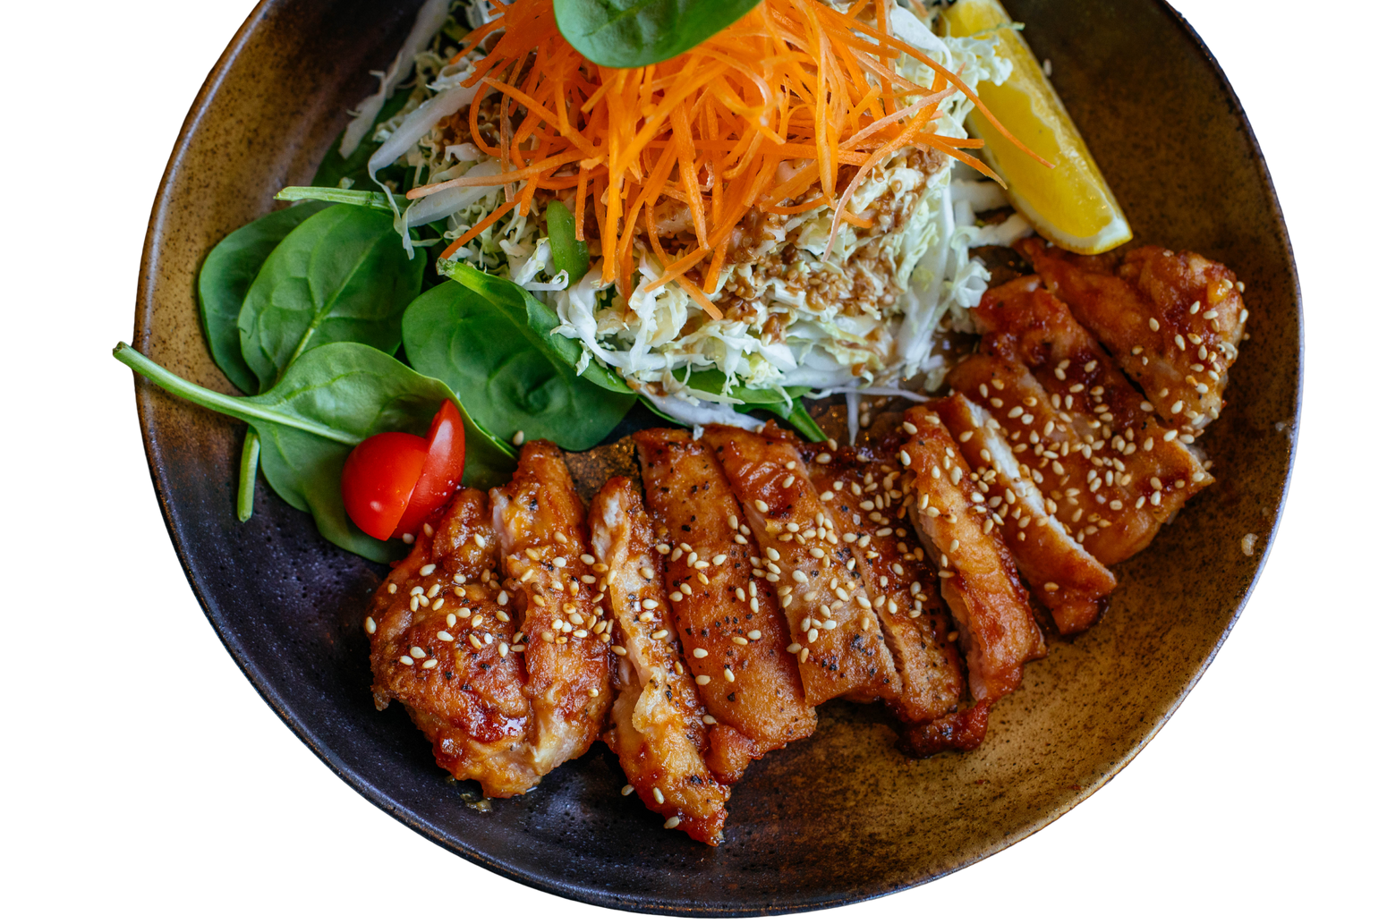
Food and Drug Administration
The FDA protects consumers from unsafe foods through:
  Research and methods development
  Inspection
  Voluntary Destruction
  Sampling
  Recall
  Seizure
  Injunction
  Criminal prosecution

Slide 6
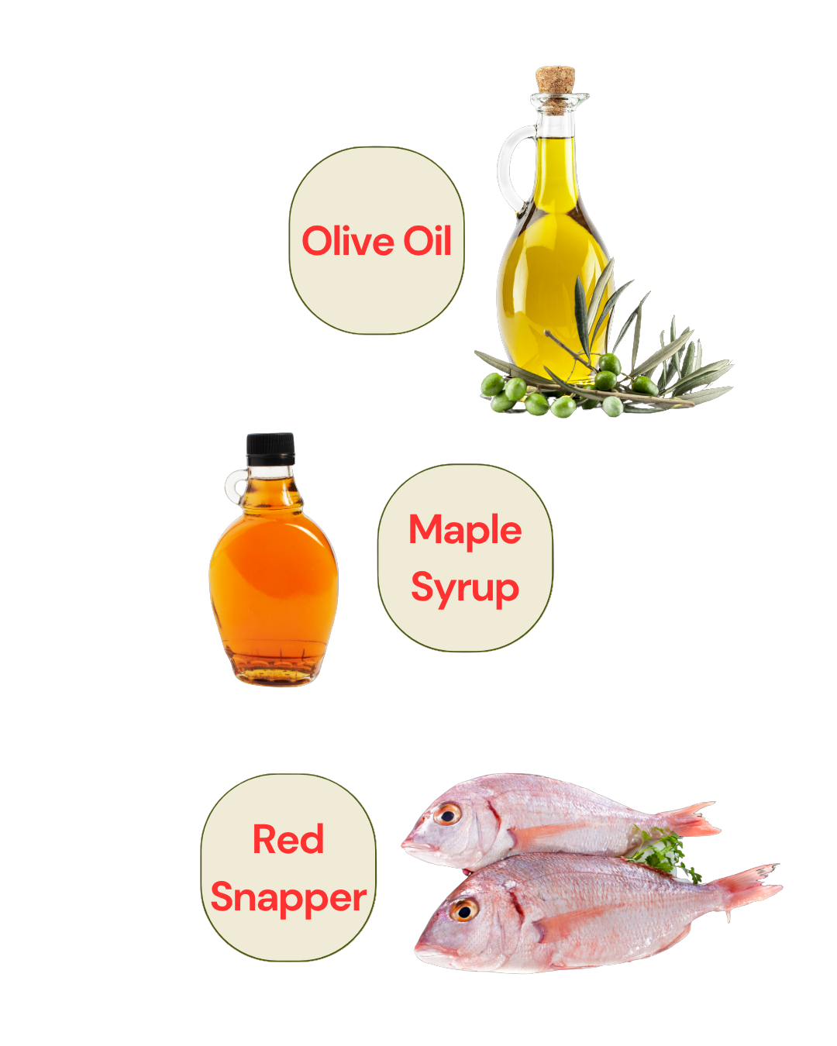
Economically Motivated Adulteration (EMA)
  occurs when someone intentionally leaves out, takes out, or substitutes a valuable ingredient or part of a food.
  occurs when someone misrepresents by adding a substance to a food to make it appear better.

Slide 7
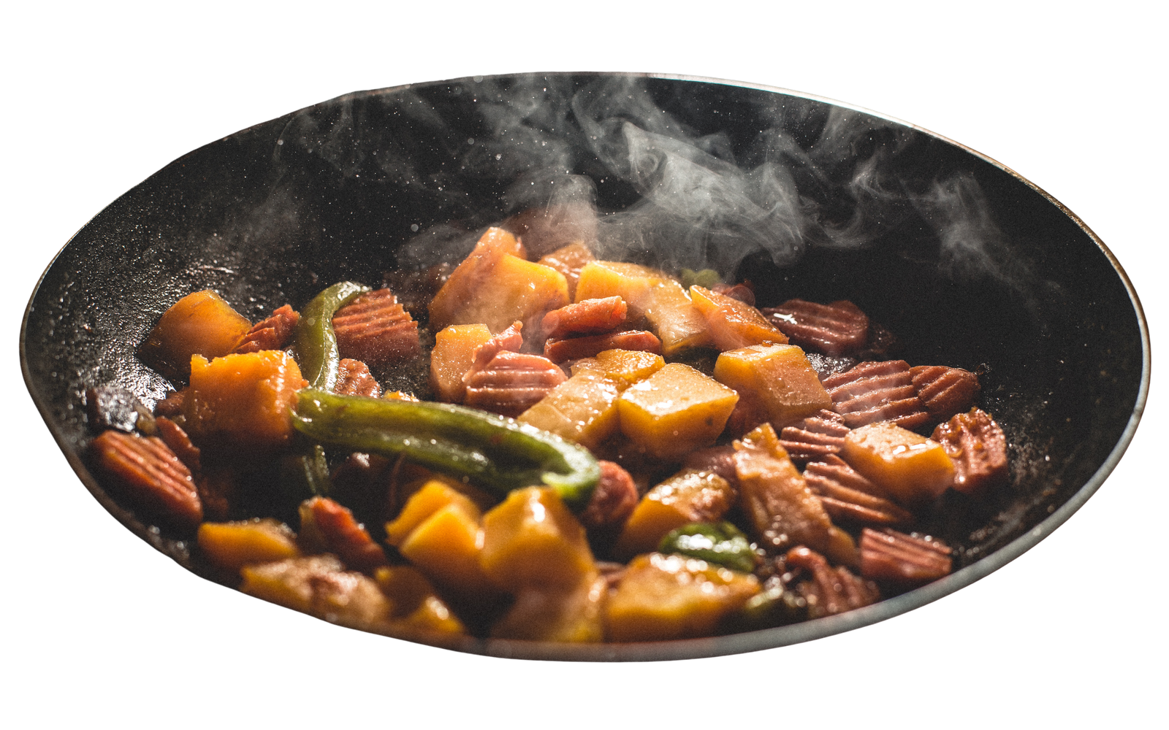
United States Department of Agriculture
  USDA Inspection
  USDA Grading

Slide 8
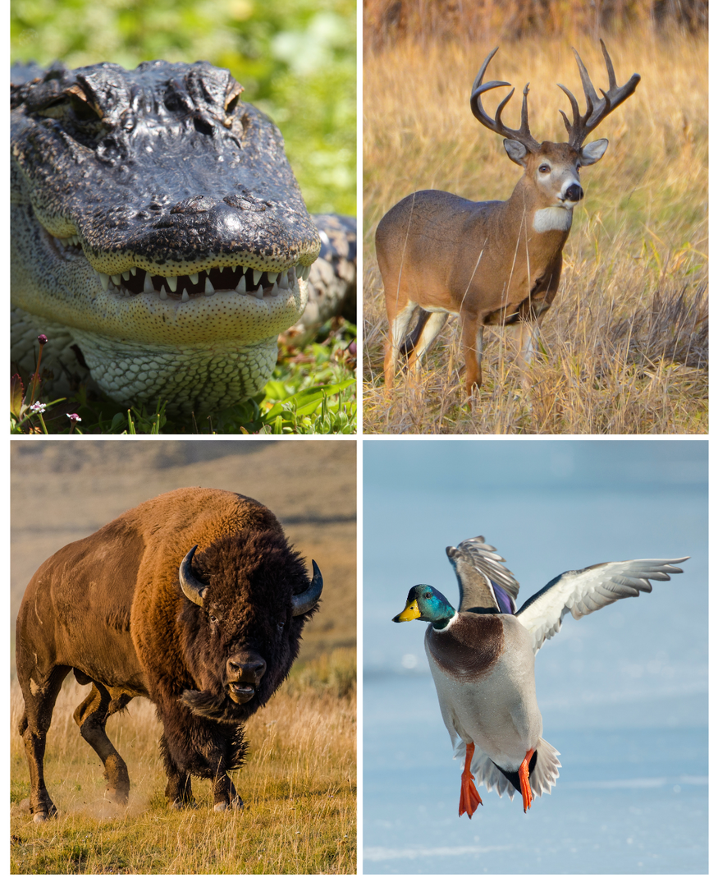
Game animals such as bison, venison, elk, aligator, rabbit or duck must be commercially raised for food and follow all regulatory guidelines.

Slide 9
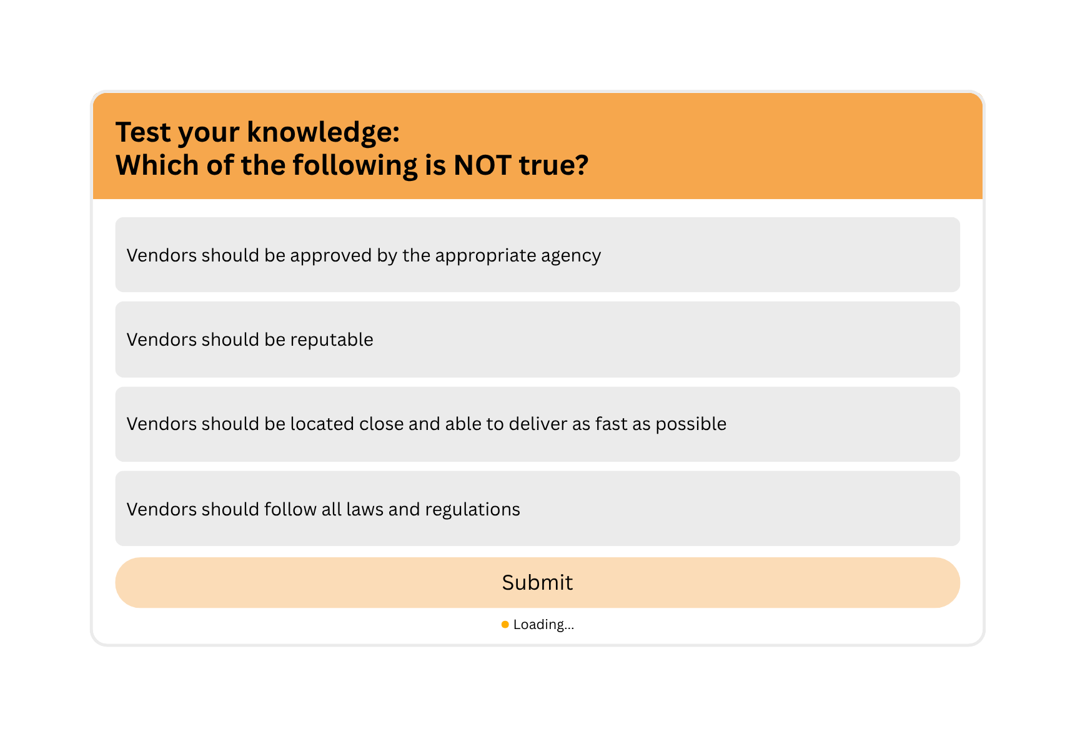

Slide 10
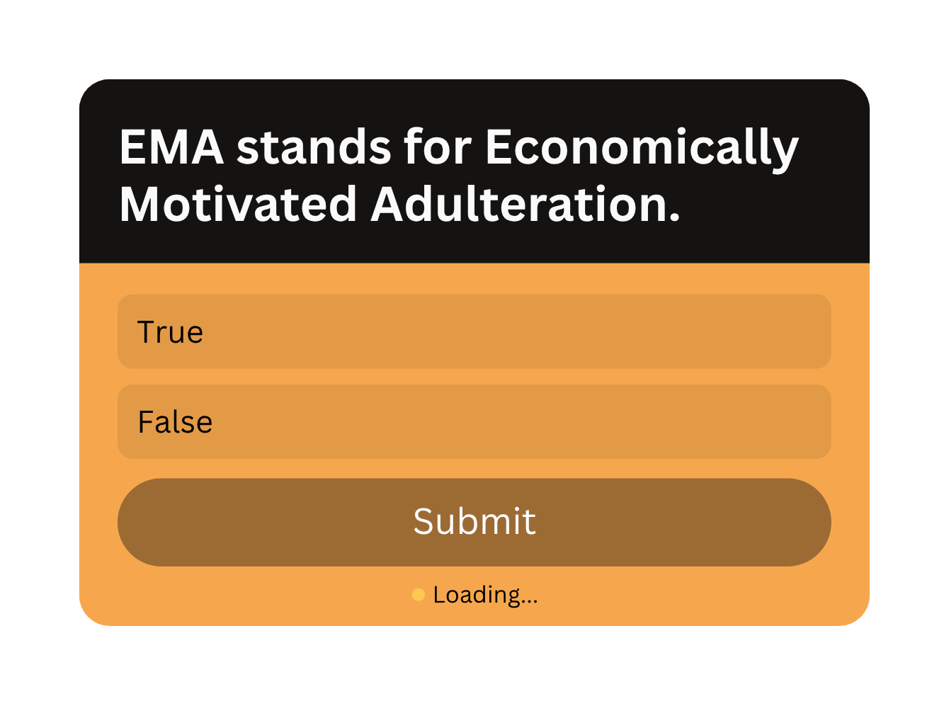

Slide 11
Receiving Deliveries
  Consequences
  Personnel
  Timing
  Receiving Area
  Delivery Vehicles
  Purchase Order
  Visual Inspection
  Tools
  Storage

Slide 12
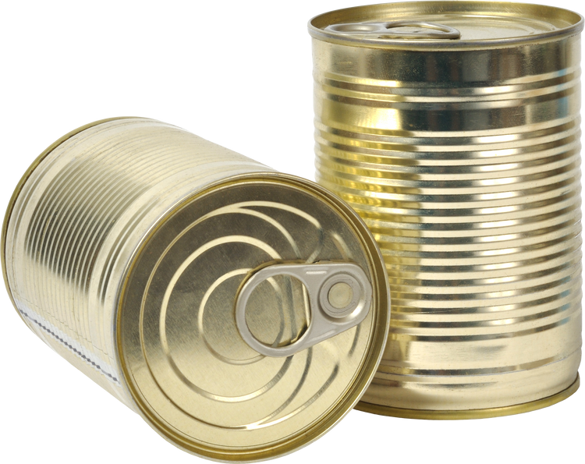

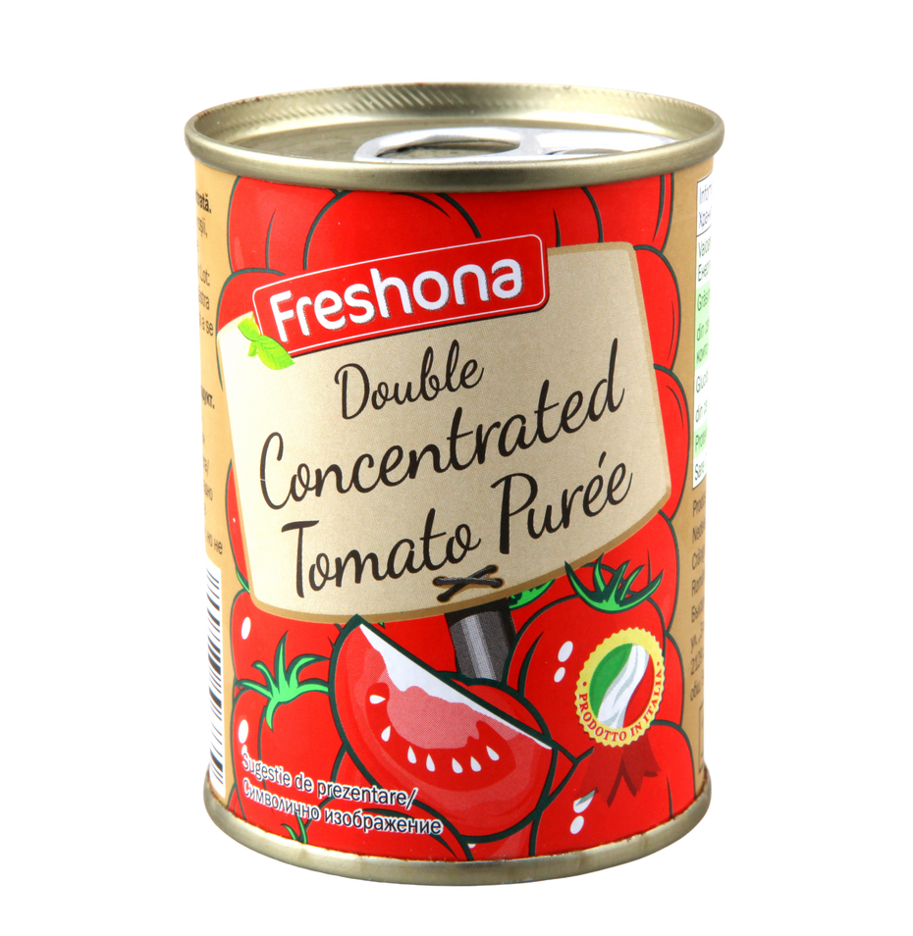

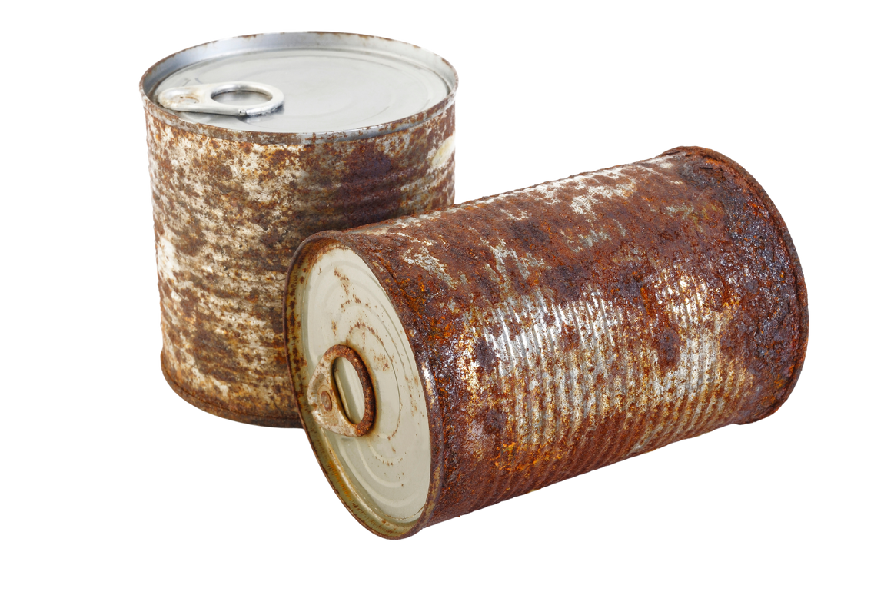
Label is missing
Label is intact, can is not rusted or dented
Cans are rusted

Slide 13

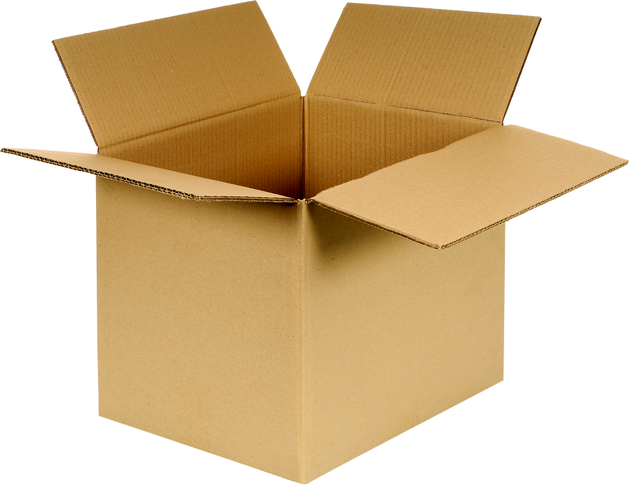
Container sealed when delivered
Free of rodents, insects and insect parts
Label identifying items
Frozen Food:
Free of water stains or large ice crystals

Slide 14
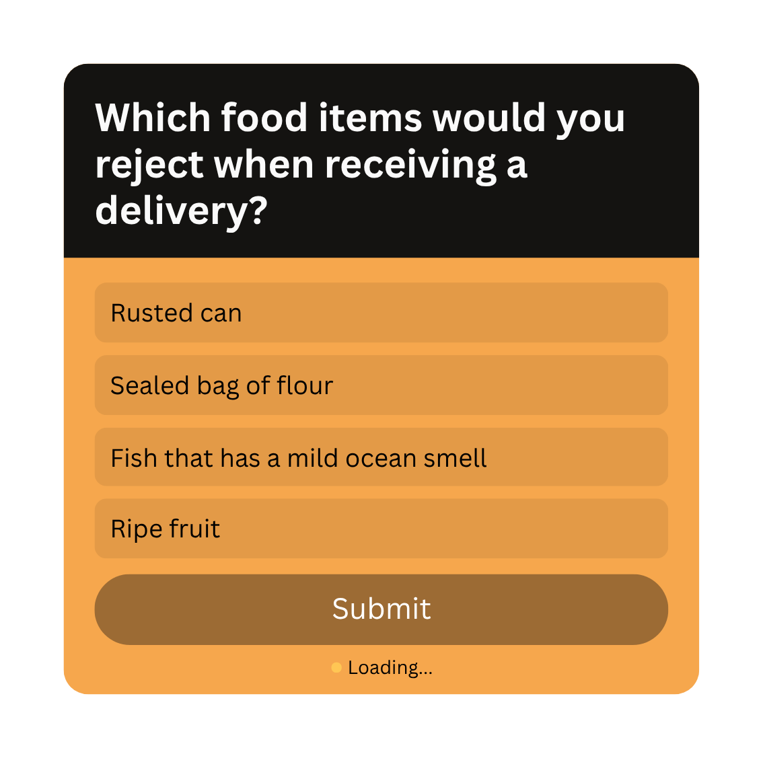

Slide 15
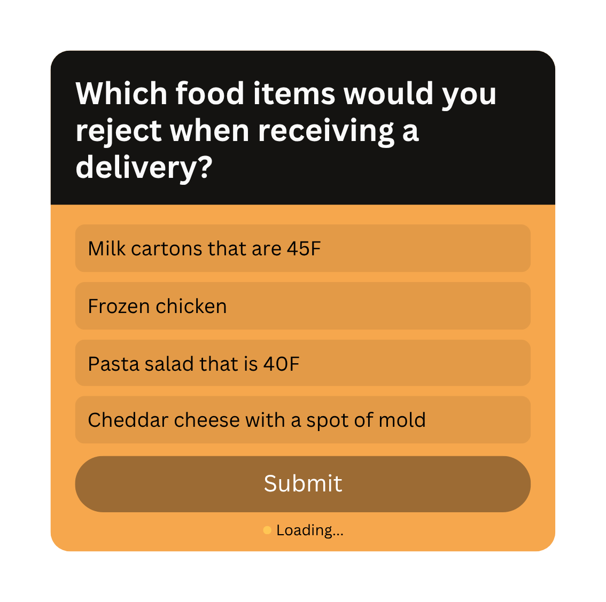

Slide 16
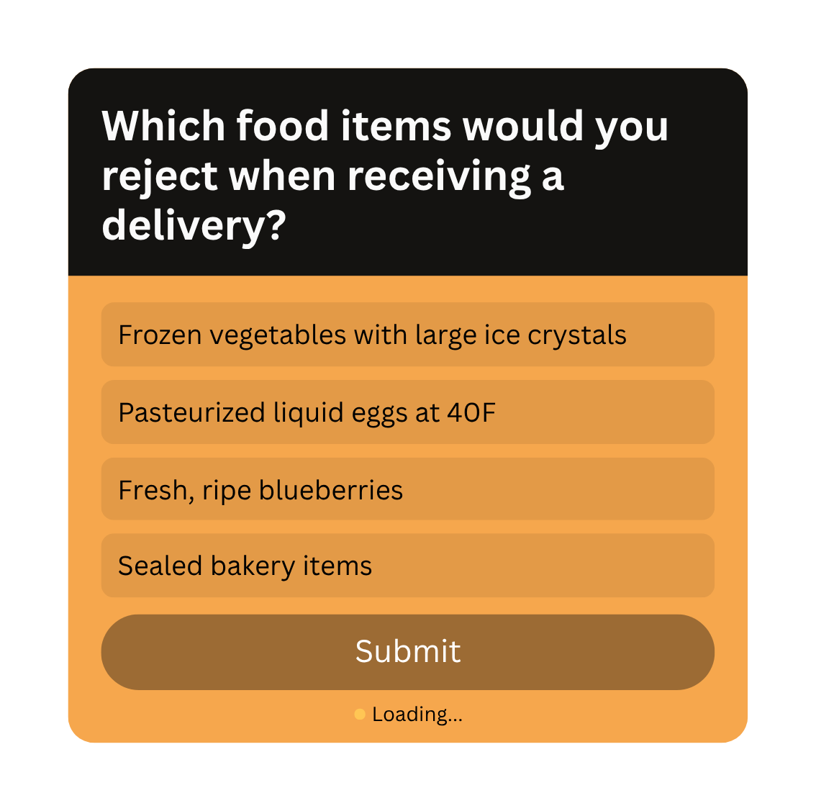

Slide 17

Receiving Temperatures and General Guidelines
  Dry Goods
  Hot Foods
  Refrigerated Goods
  Frozen Goods

Slide 18

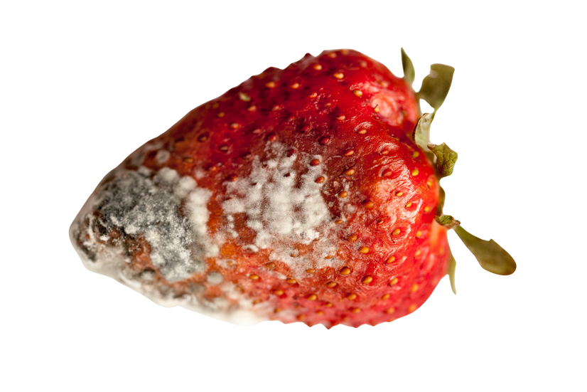
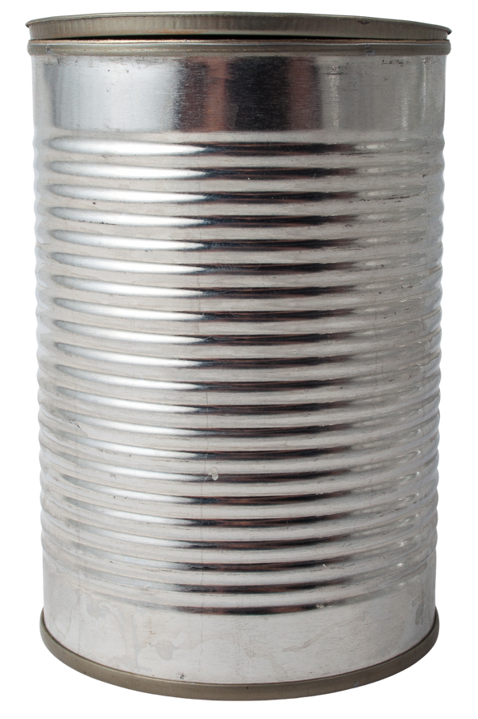
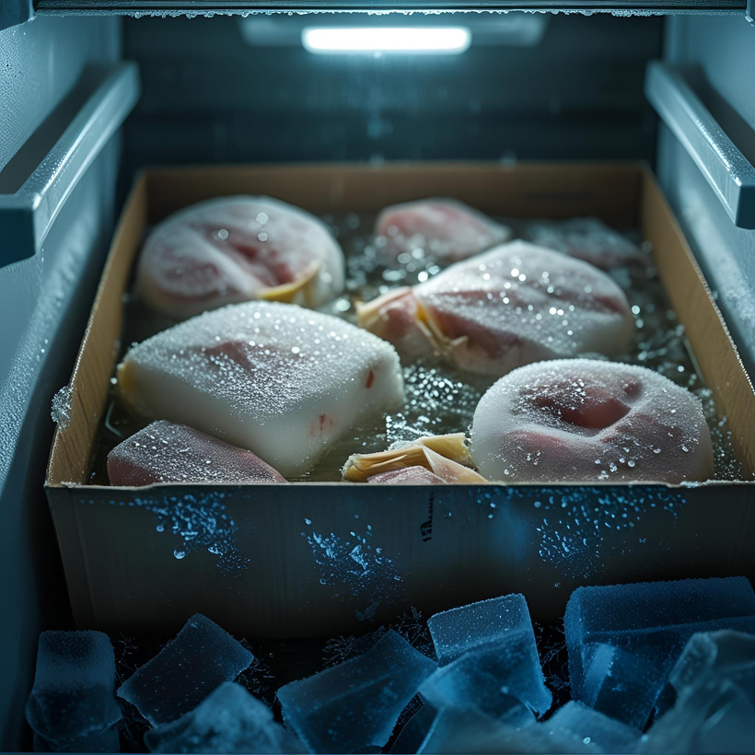
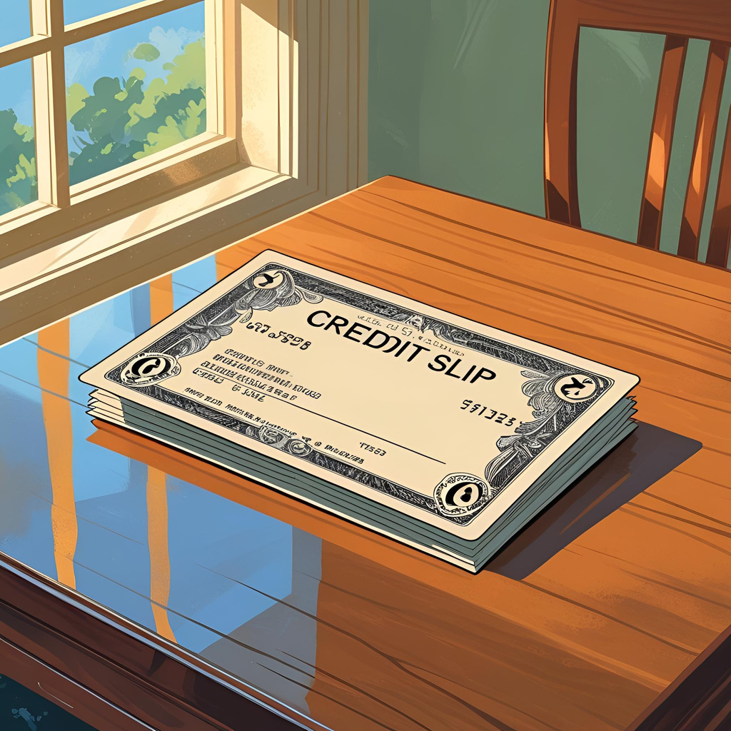
Rejecting Items
  Credit slip

Slide 19
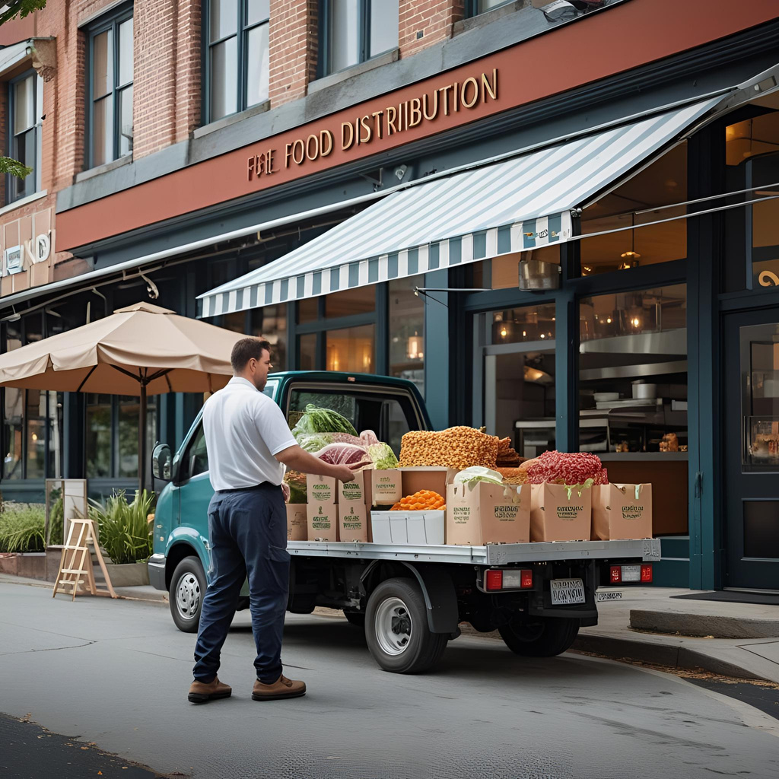
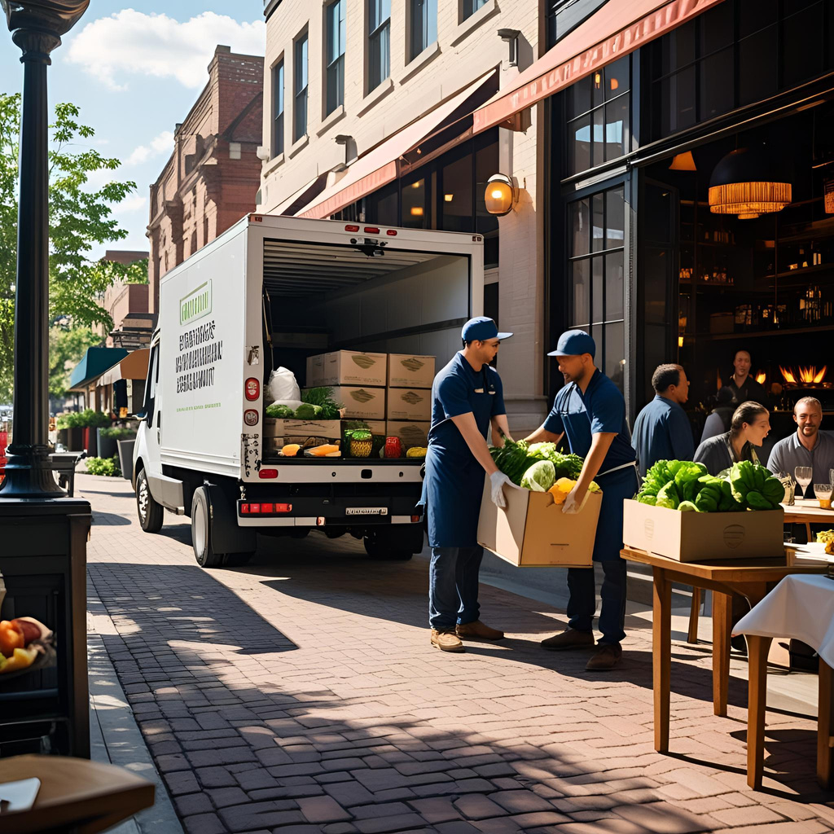
Key Drop Deliveries

