Slide 1
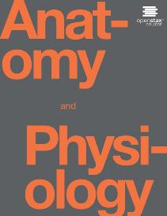
Anatomy and Physiology II
Chapter 15: Genetics & Genomics

Slide 2
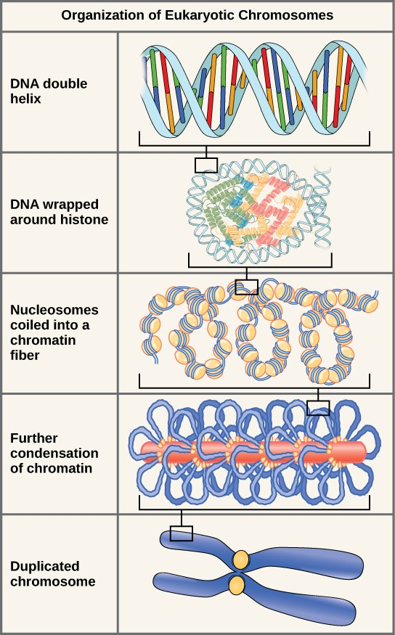

Genetics terminology
Chromosome
Homologous Chromosome
  Autosomal chromosomes
  Sex chromosomes
Gene
These figures illustrate the compaction of the eukaryotic chromosome.

Slide 3
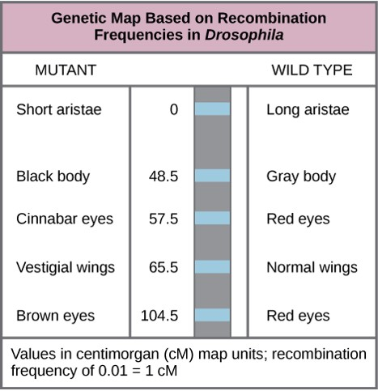
Genetics Terminology
Alleles
  Dominant
  Recessive
Genotype
  Homozygous dominant (AA)
  Heterozygous (Aa)
  Homozygous recessive (aa)
Phenotype
This genetic map orders Drosophila genes on the basis of recombination frequency.
Link: Mendel pea lab

Slide 4
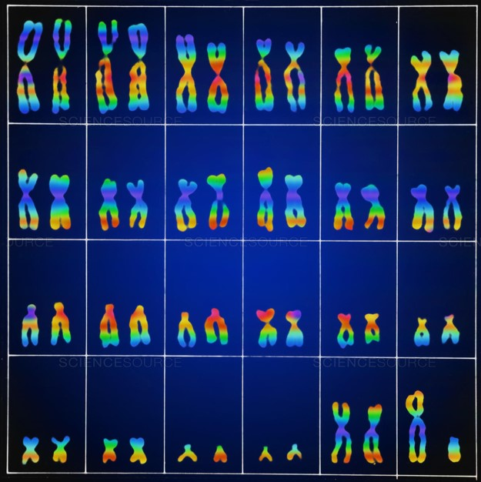
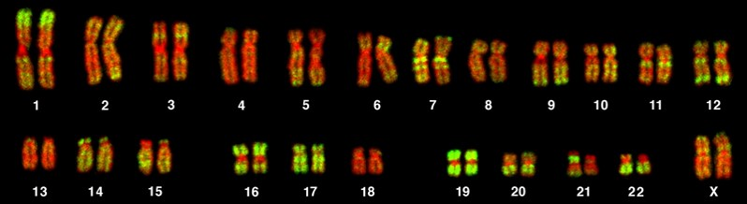
Karyotype
This karyotype is of a female human. Notice that homologous chromosomes are the same size, and have the same centromere positions and banding patterns. A human male would have an XY chromosome pair instead of the XX pair shown. (credit: Andreas Blozer et al)
This karyotype is of a male human. (credit: science source)

Slide 5
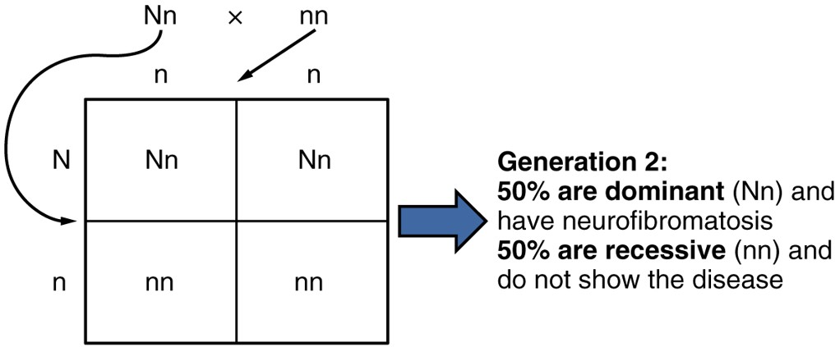

Autosomal dominant inheritance
Autosomal Dominant Inheritance
Inheritance pattern of an autosomal dominant disorder, such as neurofibromatosis, is shown in a Punnett square.

Slide 6
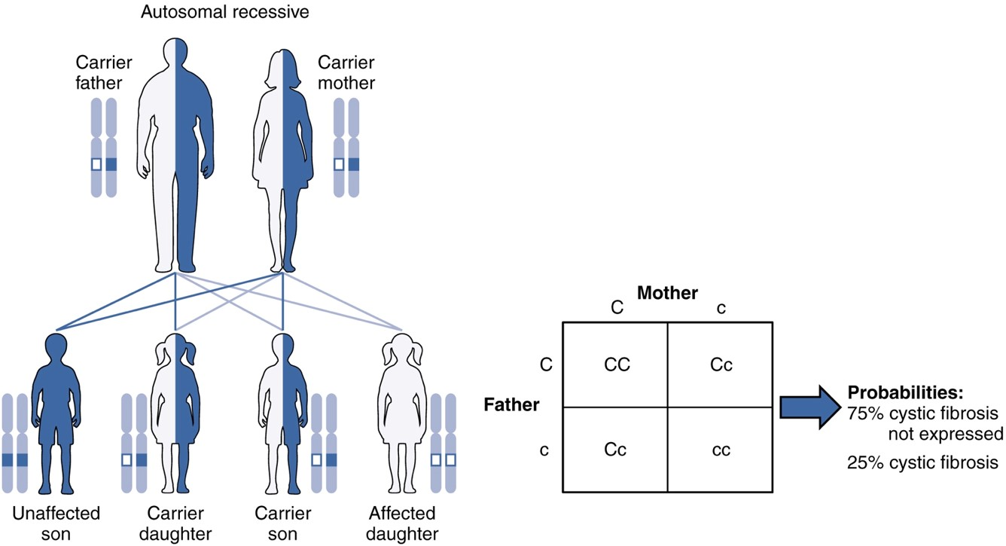
Autosomal recessive
Autosomal Recessive Inheritance
The inheritance pattern of an autosomal recessive disorder with two carrier parents reflects a 3:1 probability of expression among offspring. (credit: U.S. National Library of Medicine)

Slide 7
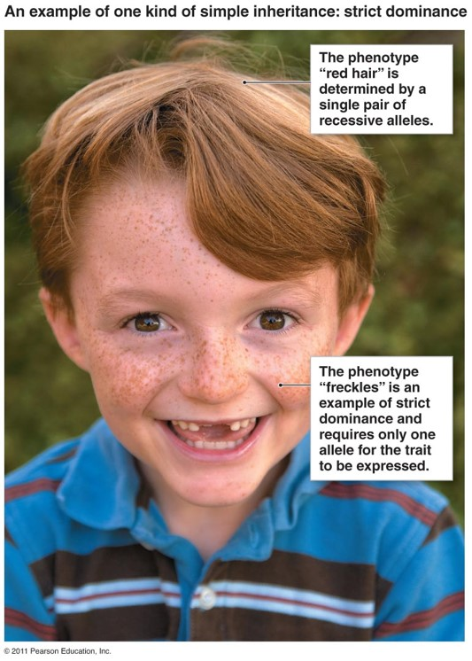
Strict Dominance-recessive

Slide 8
Inheritance
Inheritance is the passage of hereditary traits from one generation to another.
1. The branch of biology that deals with inheritance is called genetics.
2. The area of health care that offers advice on genetic problems is called genetic counseling.
B. Genotype and Phenotype
1. Nuclei of all human cells except gametes contain 23 pairs of chromosomes (diploid number).
a. One chromosome in each pair came from the mother, and the other came from the father.
b. Homologues, the two chromosomes in a pair, contain genes that control the same traits.
c. The two genes that code for the same trait and are at the same location on homologous chromosomes are termed alleles.
d. A mutation is a permanent heritable change in a gene that causes it to have a different effect than it had previously.
2. The genetic makeup of an organism is called its genotype.
a. Dominant genes control a particular trait; expression of recessive genes is inhibited by the presence of dominant genes.
b. An individual with the same genes on homologous chromosomes (e.g., PP or pp) is said to be homozygous for the trait. An individual with different genes on homologous chromosomes (e.g., Pp) is said to be heterozygous for the trait. (By convention, the dominant gene is expressed by a capital letter; and the recessive gene, by a lower case letter.)
3. The traits that are expressed are called its phenotype.
a. Most genes give rise to the same phenotype whether they are inherited from the mother or father; although, in a few cases, the phenotype is dramatically different. This phenomenon is called genomic imprinting.

Slide 9
Inheritance
To determine the possible ways that haploid gametes can unite to form diploid fertilized eggs, special charts called Punnett squares are used.
5. Meiosis errors can result in inheritance abnormalities.
a. Nondisjunction results in an abnormal number of chromosomes.
b. A cell that has one or more chromosomes of a set added or deleted is called an aneuploid.
c. In translocation, the location of a chromosome segment is changed, being moved either to another chromosome or to another location within the same chromosome.
Variations on Dominant-Recessive Inheritance
1. Most patterns of inheritance do not conform to the simple dominant recessive patterns in which only dominant and recessive genes interact.
2. In fact, the phenotypic expression of a particular gene is influenced not only by the alleles of the genes present, but also by other genes and by the environment. Most inherited traits are influenced by more than one gene, and most genes can influence more than a single trait.
3. In incomplete dominance, neither member of an allelic pair dominates; phenotypically the heterozygote is intermediate between the homozygous dominant and homozygous recessive. An example is sickle-cell disease
4. In multiple-allele inheritance, some genes have more than two alternate forms. An example is the inheritance of ABO blood groups.
5. In polygenic inheritance, an inherited trait is controlled by the combined effects of many genes.

Slide 10
Autosomes, Sex Chromosomes, and Inheritance of Gender
In 22 of the 23 pairs of chromosomes, the homologous chromosomes look alike and have the same appearance in both males and females; these 22 pairs are called autosomes. The two members of the 23rd pair are termed the sex chromosomes .
a. In females, the 23rd pair consists of two chromosomes designated as X chromosomes.
b. One X chromosome is also present in the male sex chromosomes, but its mate is a smaller chromosome called a Y chromosome.
c. If the secondary oocyte is fertilized by an X-bearing sperm, the offspring normally will be female (XX). Fertilization by a Y-bearing sperm normally produces a male (XY). Thus, gender (sex) is determined by the father’s sex chromosome
Sex is determined by the presence or absence of an SRY (sex determining region of the Y chromosome) gene on the Y chromosome at fertilization
Sex-Linked Inheritance
1. The sex chromosomes also are responsible for the transmission of several nonsexual traits. Genes for these traits appear on X chromosomes, but many of them are absent from Y chromosomes. Traits inherited in this manner are called sex-linked or X-linked traits.
2. Red-green color blindness and hemophilia primarily affect males because there are no counterbalancing dominant genes on the Y chromosome. Other sex-linked traits in humans are fragile X syndrome, nonfunctional sweat glands, certain forms of diabetes, some types of deafness, uncontrollable rolling of the eyeballs, absence of central incisors, night blindness, one form of cataract, juvenile glaucoma, and juvenile muscular dystrophy.
a. Whereas females have two X chromosomes in every cell, they actually use only one. X-chromosome inactivation or lyonization inactivates one X-chromosome so that its genes are not expressed.
b. The inactivated X chromosome shows up as a Barr body in cells.

Slide 11
Autosomes, Sex Chromosomes, and Inheritance of Gender
Environmental Influences on Genotype and Phenotype
1. A given phenotype is the result of the interactions of genotype and the environment. A teratogen is any agent or influence that causes developmental defects in the embryo.
2. Chemicals and Drugs
a. Because the placenta is a porous barrier between the maternal and fetal circulations, any drug or chemical dangerous to an infant may be considered potentially dangerous to the fetus when given to the mother.
b. Alcohol is by far the number one fetal teratogen. Intrauterine exposure to even a small amount of alcohol may result in fetal alcohol syndrome, one of the most common causes of mental retardation and one of the most common preventable causes of birth defects in the United States.
c. Other fetal teratogens include pesticides, industrial chemicals, some hormones, antibiotics, some prescription drugs, and street drugs.
3. Cigarette Smoking
a. Cigarette smoking is implicated as a cause of low birth weight and a higher fetal and infant mortality rate.
b. Cigarette smoke may be teratogenic and cause cardiac abnormalities and anencephaly.
4. Ionizing radiations are potent teratogens. X

Slide 12
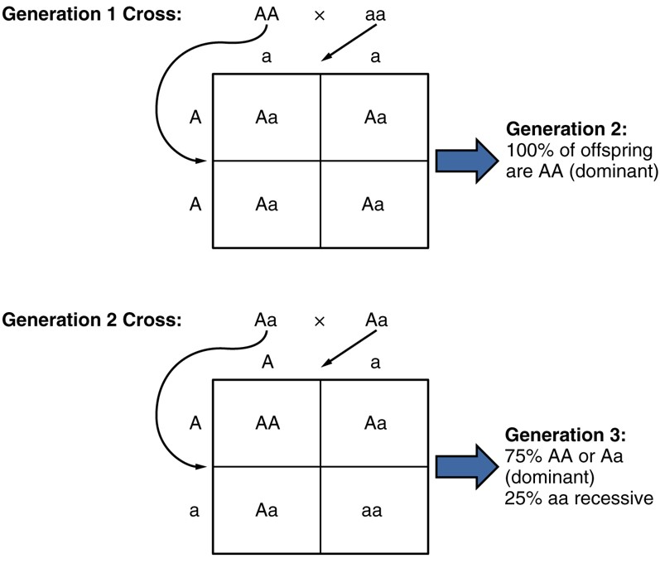
Random segregation
Random Segregation
In the formation of gametes, it is equally likely that either one of a pair alleles from one parent will be passed on to the offspring. This figure follows the possible combinations of alleles through two generations following a first-generation cross of homozygous dominant and homozygous recessive parents. The recessive phenotype, which is masked in the second generation, has a 1 in 4, or 25 percent, chance of reappearing in the third generation.

Slide 13
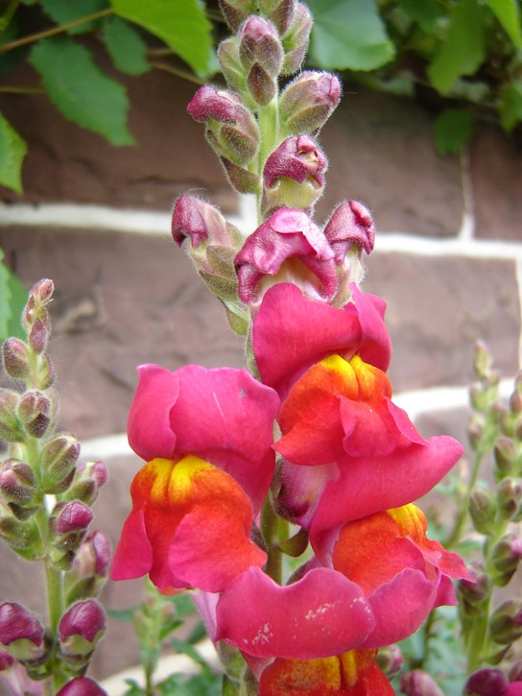
Incomplete Dominance
These pink flowers of a heterozygote snapdragon result from incomplete dominance.
(credit: “storebukkebruse”/Flickr)

Slide 14
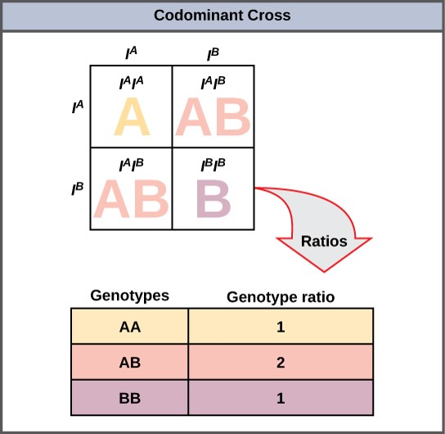
Co-dominance
This Punnet square shows an AB/AB blood type cross

Slide 15
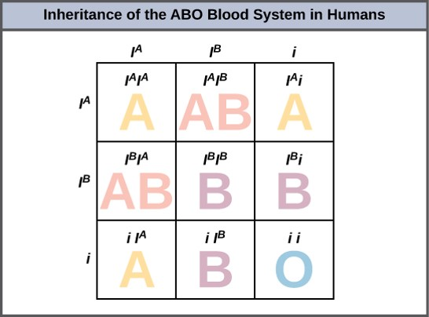
Multiple Alleles
Inheritance of the ABO blood system in humans is shown.

Slide 16
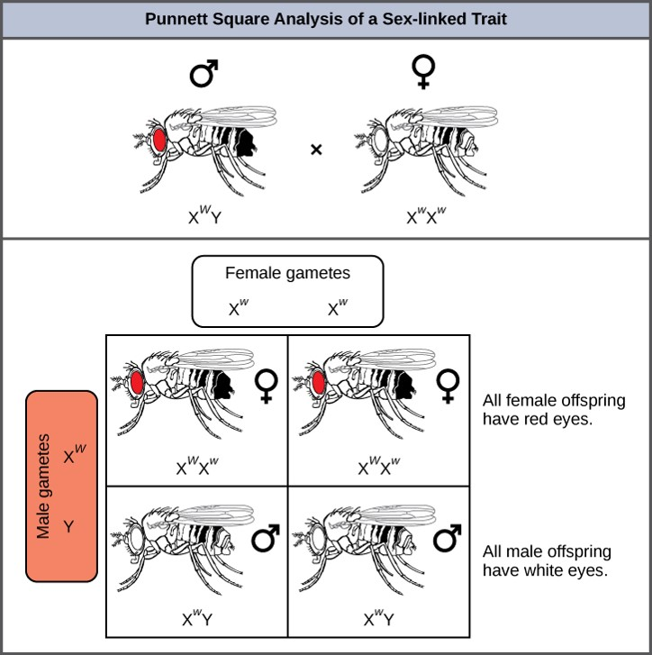
X-linked Punnett Square
Punnett square analysis is used to determine the ratio of offspring from a cross between a red-eyed male fruit fly and a white-eyed female fruit fly.

Slide 17
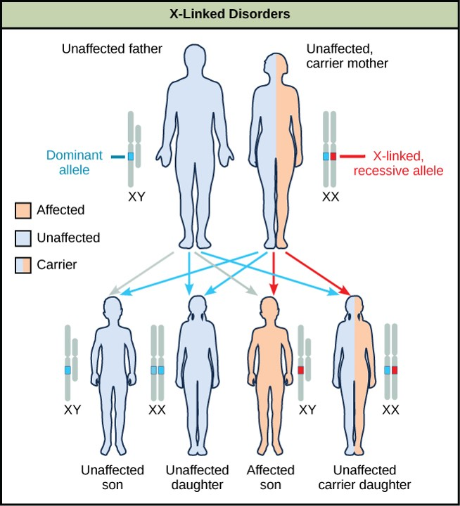
X-Linked Disorders
The son of a woman who is a carrier of a recessive X-linked disorder will have a 50 percent chance of being affected. A daughter will not be affected, but she will have a 50 percent chance of being a carrier like her mother.

Slide 18
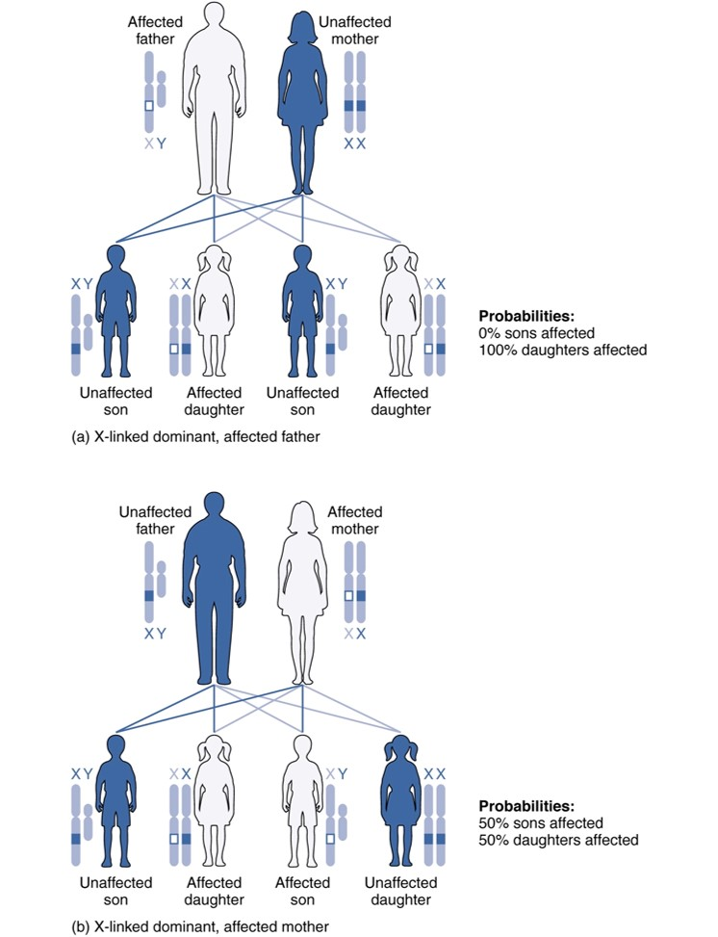
X-linked patterns of inheritance
X-Linked Patterns of Inheritance
A chart of X-linked dominant inheritance patterns differs depending on whether (a) the father or (b) the mother is affected with the disease. (credit: U.S. National Library of Medicine)

Slide 19
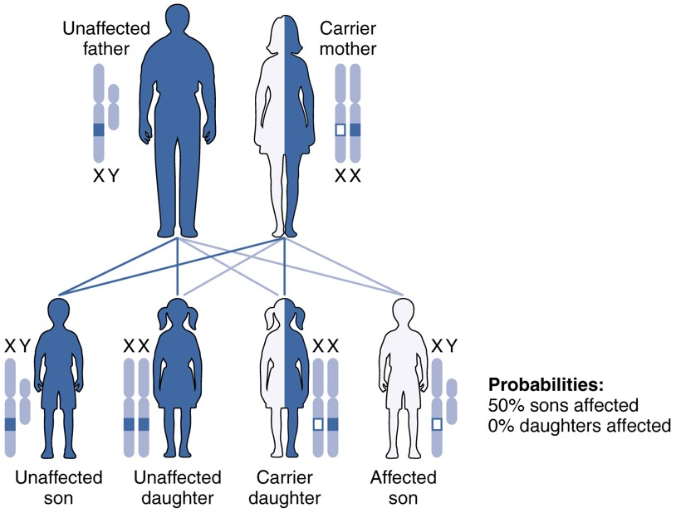
X-linked recessive inheritance
X-Linked Recessive Inheritance
Given two parents in which the father is healthy and the mother is a carrier of an X-linked recessive disorder, a son would have a 50 percent probability of being affected with the disorder, whereas daughters would either be carriers or entirely unaffected. (credit: U.S. National Library of Medicine)

Slide 20
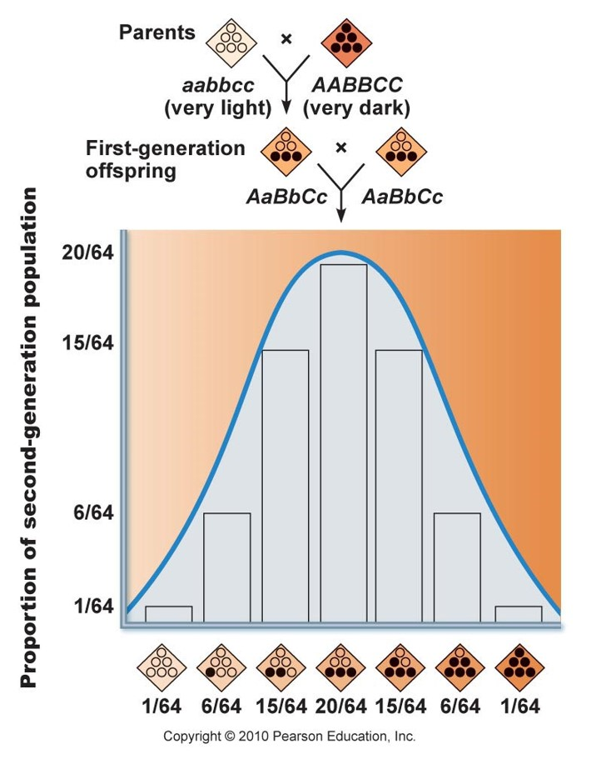

Polygenic Inheritance
Credit: Pearson
Eye color calculator

Slide 21
Solving Genetics Problems
Be able to perform basic genetic problems using the Punnett Squares for each of the following types of inheritance:
    Strict Dominant-Recessive Inheritance
    Multiple Allele with Codominance
    Sex-linked Inheritance

Slide 22
Genetic Screening
Amniocentesis
Chorionic Villi Sampling
Karyotype
Pedigree Analysis

Slide 23

Female chromosomal complement
This karyotype is of a female human. Notice that homologous chromosomes are the same size, and have the same centromere positions and banding patterns. A human male would have an XY chromosome pair instead of the XX pair shown. (credit: Andreas Blozer et al)

Slide 24
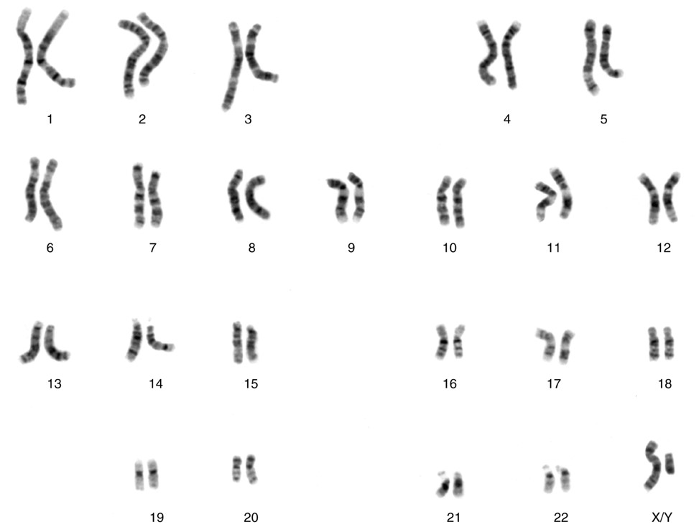
Male chromosomal complement
Chromosomal Complement of a Male
Each pair of chromosomes contains hundreds to thousands of genes. The banding patterns are nearly identical for the two chromosomes within each pair, indicating the same organization of genes. As is visible in this karyotype, the only exception to this is the XY sex chromosome pair in males. (credit: National Human Genome Research Institute)

Slide 25
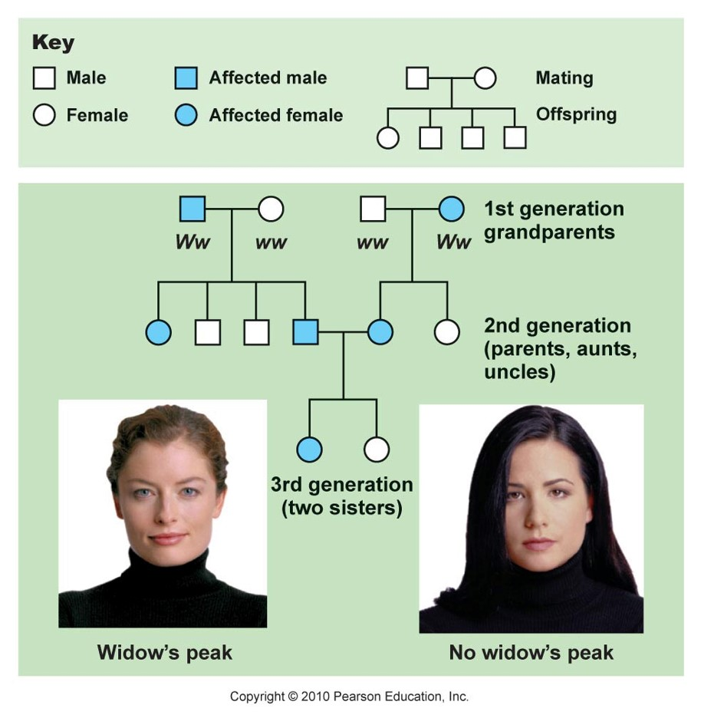
Pedigree Analysis

Slide 26
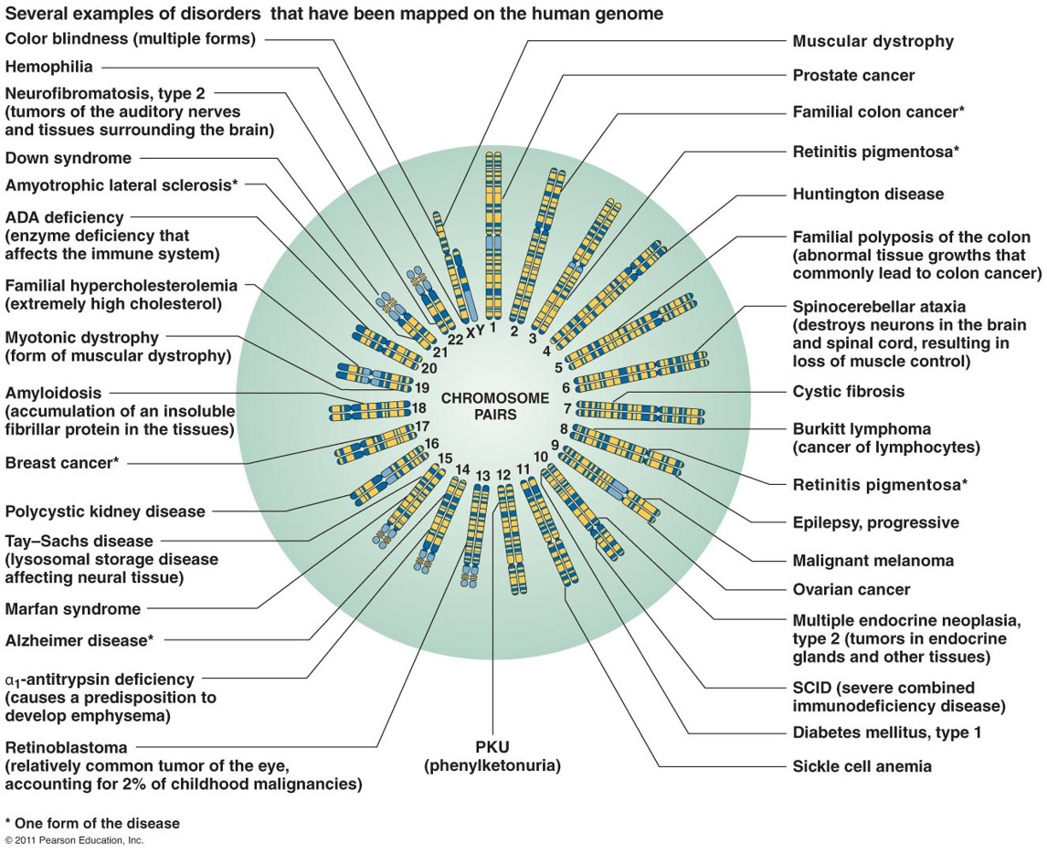
The Human Genome

Slide 27
Genetic Disorders
Non-disjunction
Autosomal dominant
Autosomal recessive
Sex-linked

Slide 28
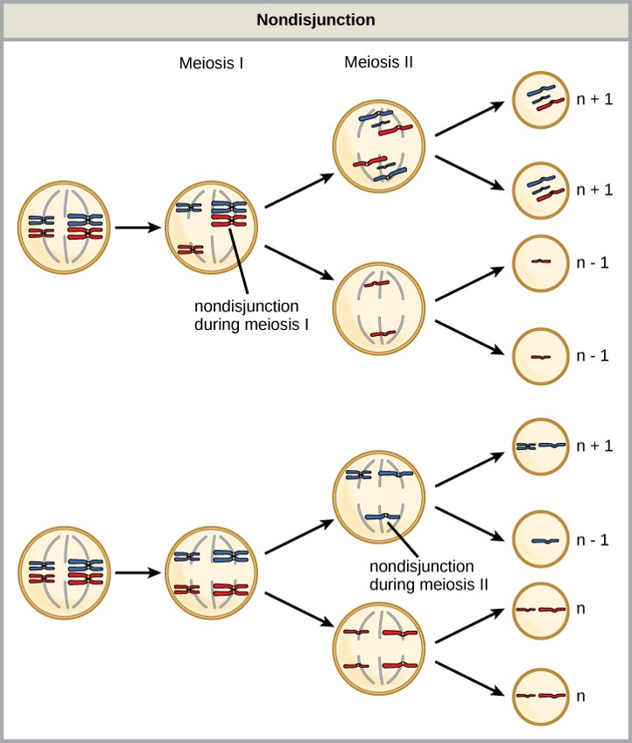
Nondisjunction
Nondisjunction occurs when homologous chromosomes or sister chromatids fail to separate during meiosis, resulting in an abnormal chromosome number.
Nondisjunction may occur during meiosis I or meiosis II.
Down syndrome
Turner’s syndrome
Klinefelter’s syndrome

Slide 29
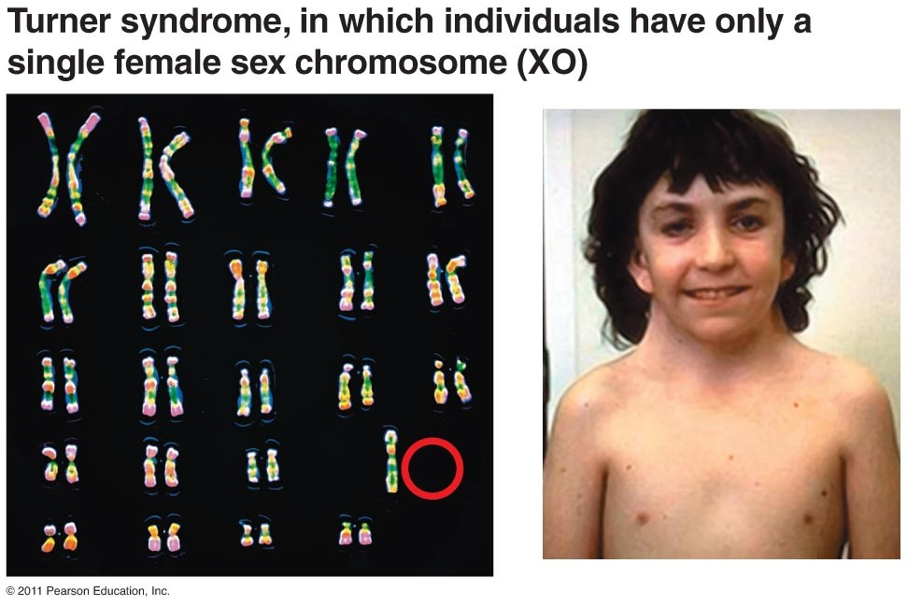
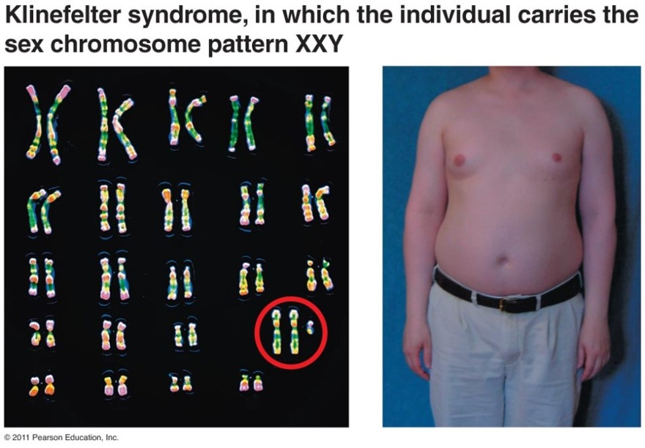
Non-Disjunction Disorders

Slide 30
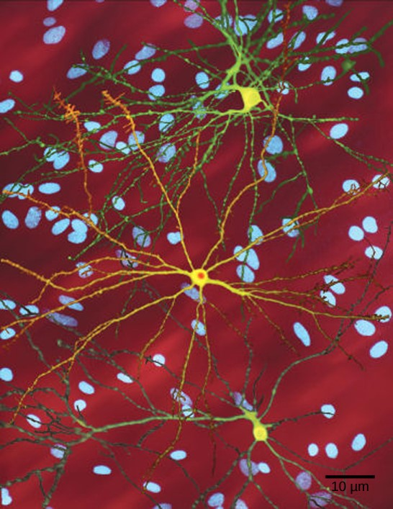
Autosomal dominant - Huntington’s Disease
The neuron in the center of this micrograph (yellow) has nuclear inclusions characteristic of Huntington’s disease (orange area in the center of the neuron).
Huntington’s disease occurs when an abnormal dominant allele for the Huntington gene is present. (credit: Dr. Steven Finkbeiner, Gladstone Institute of Neurological Disease, The Taube-Koret Center for Huntington's Disease Research, and the University of California San Francisco/Wikimedia)
Neurofibromatosis is autosomal dominant.

Slide 31
Disorders
DISORDERS: HOMEOSTATIC IMBALANCES
A. Infertility
1. Female infertility may be caused by ovarian disease, uterine tube obstruction, conditions in which the uterus is not adequately prepared to receive the fertilized ovum, and inadequate body fat.
2. Male infertility is an inability to fertilize a secondary oocyte.
3. Many fertility-expanding techniques now exist for assisting infertile couples to have a baby.
a. In vitro fertilization (IVF) refers to the fertilization of a secondary oocyte outside the body and the subsequent introduction of an 8-cell or 16-cell embryo for implantation and subsequent growth.
b. In intracytoplasmic sperm injection (ICSI), an oocyte may be fertilized by suctioning a sperm or even a spermatid obtained from the testis into a tiny pipette and then injecting it into the oocyte’s cytoplasm.
c. In embryo transfer, a husband’s sperm is used to artificially inseminate a fertile secondary oocyte donor.
d. In gamete intrafallopian transfer, a sperm and secondary oocyte are united in the prospective mother’s uterine tube.
B. Down syndrome (DS) is a disorder that results from an error in cell division called nondisjunction, involving chromosome pair #21. This syndrome is caused by trisomy of an autosome rather than aneuploidy of a sex chromosome. Although it is more common as the mother approaches age 35 and beyond, many women under the age of 35 give birth to children with DS.
C. Fragile X syndrome is due to a defective gene on the X chromosome. It is so named because a small portion of the tip of the X chromosome seems susceptible to breakage. It affects more males than females and may be involved in autism, in which the individual exhibits extreme withdrawal and refusal to communicate.

Slide 32
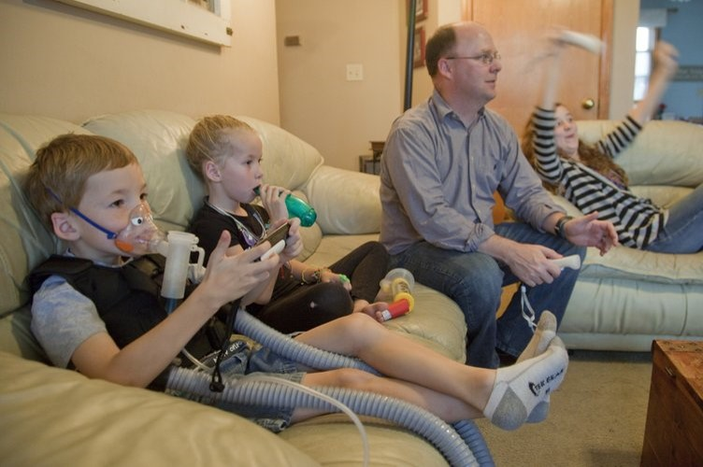
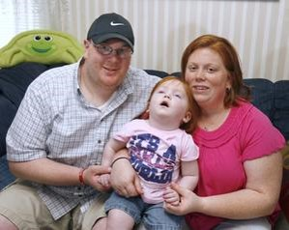
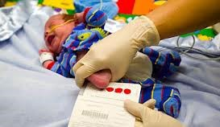
Autosomal Recessive Disorders
Cystic fibrosis
Tay-Sachs
Phenylketonuria (PKU)

Slide 33
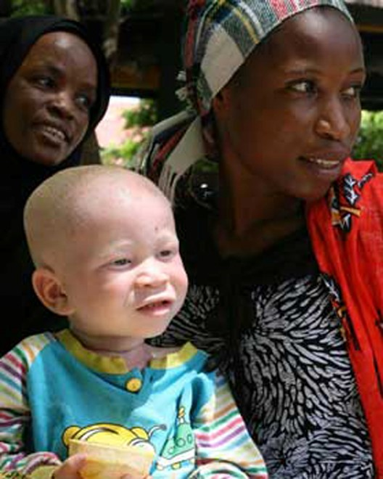
Albinism
The child in the photo expresses albinism, a recessive trait.

Slide 34
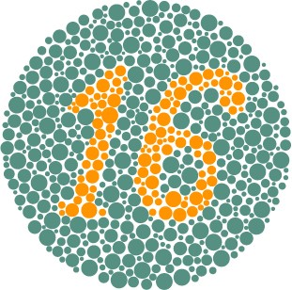
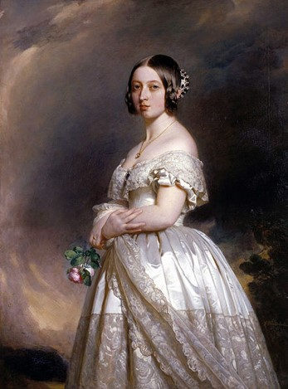
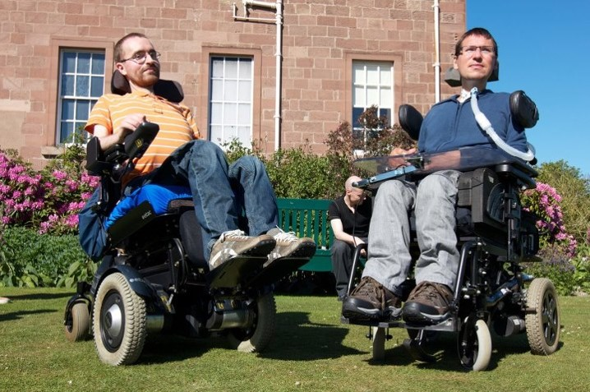
Sex-Linked Disorders
Colorblindness
Hemophilia
Duchene’s muscular dystrophy

