Slide 1
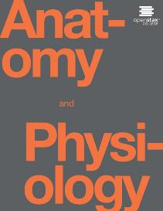
Anatomy and Physiology II
Chapter 14: Pregnancy, Growth, Development, and Aging

Slide 2
Pregnancy
Pregnancy is a sequence of events that normally includes fertilization, implantation, embryonic growth, and fetal growth, that ends with birth about 38 weeks later.

Slide 3
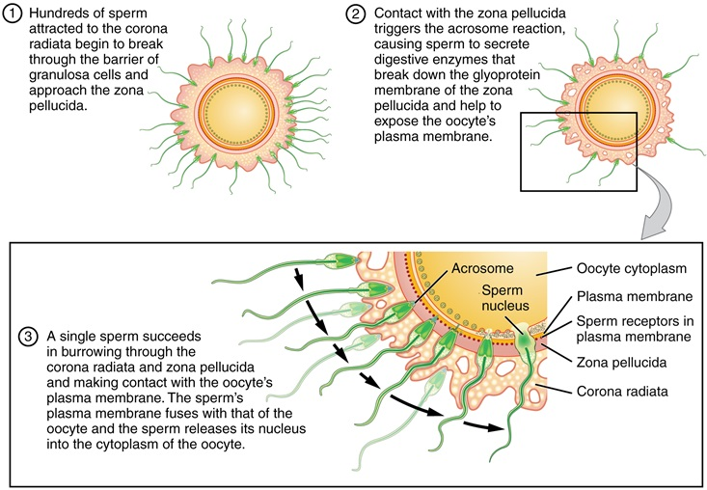

Fertilization
Most sperm never make it to the egg!
Fertilization requires capacitation.
Cortical reaction ensures monospermy.
Link: Fertilization video
Sperm and the Process of Fertilization
Before fertilization, hundreds of capacitated sperm must break through the surrounding corona radiata and zona pellucida so that one can contact and fuse with the oocyte plasma membrane.

Slide 4
Fertilization
1. During fertilization, the genetic material from a haploid sperm cell (spermatozoon) and a haploid secondary oocyte merges into a single diploid nucleus.
a. Fertilization normally occurs in the uterine (Fallopian) tube when the oocyte is about one-third of the way down the tube to the uterus, usually within 12 to 24 hours after ovulation.
b. The process leading to fertilization begins as peristaltic contractions and the actions of cilia transport the oocyte through the uterine tube.
c. Sperm swim up the uterus and into the uterine tube by the whiplike movements of their tails and muscular contractions of the uterus.
2. The functional changes that sperm undergo in the female reproductive tract that allow them to fertilize a secondary oocyte are referred to as capacitation
3. To fertilize an oocyte, a sperm must penetrate the corona radiata and zona pellucida around the oocyte.
a. A glycoprotein in the zona pellucida (ZP3) acts as a sperm receptor, binds to specific membrane proteins in the sperm head and triggers the acrosomal reaction, the release of the contents of the acrosome.
b. The acrosomal enzymes digest a path through the zona pellucida allowing only one sperm to make its way through the barrier and reach the oocyte’s plasma membrane.
1) Fusion of a sperm with a secondary oocyte is called syngamy.
2) Polyspermy is prevented by chemical changes that prevent a second sperm from entering the oocyte.

Slide 5
Development after fertilization
4. Once a sperm enters a secondary oocyte, the oocyte completes meiosis, and the male pronucleus and female pronucleus fuse forming the fertilized ovum or zygote.
a. Dizgyotic (fraternal) twins are produced from the independent release of two ova and the subsequent fertilization of each by different spermatozoa. They are the same age and are in the uterus at the same time but are as genetically dissimilar as other siblings.
b. Monozygotic (identical) twins are derived from a single fertilized ovum that splits at an early stage in development. They contain exactly the same genetic material and are always the same sex.
5. Formation of the Morula
a. Early rapid mitotic cell division of a zygote is called cleavage
b. The cells produced by cleavage are called blastomeres.
c. Successive cleavages produce a solid mass of cells, called the morula
6. Development of the Blastocyst
1. As the number of cells in the morula increases, it moves from the site of fertilization down through the ciliated uterine tube toward the uterus and enters the uterine cavity.
2. The morula develops into a blastocyst, a hollow ball of cells that is differentiated into a trophoblast (which will form the future embryonic membranes), an inner cell mass or embryoblast (the future embryo), and an internal fluid-filled cavity called the blastocele

Slide 6
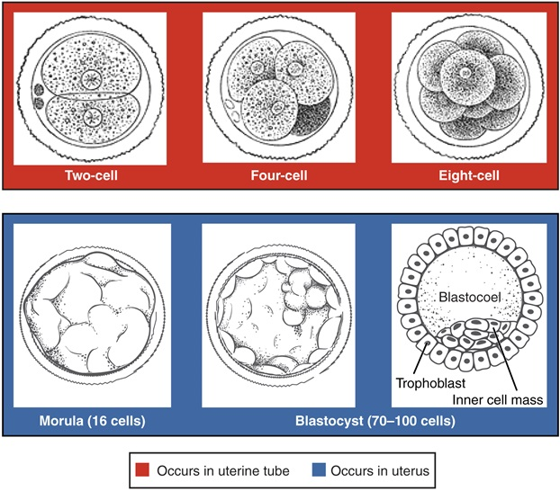
Cleavage
Pre-Embryonic Cleavages
Pre-embryonic cleavages make use of the abundant cytoplasm of the conceptus as the cells rapidly divide without changing the total volume.

Slide 7
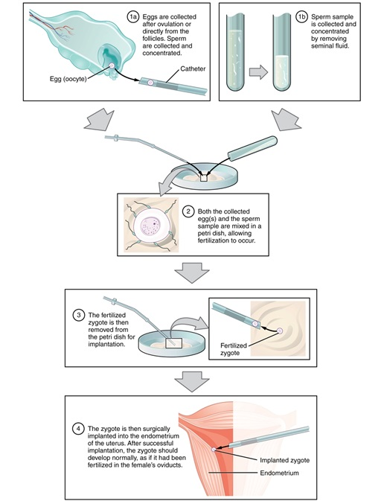
IVF
In vitro fertilization involves egg collection from the ovaries, fertilization in a petri dish, and the transfer of embryos into the uterus.

Slide 8
Implantation
1. The blastocyst remains free with the cavity of the uterus for two to four days before it actually attaches to the uterine wall.
2. The attachment of a blastocyst to the endometrium occurs seven to eight days after fertilization and is called implantation
3. Implantation occurs by enzymatic degradation of the endometrium, usually on the posterior wall of the fundus or body of the uterus.
a. The trophoblast develops into a syncytiotrophoblast and a cytotrophoblast.
b. These two layers become part of the chorion as they undergo further growth.
c. The trophoblast syncytiotrophoblast cells enable the blastocyst to penetrate the uterine lining.
4. The trophoblast also secretes human chorionic gonadotropin which rescues the corpus luteum from degeneration and sustains its function.

Slide 9
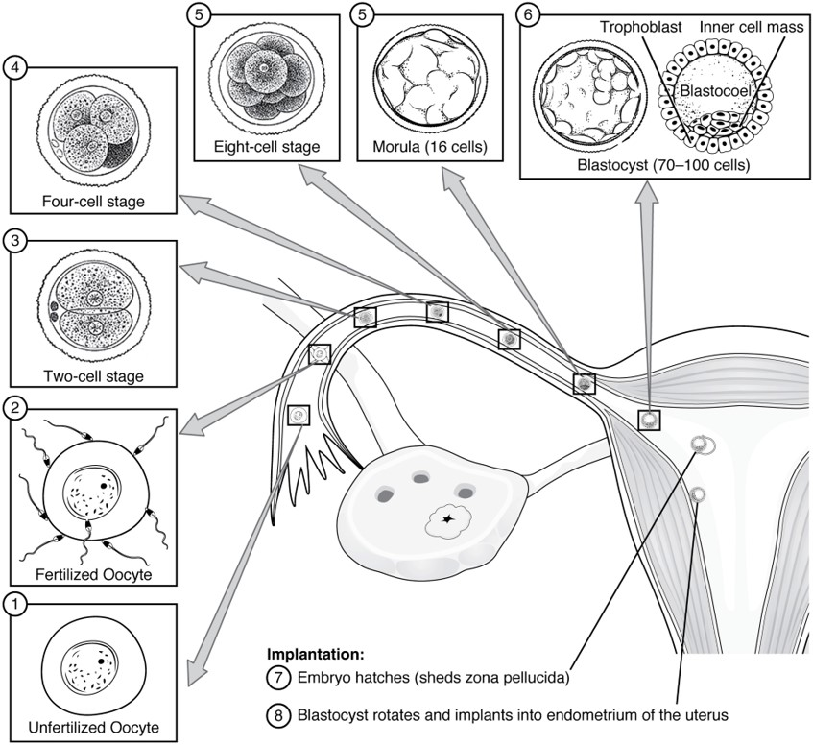
Ovulation to implantation
Pre-Embryonic Development
Ovulation, fertilization, pre-embryonic development, and implantation occur at specific locations within the female reproductive system in a time span of approximately 1 week.

Slide 10
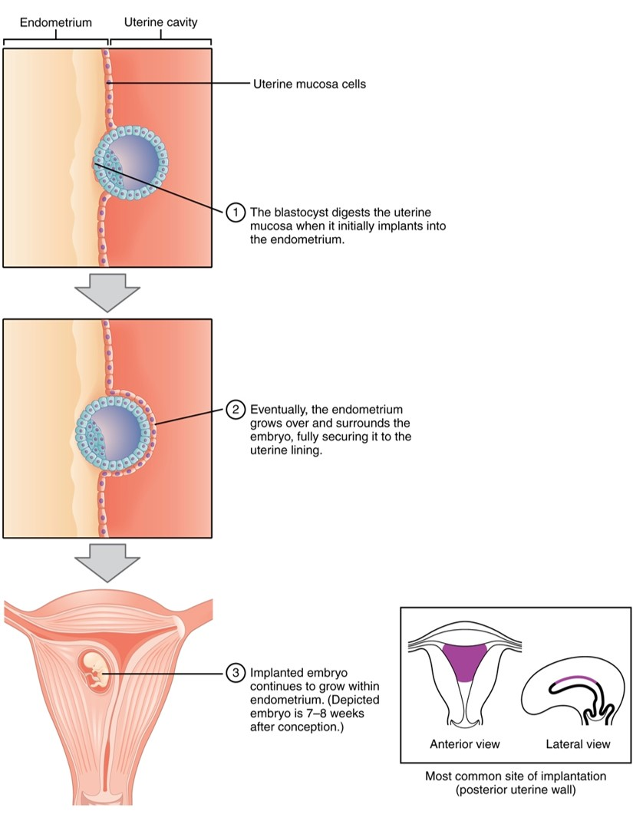
Implantation
During implantation, the trophoblast cells of the blastocyst adhere to the endometrium and digest endometrial cells until it is attached securely.

Slide 11
Ectopic pregnancy
Ectopic pregnancy refers to the development of an embryo or fetus outside the uterine cavity. Most occur in the uterine tube, usually in the ampullar or infundibular portions. Some occur in the ovaries, abdomen, uterine cervix, or broad ligaments. Depending on the location of the ectopic pregnancy, the condition can become life-threatening to the mother.

Slide 12
Diagnostic tests
In fetal ultrasonography, an image of the fetus, called a sonogram, is displayed on a screen. It is used most often to determine true fetal age when the date of conception is uncertain. It is also used to evaluate fetal viability and growth, determine fetal position, ascertain multiple pregnancies, identify fetal-maternal abnormalities, and serve as an adjunct to special procedures such as amniocentesis and chorionic villus sampling.
Amniocentesis is the transabdominal withdrawal of some of the amniotic fluid that bathes the developing fetus and subsequent analysis of the fetal cells and dissolved substances. It is used to test for the presence of certain genetic disorders, such as Down syndrome, spina bifida, hemophilia, Tay-Sachs disease, Sickle-cell disease, and certain muscular dystrophies or to determine fetal maturity and well-being near the time of delivery. The test is usually done at 14-16 weeks gestation to detect suspected genetic abnormalities. To assess fetal maturity, it is usually done after the 35th week of gestation
Chorionic villi sampling (CVS) involves withdrawal of chorionic villi for chromosomal analysis. CVS can be done earlier than amniocentesis (at 8-10 weeks gestation), and the results are available more quickly. The sampling is normally done transvaginally using an ultrasound-guided catheter; transabdominal sampling, similar to amniocentesis, is also possible.

Slide 13
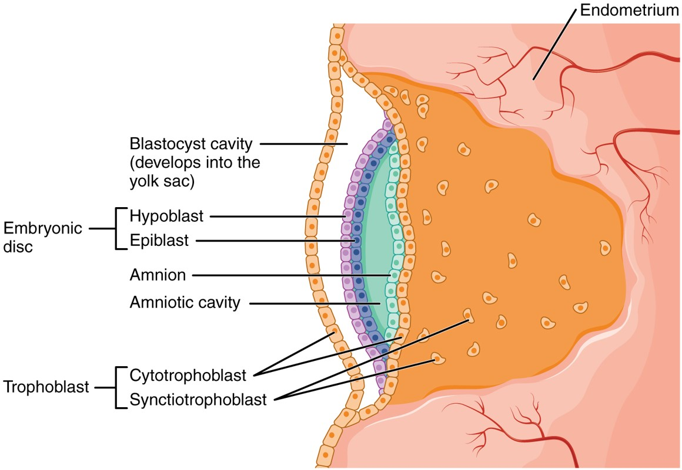
Embryonic disc
Formation of the embryonic disc leaves spaces on either side that develop into the amniotic cavity and the yolk sac.

Slide 14
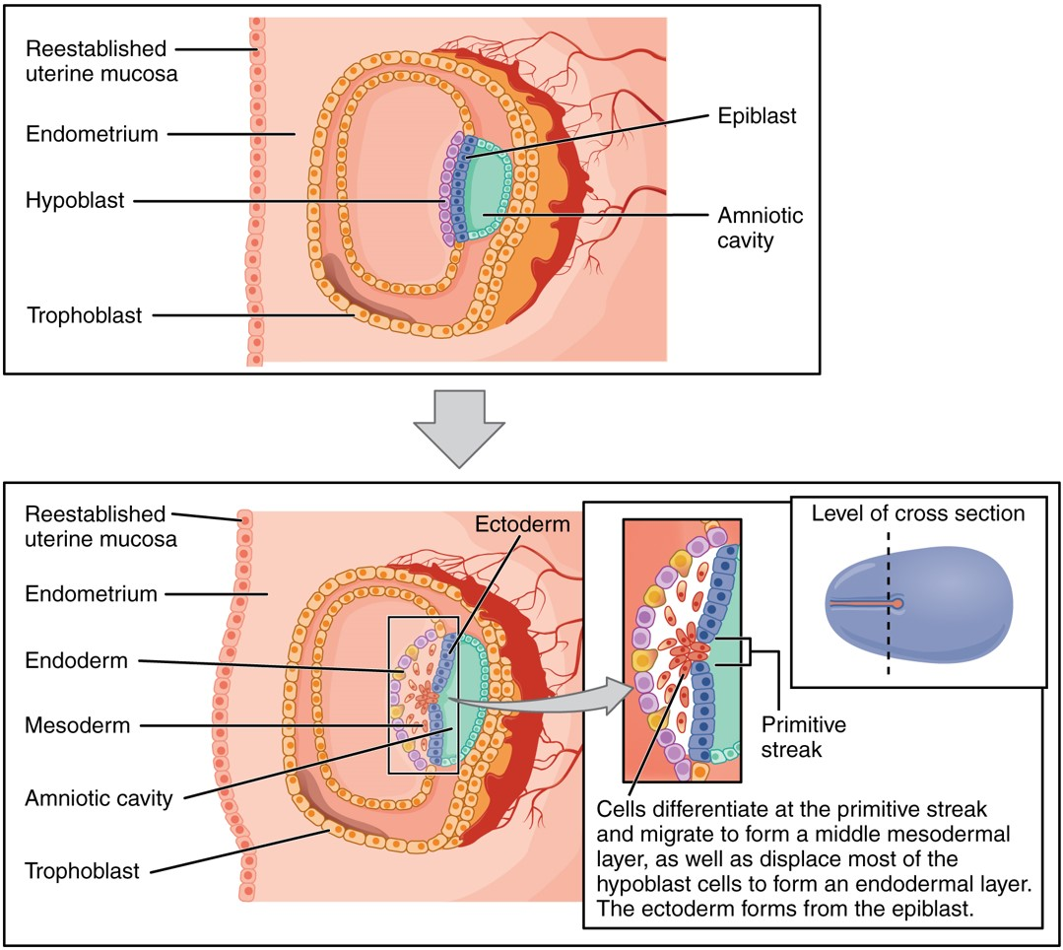
Gastrulation
Germ Layers
Formation of the three primary germ layers occurs during the first 2 weeks of development. The embryo at this stage is only a few millimeters in length.

Slide 15
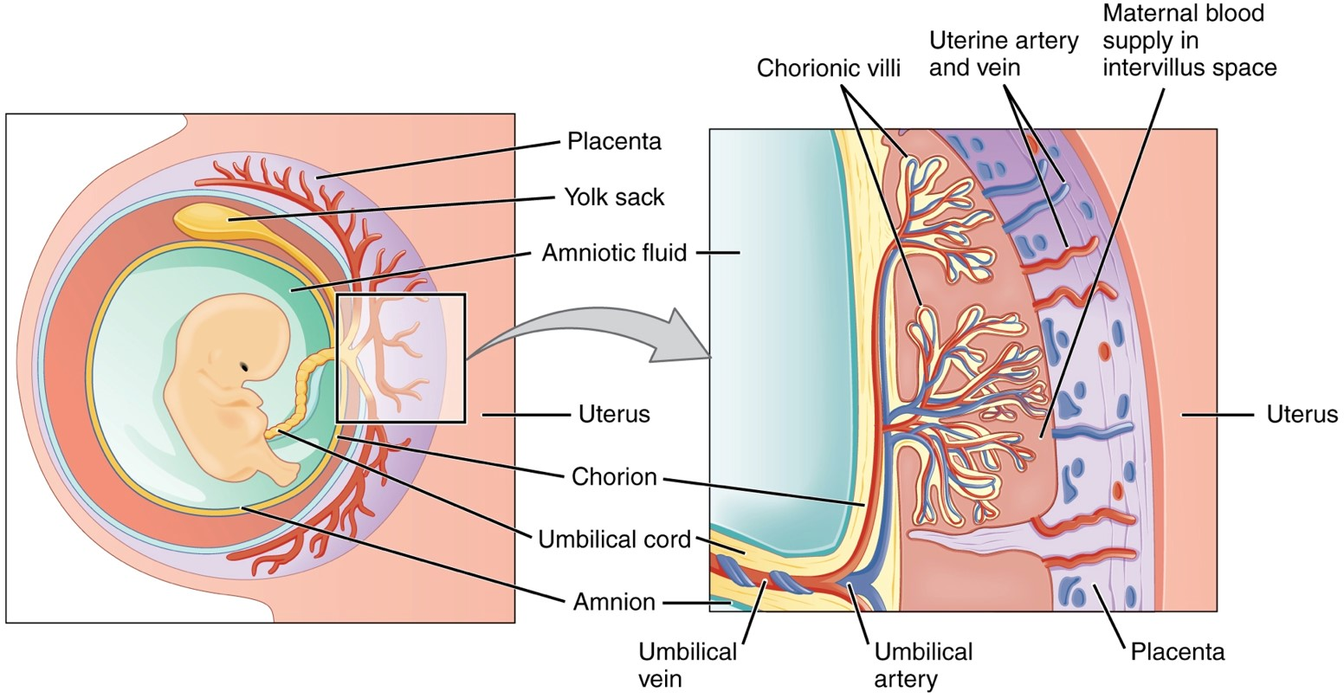
Placenta
Amnion
Chorion
Allantois
Yolk sac
Cross-Section of the Placenta
In the placenta, maternal and fetal blood components are conducted through the surface of the chorionic villi, but maternal and fetal bloodstreams never mix directly.

Slide 16
Placenta
1. The placenta is developed by the third month of pregnancy and is formed by the chorion of the embryo and a portion of the endometrium of the mother.
a. Functionally, the placenta allows oxygen and nutrients to diffuse into fetal blood from maternal blood, and carbon dioxide and wastes to diffuse from fetal blood into maternal blood.
b. The placenta also provides some degree of protection, since most microorganisms cannot cross it; the notable exception is a number of viruses. Almost all drugs, including alcohol, can pass freely through the placenta.
2. The placenta stores nutrients such as carbohydrates, proteins, calcium, and iron, which are released into fetal circulation as required.
3. The placenta also produces several hormones that are necessary to maintain pregnancy.
4. If implantation occurs, a portion of the endometrium modifies and is known as the decidua.
a) Different regions of the decidua are named based on their positions relative to the site of the implanted blastocyst
1) The decidua basalis lies between the chorion and the stratum basalis of the uterus. It becomes the maternal part of the placenta.
2) The decidua capsularis covers the embryo and is located between the embryo and the uterine cavity.
3) The decidua parietalis lines the noninvolved areas of the entire pregnant uterus.

Slide 17
Placenta
1. During embryonic life, chorionic villi grow into the decidua basalis . They contain fetal blood vessels of the allantois and are bathed in maternal blood sinuses called intervillous spaces.
2. Normally, fetal and maternal blood do not mix but exchange does occur between them.
3. The umbilical cord is a vascular connection between mother and fetus and consists of two umbilical arteries carrying deoxygenated fetal blood to the placenta and one umbilical vein that carries oxygenated blood from the placenta into the fetus.
4. After the birth of the baby, the placenta detaches from the uterus and is termed the afterbirth.
5. Placenta previa is a condition in which part or all of the placenta becomes implanted in the lower portion of the uterus, near or over the internal os of the cervix. If detected during pregnancy (either by ultrasound or as a result of sudden painless bright red vaginal bleeding during the third trimester), cesarean section is the preferred method of delivery.

Slide 18
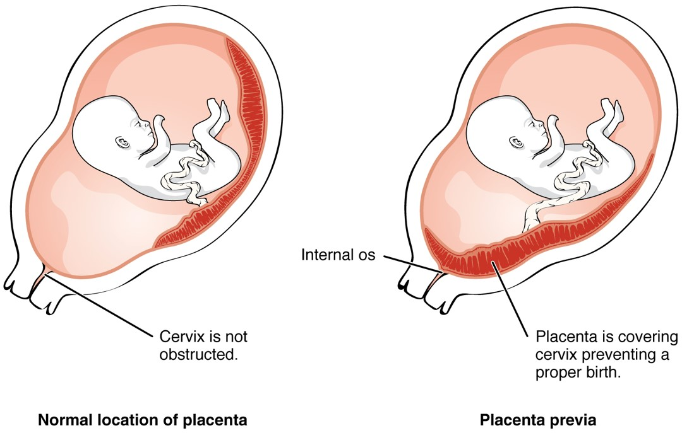
Placenta previa
Placenta Previa
An embryo that implants too close to the opening of the cervix can lead to placenta previa, a condition in which the placenta partially or completely covers the cervix.

Slide 19
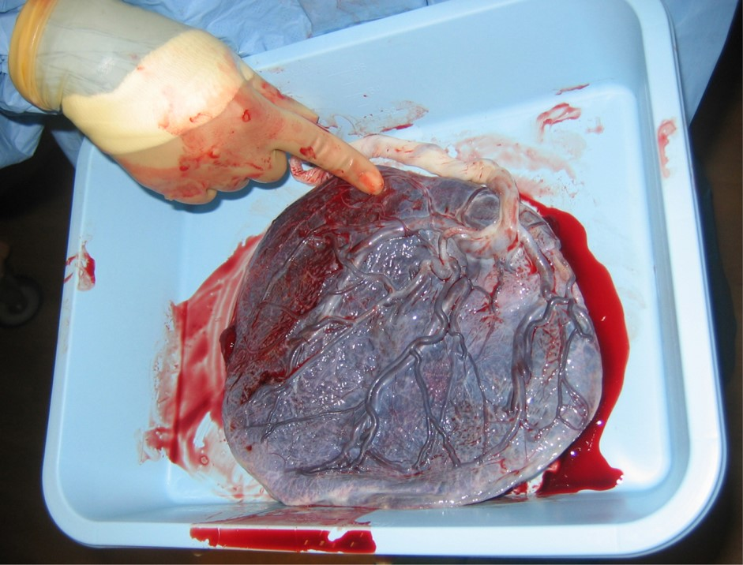
Placenta
Placenta
This post-expulsion placenta and umbilical cord (white) are viewed from the fetal side.

Slide 20
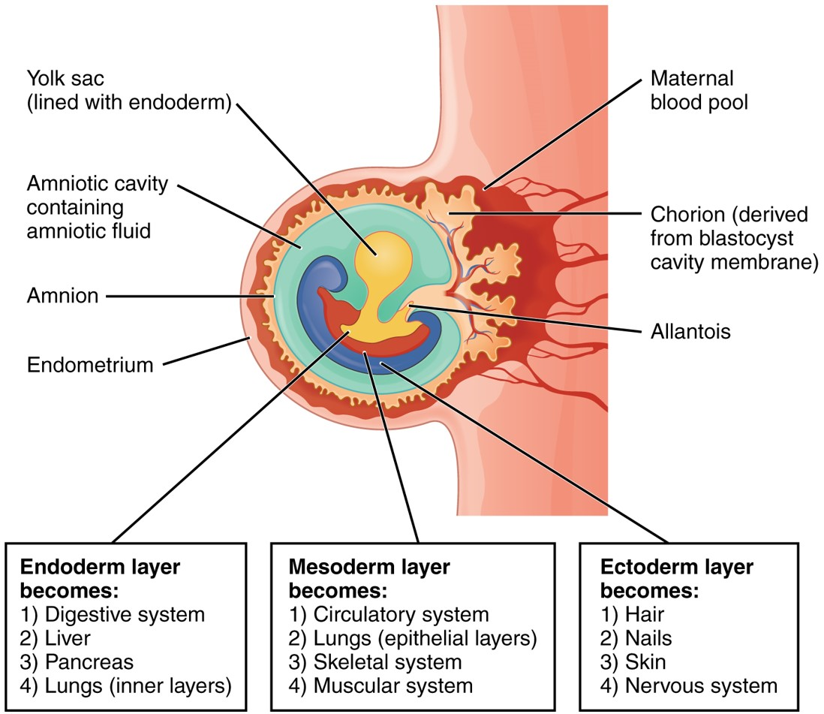
Germ layer development
Fates of Germ Layers in Embryo
Following gastrulation of the embryo in the third week, embryonic cells of the ectoderm, mesoderm, and endoderm begin to migrate and differentiate into the cell lineages that will give rise to mature organs and organ systems in the infant.

Slide 21
Fate of the Germ Layers
Body System | Ectodermal Contribution
Integumentary system | Epidermis, hair follicles and hairs, nails, and glands communicating with the skin (sweat glands, mammary glands, and sebaceous glands)
Skeletal system | Pharyngeal cartilages and their derivatives in adults (portion of sphenoid, the auditory ossicles, the styloid processes of the temporal bones, the cornu and superior rim of the hyoid bone)
Nervous system | All neural tissue, including brain and spinal cord
Endocrine system | Pituitary gland and adrenal medullae
Respiratory system | Mucous epithelium of nasal passages
Digestive system | Mucous epithelium of mouth and anus, salivary glands

Slide 22
Fate of the Germ Layers
Body System | Mesodermal Contributions
Integumentary system | Dermis and hypodermis
Skeletal system | All structures except some pharyngeal derivatives
Muscular system | All structures
Endocrine system | Adrenal cortex, endocrine tissues of hear, kidneys, and gonads
Cardiovascular system | All structures
Lymphatic system | All structures
Urinary system | The kidneys, including the nephrons and the initial portions of the collecting system
Reproductive system | The gonads and the adjacent portions of the duct system

Slide 23
Fate of the Germ Layers
Body System | Endodermal Contribution
Endocrine system | Thymus, thyroid gland, and pancreas
Respiratory system | Respiratory epithelium (except nasal passageways) and associated mucous glands
Digestive system | Mucous epithelium (except mouth and anus), exocrine glands (except salivary glands), liver, and pancreas
Urinary system | Urinary bladder and distal portions of the duct system
Reproductive system | Distal portions of the duct system, stem cells that produce gametes

Slide 24
Embryonic Development
The first two months of development are generally considered the embryonic period during which the developing human is called an embryo. By the end of the embryonic period, the rudiments of all the principal adult organs and the embryonic membranes are formed, and the placenta is functioning.
After the eighth week, the developing human is called a fetus, and the period of time from then until the birth is called the fetal period.
Beginnings of Organ Systems
1. The first major event of the embryonic period is gastrulation.
a. During gastrulation, the inner cell mass of the blastocyst differentiates into three primary germ layers.
b. The primary germ layers - ectoderm, mesoderm, and endoderm - form all tissues and embryonic membranes
2. A second major embryonic event is the formation of embryonic membranes.
3. Embryonic membranes, which lie outside the embryo and protect and nourish the embryo and, later, the fetus, include the yolk sac, amnion, chorion, and allantois.
a. The yolk sac is an endoderm-lined membrane that, in many species, is the primary source of nourishment for the embryo. However, the human embryo receives nutrients from the endometrium, and the yolk sac remains small, providing an early site of blood formation. organs of the developing organism
b. The amnion is a thin, protective membrane that forms by the eighth day after fertilization and initially overlies the embryonic disc

Slide 25
Embryonic Development
As the embryo grows, the amnion entirely surrounds the embryo, creating a cavity that becomes filled with amniotic fluid.
Most amniotic fluid is initially derived from a filtrate of maternal blood. Later, the fetus makes daily contributions to the fluid by excreting urine into the amniotic cavity.
Amniotic fluid serves as a shock absorber for the fetus, assists in the regulation of fetal body temperature, and prevents adhesions between the skin of the fetus and the surrounding tissues.
4) The amnion usually ruptures during the process of labor and with its fluid constitutes the “bag of waters.”

Slide 26
Development
The chorion is derived from the trophectoderm of the blastocyst and the mesoderm that lines the trophoblast. It surrounds the embryo and, later, the fetus.
Eventually, the chorion becomes the principal embryonic part of the placenta, the structure through which materials are exchanged between mother and fetus.
2) The amnion also surrounds the fetus, eventually fusing to the inner layer of the chorion.
3) The allantois is a small vascularized membrane.
1) It serves as an early site of blood formation.
2) Later its blood vessels serve as connections in the placenta between mother and fetus. This connection is the umbilical cord.

Slide 27
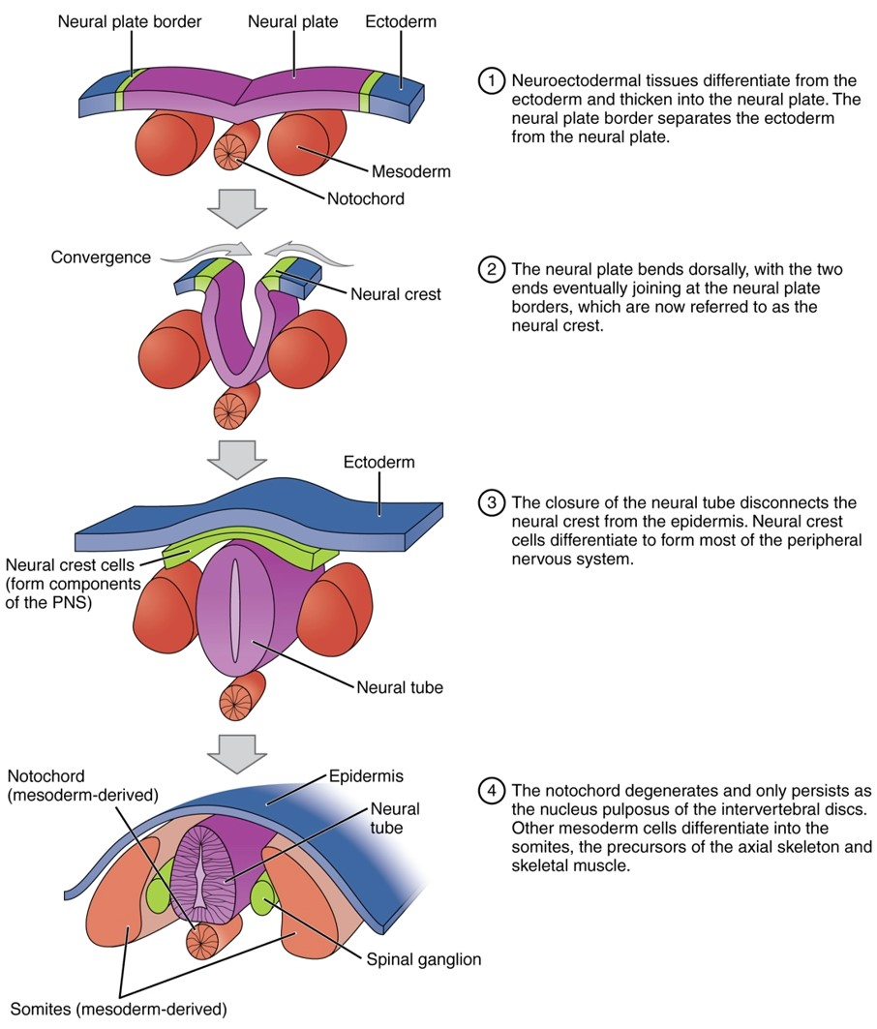
Neurulation
Organogenesis- the process of organ formation
  Week 2
    Central nervous system is forming
    Deep groove develops in ectodermal band along the posterior midline of the embryo
    The neural plate (which will form the brain) and neural folds are located adjacent to the central groove
Neurulation
The embryonic process of neurulation establishes the rudiments of the future central nervous system and skeleton.

Slide 28
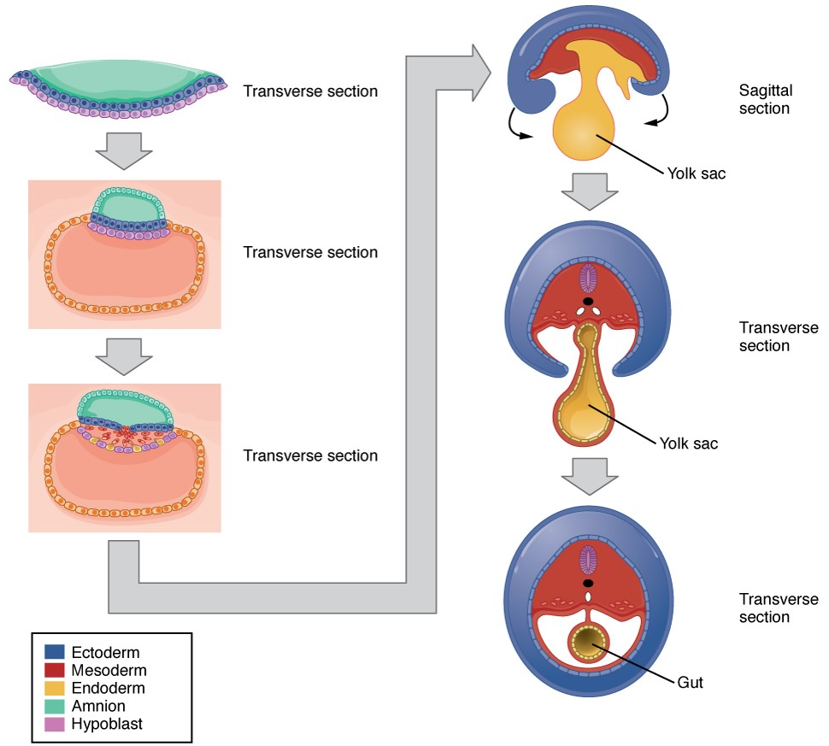
Embryonic folding
Embryonic Folding
Embryonic folding converts a flat sheet of cells into a hollow, tube-like structure.

Slide 29
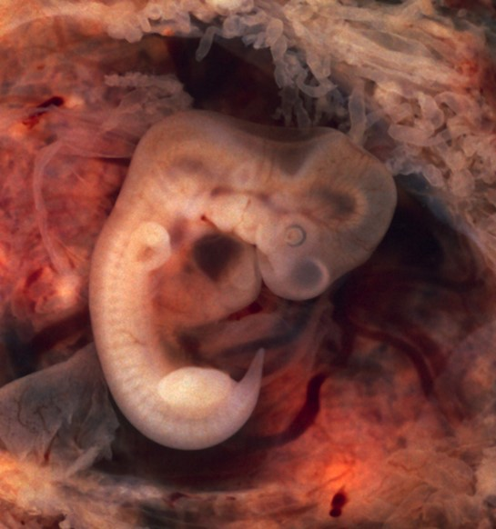

Embryonic Development – Week 4
  Week 4
    The heart is beating
      Providing nutrients for additional growth and development
Link: Chicken egg video
In this five-week old human embryo, somites are segments along the length of the body. (credit: modification of work by Ed Uthman)

Slide 30
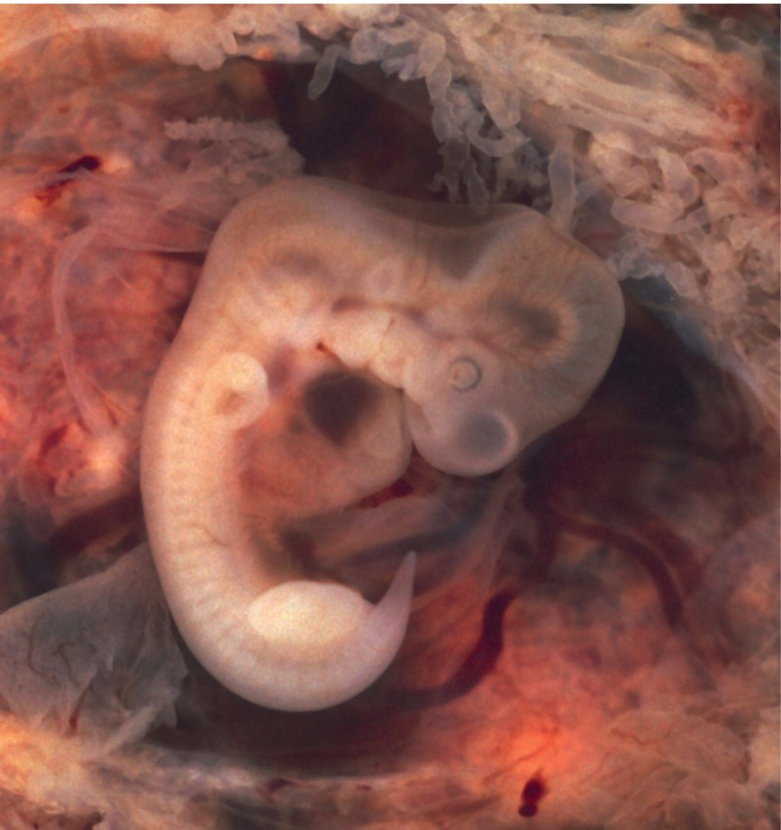
Embryo at 7 weeks
Embryo at 7 Weeks
    The placenta has formed
    Embryo is floating in the amniotic cavity
    Limbs grow longer
    Skull bones are forming around the brain
An embryo at the end of 7 weeks of development is only 10 mm in length, but its developing eyes, limb buds, and tail are already visible. (This embryo was derived from an ectopic pregnancy.) (credit: Ed Uthman)

Slide 31
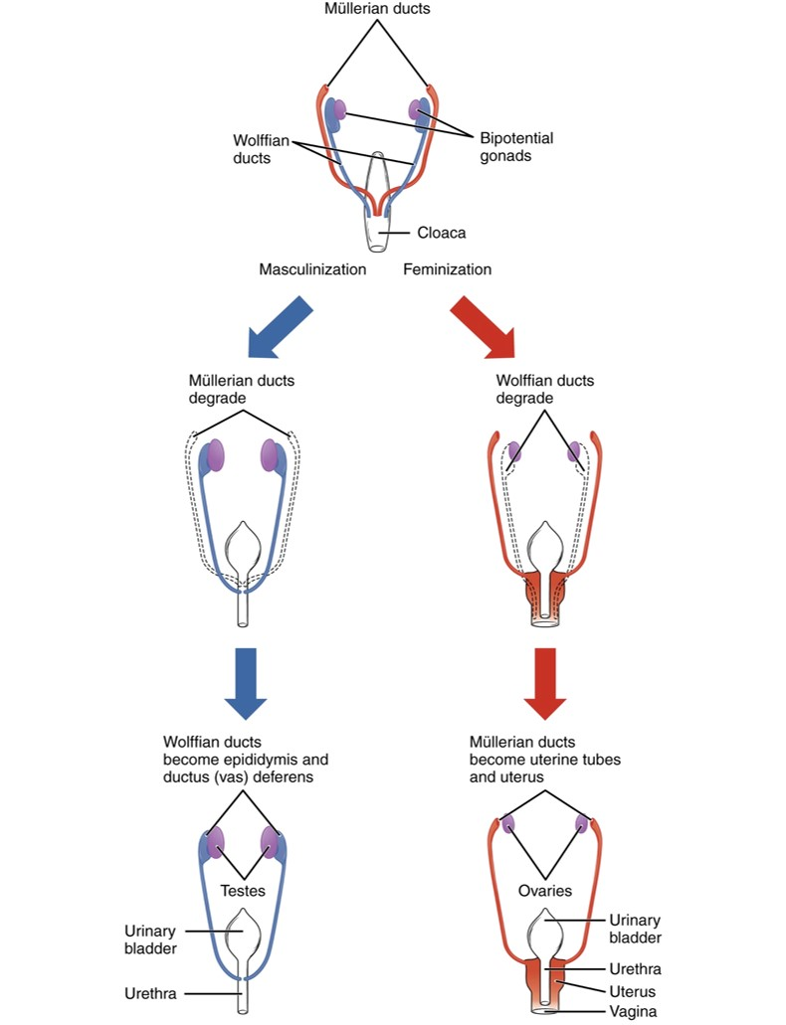
Sexual differentiation
Sexual Differentiation
Differentiation of the male and female reproductive systems does not occur until the fetal period of development.

Slide 32
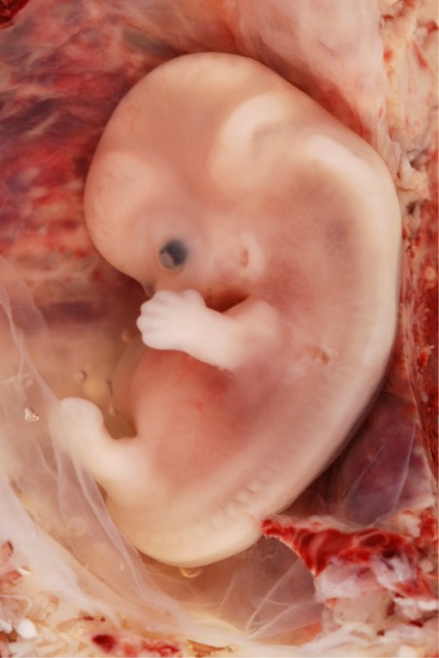
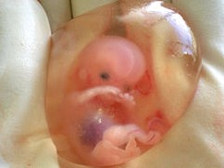
Fetal development end of 1st trimester
  Human features are better defined
  Liver prominent and bile being secreted
  Palate fusing
  Smooth muscle forming on walls of hollow organs
  Axial and appendicular muscles forming
  Blood cell formation begins in bone marrow
  Notochord degenerating
  Ossification accelerating
  Sex detected by the genitals
10 week fetus
Credit: Wikipedia
Fetal development is shown at nine weeks gestation. (credit: Ed Uthman)

Slide 33
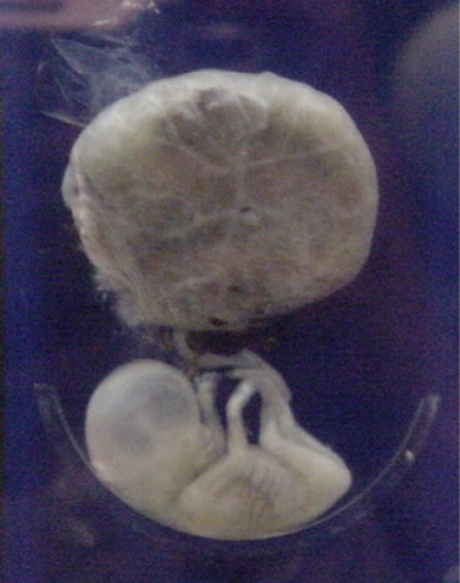
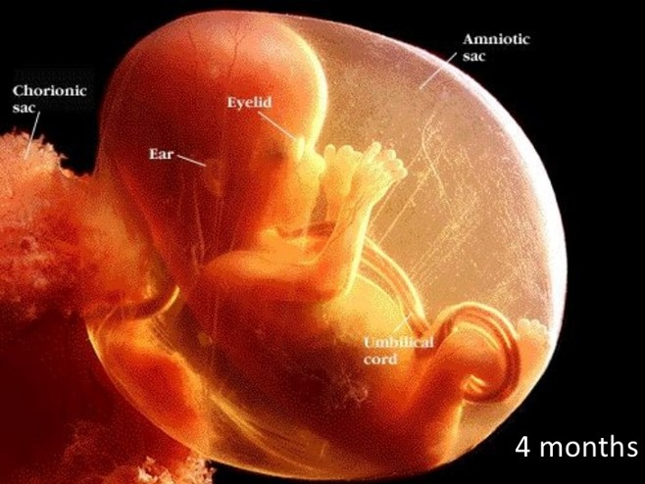
End of 2nd trimester
The second trimester
  By the end of 4 months
    Eyes and ears have assumed characteristic position and shape
    Cerebral hemispheres enlarging
    Hair follicles are present, and hair is growing
    Peripheral nerves are formed
    Glands develop in GI, meconium is collecting
    Most bones and joints are distinct
  By the end of 5 months
    Vernix covers skin
    Limbs reach final proportions
    Fetal movements (quickening) felt by mother
    By the end of the second trimester, fetus weighs about 0.64 kg (1.4 lb)
Credit: slideshare
This fetus is just entering the second trimester, when the placenta takes over more of the functions performed as the fetus develops. (credit: National Museum of Health and Medicine)

Slide 34
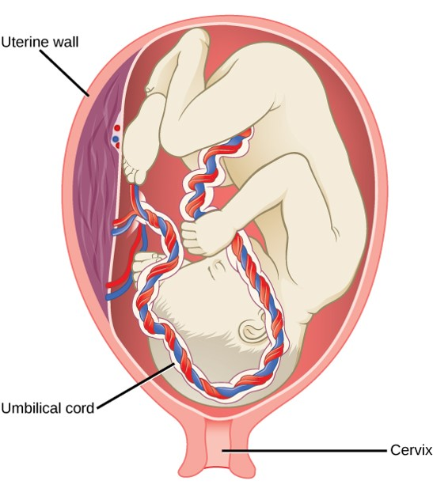
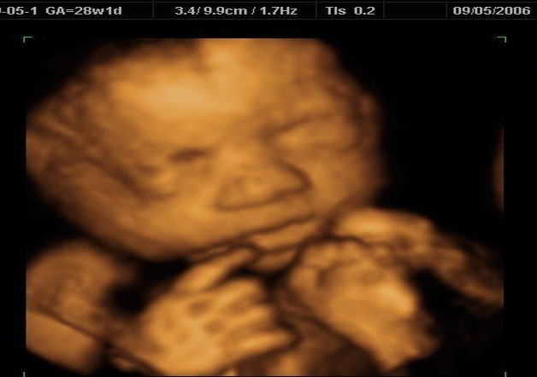
Third Trimester
Large fetal weight gain
Organ systems functional
Bone marrow now sole cite for blood cell formation
May survive if born at 27 weeks, but lung surfactants and temp regulation underdeveloped
Eyes open
Testes descend at 7 months
Finger and toenails present
Myelination of nerve cord
Link: Fetal development
7 month ultrasound
Credit: Goldenview Ultrasound
There is rapid fetal growth during the third trimester. (credit: modification of work by Gray’s Anatomy)

Slide 35
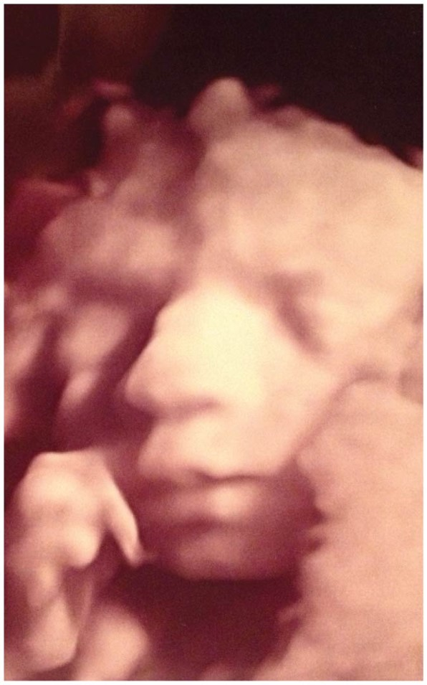
End of 3rd trimester
Third trimester
  Organ systems become ready for normal function
  Rate of growth slows a little
  In absolute terms, the largest weight gain occurs in the third trimester
    Fetus gains ~2.6 kg (5.7 lb) to reach full-term weight of ~3.2 kg (7 lb)
6 month ultrasound

Slide 36

Multiple births
  Dizygotic (“fraternal”) twins
    Develop when two separate oocytes are ovulated and fertilized
    70 percent of twins are dizygotic
  Monozygotic (“identical”) twins
    Result from separation of blastomeres early in cleavage
    Can also result when inner cell mass splits before gastrulation
    Genetic makeup of twins is identical (both formed from the same set of gametes)
Bryan brothers
Credit: Wikipedia

Slide 37
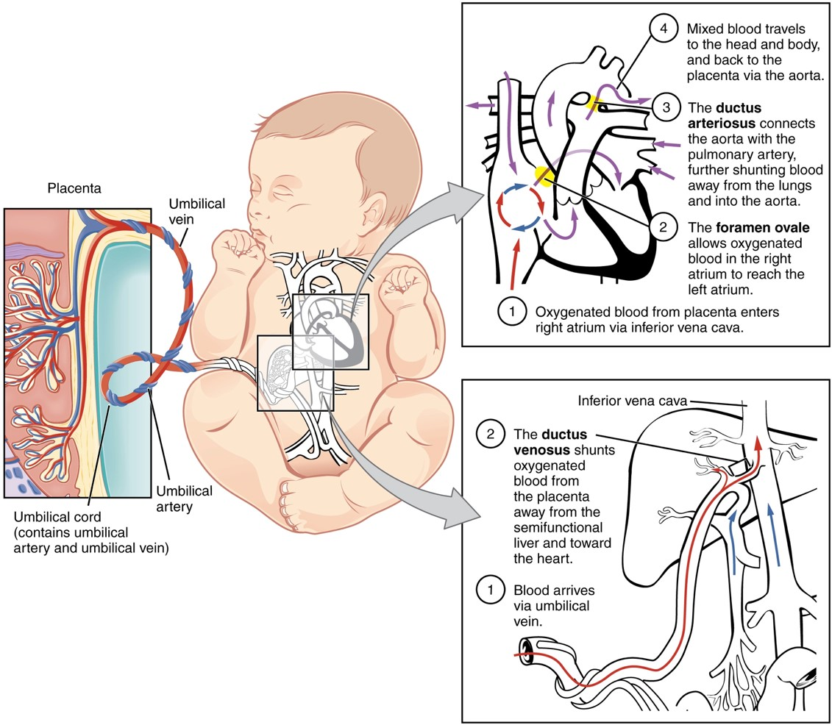
Fetal circulation
Fetal Circulatory System
The fetal circulatory system includes three shunts to divert blood from undeveloped and partially functioning organs, as well as blood supply to and from the placenta.

Slide 38
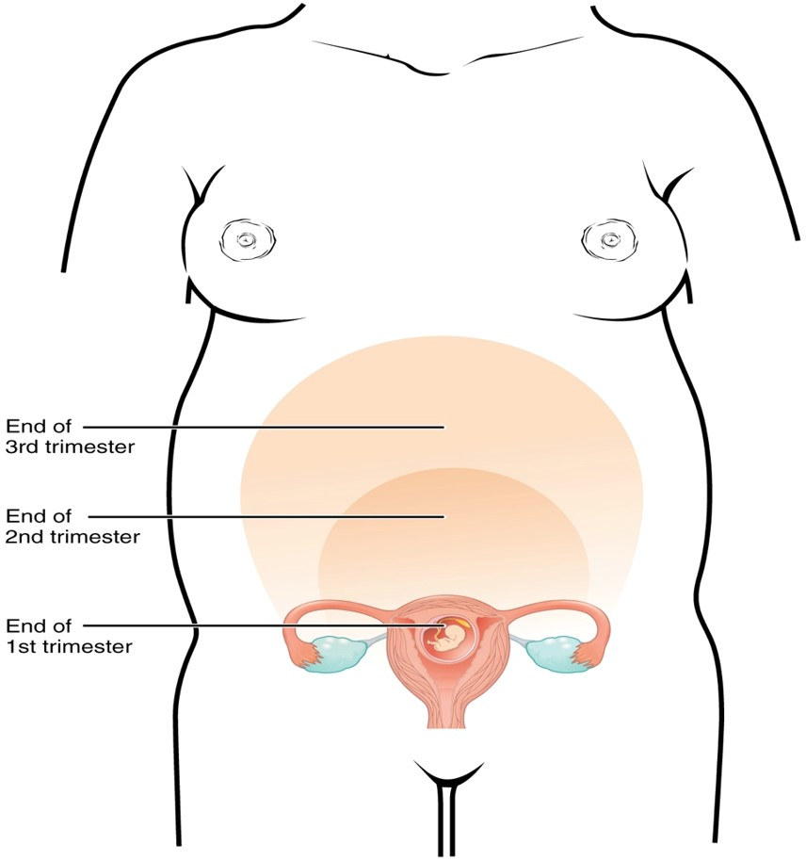
Size of uterus during pregnancy
Size of Uterus throughout Pregnancy
The uterus grows throughout pregnancy to accommodate the fetus.

Slide 39
Changes during pregnancy
A. Hormones of Pregnancy
1. During the first 3-4 months of pregnancy, the corpus luteum continues to secrete progesterone and estrogens to maintain the uterine lining and prepare the mammary glands to secrete milk.
2. From the third month on, the placenta provides the high levels of estrogens and progesterones necessary to maintain the pregnancy.
3. The chorion of the placenta secretes human chorionic gonadotropin (hGH), relaxin, and human somatomammotropin (hCS).
a. Human chorionic gonadotropin (hCG) mimics LH; its primary role is to stimulate continued production by the corpus luteum of estrogens and progesterone - an activity necessary for the continued attachment of the embryo and fetus to the lining of the uterus
b. Relaxin, produced by the ovaries, testes, and placenta, inhibits secretion of FSH and might regulate secretion of hGH.
c. Human chorionic somatomammotropin (hCS) (also known as human placental lactogen, or hPL), also produced by the chorion, assumes a role in breast development for lactation, protein anabolism, and catabolism of glucose and fatty acids.
4. Corticotropin-releasing hormone (CRH) is thought to be the “clock” that establishes the timing of birth.
5. Early pregnancy tests detect the tiny amounts of hCG in the urine that begin to show up about 8 days after fertilization.

Slide 40
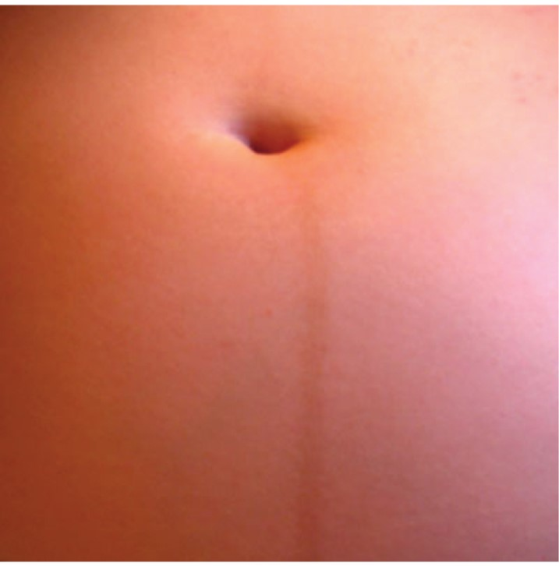
Linea nigra
The linea nigra, a dark medial line running from the umbilicus to the pubis, forms during pregnancy and persists for a few weeks following childbirth. The linea nigra shown here corresponds to a pregnancy that is 22 weeks along.

Slide 41
Effects of Pregnancy- Physiological Changes
Morning sickness
Heartburn
Constipation
Increased urine output
Frequency
Urgency
Stress incontinence
Increased respiratory rate
Increased vital capacity
Dyspnea
Decreased residual volume
Increased blood volume
Edema
Hypertension
Increased cardiac output

Slide 42
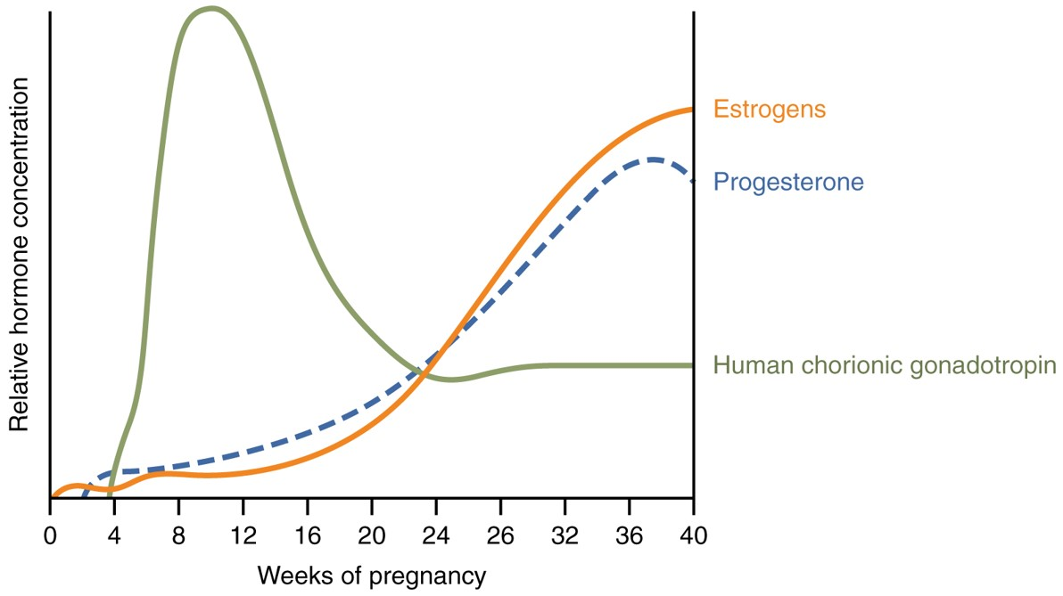
Hormones initiating labor
Hormones Initiating Labor
A positive feedback loop of hormones works to initiate labor.

Slide 43
Anatomical and Physiological Changes During Pregnancy
1. During gestation, several anatomical and physiological changes occur.
a. The uterus continuously enlarges, filling first the pelvic and then the abdominal cavity, displacing and compressing a number of structures.
b. Pregnancy-induced physiological changes include weight gain; increased protein, fat, and mineral storage; marked breast enlargement; and lower back pain .
c. Cardiovascular modifications include increase in stroke volume by approximately 30%, rise in cardiac output by approximately 20-30%, increase in heart rate by 10- 15%, and increase in blood volume up to 30-50% (mostly during the latter half of pregnancy). The uterus may compress large blood vessels, diminishing blood flow and return to the heart.
d. Pulmonary function alternations include increased tidal volume (30-40%), decreased expiratory reserve volume (by up to 40%), increased minute volume of respiration (by up to 40%), decreased airway resistance in the bronchial tree (by up to 36%), and increase in total body oxygen consumption (by 1020%). Dyspnea also occurs.
e. With regard to the gastrointestinal tract, there is an increase in appetite and decreased motility that can result in constipation and delayed gastric emptying. Nausea, vomiting, and heartburn also occur.
f. Pressure on the urinary bladder increases frequency and urgency of urination; stress incontinence may occur. Glomerular filtration rate rises up to 40%.
g. The skin may display increased pigmentation, striae (stretch marks) over the abdomen occur as the uterus enlarges, and hair loss increases.
h. In the reproductive system, there is edema and increased vascularity of the vulva and increased pliability and vascularity of the vagina. The weight of the uterus increases 15 to 20-fold during pregnancy due to hyperplasia of muscle fibers (cells) in the myometrium in early pregnancy and hypertrophy of muscle fibers during the second and third trimesters.
2. Approximately 10-15% of all pregnant women in the United States experience pregnancy-induced hypertension, elevated blood pressure associated with pregnancy. The major cause is preeclampsia, in which the hypertension seems to result from impaired renal function. It typically occurs after the 20th week of gestation and there are large amounts of protein in the blood. When associated with convulsions and coma, the condition is termed eclampsia.

Slide 44
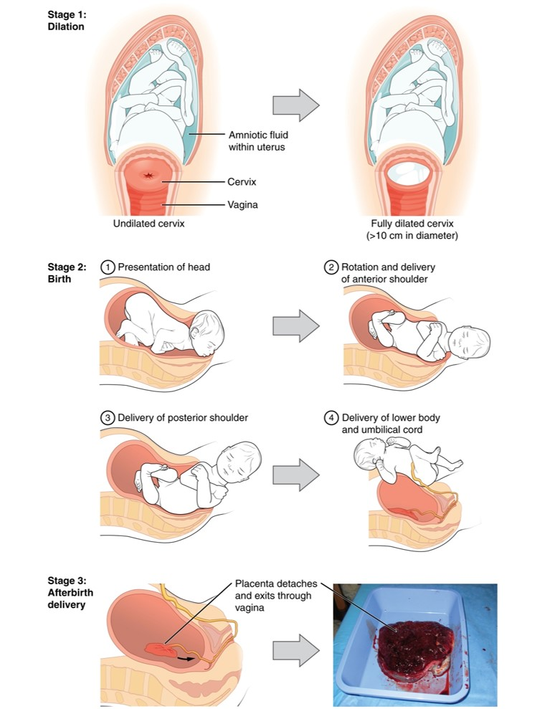
Stages of labor
Stages of Childbirth
The stages of childbirth include Stage 1, early cervical dilation; Stage 2, full dilation and expulsion of the newborn; and Stage 3, delivery of the placenta and associated fetal membranes. (The position of the newborn’s shoulder is described relative to the mother.)

Slide 45
Labor
Labor is the process by which the fetus is expelled from the uterus through the vagina to the outside. Parturition also means giving birth.
1. A decrease in progesterone levels and elevated levels of estrogens, prostaglandins, oxytocin, and relaxin are all probably involved in the initiation and progression of labor.
2. True labor begins when uterine contractions occur at regular intervals, usually producing pain. As the interval between contractions shortens, the contractions intensify. Other signs of true labor may be localization of pain in the back, which in intensified by walking; “show”(discharge of blood-containing mucus from the cervical canal); and dilation of the cervix. In false labor, pain is felt in the abdomen at irregular intervals. The pain does not intensify and is not altered significantly by walking. There is no “show” and no cervical dilation.
The birth of a baby involves three stages: dilation of the cervix, expulsion of the fetus, and delivery of the placenta .
1. The stage of dilation is the time from the onset of labor to the complete dilation of the cervix. During this stage, there are regular contractions of the uterus, usually a rupturing of the amniotic sac, and complete dilation (10cm) of the cervix. If the amniotic sac does not rupture spontaneously, it is done artificially.
2. The stage of expulsion is the time from complete cervical dilation to delivery.
3. The placental stage is the time after delivery until the placenta or “afterbirth” is expelled by powerful uterine contractions. These contractions also constrict blood vessels that were torn during delivery, reducing the possibility of hemorrhage.

Slide 46
Labor
During labor, the fetus is squeezed through the birth canal for up to several hours, resulting in compression of the fetal head and some intermittent hypoxia due to compression of the umbilical cord and placenta during uterine contractions. In response to this compression, the adrenal medullae of a fetus secrete very high levels of epinephrine and norepinephrine. These hormones afford the fetus protection against the stresses of the birth process and prepare the infant to survive extrauterine life.
After delivery of the baby and placenta, there is a period of time, called the puerperium, that lasts about six weeks. During this time the reproductive organs and maternal physiology return to the prepregnancy state. The uterus undergoes a remarkable reduction in size called involution and there is a uterine discharge (lochia) of blood and serous fluid for two to four weeks after delivery.
Dystocia, or difficult labor, may result from impaired uterine forces, an abnormal position (presentation) of the fetus, or a birth canal of inadequate size to permit vaginal birth. In these instances, and in certain conditions of fetal or maternal distress during labor, it may be necessary to deliver the baby via cesarean section (C-section). Even a history of multiple C-sections need not preclude a pregnant woman from attempting a vaginal delivery.

Slide 47
Neonatal adjustments
Respiratory
Circulatory
Thermoregulatory
GI and Urinary

Slide 48
Adjustments of the Infant at Birth
A. During pregnancy, the embryo (and later, the fetus) depends on the mother for oxygen and nutrients, removal of wastes, and protection against shocks, temperature changes, and certain harmful microbes. At birth, a physiologically mature baby becomes self-supporting, and the newborn’s body systems must make various adjustments.
1. After delivery the baby’s supply of oxygen from the mother is stopped.
a. Circulation in the baby continues, and as the blood level of carbon dioxide increases, the respiratory center in the medulla is stimulated. This causes the respiratory muscles to contract, and the baby draws its first breath. Since the first inspiration is unusually deep because the lungs contain no air, the baby exhales vigorously and naturally cries.
b. A full-term baby may breathe 45 times a minute for the first two weeks after birth. The rate is gradually reduced until it approaches a normal rate.
2. Following the first inspiration by the baby, the cardiovascular system must make several adjustments
a. The foramen ovale between the atria of the fetal heart closes at the moment of birth. This diverts deoxygenated blood to the lungs for the first time.
1) The foramen ovale is closed by two flaps of heart tissue that fold together and permanently fuse.
2) The remnant of the foramen ovale is the fossa ovalis.
b. Once the lungs begin to function, the ductus arteriosus is shut off by contractions of the muscles in its wall.
1) The ductus arteriosus generally does not completely and irreversibly close for about three months following birth.
2) The ligamentum arteriosum is the remnant of the ductus arteriosus.
c. When the umbilical cord is severed, all visceral blood of the fetus goes directly to the infant heart via the inferior vena cava.
1) This shunt of blood usually occurs within minutes after birth but may take a week or two to complete.
2) The ligamentum venosum, the remnant of the ductus venosus, is well established by the eighth postnatal week.
d. At birth, the infant’s pulse may be from 120 to 160 per minute and may go as high as 180 following excitation.
e. Several days after birth, there is a greater independent need for oxygen, which stimulates an increase in the rate of erythrocyte and hemoglobin production. This increase usually lasts for only a few days.
f. The white blood cell count at birth is very high, sometimes as much as 45,000 cells per cubic millimeter, but this decreases rapidly by the seventh day.
B. Delivery of a physically immature baby carries certain risks. Major problems aced by a premature infant include respiratory distress syndrome, blindness, brain hemorrhages, and digestive disorders. The problems related to survival of premature infants are due to the fact that they are not yet ready to take over functions the mother’s body should be performing.

Slide 49
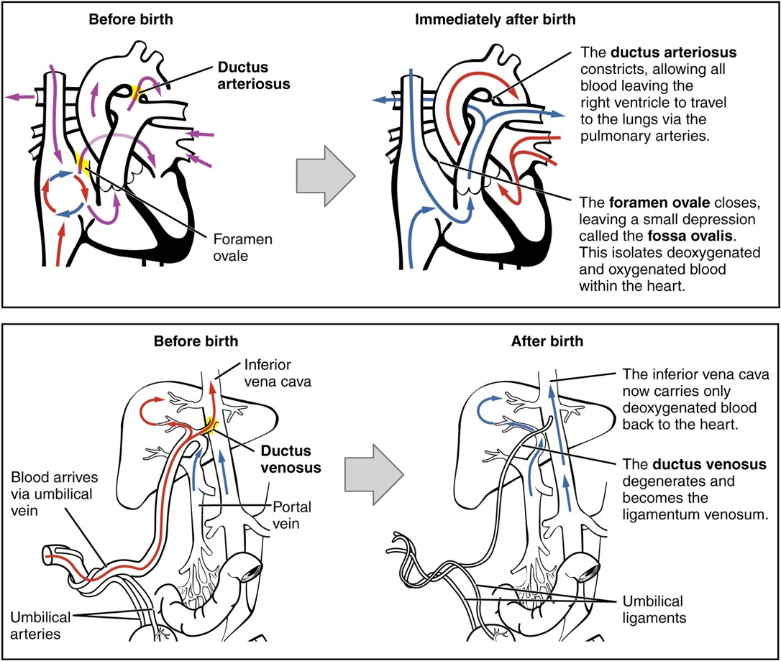
Neonatal circulation
Neonatal Circulatory System
A newborn’s circulatory system reconfigures immediately after birth. The three fetal shunts have been closed permanently, facilitating blood flow to the liver and lungs.

Slide 50
APGAR
A – Appearance (skin color)
P - Pulse (heart rate)
G – Grimace (reflex)
A – Activity (muscle tone)
R – Respiration
Scored between 0, 1 and 2 as highest. Measured at 1 and 5 minutes after birth.

Slide 51
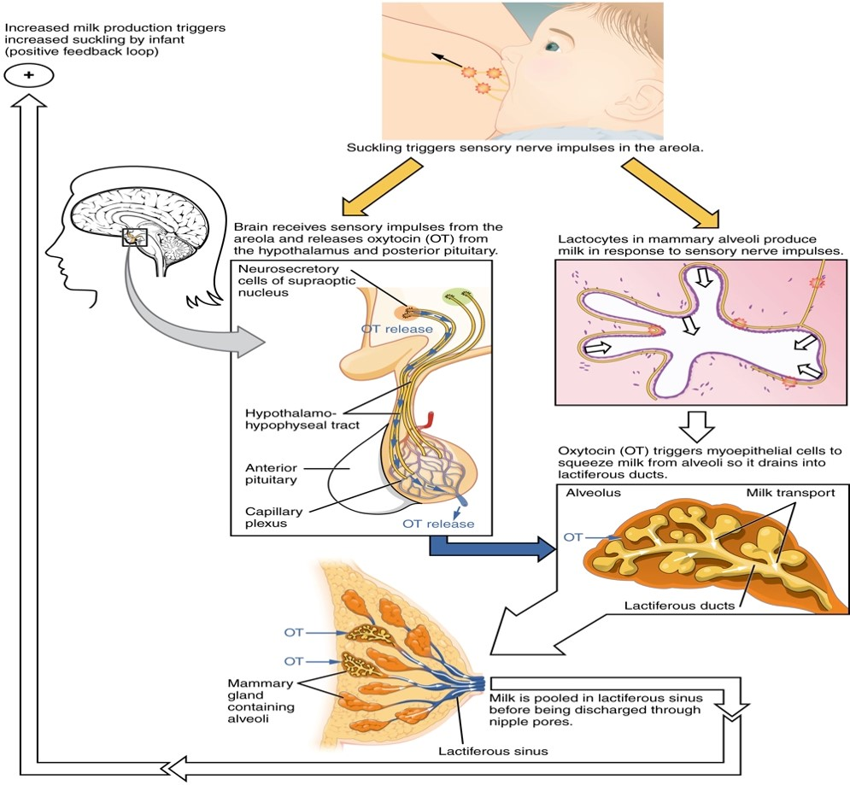
Lactation
Let-Down Reflex
A positive feedback loop ensures continued milk production as long as the infant continues to breastfeed.

Slide 52
Lactation
Lactation refers to the secretion and ejection of milk by the mammary glands.
1. A principal hormone in promoting lactation is prolactin (PRL) from the anterior pituitary gland.
a. PRL levels increase as the pregnancy progresses, but there is no milk secretion because estrogens and progesterone inhibit PRL from being effective.
b. Following delivery, estrogens and progesterone decrease, removing their inhibitory effect.
c. The principal stimulus in maintaining prolactin secretion during lactation is the sucking action of the infant.
2. Oxytocin (OT) causes release of milk into mammary ducts by the milk ejection
a. OT induces smooth muscle cells surrounding the outer walls of the alveoli to contract, thereby compressing the alveoli and ejecting milk. The compression moves milk from the alveoli of the mammary gland into the ducts, where it can be sucked. This process is referred to a milk ejection (let-down) .
b. Although the actual ejection of milk does not occur from 30 seconds to 1 minute after nursing begins, some milk is stored in lactiferous sinuses near the nipple. Thus, some milk is available during the latent period.
During late pregnancy and the first few days after birth, the mammary glands secrete a cloudy fluid called colostrum. It is not as nutritious as true milk but serves adequately until the appearance of true milk on about the fourth postpartum day. Colostrum and maternal milk are thought to contain antibodies that protect the infant during the first few months of life.

Slide 53
Lactation
1. Nursing causes neural feedback to the hypothalamus and the anterior pituitary gland that stimulates the production of PRF (prolactin releasing factor) and PRL, causing the mammary glands to prepare for the next nursing period.
a. Milk secretion can continue for several years if the child continues to suckle. Milk secretion normally decreases considerably within seven to nine months.
b. The mammary glands can lose their ability to secrete milk in a period of only a few days if nursing is discontinued or hormonal release is blocked by injury or disease.
2. Lactation often prevents the occurrence of female ovarian cycles for the first few months following delivery if the frequency of nursing is about 8-10 times a day. However, there is no guarantee of contraception.
3. A primary benefit of breast feeding is nutritional. Other benefits include the baby receiving beneficial cells and molecules from the breast milk, showing a decreased incidence of diseases later in life, as well as other benefits.
4. Nursing stimulates the release of oxytocin and helps promote expulsion of the placenta and the uterus to regain its smaller size.

