Slide 1

Topic Overview
Principles of Blood Products
Principles of Chemotherapy
Principles of Parenteral Nutrition

Slide 2
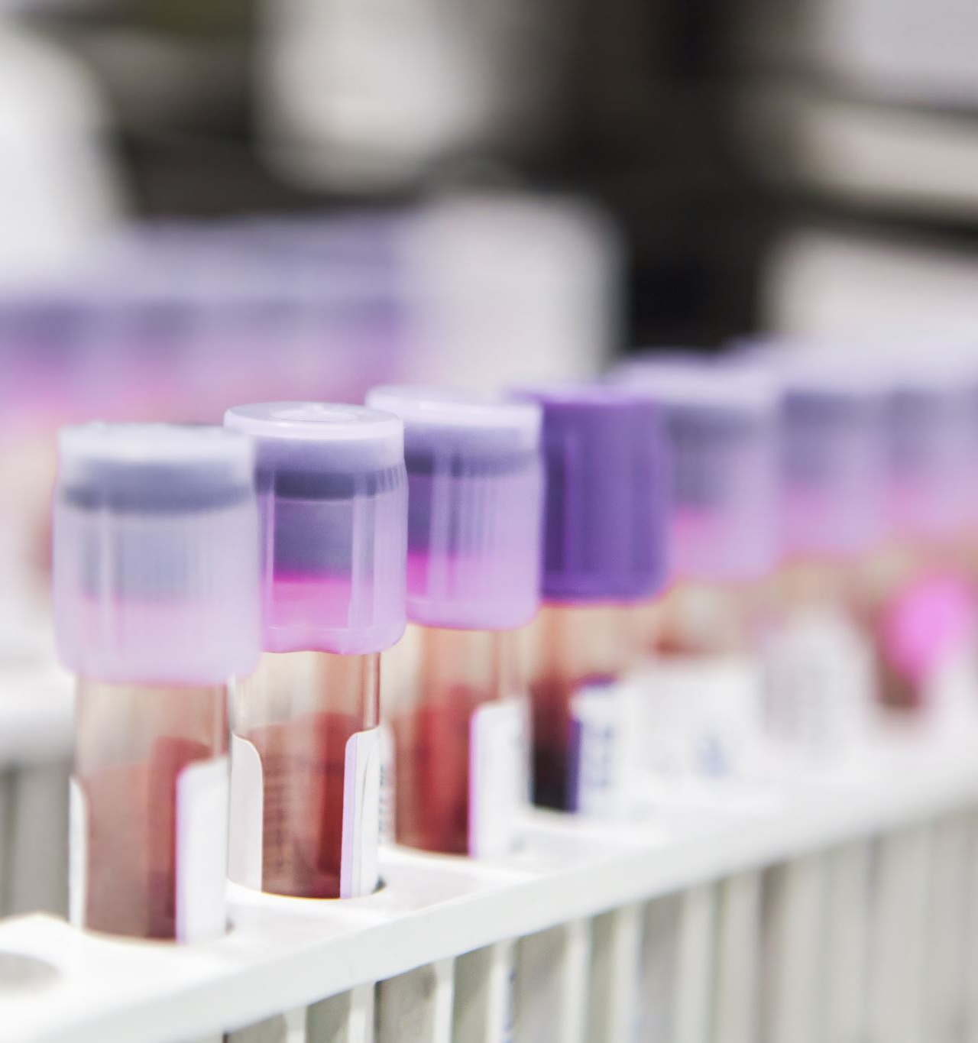
Blood Products: Introduction
Used to treat various hematologic and volume depletion conditions
Requires careful matching and monitoring
Notes:
Blood products are components derived from donated whole blood. They're used to treat a variety of medical conditions, such as blood loss, anemia, clotting disorders, and immune deficiencies. Each product targets a specific deficiency in the patient.

Slide 3
Types of Blood Products
• PRBCs – for anemia, blood loss
• Platelets – for thrombocytopenia
• FFP – for coagulation disorders
• Cryoprecipitate – for fibrinogen deficiency
• Albumin – for hypovolemia, hypoalbuminemia
Notes:
PRBCs (Packed Red Blood Cells)Treat anemia or acute blood loss. Increases oxygen delivery .Must match ABO and Rh; monitor for transfusion reaction. Platelets ;For thrombocytopenia or active bleeding with low platelet count. Often used in cancer, DIC, or massive transfusion. Fresh Frozen Plasma (FFP)Replaces clotting factors (e.g., in liver disease, warfarin reversal, DIC).Thawed before use; ABO compatibility needed. CryoprecipitateHigh in fibrinogen, factor VIII, and von Willebrand factor. Used in hemophilia or DIC. Small volume, very concentrated. Albumin Volume expansion in hypoalbuminemia, burns, or shock. Comes in 5% or 25% solution; no need for crossmatch. Whole Blood Rarely used; for massive hemorrhage when all components are needed. Contains all components (RBCs, plasma, platelets).

Slide 4
• Verify patient identity and product compatibility
• Use 0.9% Normal Saline only
• Infuse within 4 hours
• Monitor vital signs frequently
Transfusion Process

Slide 5
Transfusion Reactions
• Signs: fever, chills, urticaria, back pain, dyspnea
• Stop transfusion immediately if suspected
• Notify provider and follow protocol
Notes:
STOP the transfusion immediately.
Maintain IV line with normal saline.
Assess patient: vitals, breath sounds, urine output.
Notify provider and blood bank.
Save blood bag and tubing for lab analysis.
Document thoroughly.

Slide 6
Chemotherapy: Introduction
• Systemic treatment for cancer
• Can be curative, palliative, or adjuvant
Notes:
Chemotherapy is a type of cancer treatment that uses powerful drugs to destroy or slow the growth of rapidly dividing cancer cells. It can be used alone or in combination with surgery, radiation, or immunotherapy.

Slide 7
Classes of Chemotherapeutic Agents
• Alkylating agents – DNA damage
• Antimetabolites – disrupt synthesis
• Plant alkaloids – mitotic inhibitors
• Antitumor antibiotics – prevent replication
Notes:
Chemotherapy is tailored based on cancer type, location, and cell cycle behavior.
Knowing how each class works helps predict side effects and guides safe administration.
Always consider where in the cell cycle the drug acts and what healthy cells might also be affected.

Slide 8

Chemotherapy Administration
• Usually via central line (PICC, port)
• Avoid extravasation – use vesicant precautions
• Use PPE when handling

Slide 9
Chemotherapy Side Effects
• Bone marrow suppression
• Nausea and vomiting
• Hair loss (alopecia)
• Mucositis, fatigue, infection risk
Notes:
Anticipate side effects based on the chemo regimen.
Offer emotional support and educate patients on symptom management.
Coordinate with dietitians, social workers, and pharmacists for comprehensive care.

Slide 10
Neutropenic Precautions
• Avoid raw foods and sick visitors
• Use masks, good hand hygiene
• Monitor WBC closely
Notes:
Healthcare workers must perform hand hygiene before and after all patient contact.
Use gloves, masks, and gowns when appropriate.
Monitor the patient closely for signs of infection—fever is often the only sign.
If temperature exceeds 100.4°F (38°C), treat it as a medical emergency and notify the provider immediately.
Patient Education Tips
Teach patients to avoid crowds and sick individuals.
Instruct them to wear a mask in public if ANC is low.
They should check their temperature daily, and call their provider if it’s elevated.
Also teach good hygiene practices at home, including cleaning personal items like razors and toothbrushes.

Slide 11
Parenteral Nutrition: Introduction
• Nutritional support when GI tract is not usable
• Used in severe illness, surgery, bowel rest

Slide 12
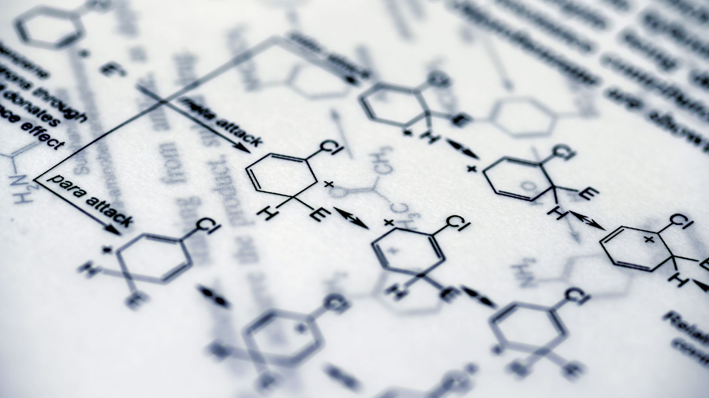
Types of Parenteral Nutrition
• TPN – central line, long-term, high osmolarity
• PPN – peripheral line, short-term, less concentrated
Notes:
TPN Provides 100% of the patient’s nutritional needs via a central venous catheter (e.g., PICC line, subclavian, or internal jugular). PPN Provides partial nutritional support through a peripheral IV line (e.g., forearm vein) Less concentrated

Slide 13
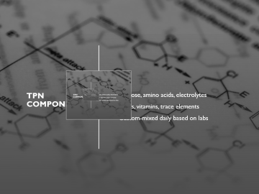
TPN Components
• Glucose, amino acids, electrolytes
• Lipids, vitamins, trace elements
• Custom-mixed daily based on labs

Slide 14

Monitoring & Maintenance
• Daily labs: glucose, lytes, liver/kidney function
• Check for infection and fluid overload
• Change tubing and bag every 24 hours

Slide 15
Summary and Key Points
• Always verify before transfusion or chemo administration
• Monitor closely for adverse reactions
• Ensure sterility and safety with TPN
• Patient education and team coordination is vital
Notes:
TPN Requires strict aseptic technique due to infection risk.
Monitor blood glucose, electrolytes, liver enzymes daily.
Change TPN bag and tubing every 24 hours.
Never stop TPN abruptly – taper to prevent hypoglycemia.
Use an infusion pump to control rate accurately.
PPN ;Lower dextrose concentration (≤10%) to reduce vein irritation.
Risk of phlebitis and infiltration—monitor IV site regularly.
Not ideal for long-term or high-calorie nutritional support.
Easier to initiate but less nutritionally complete than TPN.

