Slide 1
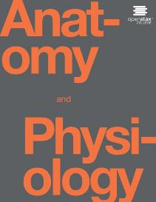
Anatomy and Physiology II
Chapter 12 Male Reproductive System

Slide 2
Reproduction
Sexual reproduction is a process in which organisms produce offspring by means of germ cells called gametes.
The organs of reproduction are grouped as gonads (produce gametes and secrete hormones), ducts (transport, receive, and store gametes), and accessory sex glands (produce materials that support gametes).
Gynecology is the specialized branch of medicine concerned with the
diagnosis and treatment of diseases of the female reproductive system.
Urology is the study of the urinary system but also includes diagnosis and treatment of diseases and disorders of the male reproductive system

Slide 3
THE CELL CYCLE IN THE GONADS
A. The cell cycle in the gonads produces gametes by a special type of nuclear division called meiosis, that reduces the number of chromosomes by one half.
B. Chromosomes in Gametes
1. A gamete has only 23 chromosomes, one member of each chromosome pair.
2. The two chromosomes that make up a chromosome pair are called homologous chromosomes or homologs.
a. They contain similar genes arranged in the same or almost the same order and look very similar.
b. The exception is the sex chromosomes. The female contains two X chromosomes; and the male, an X and a Y chromosome.
c. The other 22 pairs of chromosomes are called autosomes.
3. A cell with a full set of chromosomes is called a diploid cell. One with only one chromosome from each pair is termed haploid.

Slide 4
Meiosis
Meiosis
1. Meiosis results in the production of haploid cells that contain only 23 chromosomes.
2. Meiosis I
a. Meiosis I consists of four phases: prophase I, metaphase I, anaphase I, and telophase I
1) During prophase I, the chromosomes become arranged in homologous pairs.
2) During metaphase I, the homologous pairs of chromosomes line up along the metaphase plate of the
cell, with the homologous chromosomes side by side.
3) During anaphase I, the members of each homologous pair separate, with one member of each pair moving to an opposite pole of the cell.
4) Telophase I and cytokinesis are similar to telophase and cytokinesis of mitosis.
b. During prophase I, the two chromatids of each pair of homologous chromosomes pair off, an event called synapsis.
The resulting four chromatids form a tetrad. Portions of one chromatid may be exchanged with portions of another an event called crossing-over.
1) This process permits an exchange of genes among homologous chromosomes.
2) It results in genetic recombination, the formation of new combinations of genes.
Meiosis II
a. Meiosis II consists of prophase II, metaphase II, anaphase II, and telophase II.
b. These phases are similar to those in mitosis, but result in four haploid cells.

Slide 5
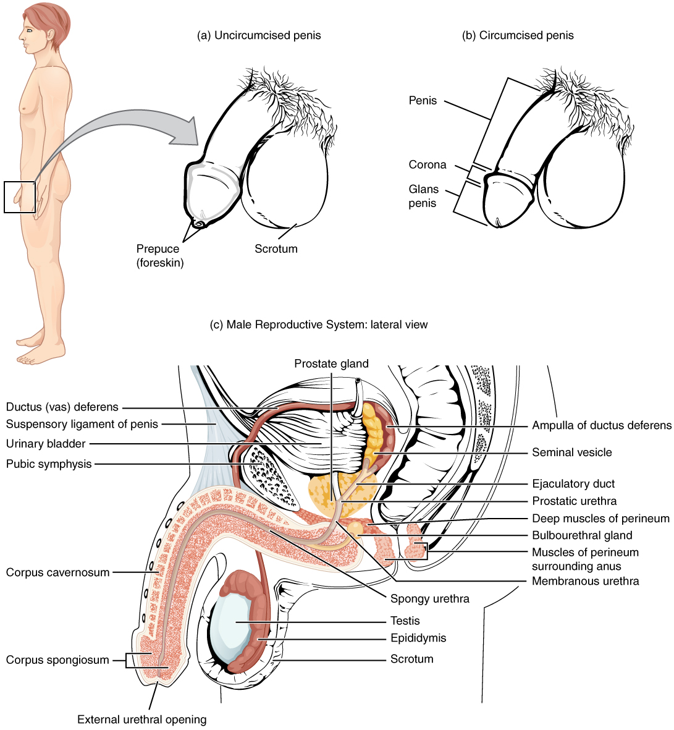

Male reproductive system
Male Reproductive System
The structures of the male reproductive system include the testes, the epididymides, the penis, and the ducts and glands that produce and carry semen. Sperm exit the scrotum through the ductus deferens, which is bundled in the spermatic cord. The seminal vesicles and prostate gland add fluids to the sperm to create semen.

Slide 6
Male
The male structures of reproduction include the testes, a system of ducts (ductus epididymis, ductus deferens, ejaculatory duct, urethra), accessory sex glands (seminal vesicles, prostate gland, bulbourethral glands), and several supporting structures, including the penis
Scrotum
1. The scrotum is a cutaneous outpouching of the abdomen that supports the testes; internally, a vertical septum divides it into two sacs, each containing a single testis
2. The reproduction and survival of spermatozoa require a temperature that is lower than normal core body temperature. The temperature of the testes is regulated by the cremaster muscle, which elevates them and brings them closer to the pelvic cavity or relaxes, causing the testes to move farther from the pelvic cavity.

Slide 7
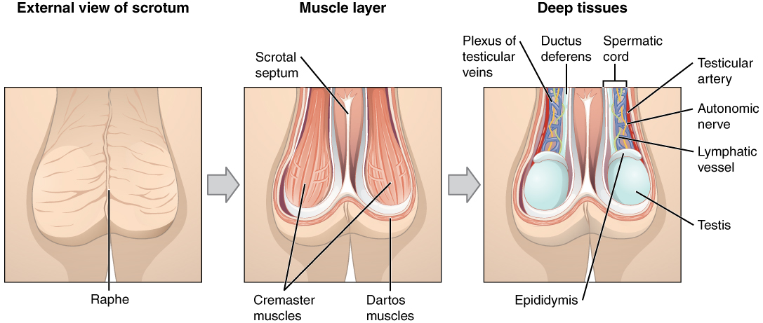
The scrotum and testes

Slide 8
Testes
Testes
1. The testes, or testicles, are paired oval-shaped glands (gonads) in the scrotum
a. The testes develop high on the embryo’s posterior abdominal wall and usually begin their descent into the scrotum through the inguinal canals during the latter half of the seventh month of fetal development.
b. The testes contain seminiferous tubules (in which sperm cells are made).
c. Embedded among the spermatogenic cells in the tubules are large Sertoli cells or sustentacular cells.
1) The tight junctions of these cells form the blood-testis barrier that prevents an immune response against the surface antigens on the spermatogenic cells.
2) The sustentacular cells also nourish spermatocytes, spermatids, and spermatozoa;
mediate the effects of testosterone and follicle stimulating hormone on spermatogenesis;
phagocytize excess spermatid cytoplasm as development proceeds; control movements of spermatogenic cells and the release of spermatozoa into the lumen of the seminiferous tubule;
and secrete fluid for sperm transport and the hormone inhibin.
The Leydig cells or interstitial endocrinocytes found in the spaces between adjacent seminiferous tubules secrete testosterone
Failure of the testes to descend is called cryptorchidism, involving one or both testes

Slide 9
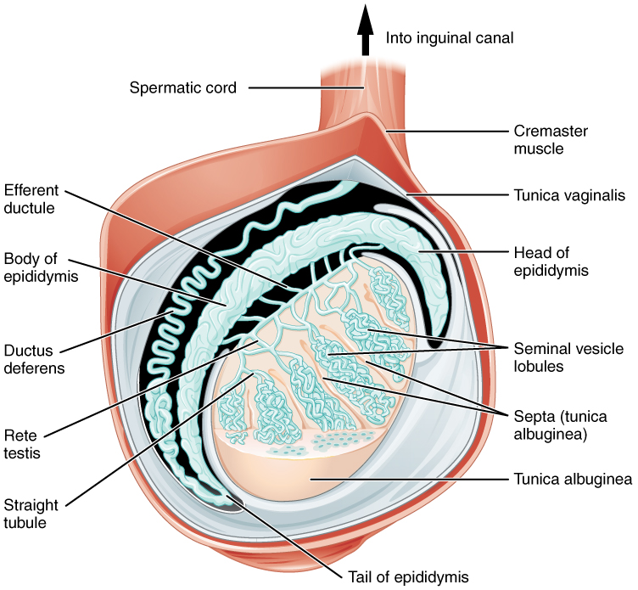
The testis
Anatomy of the Testis
This sagittal view shows the seminiferous tubules, the site of sperm production. Formed sperm are transferred to the epididymis, where they mature. They leave the epididymis during an ejaculation via the ductus deferens.

Slide 10
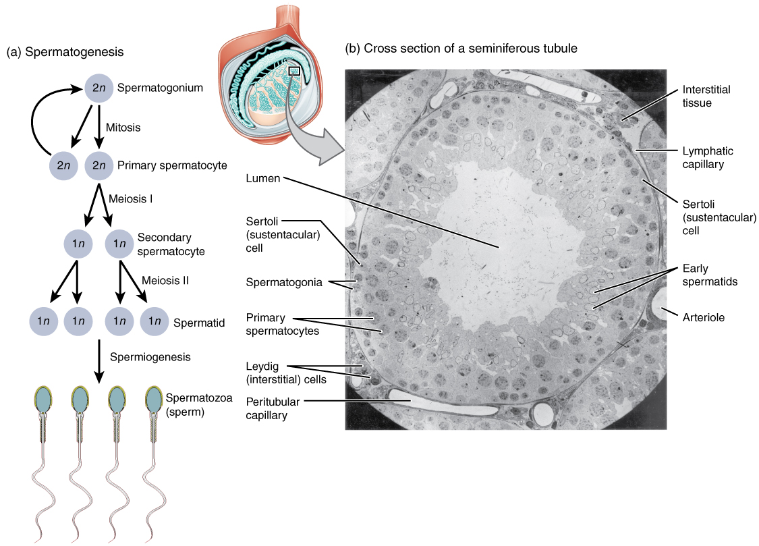
spermatogenesis
Spermatogenesis
Mitosis of a spermatogonial stem cell involves a single cell division that results in two identical, diploid daughter cells (spermatogonia to primary spermatocyte). Meiosis has two rounds of cell division: primary spermatocyte to secondary spermatocyte, and then secondary spermatocyte to spermatid. This produces four haploid daughter cells (spermatids).
In this electron micrograph of a cross-section of a seminiferous tubule from a rat, the lumen is the light-shaded area in the center of the image. The location of the primary spermatocytes is near the basement membrane, and the early spermatids are approaching the lumen (tissue source: rat). EM × 900. (Micrograph provided by the Regents of University of Michigan Medical School © 2012)

Slide 11
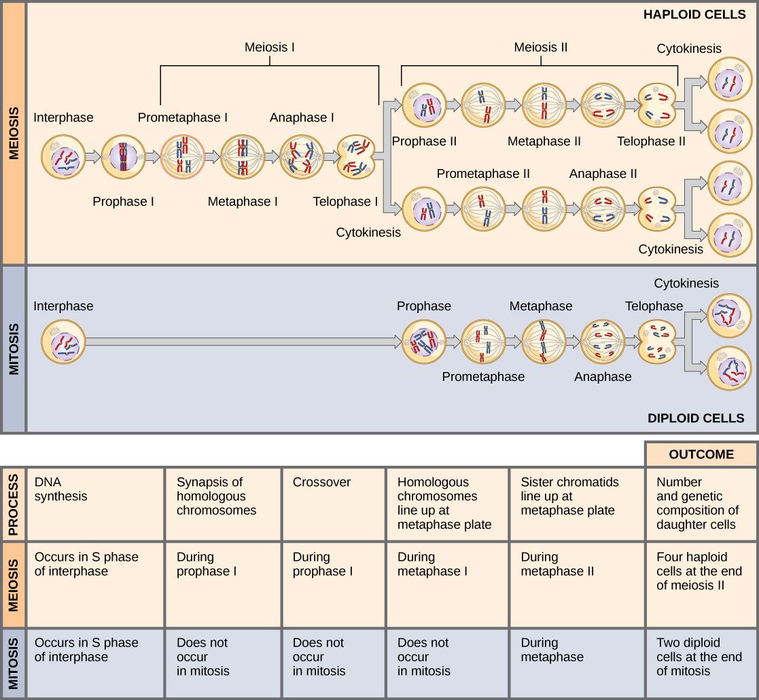

Compare
Meiosis and mitosis are both preceded by one round of DNA replication; however, meiosis includes two nuclear divisions.
The four daughter cells resulting from meiosis are haploid and genetically distinct.
The daughter cells resulting from mitosis are diploid and identical to the parent cell.
How cells divide

Slide 12
Mitosis versus Meiosis
Characteristic | MITOSIS | MEIOSIS
Reason for conducting cell division | Growth, repair, and maintenance of body cells. | Formation of gametes (sperm or eggs)
Type of cell undergoing division | Somatic cells (body cells) | Gametes (sex cells)
Number of divisions | One | Two
Synapsis of homologous chromosomes | No | Yes, in Meiosis I tetrad formation and crossover occur
Number of daughter cells produced | 2 daughter cells formed | 4 spermatids
Number of chromosomes in each daughter cells | 46 (diploid) | 23 (haploid)
Comparison of the daughter cells to the mother cell | Genetically identical | Genetically different due to crossing over and random fertilization events

Slide 13
Spermatogenesis
Spermatogenesis is the process by which the seminiferous tubules of the testes produce haploid sperm.
a. It begins in the diploid spermatogonia (stem cells). They undergo mitosis to reserve future stem cells and to develop cells (2n primary spermatocytes) for sperm production.
b. The diploid primary spermatocytes undergo meiosis I forming haploid secondary spermatocytes.
c. Meiosis II results in the formation of the haploid spermatids. The spermatids are connected by cytoplasmic bridges.
d. The final stage of spermatogenesis is spermiogenesis which is the maturation of the spermatids into sperm.
e. The release of a sperm from its connection to a Sertoli cell is known as spermiation.
Mature sperm consist of a head, midpiece, and tail They are produced at the rate of about 300 million per day and, once ejaculated, have a life expectancy of 48 hours within the female reproductive tract. Their function is to fertilize a secondary oocyte.
Hormonal Control of spermatogenesis
a. at puberty, gonadotropin releasing hormone stimulates anterior pituitary secretion of follicle-stimulating hormone (FSH) and luteinizing hormone (LH). FHS initiates spermatogenesis, and LH assists spermatogenesis and stimulates production of testosterone. the hormonal relationships of the hypothalamus, pituitary gland, and testes.
b. Testosterone controls the growth, development, functioning, and maintenance of sex organs; stimulates bone growth, protein anabolism, and sperm maturation; and stimulates development of male secondary sex characteristics. Negative feedback systems regulate testosterone production (Figure
c. Inhibin is produced by sustentacular (Sertoli) cells. Inhibition of FSH by inhibin helps to regulate the rate of spermatogenesis.

Slide 14
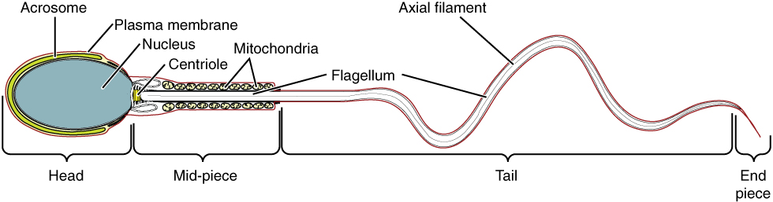
Sperm anatomy
Structure of Sperm
Sperm cells are divided into a head, containing DNA; a mid-piece, containing mitochondria; and a tail, providing motility. The acrosome is oval and somewhat flattened.

Slide 15
Ducts
Ducts
1. The duct system of the testes includes the seminiferous tubules, straight tubules, and rete testis.
2. Epididymis
a. The epididymis is a comma-shaped organ that lies along the posterior border of the testis
b. Sperm are transported out of the testes through the efferent ducts in the epididymis which empty into a single tube called the ductus epididymis.
c. The ductus epididymis is lined by stereocilia and is the site of sperm maturation and storage; sperm may remain in storage here for at least a month, after which they are either expelled or degenerated and reabsorbed.

Slide 16
Ducts
Ductus Deferens
a. The ductus (vas) deferens, or seminal duct, stores sperm and propels them toward the urethra during ejaculation
b. The spermatic cord is a supporting structure of the male reproductive system, consisting of the ductus deferens, the
testicular artery, autonomic nerves, veins that drain the testes, lymphatic vessels, and the cremaster muscle (Figure 28.2).
c. The inguinal canal represents a weak spot in the abdominal wall. It is frequently the site of an inguinal hernia - a rupture or separation of a portion of the abdominal wall resulting in the protrusion of a part of an organ (most commonly the small or large intestine). Since the inguinal canal is smaller in females, women have inguinal hernias much less often.
The ejaculatory ducts are formed by the union of the ducts from the seminal vesicles and ducti deferens; their function is to eject spermatozoa into the prostatic urethra
The male urethra is the shared terminal duct of the reproductive and urinary systems which serves as a passageway for semen and urine.
The male urethra is subdivided into three portions: prostatic, membranous, and spongy (cavernous)

Slide 17
Male reproductive system
vasectomy
Male Reproductive System
The structures of the male reproductive system include the testes, the epididymides, the penis, and the ducts and glands that produce and carry semen. Sperm exit the scrotum through the ductus deferens, which is bundled in the spermatic cord. The seminal vesicles and prostate gland add fluids to the sperm to create semen.

Slide 18
Penis
Penis
1. The penis is the male organ of copulation that consists of a root, body, and glans penis. It is used to introduce spermatozoa into the vagina
2. Expansion of its blood sinuses under the influence of sexual excitation is called erection; ejaculation, propulsion of semen from the urethra to the exterior, is a sympathetic reflex.
3. Covering the glans penis is the loosely fitting prepuce, or foreskin.
Circumcision is a surgical procedure in which part of all of the prepuce is removed (for either religious or hygienic reasons). There is no consensus among physicians regarding the need for circumcision or the use of anesthesia during the procedure.

Slide 19
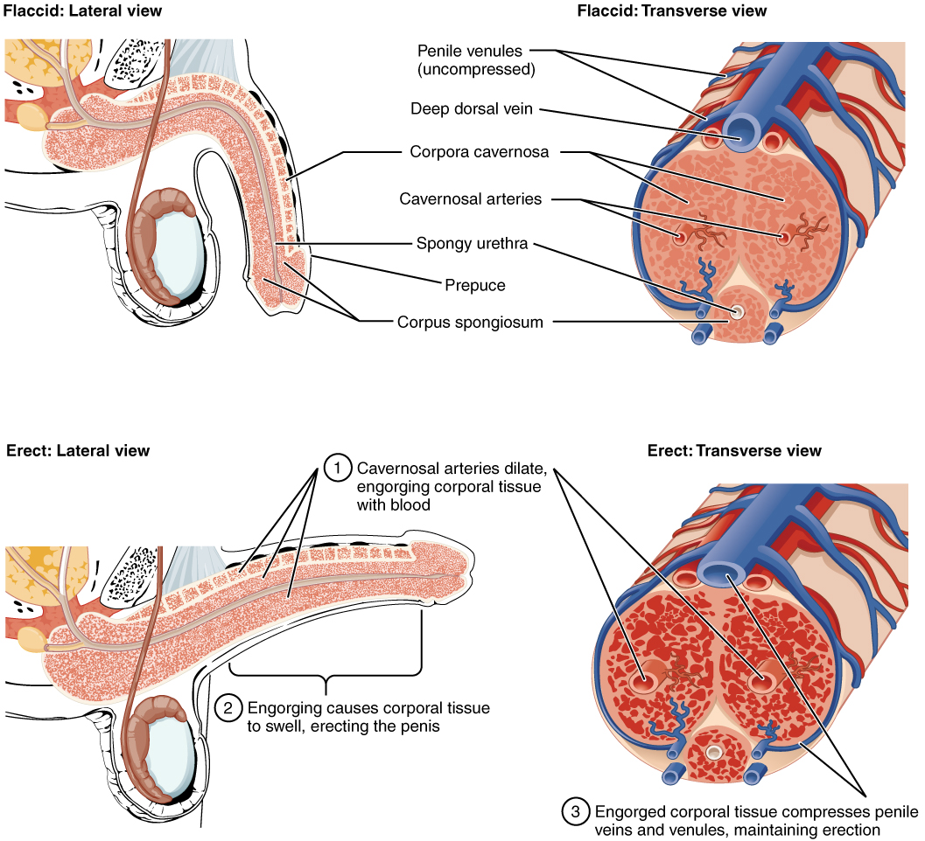
Penile cross-section
Path of sperm video
Cross-Sectional Anatomy of the Penis
Three columns of erectile tissue make up most of the volume of the penis.

Slide 20
Accessory Sex Glands
1. The seminal vesicles secrete an alkaline, viscous fluid that contains fructose, prostaglandins, and clotting proteins.
a. The alkaline nature of the fluid helps to neutralize acid in the male urethra and female reproductive tract.
b. The fructose is for ATP production by sperm.
c. Prostaglandins contribute to sperm motility and viability.
d. Semenogelin is the main protein that causes coagulation of semen after ejaculation.
2. The prostate gland secretes a milky, slightly acidic fluid that contains:
(1) citric acid, which can be used by sperm for ATP production;
(2) acid phosphatase; and (3) several proteolytic enzymes, such as prostate-specific antigen (PSA), pepsinogen, lysozyme, amylase, and hyaluronidase which liquify coagulated semen.
3. The bulbourethral (Cowper’s) glands secrete mucus for lubrication and an alkaline substance that neutralizes acid.
Semen (seminal fluid) is a mixture of spermatozoa and accessory sex gland secretions that provides the fluid in which spermatozoa are transported, provides nutrients, and neutralizes the acidity of the male urethra and female vagina.
1. Semen contains an antibiotic, seminal plasmin, and prostatic enzymes that coagulate and then liquify semen to aid in its movement through the uterine cervix.
2. Once ejaculated, liquid semen coagulates within 5 minutes due to the presence of clotting proteins from the seminal vesicles.
3. After about 10-20 minutes, semen reliquefies because PSA and other proteolytic enzymes produced by the prostate gland break down the clot.

Slide 21
Physiology of Male System
Arousal
Emission
Ejaculation

Slide 22
Physiology of Male sexual activity
Arousal
During arousal, erotic thoughts or stimulation of sensory nerves in the genital region leads to an increase in the parasympathetic outflow over the pelvic nerves.
The parasympathetic innervation of the penile arteries involves neurons that release nitric oxide (NO) at their synaptic terminals. The smooth muscles in the arterial walls relax when NO is released, at which time the vessels dilate, blood flow increases, the vascular channels become engorged with blood, and erection of the penis occurs.
Arousal also stimulates the bulbourethral glands, whose secretions lubricate the urethra and the tip of the glans.

Slide 23
Physiology of Male System
Emission
Further stimulation leads to sympathetic activation that causes emission.
3. Emission begins with peristaltic contractions in the ampullae of the ductus deferens. This pushes spermatozoa into the urethra within the prostate gland.
4. Contractions then begin the walls of the seminal glands and the prostate gland, and their secretions now enter the urethra and mix with the spermatozoa introduced by ampullary contractions to form semen.

Slide 24
Physiology of Male System
Ejaculation
Ejaculation occurs as powerful, rhythmic contractions take place I the ischiocavernosus and bulbocavernosus muscles. These contractions are controlled by somatic motor neurons in the lower lumbar and upper sacral segments of the spinal cord. These contractions are associated with pleasurable sensations known as male orgasm.
5. The bulbocavernosus muscles wrap around the base of the penis, and their contractions push semen toward the external urethral orifice.
6. The ischiocavernosus muscles insert along the sides of the penis, and their contractions serve primarily to stiffen the erect penis.

Slide 25
Semen Analysis
Alkalinity=7.2 to 7.6
Normal discharge=2-5 ml per ejaculation
Sperm count is roughly 50 to 130 million per ml of ejaculate ~5%.
Morphology= <35% are abnormal
Motility= 60% exhibit forward motility
Survival=can live 48 hours after ejaculation
Sterility=less than 20 million sperm/ml

Slide 26
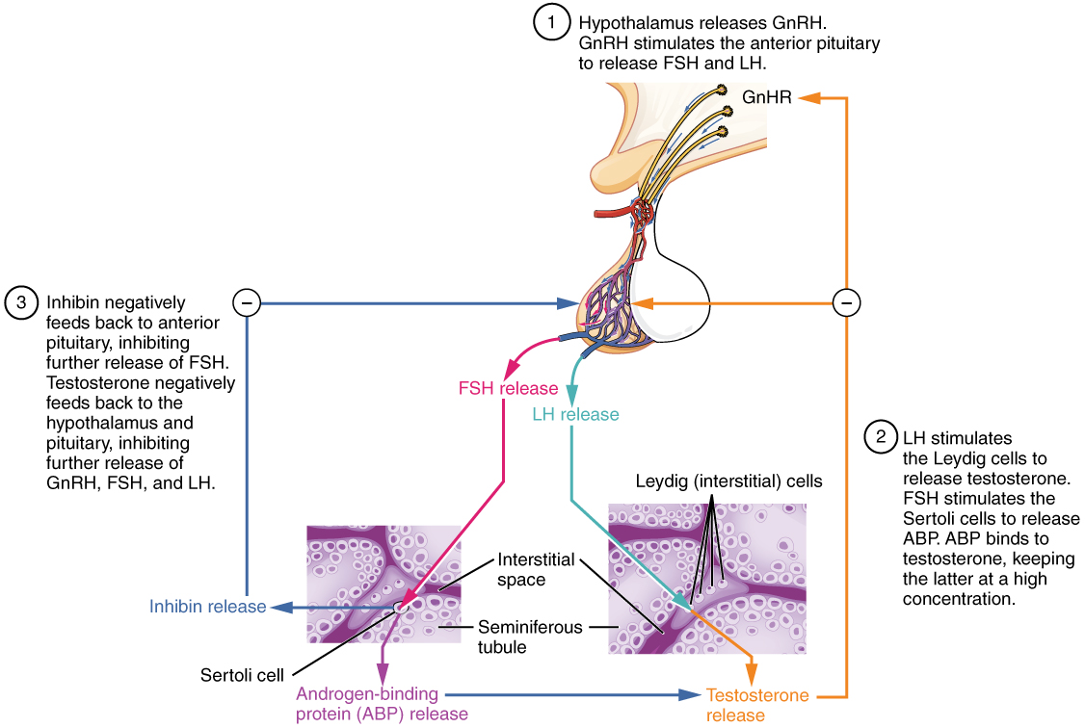
Testosterone synthesis
Regulation of Testosterone Production
The hypothalamus and pituitary gland regulate the production of testosterone and the cells that assist in spermatogenesis. GnRH activates the anterior pituitary to produce LH and FSH, which in turn stimulate Leydig cells and Sertoli cells, respectively. The system is a negative feedback loop because the end products of the pathway, testosterone and inhibin, interact with the activity of GnRH to inhibit their own production.

Slide 27
Sexual Response
THE HUMAN SEXUAL RESPONSE
A. Sexual intercourse, or copulation (in humans, called coitus), is the process by which spermatozoa are deposed in the vagina.
B. The four stages of human sexual response are related to the physical and physiological states that occur to both men and women during sexual intercourse.
1. In the arousal phase parasympathetic impulses pass through the sacral region to cause vasocongestion and secretion by the genitalia.
a. Arousal is in response to mental and tactile stimulation.
b. There is also increased activity in the cardiovascular, respiratory, and muscular systems.
2. The plateau stage is characterized by a “sexual flush” due to cutaneous vasodilation.
3. Sympathetic nervous stimulation of the whole body leads to the orgasm stage, accompanied by an intense sensation of pleasure, in addition to rhythmic somatic and smooth muscle contractions.
4. The resolution stage occurs as the aroused systems relax.
C. The changes of the male in the sex act involve erection, minimal lubrication, and ejaculation, a component of orgasm.
D. The female role changes also involve erection, lubrication, and orgasm (climax).
E. Erectile dysfunction, previously termed impotence, is the consistent inability of an adult male to ejaculate or to attain or hold an erection long enough for sexual intercourse.

Slide 28
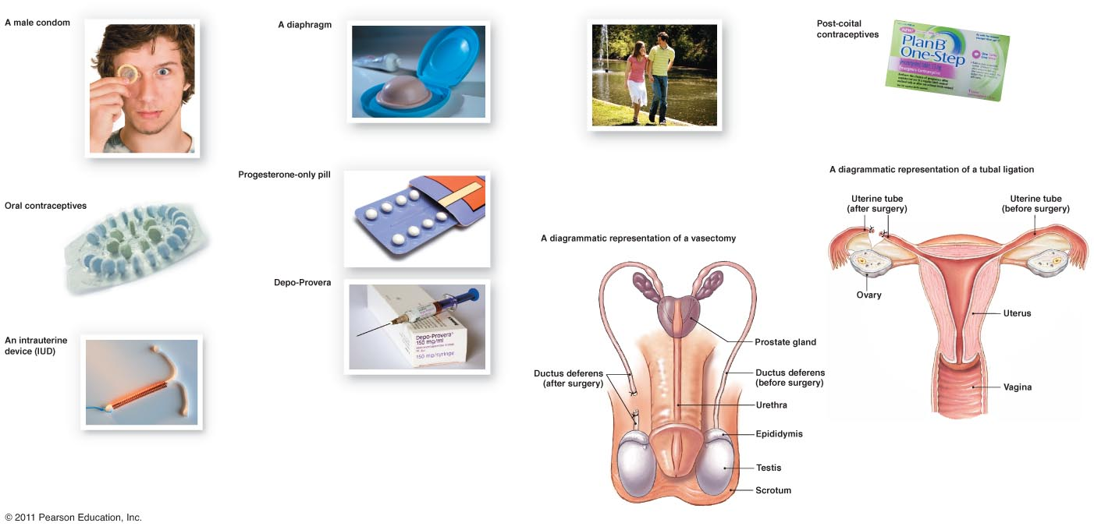
Contraceptive Devices
Natural Family Planning
Female condom
Failure Rates:
Barrier - 15-20%
Hormonal (oral, ring) - 8%
H (injection) – 3%
H (implant) - <1%
NFP – 12-25%
Withdrawal – 27%
Sterilization <1%
Jadelle
NuvaRing

Slide 29
Birth Control
Several methods of birth control are available, each with advantages and disadvantages.
B. The only method of preventing pregnancy that is 100% reliable is total abstinence, avoidance of sexual intercourse.
C. Methods of birth control discussed in the text include
1.Abstinence
a. Abstinence is not having sex
b. 100% effective
2. surgical sterilization
a. vasectomy
I. the vas deferens are cut and burned
i. semen is still produced but no sperm
b. tubal ligation
i. fallopian tubes are cut and burned
ii. eggs are still produced but do not reach the
fallopian tubes
hormonal methods
a. oral contraception
Birth control pill
i. Contains hormones to change the way the body works
ii. Most use combination pills containing a combination of the hormones estrogen and progesterone
iv. Possible side effects
1. irregular menstrual bleeding nausea, weight gain, headaches, dizziness, and breast tenderness ,mood changes ,blood clots
b. Birth control patch
i. Thin, beige, square patch that sticks to the skin
ii. It release hormones through the skin into the bloodstream to prevent pregnancy
iii. The combination of the hormones progesterone and estrogen
iv. 95% effective Possible side effects
1. irregular menstrual bleeding nausea, weight gain, headaches, dizziness, and breast tenderness . mood changes, blood clots ,skin reactions ,problems with contact lens , menstrual cramps

Slide 30
Birth control
the Norplant implant,
d. Depo-Provera injection
i. Long-acting form of progesterone
ii. The shot is given in the upper arm or in the buttocks once very 3 months
iii. Possible side effects
1. irregular or no menstrual periods , weight gain, headaches, and breast ,tenderness , depression
e. the vaginal ring
i. soft, flexible, doughnut-shaped ring about 2 inches in diameter
ii. inserted into the vagina , where it slowly releases hormones
iii. the hormones in the ring control the ovaries and the uterus the cervical mucus is also thickened
iv. side effects
1. irregular menstrual bleeding , nausea, weight gain, headaches, ,dizziness, and breast tenderness , mood changes , blood clots ,vaginal irritation or infections ,vaginal discharge ,problems with contact lens
intrauterine devices (IUDs)
i. A T-shaped piece of plastic about the size of a quarter that is placed inside the uterus
ii. Two types
1. one is covered with copper wire
2. the other is coated with and releases the hormone progesterone
iii. Possible side effects
1. spotting between periods ,. heavier periods with more cramps . irregular or loss of periods , expulsion or loss of the IUD . perforation of the uterus, acne, breast tenderness, and nausea
Spermicides
i. cream, foam, gel, film and suppositories
ii. contain nonoxynol-9, a chemical that kills sperms

Slide 31
Birth Control
barrier methods
condom
1. there are male and female condoms
2 .keeps the semen from working
3. possible side effects
a. allergy to latex ,irritation of the penis
female condom
a. a lubricated polyurethane sheath shaped similar to the male condom . The closed end has a flexible ring that is inserted into the vagina.
b. vaginal pouch,
c. diaphragm,
i. dome shaped bowl made of thin, flexible rubber that sit over the cervix
ii. keeps sperm from entering the uterus
iii. possible side effects
a. spermicides may irritate the vagina , strong odors ,rubber may cause allergies toxic shock syndrome
cervical cap
fitted directly over the cervix
periodic abstinence
a. rhythm method
i. calendar – counting the days till ovulation
ii. temperature – taking your basal temperature and then checking to see a few tenths of a degree of a change
iii. Billings’ method – checking the mucus in the vagina
coitus interruptus (withdrawal),
i. possible pregnancy due to the Cowper’s gland or the Bulbourethral gland
induced abortion
a. (including the drug RU 486, or mifepristone).

Slide 32
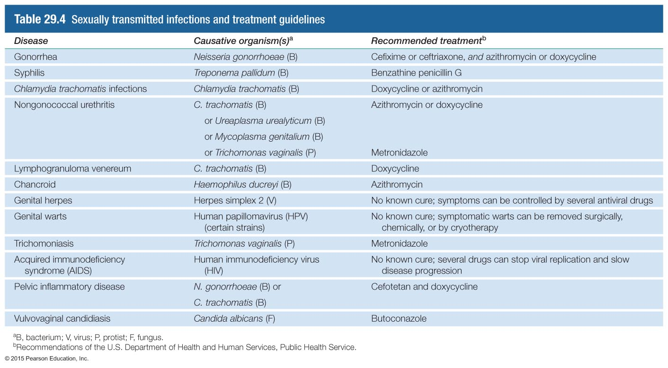
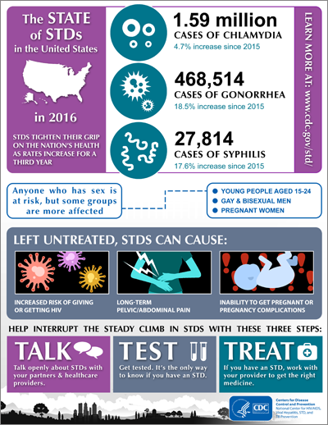
STDs – caused by a wide variety of organisms
GA Rankings, 2016 (CDC)
Disease | Ranking | Cases | Rate per 100,000
Chlamydia | 5 | 62,776 | 614.6
Gonorrhea | 3 | 20,553 | 201.2
Syphilis (primary/secondary) | 4 | 1350 | 13.2
Syphilis (congenital) | 9 | 21 | 16.0
Notes:
Table 29.4

Slide 33
Male and female embryological development
All fertilized eggs will become female without the addition of the gene from the SRY.
Certain tissue has bipotential
Other reproductive structures are developed from embryological ducts (uterus, uterine tubes and part of vagina; epididymis, ductus deferens, and seminal vesicles)
Male and female development video

Slide 34
AGING AND THE REPRODUCTIVE SYSTEMS
A. Puberty refers to the period of time when secondary sexual characteristics begin to develop and the potential for sexual reproduction is reached.
B. In females, the reproductive cycle normally occurs once each month from menarche, the first menses, to menopause, the last menses.
1. Between the ages of 40 and 50 the ovaries become less responsive to the stimulation of gonadotropic hormones from the anterior pituitary. As a result, estrogen and progesterone production decline, and follicles do not undergo normal development.
2. In addition to the symptoms of menopause, such as hot flashes, copious sweating, headache, vaginal dryness, depression, weight gain, and emotional fluctuations, with age females also experience increased incidence of osteoporosis, uterine cancer, and breast cancer.
C. In males, declining reproduction function is more subtle, with males often retaining reproductive capacity into their 80s or 90s.
1. In males, decreasing levels of testosterone decrease muscle strength, sexual desire, and viable sperm.
2. Prostate disorders are increasingly common with age, particularly benign hypertrophy

Slide 35
Development
DEVELOPMENTAL ANATOMY OF THE REPRODUCTIVE SYSTEMS
A. The gonads develop from intermediate mesoderm and are differentiated into ovaries or testes by about the seventh week of fetal development
B. The external genitalia develop from the genital tubercle .
C. Deficiency of 5-alpha-reductase results in a female external appearance at birth, but the development of male characteristics at puberty

Slide 36
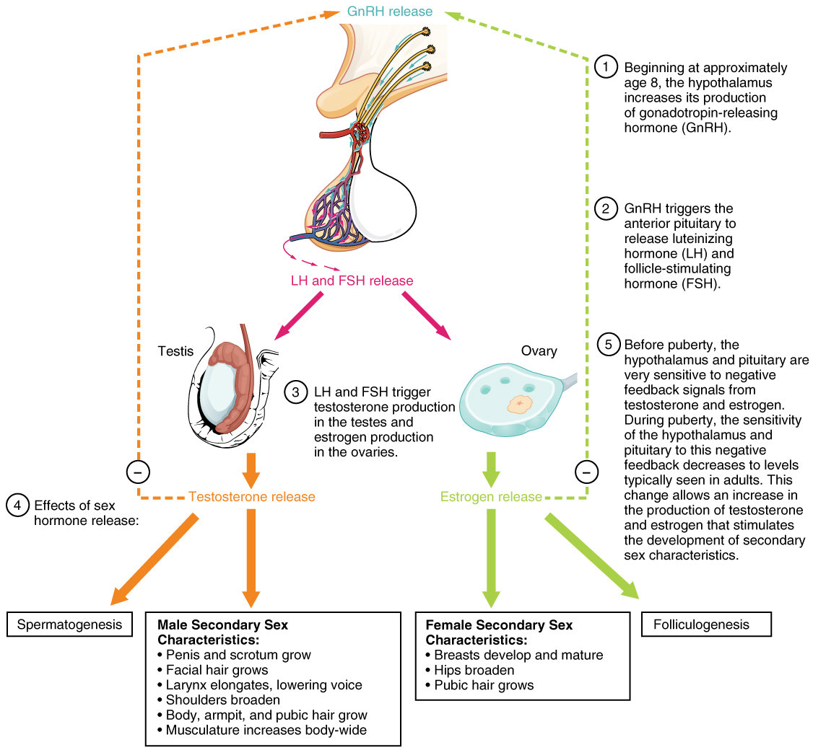
puberty
Hormones of Puberty
During puberty, the release of LH and FSH from the anterior pituitary stimulates the gonads to produce sex hormones in both male and female adolescents.

Slide 37
Homeostatic Imbalances
Testicular cancer
Prostate cancer
Cryptorchidism
Impotence
Pelvic inflammatory disease
Ovarian cancer
Cervical cancer
Breast cancer
Sexually transmitted diseases
  Gonorrhea
  Syphilis
  Chlamydia
  Genital warts
  Genital herpes
Amenorrhea
Dysmenorrhea
Endometriosis

Slide 38
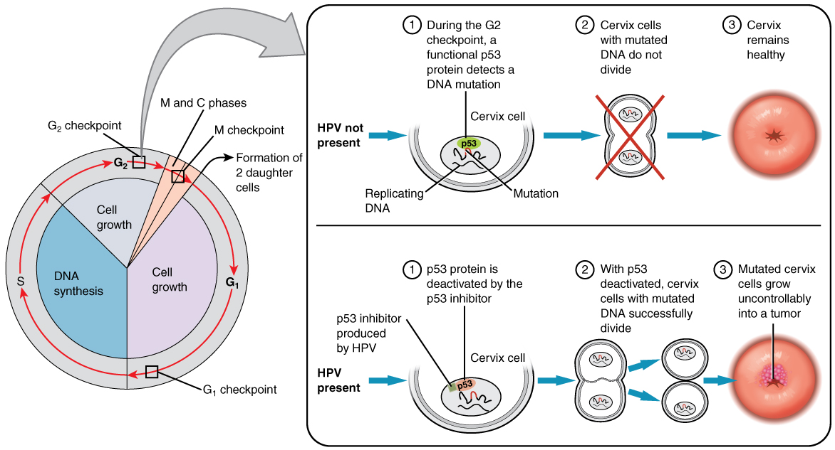
Cervical cancer
Development of Cervical Cancer
In most cases, cells infected with the HPV virus heal on their own. In some cases, however, the virus continues to spread and becomes an invasive cancer.

Slide 39
Sexually transmitted diseases
Sexually transmitted diseases (STDs) are disease spread by sexual contact and include chlamydia, gonorrhea, syphilis, and genital herpes.
1. Chlamydia is a STD caused by the bacterium Chlamydia trachomatis. At present chlamydia is the most prevalent and one of the most damaging of the STDs.
a. In most cases, the initial infection is asymptomatic and difficult to recognize clinically.
b. In males, urethritis is the principal result.
c. In females, urethritis may spread through the reproductive tract and develop into inflammation of the uterine tubes, which increases the risk of ectopic pregnancy and sterility.
2. Gonorrhea (“clap”) is an infectious STD that affects primarily the mucous membrane of the urogenital tract, the rectum, and occasionally the eyes. The disease is caused by the bacterium Neisseria gonorrhoreae.
a. Males usually suffer inflammation of the urethra with pus and painful urination.
b. In females, infection may occur in the urethra, vagina, and cervix, and their may be a discharge of pus. However, infected females often harbor the disease without any symptoms until it has progressed to a more advanced stage. If the uterine tubes become involved, pelvic inflammation may follow, often causing sterility and occasionally causing peritonitis.
c. If the bacteria are transmitted to the eyes of a newborn in the birth canal, blindness can result. Administration of a 1% silver nitrate solution or penicillin or erythromycin in the neonate’s eyes prevents infection.
Syphilis is an STD caused by the bacterium Treponema pallidum.
a. It is acquired through sexual contact, exchange of blood, or transmitted through the placenta to a fetus.
b. The disease progresses through several stages: primary, secondary, latent, and tertiary.
1) During the primary stage, the chief symptom is a painless open sore, called a chanker.
2) A skin rash, fever, and aches in the joints usher in the secondary stage: a systemic infection.
3) The tertiary stage occurs when signs of organ degeneration appear.
4. Genital herpes is an incurable STD caused by the type II herpes simplex virus (HSV-2).
a. HSV-2 causes genital infections such as painful blisters on the prepuce, glans penis, and penile shaft in males and on the vulva or sometimes high up in the vagina in females.
b. The blisters disappear and reappear in most patients, but the virus itself remains in the body

Slide 40
Male Disorders
Testicular cancer originates in the sperm-producing cells.
a. It occurs most commonly in young men between the ages of 15 and 34.
b. An early sign is a mass in the testis, often associated with pain or discomfort. All males should perform regular testicular self exams.
Prostate Disorders
a. In acute prostatitis, the prostate gland becomes swollen and tender.
b. In chronic prostatitis, one of the most common chronic infections in men of the middle and later years, the gland feels enlarged, soft, and very tender with an irregular surface outline.
c. Prostate cancer is the leading cause of cancer deaths in men in the United States.
1) A blood test can measure the level of prostate-specific antigen (PSA) in the blood.
2) The amount of PSA increases with the enlargement of the prostate gland and may indicate infection, benign enlargement, or prostate cancer.
3) Treatment for prostate cancer may involve surgery, radiation, hormonal therapy, or chemotherapy

