Slide 1
Integration of Lab Values into Medication Safety

Slide 2
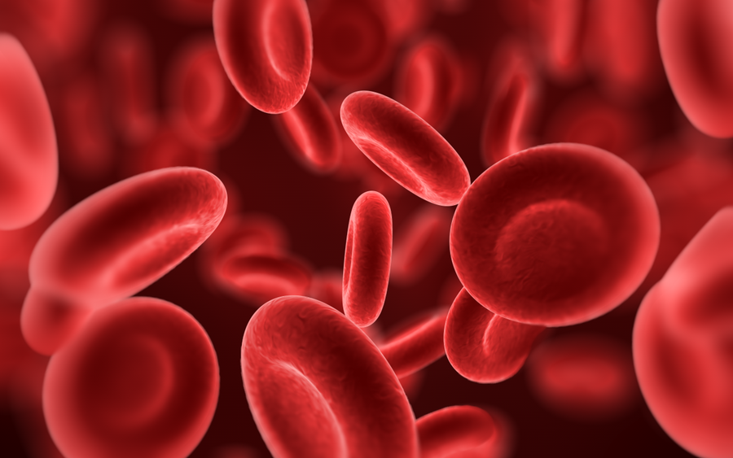
Components of a CBC
(Complete Blood Count)
Red Blood Cells
White Blood Cells
Platelets

Slide 3
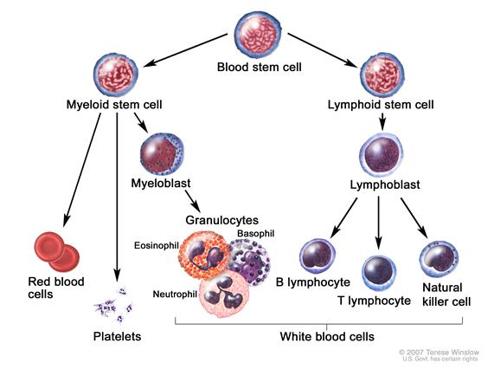
Where do they come from

Slide 4
Red Blood Cells
(Erythrocytes)
Causes of low hematocrit:
Hemodilution
Anemia
Destruction of red blood cells (sickle cell anemia, enlarged spleen)
Decreased production of red blood cells (bone marrow suppression, cancer, drugs)
Nutritional problems (low iron, B 12, folate and malnutrition

Slide 5
Red Blood Cells
(Erythrocytes)
Clinically if decreased RBCs
Fatigue
Pallor
SOB
Tachycardia
Weakness

Slide 6
Medications that Cause Anemia
ACE inhibitors (Lisinopril)-decrease erythropoietin production
Antibiotics (sulfa-trimethoprim)-inhibit folic acid metabolism
Anticonvulsants- inability to metabolize folate

Slide 7
Red Blood Cells
(Erythrocytes)
Treatments/Medications for Anemia
B12 injections
Transfusions
Iron administration
Diet Modification
Procrit-erythropoietin (EPO)

Slide 8
Hemolytic Anemia
Additional symptoms
dark urine
jaundice
heart murmur
enlarged spleen
enlarged liver

Slide 9
Causes of Hemolytic Anemia
Drug-induced hemolytic anemia can be caused by:
Cephalosporins (a class of antibiotics), most common cause.
Dapsone
Levodopa
Levofloxacin
Methyldopa
Nitrofurantoin
Nonsteroidal anti-inflammatory drugs (NSAIDs)
Penicillin and its derivatives
One of the most severe forms of hemolytic anemia is the kind caused by receiving a blood transfusion of the wrong blood type.
Rh incompatibility in newborns causes hemolytic anemia.

Slide 10
Red Blood Cells
(Erythrocytes)
Causes of a high hematocrit include:
Dehydration
Low availability of oxygen (smoking, high altitude, pulmonary fibrosis)
Genetic (congenital heart diseases)
Erythrocytosis (over-production of red blood cells by the bone marrow. Polycythemia vera)
Cor pulmonale (COPD, chronic sleep apnea, pulmonary embolisms)
Medications-glucocorticoid steroids, erythropoietin

Slide 11
Red Blood Cells
(Erythrocytes)
Clinically if increased RBCs
Blurred vision
Chest pain
Headaches
Itching
Muscle pain
Dizziness
Ruddy complexion
High blood pressure

Slide 12
Red Blood Cells
(Erythrocytes)
Treatments/Medications for increased RBCs
Low-dose aspirin (unless contraindicated)
Phlebotomy
Hydroxyurea

Slide 13

White Blood Cells
(Leukocytes)
Differential
Neutrophils
Lymphocytes
Basophils
Eosinophils
Monocytes

Slide 14
White Blood Cells
(Leukocytes)
Eosinophils
Contribute to allergic reactions
Kill parasites
Basophils
Release histamine during allergic reaction
Monocytes
Clean up crew

Slide 15
White Blood Cells
(Leukocytes)
Neutrophils- (Segs + Bands)
fight bacterial infection
“Shift to the left”-sign of infection
Lymphocytes
Produce antibodies to kill viruses and bacteria
B-cell lymphocytes through antibodies
T-cell lymphocytes attack directly

Slide 16
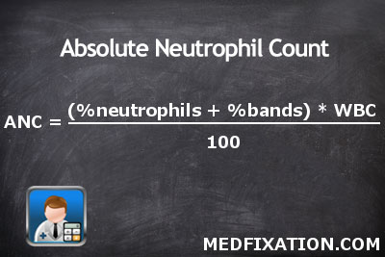
White Blood Cells
(Leukocytes)
What is an ANC, how do you calculate it,
and what does it mean
ANC of less than 1,500 puts the patient at risk for infection
Less than 1,000 requires neutropenic precautions

Slide 17
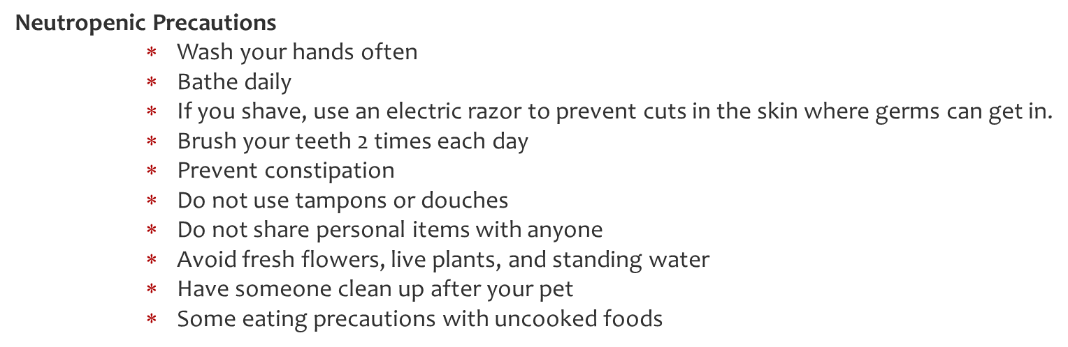
White Blood Cells
(Leukocytes)
Neutropenic Precautions

Slide 18
White Blood Cells
(Leukocytes)
Why are WBCs low:
Infections (more commonly viral infections, but also bacterial or parasitic infections) Examples include: HIV, tuberculosis, malaria, Epstein Barr virus (EBV)
Medications that may damage the bone marrow
Antibiotics
Vitamin deficiencies
Diseases of the bone marrow
Radiation Therapy
Congenital (inborn) disorders of bone marrow function
Autoimmune destruction of neutrophils
Hypersplenism

Slide 19
White Blood Cells
(Leukocytes)
If WBCs are low
Clinically:
Patient may not exhibit signs of infection such as redness, swelling, pus formation (at the site of an injury or incision), cough, sputum, nasal drainage
Be alert to:
temperature greater than or equal to 100.5 degrees F
chills or shakes
sudden onset of a new, unexplained pain or discomfort
sore throat
sores in the mouth
thrush
any signs associated with a bladder infection

Slide 20
White Blood Cells
(Leukocytes)
Treatments/Medications
antibiotic and/or antifungal medications to help fight infections;
administration of white blood cells growth factors such as recombinant granulocyte colony-stimulating factor (G-CSF, filgrastim)
granulocyte transfusion

Slide 21
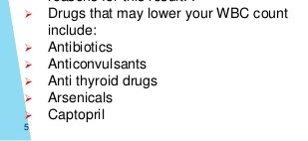
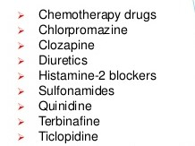
Drugs causing low white count

Slide 22
White Blood Cells
(Leukocytes)
If WBCs are high:
High WBC counts don’t often cause symptoms, although the underlying conditions causing the high count may cause their own symptoms.
Clinically:
Fever
Chills
Pain
Redness

Slide 23
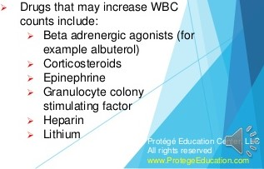
Drugs causing High white count

Slide 24
White Blood Cells
(Leukocytes)
Treatments/Medications
Treat the underlying cause
Allopurinol in hematologic malignancies

Slide 25
Sepsis Alert
Measure Lactic Acid
Obtain Blood cultures
Administer Broad spectrum antibiotics
Administer 30mL/kg NS bolus IF hypotensive (SBP <90, MAP<65) or Lactic acid > 36

Slide 26
Sepsis Alert
When the oxygen level is low, carbohydrate breaks down for energy and makes lactic acid. Lactic acid levels get higher when strenuous exercise or other conditions-such as heart failure, a severe infection (sepsis), or shock-lower the flow of blood and oxygen throughout the body.

Slide 27
Sepsis Alert
Clinically if elevated lactic acid:
Rapid breathing
Excessive sweating
Cool and clammy skin
Sweet-smelling breath
Belly pain
Nausea or vomiting
Confusion
Coma

Slide 28
Platelets
(Thrombocytes)
Causes of low platelet count
Diminished production
  vitamin B-12, folate, iron deficiency
  exposure to chemotherapy, radiation, or toxic chemicals
  Viral infection
  Drug induced-multiple
  consuming too much alcohol
Increased destruction (caused by drugs, heparin, idiopathic, pregnancy, immune system)
Sequestration in spleen, cirrhosis

Slide 29
Platelets
(Thrombocytes)
If platelet counts are low
Clinically:
Petechiae
Fatigue
Purpura
Prolonged bleeding from cuts
Spontaneous bleeding from the gums or nose
Jaundice
Heavy menstrual bleeding that's unusual for the female
Blood in the urine or stool
Splenomegaly

Slide 30
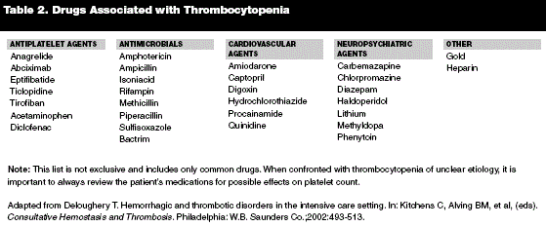
Drugs decreasing platelet count

Slide 31
Platelets
(Thrombocytes)
Treatment of low platelet count
platelet transfusions
changing medications that are causing a low platelet count
immune globulin
corticosteroids to block platelet antibodies
drugs that suppress the immune system
Splenectomy

Slide 32
Platelets
(Thrombocytes)
Causes of high platelets
The causes of high platelet count or thrombocytosis can be classified as follows:
Physiological thrombocytosis
Reactive (secondary) thrombocytosis
Clonal (primary) thrombocytosis- hematologic malignancy

Slide 33
Platelets
(Thrombocytes)
Causes of high platelets (Physiological)
Exercise (workload)
Stress
Adrenaline

Slide 34
Platelets
(Thrombocytes)
Causes of high platelets (Reactive)
Acute blood loss
Hemolytic anemia
Infection
Inflammatory diseases
Surgery
Post splenectomy / hypospleenism
Trauma

Slide 35
Platelets
(Thrombocytes)
Medications causing increased platelets
Epinephrine
Tretinoin (Retin-A)
Vincristine Sulfate

Slide 36
Platelets
(Thrombocytes)
If platelets are high
Clinically:
Headache
Dizziness or lightheadedness
Chest pain
Weakness
Unconsciousness
Temporary changes in vision
Numbness or tingling in the hands or feet

Slide 37
Platelets
(Thrombocytes)
Treatment of high platelets
Treatment of reactive thrombocytosis is directed at the cause.
The treatment of clonal thrombocytosis involves administration of hydroxyurea, interferon alfa, radioactive phosphorus 32 and low-dose aspirin on a daily basis.

Slide 38
So what happens if bone marrow is suppressed
Anemia
Neutropenia
Thrombocytopenia
Pancytopenia

Slide 39
So what happens if bone marrow is suppressed
Clinical picture
Weakness
Fatigue
Skin problems, such as rashes or easy bruising
Pale skin
Rapid heart rate
Shortness of breath
Bleeding problems, such as bleeding gums, nosebleeds or internal bleeding
Infections

Slide 40
So what happens if bone marrow is suppressed
Treatment/Medications
Supportive care
Treat underlying causes

Slide 41
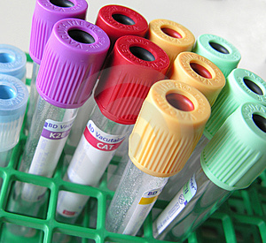
Blood Chemistries

Slide 42
Chemistries
Differences between a BMP and a CMP
Liver function tests included in CMP

Slide 43
Hypoglycemia vs Hyperglycemia
Clinically if glucose high:
Increased thirst
Increased urination
Weight loss
Fatigue
Increased appetite (Initially, loss of appetite with extremely high)
Dehydration-dry mouth and increased thirst, warm dry skin
Blurred vision
Lightheadedness.
Restlessness, drowsiness, or difficulty waking up.
Rapid, deep breathing.
Tachycardia
weak pulse
A strong, fruity breath odor.
Abdominal pain with or without vomiting
Unconsciousness
Clinically if glucose is low:
Heart palpitations
Fatigue
Pale skin
Shakiness
Anxiety
Sweating
Hunger
Irritability
Confusion

Slide 44

Hyperglycemia
High blood sugars caused by:
Stress
Uncontrolled Diabetes
Hyperthyroidism
Chronic renal disease
Pancreatitis

Slide 45
Drugs causing Hyperglycemia
corticosteroids
tricyclic antidepressants
Diuretics
estrogen (including birth control pills)
Lithium
Epinephrine
Phenytoin
salicylates

Slide 46
Hypoglycemia
Low blood sugars caused by:
Adrenal insufficiency
Excessive alcohol intake
Severe liver disease
Hypothyroidism
Severe infections
Starvation

Slide 47
Drugs causing hypoglycemia
Acetaminophen
anabolic steroids
glucose-reducing medications

Slide 48
Hyperglycemia vs Hypoglycemia
Treatment
Hyperglycemia
Insulin
Diet education
Oral Hypoglycemics
Hypoglycemia
Simple carbohydrate-rule of 15
Diet education
Glucagon
D50

Slide 49
Hypercalcemia vs Hypocalcemia
Calcium altered in disease effecting
Calcium
Kidney
Bones
Heart
Nerves
Teeth
Thyroid
Parathyroid
Malabsorption

Slide 50
Hypercalcemia
Serum level greater than 10.4 mg/dL
Mild and moderate hypercalcemia usually asymptomatic.
Hypercalcemia crisis has high mortality

Slide 51
Pathophysiology, Clinical Manifestations, Assessment and Diagnostic Findings
Hypercalcemia
  Pathophysiology: malignancy and hyperparathyroidism, bone loss related to immobility, diuretics
  Clinical manifestations: polyuria, thirst, muscle weakness, intractable nausea, abdominal cramps, severe constipation, diarrhea, peptic ulcer, bone pain, ECG changes, dysrhythmias
  Refer to Table 10-8

Slide 52
Medical and Nursing Management of Hypercalcemia
Treat underlying cause (Cancer)
Administer IV fluids, furosemide, phosphates, calcitonin, bisphosphonates
Increase mobility
Encourage fluids
Dietary teaching, fiber for constipation
Ensure safety

Slide 53
Hypercalcemia
Causes
Hyperparathyroidism (high parathyroid hormone causes too much calcium to be released into the blood)
Increased intake of calcium (excessive use of oral calcium or Vitamin D supplements)
Glucocorticoids usage (suppresses calcium absorption which leaves more calcium in the blood)
Hyperthyroidism
Calcium excretion decreased with Thiazide* diuretics & renal failure, cancer of the bones
Adrenal insufficiency (Addison’s Disease)
Lithium usage (affects the parathyroid and causes phosphate to decrease and calcium to increase)
Notes:
Remember “High Cal”

Slide 54
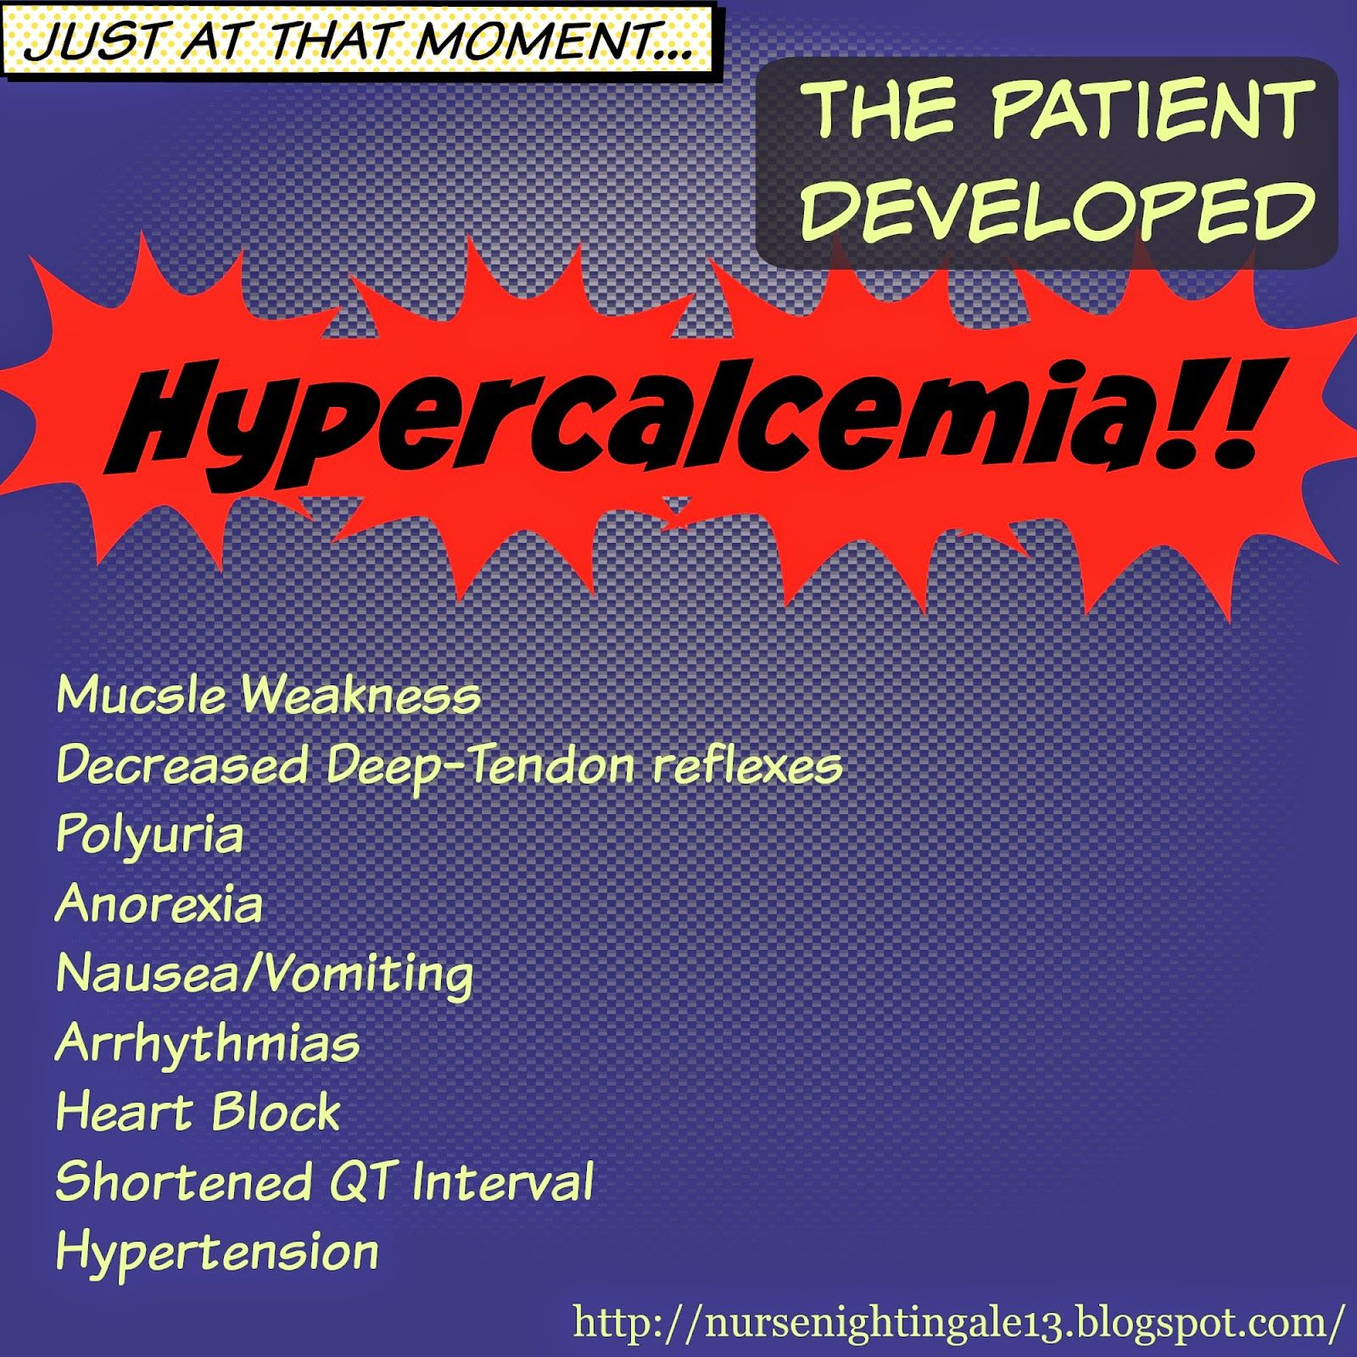

Slide 55
Treatment of Hypercalcemia
Mild Cases of Hypercalcemia
Keep patient hydrated (decrease chance of renal stone formation)
Keep patient safe from falls or injury
Monitor cardiac, GI, renal, neuro status
Assess for complaints of flank or abdominal pain & strain urine to look for stone formation
Decrease calcium rich foods and intake of calcium-preserving drugs like thiazides, supplements, Vitamin D

Slide 56
Treatment of Hypercalcemia
Moderate cases of Hypercalcemia
Administer calcium reabsorption inhibitors: Calcitonin, Bisphosphonates, prostaglandin synthesis inhibitors (ASA, NSAIDS)
Severe cases of Hypercalcemia
Prepare patient for dialysis

Slide 57
Causes of Hypocalcemia
Low parathyroid hormone due-destruction or removal parathyroid gland (thyroidectomy you want to check the calcium level)
Oral intake inadequate (alcoholism, bulimia etc.)
Wound drainage (especially GI System because this is where calcium is absorbed)
Celiac’s & Crohn’s Disease cause malabsorption of calcium in the GI track
Acute Pancreatitis
Low Vitamin D levels (allows for calcium to be reabsorbed)
Chronic kidney issues (excessive excretion of calcium by the kidneys)
Increased phosphorus levels in the blood (phosphorus and calcium do the opposite of each other)
Using medications such as magnesium supplements, laxatives, loop diuretics, calcium binder drugs
Mobility issues
Notes:
Remember “Low Calcium”

Slide 58
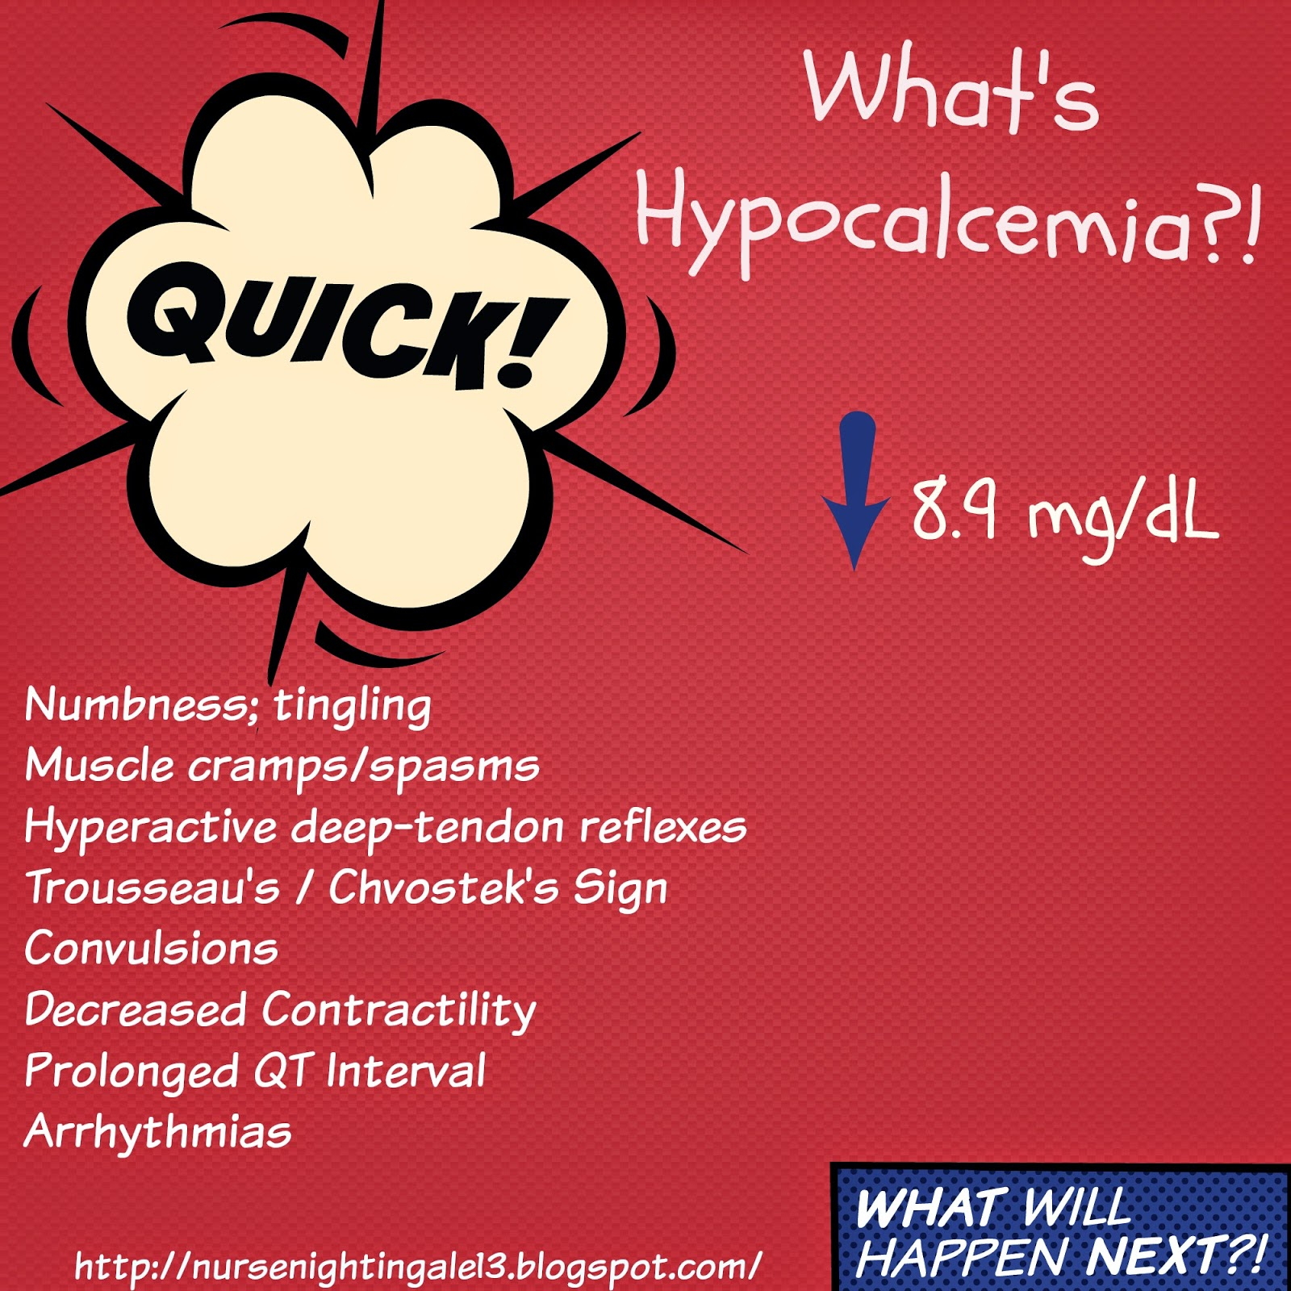

Slide 59
Hypocalcemia
Trousseau’s sign. Place blood pressure cuff around the upper arm and inflate it to a pressure greater than the systolic blood pressure and hold it in place for 3 minutes. If it is positive the hand of the arm where the blood pressure is being taken will start to contract involuntarily .
Chvostek’s Sign. hyperexcitability of the facial nerves. To elicit this response, you would tap at the angle of the jaw via the masseter muscle and the facial muscles on the same side of the face will contract momentarily (the lips or nose will twitch).

Slide 60
Treatment of Hypocalcemia
Safety (prevent falls because patient is at risk for bone fractures, seizures precautions, and watch for laryngeal spasms)
IV calcium as ordered. Give slowly (be on cardiac monitor and watch for cardiac dysrhythmias). Assess for infiltration or phlebitis because it can cause tissue sloughing Also, watch if patient is on Digoxin because this can cause Digoxin toxicity.
Administer oral calcium with Vitamin D supplements (given after meals or at bedtime with a full glass of water)
If phosphorus level is high (remember phosphorus and calcium do the opposite) the doctor may order aluminum hydroxide antacids (Tums) to decrease phosphorus level which in turn would increase calcium levels.
Notes:
Young Sally’s Calcium Serum Continues To Randomly Mess-up.
Yogurt Sardines Cheese Spinach Collard greens Tofu Rhubarb Milk

Slide 61
Drugs affecting calcium
Calcium
Calcium
Bisphosphonates(Fosamax, Boniva)-decreases bone release of calcium
Prolia-decreases bone release of calcium
Dilantin-lowers Vit. D absorption
Lithium (causes parathyroid activation)
Calcium supplements
Vit. D Supplements

Slide 62
Signs & Symptoms of Hypernatremia
Fever, flushed skin
Restless, really agitated
Increased fluid retention
Edema, extremely confused
Decreased urine output, dry mouth/skin (thirsty)

Slide 63
Treatment of hypernatremia
Restrict sodium intake!
Keep patient safe because they will be confused and agitated.
Doctor may order to give isotonic or hypotonic solutions such as 0.45% NS Give hypotonic fluids slowly because brain tissue is at risk due to the shifting of fluids back into the cell (the cell is dehydrated) and the patient is at risk for cerebral edema.
Educate patient and family

Slide 64
Drugs causing Hypernatremia
Corticosteroids
IV fluids
Drugs containing Sodium

Slide 65
Hyponatremia
Signs & Symptoms of Hyponatremia
Seizures & Stupor
Abdominal cramping, attitude changes (confusion)
Lethargic
Tendon reflexes diminished, trouble concentrating (confused)
Loss of urine & appetite
Orthostatic hypotension, overactive bowel sounds
Shallow respirations (late due to skeletal muscle weakness)
Spasms of muscles

Slide 66
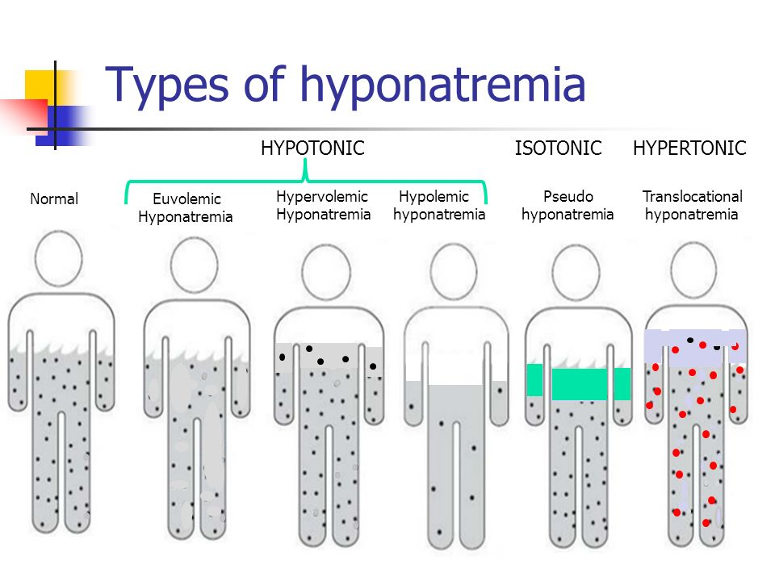
Types of Hyponatremia
vomiting, diarrhea, NG suction, diuretic therapy, burns, sweating
SIADH, diabetes insipidus, adrenal insufficiency,
Addison’s disease
congestive heart failure, kidney failure, IV infusion of saline, liver failure

Slide 67
Nursing Interventions for Hyponatremia
Watch cardiac, respiratory, neuro, renal, and GI status
Hypovolemic Hyponatremia: give IV sodium chloride infusion to restore sodium and fluids -3% Saline hypertonic solution
Hypervolemic Hyponatremia: Restrict fluid intake and in some cases administer diuretics to excretion the extra water rather than sodium to help concentrate the sodium. If the patient has renal impairment, they may need dialysis.

Slide 68
Nursing Interventions for Hyponatremia
Caused by SIADH or antidiuretic hormone problems: fluid restriction or treated with an antidiuretic hormone antagonists called Declomycin which is part of the tetracycline family (don’t give with food especially dairy or antacids…bind to cations and this affect absorption).
If patient takes Lithium remember to monitor drug levels because lithium excretion will be diminished, and this can cause lithium toxicity.
Instruct to increase oral sodium intake possibly sodium tablets

Slide 69
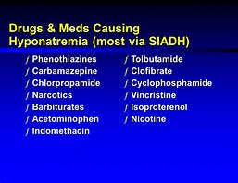
Drugs causing hyponatremia

Slide 70
Hyperkalemia
Serum potassium greater than 5.0 mEq/L
Seldom occurs in patients with normal renal function
Increased risk in older adults
Cardiac arrest is frequently associated

Slide 71
Pathophysiology, Clinical Manifestations, Assessment and Diagnostic Findings
Hyperkalemia
  Pathophysiology: Impaired renal function, rapid administration of potassium, hypoaldosteronism, medications, tissue trauma, acidosis
  Clinical manifestations: Cardiac changes and dysrhythmias, muscle weakness, paresthesias, anxiety, GI manifestations
  ECG changes
  Metabolic or respiratory acidosis
  Refer to Table 10-7

Slide 72
Medical and Nursing Management of Hyperkalemia
Monitor ECG, heart rate (apical pulse) and blood pressure, assess labs, monitor I&O, obtain apical pulse
Limitation of dietary potassium and dietary teaching
Administration of cation exchange resins (sodium polystyrene sulfonate)
Emergent care: IV calcium gluconate, IV sodium bicarbonate, IV regular insulin and hypertonic dextrose IV, beta-2 agonists, dialysis
Administer IV slowly and with an infusion pump

Slide 73
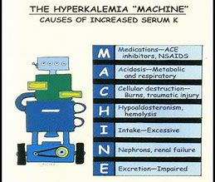
Hyperkalemia-Causes

Slide 74
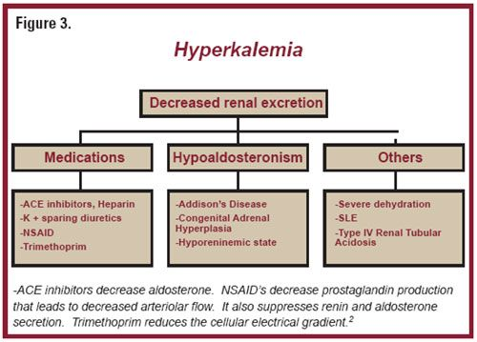
Hyperkalemia

Slide 75
Hyperkalemia vs Hypokalemia
Signs & Symptoms of Hyperkalemia
Muscle weakness
Urine production little or none (renal failure)
Respiratory failure (due to the decreased ability to use breathing muscles or seizures develop)
Decreased cardiac contractility (weak pulse, low blood pressure)
Early signs of muscle twitches/cramps…late profound weakness, flaccid
Rhythm changes: Tall peaked T waves, flat p waves, Widened QRS and prolonged PR interval
Notes:
Remember the word MURDER

Slide 76
Nursing Interventions for Hyperkalemia
Monitor cardiac, respiratory, neuromuscular, renal, and GI status
Stop IV potassium if running and hold any PO potassium supplements
Initiate potassium restricted diet and remember foods that are high in potassium
Remember the word POTASSIUM for food rich in potassium
Prepare patient for ready for dialysis. Kayexalate is sometimes ordered and given PO or via enema. This drug promotes GI sodium absorption which causes potassium excretion.
Doctor may order potassium wasting drugs like Lasix or Hydrochlorothiazide
Administer a hypertonic solution of glucose and regular insulin to pull the potassium into the cell
Notes:
Potatoes, pork Oranges Tomatoes Avocados Strawberries, Spinach fIsh mUshrooms Musk Melons: cantaloupe Also included are carrots, cantaloupe, raisins, bananas.

Slide 77
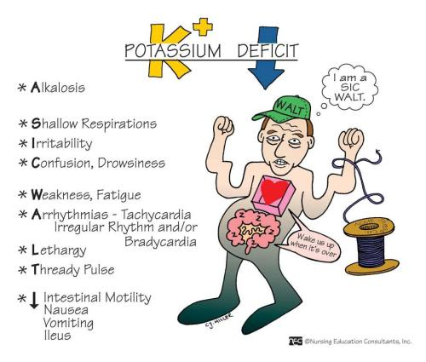
Hypokalemia
Everything is SLOW and LOW.

Slide 78
Causes of Hypokalemia
Drugs (laxatives, diuretics, corticosteroids)
Inadequate consumption of Potassium (NPO, anorexia)
Too much water intake (dilutes the potassium)
Cushing’s Syndrome (High secretion of Aldosterone)
Heavy Fluid Loss (NG suction, vomiting, diarrhea, wound drainage, sweating)
alkalosis or hyperinsulinism

Slide 79
Nursing Interventions for Hypokalemia
Watch heart rhythm respiratory status, neuro, GI, urinary output and renal status
Watch other electrolytes like Magnesium (hard to get K+ to increase if Mag is low), watch glucose, sodium, and calcium
Administer oral Supplements for potassium-give with food can cause GI upset NEVER EVER GIVE POTASSIUM via IV push or by IM or SQ routes
  Patients given more than 10-20 meq/hr IV should be on a cardiac monitor Cause phlebitis or infiltrations
Don’t give LASIX, demadex , or thiazides (waste more Potassium) or Digoxin (cause digoxin toxicity)
Physician will switch patient to a potassium sparing diuretic Spironolactone (Aldactone), Dyazide, Maxide, Triamterene

Slide 80
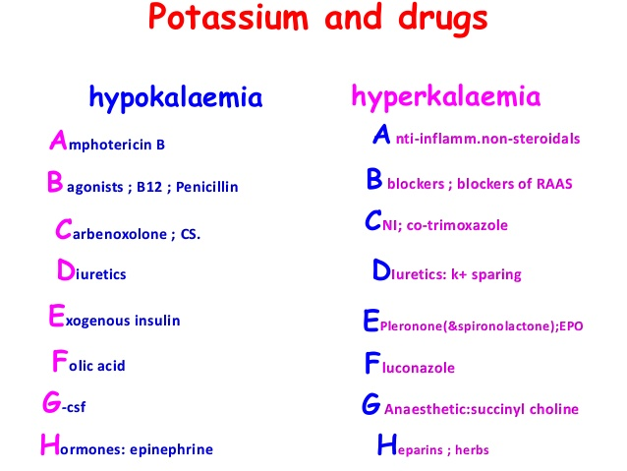
Potassium and Drugs

Slide 81
Hypermagnesemia
Serum level greater than 2.6 mg/dL
Rare electrolyte abnormality, because the kidneys efficiently excrete magnesium
Falsely elevated levels with a hemolyzed blood sample

Slide 82
Pathophysiology, Clinical Manifestations, Assessment and Diagnostic Findings
Hypermagnesemia
  Pathophysiology: kidney injury, diabetic ketoacidosis, excessive administration of magnesium, extensive soft tissue injury
  Clinical manifestations: hypoactive reflexes, drowsiness, muscle weakness, depressed respirations, ECG changes, dysrhythmias, and cardiac arrest
  Refer to Table 10-9

Slide 83
Medical and Nursing Management of Hypermagnesemia
IV calcium gluconate
Ventilatory support for respiratory depression
Hemodialysis
Administration of loop diuretics, sodium chloride, and LR
Avoid medications containing magnesium
Patient teaching regarding magnesium-containing over-the-counter medications
Observe for DTRs and changes in LOC

Slide 84
Hypomagnesemia
Serum level less than 1.8 mg/dL
Associated with hypokalemia and hypocalcemia
Drugs can cause hypomagnesemia. Examples include chronic (> 1 yr) use of a proton pump inhibitor and concomitant use of diuretics. Amphotericin B can cause hypomagnesemia, hypokalemia, and acute kidney injury.

Slide 85
Pathophysiology, Clinical Manifestations, Assessment and Diagnostic Findings
Hypomagnesemia
  Pathophysiology: alcoholism, GI losses, enteral or parenteral feeding deficient in magnesium, medications, rapid administration of citrated blood
  Clinical manifestations: Chvostek and Trousseau signs, apathy, depressed mood, psychosis, neuromuscular irritability, ataxia, insomnia, confusion, muscle weakness, tremors, ECG changes and dysrhythmias
  Ionized serum magnesium level
  Refer to Table 10-9

Slide 86
Medical and Nursing Management of Hypomagnesemia
Magnesium sulfate IV is administered with an infusion pump; monitor vital signs and urine output
Calcium gluconate or hypocalcemic tetany or hypermagnesemia
Oral magnesium
Monitor for dysphagia
Seizure precautions
Dietary teaching (green, leafy vegetables; beans, lentils, almonds, peanut butter)

Slide 87
Hyperphosphatemia
Serum level above 4.5 mg/dL
Can occur with increased intake, decreased excretion, or shifting of phosphate from intracellular to extracellular spaces
Can be caused by penicillin, corticosteroids, some diuretics, furosemide, and thiazides

Slide 88
Pathophysiology, Clinical Manifestations, Assessment and Diagnostic Findings
Hyperphosphatemia
  Pathophysiology: kidney injury, excess phosphorus, excess vitamin D, acidosis, hypoparathyroidism, chemotherapy
  Clinical manifestations: few symptoms; soft tissue calcifications, symptoms occur due to associated hypocalcemia
  X-rays show abnormal bone development
  Decreased PTH levels
  BUN
  Creatinine
  Refer to Table 10-10

Slide 89
Medical and Nursing Management of Hyperphosphatemia
Treat underlying disorder
Vitamin D preparations, calcium-binding antacids, phosphate-binding gels or antacids, loop diuretics, IV fluids (Normal Saline), dialysis
Monitor phosphorus and calcium levels
Avoid high-phosphorus foods
Patient teaching related to diet, phosphate-containing substances, signs of hypocalcemia

Slide 90
Hypophosphatemia
Serum level below 2.7 mg/dL
Hypophosphatemia can occur when total‐body phosphorus stores area normal
Antacids, catecholamines, beta-adrenergic agonists, sodium bicarbonate, and acetazolamide are commonly used therapeutic agents that could contribute significantly to the development of hypophosphatemia

Slide 91
Pathophysiology, Clinical Manifestations, Assessment and Diagnostic Findings
Hypophosphatemia
  Pathophysiology: alcoholism, refeeding of patients after starvation, pain, heat stroke, respiratory alkalosis, hyperventilation, diabetic ketoacidosis, hepatic encephalopathy, major burns, hyperparathyroidism, low magnesium, low potassium, diarrhea, vitamin D deficiency, use of diuretic and antacids
  Clinical manifestations: neurologic symptoms, confusion, muscle weakness, tissue hypoxia, muscle and bone pain, increased susceptibility to infection
  24-hour urine collection
  Elevated PTH levels
  Refer to Table 10-10

Slide 92
Medical and Nursing Management of Hypophosphatemia
Prevention is the goal
Oral or IV phosphorus replacement (only for patients with serum phosphorus levels less than 1 mg/dL not to exceed 3 mmol/hr), Burosumab, correct underlying cause
Monitor IV site for extravasation
Monitor phosphorus, vitamin D and calcium levels
Encourage foods high in phosphorus (milk, organ meats, beans nuts, fish, poultry), gradually introduce calories for malnourished patients receiving parenteral nutrition

Slide 93
Chloride
Typically follows sodium related to cause, symptoms and treatment
Hypochloremia – seen in metabolic alkalosis. Correct the underlying cause.
Hyperchloremia- seen in metabolic acidosis. Correct the underlying cause.

Slide 94
Hyperchloremia
Serum level more than 107 mEq/L
Hypernatremia, bicarbonate loss, and metabolic acidosis can occur

Slide 95
Pathophysiology, Clinical Manifestations, Assessment and Diagnostic Findings
Hyperchloremia
  Pathophysiology: usually due to iatrogenically induced hyperchloremic metabolic acidosis
  Clinical manifestations: tachypnea; lethargy; weakness; rapid, deep respirations; hypertension; cognitive changes
  Normal serum anion gap
  Potassium Levels
  ABGs
  Urine Chloride Level
  Refer to Table 10-11

Slide 96
Medical and Nursing Management of Hyperchloremia
Correct the underlying cause and restore electrolyte and fluid balance
Hypertonic IV solutions
Lactated Ringers
Sodium bicarbonate, diuretics
Monitor I&O, ABG
Focused assessments of respiratory, neurologic, and cardiac systems
Patient teaching related to diet and hydration

Slide 97
Hypochloremia
Serum level less than 97 mEq/L
Aldosterone impacts reabsorption
Bicarbonate has an inverse relationship with chloride
Chloride mainly obtained from the diet
Certain types of drugs, such as laxatives, diuretics, corticosteroids, and bicarbonates, can also cause hypochloremia. Hypochloremia and chemotherapy

Slide 98
Pathophysiology, Clinical Manifestations, Assessment and Diagnostic Findings
Hypochloremia
  Pathophysiology: Addison disease, reduced chloride intake, GI loss, diabetic ketoacidosis, excessive sweating, fever, burns, medications, metabolic alkalosis
  Loss of chloride occurs with loss of other electrolytes, potassium, sodium
  Clinical manifestations: agitation, irritability, weakness, hyperexcitability of muscles, dysrhythmias, seizures, coma
  ABG
  Refer to Table 10-11

Slide 99
Medical and Nursing Management of Hypochloremia
Replace chloride-IV NS or 0.45% NS
Ammonium chloride
Monitor I&O, ABG values and electrolyte levels
Assess for changes in LOC
Educate about foods high in chloride (tomato juice, bananas, eggs, cheese, milk) and avoid drinking free water (water without electrolytes)

Slide 100
Medical and Nursing Management of Hypochloremia
Replace chloride-IV NS or 0.45% NS
Ammonium chloride
Monitor I&O, ABG values and electrolyte levels
Assess for changes in LOC
Educate about foods high in chloride (tomato juice, bananas, eggs, cheese, milk) and avoid drinking free water (water without electrolytes)

Slide 101
Drugs effecting bicarbonate levels
Decrease
Nitrofurantoin
Tetracycline
Thiazide diuretics
Methicillin
Increase
Loop diuretics
Steroids
Hydrocortisone
Barbiturates

Slide 102
Elements of a Blood Chemistry
Liver function tests (LFTs)
ALT
More specific to liver damage
AST
Used to monitor liver toxicity with medications
Alk Phos
Used to detect liver damage and bile duct obstruction
Bilirubin
Monitor liver damage, cause of jaundice, and blocked bile ducts

Slide 103
Elements of a Blood Chemistry
Causes of elevated LFTs
Taking too many over-the-counter medications
Problematic alcohol use
Exposure to toxins
Hepatitis A, B, or C
Heart failure
Obesity
Cirrhosis
Hypothyroidism
Mononucleosis

Slide 104
Elements of a Blood Chemistry
Clinical
Signs of elevated LFTs
Weakness, fatigue
Loss of appetite
Nausea and vomiting
Ascites or pain
Jaundice
Purititis
Dark urine or light stool
Lower extremity edema
Tendency to bleed easily

Slide 105
Elements of a Blood Chemistry
Drug metabolism and Hepatotoxicity
Acetaminophen
Ibuprofen, Naproxen
“Statins” for cholesterol
Herbal supplements
Anti-seizure medications
Sulfonamides
Fluconazole

Slide 106
Elements of a Blood Chemistry
Renal Function
BUN
Creatinine

Slide 107
Elements of a Blood Chemistry
Causes of Renal Failure
Blood or fluid loss.
Blood pressure medications.
Heart attack.
Heart disease.
Infection.
Liver failure.
Use of aspirin, ibuprofen (Advil, Motrin IB, others), naproxen (Aleve, others) or related drugs.

Slide 108
Elements of a Blood Chemistry
Clinical Symptoms of Renal dysfunction
Fatigue
Lack of concentration
Poor appetite
Generalized edema
Decrease in amount of urine
Urine that is foamy, bloody, or coffee-colored
Problems urinating
Mid-back/flank pain
High blood pressure

Slide 109
Elements of a Blood Chemistry
Treatment for acute kidney failure
Treat the underlying cause and monitor /control complications while allowing recovery time.
Treatments that help prevent complications include:
Treatments to balance the amount of fluids in your blood. If your acute kidney failure is caused by a lack of fluids in your blood, your doctor may recommend intravenous (IV) fluids. In other cases, acute kidney failure may cause you to have too much fluid, leading to swelling in your arms and legs. In these cases, your doctor may recommend medications (diuretics) to cause your body to expel extra fluids.
Medications to control blood potassium. If your kidneys aren't properly filtering potassium from your blood, your doctor may prescribe calcium, glucose or sodium polystyrene sulfonate (Kayexalate, Kionex) to prevent the accumulation of high levels of potassium in your blood..
Medications to restore blood calcium levels. If the levels of calcium in your blood drop too low, your doctor may recommend an infusion of calcium.
Dialysis to remove toxins from your blood.

Slide 110
Acid-Base Balance

Slide 111
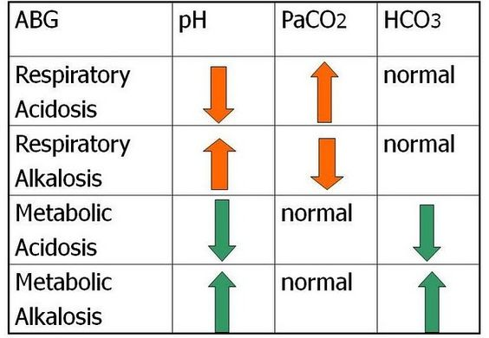
Bicarbonate
Relevant in establishment of cause of
metabolic vs. respiratory /alkalosis vs. acidosis

Slide 112
Assessing Arterial Blood Gases
pH 7.35–(7.4)–7.45
PaCO2 35–(40)–45 mm Hg
HCO3- 22–(24)–26 mEq/L
PaO2 80–100 mm Hg
Oxygen saturation >94%
Base excess/deficit ±2 mEq/L
Refer to Chart 10-3

Slide 113
Maintaining Acid–Base Balance
Normal plasma pH 7.35 to 7.45: hydrogen ion concentration
Major extracellular fluid buffer system;
bicarbonate–carbonic acid buffer system
Kidneys regulate bicarbonate in ECF
Lungs, under control of medulla, regulate CO2, and thus the carbonic acid in ECF
Refer to Table 10-12
Other buffer systems
  ECF: inorganic phosphates, plasma proteins
  ICF: proteins, organic, inorganic phosphates
  Hemoglobin

Slide 114
Acute and Chronic Metabolic Acidosis
Low pH <7.35
Increased hydrogen concentration
Low plasma bicarbonate <22 mEq/L
Normal anion gap is 8 to 12 mEq/L
With acidosis, hyperkalemia may occur as potassium shifts out of cell
Serum calcium levels may be low with chronic metabolic acidosis

Slide 115
Pathophysiology, Clinical Manifestations, Assessment and Diagnostic Findings
Metabolic Acidosis
  Pathophysiology: salicylate poisoning, renal failure, propylene glycol toxicity, diabetic ketoacidosis, starvation
  Clinical manifestations: headache, confusion, drowsiness, increased respiratory rate and depth, decreased blood pressure, decreased cardiac output, dysrhythmias, shock; if decrease is slow, patient may be asymptomatic until bicarbonate is 15 mEq/L or less
  ABG
  Serum electrolytes
  Refer to Table 10-13

Slide 116
Medical and Nursing Management of Metabolic Acidosis
Correct underlying problem, correct metabolic imbalance
Bicarbonate may be administered
Monitor serum electrolytes
Monitor potassium levels
Hemodialysis
Peritoneal dialysis

Slide 117
Acute and Chronic Metabolic Alkalosis
High pH >7.45
High bicarbonate >26 mEq/L
Hypokalemia will produce alkalosis

Slide 118
Pathophysiology, Clinical Manifestations, Assessment and Diagnostic Findings
Metabolic Alkalosis
  Pathophysiology: Most commonly due to vomiting or gastric suction, may also be due to medications, especially long-term diuretic use, hyperaldosteronism, Cushing’s syndrome, and hypokalemia will produce alkalosis
  Clinical manifestations: symptoms related to decreased calcium, respiratory depression, tachycardia, symptoms of hypokalemia including tingling of toes, fingers, dizziness and tetany, ECG changes, decreased GI motility
  Urine chloride levels
  Refer to Table 10-13

Slide 119
Medical and Nursing Management of Metabolic Alkalosis
Correct the underlying acid–base disorder
Restore fluid volume with sodium chloride solutions
Monitor I&O
Monitor for ECG and neurologic changes

Slide 120
Acute and Chronic Respiratory Acidosis
Low pH <7.35
PaCO2 >42 mm Hg
Always due to respiratory problem with inadequate ventilation, resulting in elevated plasma levels of CO2

Slide 121
Pathophysiology, Clinical Manifestations, Assessment and Diagnostic Findings
Respiratory Acidosis
  Pathophysiology: Pulmonary edema, overdose, atelectasis, pneumothorax, severe obesity, pneumonia, COPD, muscular dystrophy, multiple sclerosis, myasthenia gravis
  Clinical Manifestations: With chronic respiratory acidosis, body may compensate, may be asymptomatic. With acute respiratory acidosis may see sudden increased pulse, respiratory rate, and BP; mental changes; feeling of fullness in head (intracranial pressure), and increased conjunctival vessels.
  Refer to Table 10-13

Slide 122
Medical and Nursing Management of Respiratory Acidosis
Improve ventilation
Bronchodilators, antibiotics, anticoagulants
Pulmonary physiotherapy
Adequate hydration
Mechanical ventilation if necessary
Monitor respiratory status, I&O

Slide 123
Acute and Chronic Respiratory Alkalosis
High pH >7.45
PaCO2 <35 mm Hg
Always due to hyperventilation

Slide 124
Pathophysiology, Clinical Manifestations, Assessment and Diagnostic Findings
Respiratory Alkalosis
  Pathophysiology: extreme anxiety, panic disorder, hypoxemia, salicylate intoxication, gram-negative sepsis, inappropriate ventilator settings
  Clinical manifestations: lightheadedness, inability to concentrate, numbness and tingling in extremities, tachycardia, and ventricular and atrial arrhythmias
  ABGs
  ECGs
  Serum electrolyte levels
  Refer to Table 10-13

Slide 125
Medical and Nursing Management of Respiratory Alkalosis
Treat the underlying cause
Antianxiety agent
Have patient breathe into a bag
Monitor anxiety and respiratory status
Educate patient on techniques to decrease anxiety

Slide 126

IV Fluids

Slide 127
IV Fluids
Hypotonic
  Lower osmolality when compared to plasma
    Dilutes ECF
  Water moves from ECF to ICF by osmosis
  Usually maintenance fluids
  Monitor for changes in mentation
Notes:
See Solutions section in the textbook.
Hypotonic

Slide 128
D5W
Technically isotonic
  Dextrose quickly metabolizes
  Net result free water
Provides 170 cal/L
Used to replace water losses, helps prevent ketosis

Slide 129
IV Fluids
Isotonic
  Similar osmolality to ECF
    Expands only ECF
  No net loss or gain from ICF
  Ideal to replace ECF volume deficit
Notes:
See Solutions section in the textbook.
Isotonic

Slide 130
Normal Saline
NS, 0.9% saline, NSS
Isotonic
Slightly more NaCl than ECF
Used when both fluid and sodium lost
Only solution used with blood

Slide 131
Lactated Ringer’s Solution
Isotonic
Contains sodium, potassium, chloride, calcium and lactate
Expands ECF—treat burns and
GI losses
Contraindicated with liver dysfunction, hyperkalemia, and severe hypovolemia

Slide 132
IV Fluids
Hypertonic
  Higher osmolality compared with plasma
  Draws water out of cells into ECF
  Require frequent monitoring of
    Blood pressure
    Lung sounds
    Serum sodium levels
Notes:
See Solutions section in the textbook.
Hypertonic

Slide 133
D5 ½ NS
Hypertonic
Common maintenance fluid
Replaces fluid loss
KCl added for maintenance or replacement

Slide 134
D10W
Hypertonic
Provides 340 kcal/L
Provides free water but no electrolytes
Limit of dextrose concentration that may be infused peripherally

Slide 135
Colloids
Stay in vascular space and increase oncotic pressure
Include:
  Human plasma products (albumin, fresh frozen plasma, blood)
  Semisynthetics (dextran and starches, [Hespan])
Notes:
See Solutions section in the textbook.
Colloids

Slide 136

Dosage
Calculations

Slide 137
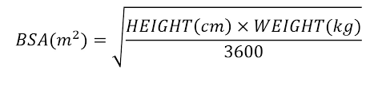
Methods of Calculating Medication Doses
BSA
Body surface area: BSA. The total surface area of the human body. The body surface area is used in many measurements in medicine, including the calculation of drug dosages and the amount of fluids to be administered IV.

Slide 138
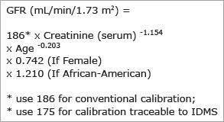
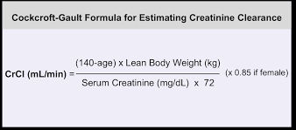
Methods of Calculating Medication Doses
GFR vs. Creatinine Clearance

Slide 139
Renal Dosing
Allopurinol (Zyloprim)
Lithium (Lithobid)
Acyclovir (Valtrex)
Amantadine (Symmetrel)
Fexofenadine (Allegra)
Gabapentin (Neurontin)
Metoclopramide (Reglan)
Ranitidine (Zantac)
Rivaroxaban (Xarelto)
Fesoterodine (Toviaz)
Amoxicillin (Amoxil)
Cephalexin (Keflex)
Cefuroxime (Ceftin)
Ciprofloxacin (Cipro)
Clarithromycin (Biaxin)
Levofloxacin (Levaquin)
Nitrofurantoin (Macrobid)
Piperacillin/Tazobactam (Zosyn)
Tetracycline (Sumycin)
Trimethoprim/Sulfamethoxazole (Bactrim

Slide 140
Dialysis Patients
Dosing of medication done before or after dialysis
***Consult hemodialysis nurse if uncertain***
Depends on multiple factors
Synthroid, dilantin and digoxin, pain medications
can be given before dialysis
BP meds and antibiotics are held until after dialysis

