Slide 1
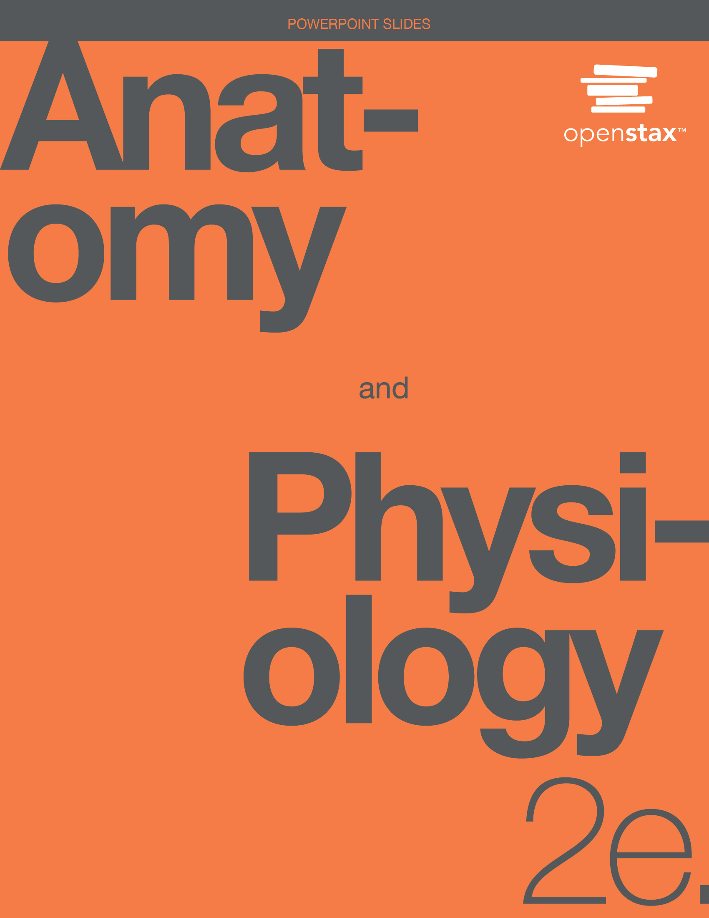
ANATOMY & PHYSIOLOGY 2e
Chapter 18 THE CARDIOVASCULAR SYSTEM: BLOOD
PowerPoint Image Slideshow

Slide 2
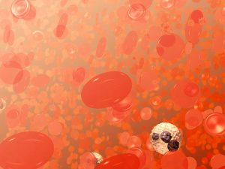
Figure 2.1
Figure 1. This image primarily shows red blood cells, also known as erythrocytes. These cells are characterized by their bi-concave disc shape. The white blood cell with the dark, purplish, multi-lobed nucleus is a neutrophil, a type of white blood cell or leukocyte. The smaller, spikey objects are platelets.
Image: Red blood cells. Source: National Cancer Institute, Donald Bliss (Illustrator), Wikimedia Commons
Blood Cells
A single drop of blood contains millions of red blood cells, platelets, and white blood cells.

Slide 3
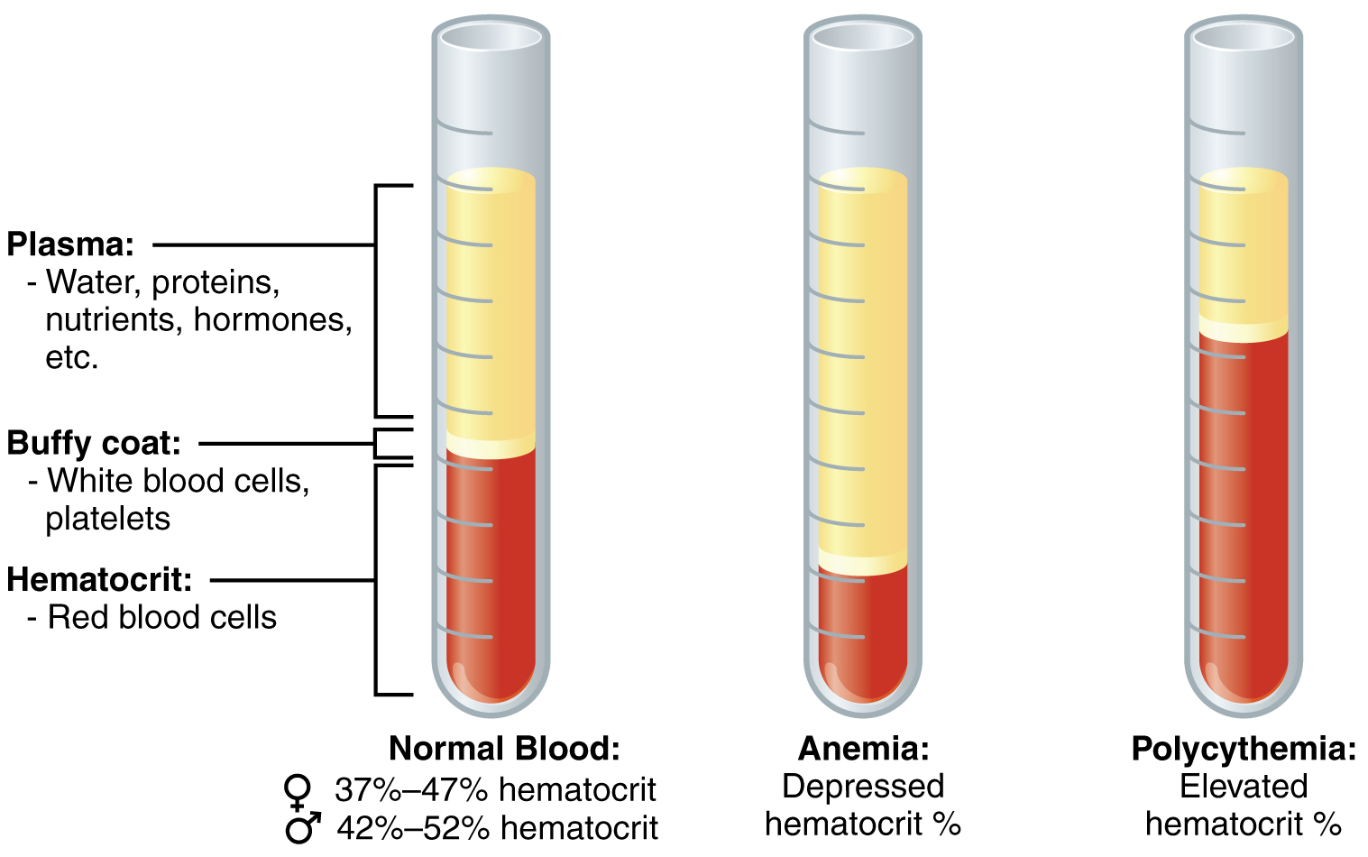
Figure 2.2
Composition of Blood
The cellular elements of blood include a vast number of erythrocytes and comparatively fewer leukocytes and platelets. Plasma is the fluid in which the formed elements are suspended. A sample of blood spun in a centrifuge reveals that plasma is the lightest component. It floats at the top of the tube separated from the heaviest elements, the erythrocytes, by a buffy coat of leukocytes and platelets. Hematocrit is the percentage of the total sample that is comprised of erythrocytes. Depressed and elevated hematocrit levels are shown for comparison.

Slide 4
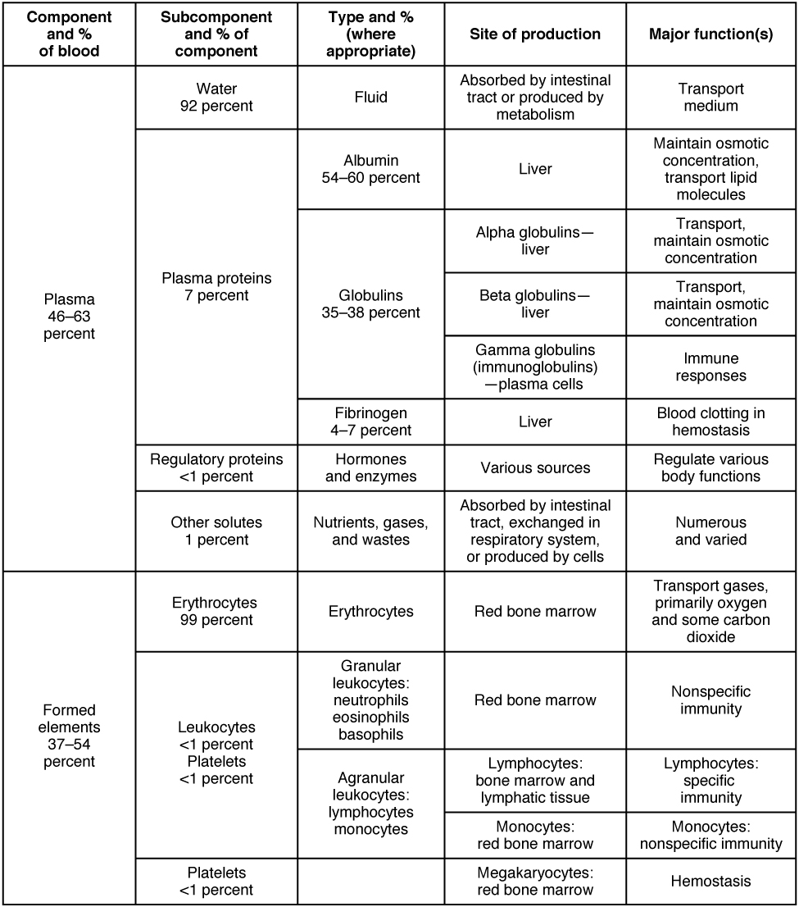
Figure 2.3
Major Blood Components

Slide 5
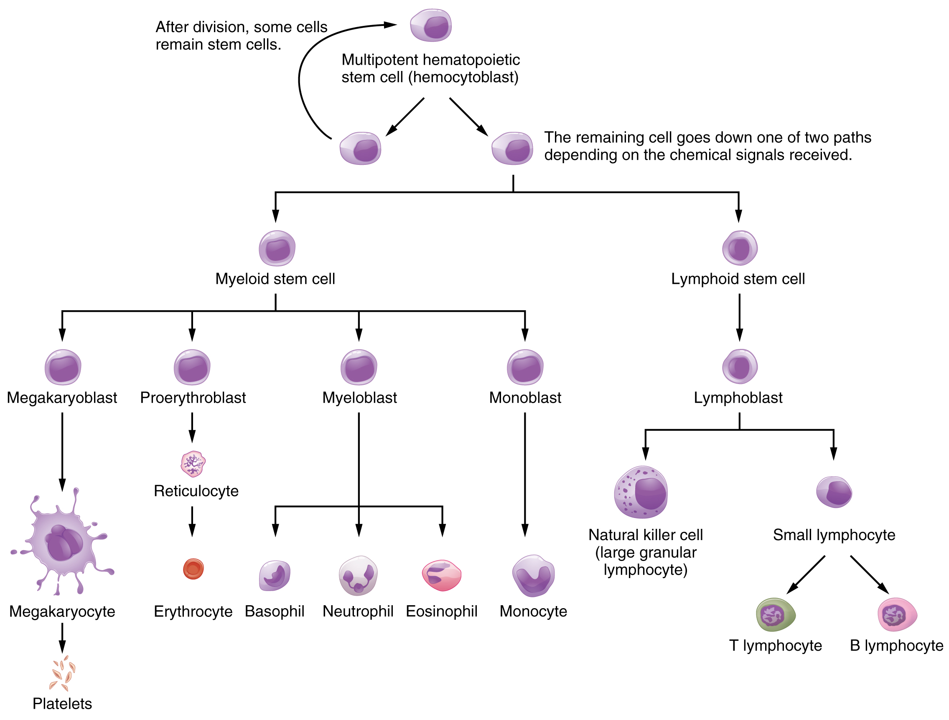
Figure 2.4
Hematopoietic System of Bone Marrow
Hemopoiesis is the proliferation and differentiation of the formed elements of blood.

Slide 6
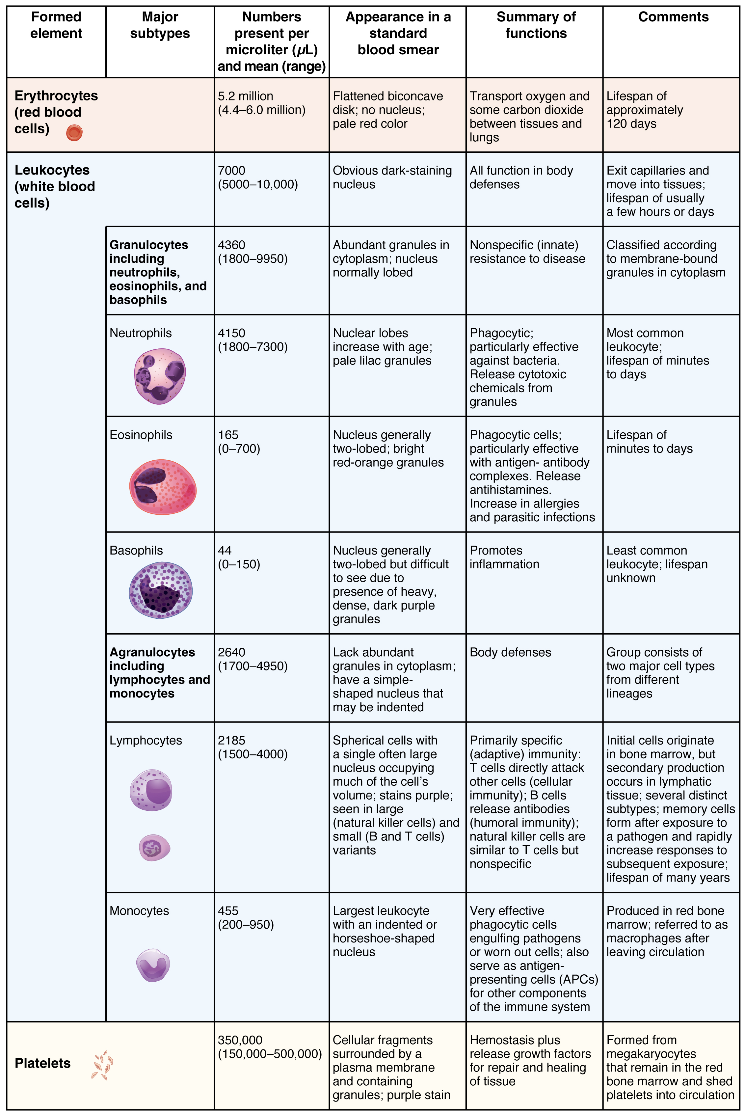
Figure 2.5
Summary of Formed Elements in Blood

Slide 7
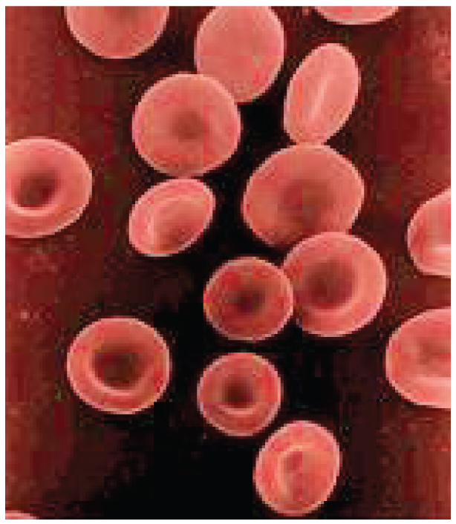
Figure 2.6
Shape of Red Blood Cells
Erythrocytes are biconcave discs with very shallow centers. This shape optimizes the ratio of surface area to volume, facilitating gas exchange. It also enables them to fold up as they move through narrow blood vessels.

Slide 8
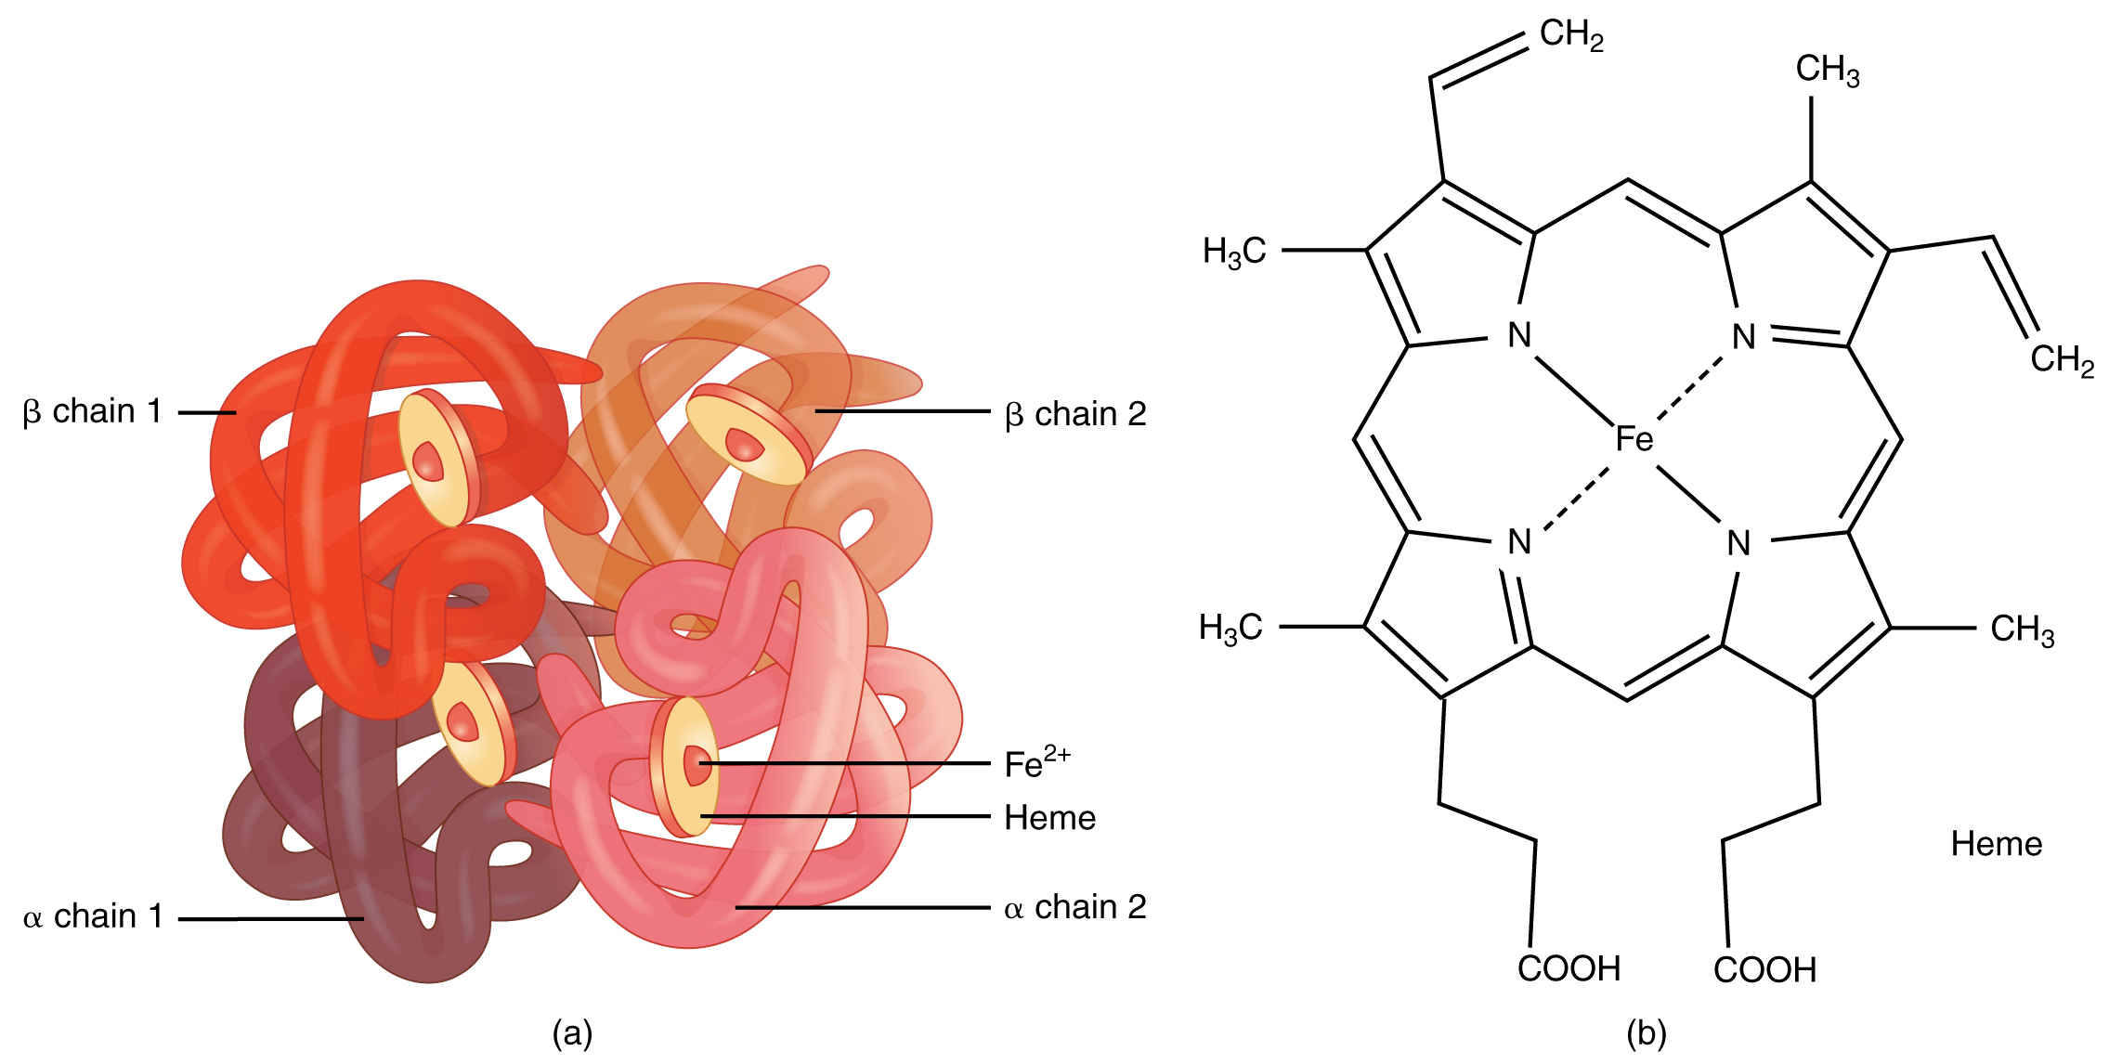
Figure 2.7
Hemoglobin
A molecule of hemoglobin contains four globin proteins, each of which is bound to one molecule of the iron-containing pigment heme.
A single erythrocyte can contain 300 million hemoglobin molecules, and thus more than 1 billion oxygen molecules.

Slide 9
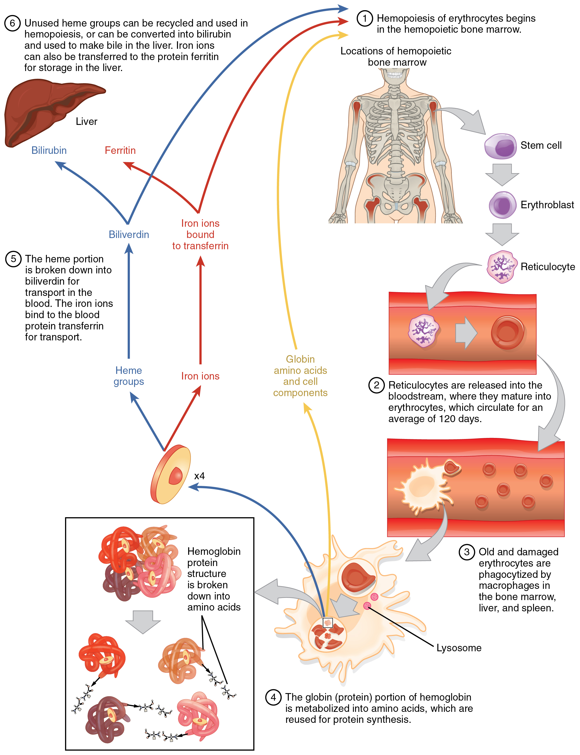
Figure 2.8
Erythrocyte Lifecycle
Erythrocytes are produced in the bone marrow and sent into the circulation. At the end of their lifecycle, they are destroyed by macrophages, and their components are recycled.

Slide 10
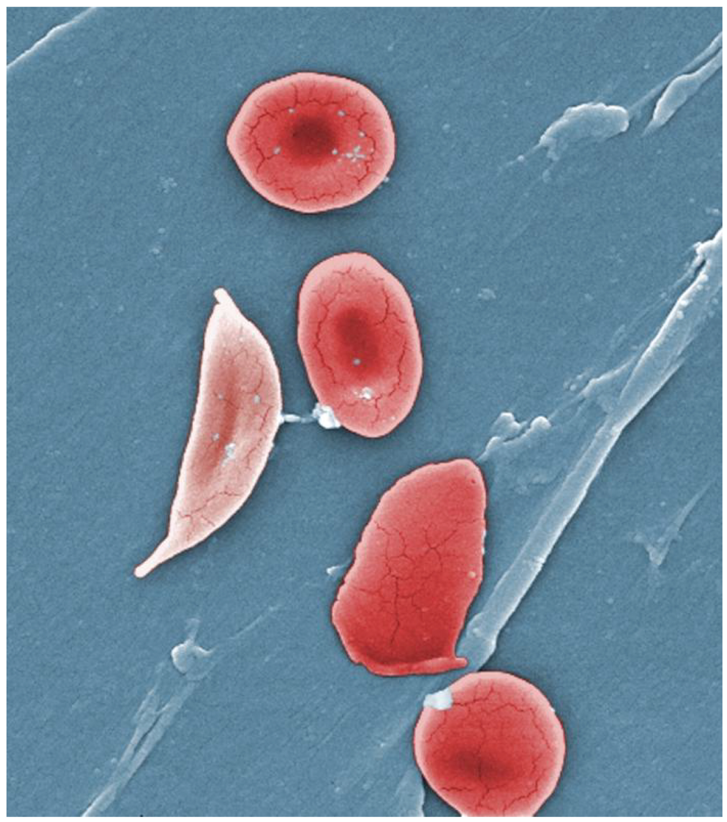
Figure 2.9
Sickle Cells
Sickle cell anemia is caused by a mutation in one of the hemoglobin genes. Erythrocytes produce an abnormal type of hemoglobin, which causes the cell to take on a sickle or crescent shape. (credit: Janice Haney Carr)

Slide 11
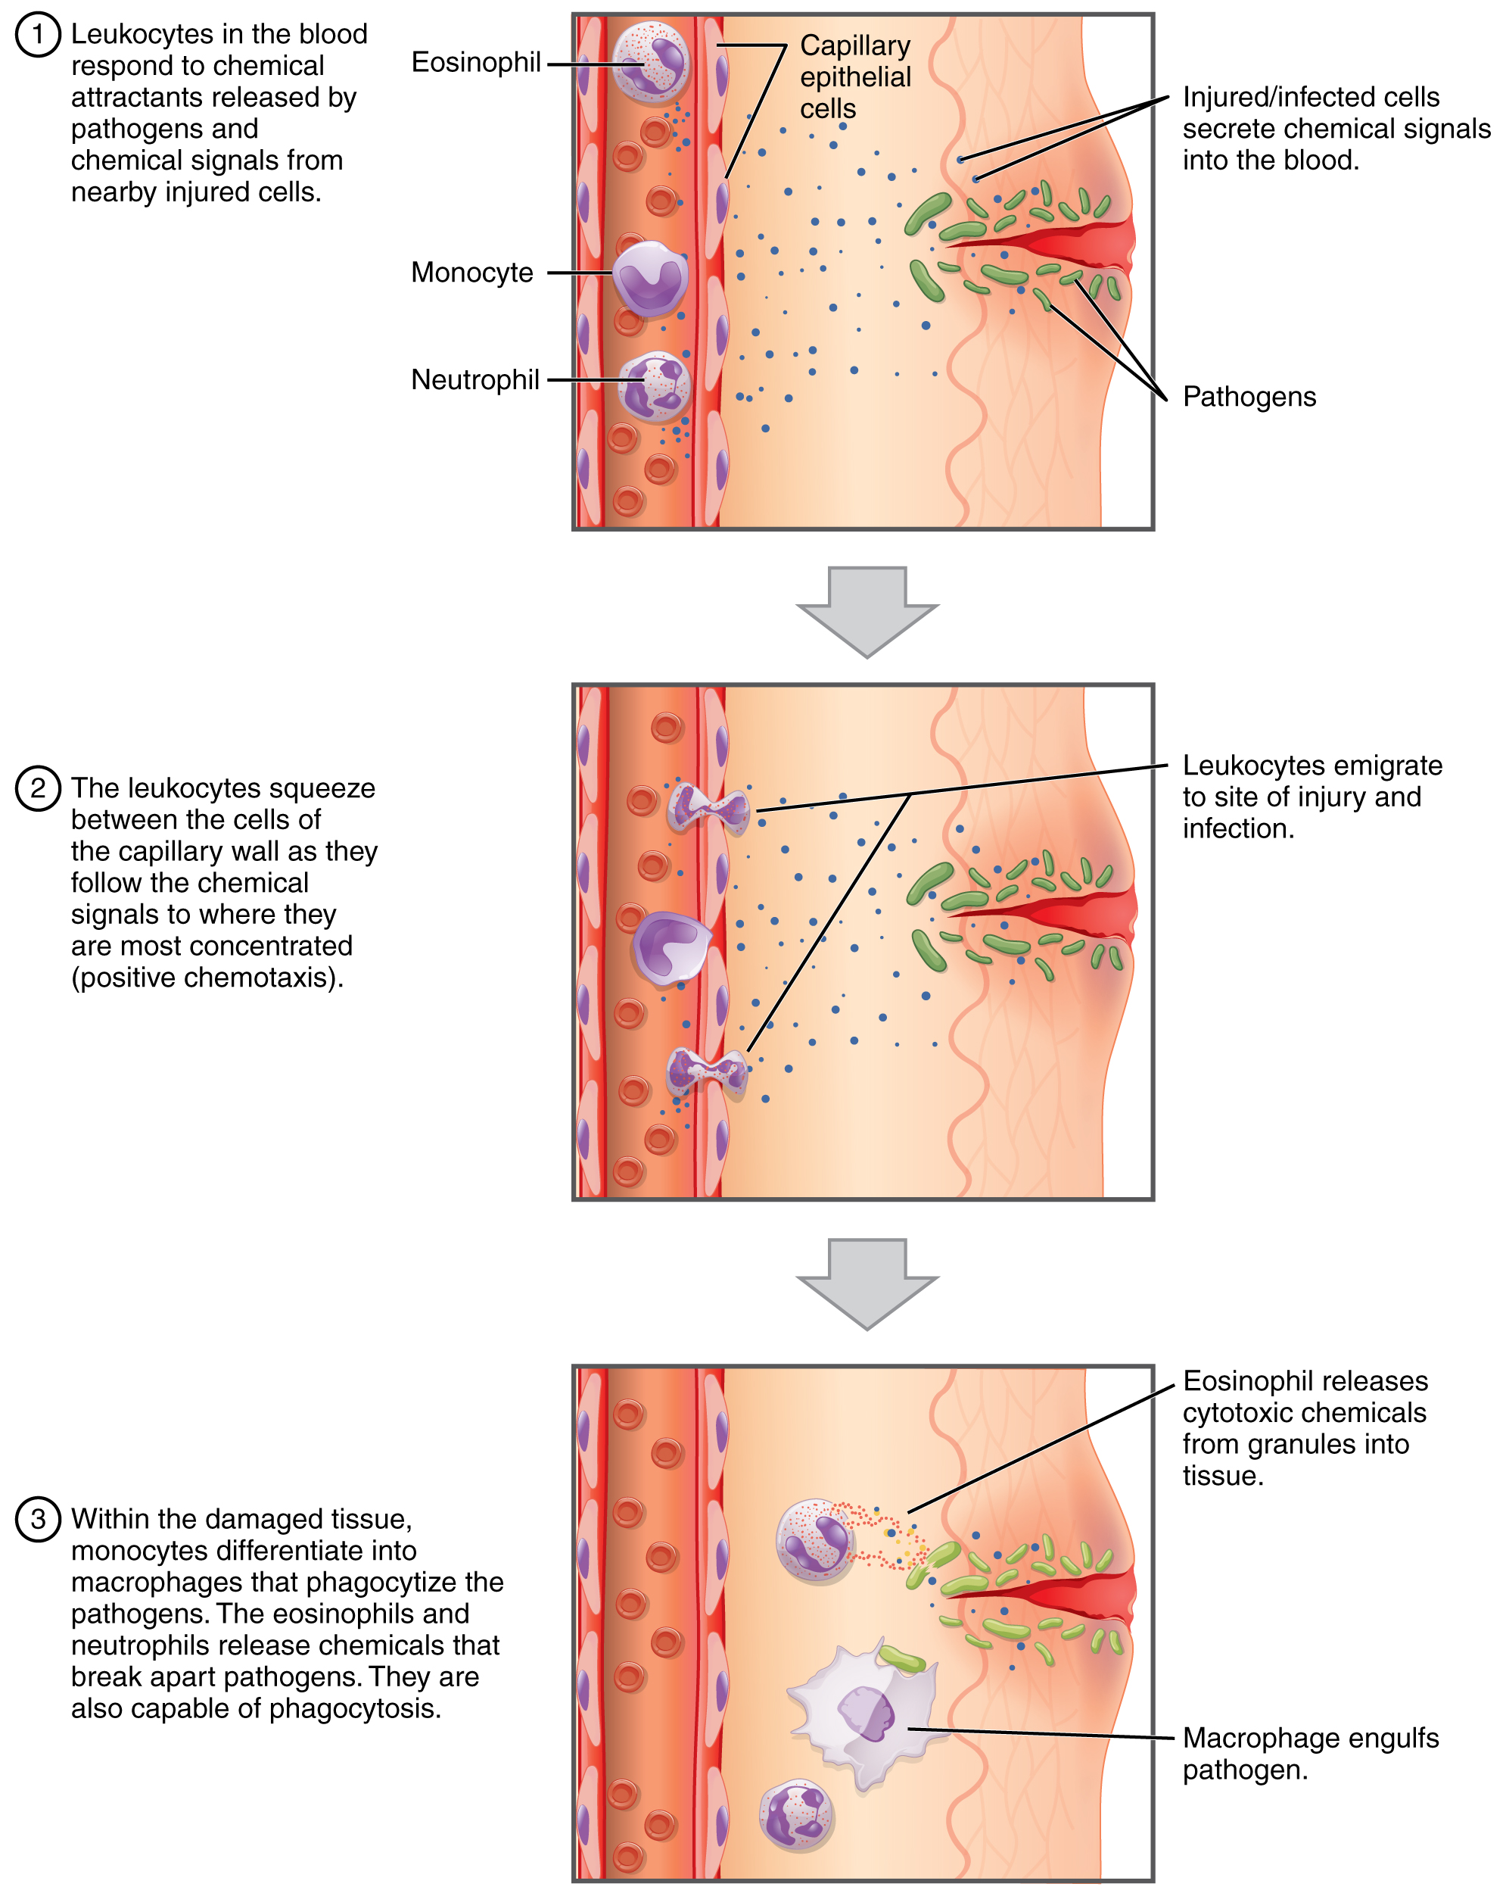
Figure 2.10
Emigration
Leukocytes exit the blood vessel and then move through the connective tissue of the dermis toward the site of a wound. Some leukocytes, such as the eosinophil and neutrophil, are characterized as granular leukocytes. They release chemicals from their granules that destroy pathogens; they are also capable of phagocytosis. The monocyte, an agranular leukocyte, differentiates into a macrophage that then phagocytizes the pathogens.

Slide 12
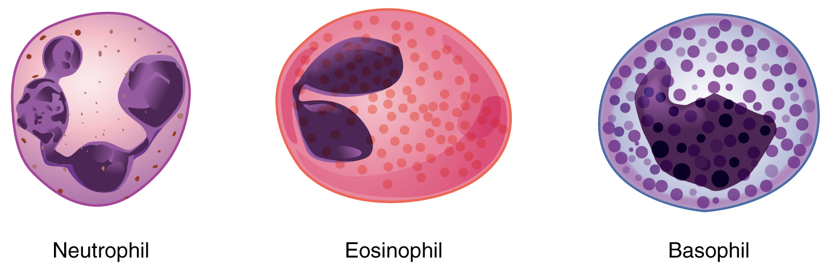
Figure 2.11
Granular Leukocytes
A neutrophil has small granules that stain light lilac and a nucleus with two to five lobes. An eosinophil’s granules are slightly larger and stain reddish-orange, and its nucleus has two to three lobes. A basophil has large granules that stain dark blue to purple and a two-lobed nucleus.

Slide 13
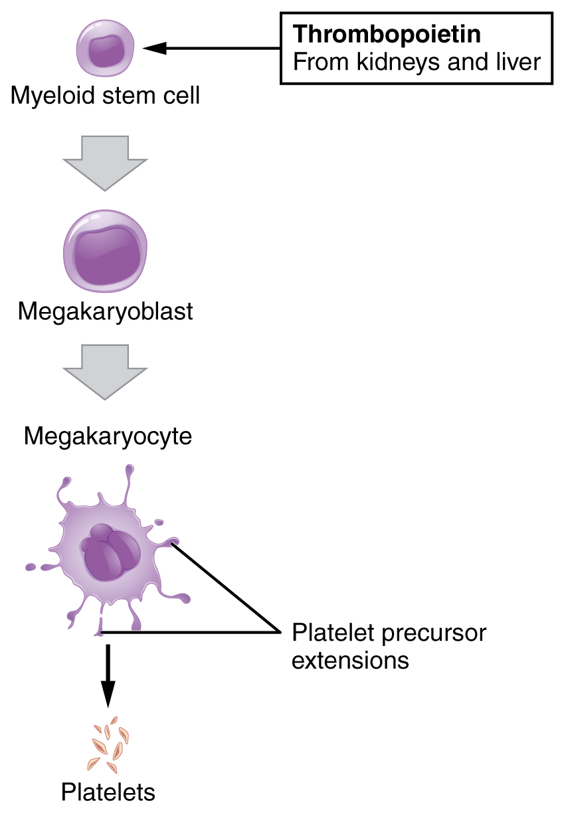
Figure 2.12
Platelets
Platelets are derived from cells called megakaryocytes.

Slide 14
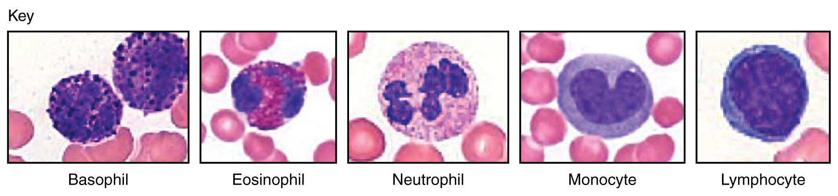
Figure 2.13
Leukocytes
(Micrographs provided by the Regents of University of Michigan Medical School © 2012)

Slide 15
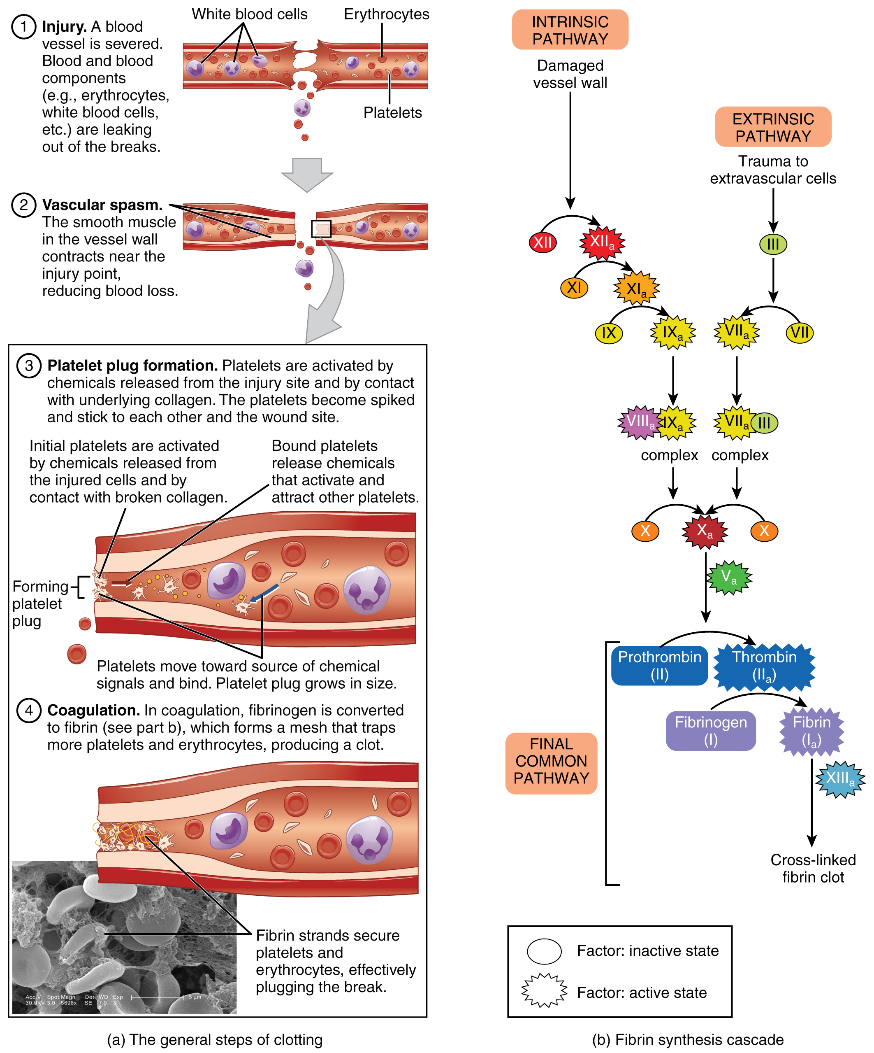
Figure 2.14
Hemostasis
An injury to a blood vessel initiates the process of hemostasis. Blood clotting involves three steps. First, vascular spasm constricts the flow of blood. Next, a platelet plug forms to temporarily seal small openings in the vessel. Coagulation then enables the repair of the vessel wall once the leakage of blood has stopped.
The synthesis of fibrin in blood clots involves either an intrinsic pathway or an extrinsic pathway, both of which lead to a common pathway. (credit a: Kevin MacKenzie)

Slide 16
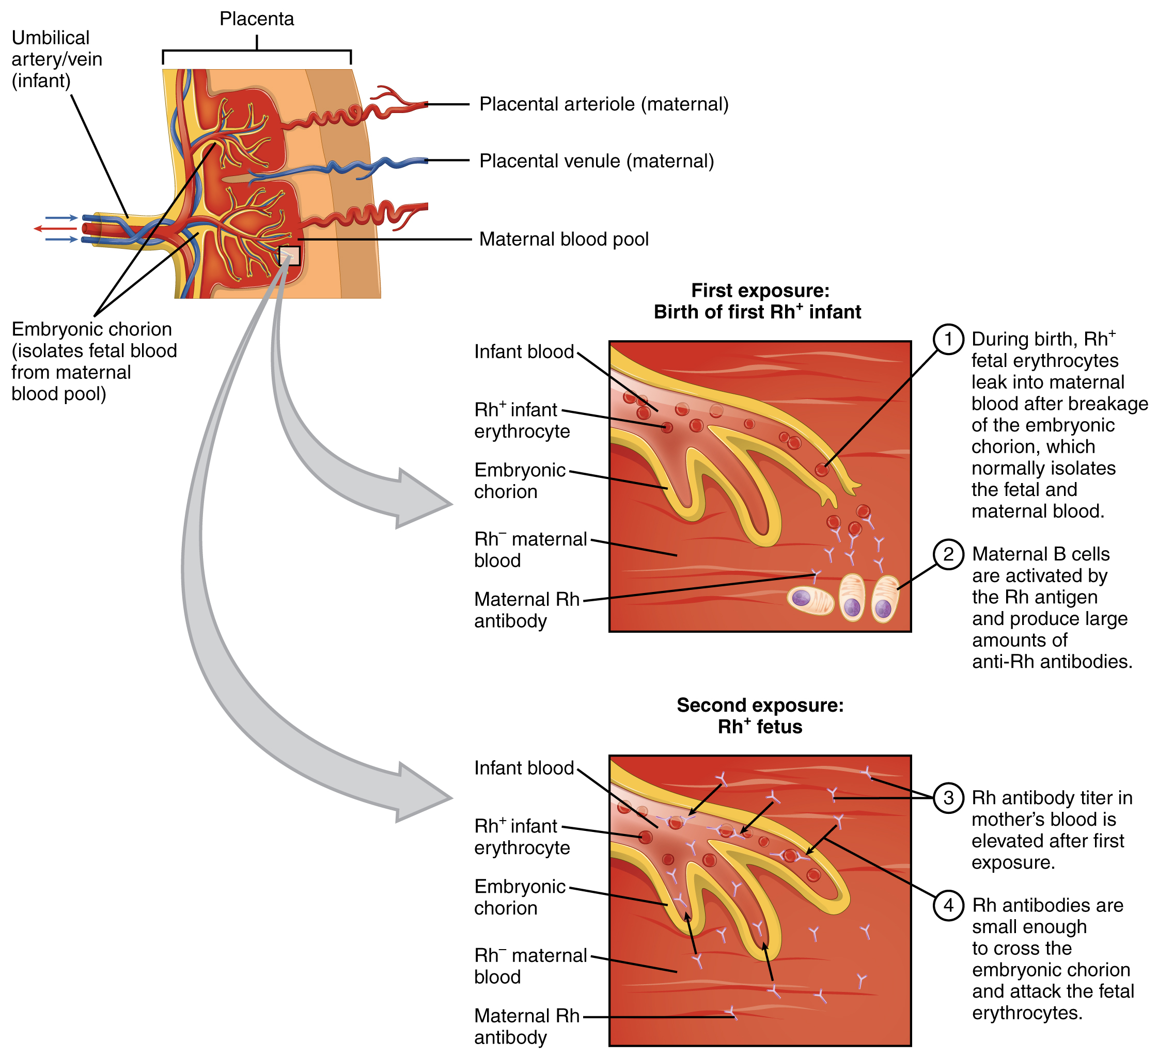
Figure 2.15
Erythroblastosis Fetalis
The first exposure of an Rh⁻ mother to Rh⁺ erythrocytes during pregnancy induces sensitization. Anti-Rh antibodies begin to circulate in the mother’s bloodstream. A second exposure occurs with a subsequent pregnancy with an Rh⁺ fetus in the uterus. Maternal anti-Rh antibodies may cross the placenta and enter the fetal bloodstream, causing agglutination and hemolysis of fetal erythrocytes.

Slide 17
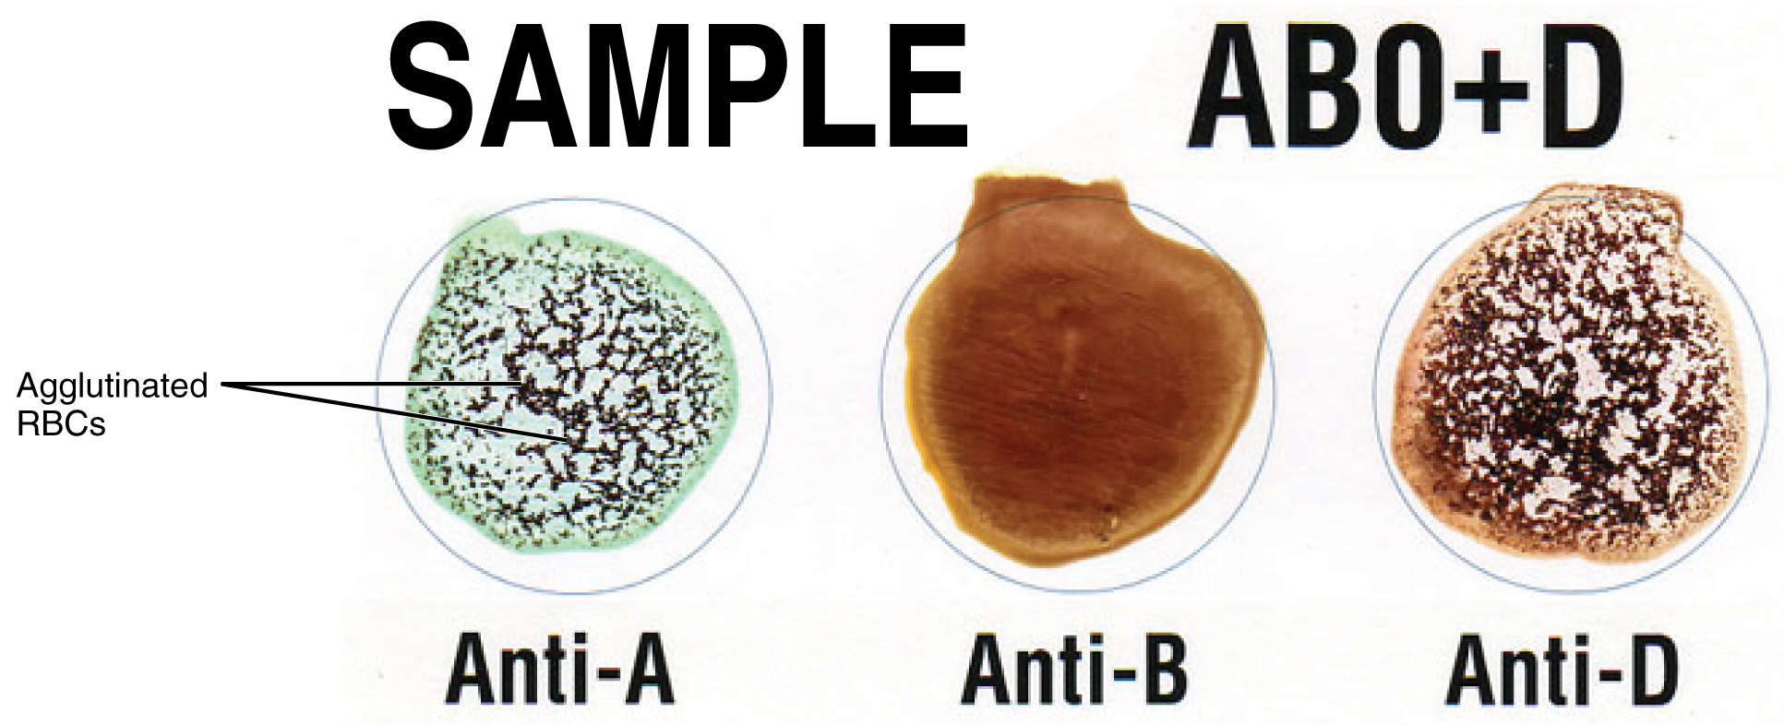
Figure 2.16
Cross Matching Blood Types
This sample of a commercially produced “bedside” card enables quick typing of both a recipient’s and donor’s blood before transfusion. The card contains three reaction sites or wells. One is coated with an anti-A antibody, one with an anti-B antibody, and one with an anti-D antibody (tests for the presence of Rh factor D). Mixing a drop of blood and saline into each well enables the blood to interact with a preparation of type-specific antibodies, also called anti-seras. Agglutination of RBCs in a given site indicates a positive identification of the blood antigens, in this case A and Rh antigens for blood type A⁺. For the purpose of transfusion, the donor’s and recipient’s blood types must match.

Slide 18
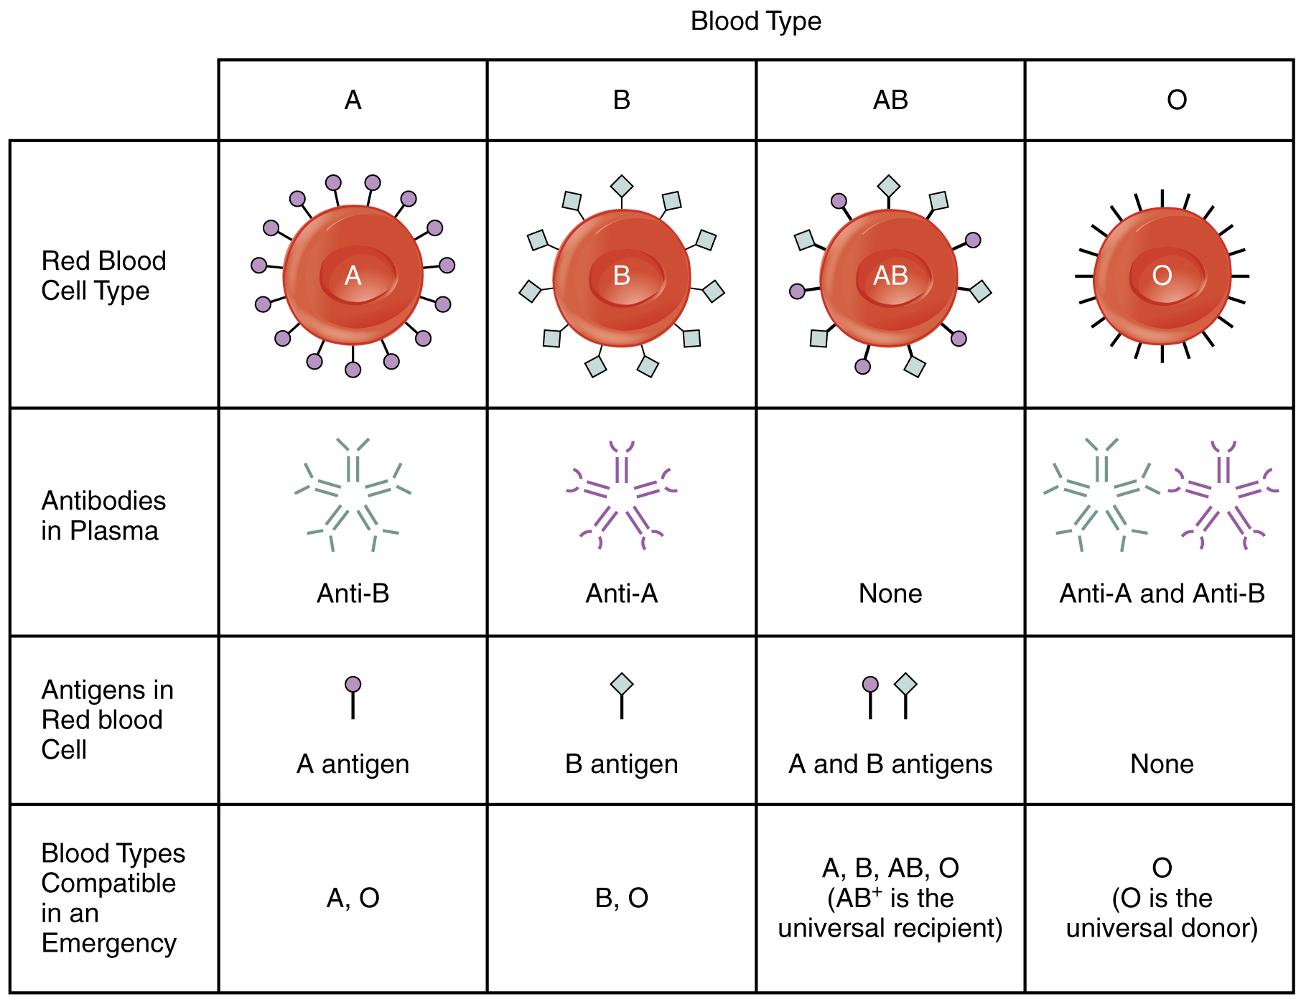
Figure 2.17
ABO Blood Group
This chart summarizes the characteristics of the blood types in the ABO blood group. See the text for more on the concept of a universal donor or recipient.

Slide 19
This OpenStax ancillary resource is © Rice University under a CC-BY 4.0 International license; it may be reproduced or modified but must be attributed to OpenStax, Rice University and any changes must be noted.

