Slide 1
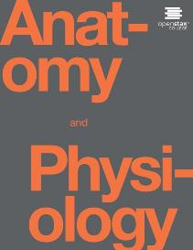
Anatomy and Physiology II
Chapter 13 Female Reproductive System

Slide 2
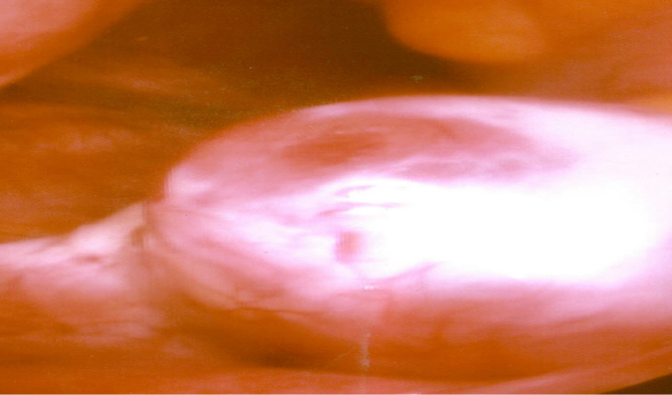

ovulation
Ovulation
Following a surge of luteinizing hormone (LH), an oocyte (immature egg cell) will be released into the uterine tube, where it will then be available to be fertilized by a male’s sperm. Ovulation marks the end of the follicular phase of the ovarian cycle and the start of the luteal phase.

Slide 3
Reproduction
Sexual reproduction is a process in which organisms produce offspring by means of germ cells called gametes.
The organs of reproduction are grouped as gonads (produce gametes and secrete hormones), ducts (transport, receive, and store gametes), and accessory sex glands (produce materials that support gametes).
Gynecology is the specialized branch of medicine concerned with the
diagnosis and treatment of diseases of the female reproductive system.
Urology is the study of the urinary system but also includes diagnosis and treatment of diseases and disorders of the male reproductive system

Slide 4
THE CELL CYCLE IN THE GONADS
A. The cell cycle in the gonads produces gametes by a special type of nuclear division called meiosis, that reduces the number of chromosomes by one half.
B. Chromosomes in Gametes
1. A gamete has only 23 chromosomes, one member of each chromosome pair.
2. The two chromosomes that make up a chromosome pair are called homologous chromosomes or homologs.
a. They contain similar genes arranged in the same or almost the same order and look very similar.
b. The exception is the sex chromosomes. The female contains two X chromosomes; and the male, an X and a Y chromosome.
c. The other 22 pairs of chromosomes are called autosomes.
3. A cell with a full set of chromosomes is called a diploid cell. One with only one chromosome from each pair is termed haploid.

Slide 5
Meiosis
Meiosis
1. Meiosis results in the production of haploid cells that contain only 23 chromosomes.
2. Meiosis I
a. Meiosis I consists of four phases: prophase I, metaphase I, anaphase I, and telophase I
1) During prophase I, the chromosomes become arranged in homologous pairs.
2) During metaphase I, the homologous pairs of chromosomes line up along the metaphase plate of the
cell, with the homologous chromosomes side by side.
3) During anaphase I, the members of each homologous pair separate, with one member of each pair moving to an opposite pole of the cell.
4) Telophase I and cytokinesis are similar to telophase and cytokinesis of mitosis.
b. During prophase I, the two chromatids of each pair of homologous chromosomes pair off, an event called synapsis.
The resulting four chromatids form a tetrad. Portions of one chromatid may be exchanged with portions of another an event called crossing-over.
1) This process permits an exchange of genes among homologous chromosomes.
2) It results in genetic recombination, the formation of new combinations of genes.
Meiosis II
a. Meiosis II consists of prophase II, metaphase II, anaphase II, and telophase II.
b. These phases are similar to those in mitosis, but result in four haploid cells.

Slide 6
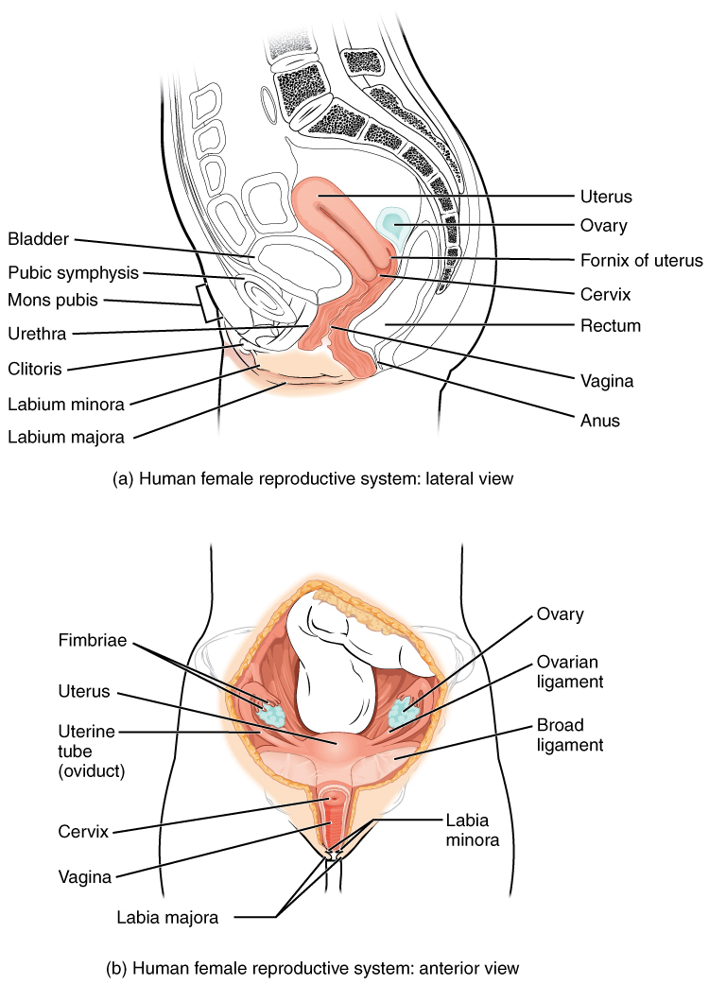
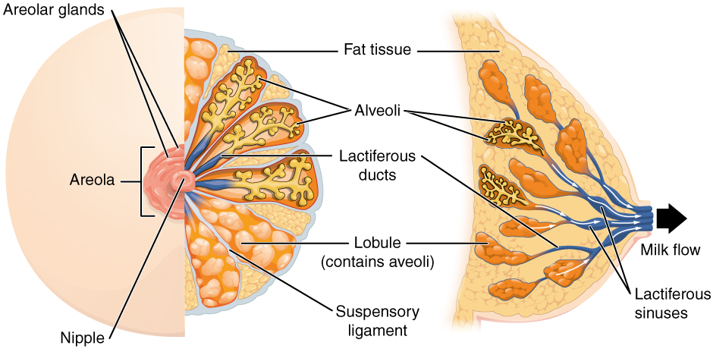
Female reproductive system

Slide 7
Ovaries
The female organs of reproduction include the ovaries (gonads), uterine (Fallopian) tubes, uterus, vagina, vulva, and mammary glands .
Ovaries
1. The ovaries are paired glands that are homologous to the testes.
2. The ovaries are located in the upper pelvic cavity, on either side of the uterus. They are maintained in position by a series of ligaments
a. The germinal epithelium covers the surface of the ovary but does not give rise to ova. It is followed by the tunica albuginea, ovarian cortex (contains ovarian follicles), and ovarian medulla (contains blood vessels, lymphatics, and nerves).
b. Ovarian follicles lie in the cortex and consist of oocytes in various stages of development.
c. A mature (Graafian) follicle expels a secondary oocyte by a process called ovulation.
d. A corpus luteum contains the remnants of an ovulated follicle and produces progesterone, estrogens, relaxin, and inhibin until it degenerates into a corpus albicans.
Oogenesis
a. Oogenesis occurs in the ovaries. It results in the formation of a single haploid secondary oocyte.
b. The oogenesis sequence includes reduction division (meiosis I), equatorial division (meiosis II), and maturation

Slide 8
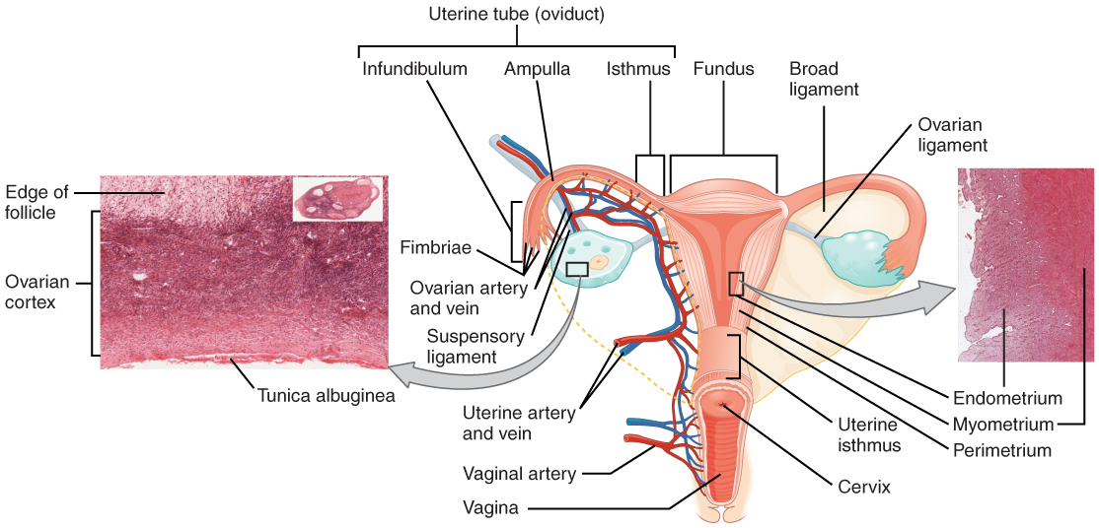
Ovaries, tubes and uterus
hymen
Ovaries, Uterine Tubes, and Uterus
This anterior view shows the relationship of the ovaries, uterine tubes (oviducts), and uterus. Sperm enter through the vagina, and fertilization of an ovulated oocyte usually occurs in the distal uterine tube. From left to right, LM × 400, LM × 20. (Micrographs provided by the Regents of University of Michigan Medical School © 2012)

Slide 9
Uterus
Uterine Tube
1. The uterine (Fallopian) tubes transport ova from the ovaries to the uterus and are the normal sites of fertilization .
2. Ciliated cells and peristaltic contractions help move a secondary oocyte toward the uterus
Uterus
1. The uterus (womb) is an organ the size and shape of an inverted pear that functions in the transport of spermatozoa, menstruation, implantation of a fertilized ovum, development of a fetus during pregnancy, and labor.
2. Anatomical subdivisions of the uterus include the fundus, body, isthmus, and cervix.
3. The uterus is normally held in position by a series of ligaments.
4. Histologically, the uterus consists of an outer perimetrium, middle myometrium, and inner endometrium .
a. The myometrium consists of three muscle layers.
b. The endometrium is divided into the stratum functionalis (shed during menstruation) and the stratum basalis (gives rise to a new stratum functionalis after each menstruation).
5. Secretory cells of the mucosa of the cervix produce a cervical mucus (a mixture of water, glycoprotein, serum-type proteins, lipids, enzymes, and inorganic salts) which, when thin, is more receptive to sperm and which, when thick, forms a cervical plug that physically impedes sperm penetration.
a. The cervical mucus supplements the energy needs of the sperm.
b. Both the cervix and the mucus serve as a sperm reservoir, protect sperm from the hostile environment of the vagina, and protect sperm from phagocytes.
c. The cervix and the mucus also play a role in capacitation.
6. Blood is supplied to the uterus by the uterine arteries and their numerous branches and is drained by the uterine veins
7. Hysterectomy refers to surgical removal of the uterus and is the most common gynecological operation.

Slide 10
Vagina
Vagina
1. The vagina functions as a passageway for spermatozoa and the menstrual flow, the receptacle of the penis during sexual intercourse, and the lower portion of the birth canal
2. The mucosa of the vagina is continuous with that of the uterus and lies in a series of transverse folds called rugae.
a. Mucosa dendritic cells are APCs (antigen-presenting cells) that participate in the transmission of viruses, such as HIV, to a female during intercourse with an infected male.
b. The mucosa contains large stores of glycogen which decompose into organic acids which set up a hostile acid environment for sperm. Alkaline components of semen neutralize the acidity and increase sperm viability.
3. The vaginal orifice is often partially covered by a thin fold of vascularized mucous membrane called the hymen. If the orifice is completely covered, this imperforate hymen must be surgically opened to permit menstrual flow

Slide 11
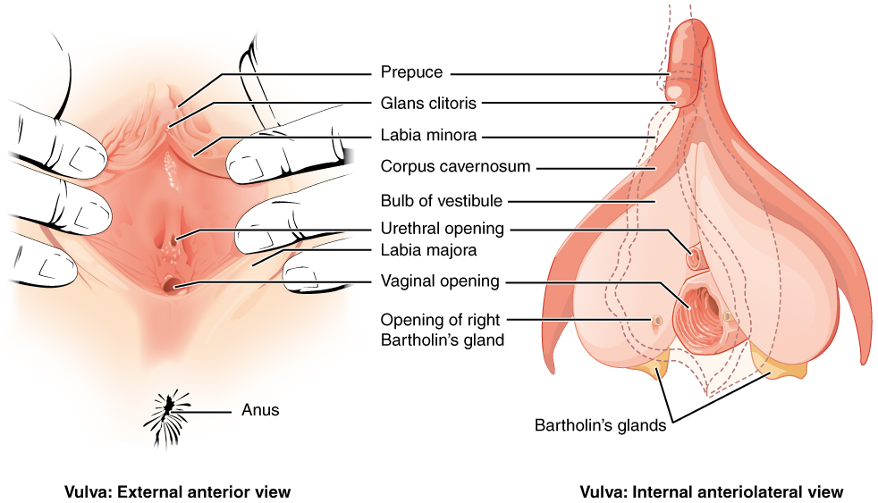
vulva
The Vulva
The external female genitalia are referred to collectively as the vulva.

Slide 12
Vulva/Mammary glands
Vulva
1. The term vulva, or pudendum, refers to the external genitalia of the female
2. It consists of the mons pubs, labia majora, labia minora, clitoris, vestibule, vaginal and urethral orifices, hymen, bulb of the vestibule, and the paraurethral (Skene’s), greater vestibular (Bartholin’s), and lesser vestibular glands
The perineum is the diamond-shaped area between the thighs and buttocks of both males and females that contains the external genitals and anus
Mammary Glands
1. The mammary glands are modified sudoriferous (sweat) glands that lie over the pectoralis major and serratus anterior muscles
2. Milk-secreting cells, referred to as alveoli, are clustered in small compartments (lobules) within the breasts.
3. The essential functions of the mammary glands are synthesis of milk, secretion and ejection of milk, which constitute lactation.
4. Fibrocystic disease is the most common cause of a breast lump in which one or more cysts (fluid-filled sacs) and thickening of alveoli (clusters of milk-secreting cells) develop.

Slide 13
Breast anatomy
Anatomy of the Breast
During lactation, milk moves from the alveoli through the lactiferous ducts to the nipple.

Slide 14
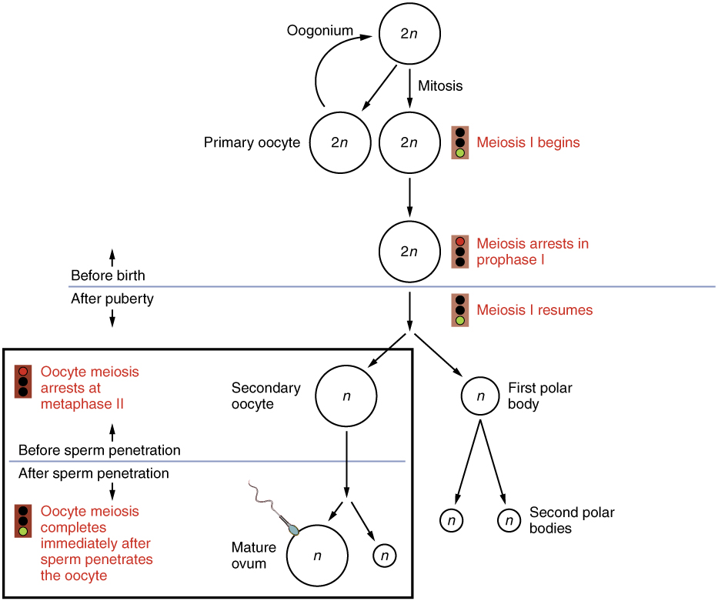
oogenesis
Eggs available after puberty for fertilization
Credit: Infertility Center of St. Louis
Oogenesis
The unequal cell division of oogenesis produces one to three polar bodies that later degrade, as well as a single haploid ovum, which is produced only if there is penetration of the secondary oocyte by a sperm cell.

Slide 15
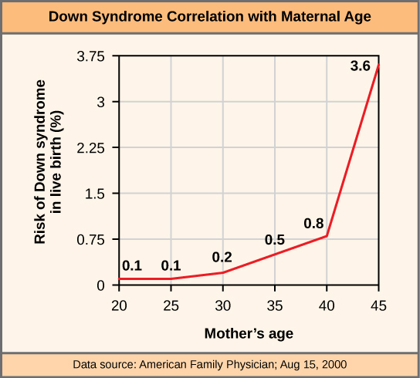

Down’s Syndrome
Down’s animation
The incidence of having a fetus with trisomy 21 increases dramatically with maternal age.

Slide 16
Reproductive cycle
The general term female reproductive cycle encompasses the ovarian and uterine cycles, the hormonal changes that regulate them, and cyclical changes in the breasts and the cervix.
1. The ovarian cycle is a series of events associated with the maturation of an ovum.
2. The uterine (menstrual) cycle involves changes in the endometrium to prepare for the reception of a fertilized ovum.
Hormonal Regulation of the Female Reproductive Cycle
1. The menstrual and ovarian cycles are controlled by GnRH from the hypothalamus, which stimulates the release of FSH and LH by the anterior pituitary gland
a. FSH stimulates the initial development of ovarian follicles and secretion of estrogens by the ovaries.
b. LH stimulates further development of ovarian follicles, ovulation, and the secretion of estrogens and progesterone by the ovaries.
At least six different estrogens have been isolated from the plasma of human females, with three in significant quantities: beta-estradiol, estrone, and estriol.
a. Estrogens have three main functions:
1) Promotion of the development and maintenance of female reproductive structures, secondary sex characteristics, and the breasts.
2) Regulation of fluid and electrolyte balance.
3) Stimulation of protein synthesis.
b. Moderate levels of estrogens in the blood inhibit the release of GnRH by the hypothalamus and secretion of LH and FSH by the anterior pituitary gland.
3. Progesterone works with estrogens to prepare the endometrium for implantation and the mammary glands for milk synthesis.
4. A small quantity of relaxin is produced monthly to relax the uterus by inhibiting contractions (making it easier for a fertilized ovum to implant in the uterus). During pregnancy, relaxin relaxes the pubic symphysis and helps dilate the uterine cervix to facilitate delivery.
5. Inhibin inhibits secretion of FHS and GnRH and, to a lesser extent, LH. It might be important in decreasing secretion of FHS and LH toward the end of the uterine cycle.

Slide 17
Phases
Ovulation is the rupture of the vesicular ovarian (Graafian) follicle with release of the secondary oocyte into the pelvic cavity, usually occurring on day 14 in a 28-day cycle.
1) The high levels of estrogen during the last part of the preovulatory phase exert a positive feedback on both LH and GnRH to cause ovulation
a) GnRH promotes release of FHS and more LH by the anterior pituitary gland.
  b) The LH surge brings about the ovulation.
2) Following ovulation, the vesicular ovarian follicle collapses (and blood within it forms a clot) to become the corpus hemorrhagicum. The clot is eventually absorbed by the remaining follicle cells. In time, the follicular cells enlarge, change character, and form the corpus luteum, or yellow body, under the influence of LH. Stimulated by LH, the corpus luteum secretes estrogens and progesterone.
d. The postovulatory phase is the most constant in duration and lasts from days 15-28 in a 28-day cycle, the time between ovulation and onset of the next menstrual period.
1) With reference to the ovaries, this phase of the cycle is also called the luteal phase, during which both estrogen and progesterone are secreted in large quantities by the corpus luteum.
A) If fertilization and implantation do not occur, the corpus luteum degenerates and becomes the corpus albicans, or white body. The decreased secretion of progesterone and estrogens then initiates another menstrual phase (uterine and ovarian cycle).
b) If fertilization and implantation do occur, the corpus luteum is maintained until the placenta takes over its hormone-producing function. During this time, the corpus luteum, maintained by human chorionic gonadotropin (hCG) from the developing placenta, secretes estrogens and progesterone to support pregnancy and breast development for lactation. Once the placenta begins its secretion, the role of the corpus luteum becomes minor.
2) With reference to the uterus, this phase is also called the secretory phase because of the secretory activity of the endometrial glands as the endometrium thickens in anticipation of implantation.
2. Menstrual abnormalities include amenorrhea (absence of menstruation), dysmenorrhea (pain associated with menstruation), and abnormal uterine bleeding.
Phases of the Female Reproductive Cycle
1. The female reproductive cycle may be divided into three phases
  a. The menstrual cycle (menstruation) lasts for approximately the first 5 days of the cycle.
1) During this phase, small secondary follicles in each ovary begin to develop.
2) Also during this phase, the stratum functionalis layer of the endometrium is shed, discharging blood, tissue fluid, mucus, and epithelial cells.
b. The preovulatory phase, or proliferative phase, is the time between menstruation and ovulation. This phase is more variable in length that the other phases, lasting from days 6-13 in a 28-day cycle.
1) During this phase, primary follicles develop into secondary follicles and a single secondary follicle (occasionally more than one) develops into a vesicular ovarian (Graafian) follicle, or mature follicle. This follicle produces a bulge on the surface of the ovary
2) The dominant follicle continues to increase its estrogen production under the influence of an increasing level of LH
3) During this phase, endometrial repair occurs.

Slide 18
Ovarian Cycle
Follicular phase
Ovulation
Luteal phase

Slide 19
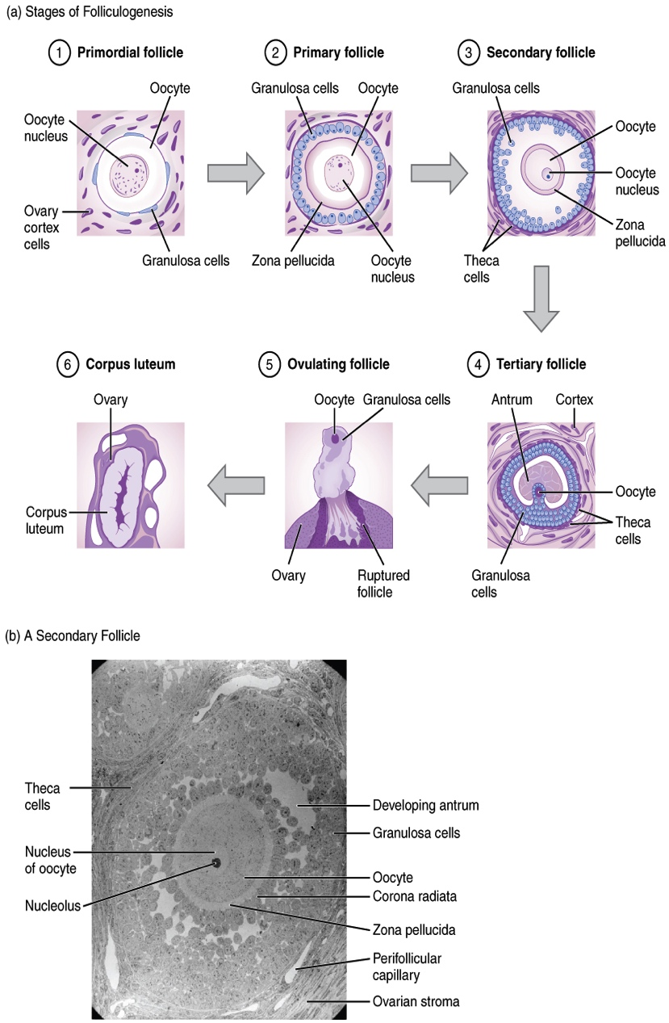
The ovarian cycle
Folliculogenesis
The maturation of a follicle is shown in a clockwise direction proceeding from the primordial follicles. FSH stimulates the growth of a tertiary follicle, and LH stimulates the production of estrogen by granulosa and theca cells. Once the follicle is mature, it ruptures and releases the oocyte. Cells remaining in the follicle then develop into the corpus luteum.
In this electron micrograph of a secondary follicle, the oocyte, theca cells (thecae folliculi), and developing antrum are clearly visible. EM × 1100. (Micrograph provided by the Regents of University of Michigan Medical School © 2012)

Slide 20
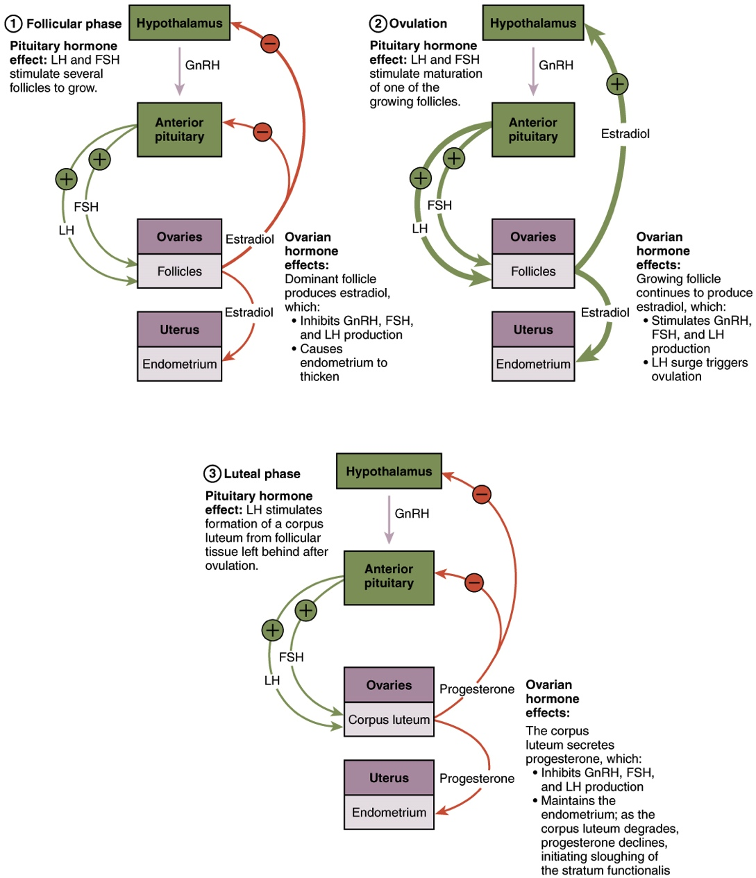
Hormonal regulation of ovulation
Hormonal Regulation of Ovulation
The hypothalamus and pituitary gland regulate the ovarian cycle and ovulation. GnRH activates the anterior pituitary to produce LH and FSH, which stimulate the production of estrogen and progesterone by the ovaries.

Slide 21
Uterine Cycle
Menstrual stage (menses)
Pre-ovulatory stage (proliferative)
Post-ovulatory stage (secretory)

Slide 22
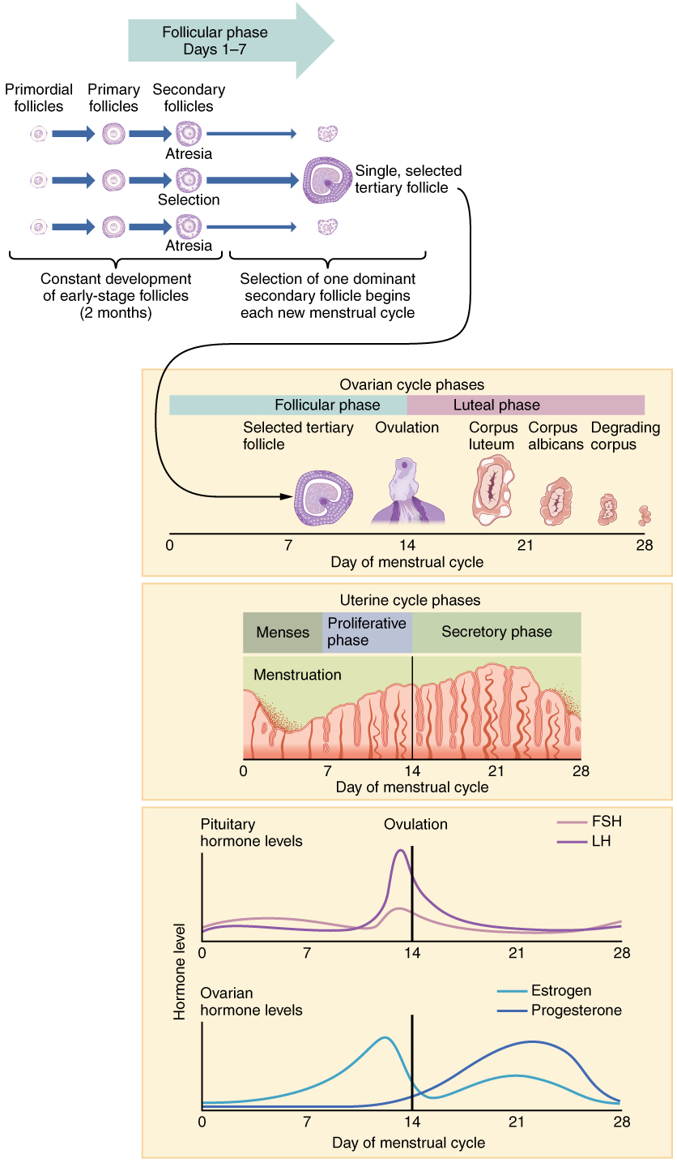
Hormones and menstruation
Hormone Levels in Ovarian and Menstrual Cycles
The correlation of the hormone levels and their effects on the female reproductive system is shown in this timeline of the ovarian and menstrual cycles. The menstrual cycle begins at day one with the start of menses. Ovulation occurs around day 14 of a 28-day cycle, triggered by the LH surge.

Slide 23
Menopause
Cessation of menstruation also known as menarche.
Occurs 45-55 years of age.
Ovaries fail to respond to FSH and estrogen levels decline.
Number of remaining follicles decrease.
Regression of organs often occurs.
Hot flashes and mood swings common due to hormonal imbalances.

Slide 24
Sexual Response
THE HUMAN SEXUAL RESPONSE
A. Sexual intercourse, or copulation (in humans, called coitus), is the process by which spermatozoa are deposed in the vagina.
B. The four stages of human sexual response are related to the physical and physiological states that occur to both men and women during sexual intercourse.
1. In the arousal phase parasympathetic impulses pass through the sacral region to cause vasocongestion and secretion by the genitalia.
a. Arousal is in response to mental and tactile stimulation.
b. There is also increased activity in the cardiovascular, respiratory, and muscular systems.
2. The plateau stage is characterized by a “sexual flush” due to cutaneous vasodilation.
3. Sympathetic nervous stimulation of the whole body leads to the orgasm stage, accompanied by an intense sensation of pleasure, in addition to rhythmic somatic and smooth muscle contractions.
4. The resolution stage occurs as the aroused systems relax.
C. The changes of the male in the sex act involve erection, minimal lubrication, and ejaculation, a component of orgasm.
D. The female role changes also involve erection, lubrication, and orgasm (climax).
E. Erectile dysfunction, previously termed impotence, is the consistent inability of an adult male to ejaculate or to attain or hold an erection long enough for sexual intercourse.

Slide 25
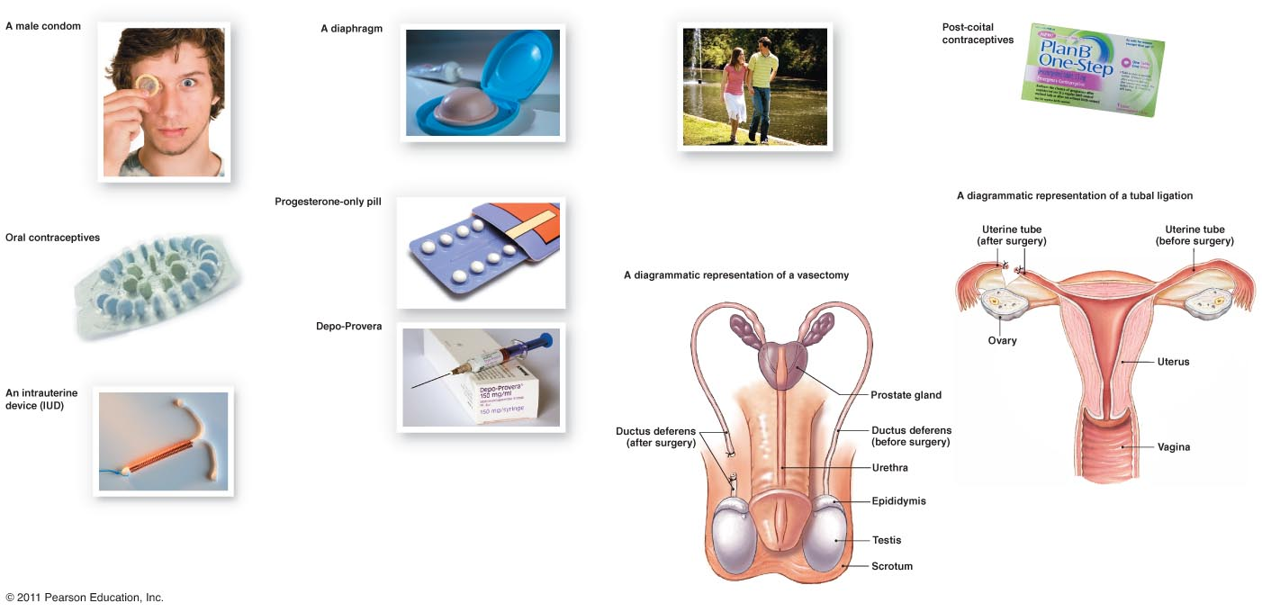
Contraceptive Devices
Natural Family Planning
Female condom
Failure Rates:
Barrier - 15-20%
Hormonal (oral, ring) - 8%
H (injection) – 3%
H (implant) - <1%
NFP – 12-25%
Withdrawal – 27%
Sterilization <1%
Jadelle
NuvaRing

Slide 26
Birth Control
Several methods of birth control are available, each with advantages and disadvantages.
B. The only method of preventing pregnancy that is 100% reliable is total abstinence, avoidance of sexual intercourse.
C. Methods of birth control discussed in the text include
1.Abstinence
a. Abstinence is not having sex
b. 100% effective
2. surgical sterilization
a. vasectomy
I. the vas deferens are cut and burned
i. semen is still produced but no sperm
b. tubal ligation
i. fallopian tubes are cut and burned
ii. eggs are still produced but do not reach the
fallopian tubes
hormonal methods
a. oral contraception
Birth control pill
i. Contains hormones to change the way the body works
ii. Most use combination pills containing a combination of the hormones estrogen and progesterone
iv. Possible side effects
1. irregular menstrual bleeding nausea, weight gain, headaches, dizziness, and breast tenderness ,mood changes ,blood clots
b. Birth control patch
i. Thin, beige, square patch that sticks to the skin
ii. It release hormones through the skin into the bloodstream to prevent pregnancy
iii. The combination of the hormones progesterone and estrogen
iv. 95% effective Possible side effects
1. irregular menstrual bleeding nausea, weight gain, headaches, dizziness, and breast tenderness . mood changes, blood clots ,skin reactions ,problems with contact lens , menstrual cramps

Slide 27
Birth control
the Norplant implant,
d. Depo-Provera injection
i. Long-acting form of progesterone
ii. The shot is given in the upper arm or in the buttocks once very 3 months
iii. Possible side effects
1. irregular or no menstrual periods , weight gain, headaches, and breast ,tenderness , depression
e. the vaginal ring
i. soft, flexible, doughnut-shaped ring about 2 inches in diameter
ii. inserted into the vagina , where it slowly releases hormones
iii. the hormones in the ring control the ovaries and the uterus the cervical mucus is also thickened
iv. side effects
1. irregular menstrual bleeding , nausea, weight gain, headaches, ,dizziness, and breast tenderness , mood changes , blood clots ,vaginal irritation or infections ,vaginal discharge ,problems with contact lens
intrauterine devices (IUDs)
i. A T-shaped piece of plastic about the size of a quarter that is placed inside the uterus
ii. Two types
1. one is covered with copper wire
2. the other is coated with and releases the hormone progesterone
iii. Possible side effects
1. spotting between periods ,. heavier periods with more cramps . irregular or loss of periods , expulsion or loss of the IUD . perforation of the uterus, acne, breast tenderness, and nausea
Spermicides
i. cream, foam, gel, film and suppositories
ii. contain nonoxynol-9, a chemical that kills sperms

Slide 28
Birth Control
barrier methods
condom
1. there are male and female condoms
2 .keeps the semen from working
3. possible side effects
a. allergy to latex ,irritation of the penis
female condom
a. a lubricated polyurethane sheath shaped similar to the male condom . The closed end has a flexible ring that is inserted into the vagina.
b. vaginal pouch,
c. diaphragm,
i. dome shaped bowl made of thin, flexible rubber that sit over the cervix
ii. keeps sperm from entering the uterus
iii. possible side effects
a. spermicides may irritate the vagina , strong odors ,rubber may cause allergies toxic shock syndrome
cervical cap
fitted directly over the cervix
periodic abstinence
a. rhythm method
i. calendar – counting the days till ovulation
ii. temperature – taking your basal temperature and then checking to see a few tenths of a degree of a change
iii. Billings’ method – checking the mucus in the vagina
coitus interruptus (withdrawal),
i. possible pregnancy due to the Cowper’s gland or the Bulbourethral gland
induced abortion
a. (including the drug RU 486, or mifepristone).

Slide 29
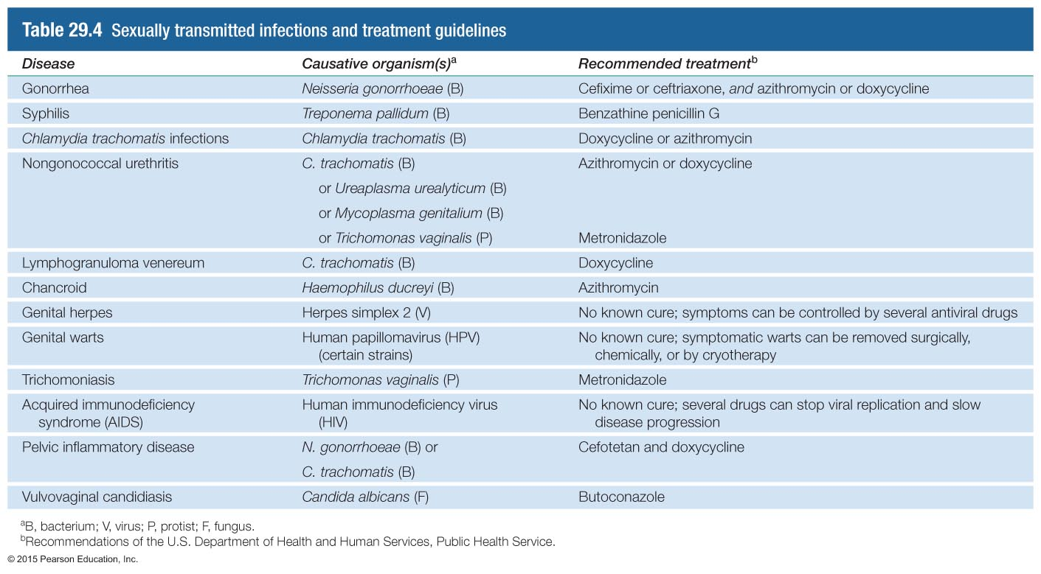
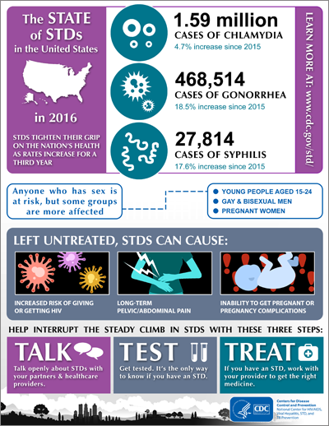
STDs – caused by a wide variety of organisms
GA Rankings, 2016 (CDC)
Disease | Ranking | Cases | Rate per 100,000
Chlamydia | 5 | 62,776 | 614.6
Gonorrhea | 3 | 20,553 | 201.2
Syphilis (primary/secondary) | 4 | 1350 | 13.2
Syphilis (congenital) | 9 | 21 | 16.0
Notes:
Table 29.4

Slide 30
Male and female embryological development
All fertilized eggs will become female without the addition of the gene from the SRY.
Certain tissue has bipotential
Other reproductive structures are developed from embryological ducts (uterus, uterine tubes and part of vagina; epididymis, ductus deferens, and seminal vesicles)
Male and female development video

Slide 31
AGING AND THE REPRODUCTIVE SYSTEMS
A. Puberty refers to the period of time when secondary sexual characteristics begin to develop and the potential for sexual reproduction is reached.
B. In females, the reproductive cycle normally occurs once each month from menarche, the first menses, to menopause, the last menses.
1. Between the ages of 40 and 50 the ovaries become less responsive to the stimulation of gonadotropic hormones from the anterior pituitary. As a result, estrogen and progesterone production decline, and follicles do not undergo normal development.
2. In addition to the symptoms of menopause, such as hot flashes, copious sweating, headache, vaginal dryness, depression, weight gain, and emotional fluctuations, with age females also experience increased incidence of osteoporosis, uterine cancer, and breast cancer.
C. In males, declining reproduction function is more subtle, with males often retaining reproductive capacity into their 80s or 90s.
1. In males, decreasing levels of testosterone decrease muscle strength, sexual desire, and viable sperm.
2. Prostate disorders are increasingly common with age, particularly benign hypertrophy

Slide 32
Development
DEVELOPMENTAL ANATOMY OF THE REPRODUCTIVE SYSTEMS
A. The gonads develop from intermediate mesoderm and are differentiated into ovaries or testes by about the seventh week of fetal development
B. The external genitalia develop from the genital tubercle .
C. Deficiency of 5-alpha-reductase results in a female external appearance at birth, but the development of male characteristics at puberty

Slide 33
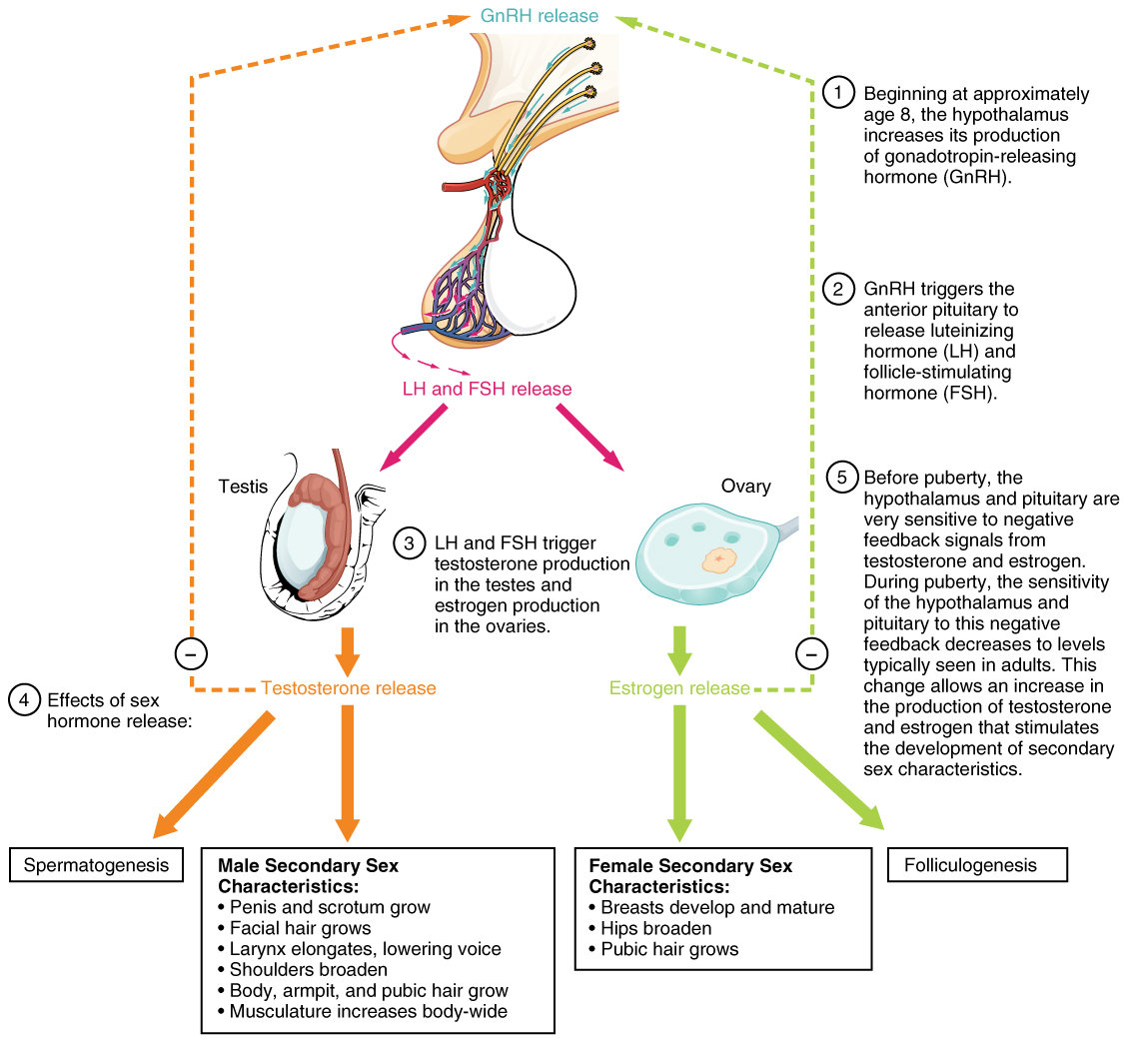
puberty
Hormones of Puberty
During puberty, the release of LH and FSH from the anterior pituitary stimulates the gonads to produce sex hormones in both male and female adolescents.

Slide 34
Homeostatic Imbalances
Testicular cancer
Prostate cancer
Cryptorchidism
Impotence
Pelvic inflammatory disease
Ovarian cancer
Cervical cancer
Breast cancer
Sexually transmitted diseases
  Gonorrhea
  Syphilis
  Chlamydia
  Genital warts
  Genital herpes
Amenorrhea
Dysmenorrhea
Endometriosis

Slide 35
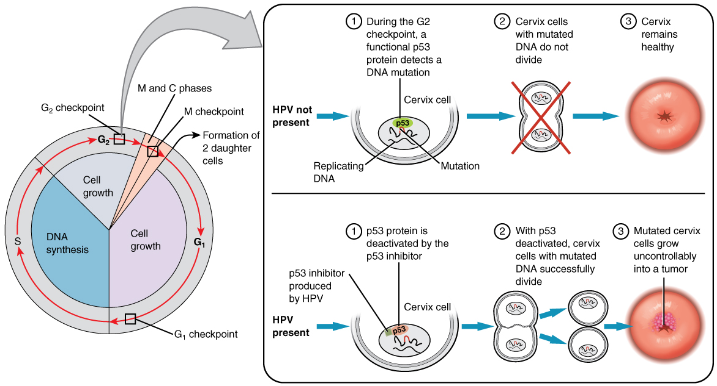
Cervical cancer
Development of Cervical Cancer
In most cases, cells infected with the HPV virus heal on their own. In some cases, however, the virus continues to spread and becomes an invasive cancer.

Slide 36
Sexually transmitted diseases
Sexually transmitted diseases (STDs) are disease spread by sexual contact and include chlamydia, gonorrhea, syphilis, and genital herpes.
1. Chlamydia is a STD caused by the bacterium Chlamydia trachomatis. At present chlamydia is the most prevalent and one of the most damaging of the STDs.
a. In most cases, the initial infection is asymptomatic and difficult to recognize clinically.
b. In males, urethritis is the principal result.
c. In females, urethritis may spread through the reproductive tract and develop into inflammation of the uterine tubes, which increases the risk of ectopic pregnancy and sterility.
2. Gonorrhea (“clap”) is an infectious STD that affects primarily the mucous membrane of the urogenital tract, the rectum, and occasionally the eyes. The disease is caused by the bacterium Neisseria gonorrhoreae.
a. Males usually suffer inflammation of the urethra with pus and painful urination.
b. In females, infection may occur in the urethra, vagina, and cervix, and their may be a discharge of pus. However, infected females often harbor the disease without any symptoms until it has progressed to a more advanced stage. If the uterine tubes become involved, pelvic inflammation may follow, often causing sterility and occasionally causing peritonitis.
c. If the bacteria are transmitted to the eyes of a newborn in the birth canal, blindness can result. Administration of a 1% silver nitrate solution or penicillin or erythromycin in the neonate’s eyes prevents infection.
Syphilis is an STD caused by the bacterium Treponema pallidum.
a. It is acquired through sexual contact, exchange of blood, or transmitted through the placenta to a fetus.
b. The disease progresses through several stages: primary, secondary, latent, and tertiary.
1) During the primary stage, the chief symptom is a painless open sore, called a chanker.
2) A skin rash, fever, and aches in the joints usher in the secondary stage: a systemic infection.
3) The tertiary stage occurs when signs of organ degeneration appear.
4. Genital herpes is an incurable STD caused by the type II herpes simplex virus (HSV-2).
a. HSV-2 causes genital infections such as painful blisters on the prepuce, glans penis, and penile shaft in males and on the vulva or sometimes high up in the vagina in females.
b. The blisters disappear and reappear in most patients, but the virus itself remains in the body

Slide 37
Female Disorders
Female Disorders
1. Premenstrual syndrome (PMS) refers to severe physical and emotional distress that occurs during the postovulatory (luteal) phase of the female reproductive cycle.
2. Endometriosis is characterized by the growth of endometrial tissue outside the uterus.
a. The tissue enters the pelvic cavity via the open uterine tubes and may be found in any of several sites - on ovaries, rectouterine pouch, surface of the uterus, sigmoid colon, pelvic and abdominal lymph nodes, cervix, abdominal wall, kidneys, and/or urinary bladder.
b. Symptoms include premenstrual pain or unusual menstrual pain.
3. Breast cancer is the second-leading cause of death from cancer in United States women.
a. It is seldom seen before age 30, but its occurrence rises rapidly after menopause.
b. Two genes increase susceptibility to breast cancer: BRCA1 (breast cancer 1) and BRCA2. Mutation of BRCA1 also confers high risk for ovarian cancer.
c. Early detection - especially by breast self-examination and mammography - is still the most promising method to increase the survival rate for breast cancer.
d. The factors that increase the risk of breast cancer development include family history of breast cancer, especially in a mother or sister; never having a child or having a first child after age 35; previous cancer in one breast; exposure to ionizing radiation, such as x-rays; excessive alcohol intake; and cigarette smoking.
e. Treatment for breast cancer may involve hormone therapy, chemotherapy, radiation therapy, lumpectomy (removal of just the tumor and immediate surrounding tissue), a modified or radical mastectomy (removal of part or all of the affected breast, along with underlying pectoral muscles and the axillary lymph nodes in the latter case), or a combination of these. Radiation treatment and chemotherapy may follow the surgery.

Slide 38
Female disorders
4. Ovarian cancer is the sixth most common form of cancer in females.
a. It is difficult to detect before it metastasizes beyond the ovaries.
b. Risk factors include age (usually over age 50); race (white are at greatest risk); family history of ovarian cancer; never having children or first pregnancy after age 30; high-fat, low-fiber, vitamin A-deficient diet; and prolonged exposure to asbestos or talc.
c. Earl Later-stage signs and symptoms include an enlarged abdomen, abdominal and/or pelvic pain, persistent gastrointestinal disturbances, urinary complications, menstrual irregularities, and heavy menstrual bleeding.
5. Cervical cancer starts with cervical dysplasia and can be diagnosed in its earliest stages with a Pap smear.
a. There is some evidence linking cervical cancer to the virus that produces genital warts (papilloma virus).
b. Other risk factors are increased incidence associated with an increased number of sexual partners, young age at first intercourse, and cigarette smoking.
6. Vulvovaginal candidiasis is the most common form of vaginitis and is caused by the yeastlike fungus Candida albicans.
a. Candidiasis is characterized by severe itching; a thick, yellow, cheesy discharge; a yeasty odor; and pain.
b. The disorder, experienced at least once by about 75% of
females, is usually a result of proliferation of the fungus
following antibiotic therapy for another condition y ovarian cancer has no symptoms or only mild ones associated with other common problems.

