Slide 1
The Guardian Network: A Journey Through the Body's Defense System
Exploring how the body protects itself from threats
Notes:
---

Slide 2
Introduction to the Guardian Network
Notes:
Overview of the Body's Defense System

Slide 3
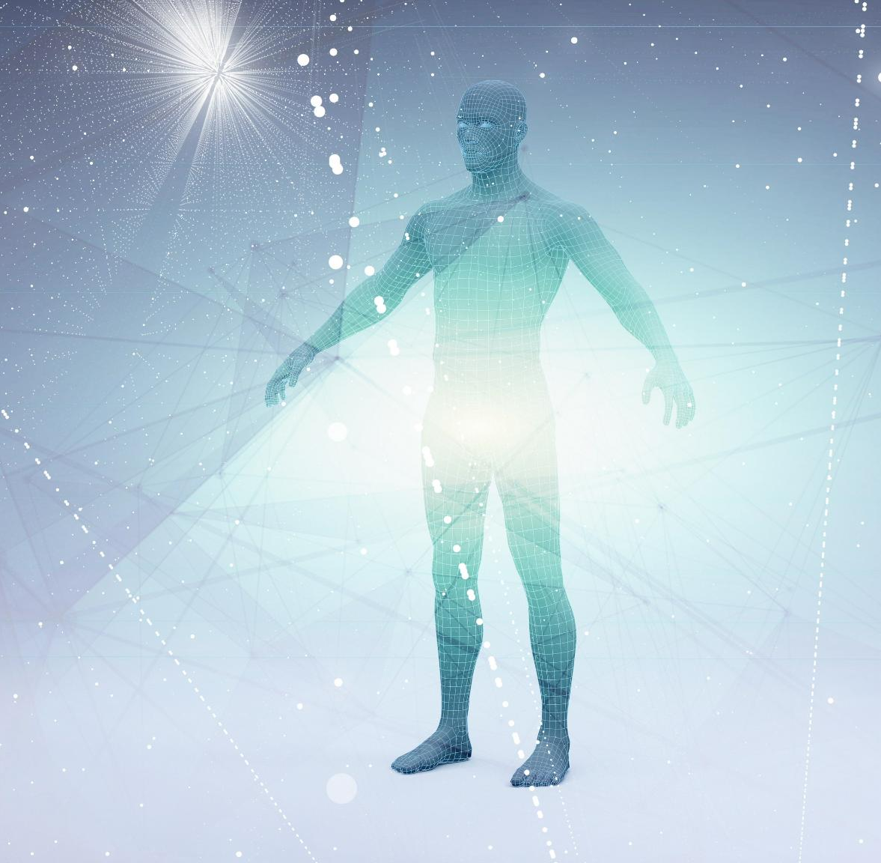
Overview of the Body's Defense System
Lymphatic System Function
  The lymphatic system manages fluid balance and serves as a pathway for immune surveillance throughout the body.
Immune System Role
  The immune system detects and eliminates pathogens using cells, proteins, and organs to protect health.
Integrated Defense Mechanism
  Together, the lymphatic and immune systems form an integrated network that maintains homeostasis and defends against infections.
Notes:
The human body relies on a sophisticated and integrated defense system to maintain health and prevent disease. This system consists of two major components: the lymphatic system and the immune system. Together, they form what can be described as the Guardian Network—a silent yet powerful mechanism that constantly monitors, filters, and protects the body from internal imbalances and external threats. The lymphatic system primarily manages fluid balance by reclaiming excess interstitial fluid and returning it to the bloodstream, while also serving as a conduit for immune surveillance. The immune system, on the other hand, is a dynamic network of cells, proteins, and organs that identify, neutralize, and eliminate pathogens. This presentation explores how these systems collaborate seamlessly to maintain homeostasis and defend against infections, highlighting their anatomical structures, physiological processes, and cellular components. Understanding this network is crucial for appreciating the complexity of human biology and the resilience of our internal defense mechanisms.

Slide 4
Fluid Balance and Initial Challenges
Notes:
The Body's Constant Challenge: Leaks and Invaders

Slide 5
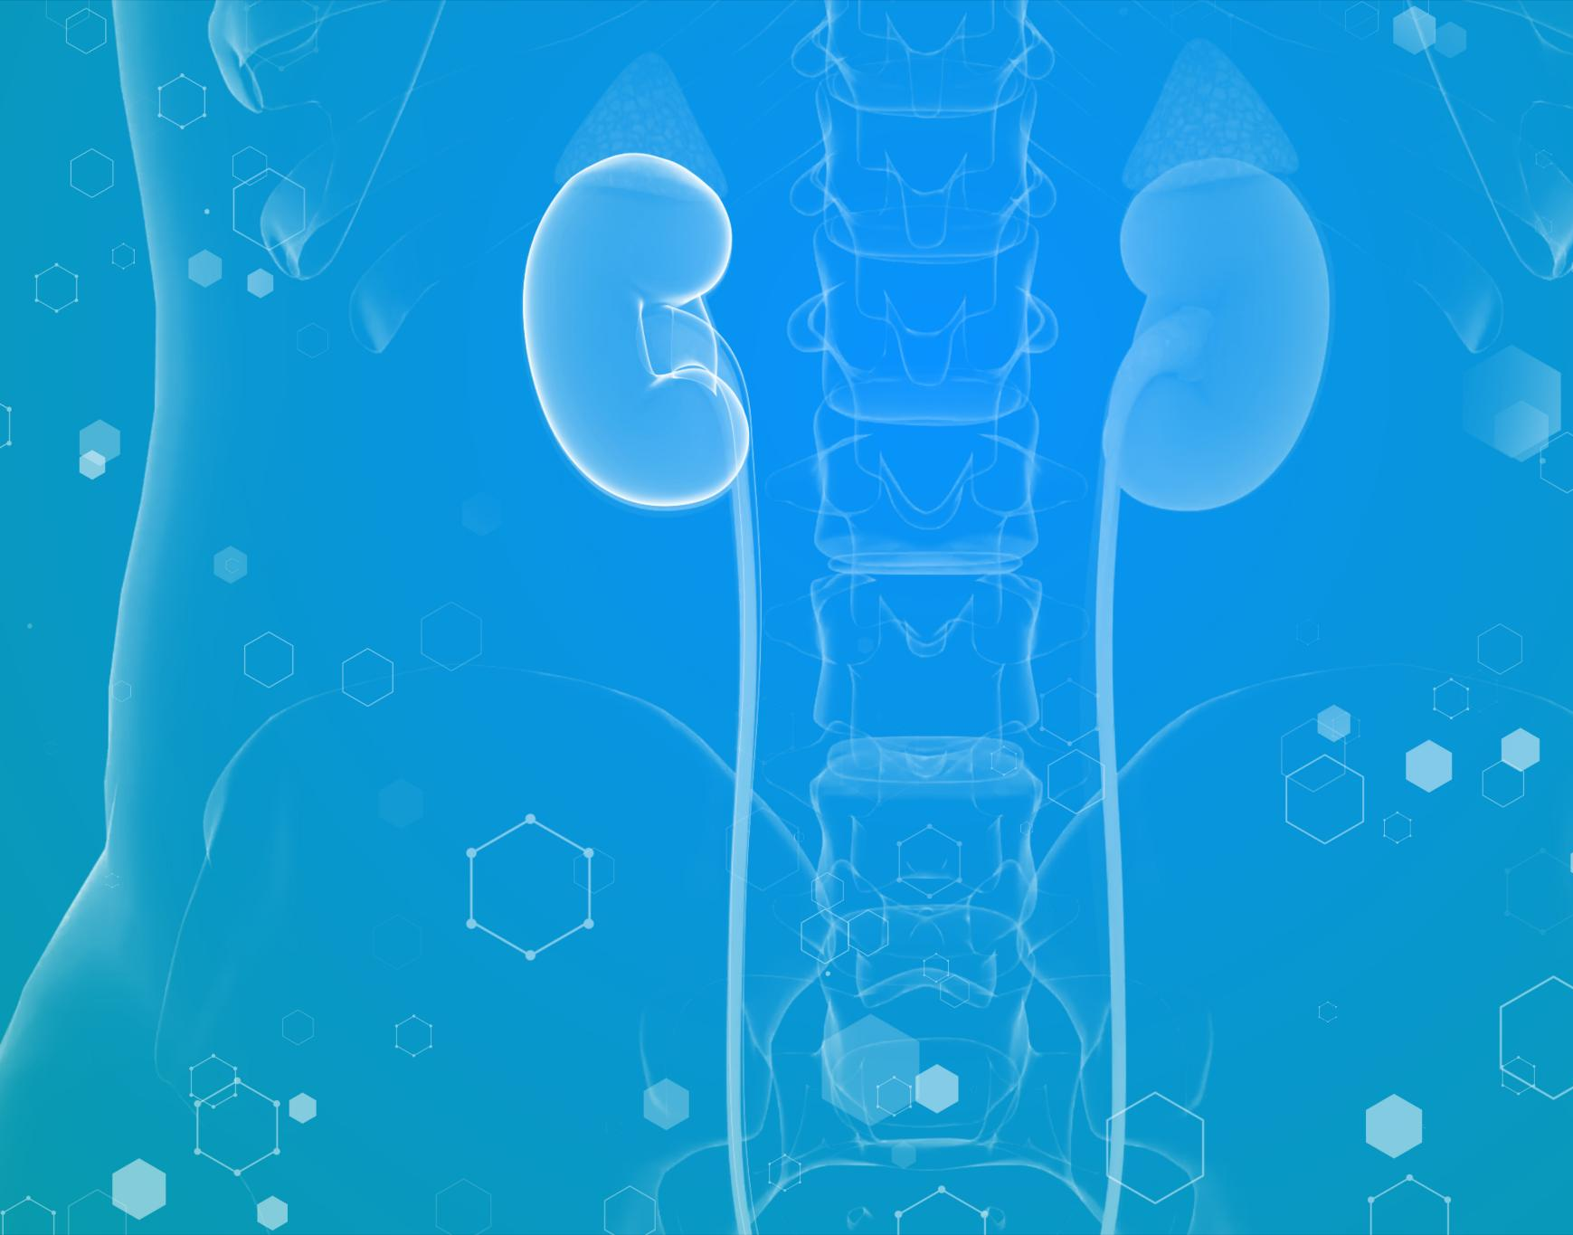
The Body's Constant Challenge: Leaks and Invaders
Fluid Leakage and Reabsorption
  Daily, 20 liters of plasma leak from capillaries, with 17 liters reabsorbed back into blood vessels.
Lymphedema and Its Risks
  3 liters of fluid remain in tissues causing swelling and risk of infection known as lymphedema.
Lymphatic System Function
  The lymphatic system collects excess fluid and returns it to bloodstream while blocking pathogens.
Immune Defense Role
  Lymphatic system acts as a sanitation mechanism critical to immune defense against pathogens.
Notes:
Every day, approximately 20 liters of plasma are forced out of capillaries into surrounding tissues due to blood pressure. While most of this fluid—around 17 liters—is reabsorbed by blood vessels, about 3 liters remain in the interstitial spaces. This residual fluid, if left unchecked, can lead to swelling and create a pathway for pathogens to spread. The accumulation of this fluid, known as lymphedema, poses significant health risks, including tissue damage and increased susceptibility to infections. To counter this, the body employs the lymphatic system, which acts as a specialized drainage network to collect and return this excess fluid to the bloodstream. This process not only prevents edema but also ensures that any pathogens present in the fluid are intercepted and neutralized. The challenge of maintaining fluid balance underscores the importance of the lymphatic system as both a sanitation mechanism and a critical component of immune defense.

Slide 6
The Lymphatic and Immune Systems
Notes:
Two Systems, One Integrated Mission

Slide 7
Two Systems, One Integrated Mission
Lymphatic System Structure
The lymphatic system includes vessels, nodes, and organs that transport lymph and filter harmful substances.
Immune System Function
The immune system deploys specialized cells and proteins to detect and destroy pathogens effectively.
System Collaboration
Lymphatic and immune systems collaborate to maintain infection-free body and internal stability.
Notes:
The lymphatic system and the immune system work in tandem to protect the body. The lymphatic system consists of a network of vessels, nodes, and organs that drain excess interstitial fluid, now called lymph, and return it to the bloodstream. Along the way, lymph passes through lymph nodes, which act as filtration checkpoints to remove debris and pathogens. The immune system complements this by deploying specialized cells and proteins to identify and destroy harmful microorganisms. While the lymphatic system provides the physical infrastructure for fluid transport and pathogen interception, the immune system delivers the biological response necessary for neutralization. This collaboration ensures that the body remains free from infections and maintains internal stability. Far from being separate entities, these systems form a unified defense network that operates continuously and efficiently.

Slide 8
Anatomical Pathways and Structures
Notes:
Journey of Lymph and Its Pathways

Slide 9
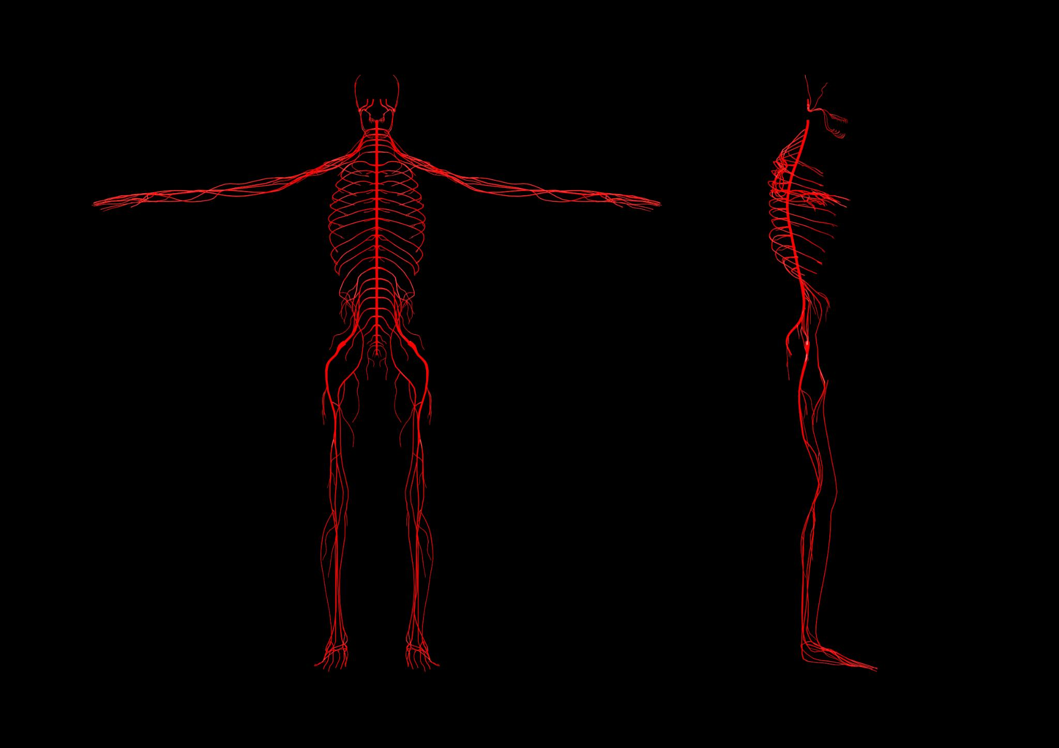
Journey of Lymph and Its Pathways
Lymphatic Capillaries Structure
  Lymphatic capillaries have overlapping endothelial cells acting as one-way valves to allow fluid entry and prevent escape.
Lymphatic Vessels and Valves
  Larger lymphatic vessels contain valves to prevent backflow and appear beaded due to these structures.
Lymphatic Trunks and Collecting Ducts
  Lymphatic trunks drain major body regions and lead to collecting ducts, the right lymphatic and thoracic ducts.
Asymmetrical Lymph Drainage
  Right lymphatic duct drains upper right quadrant; thoracic duct drains remainder, ensuring efficient circulation return.
Notes:
The lymphatic system begins at the microscopic level with lymphatic capillaries, which are formed by overlapping endothelial cells acting as one-way valves. These structures allow interstitial fluid to enter but prevent it from escaping. Collagen filaments anchor the capillaries to surrounding tissues, and when tissue pressure increases, these filaments pull the endothelial flaps open, facilitating fluid entry. From these capillaries, lymph travels through larger lymphatic vessels equipped with valves to prevent backflow, giving them a characteristic beaded appearance. These vessels converge into lymphatic trunks, which drain major regions of the body, and ultimately into collecting ducts—the right lymphatic duct and the thoracic duct. The right lymphatic duct drains lymph from the upper right quadrant of the body, while the thoracic duct handles the rest, beginning at the cisterna chyli and emptying into the left subclavian vein. This asymmetrical drainage system ensures efficient fluid return to the circulatory system.

Slide 10
Immune Surveillance and Organs
Notes:
Primary and Secondary Lymphoid Organs

Slide 11
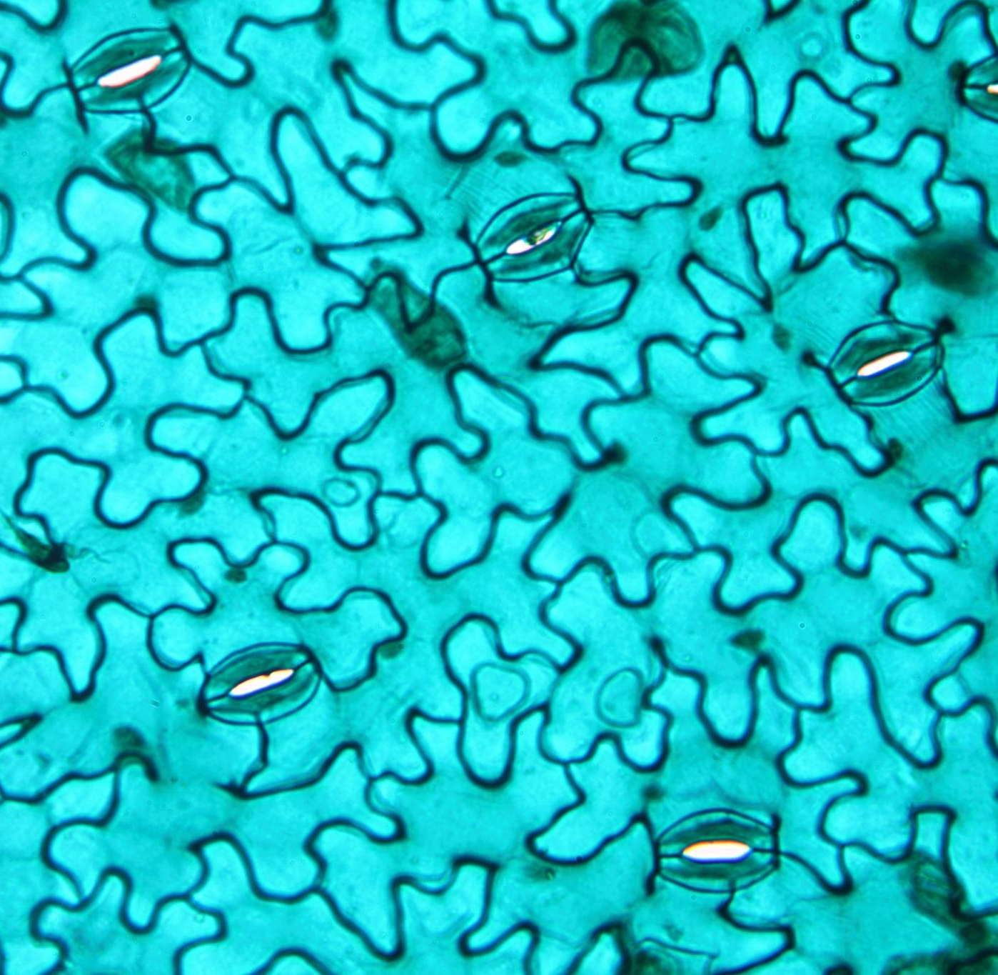
Primary and Secondary Lymphoid Organs
Primary Lymphoid Organs
  Bone marrow produces all lymphocytes and matures B cells, while the thymus trains T cells for immune function.
Secondary Lymphoid Organs
  Lymph nodes, spleen, and MALT initiate immune responses by filtering lymph and blood and guarding mucosal surfaces.
Immune Surveillance
  These organs provide both localized and systemic protection by ensuring lymphocytes meet antigens throughout the body.
Notes:
Immune function depends on specialized organs where lymphocytes develop and respond to antigens. Primary lymphoid organs include the bone marrow and thymus. Bone marrow is the origin of all lymphocytes and the maturation site for B cells, while the thymus serves as a training ground for T cells. Secondary lymphoid organs, such as lymph nodes, spleen, and mucosa-associated lymphoid tissue (MALT), are sites where immune responses are initiated. Lymph nodes filter lymph and provide a meeting point for antigens and lymphocytes. The spleen filters blood and mounts responses against blood-borne pathogens. MALT, which includes tonsils, Peyer’s patches, and bronchus-associated lymphoid tissue, guards mucosal surfaces against ingested or inhaled pathogens. These organs collectively ensure that immune surveillance occurs throughout the body, providing both localized and systemic protection.

Slide 12
Defense Mechanisms and Immune Cells
Notes:
Lines of Defense and Key Immune Cells

Slide 13
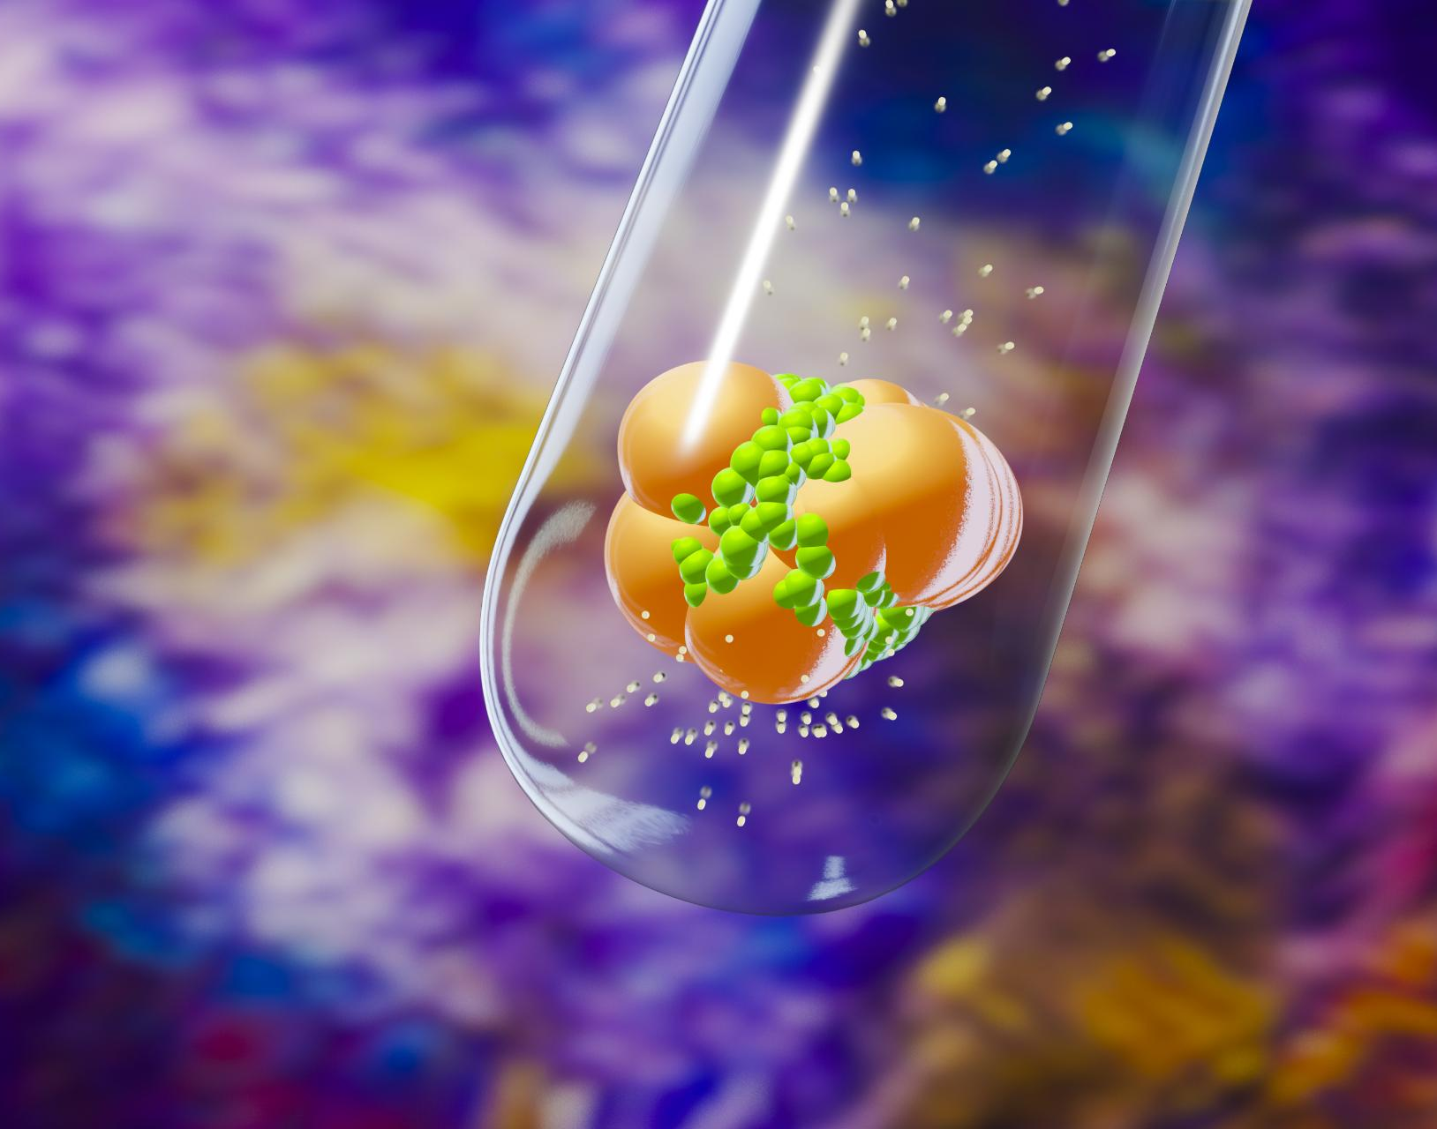
Lines of Defense and Key Immune Cells
Three Lines of Defense
  The immune system defends via three lines: physical barriers, innate immunity, and adaptive immunity.
Innate Immune Cells
  Macrophages and neutrophils act rapidly to engulf pathogens and initiate immune responses.
Adaptive Immunity Cells
  B and T lymphocytes provide specific, long-lasting protection against pathogens.
Specialized Immune Cells
  Natural killer cells and granulocytes combat infected or abnormal cells and mediate allergic reactions.
Notes:
The immune system operates through three lines of defense. The first line consists of physical and chemical barriers, such as skin and mucous membranes, which prevent pathogen entry. The second line involves innate immunity, including phagocytic cells like macrophages and neutrophils that respond rapidly to infections. The third line is adaptive immunity, mediated by B and T lymphocytes, which provide specific and long-lasting protection. Key immune cells include macrophages and dendritic cells, which engulf pathogens and present antigens; B cells, which produce antibodies; T cells, which coordinate immune responses and kill infected cells; and natural killer cells, which target virus-infected and cancerous cells. Granulocytes like eosinophils and basophils play roles in combating parasites and mediating allergic reactions. Together, these cells form a versatile and highly effective defense force.

Slide 14
System Integration and Response
Notes:
Coordinated Action and Continuous Protection

Slide 15
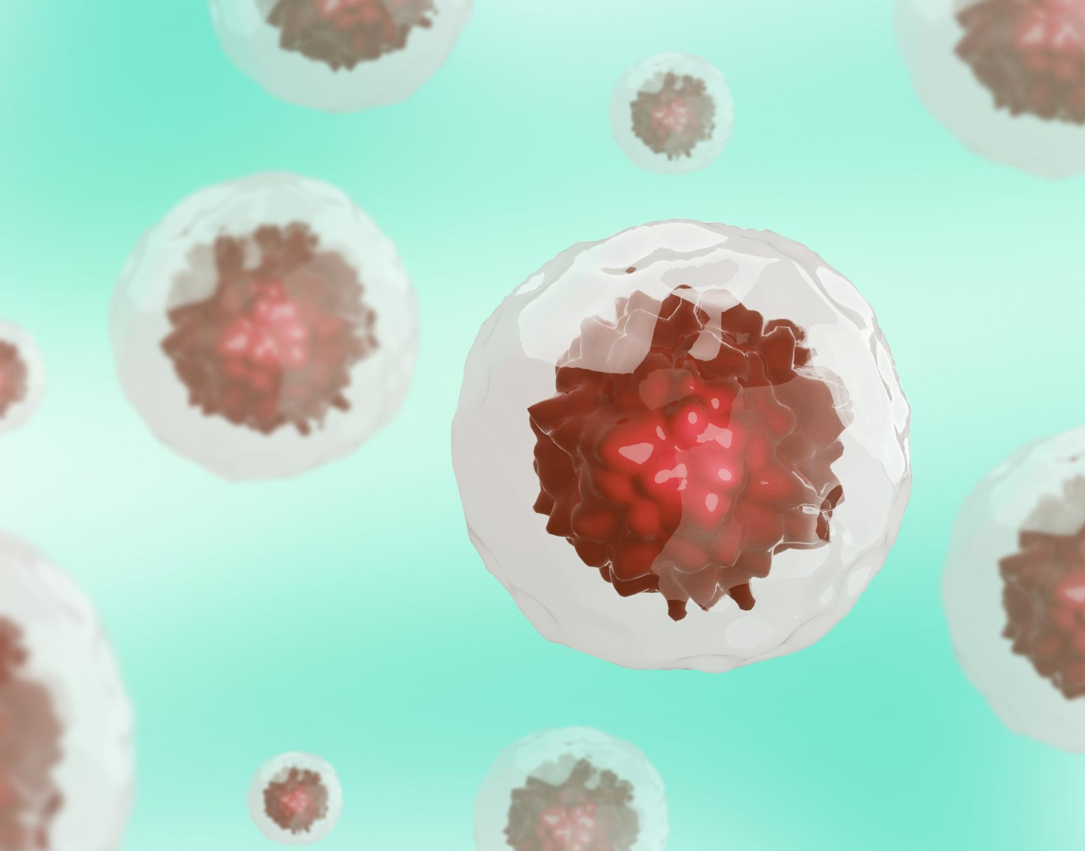
Coordinated Action and Continuous Protection
Initial Immune Response
  Macrophages perform phagocytosis and trigger inflammation when bacteria invade tissue through wounds.
Lymphatic Fluid Transport
  Excess fluid and pathogens enter lymphatic capillaries and travel to lymph nodes for filtration and immune activation.
Adaptive Immunity Activation
  Dendritic cells present antigens to T cells, activating adaptive immunity and resulting in antibody production by B cells.
Continuous Protection Mechanism
  The lymphatic system reclaims fluid, prevents swelling, and neutralizes threats to maintain bodily resilience.
Notes:
The lymphatic and immune systems demonstrate remarkable integration during an immune response. For example, when a puncture wound introduces bacteria into tissue, local macrophages immediately begin phagocytosis, triggering inflammation. Excess fluid and pathogens enter lymphatic capillaries and travel to regional lymph nodes, where dendritic cells present antigens to T cells, activating adaptive immunity. B cells produce antibodies, and the filtered lymph eventually returns to circulation via the thoracic duct. This sequence illustrates how fluid dynamics, anatomical structures, and cellular responses converge to protect the body. The Guardian Network operates silently and continuously, reclaiming fluid, preventing swelling, and neutralizing threats. Its seamless integration underscores the complexity and resilience of human physiology, ensuring survival in an environment full of potential dangers.

