Slide 1
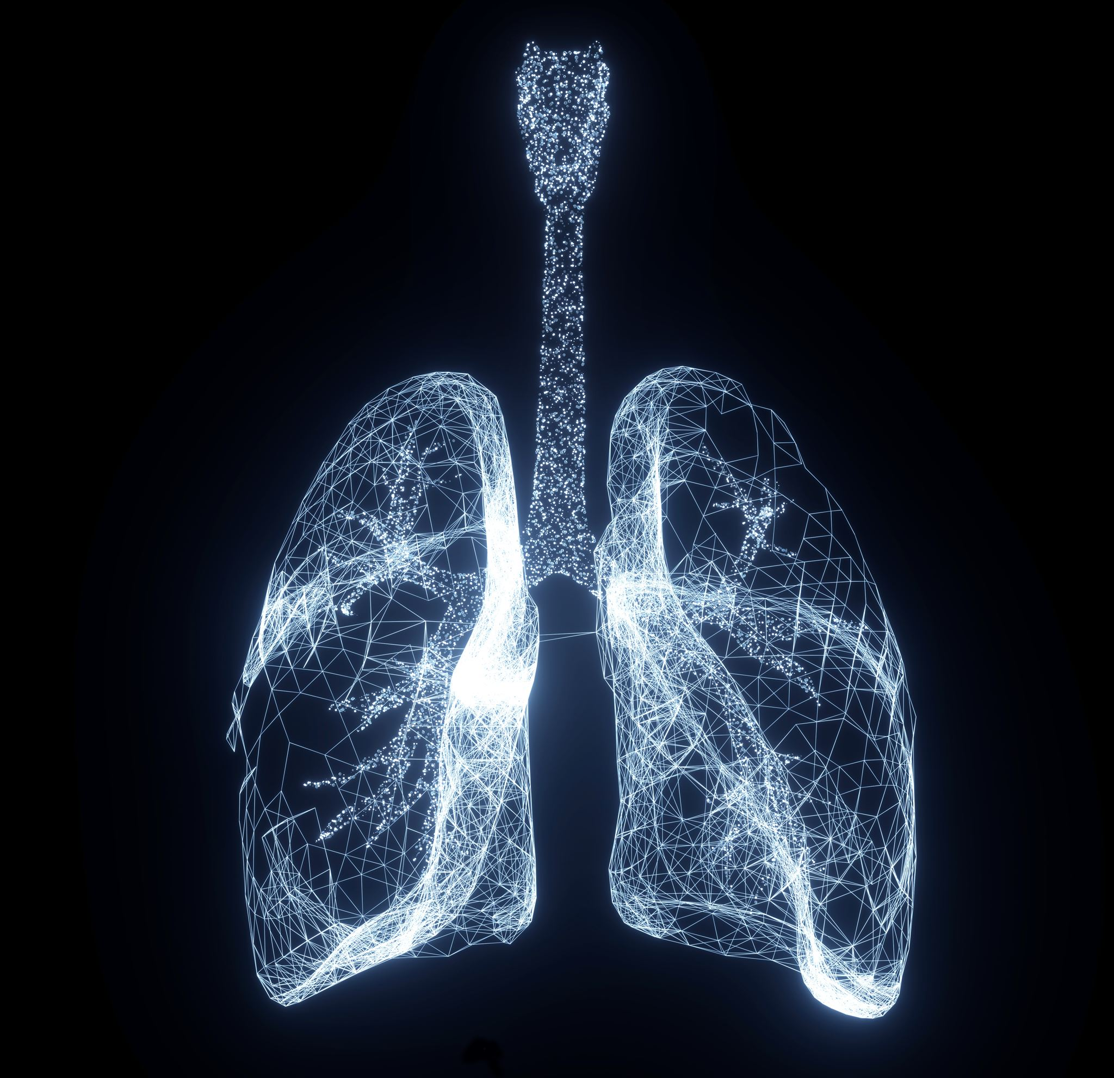
Lab 6: The Respiratory System
Exploring the structure and function of breathing organs
Notes:
---

Slide 2
Introduction to the Respiratory System
Notes:
---
This slide references information from the following file: https://susystem-my.sharepoint.com/personal/tanganika_johnson_sus_edu/Documents/Microsoft%20Copilot%20Chat%20Files/Lab%206%20Respiratory%20System%20Lab_Joy%20Davis.pdf
Overview and Importance

Slide 3
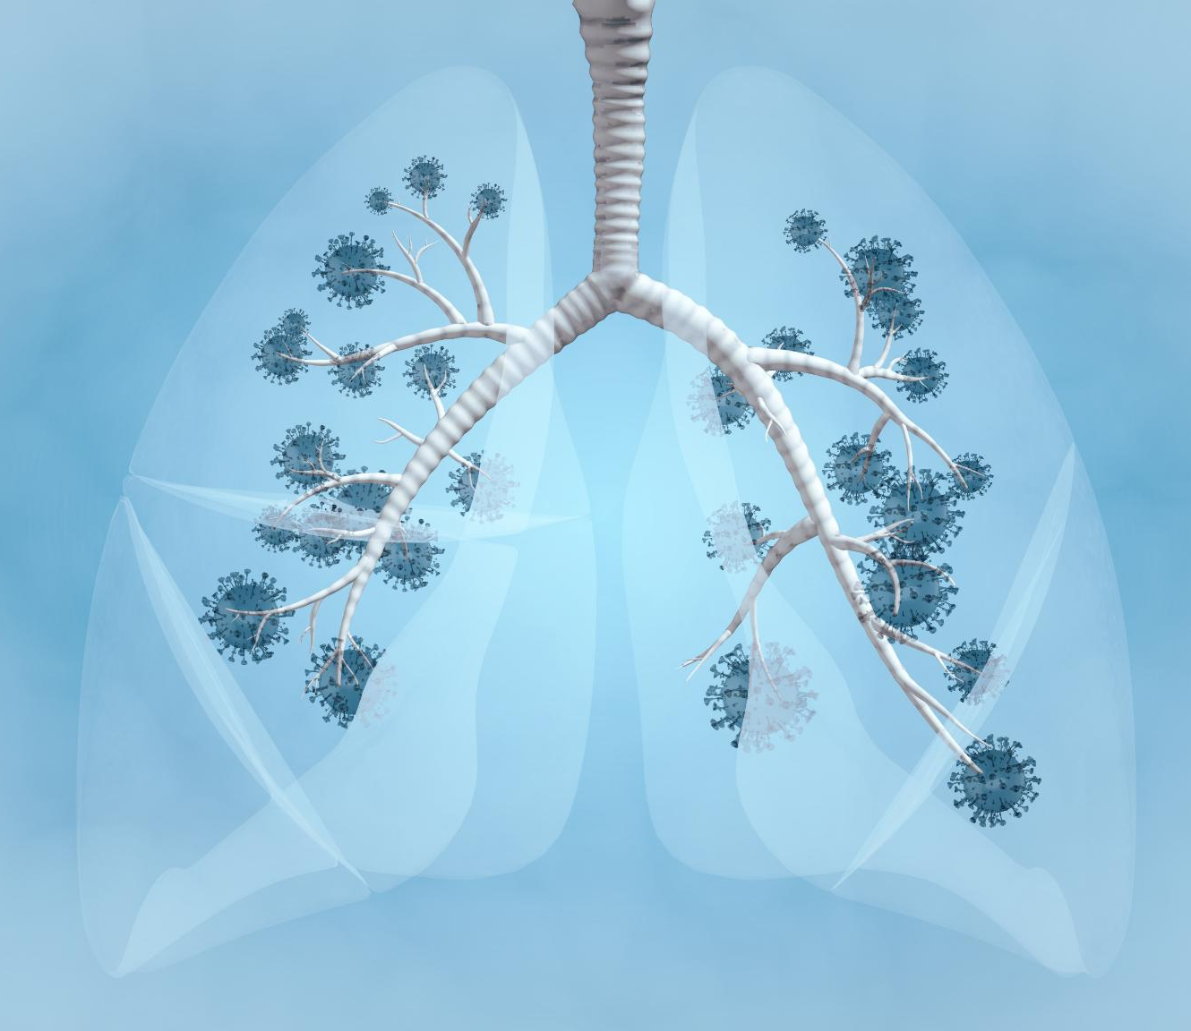
Overview and Importance
Respiratory System Function
  The respiratory system delivers oxygen to cells and removes carbon dioxide, maintaining homeostasis and blood pH.
Anatomy and Physiology
  The system includes air passages, muscles, and microscopic structures that facilitate breathing and gas exchange.
Integration with Other Systems
  It works closely with cardiovascular and muscular systems for oxygen transport and airflow generation.
Educational Laboratory Activities
  Dissections, models, and spirometry help students visualize and understand respiratory processes practically.
Notes:
---
This slide references information from the following file: https://susystem-my.sharepoint.com/personal/tanganika_johnson_sus_edu/Documents/Microsoft%20Copilot%20Chat%20Files/Lab%206%20Respiratory%20System%20Lab_Joy%20Davis.pdf
The respiratory system is a vital network that ensures oxygen delivery to every cell and the removal of carbon dioxide, maintaining homeostasis and regulating blood pH. Breathing occurs automatically, but its complexity becomes evident when analyzing its anatomy, histology, and physiology. This system includes passages, muscles, and microscopic structures that work together to facilitate gas exchange. It interacts closely with other systems, such as the cardiovascular system for oxygen transport and the muscular system for generating pressure changes that drive airflow. Understanding the respiratory system involves tracing the path of air from the atmosphere to tissues, explaining gas exchange and transport, and recognizing how the body adapts to varying oxygen demands and environmental conditions. Laboratory activities such as dissections, model work, and spirometry experiments help students visualize and measure these processes, reinforcing theoretical knowledge with practical application.

Slide 4
Learning Objectives
Notes:
---
This slide references information from the following file: https://susystem-my.sharepoint.com/personal/tanganika_johnson_sus_edu/Documents/Microsoft%20Copilot%20Chat%20Files/Lab%206%20Respiratory%20System%20Lab_Joy%20Davis.pdf
Goals of the Lab

Slide 5
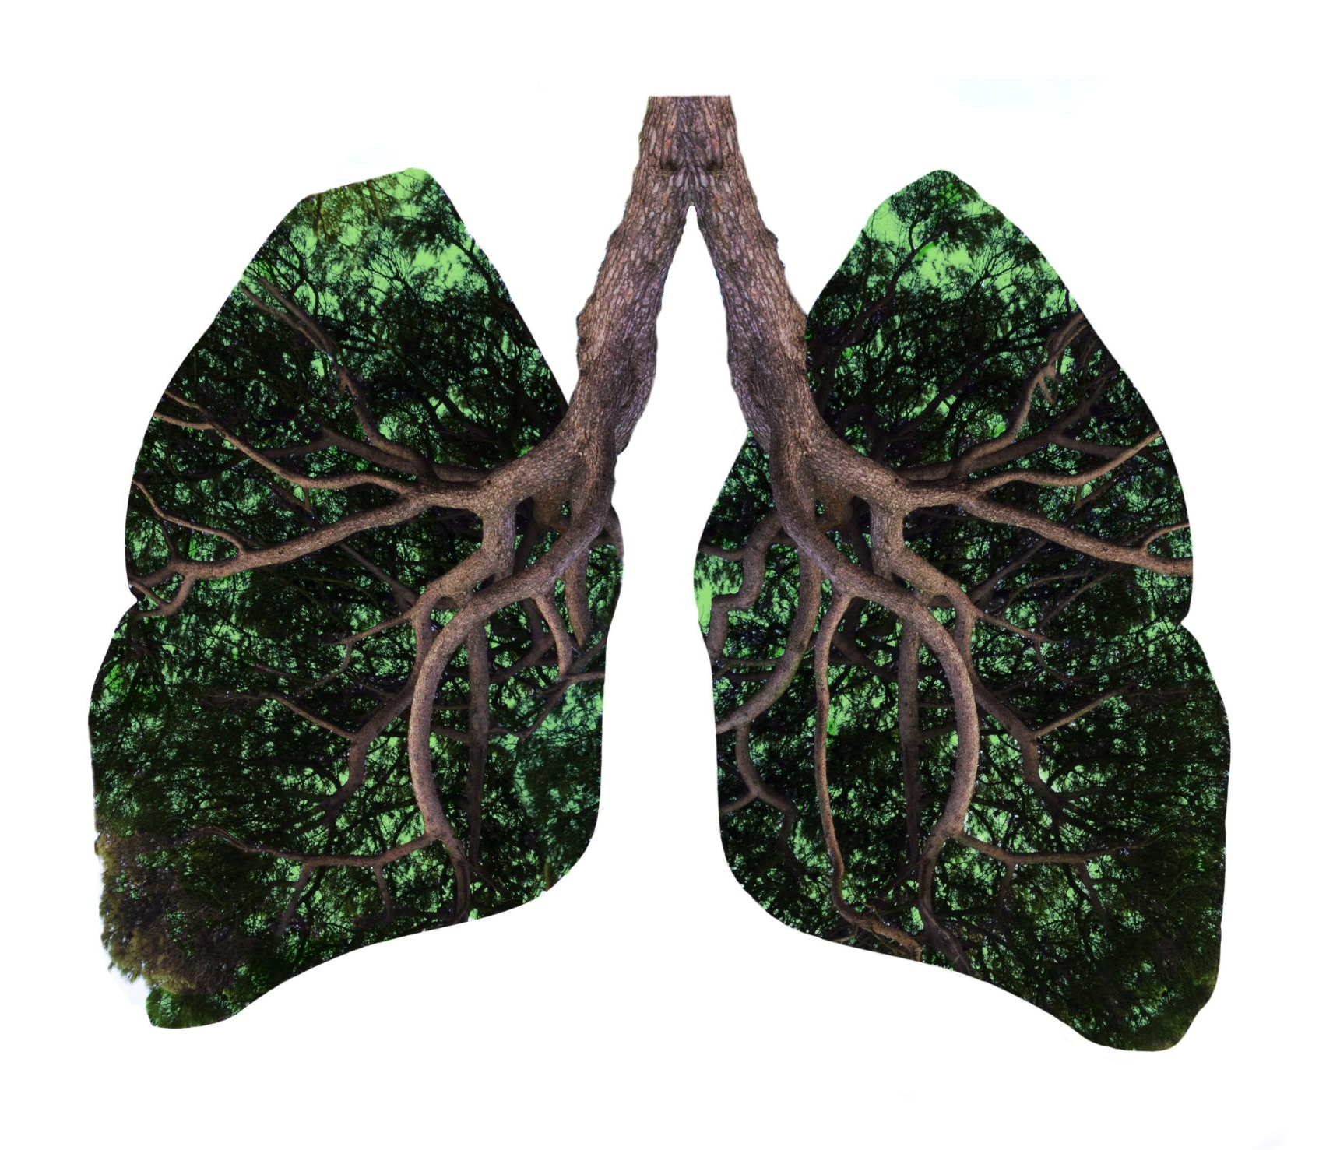
Goals of the Lab
Respiratory Structures Identification
  Students will identify and describe major structures of the upper and lower respiratory systems to understand their anatomy.
Pulmonary Ventilation Mechanisms
  Explain inspiration and expiration processes to illustrate how pulmonary ventilation functions during breathing.
Regulation of Breathing
  Understand the roles of pH, arterial pCO2, and arterial pO2 in controlling respiratory rates and depths.
Hands-on and Simulation Learning
  Perform experiments and analyze histological slides to explore respiratory anatomy and physiology practically.
Notes:
---
This slide references information from the following file: https://susystem-my.sharepoint.com/personal/tanganika_johnson_sus_edu/Documents/Microsoft%20Copilot%20Chat%20Files/Lab%206%20Respiratory%20System%20Lab_Joy%20Davis.pdf
By the end of this lab, students should be able to identify and describe major structures of the upper and lower respiratory system, explain the mechanisms of pulmonary ventilation including inspiration and expiration, and trace the pathway of air from the atmosphere to tissue cells. Additionally, learners will understand the roles of pH, arterial pCO₂, and arterial pO₂ in regulating breathing, interpret histological slides of lung and trachea tissue, and perform hands-on and simulation-based experiments to explore respiratory anatomy and physiology. These objectives ensure a comprehensive understanding of both structural and functional aspects of the respiratory system, preparing students to analyze respiratory responses under normal and stressed conditions.

Slide 6
Key Terms and Pre-Lab Activities
Notes:
---
This slide references information from the following file: https://susystem-my.sharepoint.com/personal/tanganika_johnson_sus_edu/Documents/Microsoft%20Copilot%20Chat%20Files/Lab%206%20Respiratory%20System%20Lab_Joy%20Davis.pdf
Essential Vocabulary and Structure Table

Slide 7
Essential Vocabulary and Structure Table
Structure | Function | Location | Upper or Lower
Nasal cavity | Filters, warms, and humidifies air | Within the nose | Upper
Pharynx | Passageway for air and food | Behind nasal and oral cavities | Upper
Larynx | Voice production and airway protection | Below pharynx | Lower
Trachea | Conducts air to bronchi | Extends from larynx to bronchi | Lower
Bronchi | Distribute air to lungs | Branches from trachea | Lower
Alveoli | Site of gas exchange | Within lungs | Lower
Lungs | House bronchi and alveoli | Thoracic cavity | Lower
Notes:
---
This slide references information from the following file: https://susystem-my.sharepoint.com/personal/tanganika_johnson_sus_edu/Documents/Microsoft%20Copilot%20Chat%20Files/Lab%206%20Respiratory%20System%20Lab_Joy%20Davis.pdf
Key terms include pulmonary ventilation, inspiration, expiration, vital capacity, tidal volume, hypercapnia, hypoxemia, residual volume, inspiratory reserve volume, expiratory reserve volume, pCO₂, pO₂, pleura, diaphragm, bronchial tree, alveoli, chemoreceptors, Boyle’s Law, and bicarbonate buffering system. Understanding these terms is crucial for interpreting respiratory functions and physiological responses. Pre-lab activities involve filling in a structure table that lists major respiratory structures such as the nasal cavity, pharynx, larynx, epiglottis, vocal folds, trachea, bronchi, alveoli, and lungs, specifying their functions, locations, and classification as part of the upper or lower respiratory system. These preparatory steps help students familiarize themselves with anatomical terminology and functional roles before engaging in practical exercises.

Slide 8
Anatomy and Histology
Notes:
---
This slide references information from the following file: https://susystem-my.sharepoint.com/personal/tanganika_johnson_sus_edu/Documents/Microsoft%20Copilot%20Chat%20Files/Lab%206%20Respiratory%20System%20Lab_Joy%20Davis.pdf
Structural Overview and Tissue Types

Slide 9
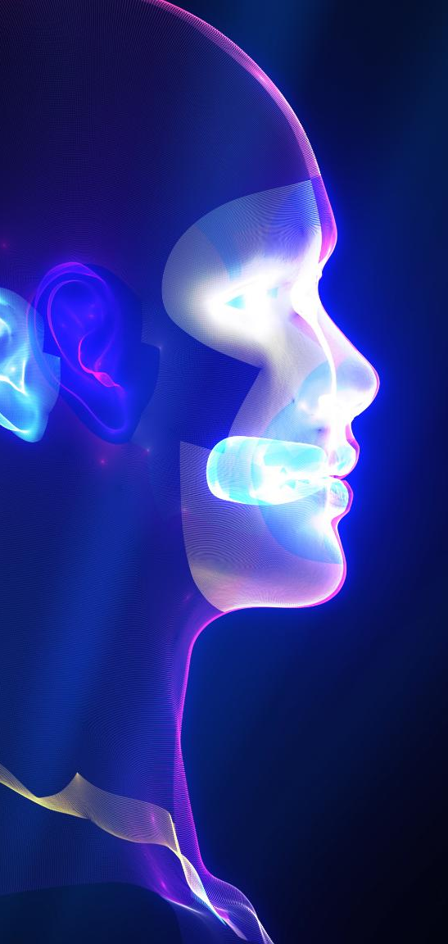
Structural Overview and Tissue Types
Anatomy of Respiratory Tract
  The respiratory system is divided into conducting and respiratory zones with distinct structures in upper and lower tracts.
Key Respiratory Structures
  Important structures include nasal conchae, pharyngeal regions, laryngeal cartilages, tracheal rings, and the bronchial tree ending in alveoli.
Histology of Trachea
  The trachea is lined by pseudostratified ciliated columnar epithelium with goblet cells and supported by hyaline cartilage and submucosa.
Lung Alveolar Tissue
  Alveoli are lined with simple squamous epithelium including type I and II alveolar cells and macrophages to support gas exchange and protection.
Notes:
---
This slide references information from the following file: https://susystem-my.sharepoint.com/personal/tanganika_johnson_sus_edu/Documents/Microsoft%20Copilot%20Chat%20Files/Lab%206%20Respiratory%20System%20Lab_Joy%20Davis.pdf
The respiratory system consists of conducting and respiratory zones. The upper respiratory tract includes the nose, nasal cavity, paranasal sinuses, and pharynx, while the lower tract comprises the larynx, trachea, bronchi, and lungs. Key structures include nasal conchae, meatuses, pharyngeal regions, laryngeal cartilages, tracheal rings, and the bronchial tree branching into alveoli. Histologically, the trachea is lined with pseudostratified ciliated columnar epithelium containing goblet cells, supported by hyaline cartilage and submucosa. The lungs feature alveoli lined with simple squamous epithelium, type I and type II alveolar cells, and alveolar macrophages. These specialized tissues facilitate efficient gas exchange and protect against pathogens and debris.

Slide 10
Mechanics and Regulation of Breathing
Notes:
---
This slide references information from the following file: https://susystem-my.sharepoint.com/personal/tanganika_johnson_sus_edu/Documents/Microsoft%20Copilot%20Chat%20Files/Lab%206%20Respiratory%20System%20Lab_Joy%20Davis.pdf
Boyle’s Law and Ventilation Control

Slide 11
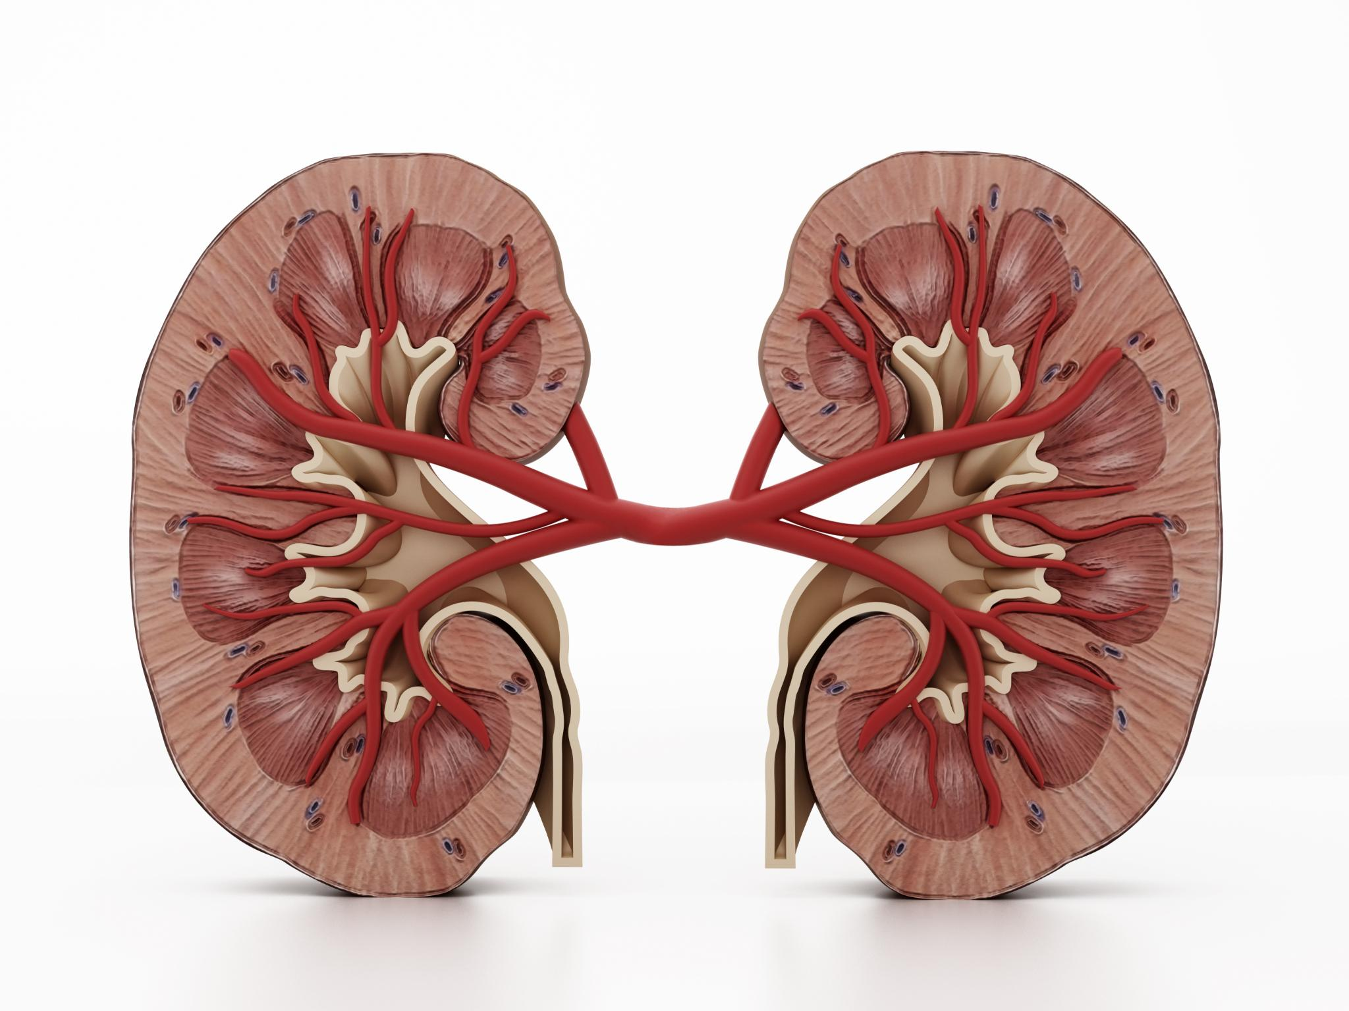
Boyle’s Law and Ventilation Control
Boyle’s Law in Breathing
  Thoracic volume increases lower intrapulmonary pressure, driving air into the lungs during inspiration.
Muscles Involved in Ventilation
  Quiet inspiration uses diaphragm and external intercostals; forced breathing recruits accessory muscles.
Neural Control of Breathing
  Medulla and pons centers regulate ventilation based on input from chemoreceptors detecting blood gas changes.
Chemical and Emotional Influence
  Chemoreceptors respond to CO₂ and O₂ levels; limbic and hypothalamus modulate breathing with emotional input.
Notes:
---
This slide references information from the following file: https://susystem-my.sharepoint.com/personal/tanganika_johnson_sus_edu/Documents/Microsoft%20Copilot%20Chat%20Files/Lab%206%20Respiratory%20System%20Lab_Joy%20Davis.pdf
Breathing mechanics follow Boyle’s Law: as thoracic volume increases, intrapulmonary pressure decreases, allowing air to flow in. Quiet inspiration involves the diaphragm and external intercostals, while forced inspiration recruits scalene and sternocleidomastoid muscles. Forced expiration uses internal intercostals and abdominal muscles. Pleurae reduce friction and create surface tension for lung expansion. Ventilation regulation is controlled by the medulla (DRG, VRG) and pons (apneustic and pneumotaxic centers), with chemoreceptors detecting changes in pCO₂, pO₂, and pH. Hypercapnia (elevated CO₂) lowers pH and increases ventilation, while hypoxemia (low O₂) also stimulates breathing. Emotional and sensory inputs from the limbic system and hypothalamus further modulate respiratory patterns.

Slide 12
Laboratory Activities and Post-Lab Review
Notes:
---
This slide references information from the following file: https://susystem-my.sharepoint.com/personal/tanganika_johnson_sus_edu/Documents/Microsoft%20Copilot%20Chat%20Files/Lab%206%20Respiratory%20System%20Lab_Joy%20Davis.pdf
Hands-On Experiments and Analysis

Slide 13
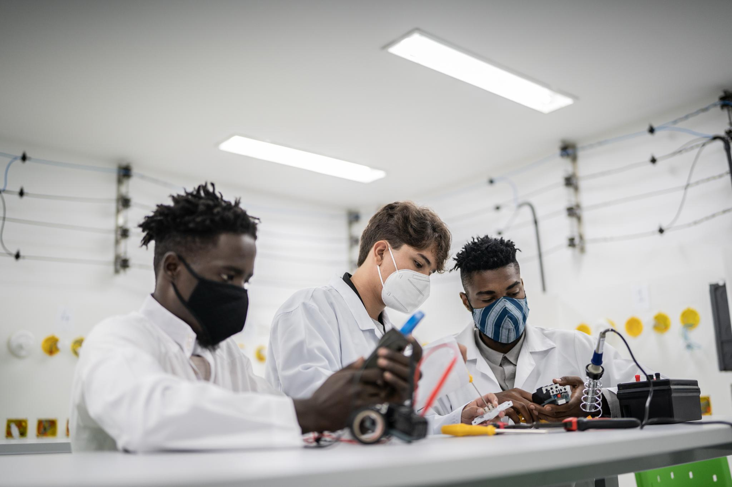
Hands-On Experiments and Analysis
Anatomical Identification and Observation
  Students explore lung anatomy using models, dissections, and histology slides to identify key structures.
Physiology Experiments with Spirometry
  Spirometry measures tidal volume, expiratory reserve, and vital capacity to analyze lung function.
Breathing Rate and Simulation Tests
  Experiments track breathing changes under exercise, breath-holding, and hyperventilation conditions with simulations of gas effects.
Data Analysis and Critical Thinking
  Post-lab reviews involve labeling diagrams, analyzing lung data, and solving respiratory distress case studies.
Notes:
---
This slide references information from the following file: https://susystem-my.sharepoint.com/personal/tanganika_johnson_sus_edu/Documents/Microsoft%20Copilot%20Chat%20Files/Lab%206%20Respiratory%20System%20Lab_Joy%20Davis.pdf
Laboratory activities include anatomical identification using models and dissections, histology slide observations of trachea and lung tissues, and demonstrations of lung inflation. Physiology experiments involve spirometry to measure tidal volume, expiratory reserve volume, and vital capacity, as well as simulations exploring the effects of pH, pCO₂, and pO₂ on ventilation. Breathing rate experiments assess changes during various activities and conditions such as exercise, breath-holding, and hyperventilation. Post-lab reviews require labeling diagrams, analyzing data on lung capacities and breathing recovery times, and answering applied physiology questions. Critical thinking scenarios challenge students to interpret cases involving respiratory distress, environmental changes, and pathological conditions, reinforcing theoretical knowledge through practical application.

