Slide 1
Lab 8: The Urinary System
Exploring anatomy and function of urinary organs
Notes:
---

Slide 2
Introduction to the Urinary System
Notes:
---
This slide references information from the following file: https://susystem-my.sharepoint.com/personal/tanganika_johnson_sus_edu/Documents/Microsoft%20Copilot%20Chat%20Files/Lab%208%20Urinary%20System%20Lab_Joy%20Davis.pdf
Overview and Functions

Slide 3
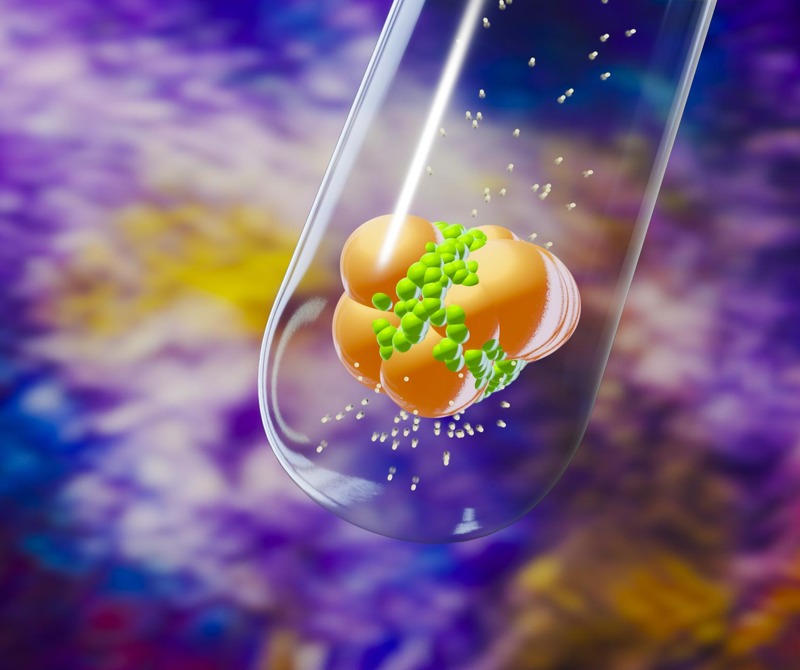
Overview and Functions
Homeostatic Regulation
  The urinary system maintains blood composition, fluid volume, electrolytes, and acid-base balance for body homeostasis.
Kidney Functions Beyond Waste
  Kidneys control blood pressure, activate Vitamin D, and produce erythropoietin to support red blood cell formation.
Microscopic Filtration Process
  Millions of nephrons filter 200 liters daily, reabsorbing essentials and secreting wastes to form urine efficiently.
Structure-Function Relationship
  Understanding anatomy, histology, and physiology reveals how urinary system changes impact overall health.
Notes:
---
This slide references information from the following file: https://susystem-my.sharepoint.com/personal/tanganika_johnson_sus_edu/Documents/Microsoft%20Copilot%20Chat%20Files/Lab%208%20Urinary%20System%20Lab_Joy%20Davis.pdf
The urinary system is a vital component of the body’s homeostatic mechanisms, ensuring internal balance by regulating blood composition, fluid volume, electrolyte concentrations, and acid-base equilibrium. While commonly associated with urine production and elimination, its functions extend far beyond waste removal. The kidneys play a central role in controlling blood pressure, activating Vitamin D, and producing erythropoietin (EPO) for red blood cell formation. These processes collectively support the function of every organ system. At the microscopic level, millions of nephrons within the kidneys filter nearly 200 liters of fluid daily, selectively reabsorbing essential substances and secreting waste products. This remarkable efficiency ensures that only a small fraction of the filtrate becomes urine. Understanding the urinary system requires exploring its gross anatomy, histology, and physiological processes, as well as recognizing how structural changes can lead to systemic effects. This lab emphasizes the relationship between structure and function, guiding students through anatomical identification, histological analysis, and clinical applications. By the end of this study, learners should appreciate the urinary system as a dynamic regulator of internal conditions rather than a simple waste disposal mechanism.

Slide 4
Learning Objectives and Key Terms
Notes:
---
This slide references information from the following file: https://susystem-my.sharepoint.com/personal/tanganika_johnson_sus_edu/Documents/Microsoft%20Copilot%20Chat%20Files/Lab%208%20Urinary%20System%20Lab_Joy%20Davis.pdf
Objectives and Terminology

Slide 5
Objectives and Terminology
Term | Definition
Nephron | Functional unit of the kidney responsible for filtration and urine formation
Renal Corpuscle | Structure consisting of the glomerulus and Bowman’s capsule
Glomerulus | Capillary network where blood filtration begins
PCT | Segment of nephron where most reabsorption occurs
DCT | Segment involved in selective secretion and reabsorption
Loop of Henle | Structure critical for concentration of urine
Collecting Duct | Final site for urine concentration and transport to renal pelvis
Notes:
---
This slide references information from the following file: https://susystem-my.sharepoint.com/personal/tanganika_johnson_sus_edu/Documents/Microsoft%20Copilot%20Chat%20Files/Lab%208%20Urinary%20System%20Lab_Joy%20Davis.pdf
Upon completing this lab, students should be able to identify the gross and microscopic anatomy of the urinary system, distinguish nephron structures in histological images, and relate structural features to urine formation and homeostasis. Additionally, learners will apply anatomical knowledge to interpret clinical scenarios. Key terms include nephron, renal corpuscle, glomerulus, Bowman’s capsule, proximal convoluted tubule (PCT), loop of Henle, distal convoluted tubule (DCT), collecting duct, peritubular capillaries, vasa recta, renal cortex, renal medulla, renal pelvis, ureter, urinary bladder, urethra, and associated physiological processes such as filtration, reabsorption, and secretion. Understanding these terms is essential for grasping the complexity of renal function and its systemic implications.

Slide 6
Anatomy of the Urinary System
Notes:
---
This slide references information from the following file: https://susystem-my.sharepoint.com/personal/tanganika_johnson_sus_edu/Documents/Microsoft%20Copilot%20Chat%20Files/Lab%208%20Urinary%20System%20Lab_Joy%20Davis.pdf
Major Organs and Kidney Structure

Slide 7
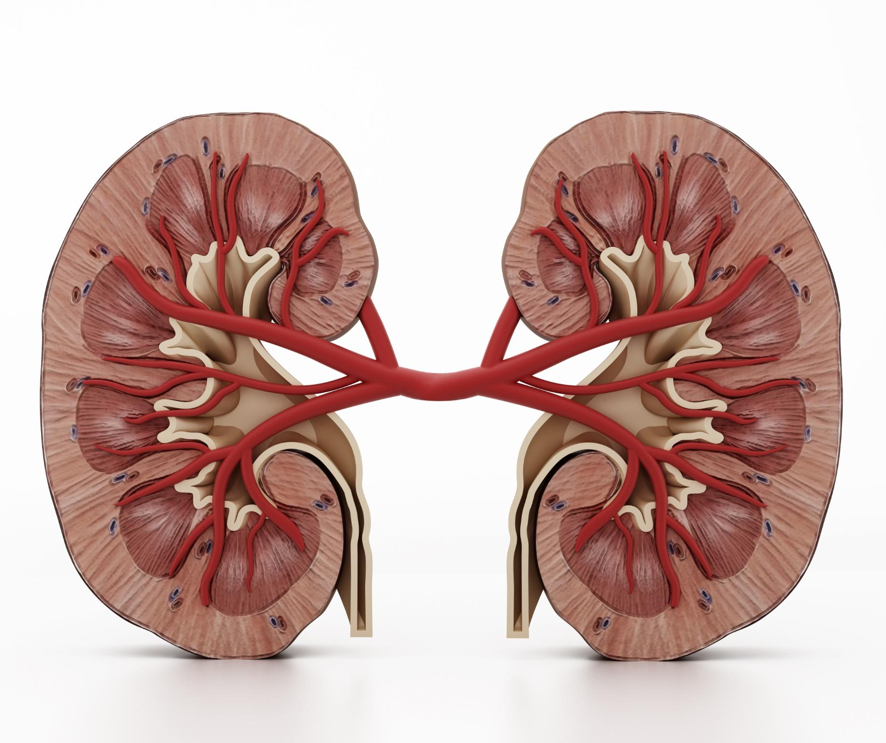
Major Organs and Kidney Structure
Urinary System Components
  The urinary system includes kidneys, ureters, urinary bladder, and urethra, all working together for urine transport.
Kidney Anatomy Overview
  Kidneys are bean-shaped organs with renal capsule, cortex, and medulla, positioned near the posterior abdominal wall.
Internal Kidney Structures
  Renal medulla contains pyramids and columns; urine flows from papillae to calyces and then renal pelvis.
Renal Hilum Function
  Renal hilum is the entry and exit point for blood vessels, lymphatics, and nerves supporting kidney function.
Notes:
---
This slide references information from the following file: https://susystem-my.sharepoint.com/personal/tanganika_johnson_sus_edu/Documents/Microsoft%20Copilot%20Chat%20Files/Lab%208%20Urinary%20System%20Lab_Joy%20Davis.pdf
The urinary system consists of two kidneys, two ureters, one urinary bladder, and one urethra. The kidneys are retroperitoneal, bean-shaped organs located near the posterior abdominal wall, partially protected by ribs 11 and 12. Each kidney is covered by a renal capsule and contains two main regions: the renal cortex and renal medulla. The medulla houses cone-shaped pyramids separated by renal columns, while urine flows from the papillae into minor calyces, then major calyces, and finally into the renal pelvis before entering the ureter. The renal hilum serves as the entry and exit point for blood vessels, lymphatics, and nerves. This structural organization supports efficient filtration and urine transport. Understanding these anatomical details is crucial for interpreting physiological processes and diagnosing pathological conditions.

Slide 8
Nephron and Blood Flow
Notes:
---
This slide references information from the following file: https://susystem-my.sharepoint.com/personal/tanganika_johnson_sus_edu/Documents/Microsoft%20Copilot%20Chat%20Files/Lab%208%20Urinary%20System%20Lab_Joy%20Davis.pdf
Structure and Circulation

Slide 9
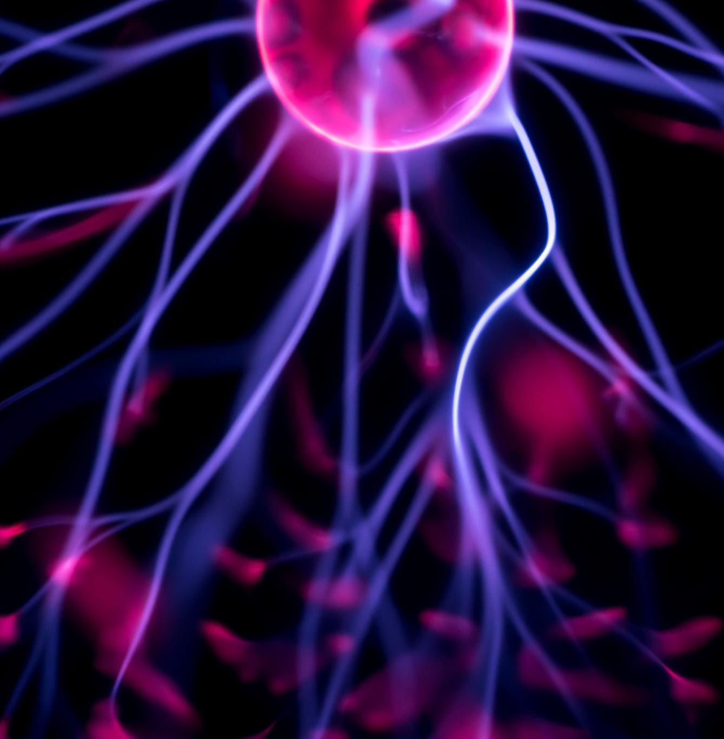
Structure and Circulation
Nephron Structure Overview
  The nephron begins with the renal corpuscle, including the glomerulus and Bowman’s capsule, essential for filtration.
Filtrate Pathway
  Filtrate passes through proximal tubule, loop of Henle, distal tubule, and collecting duct for selective reabsorption and secretion.
Kidney Blood Circulation
  Blood flows through a precise route from renal artery to peritubular capillaries, enabling efficient substance exchange.
Notes:
---
This slide references information from the following file: https://susystem-my.sharepoint.com/personal/tanganika_johnson_sus_edu/Documents/Microsoft%20Copilot%20Chat%20Files/Lab%208%20Urinary%20System%20Lab_Joy%20Davis.pdf
The nephron is the functional unit of the kidney, beginning with the renal corpuscle composed of the glomerulus and Bowman’s capsule. Blood enters the nephron via the afferent arteriole, passes through the glomerulus for filtration, and exits through the efferent arteriole. The filtrate flows through the proximal convoluted tubule, loop of Henle, distal convoluted tubule, and collecting duct, where selective reabsorption and secretion occur. Blood circulation within the kidney follows a precise route: renal artery → segmental artery → interlobar artery → arcuate artery → cortical radiate artery → afferent arteriole → glomerulus → efferent arteriole → peritubular capillaries and vasa recta. This arrangement ensures efficient exchange of substances between blood and filtrate, maintaining homeostasis and enabling fine control of fluid and electrolyte balance.

Slide 10
Histology and Functional Insights
Notes:
---
This slide references information from the following file: https://susystem-my.sharepoint.com/personal/tanganika_johnson_sus_edu/Documents/Microsoft%20Copilot%20Chat%20Files/Lab%208%20Urinary%20System%20Lab_Joy%20Davis.pdf
Microscopic Anatomy

Slide 11
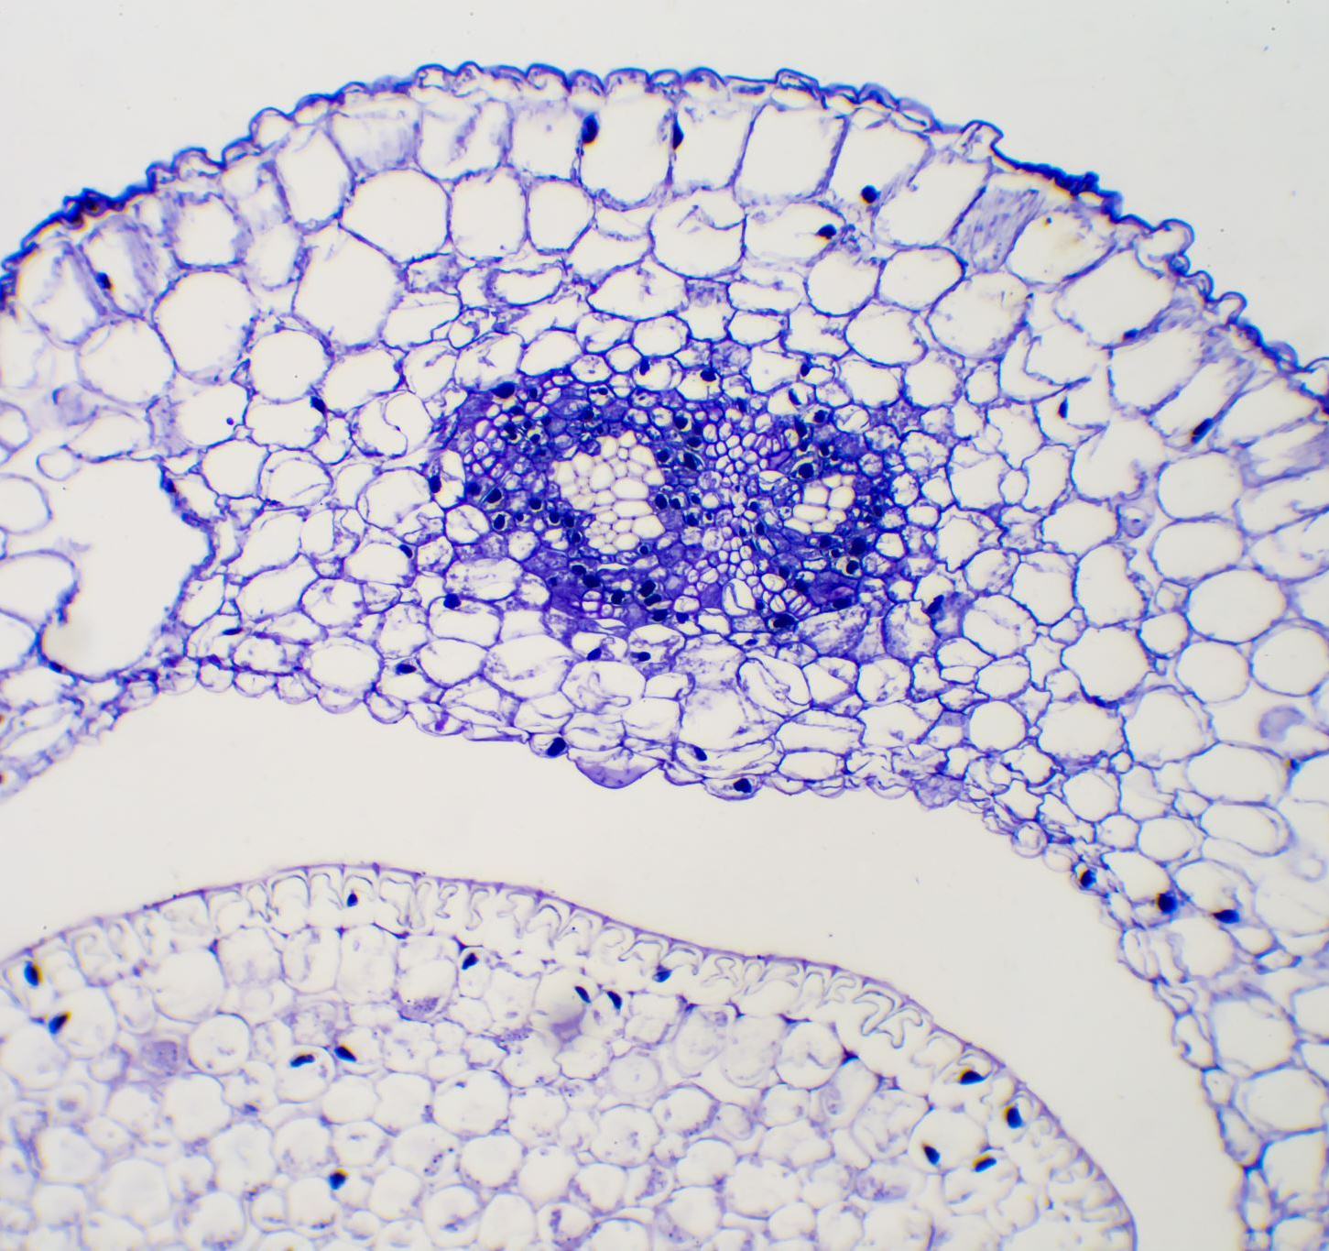
Microscopic Anatomy
Kidney Microstructures
  Renal corpuscles, proximal and distal tubules, and collecting ducts are lined with cuboidal epithelium for efficient filtration.
Bowman’s Capsule Role
  Bowman’s capsule surrounds the glomerulus, playing a key role in blood filtration within the kidney.
Urinary Bladder Epithelium
  The bladder's transitional epithelium allows expansion and contraction while preventing urine leakage, supported by muscularis and serosa layers.
Pathological Implications
  Recognizing microscopic anatomical features helps understand diseases like infections and chronic kidney disease that affect urinary function.
Notes:
---
This slide references information from the following file: https://susystem-my.sharepoint.com/personal/tanganika_johnson_sus_edu/Documents/Microsoft%20Copilot%20Chat%20Files/Lab%208%20Urinary%20System%20Lab_Joy%20Davis.pdf
Histological examination reveals specialized structures that support urinary function. The kidney contains renal corpuscles, proximal and distal tubules, and collecting ducts lined with cuboidal epithelium. Bowman’s capsule surrounds the glomerulus, facilitating filtration. The urinary bladder features transitional epithelium, allowing expansion and contraction, supported by muscularis and serosa layers. These tissue adaptations enable the bladder to store urine without leakage and the kidney to filter blood efficiently. Recognizing these microscopic features is essential for understanding pathological changes, such as those seen in infections or chronic kidney disease, which can disrupt normal architecture and impair function.

Slide 12
Urinalysis and Clinical Relevance
Notes:
---
This slide references information from the following file: https://susystem-my.sharepoint.com/personal/tanganika_johnson_sus_edu/Documents/Microsoft%20Copilot%20Chat%20Files/Lab%208%20Urinary%20System%20Lab_Joy%20Davis.pdf
Normal Characteristics and Interpretation

Slide 13
Normal Characteristics and Interpretation
Characteristic | Normal Range
Color | Pale yellow to amber
pH | 4.5 - 8.0
Specific Gravity | 1.003 - 1.032
Glucose | None
Protein | None or trace
Notes:
---
This slide references information from the following file: https://susystem-my.sharepoint.com/personal/tanganika_johnson_sus_edu/Documents/Microsoft%20Copilot%20Chat%20Files/Lab%208%20Urinary%20System%20Lab_Joy%20Davis.pdf
Urinalysis is a key diagnostic tool for assessing renal health. Normal urine ranges from pale yellow to amber, with a pH between 4.5 and 8.0, specific gravity from 1.003 to 1.032, and absence of glucose, protein, ketones, nitrites, and blood. Deviations from these norms can indicate conditions such as diabetes mellitus (presence of glucose), urinary tract infections (presence of nitrites or white blood cells), or kidney disease (proteinuria). Specific gravity reflects hydration status, with higher values suggesting dehydration. Understanding these parameters allows clinicians to detect early signs of systemic disorders and guide appropriate interventions.

Slide 14
Laboratory Activities and Post-Lab Review
Notes:
---
This slide references information from the following file: https://susystem-my.sharepoint.com/personal/tanganika_johnson_sus_edu/Documents/Microsoft%20Copilot%20Chat%20Files/Lab%208%20Urinary%20System%20Lab_Joy%20Davis.pdf
Hands-On Exploration

Slide 15
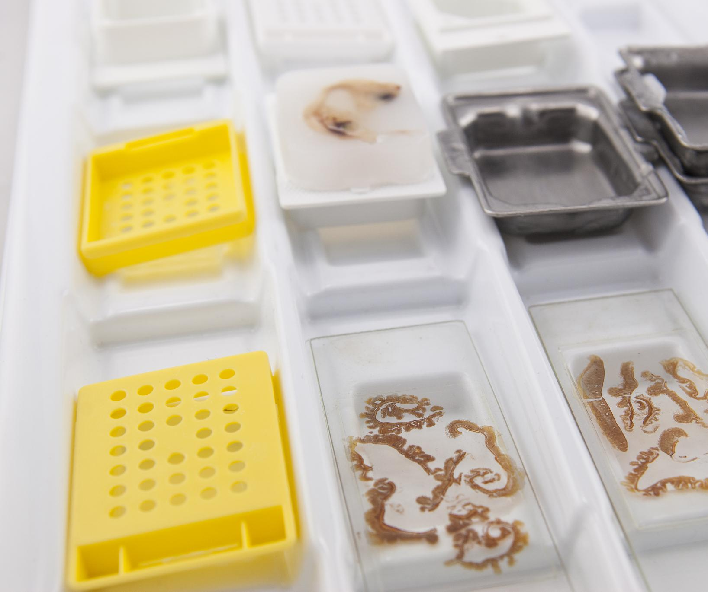
Hands-On Exploration
Urinary Structure Identification
  Students identify urinary system structures using models and perform kidney dissections to understand anatomy practically.
Histology Slide Examination
  Examination of bladder and kidney histology slides helps students recognize cellular structures and tissue organization.
Urinalysis Testing
  Students conduct urinalysis by measuring urine color, pH, specific gravity, glucose, and protein to assess physiological health.
Clinical Interpretation and Review
  Post-lab reviews reinforce nephron function understanding and clinical correlations for comprehensive learning.
Notes:
---
This slide references information from the following file: https://susystem-my.sharepoint.com/personal/tanganika_johnson_sus_edu/Documents/Microsoft%20Copilot%20Chat%20Files/Lab%208%20Urinary%20System%20Lab_Joy%20Davis.pdf
Laboratory activities include identifying urinary structures on models, performing kidney dissections, examining histology slides of the bladder and kidney, and conducting urinalysis tests. Students will measure urine characteristics such as color, pH, specific gravity, glucose, and protein, and interpret results in the context of normal physiology and disease states. Post-lab review questions reinforce understanding of anatomical structures, nephron function, and clinical correlations. These exercises provide practical experience, bridging theoretical knowledge with real-world applications, and prepare students for advanced studies in anatomy, physiology, and healthcare.

