Slide 1

ANATOMY & PHYSIOLOGY 2e
Chapter 4 THE CARDIOVASCULAR SYSTEM:
BLOOD VESSELS AND CIRCULATION
PowerPoint Image Slideshow

Slide 2

Figure 4.1
Blood Vessels
While most blood vessels are located deep from the surface and are not visible, the superficial veins of the upper limb provide an indication of the extent, prominence, and importance of these structures to the body. (credit: Colin Davis)

Slide 3
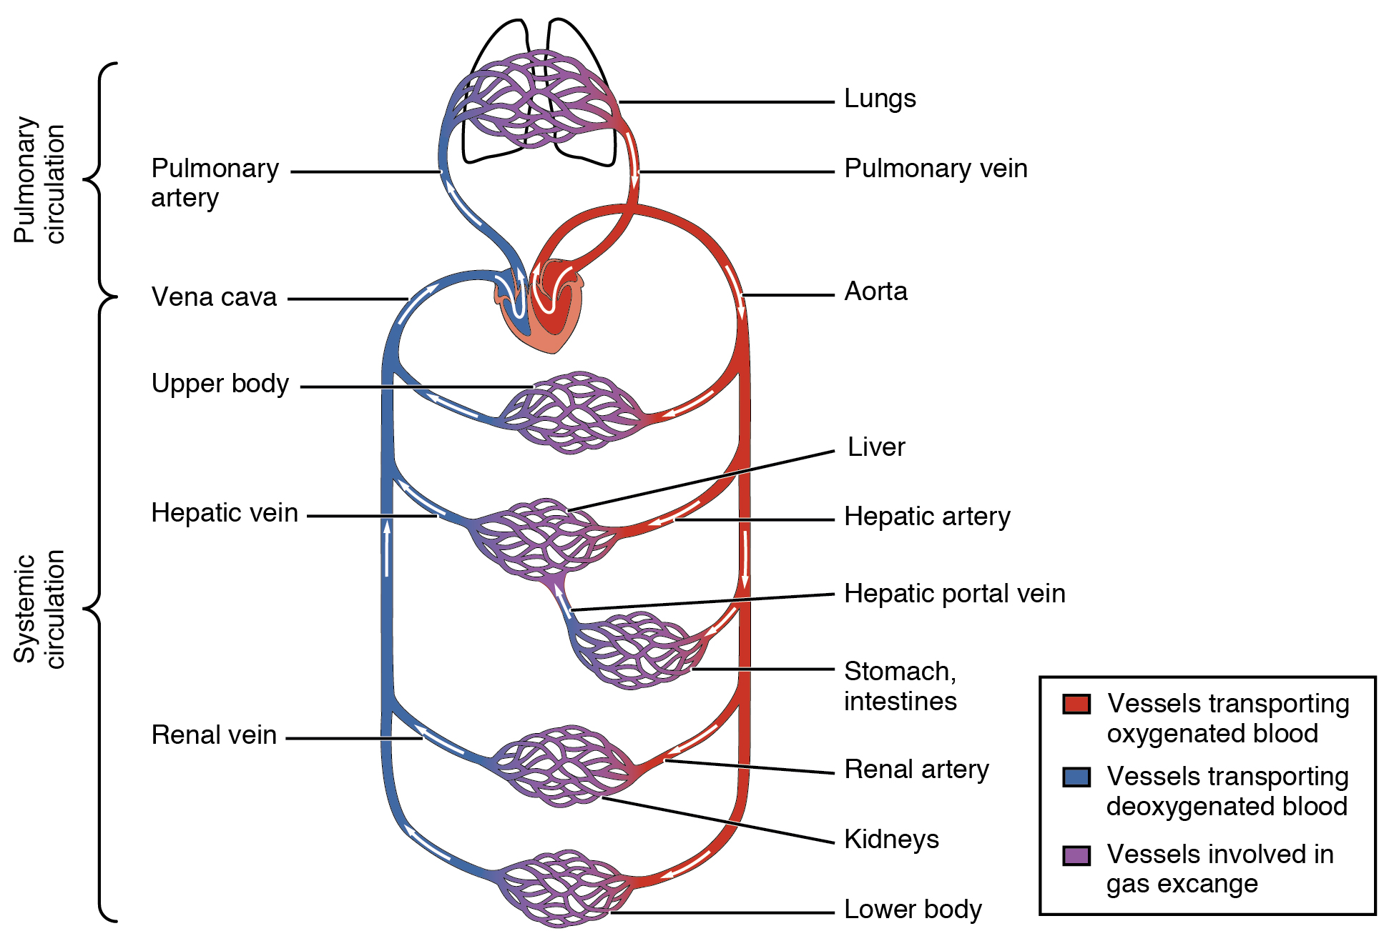
Figure 4.2
Cardiovascular Circulation
The pulmonary circuit moves blood from the right side of the heart to the lungs and back to the heart. The systemic circuit moves blood from the left side of the heart to the head and body and returns it to the right side of the heart to repeat the cycle. The arrows indicate the direction of blood flow, and the colors show the relative levels of oxygen concentration.

Slide 4
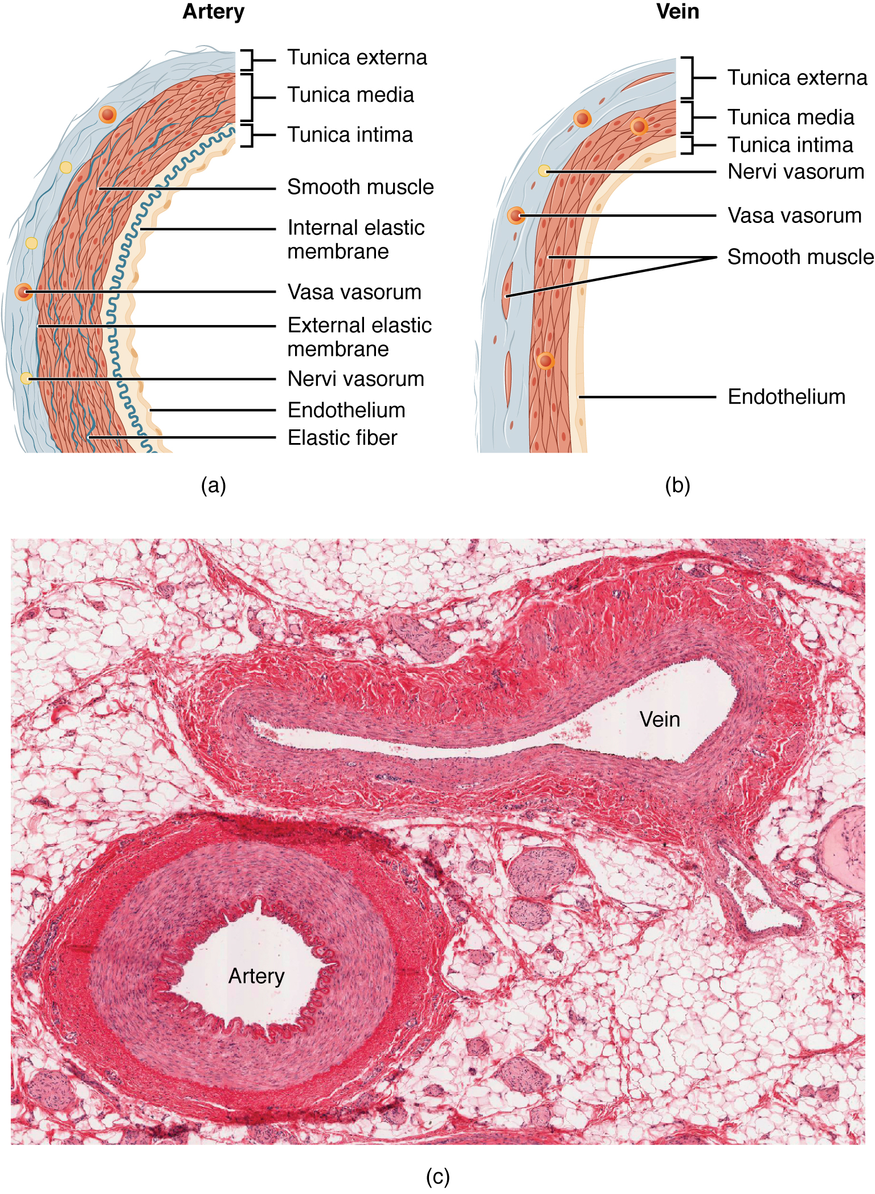
Figure 4.3
Structure of Blood Vessels
(a) Arteries and (b) veins share the same general features, but the walls of arteries are much thicker because of the higher pressure of the blood that flows through them. (c) A micrograph shows the relative differences in thickness. LM × 160.(Micrograph provided by the Regents of the University of Michigan Medical School © 2012)

Slide 5
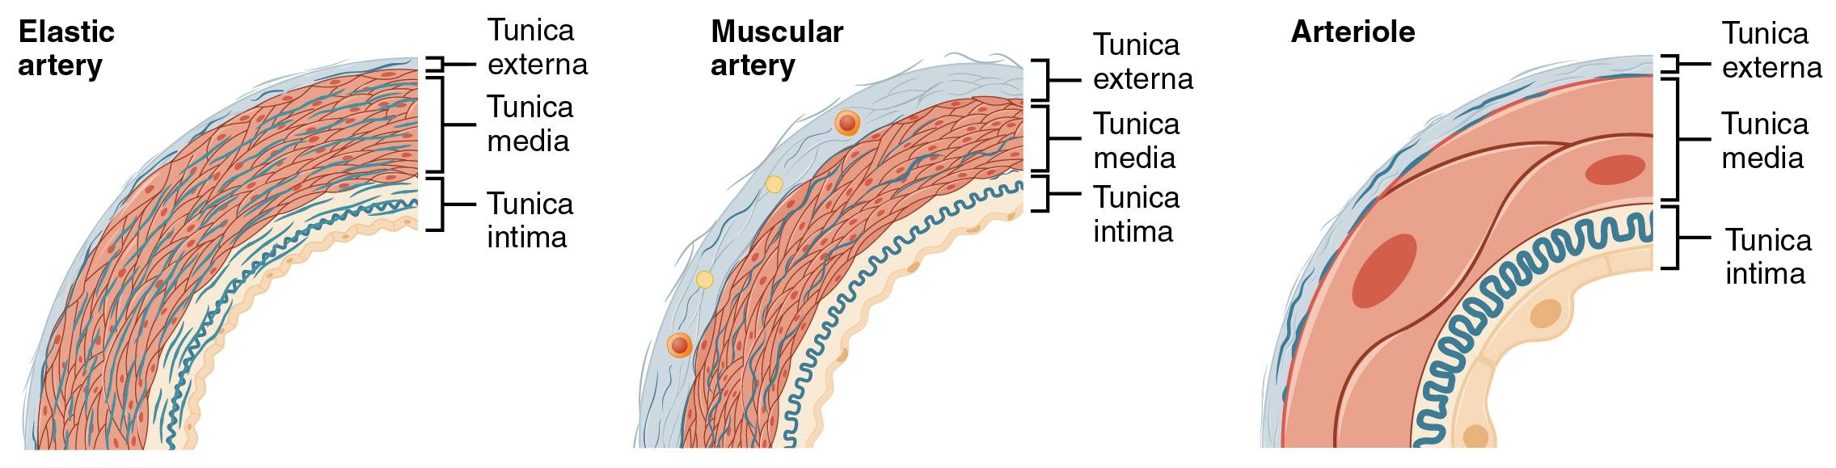
Figure 4.4
Types of Arteries and Arterioles
Comparison of the walls of an elastic artery, a muscular artery, and an arteriole is shown. In terms of scale, the diameter of an arteriole is measured in micrometers compared to millimeters for elastic and muscular arteries.

Slide 6
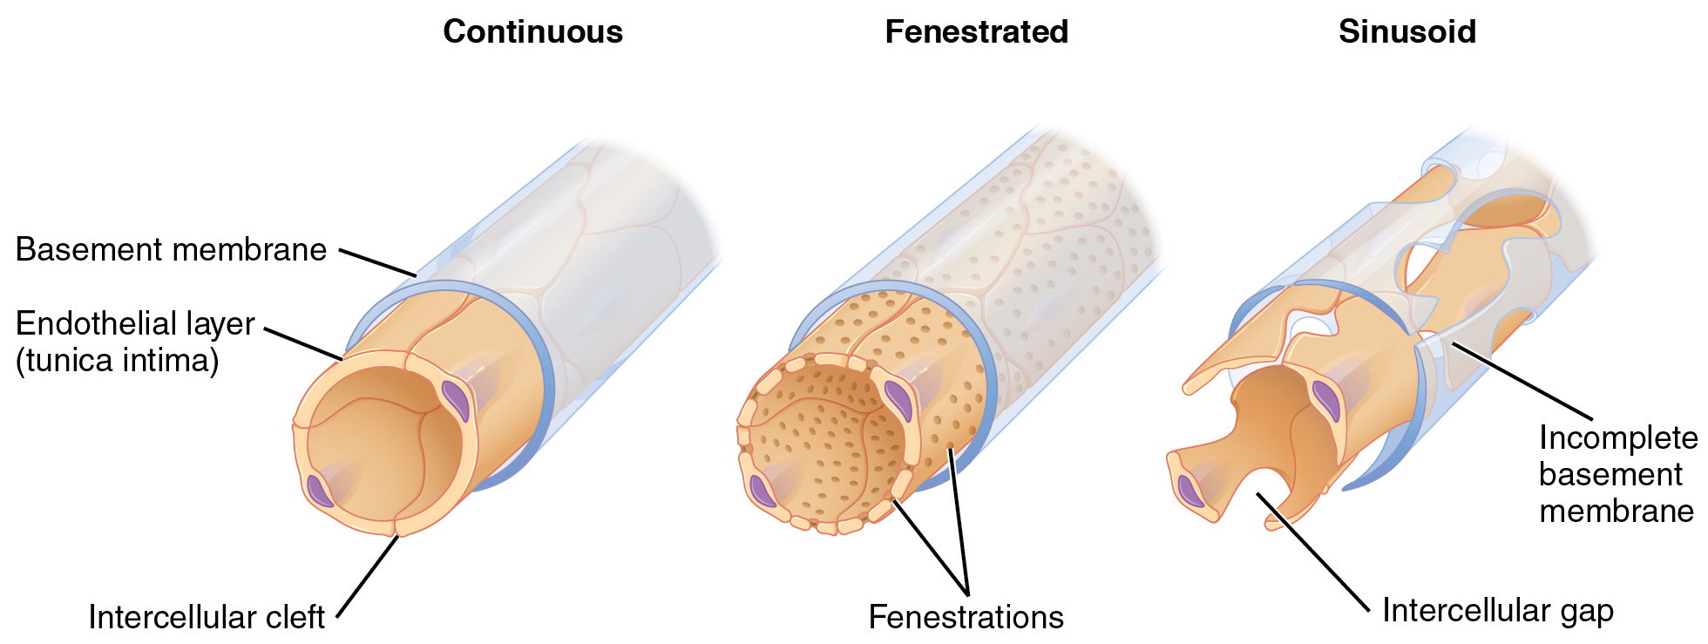
Figure 4.5
Types of Capillaries
The three major types of capillaries: continuous, fenestrated, and sinusoid.

Slide 7
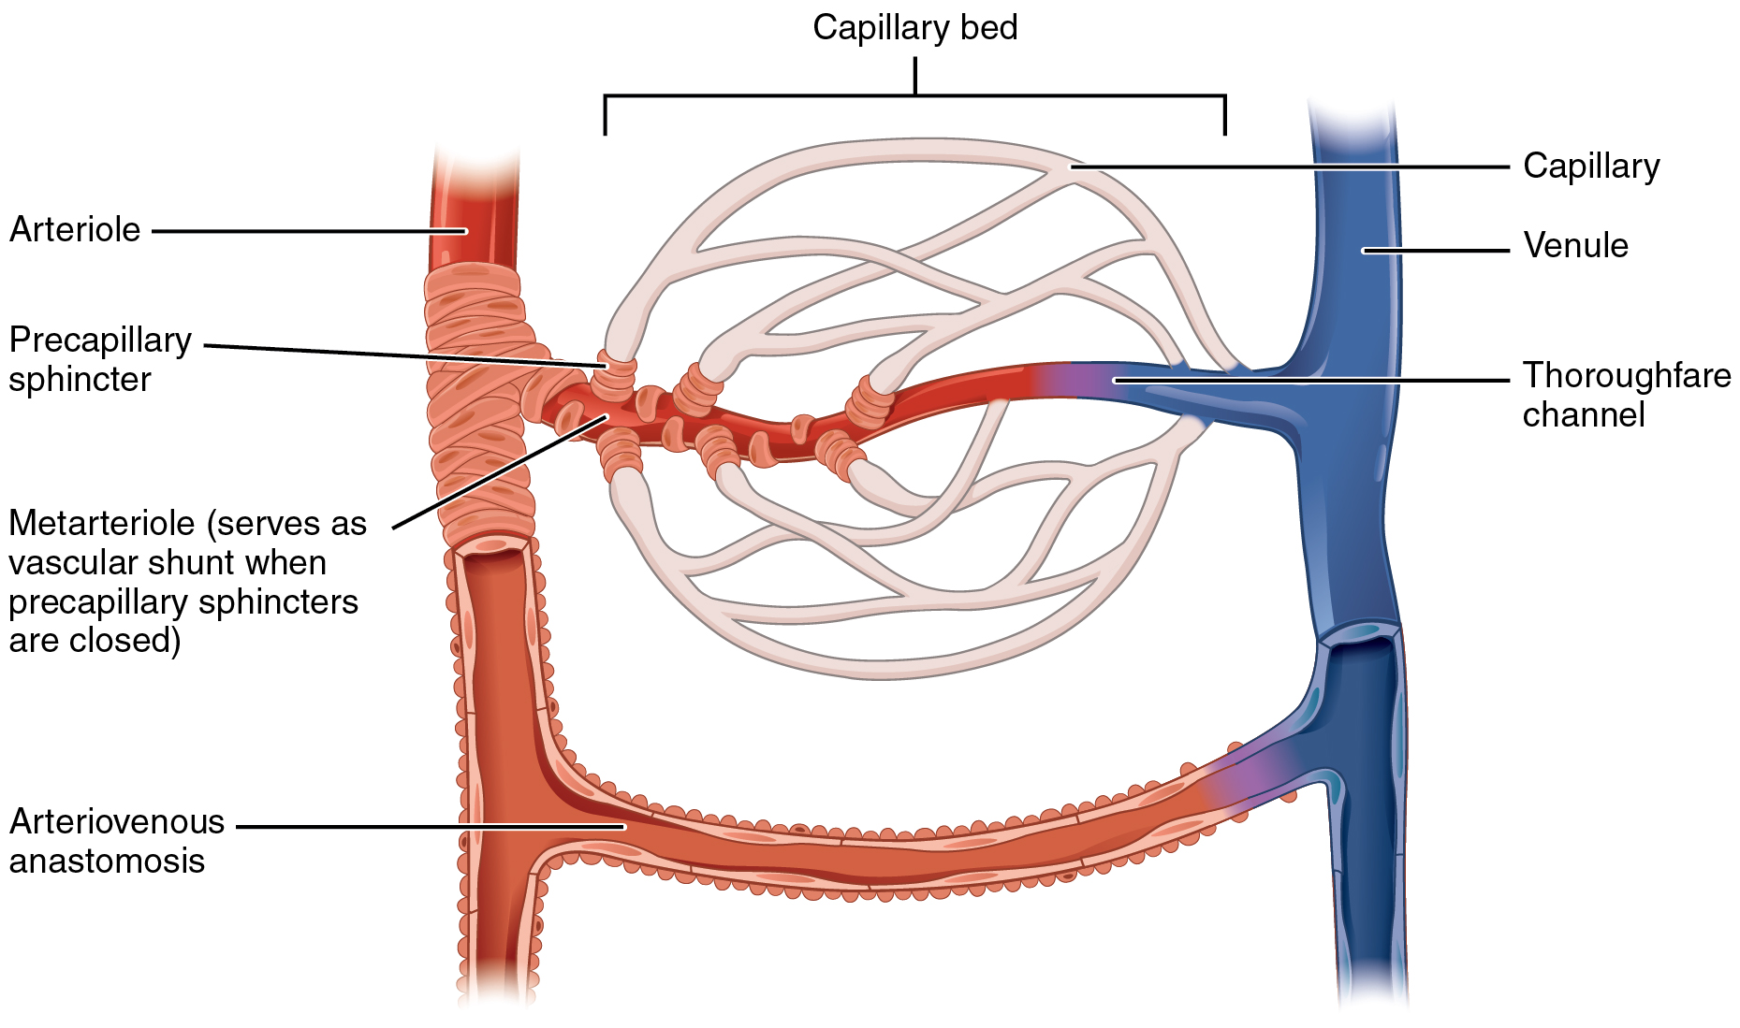
Figure 4.6
Capillary Bed
In a capillary bed, arterioles give rise to metarterioles. Precapillary sphincters located at the junction of a metarteriole with a capillary regulate blood flow. A thoroughfare channel connects the metarteriole to a venule. An arteriovenous anastomosis, which directly connects the arteriole with the venule, is shown at the bottom.

Slide 8
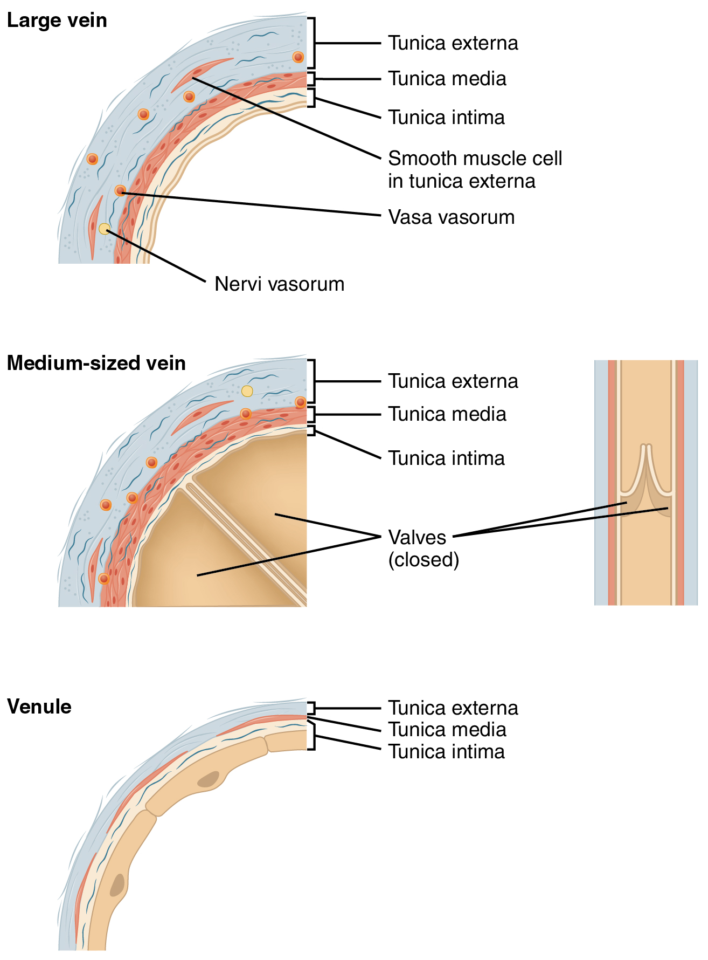
Figure 4.7
Comparison of Veins and Venules
Many veins have valves to prevent back flow of blood, whereas venules do not. In terms of scale, the diameter of a venule is measured in micrometers compared to millimeters for veins.

Slide 9
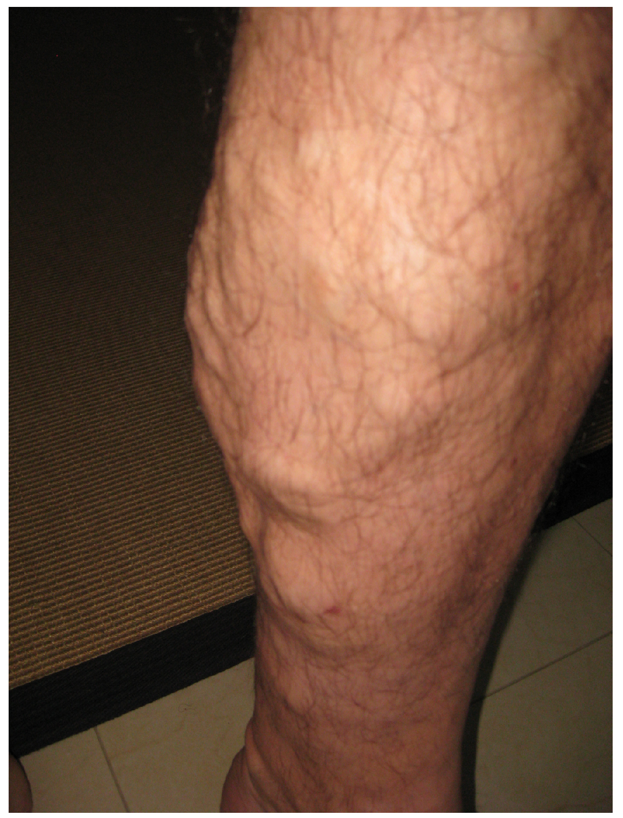
Figure 4.8
Varicose Veins
Varicose veins are commonly found in the lower limbs. (credit: Thomas Kriese)

Slide 10
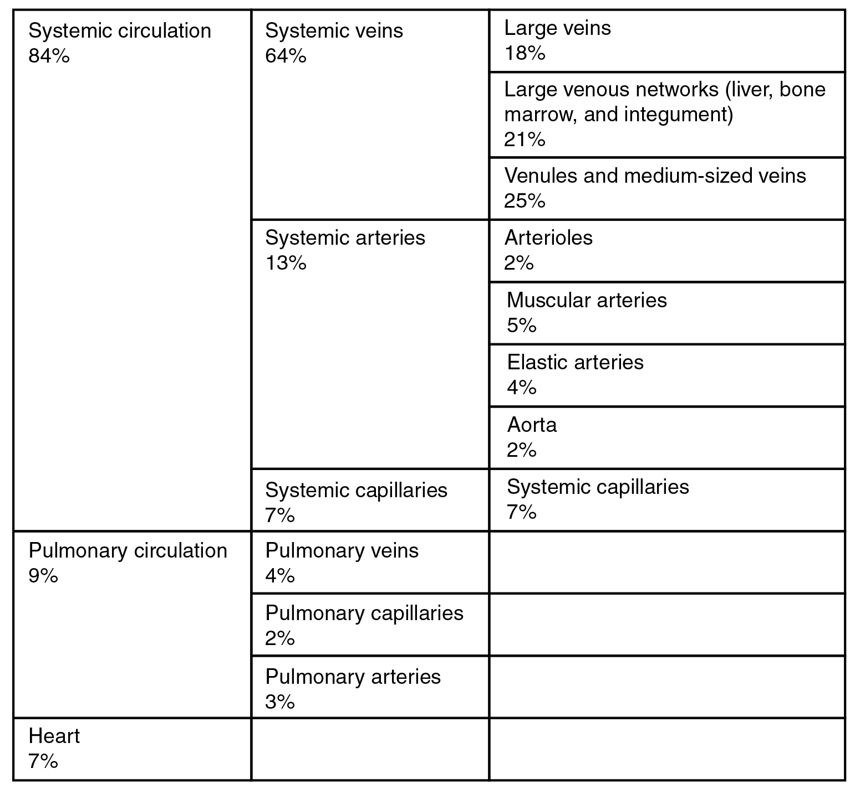
Figure 4.9
Distribution of Blood Flow

Slide 11
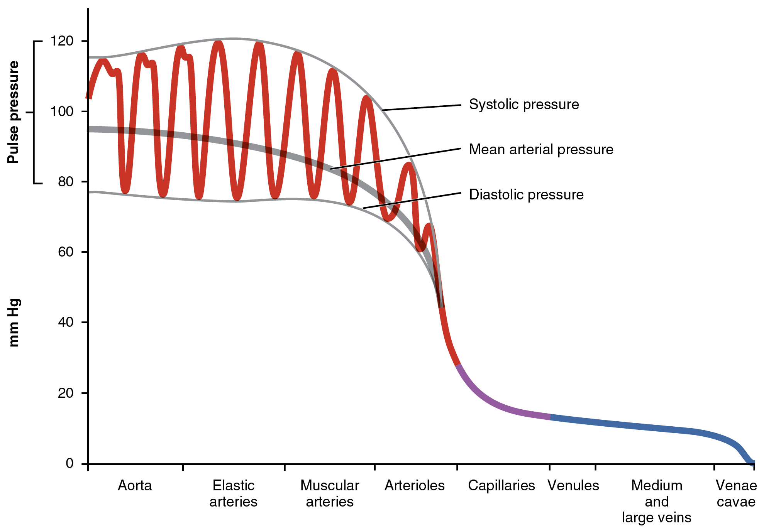
Figure 4.10
Systemic Blood Pressure
The graph shows the components of blood pressure throughout the blood vessels, including systolic, diastolic, mean arterial, and pulse pressures.

Slide 12
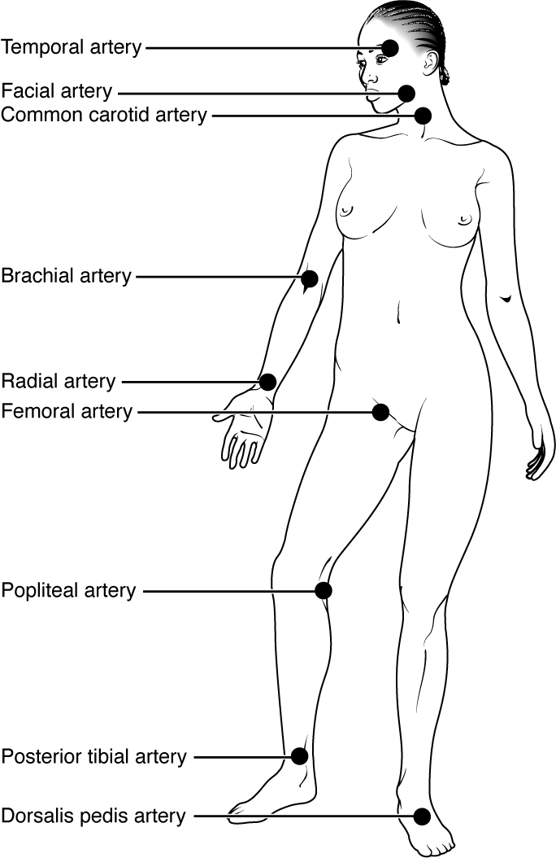
Figure 4.11
Pulse Sites
The pulse is most readily measured at the radial artery, but can be measured at any of the pulse points shown.

Slide 13
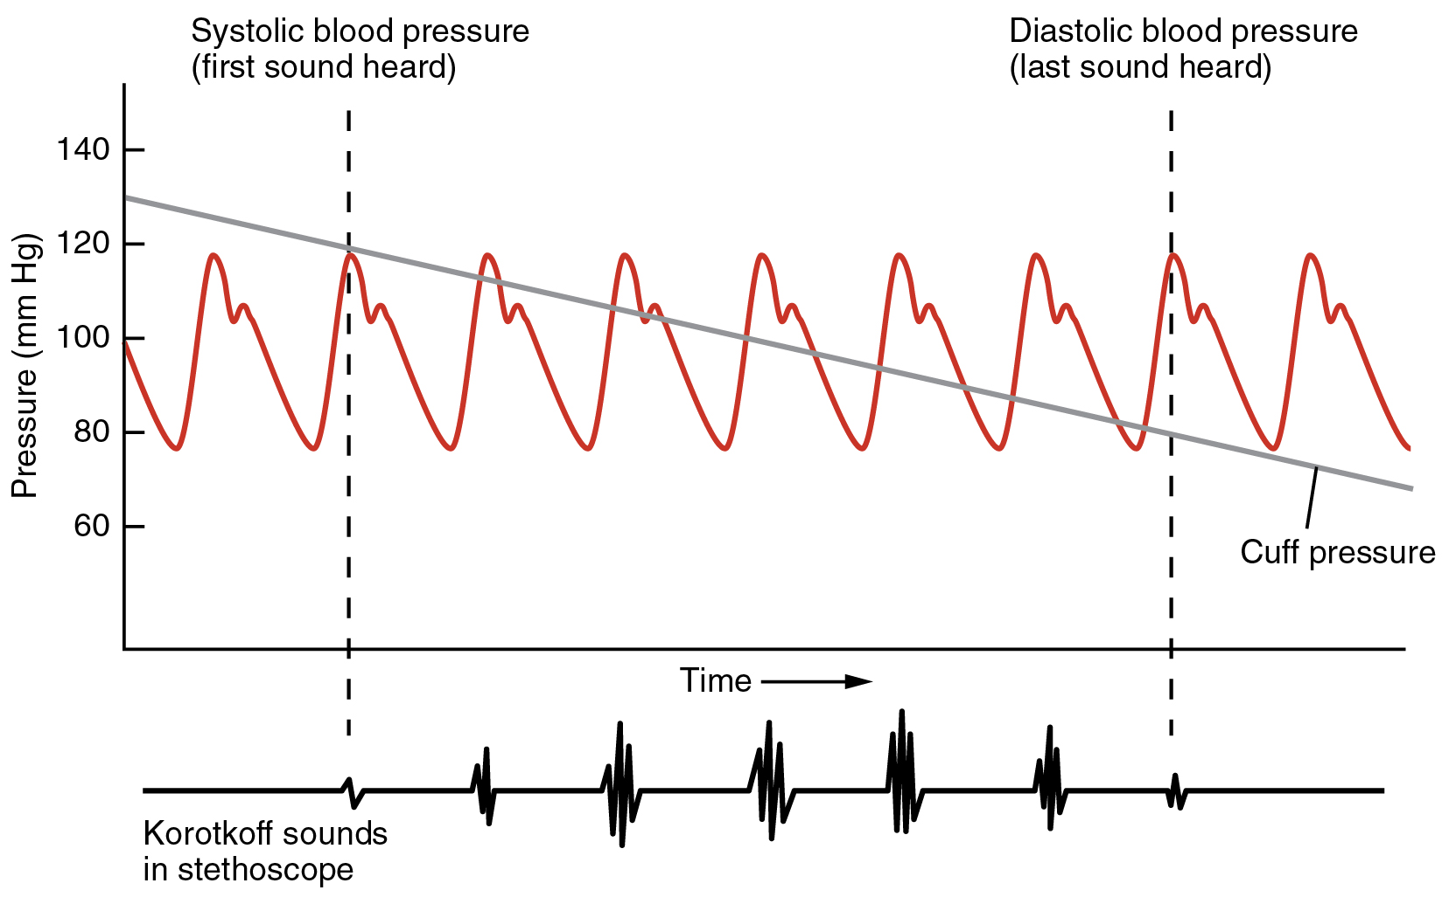
Figure 4.12
Blood Pressure Measurement
When pressure in a sphygmomanometer cuff is released, a clinician can hear the Korotkoff sounds. In this graph, a blood pressure tracing is aligned to a measurement of systolic and diastolic pressures.

Slide 14
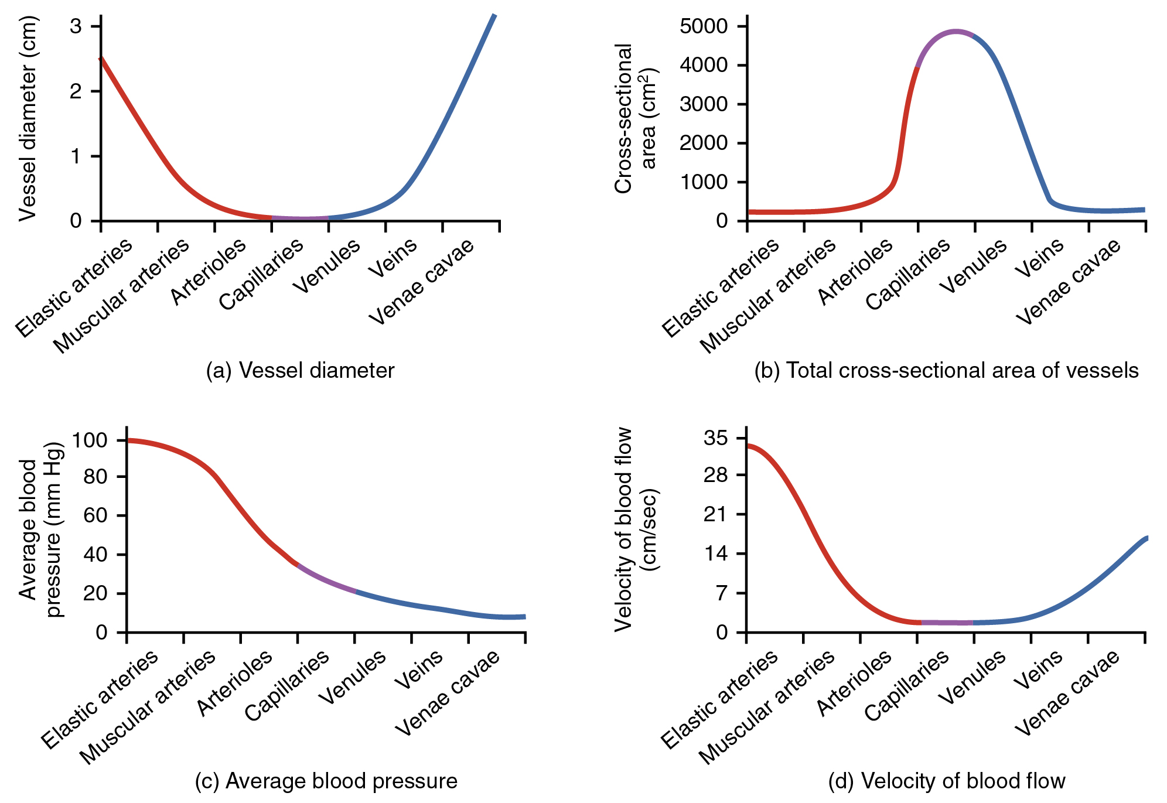
Figure 4.13
Relationships among Vessels in the Systemic Circuit
The relationships among blood vessels that can be compared include (a) vessel diameter, (b) total cross-sectional area, (c) average blood pressure, and (d) velocity of blood flow.

Slide 15
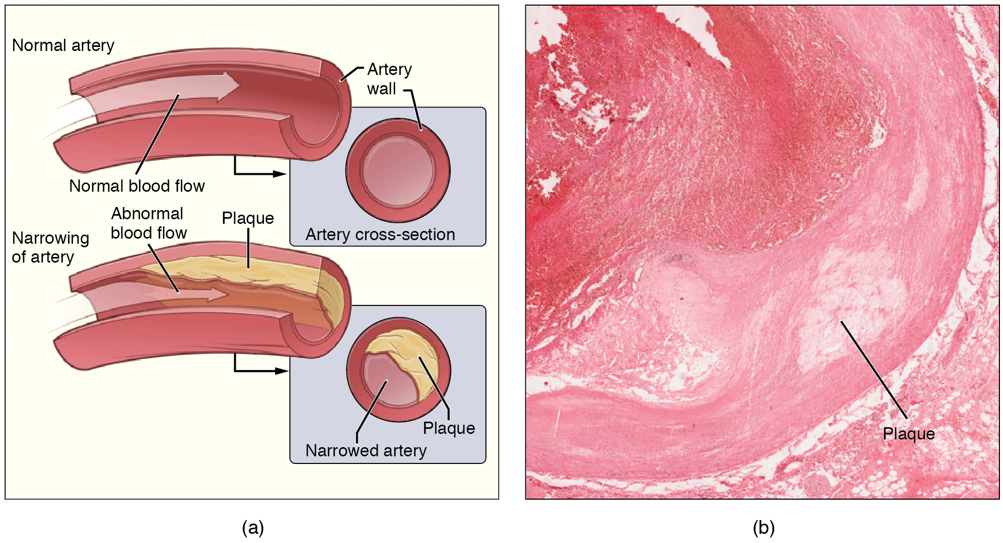
Figure 4.14
Atherosclerosis
(a) Atherosclerosis can result from plaques formed by the buildup of fatty, calcified deposits in an artery. (b) Plaques can also take other forms, as shown in this micrograph of a coronary artery that has a buildup of connective tissue within the artery wall. LM × 40. (Micrograph provided by the Regents of University of Michigan Medical School © 2012)

Slide 16
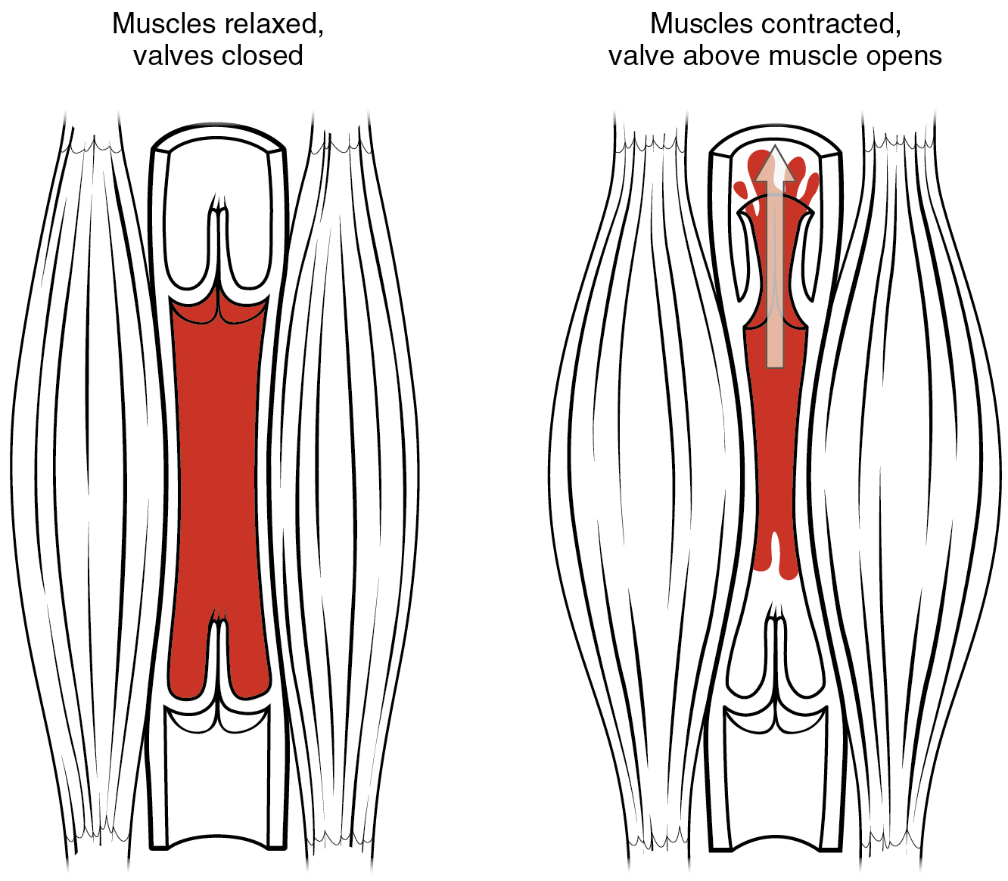
Figure 4.15
Skeletal Muscle Pump
The contraction of skeletal muscles surrounding a vein compresses the blood and increases the pressure in that area. This action forces blood closer to the heart where venous pressure is lower. Note the importance of the one-way valves to assure that blood flows only in the proper direction.

Slide 17
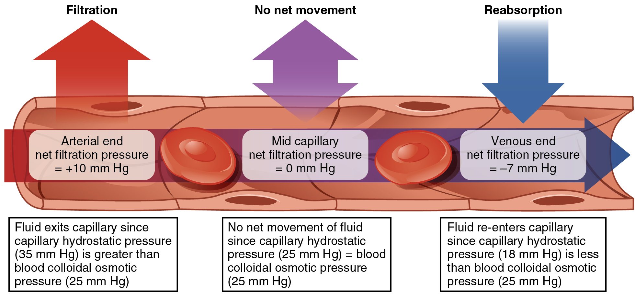
Figure 4.16
Capillary Exchange
Net filtration occurs near the arterial end of the capillary since capillary hydrostatic pressure (CHP) is greater than blood colloidal osmotic pressure (BCOP). There is no net movement of fluid near the midpoint since CHP = BCOP. Net reabsorption occurs near the venous end since BCOP is greater than CHP.

Slide 18
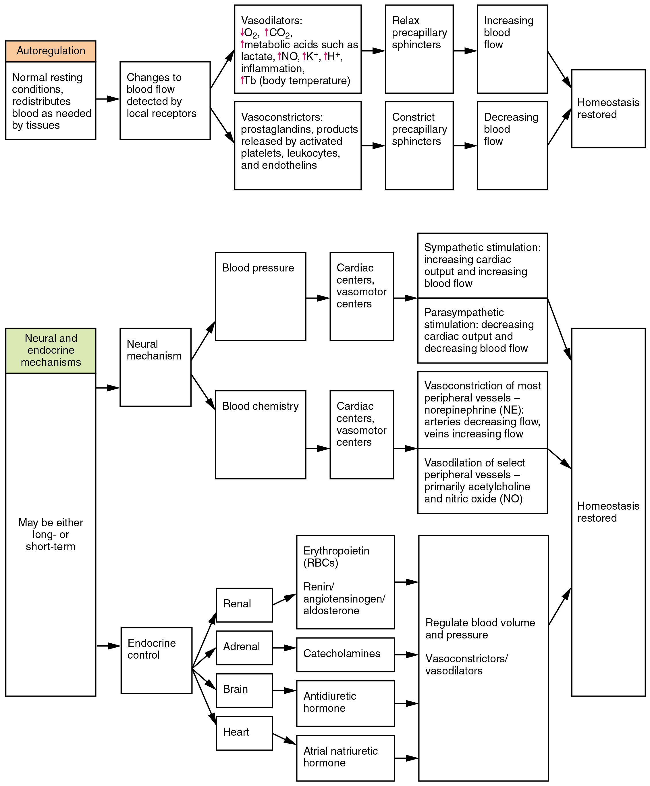
Figure 4.17
Summary of Factors Maintaining Vascular Homeostasis
Adequate blood flow, blood pressure, distribution, and perfusion involve autoregulatory, neural, and endocrine mechanisms.

Slide 19
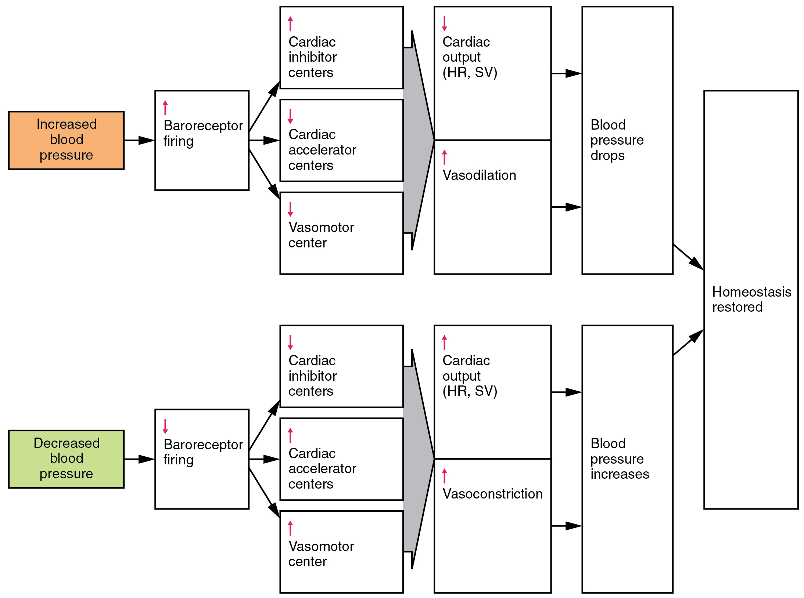
Figure 4.18
Baroreceptor Reflexes for Maintaining Vascular Homeostasis
Increased blood pressure results in increased rates of baroreceptor firing, whereas decreased blood pressure results in slower rates of fire, both initiating the homeostatic mechanism to restore blood pressure.

Slide 20
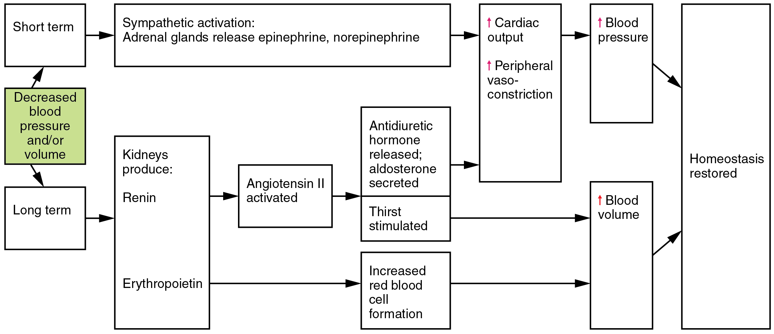
Figure 4.19
Hormones Involved in Renal Control of Blood Pressure
In the renin-angiotensin-aldosterone mechanism, increasing angiotensin II will stimulate the production of antidiuretic hormone and aldosterone. In addition to renin, the kidneys produce erythropoietin, which stimulates the production of red blood cells, further increasing blood volume.

Slide 21
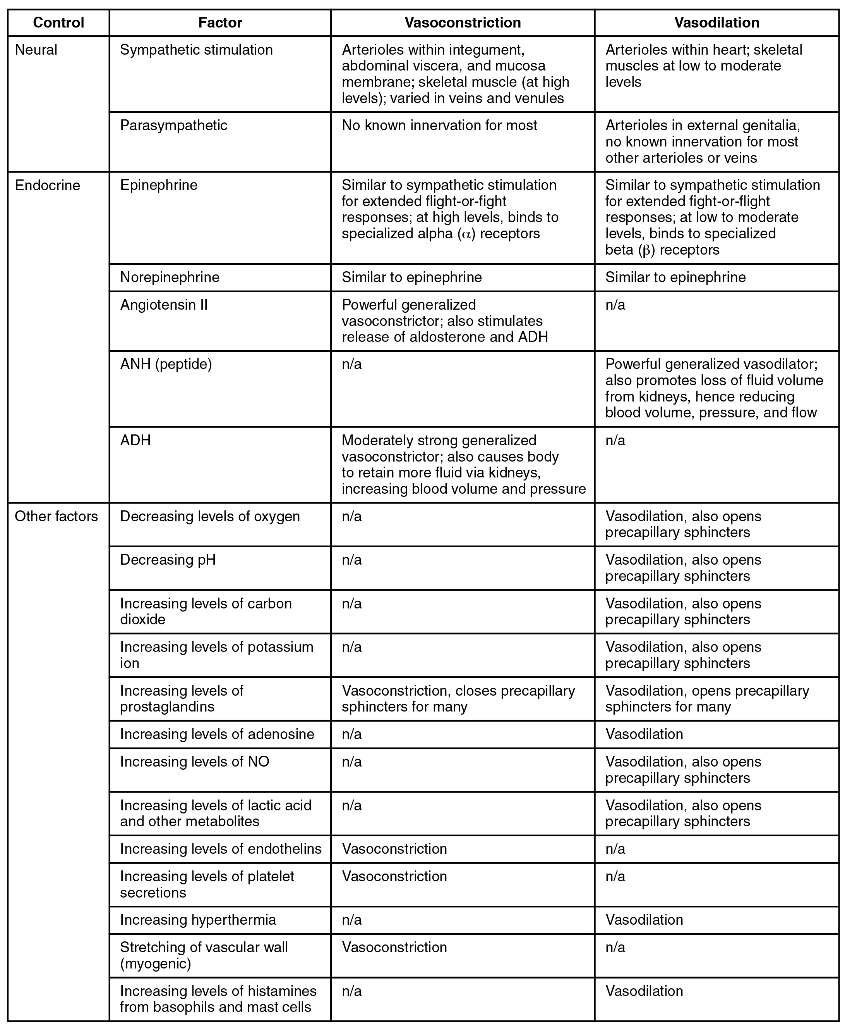
Figure 4.20
Summary of Mechanisms Regulating Arteriole Smooth Muscle and Veins

Slide 22
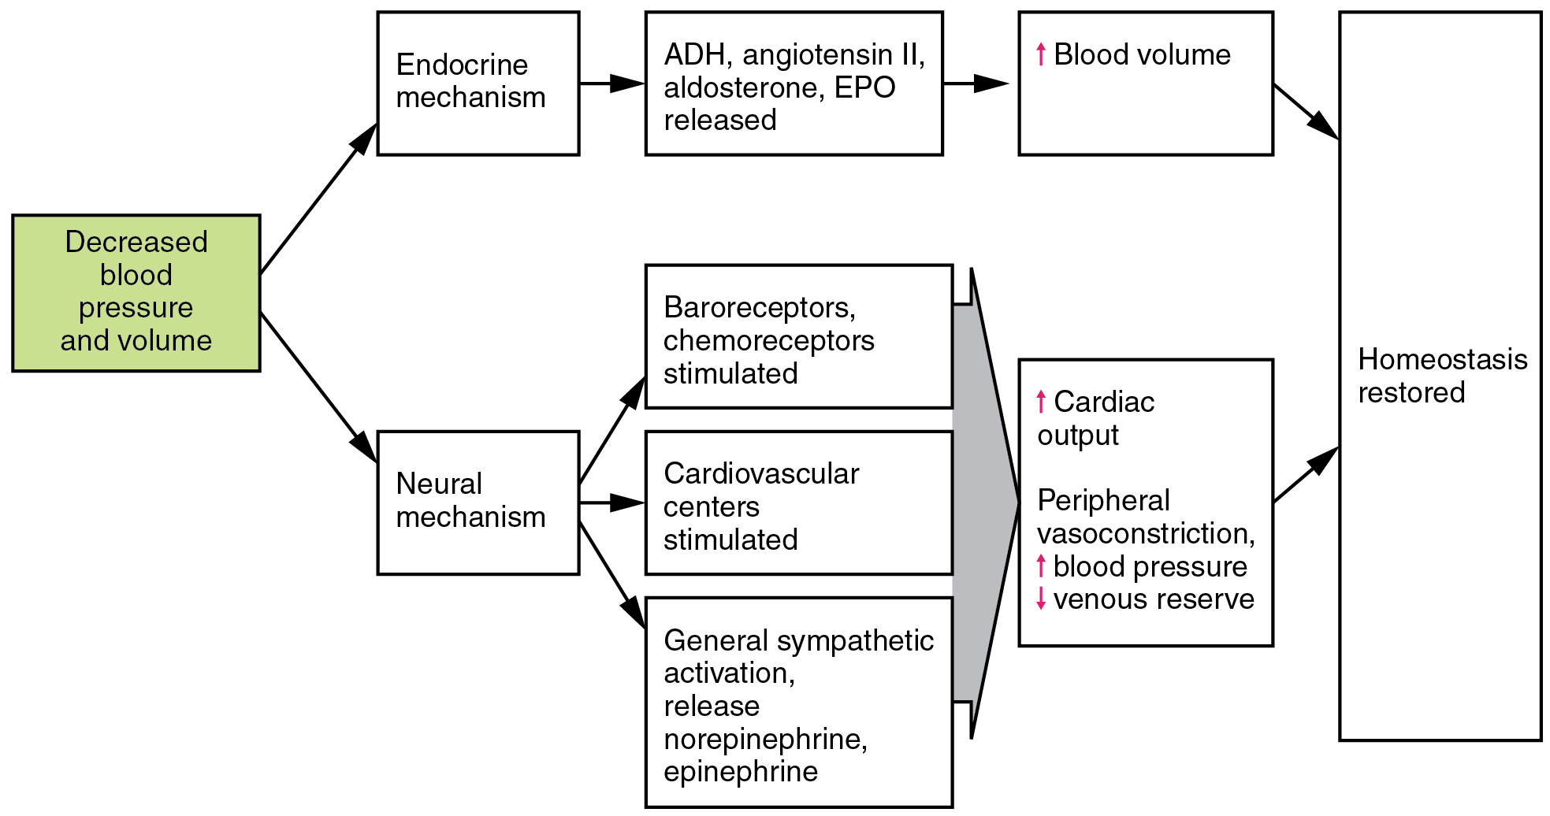
Figure 4.21
Homeostatic Responses to Loss of Blood Volume

Slide 23
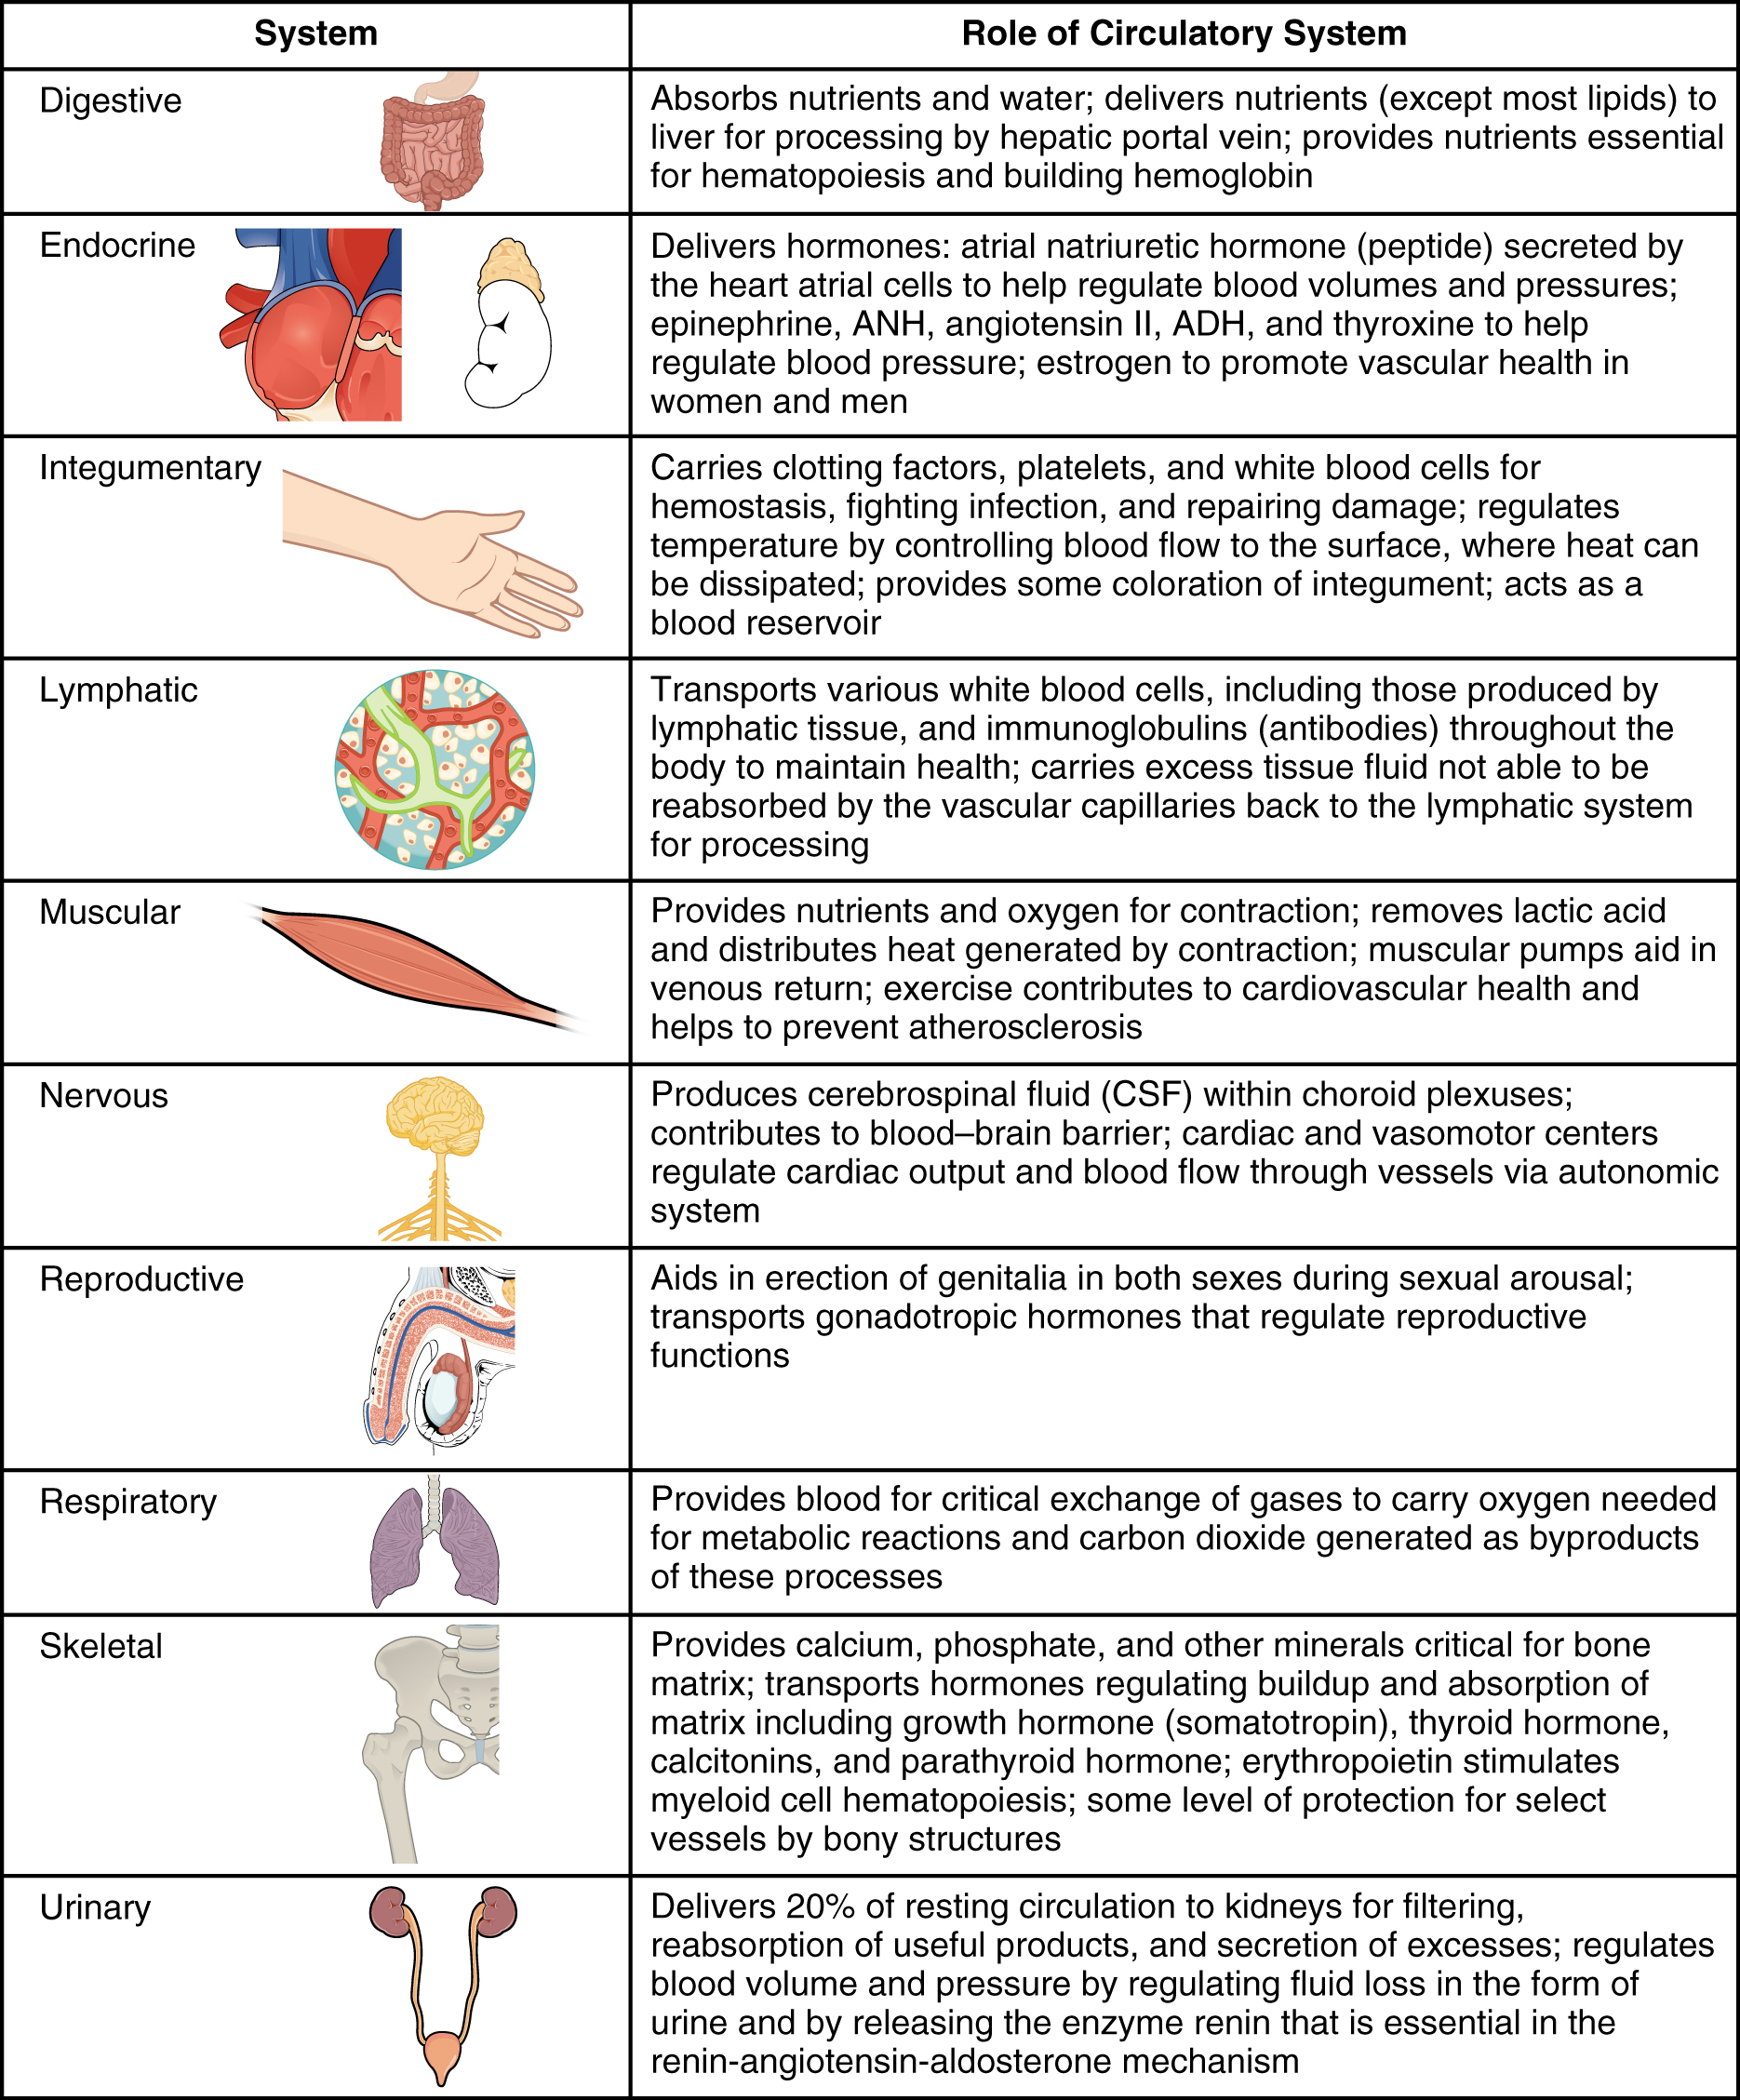
Figure 4.22
Interaction of the Circulatory System with Other Body Systems

Slide 24
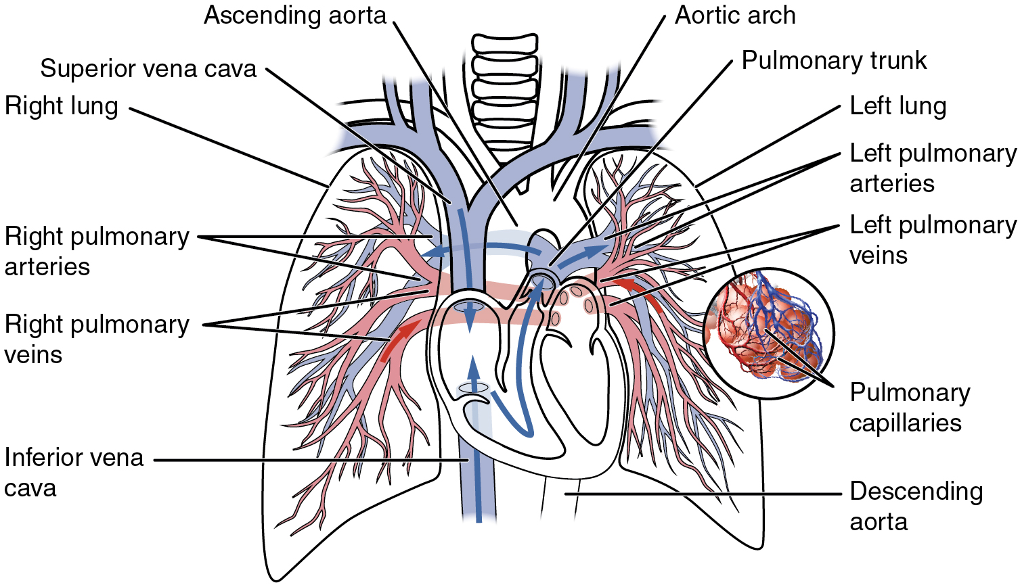
Figure 4.23
Pulmonary Circuit
Blood exiting from the right ventricle flows into the pulmonary trunk, which bifurcates into the two pulmonary arteries. These vessels branch to supply blood to the pulmonary capillaries, where gas exchange occurs within the lung alveoli. Blood returns via the pulmonary veins to the left atrium.

Slide 25
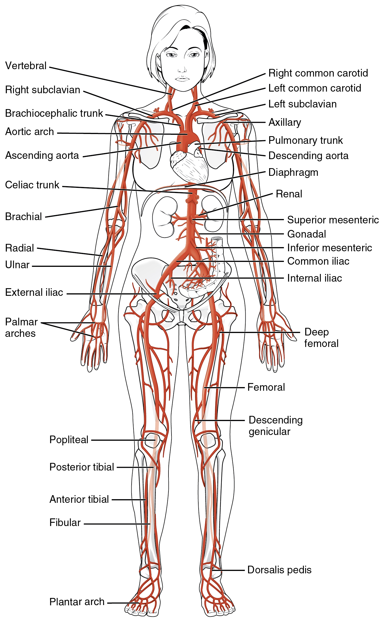
Figure 4.24
Systemic Arteries
The major systemic arteries shown here deliver oxygenated blood throughout the body.

Slide 26
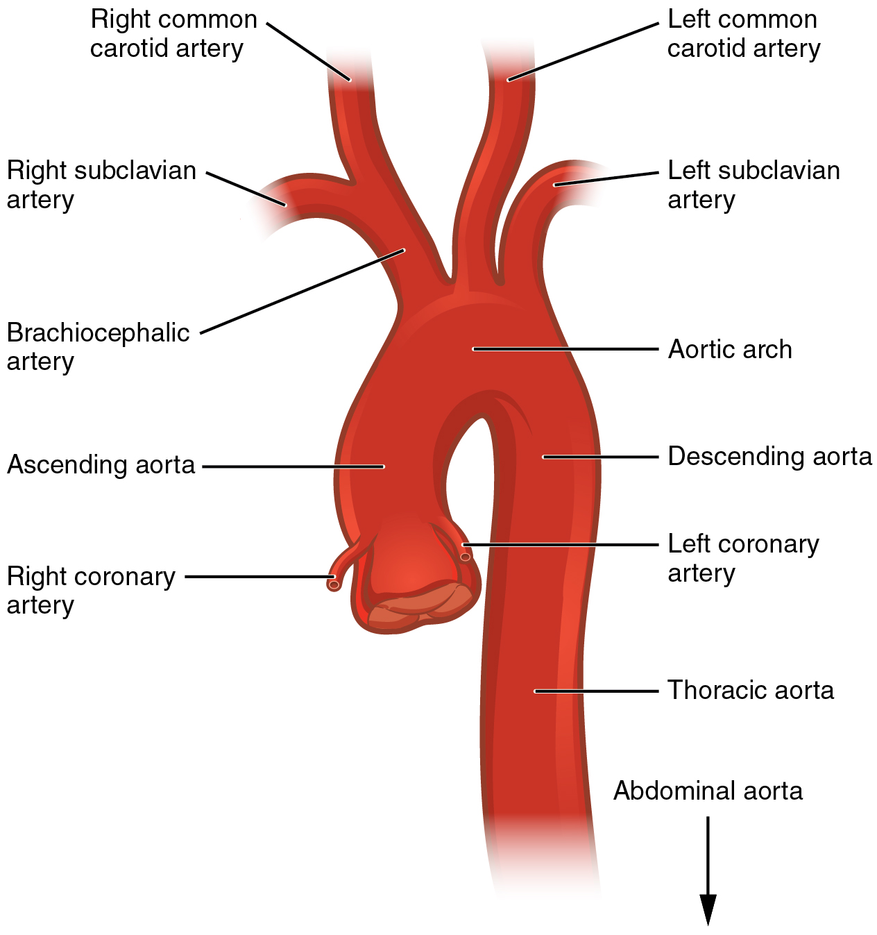
Figure 4.25
Aorta
The aorta has distinct regions, including the ascending aorta, aortic arch, and the descending aorta, which includes the thoracic and abdominal regions.

Slide 27
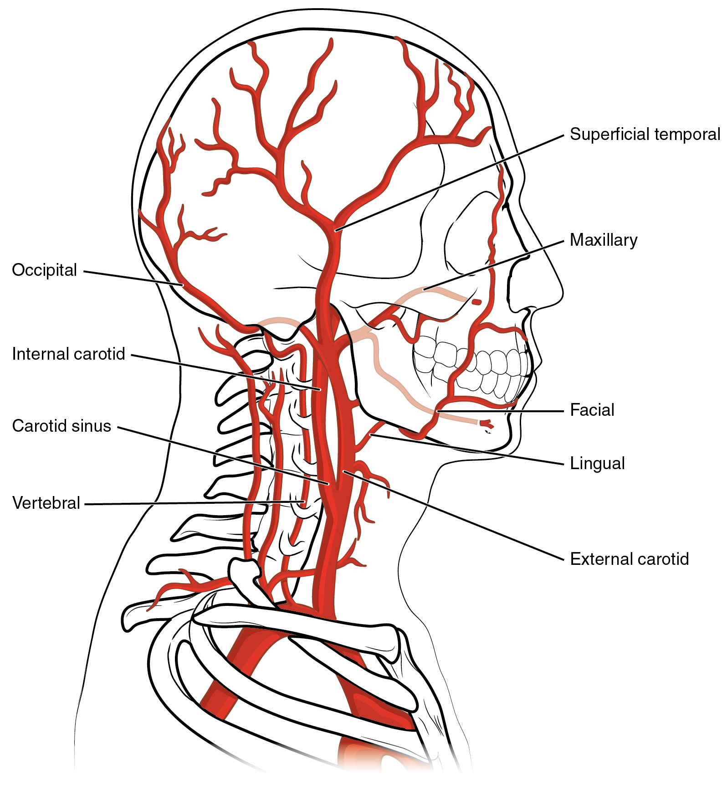
Figure 4.26
Arteries Supplying the Head and Neck
The common carotid artery gives rise to the external and internal carotid arteries. The external carotid artery remains superficial and gives rise to many arteries of the head. The internal carotid artery first forms the carotid sinus and then reaches the brain via the carotid canal and carotid foramen, emerging into the cranium via the foramen lacerum. The vertebral artery branches from the subclavian artery and passes through the transverse foramen in the cervical vertebrae, entering the base of the skull at the vertebral foramen. The subclavian artery continues toward the arm as the axillary artery.

Slide 28
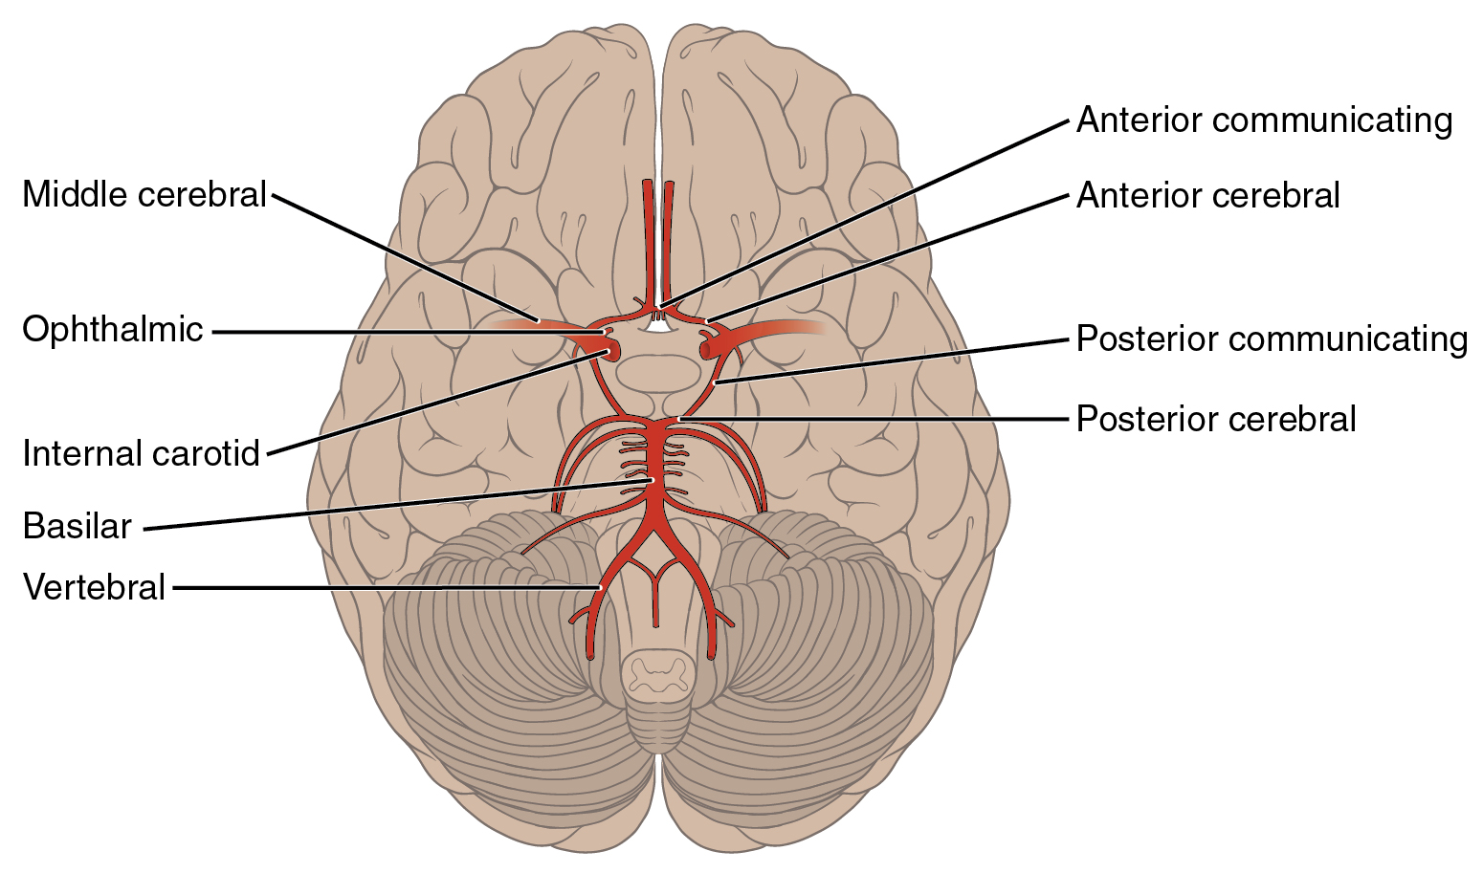
Figure 4.27
Arteries Serving the Brain
This inferior view shows the network of arteries serving the brain. The structure is referred to as the arterial circle or circle of Willis.

Slide 29
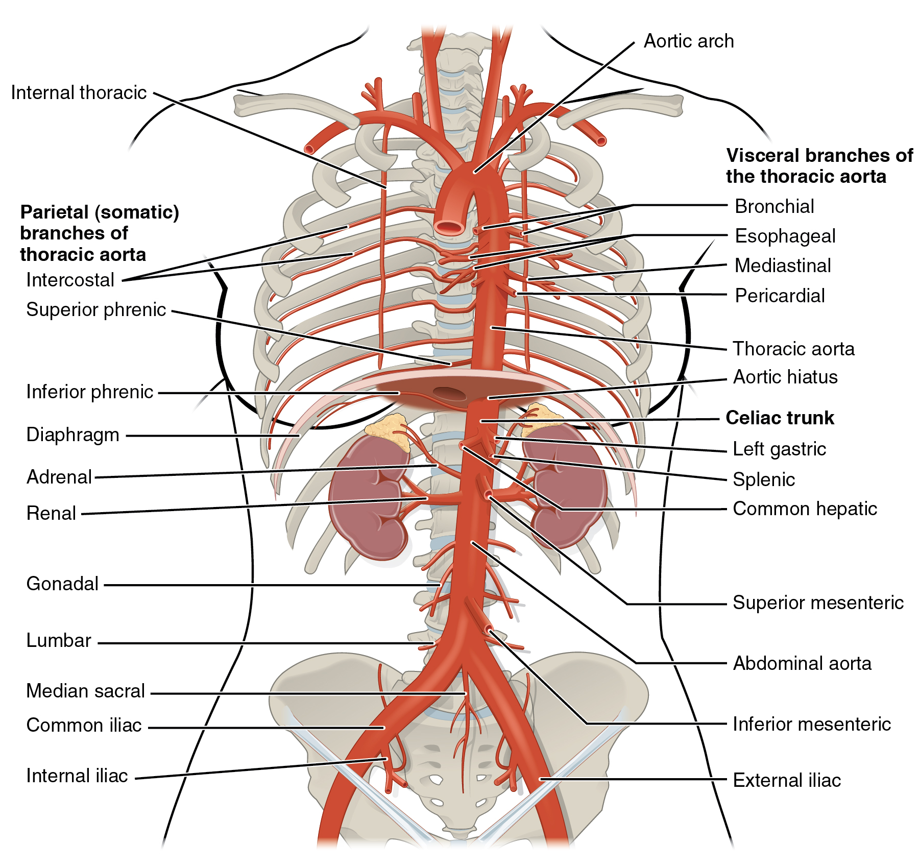
Figure 4.28
Arteries of the Thoracic and Abdominal Regions
The thoracic aorta gives rise to the arteries of the visceral and parietal branches.

Slide 30
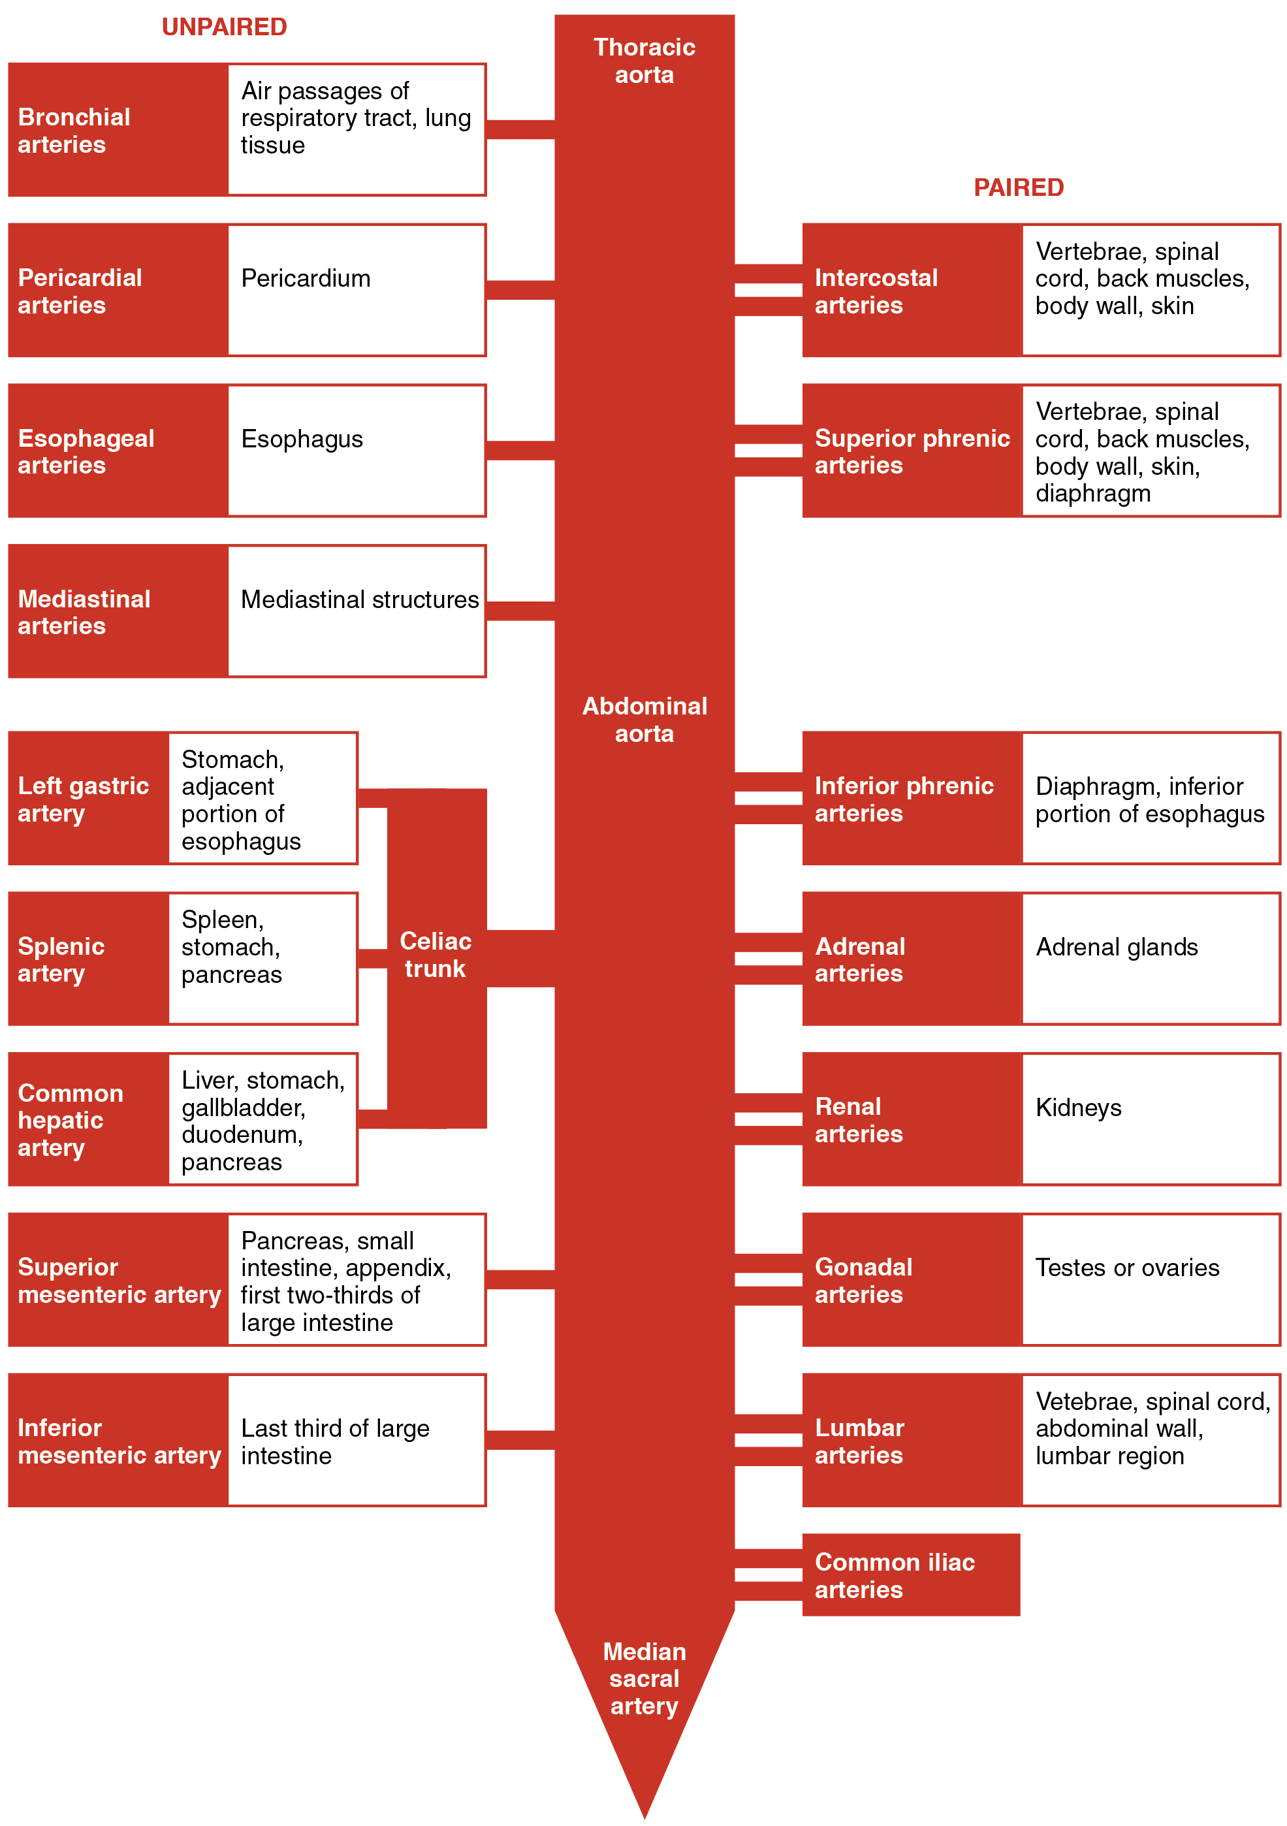
Figure 4.29
Major Branches of the Aorta
The flow chart summarizes the distribution of the major branches of the aorta into the thoracic and abdominal regions.

Slide 31
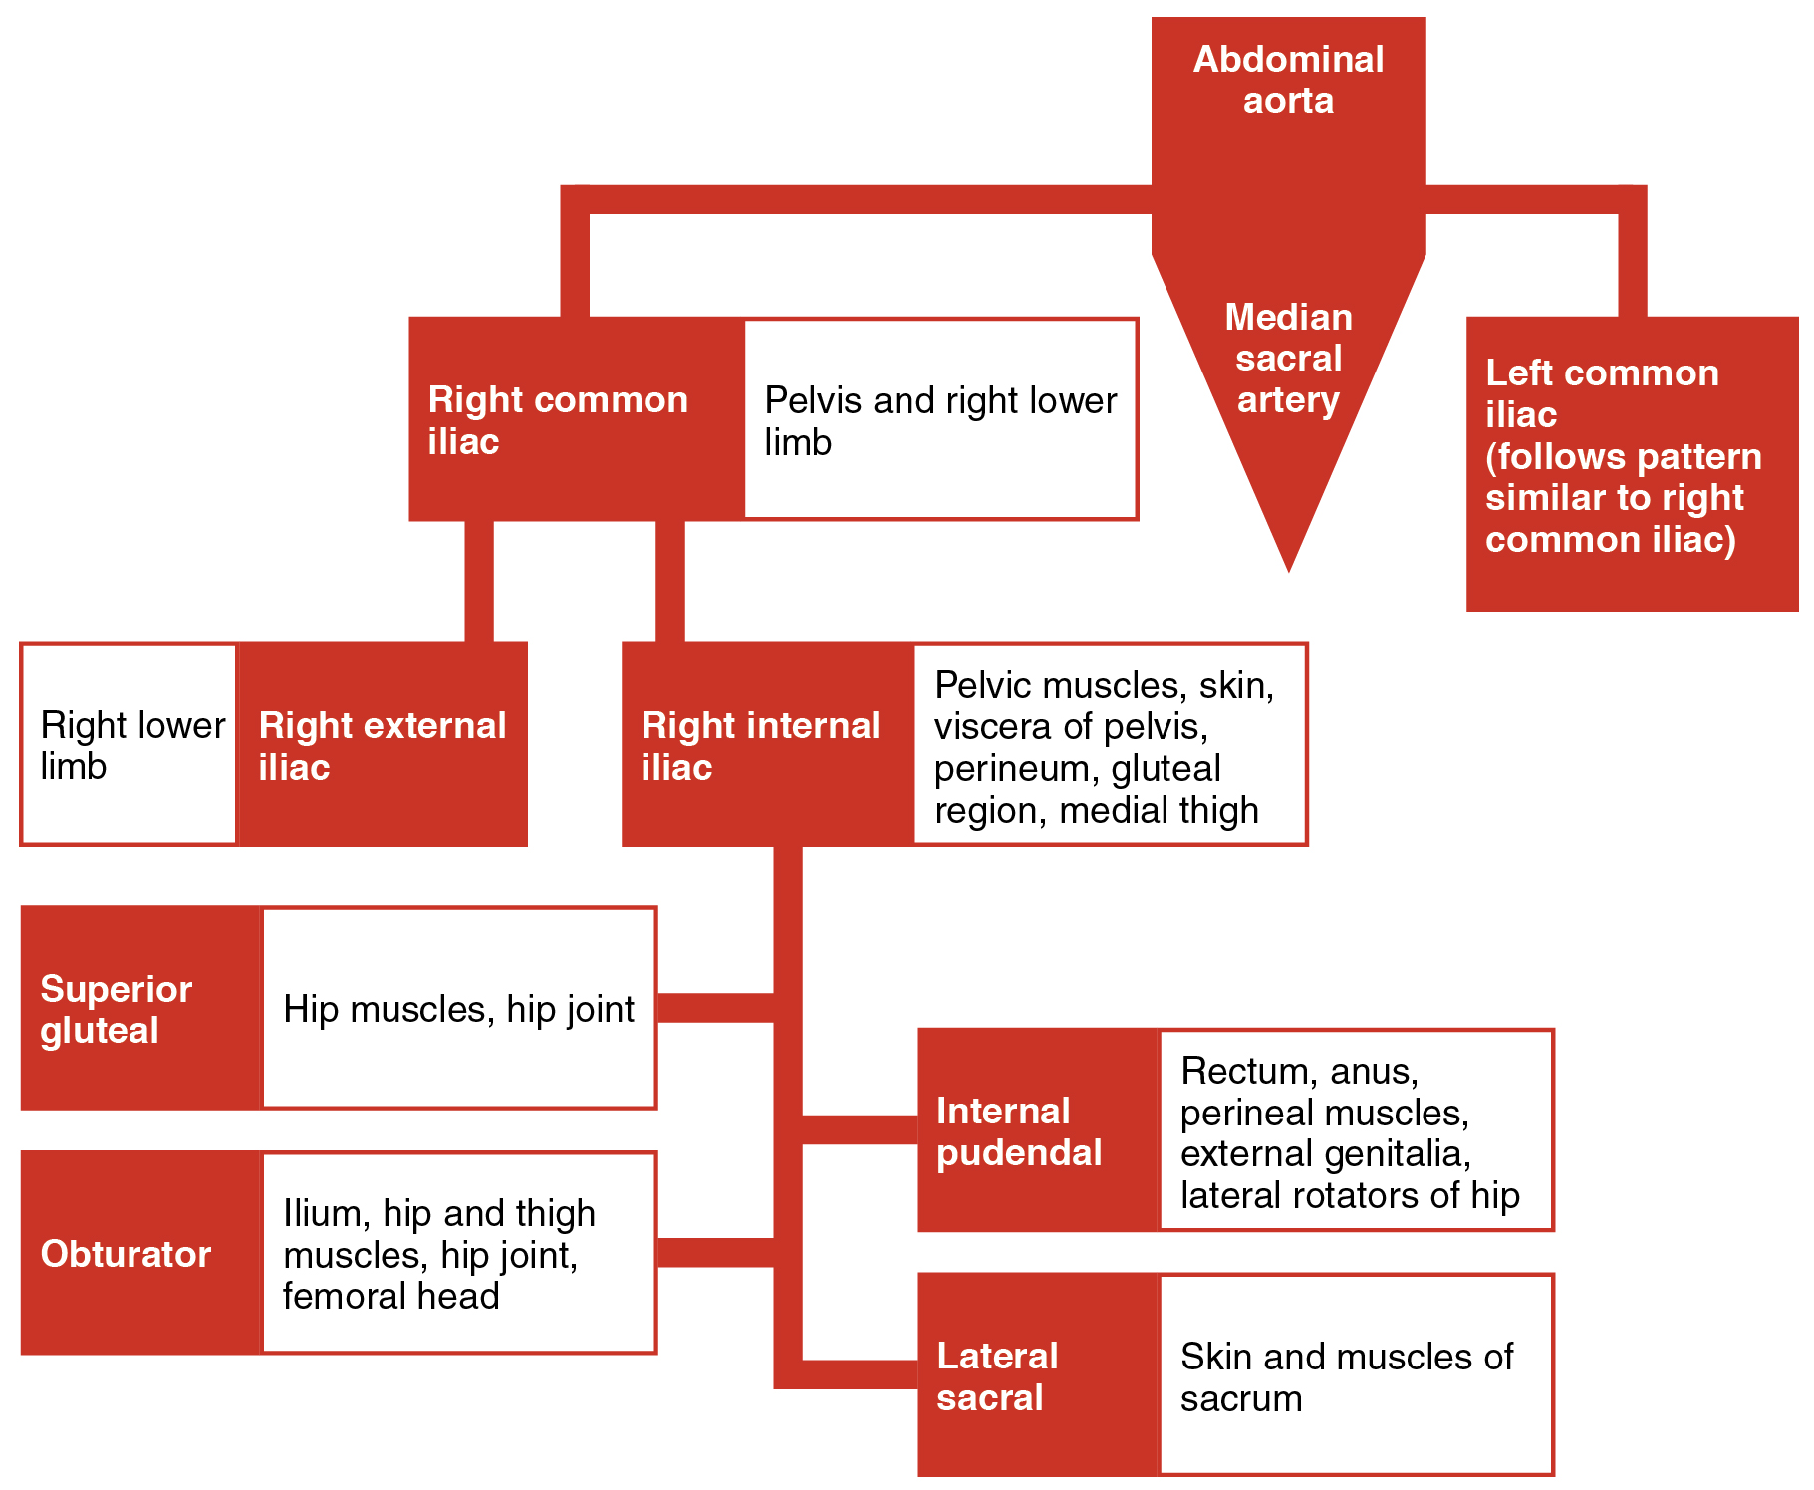
Figure 4.30
Major Branches of the Iliac Arteries
The flow chart summarizes the distribution of the major branches of the common iliac arteries into the pelvis and lower limbs. The left side follows a similar pattern to the right.

Slide 32
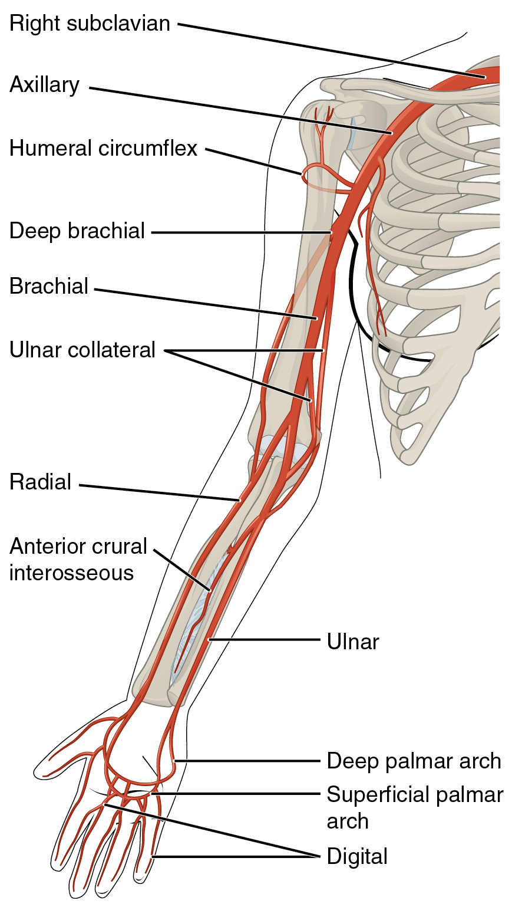
Figure 4.31
Major Arteries Serving the Thorax and Upper Limb
The arteries that supply blood to the arms and hands are extensions of the subclavian arteries.

Slide 33
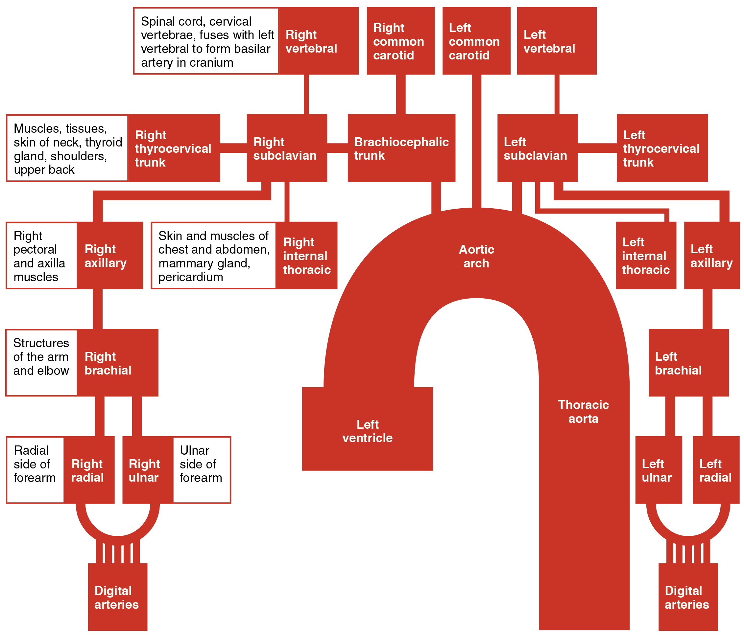
Figure 4.32
Major Arteries of the Upper Limb
The flow chart summarizes the distribution of the major arteries from the heart into the upper limb.

Slide 34
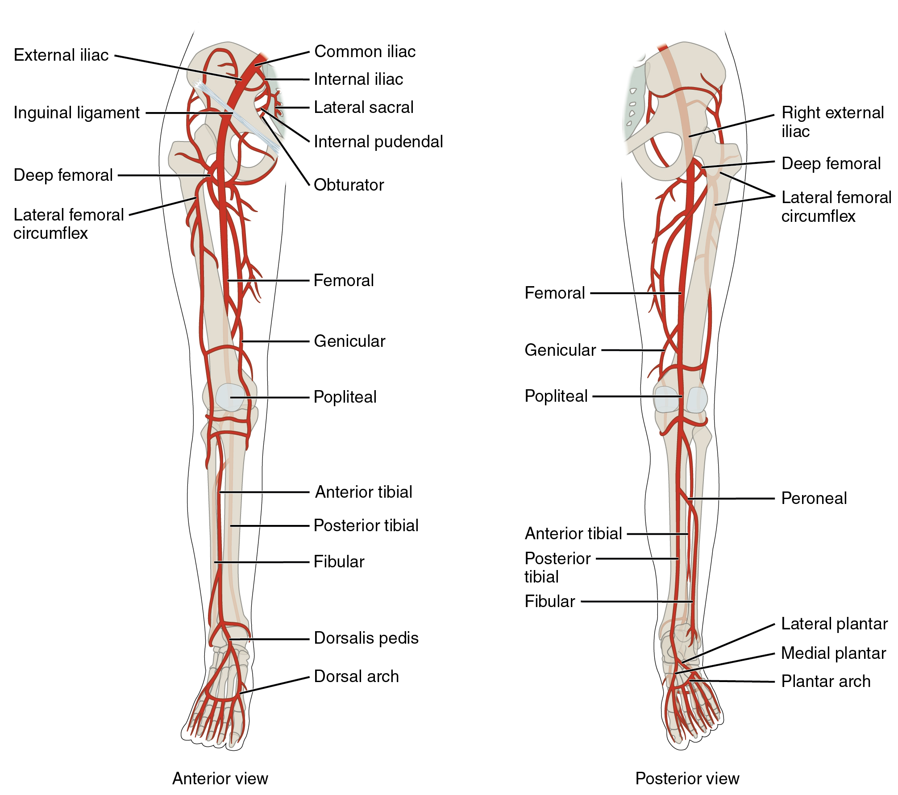
Figure 4.33
Major Arteries Serving the Lower Limb
Major arteries serving the lower limb are shown in anterior and posterior views.

Slide 35
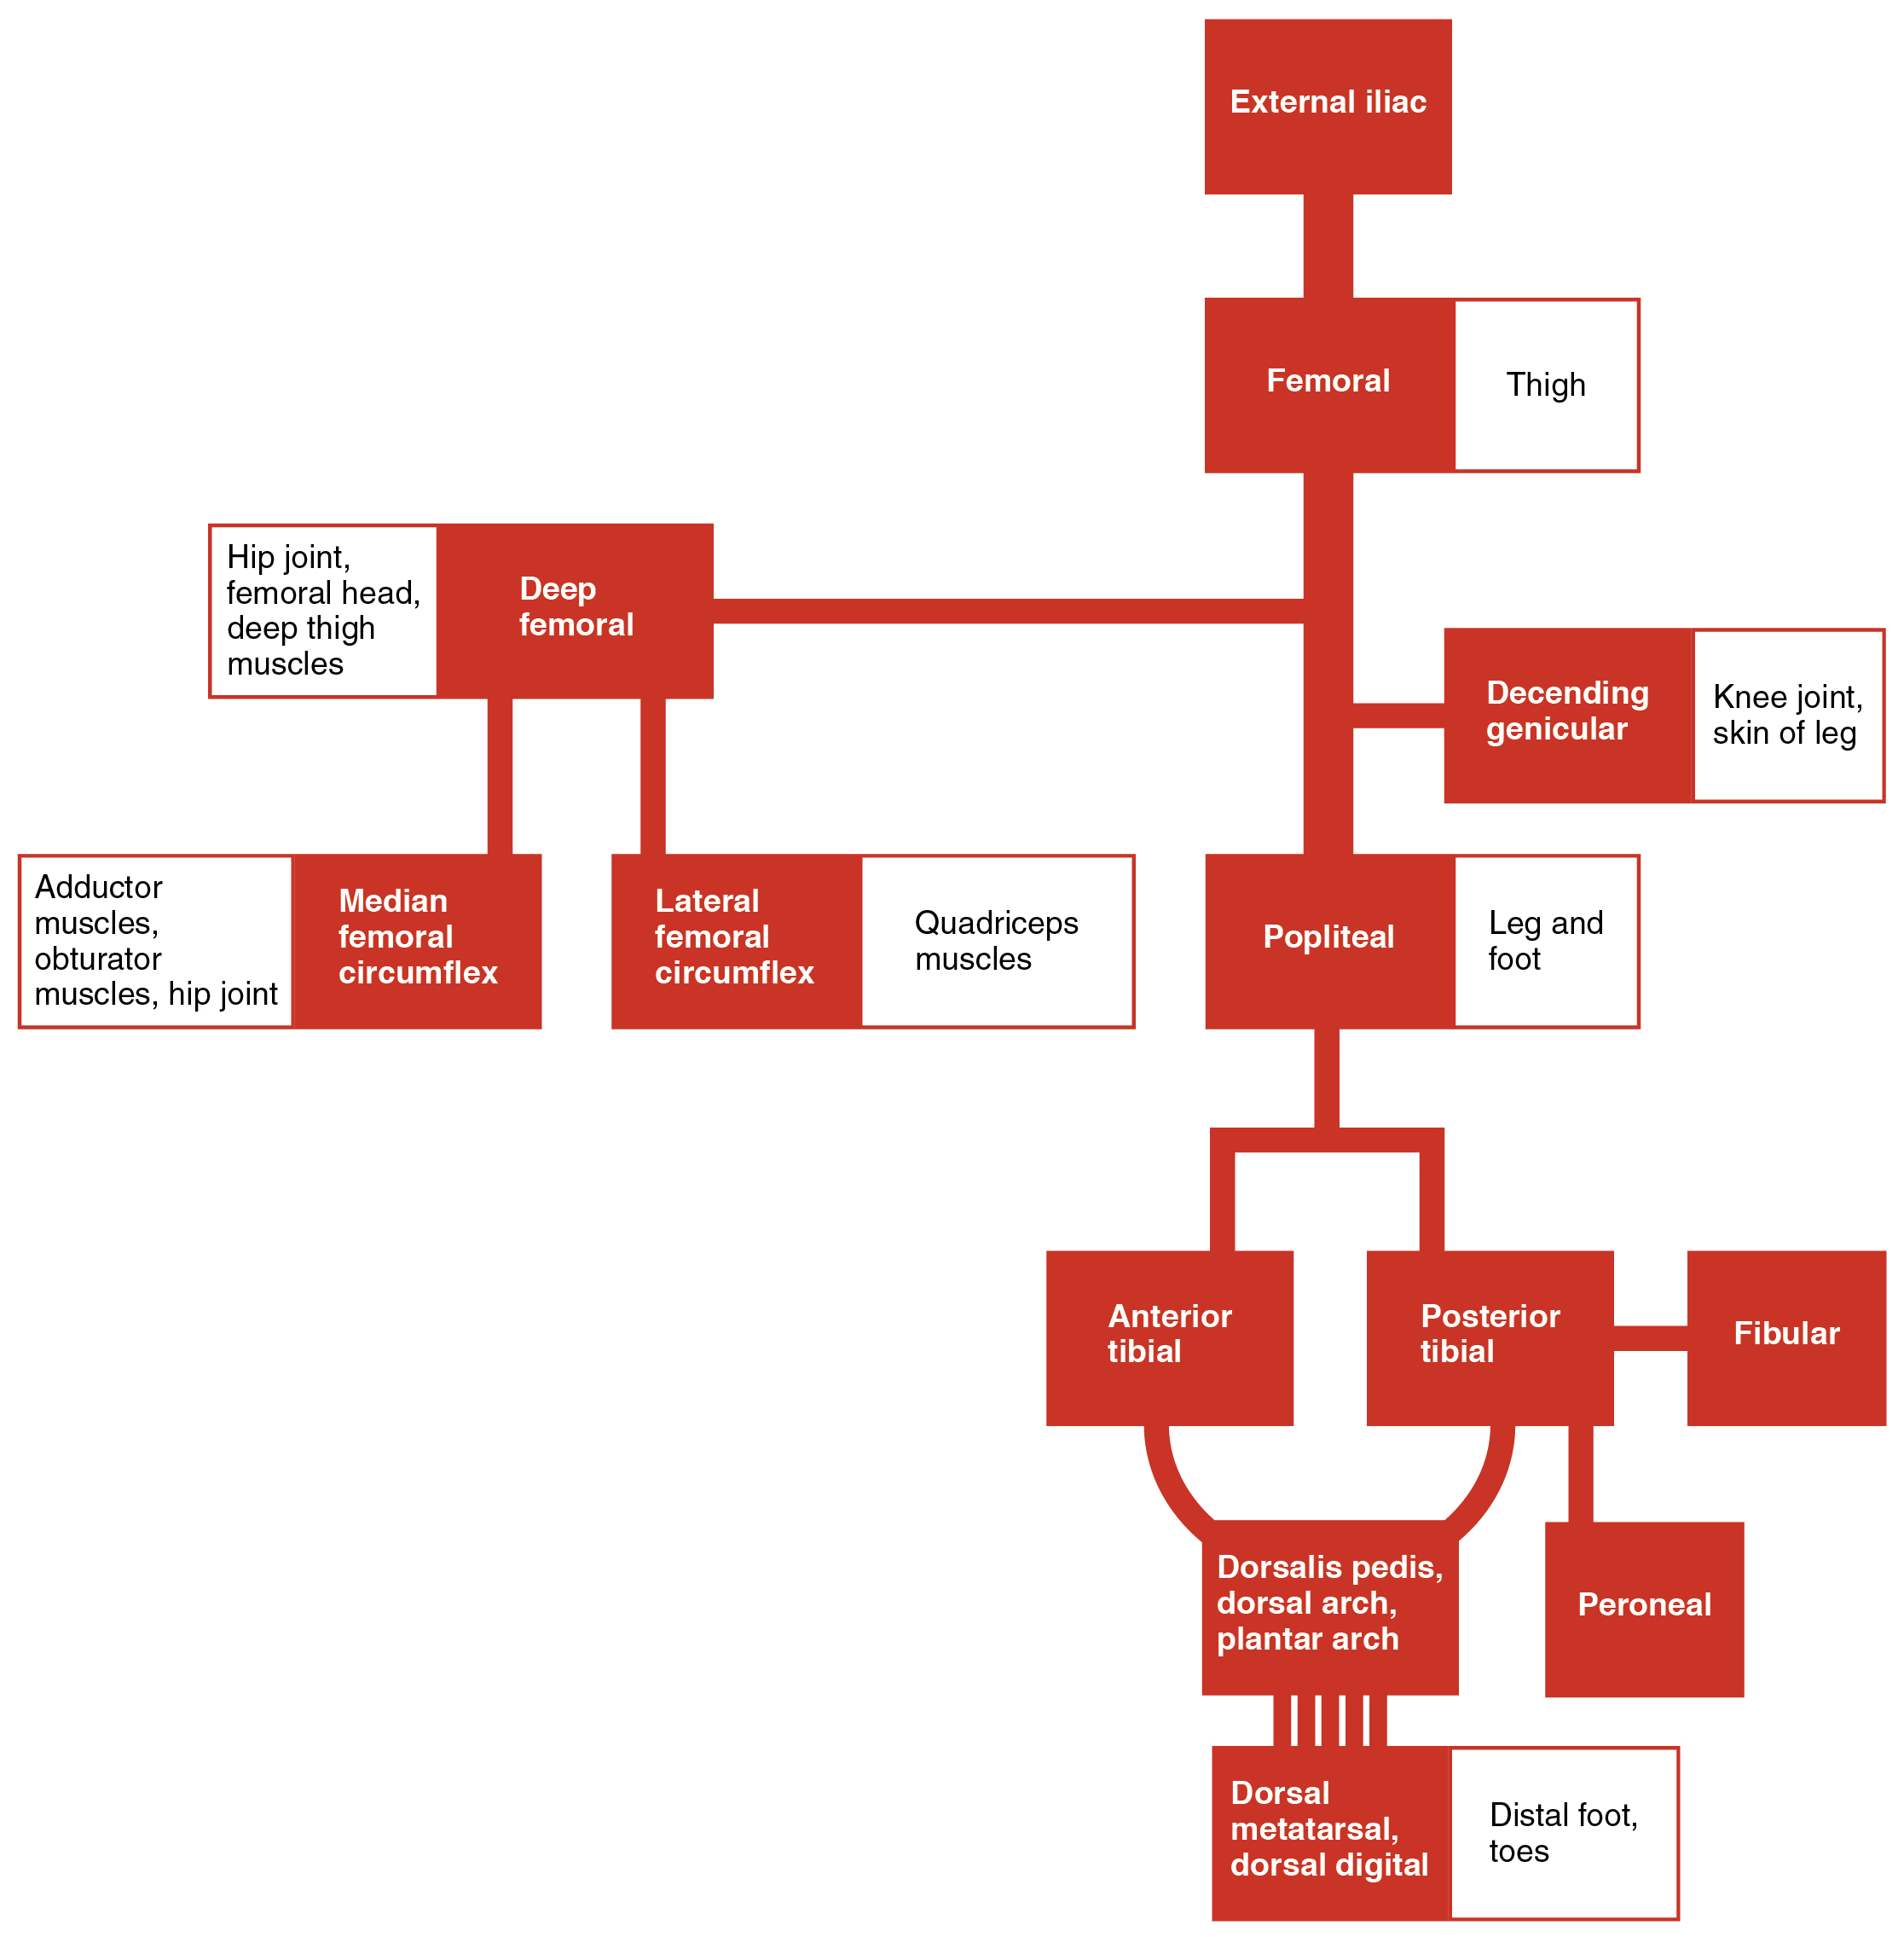
Figure 4.34
Systemic Arteries of the Lower Limb
The flow chart summarizes the distribution of the systemic arteries from the external iliac artery into the lower limb.

Slide 36
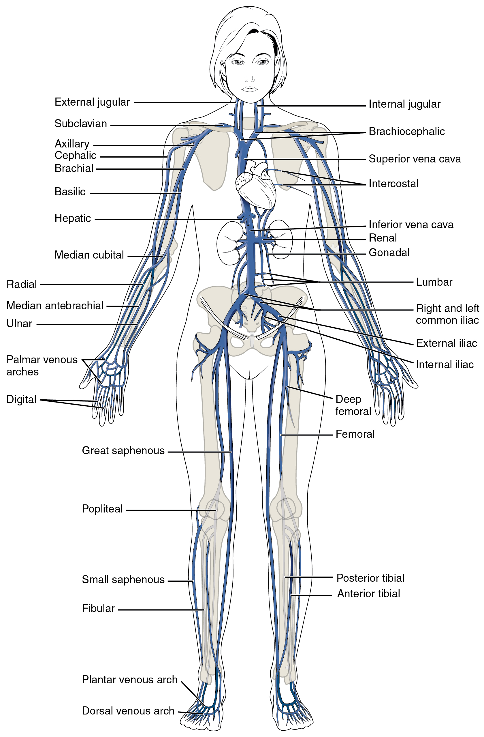
Figure 4.35
Major Systemic Veins of the Body
The major systemic veins of the body are shown here in an anterior view.

Slide 37
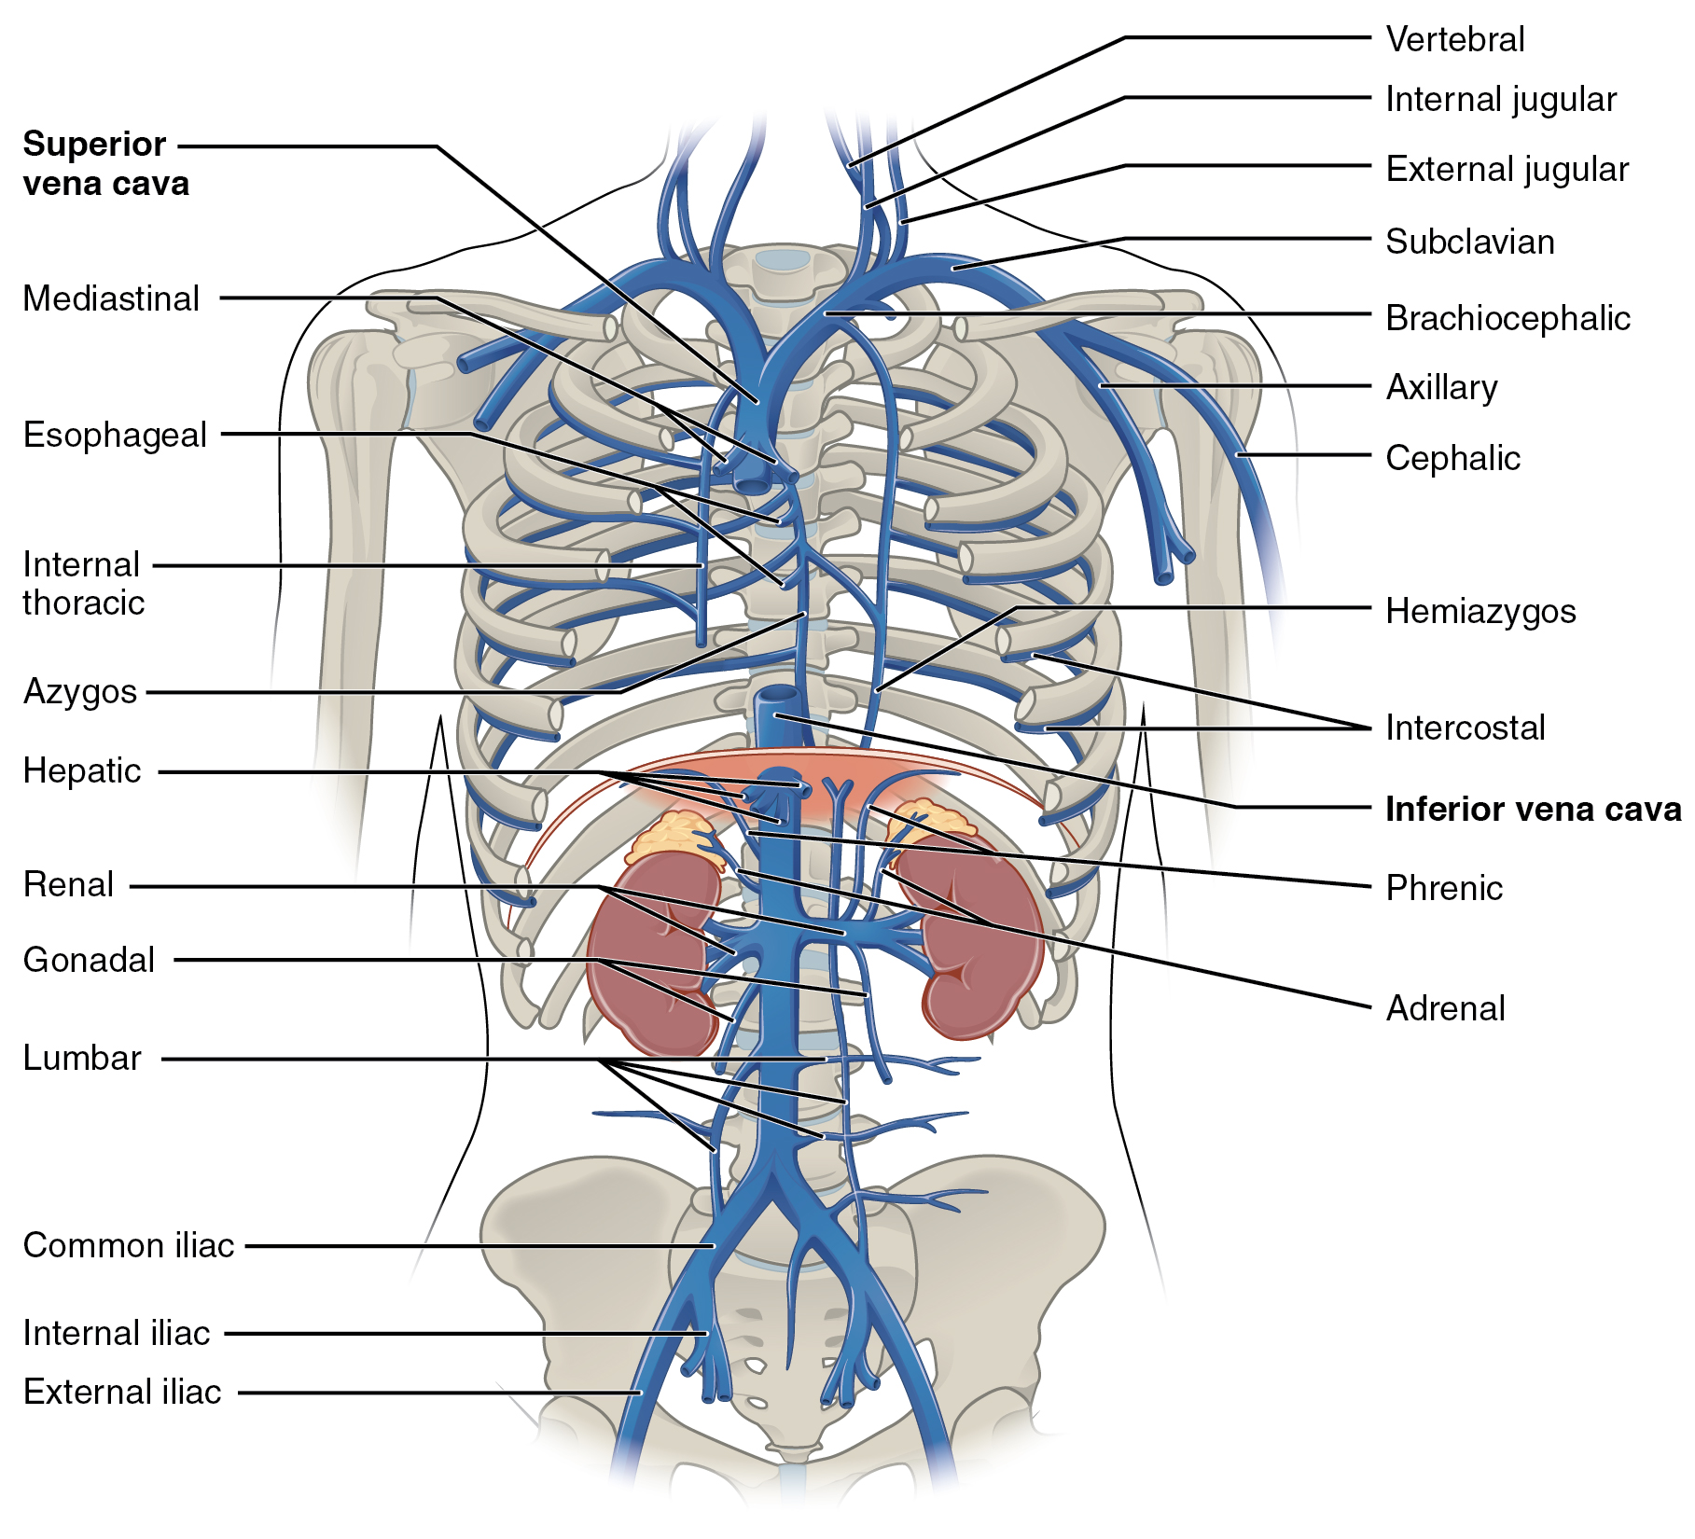
Figure 4.36
Veins of the Thoracic and Abdominal Regions
Veins of the thoracic and abdominal regions drain blood from the area above the diaphragm, returning it to the right atrium via the superior vena cava.

Slide 38
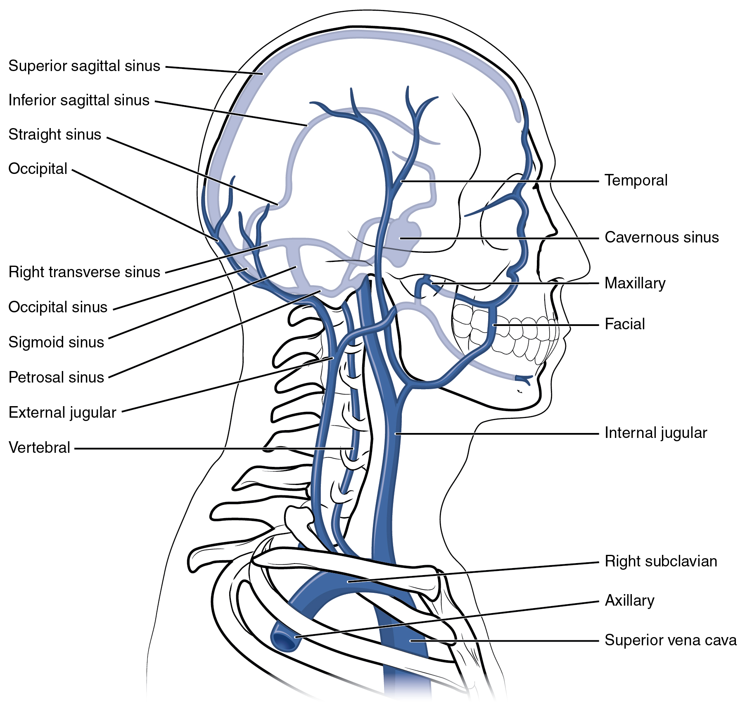
Figure 4.37
Veins of the Head and Neck
This left lateral view shows the veins of the head and neck, including the intercranial sinuses.

Slide 39
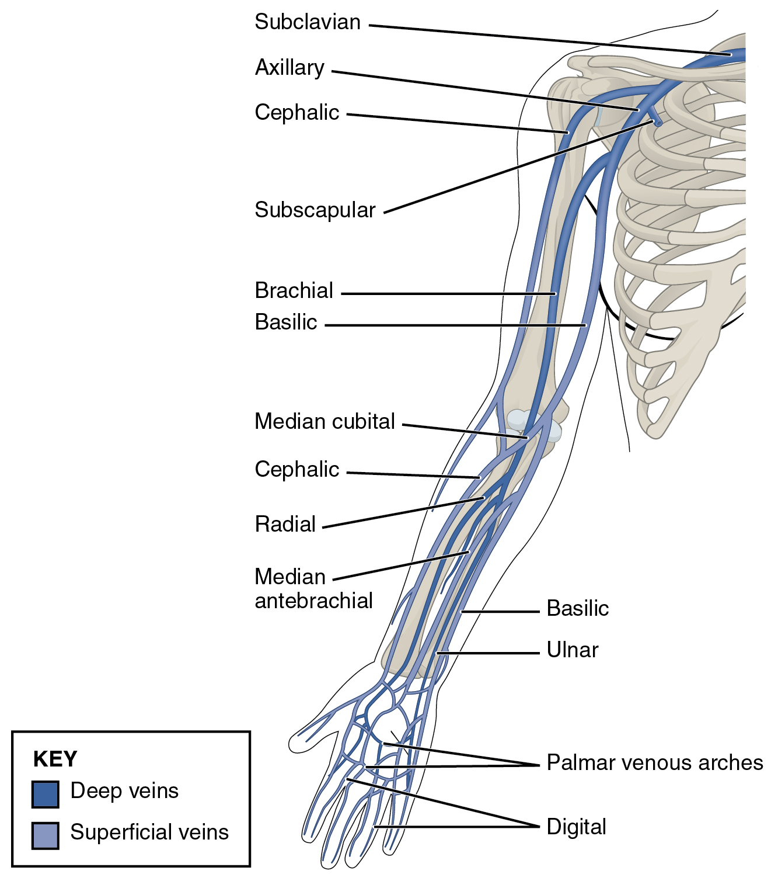
Figure 4.38
Veins of the Upper Limb
This anterior view shows the veins that drain the upper limb.

Slide 40
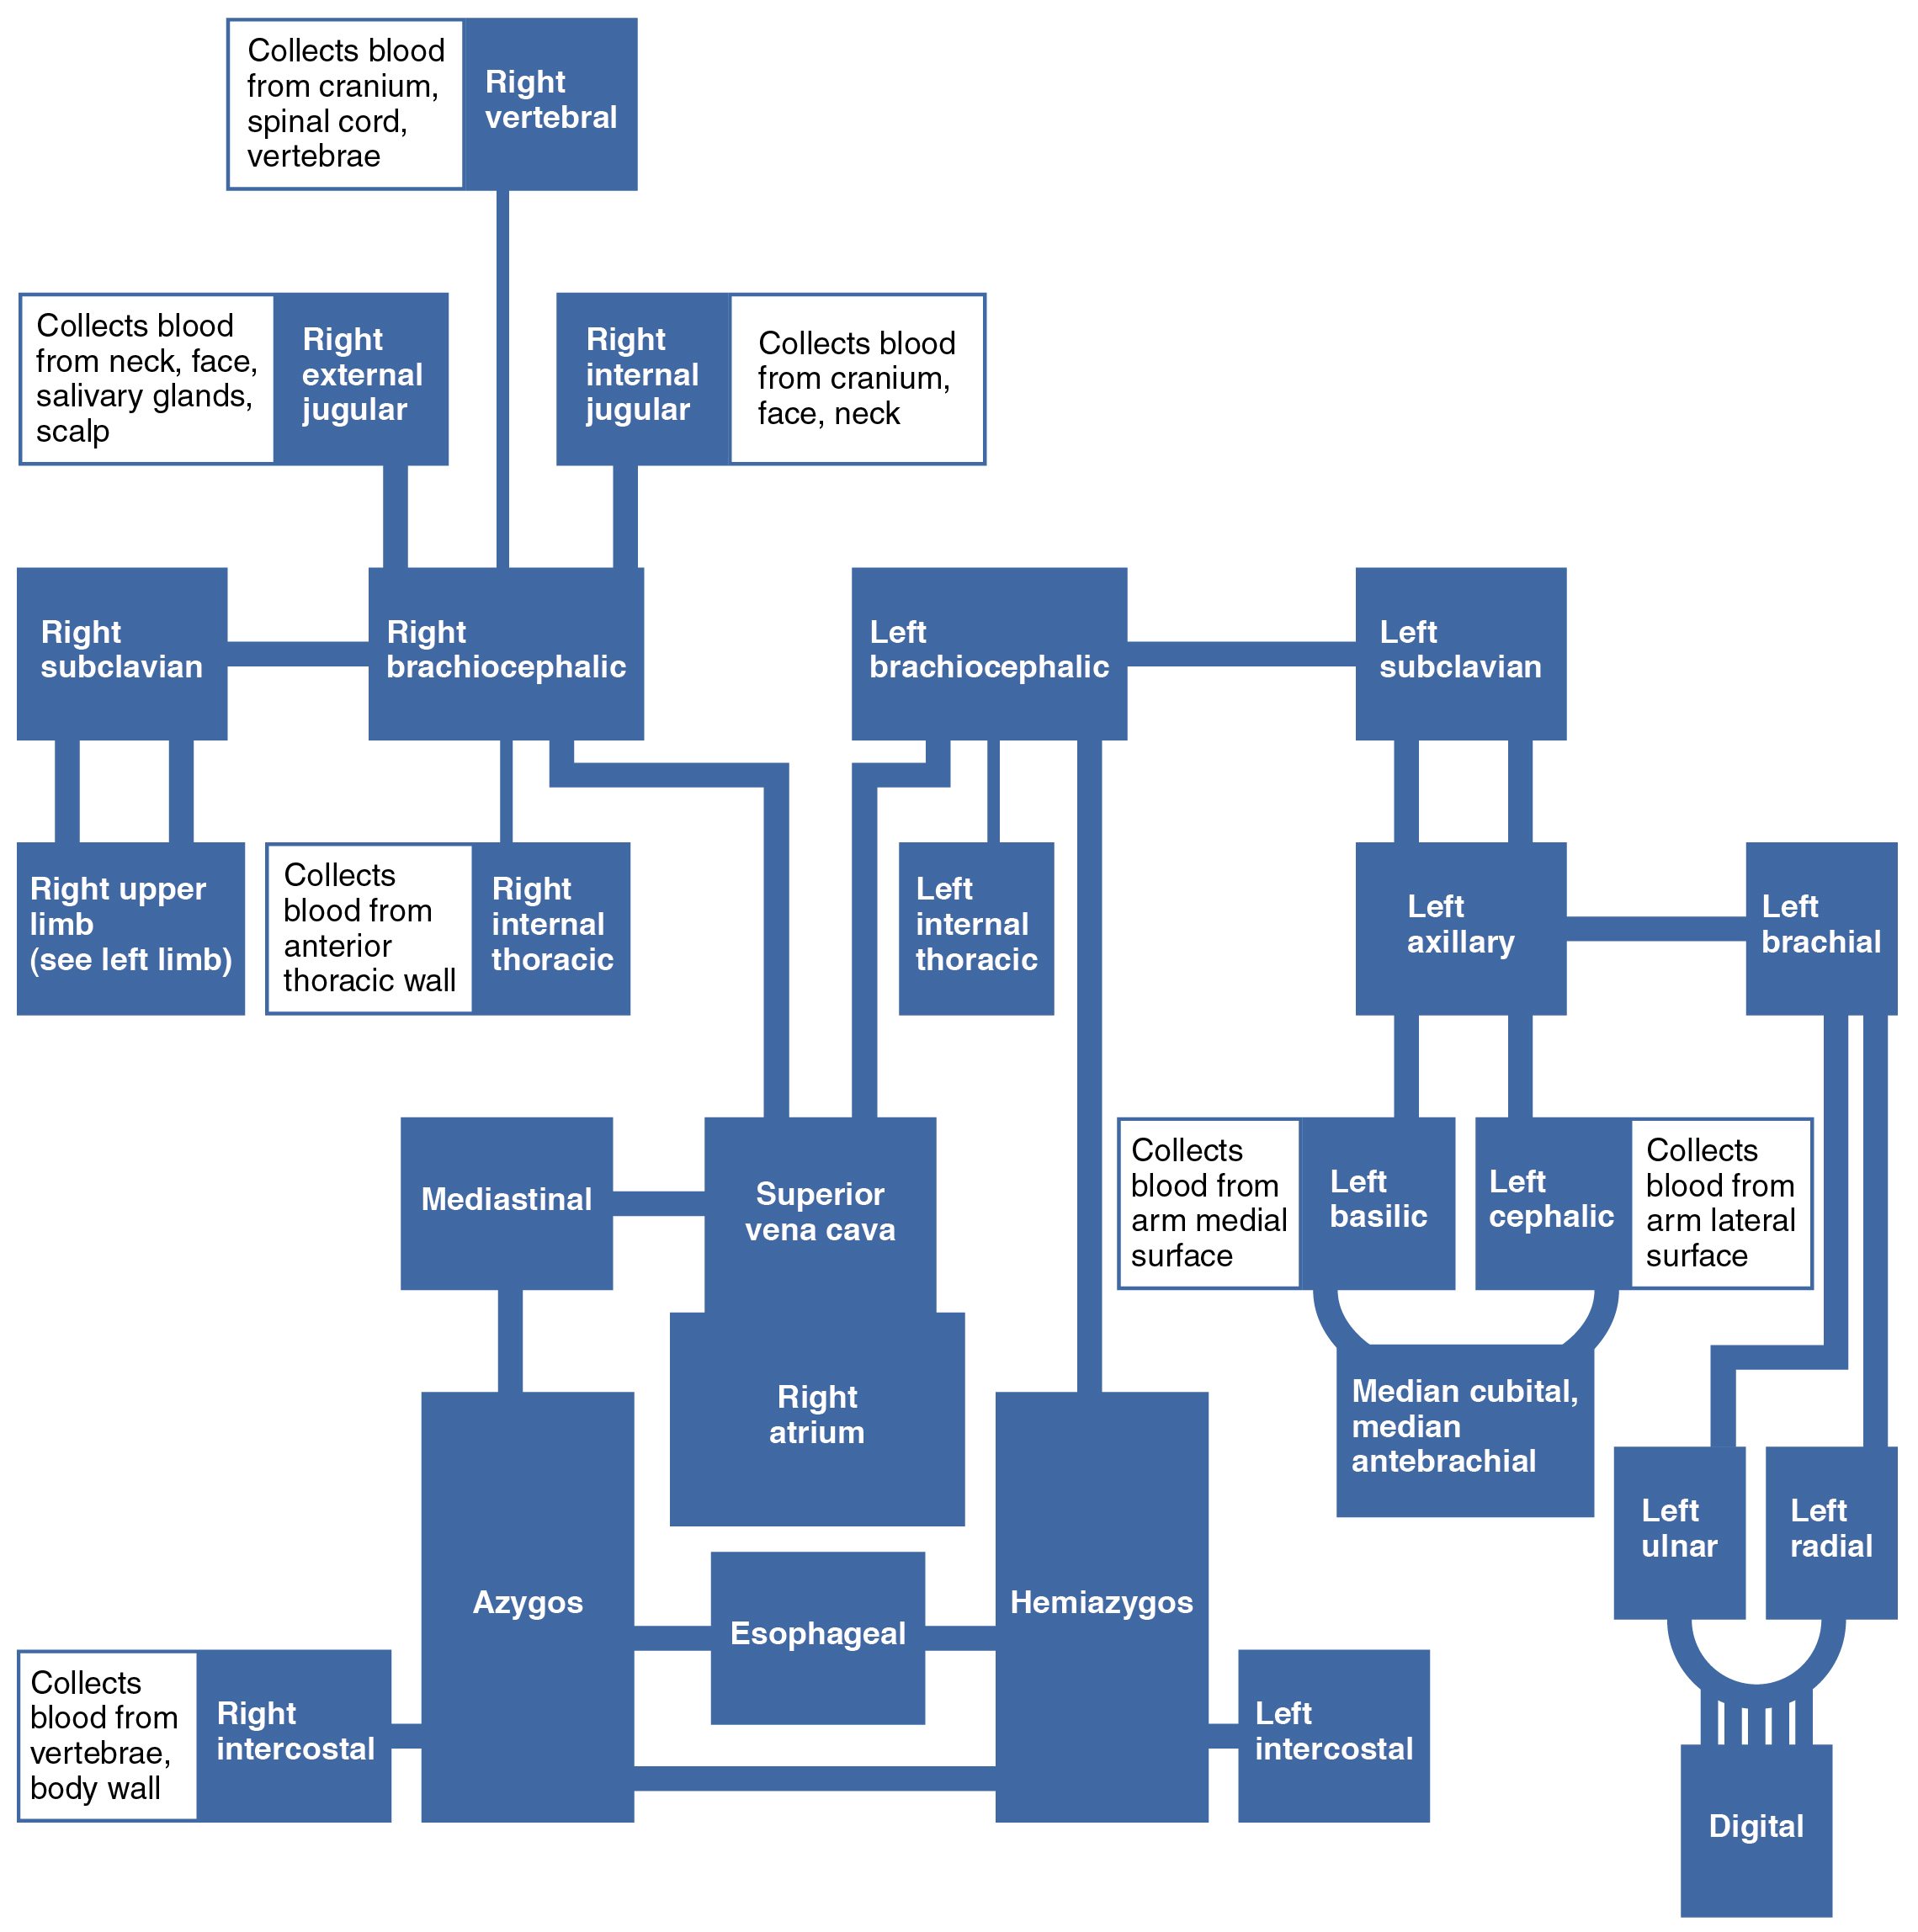
Figure 4.39
Veins Flowing into the Superior Vena Cava
The flow chart summarizes the distribution of the veins flowing into the superior vena cava.

Slide 41
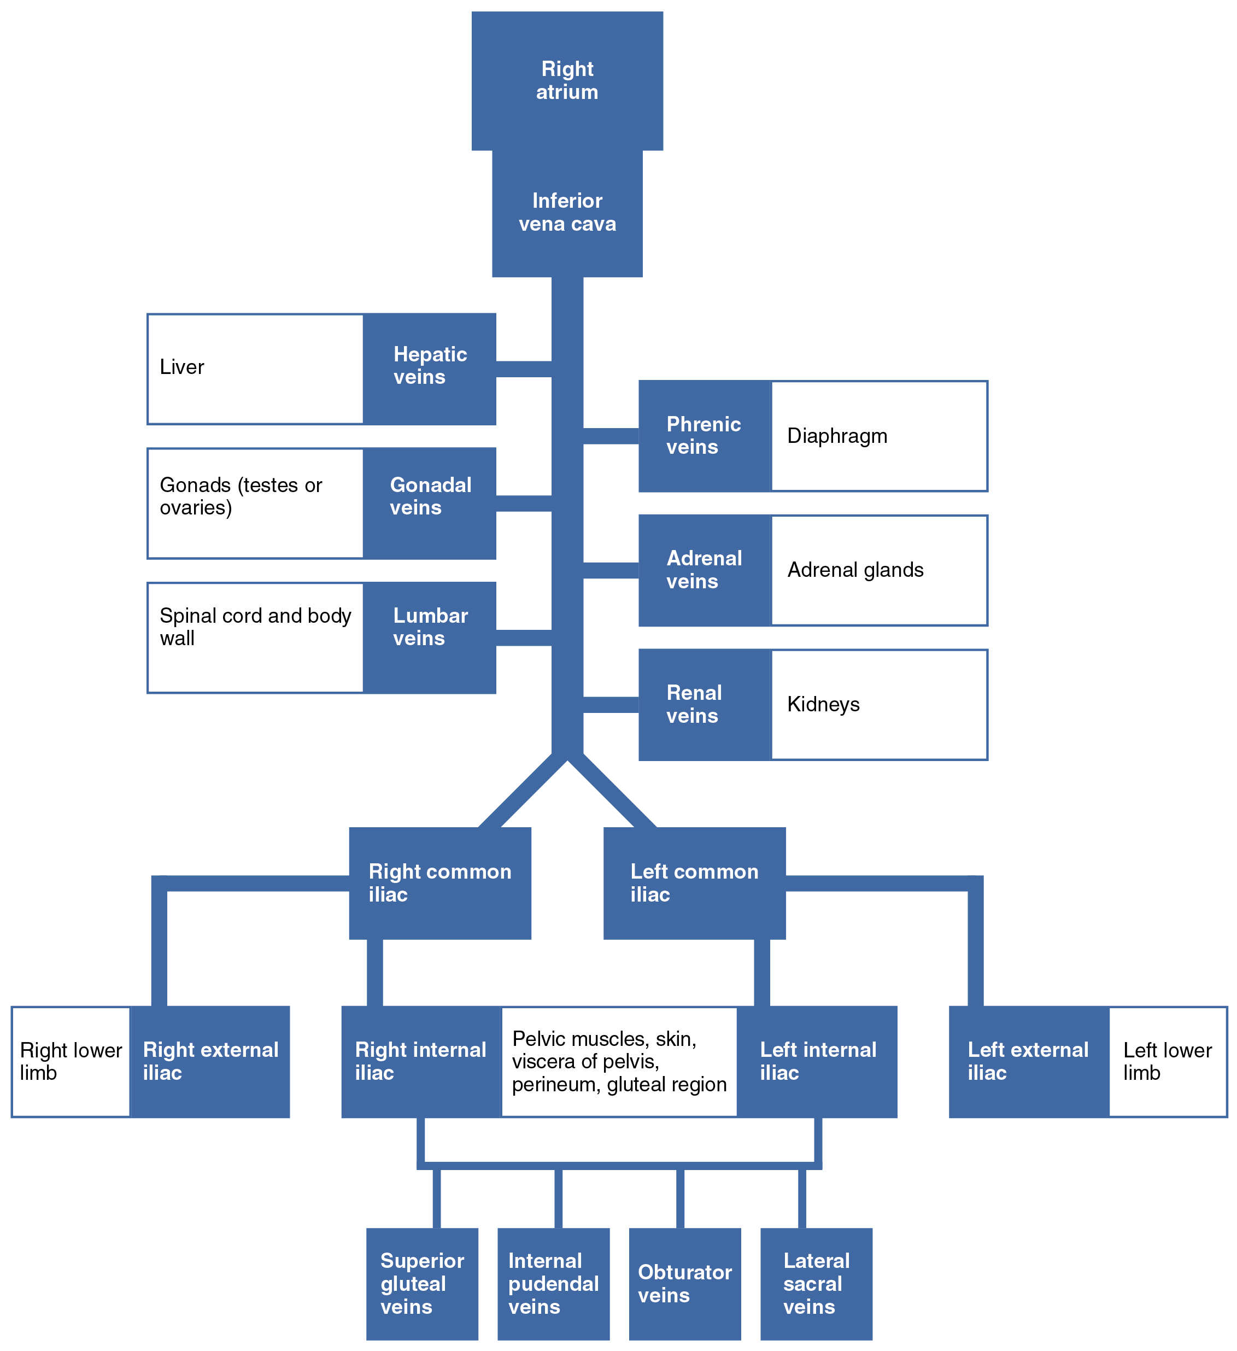
Figure 4.40
Venous Flow into Inferior Vena Cava
The flow chart summarizes veins that deliver blood to the inferior vena cava.

Slide 42
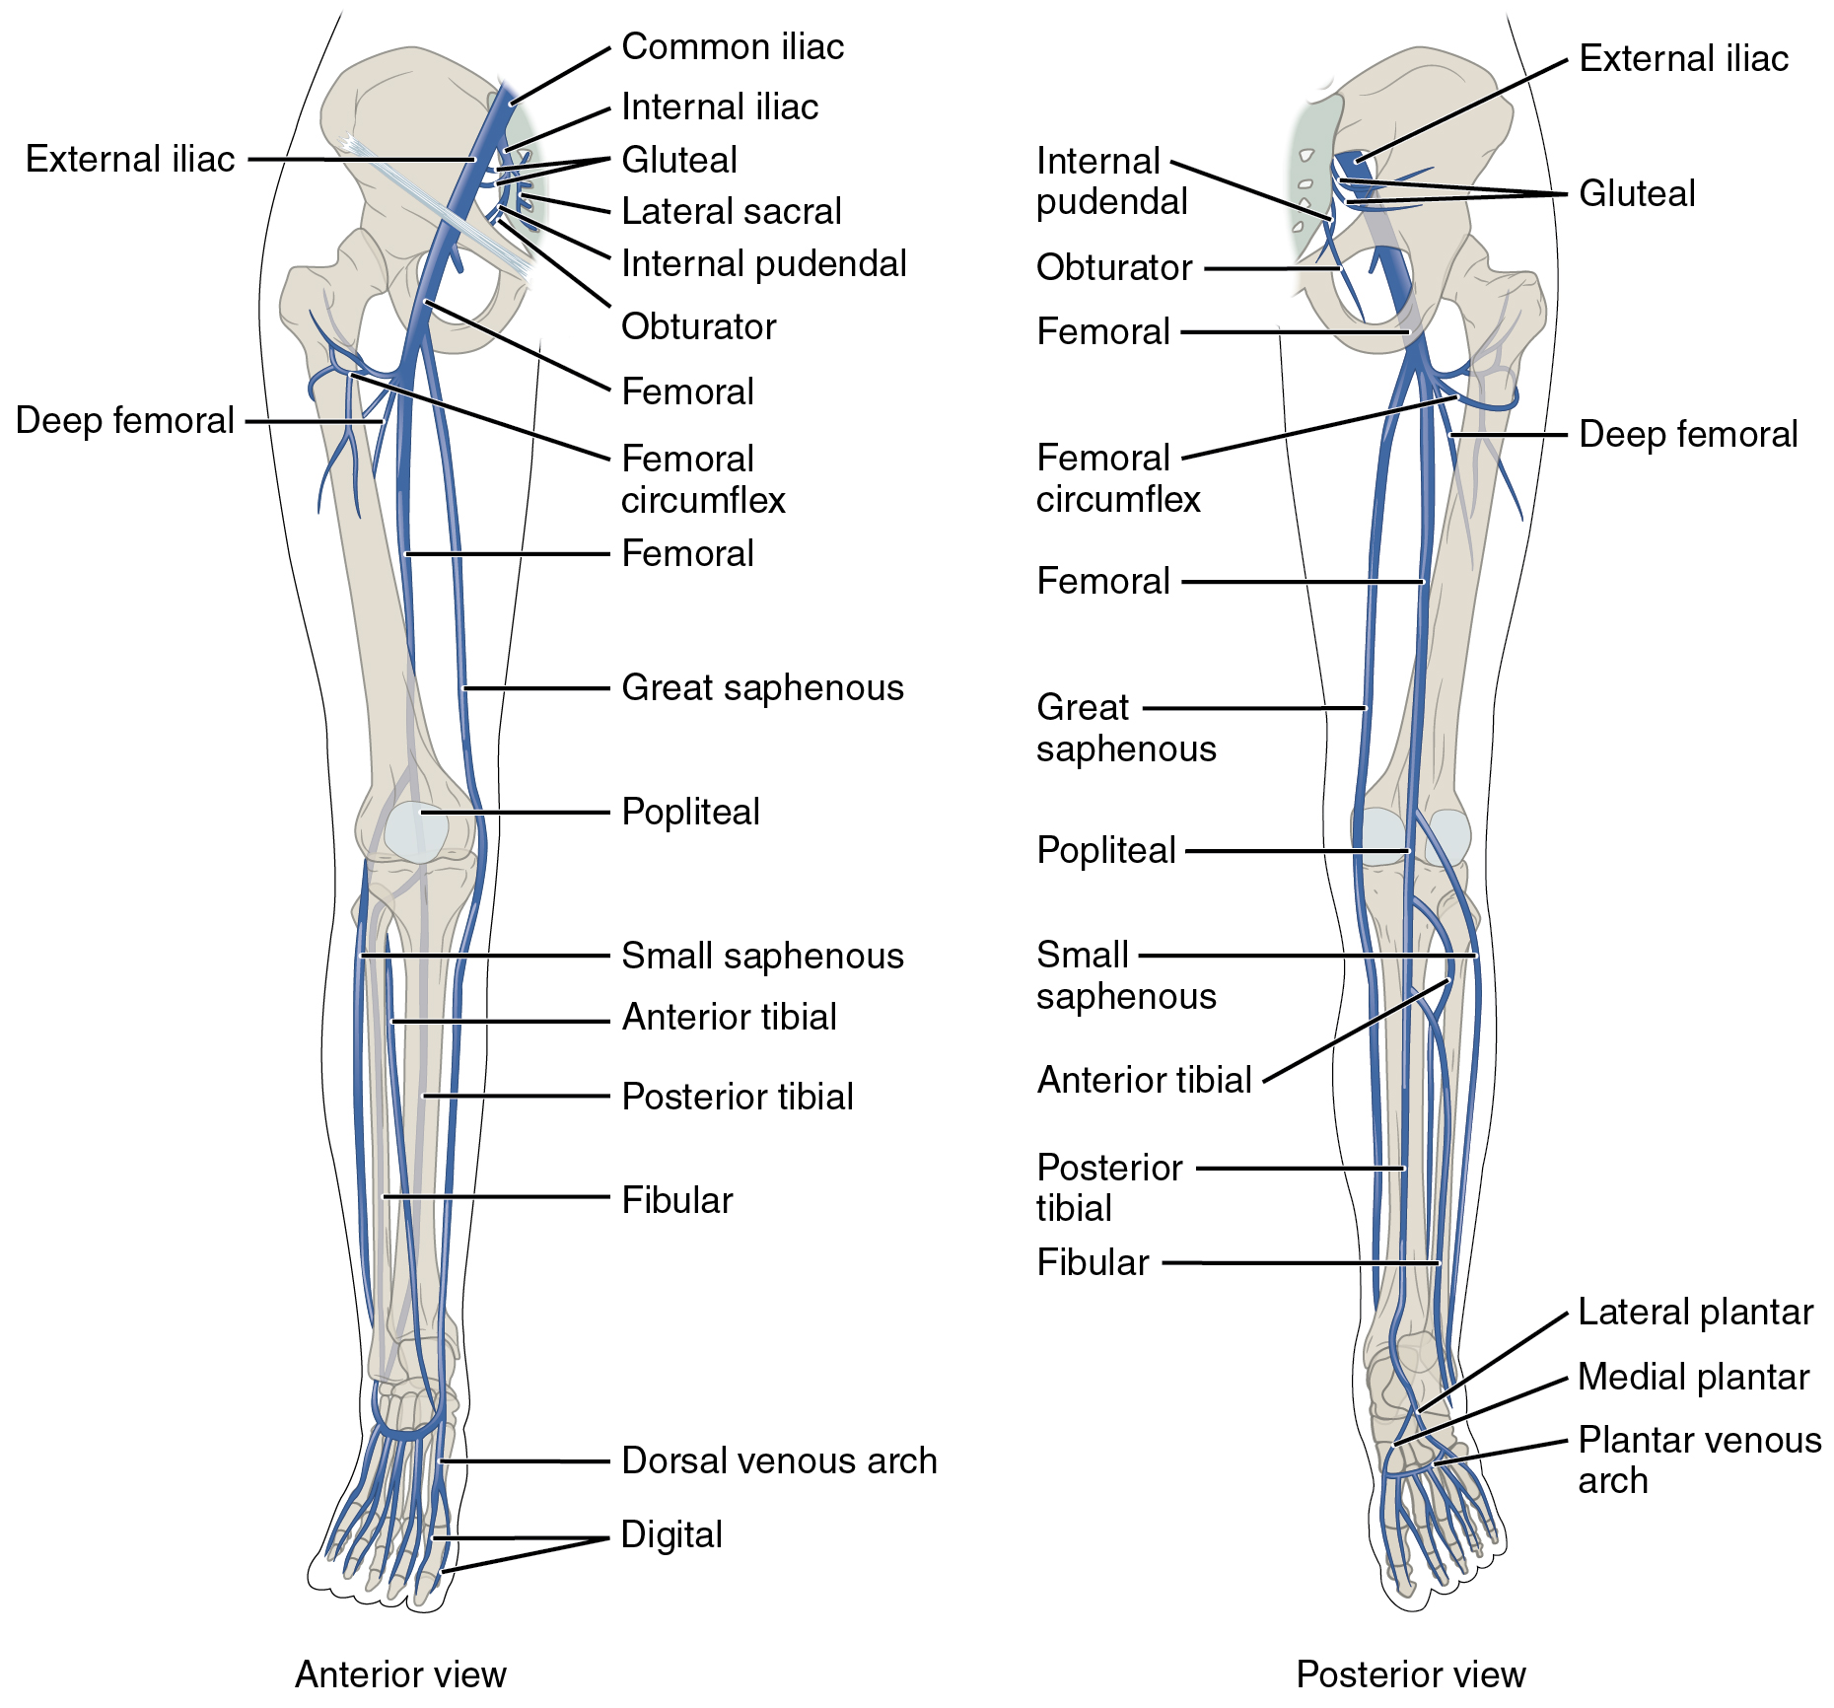
Figure 4.41
Major Veins Serving the Lower Limbs
Anterior and posterior views show the major veins that drain the lower limb into the inferior vena cava.

Slide 43
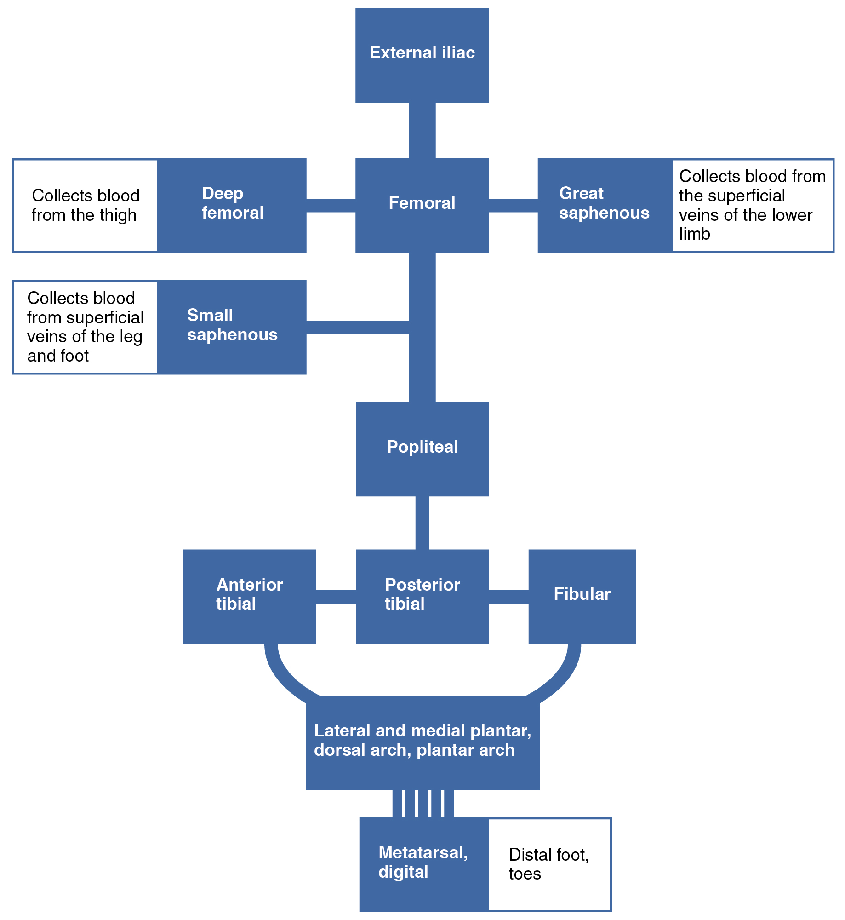
Figure 4.42
Major Veins of the Lower Limb
The flow chart summarizes venous flow from the lower limb.

Slide 44
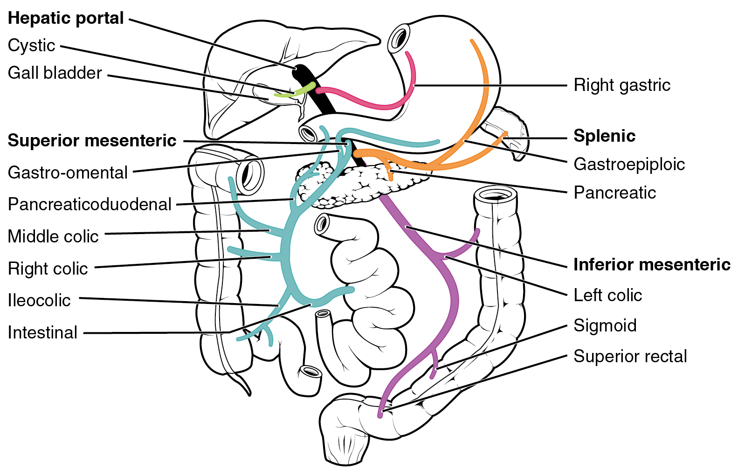
Figure 4.43
Hepatic Portal System
The liver receives blood from the normal systemic circulation via the hepatic artery. It also receives and processes blood from other organs, delivered via the veins of the hepatic portal system. All blood exits the liver via the hepatic vein, which delivers the blood to the inferior vena cava. (Different colors are used to help distinguish among the different vessels in the system.)

Slide 45
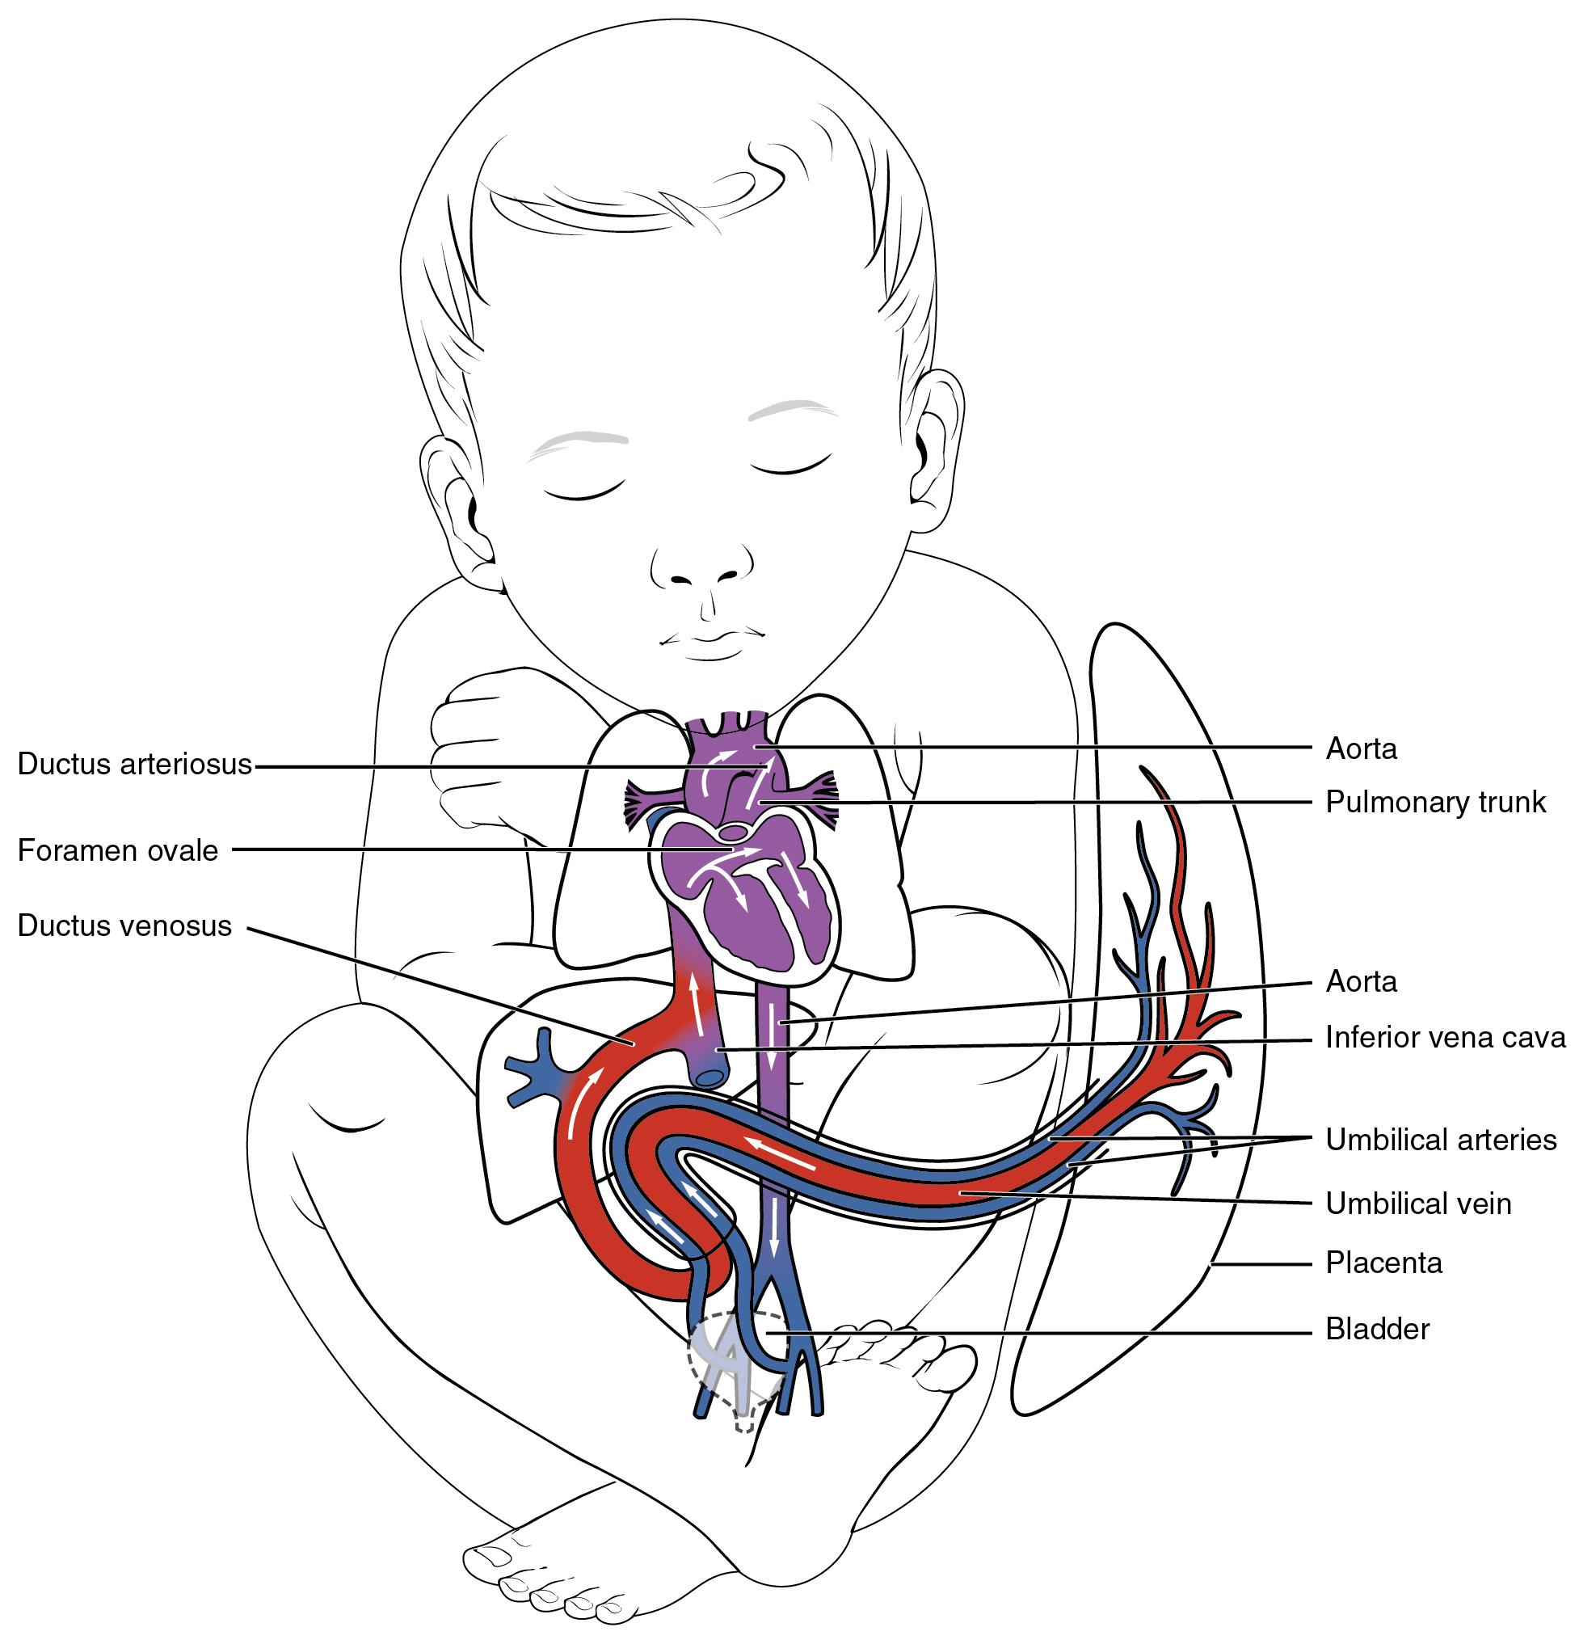
Figure 4.44
Fetal Shunts
The foramen ovale in the interatrial septum allows blood to flow from the right atrium to the left atrium. The ductus arteriosus is a temporary vessel, connecting the aorta to the pulmonary trunk. The ductus venosus links the umbilical vein to the inferior vena cava largely through the liver.

Slide 46
This OpenStax ancillary resource is © Rice University under a CC-BY 4.0 International license; it may be reproduced or modified but must be attributed to OpenStax, Rice University and any changes must be noted.

