Slide 1
Acid-Fast Stain Lab
Ziehl–Neelsen Method
Microbiology Laboratory
By Professor Erica A. Burns

Slide 2
Learning Objectives
• Explain the purpose of the acid-fast stain
• Identify mycolic acids in acid-fast cell walls
• Identify the decolorizer used
• List pathogenic acid-fast organisms
• Perform a Ziehl–Neelsen stain
• Distinguish acid-fast vs non–acid-fast cells

Slide 3
Overview
The acid-fast stain is a differential stain used to identify bacteria with waxy, lipid-rich cell walls containing mycolic acids.
These bacteria do not stain well with standard stains such as crystal violet.

Slide 4
Clinically Important Acid-Fast Organisms
• Mycobacterium tuberculosis
• Mycobacterium leprae
• Nocardia species (partially acid-fast)

Slide 5
Organisms Used in This Lab
• Mycobacterium smegmatis (acid-fast, safe lab strain)
• Staphylococcus aureus (non–acid-fast control)

Slide 6
Materials
• Bacterial cultures
• Microscope slides
• Carbolfuchsin (Ziehl–Neelsen)
• Acid-alcohol
• Methylene blue
• Microscope (oil immersion)
• Heat source and safety equipment

Slide 7
Safety Precautions
• Wear gloves, goggles, and lab coat
• Use only approved cultures
• Work in a ventilated area
• Heat slides carefully
• Disinfect work surfaces
Used slides should be disposed biological sharps container
Stain waste collected into a labeled waste container for proper chemical removal

Slide 8
Procedure: Prepare the Smear
1. Place a drop of water on slide
2. Add bacteria using aseptic technique
3. Spread thin smear
4. Air dry
5. Heat-fix

Slide 9
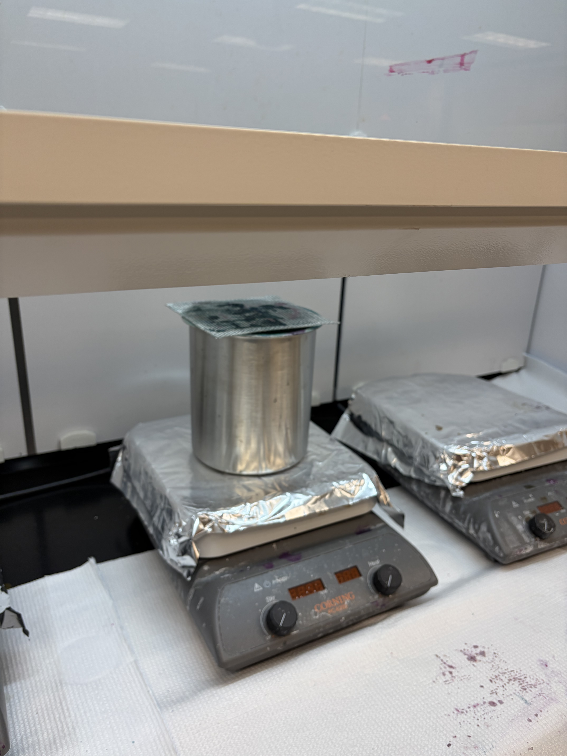
Procedure: Primary Stain
Flood slide with carbolfuchsin
Heat gently until steaming
Maintain steam for 5 minutes
Do not allow stain to dry
Notes:
This image shows the steaming setup used during the Ziehl–Neelsen acid-fast staining procedure. A metal beaker is placed on a hot plate covered with aluminum foil and positioned under a fume hood. The setup is used to gently heat microscope slides flooded with carbolfuchsin, allowing steam to rise without boiling. This controlled heating helps the primary stain penetrate the waxy cell wall of acid-fast bacteria while maintaining laboratory safety.

Slide 10
Procedure: Decolorization & Counterstain
Decolorize with acid-alcohol (10–20 sec)
Rinse with water
Counterstain with methylene blue (1 min)
Rinse and blot dry

Slide 11
Microscopy
• Observe under 100x oil immersion
• Acid-fast cells = pink/red
• Non–acid-fast cells = blue

Slide 12
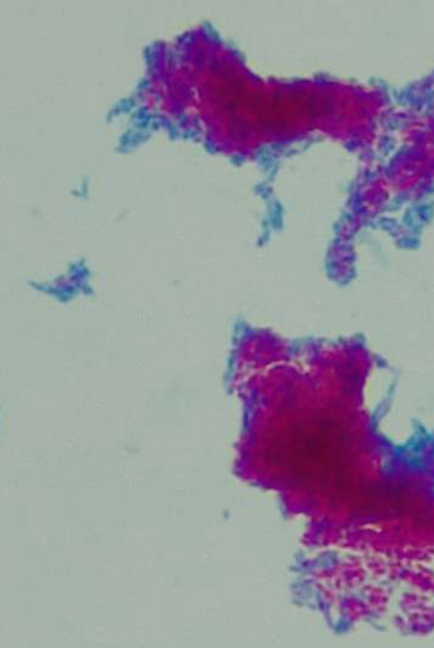
Results: Acid-Fast Positive
Cells appear pink/red
Indicates presence of mycolic acids
Seen in Mycobacterium and Nocardia
Notes:
This image shows an acid-fast stained smear viewed under the microscope (1,000X). Bright pink to red areas represent acid-fast bacteria (Mycobacterium smegmatis) that retained the primary stain, while the surrounding blue areas represent non–acid-fast cells or background material that took up the counterstain (methylene blue). The strong pink color indicates the presence of a waxy cell wall that resists decolorization. Smear made by Fletcher Technical Community College student Nicola Ladner. Picture taken by Professor Erica A. Burns

Slide 13
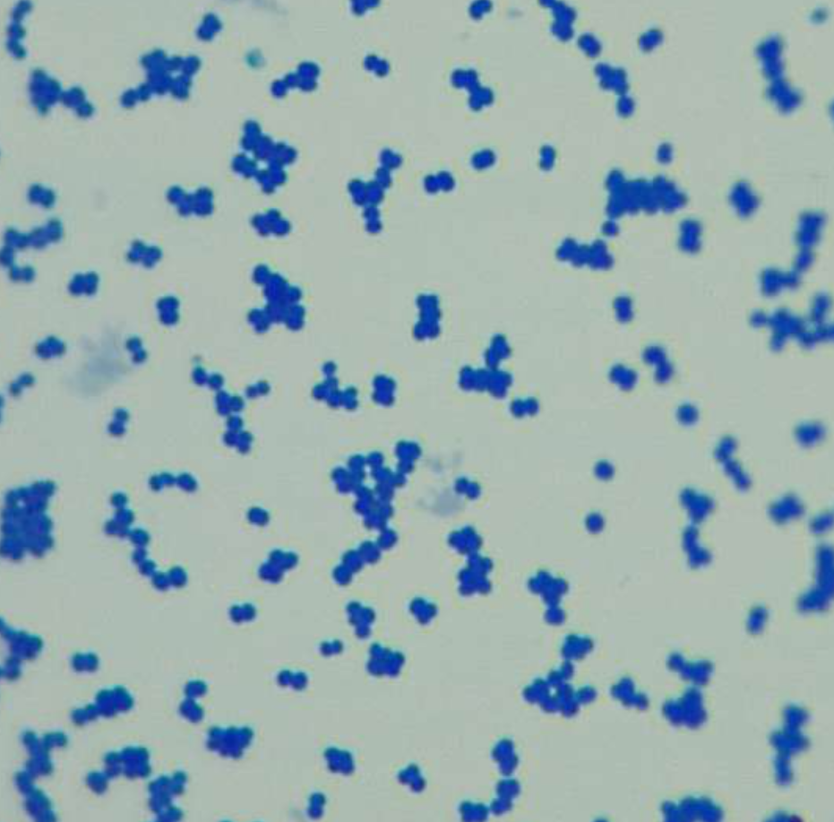
Results: Acid-Fast Negative
Cells appear blue
No waxy lipid layer present
Notes:
This image shows a non–acid-fast stained bacterial smear viewed under the microscope (1,000X). The cells appear blue, indicating they did not retain the primary stain (Z-N Carbolfuchsin stain) and instead took up the counterstain (methylene blue). The bacteria (Micococcus luteus) are small and round in shape and are distributed singly and in small clusters (tetrads) against a light background. Smear made by Fletcher Technical Community College student Nicola Ladner. Picture taken by Professor Erica A. Burns

Slide 14
Troubleshooting
All blue: over-decolorization or insufficient heat
All red: under-decolorization
Stain dries: artifacts form
Smear washes off: poor fixation

Slide 15
Post-Lab Questions
What cell wall component causes acid-fastness?
Why is heat needed for carbolfuchsin?
Compare acid-fast vs non–acid-fast walls
Name an acid-fast pathogen
What if decolorizer is skipped?

Slide 16
Glossary
Acid-fast – retains carbolfuchsin
Carbolfuchsin – primary stain
Acid-alcohol – decolorizer
Mycolic acids – waxy cell wall lipids

