Slide 1
Capsule Stain Laboratory
Microbiology Lab
By Professor Erica A. Burns

Slide 2
Learning Objectives
Describe the structure and function of the bacterial capsule
Explain the basic principles of the capsule stain
List clinically important pathogenic organisms that have a capsule
Demonstrate how to perform a capsule stain
Interpret capsule stain results using a microscope
Draw, label, and describe the location of the capsule

Slide 3
Overview: Capsule Stain
Special staining technique used to visualize bacterial capsules
Capsule is part of the glycocalyx external to the cell wall
Capsules are thick and tightly bound; slime layers are thin and loose
Capsules protect cells and contribute to virulence

Slide 4
Functions of the Glycocalyx
Protects against desiccation
Helps bacteria adhere to surfaces and host tissues
Protects against phagocytosis by immune cells
Contributes to biofilm formation
Acts as a virulence factor

Slide 5
Principles of Staining
Bacterial cells are negatively charged
Acidic dyes (negative charge) stain the background
Basic dyes (positive charge) stain the cell
Capsules are non-ionic and remain unstained

Slide 6
How the Capsule Stain Works
Acidic dye stains the background (negative stain)
Basic dye stains the bacterial cell
Capsule appears as a clear halo around the cell

Slide 7
Clinically Important Encapsulated Organisms
Streptococcus pneumoniae
Neisseria meningitidis
Klebsiella pneumoniae
Salmonella typhi
Cryptococcus neoformans (fungus)

Slide 8
Suggested Organisms for Lab
Serratia marcescens
Bacillus megaterium
Micrococcus luteus
Saccharomyces cerevisiae (yeast)

Slide 9
Materials
Bacterial or yeast cultures
Microscope slides and inoculating loop
Nigrosin or Congo red
Crystal violet or Maneval’s stain
Compound light microscope with immersion oil

Slide 10
Safety Precautions
Wear gloves, goggles, and lab coat
Treat all cultures as potential pathogens
Do NOT heat-fix slides
Disinfect workspace before and after lab
Used slides should be disposed biological sharps container
Stain waste collected into a labeled waste container for proper chemical removal

Slide 11
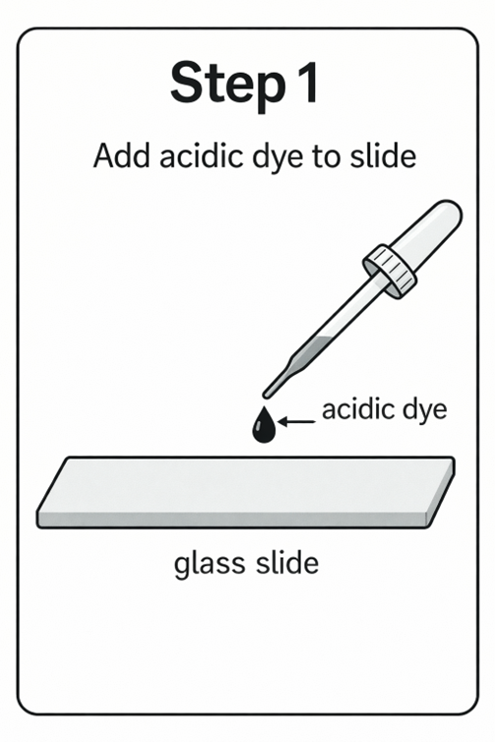
Capsule Stain Procedure (Step 1)
Step 1: Place a small drop of acidic dye (Nigrosin or Congo red) at one end of a clean slide.

Slide 12
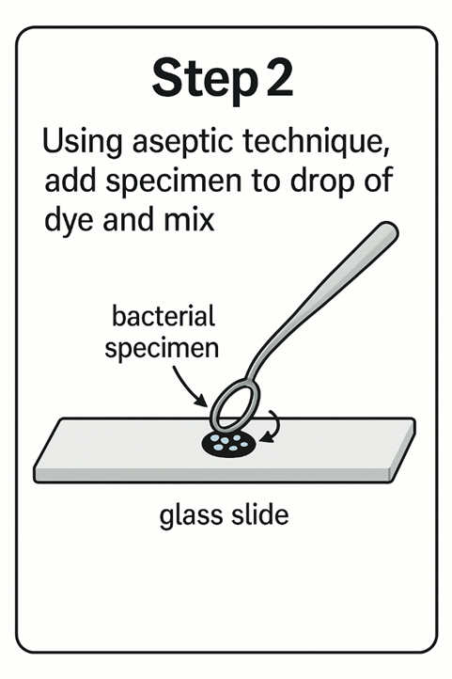
Capsule Stain Procedure (Step 2)
Step 2: Using aseptic technique, add a small amount of the specimen to the drop of dye on the slide and mix gently by moving the loop in a circular motion within the dye drop.

Slide 13
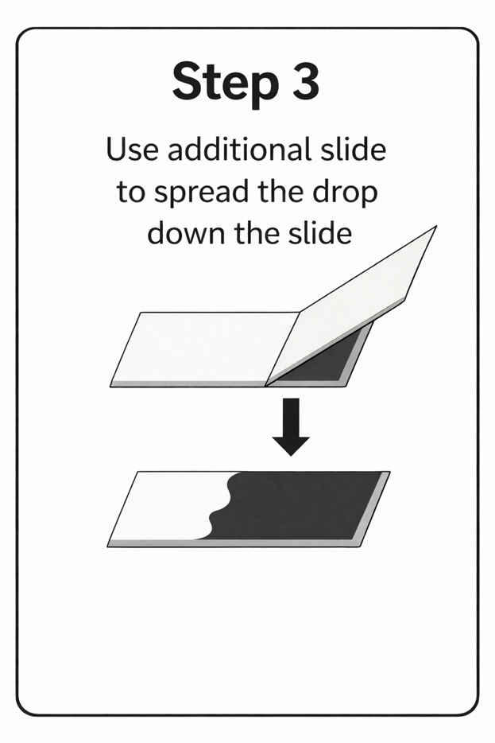
Capsule Stain Procedure (Step 3)
Step 3: Use additional slide to spread the drop across the slide

Slide 14
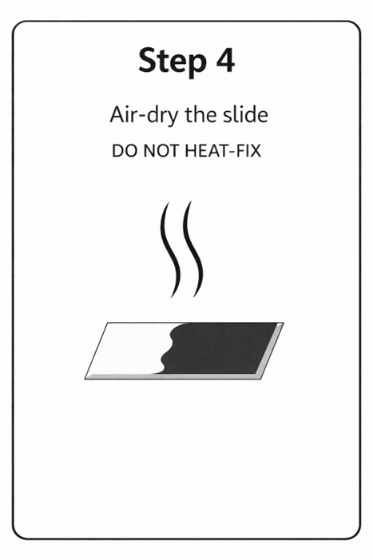
Capsule Stain Procedure (Step 4)
Step 4: Air- dry slide (Do not heat-fix slide) but make sure the slide is completely dry before doing the next step

Slide 15
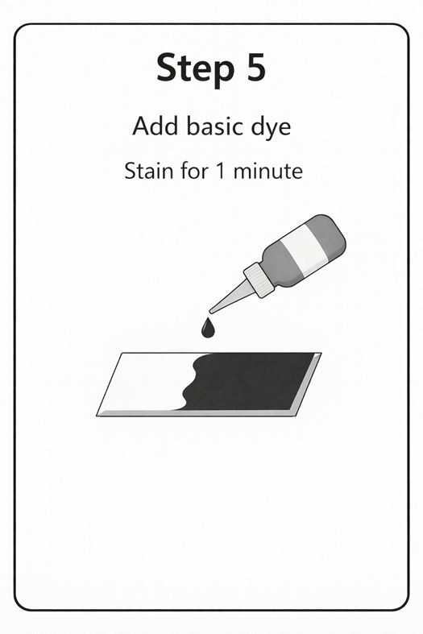
Capsule Stain Procedure (Step 5)
Step 5: Add the basic dye (crystal violet or Maneval's stain) stain for 1 minute

Slide 16
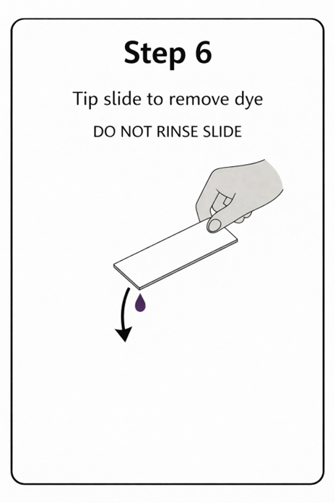
Capsule Stain Procedure (Step 6 )
Step 6: Tip slide to remove second dye (It is best not to rinse the slide because rinsing too much can wash the specimens off the slide due to not heat fixing the slide. But don't heat-fix!)

Slide 17
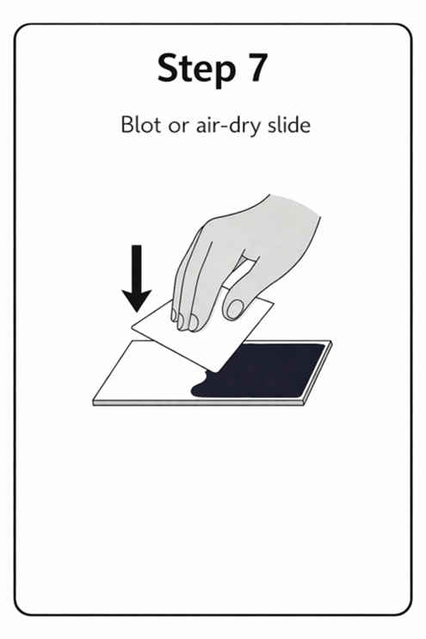
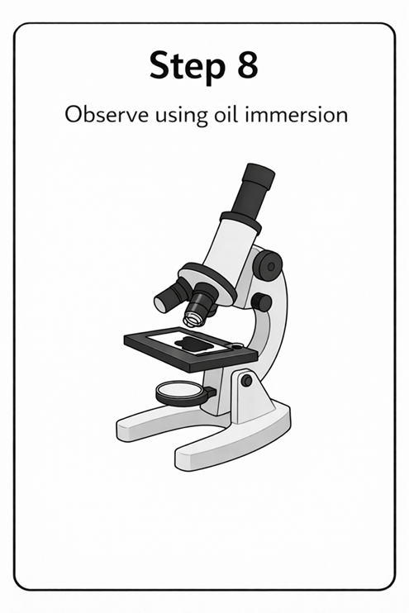
Capsule Stain Procedure (Step 7 & 8 )

Slide 18
Expected Observations
Dark background from acidic dye
Stained bacterial cells
Clear halo indicating capsule

Slide 19
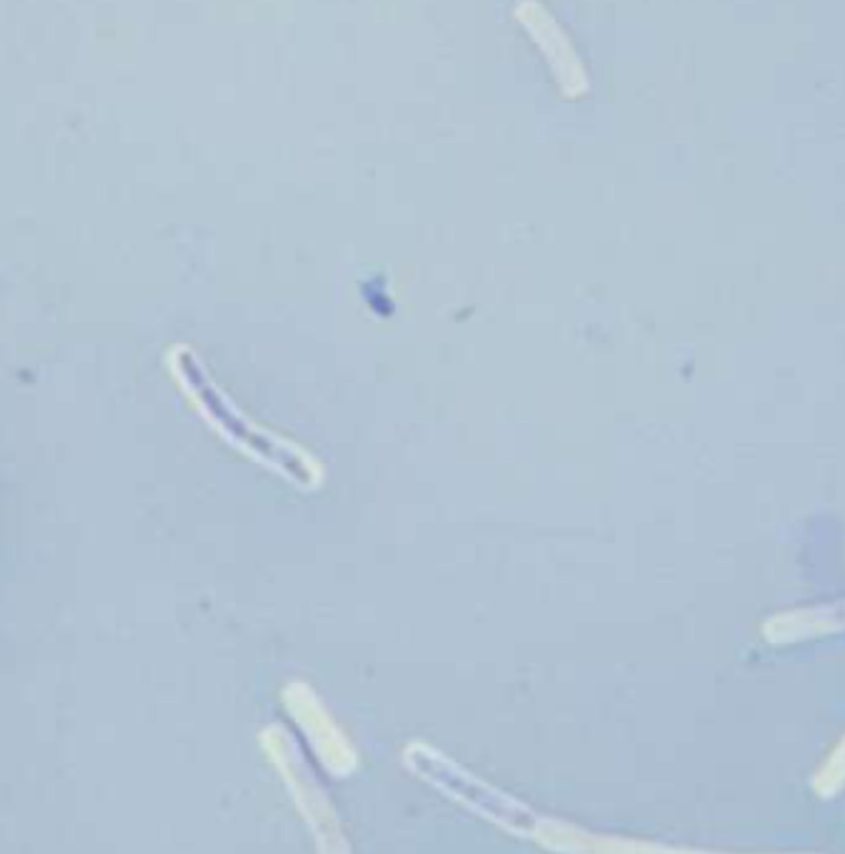
Positive Capsule Stain (1)
Cell is stained
Capsule appears as clear halo
Indicates presence of capsule
Bacillus megaterium
Nigrosin & crystal violet method
Notes:
This image shows a capsule-stained bacterial smear viewed under the microscope (1,000X). The rod-shaped bacteria (Bacillus megaterium) appear purple (crystal violet), while the capsules are visible as clear, unstained halos surrounding each cell. The light background (nigrosin) contrasts with the cell bodies, allowing the capsule to be identified as a transparent outline around the bacteria. Slide prepared and image captured by Professor Erica A. Burns, Fletcher Technical Community College.

Slide 20
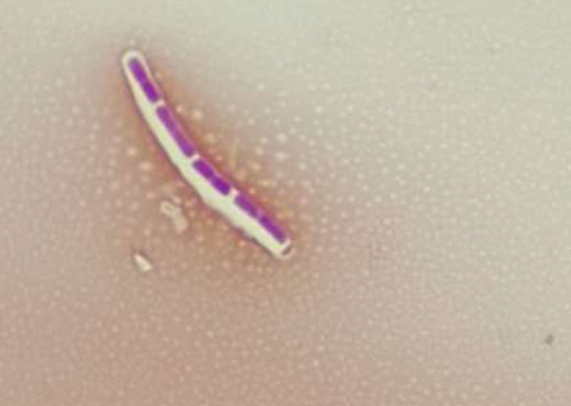
Positive Capsule Stain (2)
Cell is stained
Capsule appears as clear halo
Indicates presence of capsule
Bacillus megaterium
Congo Red & Maneval’s stain method
Notes:
This image shows a capsule-stained bacterial cell viewed under the microscope (1,000X). Procedure to make slide used Congo red and Maneval’s stain. The rod-shaped bacterium (Bacillus megaterium) appears purple, while the capsule surrounding the cell is visible as a clear, unstained halo. The background is lightly stained, creating contrast that allows the capsule to be identified as a transparent layer around the cell. Slide prepared and image captured by Professor Erica A. Burns, Fletcher Technical Community College.

Slide 21
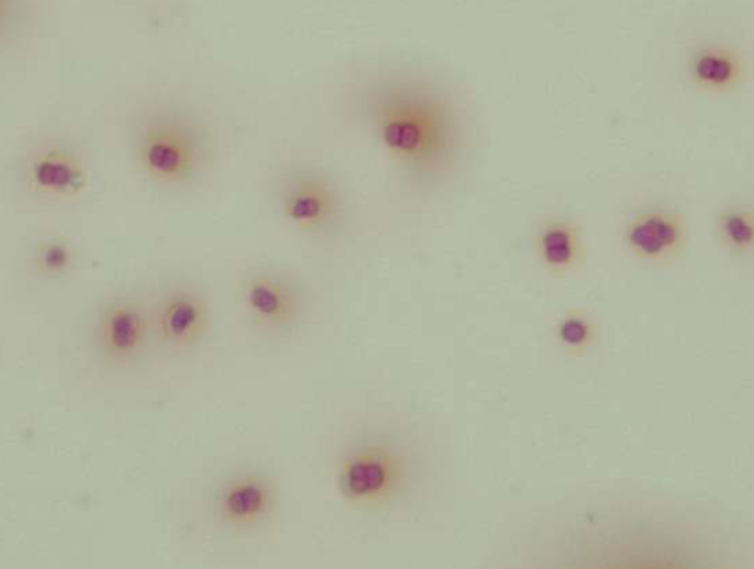
Negative Capsule Stain
No clear halo observed
Organism may lack capsule
Possible staining error
Micrococcus luteus
Notes:
This image shows a negative capsule stain viewed under the microscope (1,000X). The procedure deployed to make slide used Congo red and Maneval’s stain. The bacterial cells (Micrococcus luteus) appear purple and are surrounded directly by the background stain, with no clear halos visible around the cells. The absence of a clear, unstained zone indicates that the bacteria do not produce a capsule. Slide prepared and image captured by Professor Erica A. Burns, Fletcher Technical Community College.

Slide 22
Post-Lab Questions
What is the function of a bacterial capsule?
Why is heat-fixing avoided?
Why does the capsule remain unstained?
How does a capsule contribute to virulence?
Name one encapsulated pathogen

Slide 23
Glossary
Capsule: Thick protective outer layer
Negative stain: Stains background
Simple stain: Colors bacterial cell body

